Slide 1
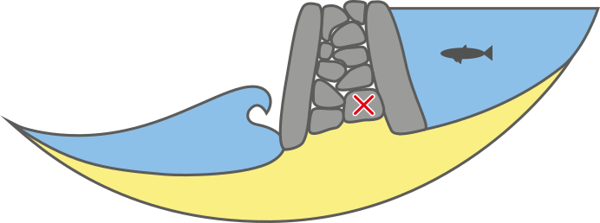
Stone fish weirs dating with rock surface OSL
Arthur JUMAUCOURT
Directors :
Guillaume GUERIN and Daniel LE BRIS

Slide 2
Stone fish weirs dating through rock surface OSL
Fish weirs are made of wood or stone. This obstacle, erected in a tidal or fluvial area, traps fish thanks to stream or low tide flow.
In Northern Europe, several wooden fish traps are dated from the Mesolithic period (McQuade and O’Donnell, 2007). Although, in France there’s some suspicions, there’s still no evidence to support this.
Many weir remains are now several meters under sea level and by comparing their depth with the sea level rise for 10 000 years it’s admitted that stone fish traps are built in Brittany at least since the very beginning of Neolithic.
During the 16th and 17th the french Crown order to destruct all the weirs built after 1544 (Langouët et al., 2008). Thus this fishing practice has been tremendously abandoned and is nowadays rare along the french coast.
McQUADE M, O’DONNELL L 2007,. Late Mesolithic fish traps from the Liffey estuary, Dublin, Ireland. Antiquity. 81(313):569-584.
LANGOUËT L., Le QUELLEC J.M. et PRIGENT G. 2008, Des pêcheries monastiques insulaires en Bretagne, Bulletin de l’A.M.A.R.A.I., vol. 21, p. 59-80.

Slide 3
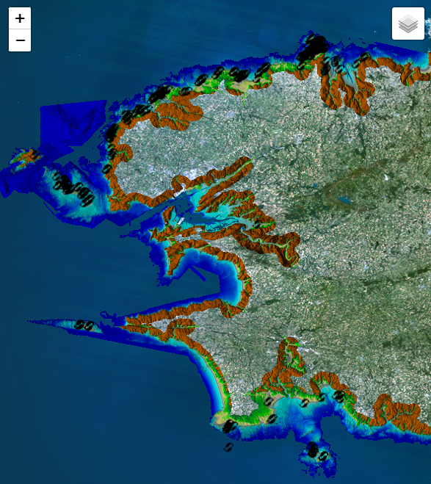
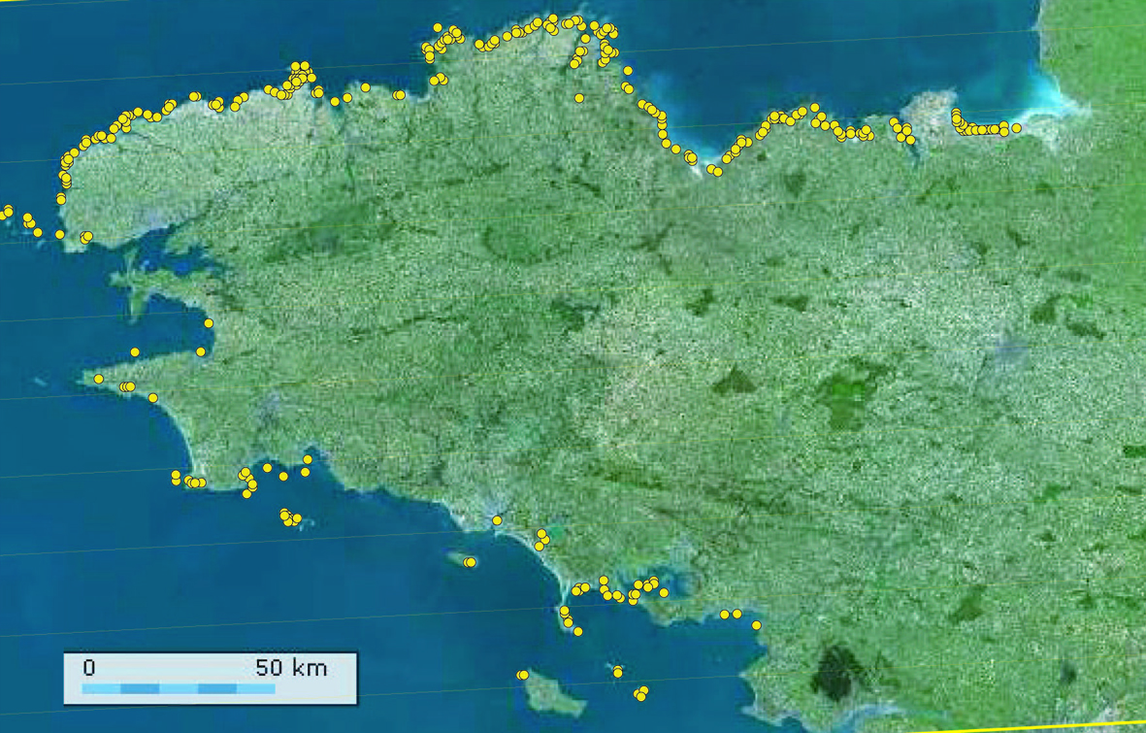
Stone fish weirs dating through rock surface OSL
L. Langouët
Inventory of fish weirs identified in Britanny in 2014.
Map of currently identified fish weirs in Finistère
20 km

Slide 4
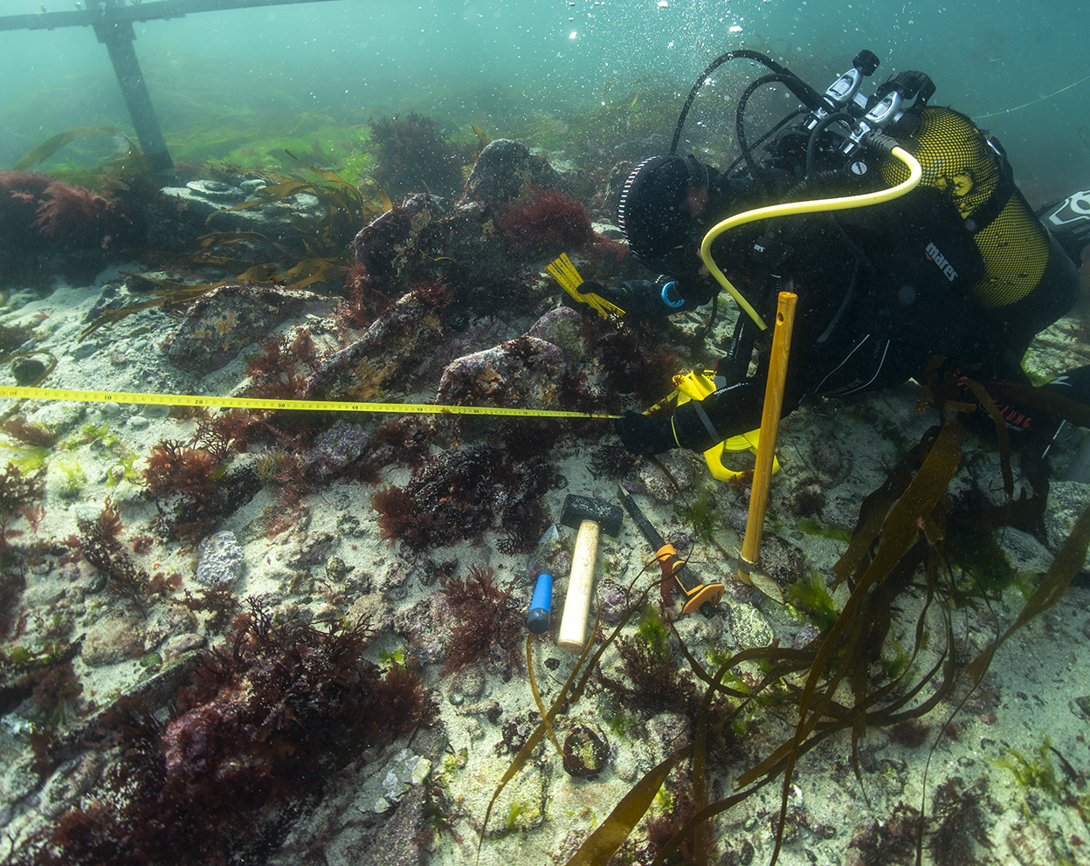
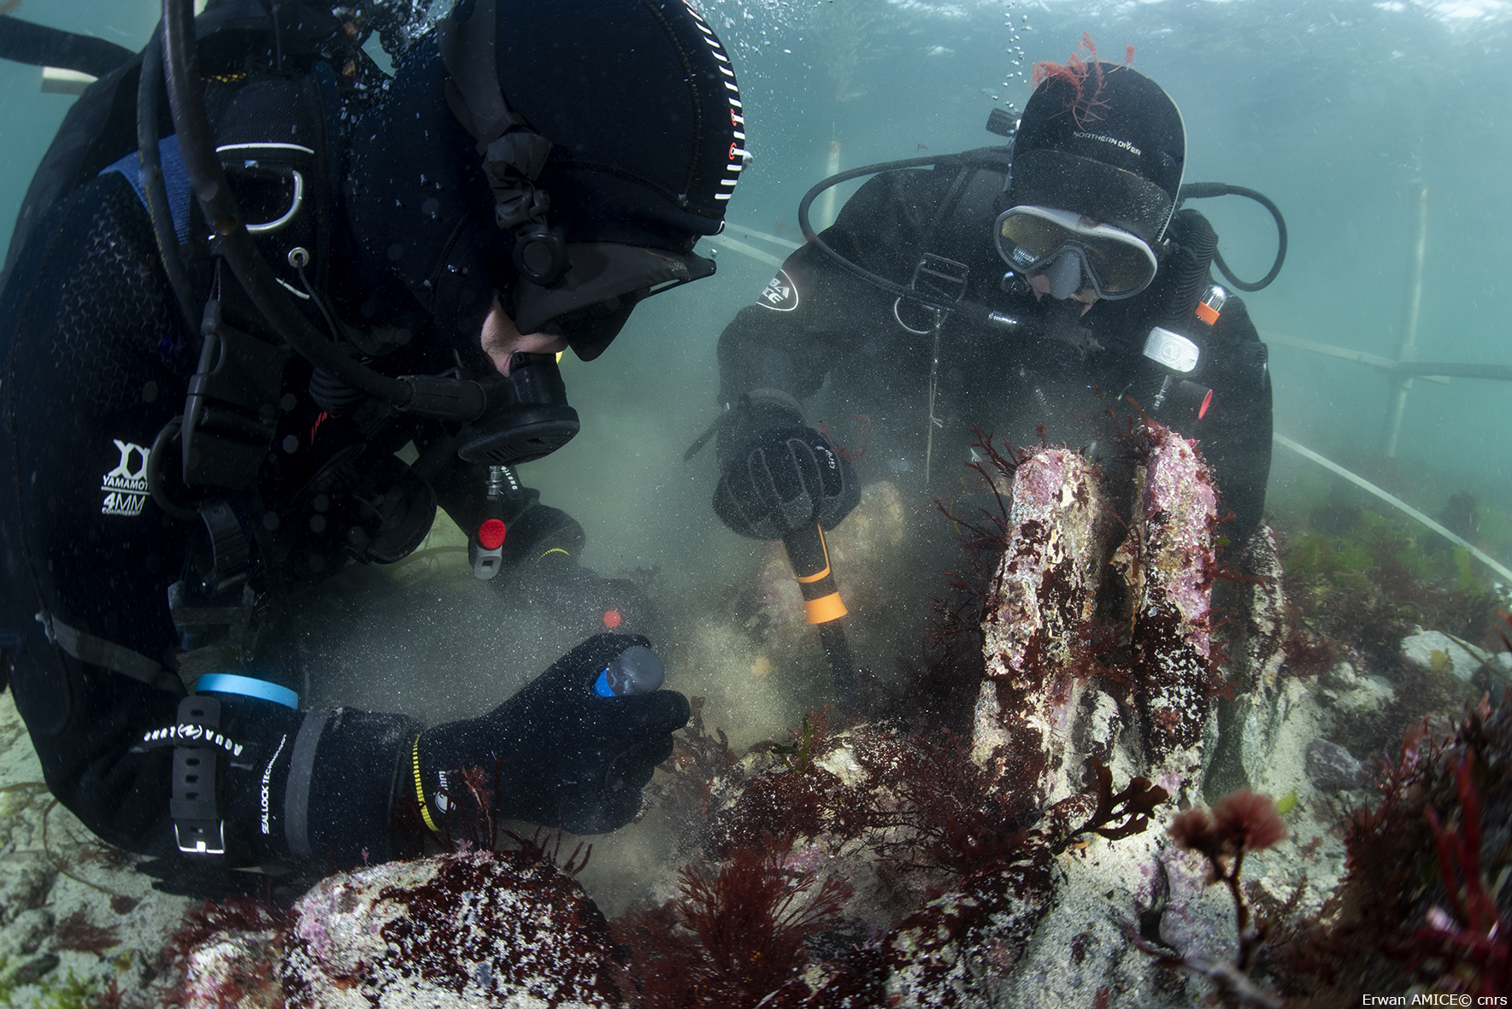
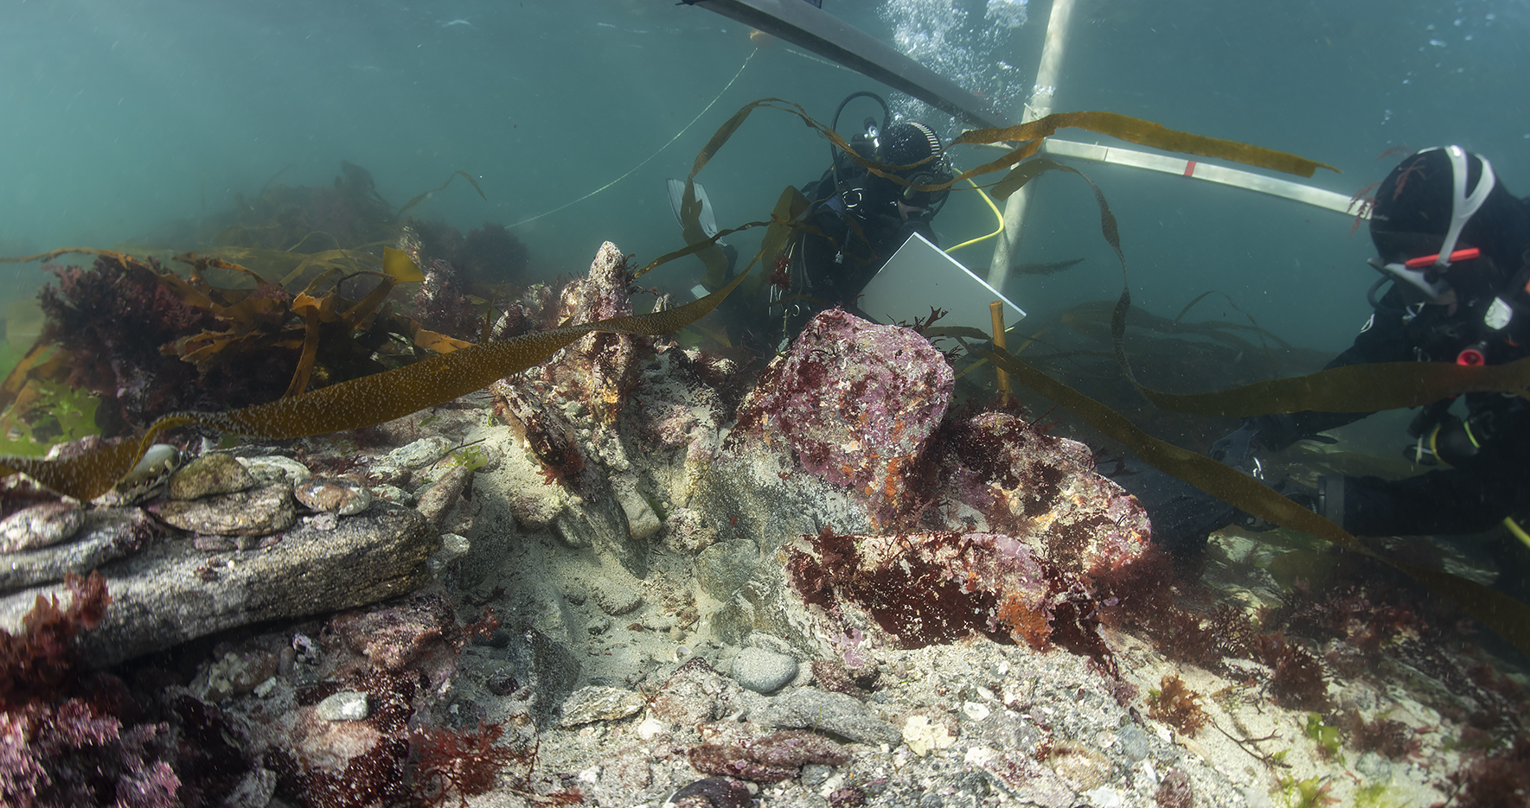
Stone fish weirs dating through rock surface OSL
Béniguet fish weir.
The excavation occurs
in April 2025.
Credits : Erwan AMICE

Slide 5
Stone fish weirs dating through rock surface OSL
A way to date immerged stone fish weirs ?
Depth (m)
+5
0
-5
-10
0
-2000
-4000
-6000
-8000
Age (BCE)

Slide 6
Stone fish weirs dating through rock surface OSL
A way to date immerged stone fish weirs ?
Depth (m)
+5
0
-5
-10
0
-2000
-4000
-6000
-8000
Age (BCE)

Slide 7
Stone fish weirs dating through rock surface OSL
A way to date immerged stone fish weirs ?
Depth (m)
+5
0
z
-5
-10
z
0
-2000
-4000
-6000
-8000
Age (BCE)

Slide 8
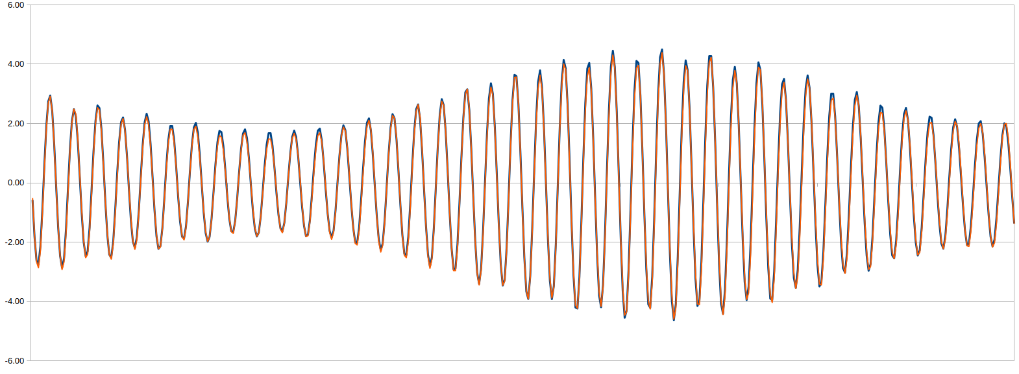
Stone fish weirs dating through rock surface OSL
Tide frequency curve construction
4.5 | 4 | 3 | 2 | 1 | 0 | -1 | -2 | -3 | -4
0 | 8 | 14 | 33 | 40 | 40 | 40 | 33 | 15 | 8

Slide 9
Stone fish weirs dating through rock surface OSL
Tide frequency curve construction
4.5 | 4 | 3 | 2 | 1 | 0 | -1 | -2 | -3 | -4
0 | 8 | 14 | 33 | 40 | 40 | 40 | 33 | 15 | 8

Slide 10
Stone fish weirs dating through rock surface OSL
Age assessment
Y = aX + b

Slide 11
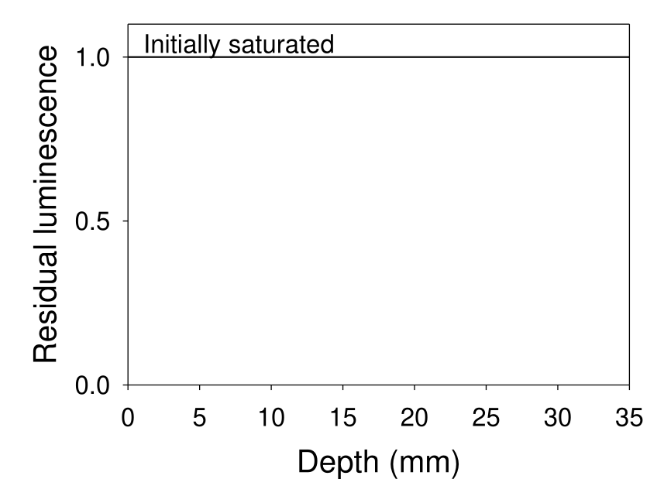
Stone fish weirs dating through rock surface OSL
Rock surface OSL dating

Slide 12
Stone fish weirs dating through rock surface OSL
Rock surface OSL dating

Slide 13
Stone fish weirs dating through rock surface OSL
Rock surface OSL dating

Slide 14
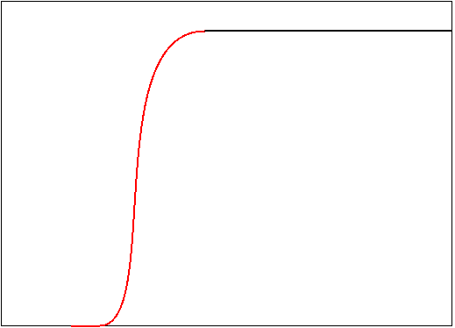
Stone fish weirs dating through rock surface OSL
Rock surface OSL dating

Slide 15
Stone fish weirs dating through rock surface OSL
Rock surface OSL dating
Exposure time
Buried time

