Slide 1
Development and Validation of a GIS-Based Tool for Disinfection Byproduct Formation Prediction in Water Distribution Systems
Session HS1.1.4, EGU2025
Thursday, 01 May, 10:05–10:15 (CEST) Room 2.15
https://doi.org/10.5194/egusphere-egu25-19192
Stelios Vrachimis, Senior Research Associate
Pavlos Pavlou, Research Engineer II
Marios Kyriakou, Research Software Engineer II
Demetrios Eliades, Research Assistant Professor
KIOS Research and Innovation Center of Excellence
University of Cyprus

Slide 2
Overview of presentation
The challenge of disinfection by-products
Towards a DBP modelling tool
Demonstration
Conclusions & Discussion

Slide 3
Disinfection By-Products
Background & Motivation
Disinfection for public health is linked with the unintended formation of >700 disinfection by-products.
Several DBPs (THMs, HAAs, …) are regulated, due to association with carcinogenic and mutagenic risks.
DBP concentrations fluctuate spatiotemporally inside Drinking Water Distribution Networks (DWDNs).
Real-time assessment is limited by expensive, sparse sensing.
Few sensors measure DBP directly, surrogate sensors can have uncertainties.

Slide 4
Modelling DBP Formation
Complex reaction dynamics
Dependence on hydraulics, water age, temperature, pH, NOM, etc…
Use Digital Twins to capture dynamics make decisions.
A Digital Twin (DT) is a high-fidelity, computational representation of a physical system, enriched with real-time data, that enables the “what-if” analysis, prediction, and optimisation across its life-cycle.

Slide 5
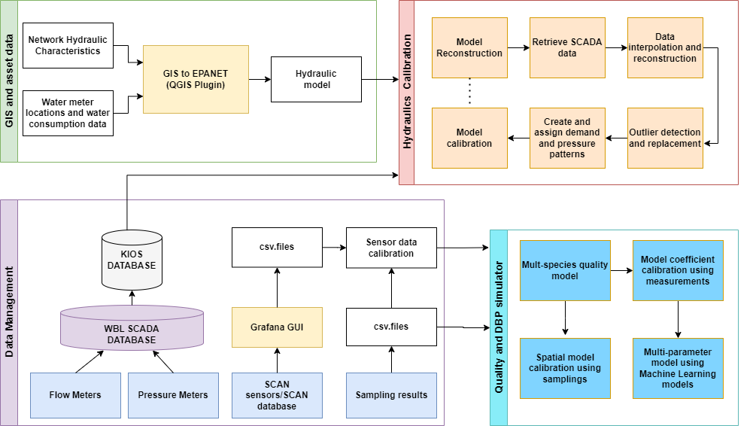
Developing a GIS-based Digital Twin for DBPs
GIS and assets model
Hydraulic modelling and calibration using sensors
Development of a multi-species water quality model based on literature
Quality sensor calibration using sampling data
Quality model calibration using sensor data and DBP formation potential
Spatial model calibration using additional sampling locations
Development of a multi-parameter model for improved predictions
From QGIS to EPANET Models
Calibrating EPANET Models
with real data
Managing real sensor data and sampling results
Calibrating models for simulations

Slide 6
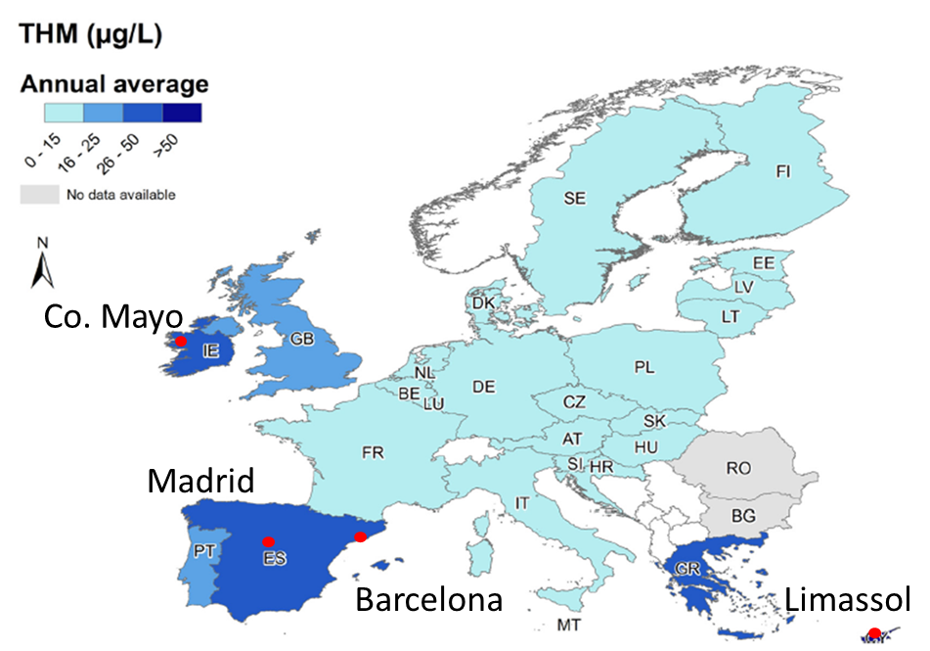
CS1-LIMASSOL (CYPRUS)
high variability of source water and quality and high formation of THMs.
CS2- BARCELONA (SPAIN)→
high THMs formation potential in distributed water and changing conditions in the source reservoirs. High concentration of bromide in drinking water sources.
CS3- MADRID (SPAIN)→
possible formation of Nitrogenous-DBPs from generation of chloramines
CS4- Co. MAYO (IRELAND)→
high formation of THMs from peatland dominated catchments. EU infringement for unsafe drinking water.
Adapted from (Evlampidou, 2020)

Slide 7
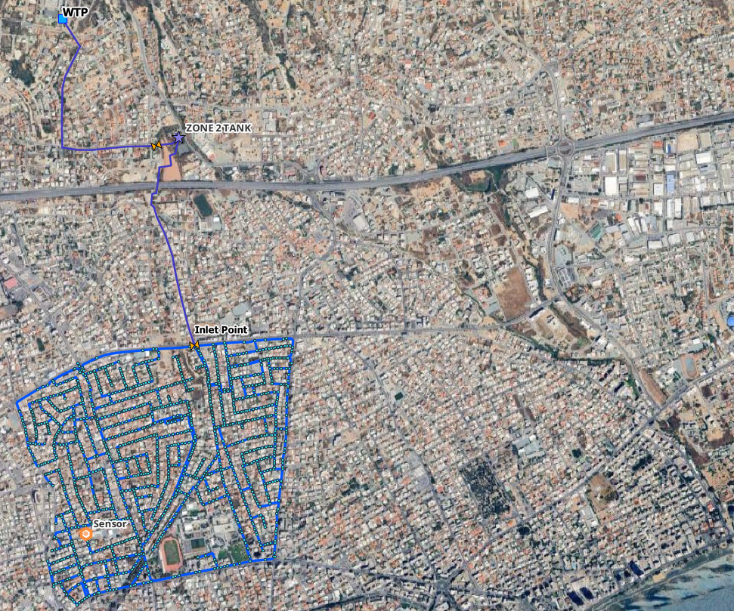
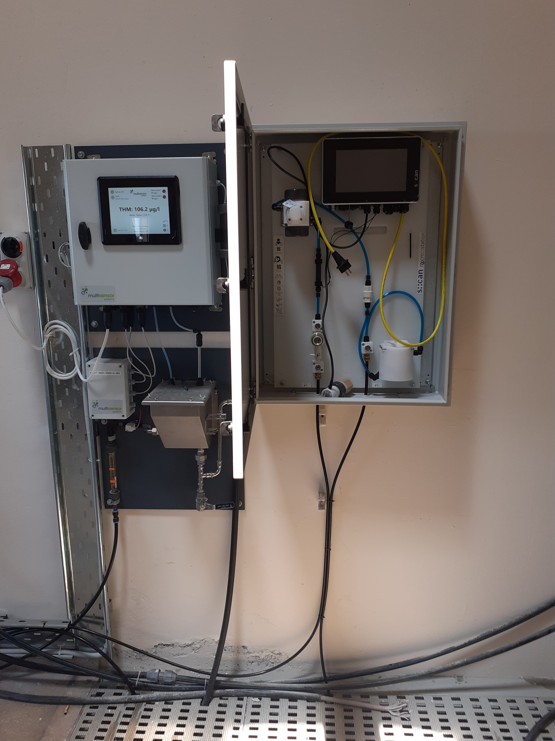
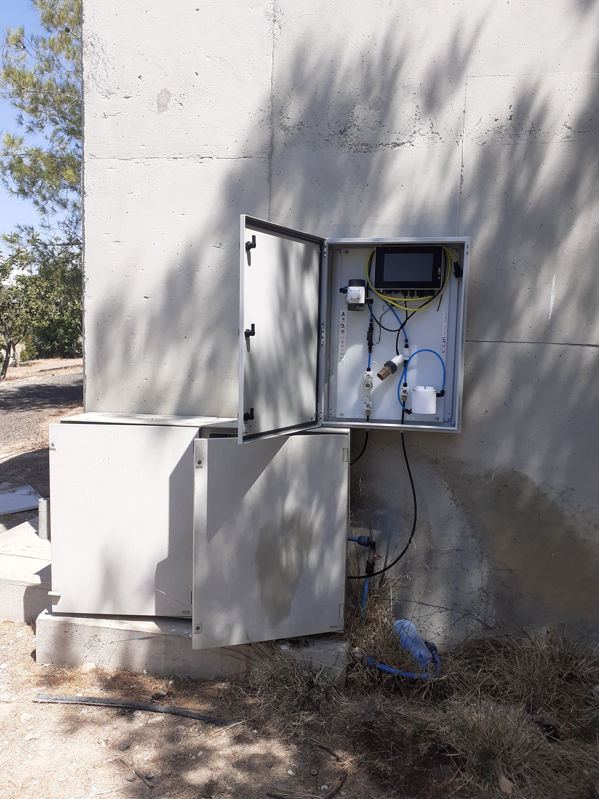
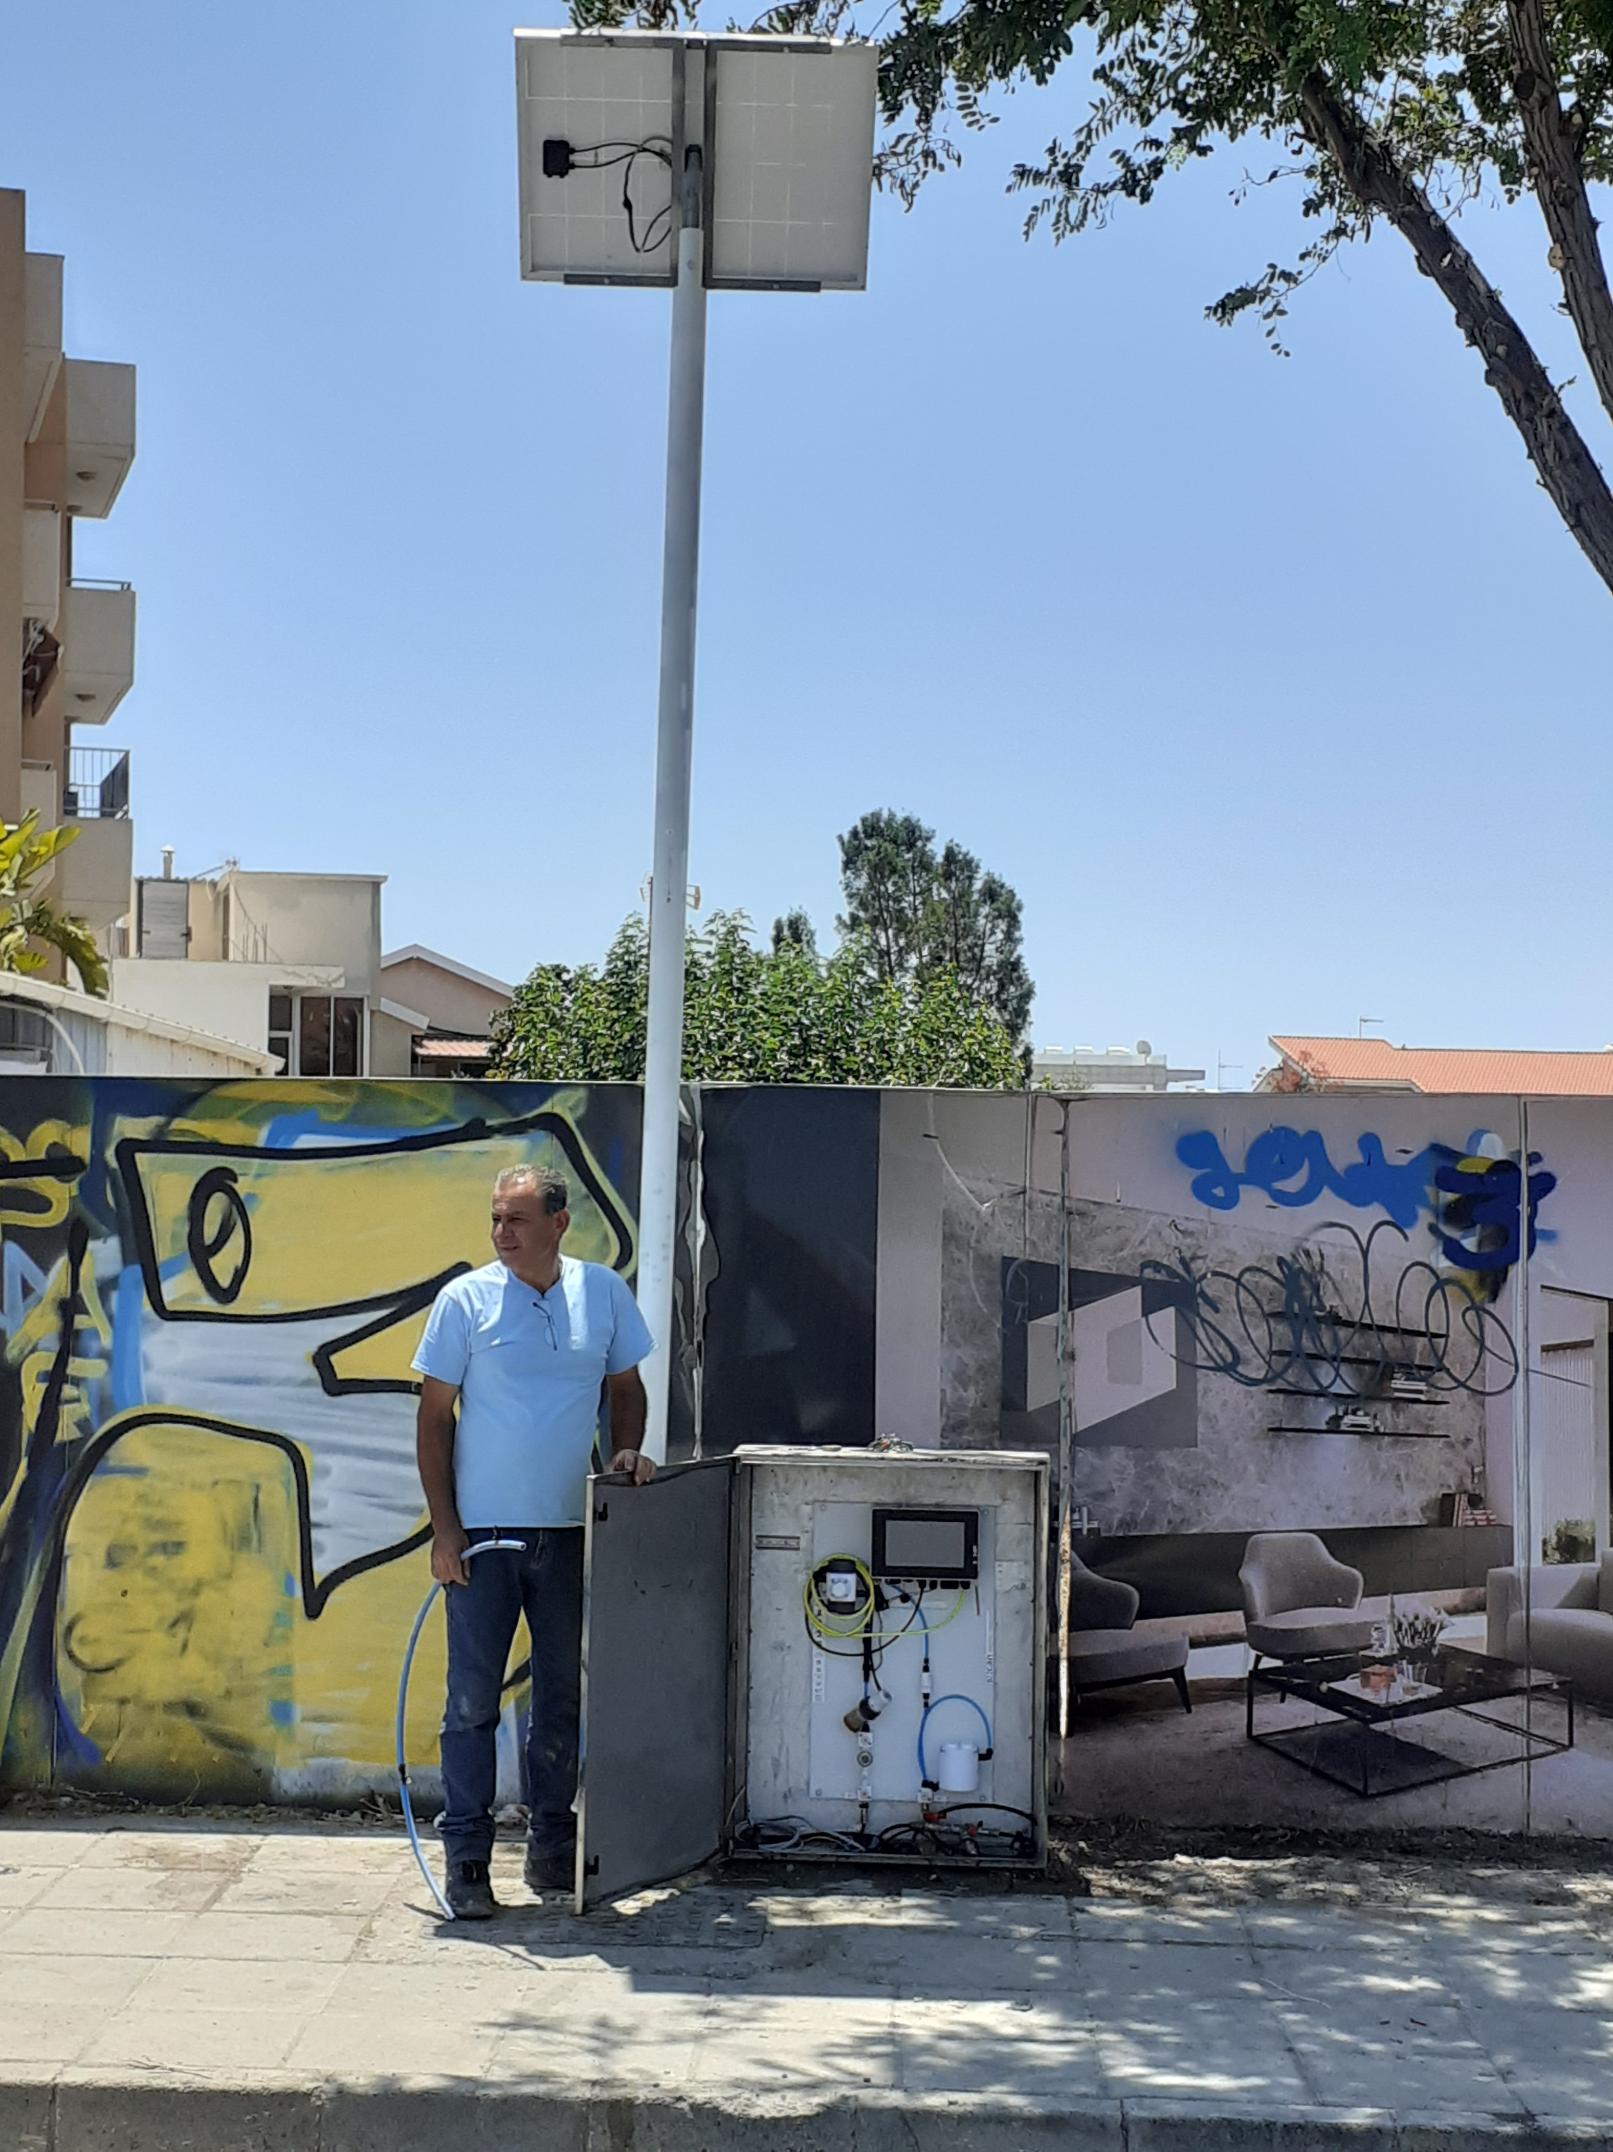
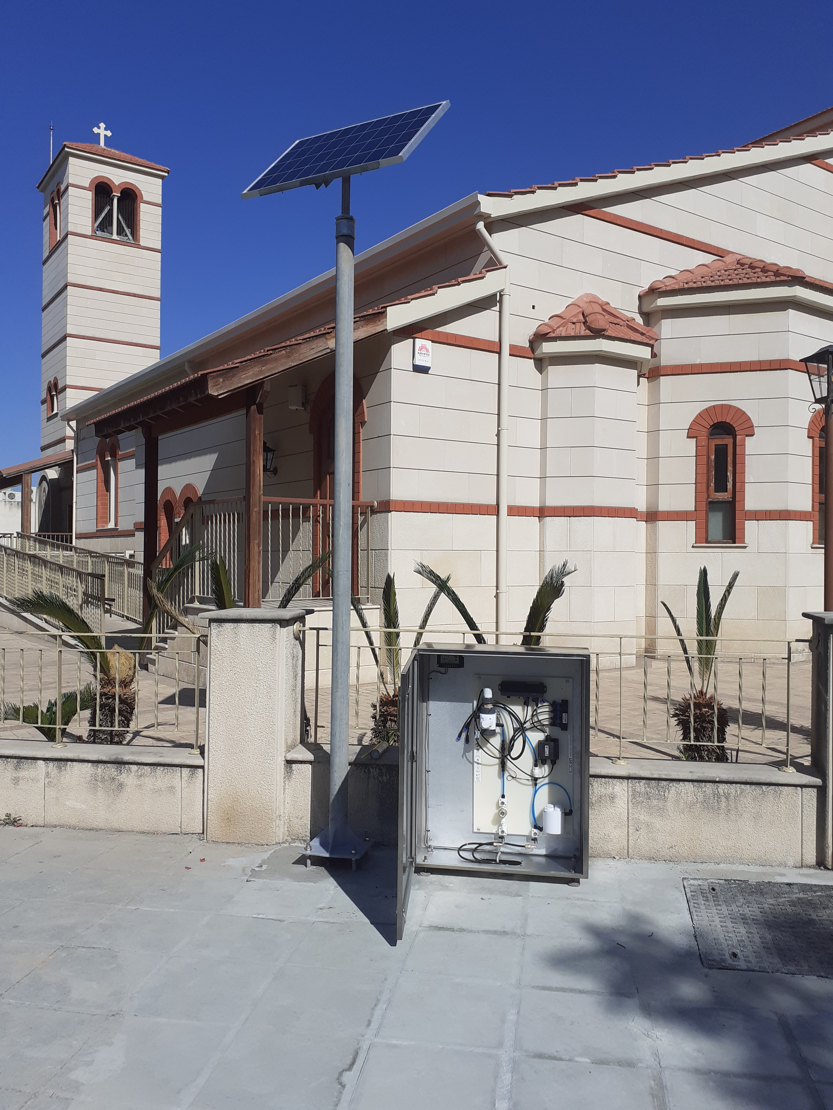
DWTP
1
1
1
Limassol
Pilot
2
Zone 2 Tank
2
2
Desalinated
water input
3
3
DMA Inlet
3
4
4
DMA DP 3
4

Slide 8
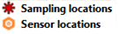
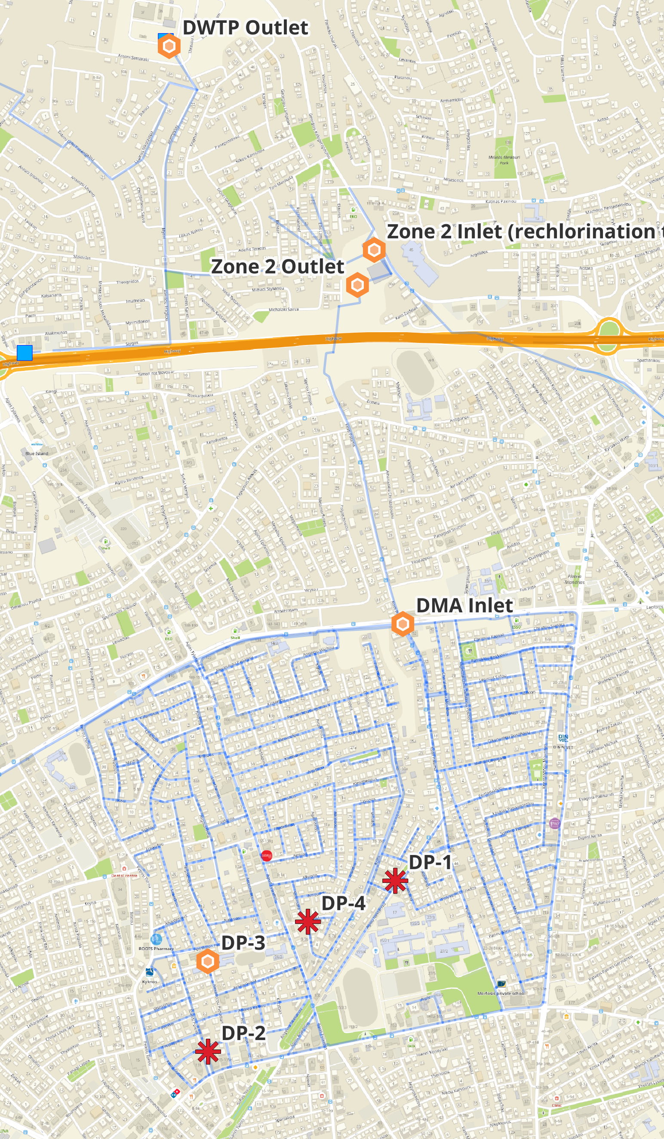
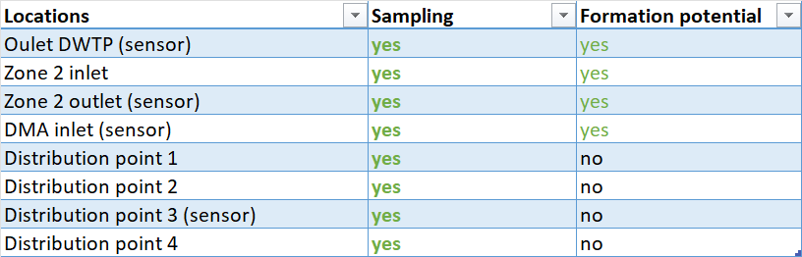
Optimal sensor placement and manual sampling plan
Define optimization problem
Nodes that are not affected by reverse flows in the network
Cover as much of the network as possible with minimum overlaps with the other sensors
1
2
3
4

Slide 9
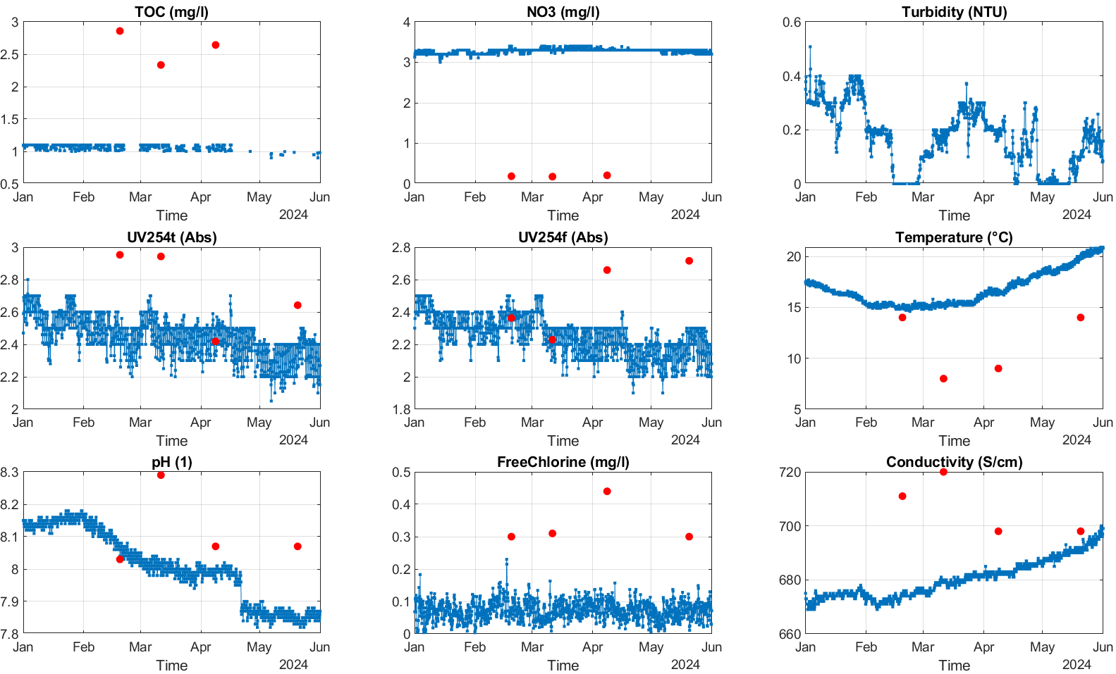
1
DWTP

Slide 10
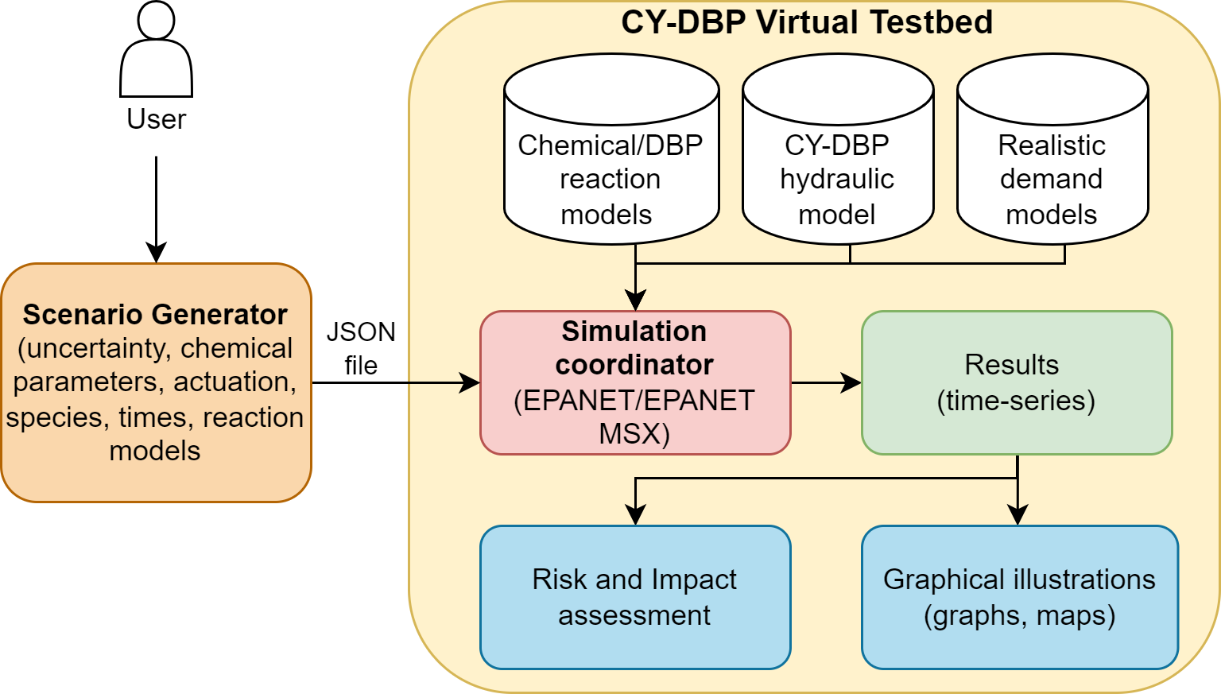
Modeling tool to predict DBP formation
Researchers/practitioners/operators
can evaluate variations in:
Reaction models
  Multiple species
  Reaction coefficients
Hydraulic conditions
  Demands
  Sources
Control actions and mitigation strategies:
  Valve/pump
  Network reconfiguration
  Booster station disinfection scheduling
Pavlou P, Kyriakou M, Vrachimis SG, Eliades DG. “A Comprehensive Virtual Testbed for Modeling Disinfection Byproduct Formation in Water Distribution Networks”. Engineering Proceedings. 2024; 69(1):33. https://doi.org/10.3390/engproc2024069033

Slide 11
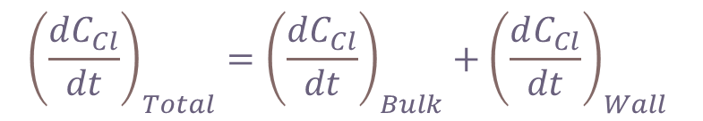
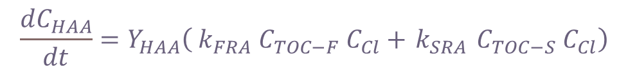
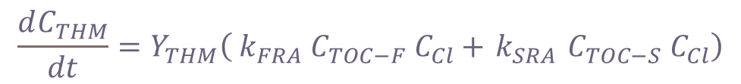
Example application scenario
Multi-species model:
Chlorine (Cl)
Total organic carbon (TOC)
  Slow reducing agent
  Fast reducing agent
Trihalomethanes (THM)
Halo-acetic Acids (HAA)
$${\left(\frac{dC_{Cl}}{dt}\right)}_{Total}={\left(\frac{dC_{Cl}}{dt}\right)}_{Bulk}+{\left(\frac{dC_{Cl}}{dt}\right)}_{Wall}$$
$$\frac{dC_{THM}}{dt}=Y_{THM}\left({ k}_{FRA} C_{TOC−F} C_{Cl}+{ k}_{SRA} C_{TOC−S} C_{Cl}\right)$$
$$\frac{dC_{HAA}}{dt}=Y_{HAA}\left({ k}_{FRA} C_{TOC−F} C_{Cl}+{ k}_{SRA} C_{TOC−S} C_{Cl}\right)$$
Scenario configuration
(set as in real system):
7- day simulation period
Chlorination input at sources (desalination, DWTP) and
re-chlorination tank
Scenario uncertainty considered:
Ratio of water acquired from each source (affecting TOC)
Chlorine inserted to the system
THM Yield coefficient - Y_{THM}
HAA Yield coefficient - Y_{HAA}

Slide 12
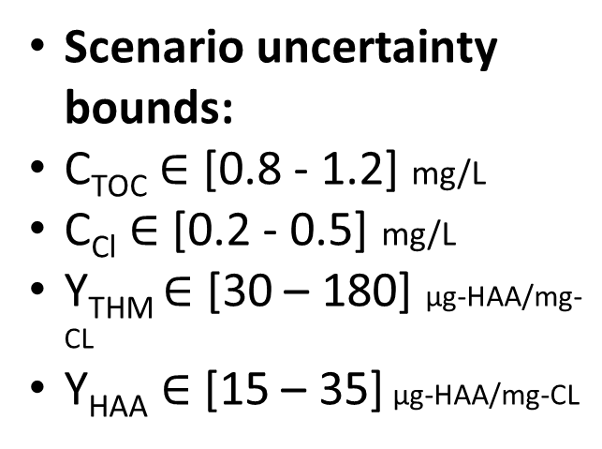
THM and HAA prediction
THM and HAA prediction
THM
Scenario uncertainty bounds:
C_{TOC} $∈$ [0.8 - 1.2] mg/L
C_{Cl} $∈$ [0.2 - 0.5] mg/L
Y_{THM} $∈$ [30 – 180] μg-HAA/mg-CL
Y_{HAA} $∈$ [15 – 35] μg-HAA/mg-CL
HAA

Slide 13
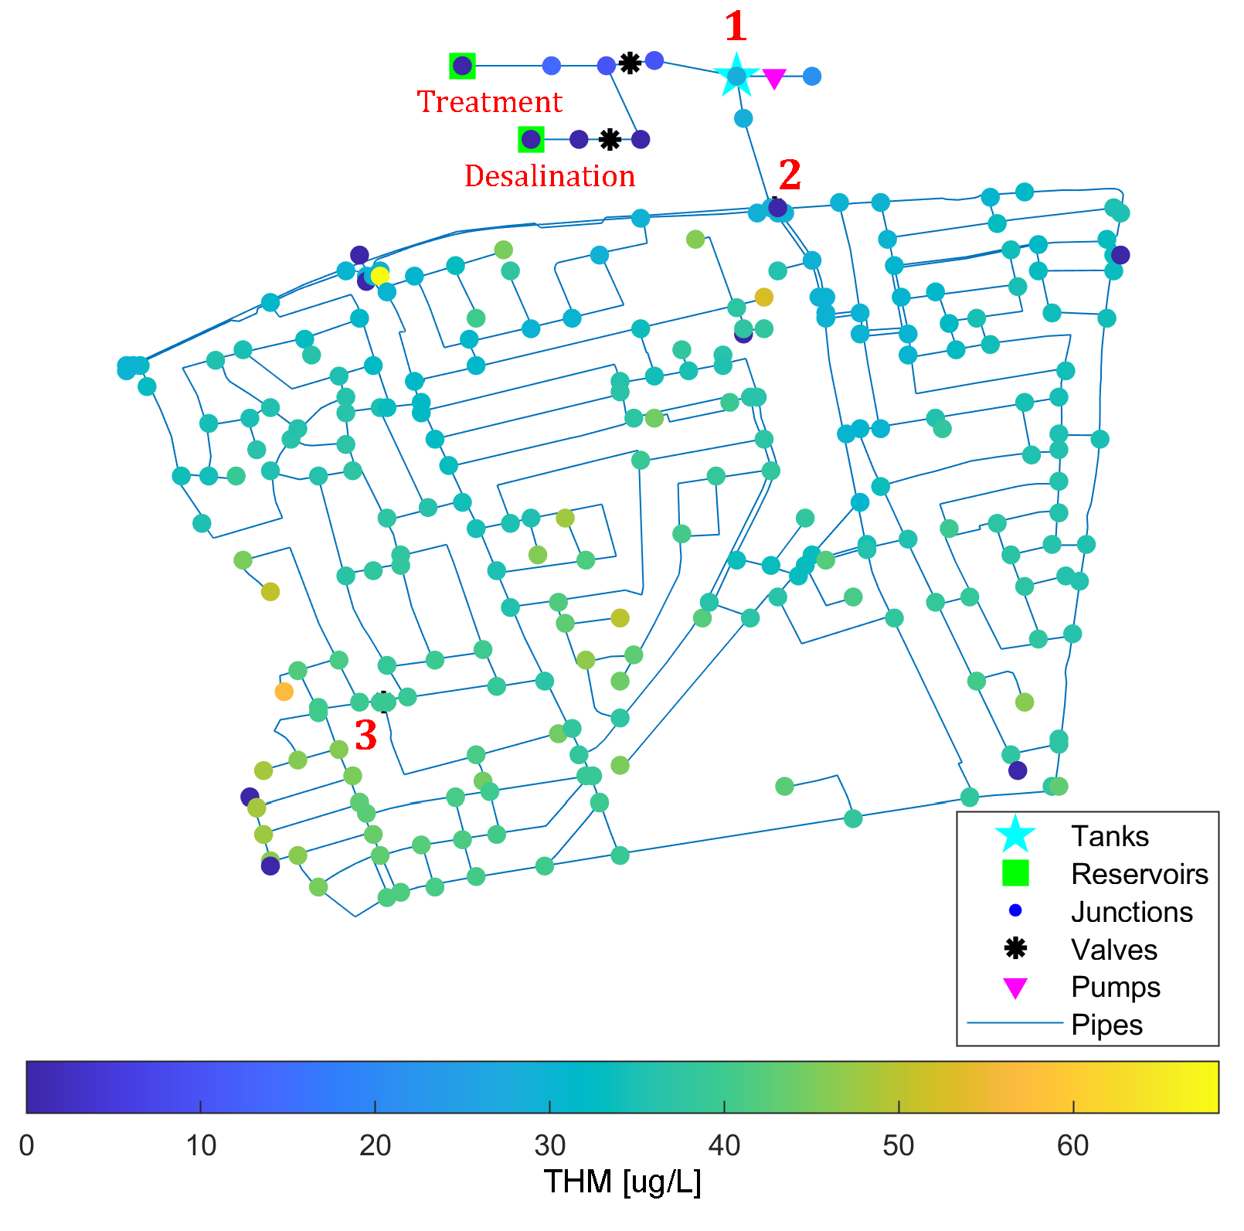
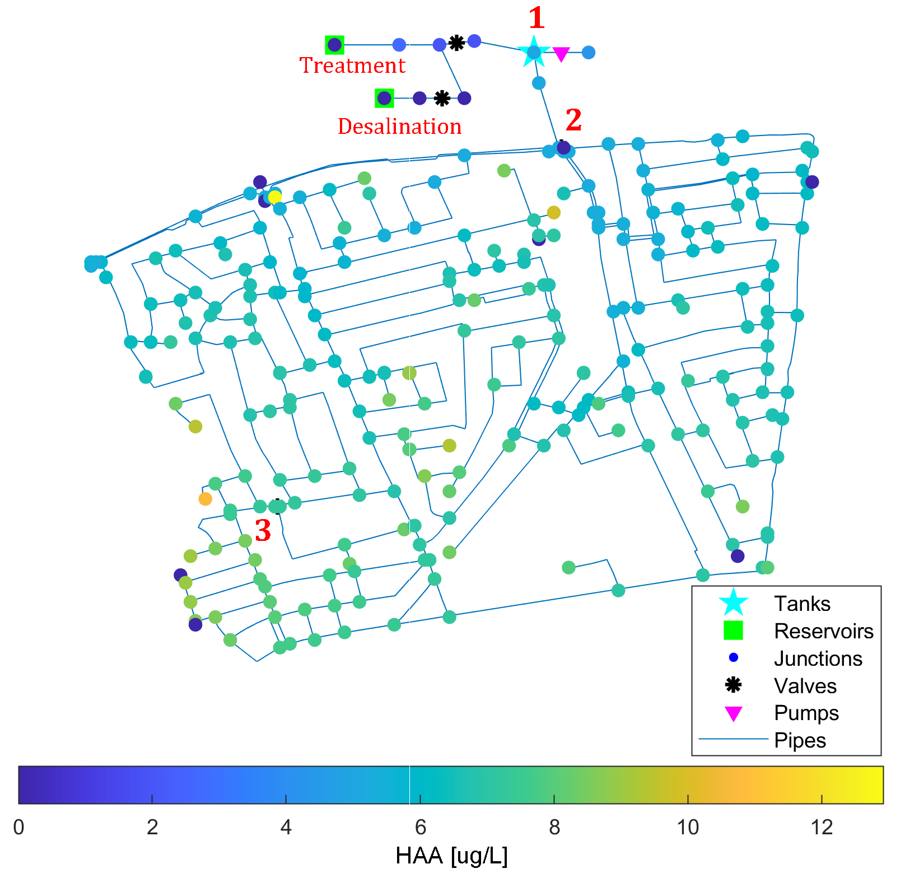
Maximum concentration per node
Maximum concentration per node

Slide 14
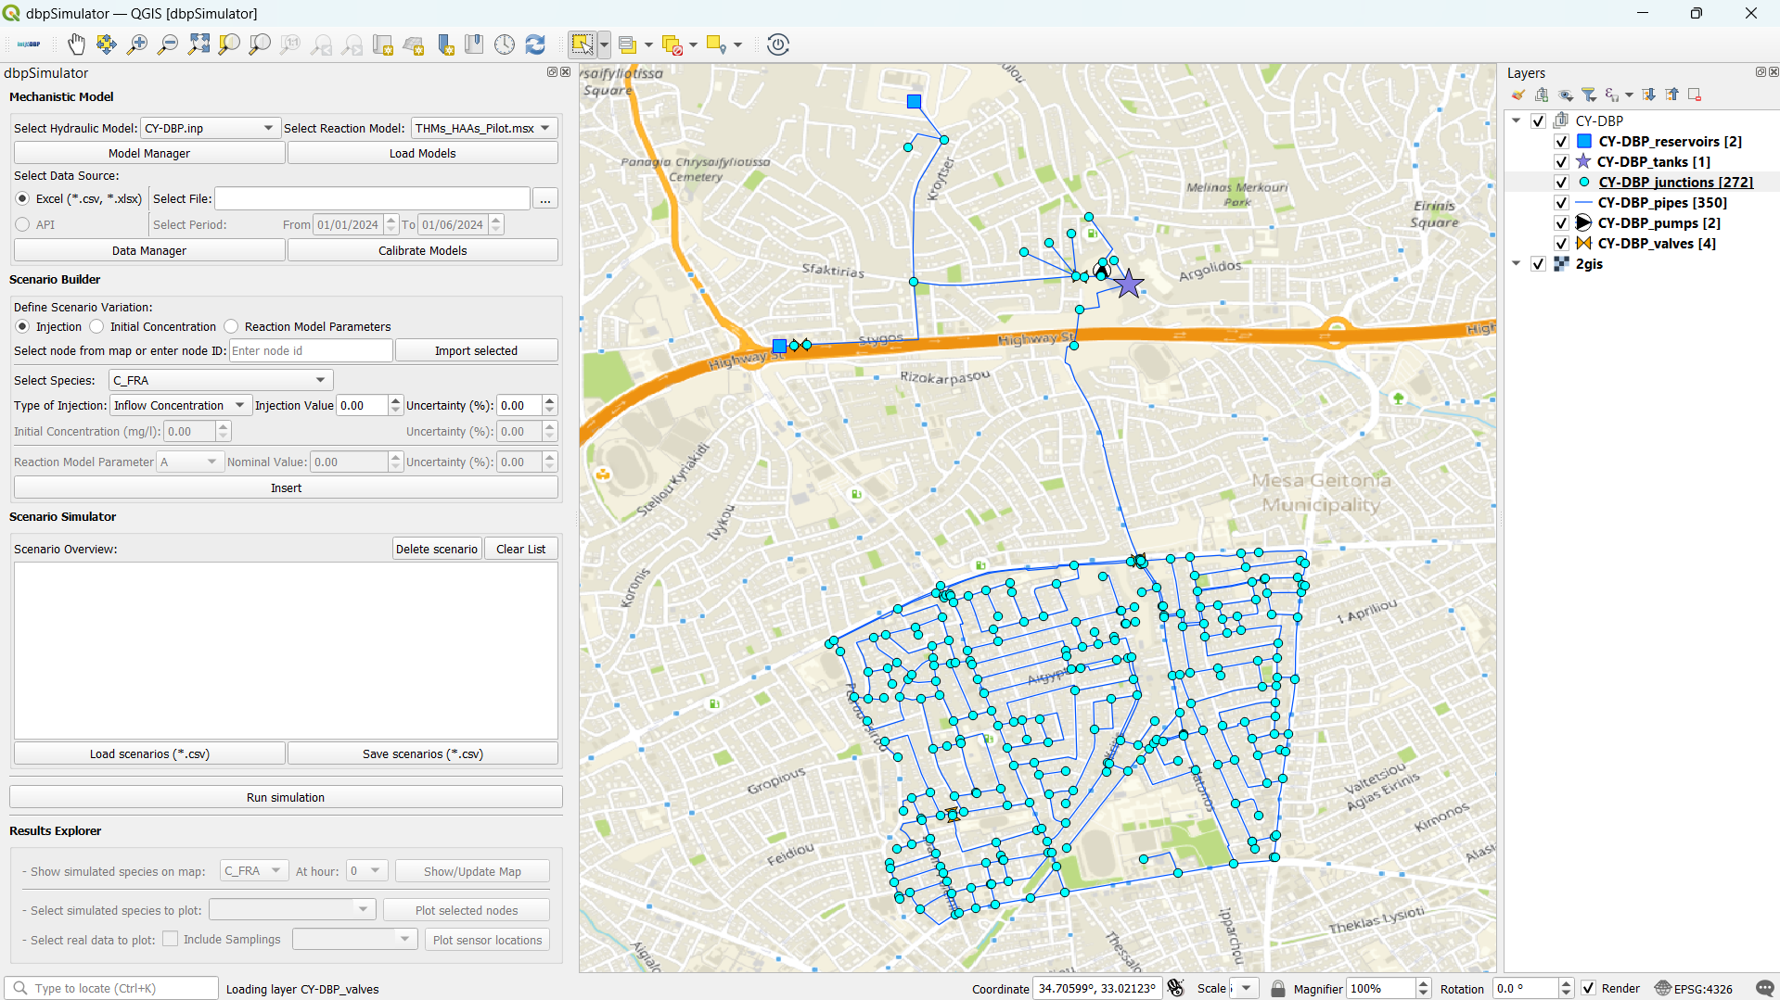
Plugin
Mechanistic models and data
Interactive map
Scenario builder
Scenario simulator
Results explorer

Slide 15


Slide 16
Effect of temperature variations
10 20 30

Slide 17
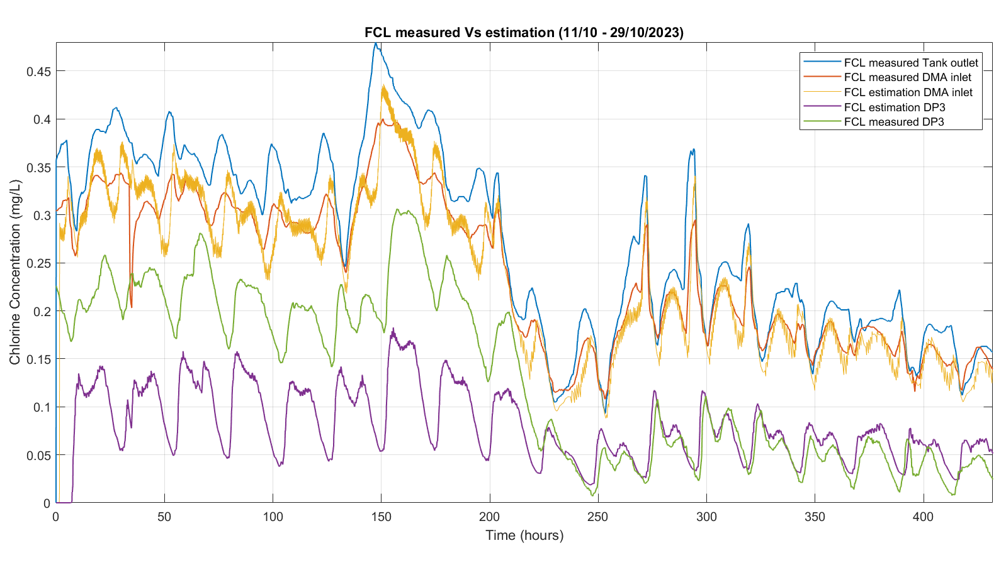
*Model mismatch possibly due to hydraulics

Slide 18
Conclusions & Discussion
The risk DBP is increasing, and there are many unknowns
Accurate data for online monitoring of DBPs is a challenge
Digital Twins, coupled with GIS and Sensor/Sampling data, can help answer operational and policy questions
Model calibration requires good sampling data
Intervals are suitable for handling uncertainties

Slide 19
Demetrios Eliades
eldemet@ucy.ac.cy

