Slide 1
Estimating Rhizosphere Priming in European Agricultural Soils
Nicolas L. Breil, Ahrens Bernhard, Wild Birgit, Hugelius Gustaf, Clivot Hugues, Lashermes Gwenaëlle, Monteux Sylvain, Kummu Matti, and Keuper Frida
Soil respiration (Rs)
Incubation studies : potential increase in SOC respiration by up to 300% due to RPE
Cheng et al., 2003
Total heterotrophic respiration (Rht)
Root respiration (Rr)
¹³C
Rhizosphere Priming Effect
(RPE)
¹³C
Residues respiration
Largest uncertainty:
RPE magnitude in croplands
Wang et al., 2024
¹³C
Basal respiration
(Rhb)
MISSING: broad scale spatial & depth explicit estimate
but see: additional 40 Gt C loss by 2100 from permafrost area, Keuper, Wild et al. 2020
Exudation
¹³C
SOC
We do not know how much the RPE contributes to Rh

Slide 2
PrimeSCale model
Method I : assuming RPE is included in Rh
Soil layer
(cm)
0-10
10-30
30-60
60-100
100-200
RPE SOC loss
First results
RPE mainly occurs in topsoil layers (0-30cm)
RPE estimated at 19(±25) gC m⁻² yr⁻¹ (Method I)
RPE estimated at 26(±67) gC m⁻² yr⁻¹ (Method II)
RPE ≈ 10% of Rh
Assumptions
RPE includes the mineralisation of residues
No seasonal variation in RPE ratio
Uncertainty
RPE SOC loss (gC m⁻² yr⁻¹)

Slide 3
Supplements
PrimeSCale – conception, functions and structure
Conceptual scheme of soil carbon fluxes
Rhizosphere Priming Effect Ratio
The PrimeSCale model
Soil heterotrophic respiration estimates
Soil respiration → Heterotrophic respiration
Estimation of Rh based on the Bond-Lamberty¹ equation
Preliminary results
Preliminary results
Crop residues
Research gap – Crop Residues
Residues included in Rh ?
Transfert function
GPP to root respiration
Depth distribution
Depth distribution of soil respiration
Inputs description
PrimeSCale input for European croplands

Slide 4
Conceptual scheme of soil carbon fluxes
↑
No vegetation
With vegetation (with ¹³C labeling)
Soil respiration (Rs)
Rs
Total heterotrophic respiration (Rht)
¹³C
Rr
Rht
Rhizosphere Piming Effect
(RPE)
¹³C
Basal respiration
(Rhb)
Root autotrophic respiration
(Rr)
Rres.
Rhb
RPE
¹³C
¹³C
Exudation
SOC

Slide 5
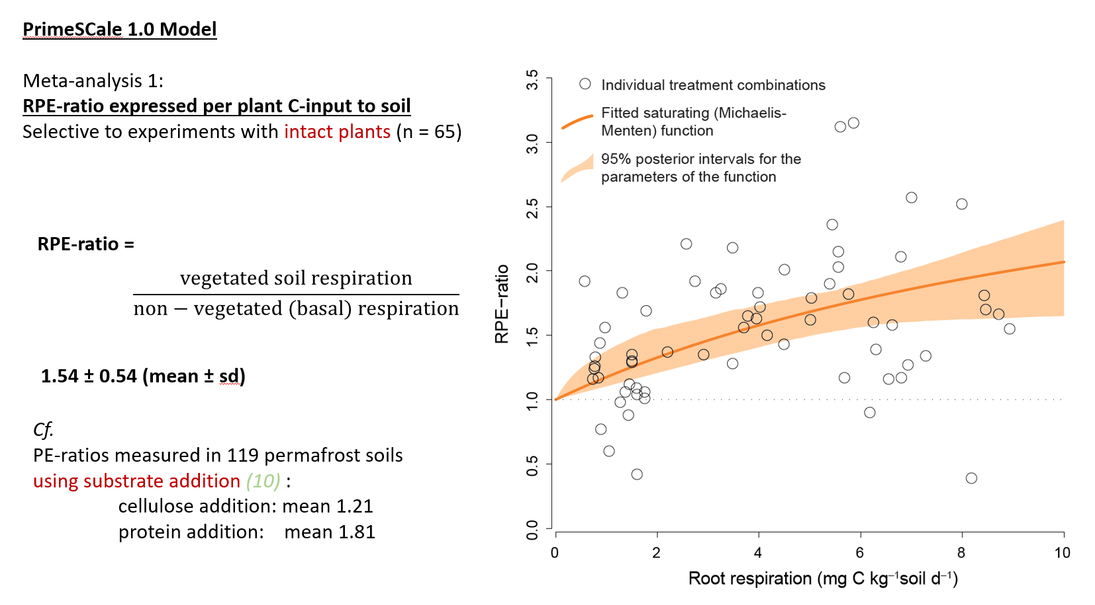
Rhizosphere Priming Effect Ratio
↑
Based on a meta-analysis of ¹³C labelled plant experiments
The ratio was estimated by comparing soil microorganisms SOC mineralisation on non-vegetated versus vegetated soil
Parameters (a and b) were calibrated based on 11 studies, giving 65 observations
$$RPE ratio=1+\left(\frac{2.47 ×Root resp.}{13.01+Root resp.}\right)$$

Slide 6
The PrimeSCale model
↑
Resolution
Time: year
Spatial: 5km
Depth (cm):
0-10
10-30
30-60
60-100
100-200
Heterotrophic respiration module
RPE ratio module
[5]
RPE ratio
$$=1+\frac{2.47×Root resp. ∗}{13.01+Root resp. ∗}$$
Soil resp.
[3]
Rs to Rh
Rh
$$\ln\left(Rh\right)=1.22+0.73 ln⁡(Rs)$$
[4]
Root respiration module (not detailed here)
RPE-induced SOC loss module
Rh
RPE
SOC
loss
GPP
[1]
GPP to root respiration
[2]
RPE ratio
Root resp*
= map
= function
¹MODIS (MOD17A2Hv061), ^{2,5} Keuper & Wild et al., 2020, Nat. Geosci., ³ Stell et al., 2021, Glob Change Biol ,⁴ Bond-Lamberty et al., 2004, Glob Change Biol

Slide 7
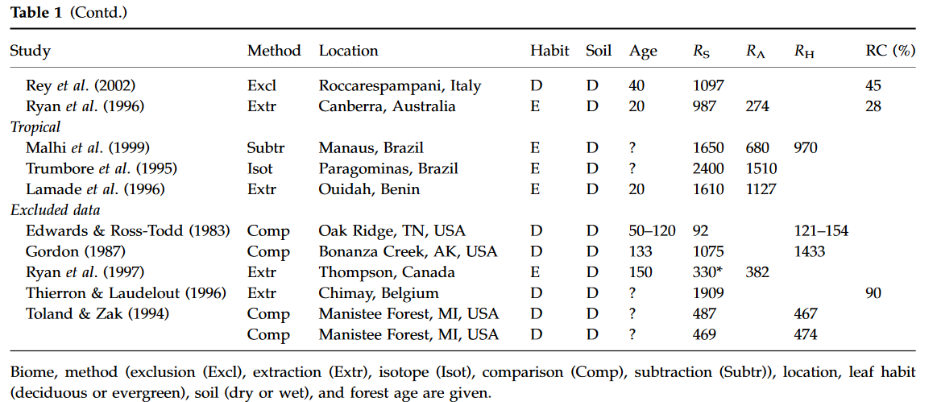
Soil respiration → Heterotrophic respiration
↑
Bond-Lamberty’s equation, 2004¹
$$\ln\left(Rh\right)=1.22+0.73 ln⁡(Rs)$$
Based on:
Soil Respiration Data Base (SRDB, 2004)
Mix of different partitioning methods -> We do not know if RPE is included in Bond-Lamberty’s Rh estimate !
Could include RPE
Do not include RPE
Exclusion
Trenched plots
Extraction
Measuring respiration of either roots or pure soil
Isotope
Stable or radioactive isotope labelling when comparing bare and vegetated
Comparison
Comparing RS at intact stands and recent burns, or physiological manipulation of root photosynthate supply in treatment plots
Subtraction
Subtraction using other components of the carbon cycle
¹ Bond-Lamberty et al., 2004, Glob Change Biol

Slide 8
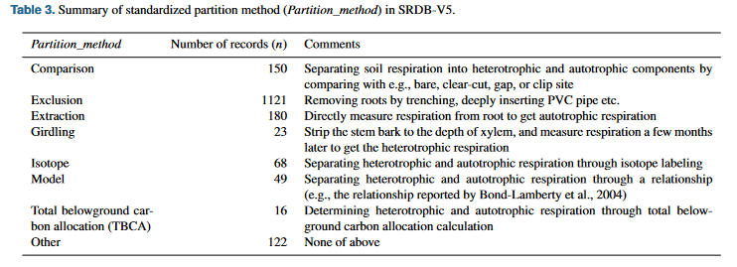
↑
Soil respiration → Heterotrophic respiration
Bond-Lamberty’s equation, 2004¹
$$\ln\left(Rh\right)=1.22+0.73 ln⁡(Rs)$$
Based on:
Soil Respiration Data Base (SRDB, 2004)
Mix of different partitioning methods -> We do not know if RPE is included in Bond-Lamberty’s Rh estimate !
Partition methods in the SRDB v5
Could include RPE
Do not include RPE
Exclusion
Trenched plots
Extraction
Measuring respiration of either roots or pure soil
Isotope
Stable or radioactive isotope labelling when comparing bare and vegetated
Comparison
Comparing RS at intact stands and recent burns, or physiological manipulation of root photosynthate supply in treatment plots
Subtraction
Subtraction using other components of the carbon cycle
Jian et al., 2021
¹ Bond-Lamberty et al., 2004, Glob Change Biol

Slide 9
Estimation of Rh based on the Bond-Lamberty¹ equation
↑
Yes
Is RPE included in Rh ?
No
Method 1
Method 2
Rh
= Rh_{total}
= Rh_{basal} + RPE
Rh
= Rh_{basal}
Estimation of Rh_{basal}
Estimation of Rh_{total} :
$$Rh_{Basal}=\frac{Rh_{RPEincl}}{RPE ratio}$$
$$Rh_{RPEincl}=Rh_{basal}×RPEratio$$
Estimation of RPE
Estimation of Rh_{total} :
$$RPE=Rh_{total}−Rh_{basal}$$
$$RPE=Rh_{total}−Rh_{basal}$$
Could underestimate RPE ?
Could overestimate RPE ?
¹ Bond-Lamberty et al., 2004, Glob Change Biol

Slide 10
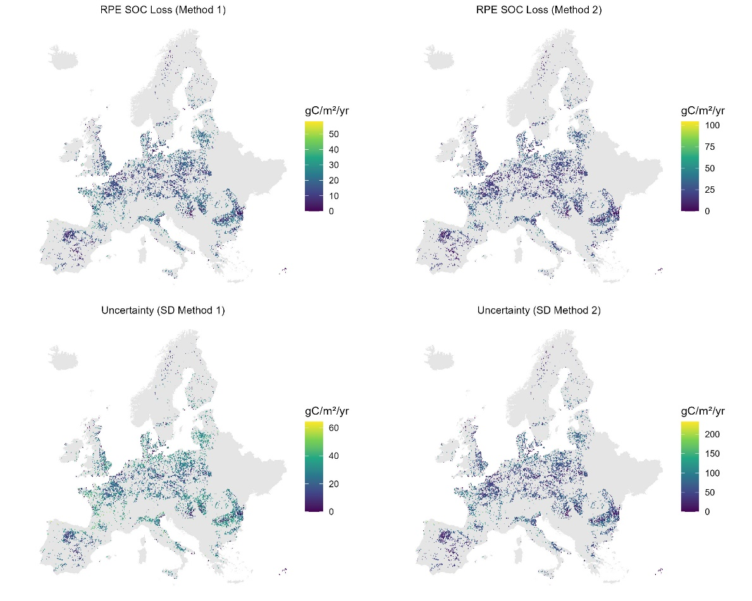
First results - details
↑
Assuming RPE is included in the Rh data
Assuming RPE is not include in the Rh data
 |  | Method 1 |  |  | Method 2
 | RPE ratio | Rh total | RPE SOC loss | RPE proportion | Rh total | RPE SOC loss | RPE proportion
Soil layer |  | (gC m-2 yr-1) | (gC m-2 yr-1) |  | (gC m-2 yr-1) | (gC m-2 yr-1)
0-10 | 1.25 | 213.31 | 15.36 | 0.07 | 235.14 | 22.18 | 0.09
10-30 | 1.09 | 80.11 | 2.62 | 0.03 | 83.18 | 3.23 | 0.04
30-60 | 1.03 | 50.01 | 0.50 | 0.01 | 51.05 | 0.55 | 0.01
60-100 | 1.01 | 24.45 | 0.10 | 0.00 | 24.73 | 0.10 | 0.00
100-200 | 1.00 | 35.33 | 0.04 | 0.00 | 35.73 | 0.04 | 0.00
Total |  | 403.21 | 18.63 | 0.12 | 429.82 | 26.09 | 0.15
First results summary
RPE mainly occurs in topsoil layers (0-30cm)
RPE estimated at 19(±25) gC m⁻² yr⁻¹ (Method I)
RPE estimated at 26(±67) gC m⁻² yr⁻¹ (Method II)
RPE ≈ 10% of Rh

Slide 11
Research gap – Crop Residues
↑
Belowground plant-associated respiration
Research Gap
Crop residues = around 2/3 of Rh (croplands)
Barré et al., 2010
Issues with the current model
RPE-ratio based on sieved experiments that do not include residues
Basal SOC respiration in field conditions (~4 tC/ha/yr) mandatory includes residue respiration
Root respiration (Rr)
¹³C
Respiration from exudates
¹³C
Residues respiration
¹³C
¹³C
Exudation
¹³C
SOC

Slide 12
Research gap – Crop Residues
↑
Belowground plant-associated respiration
Research Gap
Crop residues = around 2/3 of Rh (croplands)
Barré et al., 2010
Issues with the current model
RPE-ratio based on sieved experiments that do not include residues
Basal SOC respiration in field conditions (~4 tC/ha/yr) mandatory includes residue respiration
Root respiration (Rr)
¹³C
Respiration from exudates
¹³C
Residues respiration
¹³C
¹³C
Exudation
¹³C
Main risk
Overestimate the RPE by a factor 3
SOC

Slide 13
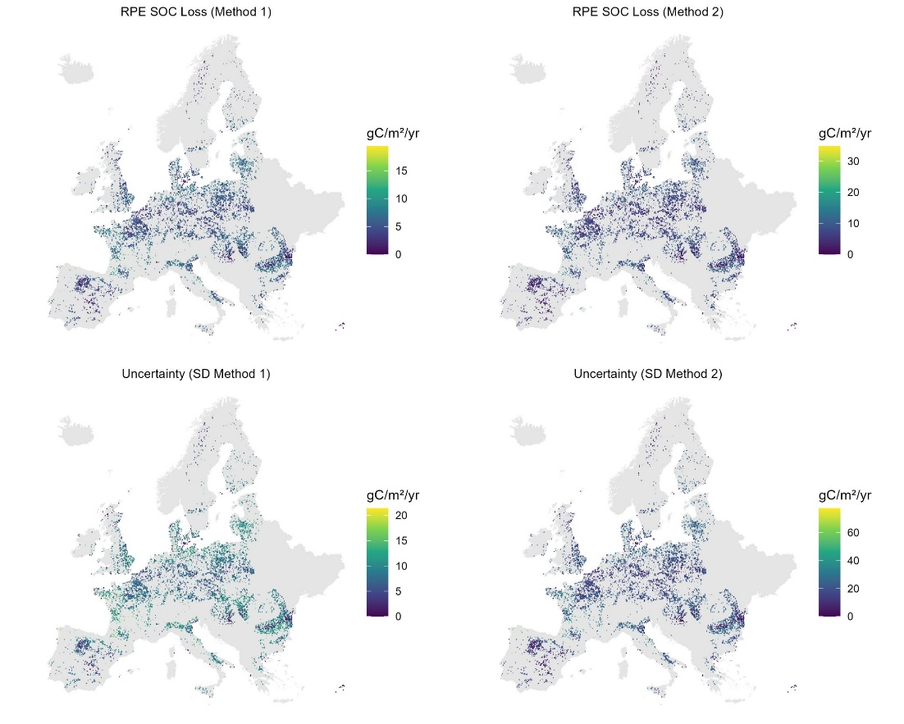
Research gap – Crop Residues
↑
How to include residues in RPE studies?
First exercice (rough approach): use Rh/3 to take the residues part out of the inputs
RPE SOC loss (res. out)
6 – 7.5gC m⁻² yr⁻¹
Proportion of RPE
12 – 14%
Proportion is stable between the two exercices

Slide 14
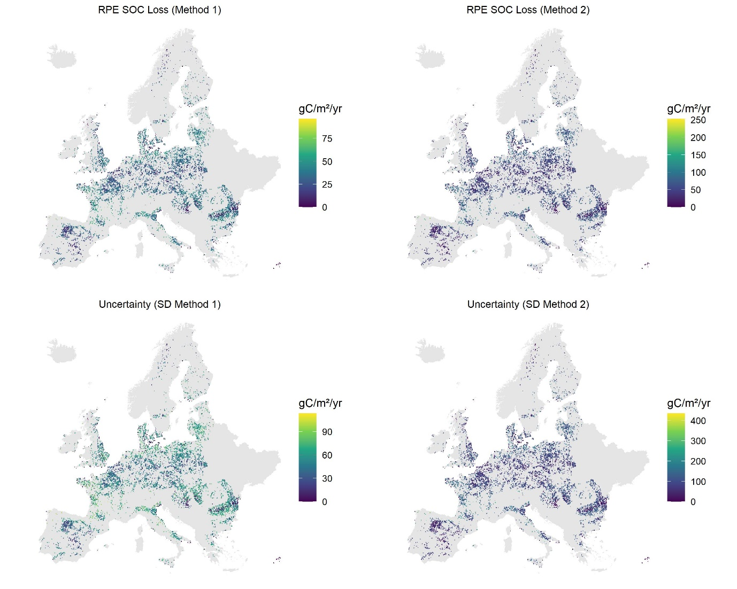
Residues included in Rh ?
↑
First estimation of Rh ~4GtC yr⁻¹
Inevitably includes residues respiration
Residues account for around 2/3 of Rh
Exercice: run the model with Rh x 1/3
Comparable results
RPE = 24 – 32 % of Rh

Slide 15
GPP to root respiration
↑
Belowground plant-associated respiration
RPE ratio uses root respiration (Rr) data
How to Produce Spatial Root Respiration Data?
$Rr=c ×below$*
Kuzyakov and Larinova, 2005
Where below = belowground plant-associated respiration
$$below=b ×\left(NPP+below\right)$$
$$below=b ×NPP/(1−b)$$
Jones et al., 2009
$$NPP=a×GPP$$
Zhang et al., 2009
Then:
$$Rr=GPP ×a×b×c/(1−b)$$
Root respiration (Rr)
¹³C
Respiration from exudates
¹³C
¹³C
Exudation
¹³C
SOC

Slide 16
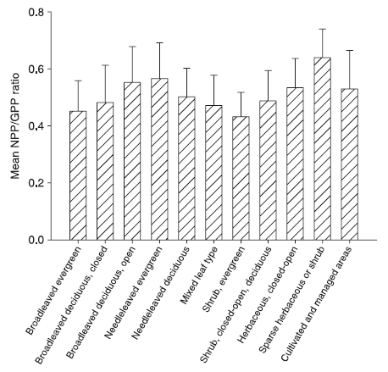
GPP to root respiration
↑
$$Root respiration=GPP ×a×b×c/(1−b)$$
Keuper & Wild et al., 2020, Nat. Geosci
Where :
« c » is the root respiration as the proportion of plant-associated respiration^{[1]}
« b » is the plant-associated respiration as the proportion of net fixed C ^{[2]}
« a » is the GPP/NPP ratio ^{[3]}
¹Kuzyakov and Larionova, 2005, Journal of Plant Nutrition and Soil Science
¹
$$Root respiration=c×below$$
²
$$below=b ×\left(NPP+below\right) \\ below=b ×NPP /(1−b)$$
³
$$a=NPP/GPP$$
$$NPP=a ×GPP$$
Thus;
$$Root respiration=c ×below$$
$$Root respiration=c ×b×NPP/(1−b)$$
$$Root respiration=c ×b×a×GPP/(1−b)$$
$$Root respiration=GPP ×a×b ×c/(1−b)$$
²Jones et al., 2009, Plant and Soil
³Zhang et al., 2009, Global Ecology and Biogeography

Slide 17
Depth distribution of soil respiration
↑
How can we distribute the soil respiration through the soil layers?
Use the same distribution as SOC?
Rh is the direct result of SOC mineralisation by microorganisms and carbon turnover
But microorganisms are not equally distributed over depth
Use the distribution of roots?
Root presence is associated with microorganisms presence
But Rh adn carbon turnover is not a direct result of root presence
?
Use both to estimate a distribution that would be representative of SOC, root presence, and carbon turnover

Slide 18
Depth distribution of soil respiration
↑
Use both to estimate a distribution that would be representative of SOC, root presence, and carbon turnover
Soil respiration percentage =
distribution of root respiration substrate over the distribution of microorganisms respiration substrate
NPP x Root%: represents the distribution of root carbon input over depth used for root respiration
Why not use GPP? → To lower the noise. GPP includes the plant respiration when NPP does not
SOC : represents the substrate of the heterotrophic respiration
Root %
SOC
?
Rs
%
$$\%Rs=\frac{NPP ×Root \%}{\left(NPP ×Root \%\right)+SOC}$$

Slide 19
PrimeSCale inputs for European croplands
↑
Input | Source
GPP | MODIS (MOD17A2H, GPP from 2010 to 2020)
NPP | MODIS (MOD17A3HGF, NPP from 2010 to 2020)
Root percentages | Estimated with the Schenk and Jackson function, the vegetation root parameters (Fan et al., 2016) and the crop map (d’Andrimond et al., 2020)
Soil bulk density | EcoDataCube -
Soil organic carbon stock | EcoDataCube -
Soil respiration | Stell et al., 2021 – Soil respiration based on SRDBv3 and v5, produced with machine learning methods (random forest)

