Slide 1
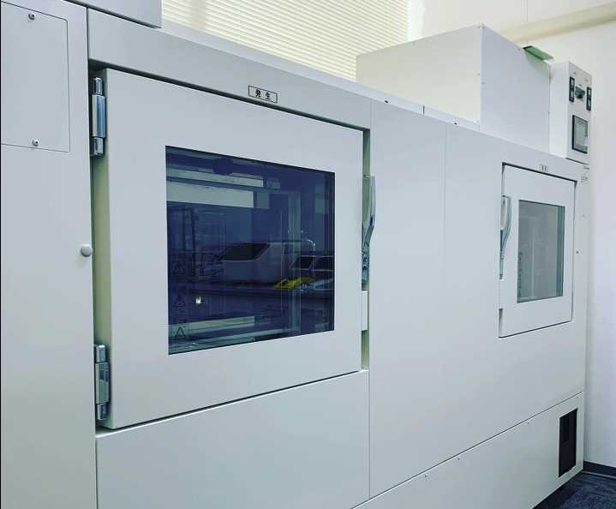
Development of a Dual‑Chamber Atmospheric Simulation System for Bioaerosol Research:
Size‑Dependent Analysis and Surface Interaction Studies
EGU25-1931 (AS4.17):
PICO spot 3 at 10:45-10:47, Vienna, May 2nd, 2025
Fumito Maruyama and So Fujiyoshi
Microbial Genomics and Ecology,
Hiroshima University,
The IDEC Institute, Japan

Slide 2
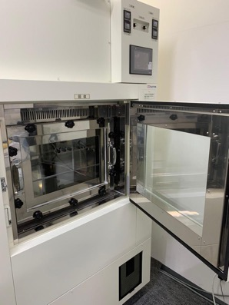
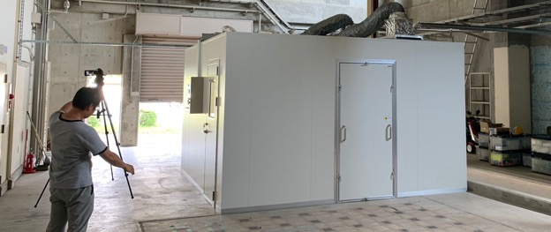
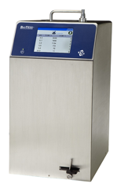
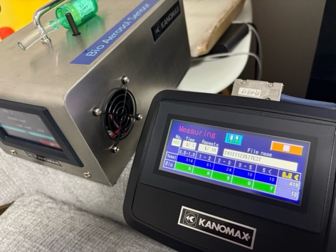
Airborne microorganisms (bioaerosols) play essential roles in global biogeochemical cycles and ecosystem dynamics
Overview: Development of a Dual-Chamber Atmospheric Simulation System for Bioaerosol Research
Custom dual bioaerosol chamber (BSL2, UV, Temp control)
Outdoor comparison of two real-time bioaerosol counters
Indoor comparison of two real-time bioaerosol counters
Case Study: Bioaerosol Measurement at a University Hospital
Integrated lab–field approach offers an unprecedented platform for bioaerosol research, significantly advancing understanding of microbial aerosol dynamics and their environmental and health impacts.
* Dual-chamber system enabled stable, reproducible bioaerosol measurements.
* Field tests showed particle counts agreement; Kanomax detected higher biological variability.
* Hospital study linked larger bioaerosol peaks to human activity; smaller particles dominated by background aerosols.

Slide 3


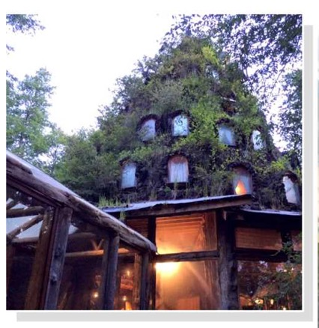

Viewing 11:07-12:30 at PICO3.1
Google:
MGE, HIROSHIMA
fumito@hiroshima-u.ac.jp
EGU General Assembly 2025, Vienna, Austria
Notes:
Regarding the EGU General Assembly 2025, we hereby inform you that your following abstract has been re-scheduled based on the decision of the respective convener:
EGU25-1931
&nbsp;Development of a Dual-Chamber Atmospheric Simulation System for Bioaerosol Research: Size-Dependent Analysis and Surface Interaction Studies
by Fumito Maruyama and So Fujiyoshi
Your contribution is now scheduled as PICO presentation in session AS4.17 - Characterization, processes, and surface interactions of the atmospheric microbiome. The oral presentation of your PICO, 2-minute summary, takes place at PICO spot 3 on Friday, 2 May 2025, 10:45. The PICO viewing time will be Friday, 2 May 2025, 11:07-12:30 at PICO screen PICO3.1.
For details of your presentation as well as of the corresponding session programme please see: https://jpn01.safelinks.protection.outlook.com/?url=https%3A%2F%2Fmeetingorganizer.copernicus.org%2FEGU25%2Fsession%2F53552&data=05%7C02%7Cfumito%40hiroshima-u.ac.jp%7C5ae0b8be09744f31d2ec08dd817f7763%7Cc40454ddb2634926868d8e12640d3750%7C1%7C0%7C638809106672334840%7CUnknown%7CTWFpbGZsb3d8eyJFbXB0eU1hcGkiOnRydWUsIlYiOiIwLjAuMDAwMCIsIlAiOiJXaW4zMiIsIkFOIjoiTWFpbCIsIldUIjoyfQ%3D%3D%7C0%7C%7C%7C&sdata=Ba%2BVgoS2vRPDINeCqb0KvSSfnNnhrr1eWWCyxJKkoI4%3D&reserved=0.
We thank you very much for your cooperation and we are looking forward to seeing you at the EGU General Assembly 2025.
In case any questions arise, please do not hesitate to contact us.
Kind regards,
The Copernicus Meetings team
egu25@copernicus.org
https://meetingorganizer.copernicus.org/EGU25/EGU25-1931.html

Slide 4
Overview

Slide 5
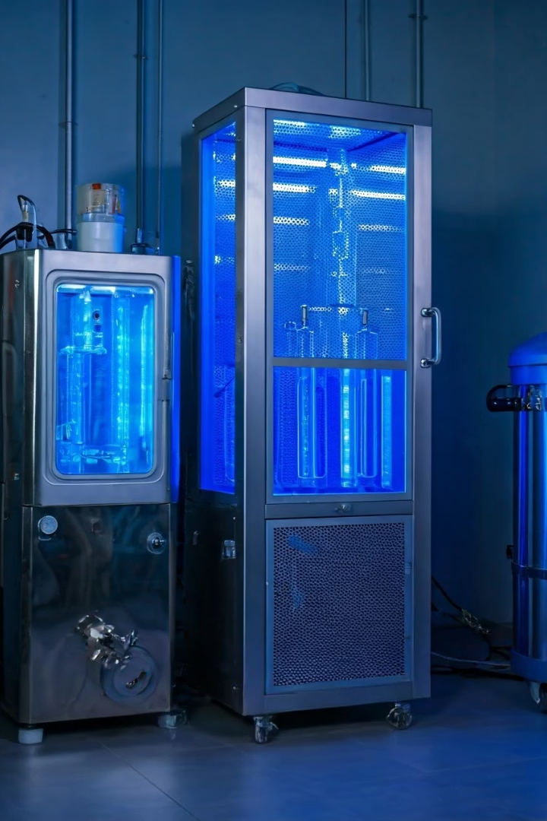
Overview
Development of a Dual-Chamber Atmospheric Simulation System for Bioaerosol Research
Airborne microorganisms, or bioaerosols, play essential roles in global biogeochemical cycles and ecosystem dynamics. To study their physicochemical properties and survival mechanisms, a novel dual-chamber atmospheric simulation system has been developed. This innovative platform allows detailed investigation under controlled conditions, combining advanced technology and environmental precision to unlock new insights into bioaerosol behaviour.
This research offers crucial advancements for environmental microbiology and atmospheric sciences, supporting comprehensive exploration of microbial transport and surface interactions with unprecedented accuracy.
NOT real!
FM

Slide 6
Overview
System Architecture and Clean Room Installation
Dual Stainless Steel Chambers
BSL-2 Class 100 Clean Room Installation
Designed with two interconnected stainless steel chambers to ensure precise environmental control. Chambers minimize microbial adhesion and prevent electrostatic losses, enhancing experiment reliability.
Installed in a biocontainment Level 2 clean room certified to Class 100 standards, guaranteeing a highly sterile and safe environment essential for accurate bioaerosol experiments.

Slide 7
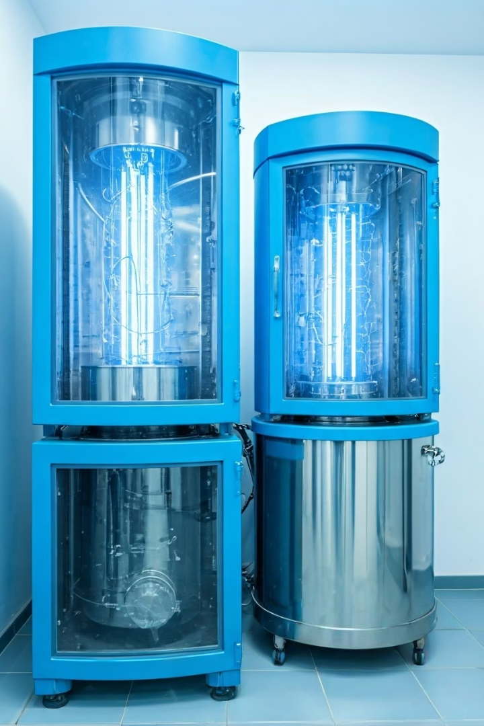
Overview
Environmental Controls and Interconnected Chamber Design
UV Irradiation and Temperature Control
Interconnected Chambers with Dampers
Each chamber includes dedicated UV irradiation and temperature control systems, allowing simulation of environmental stressors such as radiation and thermal changes.
Dampers permit independent environmental regulation in each chamber, enabling bioaerosol generation in one while exposure experiments occur in the other.
Surface Treatment Optimization
Advanced surface treatments were applied to reduce microbial adhesion, ensuring accurate aerosol behaviour and minimal experimental artefacts.
NOT real!

Slide 8
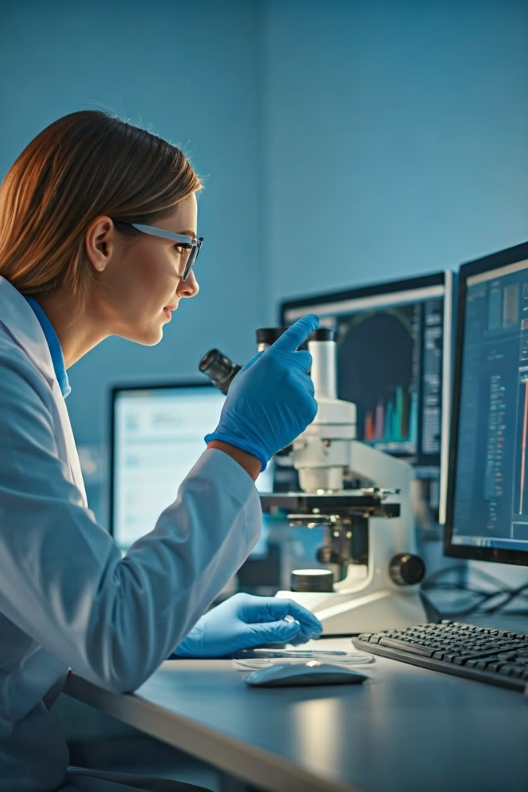
Overview
Simultaneous Physical and Biological Monitoring
Real-Time Particle Counting
SEM-EDS Morphology and Composition
Continuous monitoring of aerosol particle size and concentration enables observation of dynamic changes during experiments.
Scanning electron microscopy with energy-dispersive X-ray spectroscopy reveals detailed particle morphology and elemental composition.
Biological Activity Assessment
Concurrent evaluation of microbial viability supports understanding of survival strategies under various environmental stresses.
NOT real!

Slide 9
Overview
Size-Dependent Effects and Surface Interaction Studies
Size Segregation Capability
Surface Interaction Optimisation
The system segregates particles by size, allowing targeted analysis of size-dependent disinfectant efficacy and environmental stress effects.
Surface properties of the chambers are fine-tuned to study bioaerosol adhesion and retention, critical for understanding microbial transport mechanisms.

Slide 10

Overview
Validation and Experimental Applications
The system’s effectiveness was validated through rigorous experiments with various environmental microorganisms. Results demonstrate stable conditions and precise control enabling reproducible measurement of bioaerosol physical characteristics and biological activity.
Such validation confirms this platform's utility for a broad range of bioaerosol research, including pathogen survival, environmental stress response, and aerosol transport studies.

Slide 11

Overview
Current Research Focus: Airborne Microorganism Transport
Environmental Impact Assessment
Atmospheric Component Interactions
Bioaerosol Transport Processes
Determining implications for global biogeochemical cycling and ecosystem dynamics influenced by airborne microbes.
Investigating how microorganisms travel through the atmosphere under varying environmental conditions.
Studying interactions between bioaerosols and atmospheric particles such as dust, pollutants, and water vapour.

Slide 12

Overview
Significance and Future Directions
This dual-chamber system provides an unprecedented platform for comprehensive bioaerosol research, integrating physical characterisation with biological analysis. It paves the way for enhanced understanding of microbial ecology in the atmosphere and informs strategies for infection control and environmental management.
Future developments may include automation, integration with molecular techniques, and expanded environmental simulation capabilities to further advance bioaerosol science.

Slide 13
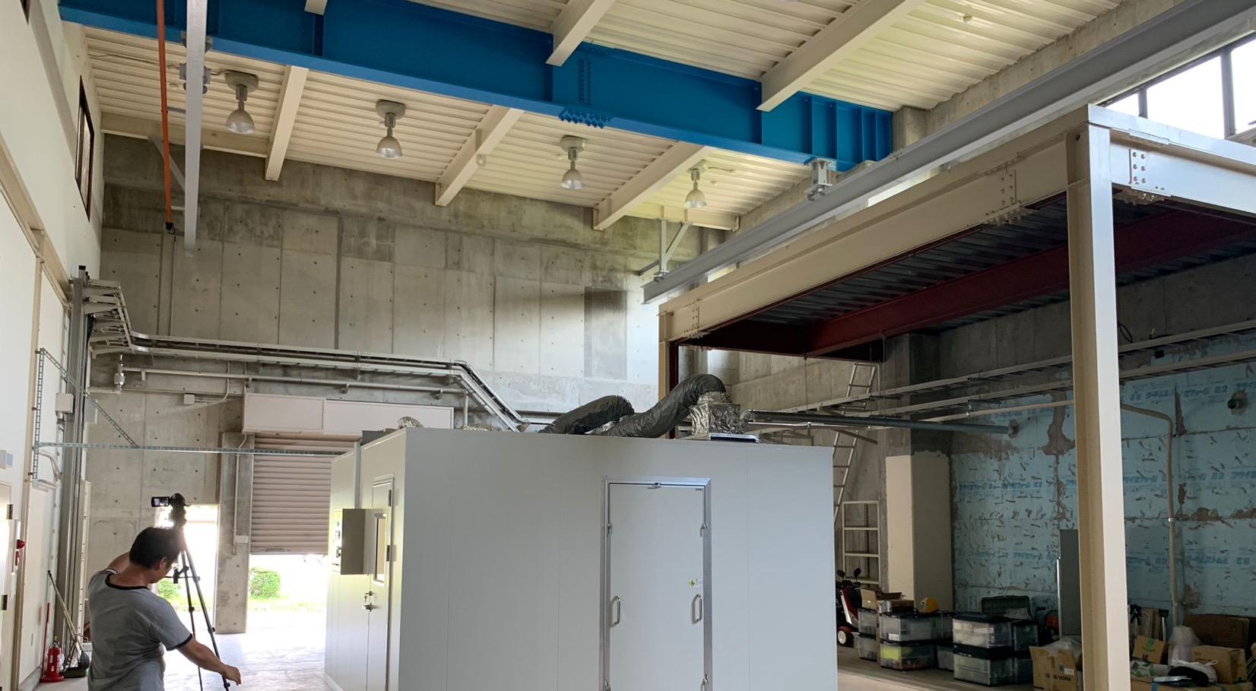
Bioaerosol chamber

Slide 14
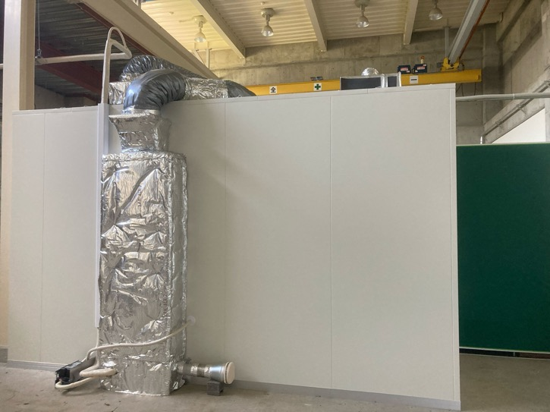
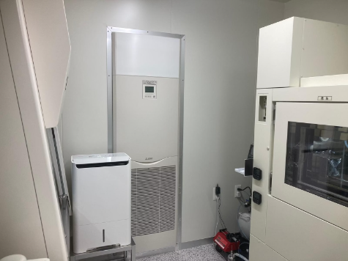
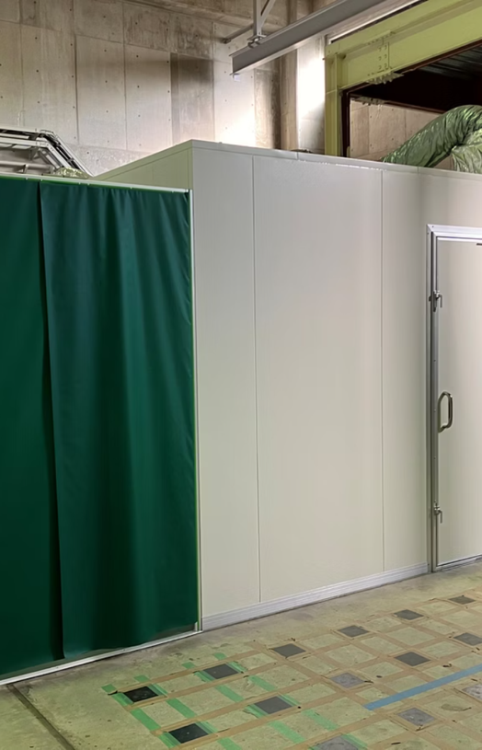
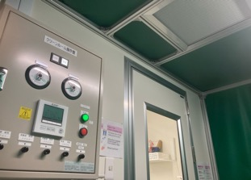
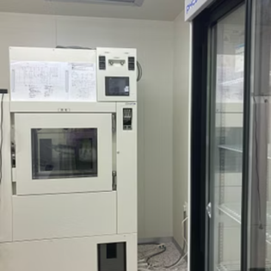
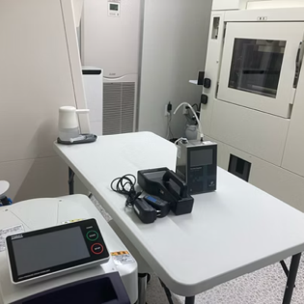
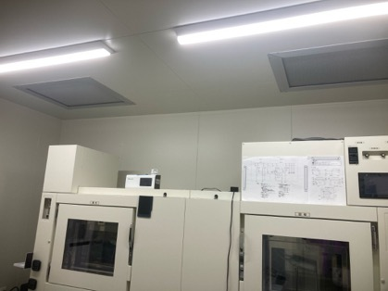
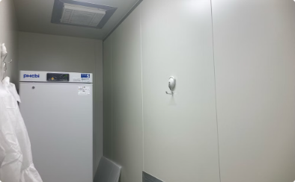
Chamber
Three rooms
BSL2, C100
FM

Slide 15
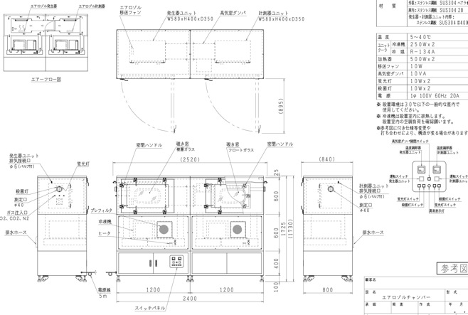
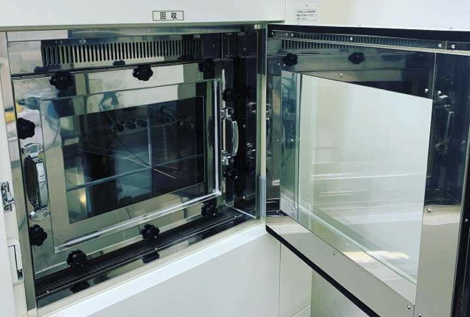
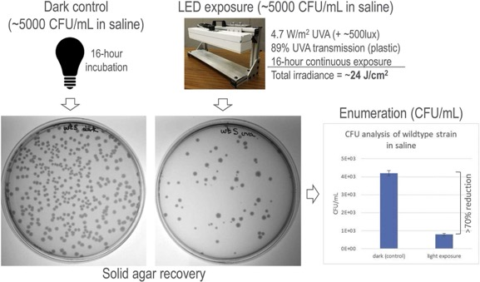
Bioaerosol Research Setup and Testing
Chamber
Toward precise evaluation of dynamics of aerosol
23.2L x 2 rooms
Temperature
Pressure
UV light
Photo: Taken by presenter
https://doi.org/10.1016/j.jphotobiol.2020.111899.
Notes:
23.2L x 2

Slide 16
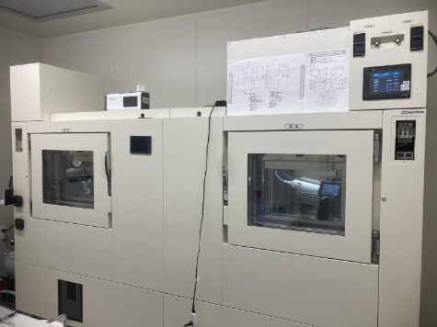
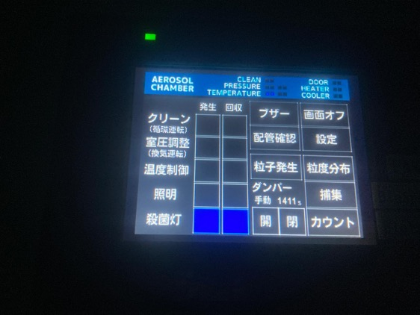
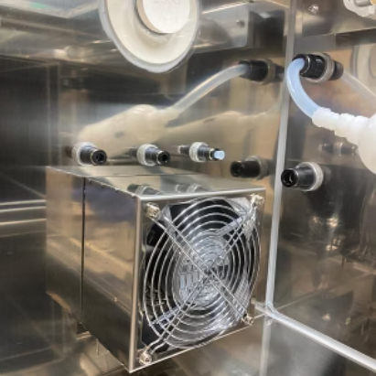
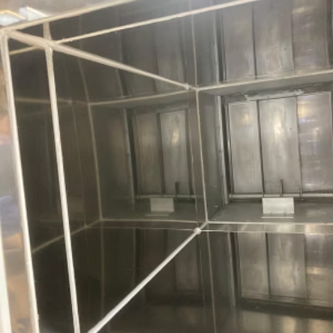
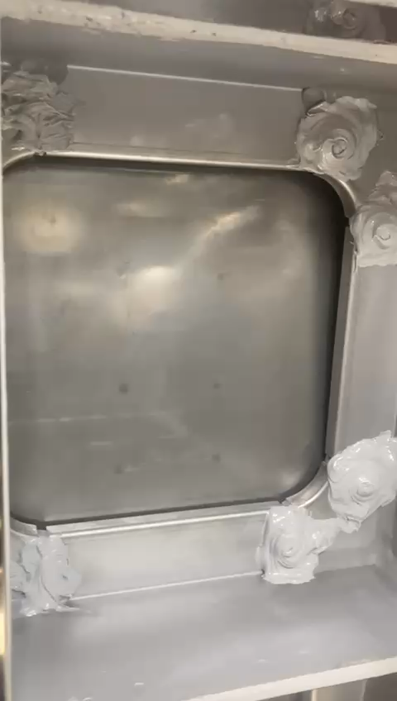
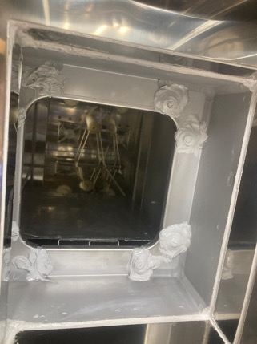
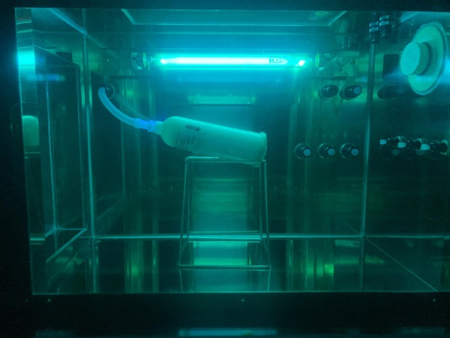
Chamber characteristics
Chamber
FM

Slide 17
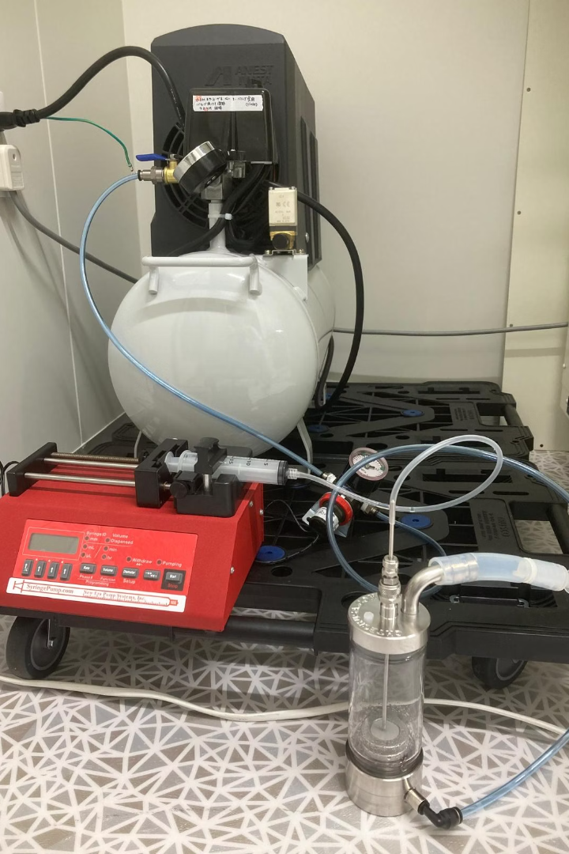
Chamber
Syringe Pump Configuration
Set Syringe Diameter
Input syringe diameter and wait 2 seconds to confirm.
Select Flow Rate
Choose mL/min rate and enter desired value.
Setup Procedure
Attach tubing, draw liquid, purge air, and connect to system.
Maintain Pump Pressure
Keep pressure at 0.1 MPa during operation for reliability.

Slide 18
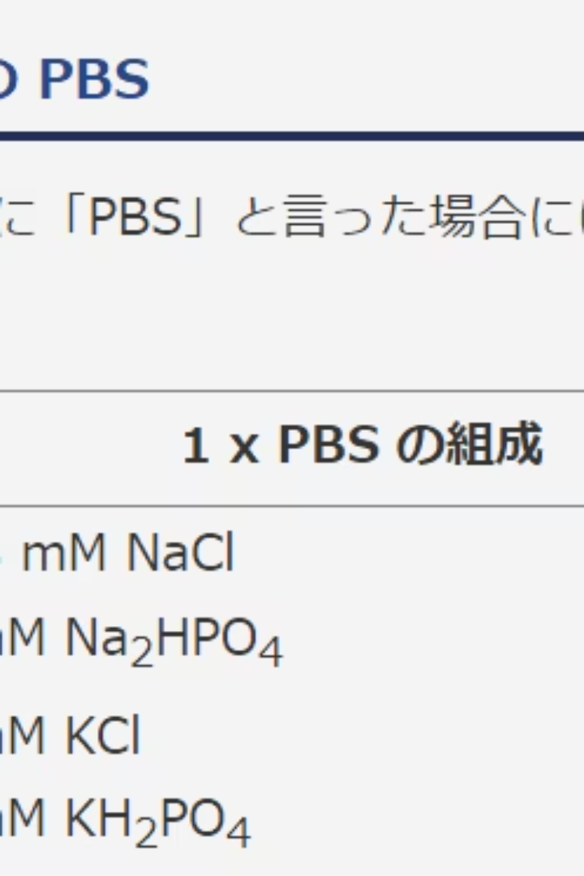
Chamber
Substances Added to Chamber
MQ Water
70% Ethanol
Pure H2O used as liquid base
Organic solvent: C2H6O
Phosphate Buffered Saline
PBS solution for stability

Slide 19
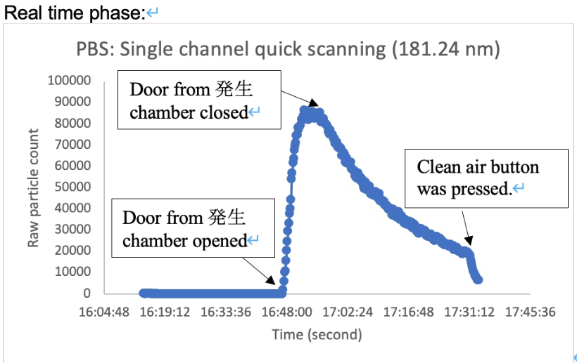
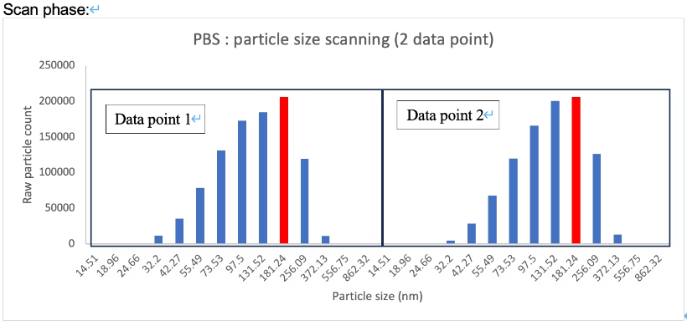
Chamber
Nanoparticle Size Distribution of PBS Solution
Optimal PBS particle size measured at 181.24 nm with clear generation and decay phases.
Glycerol solution plus SLAGS aerosolizer produces 55.49 nm nanoparticles (not shown in graphs).
PROBLEM happened!!
Unknown PM appeared

Slide 20
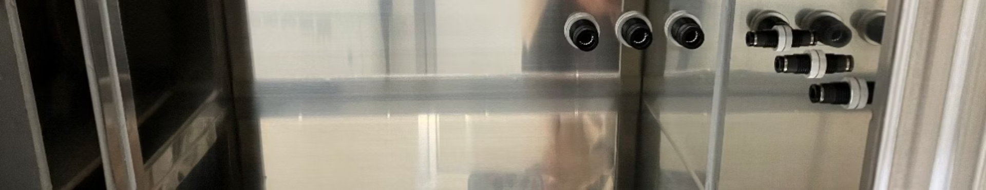
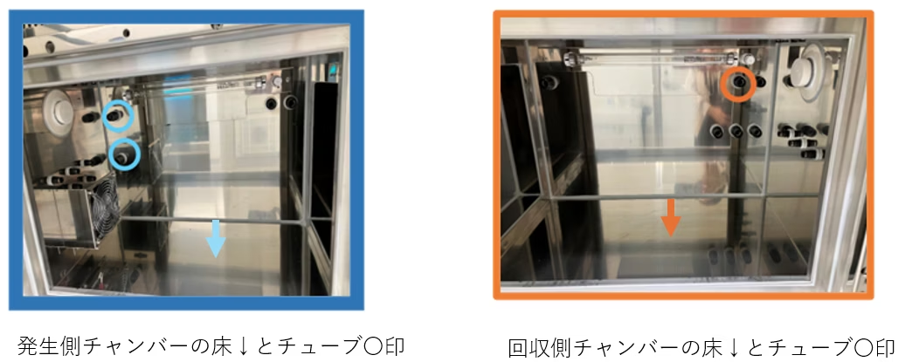
Chamber
Particle Analysis in Aerosol Chamber
SEM-EDX used for elemental analysis
Purpose
4 locations examined inside chamber
Identification of particle composition

Slide 21
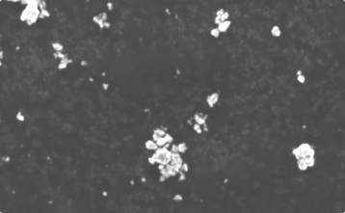
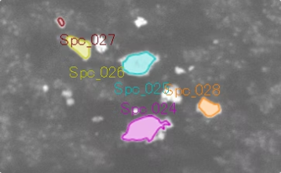
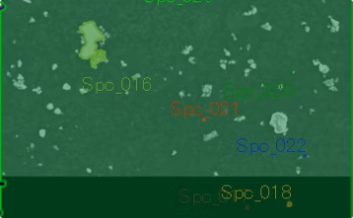
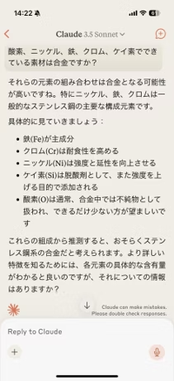
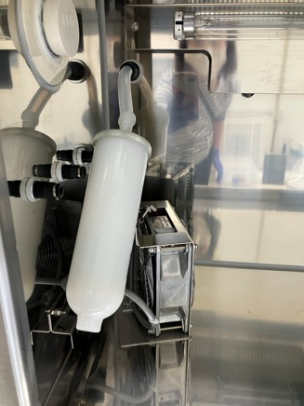
Chamber
Source Side Tube Mouth Analysis
Particles uniform morphology; stainless steel alloy composition suspected
Solenoid valve in Aerosol Chamber caused PM!
HEPA capsule was implemented

Slide 22
Chamber
Bubble Coverage Control in Slag Plate
Bubble Coverage Adjustment
Adjust liquid amount to cover slag plate partially or fully with foam.

Slide 23
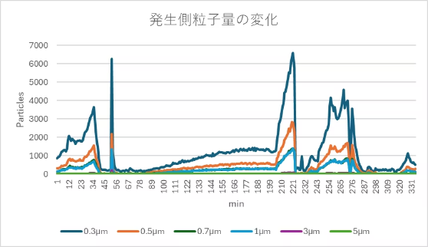
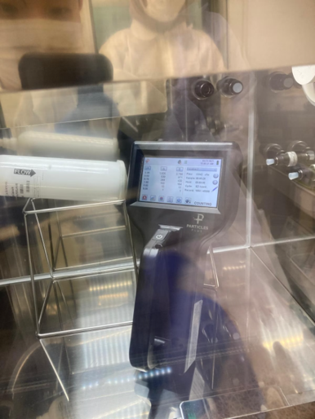
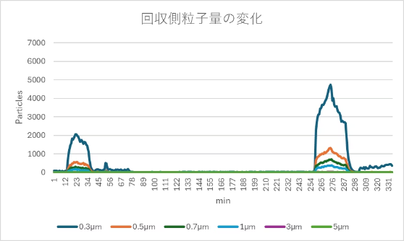
Chamber
Aerosolization of Injection Water at 8.5 mL/min
Key Observations
Generation side
Particle transfer confirmed upon damper opening.
Syringe pump adjustment needed for stable operation.
Single operator struggles with detailed operation logging.
Cleaning increased particle count on generation side only.
Systematic operation control is essential.
Recovery side

Slide 24
Outdoor comparison

Slide 25
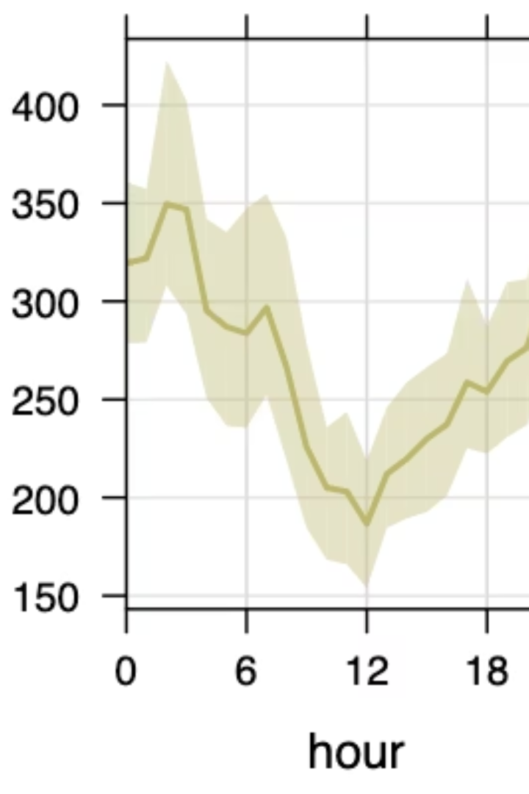
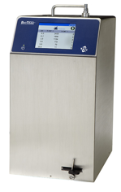
Outdoor
Outdoor comparison of two real-time bioaerosol counters
Analysis of total and biological particle counts using KANOMAX and BioTrak instruments in 2024.

Slide 26
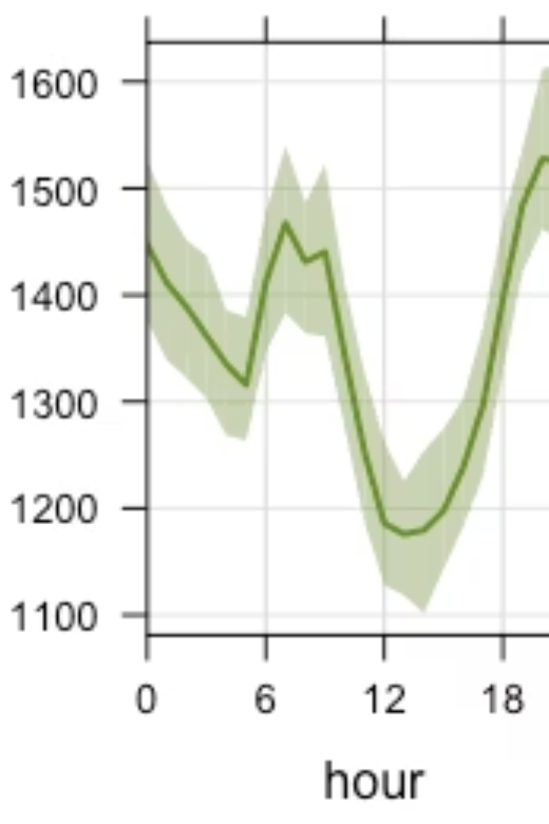
Outdoor
Initial 10-Minute Continuous Measurement
Total particle trends
Particle count differences
Consistent fluctuations between devices
KANOMAX detects fewer particles
Biological particle timing
Minimum occurs at different times

Slide 27
Outdoor
Latest 10-Minute Measurement Overview
2024.10.25
KANOMAX (2024/10/2-21)
φ1_3 µm
φ2_3 µm
2.83 L/min
Total consistent
Y軸の値に関してはKANOMAX＞BioTrak
Bio
Similar dynamics
BioTrak (2024/10/2-21)
28.3 L/min
Particle count agreement
Higher counts in KANOMAX
Similar biological particle trends
Total particles mostly match between devices
KANOMAX readings slightly exceed BioTrak
Variations align closely

Slide 28
Correlation Coefficients Overview
Outdoor
R²: 0.628
R²: 0.557
R²: 0.54
R²: 0.743
R² range: 0.54 to 0.74
Highest correlation at 3-5 µm
Indicating moderate to strong linear relationships
R² = 0.743, strongest explanatory power
All size ranges show positive correlation
r values above 0.7 indicate robustness
Notes:
サンプラー入り口あっためる。
コリオリス->BioSpot->FlowCam

Slide 29
Outdoor
Particle Size Range Correlations
Size Range (µm)
Correlation (r)
R²
0.5-1
0.793
0.628
1-2
0.747
0.557
2-3
0.735
0.540
3-5
0.862
0.743
Stronger correlation with increasing particle size

Slide 30
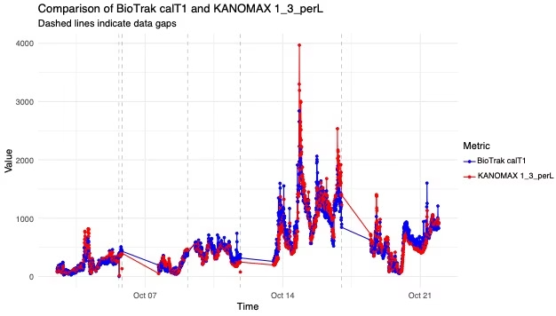
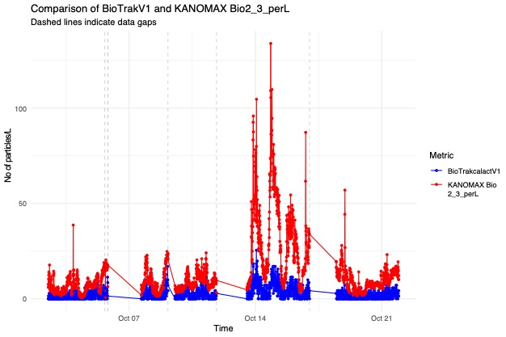
Outdoor
Time-Variation Particle Count Comparison
Total Particles (φ1_3 µm)
Biological Particles (φ2_3 µm)
Nearly identical variation trends between instruments
KANOMAX consistently higher, notably 10/14–16

Slide 31
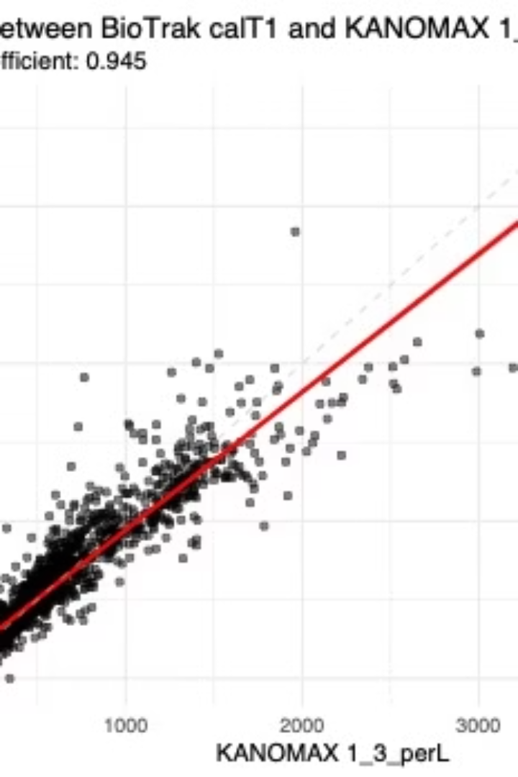
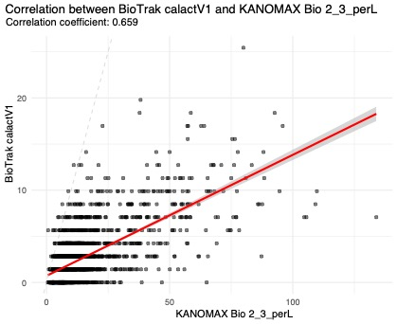



Outdoor
Correlation Between Instruments
Total Particles
Biological Particles
Correlation coefficient R=0.945, highly significant
Moderate correlation R=0.659, p-values near zero

Slide 32
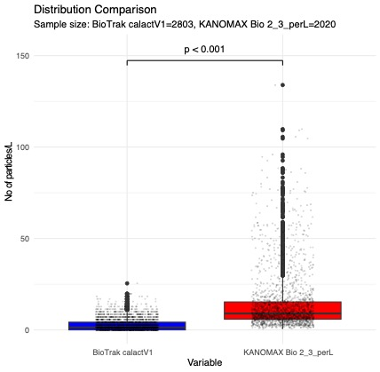
Outdoor
Biological Particle Distribution Comparison
statistic | BioTrak calactV1 | KANOMAX Bio2_3_perL
①mean | 2.954432 | 14.2853619
②median | 1.413428 | 8.975265
③sd | 3.280313 | 15.4469754
④q1 | 0 | 5.8303887
⑤q3 | 4.240283 | 15.3003534
⑥min | 0 | 0.5300353
⑦max | 25.441696 | 133.9222615
⑧n | 2803 | 2020
⑨Wilcoxon p-value（中央値比較） | 0.000000 | NA
⑩KS-test p-value （分布の形状比較） | 0.000000 | NA
KANOMAX higher mean
Greater variability
About 4.8 times BioTrak average
KANOMAX shows larger data spread
Significant distribution difference
Statistical tests show p<0.001

Slide 33

Outdoor
Summary and Implications
Measurement Agreement
KANOMAX and BioTrak generally align in total counts
Biological Particle Variance
KANOMAX reports higher bio-particles, wider range
Correlation Strength
Strong positive correlations across size ranges
Future Work
Refine calibration for biological particle accuracy
NOT real!

Slide 34
Indoor comparison

Slide 35
Comparison of two real-time bioaerosol counters
Indoor
Dec 13th 00:25 (Thu) ~ Dec 16th 11:05 (Mon)
1 min measure and 9 min interval
28.3 L/min
Fumito MARYAMA and So FUJIYOSHI
Dec29th, 2024
Notes:
Indoor validation: Comparison of two real-time bioaerosol counters

Slide 36



Indoor
Simultaneous monitoring with prototype device from Kanomax
Biotrak is much more noisy
Kanomax measures more large particles. (3-5, 5<)

Slide 37


Indoor
Monitoring site
Set at a volunteer’s living room of an apartment in Higashi-Hiroshima, Hiroshima, Japan
Window
Window
AC
Kanomax
Screen
BioTrak
Roomba
Window
Sofa
Desk
Veranda
Window
Sofa
Food dryer
Cooker
Laundry
Table
Airdog
Fridge
Bathroom
Basin
Table
Stairs to
loft
Window
Restroom
Corridor
Micro
Dish washer
Sink
Burner
Stairs to
Entrance
Fan
Corridor

Slide 38

Indoor
10⁵
Sat
Sun
Mon
10⁴
10³
Total PM
10²
10¹
BioTrak
10⁰
10³
10²
Viable PM
10¹
10⁰
2024/12/13 19:05
2024/12/16 11:05
Total 0.5, 0.7, 1.0 similar, 3.0 unique, and 5.0, 10.0 similar dynamics
Viable 0.5, 0.7 none, 1.0 unique, 3.0, 5.0, 10.0 similar dynamics

Slide 39
Indoor
80,000
Sat
Sun
BioTrak
Mon
Total PM
0
250
Viable PM
0
2024/12/13 19:05
2024/12/16 11:05
Total 0.5 unique, 0.7 and 1.0 similar dynamics; PM2.5 and PM10 are not useful for the biological air quality
Total and Viable are not correlated, meaning Total is not Viable alternative

Slide 40


BioTrak
Indoor
Sat
Sun
Mon
Total
Viable
Log Total
Log Viable
2024/12/13 19:05
2024/12/16 11:05
Total 5.0 appears more related to Viable 1.0
Viable 3.0 are more related to human activities

Slide 41


Sat
Sun
Mon
Tue
Indoor
10⁵
10⁴
10³
Total PM
10²
10¹
Kanomax
10⁰
10⁴
10³
10²
Viable PM
10¹
10⁰
2024/12/13 20:31
2024/12/17 7:31
Total 2.0 is similar to 0.5 and 1.0 and same T and V size sometime similar dynamics
Viable 0.5,1.0,2.0 similar, 3.0 and 5.0 similar, dynamic change in abundance

Slide 42

Indoor
Biotrak T
Kanomax T
BioTrak and Kanomax smilar and Total 2.0 is between 1.0 and 3.0.
BioTrak 5.0 and 10.0 is clear but Kanomax 5.0> is intermittent

Slide 43
Indoor
10³
10²
Biotrak V
10¹
10⁰
10⁴
10³
Kanomax V
10²
10¹
10⁰
Large V sometimes higher than smaller in Kanomax
Human activities correlated large V
Small V dynamics are similar
Kanomax provide 0.5 and 10 dynamics

Slide 44
Next Steps
Indoor
More finer scale fractionation (particle size distribution)
More comparison with other devices
Detailed correlation of human activities or behavior with total and viable aerosol (bath, shower, fermented food, etc)
Difference between Kanomax and BioTrak

Slide 45
Case study

Slide 46

Case Study
Bioaerosol Measurement
at a University Hospital
This presentation shares results from bioaerosol measurements conducted at a University Hospital in April 2025, analyzing particle distribution and human traffic correlation.
NOT real!
Notes:
Case Study: Bioaerosol Measurement at a University Hospital

Slide 47


Case Study
Sensing Principle
Light Scattering
Fluorescence Detection
All particles produce scattered light when illuminated.
Bio-particles emit fluorescence when illuminated.
Particle Classification
Simultaneous detection of scattered light and fluorescence identifies bio-particles.

Slide 48

Case Study
Measurement Setup
1
Date and Time
April 8-10, 2025. Two sessions: 17:51-10:30 and 17:53-3:32.
2
Location
Corridor in front of negative pressure room, 8th floor, West Wing.
3
Equipment
Prototype bioaerosol sensor calibrated with standard particles.
NOT real!
Real
4
Protocol
999 measurements per minute for 16 hours 39 minutes.

Slide 49

Case Study
Traffic Patterns (number of person/hour)
Traffic peaked during morning, noon, and evening hours. Most entries were recorded as "passing through." Nighttime showed minimal traffic.

Slide 50
Case Study
Particle Size Distribution (Total, Bio, Ratio)
0.5-1.0
1.0-2.0
2.0-3.0
3.0-5.0
> 5.0

Slide 51
Case Study

Slide 52





Case Study
Particle Size Distribution
0.5-1μm
1
Highest concentration, likely dust particles
1-2μm
2
High concentration throughout measurement period
2-3μm
3
Moderate correlation with human traffic
3-5μm
4
Strong correlation with human presence
>5μm
5
Highest human-derived correlation

Slide 53
Case Study
Measurement Results
Small Particles (0.5-2μm)
Large Particles (>2μm)
High values throughout all time periods
Lower values during nighttime
Peak concentrations around midnight
Strong correlation with human traffic
No correlation with human traffic
Likely human-derived bioparticles
Likely dust or environmental particles
Less affected by air currents

Slide 54





Case Study
Correlation Analysis
Small Particles
Large Particles
Negative correlation with traffic. Possibly due to increased airflow to negative pressure room.
1
Positive correlation with traffic. Likely human-derived bioaerosols.
2
Door Opening
Particle Resistance
4
May reduce small particle concentration through airflow to negative pressure room.
Larger particles resist airflow effects due to greater mass.

Slide 55

Case Study
Key Findings
Time Patterns
Particle counts increased during morning, noon, and evening. Coincided with higher traffic periods.
Size Differentiation
Small particles (0.5-2μm): Environmental origin. Large particles (>2μm): Human-derived.
Traffic Correlation
Negative correlation for small particles. Positive correlation for large particles.
Airflow Hypothesis
Door opening frequency may affect small particle concentration through negative pressure effects.
NOT real!

Slide 56





Acknowledgement
Resistome in Bioaerosol
Pierre AMATO
Xavier RODO
Fumito MARUYAMA

Slide 57





Acknowledgement
Research Grant and Collaboration Support
Japan Prize Heisei Memorial Research Grant
Japan Society for the Promotion of Science (KAKENHI)
Kurita Water and Environment Foundation
Japan Agency for Medical Research & Development (AMED)
Kyoto University & DAIKIN Industries joint grant
Collaboration with CHOBE, Hiroshima University
Japan-Slovenia Research cooperative programs
Asahi glass foundation
Institute of Nature and Environmental Technology, Kanazawa University

