Slide 1
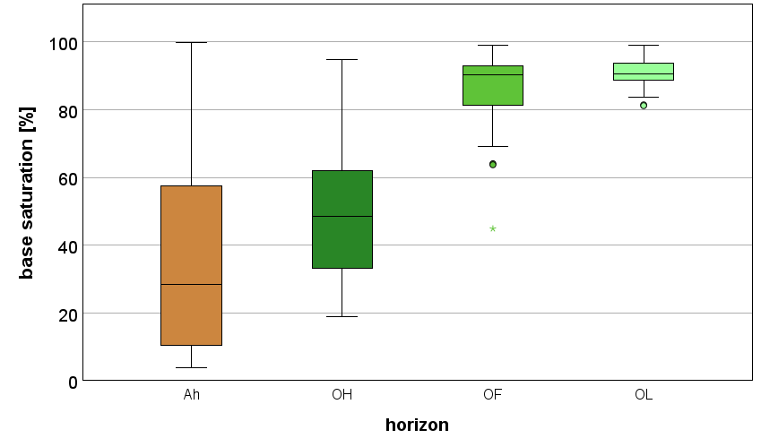
Data from all silicate site quantitive pits
a)
a)
b)
b)
Different letters indicate significant differences between the horizons,
two sided Kruskal-Wallis-Test,
significance level α = 0,05
Base saturation in the Ah topsoil horizon and the three organic horizons Ol, Of, Oh, horizon designation according the German soil classification system, KA6
(AG Boden, 2024)

Slide 2
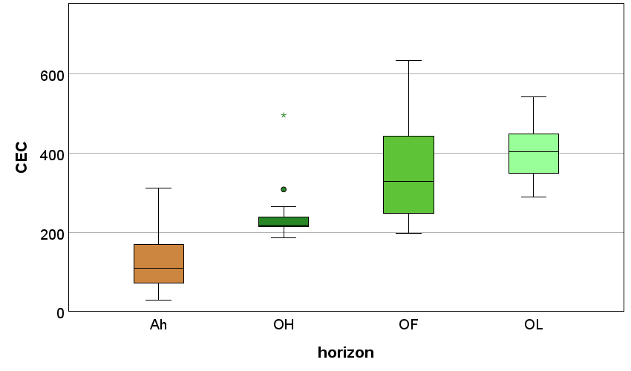
Data from all silicate site quantitive pits
a)
b)
c)
c)
Different letters indicate significant differences between the horizons,
two sided Kruskal-Wallis-Test,
significance level α = 0,05
Base saturation in the Ah topsoil horizon and the three organic horizons Ol, Of, Oh, horizon designation according the German soil classification system, KA6
(AG Boden, 2024)

Slide 3
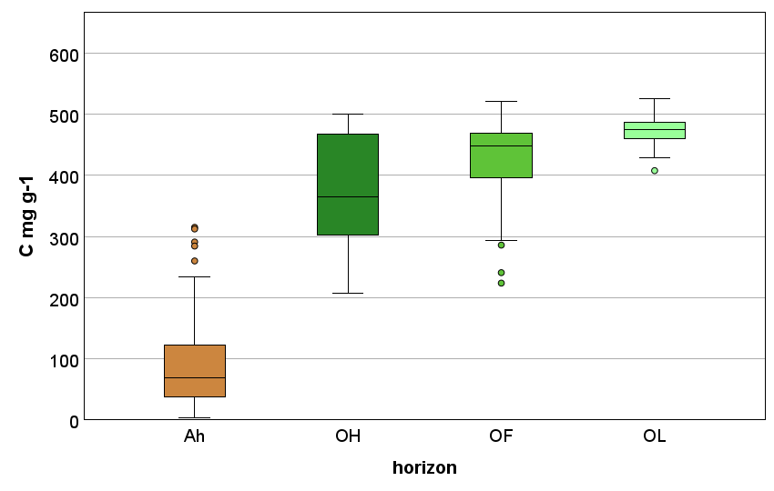
Data from all silicate site quantitive pits
a)
b)
bc)
c)
Different letters indicate significant differences between the horizons,
two sided Kruskal-Wallis-Test,
significance level α = 0,05
Carbon content in mg g⁻¹, in the Ah topsoil horizon and the three organic horizons Ol, Of, Oh, horizon designation according the German soil classification system, KA6
(AG Boden, 2024)

Slide 4
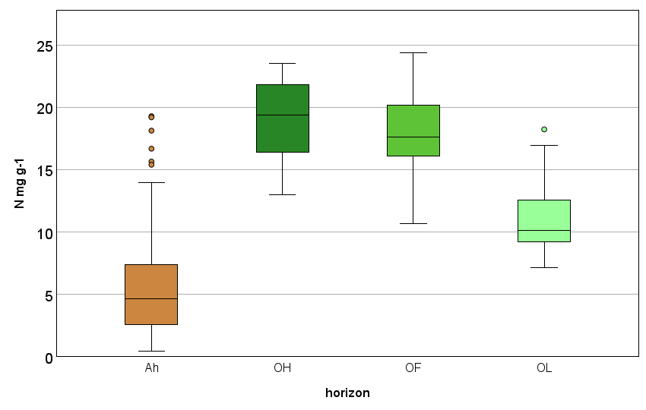
Data from all silicate site quantitive pits
a)
b)
b)
c)
Different letters indicate significant differences between the horizons,
two sided Kruskal-Wallis-Test,
significance level α = 0,05
Nitrogen content in mg g⁻¹, in the Ah topsoil horizon and the three organic horizons Ol, Of, Oh, horizon designation according the German soil classification system, KA6
(AG Boden, 2024)

Slide 5
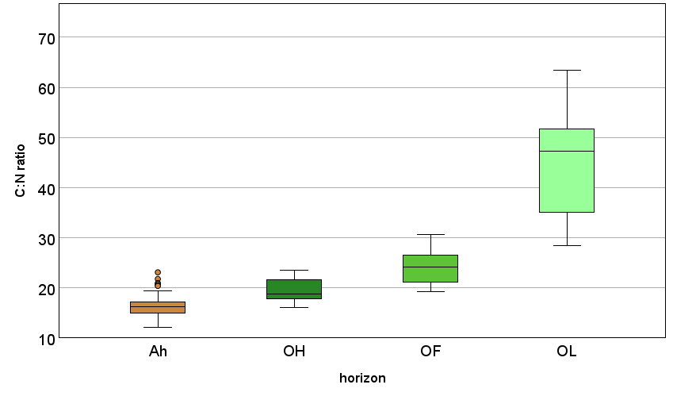
Data from all silicate site quantitive pits
a)
ab)
b)
c)
Different letters indicate significant differences between the horizons,
two sided Kruskal-Wallis-Test,
significance level α = 0,05
C:N ratio, in the Ah topsoil horizon and the three organic horizons Ol, Of, Oh, horizon designation according the German soil classification system, KA6
(AG Boden, 2024)

Slide 6
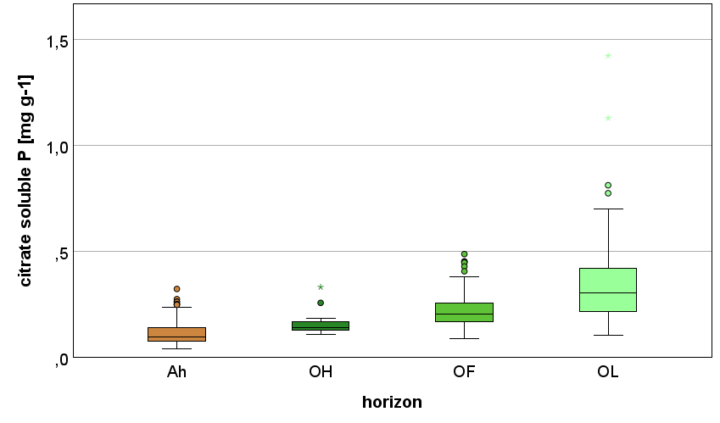
Data from all silicate site quantitive pits
a)
ab)
b)
c)
Different letters indicate significant differences between the horizons,
two sided Kruskal-Wallis-Test,
significance level α = 0,05
Citrate soluble P in mg g⁻¹, in the Ah topsoil horizon and the three organic horizons Ol, Of, Oh, horizon designation according the German soil classification system, KA6
(AG Boden, 2024)

Slide 7
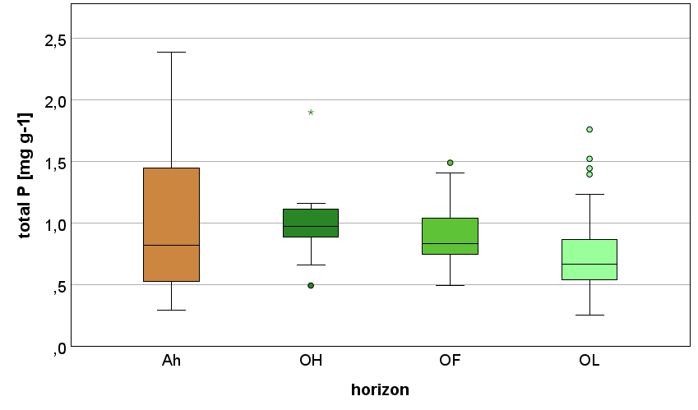
Data from all silicate site quantitive pits
a)
a)
a)
b)
Different letters indicate significant differences between the horizons,
two sided Kruskal-Wallis-Test,
significance level α = 0,05
Total P content in mg g⁻¹, in the Ah topsoil horizon and the three organic horizons Ol, Of, Oh, horizon designation according the German soil classification system, KA6
(AG Boden, 2024)

Slide 8
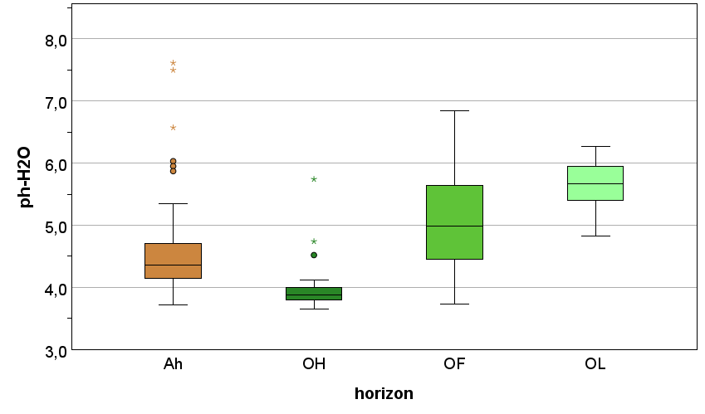
Data from all silicate site quantitive pits
a)
a)
b)
c)
Different letters indicate significant differences between the horizons,
two sided Kruskal-Wallis-Test,
significance level α = 0,05
pH values (H₂O), in the Ah topsoil horizon and the three organic horizons Ol, Of, Oh, horizon designation according the German soil classification system, KA6
(AG Boden, 2024)

Slide 9
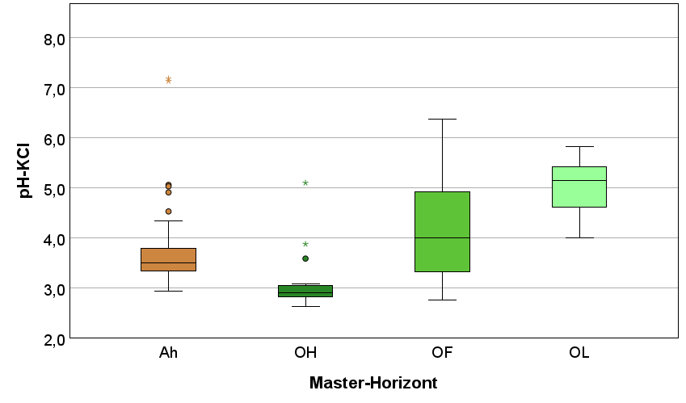
Data from all silicate site quantitive pits
a)
a)
b)
c)
Different letters indicate significant differences between the horizons,
two sided Kruskal-Wallis-Test,
significance level α = 0,05
pH values (KCl), in the Ah topsoil horizon and the three organic horizons Ol, Of, Oh, horizon designation according the German soil classification system, KA6
(AG Boden, 2024)

Slide 10
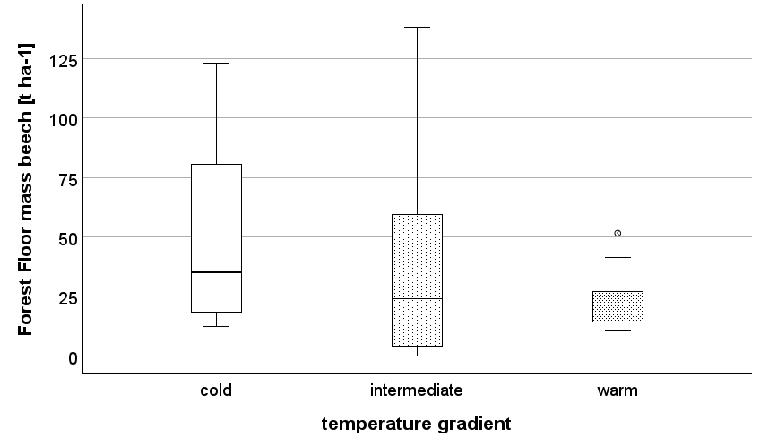
Data from all silicate site quantitive pits
a)
ab)
b)
Different letters indicate significant differences between the horizons,
two sided Kruskal-Wallis-Test,
significance level α = 0,05
Forest Floor mass under beech t ha ⁻¹, according to the temperature gradient of the study sites

Slide 11
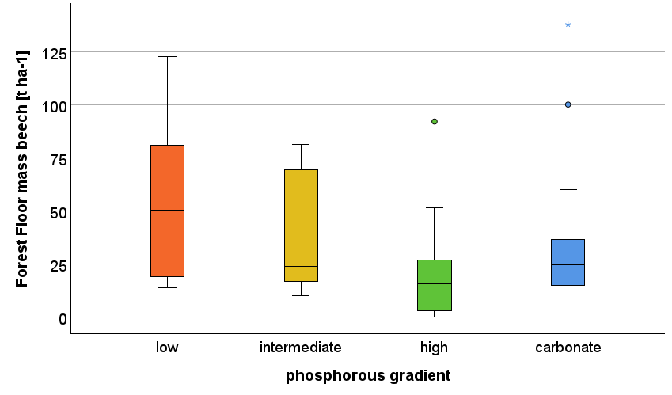
Data from all silicate site quantitive pits
a)
ab)
b)
ab)
Different letters indicate significant differences between the horizons,
two sided Kruskal-Wallis-Test,
significance level α = 0,05
Forest Floor mass under beech t ha ⁻¹, according to the phosphorous gradient of the study sites

