Slide 1



Development of a Multi-Criteria based Multi-Objective Simulation – Optimization Framework Integrated with Hydrologic Model and Evolutionary Algorithm for Planning, Design, and Analysis of SuDS at a river-basin scale
European Geosciences Union, General Assembly 2025
Vienna, Austria
April 27 – May 02, 2025
HS 5.4.1: Green Infrastructure and Nature-based Solutions for Sustainable Urban Hazard Management
EGU25-19515: April 29, 2025
Arun Sankarbalaji¹, Sreethu Subrahmanian¹, Krushil Modi², Elanchezhiyan Duraisekaran¹, and Balaji Narasimhan¹
¹ Indian Institute of Technology Madras, Chennai, India
²University of Alberta, Edmonton, Canada

Slide 2
Contents
Background and Motivation
Summary and Conclusion
Methodology
Results
1
2
3
4

Slide 3
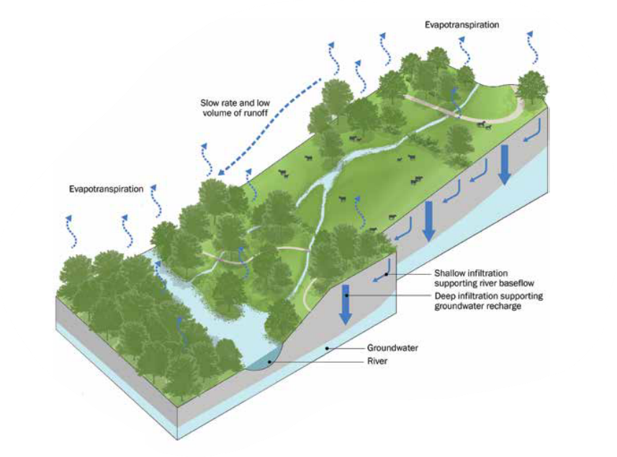
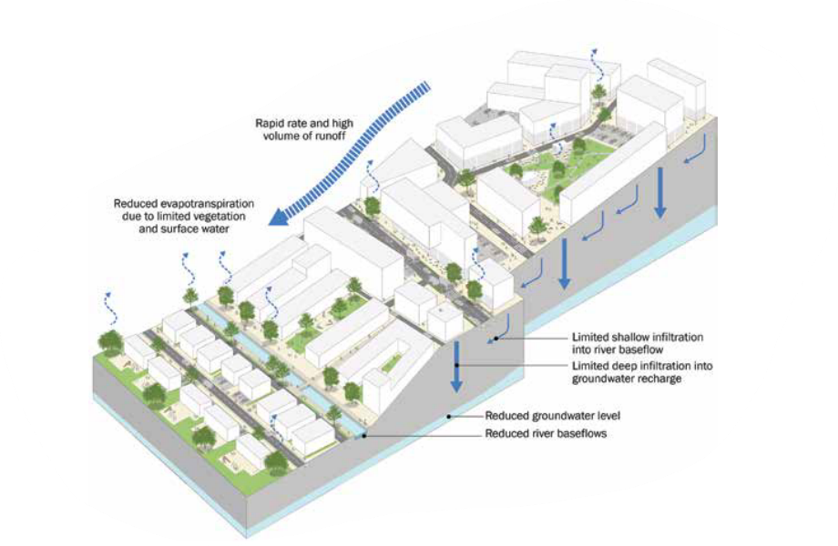
Background & Motivation
Pre-Development Hydrologic Regime
Post-Development Hydrologic Regime
Source: Kellagher et al., 2015
Impact of Urbanisation in a Watershed
Change in Hydrologic Response: Increased Peak Flow and Reduced time to peak
Notes:
The effects of urbanization on the hydrologic response of the basin are well documented in the literatures
For any given catchment, the hydrologic regime can be classified into pre-development where the surface runoff is low, ET and infiltration are high and post-development where the surface runoff is high, ET and infiltration are low because of increased imperviousness.
The change in the hydrologic regime is reflected as the change in the hydrologic response of the catchment

Slide 4
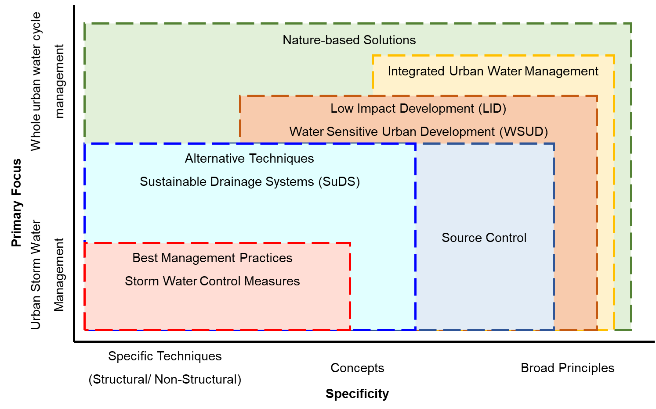
Background & Motivation: Runoff Management using SuDS
Sustainable Storm Water Management: Approach
Source: Fletcher et al., 2015
Sustainable Drainage Systems (SuDS): Source Control measures using
Infiltration- based Systems: Bio-retention Cell, Raingarden, Infiltration Trench, and Green Roof
Pervious and Conveyance Systems: Permeable Pavement and Swales
Notes:
Countries across the world define sustainable storm water management using different terminologies that ranges from simple structural or non-structural measures to broad principles with focus on only storm water management to whole urban water cycle.
Although the terminologies differ, they are all subset of nature-based solutions
Throughout the presentation, I’ll use the term Sustainable Drainage Systems
They include source control measures such as infiltration based systems and pervious and conveyance systems

Slide 5
Existing Studies
GIS-based Multi-criteria Decision Making Techniques
Subjective and biased¹ May yield priority vectors close to each other² Suitable to identify hydrologically sensitive areas³
¹Jack, 2012 ²Jia et al. 2013a ³Martin – Mikle et al. 2015
SuDS Planning
Spatial Decision Support Systems
Catchment properties are not considered¹ Urban area: Homogeneous typologies² Lacks integration with a hydrologic model²
¹Voskamp and Van de Ven, 2015 ²Bach et al. 2020
Simulation – Optimization Frameworks
Fixed percentage of SuDS elements¹ Implementation rates of SuDS: Uniform across catchments² Pre-defined locations for Detention basins³
¹Giacomoni and Joseph, 2017 ²Eckart et al., 2018 ³Saadatpour et al., 2020
Existing Frameworks
To decide “Which element?” and “Where to locate?” To determine “Which element?” and “How much?”
Notes:
Developing countries where there is a haphazard urban development, grouping urban area into homogeneous elements is challenging.

Slide 6
Assessment of SuDS at a River basin scale
SuDS
Planning
Design
Analysis
Multi-Criteria Analysis
Which element? & Where to locate?
Simulation – Optimization
Which element? & How much?
Weights: Objective Method
Areal Constraints for SuDS
%Flow Routed to SuDS
A Multi-Criteria based Multi-Objective Simulation and Optimization Framework using an Evolutionary Algorithm integrated with a Hydrologic Model
An Ideal SuDS – SDSS (Lerer et al., 2015)
Notes:
According to Lerer et al. 2015, an ideal SuDS – SDSS should answer all the three questions: Which element?, Where to locate? And How much area to allocate.
Hence, A Multi-Criteria based Multi-Objective Simulation and Optimization Framework using an Evolutionary Algorithm integrated with a Hydrologic Model is needed.

Slide 7
Background and Motivation
Summary and Conclusion
Methodology
Results
1
2
3
4

Slide 8
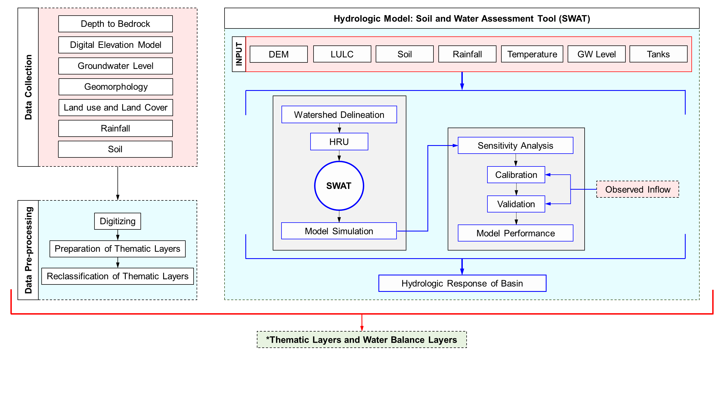
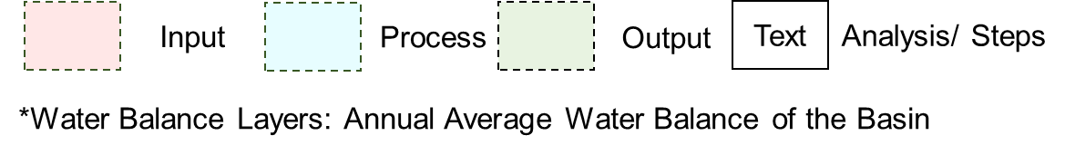
Methodology
Notes:
Inputs for MCDM method

Slide 9
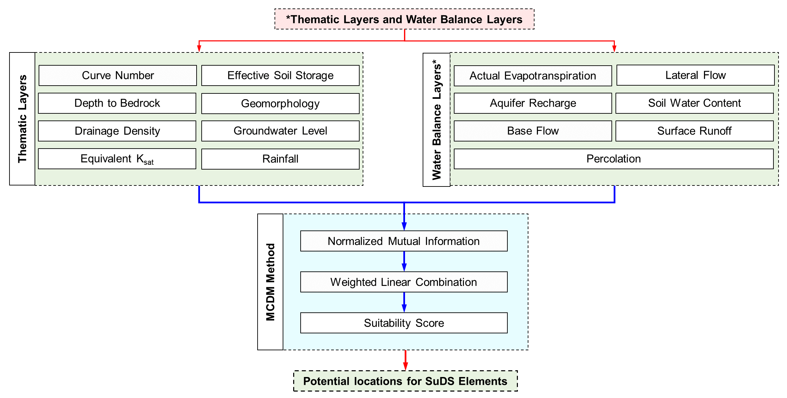
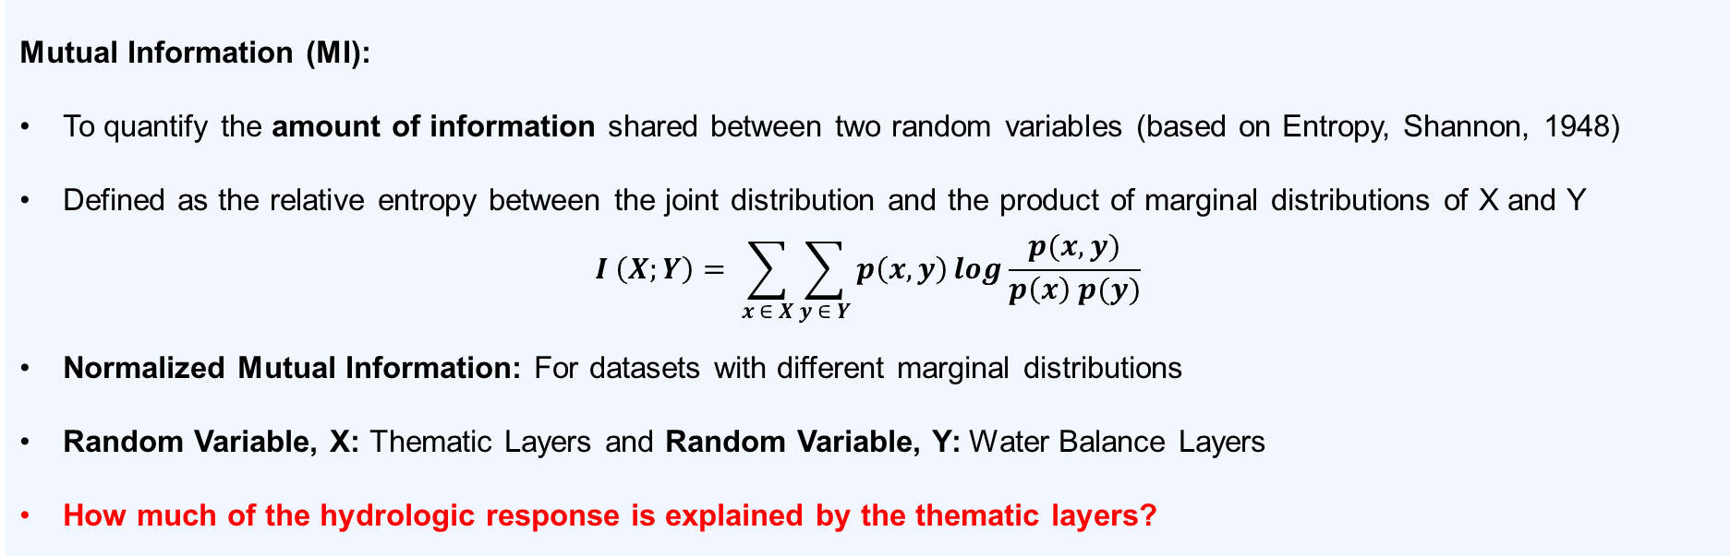
Methodology
Mutual Information (MI):
To quantify the amount of information shared between two random variables (based on Entropy, Shannon, 1948)
Defined as the relative entropy between the joint distribution and the product of marginal distributions of X and Y
$$I \left(X;Y\right)= \sum_{x ∈ X}{\sum_{y ∈ Y}{p\left(x,y\right)\log{\frac{p(x,y)}{p\left(x\right) p(y)}}}}$$
Normalized Mutual Information: For datasets with different marginal distributions
Random Variable, X: Thematic Layers and Random Variable, Y: Water Balance Layers
How much of the hydrologic response is explained by the thematic layers?
Notes:
The thematic layers and water balance layers used are listed in this flowchart.
NMI: Quantifies the amount of information shared between two random variables
In this context, Random Variable, X: Thematic Layers and Random Variable, Y: Water Balance Layers
Given the hydrologic response of the catchment, we quantify how much of it is explained by the thematic layers.
The normalized mutual information is computed and an overlay analysis is made to obtain the suitability score.
The suitability scores are reclassified to obtain the potential location for SuDS elements.

Slide 10
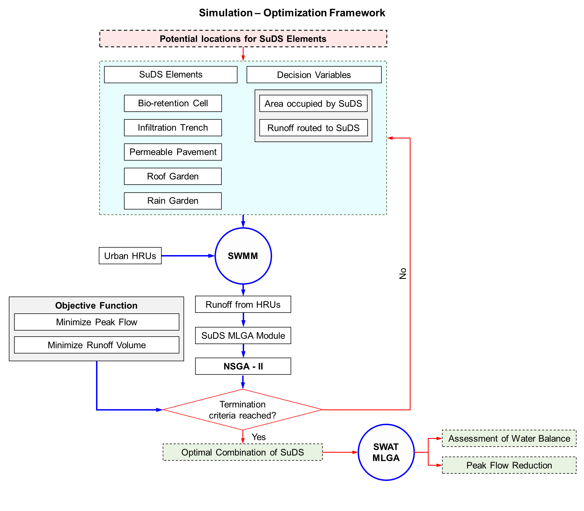
Methodology
Multi-Layer Green-Ampt Modules for SuDS
Subrahmanian S, Modi K, Bhallamudi SM, Narasimhan B. Development of a multi-layer green-ampt infiltration based modeling framework for hydrologic process simulation and design of various low impact development measures for mitigating urban flooding. Urban Water Journal. 2024 Aug 8;21(7):859-76.
https://doi.org/10.1080/1573062X.2024.2360181
Modelling of MLGA based SuDS elements in SWAT
Subrahmanian S, Sankarbalaji, A.R., Duraisekaran, E., Bhallamudi SM, Narasimhan B. Improved modeling of Low Impact Development (LID) modules within SWAT model for assessing the effectiveness of urban LID measures at river basin scale. (under review)
Tamil Nadu Building Development Guidelines 2019,
Land Availability Constraints
Green Roofs: Implemented in 70% of HRU Area
Other SuDS: Implemented in 30% of HRU Area
*MLGA: Multi-Layer Green – Ampt
Notes:
Here, the chosen SuDS elements are bio-retention cells, infiltration trench, permeable pavement, roof garden, and rain garden.
The decision variables are area occupied by SuDS and percentage of runoff routed to the SuDS elements and subjected to land availability constraints.
Since the SuDS elements are designed for a specific design storm, the urban HRUs in SWAT are synthetically simulated in SWMM to obtain the post-development runoff.
The objective here is to minimize the peak flow and runoff volume
The optimum combination of SuDS elements are obtained.

Slide 11
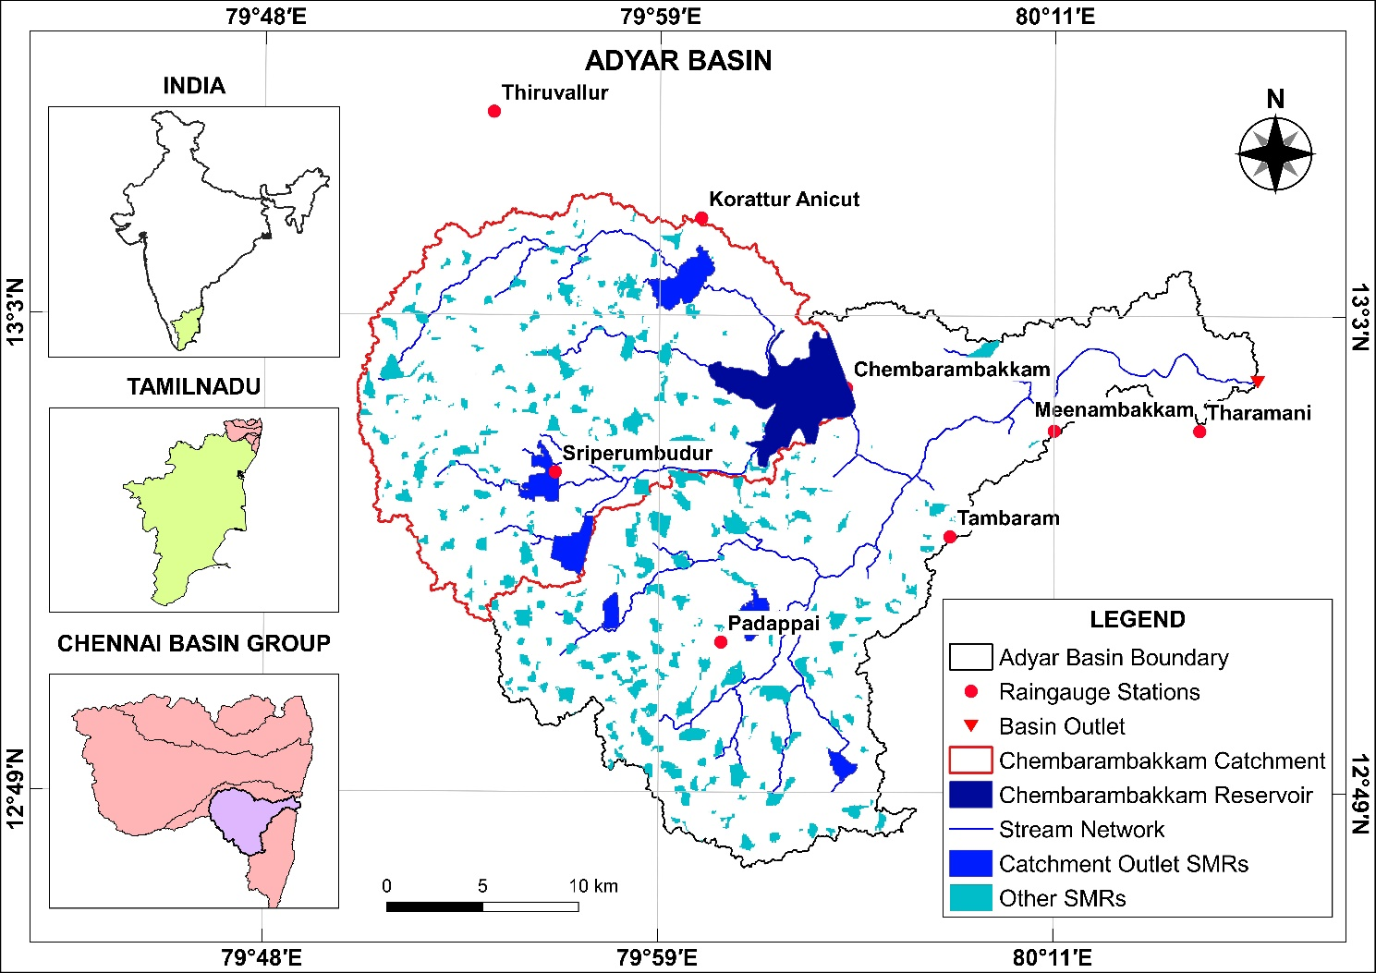
Methodology
Study Area: Adyar Basin
Highly urbanized river basin
Total area: 829.50 km²
Length of Adyar River: 43 km
Ephemeral in nature (North East Monsoon season: October to December)
Tropical wet and dry climate (Aw)
Annual Average Rainfall: 1330 mm
150 Small and Medium Reservoirs
Chembarambakkam Reservoir:
  Major water conservation reservoir
  Only gauging location, Observed inflow to reservoir
Notes:
This methodology is applied to the Adyar basin which is a highly urbanized river basin in the Chennai basin group with an area of 829.50 km².
The annual average rainfall is about 1330 mm and it receives most of the rainfall during the North East monsoon season.
This basin has about 150 SMRs of which 6 are identified as catchment outlet SMRs.
The Chembarambakkam reservoir is a major conservation reservoir and is the only gauging station.

Slide 12
Background and Motivation
Summary and Conclusion
Methodology
Results
1
2
3
4

Slide 13
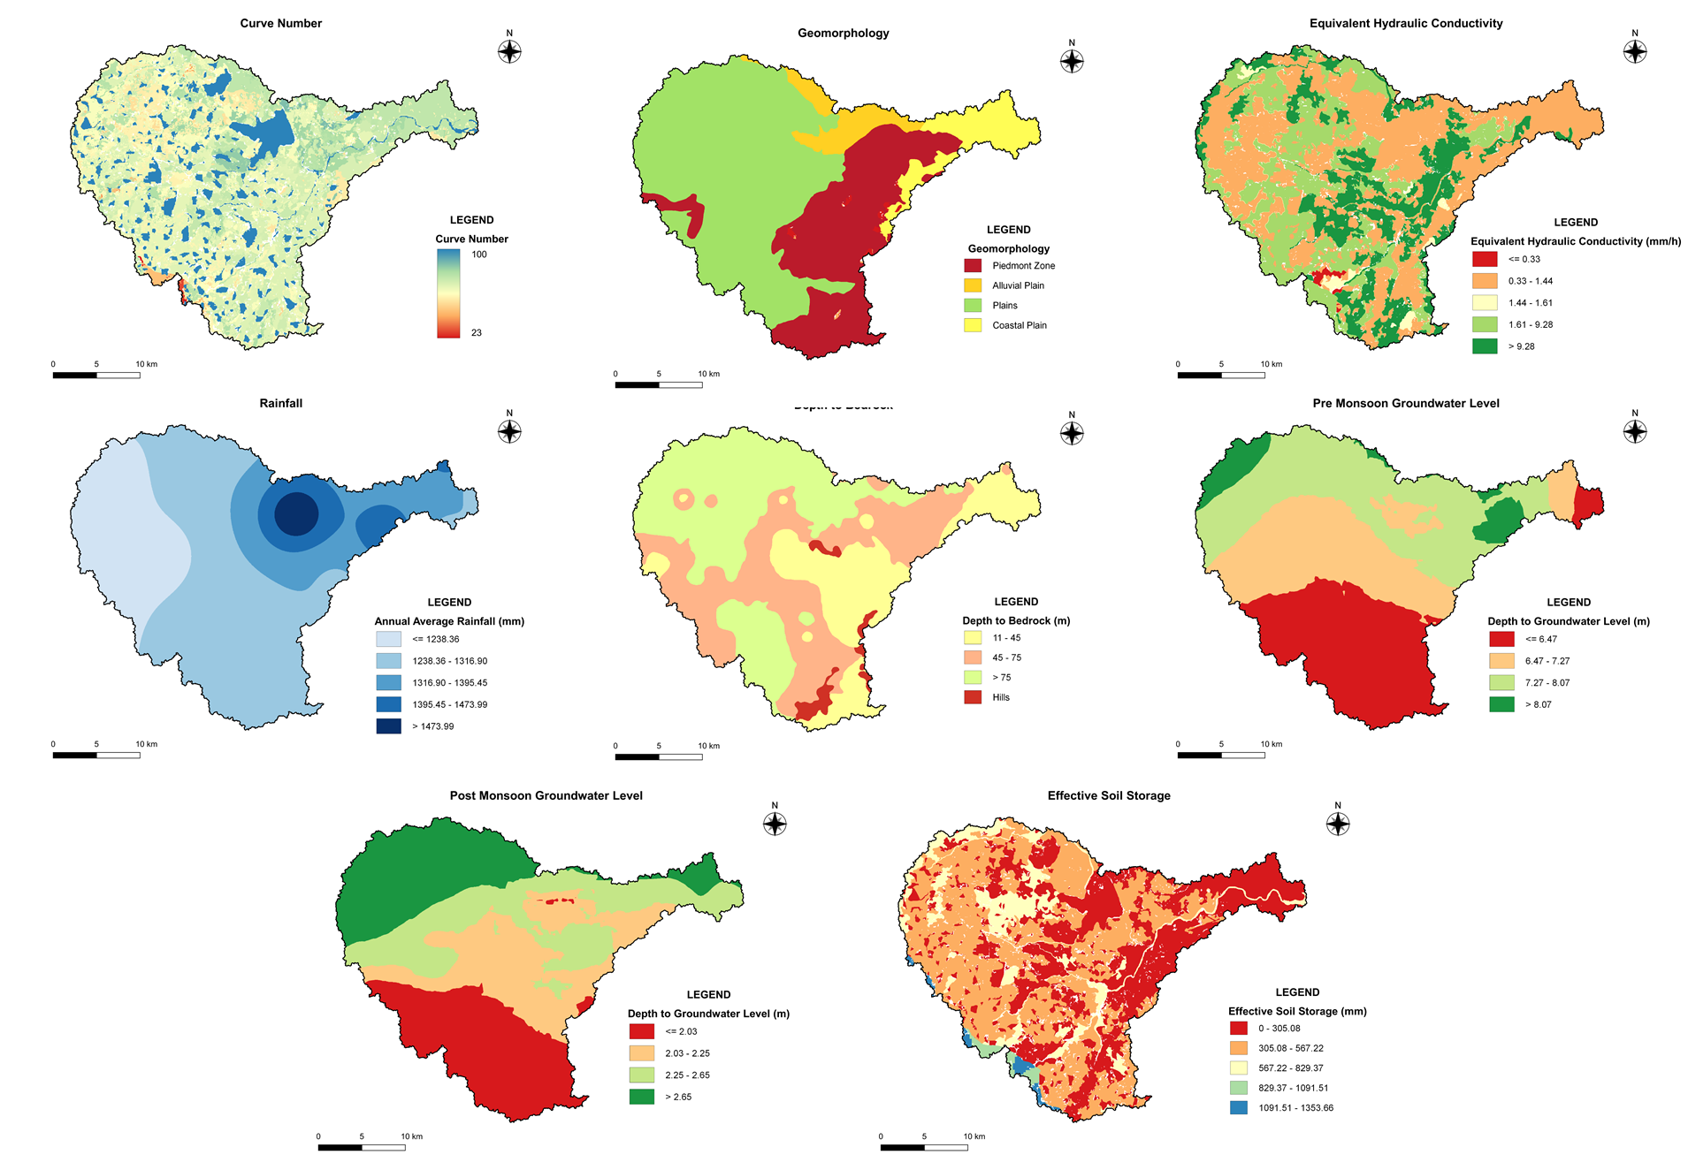
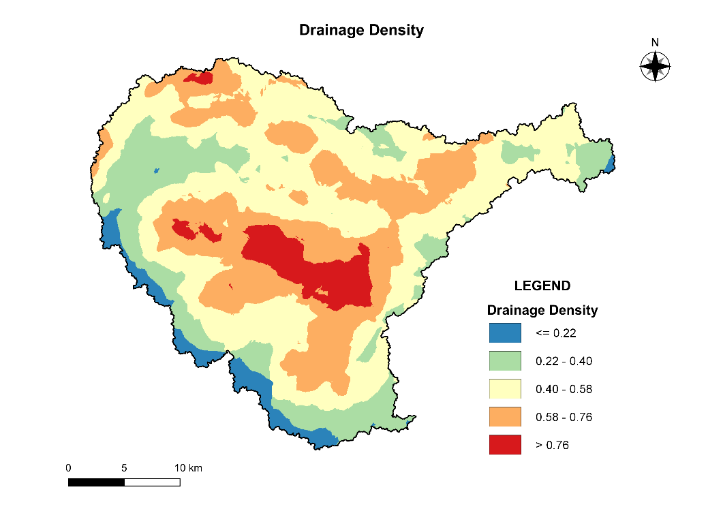
Results
a)
b)
c)
Thematic Layers (X) = 8
Curve Number
Geomorphology
Equivalent Hydraulic Conductivity
Rainfall
Depth to Bedrock
Drainage Density
Post-Monsoon Groundwater Level
Effective Soil Storage
d)
e)
f)
g)
h)
h)
Notes:
The random variable X, which is the thematic layers used in this study is presented here.
9 Thematic layers are used (Read through the names)
Effective Soil Storage: Product of depth of soil layer and porosity

Slide 14
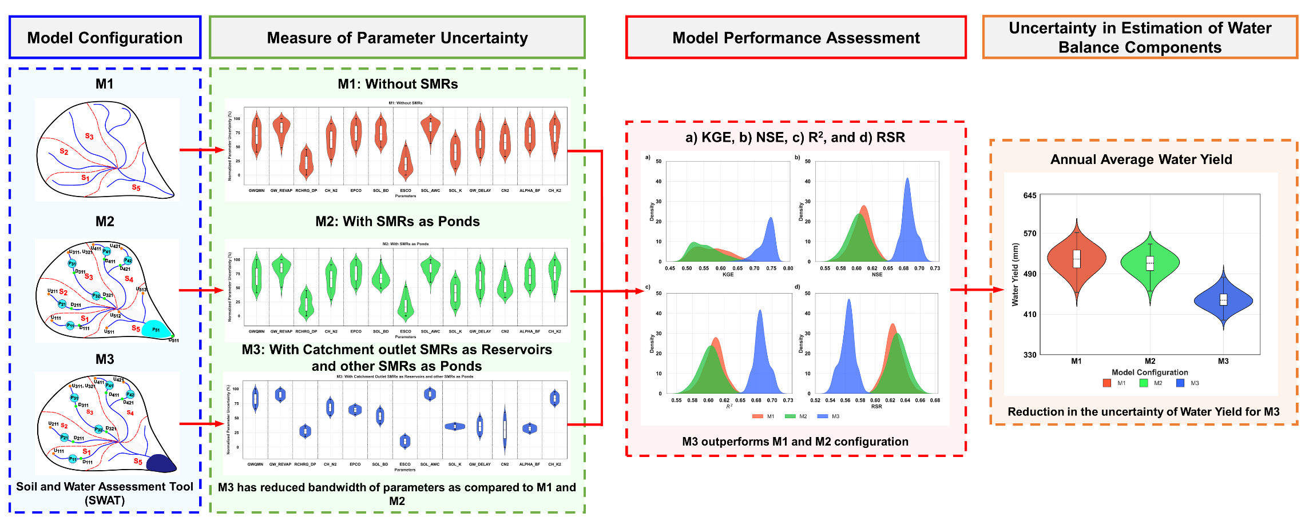
Results
Hydrologic Model: SWAT
M1
M2
M3
Sankarbalaji, A.R., Duraisekaran, E., Sangeetha, K., Modi, K. and Narasimhan, B., 2025. Assessment of increasing hydrologic model complexity in the representation of small and medium reservoirs within a river basin scale model and its impact on process simulation and parameter uncertainty. Journal of Hydrology, 655, p.132925. https://doi.org/10.1016/j.jhydrol.2025.132925
Notes:
The results of the SWAT model is shown in this slide.
I’m not going through the specifics of model and the audience are encouraged to go through the published article.
In this study, the calibrated model M3 with reduced uncertainty has been used.

Slide 15
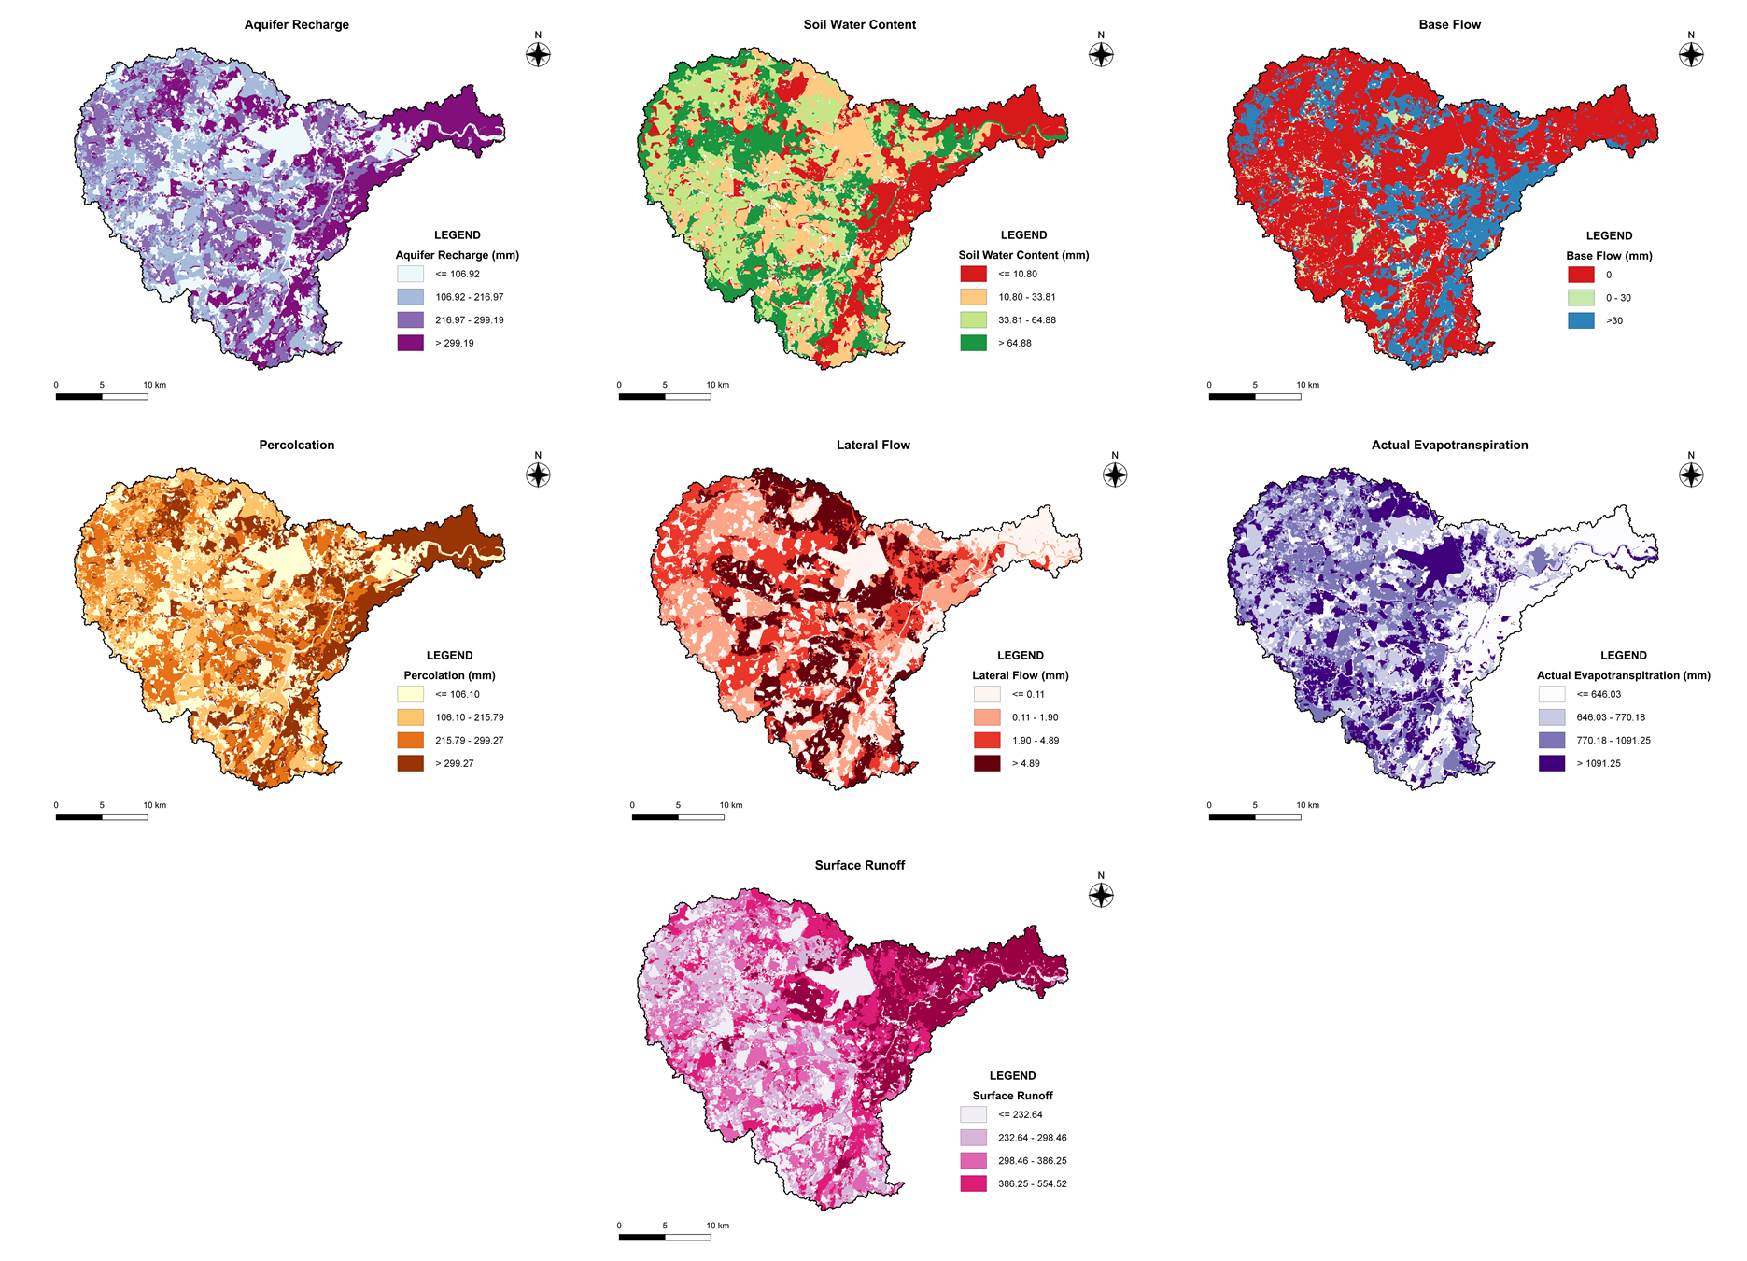
Results
a)
b)
c)
Water Balance Layers (Y) = 7
Recharge
Soil Water Content
Base Flow
Percolation
Lateral Flow
Actual Evapotranspiration
Surface Runoff
d)
e)
f)
g)
Notes:
The random variable Y, which is the water balance layers from SWAT model is presented here
The annual average water balance of the basin at the HRU level characterizes the hydrologic response of the basin.

Slide 16
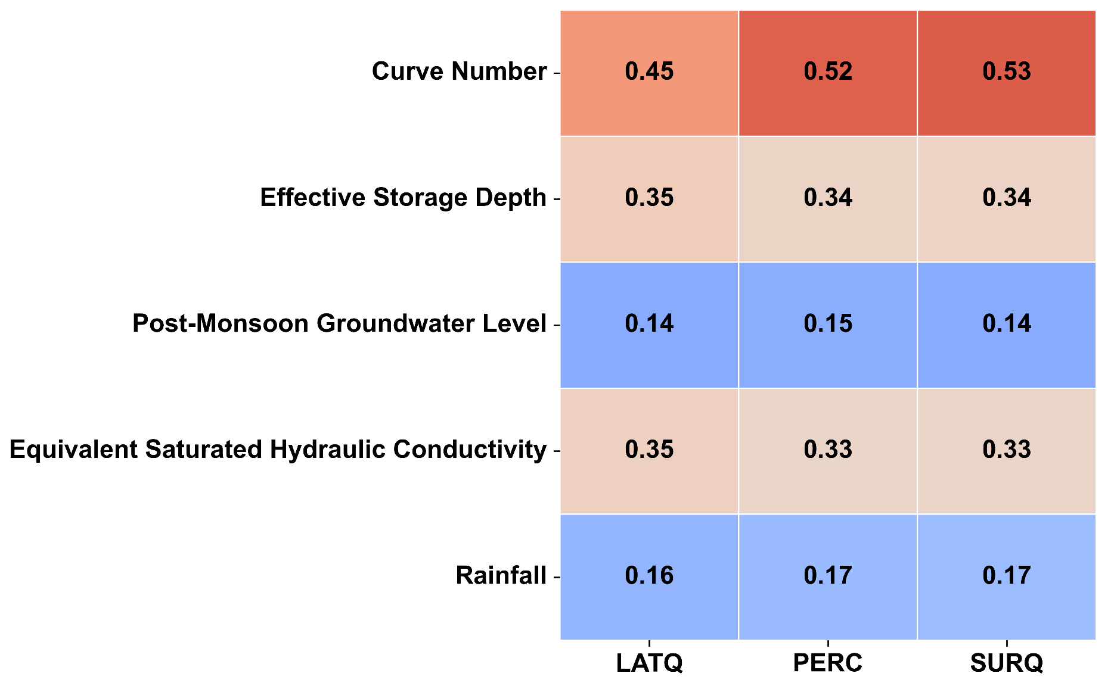
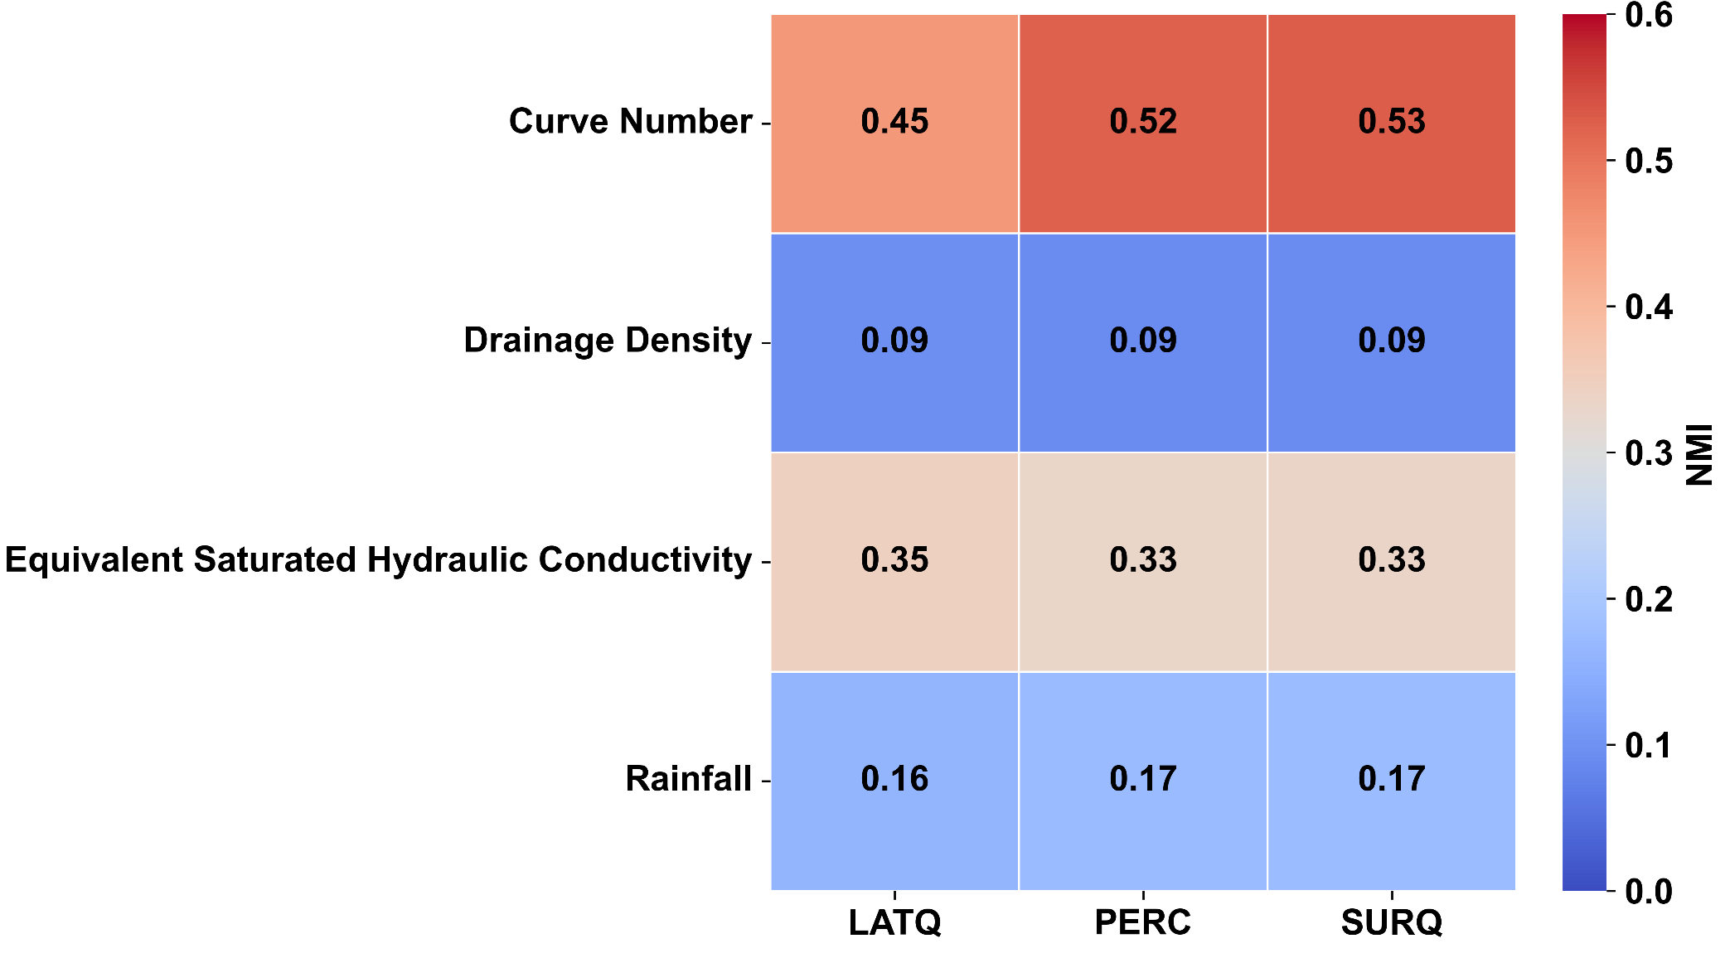
Results
Infiltration Systems
Pervious and Conveyance Systems
Layer | Weights
Curve Number | 0.3420
Effective Storage Depth | 0.2108
Post-Monsoon Groundwater Level | 0.1092
Equivalent Saturated Hydraulic Conductivity | 0.2142
Rainfall | 0.1238
Layer | Weights
Curve Number | 0.4334
Equivalent Saturated Hydraulic Conductivity | 0.2714
Rainfall | 0.1569
Post-Monsoon Groundwater Level | 0.1383
Notes:
The plot shows the heat of NMI for the two systems considered in this study.
It is seen that the CN, Equivalent hydraulic conductivity, and effective soil storage depth have high values of NMI when compared to the other layers.
It means that these layers are able to explain the response of the catchment better than other layers and consequently have higher weights.

Slide 17
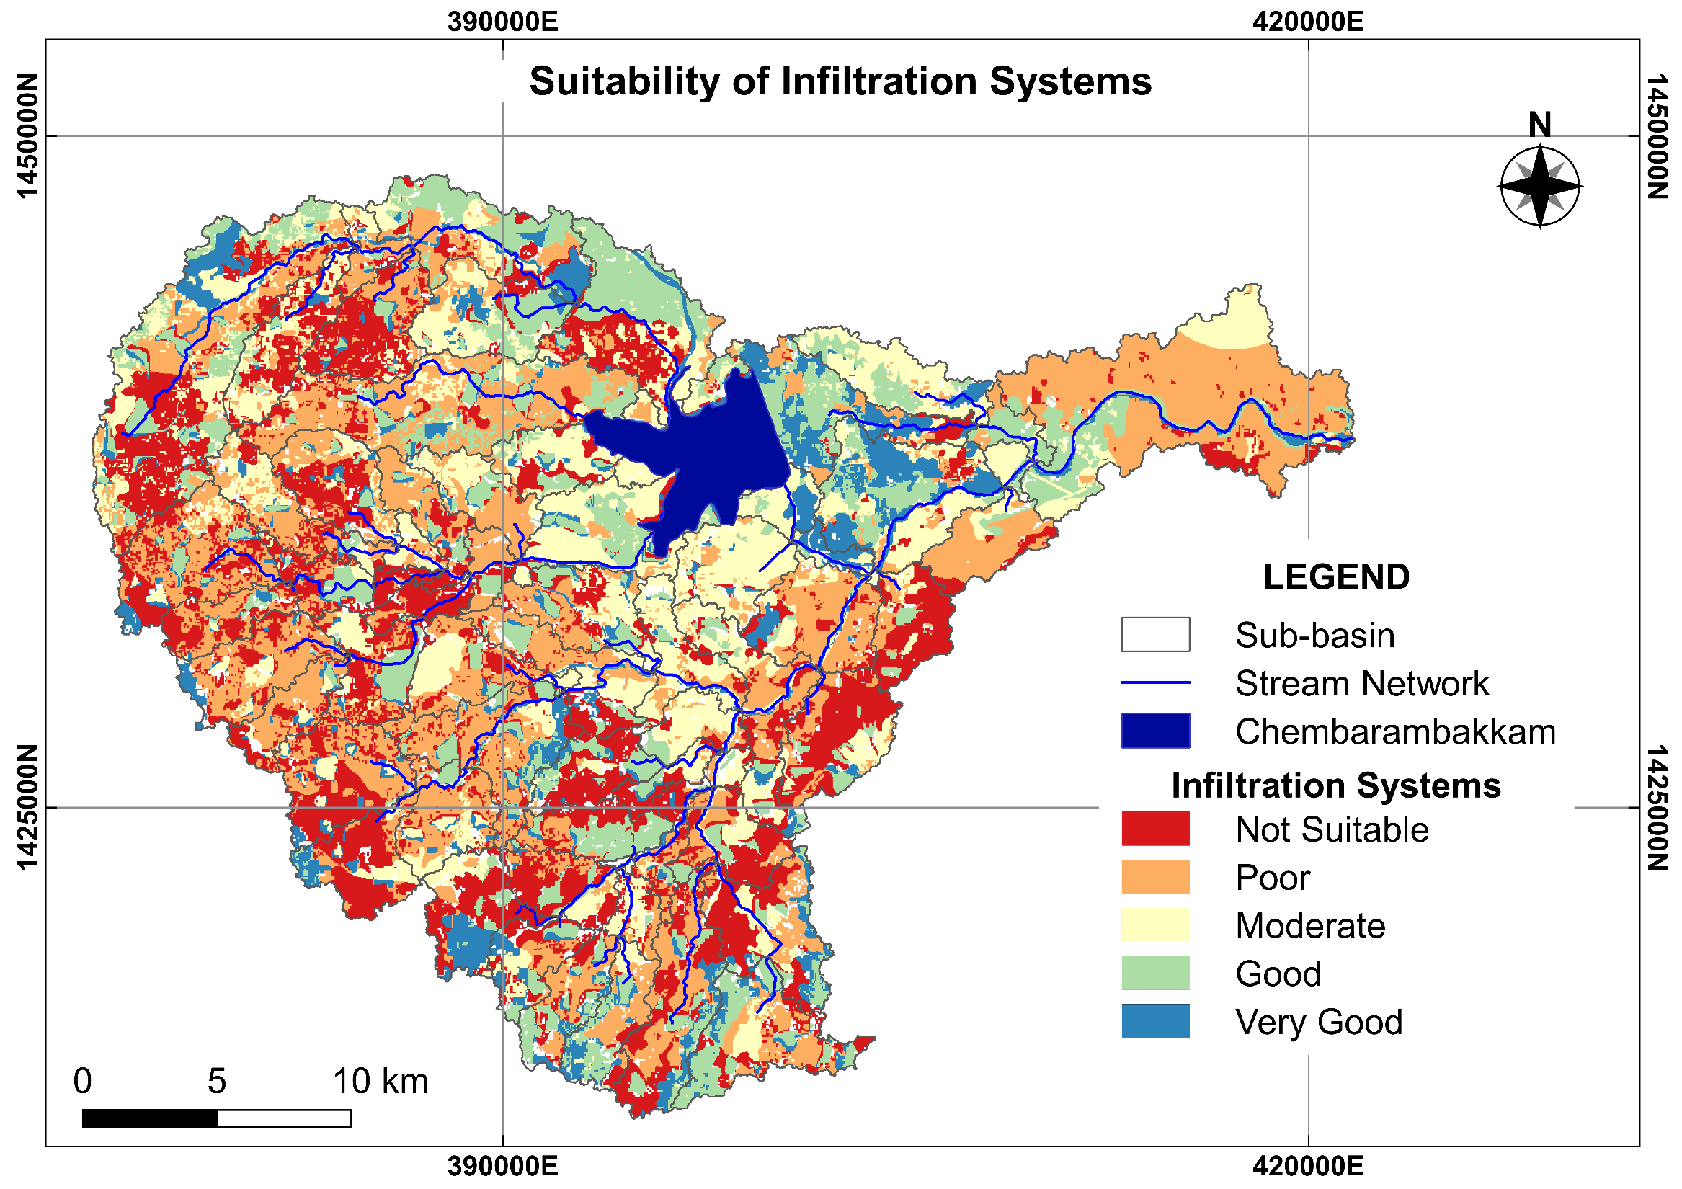
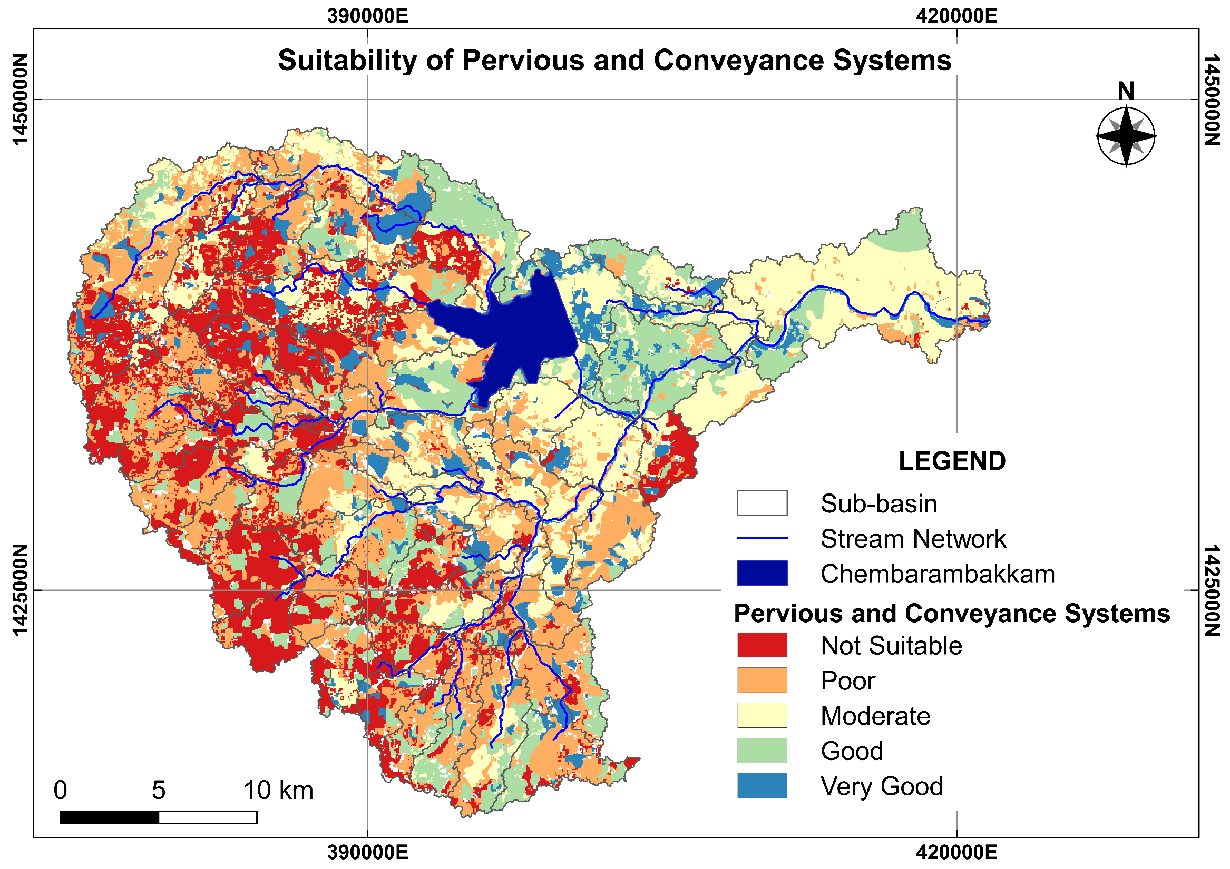
Results
Notes:
A spatial overlay analysis is performed and the potential location for SuDS elements are obtained.
In this study, the locations with very good to moderate suitability are used as inputs to the simulation – optimization framework.

Slide 18
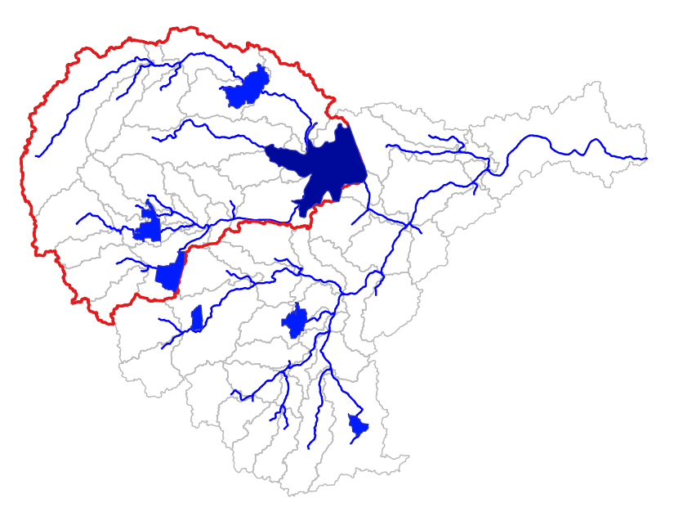
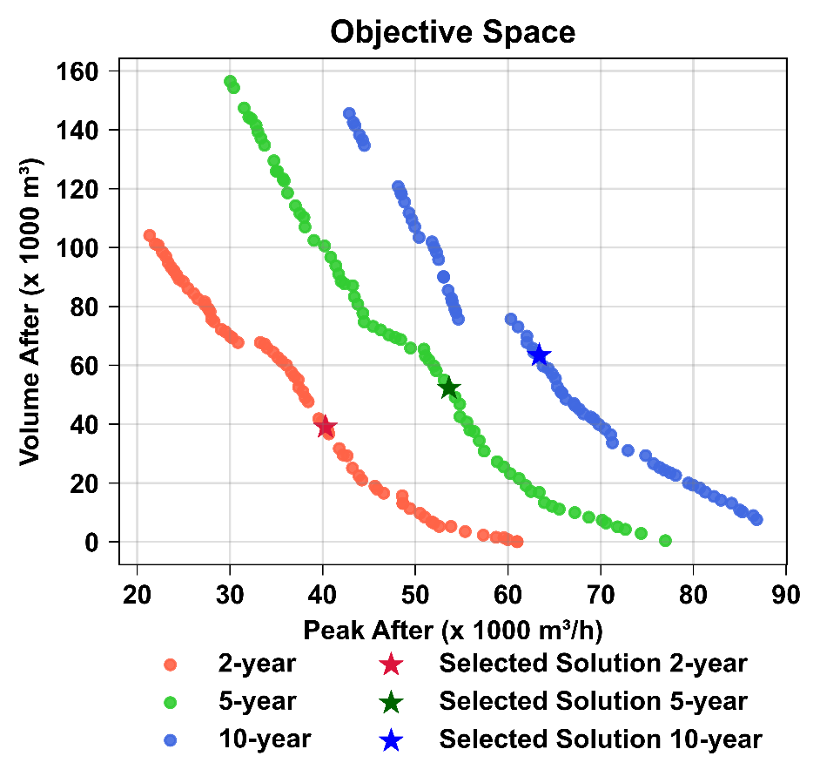
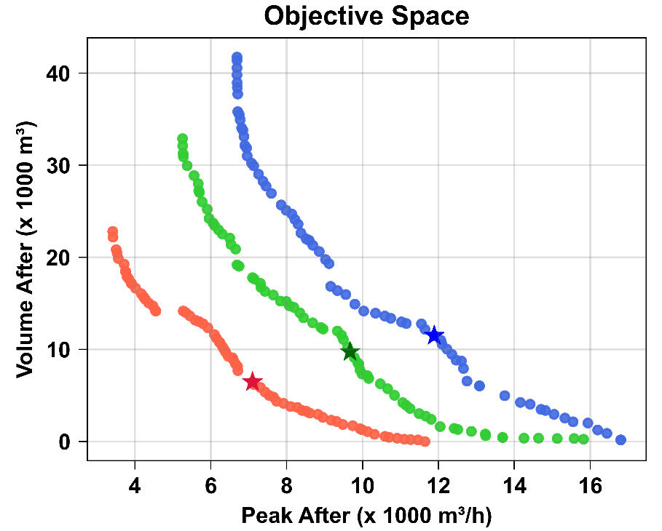
Results
Sub-basin 55
Sub-basin 17
Urban HRU 19
Urban HRU 103
Theoretical Ideal reference point (0,0)
Notes:
The results of optimization of the Urban HRUs, for three different design storms are presented here
Here the objective 1 is minimizing peak flow and objective 2 is minimizing the runoff volume after implementation of SuDS elements.
From the set of pareto solutions, a compromise solution is selected based on the Achievement Scalarizing Function using a theoretical ideal solution as reference point.
Both objectives are given equal importance and the trade-off solution is chosen.
The selected solution from each HRU is implemented at a sub-basin level in SWAT model.

Slide 19
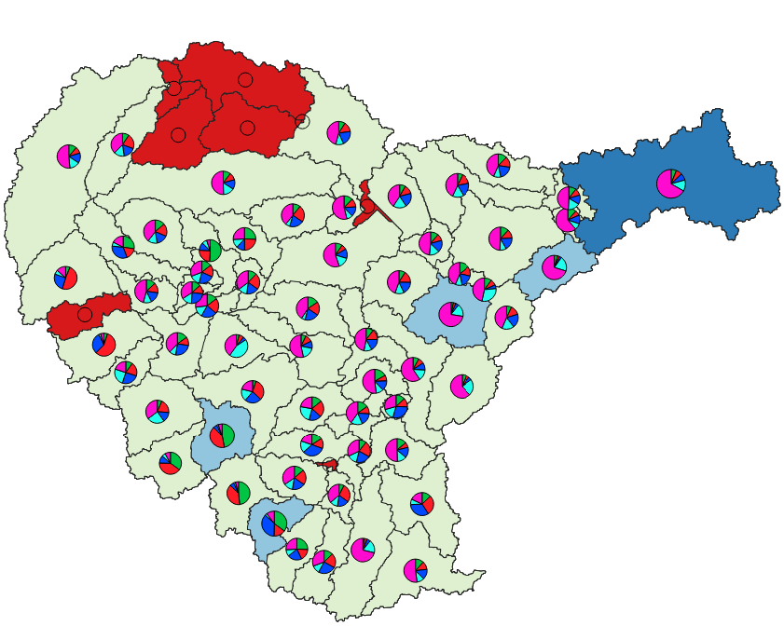
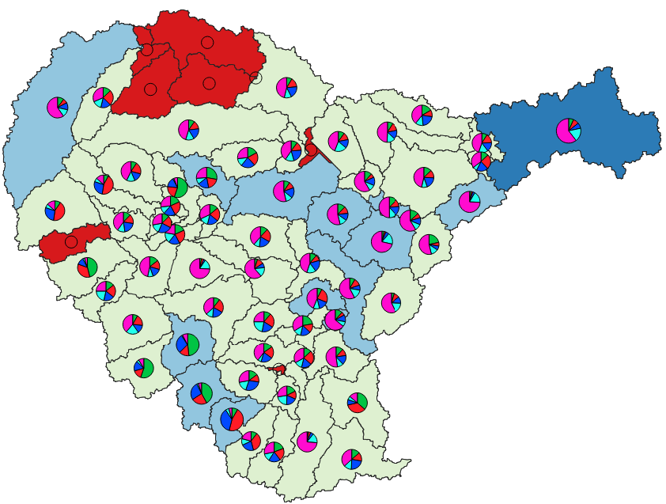
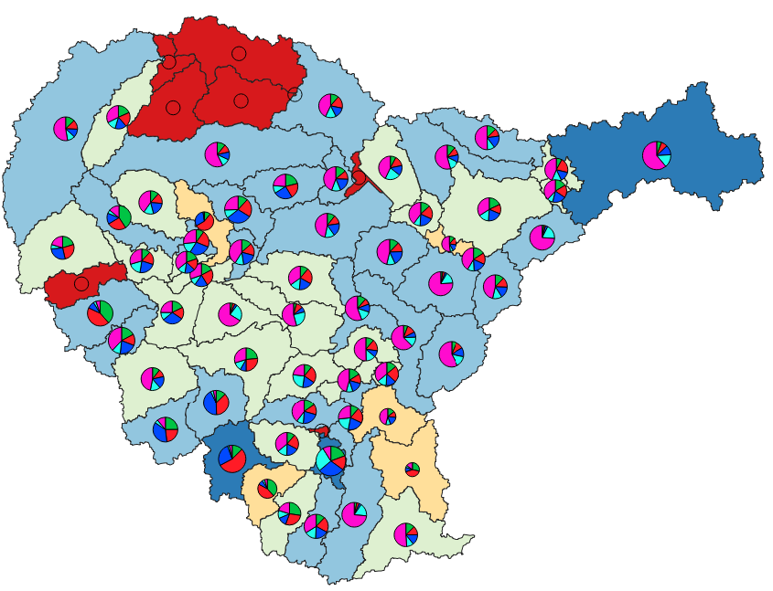
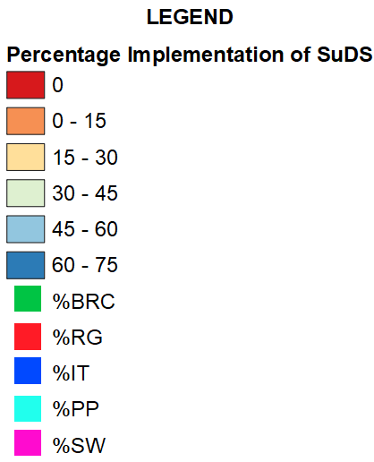
Results
Implementation of SuDS at Sub-basin Level
Return Period: 1 in 2-year
Return Period: 1 in 5-year
Return Period: 1 in 10-year
Maximum Rate of Implementation
SuDS Type |  | BRC | RG | IT | PP | SW | GR
%SuDS | 2 – Year | 8.14 | 6.56 | 6.41 | 5.89 | 15.51 | 41.84
 | 5 – Year | 7.22 | 9.15 | 7.36 | 4.57 | 16.28 | 43.07
 | 10 - Year | 6.61 | 11.32 | 5.79 | 4.71 | 17.67 | 67.27
Notes:
This rate of implementation of SuDS elements for the 3 design storms are presented here.
As the rainfall rate increases from 2-year to 10-year return period, the percentage of implementation of SuDS also increases.
The green roofs are implemented within the 70% of the building footprint area and the maximum rate of implementation varies between 40 to 67%
Whereas for other elements it varies between 6% to 18% and they are implemented in the remaining 30% of the remaining area.

Slide 20
Results
Water Balance Component |  | ET | PERC | SURQ | LAT_Q | GW_Q | WYLD
%Change relative to Baseline | 2 – Year | 0.19 | 3.74 | -6.93 | 1.82 | 3.09 | -1.23
 | 5 – Year | 0.21 | 3.83 | -6.94 | 1.83 | 3.28 | -1.14
 | 10 - Year | 0.22 | 3.89 | -7.00 | 1.88 | 3.35 | -1.16
Sub-basin 17
Water Balance Component |  | ET | PERC | SURQ | LAT_Q | GW_Q | WYLD
%Change relative to Baseline | 2 – Year | 0.76 | 10.52 | -14.19 | 4.04 | 14.77 | -2.57
 | 5 – Year | 0.73 | 10.44 | -14.05 | 4.04 | 14.66 | -2.52
 | 10 - Year | 0.78 | 11.34 | -15.26 | 4.41 | 16.08 | -2.68
Sub-basin 55
Water Balance Component |  | ET | PERC | SURQ | LAT_Q | GW_Q | WYLD
%Change relative to Baseline | 2 – Year | 4.29 | 83.17 | -18.88 | 43.39 | 32.49 | -16.94
 | 5 – Year | 4.26 | 84.97 | -19.06 | 44.10 | 33.76 | -17.08
 | 10 - Year | 4.31 | 84.33 | -19.00 | 44.24 | 32.90 | -17.04
Sub-basin 8
Notes:
The SWAT model is simulated and the assessment of the annual average waterbalance for 3 sub-basins are presented here.
Sub-basin 17 and 55 are on the upstream side whereas the sub-basin 8 is on the downstream side which is the highly urbanized part of the Adyar basin.
With respect to the baseline model without SuDS, there is a significant increase in the ET, PERC, LAT_Q, and GW_Q, and reduction in SURQ and WYLD after implementing the SuDS.
Thus the implementing plot scale measures like infiltration based systems or pervious and conveyance systems influence the water balance components of the sub-basin

Slide 21
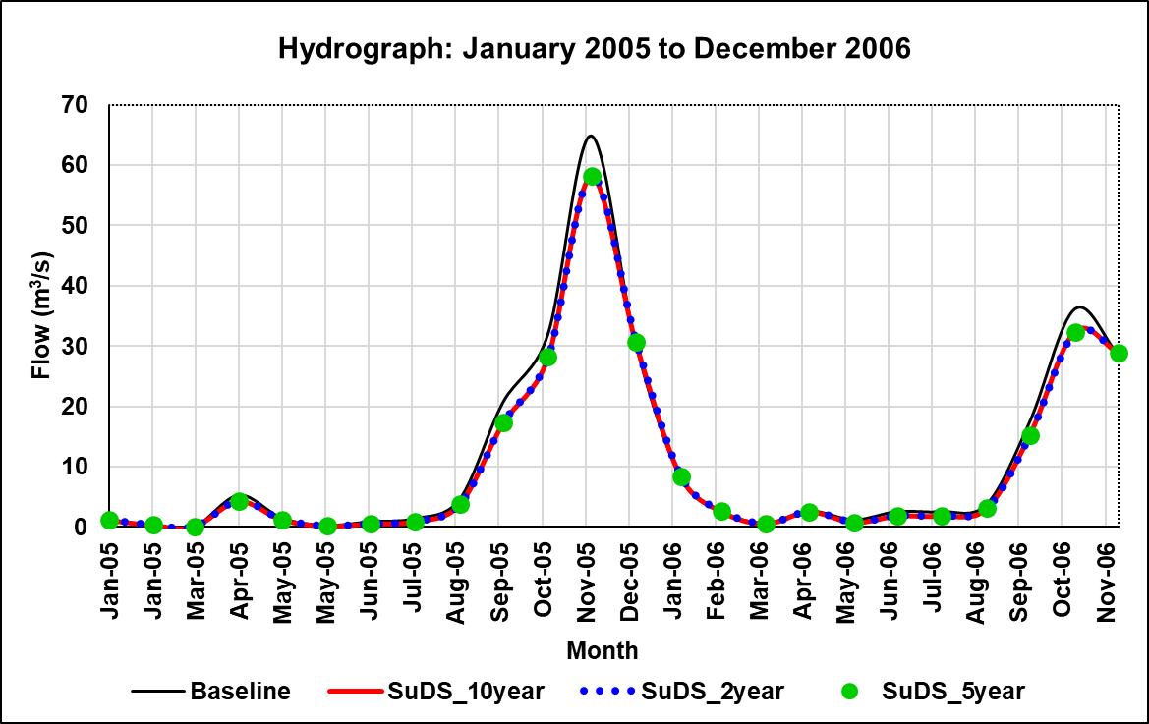
Results
Peak Flow Reduction: North East Monsoon 2005 and 2006
MMM-YY |  | Oct-05 | Nov-05 | Dec-05
%Change relative to Baseline | 2 – Year | -16.51 | -11.88 | -10.23
 | 5 – Year | -16.36 | -11.63 | -10.40
 | 10 - Year | -17.04 | -10.60 | -10.60
MMM-YY |  | Oct-06 | Nov-06
%Change relative to Baseline | 2 – Year | -12.76 | -10.69
 | 5 – Year | -13.32 | -10.91
 | 10 - Year | -12.93 | -10.41
Sub-basin 8
Notes:
The collective impact of implementing SuDS in a sub-basin is reflected in the hydrograph
The graph shows the North East monsoon event of 2005 and 2006 and a 10 to 17% reduction in the peak flow is observed.

Slide 22
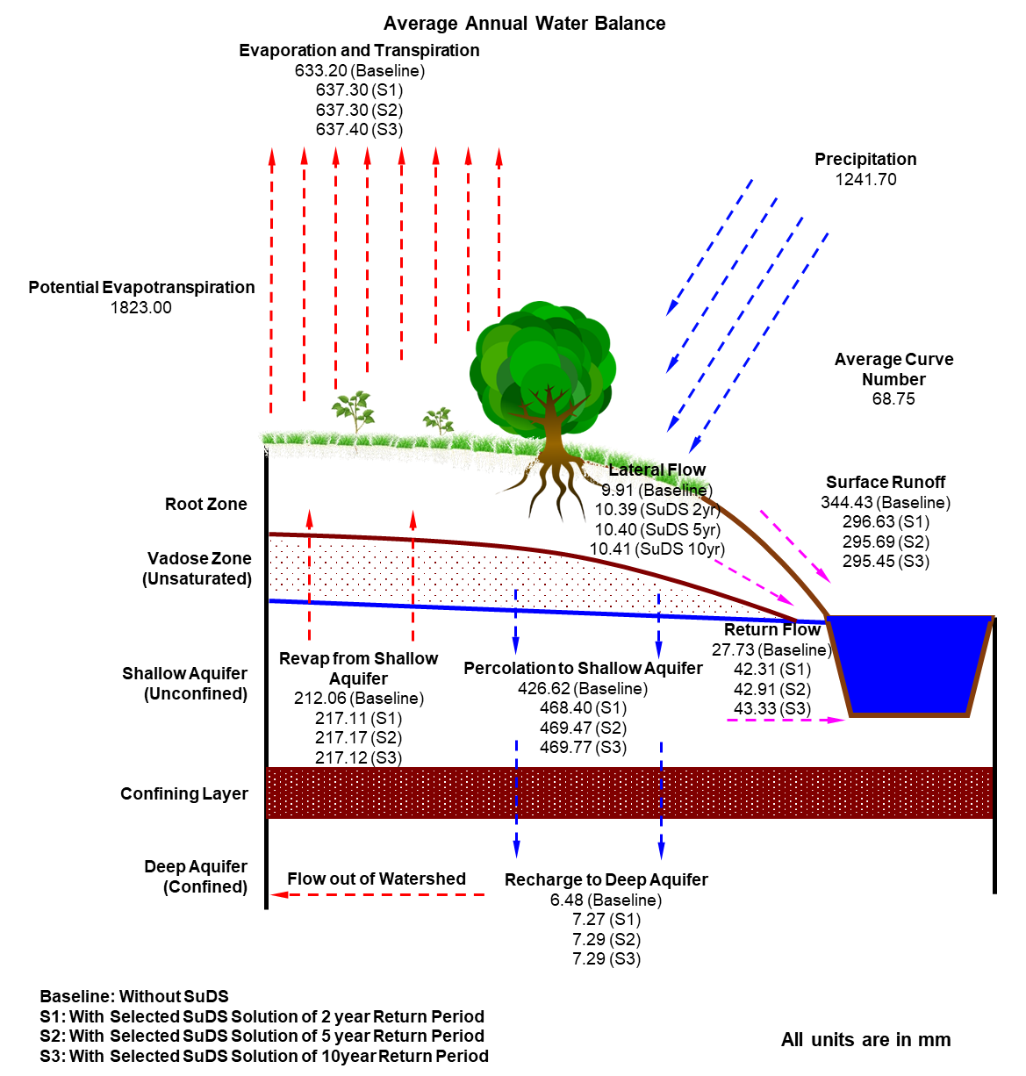
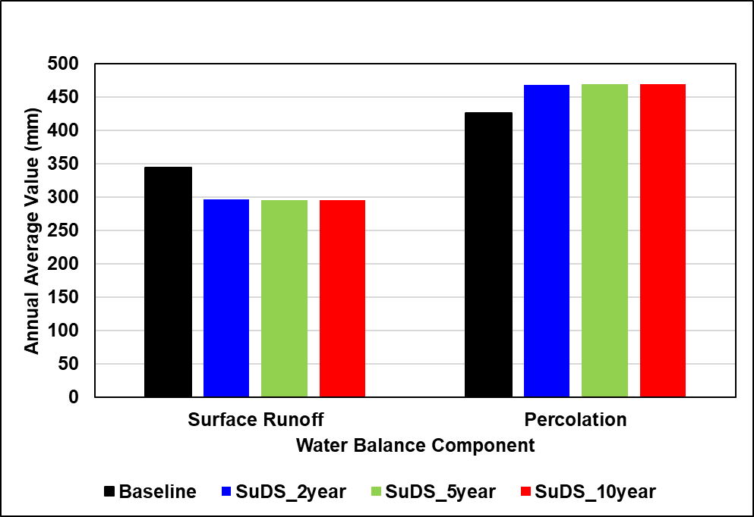
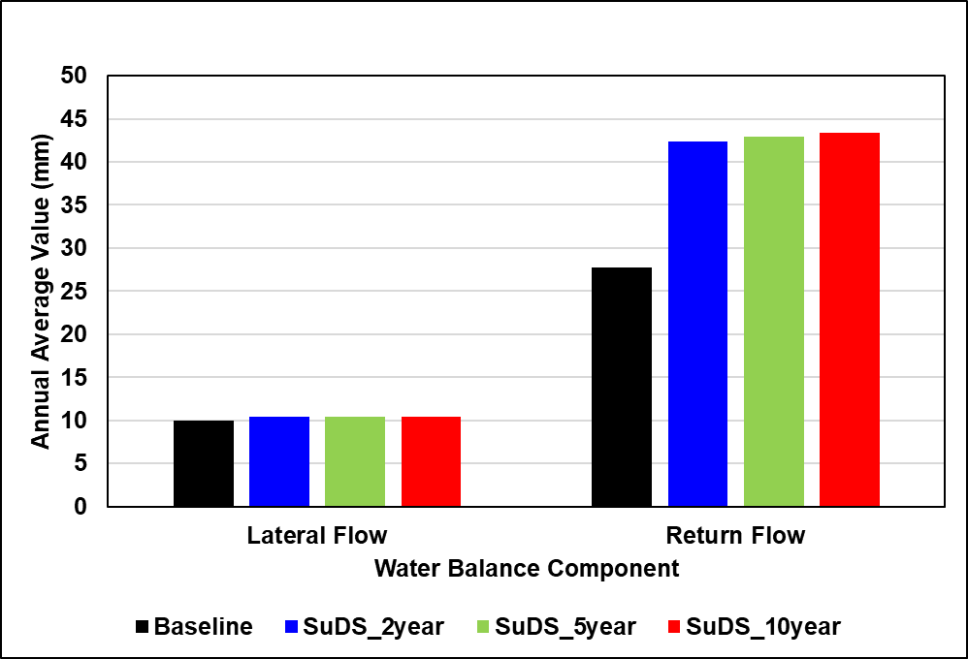

Results
Notes:
The figure here shows the annual average waterbalance of the adyar river basin.
From the bar graphs, it is observed that after implementing the SuDS elements, there is a reduction in surface runoff, and consequent increase in the percolation, lateral flow, and return flow of the river basin.

Slide 23
Background and Motivation
Summary and Conclusion
Methodology
Results
1
2
3
4

Slide 24
Summary and Conclusion
A generalized framework using an objective based MCDM method to identify potential locations for SuDS elements. (Hydrologic perspective)
Addresses all 3 questions: Which element? Where to locate? and How much area to allocate?
Simulation – Optimization framework for SWAT urban HRUs synthetically modelled using SWMM
Assessment of SuDS elements at a river basin scale using SWAT MLGA
Significant influence of SuDS elements on the water balance of the catchment

Slide 25
THANK YOU

Slide 26
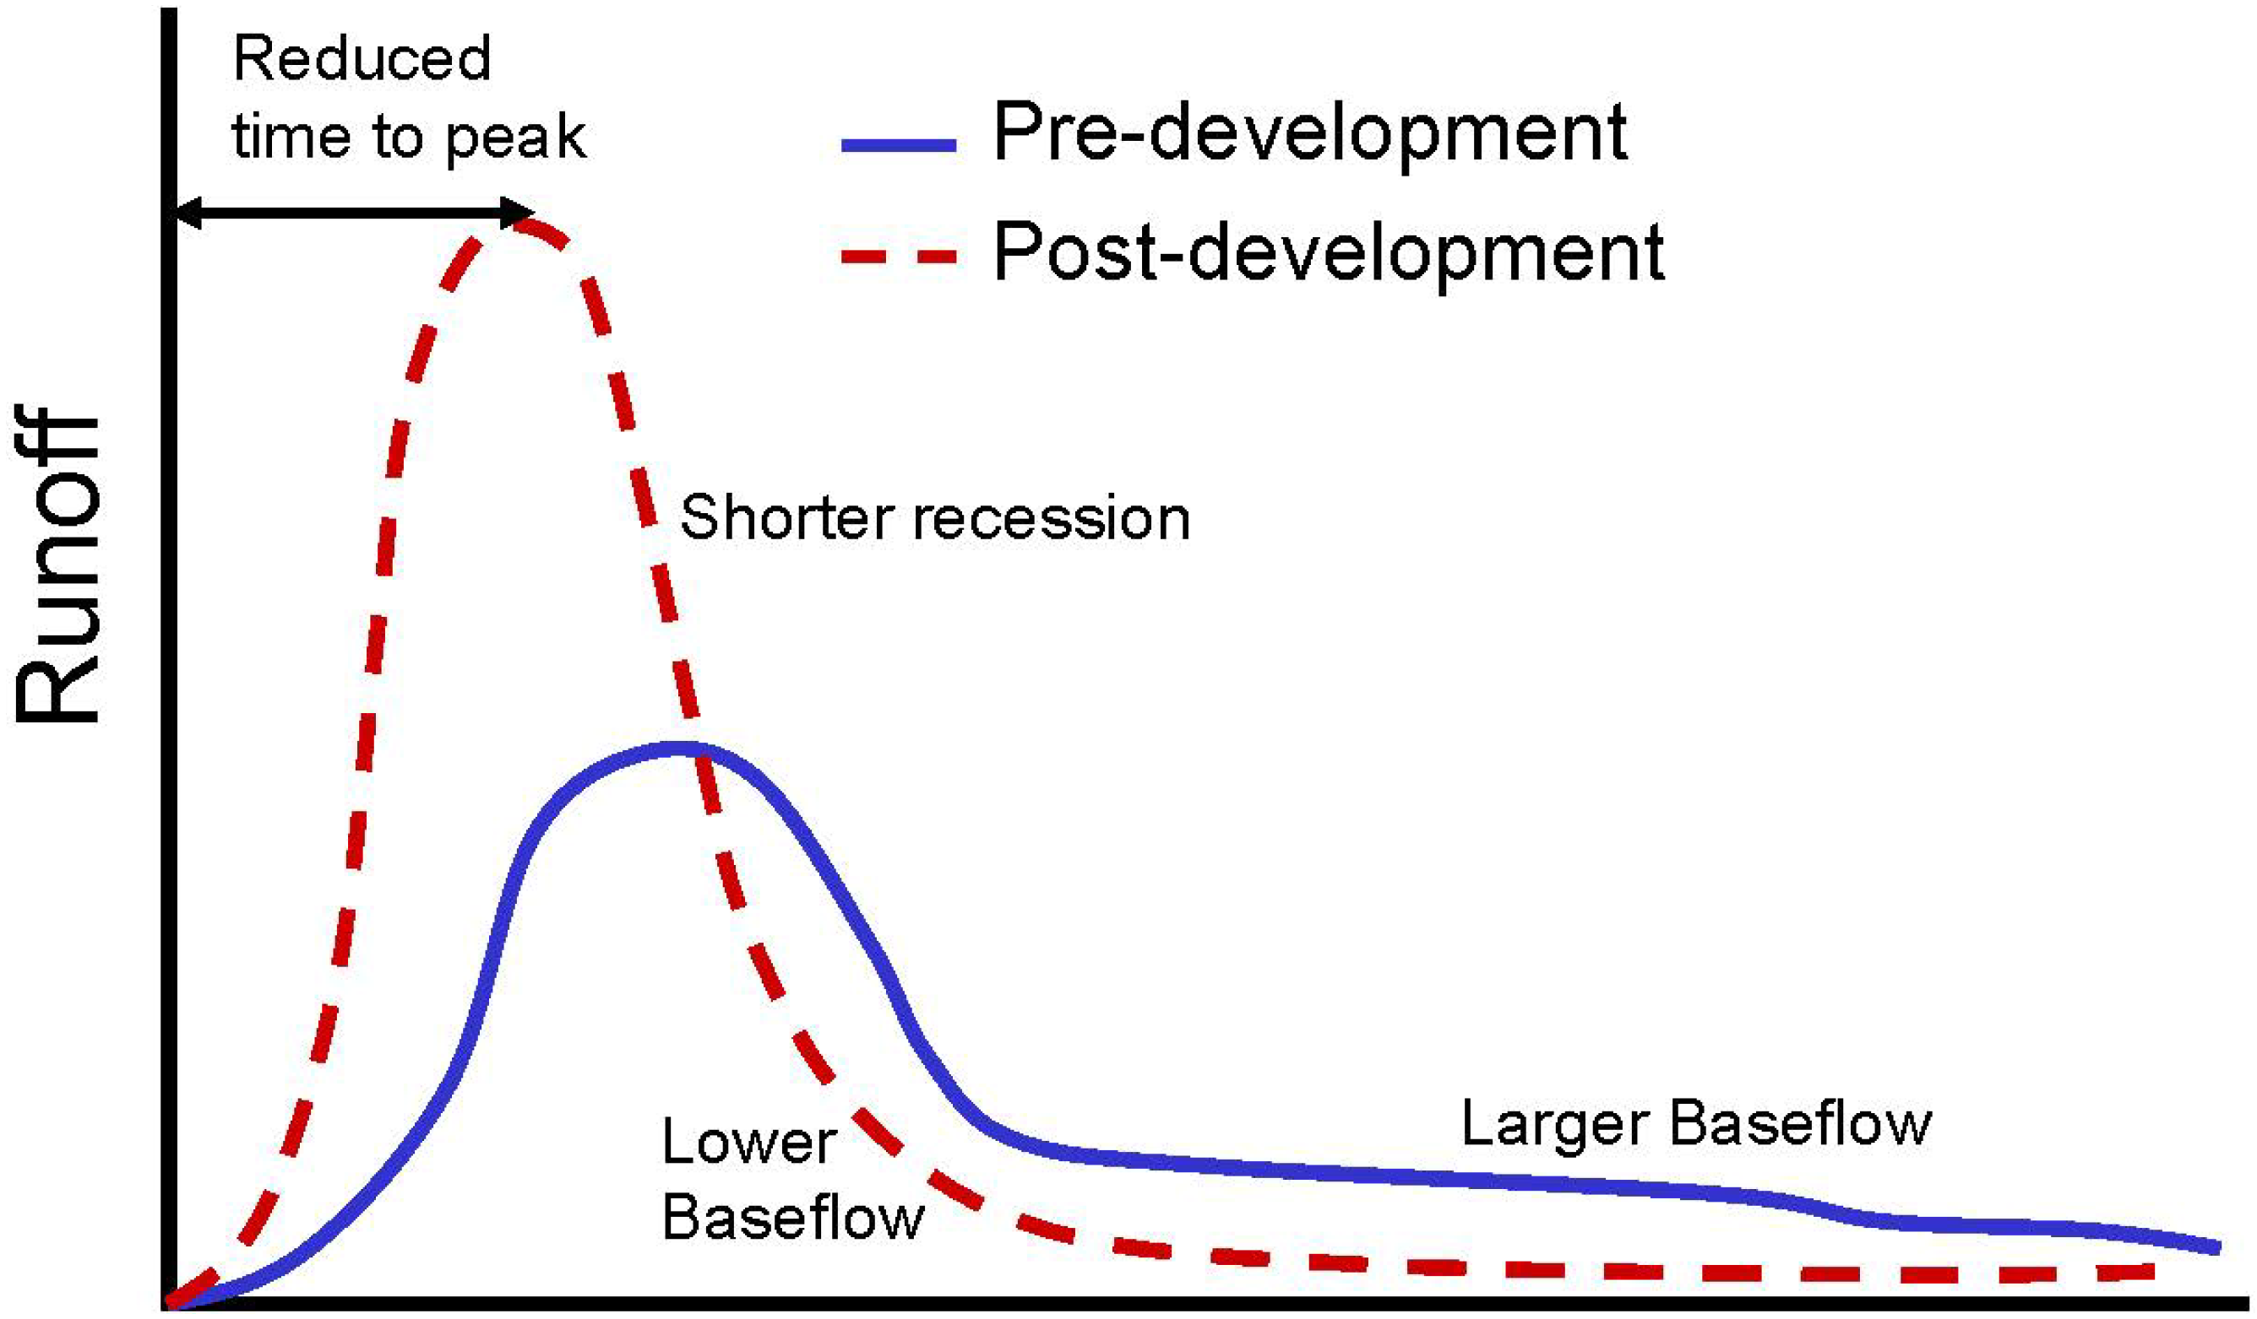
Change in the Hydrologic Response
Change in the Hydrologic Response of the Watershed
Pre-Development vs Post-Development
Reduced time to peak
Flow
Post development
Shorter Recession
Pre-development
High Baseflow
Low Baseflow
Time
Source: Liu et al. 2014
Notes:
The change in the hydrologic regime is reflected in the hydrograph as shown.
The post-development regime has increased peak discharge, reduced time to peak and shorter recession as compared to pre-development regime.

Slide 27
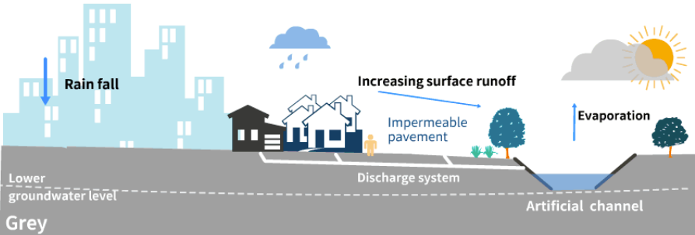
Background & Motivation: Runoff Management
Conventional Storm Water Management: Approach and Issues
“Storm Water runoff is undesirable and must be removed from the site as quickly as possible to achieve good drainage”
- Coffman et al., 1999
Source: Qi et al., 2020
Hydraulically efficient storm water runoff conveyance system
Pace of urban development >> Necessary infrastructure development
Hydrologic Response: Amplified as Pre-development conditions are compromised in lieu of development
Carrying capacities of the existing drainage systems: Overwhelmed
Notes:
The conventional approach to storm water management recognizes the runoff as undesirable and as a result hydraulically efficient storm water runoff conveyance systems were developed.
Often, the pace of the infrastructure development fails to cope with the urbanization and the carrying capacities of the existing systems are overwhelmed, resulting in pluvial flooding.
Metropolitan cities, being the centres of social and economic development, need a paradigm shift in managing the storm water runoff as development and recurring hydro-meteorological events are inevitable.

Slide 28
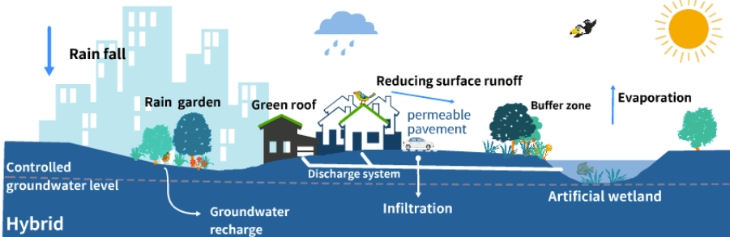
Background & Motivation: Runoff Management
Sustainable Storm Water Management: Approach
“Storm Water: Considered as a resource”
Source: Qi et al., 2020
Proactive approach to improve storm water management (quantity and quality)
Leveraging the benefits of surface runoff from urbanized regions
Limiting the negative impacts using source-control techniques
Goal: Mimic the pre-development hydrologic regime
Notes:
In this context, Sustainable storm water management emerges as a potential solution where the surface runoff is considered as a resource.
The aim of this approach is to make a transition from the post development to pre-development hydrologic regime of the catchment using a variety of source control elements.

Slide 29
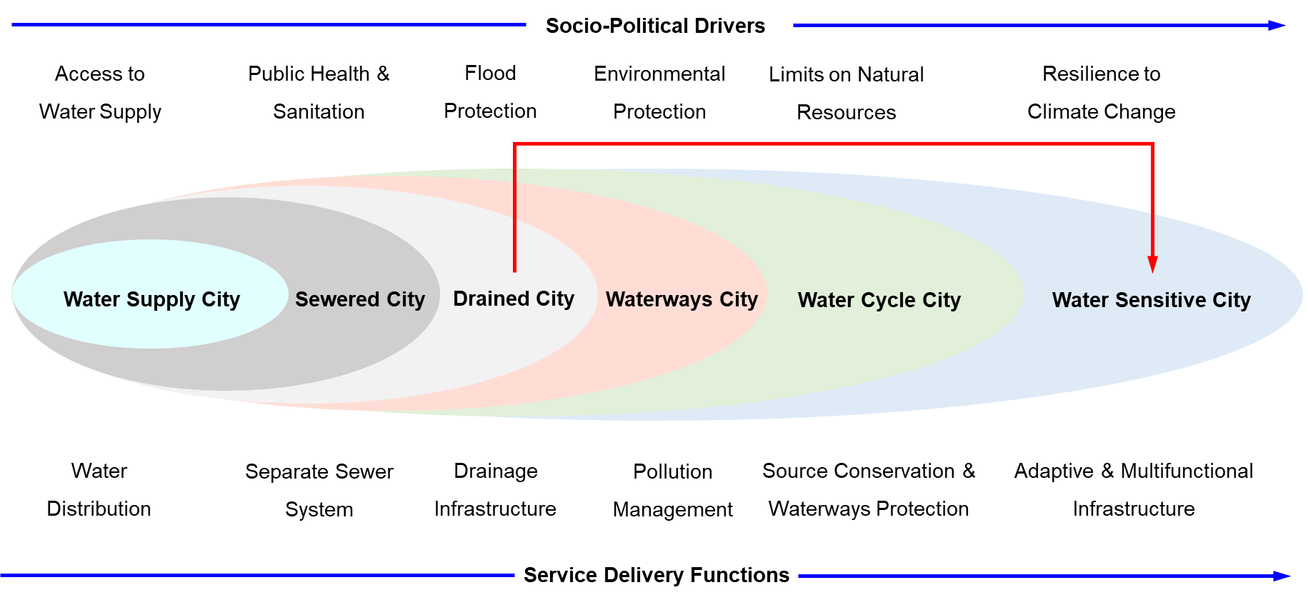
Background & Motivation: Runoff Management
Sustainable Storm Water Management: Approach
Source: Brown et al., 2009
Notes:
The figure illustrates the typologies of the different states that cities transition upon adopting sustainable practices.
The socio-political drivers at the top reflect the shift in regulations, and service delivery functions at the bottom represent the response/ action taken.
Most of the cities belong to the typology ‘Drained City’ with drainage infrastructure for flood protection.
Considering the projected climate change signals, it is the need of the hour to take a leap from ‘Drained City’ to ‘Water Sensitive City’ by adopting the nature-based solutions storm water management.

Slide 30
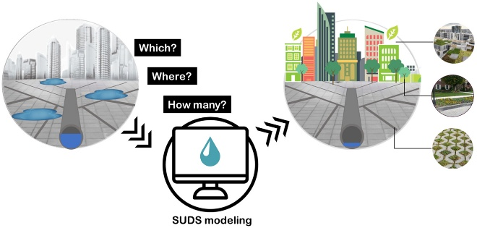




Background & Motivation
Planning, Design, and Analysis: River-basin Spatial Scale
Simulation – Optimization Framework
Find Optimum Solutions
Assessment of SuDS
Decision-making
Ferrans et al. 2021
Notes:
So, the main motivation for this study is to plan, assess, and design the SuDS elements at a river-basin scale using a comprehensive simulation – optimization framework.
The solutions obtained from this framework can be used to assess the SuDS at a river-basin scale and provide guidance to the water resource managers and urban planners to develop suitable policies.

Slide 31
Hydrologic Modelling using SWAT: Model Input Data and Source
*SRTM DEM: Refined with high-resolution hydrographic survey data and used as burn-in stream.
Notes:
Vertical accuracy of SRTM 16 m.
Vertical accuracy of CartoDEM 8 m.

Slide 32
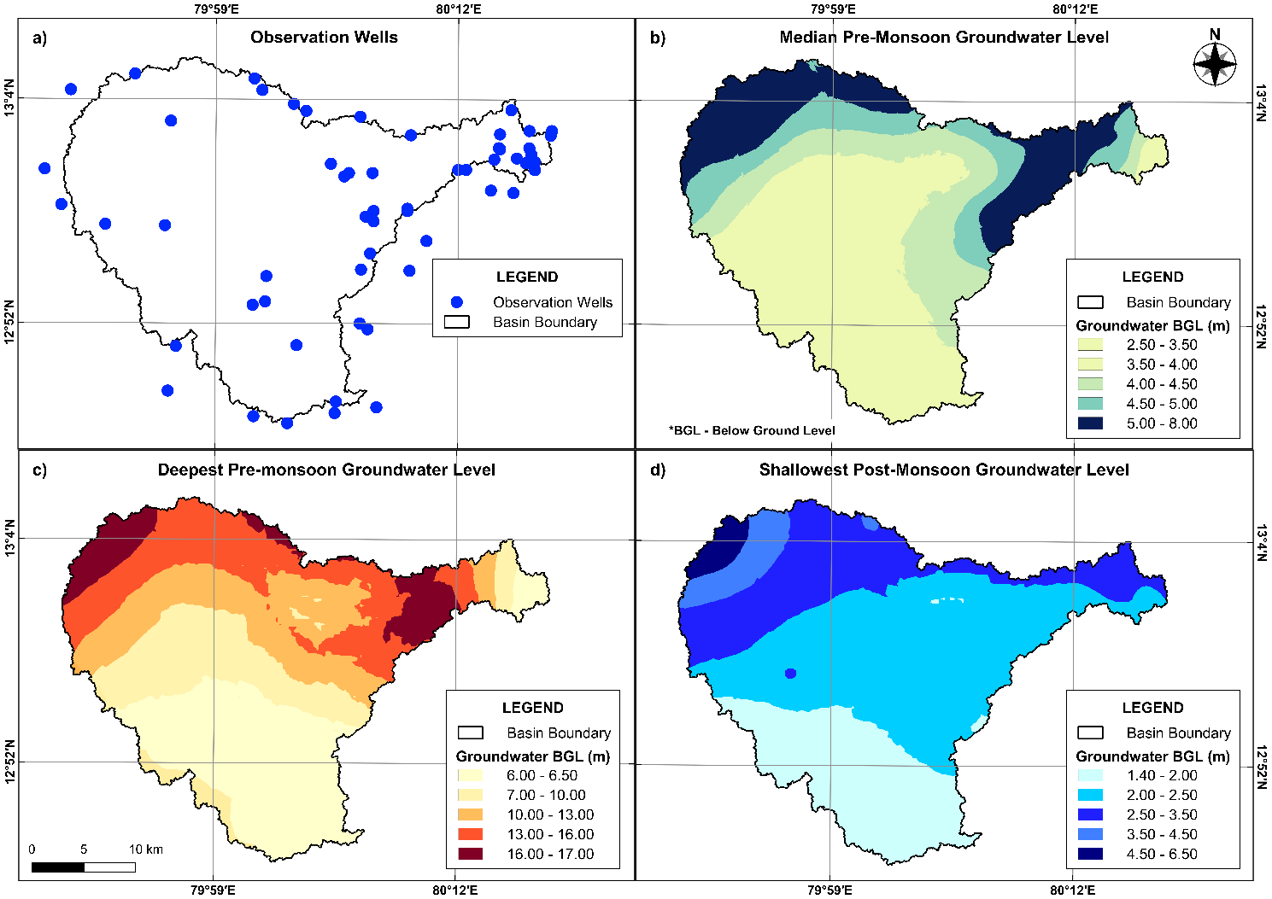
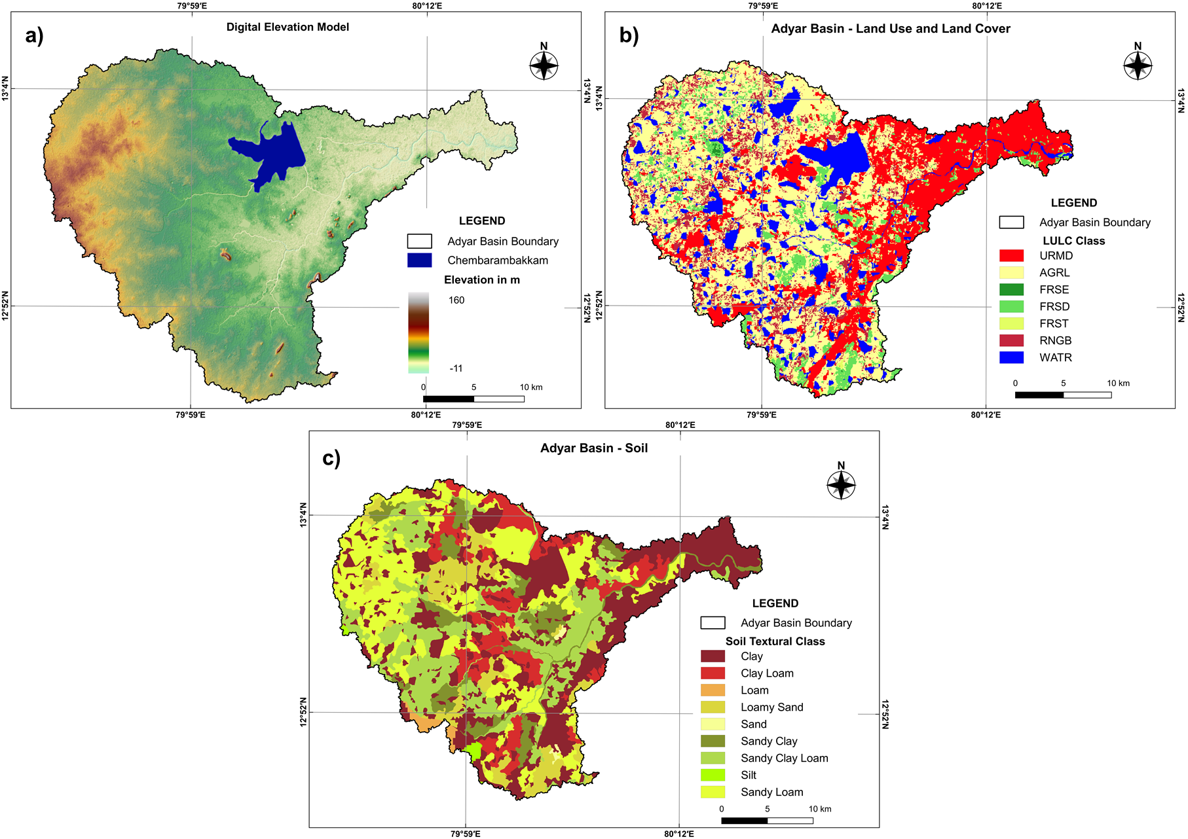
Model Input Data and Source
a) Observation Wells, b) Median Pre-Monsoon c) Deepest Pre-monsoon, and d) Shallowest Post-Monsoon Groundwater Level
a) Digital Elevation Model (DEM) b) Land use and Land Cover, and c) Soil

Slide 33
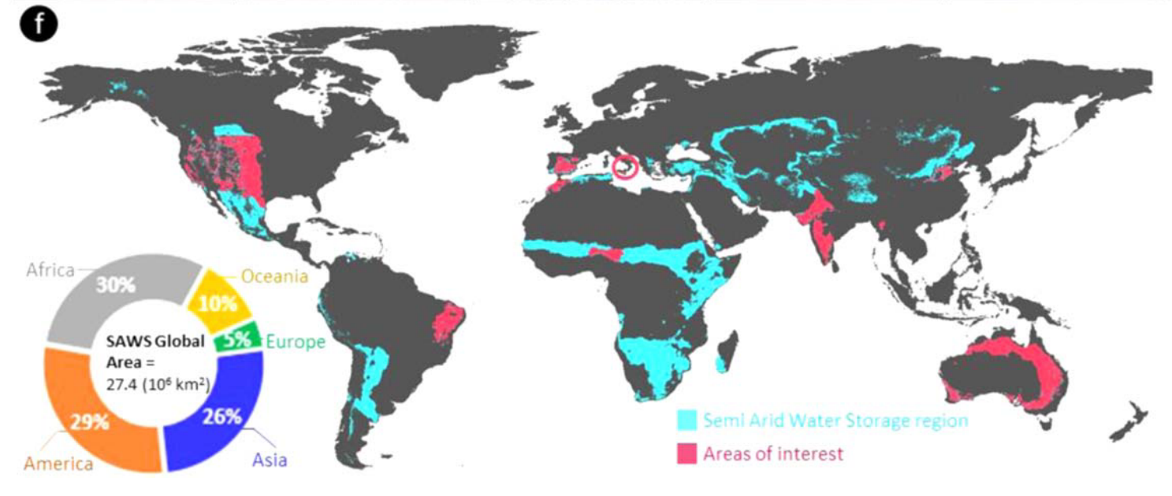
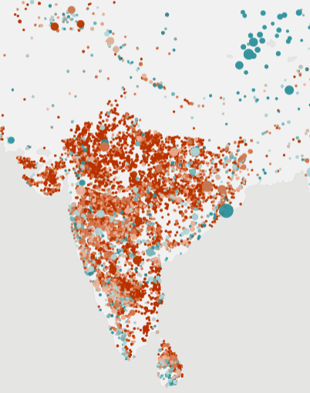
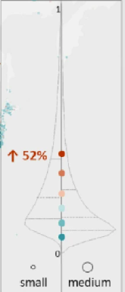
Small and Medium Reservoirs (SMRs)
Representation of Small and Medium Reservoirs (SMRs) in Hydrologic Models
Semi-Arid Water Storage Region (Small and Medium Reservoirs)
Source: Mady et al., 2020
Inter-annual variability of Storage in SMRs
Source: Donchyts et al., 2022
Global estimates suggest about 2.9 million SMRs are present in the semi-arid regions of the world (Mady et al., 2020)
Representation of SMRs are overlooked in the hydrologic models Lack of input data and increased model complexity
Dong et al. 2019, Rabelo et al. 2021
Exclusion of SMRs in the hydrologic models will lead to inaccuracies in process simulation and estimation of water balance components
Padiyedath Gopalan et al. 2021, Rabelo et al. 2022
Notes:
Mady et al., 2020 suggested that there are about 2.9 million SMRs in the semi-arid regions of the world.
Specifically in regions like India, the inter-annual variability in the storage of SMRs is very high
And studies have reported that the presence of SMRs influences the hydrologic response of the basin.
Hence, accurate process modelling of SMRs, their management activities and various hydrologic fluxes is essential for water resource management.
Although several studies on large reservoirs exist, a comprehensive evaluation on the representation of SMRs and their impact on process simulation remains scant.
Distinguish large, medium and small reservoirs: What is the criteria? Which literature?

Slide 34
Methodology
Representation of Small and Medium Reservoirs (SMRs) in SWAT
Focus (past studies): Improved model performance and better estimation of streamflow
Representation of SMRs: Spatially explicit or Statistically aggregated or Lumped approach
Challenge: To represent every single SMR in hydrologic model
Pragmatic solution:
  Representation of strategic SMRs as Reservoirs and other SMRs as Ponds (Habets et al., 2018)
  Trade-off: Number of SMRs modelled vs Improvement in model performance or information gain
SMRs in Hydrologic Model
Model Performance
Uncertainty in Process Simulation
Model Parameter Uncertainty
Notes:
Some of the key conclusions derived from some of the previous studies are listed here:
The main focus was on improved model performance and better estimation of streamflow
Most of the studies used either one of the three approaches listed here.
And a major challenge here is to represent every single SMR in a hydrologic model.
Habets et al., 2018 suggested a hybrid approach which is a combination of statistically aggregated and spatially explicit representation.
But, there is a tradeoff among number of SMRs modelled vs improvement in the model performance or information gain.
So, there is sufficient scope available to explore how the various representation of SMRs affect the model performance, model parameter uncertainty, and the estimation of water balance components

Slide 35
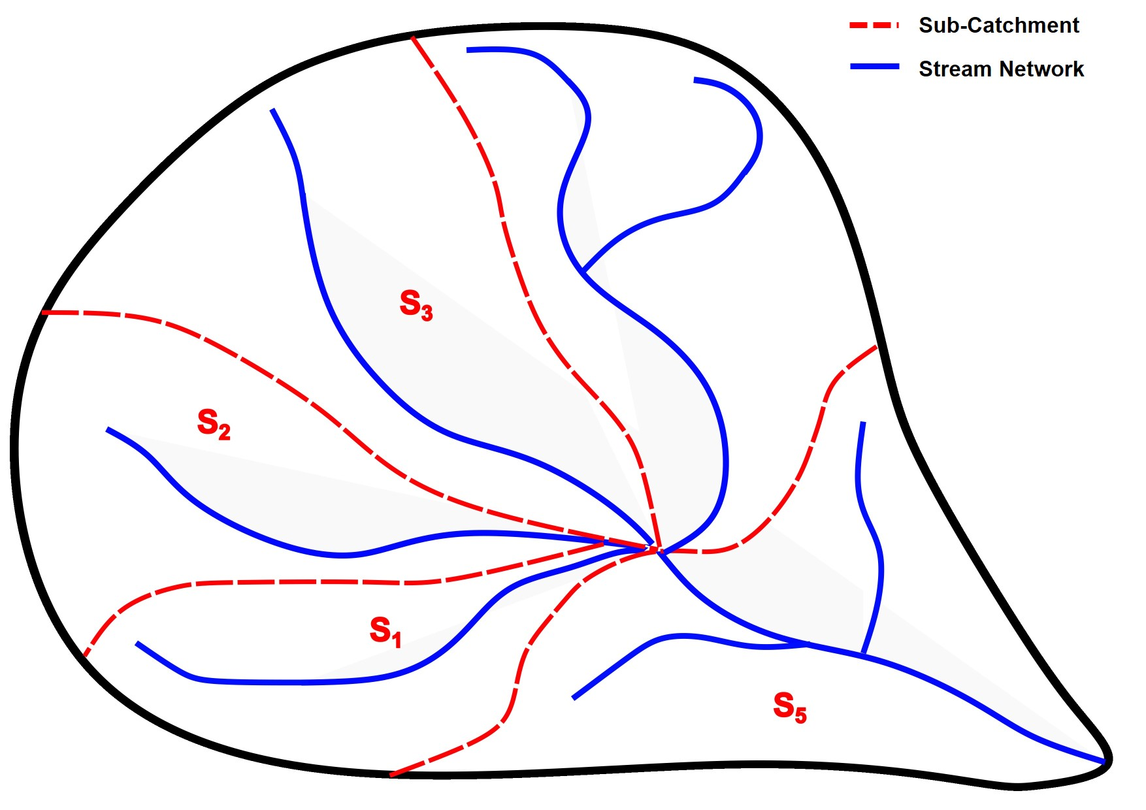
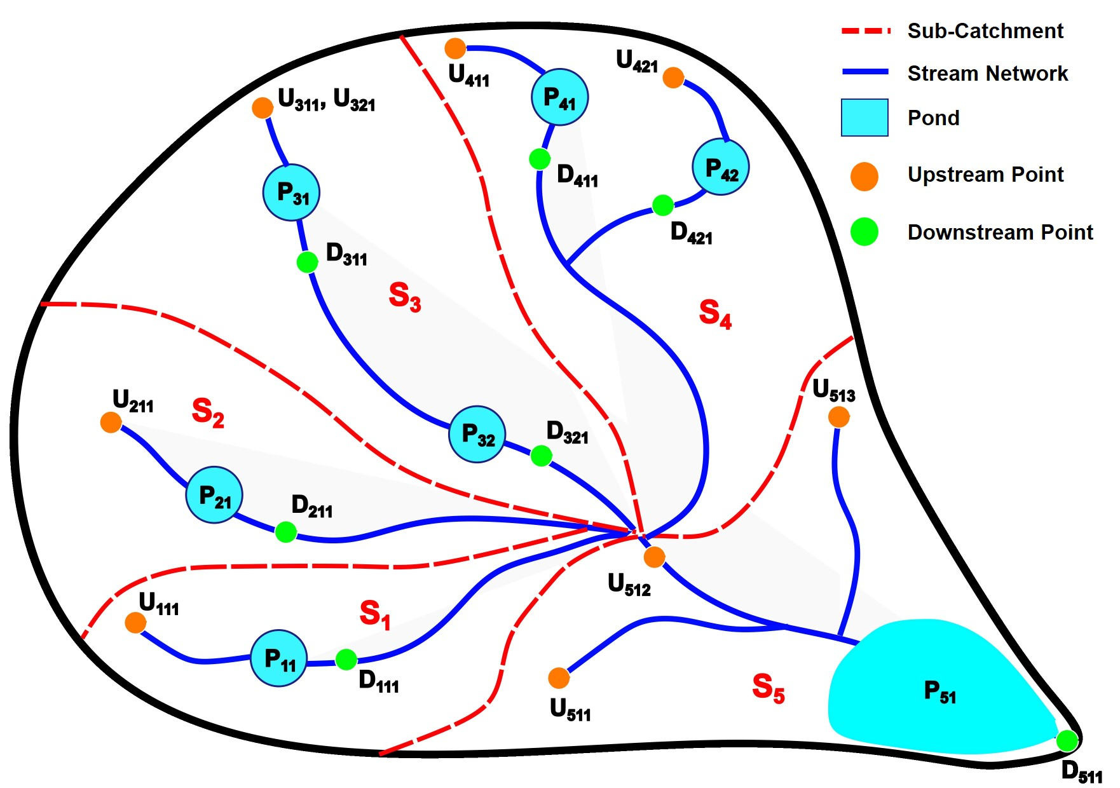
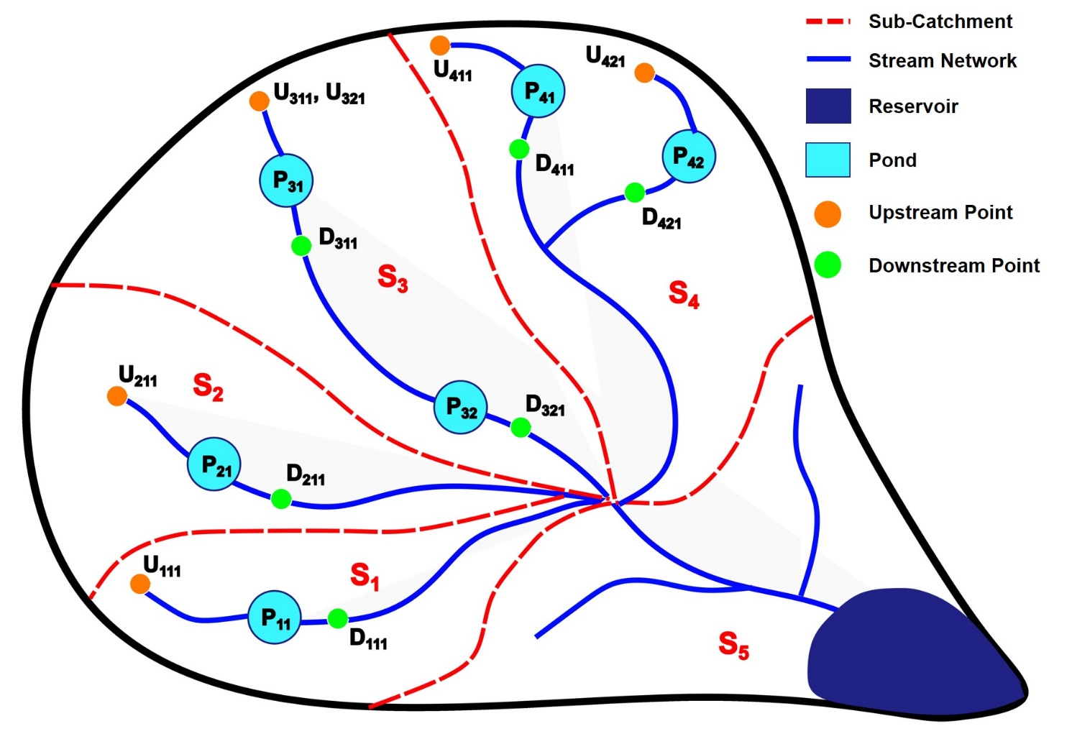
Methodology
Conceptualization of Small and Medium Reservoirs (SMRs) in SWAT
M2: With SMRs as Ponds
M1: Without SMRs
M3: With catchment outlet SMRs as Reservoirs and other SMRs as Ponds
Notes:
In the M1 configuration, none of the SMRs are considered.
For the M2 configuration, the SMRs are conceptualized as equivalent ponds in SWAT within a sub-basin
But in the M3 configuration, the catchment outlet reservoirs are modelled as reservoir element and all other SMRs are modelled as ponds.

Slide 36
Methodology
Conceptualization of Small and Medium Reservoirs (SMRs) in SWAT
Criteria
Location
System Condition
Capacity of SMR
Yes
Storage > 2 MCM*
No
Catchment Outlet Reservoir
Other SMRs
Pond
Reservoir
Pond
M2
M3
M2 and M3
*MCM: Million Cubic Metre
Notes:
Criteria used for selection of a particular SMR for hydrologic modelling is as follows:
The SMR must be along the main limb of the river network.
It should be part of cascading system of SMRs leading to a catchment outlet reservoir (medium reservoir).
All the SMRs having storage greater than 2 MCM are considered as catchment outlet reservoirs and depending on the Model Configuration
They are modelled as Pond in M2 and Reservoir in M3
All other SMRs with storage capacity less than 2 MCM are statistically aggregated as equivalent ponds in M2 and M3.

Slide 37
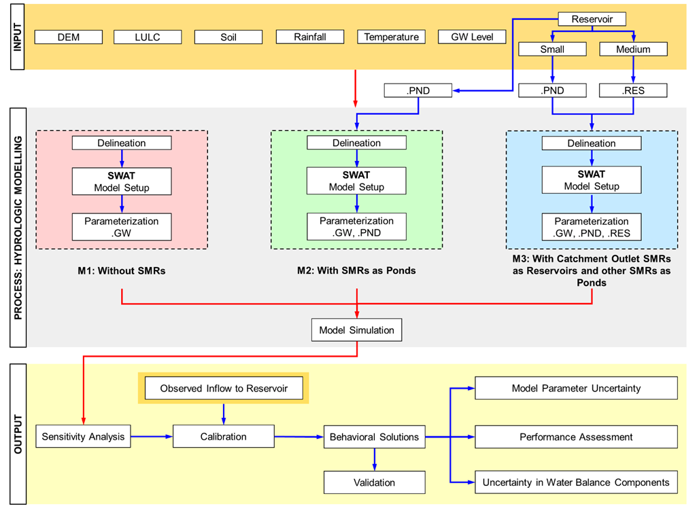
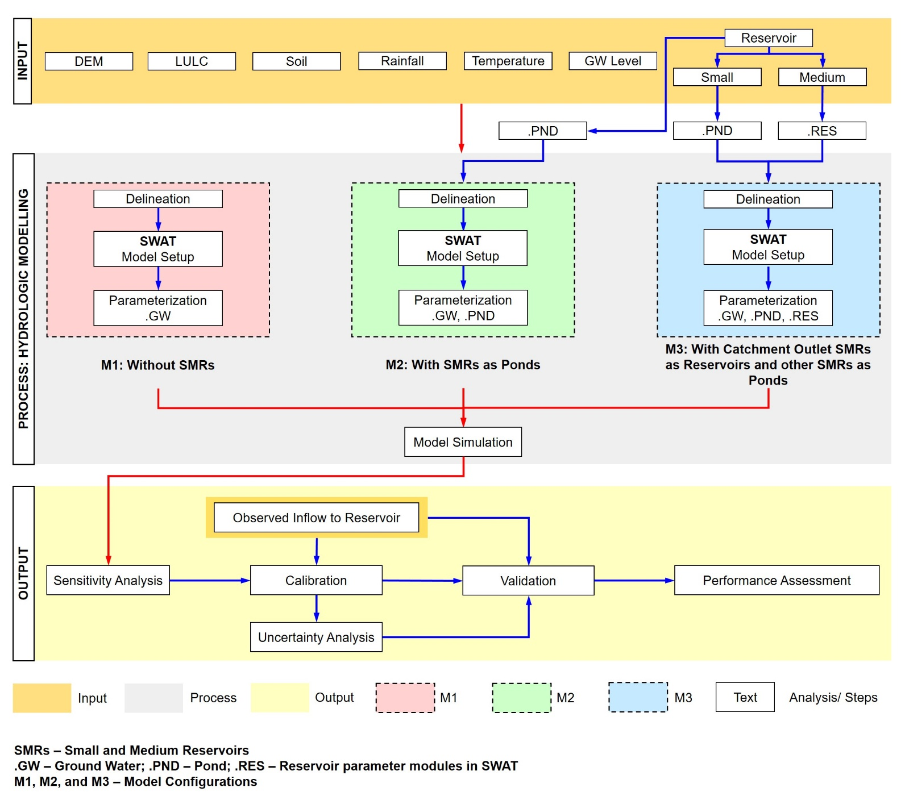
Methodology
Notes:
The input to the SWAT model are shown in the first level.
Three different model configurations M1 (without SMRs), M2 (with SMRs as ponds), and M3 (with catchment outlet SMRs as reservoirs and other SMRs as ponds were set up.
The model was simulated and a sensitivity analysis was performed to identify the sensitive parameters for model calibration.
After the calibration process, the model is validated and the performance was assessed.
Further, the uncertainty in the model parameters and the process simulations were also investigated.

Slide 38

Methodology
Model Performance Assessment and Measure of Parameter Uncertainty
SWAT – CUP: SUFI – 2 Algorithm with Latin Hypercube sampling method
Initial Range of Parameters:
  Fixed based on previous studies (Panchanathan et al. 2023)
  Prior knowledge of the watershed
Sensitivity Analysis
M1, M2, and M3 using Observed inflow to reservoir
Objective Function: Maximizing KGE, Threshold: KGE > 0.50
Calibration and Validation
Based on range of behavioral parameter sets of M1, M2, and M3
Normalization of parameters: Scale of 0 to 100% (Kumar and Merwade, 2009)
where,
  P_{N} is the normalized uncertainty score,
  P_{B} is the behavioral parameter value as identified from SUFI–2 algorithm,
  P_{LL} and P_{UL} are the lower and upper limit of the parameters
Measure of Model Parameter Uncertainty
Notes:
A global sensitivity analysis is performed using 17 parameters
The initial range of the parameters is fixed based on the previous study and prior knowledge of the watershed.
The objective function is chosen as KGE as it considers correlation, model bias, and variability and the threshold was kept as KGE > 0.50.
And the behavioral solutions are extracted.

Slide 39
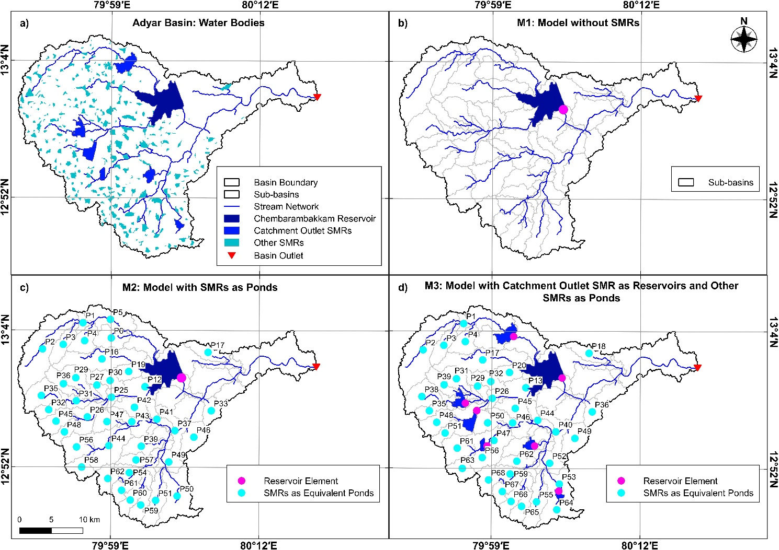
Watershed Delineation and Modelling of SMRs
Watershed Delineation: Micro-watershed scale (7.5 km²)
Total Number of HRUs: 2275
Number of Actual HRUs: 1101 (Filter by area: 10 ha)
a) Waterbodies in Adyar Basin, b) Model without SMRs (M1), c) Model with SMRs as Ponds, and d) Model with catchment outlet SMRs as Reservoirs and other SMRs as Ponds
Notes:
The watershed delineation was done at the micro-watershed scale 7.5 km². We used a filter by area approach and the actual number of HRUs modelled were about 1101.
The first image represents the system of SMRs in the basin.
In M1, only the Chembarambakkam reservoir is considered.
In M2, all the SMRs within a sub-basin are represented as equivalent ponds.
Whereas in M3, the catchment outlet SMRs are explicitly modelled as reservoirs and all other SMRs are represented as equivalent ponds.

Slide 40
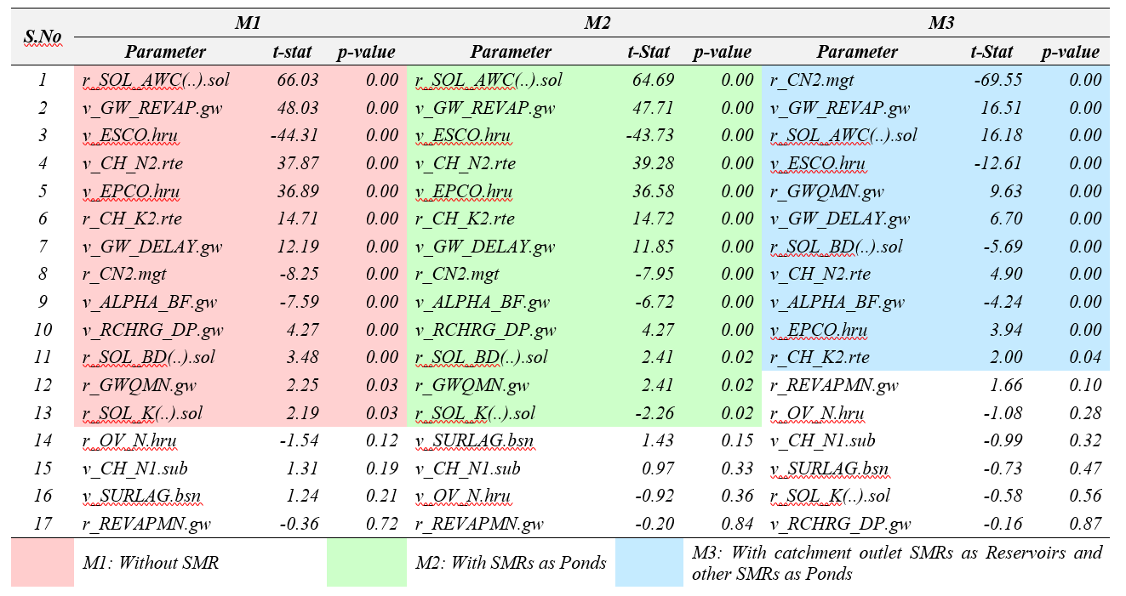
Results: Global Sensitivity Analysis for M1, M2, and M3
*Shaded cells indicate sensitive parameters, p<0.05 (Abbaspour, 2012)
Notes:
Out of the 17 parameters chosen, 13 were found to be sensitive for M1 and M2 with same ranking.
Whereas for M3 only 11 parameters were found to be sensitive with a completely different ranking.
The parameters related to surface runoff, soil storage, soil water routing, soil water evaporation and groundwater were found to be sensitive.

Slide 41
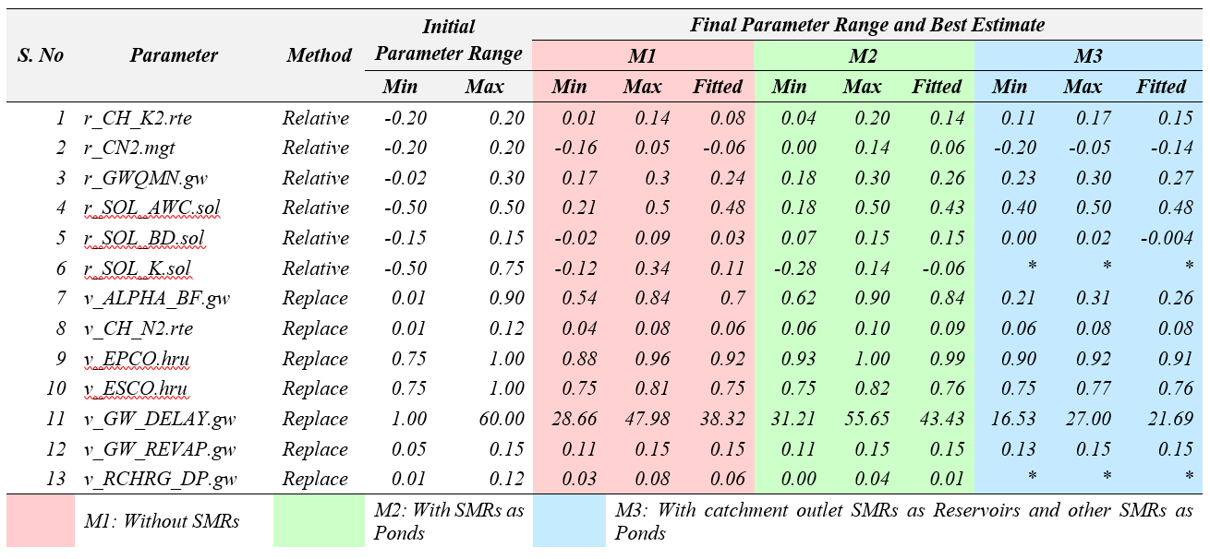
Results
Calibration of SWAT Model
Initial Range, Final Range and Fitted parameters for M1, M2 and M3 after Calibration
Initial parameter set was kept the same for all the 3 model configurations
Model Warm up (4 years)
1989 | 1990 | 1991 | 1992
Calibration Phase (18 years)
1993 | 1994 | 1995 | 1996 | 1997 | 1998 | 1999 | 2000 | 2001 | 2002 | 2003 | 2004 | 2005 | 2006 | 2007 | 2008 | 2009 | 2010
Validation Phase (9 years)
2011 | 2012 | 2013 | 2014 | 2015 | 2016 | 2017 | 2018 | 2019
(*Not a sensitive parameter for M3)
Notes:
The model is calibrated for 18 years from 1993 to 2010 and is validated for 9 years.
The calibration and validation phase is chosen such that it is representative of wet and dry cycles.
The initial parameter set was kept the same for all the three model configurations.
This table shows the initial range, minimum and maximum value as well as the fitted value of the model parameters after calibration.

Slide 42
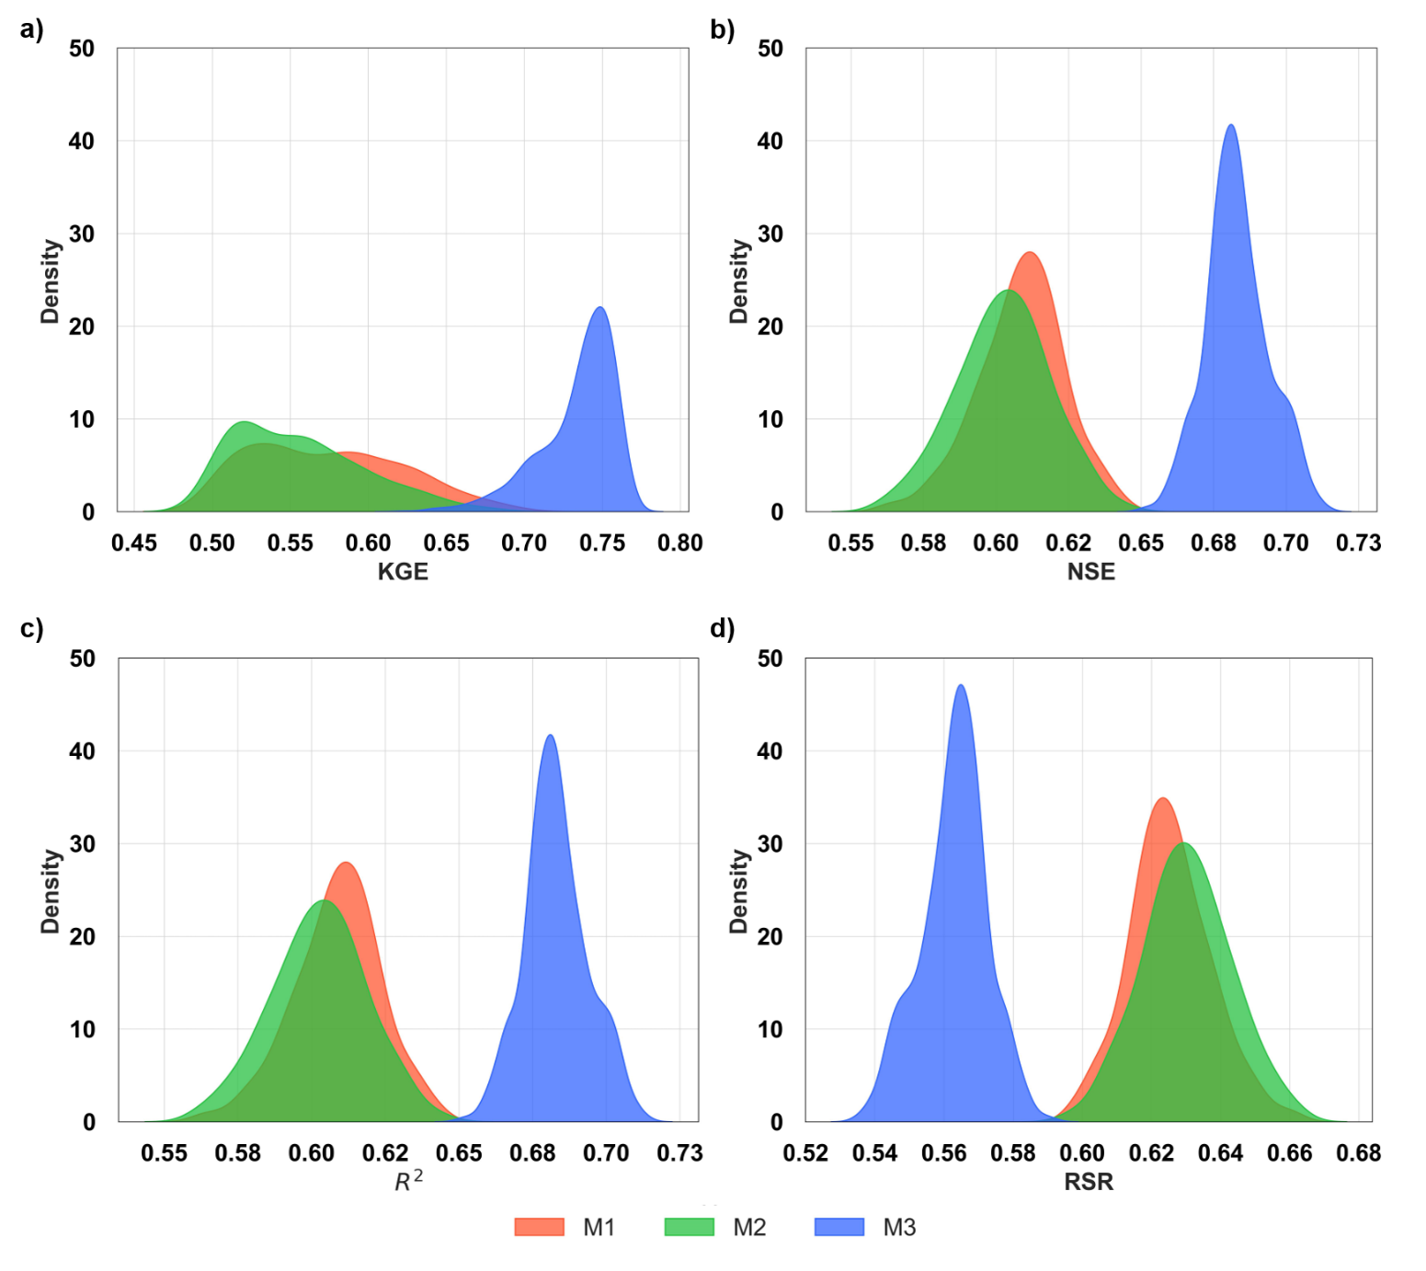
Results: Evaluation of Model Performance
Kernel Density Plots of Model Performance Metrics a) KGE, b) NSE, c) R², and d) RSR
Notes:
To understand the underlying trends in the model performance of M1, M2, and M3 the kernel density estimate plots were used.
It is clearly seen that M3 configuration outperforms M1 and M2.
It is also to be noted that the M2 configuration does not necessarily produce behavioral solutions better than M1 (similar to results by Rabelo et al., 2021).
In addition, the number of acceptable solutions produced by M3 is much higher than M1 and M2 configuration.
Reason for M2: Equivalent pond -> fraction of loading from all the HRUs.
The KDE smoothens the histogram by placing the kernel on each data point and summing them up to create a smooth curve and is a non-parametric way to represent the probability density function of the data. It provides a continuous representation of the distribution of data which is beneficial for identifying the underlying trends and patterns of the variable under consideration.

Slide 43
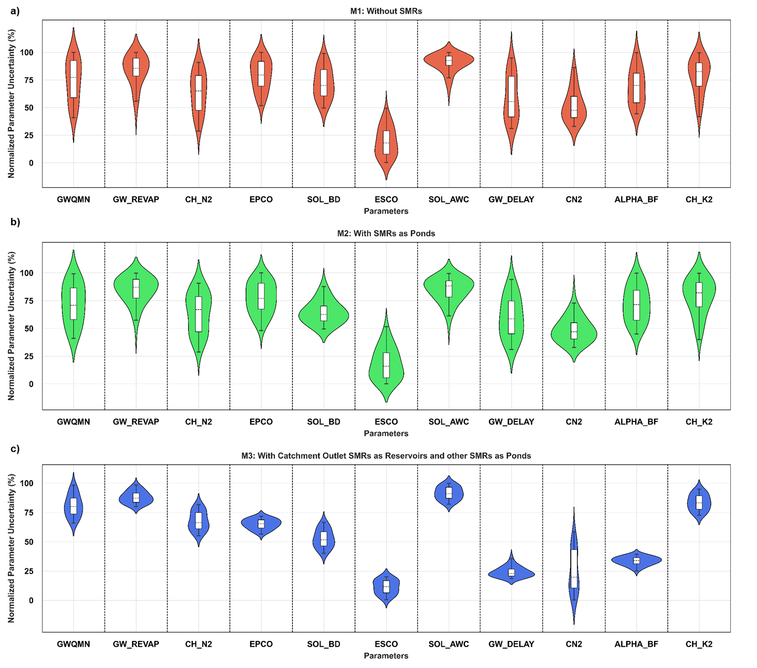
Results: Measure of Parameter Uncertainty
Notes:
A combination of violin and box plot is used to represent the range and the distribution of the normalized behavioral parameter sets.
In the M3 configuration there is a significant reduction in the overall spread of normalized parameter uncertainty scores for all parameters except CN2
This indicates the strong impact of modelling the SMRs using a hybrid approach on the hydrologic model parameters.
On the whole, it is safe to conclude that an appropriate representation of SMRs reduces the parameter uncertainty.

Slide 44
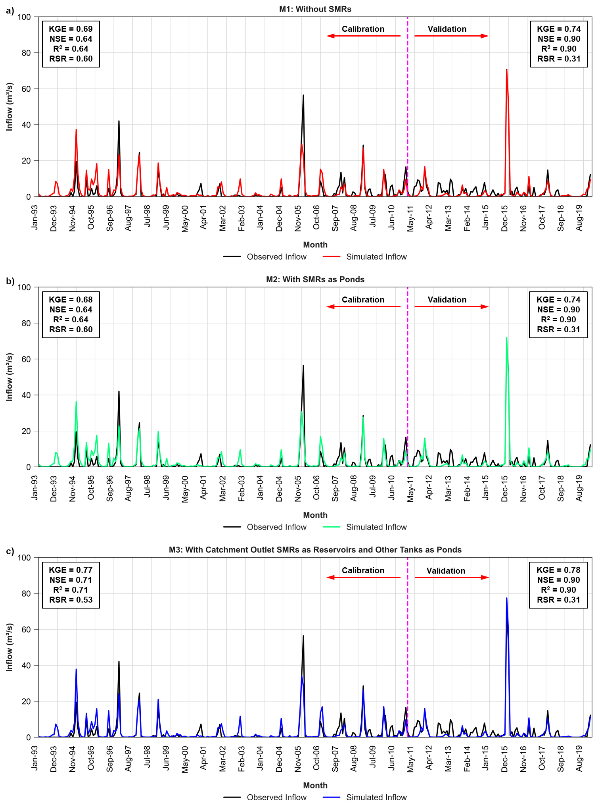
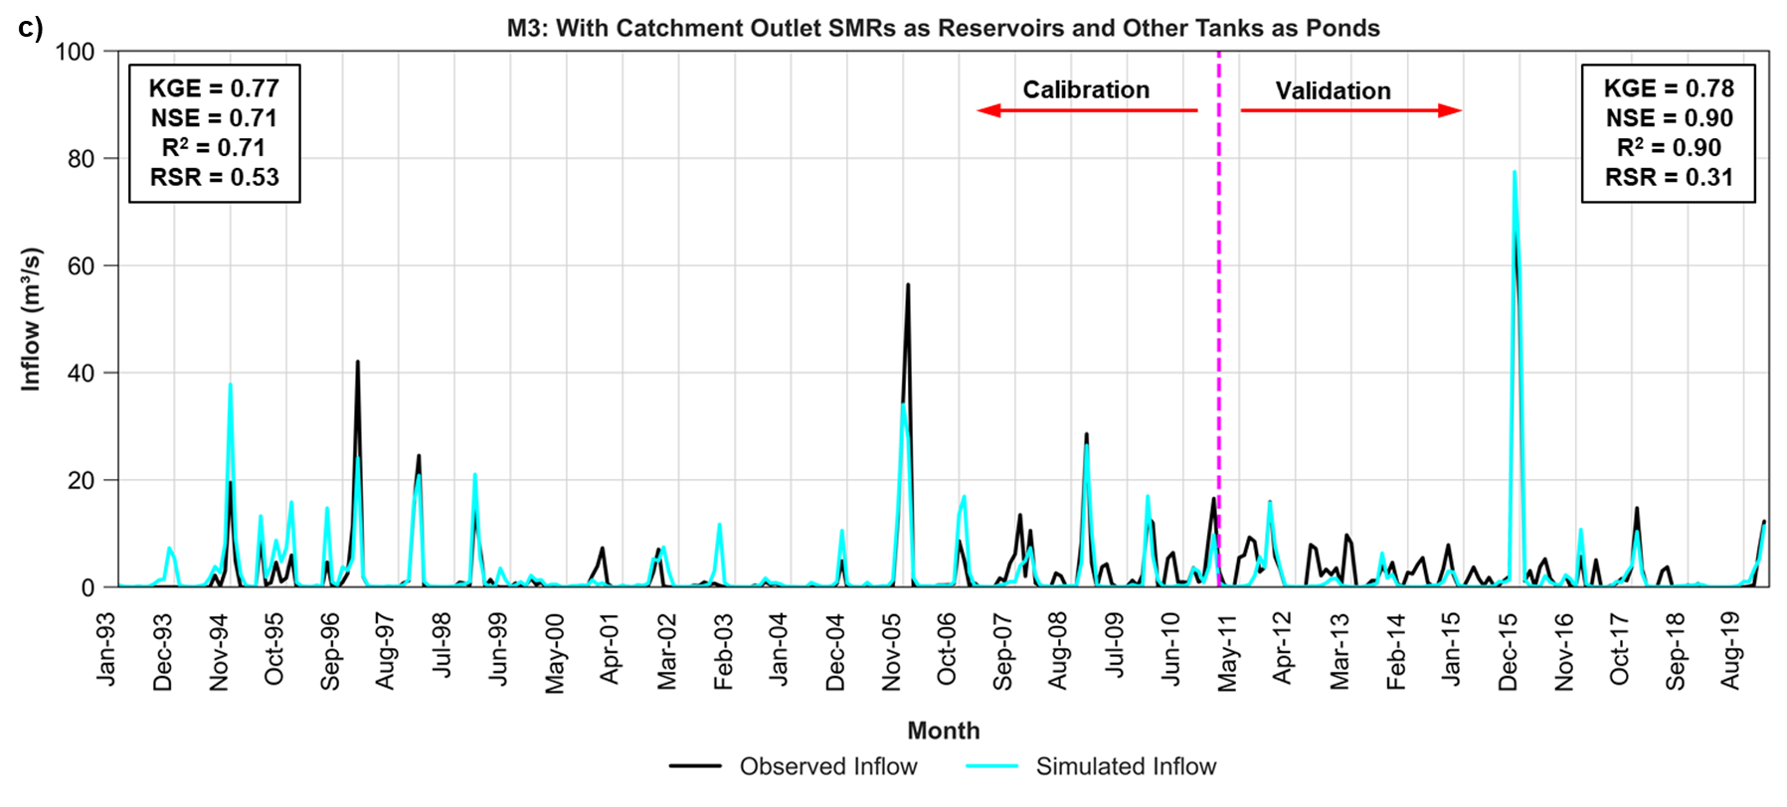
Results
Results: Model Performance – Best Simulation
Monthly inflow to Chembarambakkam Reservoir
Notes:
From the performance measures it is evident that the best performing solution of M3 has a maximum KGE of 0.77 with model performance category as good when compared to M1 and M2 in the calibration phase.
However, during the validation phase all the models yielded the similar performance statistics except for KGE in M3. This could be due to the presence of one extreme event in the validation phase.
Overall, the need for appropriate representation of the SMRs as ponds and reservoirs using the hybrid approach can be justified, as this leads to a good agreement between simulated and observed flows.
Reason for similar statistics in Validation:
This is due to the presence of one extreme event in 2015.

Slide 45
Results
Graphical Summary of Results
M1
M2
M3
Notes:
The graphical summary of the results is presented here.
After model calibration, the behavioral parameter sets were extracted, and the normalized uncertainty score is plotted.
From, the violin plot it was evident that in the M3 configuration there was a significant reduction in the overall spread for all parameters except CN2.
To understand the underlying trends in the model performance, the KDE plots for model performance metrics were plotted.
It is clearly seen that M3 configuration outperforms M1 and M2.
It is also to be noted that the M2 configuration does not necessarily produce behavioral solutions better than M1 (similar to results by Rabelo et al., 2021).

Slide 46

Design Storm Hyetograph
Return Period | Rainfall Depth (mm)
2 – Year | 155.80
5 – Year | 213.00
10 – Year | 255.50
Notes:
The optimization results are presented for a single sub-basin in the Adyar basin that has 6 urban HRUs.
The HRU properties are shown in the table.
For the preliminary study, only the bio-retention cells and infiltration trench are considered. As such, the SuDS elements are designed for a 1 in 10 year rainfall.
But, the optimization is carried out for a design storm with a return period of 1 in 5-years.
To limit the length of presentation, the S – O results are presented for 2 HRUs highlighted in the table.

Slide 47
Implementation of SuDS Elements: Land Availability Constraints
Tamil Nadu Combined Building Development Rules (2019)
Building type | Maximum plot coverage (%)
 | Chennai city, (excluding CBA)
Residential | 70
Commercial | 70
Industrial | 75
Assumption:
  70% as Maximum Plot Coverage.
  Area available for SuDS = 30%
Max. Plot Coverage
Impervious
Open Area
Notes:
For the optimization framework, the land availability constraints are provided.
As per the building development rules, any development must cover only a certain % of the total land area called as maximum plot coverage.
The remaining % of area is supposed to be kept open or undeveloped.
The table shows the different categories of building development and the maximum plot coverage.
Here, it is assumed that the developments can cover 70% of the total land area and the remaining 30% can be for implementing SuDS.

