Slide 1
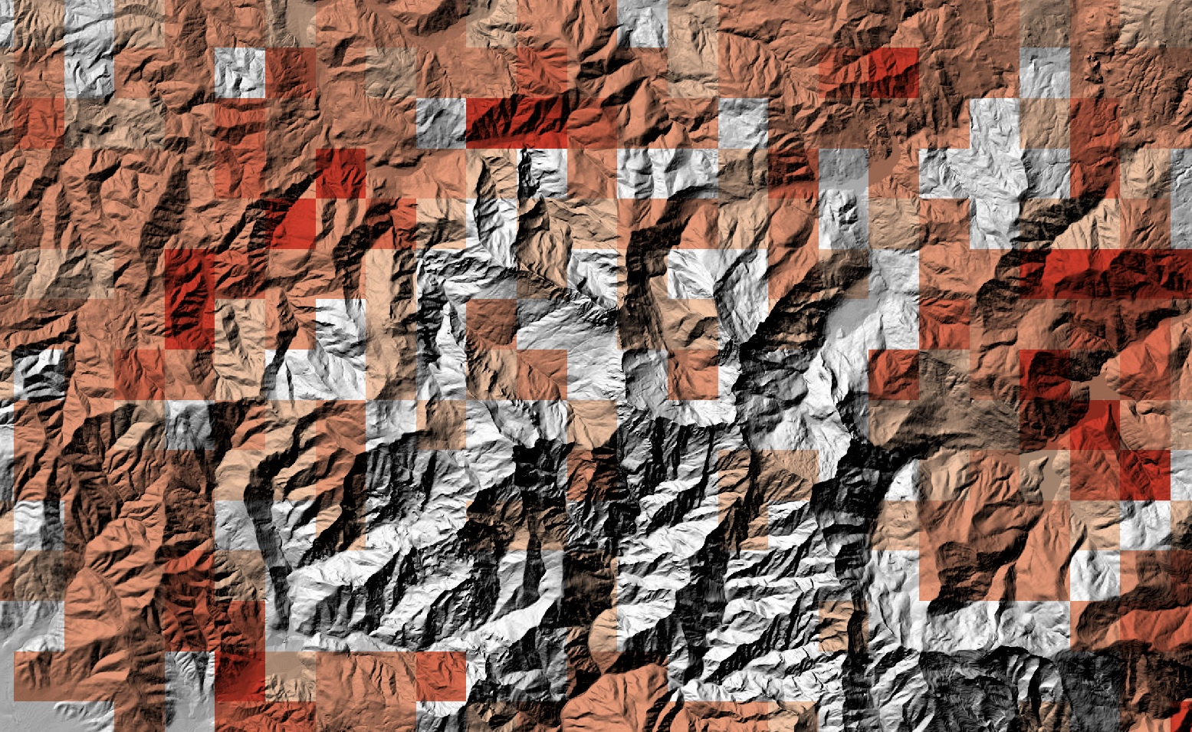




Shallow landslides in Northern Tuscany (Italy): a new multi-temporal inventory and its spatial and statistical analysis
Enrico D'Addario¹, Giulio Masoni¹, Eduardo R. Oliveira^{1,2}, Moira Pippi¹, and Leonardo Disperati¹
PICO3.2 | EGU25-19624
¹University of Siena, Physical, Earth and Environmental Science Department, Siena, Italy
²University of Aveiro, Department of Environment and Planning & CESAM, Aveiro, Portugal

Slide 2


Shallow landslides in Northern Tuscany (Italy): a new multi-temporal inventory and its spatial and statistical analysis - Enrico D'Addario et al. enrico.daddario@unisi.it

Slide 3
Orthophoto maps (1954-2021)
Topographic map (10k)
Land-use map
Visual detection workflow
No-Change mask
Bi-temporal change detection
(MINDED-FBA)
Visual interpretation
Change mask
Multi-operator cross-validation
Automatic detection workflow
Classification
Shallow landslides in Northern Tuscany (Italy): a new multi-temporal inventory and its spatial and statistical analysis - Enrico D'Addario et al. enrico.daddario@unisi.it

Slide 4

Landslides
polygons + azimut displacement vectors
Stable areas polygons
Field validation
Ground truthing
Scarp height
Material involved
Movement type
New field-detected positives (NP)
Confusion matrix
Landslide characterization
Visited Landslides
False positives (FP)
True negatives (TN)
True positives (TP)
False negatives (FN)
Shallow landslides in Northern Tuscany (Italy): a new multi-temporal inventory and its spatial and statistical analysis - Enrico D'Addario et al. enrico.daddario@unisi.it

Slide 5
DEM
Morphometric analysis
Italian National Landslide Inventory
(IFFI)
Database of shallow landslides (DBSL)
FP removal and NP append
Spatial analysis
Magnitude frequency
Lenght-to-width ratio
Statistical analysis and comparison
Shallow landslides in Northern Tuscany (Italy): a new multi-temporal inventory and its spatial and statistical analysis - Enrico D'Addario et al. enrico.daddario@unisi.it

Slide 6
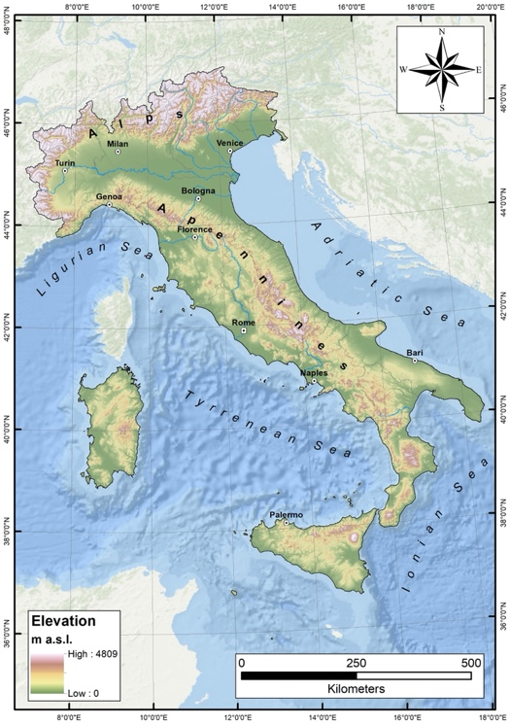
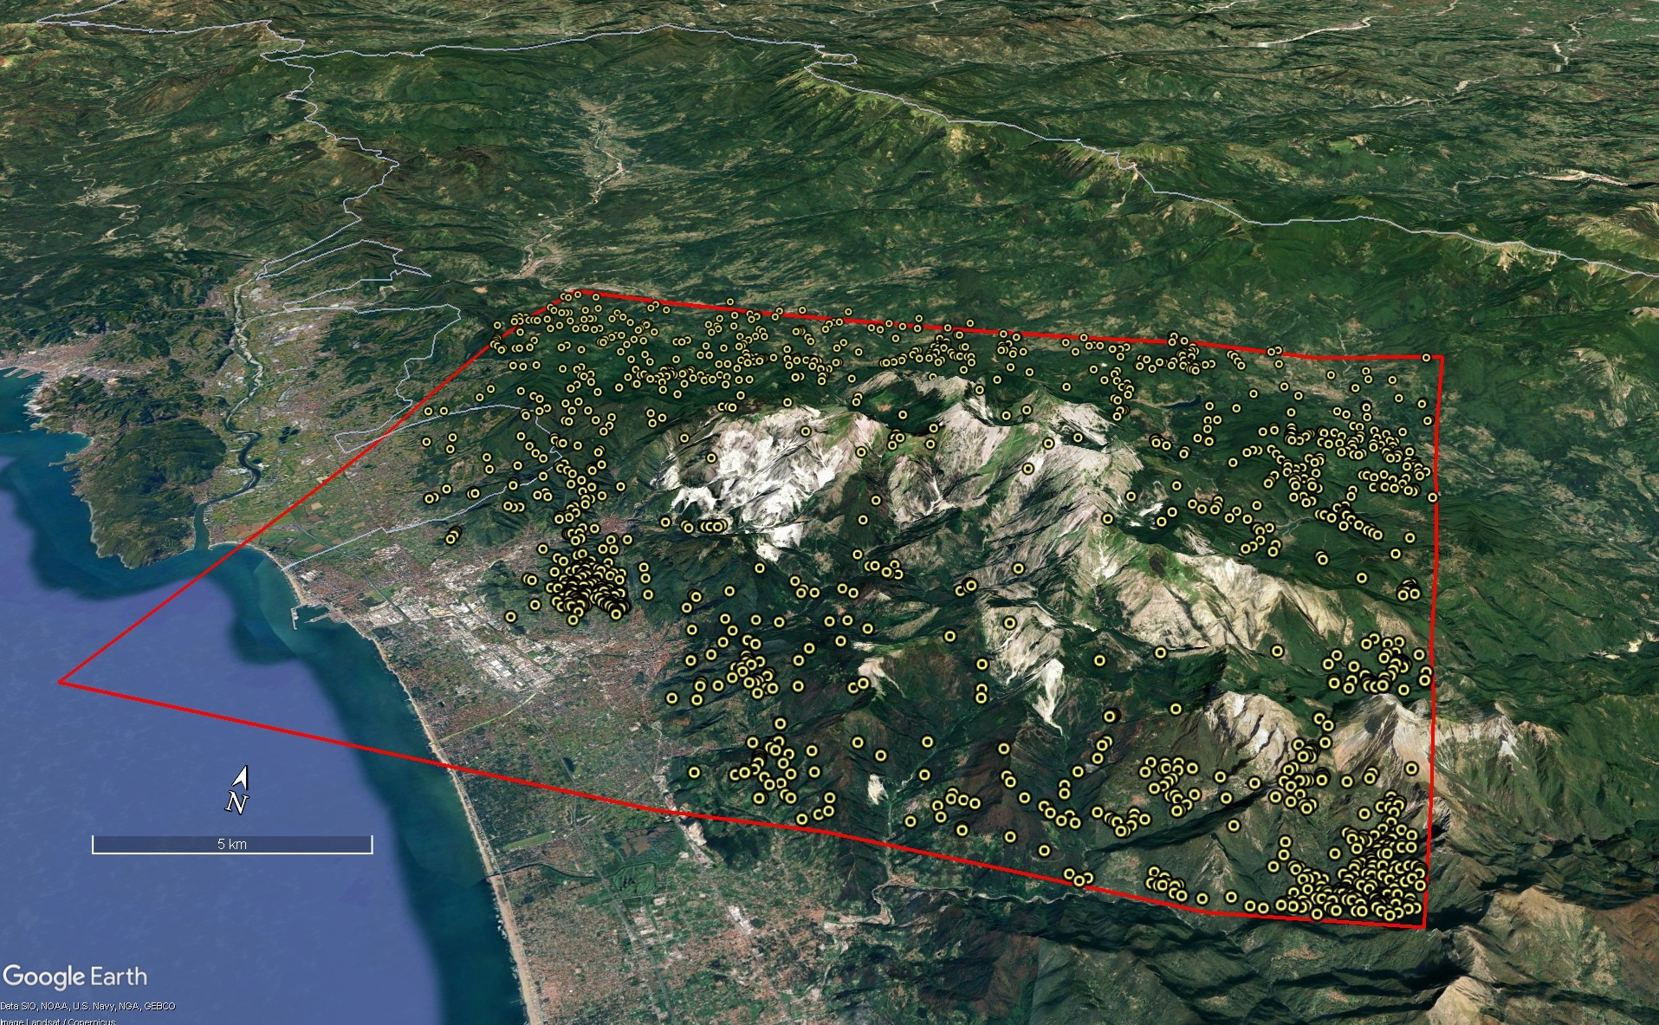
Multitemporal shallow landslide inventory (DBSL; about 1300 landslides)
Workflow applied in northern Tuscany (Italy, Massa-Carrara sheet n. 249, 1:50,000 scale) as part of the National Geological Mapping Project (CARG), commissioned by ISPRA
Area spanning for ca. 600 km² from the Ligurian Sea to the tectonically active Garfagnana graben, including the Apuan Alps Metamorphic Core Complex.
Emilia Romagna
Aulla
Tuscany
Garfagnana
Liguria
Castelnuovo
Garfagnana
Apuan Alps
Massa
Ligurian sea
Forte dei Marmi
The new inventory of shallow landslides triggered between 1954 and 2021 was built and:
  Subjected to field validation and statistical/spatial analysis
  Compared to the existing Italian National Landslide Inventory (IFFI)
Shallow landslides in Northern Tuscany (Italy): a new multi-temporal inventory and its spatial and statistical analysis - Enrico D'Addario et al. enrico.daddario@unisi.it
Notes:
The workflow described above was applied to an area in northern Tuscany, specifically within sheet no. 249 at a 1:50,000 scale, titled "Massa-Carrara." In this area, we were commissioned by ISPRA (Italian National Institute for Environmental Protection and Research) to produce the landslide hazard thematic map as part of the CARG project.
The study area extends from the Ligurian Sea in the west to the tectonically active Garfagnana graben in the east, and includes the Metamorphic Core Complex of the Apuan Alps.
The map illustrates the distribution of shallow landslides triggered between 1978 and 2021. If you are interested in further details and would like to understand why, despite the availability of the IFFI database, we chose to compile a new specific inventory of shallow landslides, we will be at monitoring station XXX.

Slide 7
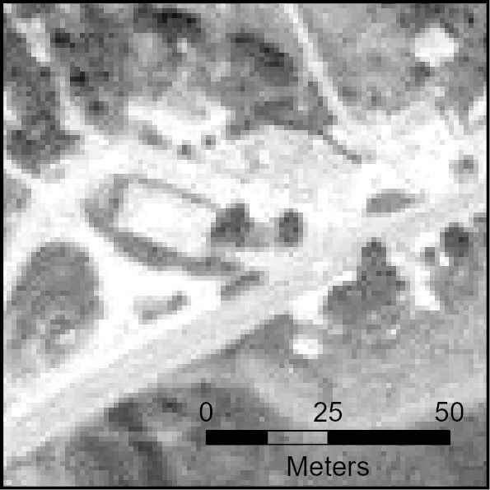
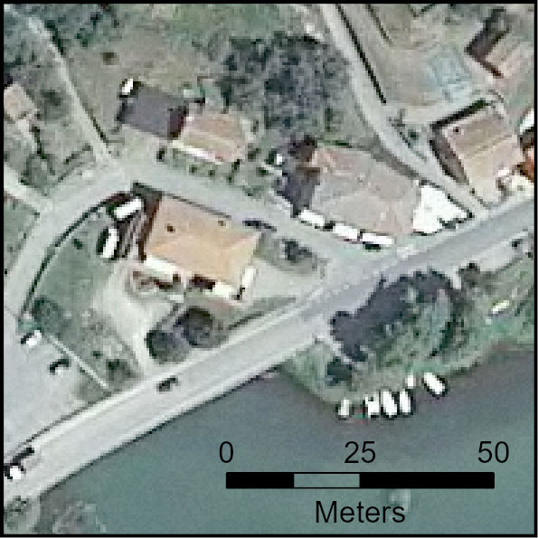
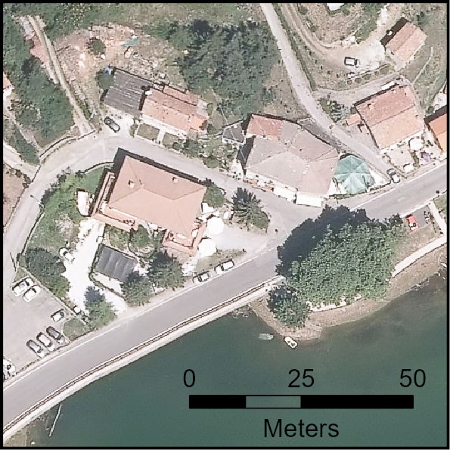
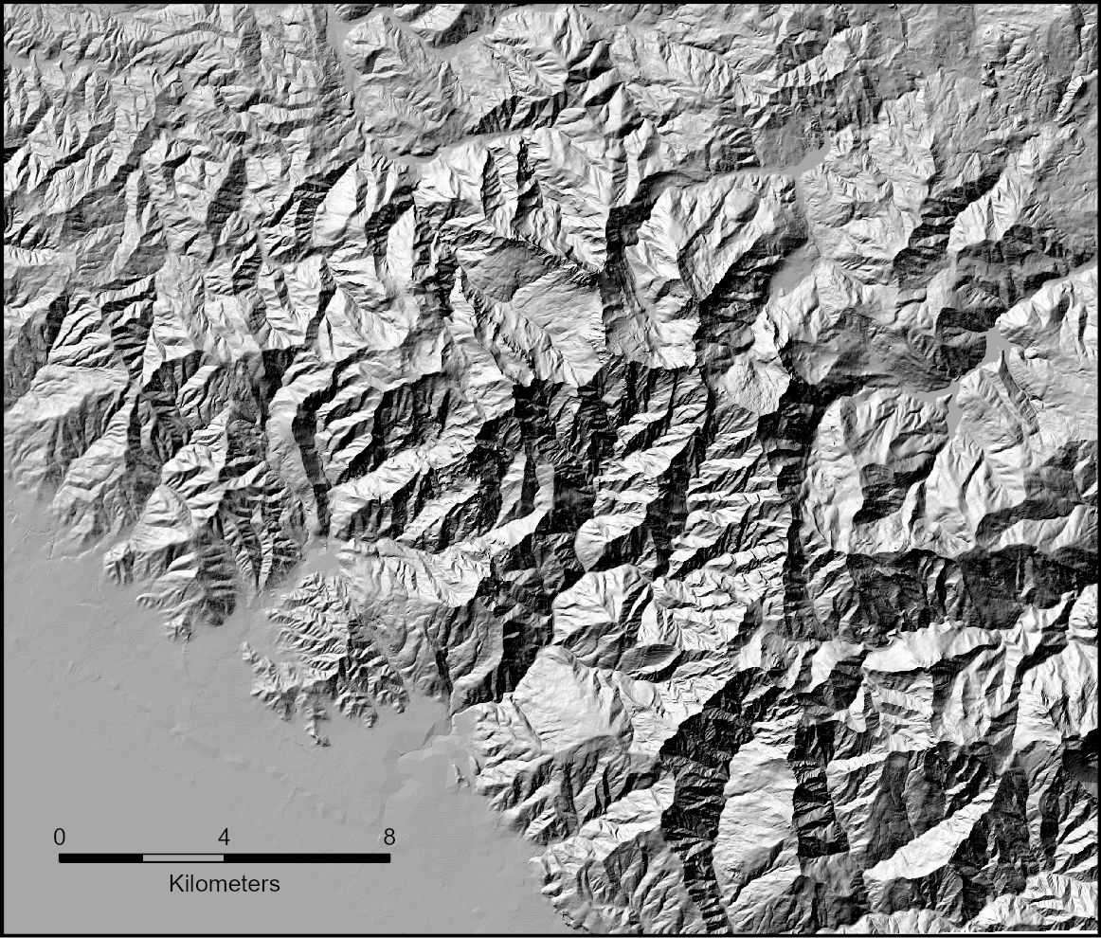
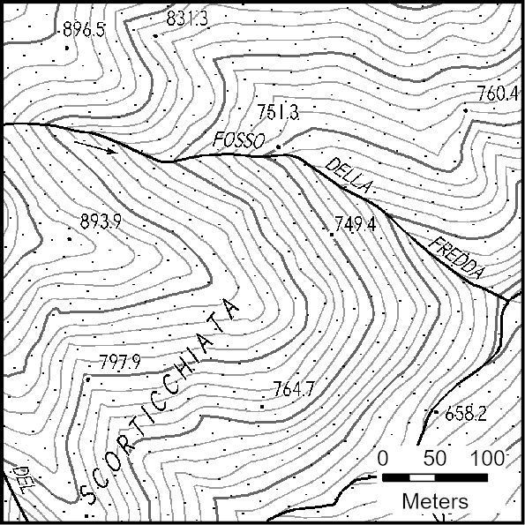
Input data
Input data
Automatic change detection
Visual detection
Ground truth
Statistical analysis and comparison
Conclusions
1988
N
2010
N
2019
N
Period ID | Time interval | Year of imagery acquisition | Type | Spatial resolution (m)
T1 | 1954 - 1978 | 1978 | B&W | 1,56 x 1,56
T2 | 1978 - 1988 | 1988 | B&W | 1 x 1
T3 | 1988 - 1996 | 1996 | B&W | 1 x 1
T4 | 1996 - 2003 | 2000; 2003 | B&W | 1 x 1
T5 | 2003 - 2007 | 2005; 2007 | 2005: B&W 2007: RGB+NIR | 2005: 1 x 1; 2007: 0,5 x 0,5
T6 | 2007 - 2010 | 2009 2010 | RGB+NIR | 0,5 x 0,5
T7 | 2010 - 2013 | 2013 | RGB+NIR | 0,5 x 0,5
T8 | 2013 - 2016 | 2016 | RGB+NIR | 0,2 x 0,2
T9 | 2016 - 2019 | 2019 | RGB | 0,2 x 0,2
T10 | 2019 - 2021 | 2021 | RGB | 0,2 x 0,2
Shallow landslides in Northern Tuscany (Italy): a new multi-temporal inventory and its spatial and statistical analysis - Enrico D'Addario et al. enrico.daddario@unisi.it

Slide 8
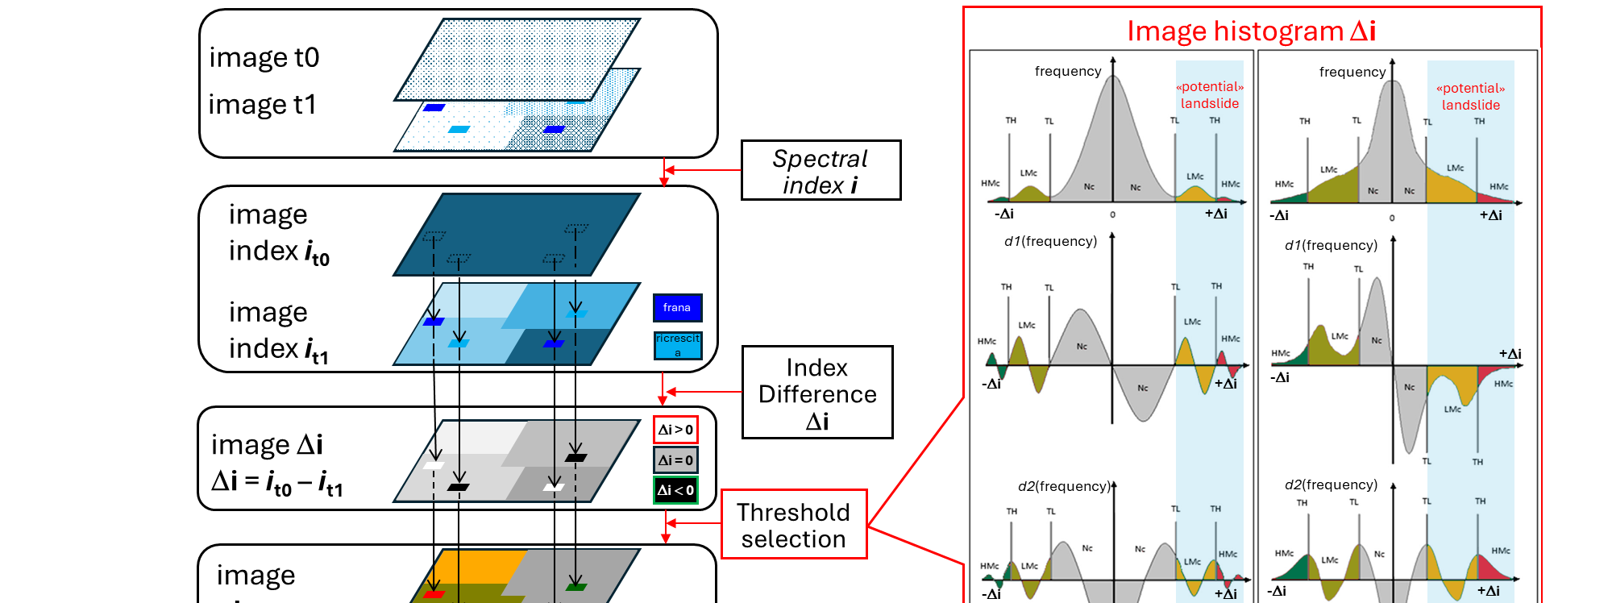
Change detection –MINDED-FBA
Input data
Automatic change detection
Visual detection
Ground truth
Statistical analysis and comparison
Conclusions
Oliveira, E.R.; Disperati, L.; Cenci, L.; Gomes Pereira, L.; Alves, F.L. Multi-Index Image Differencing Method (MINDED) for Flood Extent Estimations. Remote Sens. 2019, 11, 1305. https://doi.org/10.3390/rs11111305
Oliveira, E.R.; Disperati, L.; Alves, F.L. A New Method (MINDED-BA) for Automatic Detection of Burned Areas Using Remote Sensing. Remote Sens. 2021, 13, 5164. https://doi.org/10.3390/rs13245164
Oliveira, E.R.; Disperati, L.; Alves, F.L. MINDED-FBA: An Automatic Remote Sensing Tool for the Estimation of Flooded and Burned Areas. Remote Sens. 2023, 15, 724. https://doi.org/10.3390/rs15030724
Shallow landslides in Northern Tuscany (Italy): a new multi-temporal inventory and its spatial and statistical analysis - Enrico D'Addario et al. enrico.daddario@unisi.it

Slide 9
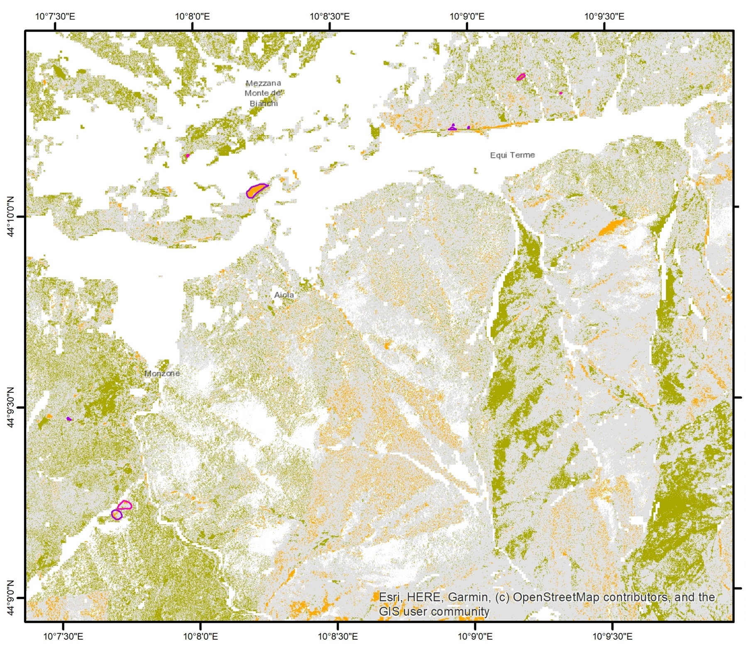
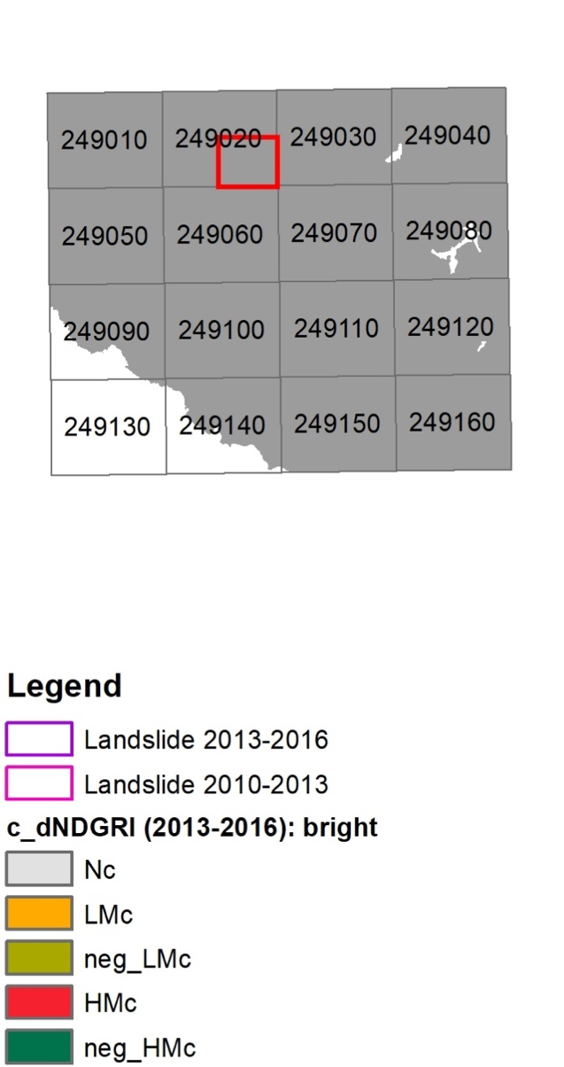
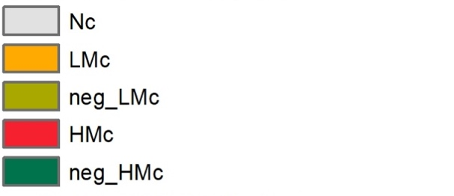

Change detection –MINDED-FBA
Input data
Automatic change detection
Visual detection
Ground truth
Statistical analysis and comparison
Conclusions
ortophoto VIS (≥1 m):
$$NDGRI=\frac{Green−Red}{Green+Red}$$
(Normalized Difference Green-Red Index)
«potential» landslide
«potential» landslide
Shallow landslides in Northern Tuscany (Italy): a new multi-temporal inventory and its spatial and statistical analysis - Enrico D'Addario et al. enrico.daddario@unisi.it

Slide 10
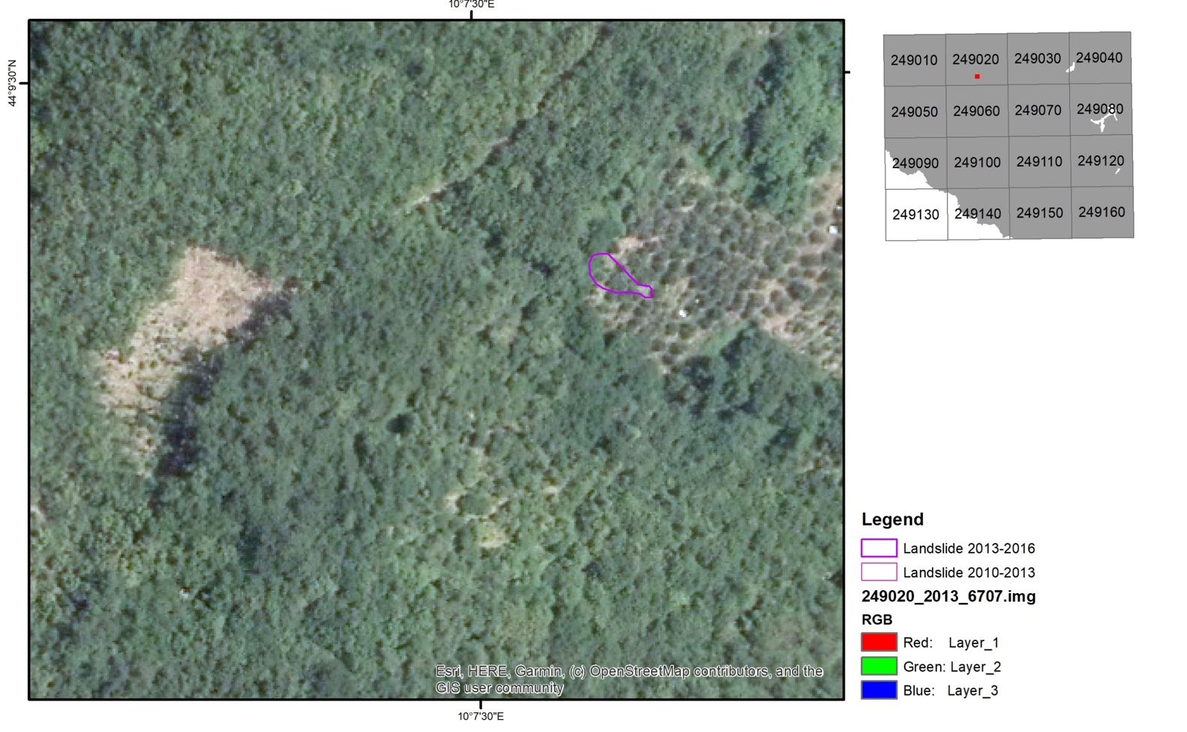
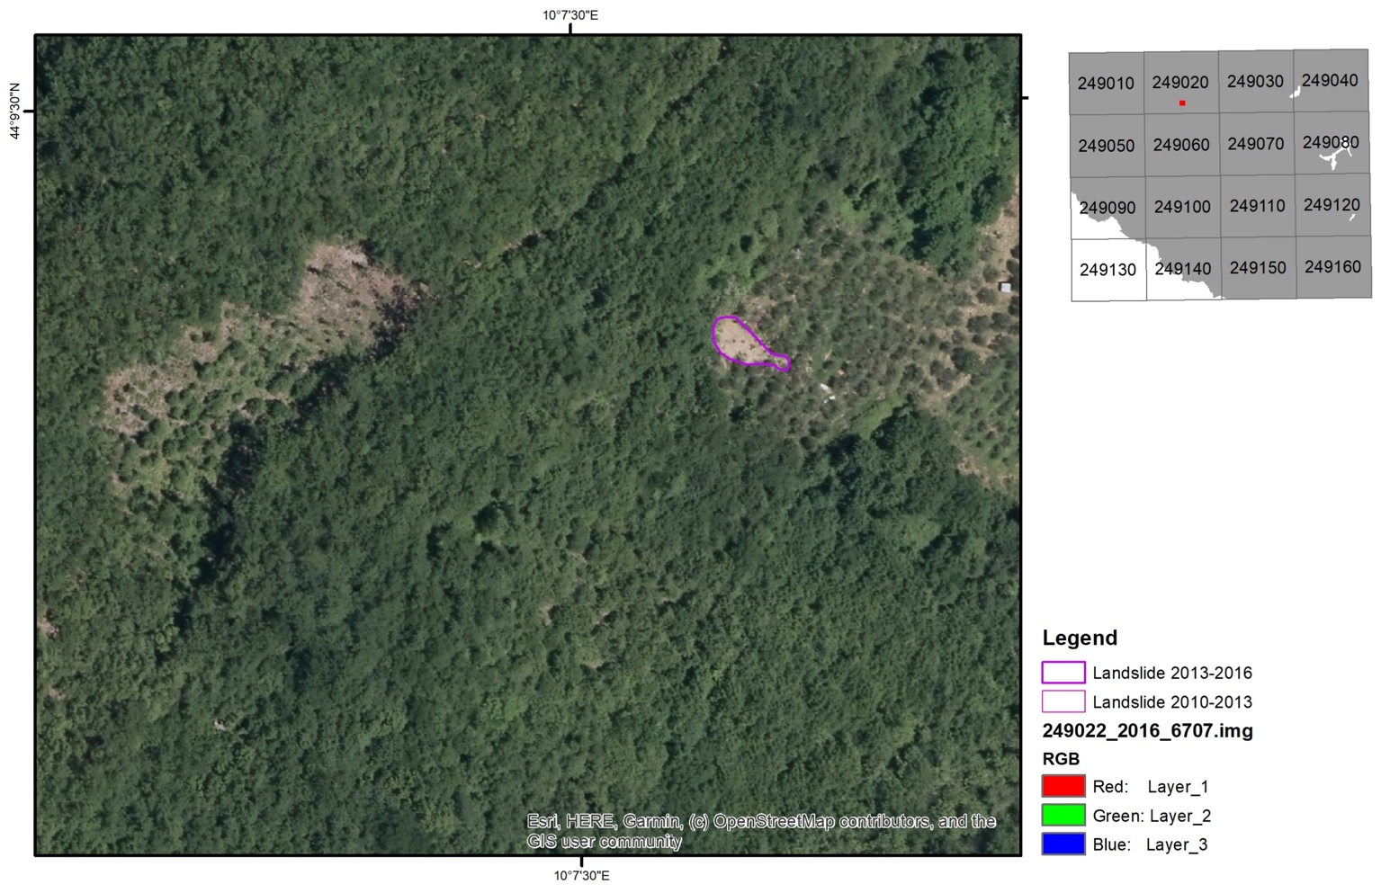
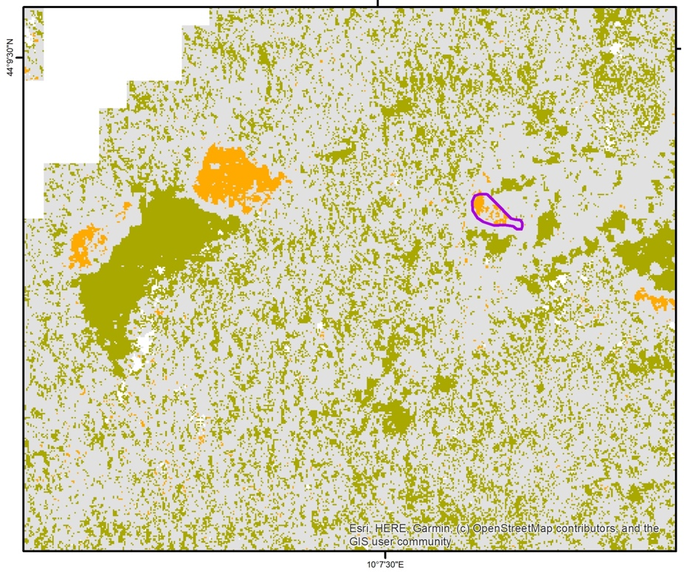
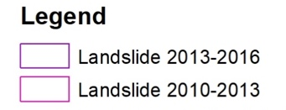
Change detection –MINDED-FBA
Input data
Automatic change detection
Visual detection
Ground truth
Statistical analysis and comparison
Conclusions
Vegetation regrowth
Clearcutting
New landslide
2013
2016
Example 1 - identification of landslide, clearcutting and regrowth areas
Image of changes
Shallow landslides in Northern Tuscany (Italy): a new multi-temporal inventory and its spatial and statistical analysis - Enrico D'Addario et al. enrico.daddario@unisi.it

Slide 11
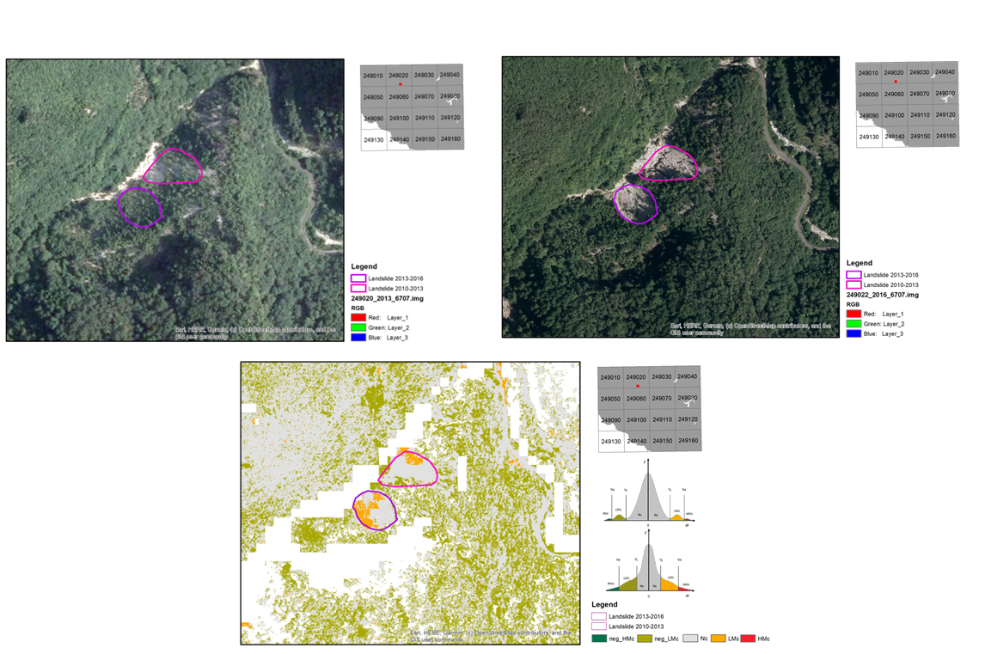
Change detection –MINDED-FBA
Input data
Automatic change detection
Visual detection
Ground truth
Statistical analysis and comparison
Conclusions
Example 2 - identification and development of landslide areas
new landslide
landslide development
Shallow landslides in Northern Tuscany (Italy): a new multi-temporal inventory and its spatial and statistical analysis - Enrico D'Addario et al. enrico.daddario@unisi.it

Slide 12
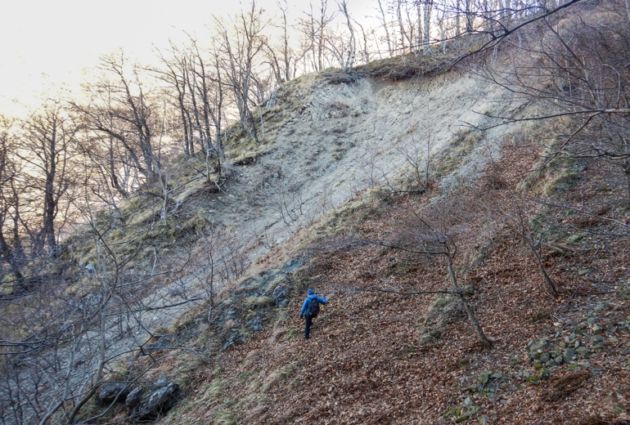
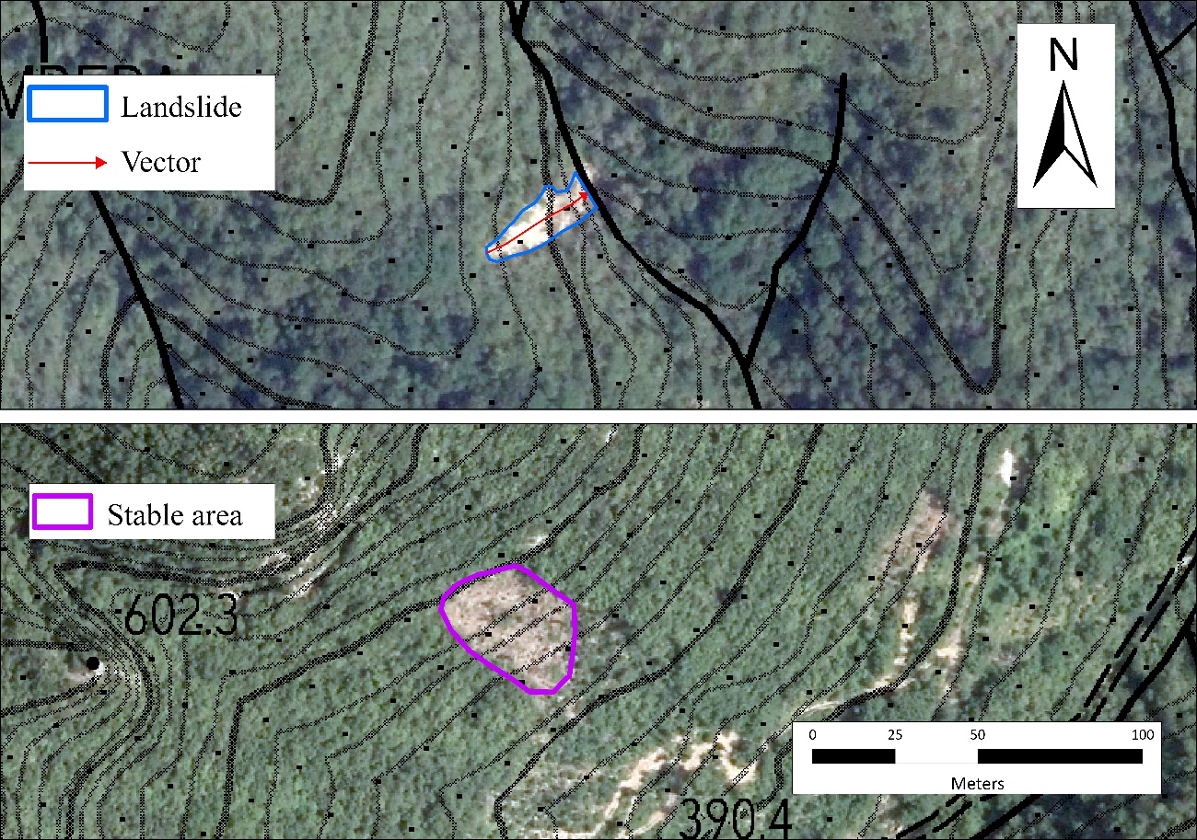
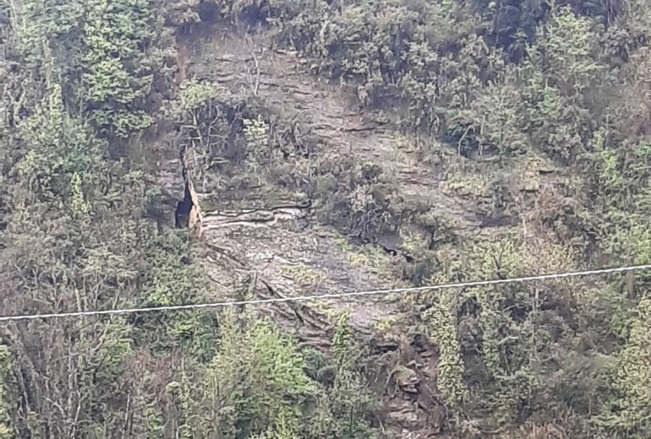
Visual detection
Input data
Automatic change detection
Visual detection
Ground truth
Statistical analysis and comparison
Conclusions
Study area divided into 750x500 m grid cells (~1:1500 scale)
Detection of changes in texture, tone/colour, vegetation, and linear patterns
Identification of elliptical shaped features, elongated along the slope direction
Three-stage interpretation and validation process:
  Initial Mapping: Team 1 delineates polygons and displacement azimut vectors across entire area. Identification of both landslides and stable “look-alike” areas
  Review and Refinement: Team 2 re-evaluates orthophotos. Adjusts boundaries, adds missed polygons, flags potential misinterpretations
  Final Validation: Team 3 checks accuracy, consistency, and quality of geometry and attributes of the database
N
N
Shallow landslides in Northern Tuscany (Italy): a new multi-temporal inventory and its spatial and statistical analysis - Enrico D'Addario et al. enrico.daddario@unisi.it
Notes:
"The analysis of the orthophotos was carried out using a regular 750x500 grid in order to examine each portion of the area at the same scale. The objective is to identify changes in texture, tone/colour, vegetation, and linear patterns of elliptical features
The interpretation was divided into three phases, each involving different operators:
Initial Mapping: Team 1 delineates polygons and movement vectors across entire area. Identification of both landslides and stable “look-alike” areas
Review and Refinement:Team 2 re-evaluates orthophotos. Adjusts boundaries, adds missed polygons, flags potential misinterpretations
Final Validation: Team 3 ensures accuracy, consistency, and quality of geometry and attributes of the database

Slide 13
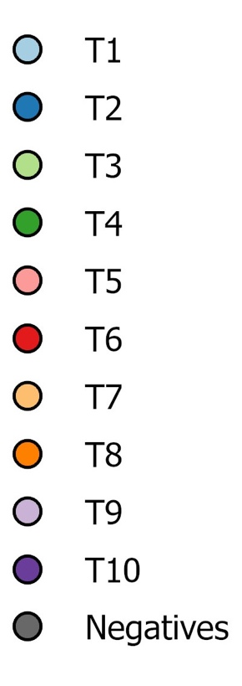
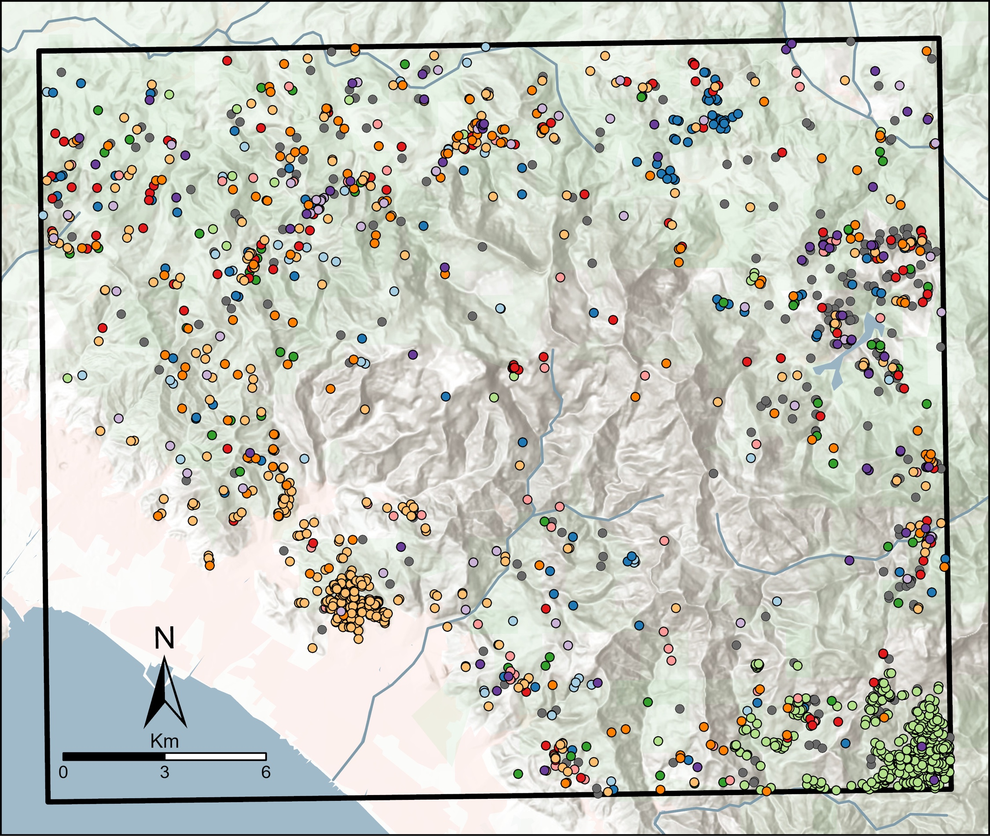
Visual detection – mapped entities
Input data
Automatic change detection
Visual detection
Ground truth
Statistical analysis and comparison
Conclusions
1954 - 1978
1978 - 1988
1988 - 1996
1996 - 2003
2003 - 2007
2007 - 2010
2010 - 2013
2013 - 2016
2016 - 2019
2019 - 2021
A total of 1569 entities were mapped:
  1294 as positives
  275 as negatives
Normalized annual frequency = ratio between the landslide frequency of each time interval (T) and duration (years) of each T
Candia event (2012)
Cardoso event : 13 casualties
Candia event : 3 casualties
Cardoso event (1996)
Shallow landslides in Northern Tuscany (Italy): a new multi-temporal inventory and its spatial and statistical analysis - Enrico D'Addario et al. enrico.daddario@unisi.it
Notes:
The temporal distribution of the positive entities across different time intervals is heterogeneous but seems to have a sort of cyclical trend in terms of normalized annual frequency.
By analyzing the peaks of the red curve (annual frequency) and the increases of the blue one (cumulative landslide area), it is evident that in T3 (Cardoso) there were fewer landslides but of larger size, whereas in T7 (Candia) there was a very high number of very small landslides. However, almost the half of the whole positive dataset, come from these two epochs (not showed by that graph, btw)
The distribution of positives of the other T is widely distributed across the area, except for the elliptical area in the center, oriented approximately NE-SW, which corresponds to the Metamorphic Units, where a very low number of landslides occur.

Slide 14






Ground truthing - metrics
Input data
Automatic change detection
Visual detection
Ground truth
Statistical analysis and comparison
Conclusions
A total of 314 entities were visited
254 interpreted entites have been validated
We assessed the completeness of the remotely mapped inventory by comparing true positives (TP), misclassified positives (FN), and missed landslides identified in the field (NI). The resulting completeness index is defined as:
60 new field-detected positives (NP)
47 landslides occured after 2021, the last orthophoto analyzed (PO)
13 undetected landslides triggered before 2021 (UN)
≈20% of the total amount of interpreted entities
164
27
1
64
New field-detected positives $\left(NP\right)=PO+UN$
The completeness of the visually interpreted inventory can be assessed by considering true positives (TP), misclassified positives (FN), and undetected pre-2021 landslides (UN). The completeness index is defined as:
0.30
$Inventory Completeness \left(IC\right)=\frac{TP+FN}{TP+FN+UN}×100$ = 93%
Shallow landslides in Northern Tuscany (Italy): a new multi-temporal inventory and its spatial and statistical analysis - Enrico D'Addario et al. enrico.daddario@unisi.it
Notes:
The Inventory Completeness (IC) is not an «official» statistical index to evaluate completeness. With this index, we aim to highlight that visual interpretation is not infallible and that, in any case, a certain number of positives are missed.
Essentially, after the visual interpretation, we proceeded to validate the mapped features. During the validation campaign, we identified new positives. Once back in the office, we checked whether these positives were visible in the analyzed orthophotos. If they were not visible, it is reasonable to assume that these landslides were triggered after the acquisition of the latest orthophoto (2021) and before the validation campaign (winter 2023–2024); this are labelled as PO (post-orthophoto).
Conversely, if the positives identified during the field campaign are visible in the orthophotos, these are cases that the operator failed to recognize and are labeled as UN (Undetected).

Slide 15
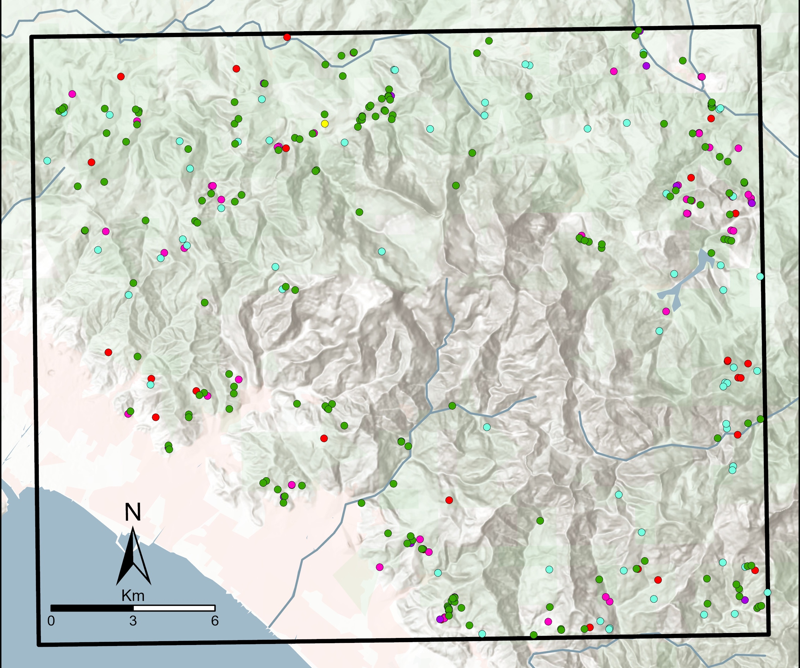
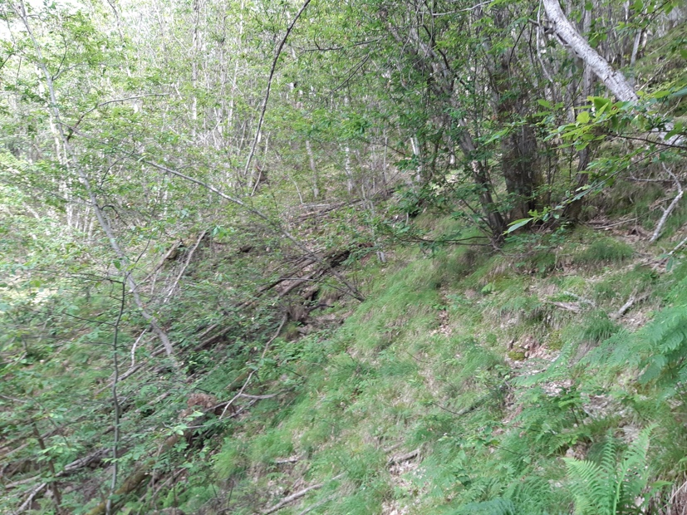
Ground truthing – distribution of validated entities
Input data
Automatic change detection
Visual detection
Ground truth
Statistical analysis and comparison
Conclusions
FN (1)
FP (27)
TN (64)
TP (164)
UN (13)
New field-detected positives (NP)
PO (47)
A total of 225 positives (TP+FN+PO+UN) were visited and most of them underwent to landslide characterization
TP: visited at least 4 years after the events
FP: trees uprooted/broken by wind (visited at least 5 years after the event)
Shallow landslides in Northern Tuscany (Italy): a new multi-temporal inventory and its spatial and statistical analysis - Enrico D'Addario et al. enrico.daddario@unisi.it
Notes:
The validation campaign was organized to visit sites distributed across the entire study area, taking into account the logistical constraints of the territory.
Many features were inaccessible due to their distance from roads and trails. Most of the false positives turned out to be areas affected by strong wind gusts that had knocked down trees or zones that had been artificially deforested.
Field validation allowed us to collect site-specific information on 224 landslides, such as the type of movement, the type of material involved, and the height of the main scarp.

Slide 16
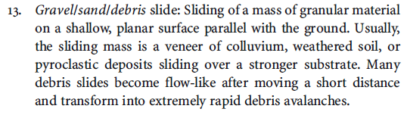
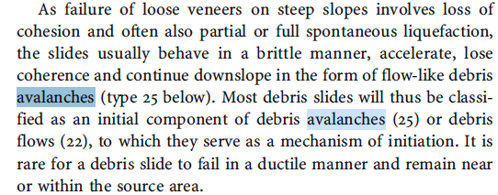
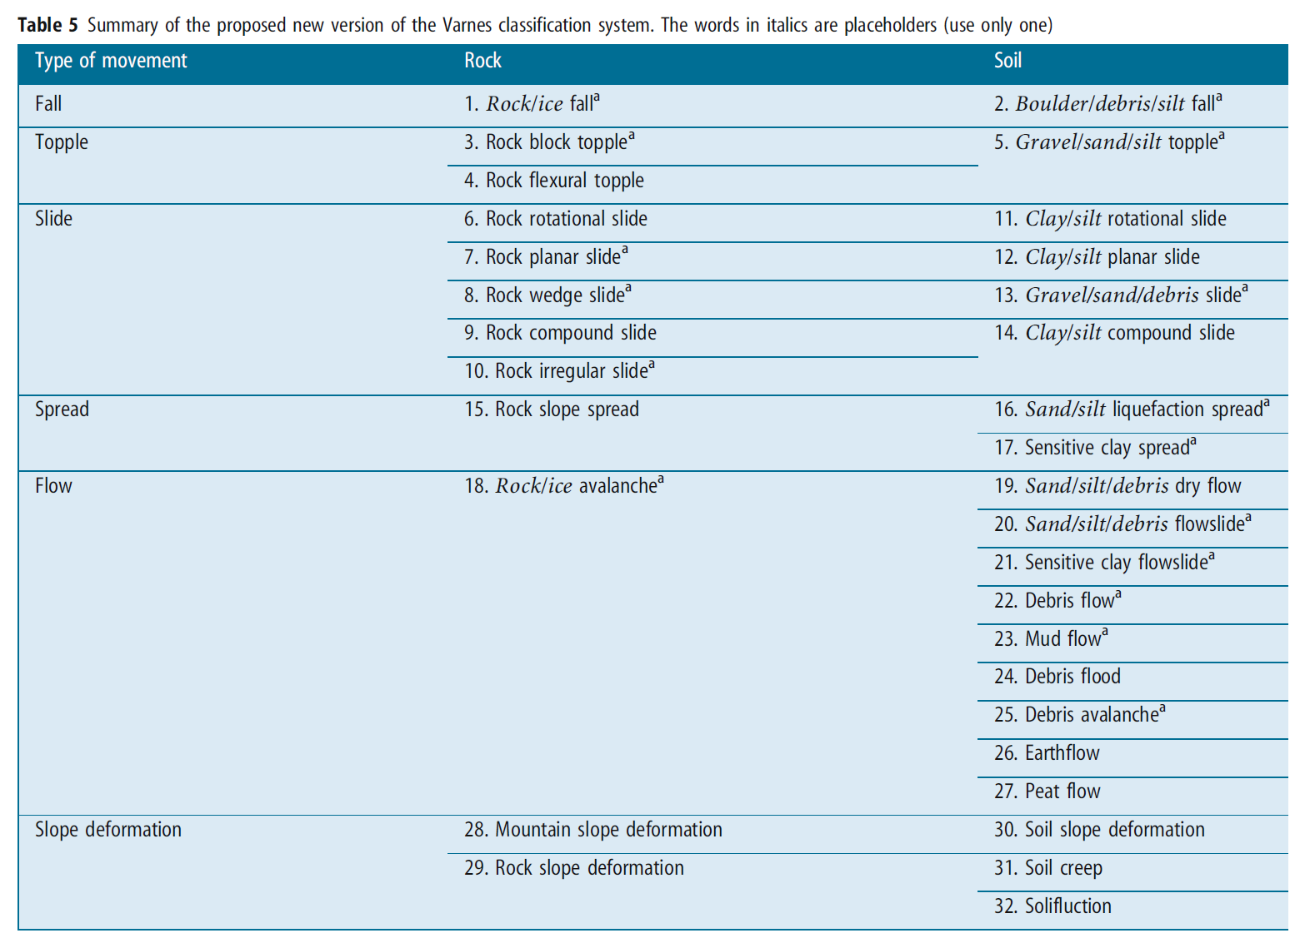



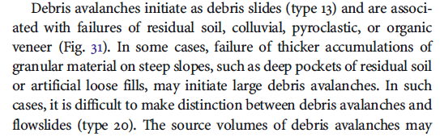
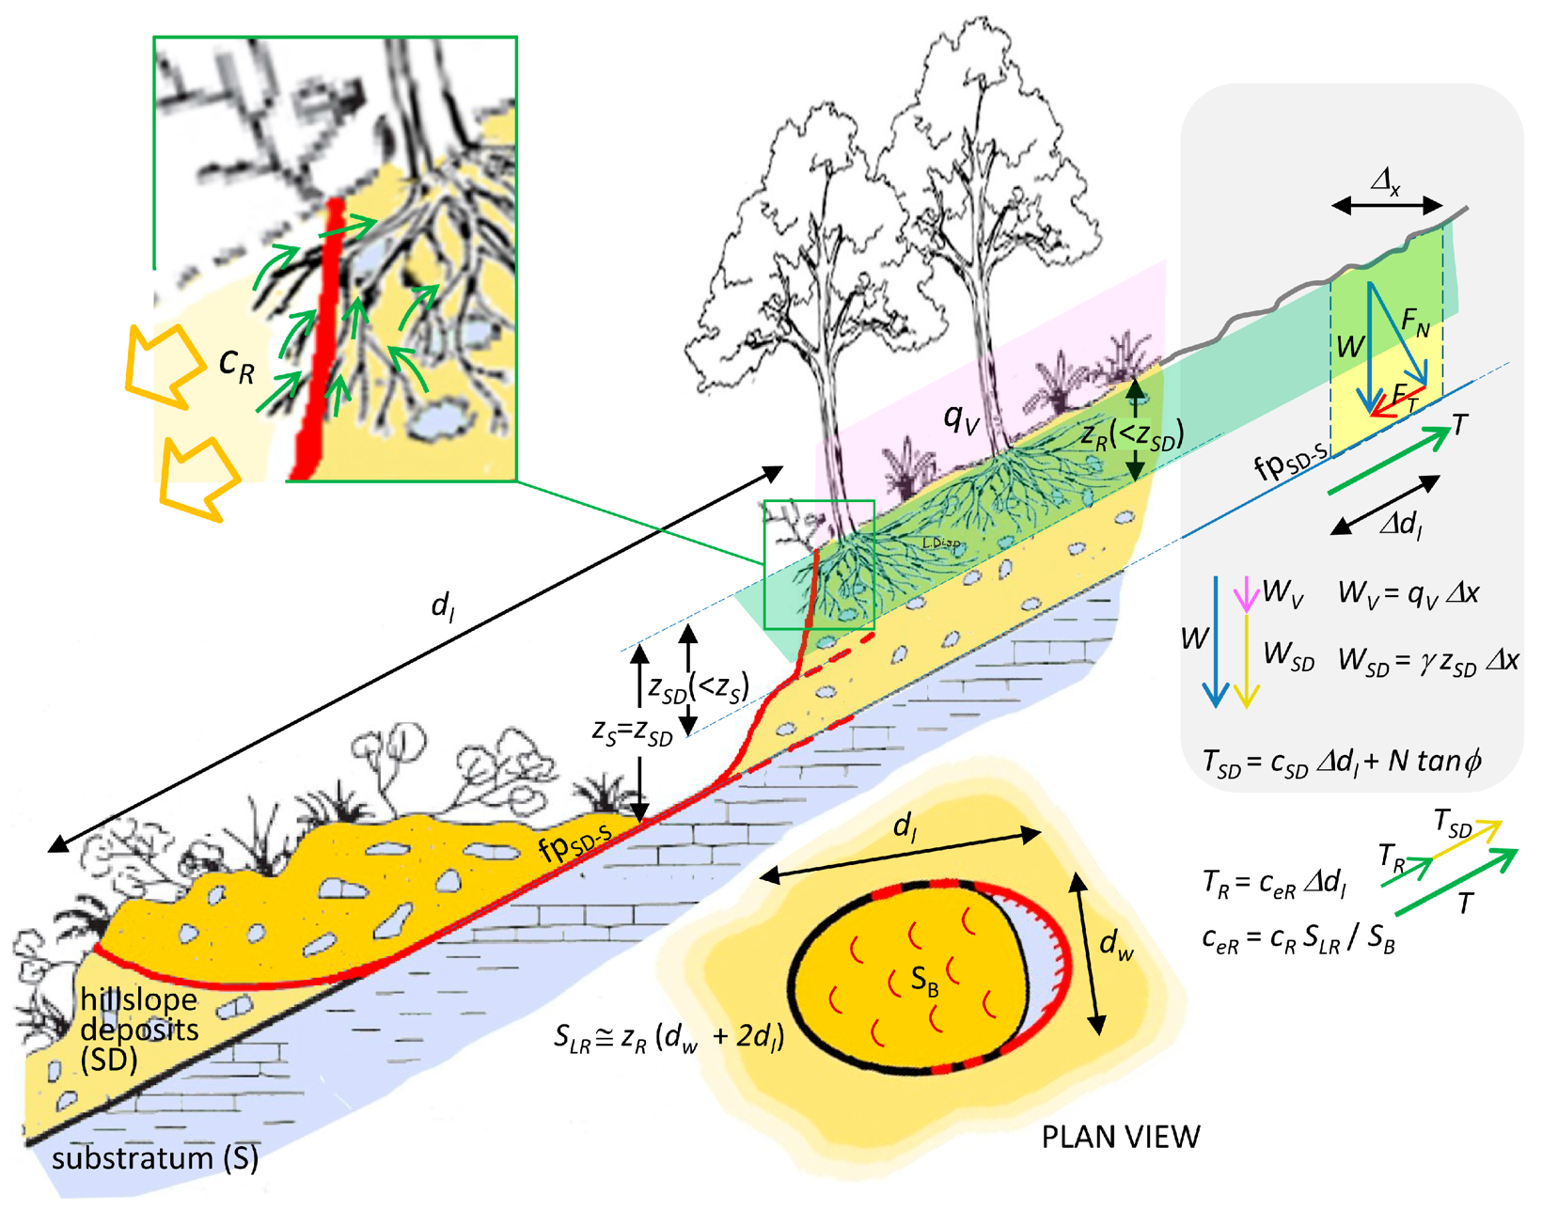
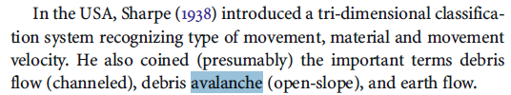
Ground truthing – landslide characterization
Input data
Automatic change detection
Visual detection
Ground truth
Statistical analysis and comparison
Conclusions
Given to the high frequency of flow-like landslides, channelized and open-slope flows have been analyzed separetely.
Topples/Falls are extremely rare in this area.
About 50% of the analyzed landslides developed a failure surface within the bedrock.
Images to support Eduardo: Enrico provide him HUNGR paper
Hungr et al. 2014
Mainly debris/rock avalanche
Failure surface
Mainly debris flows
Mainly planar slides
Failure surface
Shallow landslides in Northern Tuscany (Italy): a new multi-temporal inventory and its spatial and statistical analysis - Enrico D'Addario et al. enrico.daddario@unisi.it
Notes:
Following the updated classification by Hungr et al. (2014), all types of movements highlighted in yellow in the table were identified.
However, in order to analyze the variability of other characteristics (material type, scarp height, and aspect ratio, L/W), landslides were grouped into four main movement types: slide, fall/topple, and flow, with the latter further divided into hillslope flow and channelized flow. This distinction allows us to differentiate between landslides that develop and/or evolve into the minor drainage network, and those that occur on hillslopes.
When referring to shallow landslides, the most appropriate model to describe their development is the infinite slope model, which assumes a mechanical/hydraulic discontinuity at the interface between the slope deposit/soil/colluvium and the underlying bedrock. However, in our study area, we found that in nearly half of the cases, the slip surface is not located at this interface but rather below it. Therefore, the material controlling the rupture development is the weathered and fractured portion of the bedrock.

Slide 17
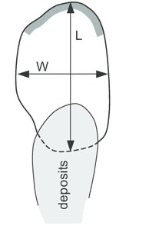
Ground truthing – landslide characterization
Input data
Automatic change detection
Visual detection
Ground truth
Statistical analysis and comparison
Conclusions
Failure surface
Scarp height
Topples/Falls: Highest scarps
Channelized Flows: Lowest scarps → Mostly within slope deposits (typical depth <2 meters)
Slides: Intermediate values reflecting the heterogeneous nature of the involved materials (both slope deposits and fractured bedrock).
Open-slope flows : Widest range, median ~1 m → as for Slides, the nature of the material is responsible for the wide variability
Failure surface
Open-slope flows
Channelized flows
Slides
Topples/Falls
L/W ratio
Topples/Falls: Lowest L/W ratio → Nearly vertical movement with short runout distances.
Slides & Open-slope flows: Intermediate ratios with compact to slightly elongated shapes.
Channelized Flows: Highest L/W ratio → High mobility due to water content and velocity.
Shallow landslides in Northern Tuscany (Italy): a new multi-temporal inventory and its spatial and statistical analysis - Enrico D'Addario et al. enrico.daddario@unisi.it

Slide 18
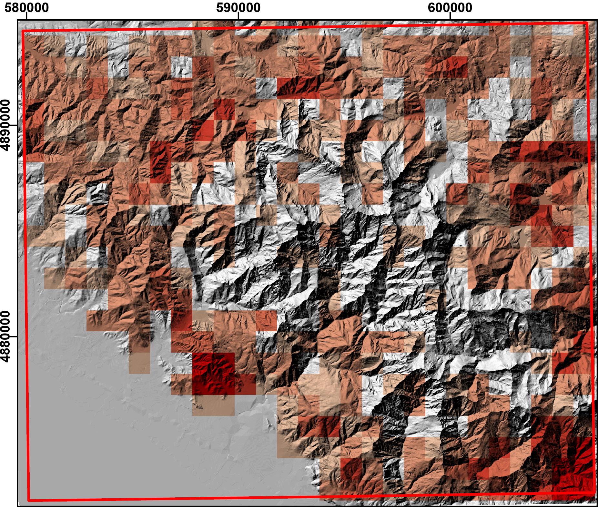
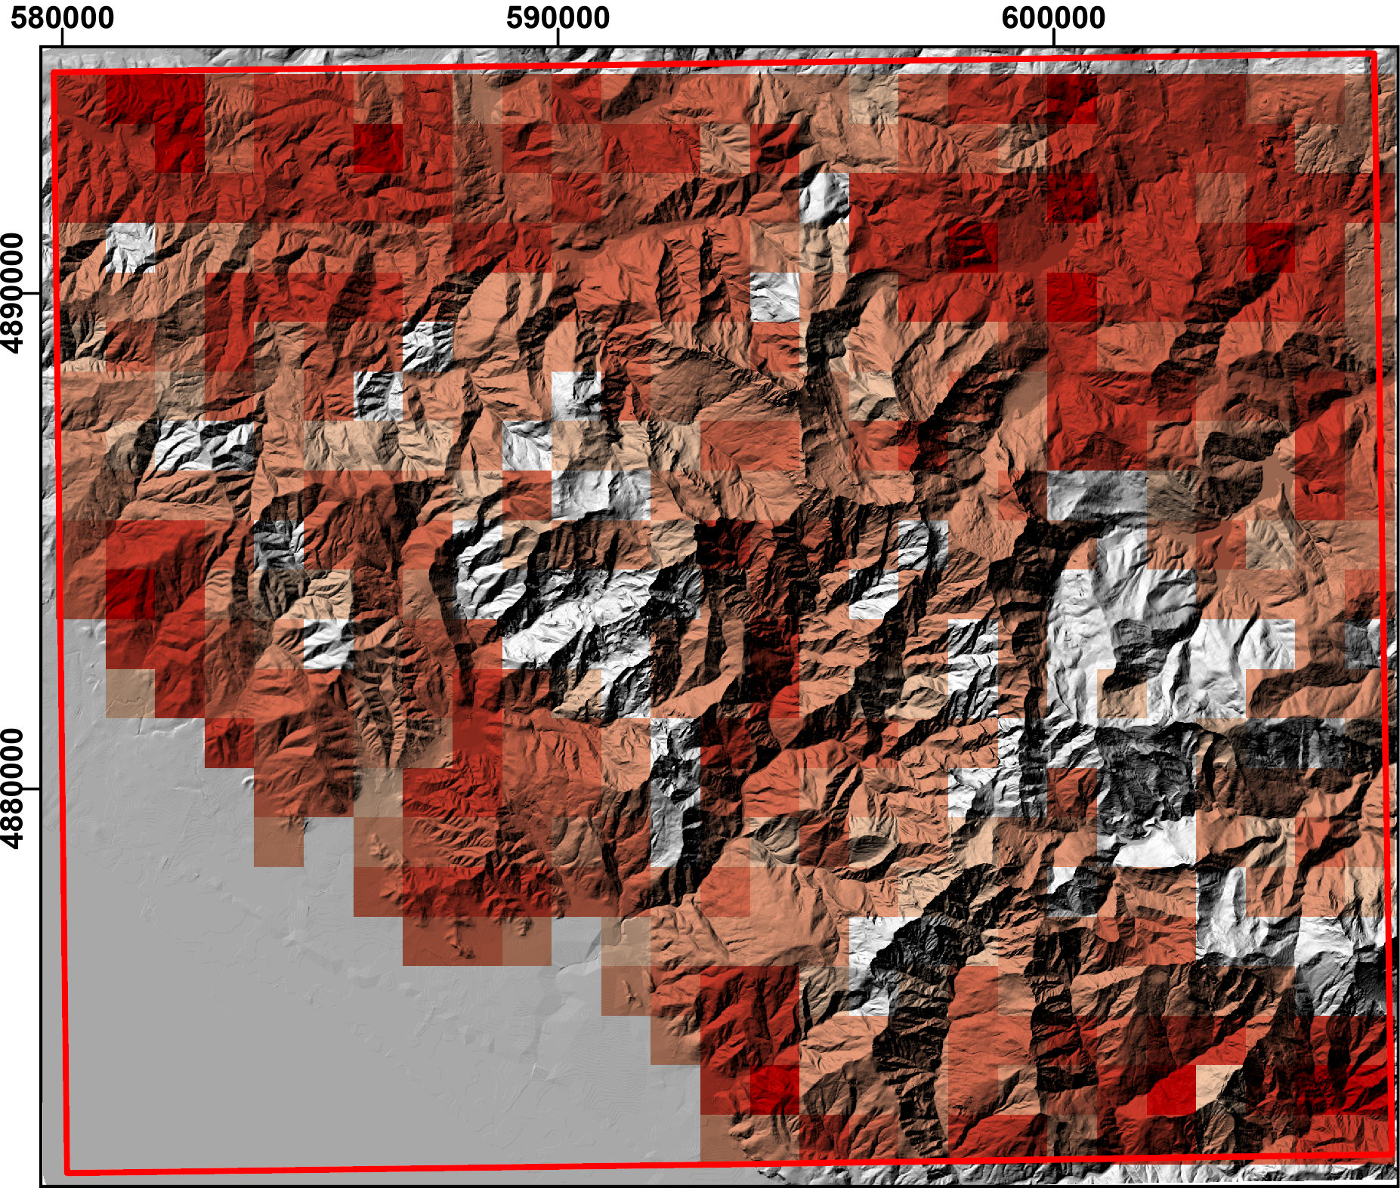
Statistical analysis and comparison – landslide density
https://idrogeo.isprambiente.it/app/iffi?@=41.55172525858242,12.573501484000001,2
Input data
Automatic change detection
Visual detection
Ground truth
Statistical analysis and comparison
Conclusions
No landslides
1 – 2 #/km²
3 - 5
6 - 10
11 – 25
>25
DBSL
Multitemporal landslide inventory, 1409 landslides occurred between 1954 and 2021
IFFI
Historical inventory (≈3800) obtained via photointerpretation and field survey, following standard national-scale method
Shallow landslides in Northern Tuscany (Italy): a new multi-temporal inventory and its spatial and statistical analysis - Enrico D'Addario et al. enrico.daddario@unisi.it
DBSL
1409 landslides occurred between 1978 and 2021
Notes:
DBSL is a multitemporal inventory that includes 1409 landslides recorded between 1978 and 2021. There are large areas in the central and northern portions of the study area showing no landslides or low densities (1–5 landslides/km²), some high-density areas (>10/km²) are present but less widespread. IFFI is an historical inventory contains approximately 3800 landslides in this area, identified through photo-interpretation and field surveys using a standardized national methodology. It displays significantly higher landslide densities across most of the study area in respect to DBSL, with many grid cells exceeding 11 or even 25 landslides/km², especially in the S and E-NE sectors.
In IFFI inventory the larger number of landslides is due to its broader temporal scope and methodological differences. In contrast, the DBSL likely focuses on more recent events visible in multi-temporal aerial imagery. These differences are responsible for the spatial mismatch, especially in high-density areas.

Slide 19
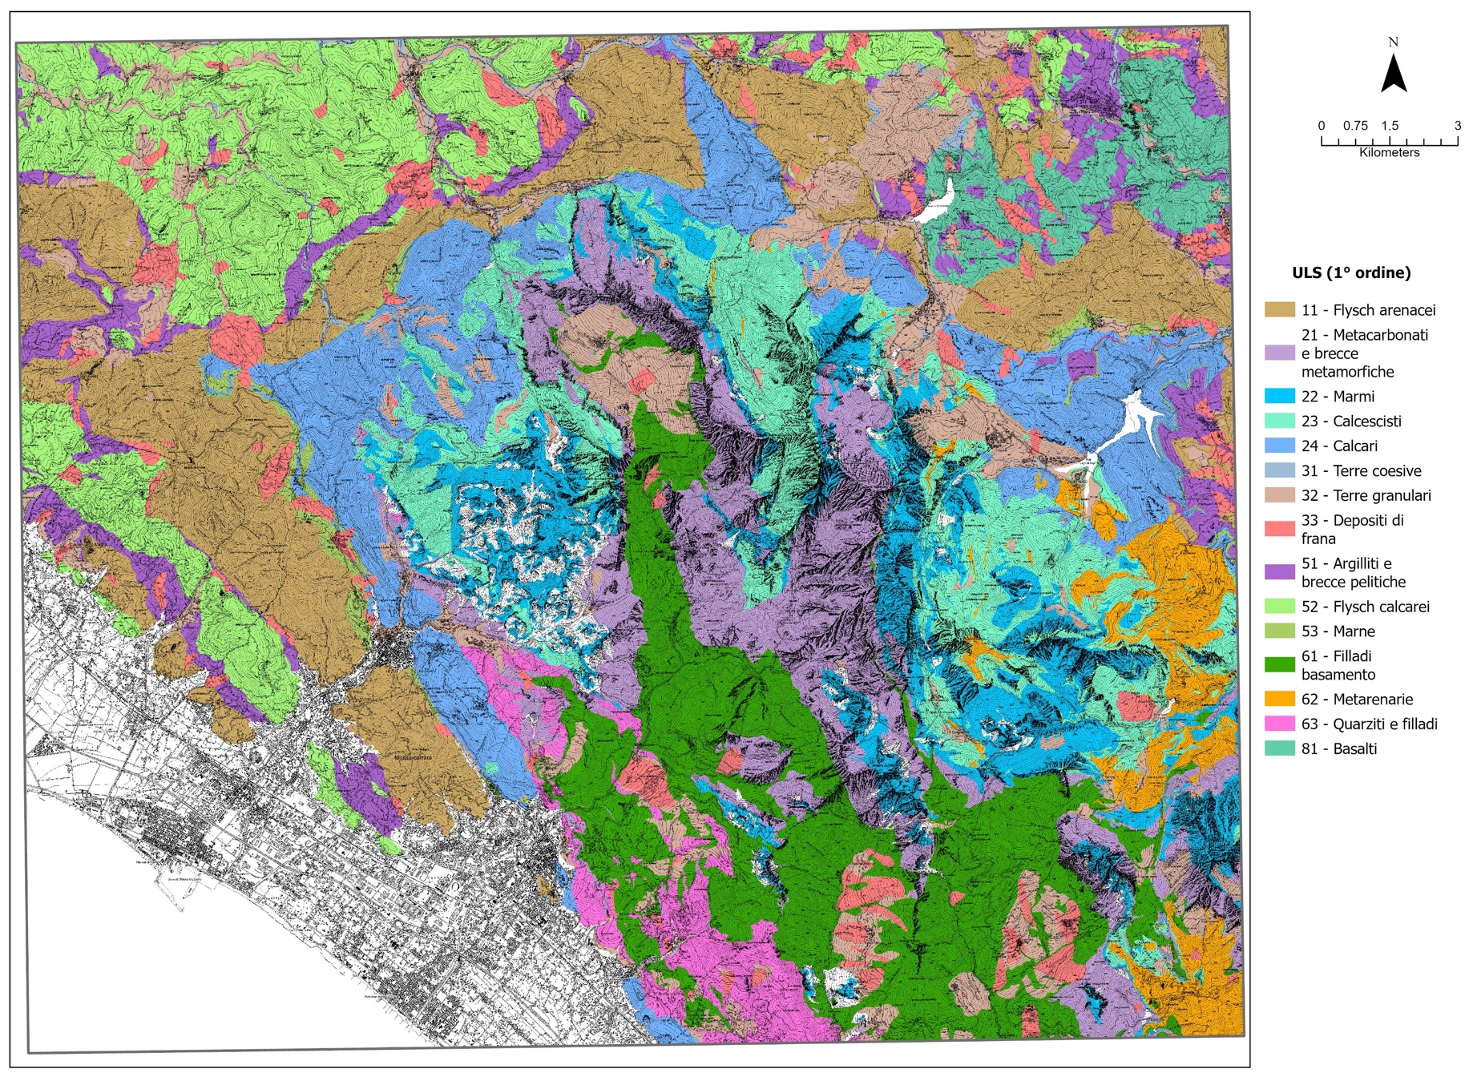
Statistical analysis and comparison – Lithology
Input data
Automatic change detection
Visual detection
Ground truth
Statistical analysis and comparison
Conclusions
ULS | Description
11 | Arenaceos flysch
21 | Metacarbonates and metamorphic breccias
22 | Marbles
23 | Calcschists
24 | Limestones
31 | Cohesive weak rocks and soils
32 | Granular weak rocks and soils
33 | Landslide deposits
51 | Argillites and pelitic breccias
52 | Calcareous flysch
53 | Marls
61 | Phyllites
62 | Metarenites
63 | Quartzites
81 | Basalts
99 | Quarry deposits
Lithological classification of geological map at 1:50,000 scale from
National Geological Mapping Project (CARG)
Shallow landslides in Northern Tuscany (Italy): a new multi-temporal inventory and its spatial and statistical analysis - Enrico D'Addario et al. enrico.daddario@unisi.it
DBSL
1409 landslides occurred between 1978 and 2021
Notes:
The difference in landslide density between the DBSL and IFFI inventories is also reflected in their distinct distribution across lithological classes. Excluding lithological class 33 (landslide deposits)—which is biased due to the reciprocal inclusion of IFFI polygons in the geological map and vice versa—many lithological units with low landslide density in the DBSL inventory show very high densities in the IFFI dataset.
This is particularly evident for units such as Argillites and pelitic breccia, Calcareous Flysch, and Basalts.
Conversely, landslide density in Arenaceous Flysch is nearly identical in both inventories.
The only lithological class where DBSL records more landslides than IFFI is Metarenites, which is notably the most affected unit during the 1996 Cardoso event, a key landslide episode in the study area.

Slide 20
Statistical analysis and comparison – Morphometry
Input data
Automatic change detection
Visual detection
Ground truth
Statistical analysis and comparison
Conclusions
DBSL
TOTAL
IFFI
Shallow landslides in Northern Tuscany (Italy): a new multi-temporal inventory and its spatial and statistical analysis - Enrico D'Addario et al. enrico.daddario@unisi.it
Notes:
All datasets are strongly concentrated around zero, but with some differences: DBSL shows a higher frequency of negative transversal and longitudinal curvature, suggesting more concave areas.
DBSL landslides are more frequent in areas with lower contributing area, likely representing small catchments or hill slopes.
DBSL landslides are associated with steeper slopes, peaking between 40°–50° while IFFI is most frequent around 30°–40°
DBSL has a clear preference for southeast (135°–180°) and south-facing slopes. IFFI landslides are more evenly distributed, with peaks between west (270°) and northwest (315°).
In summary DBSL is associated with more critical terrain conditions: steeper slopes, concave curvature, and smaller contributing areas associated with high-energy environments, making it a more selective dataset in respect to IFFI.

Slide 21
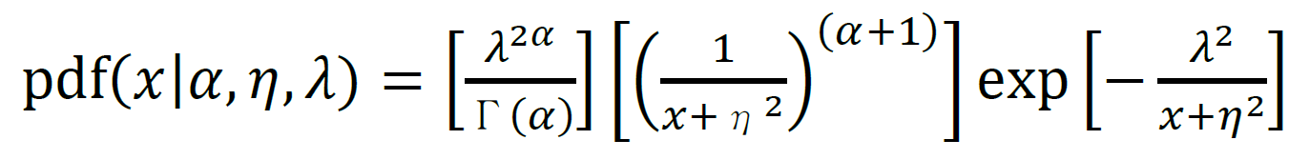
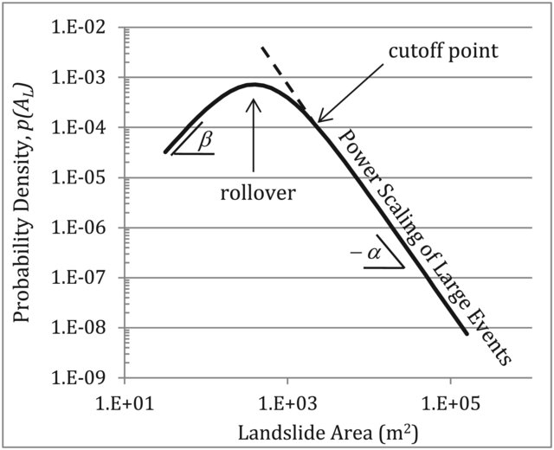
Statistical analysis and comparison – size-frequency
Input data
Automatic change detection
Visual detection
Ground truth
Statistical analysis and comparison
Conclusions
Inverse gamma distribution
Johnson&Kotz (1970)
α controls the exponent of the inverse power law (right tail)
η controls the amount the left tail bends
λ controls the position of the rollover
η
 | DBSL | IFFI
α | 1.32 | 1.15
η | 6.91 | 26.13
λ | 19.01 | 68.72
Rollover (m²) | 108 | 1512
Cutoff point (m²) | ≈500 | ≈10000
Tebbens (2020)
Shallow landslides in Northern Tuscany (Italy): a new multi-temporal inventory and its spatial and statistical analysis - Enrico D'Addario et al. enrico.daddario@unisi.it
Notes:
DBSL shows a higher frequency of small landslides, aligning well with the lower size threshold (~20 m²) suggested by Malamud et al. (2004).
IFFI is significantly shifted to the right, meaning it includes generally larger landslides, with a substantial number of very large events (compare rollover and cutoff values)
The overall shape of the two distributions differs from the Malamud curve, highlighting how:
DBSL emphasizes small-scale, possibly recent or triggered events.
IFFI reflects a more generalized inventory, likely influenced by mapping scale, methodology, or historic records.

Slide 22
Conclusions/1
Input data
Automatic change detection
Visual detection
Ground truth
Statistical analysis and comparison
Conclusions
Landslide inventories are fundamental tools for susceptibility and hazard assessments, but they must be critically analyzed and chosen according to the modeling objective.
A rigorous, multi-step mapping approach was adopted for the DBSL, combining both automated and visual methods to improve inventory reliability.
  In selected areas, we applied automated change detection (MINDED-FBA) to identify zones of bi-temporal change. These were then classified into potential positives and negatives to support visual interpretation.
  Across the whole study area, we conducted visual interpretation of orthophotos acquired in 10 different epochs, followed by delineation of features and displacement azimuth vectors.
  Expert cross-validation and ground truthing provided detailed information about inventory accuracy and landslide characteristics.
Shallow landslides in Northern Tuscany (Italy): a new multi-temporal inventory and its spatial and statistical analysis - Enrico D'Addario et al. enrico.daddario@unisi.it

Slide 23
Conclusions/2
Input data
Automatic change detection
Visual detection
Ground truth
Statistical analysis and comparison
Conclusions
Comparison with IFFI (Italian National Inventory) highlights striking differences in terms of landslide size, distribution, density, and associated morphometric and lithological patterns. These differences would potentially result in modeling inconsistencies if used interchangeably.
DBSL offers high-resolution multi-temporal change detection, making it suitable for detailed, localized studies and for investigating the triggering epoch and conditions. However, the methodology implies significant time and resource requirements.
Ultimately, the choice of methodology used to build the inventory must align with the study scale, objective, and required temporal resolution. Overlooking inventory limitations and characteristics can lead to misleading interpretations and inaccurate hazard assessments.
Shallow landslides in Northern Tuscany (Italy): a new multi-temporal inventory and its spatial and statistical analysis - Enrico D'Addario et al. enrico.daddario@unisi.it

