Slide 1
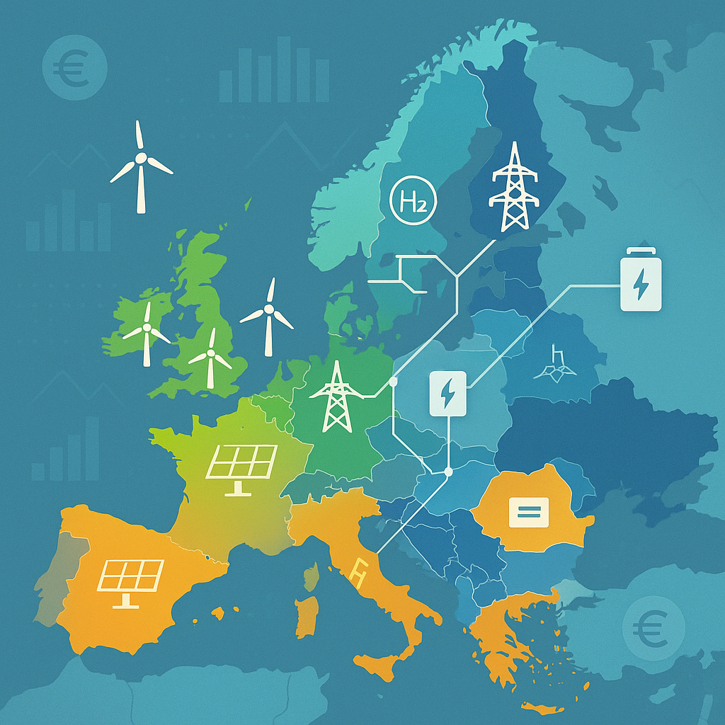


s
EGU25-19690 / ITS3.14/ERE6.5
Comparing cost-optimal scenarios for a decarbonised European energy system
Natasha Frilingou (NTUA)
Dirk-Jan Van de Ven (BC3)
Russel Horowitz (BC3)
Clàudia Rodés Bachs (BC3)
Shivika Mittal (CICERO)
Alexandre Torne (UNIGE)
Evelina Trutnevyte (UNIGE)
Konstantinos Koasidis (NTUA)
Alexandros Nikas (NTUA)
Notes:
Motivation to submit was to assess how moving from macro regions targets to country level targets could affect modelling results, and how this change of scale could be important in IAMs

Slide 2


Background
Policy Response Mechanism
Core Working Groups
Electrification
Question 1
How does the implementation of the updated National Energy and Climate Plans compare to the cost optimal approach at a European level?
What are the offshore grid investment needs to meet the EU’s 2030 targets?
Question 2
Notes:
In this study we are focusing on the cost optimal approach for now.

Slide 3
Scenario co-design
EU_FF55
EU must achieve FF55 and net zero emissions levels by 2030 and 2050.
EU_NECP
Specific to individual EU member states. Each member state achieves NECP targets of CO₂ emissions from fossil fuels and industrial sources in 2030 and 2050.
In both scenarios, EU emissions reductions are accomplished through emissions constraints without considering the current climate policies throughout, allowing the model to select the cost-optimal pathway for reducing emissions.

Slide 4
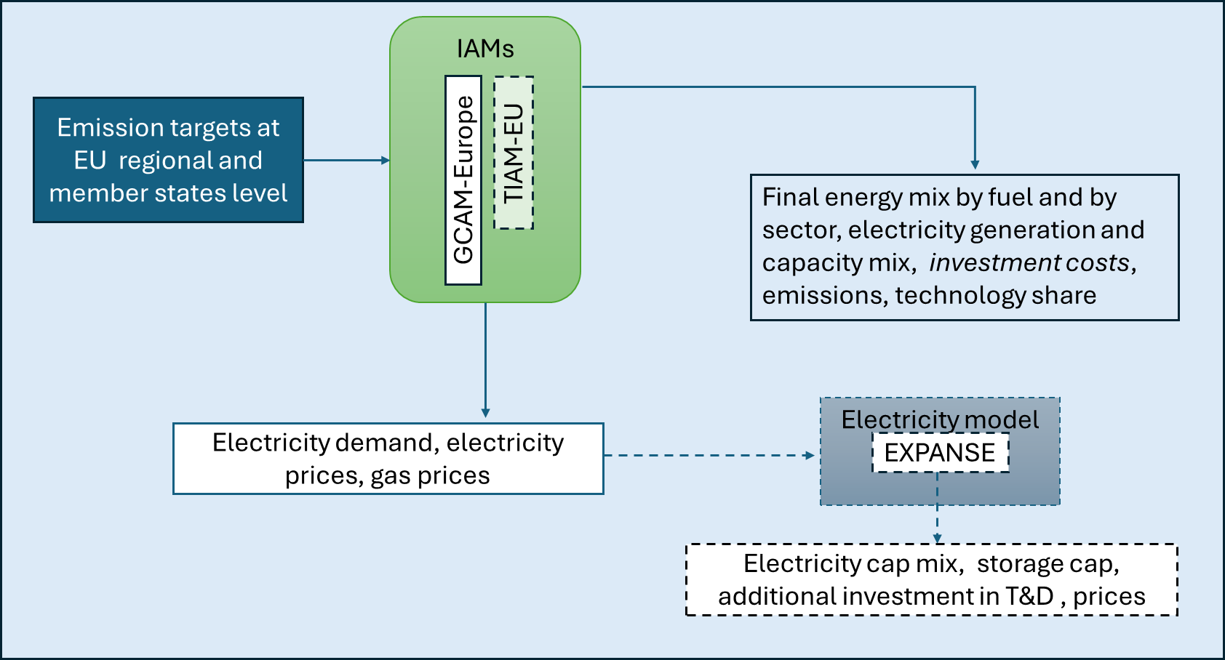
Study framework
WIP
Notes:
Dashed lines: Work in progress

Slide 5
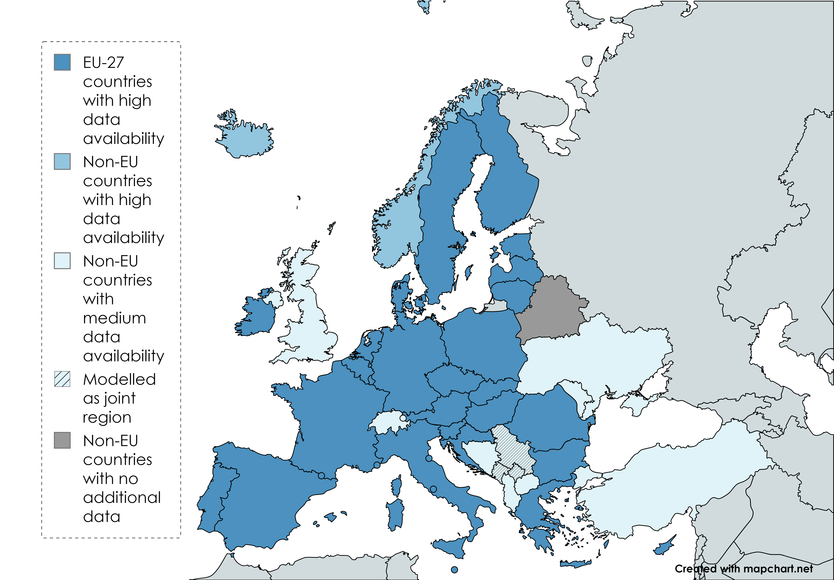
GCAM-Europe v7.1.1
Regional aggregation
Notes:
Jointly modelled Montenegro, Kosovo, Serbia

Slide 6
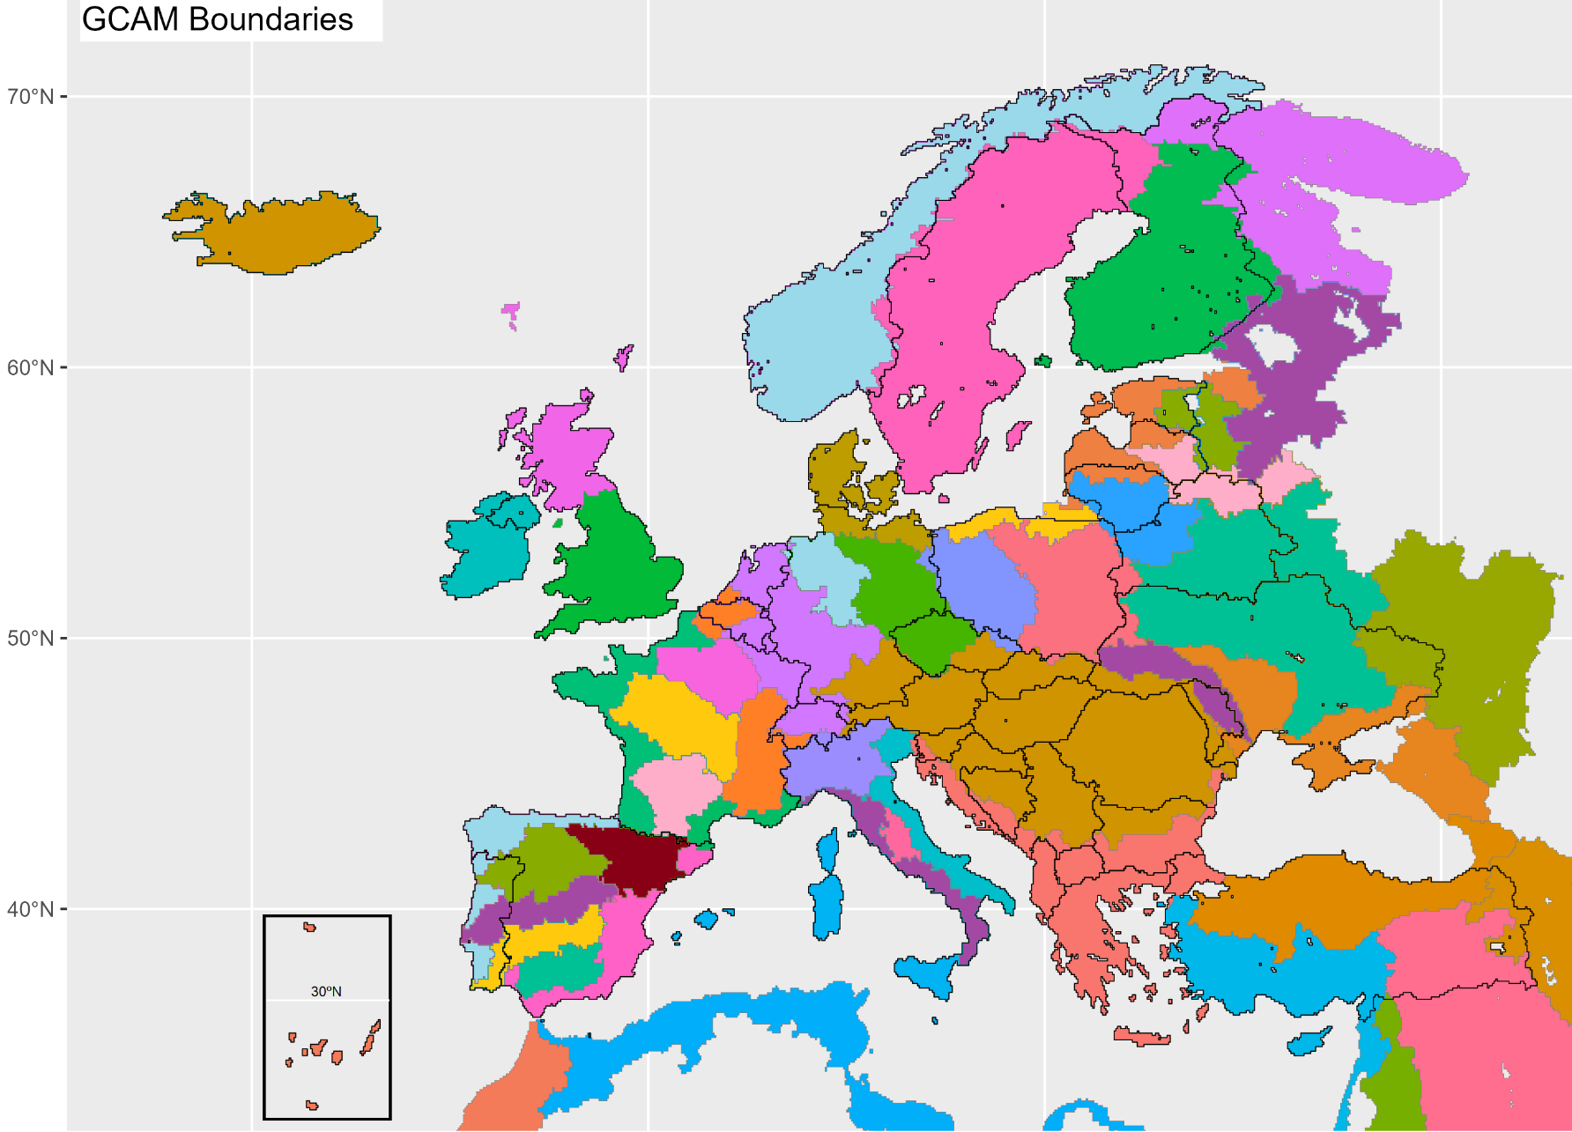
GCAM-Europe v7.1.1
Geographical coverage of land/water regions
Representation of land and water dynamics on sub-regional water basin scale:
- Land use & land cover
- Agriculture
- Forestry
119 total land regions
(intersection of water basins and country borders)

Slide 7
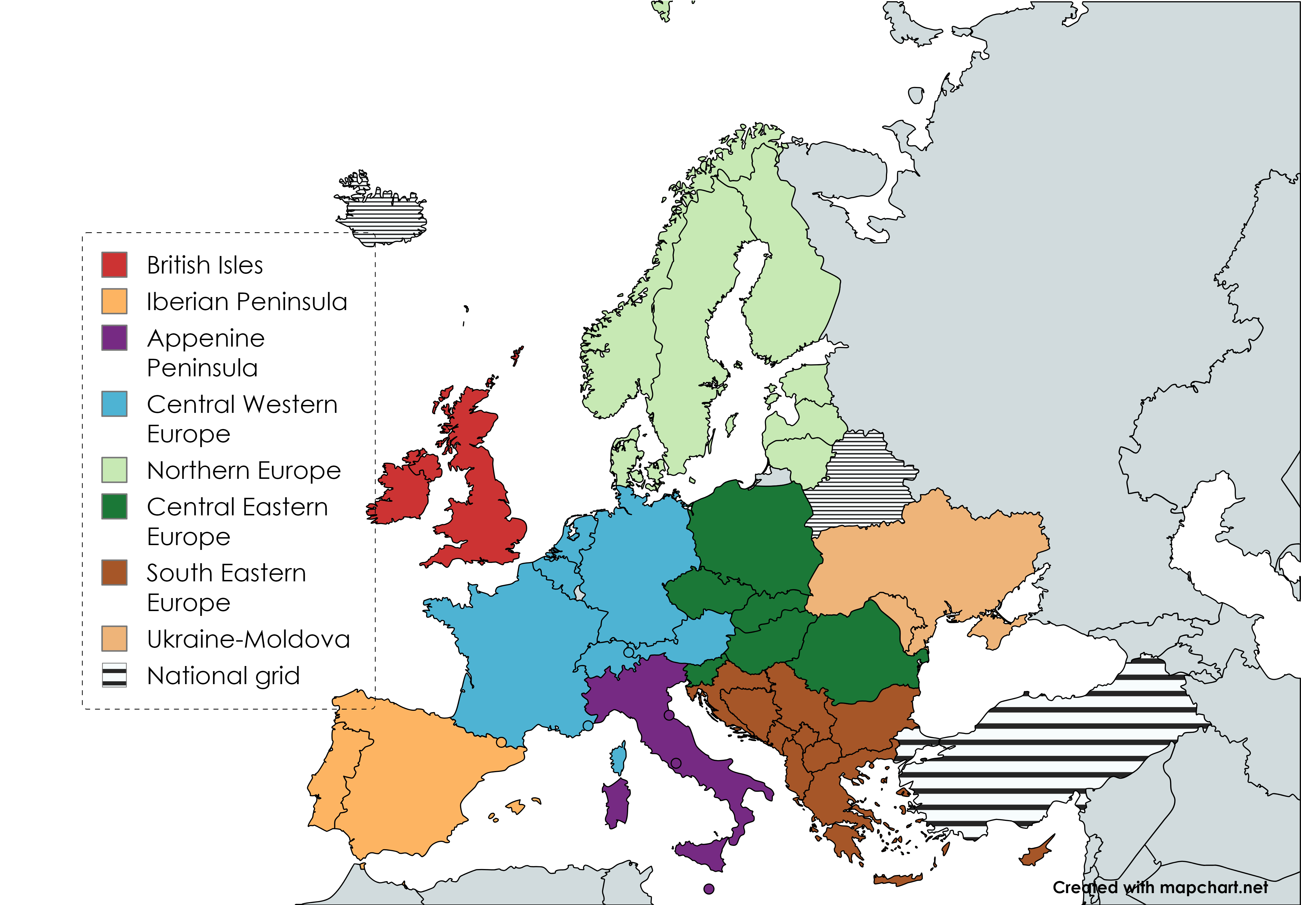
GCAM-Europe v7.1.1
Electricity dynamics and trade
Electricity in each “grid region” is a common market pool between countries.
In collaboration with Comillas, improving detail in specific grid dynamics and interactions.

Slide 8
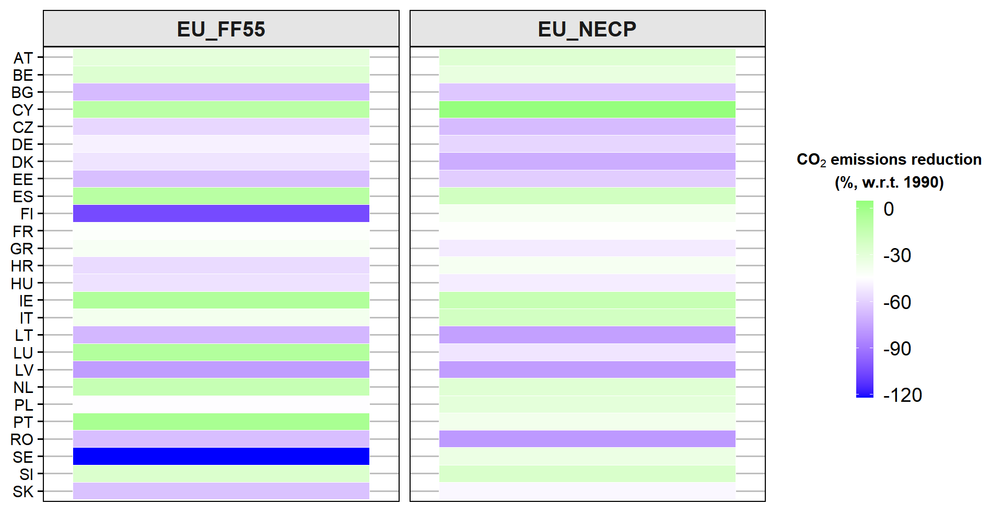
Emissions
Results
EU-wide target shifts mitigation efforts towards to countries like FI and SW, as constraints in resource availability of smaller countries makes abatement more expensive
Notes:
Constraints in resource availability makes it more difficult to mitigate in smaller countries, when forcing the model to do so based on NECP targets

Slide 9
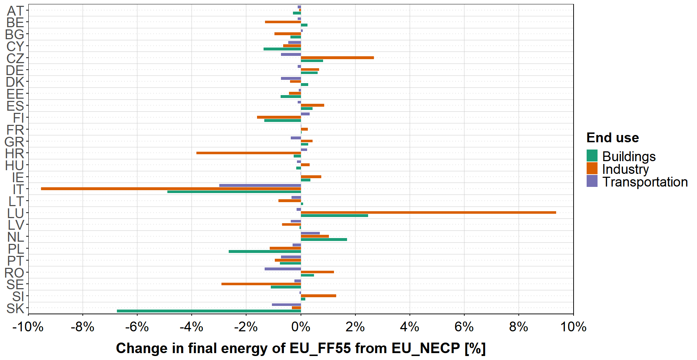
Results
Final energy consumption
Overall reduced consumption across end-use sectors in EU_FF55, more pronounced in industry & buildings

Slide 10
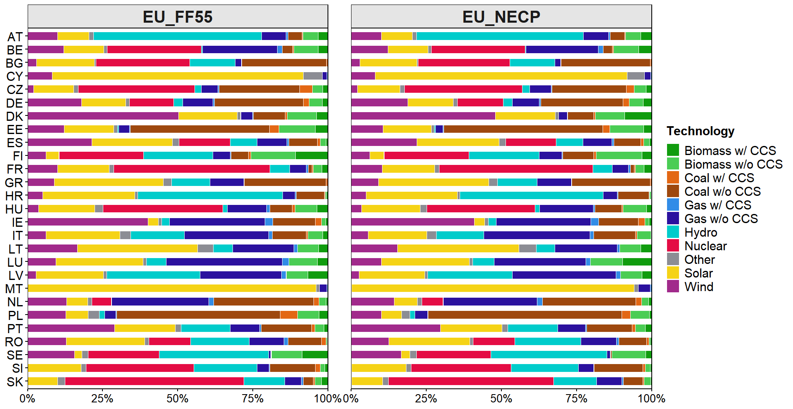
Results
Share of technology in electricity production
Overall, MS with higher mitigation in EU_FF55 (FI, SW, IT) abate using mostly BECCs and RES compared to EU_NECP.

Slide 11
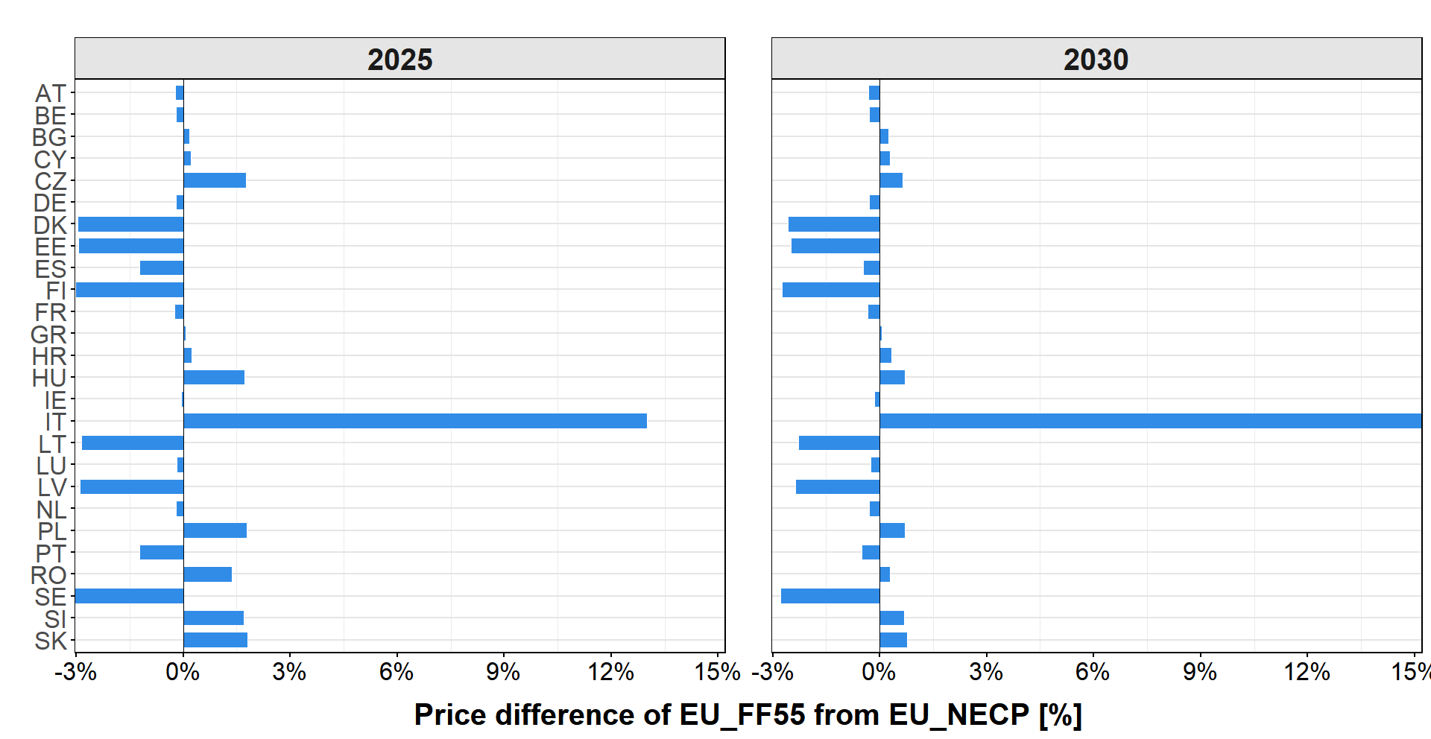
Results
Electricity price difference (EU_FF55 - EU_NECP)
Overall, prices followed mitigation patterns between scenarios – less mitigation leads to lower prices DK, ES).
When counties can cheaply abate (FI, SW), they lower single CO₂ price and marginal gen cost of any remaining fossil fuels, and thus elec price

Slide 12
Future work
Additional testing in GCAM-Europe to extend the runs to 2050
Two scenario variants with additional policy constraints besides emission caps
Compare with TIAM-EU (inter-temporal optimisation, winner-takes-it-all) for increased robustness of model insights
Soft-link IAMs with EXPANSE electricity system model

Slide 13
Future work
Additional testing in GCAM-Europe to extend the runs to 2050
Two scenario variants with additional policy constraints besides emission caps
Compare with TIAM-EU (inter-temporal optimisation, winner-takes-it-all) for increased robustness of model insights
Soft-link IAMs with EXPANSE electricity system model

Slide 14
Future work
Additional testing in GCAM-Europe to extend the runs to 2050
Two scenario variants with additional policy constraints besides emission caps
Compare with TIAM-EU (inter-temporal optimisation, winner-takes-it-all) for increased robustness of model insights
Soft-link IAMs with EXPANSE electricity system model

Slide 15
Future work
Additional testing in GCAM-Europe to extend the runs to 2050
Two scenario variants with additional policy constraints besides emission caps
Compare with TIAM-EU (inter-temporal optimisation, winner-takes-it-all) for increased robustness of model insights
Soft-link IAMs with EXPANSE electricity system model

Slide 16
Natasha Frilingou; nfrilingou@epu.ntua.gr (NTUA)
Dirk-Jan Van de Ven (BC3)
Russel Horowitz (BC3)
Clàudia Rodés Bachs (BC3)
Shivika Mittal (CICERO)
Alexandre Torne (UNIGE)
Evelina Trutnevyte (UNIGE)
Konstantinos Koasidis (NTUA)
Alexandros Nikas (NTUA)

