Slide 1
Precise Estimation of
Snow Water Equivalent with
GPS and Galileo measurements
Patrick Henkel, Markus Lamm and Franziska Koch

Slide 2
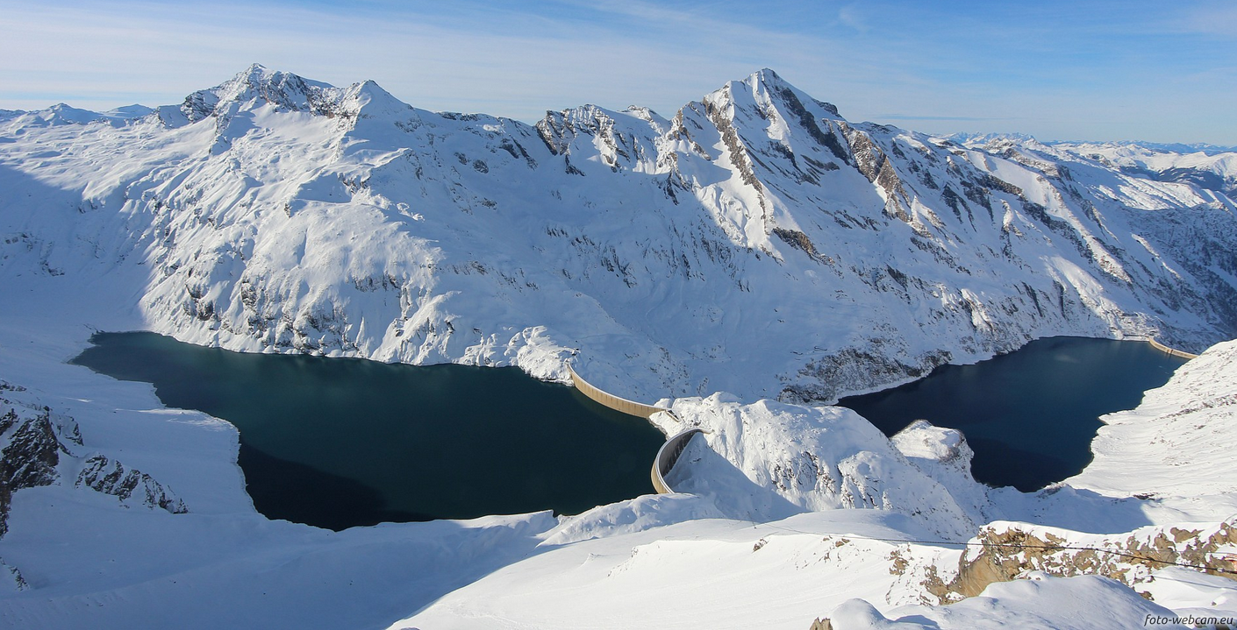
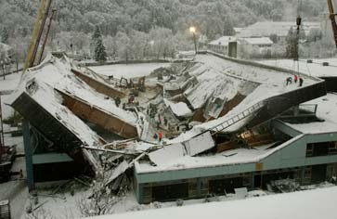
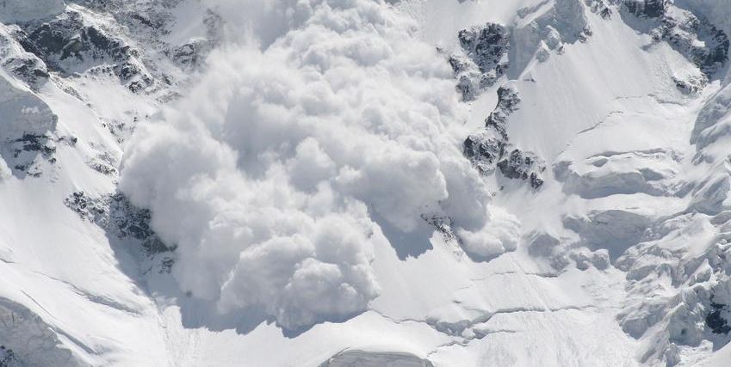
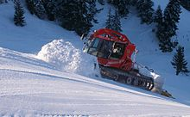
Snow Monitoring Applications

Slide 3
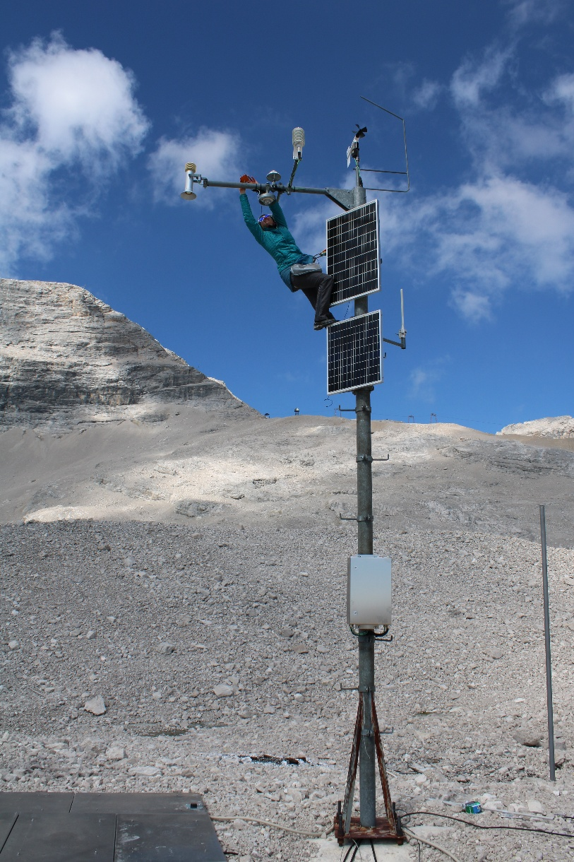
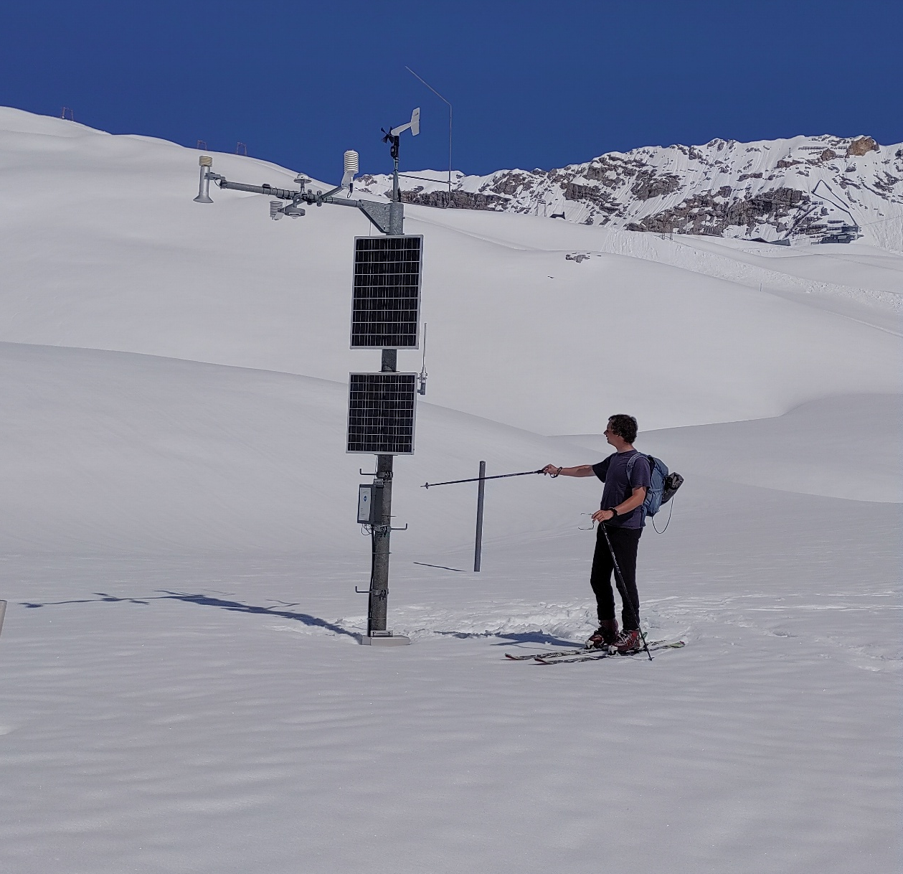
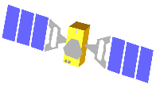

GNSS-based Snow Monitoring at Zugspitzplatt (2420 m)
GPS +
Galileo

Slide 4
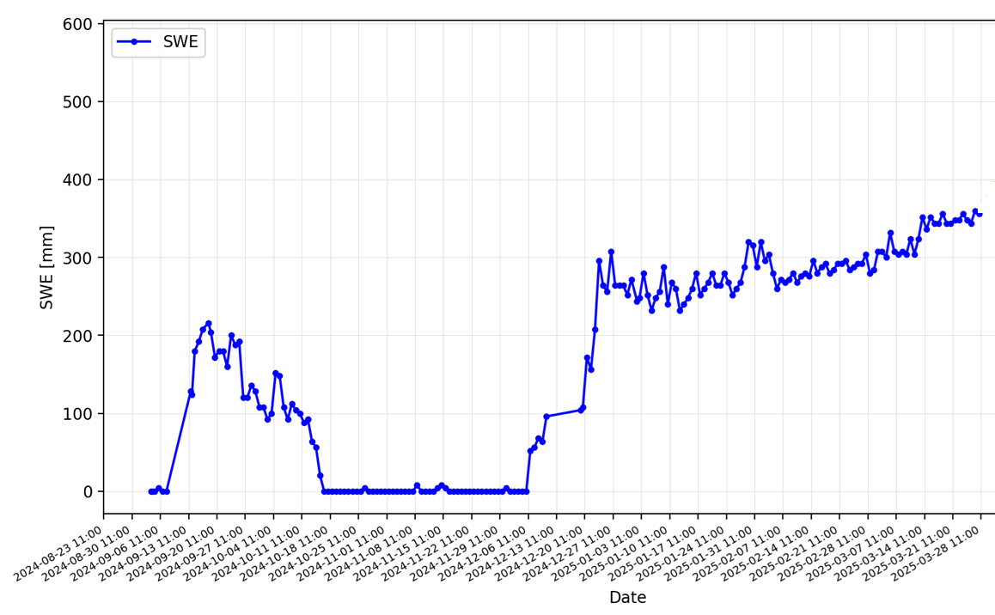
GNSS-based SWE estimates at Zugspitzplatt (2420 m) in winter 2024/ 2025
3 months without almost any precipitation
early snowfall
event in September

Slide 5
Continuous monitoring through Kalman filter
Kalman filter
based fixed solution
Single epoch float solution
Fast convergence

Slide 6



Physical Effects of Snow
on GPS + Galileo Signals
GNSS
reference antenna
③ Refraction at
air-snow interface
according to Snell‘s law
① Snow-induced time delay
due to reduced speed of
signal propagation in snow
snow
② Signal attenuation due to snow,
mainly due to
Liquid Water Content (LWC)
GNSS antenna below snow

Slide 7
Modeling of GNSS measurements
Double differenced carrier phase measurement
between two GNSS receivers and two satellites:
Integer
Ambiguity
Snow Water Equivalent (SWE)
Relative position („baseline“)
between both GNSS receivers

Slide 8
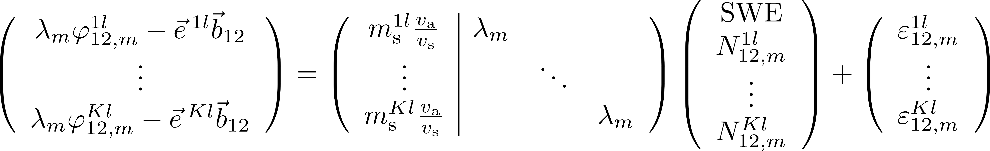
Modeling of GNSS measurements
Double differenced carrier phase measurement
between two GNSS receivers and two satellites:
Stacking measurements from all satellites gives:
Rank-defect by 1.
Consideration of time series of measurements needed to obtain full-rank system of equations.

Slide 9
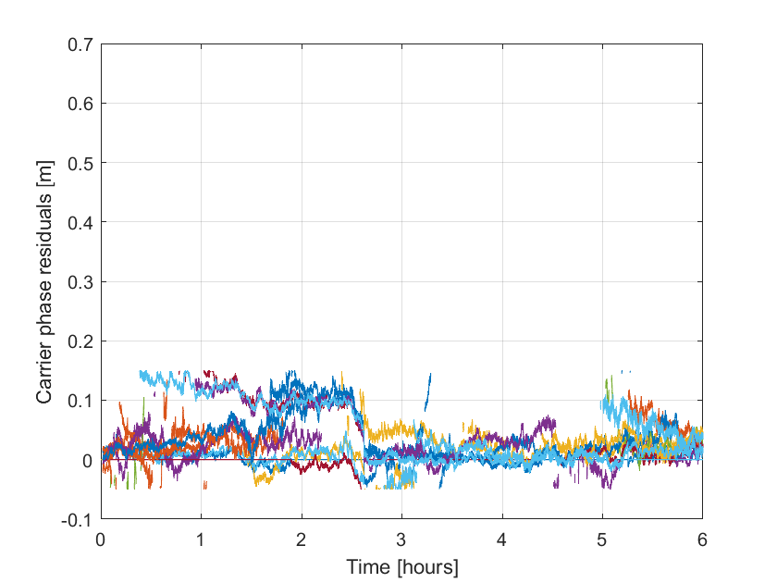
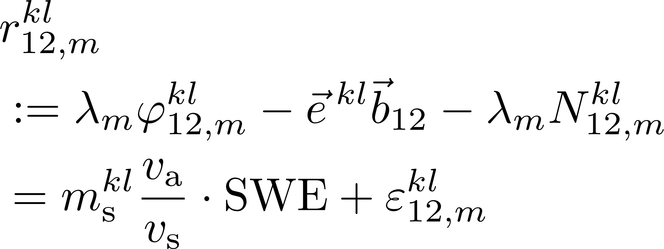
Measurement basis – GNSS carrier phases
Snow-free day

Slide 10
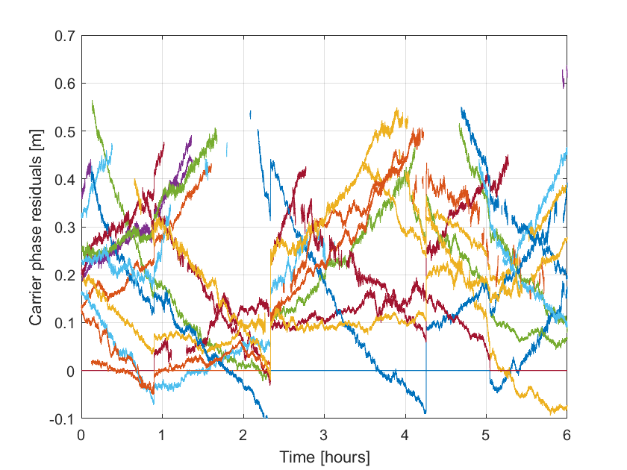
Measurement basis – GNSS carrier phases
Snow-free day

Slide 11
GNSS-based Snow Parameter Estimation
Calibration: RTK positioning at a snow-free time.
Joint estimation of relative position between both GNSS antennas and carrier phase double difference ambiguities
Snow Parameter Estimation
Kalman filter based estimation of SWE and float ambiguities
Integer ambiguity fixing with LAMBDA method
Least-squares adjustment of SWE estimates
Determination of snow height/ depth and LWC

Slide 12
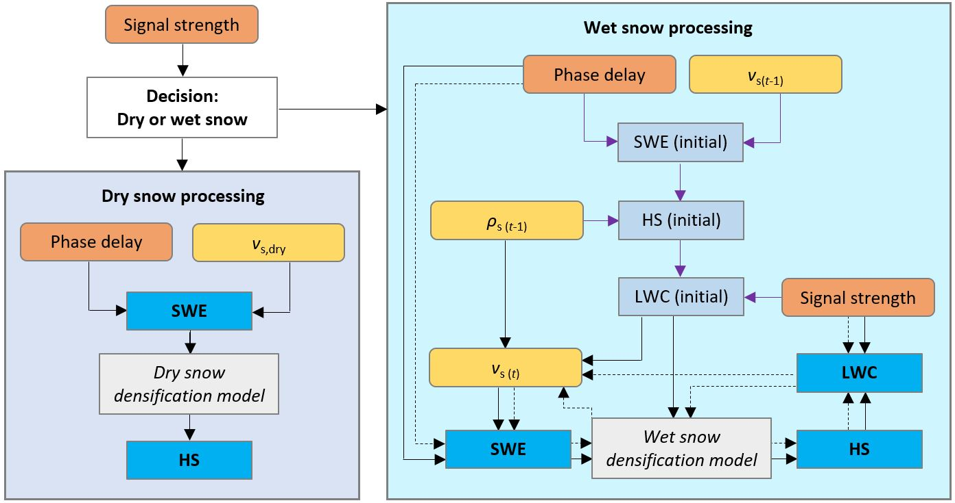
Consideration of both dry and wet snow conditions
References: Henkel et al., 2018 (IEEE Transactions on Geoscience and Remote Sensing) and Koch et al., 2019 (Water Resources Research)

Slide 13
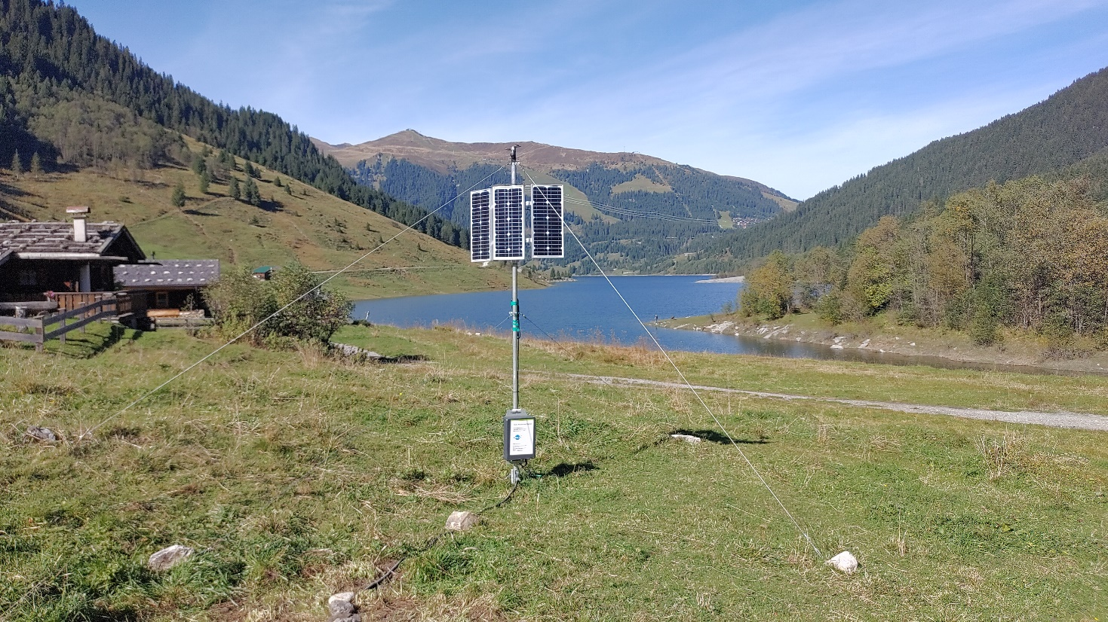
ANavS Snow Monitoring Station
GPS +
Galileo
- Easy to carry
and install
by a single person
- No foundation
required
- No flat ground
required
- Completely
autonomous
operation with
solar power &
satellite communication

Slide 14

Contact data
ANavS GmbH
Gotthardstraße 40
80686 München
Germany
ANavS Sensor Technologies GmbH
Weißstraße 9
6112 Wattens
Austria
Advanced Navigation Solutions
We are the Collaborative Change Makers.
Managing directors: Dr.-Ing. habil. Patrick Henkel and Andreas Sperl
Phone number: +49 - (0)89 - 890567 - 21
Emails: patrick.henkel@anavs.de
patrick.henkel@anavs-sensor-tech.at
Web: www.anavs.com

