Slide 1
On the Long-Term Propagation of Contrails using a Novel High-Fidelity
Advection-Diffusion Model
Amin M. Jafari, Postdoctoral Researcher,
Aerospace Engineering Department, Universidad Carlos III de Madrid
May 2nd, 2025

Slide 2
Content
Problem Statement
A High-Fidelity Eulerian Framework for Long-Term Contrail Evolution
Settling Velocity v.s. Terminal Velocity
Solution Methodology
Results

Slide 3
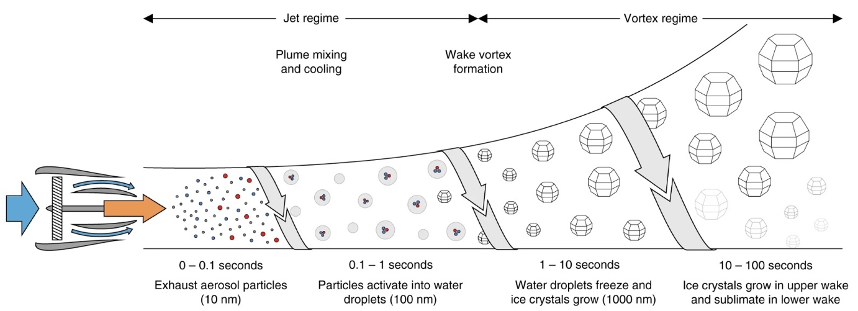
Problem Statement
Contrails undergo multiple regimes/stages right after their birth to eventually becoming cirrus clouds.

Slide 4
Problem Statement
Microphysics for ice-particle growth
and shape evolution:
Starting with PBE:
Together with the particle velocity vp:
b
We can derive the moment equations as:
equatorial radius (a): $φ=\frac{b}{a}$
where, m(x,t) is the representative particle mass in control volume, and cN (x,t)is
number concentration.
The interaction between the flow and solid phases is governed by:
where
$${\text{ε}}_{p}=\frac{c_{N}m}{ρ_{dep}}$$

Slide 5
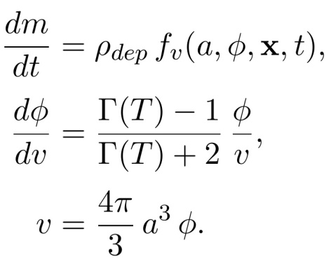
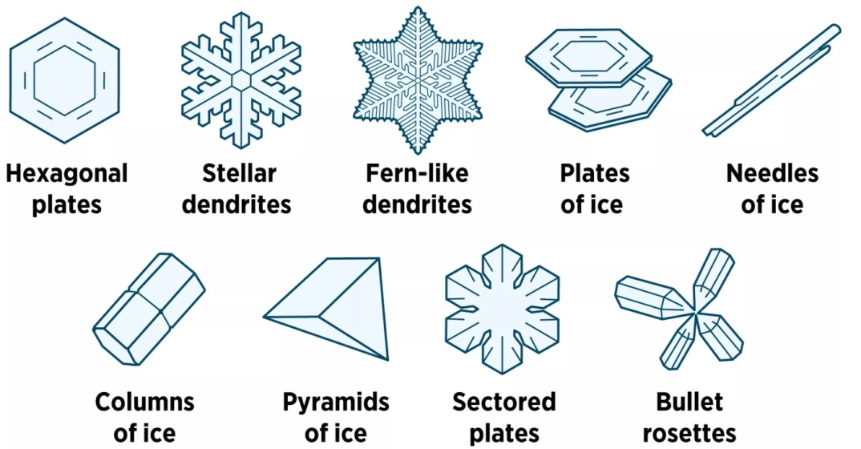
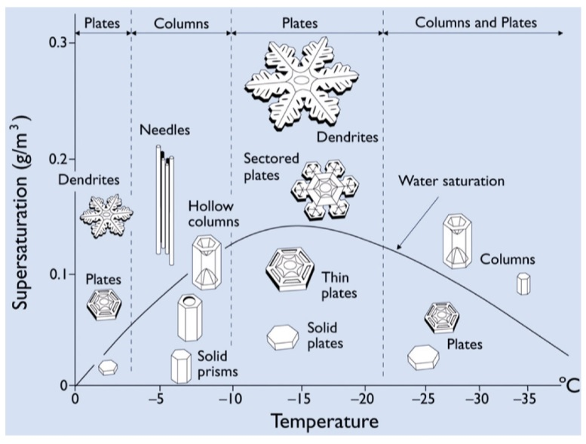
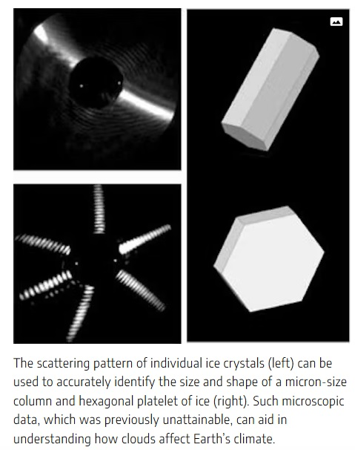
Problem Statement

Slide 6
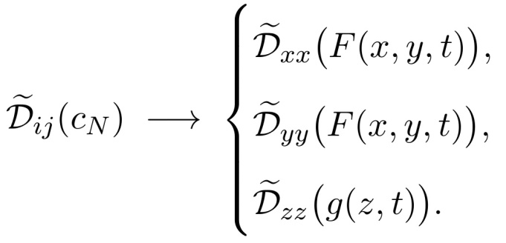
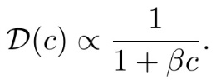
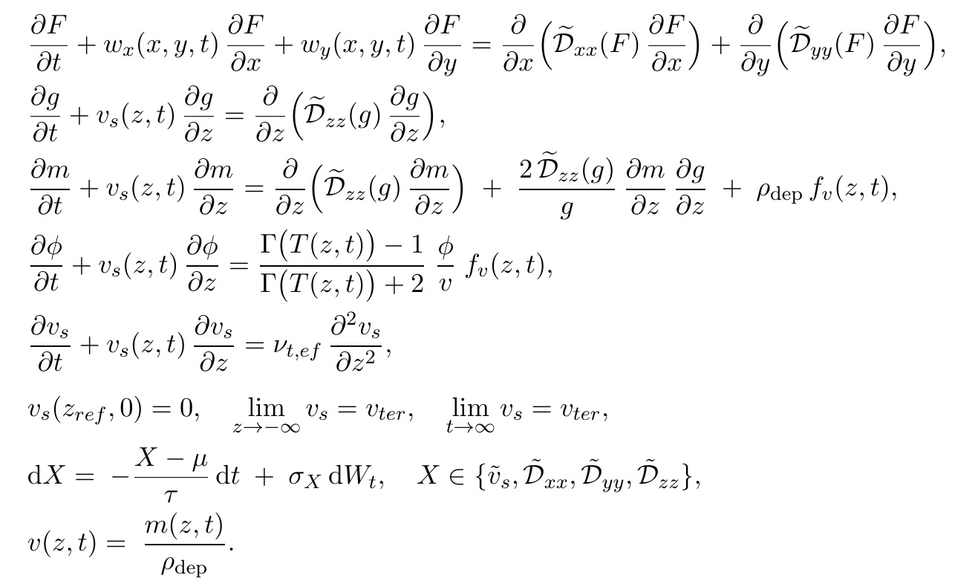
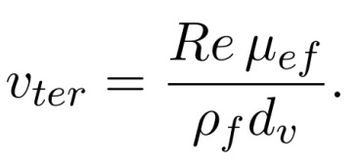
A High-Fidelity Eulerian Framework for Long-Term Contrail Evolution
It turns out the homogeneous boundary and initial conditions allow separation of variables through:
wind turbulence
Therefore, following the assumption of local (piece-wise) constant temperature, we can show that the system breaks down into:
number concentration
Terminal Velocity
microphysics evolution
settling velocity
stochasticity

Slide 7
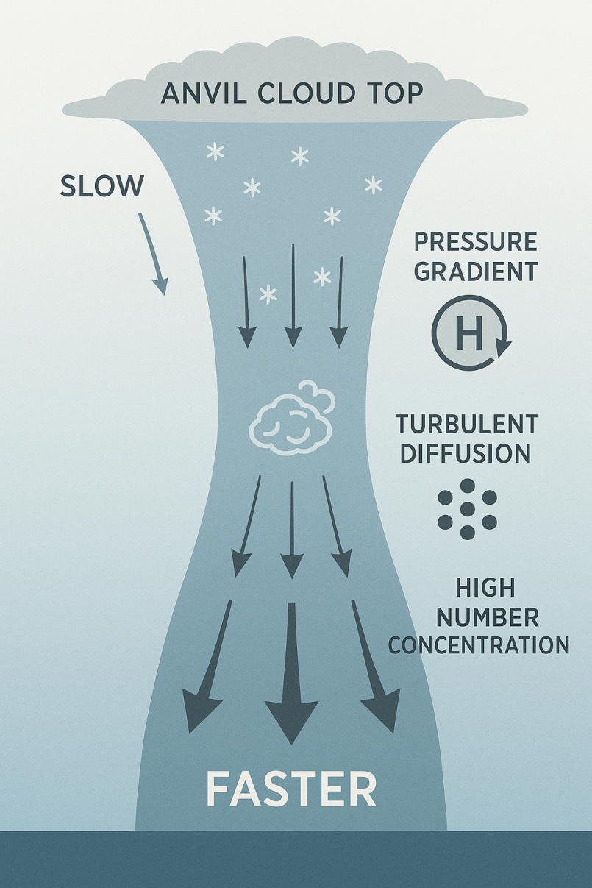
Problem Statement: Settling Velocity
In Eulerian framework, settling velocity requires more careful implementation to account for self-diffusion effect:
Starting with multi-phase flow equation in an Euler-Euler framework:
We can show that the equation can reduce to:

Slide 8
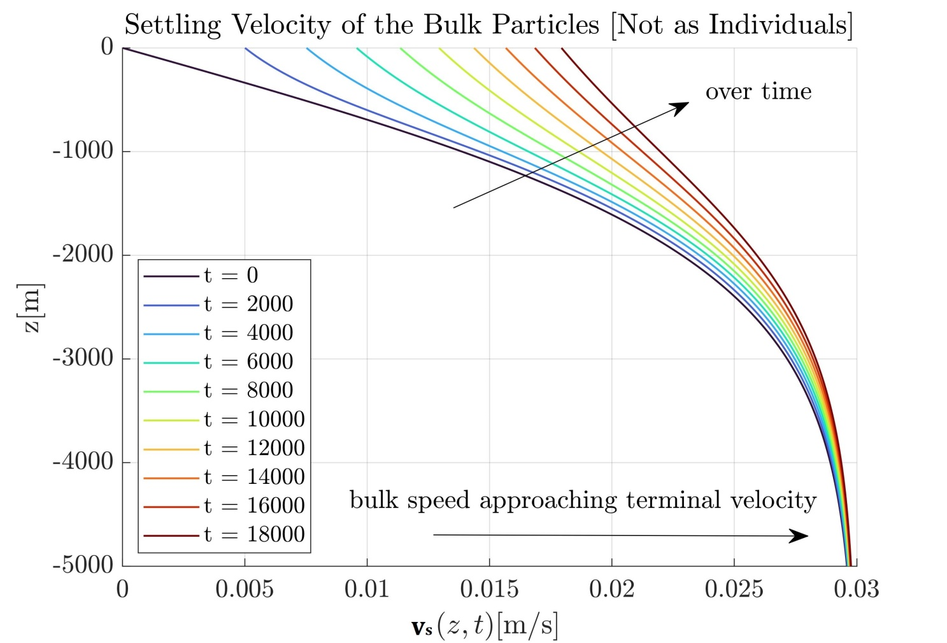
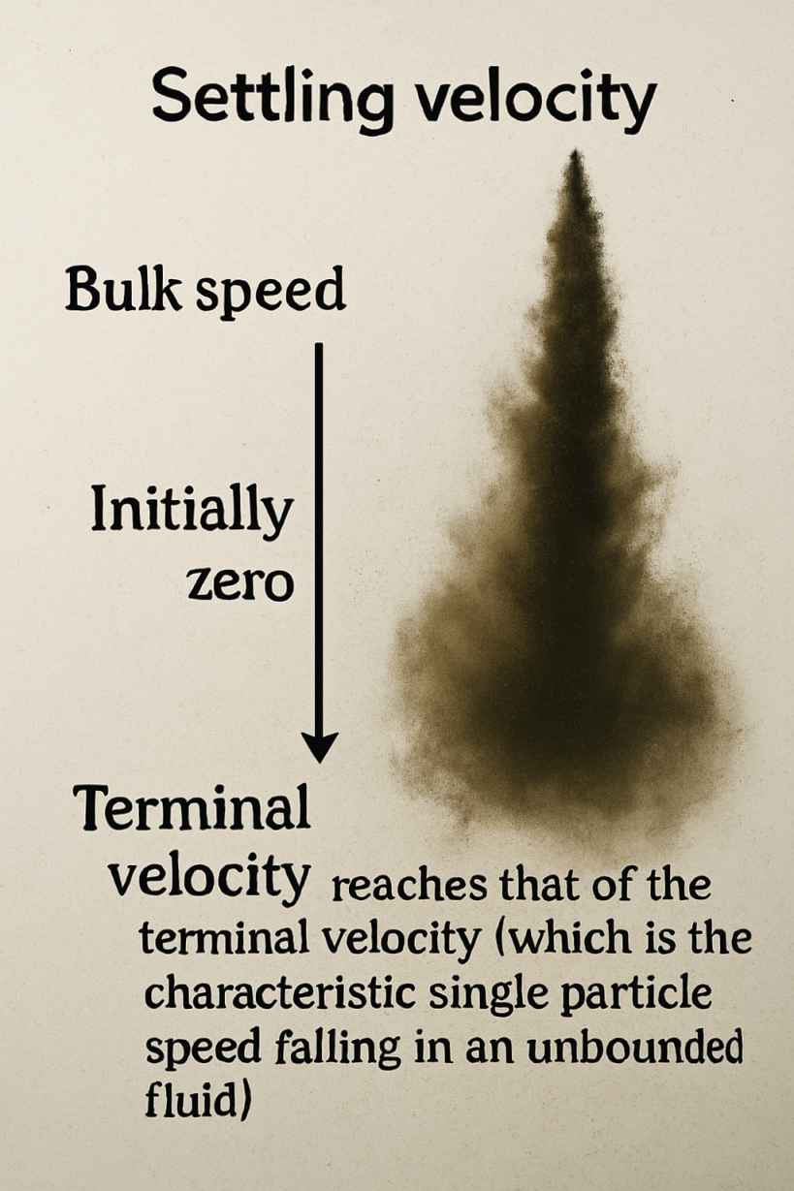
Problem Statement: Settling Velocity
In Eulerian framework, settling velocity requires more careful implementation to account for self-diffusion effect:
The schematic shows Free-Fall of particles as a bulk

Slide 9
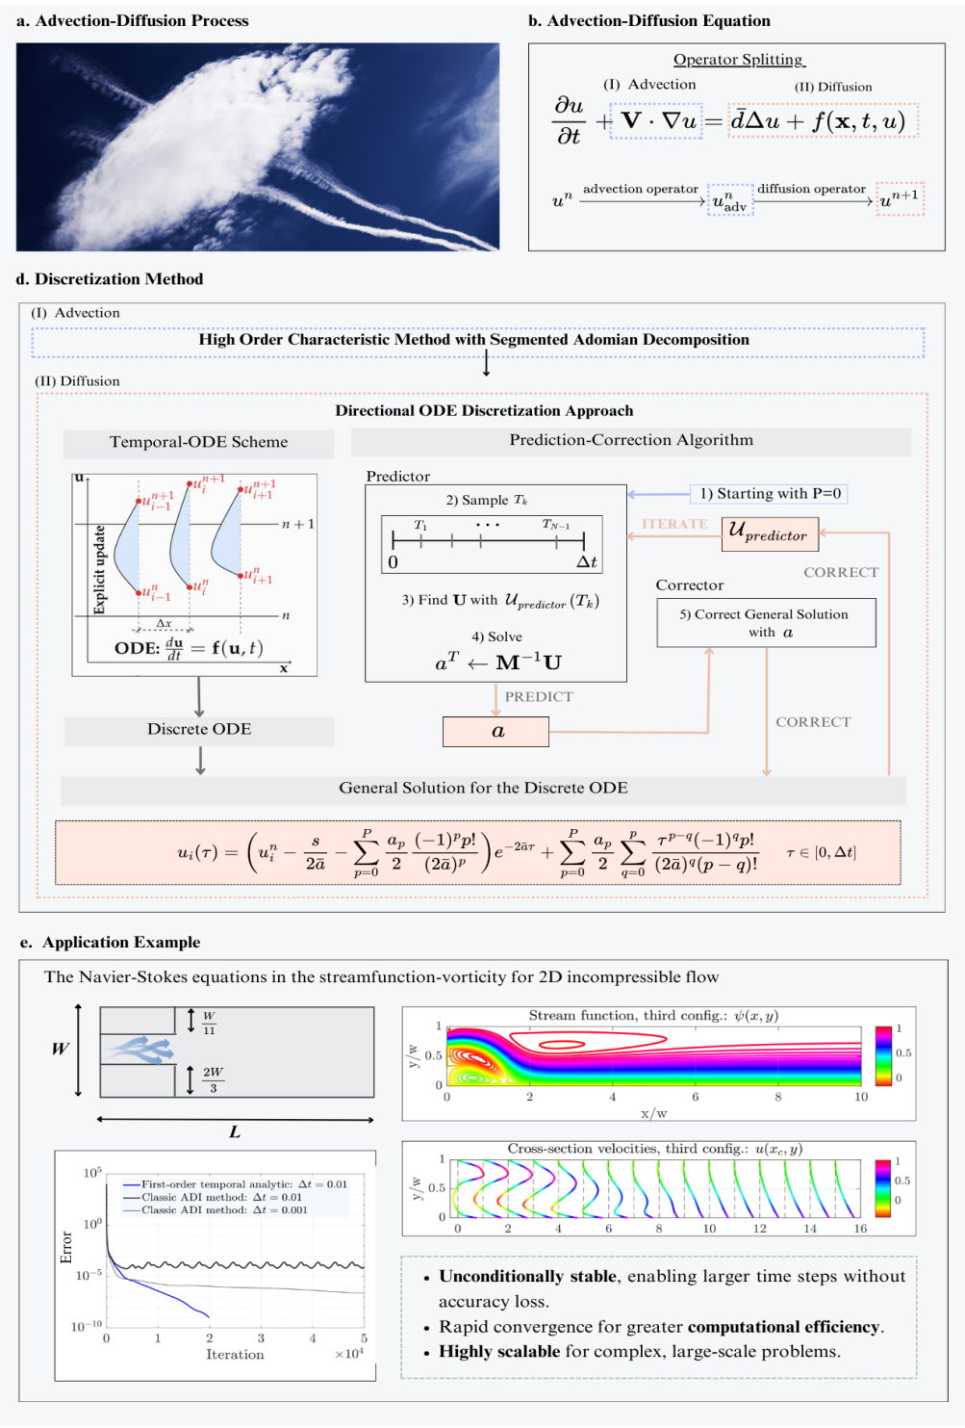
Solution Methodology: Directional-ODE Discretization Approach
traditional way
modern way
Constant Neighboring Nodes:
Solution with Constant Neighboring Nodes:
Global Update Formula with Non-Constant Neighboring Nodes:

Slide 10
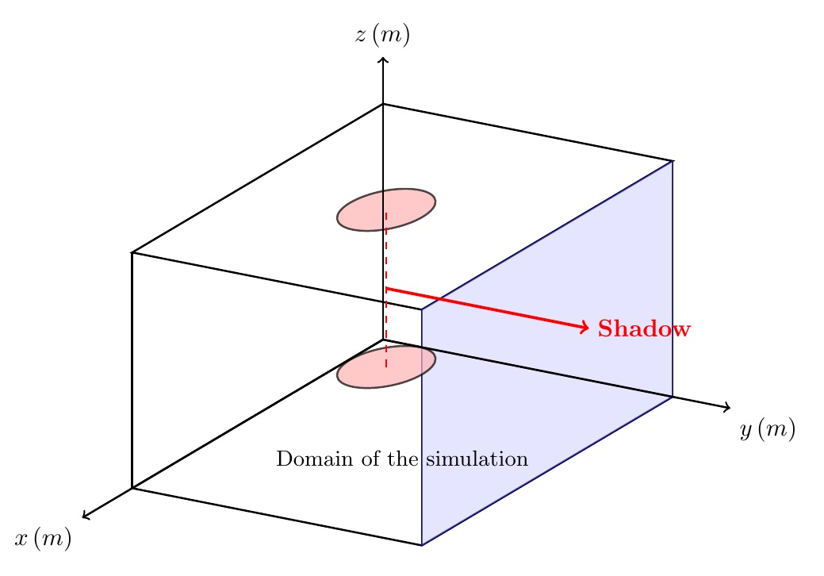
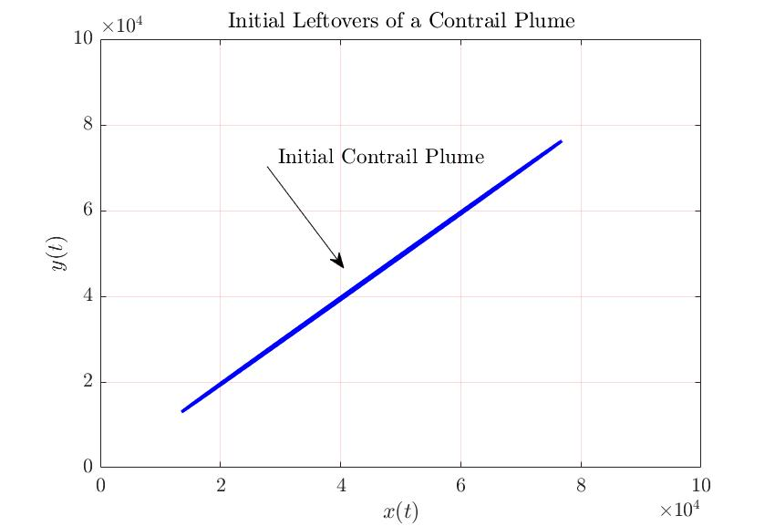
Results
Plume Initialization: Particles’ radii of 1 micro meter considered.

Slide 11
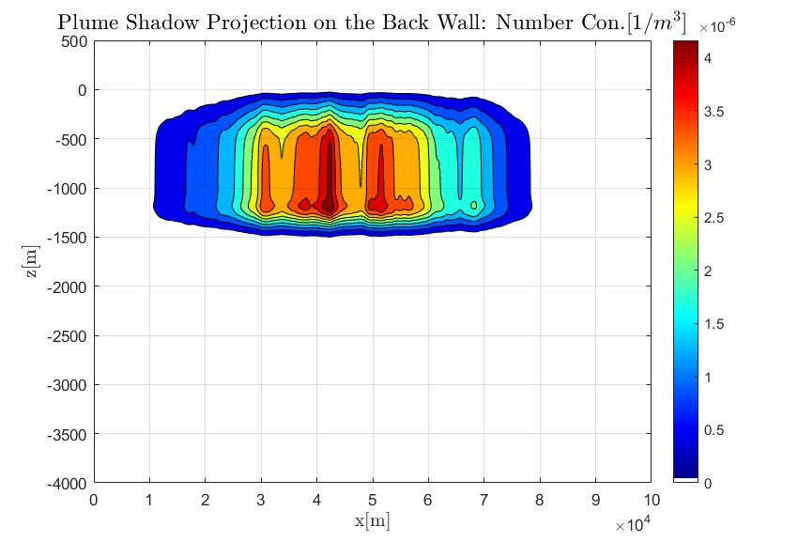
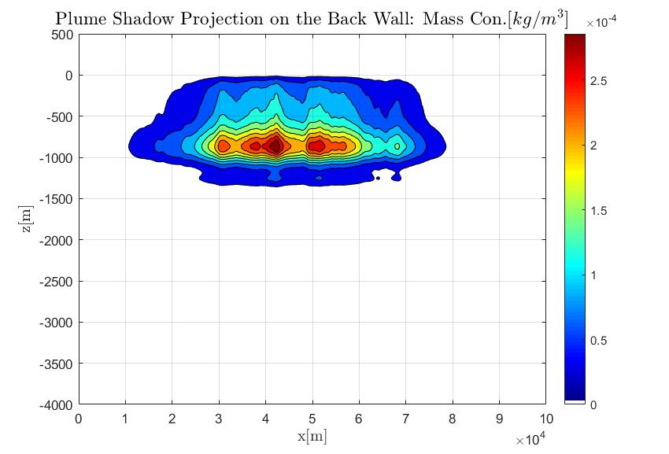
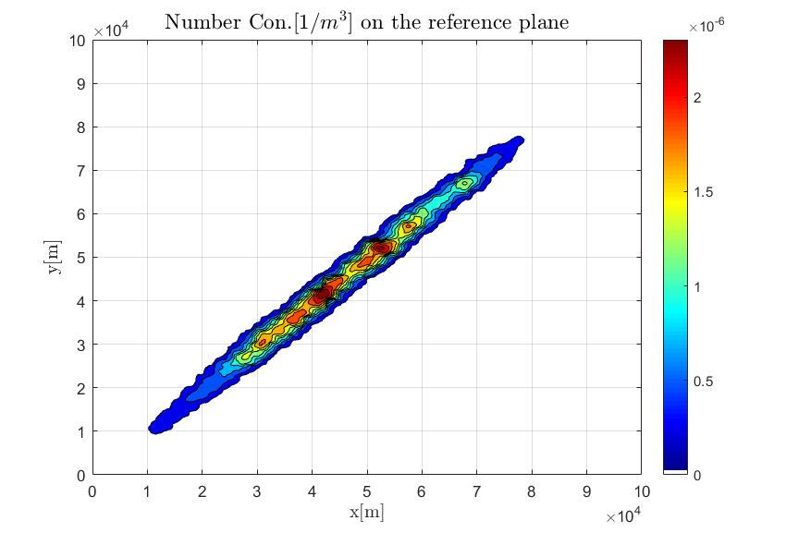
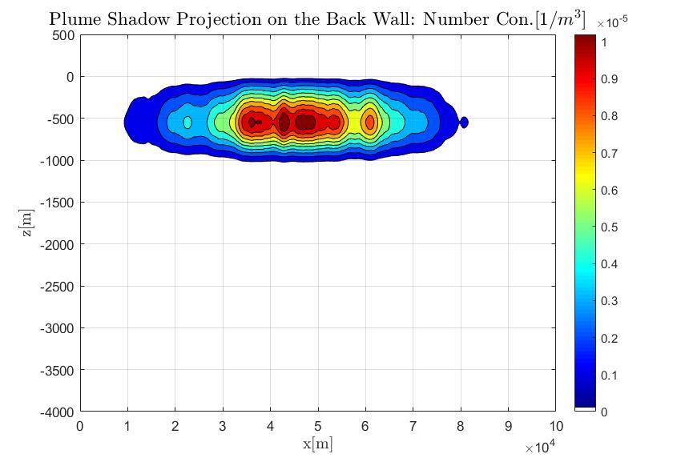
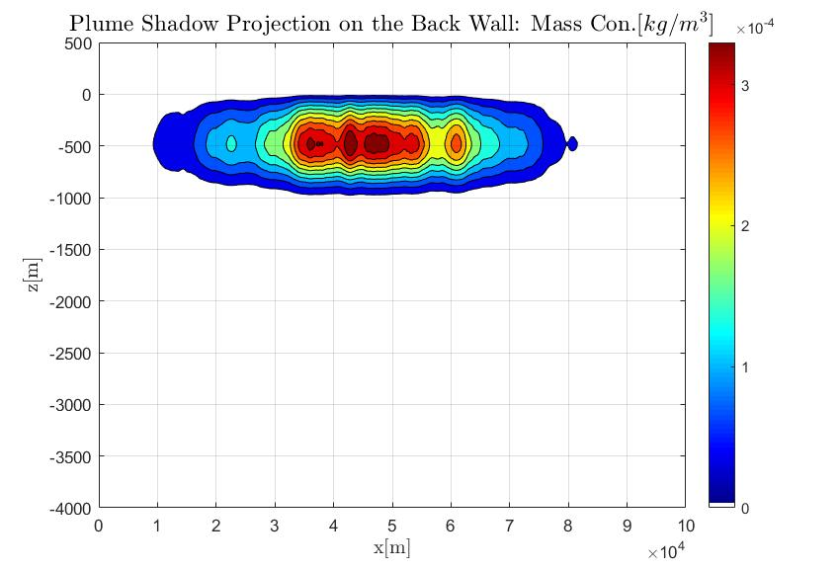
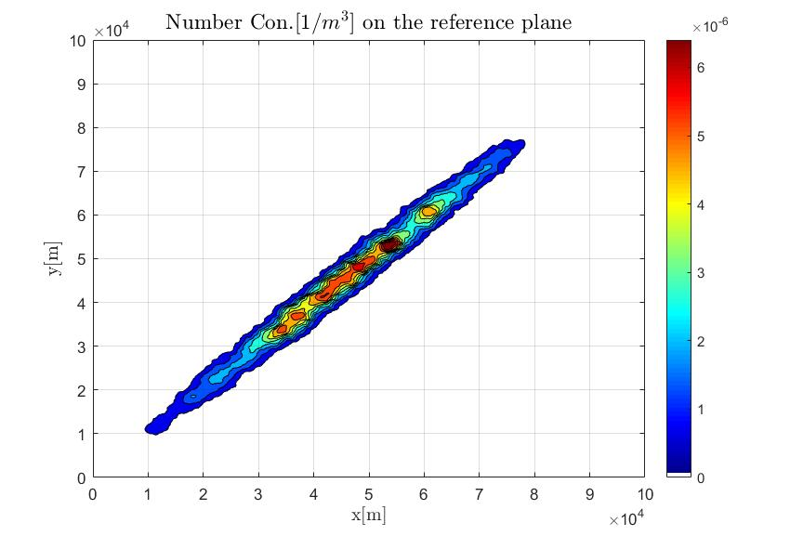
Results (First raw: Particle shape included; Second Raw: Particle shape Excluded): 10 Hours

Slide 12
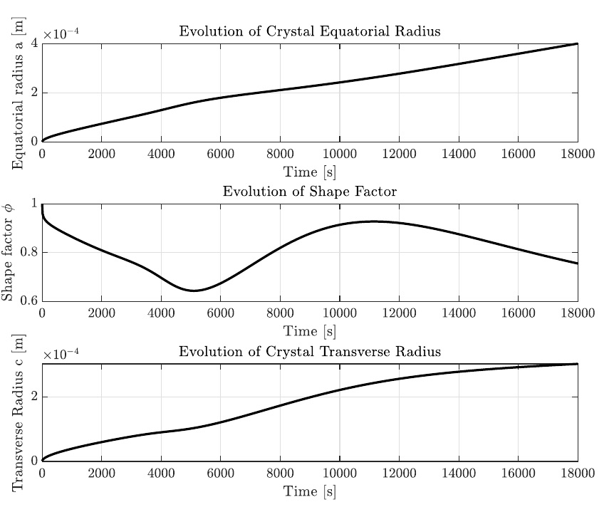
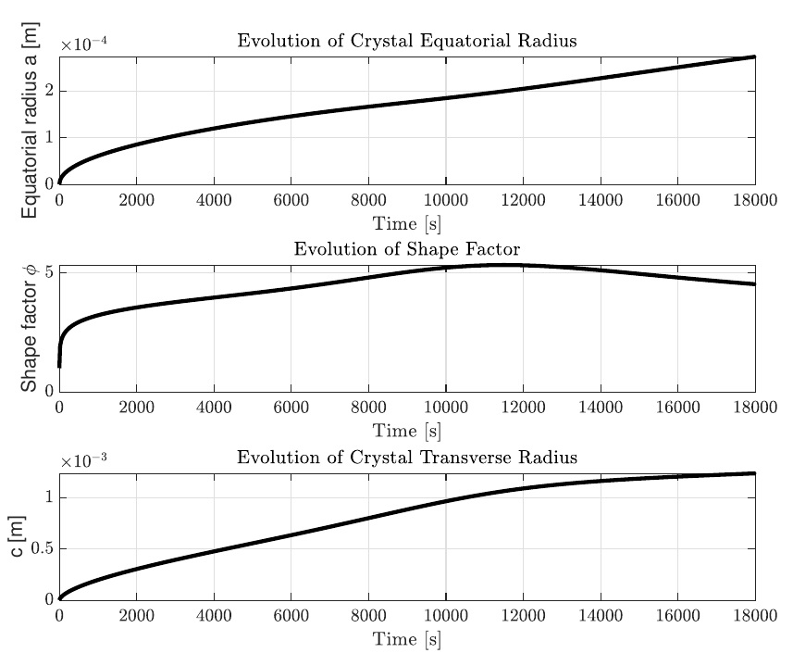
Results: Influence of Temperature on the Ice-Particle Shape
Evolution of ice-particle shape: Solving the following coupled microphysics equations with different predefined temperature profiles:
$$\frac{dv}{dt}{=f}_{v}$$
$$\frac{dφ}{dt}{=f}_{φ}$$
Depending on the starting ice-particle shape, size,
and temperature, ice particles can evolve significantly.
Solution after 5 hours for any evolving ice-particle starting
from a spherical shape with 1 micro-meter radius.
T=260+0.0005 t
T=240+0.0005 t

Slide 13
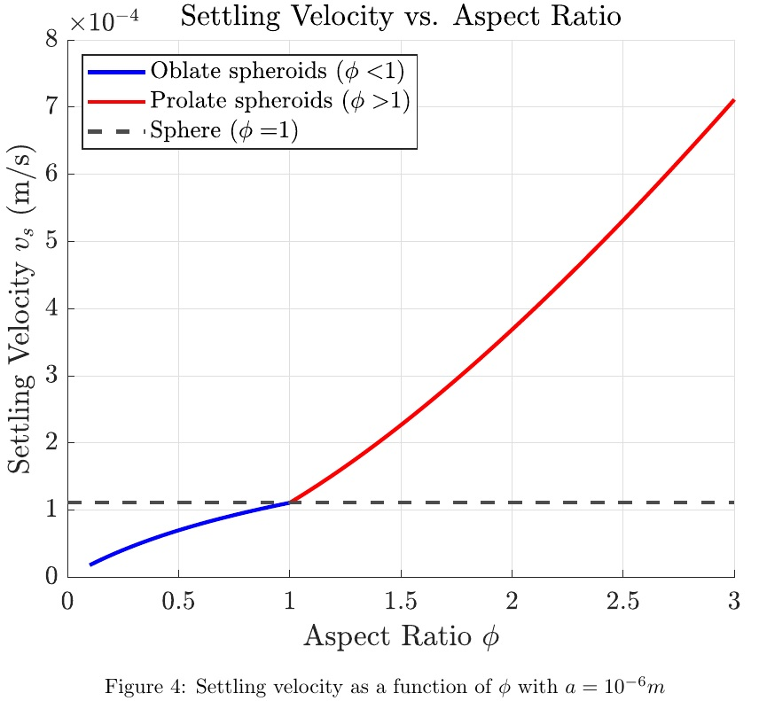
Results
1) The influence of particle-shape index on terminal velocity of individual particles:

Slide 14
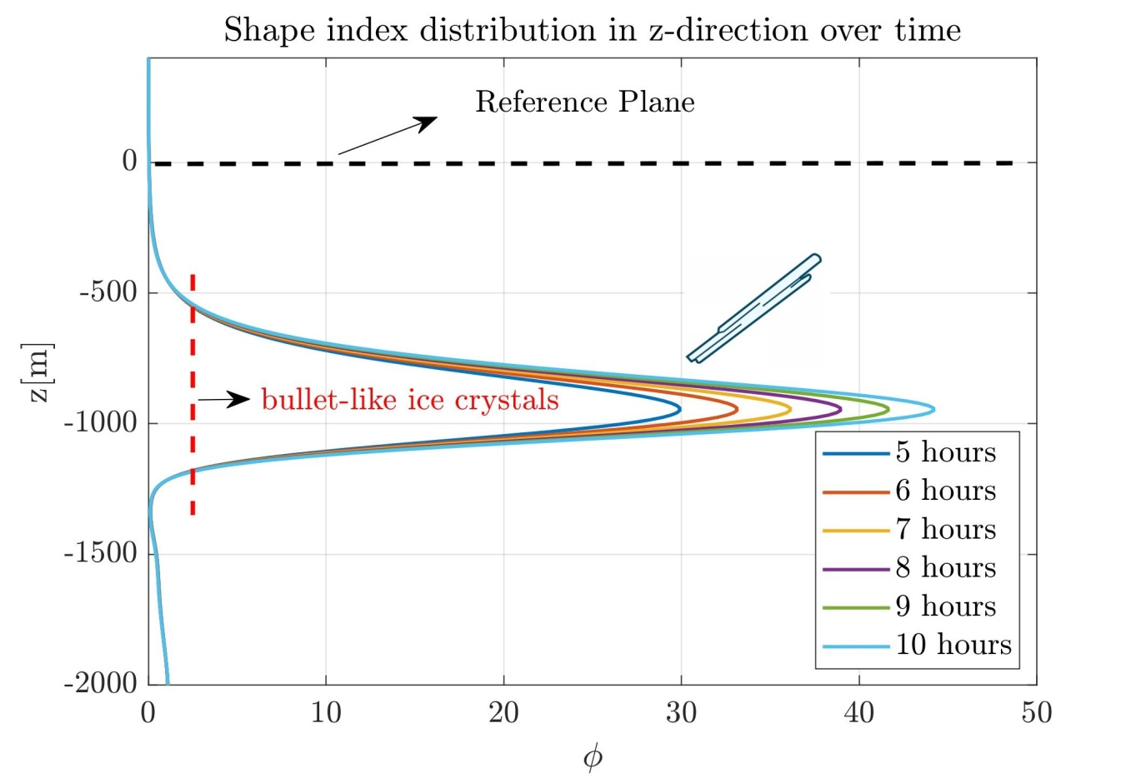
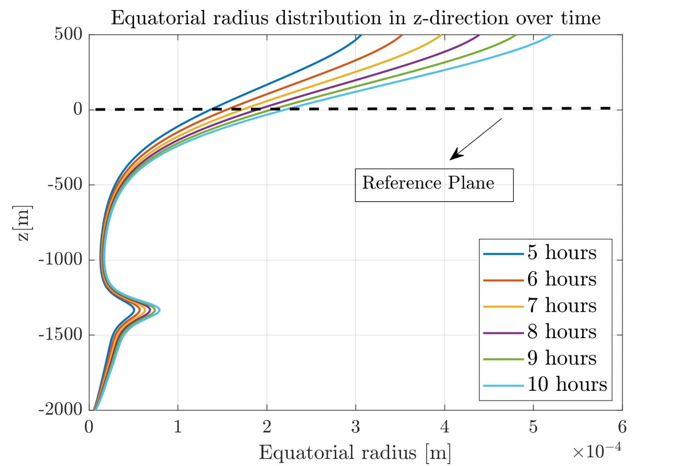
Results
3) Evolution of a Contrail Plume under the proposed model: Initialized by particles’ radii of 10 micro meters.

Slide 15
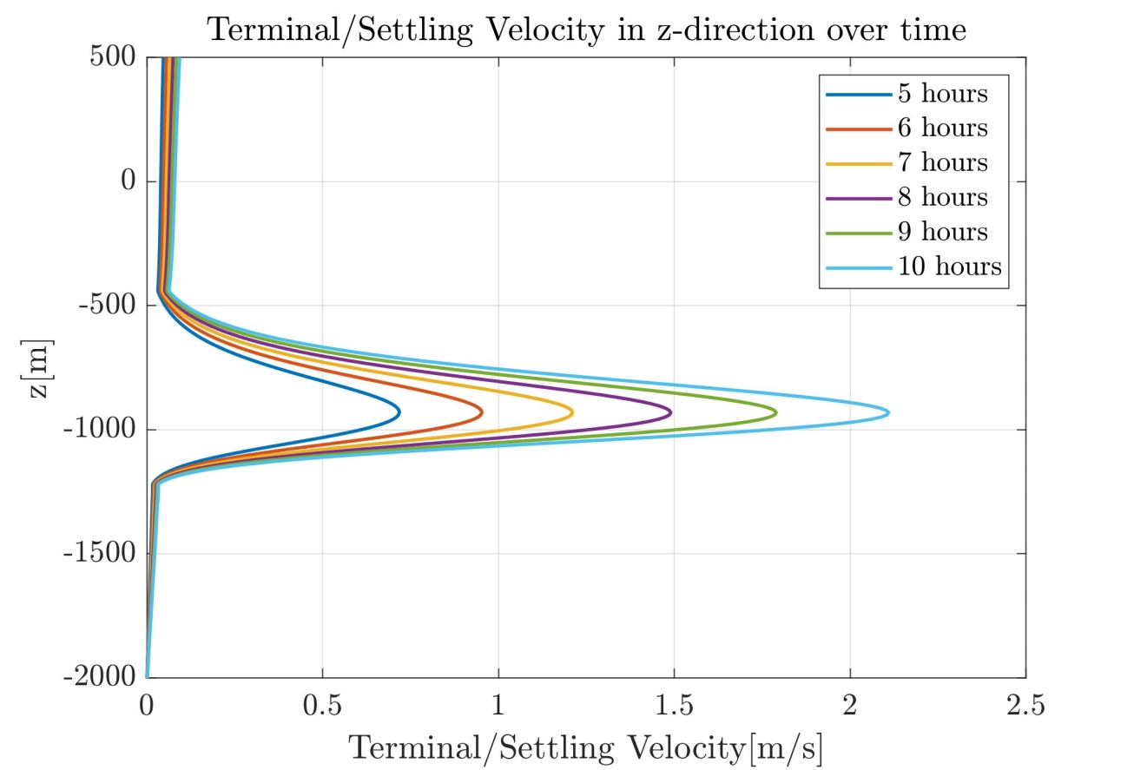
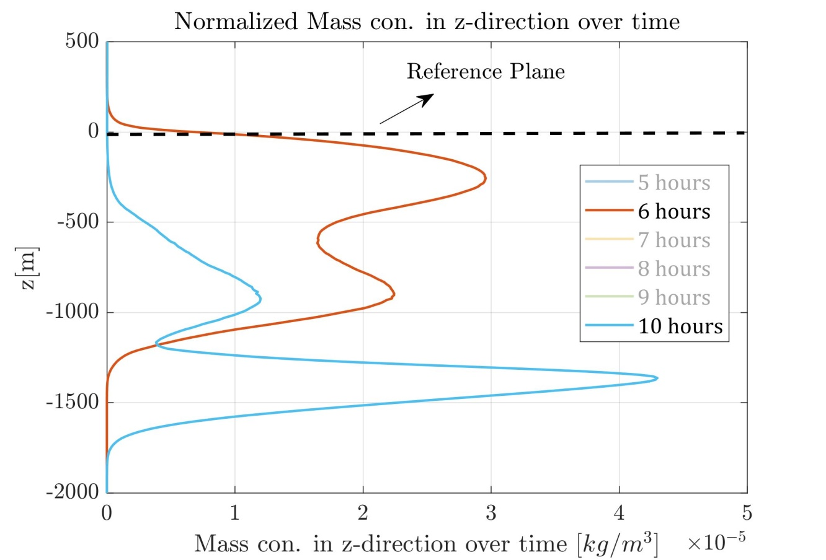
Results
3) Evolution of a Contrail Plume under the proposed model: Average wind is assumed Zero

Slide 16
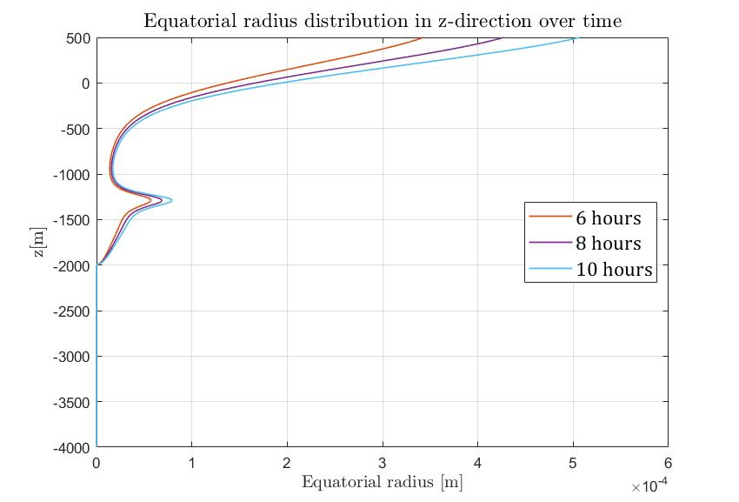
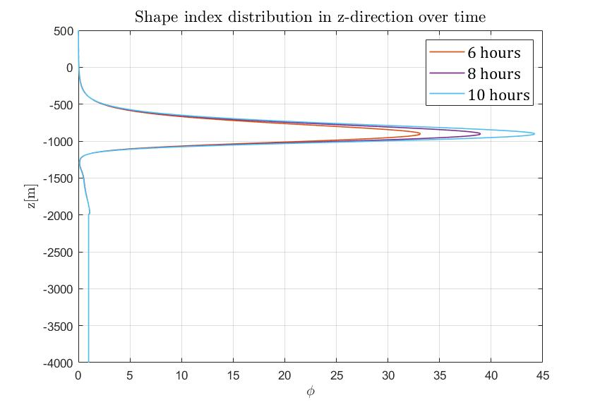
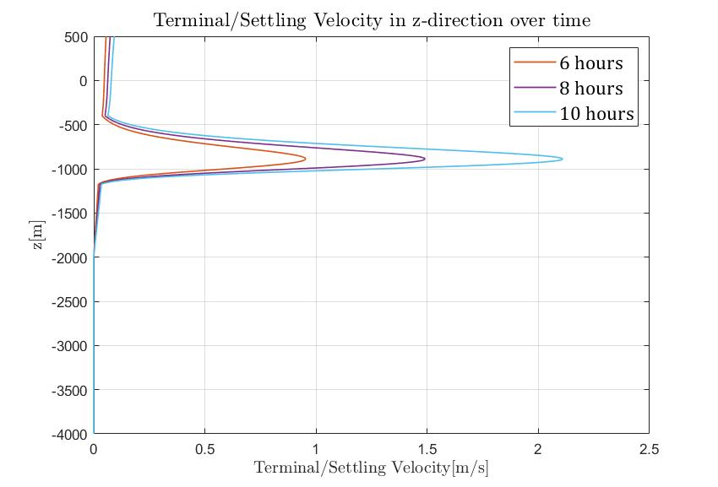
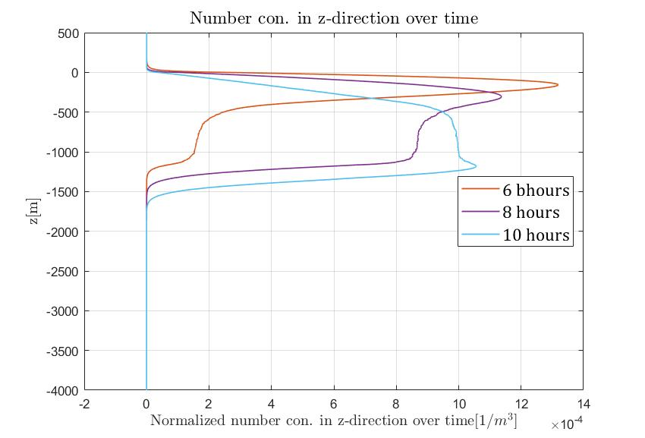
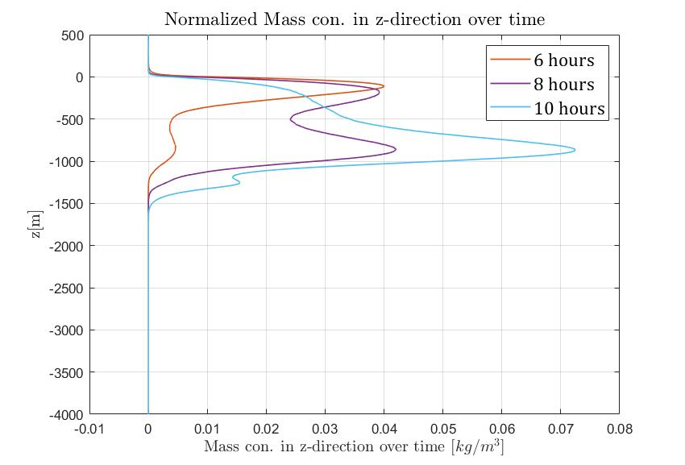
Results
3) Evolution of a Contrail Plume under the proposed model: Initialized by particles’ radii of 10 micro meters.

