Slide 1
Postprocessing of rainfall forecasts over East Africa
Oxford team: Fenwick Cooper, Shruti Nath, Antje Weisheimer, Tim Palmer
Funding and technical support from

Slide 2
Timescale:
ECMWF IFS ensemble forecast
50 ensemble members
Operational model (~9km)
6 hourly precipitation out to +54 hours
24 hour accumulations out to 7 days
The process:
cGAN: conditional Generative Adversarial Network
1000 ensemble members
Antonio et al. (2025), JAMES
Harris et al. (2022), JAMES
EasyUQ: Isotonic Distributional Regression
Separate models at different elevations and for low rainfall areas.
Walz et al. (2024), SIAM review
Henzi et al. (1999), J. Roy Stat. Soc.

Slide 3
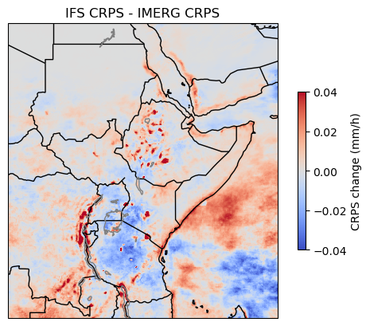
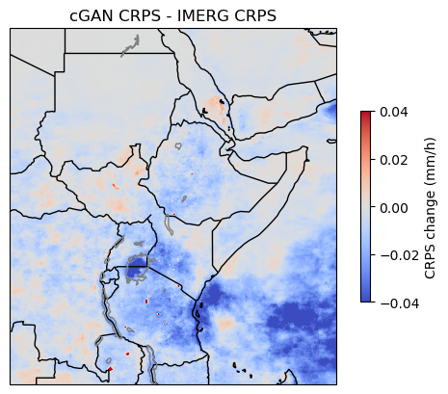
2020 whole year mean CRPS

Slide 4
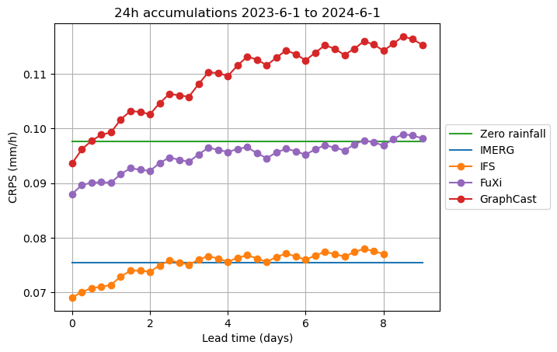

Slide 5
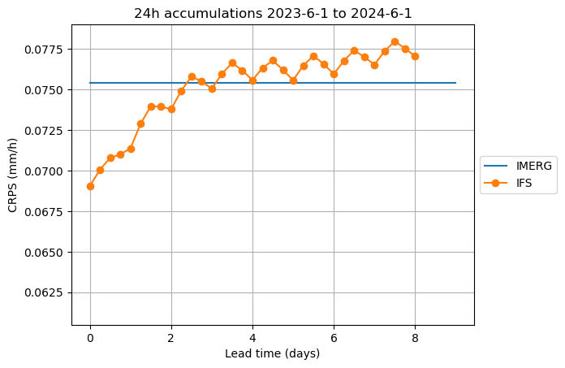

Slide 6
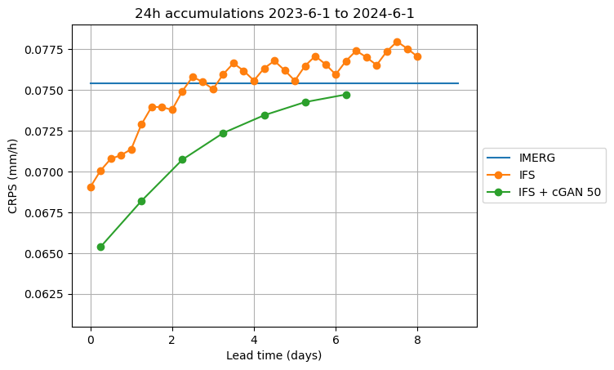

Slide 7
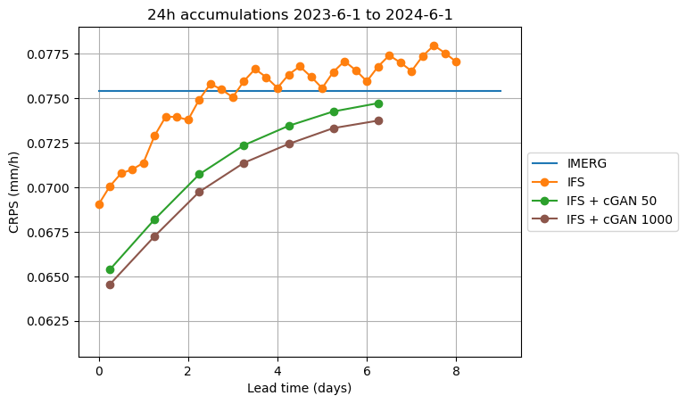

Slide 8
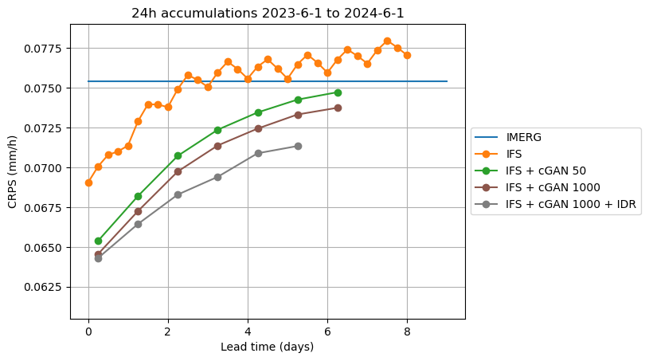

Slide 9
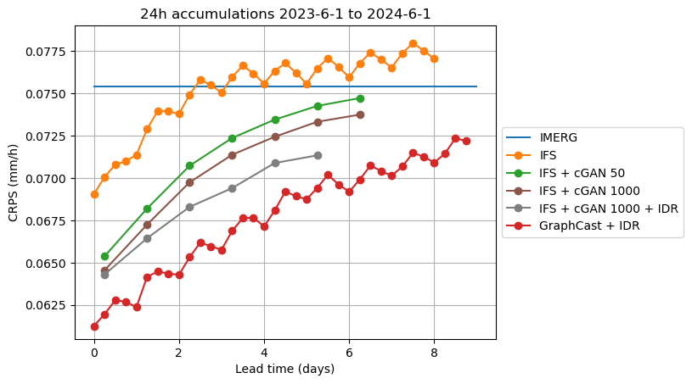

Slide 10
