Slide 1
Drivers of fluvial terrace formation and quantifying their impacts
Ruby, Andreas¹; McNab, Fergus¹; Schildgen, Taylor^{1,2}; Wickert, Andrew^{1,3,4}; Fernandes, Victoria M. ¹
1 GFZ Helmholtz Centre for Geosciences, Potsdam, Germany
2 Institute for Geosciences, Potsdam University, Potsdam, Germany
3 Department for Earth & Environmental Sciences, University of Minnesota, Minneapolis, USA
4 Saint Anthony Falls Laboratory, University of Minnesota, Minneapolis, USA

Slide 2
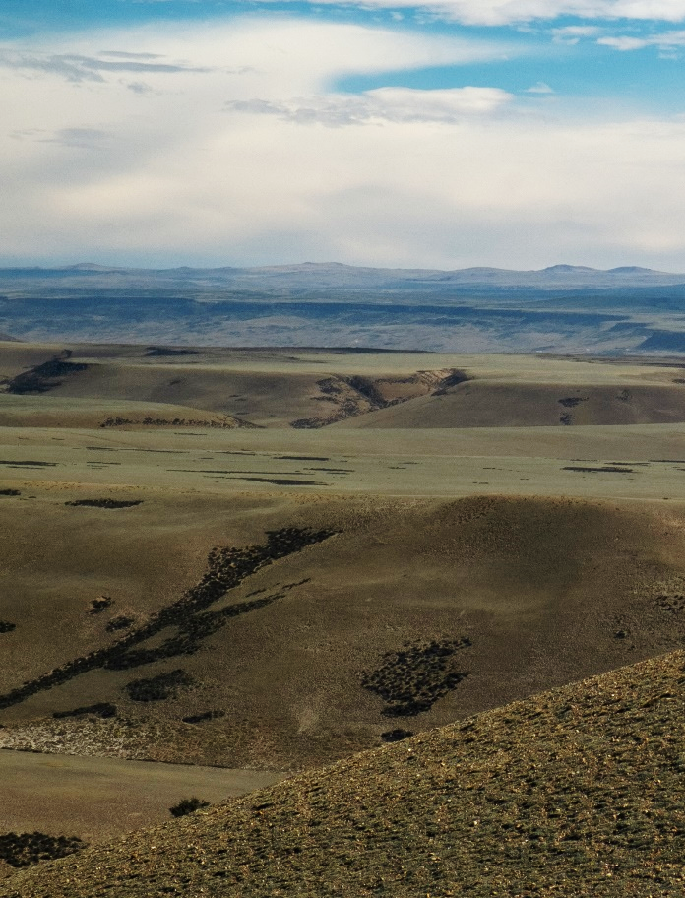
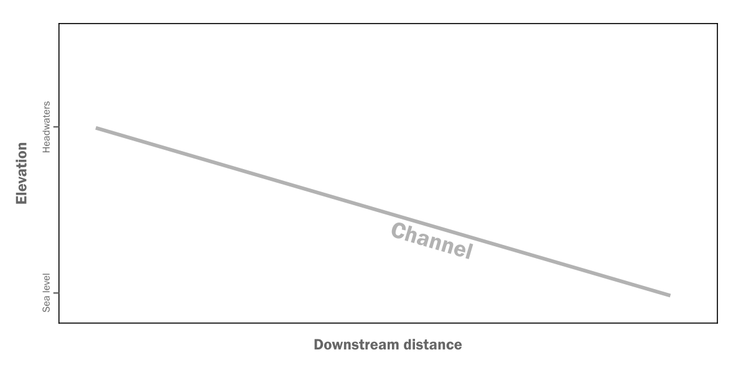
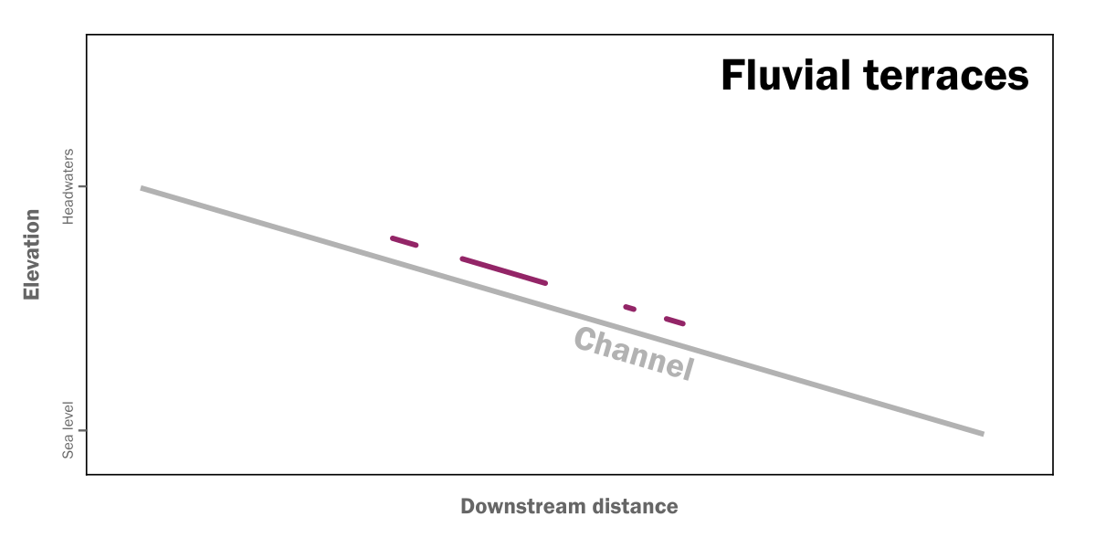
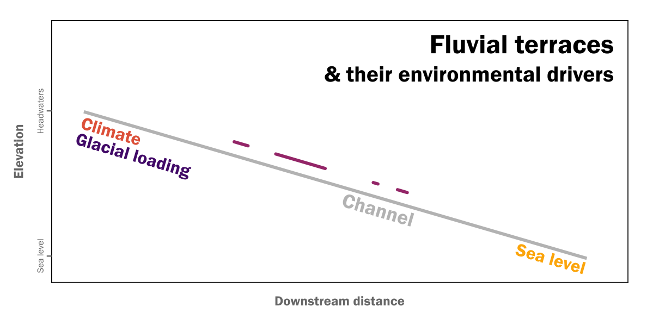
Climate & Tectonics
Río Santa Cruz, Patagonia
Fergus McNab

Slide 3
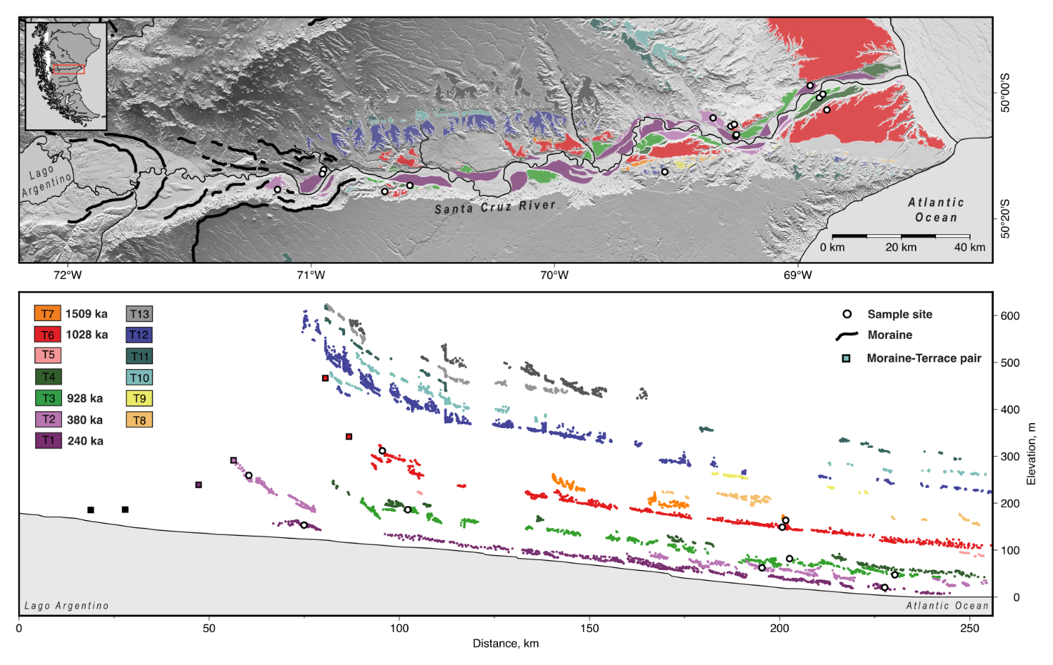
Motivation: Río Santa Cruz, Patagonia
Fernandes et al., 2025 (submitted to Geology)
Exceptional terrace profiles, with ages up to 1.5 My
Glacial impact & sea-level changes

Slide 4
Research question
What is the impact of different environmental drivers on terrace formation & long profile river evolution?
Can we derive a better understanding of environmental drivers based on terrace profiles?

Slide 5
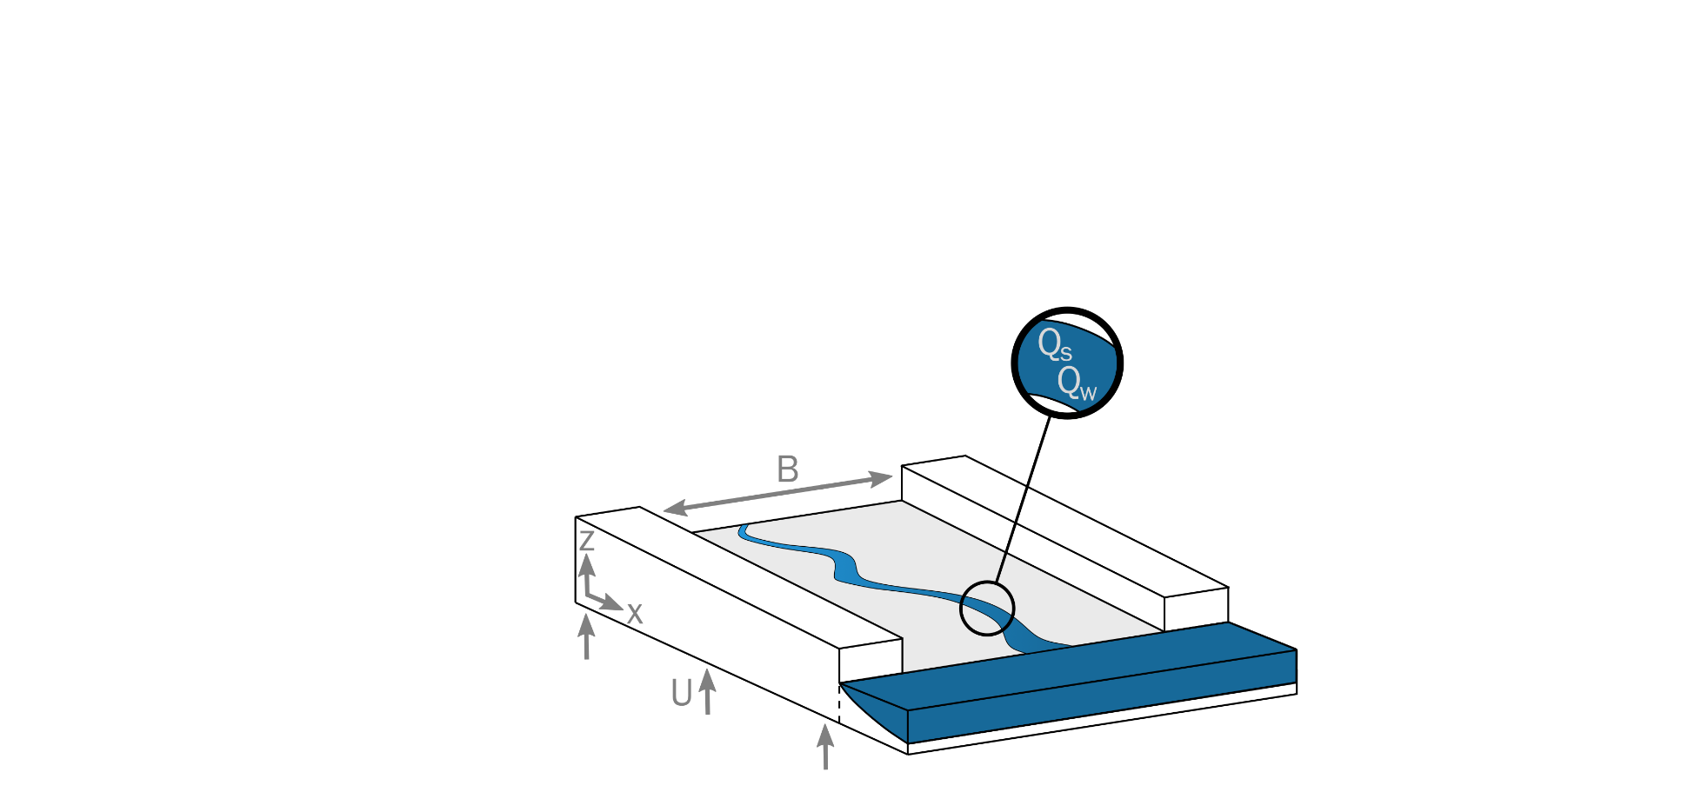
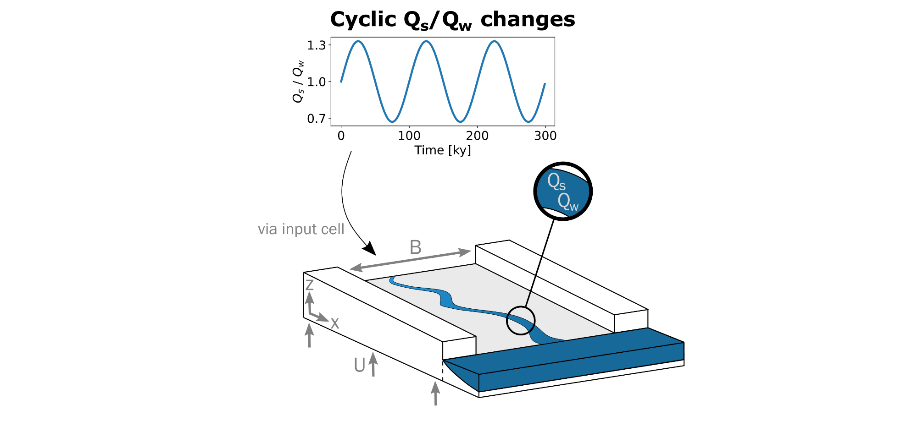
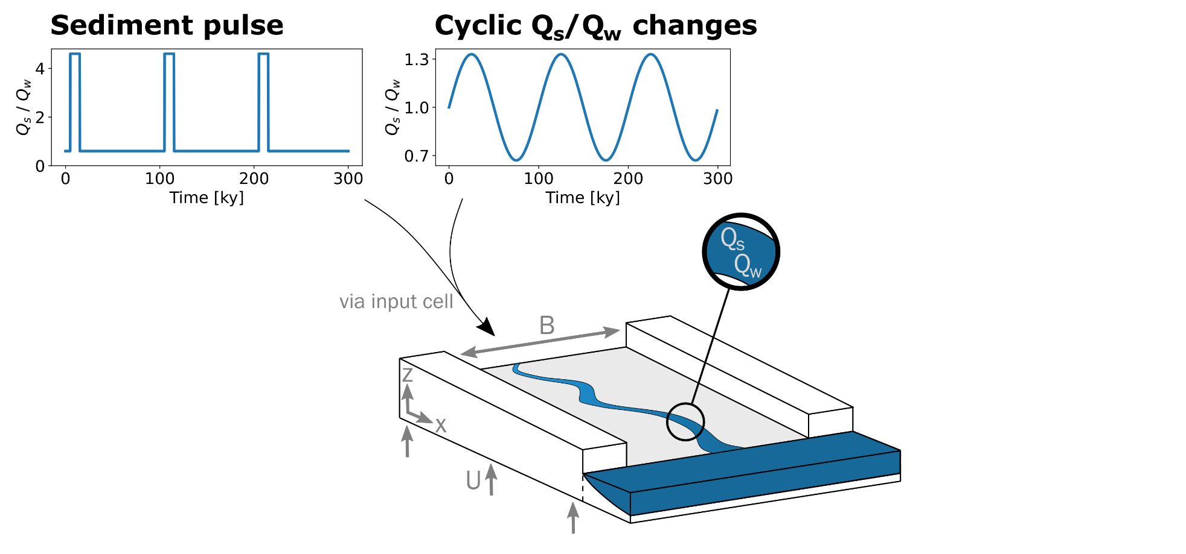
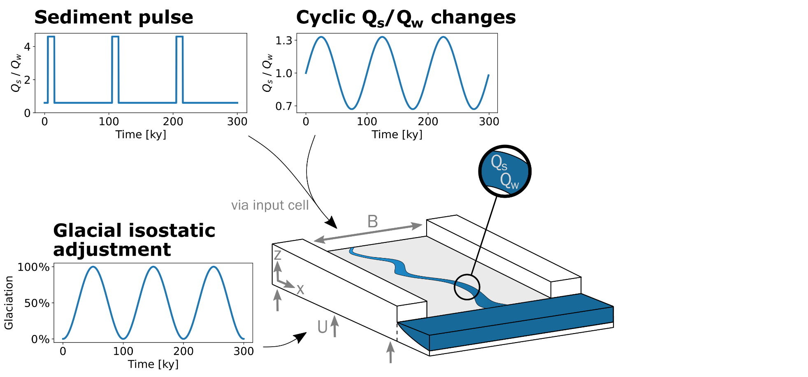
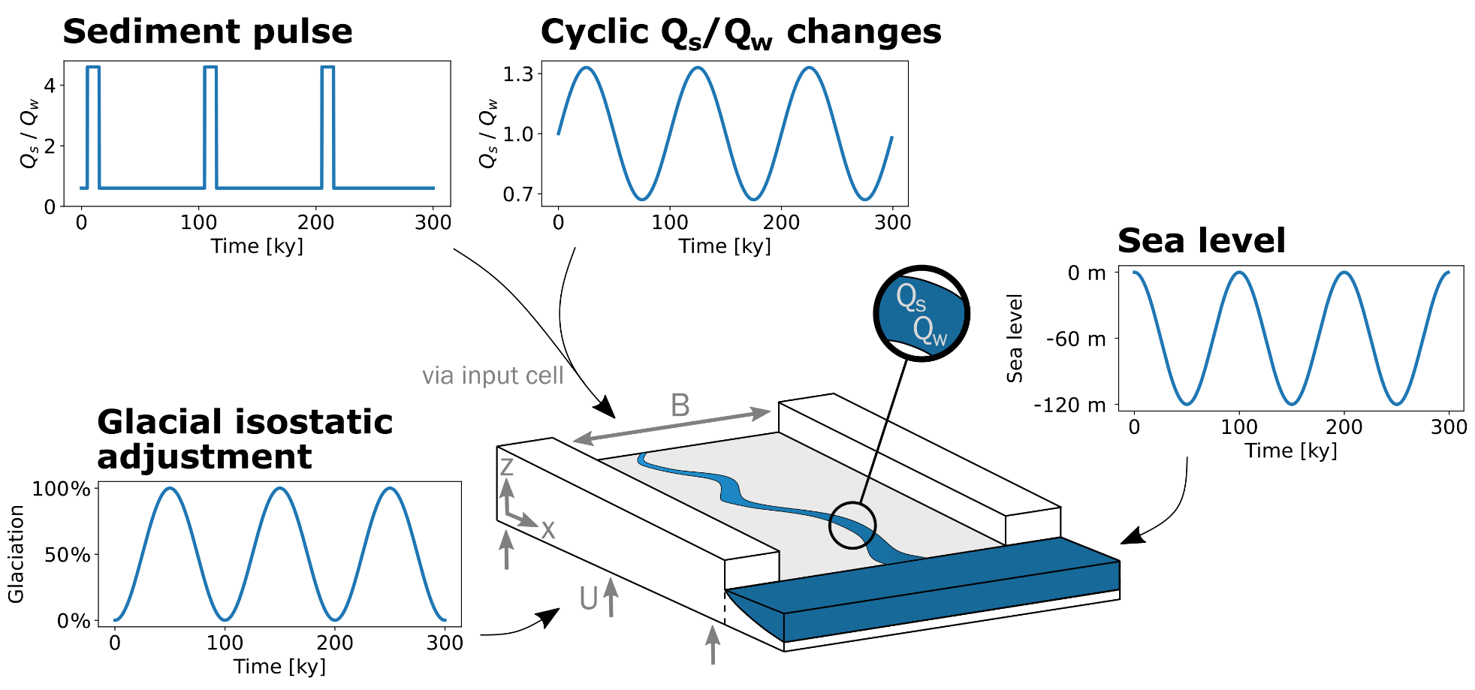
Concept & Model
Main equation:
$$\frac{∂z}{∂t}=\frac{k_{Q_{s}}IQ_{w}}{𝕊^{7/6}B\left(1−λ_{p}\right)}\frac{∂}{∂x}\left(\frac{∂z}{∂x}{\left|\frac{∂z}{∂x}\right|}^{1/6}\right)+U$$
Wickert & Schildgen (2019, ESD)
- available on GitHub

Slide 6
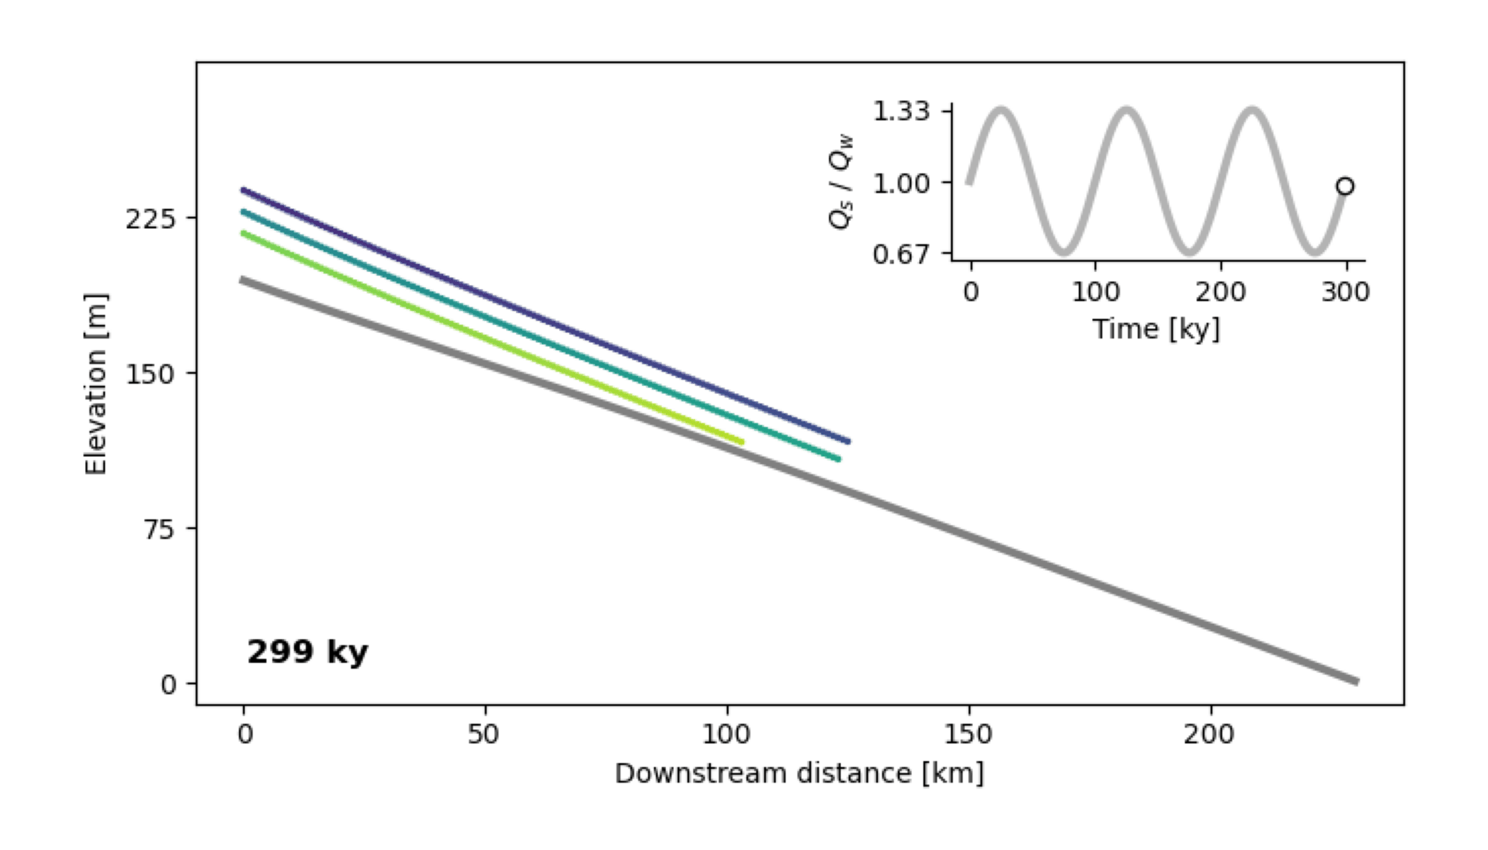
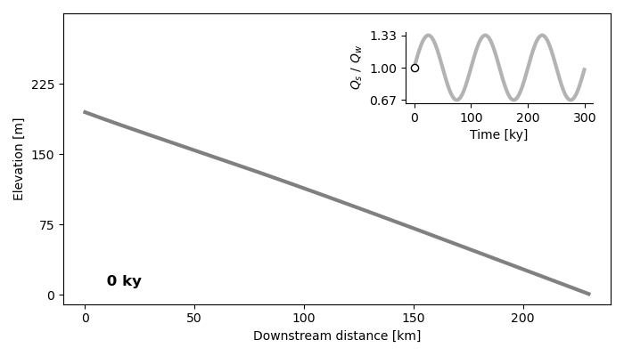
Cyclic changes in Qs/Qw
Time lag!
Aggradation & incision cycles

Slide 7
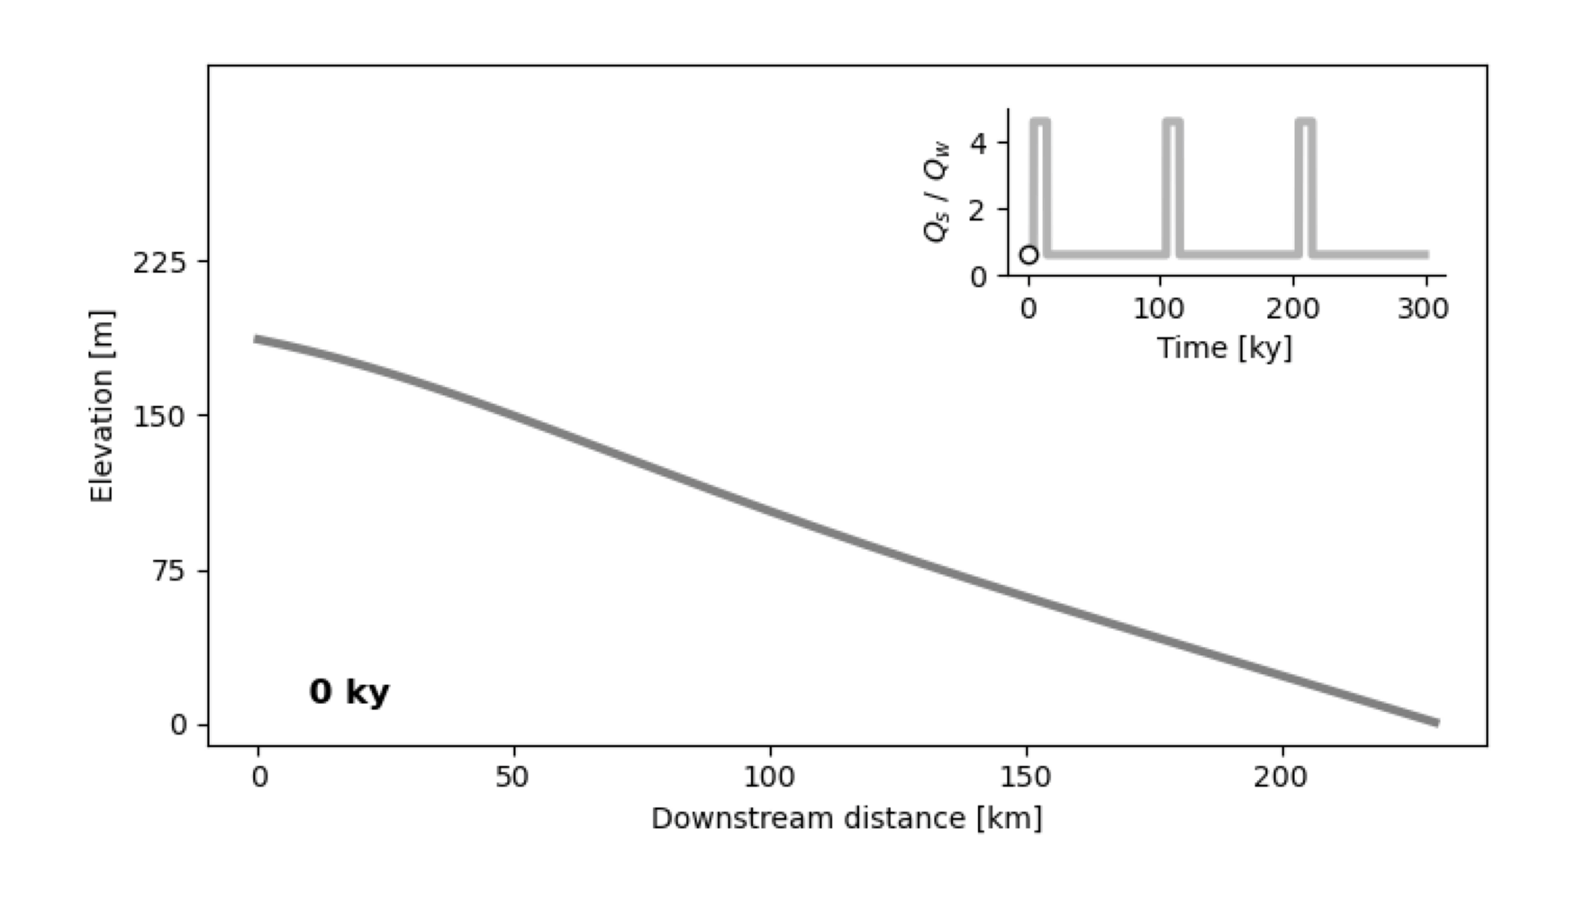
Sediment pulse
Profile concavity

Slide 8
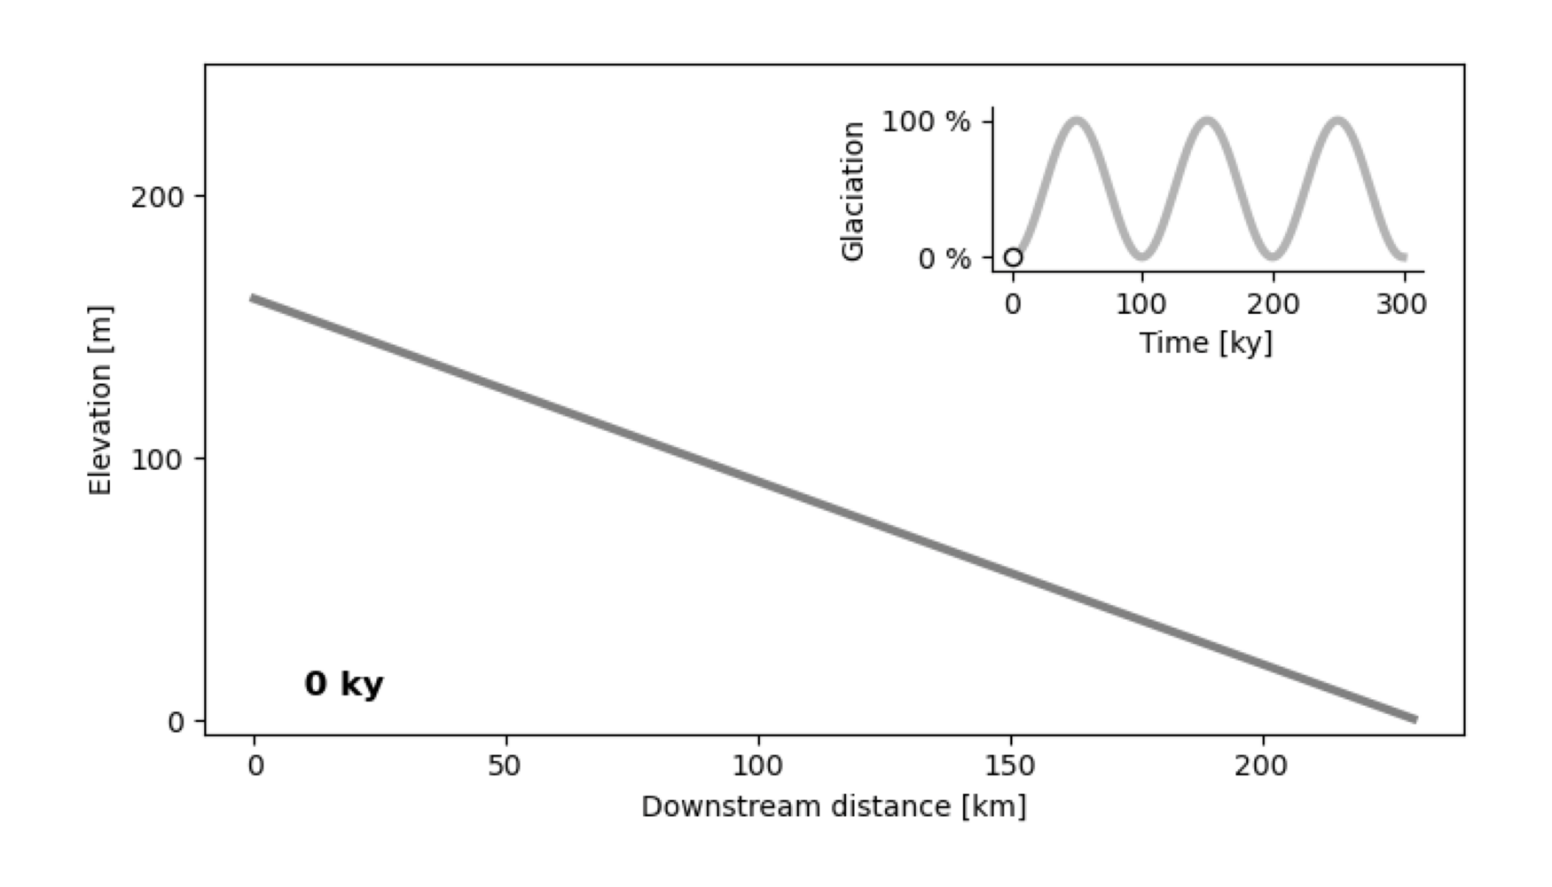
Glacial isostatic adjustment
Two distinct terraces!
Temporary profile concavity

Slide 9
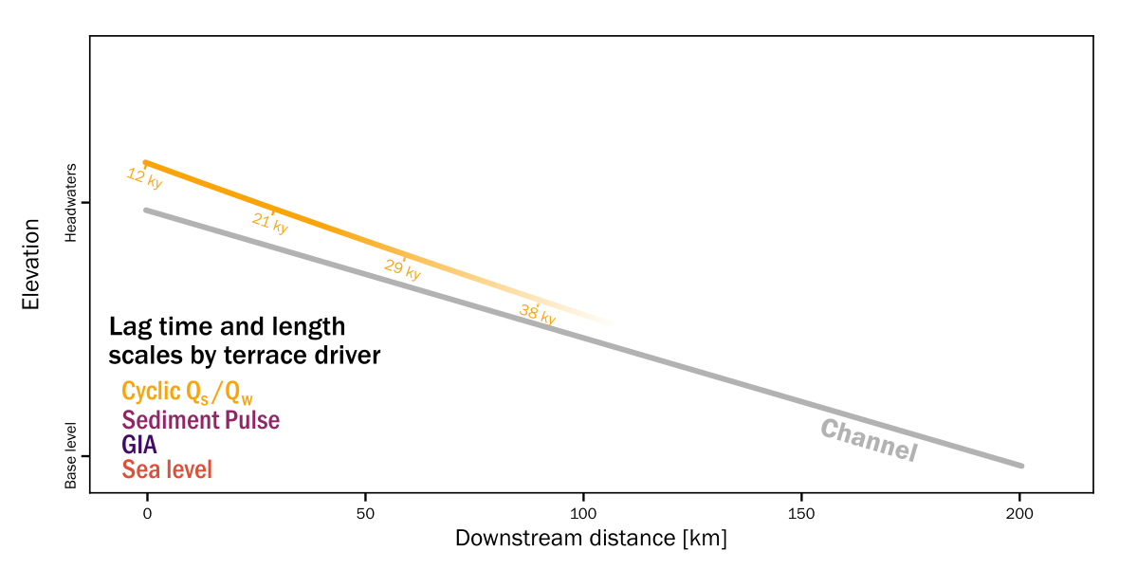
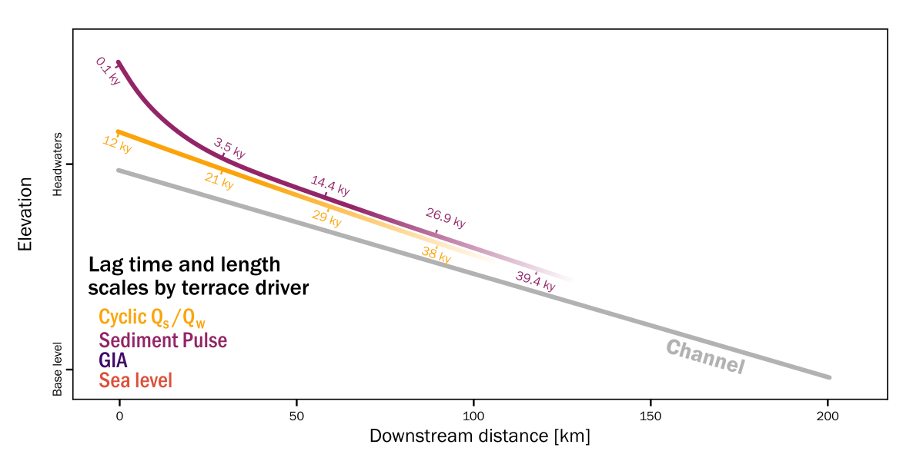
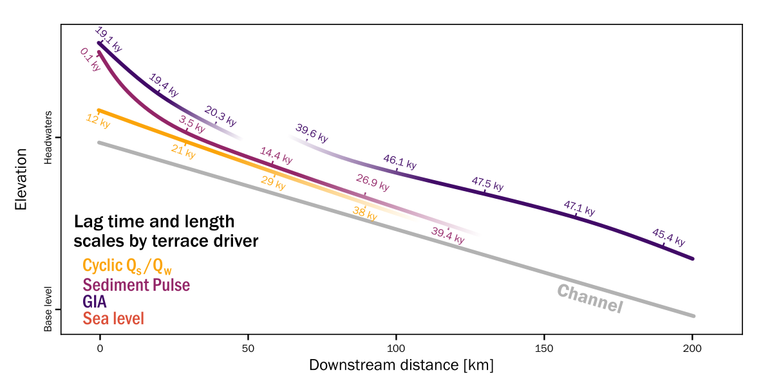
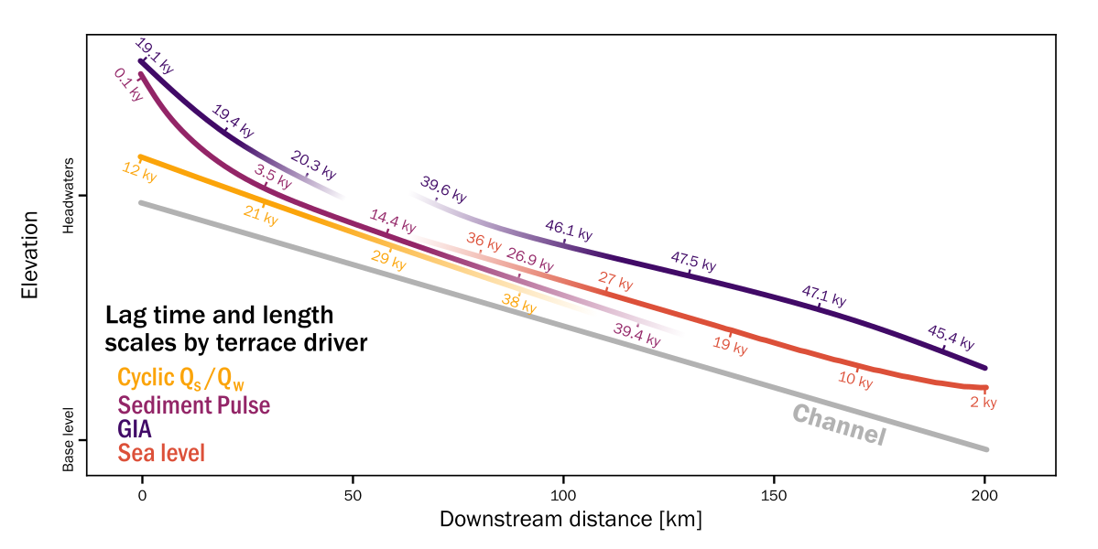
Lag times of terrace formation

Slide 10
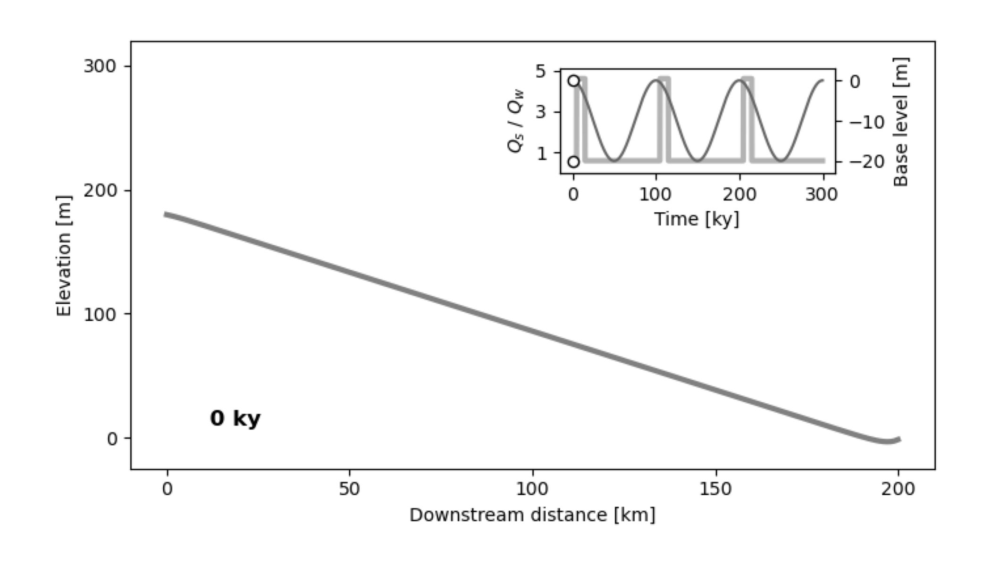
Modelling a full terrace profile
Timing is key!
Lag time

Slide 11
What is the impact of different environmental drivers on terrace formation & long profile river evolution?
Environmental drivers produce different terrace geometry, age and lag time
Can we derive a better understanding of environmental drivers based on terrace profiles?
Potential: Quantitative interpretation of terrace formation drivers
Better understanding of Río Santa Cruz in Patagonia & systems beyond
Contact
andreas.ruby@gfz.de

Slide 12
Contact
andreas.ruby@gfz.de

Slide 13
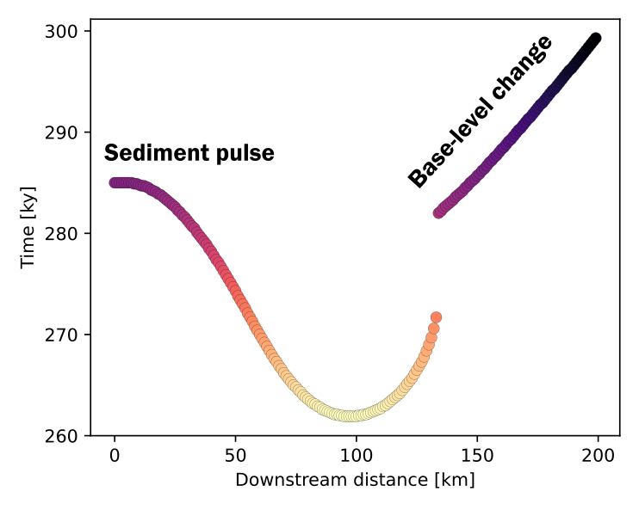
Combined model
Timing is key!
Lag time

Slide 14
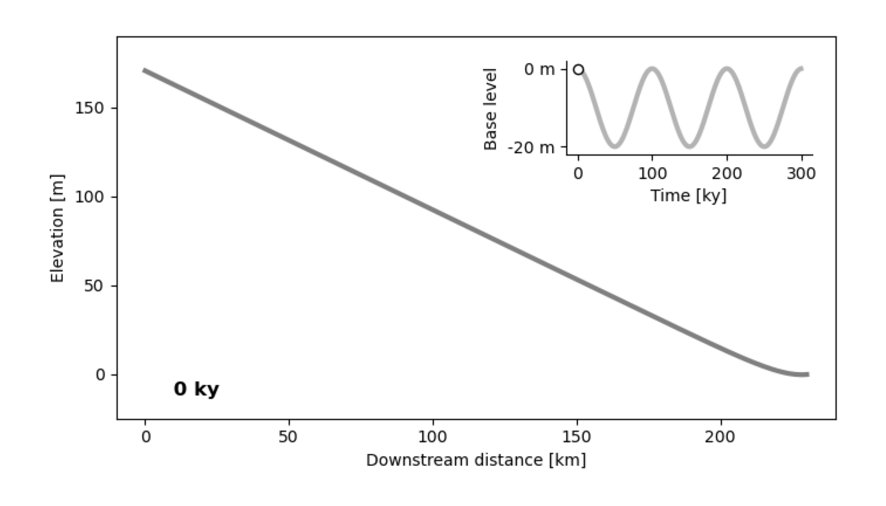
Sea-level changes
Similar to cyclic Qs/Qw changes upstream

