Slide 1
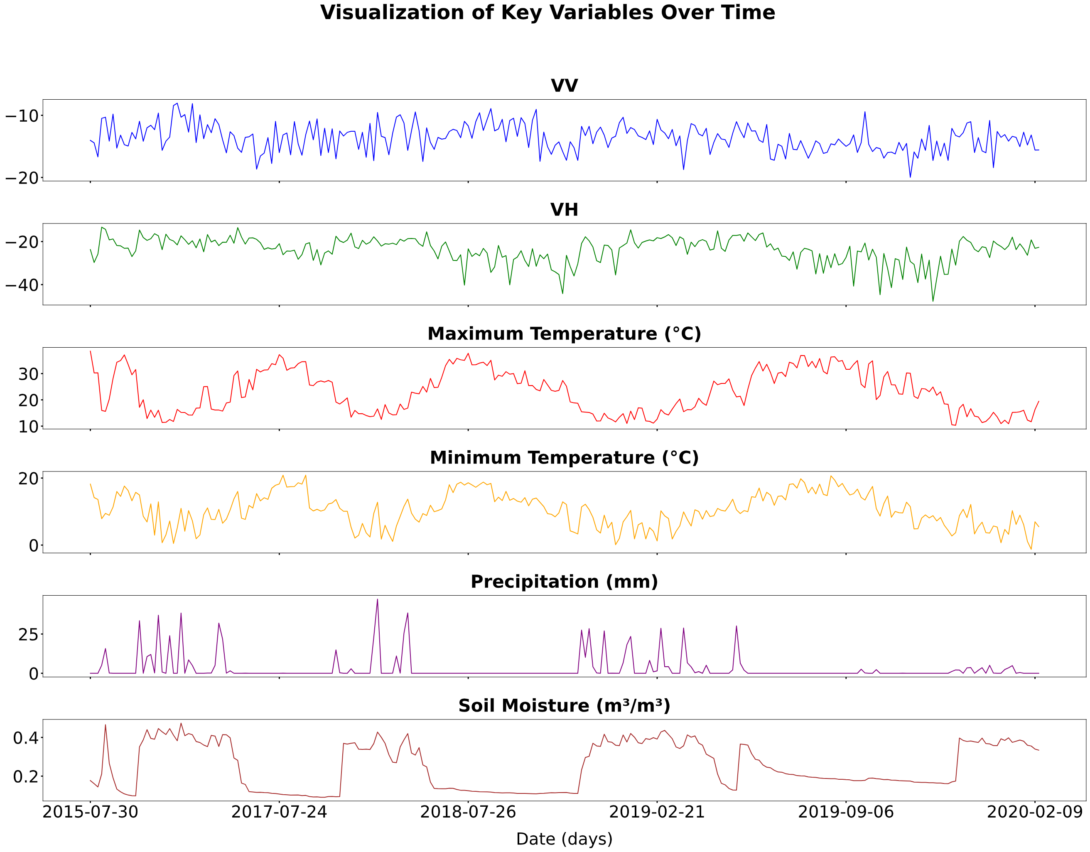
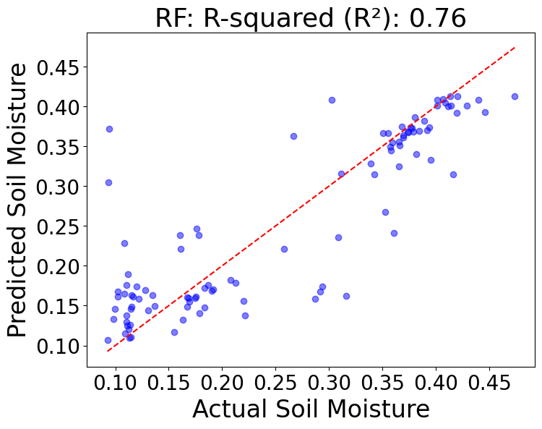
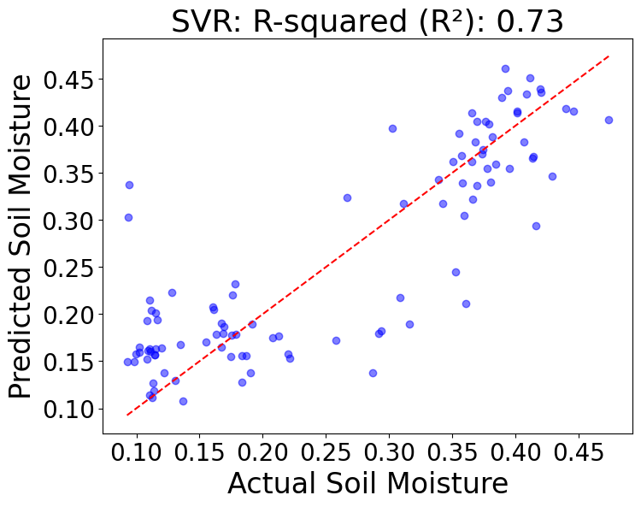
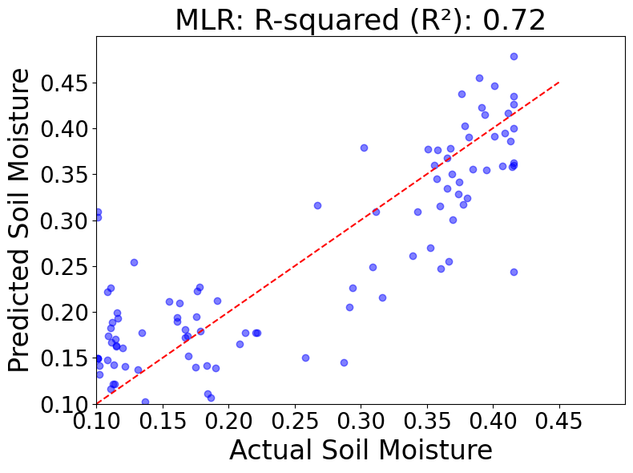
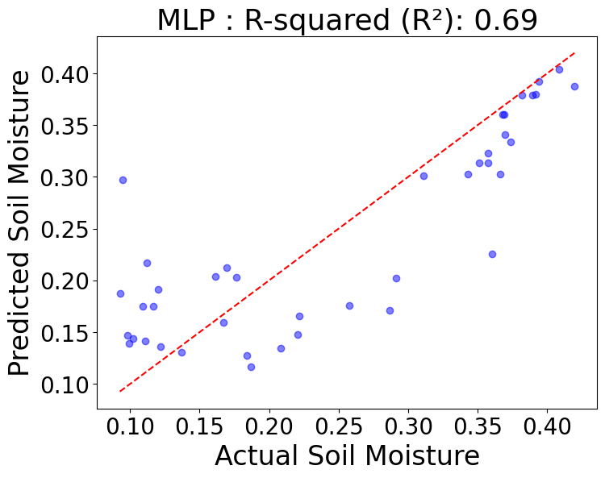
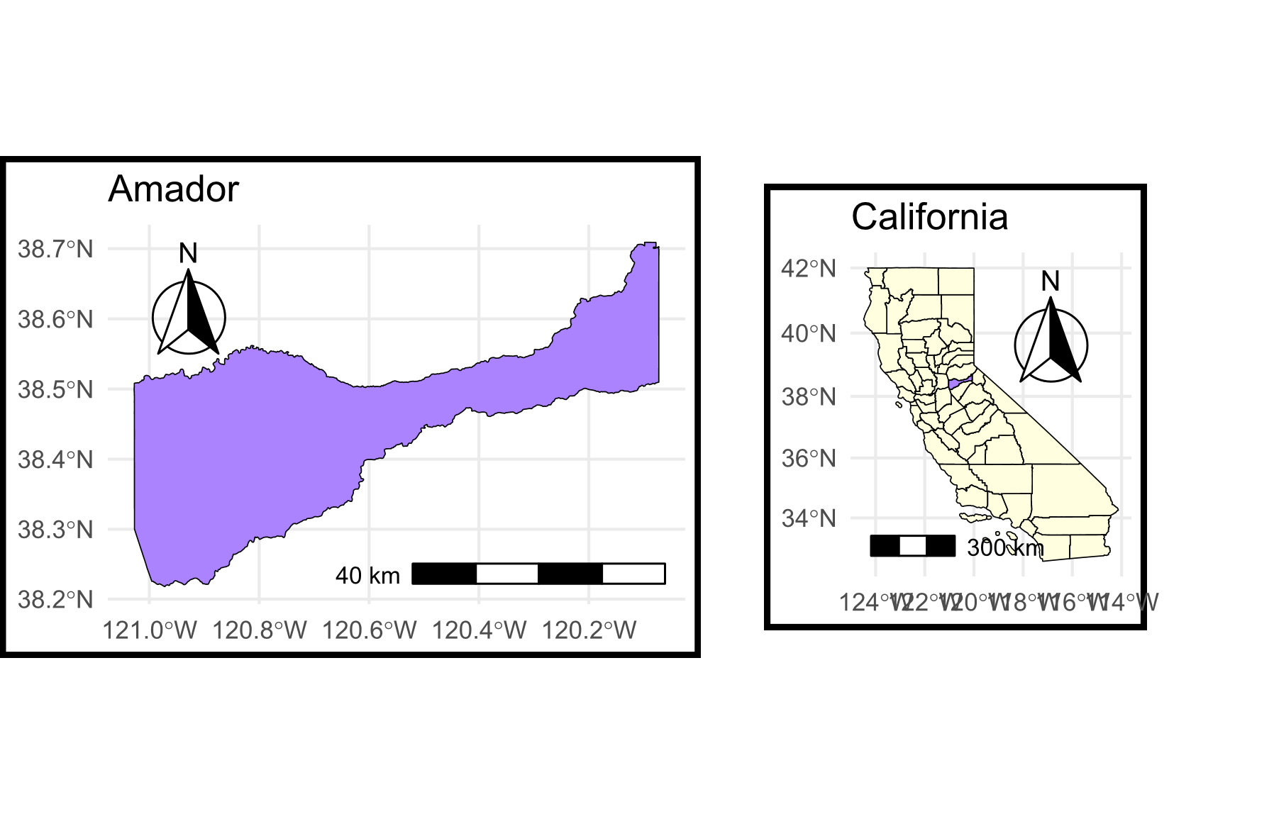
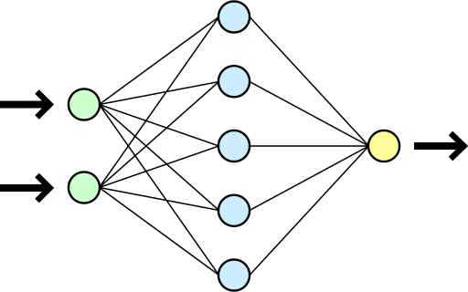
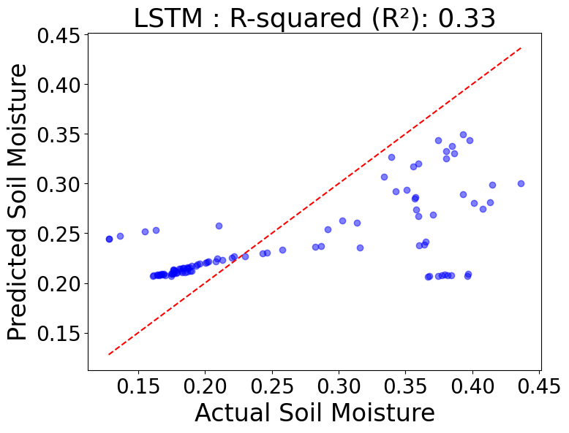
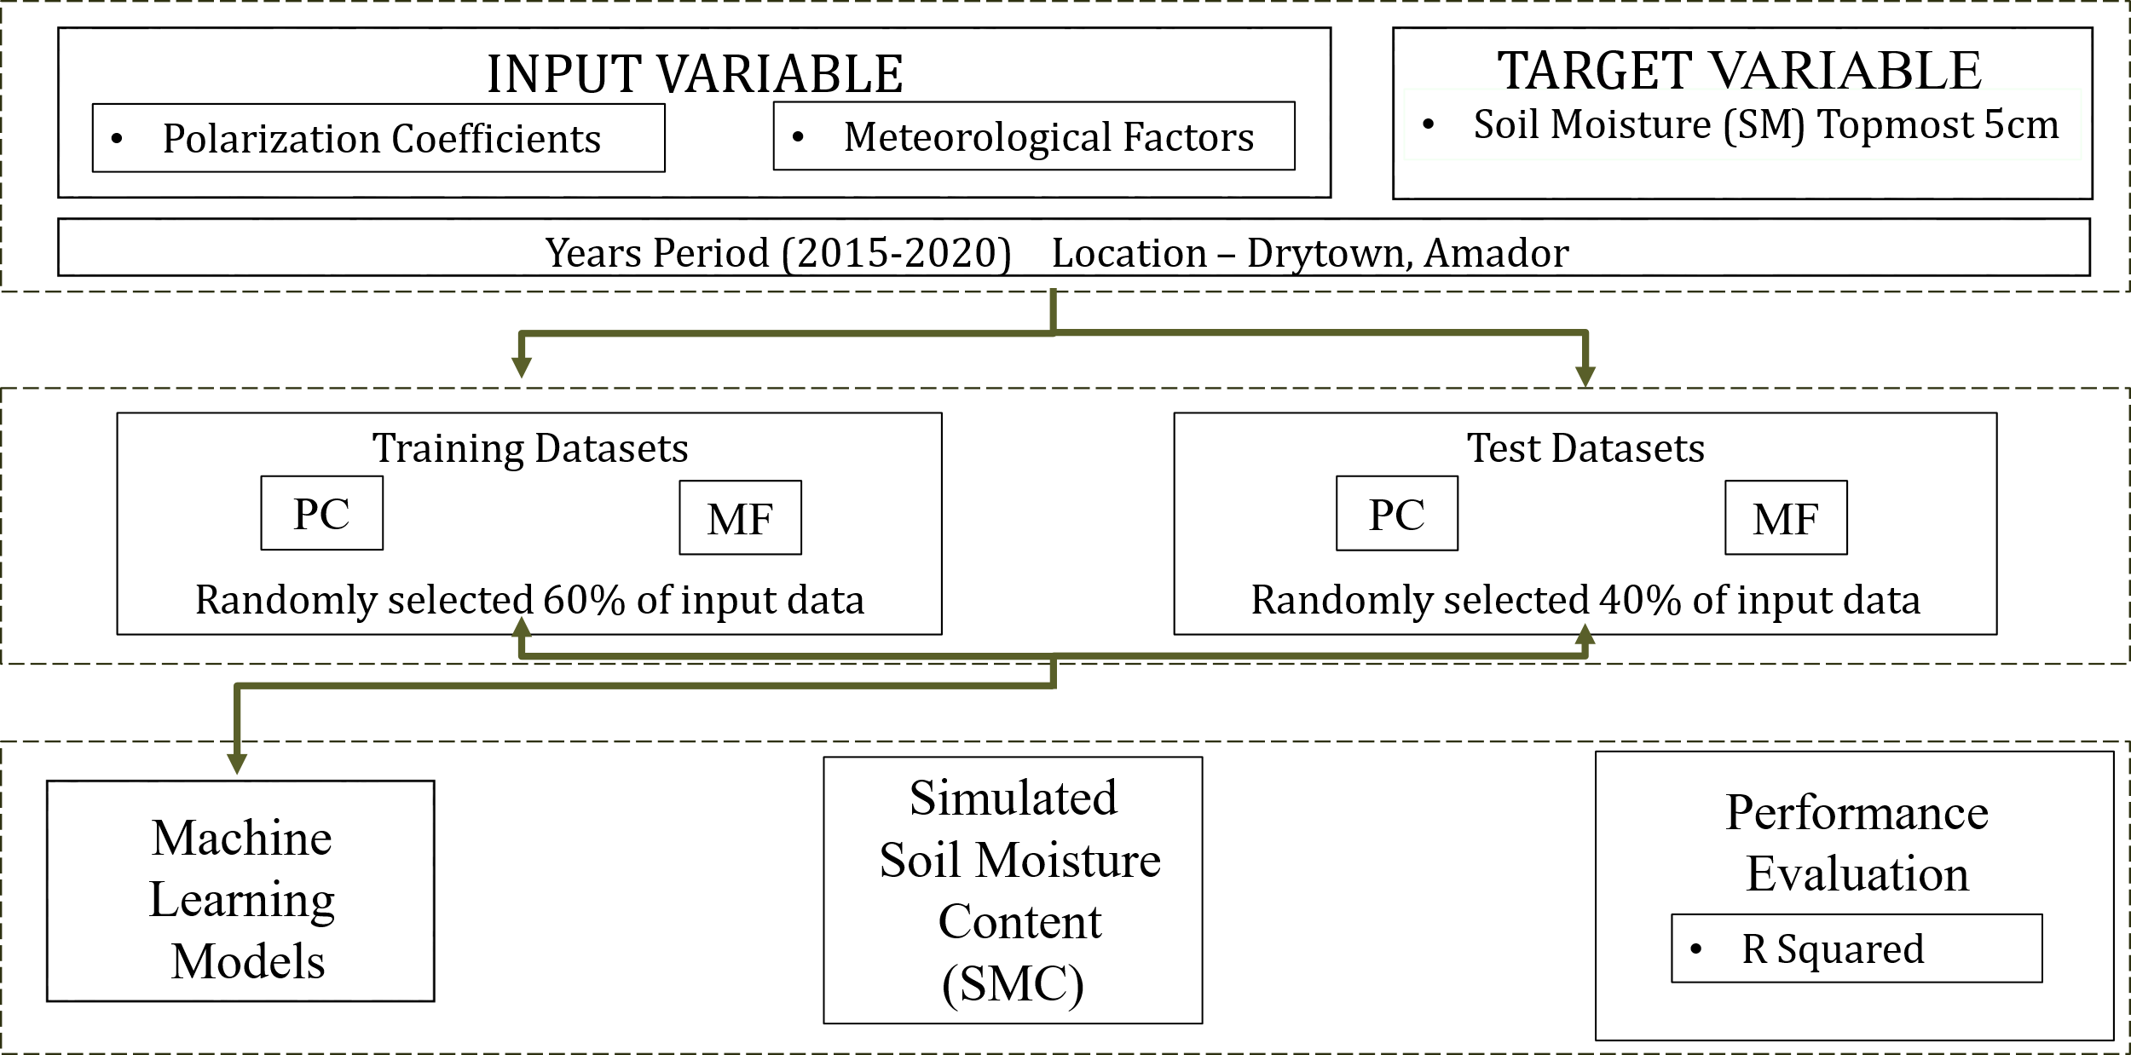
Enhancing Soil Moisture Estimation through Machine Learning Models and Remote Sensing Data
Vidushi Sharma¹, Siddik Barbhuiya², Vivek Gupta³
Abstract ID
EGU25-20070
¹ MS Scholar, School of Civil and Environmental Engineering, Indian Institute of Technology, Mandi,
² PhD Scholar, School of Civil and Environmental Engineering, Indian Institute of Technology, Mandi ,
³Assistant Professor, School of Civil and Environmental Engineering, Indian Institute of Technology, Mandi
Email: vidushisharma924@gmail.com , siddikbarbhuiya@gmail.com , vivekgupta@iitmandi.ac.in
INTRODUCTION
Soil moisture content is vital for understanding key water cycle processes such as runoff and evaporation, which impact water availability and climate dynamics.
Traditional measurement techniques, like time-domain reflectometry (TDR), provide limited coverage and accuracy. Remote sensing technologies, especially synthetic aperture radar (SAR), offer a high-resolution and cost-effective method for monitoring soil moisture across diverse landscapes.
Accurate soil moisture predictions are crucial for optimizing irrigation in agriculture, managing water resources during droughts and floods, and enhancing climate models. Reliable soil moisture data helps improve crop yields, support disaster preparedness and assess ecosystem health.
DATASET USED IN THE STUDY
RESULTS
OBJECTIVE
Integrate meteorological factors (rainfall, temperature) with Polarization Coefficients(VV,VH) to develop models for estimating soil moisture dynamics.
Evaluate the reliability by comparing simulated soil moisture with in-situ measurements in accurately representing soil moisture patterns.
Compare the performance of five models (MLP, SVR, MLR, RF, LSTM) in soil moisture estimation using R-squared to identify the most effective model.
STUDY AREA
MODELS
LSTM
MLP
Forget Gate
Input Gate
Output Gate
F
Wi
$$f\left(x\right)=\left\{\begin{matrix}0 \text{for} x=0 \\ 1 \text{for} x≥0\end{matrix}\right.$$
c_{t-1}
X
+
C_{t}
Xi
F
F
X
tanh
Xi
F
F
$$f\left(x\right)=\frac{1}{1+e^{−x}}$$
σ
σ
tanh
σ
X
F
h_{t-1}
h_{t}
Input Layer
10
F
Y $=\left(∑_{i=1}^{n} w_{i}x_{i}+b\right)$
Adam Optimiser
Hidden Layer
20 , relu
Output Layer
1 , Sigmoid
METHODOLOGY
x_{t}
MLR
RF
αi
Dataset
Xi
αiXi
RESULTS
Random Forest (RF) outperformed other models in terms of capturing relationships between the features and target variable for soil moisture estimation with a R² = 0.76, providing robust predictions and demonstrating strong performance in both training and testing scenarios.
The small difference between training and testing R² values indicates that the RF is not overfitting and is generalizing well to unseen data.
RF is followed by Support Vector Regression (SVR) with a R² = 0.73 and Multiple Linear Regression (MLR) with R² = 0.72 showing good performance at capturing temporal patterns.
Multi-Layered Perceptron (MLP) has a R² = 0.69 while Long Short Term Memory (LSTM) shows the least R² = 0.33 and represents its underperformance.
Kratzert et al. (2024) suggest that LSTMs require large, diverse datasets to effectively capture hydrological patterns, and training on a single basin, as in this case, limits its ability to generalize, therefore the model shows such suboptimal results.
(Reference: Kratzert, F., Gauch, M., Klotz, D., & Nearing, G. (2024). Never train a Long Short-Term Memory (LSTM) network on a single basin. Hydrology and Earth System Sciences, 28(17), 4187–4201. https://doi.org/10.5194/hess-28-4187-2024)
Xi
αi
αiXi
$$\sum_{0}^{n}{\text{α}\text{i}\text{Xi} }$$
E
Z
…
Xi
αi
αiXi
$$RF\left(x\right)=\frac{1}{N}\sum_{i=1}^{N}{T_{i}(x)}$$
Mean
Z = α0 ​+ $\sum{\text{α}\text{i}\text{​}\text{X}\text{i}}$​ + E
Prediction
Bias
b
SVR
K(x, x1)
α1
K(x, x2)
α2
Input Vector x
K(x, x3)
α3
Output Vector y
Hidden Nodes (Support Vectors)
K(x, xm)
αm

