Slide 1
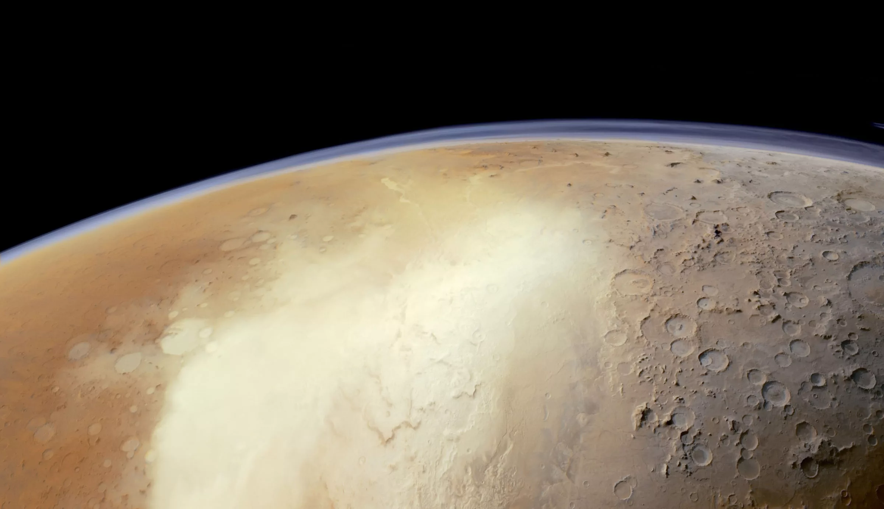
Enhancing SHARAD Subsurface Imaging on Mars through a combination of Very-Large Roll (VLR) Maneuvers and Super-Resolution Techniques.
¹﻿California Institute of Technology, Pasadena, CA, USA, ²UniLink of Rome, Italy, ³Sapienza University of Rome, Italy
M.C. Raguso¹, M. Mastrogiuseppe^{2,3}, P. Lombardo³, D. Pastina³
Vienna, Austria |27 April–2 May 2025

Slide 2
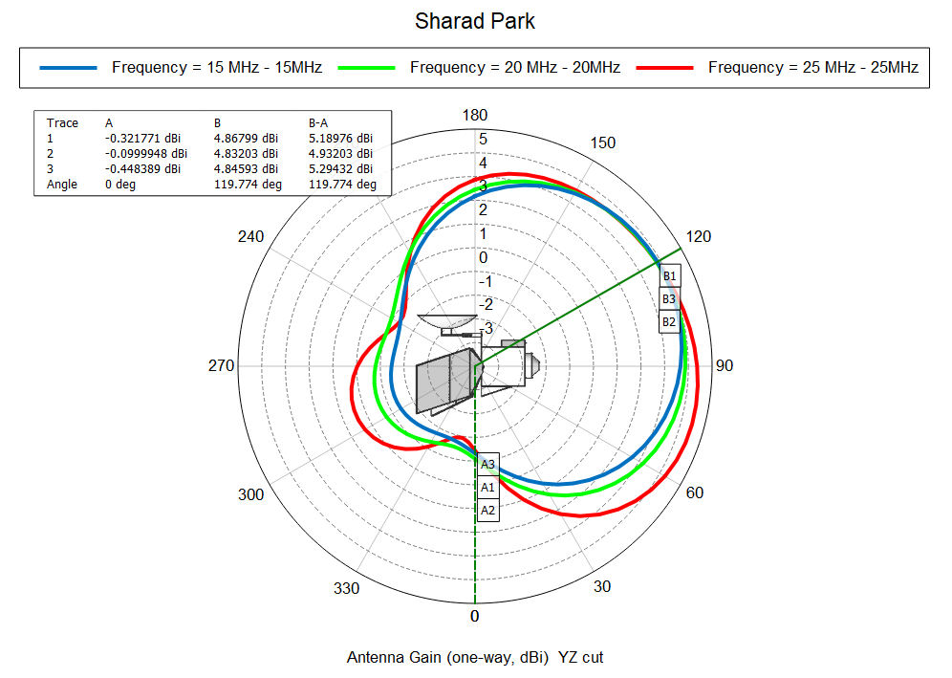
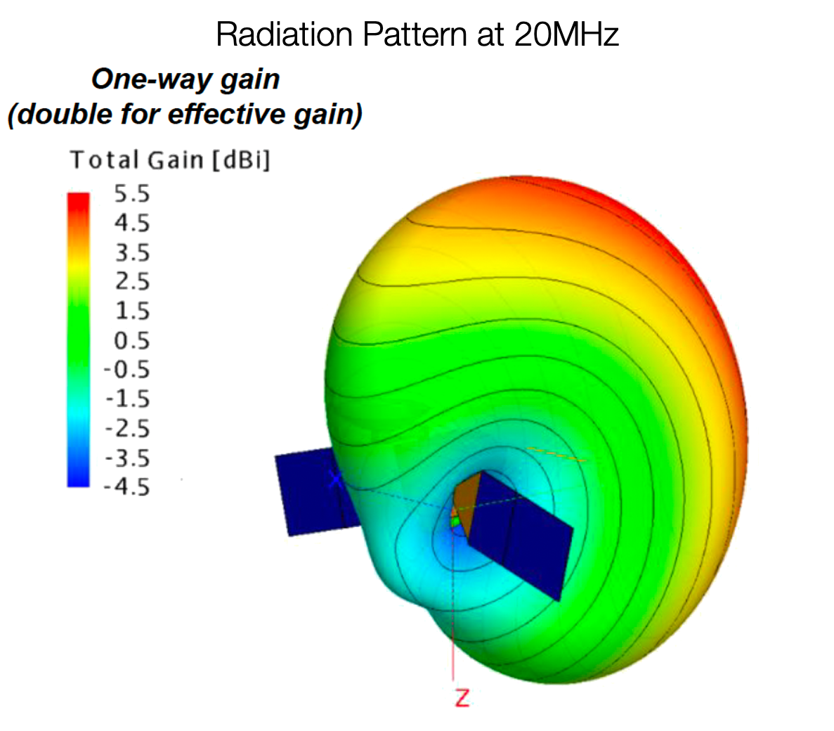
Very Large Roll Experiment: Antenna Total Gain (one-way) Modeling
Antenna Gain vs angle $θ$ at 15-20-25 MHz
SHARAD's antenna location has always been sub-optimally located — mounted at the corner of MRO’s upper deck.
Interferences caused by the spacecraft body and components reduce the signal-to-noise ratio (SNR)
120° roll
Since 2017, the SHARAD team has explored the potential of performing large rolls maneuvers (R > +30°) to improve radar performance.
SHARAD rolled observations
(up to 28°) have been proposed
by Campbell et al. (2021),
with the intent of further increasing
gain to observer high-science value
targets.
DiCarlofelice et al., 2024
A new EM model (DiCarlofelice et al., 2024) suggests using a neutral position (all gimbals to 0°) for the SA.
By recomputing the EM model of the SHARAD antenna and its interaction with the spacecraft demonstrate a 10 dB (or more) SNR boost.
The HGA impact is negligible and set to a
position with minimum interference.

Slide 3
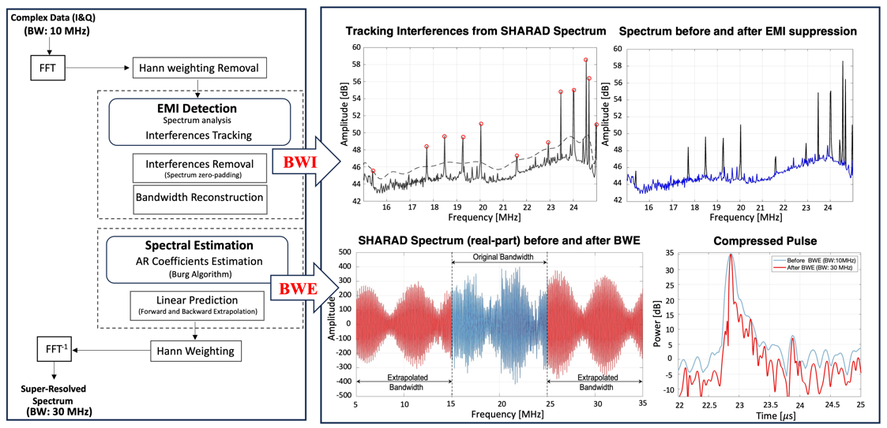
Enhancing Radar Sounder: EMI Suppression + Bandwith Extrapolation (BWE)
Specialized signal processing techniques can be applied to SHARAD data products in addition to the standard processing.
Bandwidth extrapolation/interpolation (BWE/BWI) techniques can be employed to reconstruct the sounder spectra after EMI suppression and to enhance vertical resolution.
Raguso et al., 2024

Slide 4
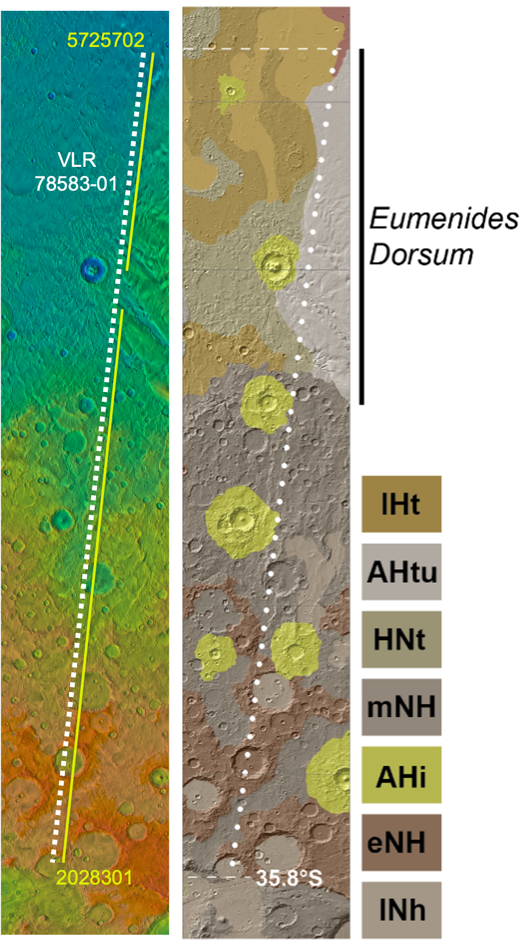
First VLR Test: Eumenides Dorsum
Left: Orbit selected for the VLR test plus existing SHARAD tracks, with the start and stop limits of the radar acquisition. The flight path: descending (N to S), over MOLA hill-shades topography data.
Mid: Geological map from Tanaka et al. (2014) (right).
Below: Radargrams for nearly-coincident observations at 0 roll angle (top) and the first Very Large Roll (bottom).
Eumenides
Dorsum
57257-02
20283-01
Zones with known reflectors
Zones with possible new reflections??
dB relative to average noise level
VLR 78583-01
MFF Region of Interest

Slide 5
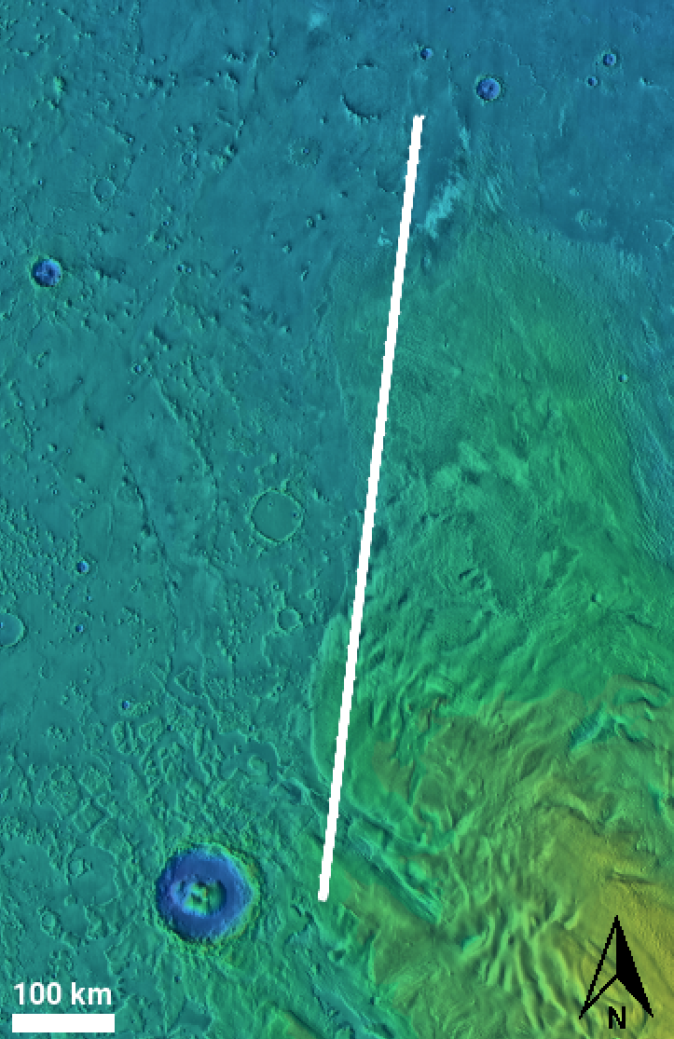
VLR#1 7858301 vs SHARAD ID 5725702
a
SHARAD ID 5725702 (0° roll)
Eumenides Dorsum
7.5 $μs$
50 km
SHARAD VLR 7858301 (120° roll)
a’
a
a’

Slide 6
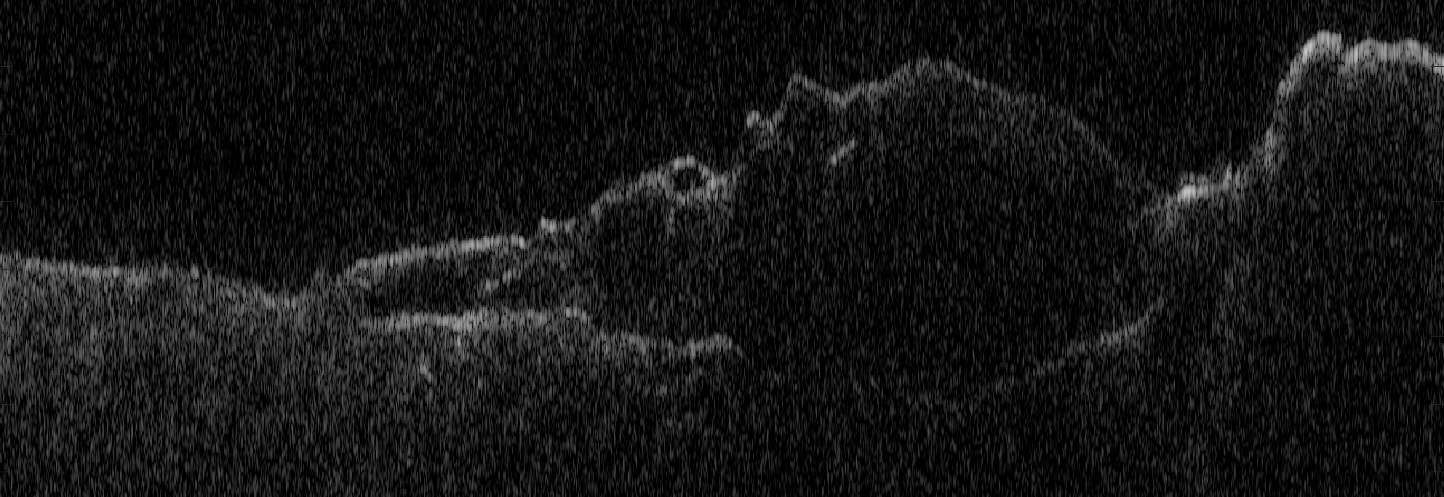
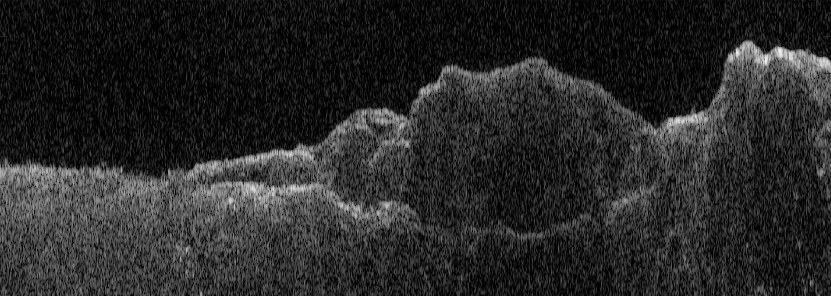
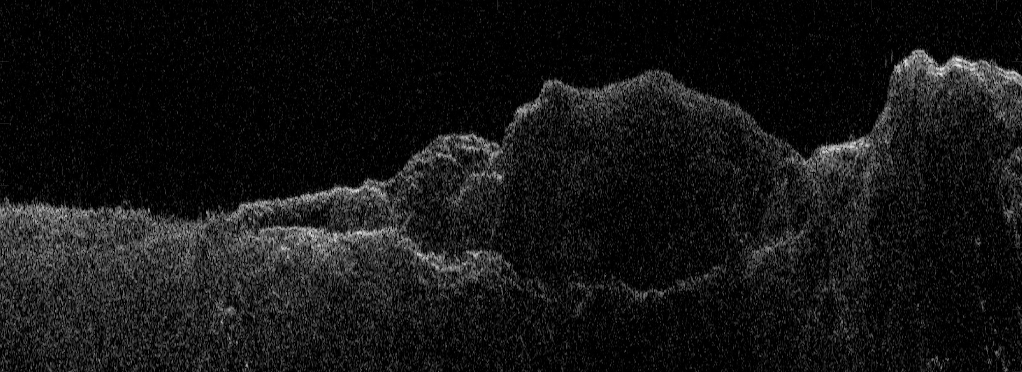
VLR#1 7858301 vs 5725702: Before and After Processing
SHARAD ID 5725702 - 0° roll STD radargram
SHARAD ID 5725702 - 0° roll SXR radargram
SHARAD ID 7858301 - 120° roll STD radargram
SHARAD ID 7858301 - 120° roll SXR radargram
In both cases, the standard radargrams (left) suffer from limited contrast and diffuse internal reflectors.
After SXR processing (right panels), we observe a marked improvement in reflector continuity and definition — particularly within the thick MFF interior.
These enhancements are visible in both observation geometries, confirming that SXR algorithms are effective not only for standard nadir-mode acquisitions but especially under very large roll-enhanced gain conditions.
In Medusae Fossae, where material properties may suppress or scatter radar signals, the improved visibility of internal reflectors post-SXR could provide new constraints on layering, compaction, or depositional processes.

Slide 7
SHARAD ID 5725702 (0° roll)
Radargram for a portion of SHARAD observation 57257-02 at 0° roll angle. Highlighting the “northern mound” of Eumenides Dorsum.
50 km
7.5 $μs$
Bottom of the sedimentary deposit not completely detected

Slide 8
SHARAD ID 7858301 (120° roll): Std Resolution
Radargram for a portion of SHARAD observation 78583-01 at 120° roll angle. Highlighting the “northern mound” of Eumenides Dorsum.
50 km
7.5 $μs$
Bottom of the sedimentary deposit entirely detected now thanks to the VLR gain

Slide 9
SHARAD ID 7858301 (120° roll): SXR Resolution
There is a substantial improvement in signal-to-noise ratio (S/N) throughout the observation relative to VLR collected data.
New reflection?
(requires further investigation)
50 km
7.5 $μs$
The SHARAD VLR observation over the Eumenides Dorsum section of the Medusae Fossae formation enabled the full basal reflection of the northern mound to be traced with a higher accuracy thanks to the improvement in resolution and SNR.
Notes:
Leveraging these deeper reflections provides more insight into the loss properties of the deposits and adds weight to the assessment that they consist of a low loss, non-compacting material.

Slide 10
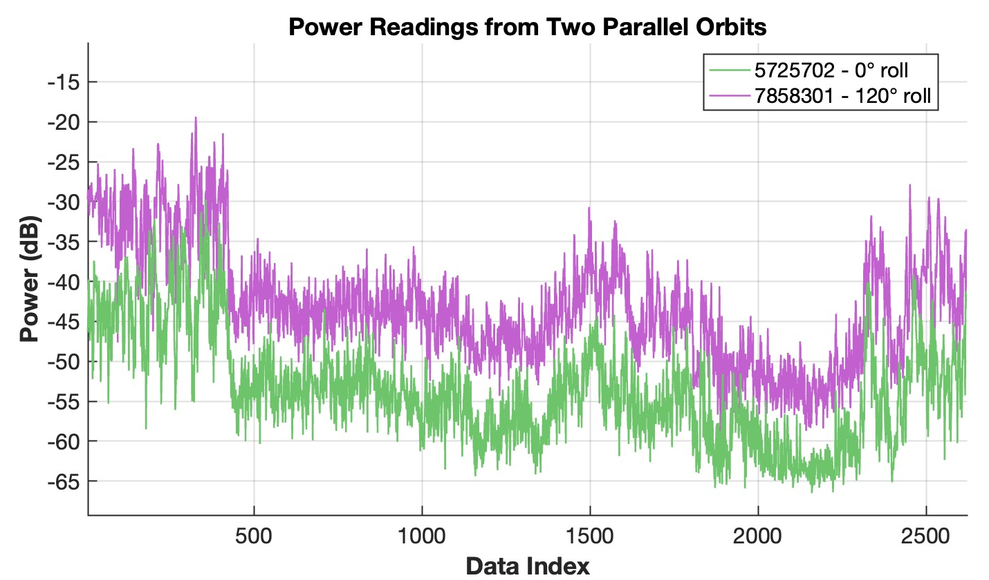
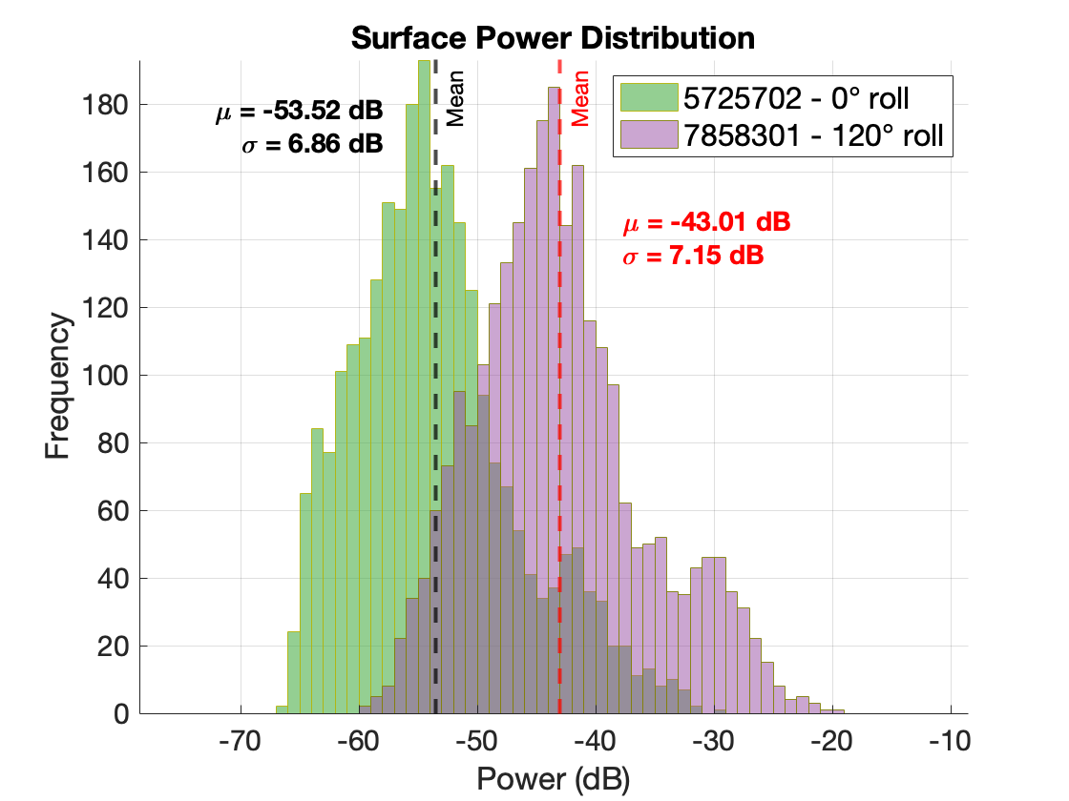
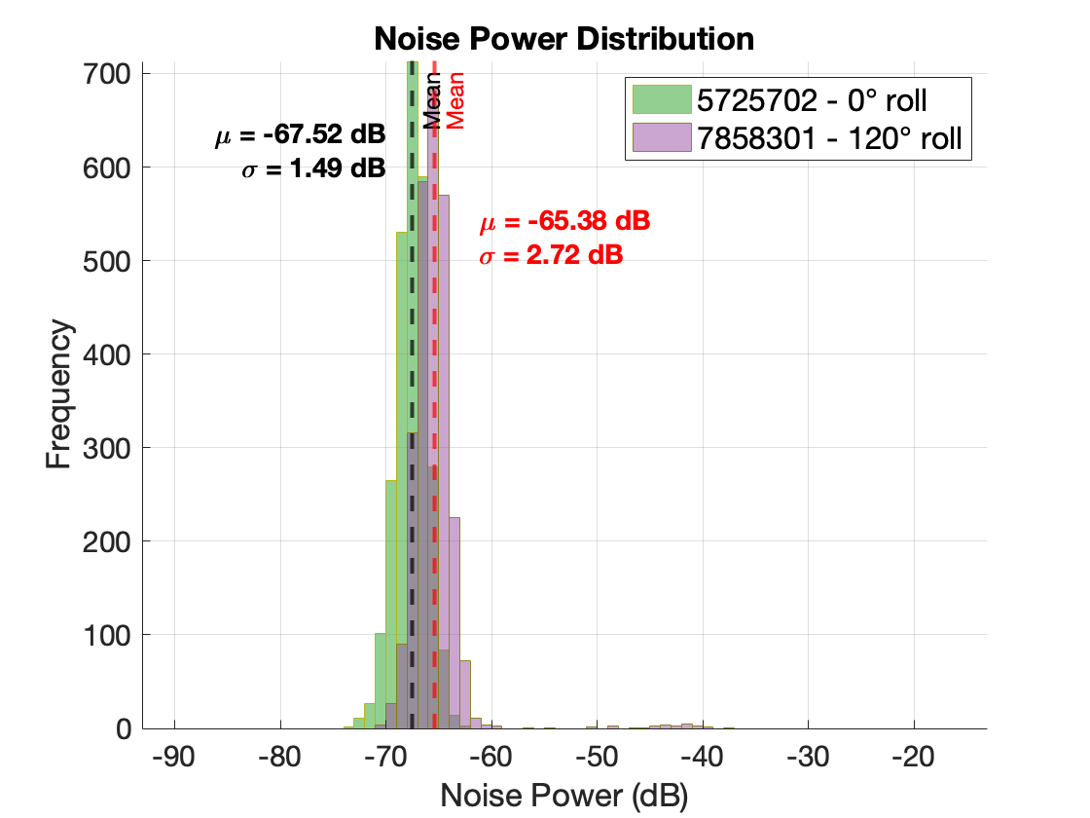
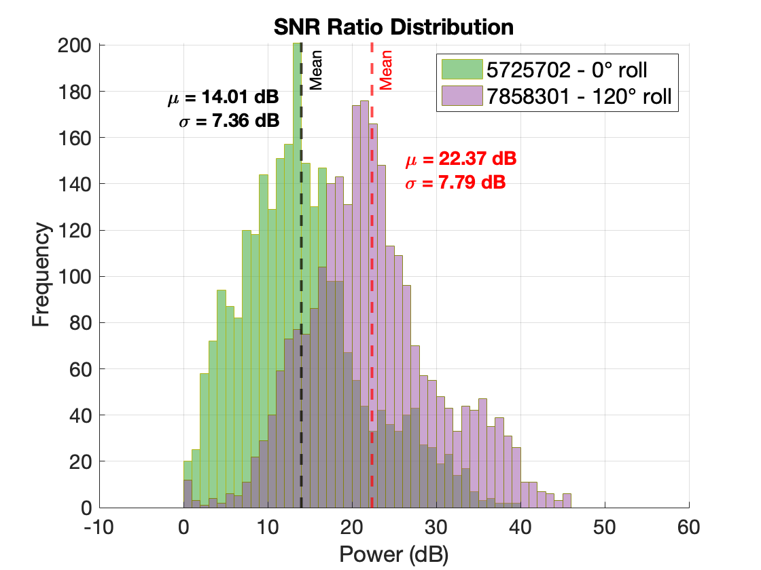
VLR#1 (7858301) vs SHARAD Existing Data (5725702)
5725702 – 0° roll
7858301- 120° roll
~8.4 dB SNR improvement
10.51 dB improvement in VLR
(11.2 dB expected from models)
Comparison between VLR (120° roll) and SHARAD nadir-looking observation: a) surface power returns, b) noise level, and c) signal-to-noise ratio extracted from coincident observations 5725702 (green) and 7858301 (VLR, magenta).
All histograms are calculated using 1 dB bin widths spanning each dataset.

Slide 11
7858301 STD Product vs 7858301 SXR Product
10.51 dB improvement in VLR dB
(11.2 dB expected from models)
7858301 (120° roll) – SXR Resolution
7858301 (120° roll) – Std Resolution
~3 dB improvement respect to the VLR
~3 dB SNR improvement over the standard VLR product is achieved through EMI suppression and bandwidth extrapolation (BWE). Surface echoes become stronger, noise is reduced, and overall SNR improves, enabling more confident subsurface tracking and analysis.

Slide 12
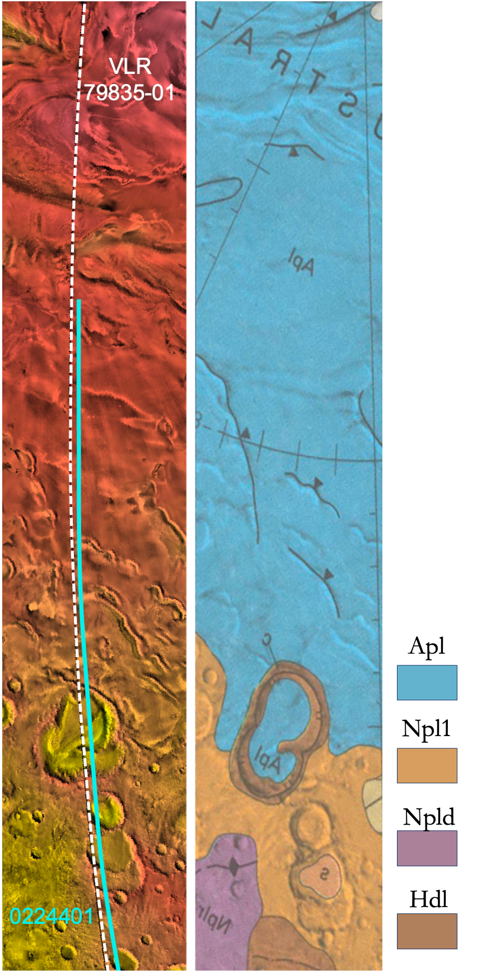
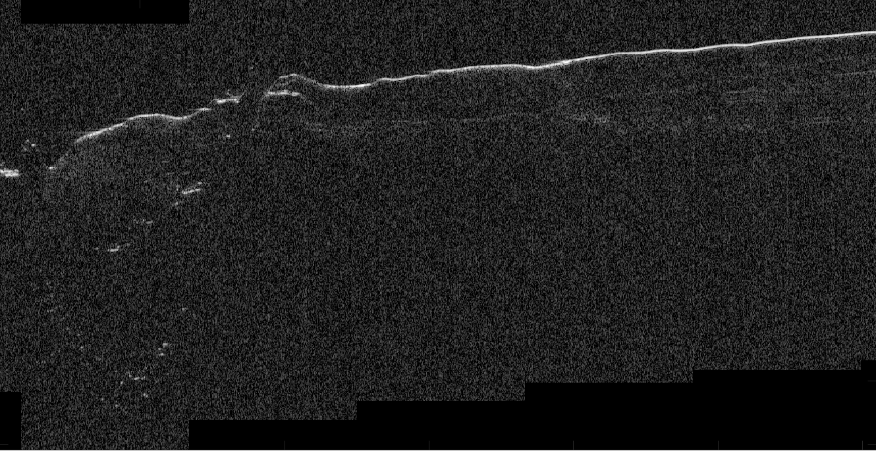
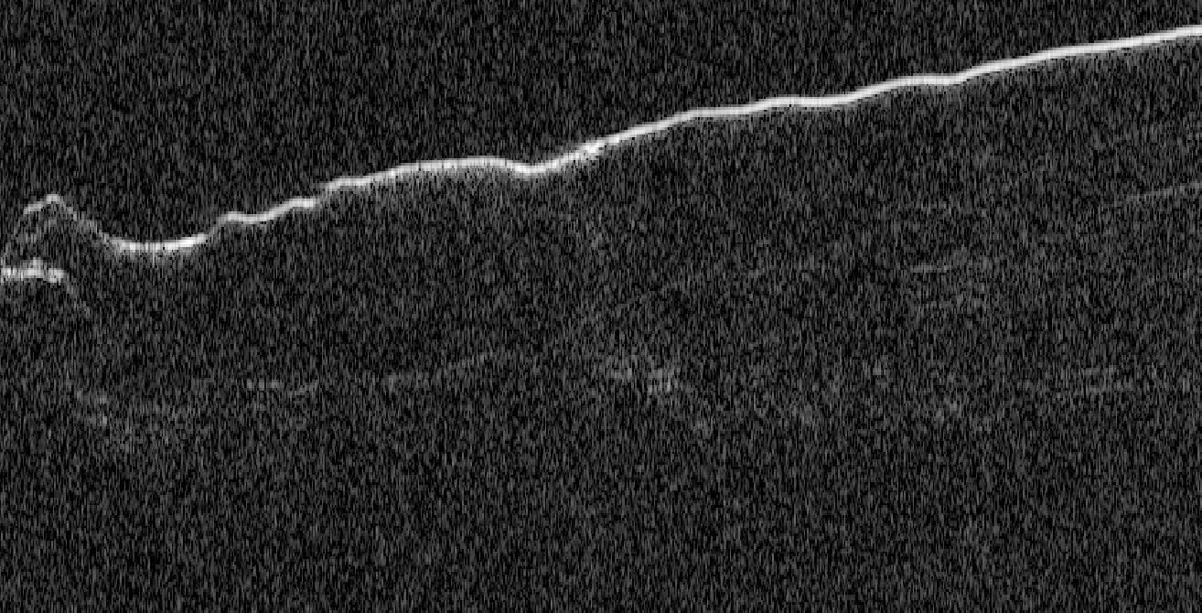
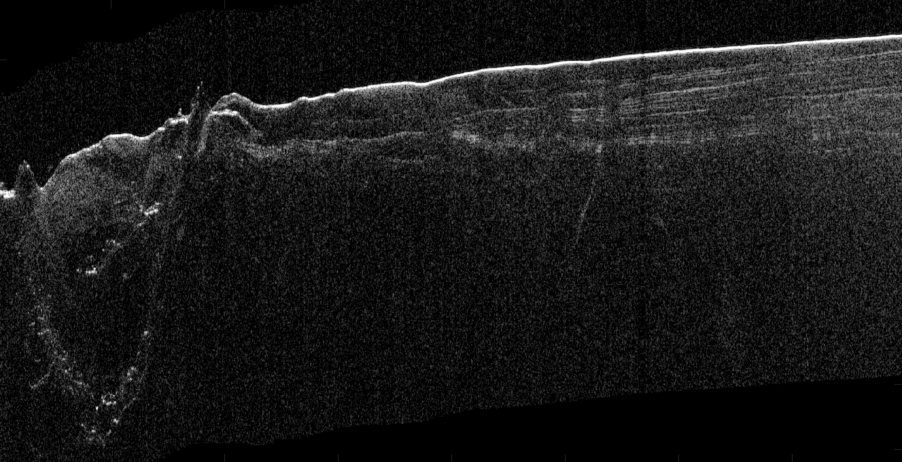
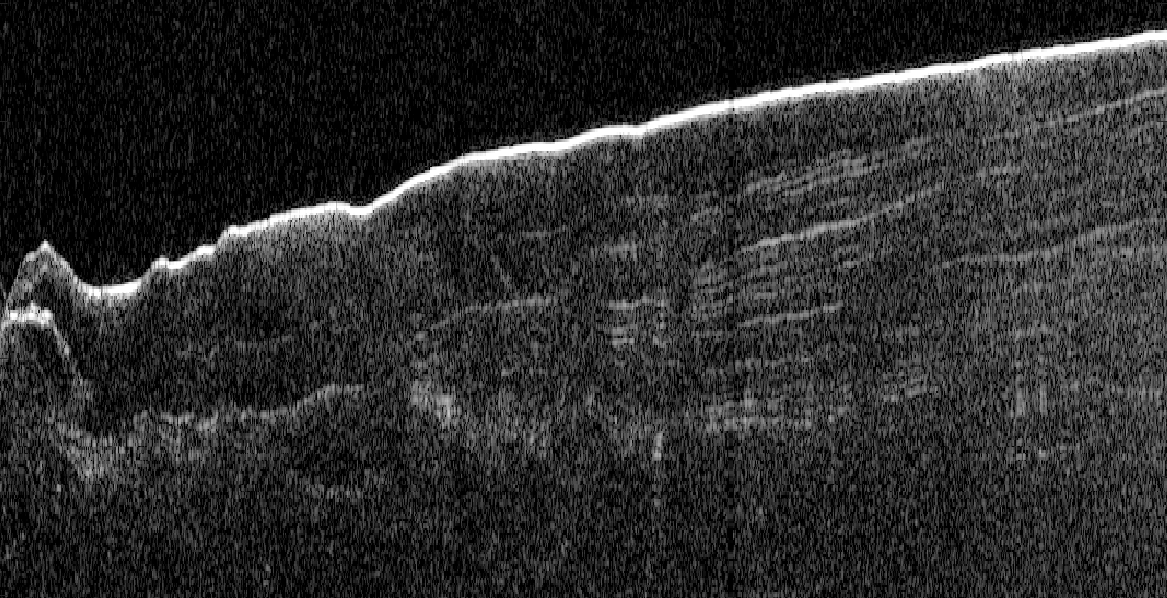
Second VLR Test: 7983501 vs 0224401
Left: Orbit selected for the VLR test plus existing SHARAD tracks, with the start and stop limits of the radar acquisition. The flight path: descending (N to S), over MOLA hill-shades topography data.
Mid: Geological map from Tanaka et al. (2014) (right).
Below: Radargrams for nearly-coincident observations at 0 roll angle (top) and the first Very Large Roll (bottom).
0224401
0224401 - Zoom
VLR 79835-01
VLR 79835-01 - Zoom
Improved SPLD layering
Improved Basal Reflector

Slide 13
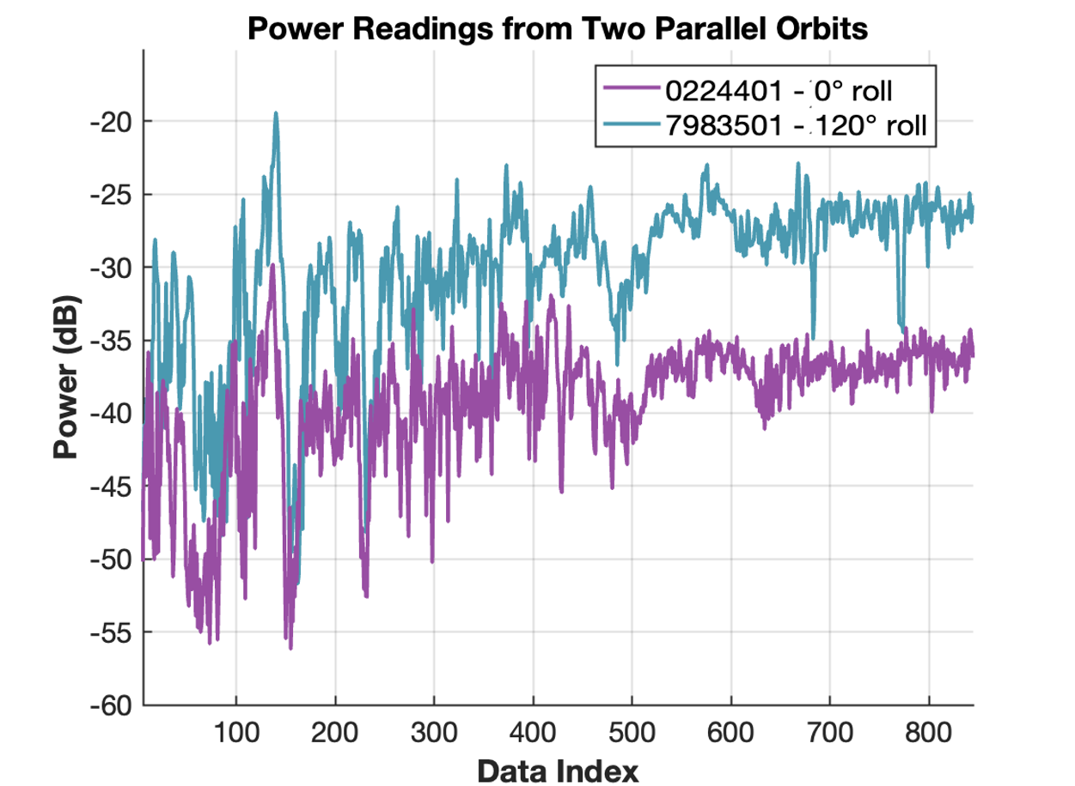
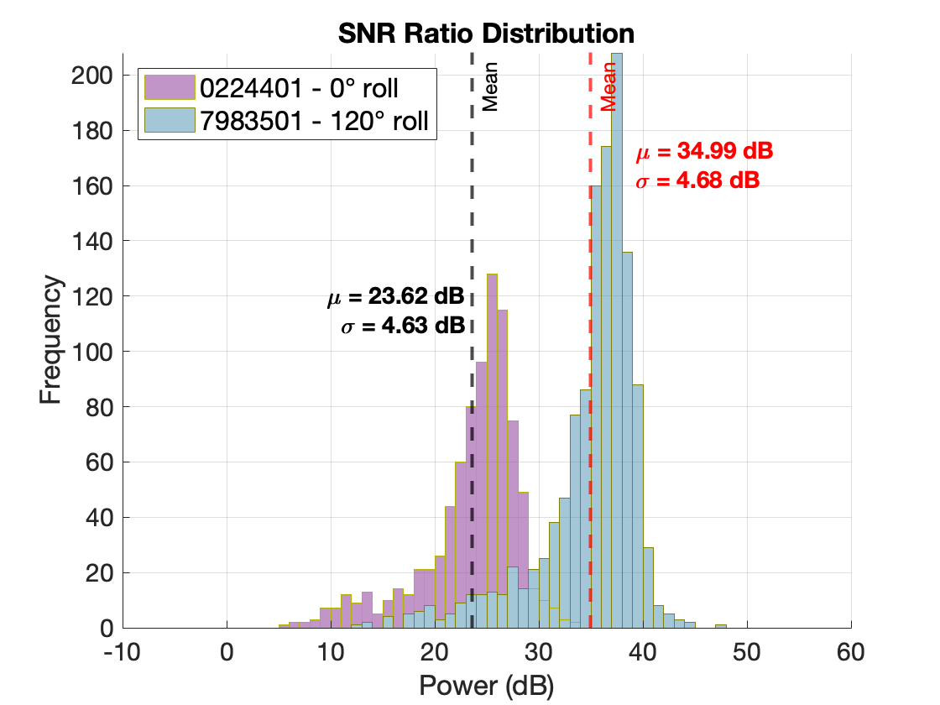
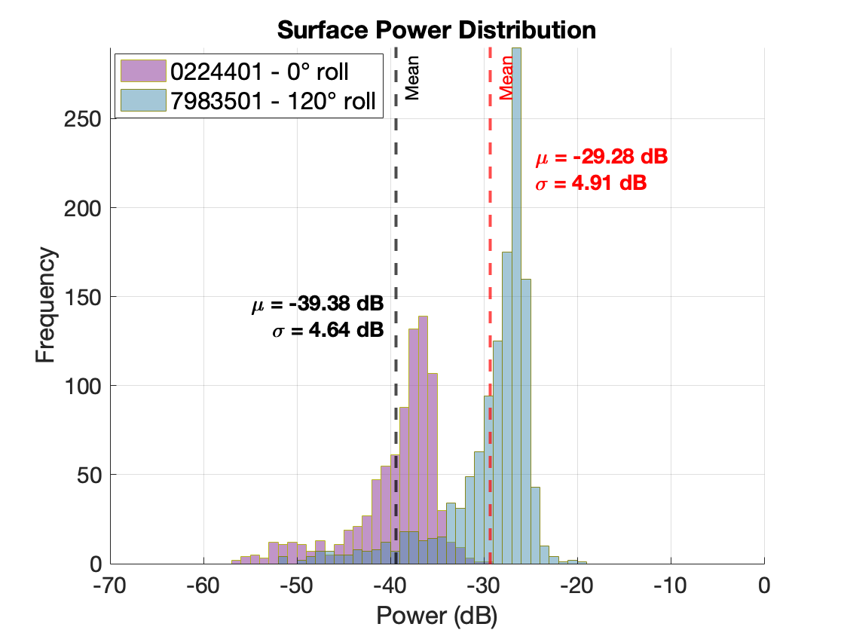
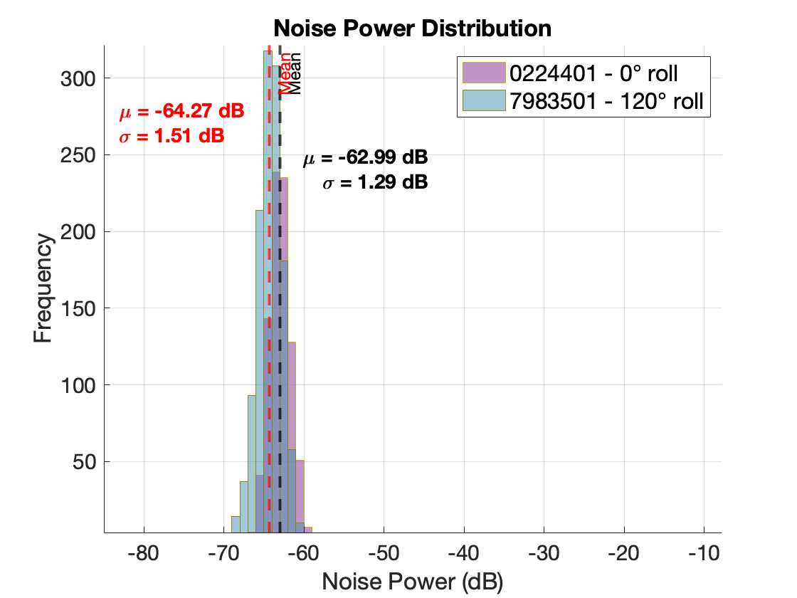
VLR#2 (7983501) vs SHARAD Existing Data (0224401)
0224401 – 0° roll
VLR 79835-01 – 120° roll
A comparison of the S/N distribution for the two observations shows a ~11.3 dB increase with the 120° roll angle.

Slide 14
7983501 STD Product vs 7983501 SXR Product
VLR 79835-01 – STD
VLR 79835-01 – SXR
No Basal Return
(Fog intensity also higher)
No Basal Return
(Fog intensity also higher)
No Basal Return
(Orosei et al., 2018)
The standard product (left) exhibits higher noise and weaker contrast in deeper layers, especially near the base of the SPLD.
Our SXR product (right), enhanced via VLR maneuvers and advanced spectral processing, improves SNR and layer continuity, revealing subsurface features with greater confidence.
Subtle internal reflectors (white arrows) become clearer and more persistent in the SXR data, supporting improved stratigraphic interpretation.
The area annotated as "No Basal Return" shows improved contrast, but no basal reflector (Orosei et al. (2018) has been detected even with the improved SNR.

Slide 15
7983501 STD vs 7983501 SXR: SNR Improvement
Improved SPLD layering
An additional ~4.4 dB improvement respect to the std VLR

Slide 16
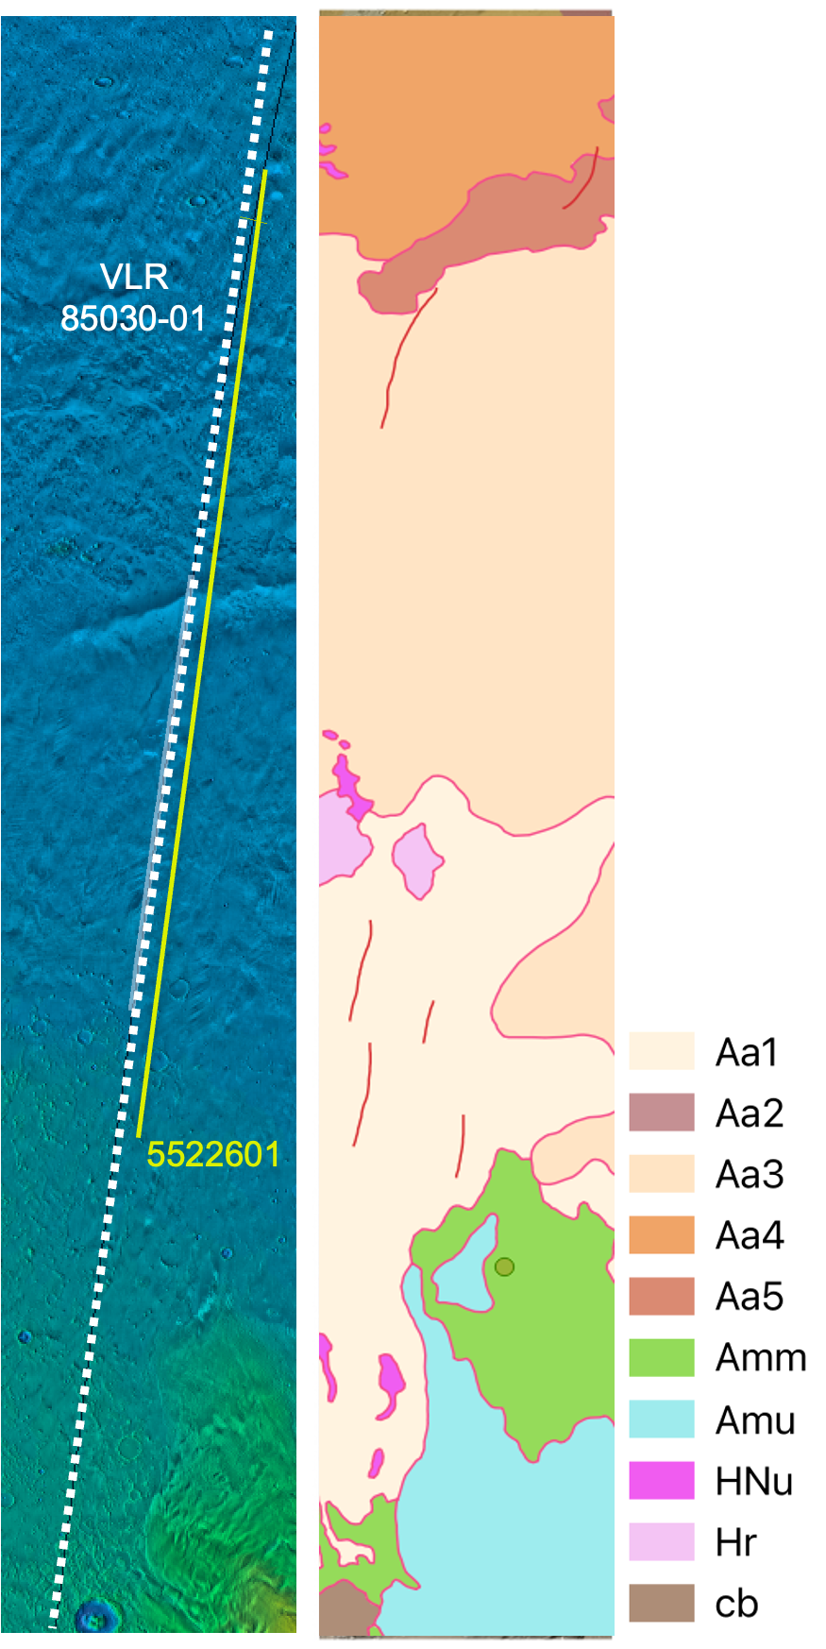
Third VLR Test: 8503001 vs 5522601
Left: Third VLR test versus existing SHARAD track over MOLA hill-shades topography data.
The target was the volcanic terrain in Amazonis Planitia.
Mid: Geological map from Tanaka et al. (2014) (right).
Below: Radargrams for nearly-coincident observations at 0° roll angle (top) and the first Very Large Roll (bottom).
5522601 – 0° roll
dB relative to average noise level
8503001 – 120° roll
Reflector continuity is improved, yet its extent did not change.

Slide 17
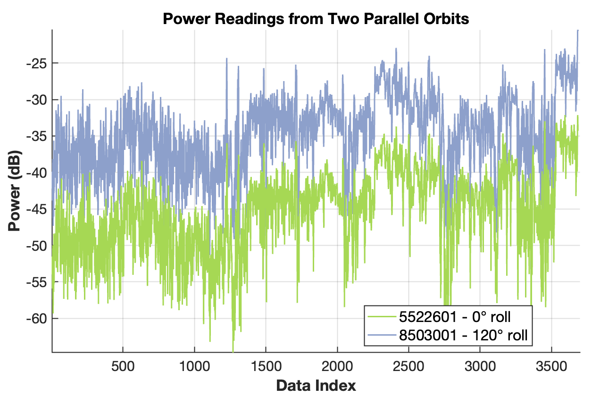
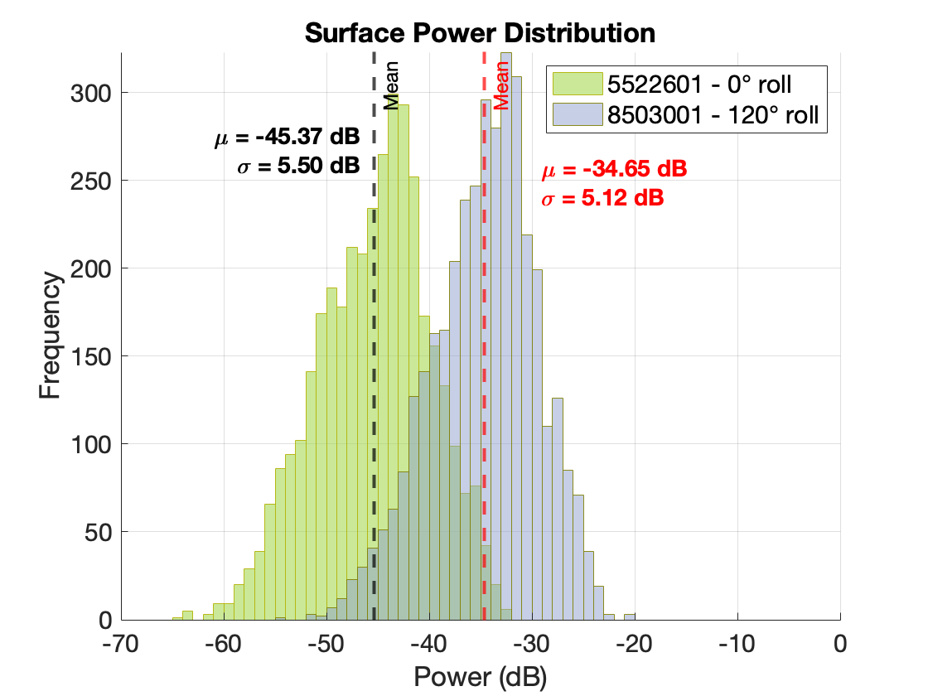
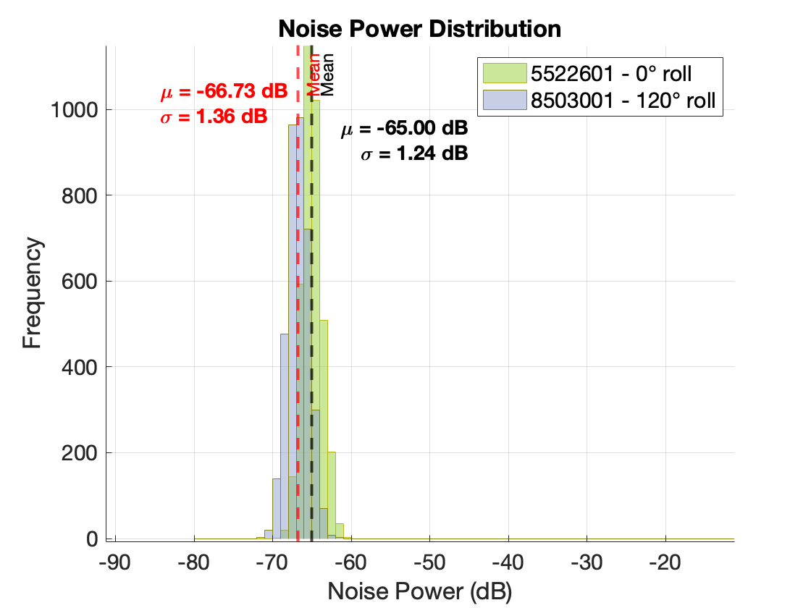
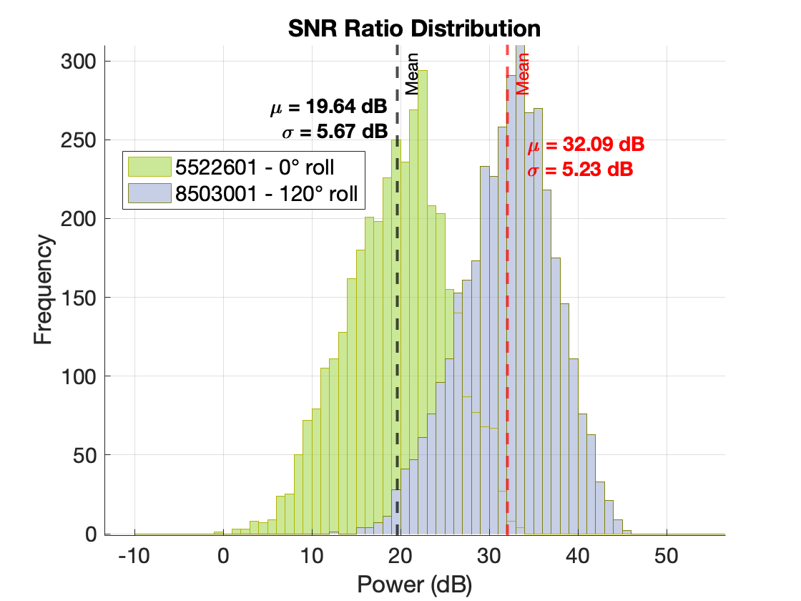
VLR#3 (8503001) vs SHARAD 0° roll (5522601)
5522601 – 0° roll
8503001 – 120° roll
A comparison of the S/N distribution for the two observations shows a ~13 dB increase with the 120° roll angle.

Slide 18
VLR#3 (8503001) STD vs SXR resolution
VLR 8503001 : STD vs SXR
Reduced noise and enhanced definition support more confident interpretation deposits.
The reflector extent remains similar to the 0° roll.
Why? Radar’s sensitivity, signal attenuation, reduced contrast or no reflector?
Subtle reflector features that are marginally visible in the standard product become clearer in the SXR version — an important gain
for automated mapping or stratigraphic correlation.
~5.1 dB improvement respect to the std VLR
SXR processing improves reflector clarity and continuity, yielding an additional improvement of about 5 dB SNR wrt the standard VLR product.
Notes:
SXR algorithms allow an additional improvement of about 5 dB SNR thanks to the BWE

Slide 19
What We Learned – And Why It Matters…
Enhanced SHARAD signals via Very Large Rolls Maneuvers
VLR tests conducted across diverse Martians terrains (e.g., lava flows, ice and sedimentary deposits) demonstrated that very large rolls (>>28°, ideally in the 90-120° range) can produce a significant SNR improvement (~9-13 dB).
Integration with Advanced Processing.
Combining VLR with advanced radar signal processing techniques, such as EMI suppression and SXR algorithms, yields a +3–5 dB boost in SNR beyond VLR alone.
This improvement (12-18dB in total) yields sharper subsurface reflectors and potentially enables deeper signal penetration.
Scientific Payoff
Improved subsurface imaging supports better understanding of Martian geology:
Provides a clearer view of Mars' subsurface structures.
Helps study ice deposits, geologic formations, and potential past liquid water reservoirs.
Supports future Mars exploration by identifying key subsurface features.

Slide 20
Thank you!
Acknowledgements
The SHAllow RADar (SHARAD) was provided by the Italian Space Agency and operated by the Dipartimento di Ingegneria dell'Informazione, Elettronica e Telecomunicazioni (DIET), Sapienza University of Rome, Italy.
The Mars Reconnaissance Orbiter mission is managed by the Jet Propulsion Laboratory, California Institute of Technology, for the NASA Science Mission Directorate, Washington, DC. We are grateful to all the people at these Institutions who have been fundamental in the success of the SHARAD experiment and for their efforts in acquiring the radar sounder dataset.
How to cite: Raguso, M., Mastrogiuseppe, M., Lombardo, P., and Pastina, D.: Enhancing SHARAD Subsurface Imaging on Mars through a combination of Very-Large Roll (VLR) Maneuvers and Super-Resolution Techniques., EGU General Assembly 2025, Vienna, Austria, 27 Apr–2 May 2025, EGU25-20114, https://doi.org/10.5194/egusphere-egu25-20114, 2025.

