Slide 1
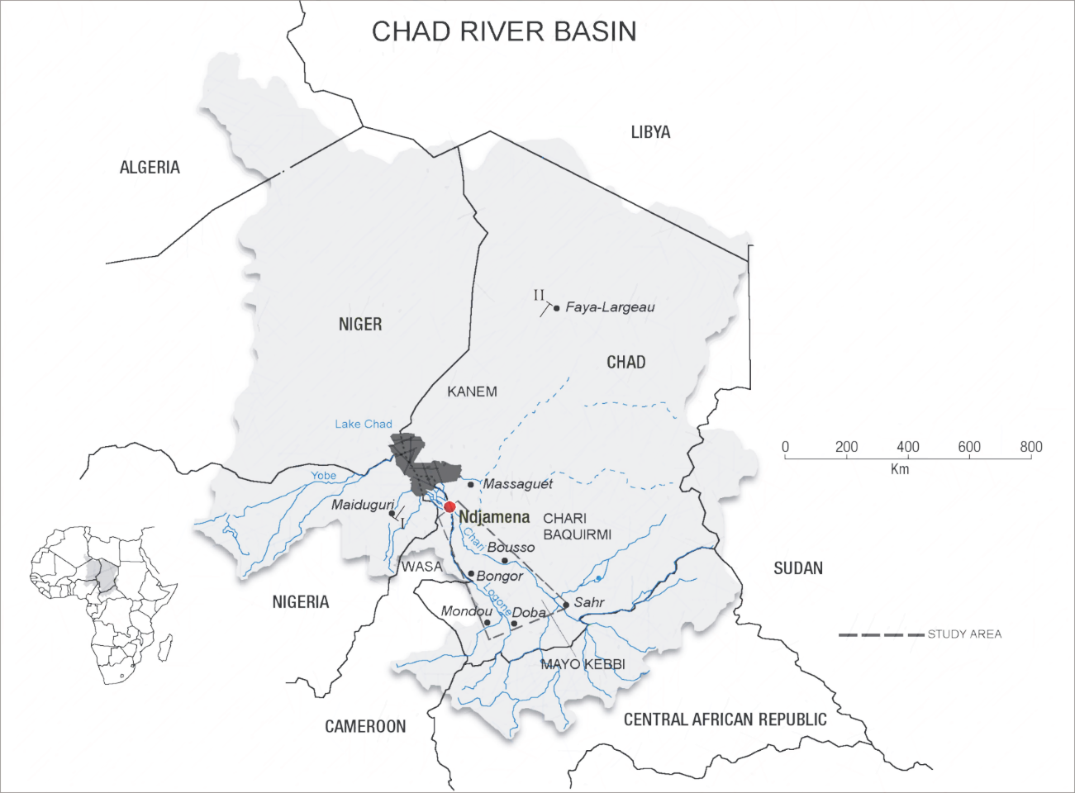
Lake Chad Basin Groundwater Modelling
IMDEA-Water, CSIC, UPM) (WB funding)

Slide 2
Objetives
Regional aquifer system update
Groundwater modelling of the Chad Formation
Scenarios simulation of water abstraction and climatic conditions to quantify impact to aquifer system at regional level

Slide 3
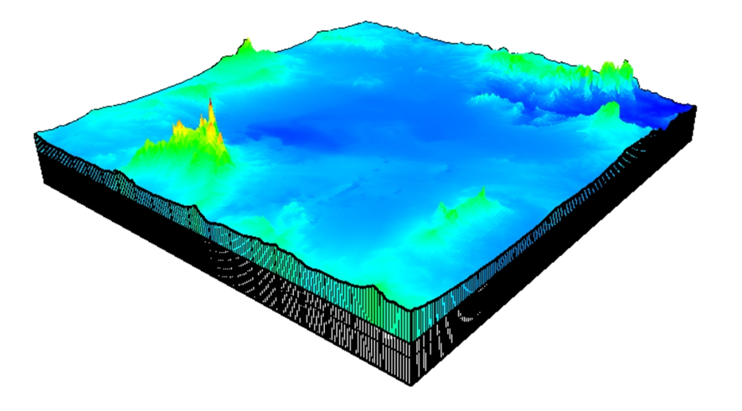
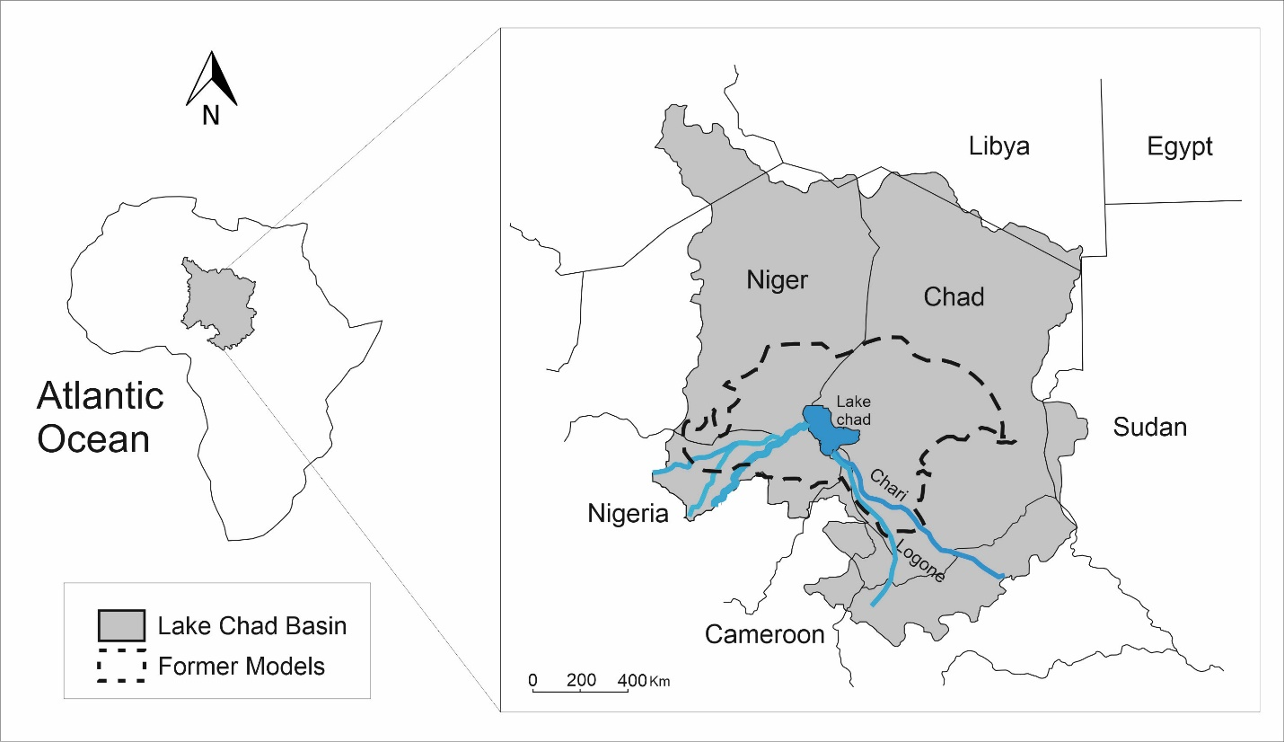
Numerical model
Groundwater system
ModelMuse
Modflow 2005

Slide 4
Groundwater System Update
Update existing database with new hydrological information for groundwater studies with critical assessment of information found
Update the regional aquifer boundaries, its geometry and new model layers structural contours
Update understanding of Chad formation aquifer system dynamics (flow) for 2008-2011 (piezometric map, natural recharge)
Establishment of conceptual model based on analysis of water bearing formations and conceptual model

Slide 5
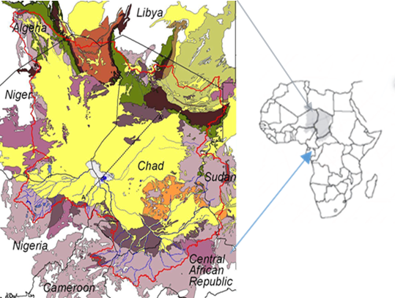
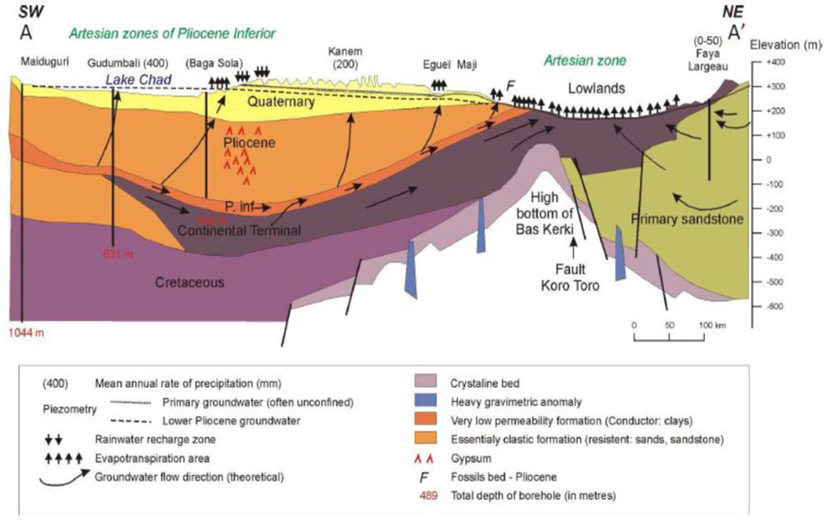
Aquifer System. Chad Formation

Slide 6
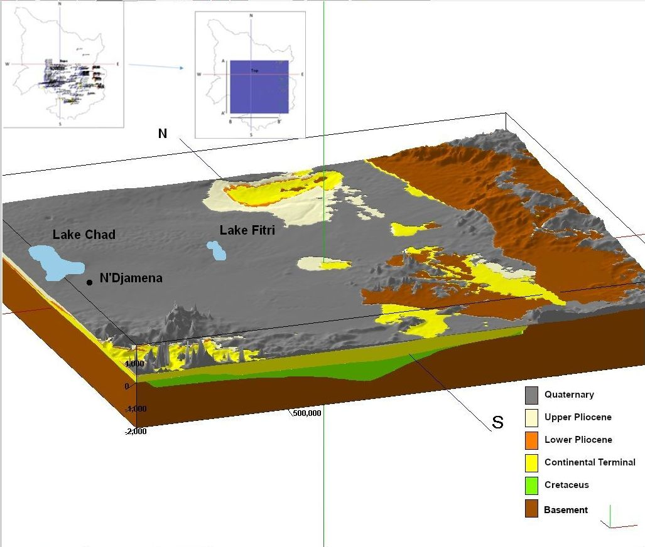
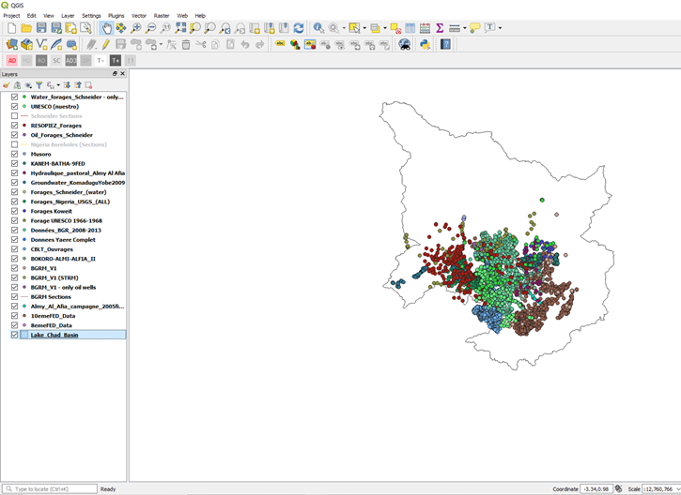
Groundwater conceptual model
Subsurface geology from
lithologic logs and GIS storage

Slide 7
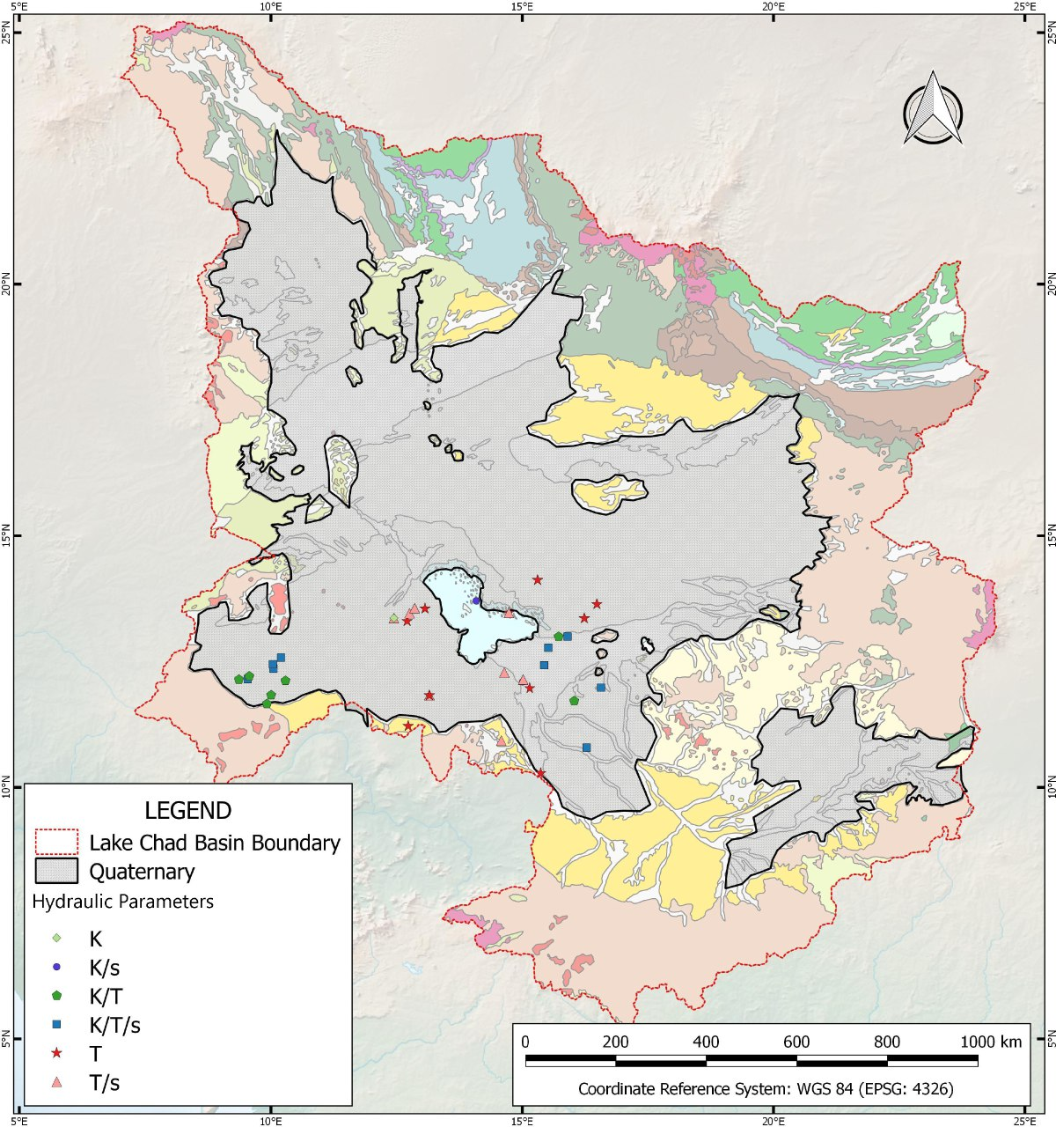
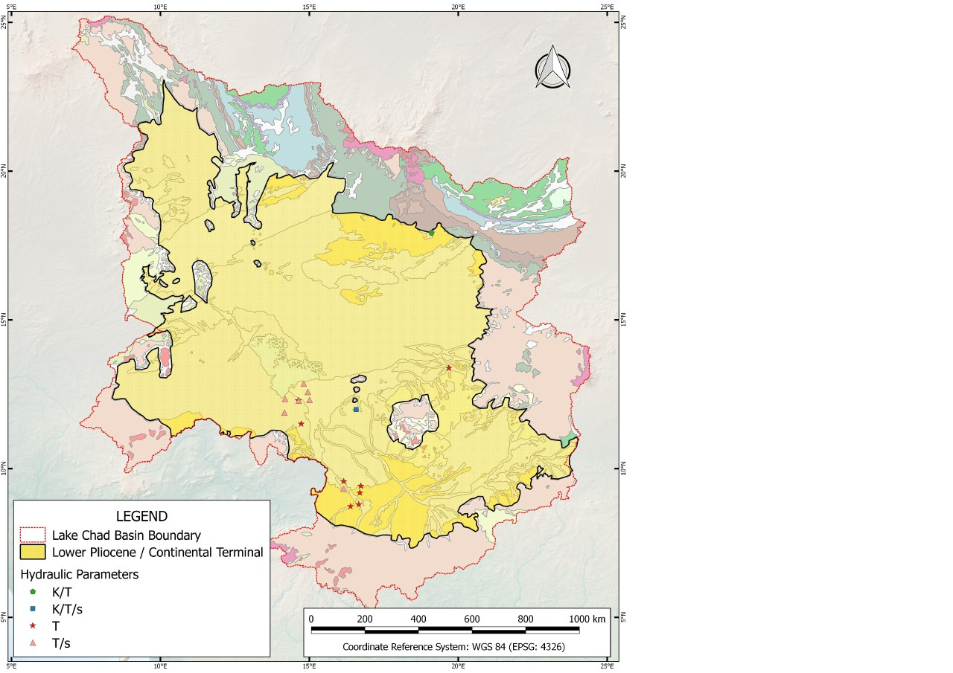
Water bearing formations delineation
Areal extention of Quaternary
Areal extention of Lower Pliocene - Continental Terminal

Slide 8
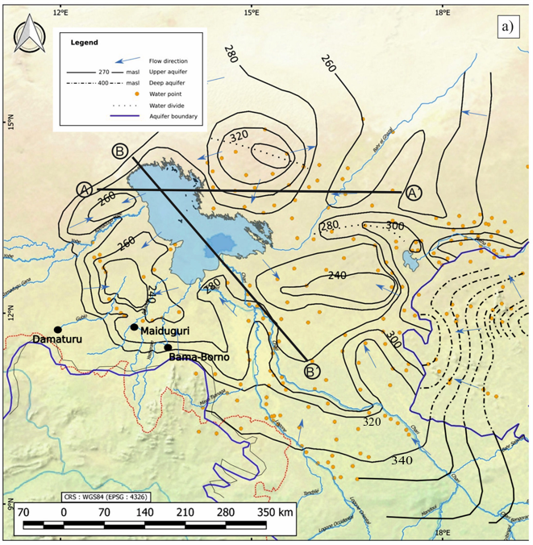
Piezometric map (confined and unconfined aquifers) for 2008-2011

Slide 9
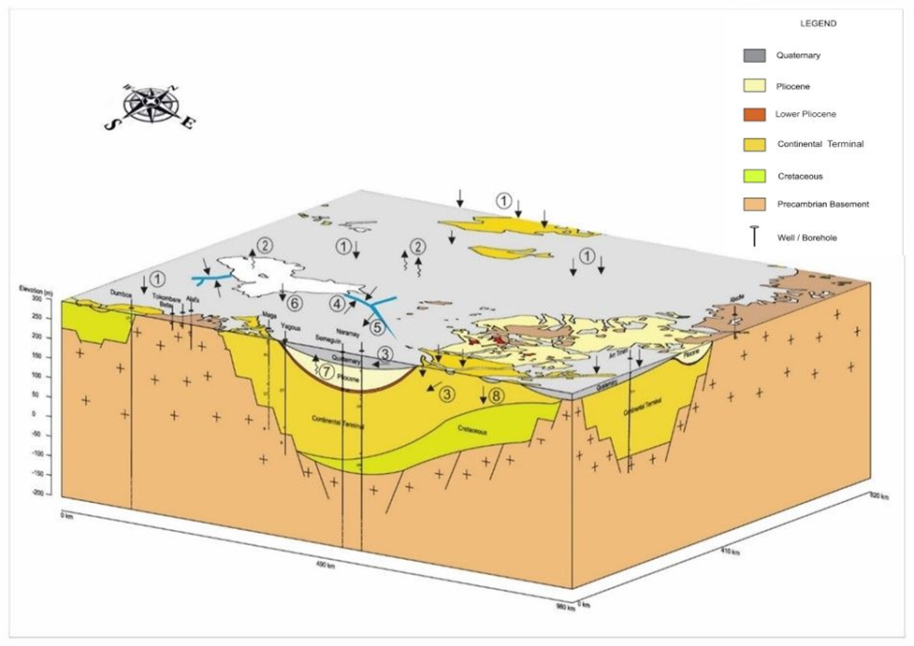
Conceptual model
(1) Natural recharge
(2) evapotranspiration
(3) groundwater inflow
(4) recharge from river
(5) discharge from river
(6) recharge from Lake
(7) up flow from deep aquifer
(8) vertical recharge from shallower aquifer to deep aquifer
Schematic 3D conceptual model diagram (a partial section of the study area) with the input-output processes in the basin

Slide 10
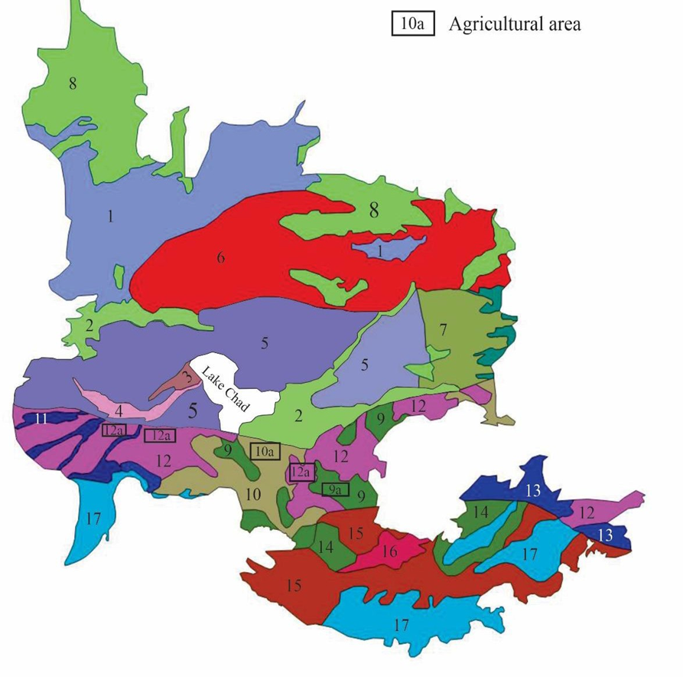
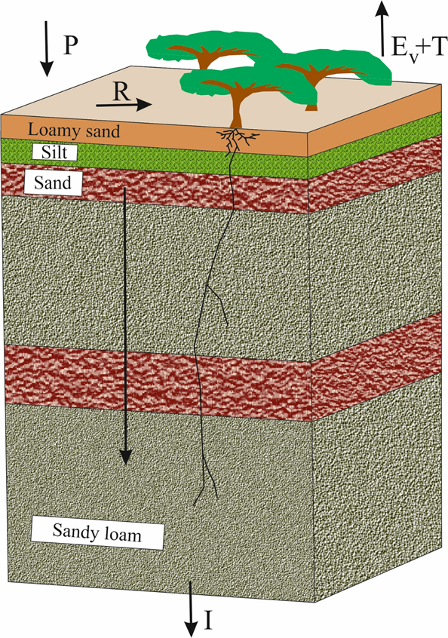
Independent estimation of natural recharge
(distributed model, GIS-BALAN)
Salehi Siavashani et al. (2021). Assessment of CHADFDM satellite-based input dataset for the groundwater recharge estimation in arid and data scarce regions. Hydrol. Proc. DOI: 10.1002/hyp.14250

Slide 11
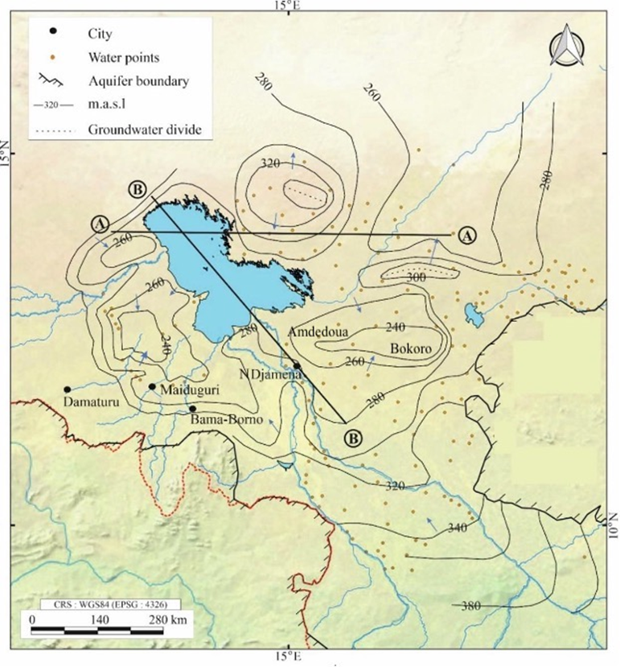
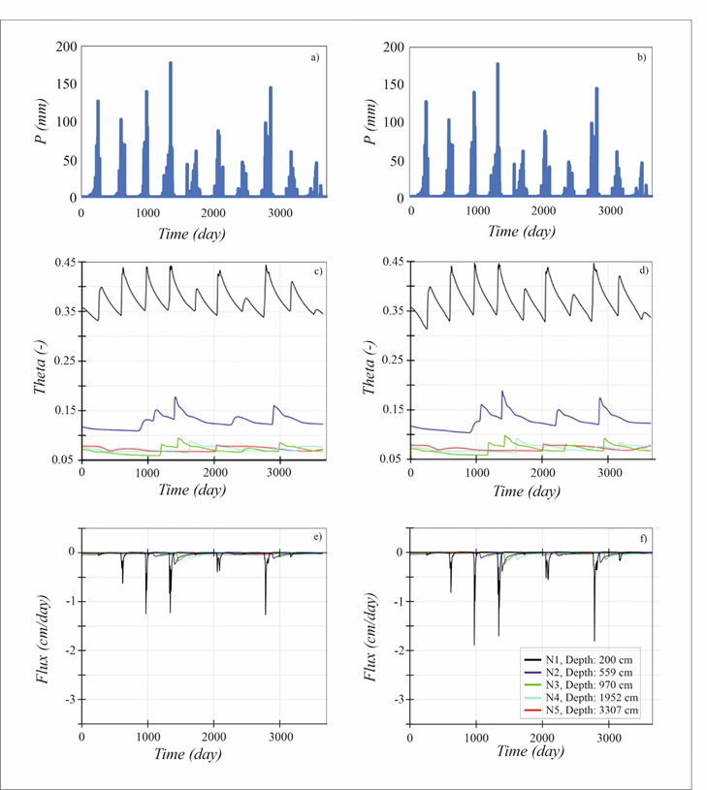
Independent estimation of natural recharge
(HYDRUS)
Salehi Siavashani et al.(2023). Modeling vadose zone hydrological processes in naturally-occurring piezometric depressions. The Chari-Baguirmi region, southeastern of the Lake Chad Basin, Republic of Chad. Environ. Earth Sci. DOI: 10.1007/s12665-023-11100-0

Slide 12
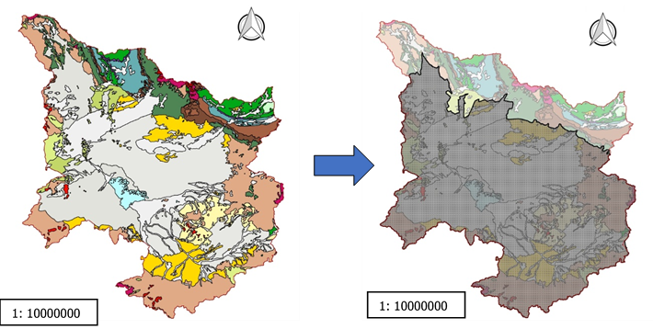
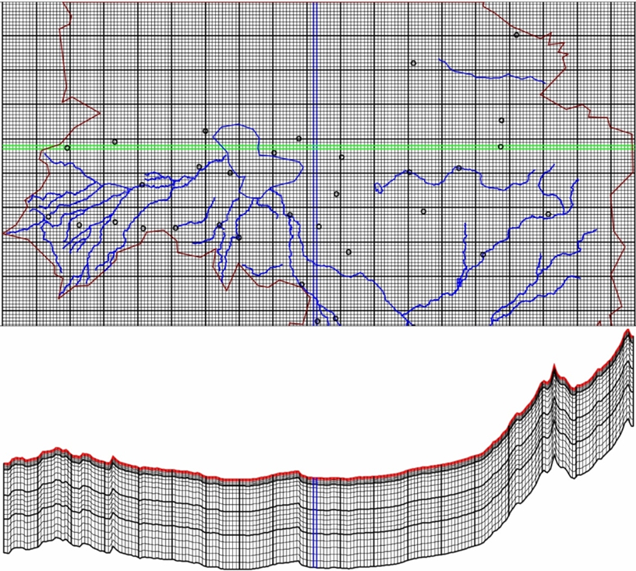
The numerical model-3D steady-state
Model domain
10 km x10 km mesh
with enhanced areas
20 layers
Vaquero et al. (2021). The Lake Chad transboundary aquifer. Estimation of groundwater fluxes through international borders from regional numerical modeling. Journ. of Hydrol. Regional Estudies. https://doi.org/10.1016/j.ejrh.2021.100935

Slide 13
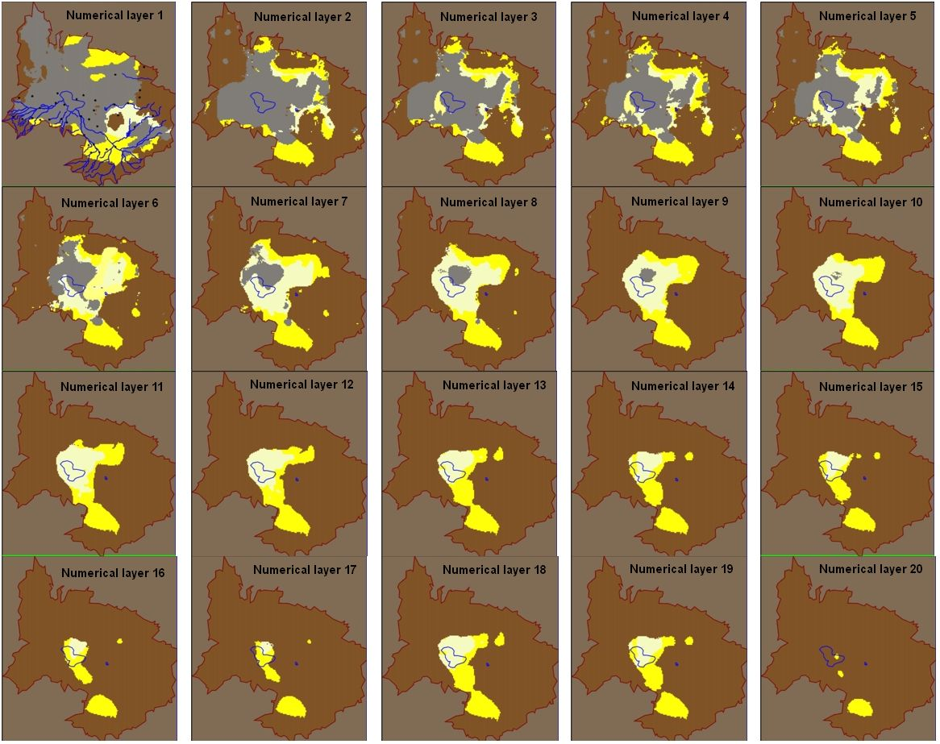
Each layer is conformed by one or more water bearing formation

Slide 14
Scenarios definition
Scenario | Climate | Groundwater abstraction | Irrigated surface
Base line | Climate conditions (2008 -2011) | Estimates for period 2008-2009 | Estimates for period 2008-2009
Sc 1 | Drier than median (2008 - 2011) Recharge decrease 10% | Estimates for period 2008-2009 | Estimates for period 2008-2009
Sc 2 | As in Base line | Increased abstraction from baseline (10%) | Increase of irrigated area from baseline
Sc 3 | Drier than median (2008 – 2011) Recharge decrease 10% | Increase abstraction from baseline (10%) | Increase of irrigated area from baseline

Slide 15
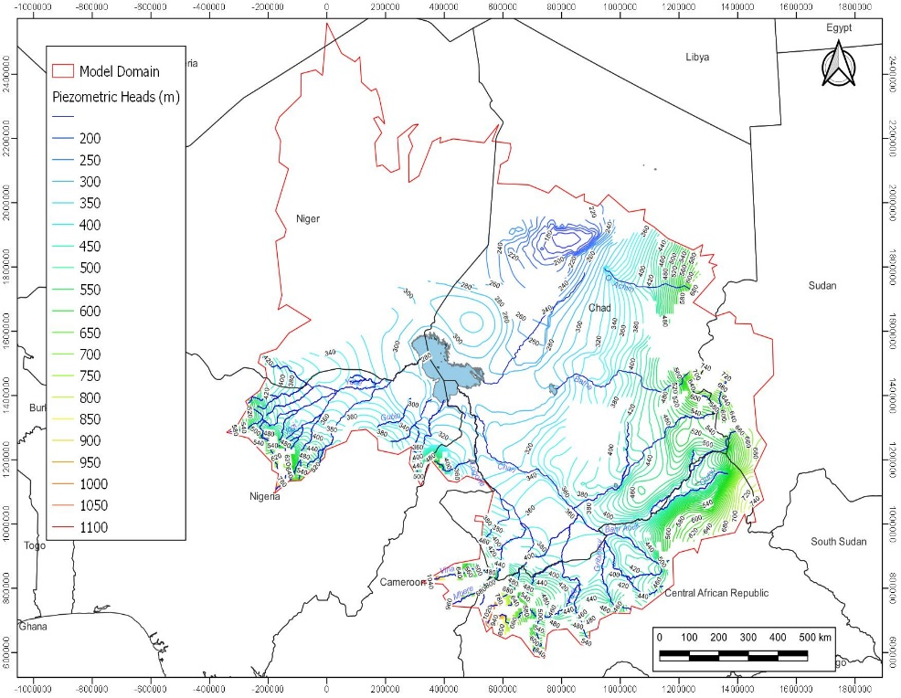
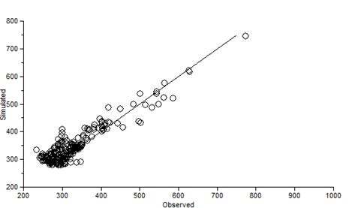
Results. Regional piezometric level
Calibration
Regional

Slide 16
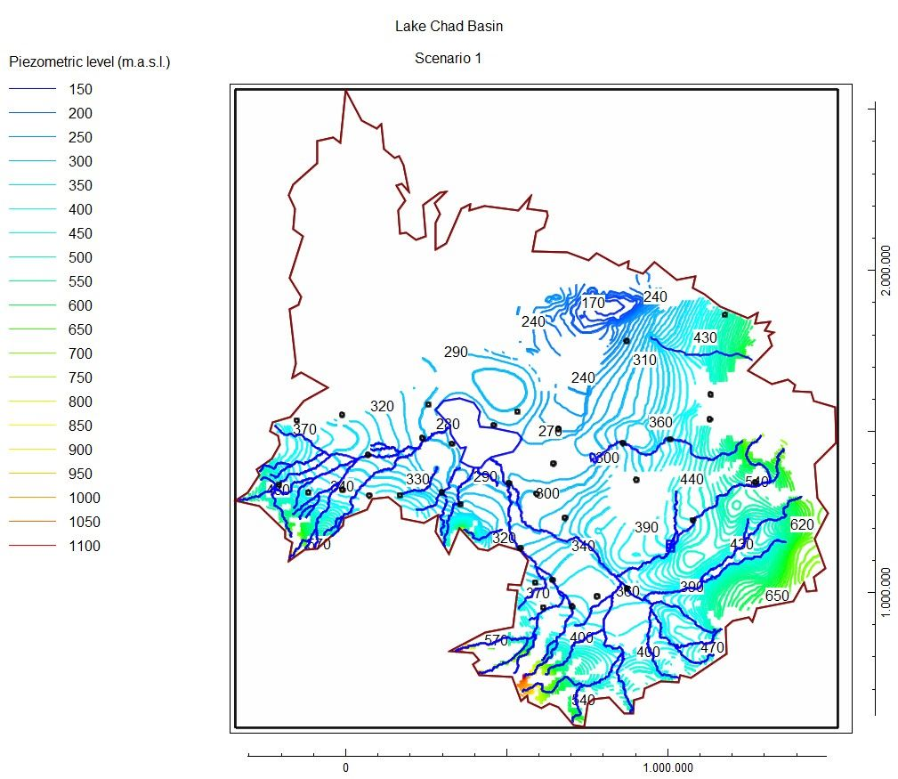
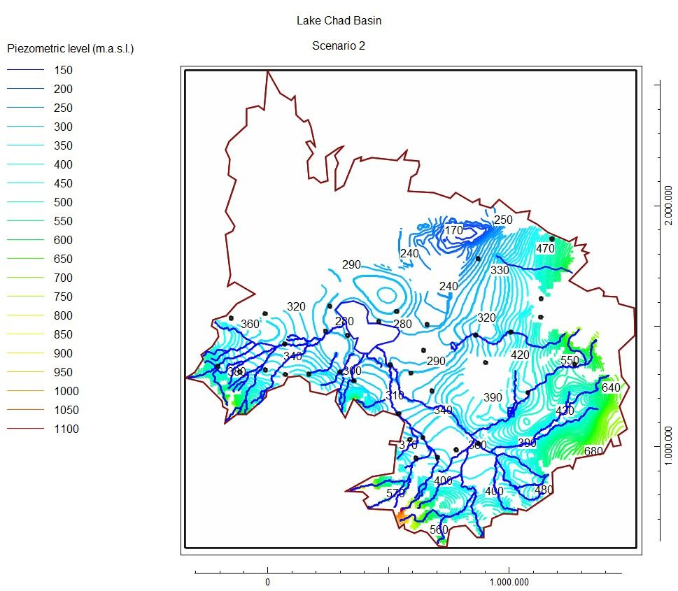
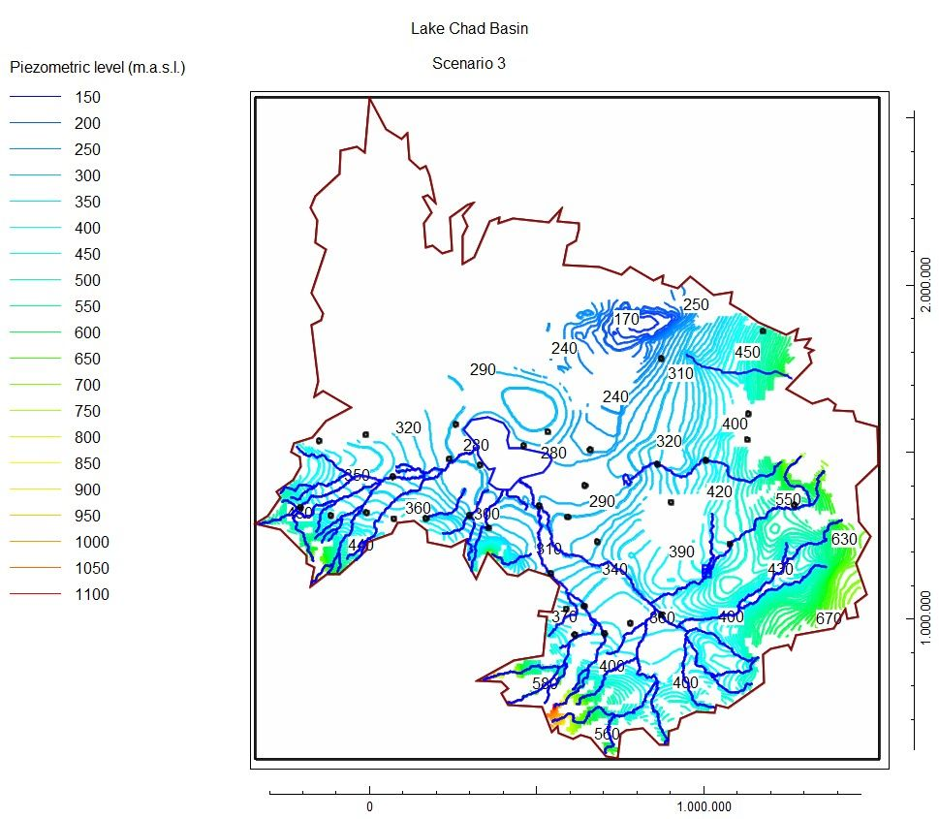
Scenarios. Regional Piezometric level
S1
Decrease of recharge
Greatest impact
The average groundwater level decreases 3 m approximately
For the Lake Chad area, there is practically no change of groundwater level for the 3 scenarios in comparison to the baseline
S3
Decrease recharge
Increase abstraction
January/April
1999
S2
Increase abstractions
Only evident at areas distant few kilometres from the pumping areas

