Slide 1
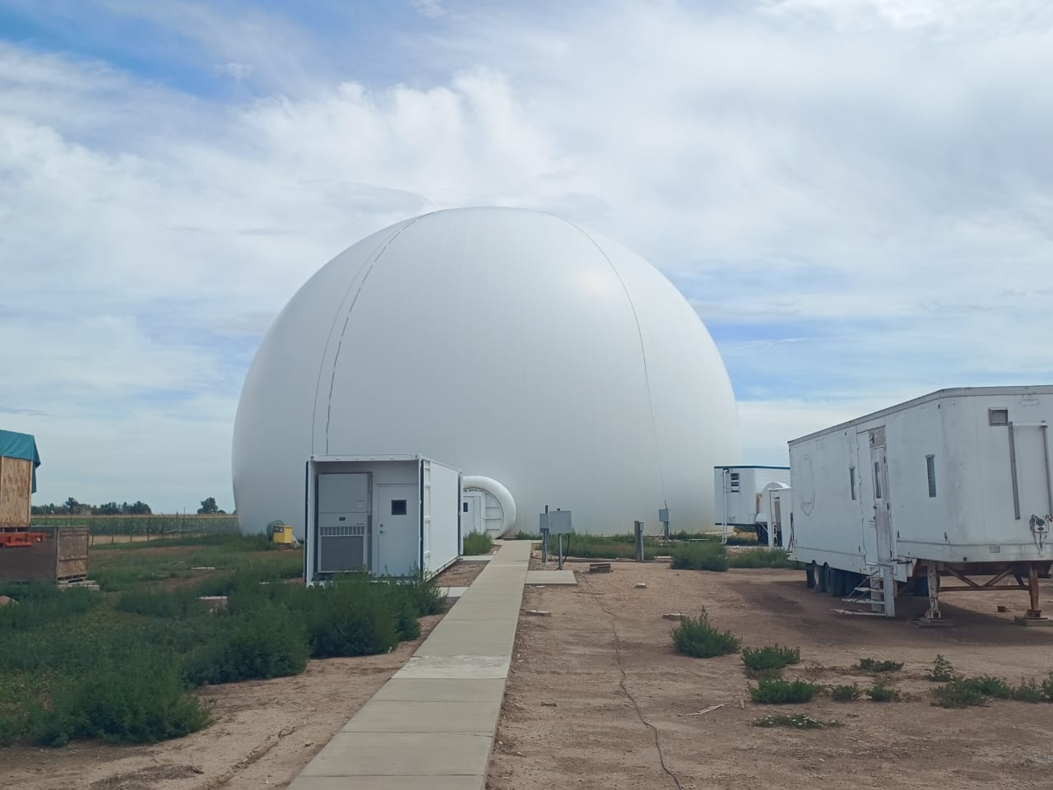
Integration of Clutter Mitigation Algorithm into PYIWR Framework: A Python Toolkit for Analyzing Weather Radar Data
Vaibhav Tyagi and Saurabh Das
Indian Institute of Technology Indore, India
EGU25-20297ECS, Prog. Group: ESSI3, Session: ESSI3.4
(PICO Presentation – Monday, 28 Apr 2025)
OSPP Voting
Image: CHILL DWR Site,
CSU, USA

Slide 2
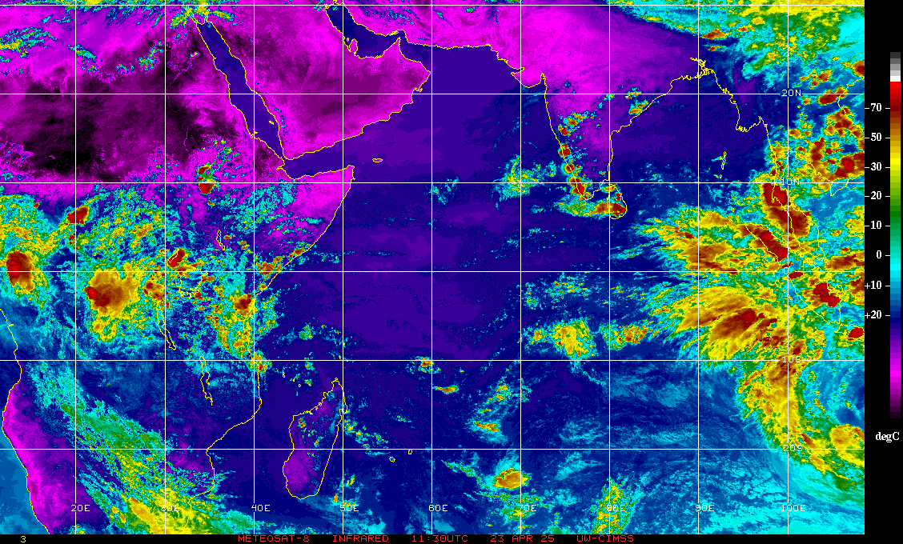
Clutter in DWR Data
Python Library
Dataset and Methodology
OSPP Voting
Introduction
Results

Slide 3
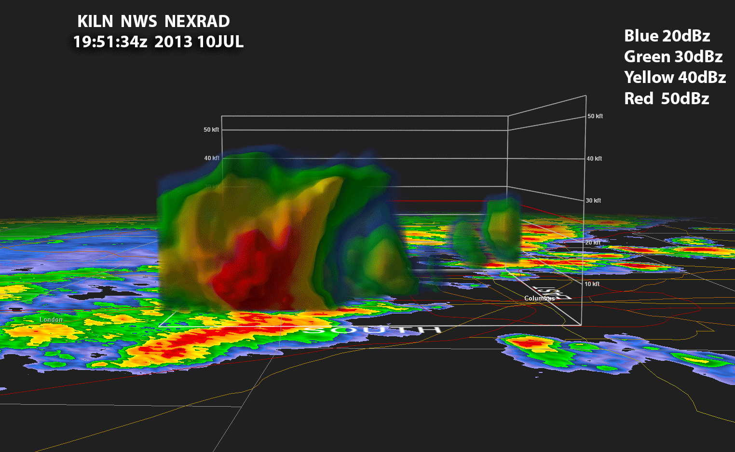
Doppler Weather Radar (DWR) Observations
3D observations
Very high Spatial and
Temporal resolution
Large coverage
PYTHON INDIAN WEATHER
RADAR TOOLKIT
Credit: Steve Horstmeyer

Slide 4
Applications
Radar Data
Quality
Quantitative precipitation estimation (QPE)
Flash flood analysis
Short-term weather forecasting
Operational warnings
Clutter
Development of an algorithm to mitigate persistent ground clutter in Doppler Weather Radar data

Slide 5
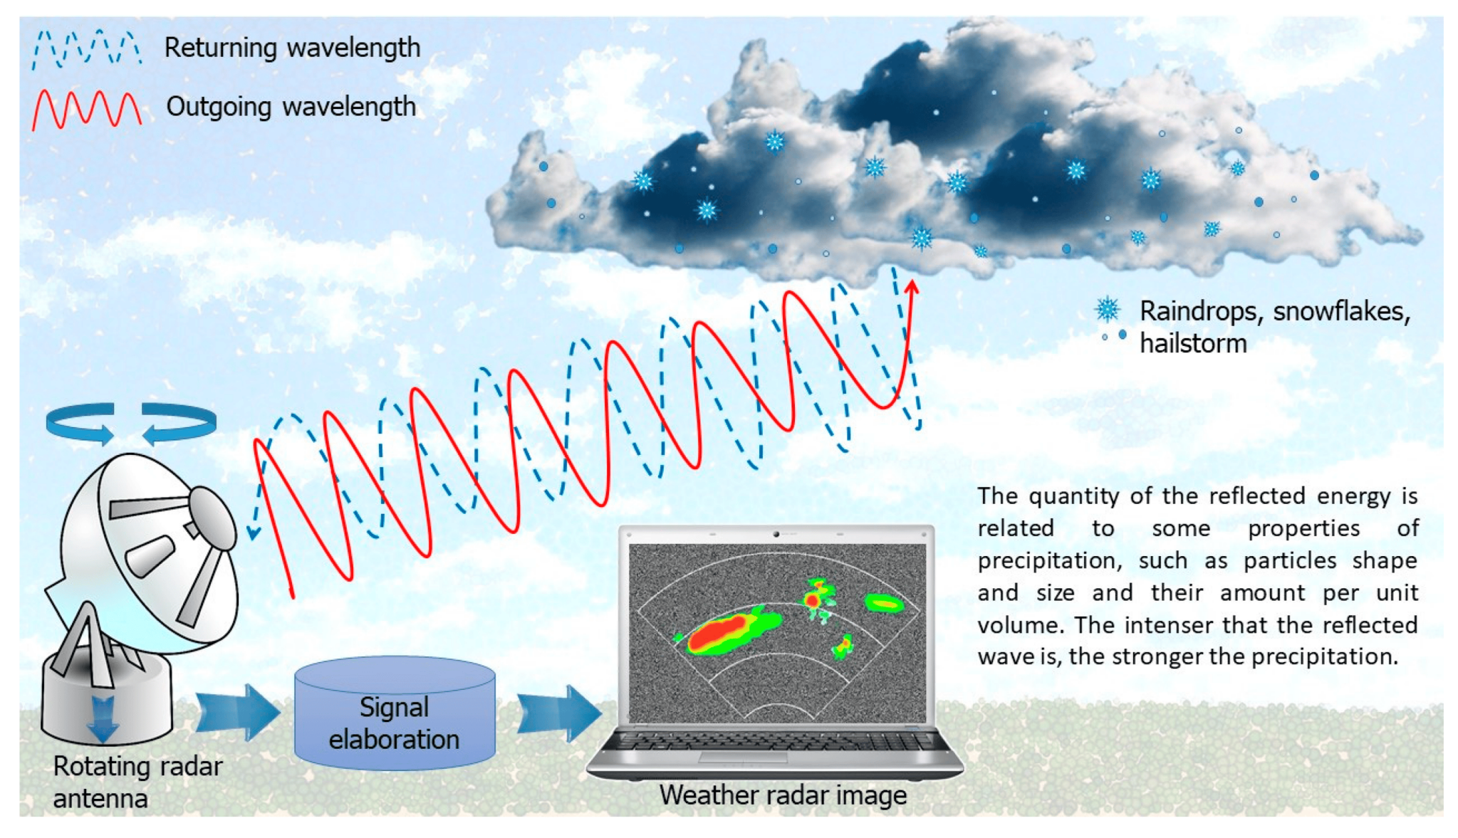
Binetti et al. (2022)

Slide 6
Tools for RADAR data processing
Pyart
Wradlib
Pyscancf
Pycwr
Need for PYIWR?
Different data formats
Merge individual sweeps to create PPI
Correcting missing attributes issues like datetime.
Quality control procedures
Radar QPE

Slide 7
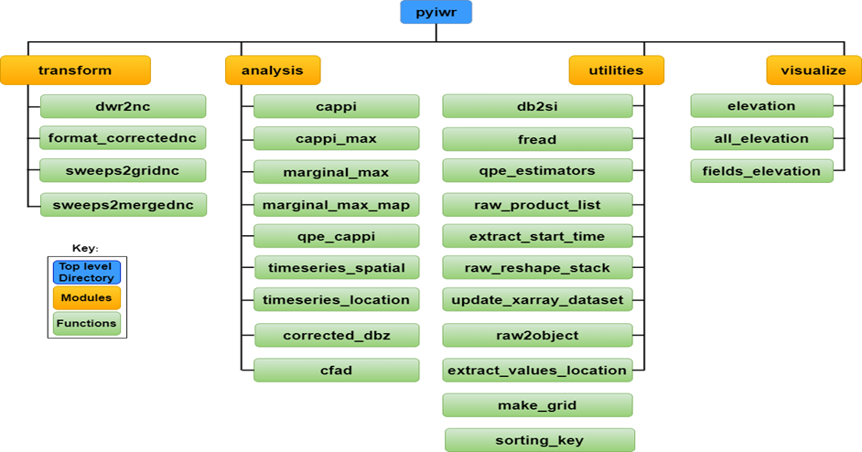
PYTHON INDIAN WEATHER RADAR TOOLKIT
Developed by Mr Nitig Singh and Mr Vaibhav Tyagi,
researcher’s at SIGMA research Lab, DAASE, IIT Indore
Architecture of pyiwr
User-friendly toolkit.
Tailored to address the distinctive requirements of Indian DWR data analysis.
The pyiwr is divided into four modules namely “transform”, “visualize”, “analysis” and “utilities”.

Slide 8
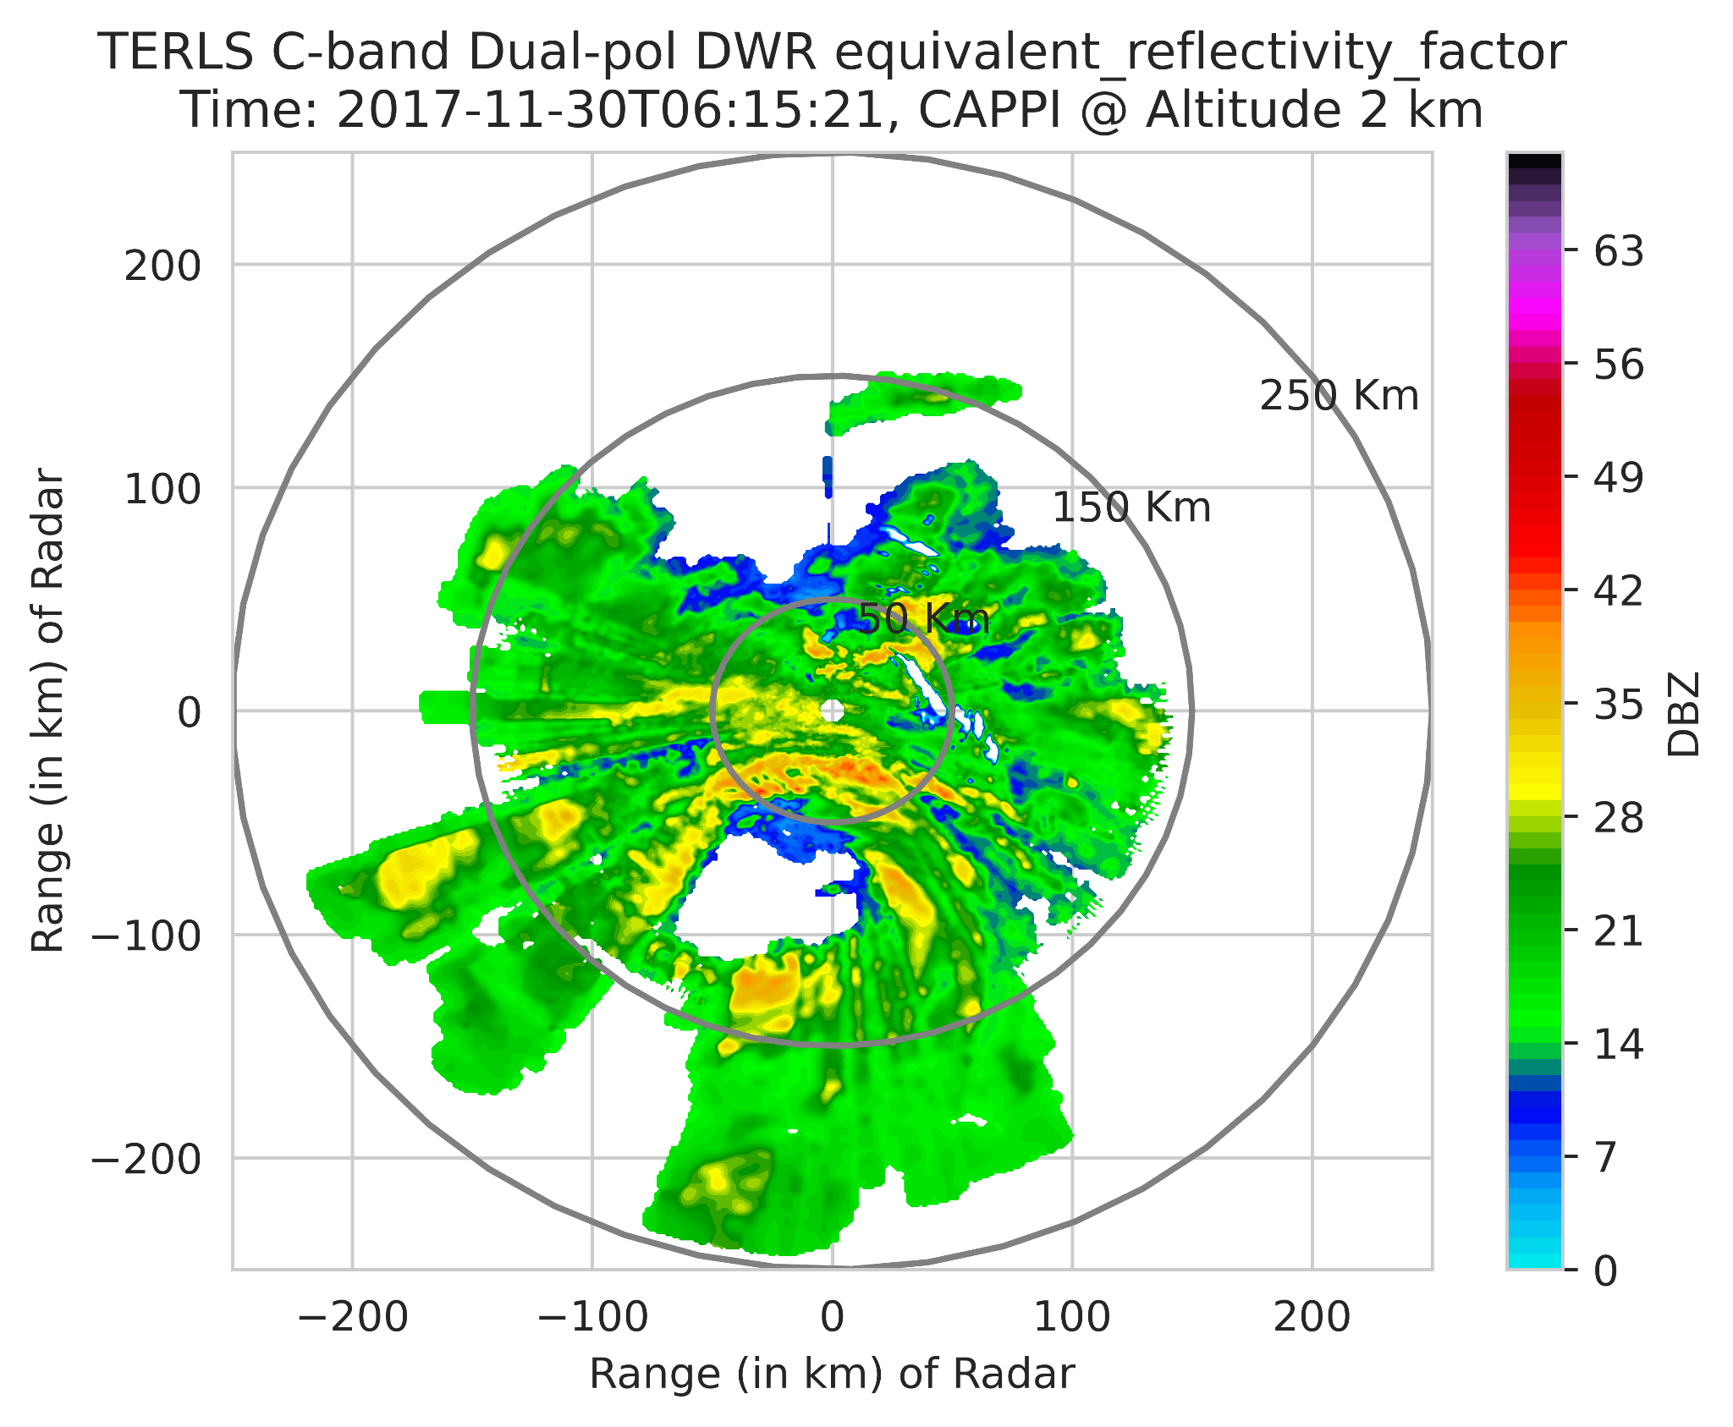
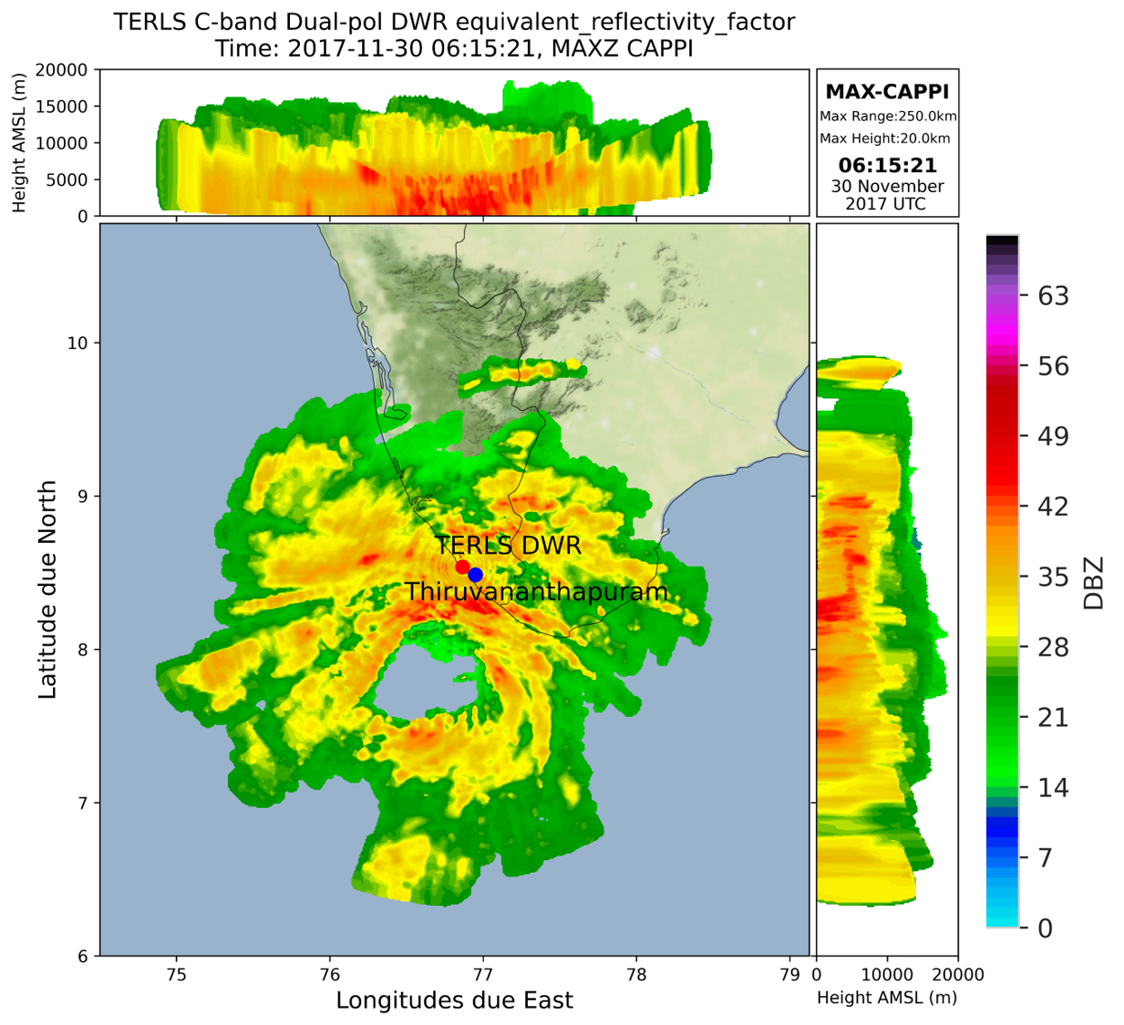
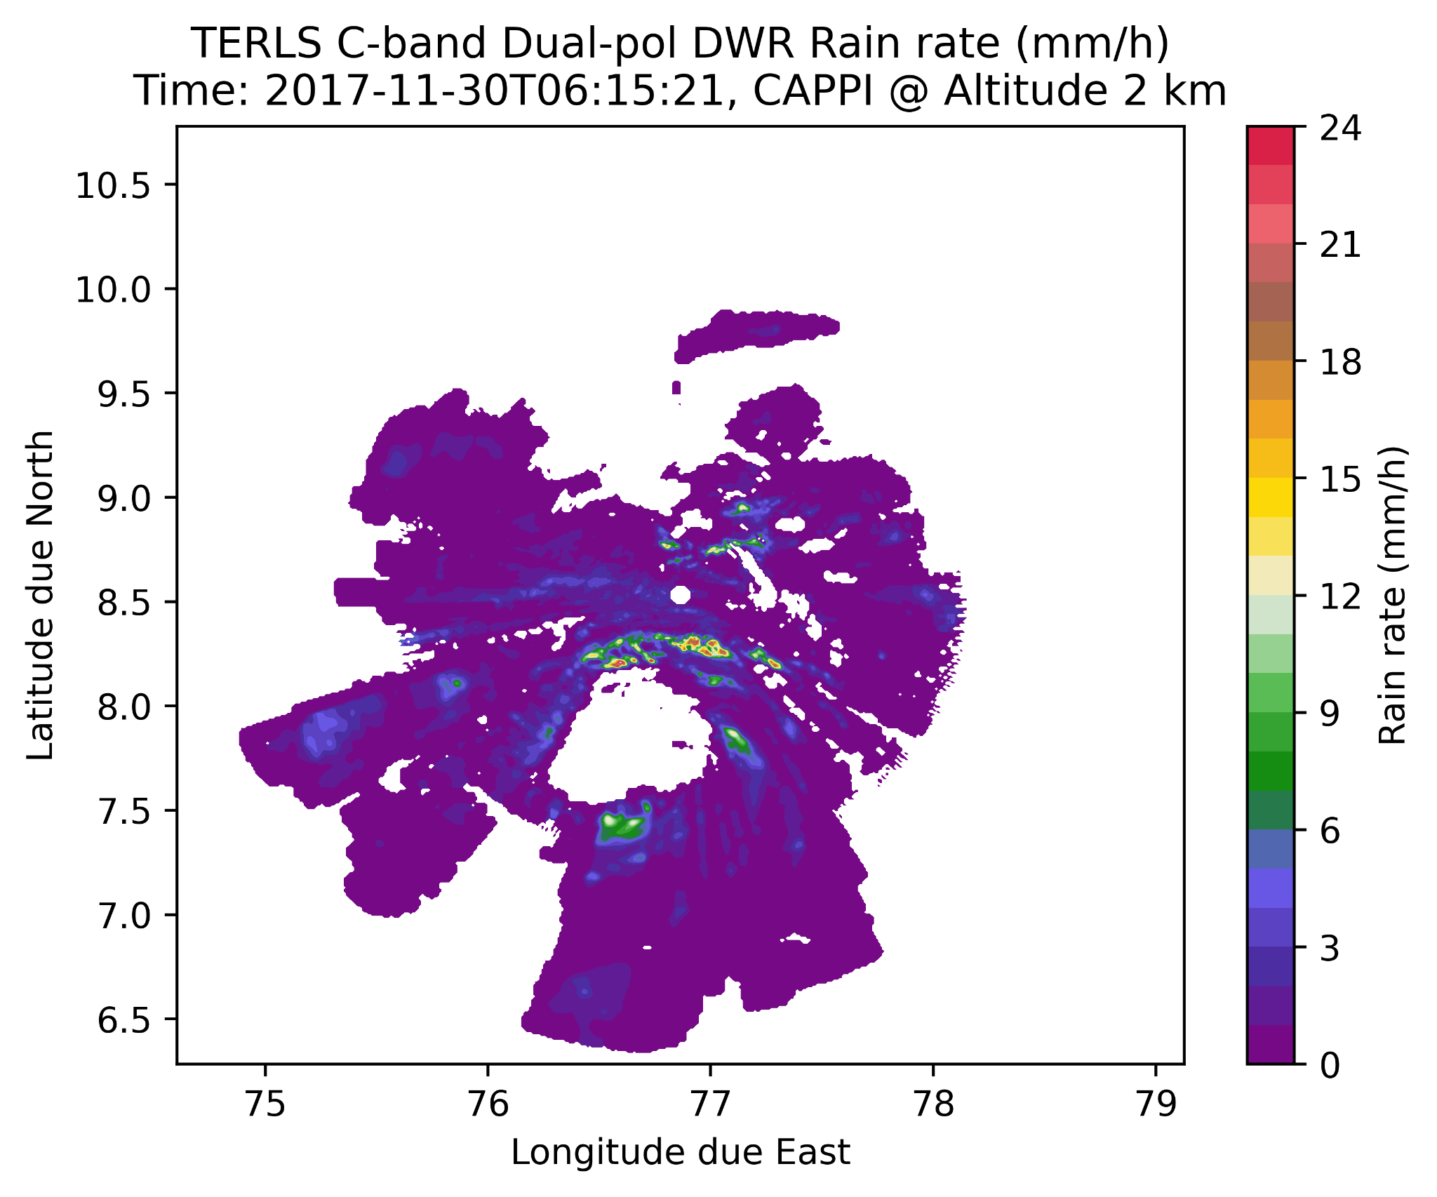
USAGE of PYIWR
Radar QPE
MAXZ: Cyclone Analysis

Slide 9
Clutter
Clutter, in general, refers to unwanted signals that originate from various non-meteorological sources.
Signals originates from tall buildings, mountains, trees, etc. are specifically known as ground clutter, predominantly observed at low elevation angles.
The echoes from the ground clutter are a challenging problem, especially in complex mountainous terrains.
Thus, its identification and elimination are particularly important before working with DWR data for both qualitative and quantitative applications.
Bøvith et al., (2008)

Slide 10
Clutter Correction
Ground-clutter filters (GCF) are developed based on the appropriate signal processing techniques on the received complex voltages, i.e., in-phase (I) and quadrature (Q) data.
The residual ground clutter can be removed using appropriate post processing techniques.
- Dual-polarized radars: Based on dual-polarized variables using fuzzy logic techniques.
- Single-pol radars: Based on radar reflectivity and radial velocity.
Gabella et al (2002) proposed a simple texture based techniques to eliminate the residual ground clutter.
Since the ground clutter are the characteristic properties of the site, the studies in past suggest that the development of static clutter map can effective eliminate ground clutter.
Vulpiani et al., (2012)
Objective
Development of an algorithm to mitigate persistent ground clutter in Doppler Weather Radar data and integrate in PYIWR framework

Slide 11
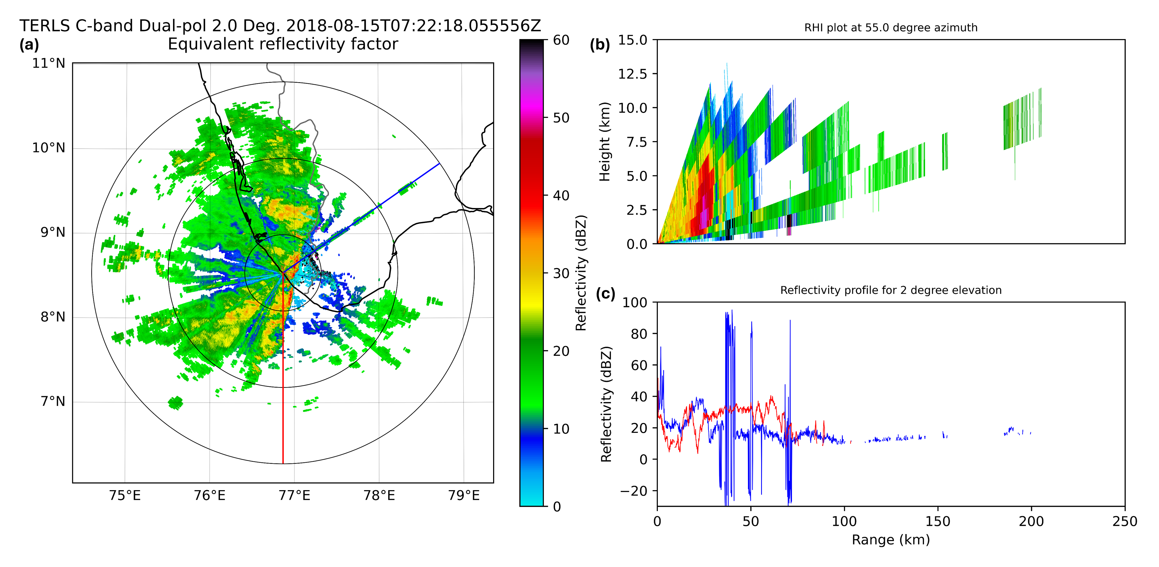
Clutter Characteristics
High reflectivity tower
Fluctuations in radar reflectivity due to clutter

Slide 12
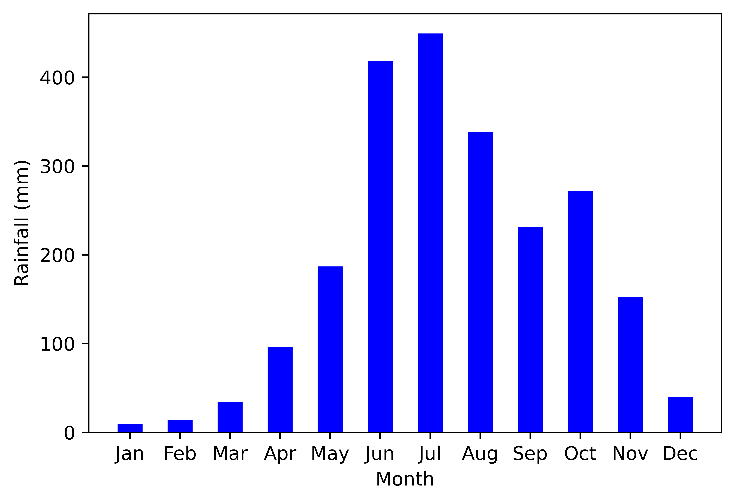
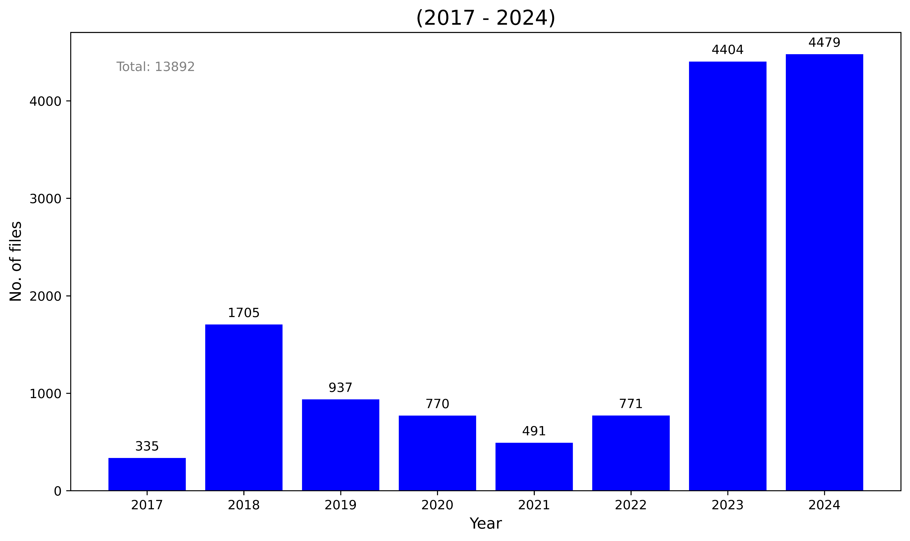
Datasets Used
Mean Monthly Rainfall
Radar data reading and processing
An inhouse developed open source Python library to work with Doppler Weather Radar data

Slide 13
Gabella Filter: Overview
Technique to eliminate ground clutter in mountainous terrain
Texture based technique: horizontal spatial variation of reflectivity
Part I: Spatial-proximity filter
Part II: Compactness
Choose a 5x5 window around a pixel
Its is assumed to be met. Echo when the diff. b/w it and n_p surrounding pixels are below a threshold (tr_var); else flagged as clutter
acceptable range:
n_p: [6, 10]
tr_var: [3,9]
param/.
window
np
tr_1
tr_2
Gabella et al (2002)

Slide 14
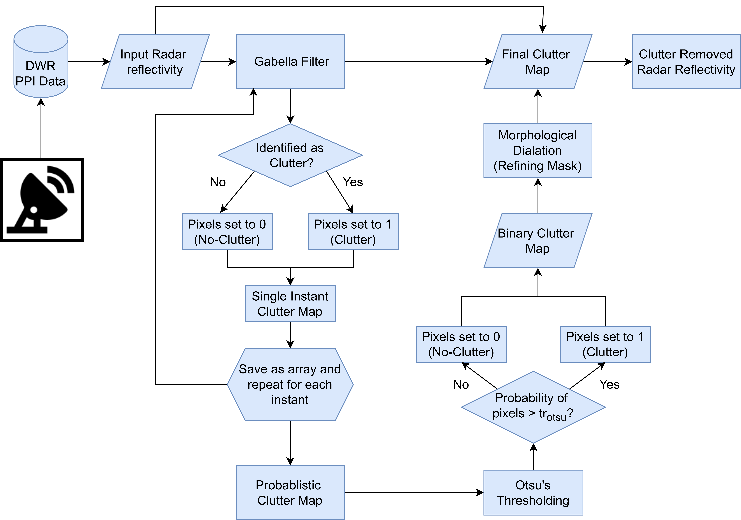
Proposed
Technique
Texture based technique: horizontal spatial variation of reflectivity
Part I: Spatial-proximity filter
Part II: Compactness

Slide 15
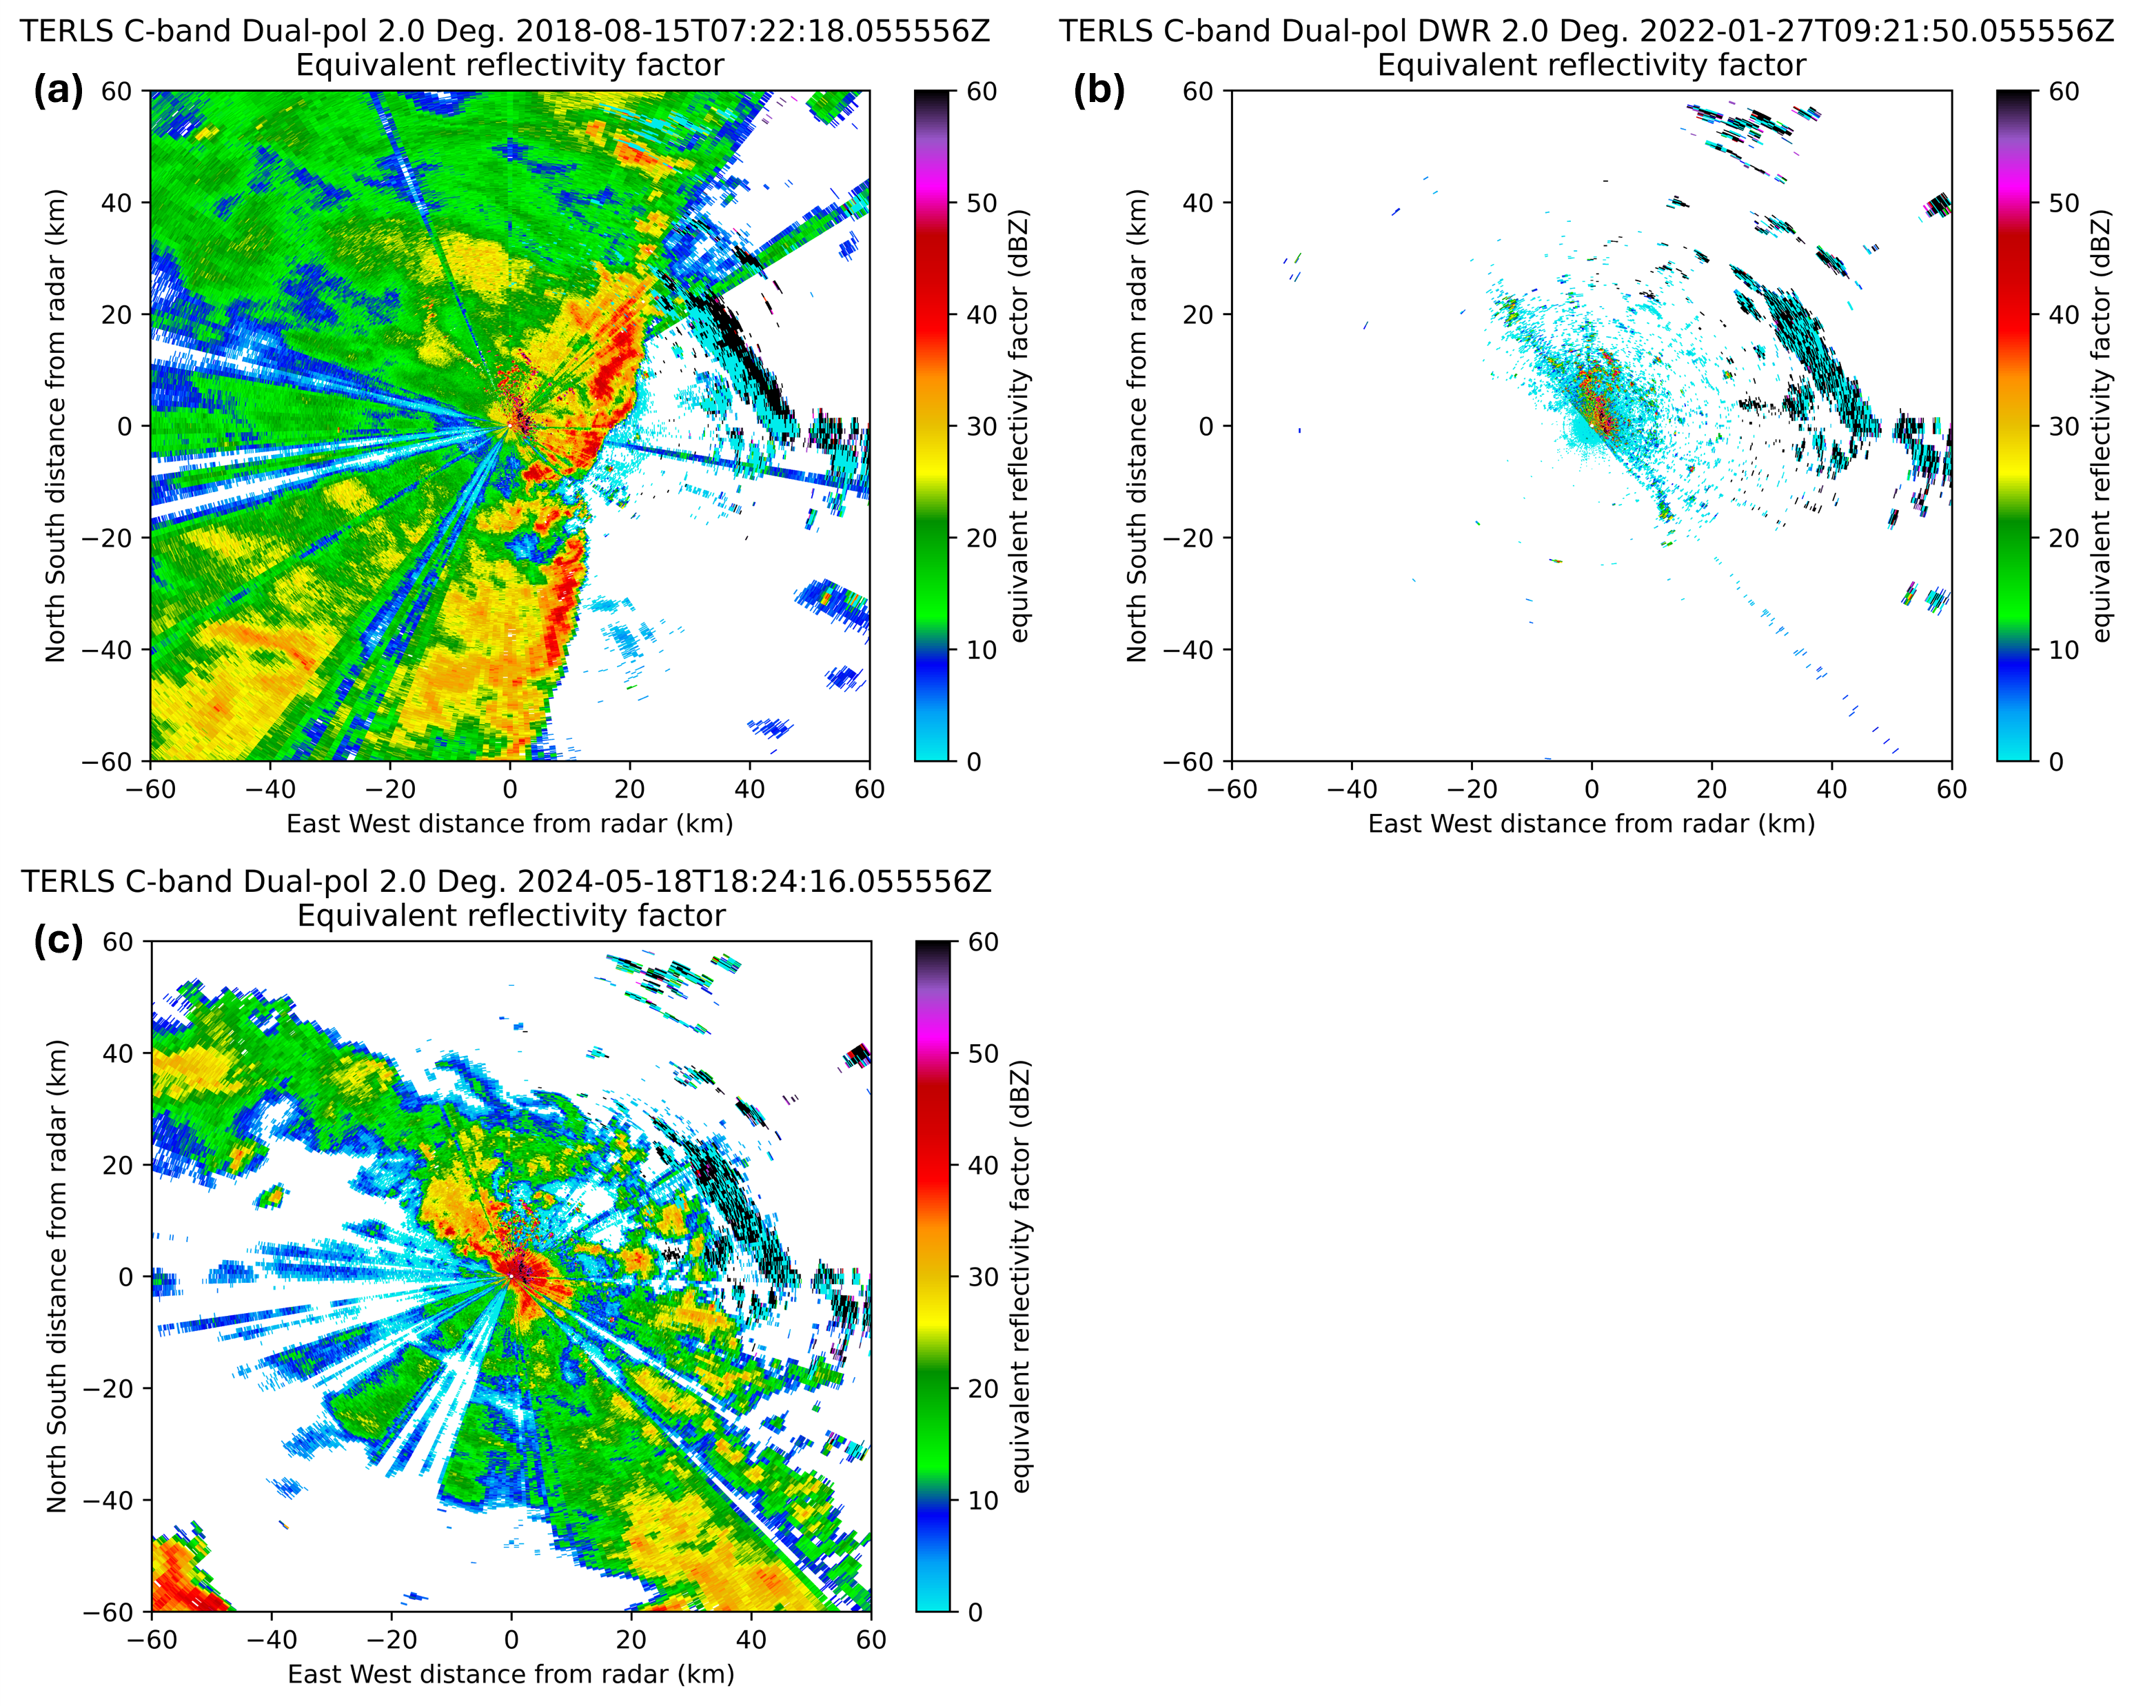
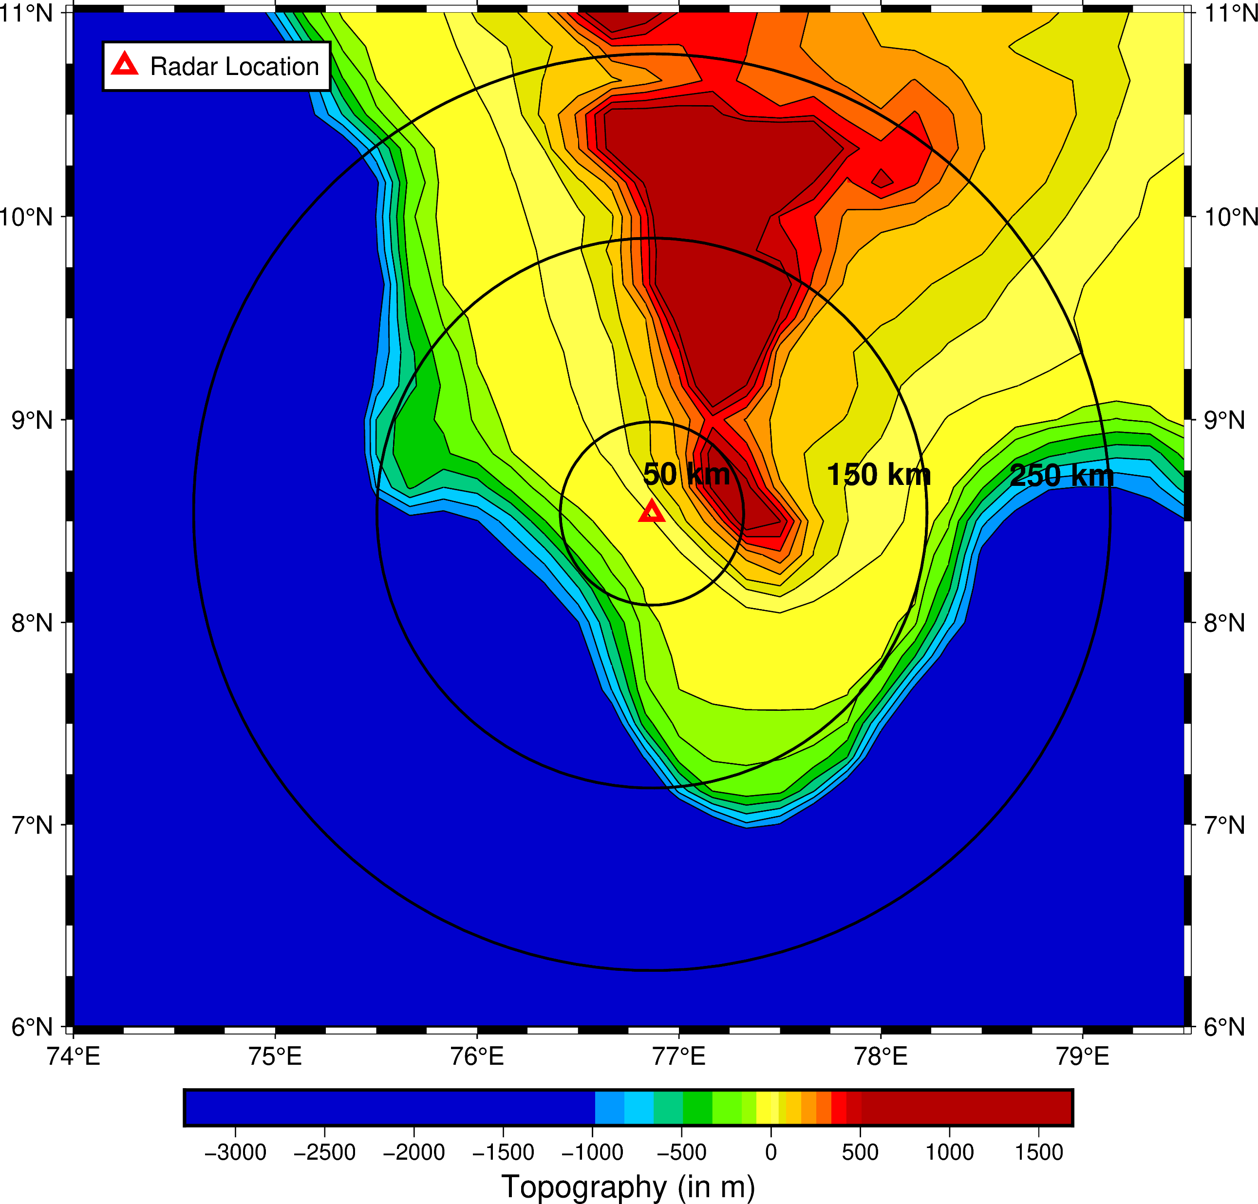
Implementation on TERLS C-Band DWR
Raw Radar Reflectivity Examples
Topography Map
Clutter

Slide 16
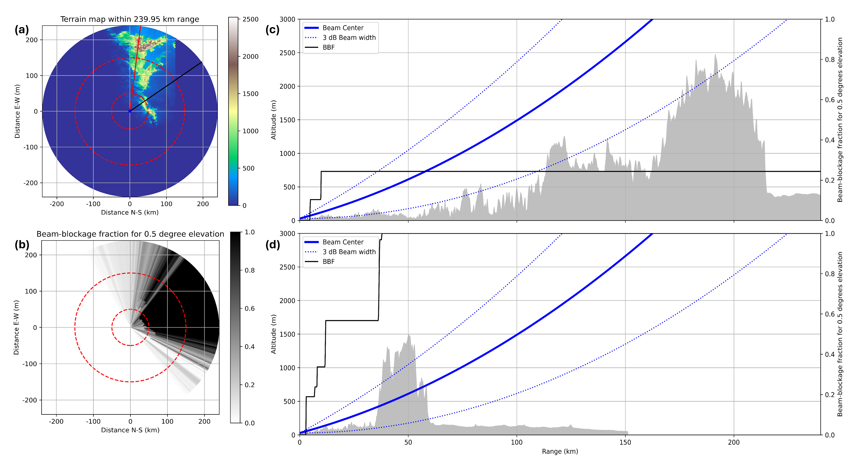
Partial Beam Blockage Analysis
Significant beam blockage at low elevations

Slide 17
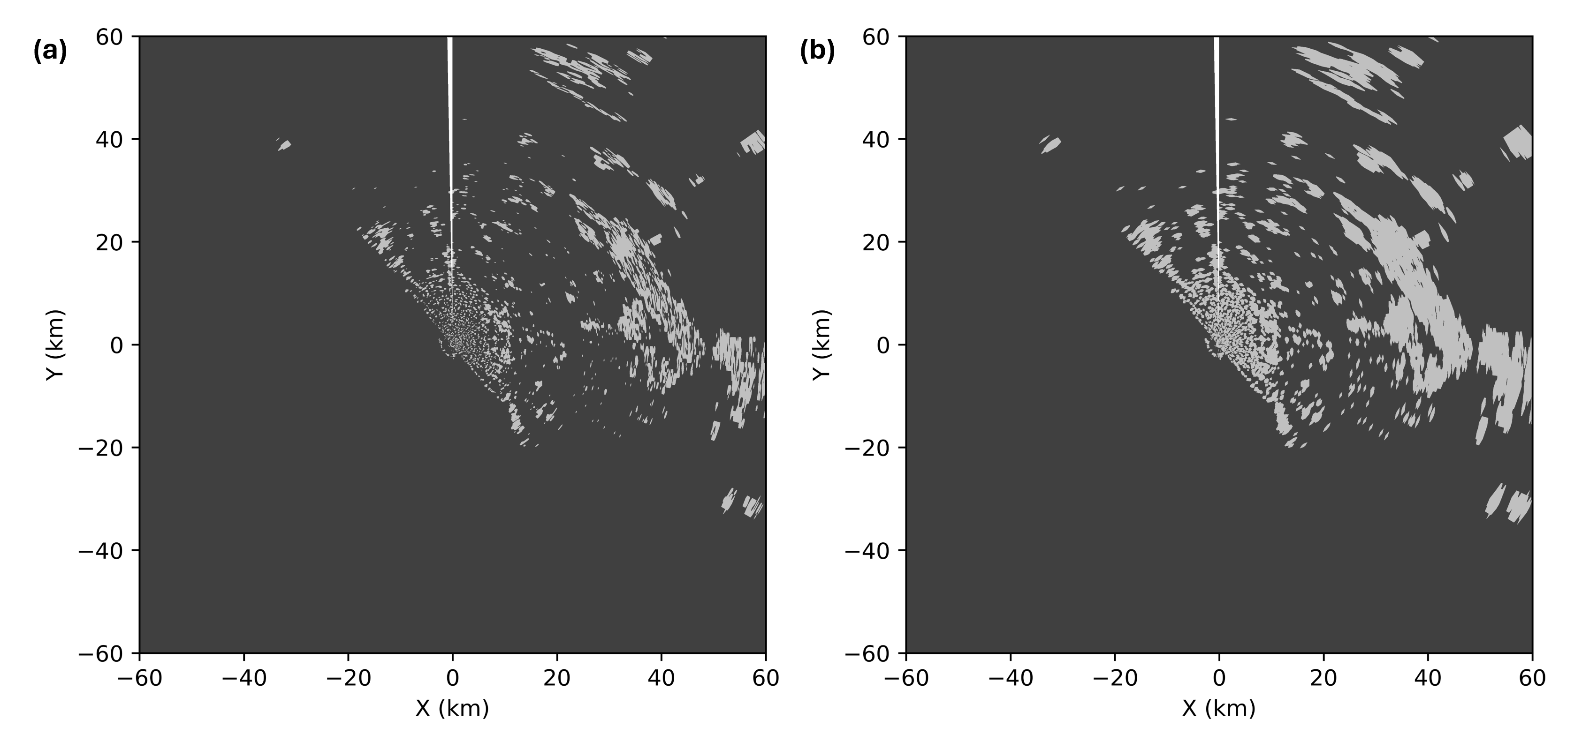
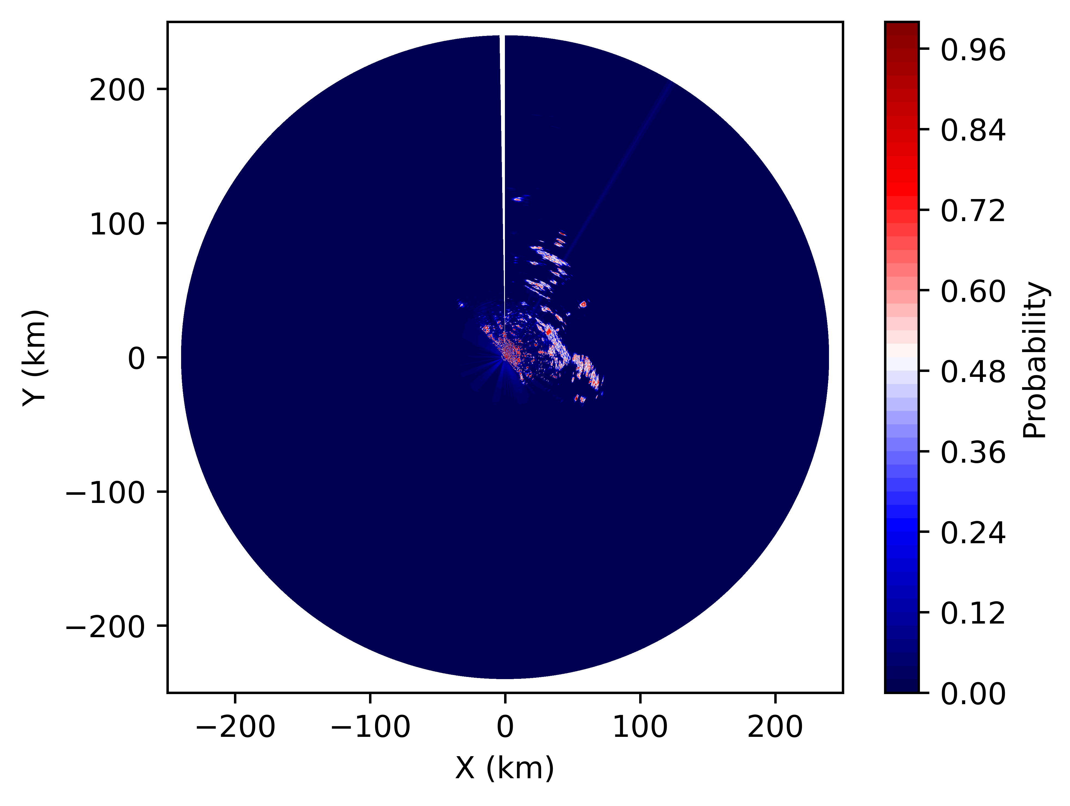
Clutter Mask Development
Clutter Probability Map
Clutter Mask
Refined Clutter Mask
Over the radar's full coverage, for a particular sweep:
Total number of pixels: 5,76,000. Clutter pixels: 21,102 (3.66%)

Slide 18
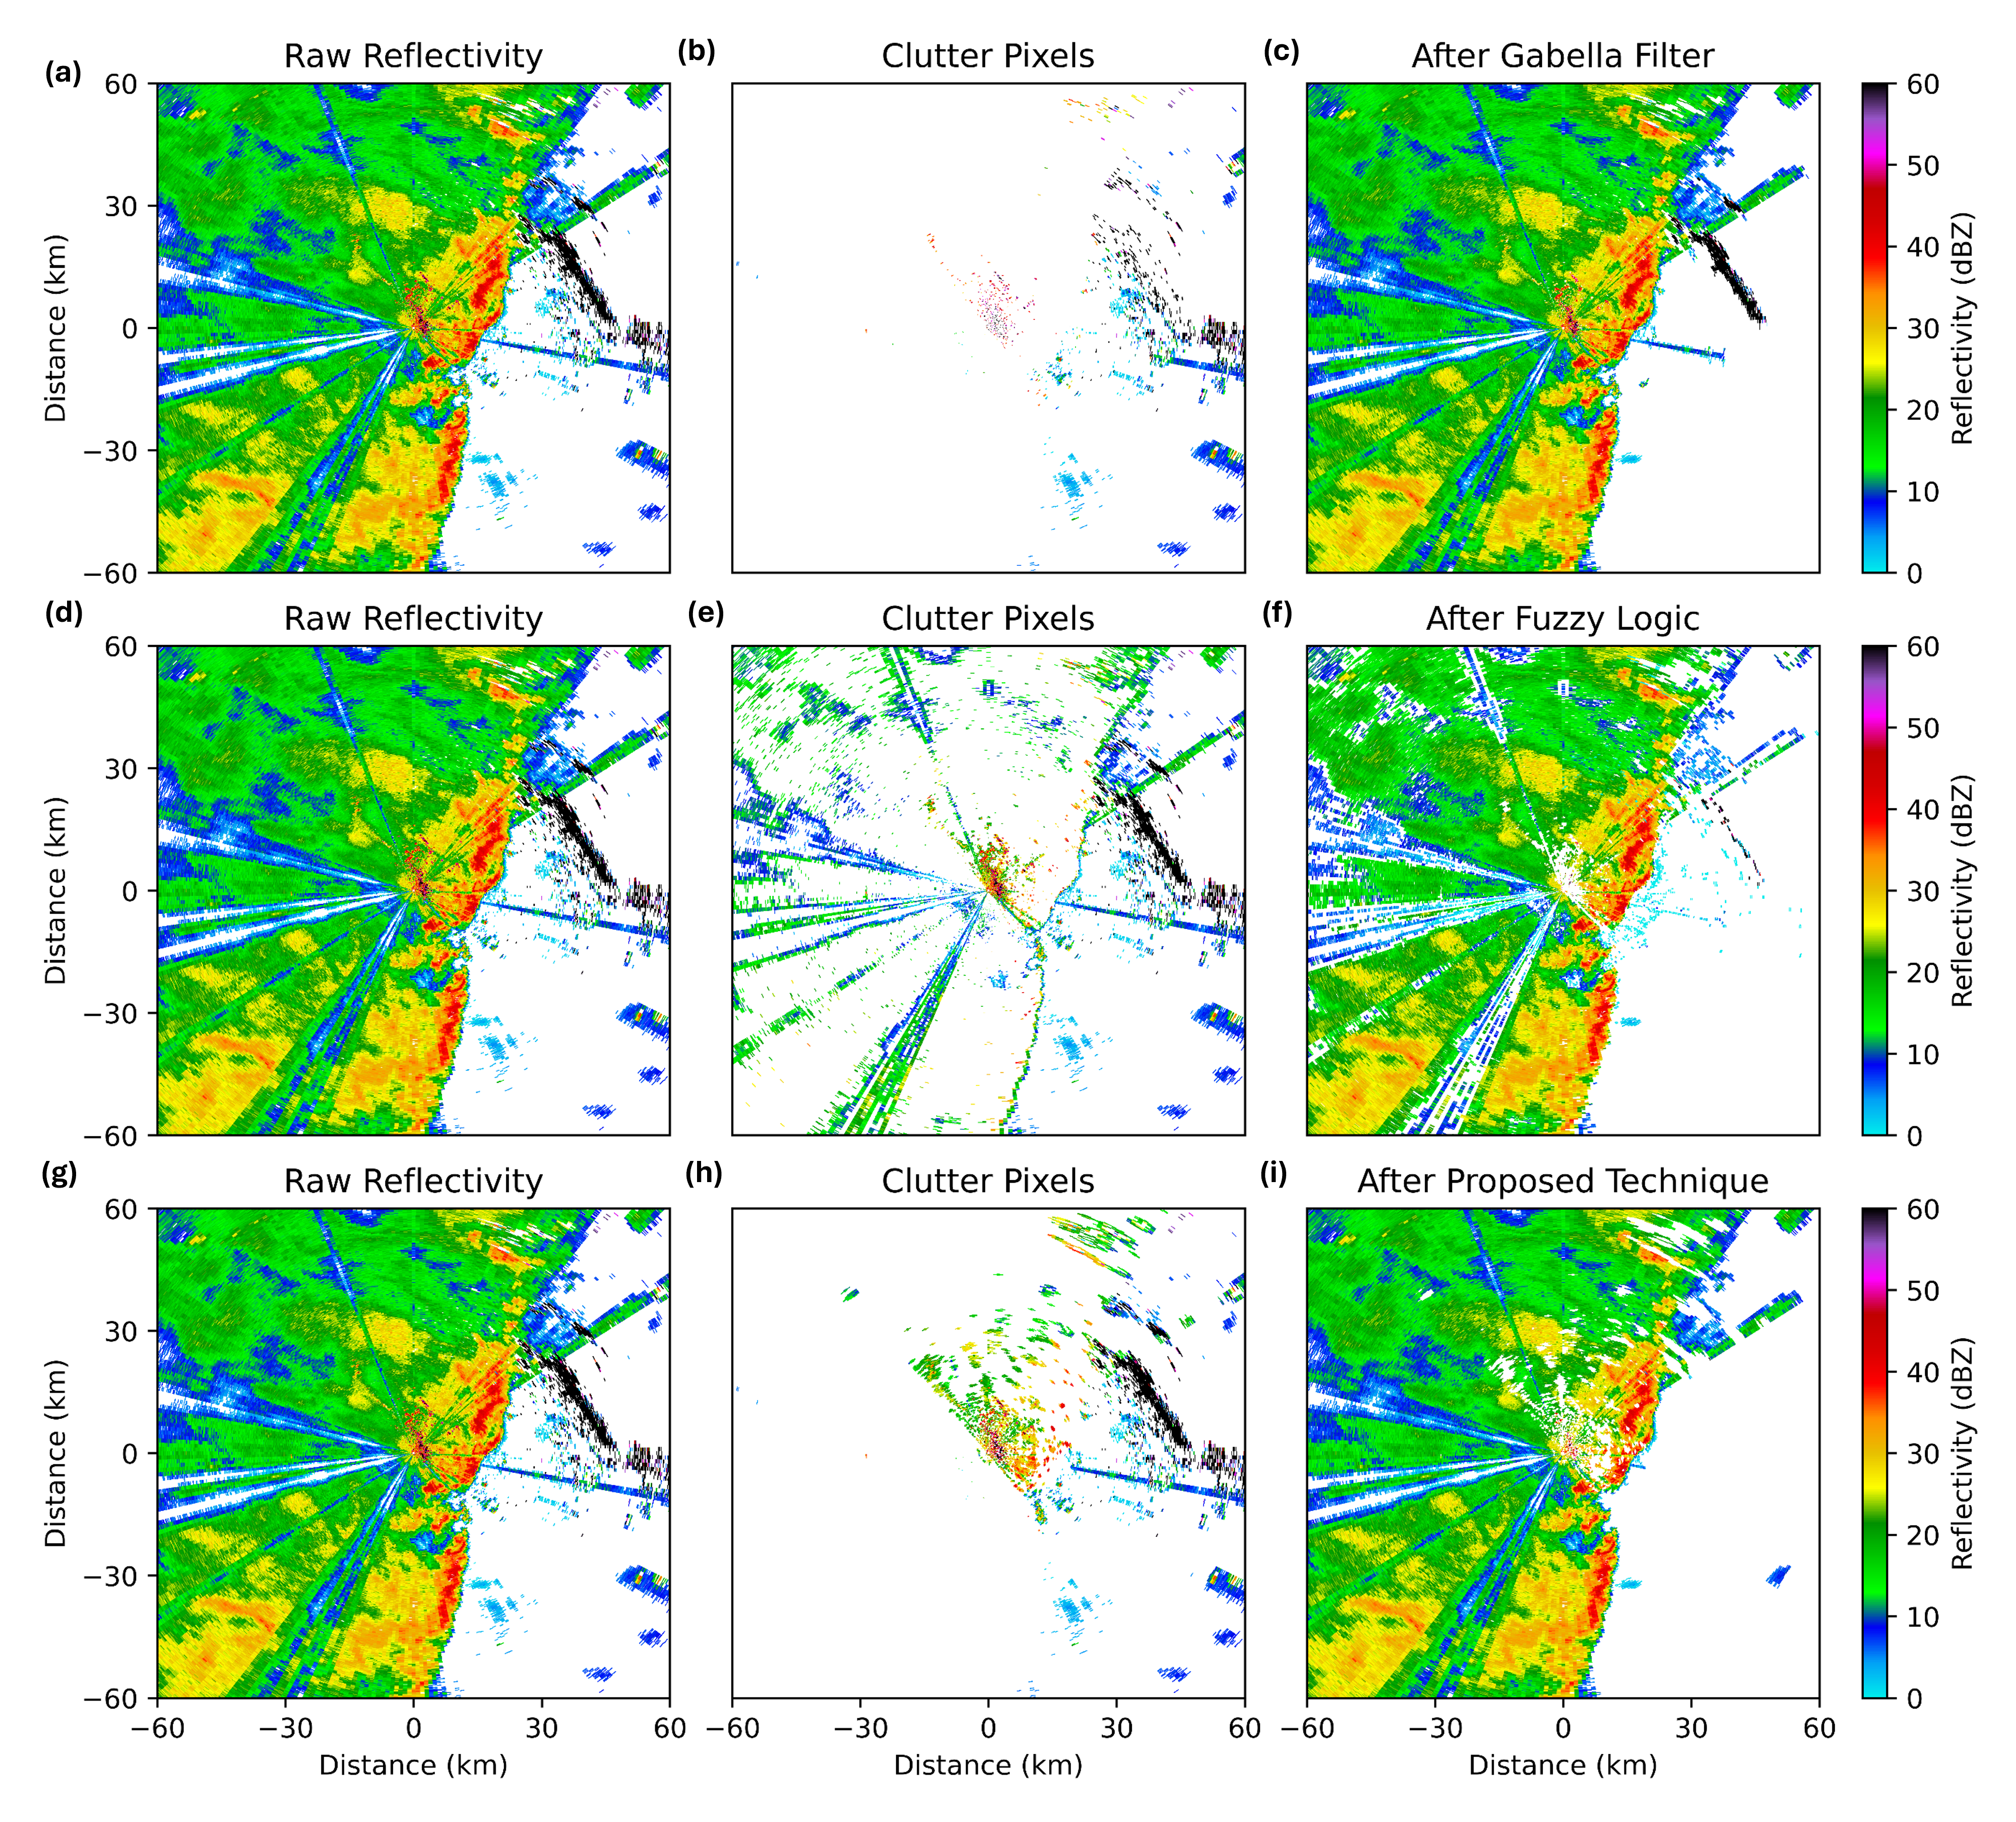
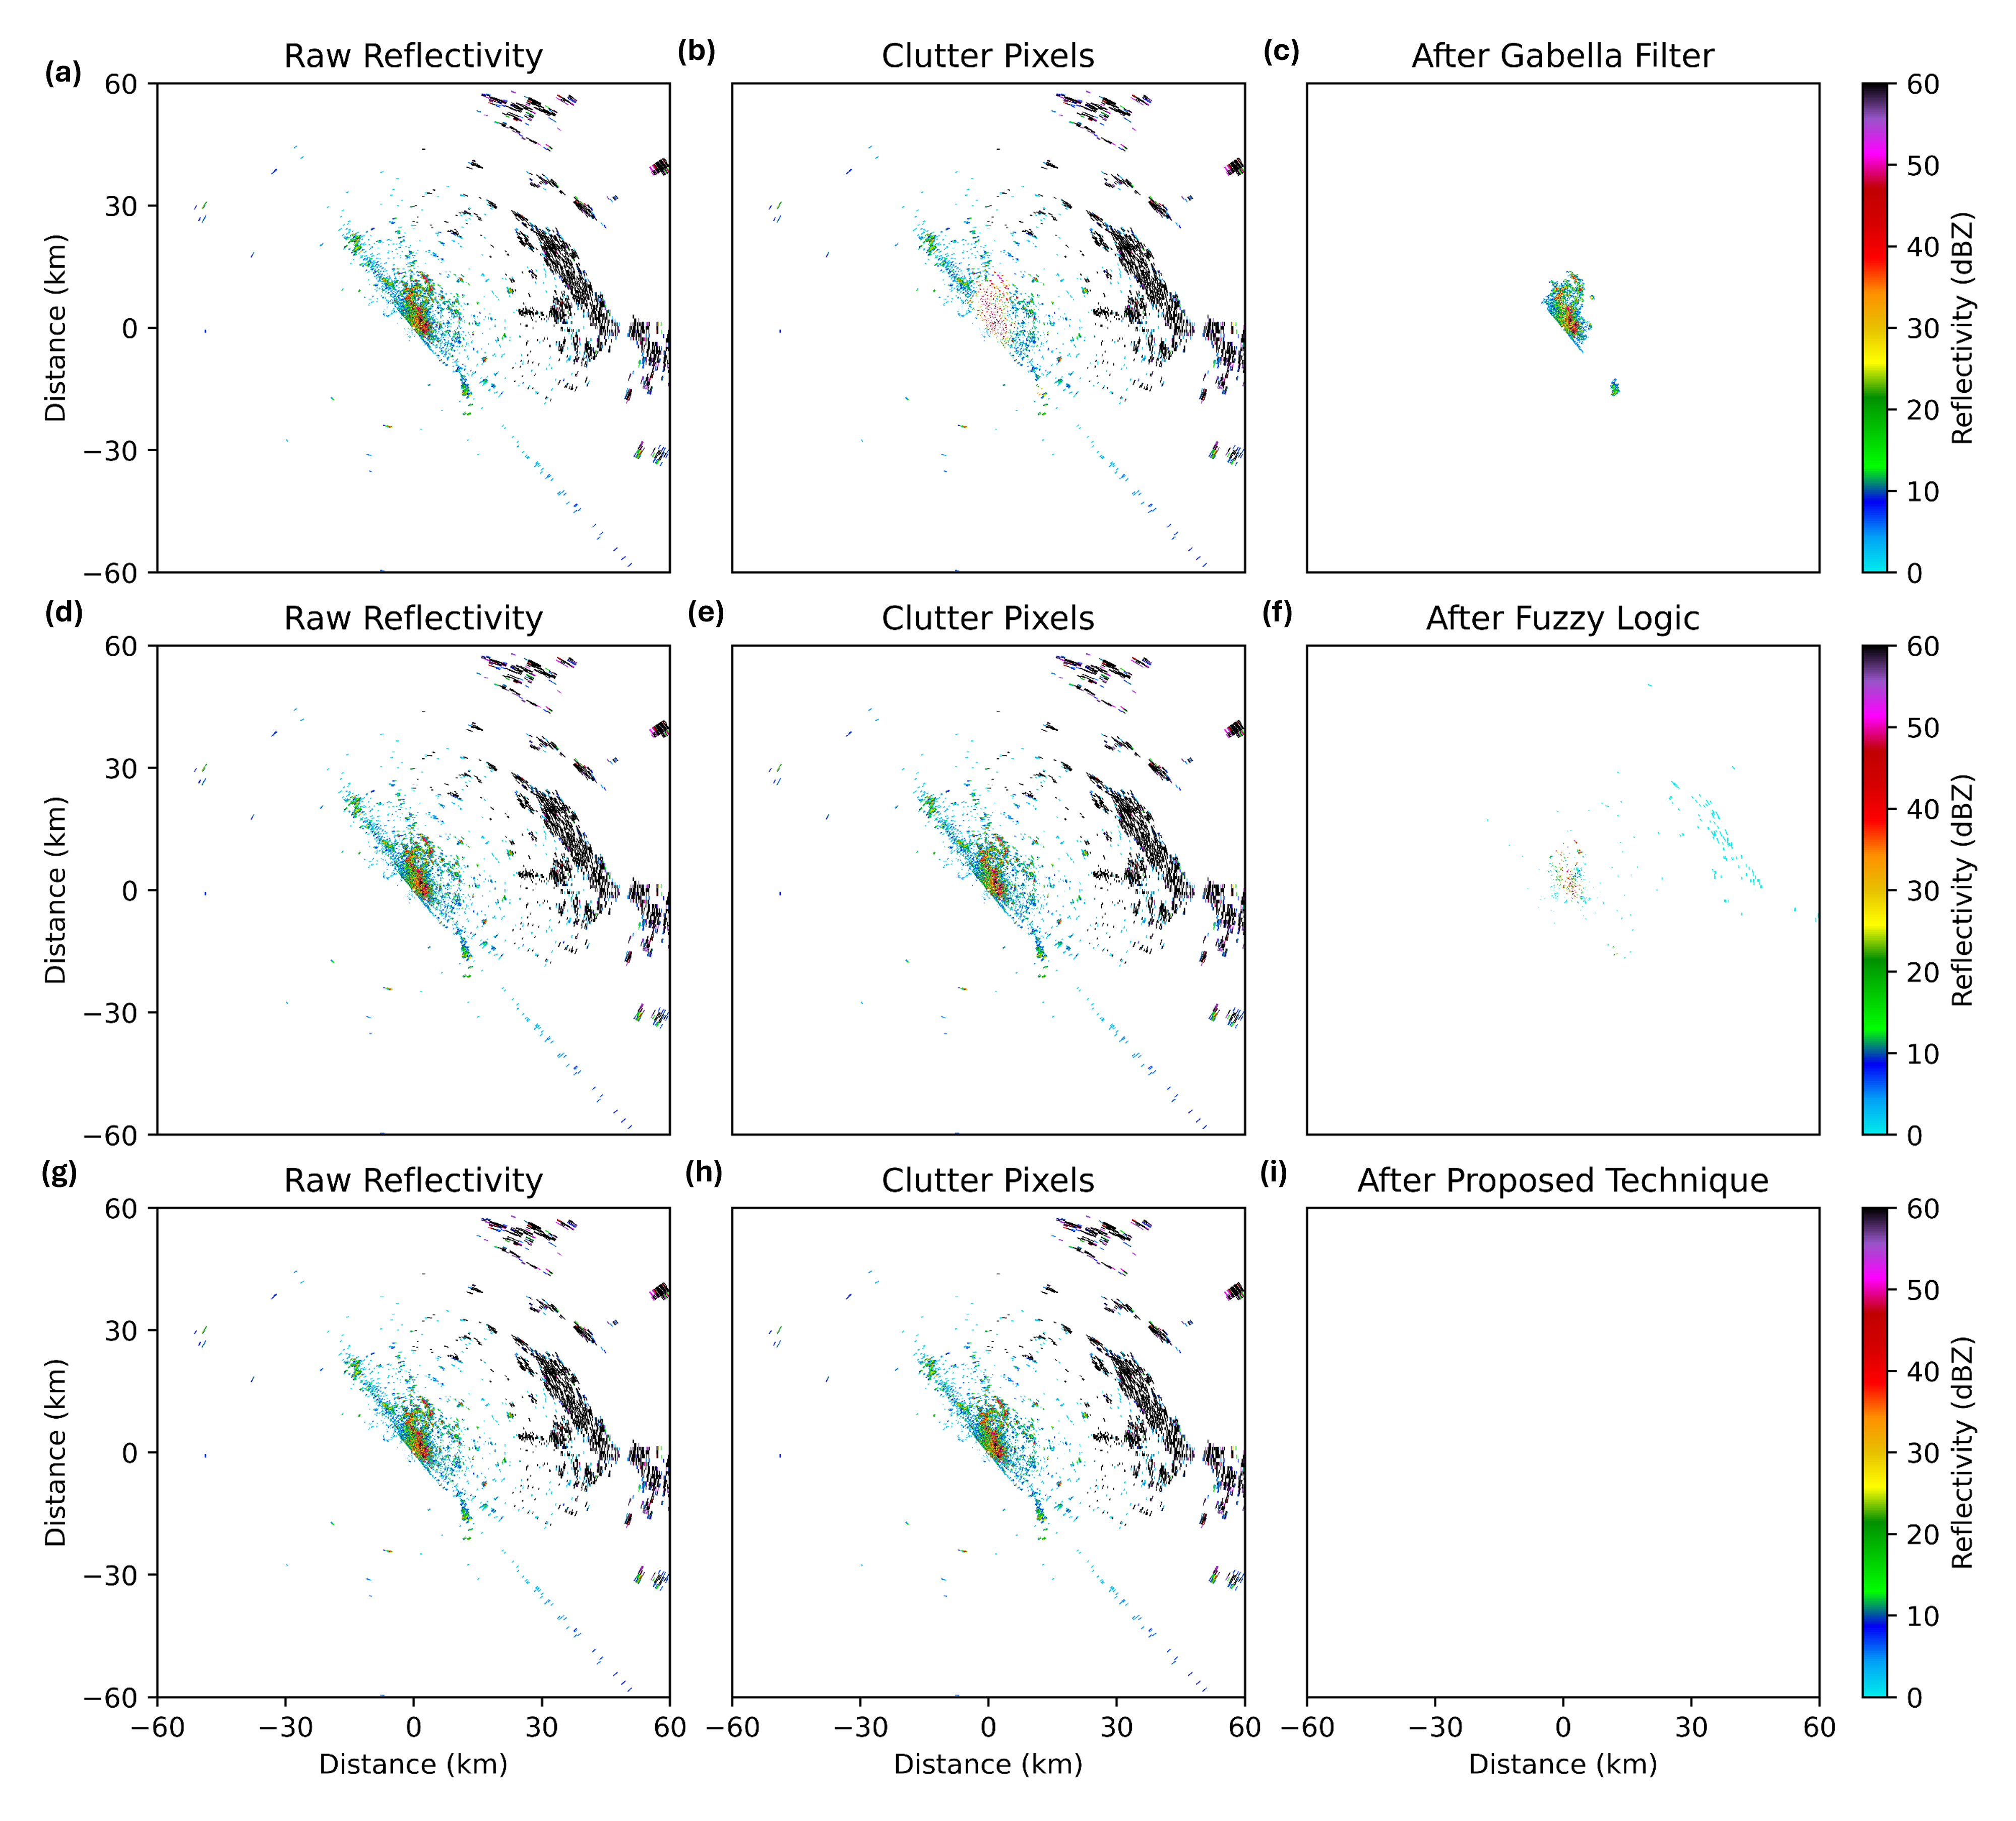
Performance Evaluation
The proposed technique successfully eliminates the ground clutter.

Slide 19
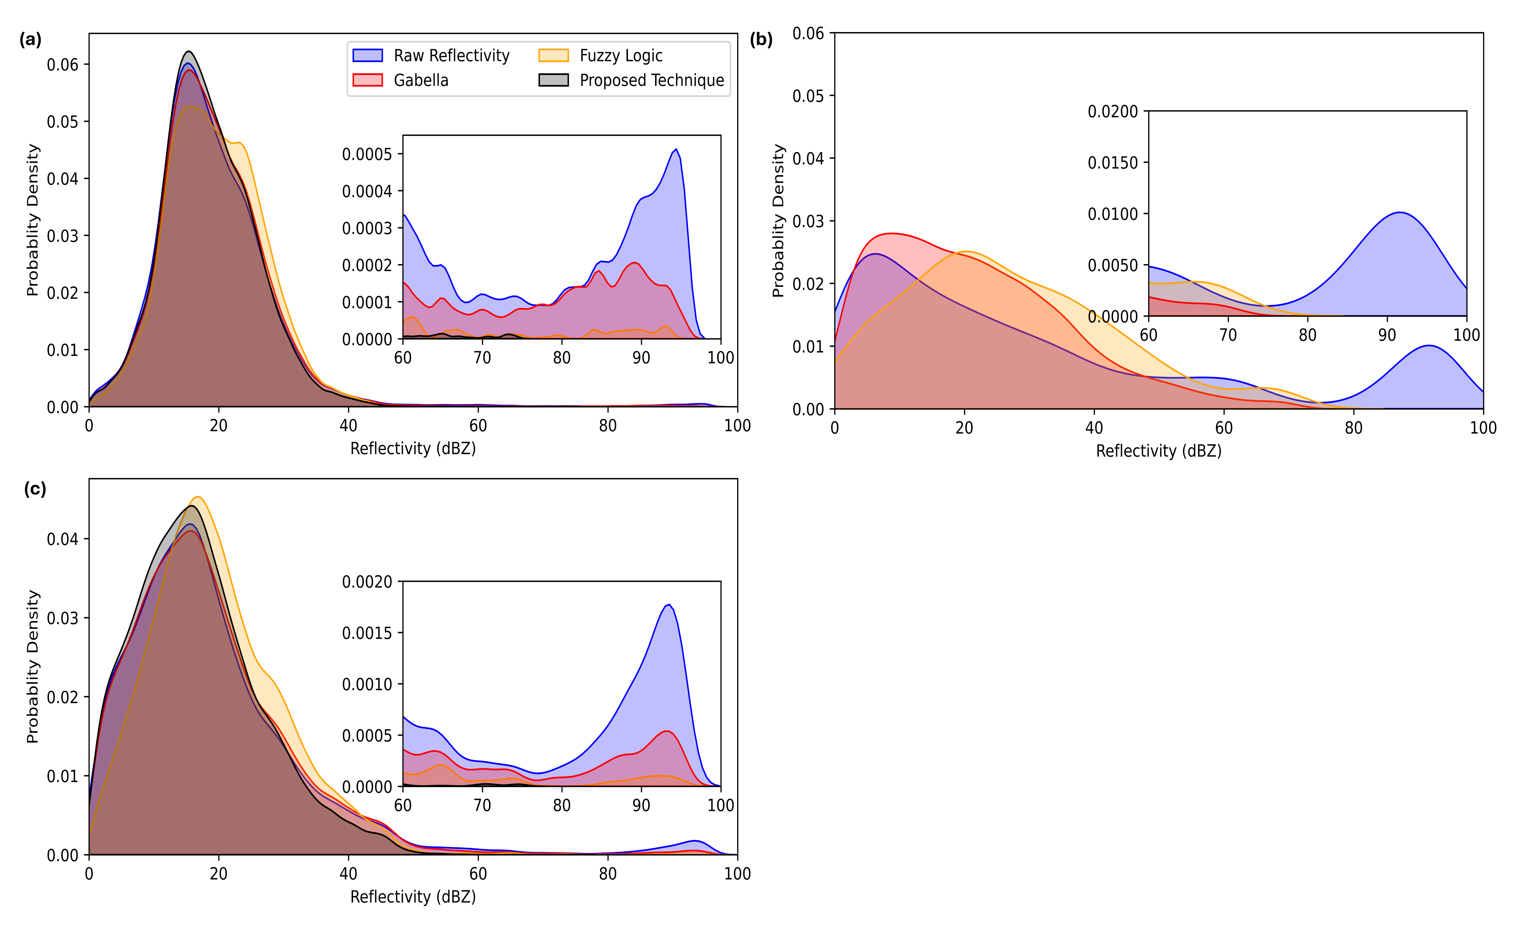
Performance Evaluation
Effectively eliminating high reflectivity tail region

Slide 20
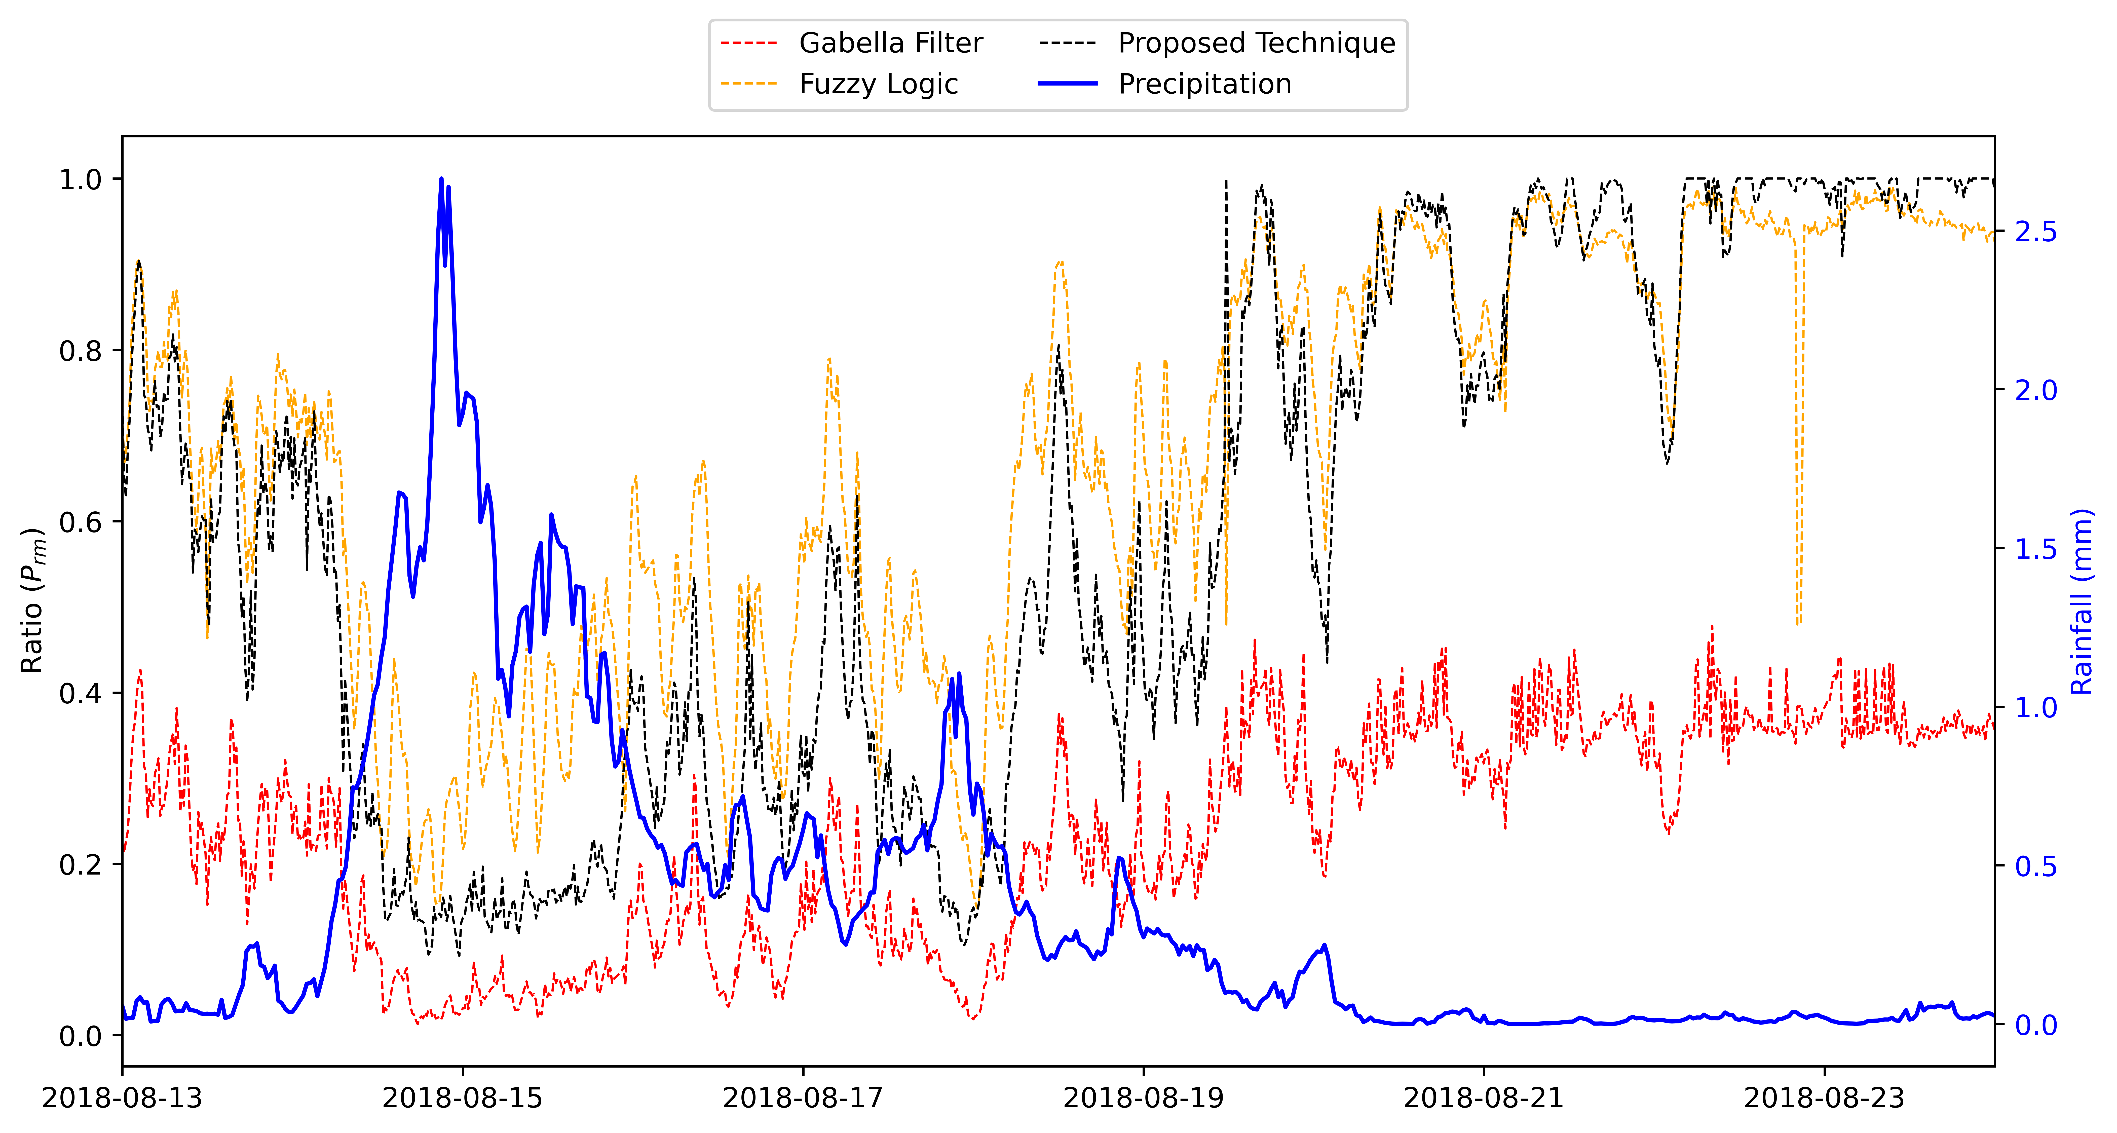
Quantitative Evaluation
Haibo et al. (2018) defines a quantitative measure, a clutter removal ratio (P_{rm})
where, Aa (Aa) is the area of pixels with reflectivity greater than 20 dBZ after (before) the clutter removal
For rainy free condition P_{rm} ~ 1 while for rainy vary from 0.2-0.5.

Slide 21
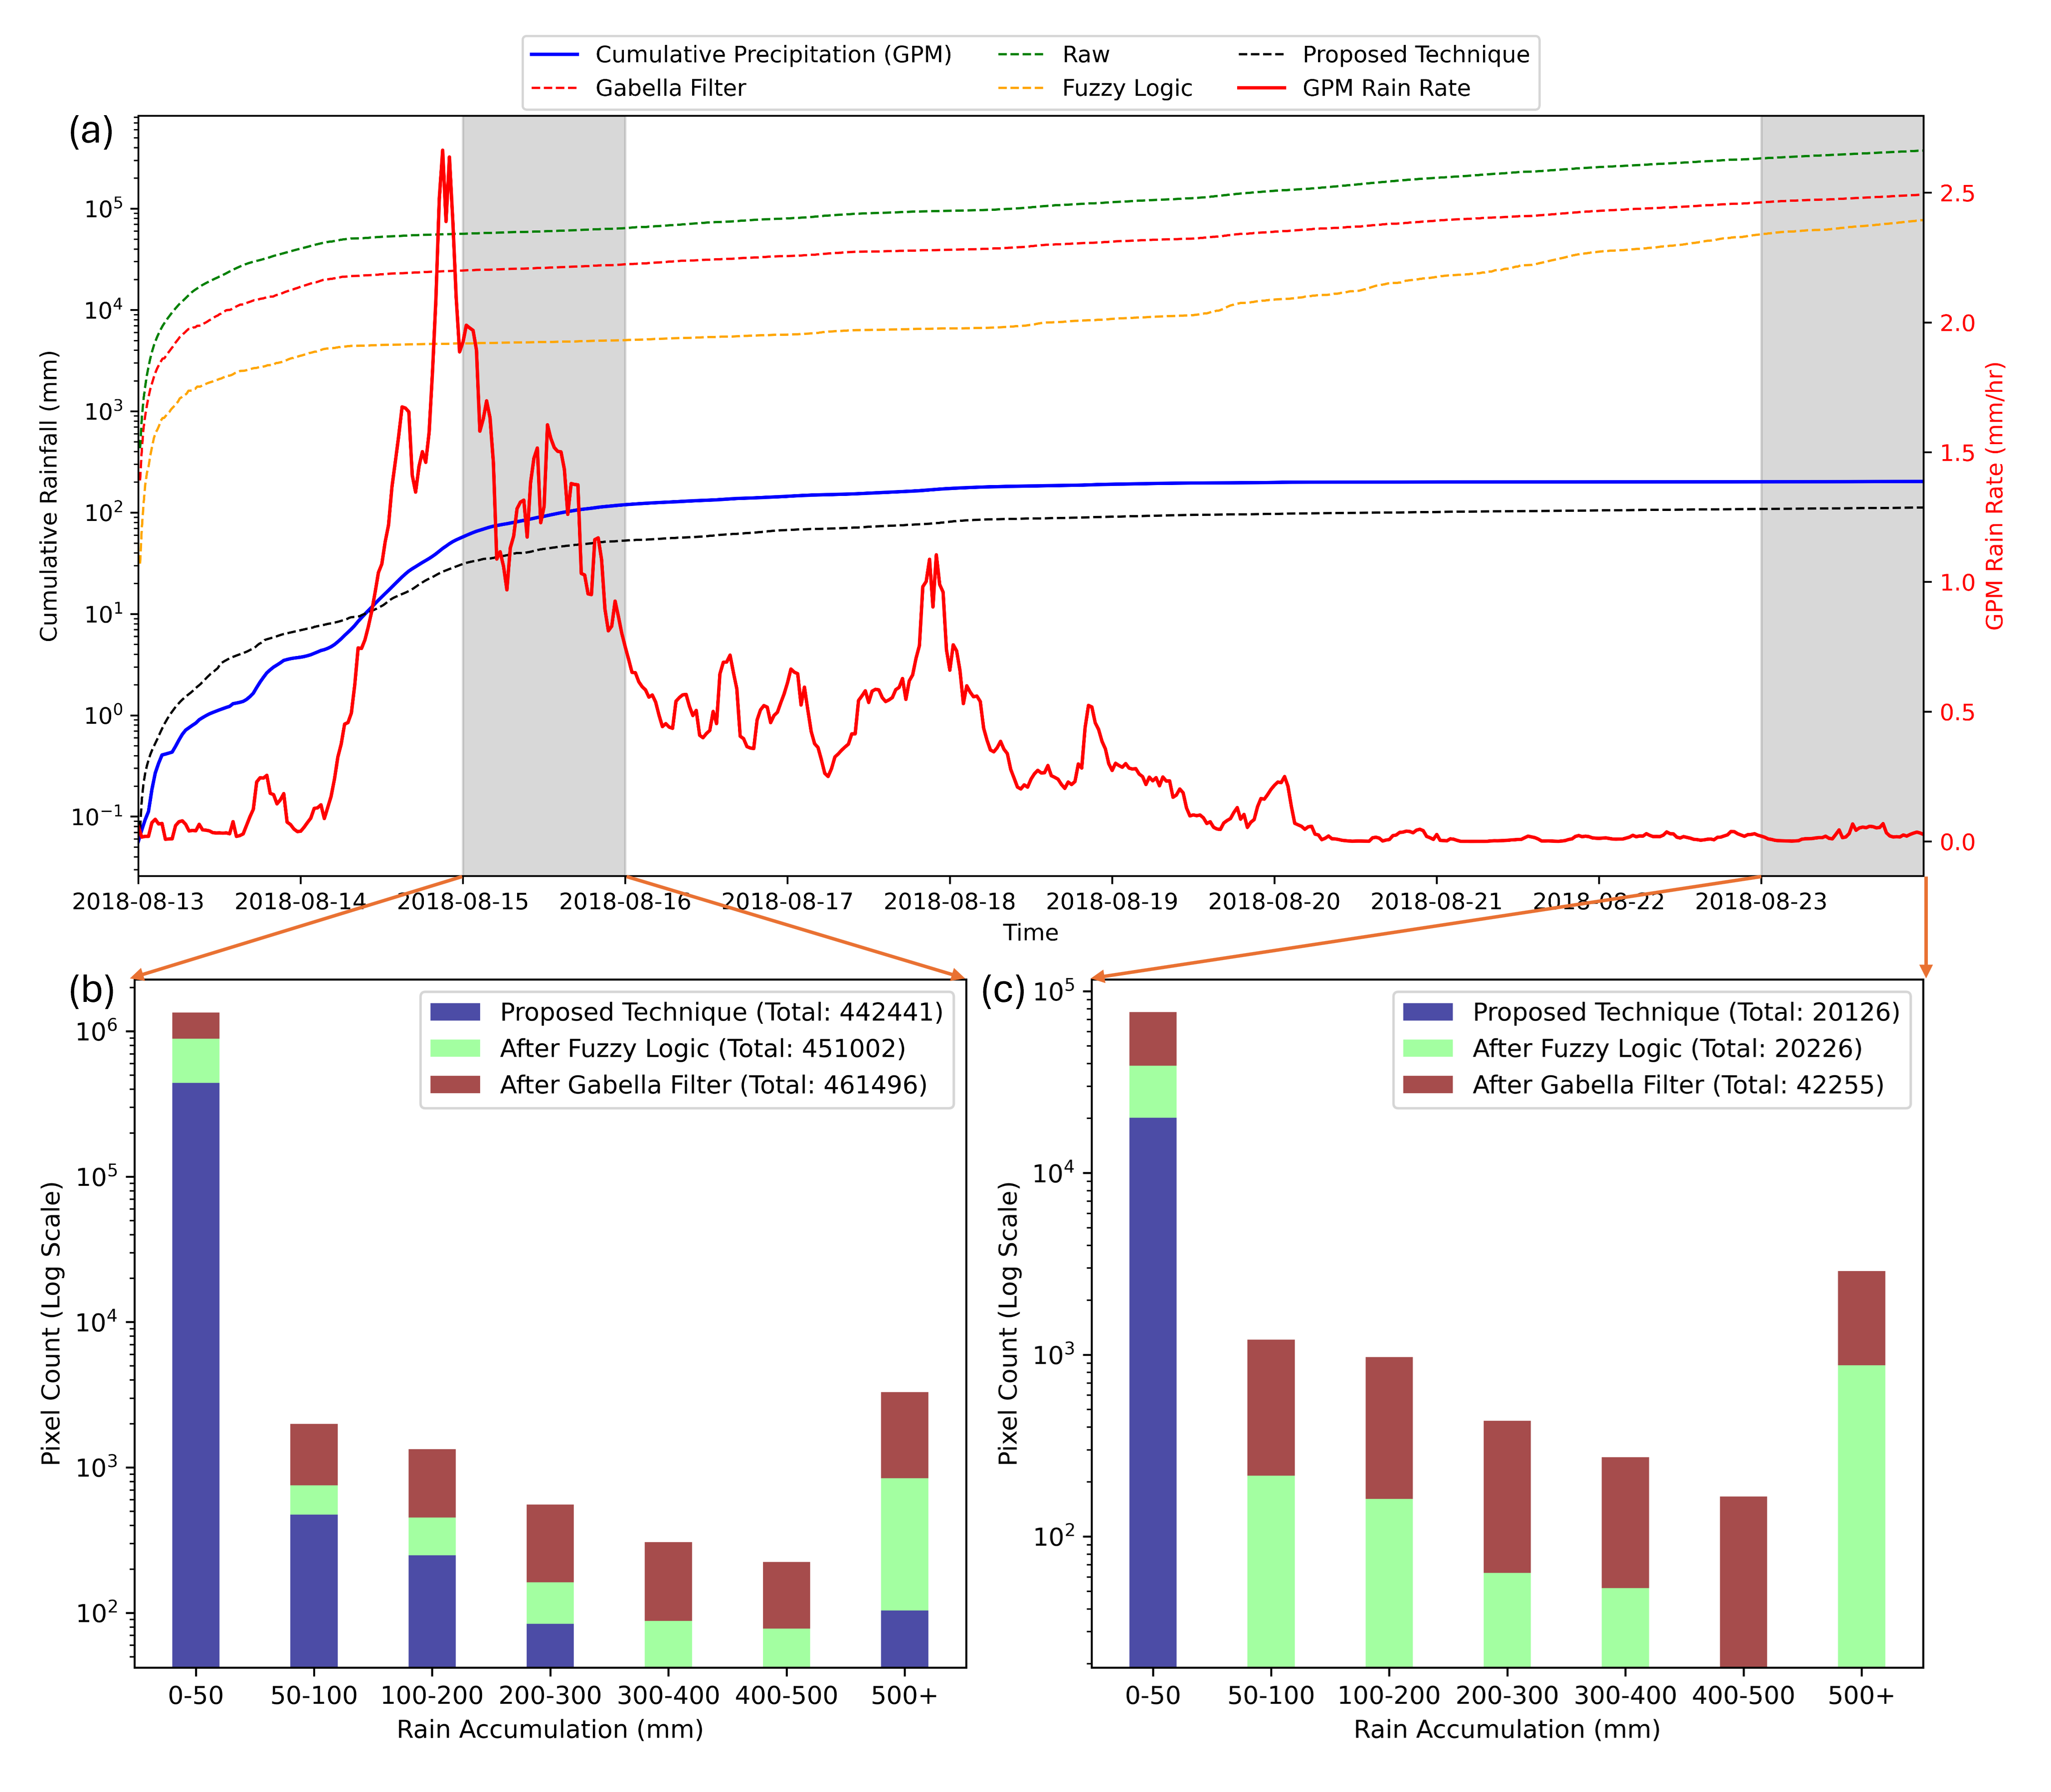
Impact on Radar QPE
The presence of clutter significantly affects the radar-QPE.
Figure shows the cumulative daily rainfall using raw radar reflectivity and clutter removal reflectivity using various techniques.
It is clear from the figure that after applying the proposed technique, the radar estimated rainfall is close to the GPM observed rainfall.
However, there is a huge difference in the rainfall estimated by radar after applying the Gabella filter and fuzzy logic as compared with GPM observed rainfall.

Slide 22
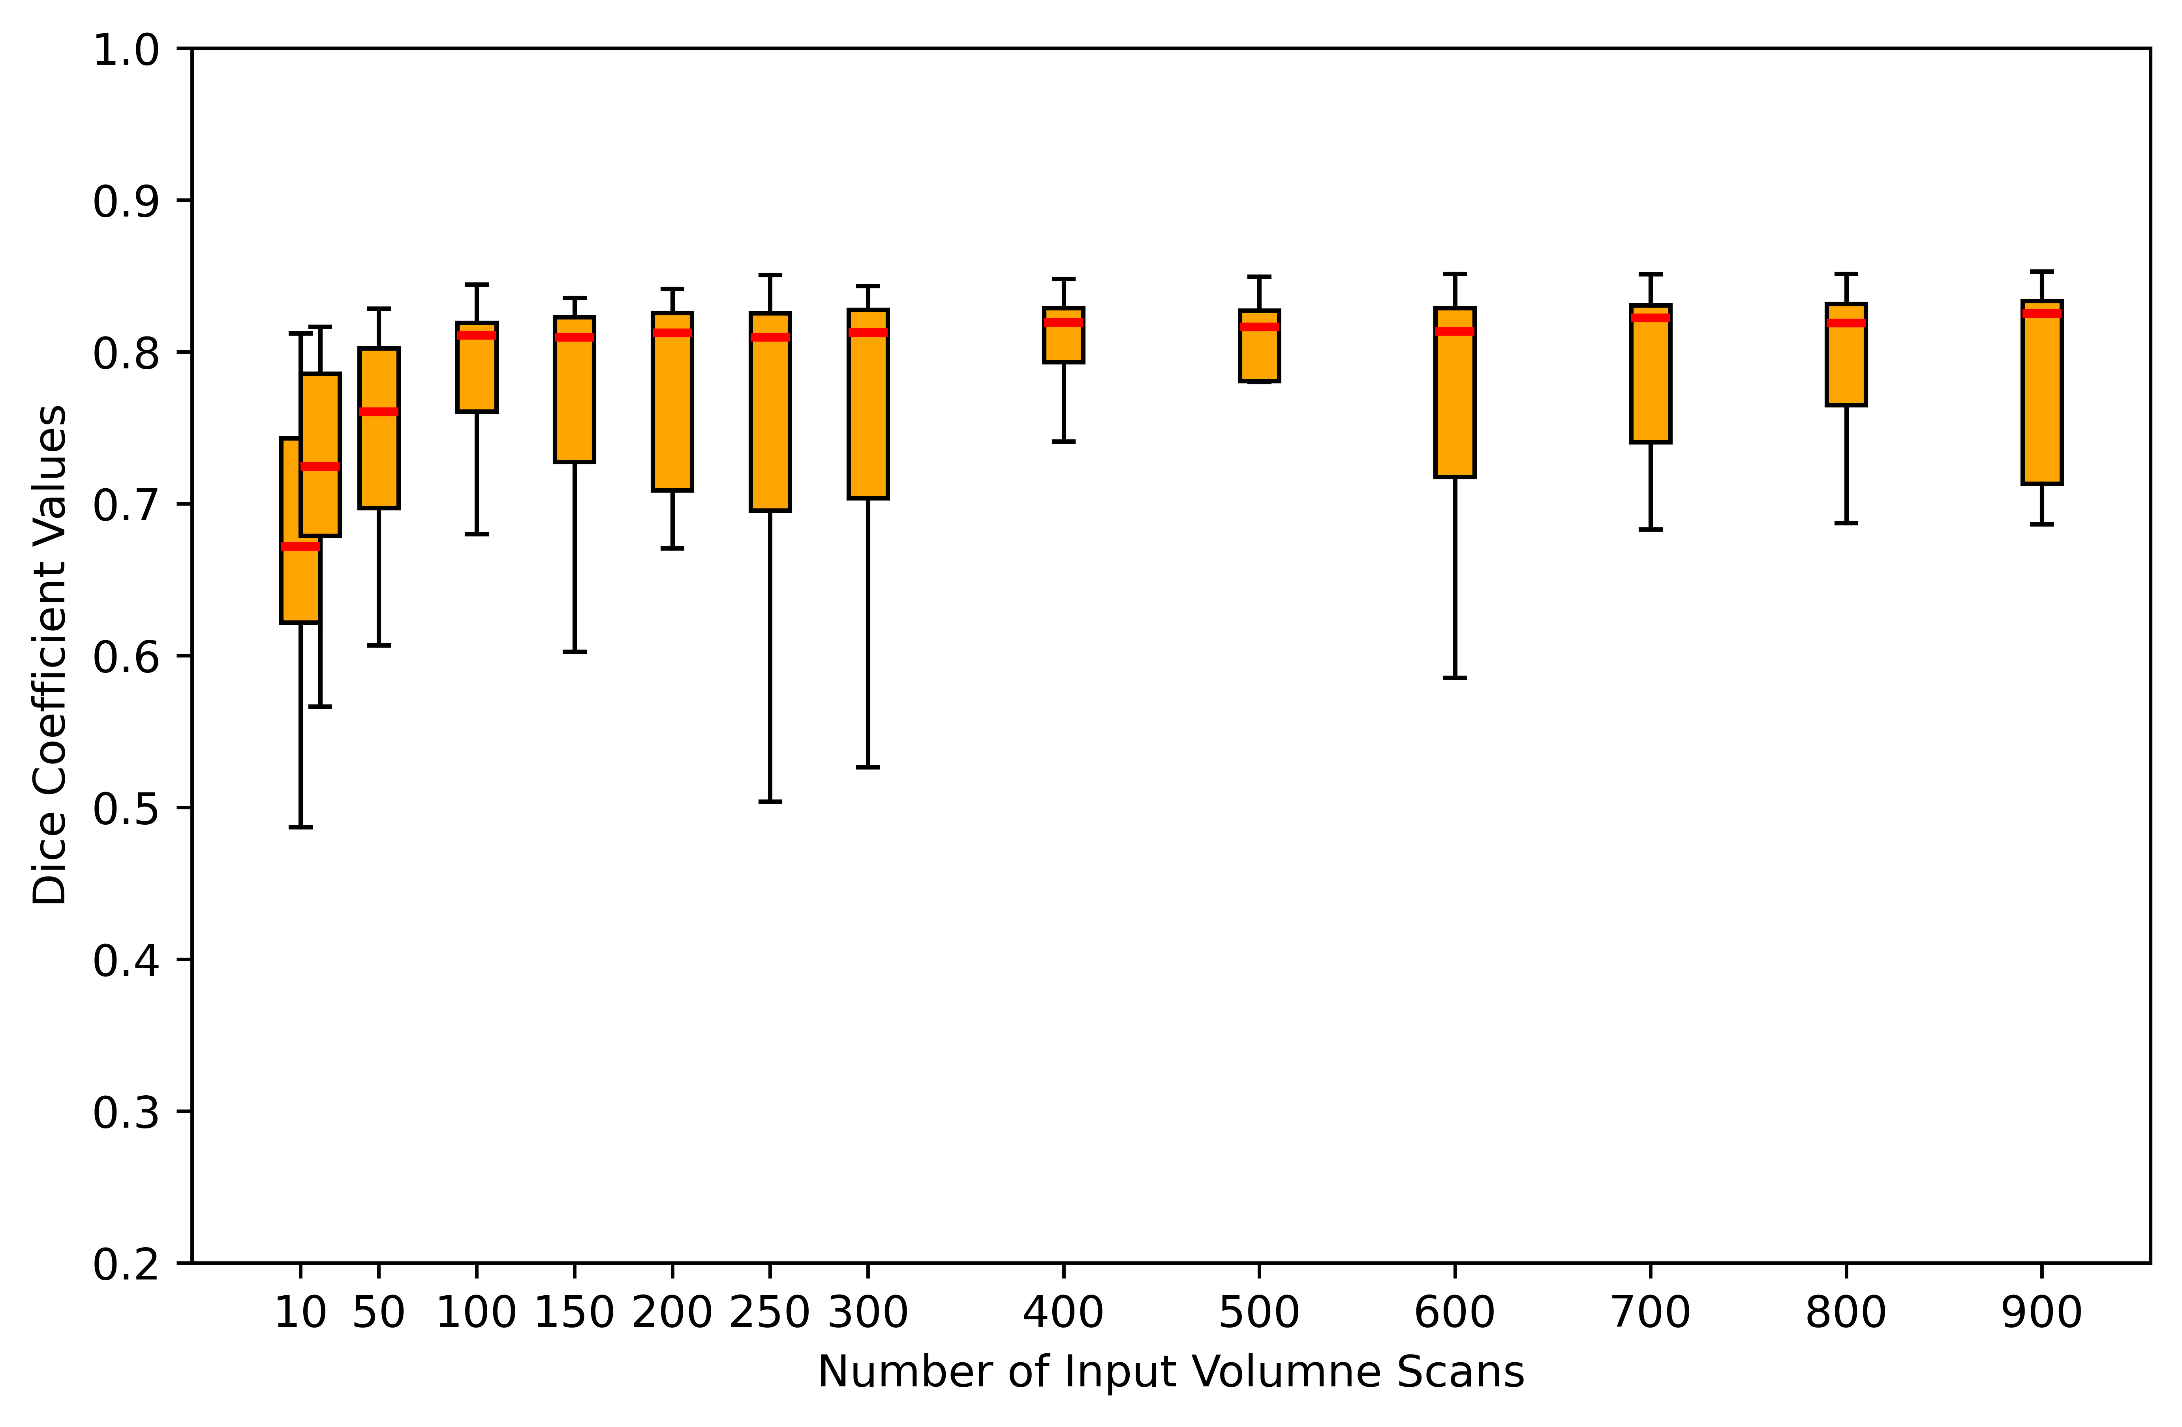
Sensitivity Analysis: No. of Input Volume Scans
Different clutter masks with varying numbers of volume scans were generated, and a Dice coefficient was calculated, considering the developed clutter mask with full data as the base.
Figure shows the Dice coefficient with the number of volume scans.
It can be seen that the Dice coefficient reaches around 0. 82 and saturates after 150/200 volume scans.
It highlights that the technique is not overly dependent on the availability of large number of volume scans used to generate the clutter mask.

Slide 23
Summary
The study discusses a Probabilistic algorithm for ground clutter mitigation applicable to any DWR.
Tested and evaluated using TERLS C-Band DWR data.
The proposed technique outperforms Gabella filter and fuzzy logic methods for ground clutter removal.
The removal ratio for the proposed technique is near 1 for the no rainy conditions.
These static clutter also supports precise radar relative calibrations.

Slide 24
Contributions Welcome!!
PYTHON INDIAN WEATHER RADAR TOOLKIT
Clutter Correction
Thank you
Vaibhav Tyagi
SIGMA Research Lab, IIT Indore
Indian Institute of Technology Indore, India
vaibhavtyagi7191@gmail.com
OSPP Voting

Slide 25
Clutter in DWR Data
Python Library
Methodology
OSPP Voting
Introduction
Results

