Slide 1
High-resolution time-lapse ERT imaging of a green infrastructure’s response to a flooding test and a heavy rain event
Alexis Luzy, Adrien Dimech, François Duhaime, Jean-Sébastien Dubé, Janie Masse-Dufresne, Rose-Anne Farley

Slide 2
Problem statement
Problem: Stormwater management
Extreme rainfall events (august 9th 2024) : most expensive climatic event in Quebec history
Increasing variability of climatic events
A solution: Green Infrastructures
Environmentally friendly approach
Social and aesthetic benefits
Source : Catalogue d’infrastructure vertes sur rue, Ville de Montréal, 2022
Notes:
Stormwater management is a growing problem in a lot of cities all around the world, for exemple montrealers in the room will remember the rainfall from 2 months ago which was a new record. Furthermore this problem is only worsen by climate change and the deregulations it brings.
A verstatile solution to alleviate sewage systems are green infrastructures, that the city is already building everywhere, that are an environmentally friendly approach easily accepted by the public.

Slide 3
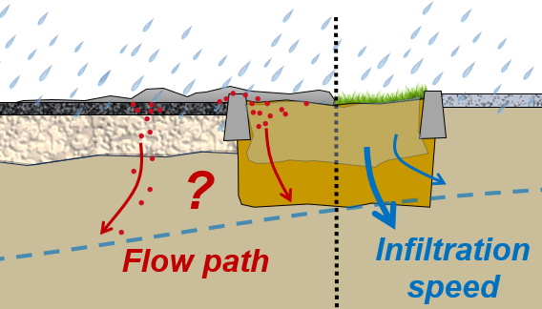
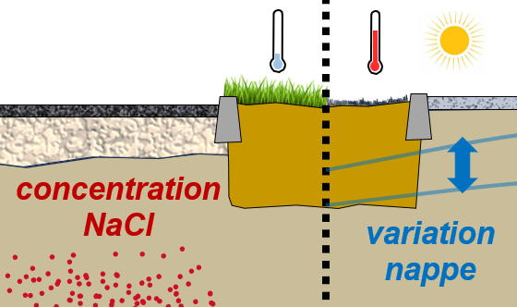
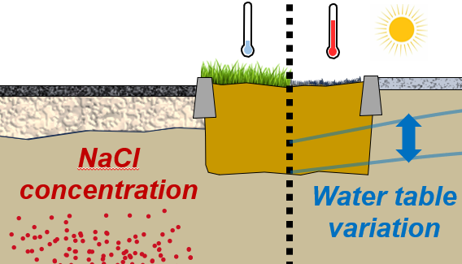
Project goals
To see where water and chloride infiltrate in and around the Green Infrastructure.
Short term (days): response to rain
Flow path of water / chloride
Infiltration speed
Asphalt pavement watertightness
Long term (months): seasonal variations
Chloride accumulation
Cyclic behavior
Water table changes

Slide 4
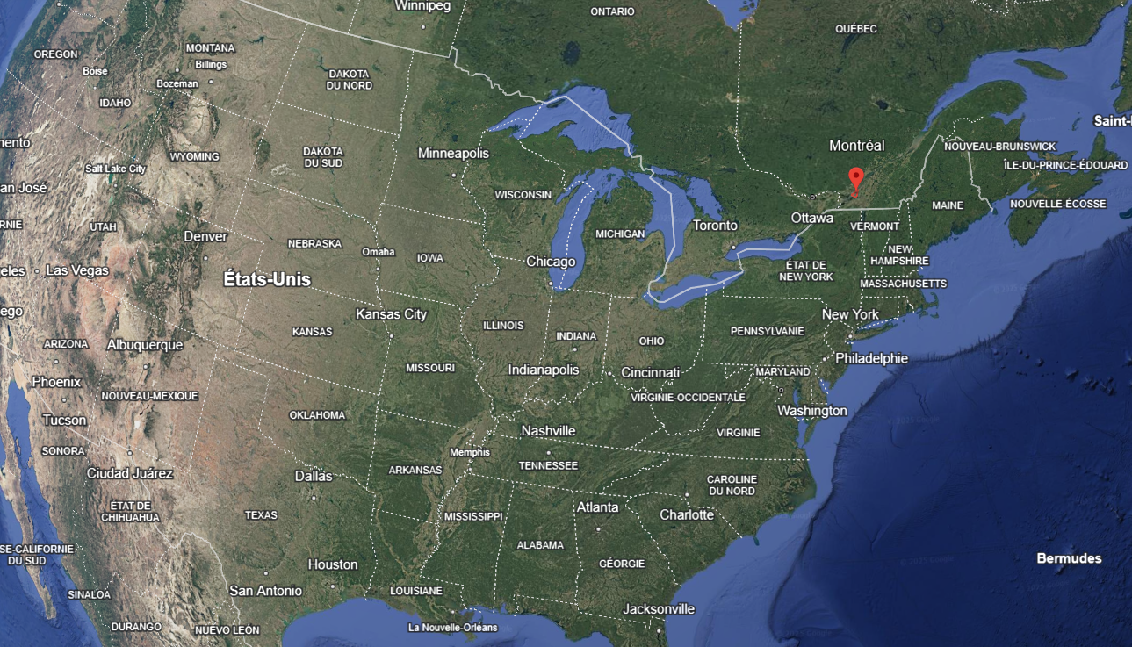
Study site
Montréal
(Google earth)

Slide 5
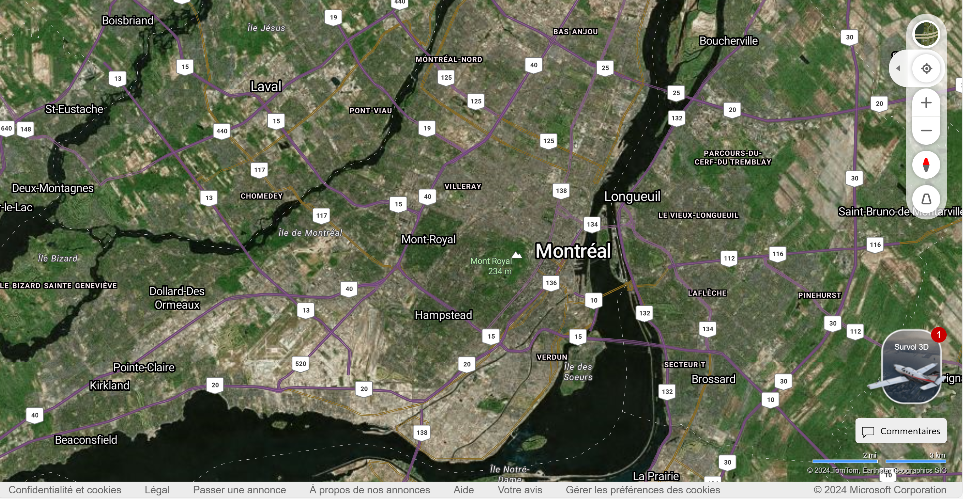
Study site
GI

Slide 6
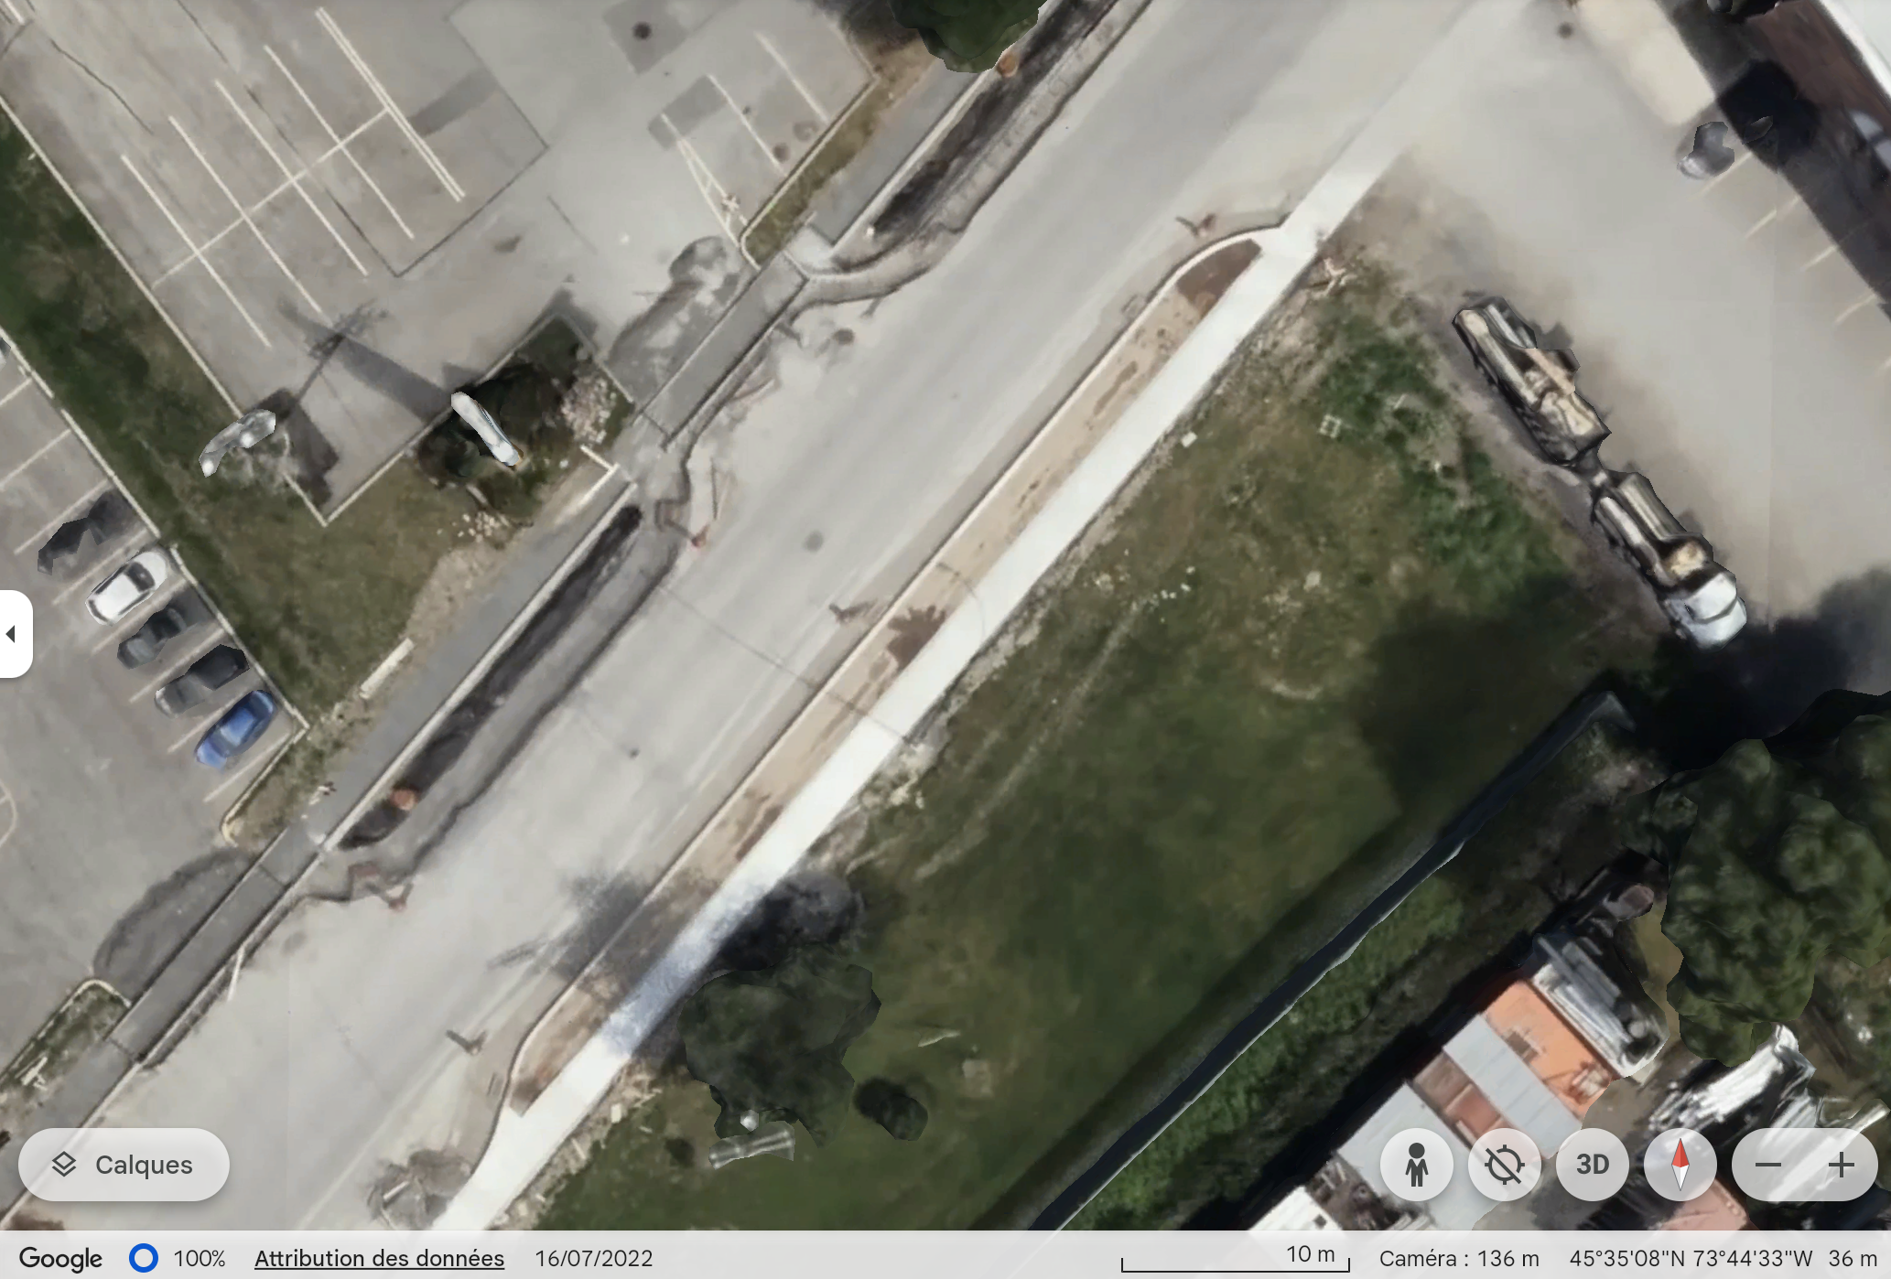
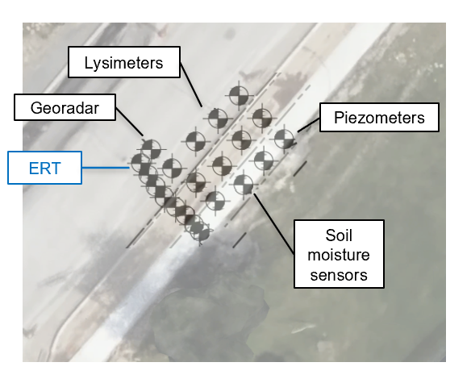
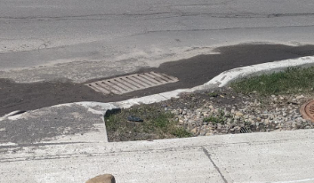
Study site
GI
50m
ERT

Slide 7
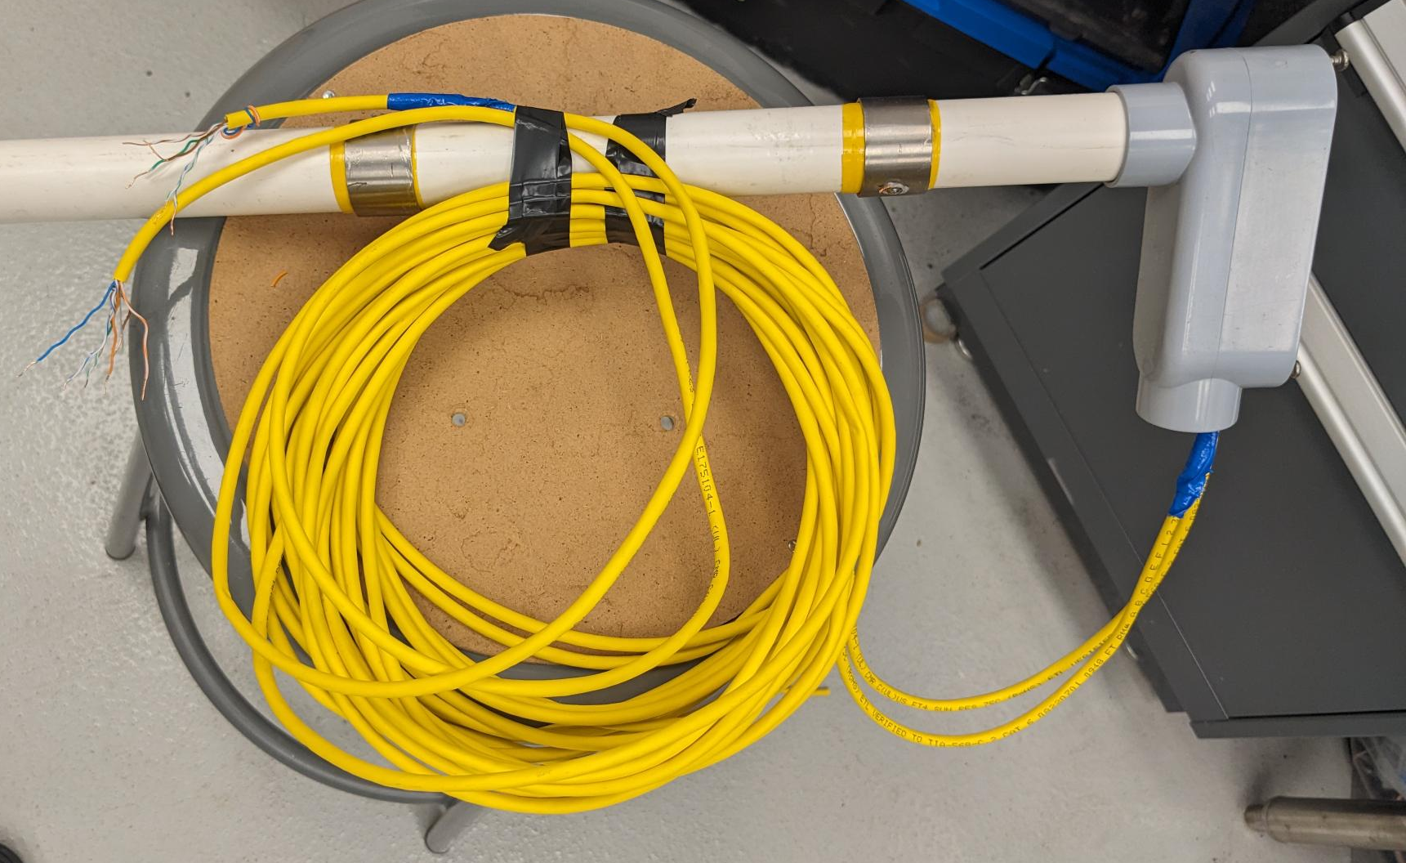
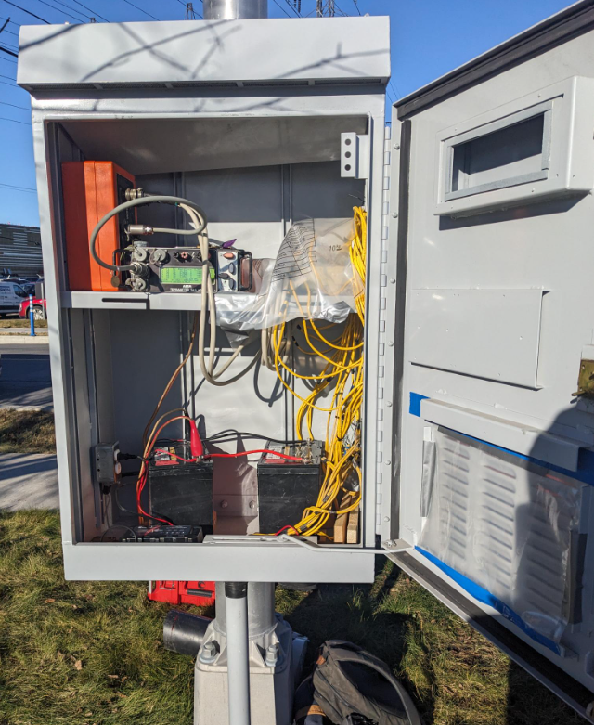
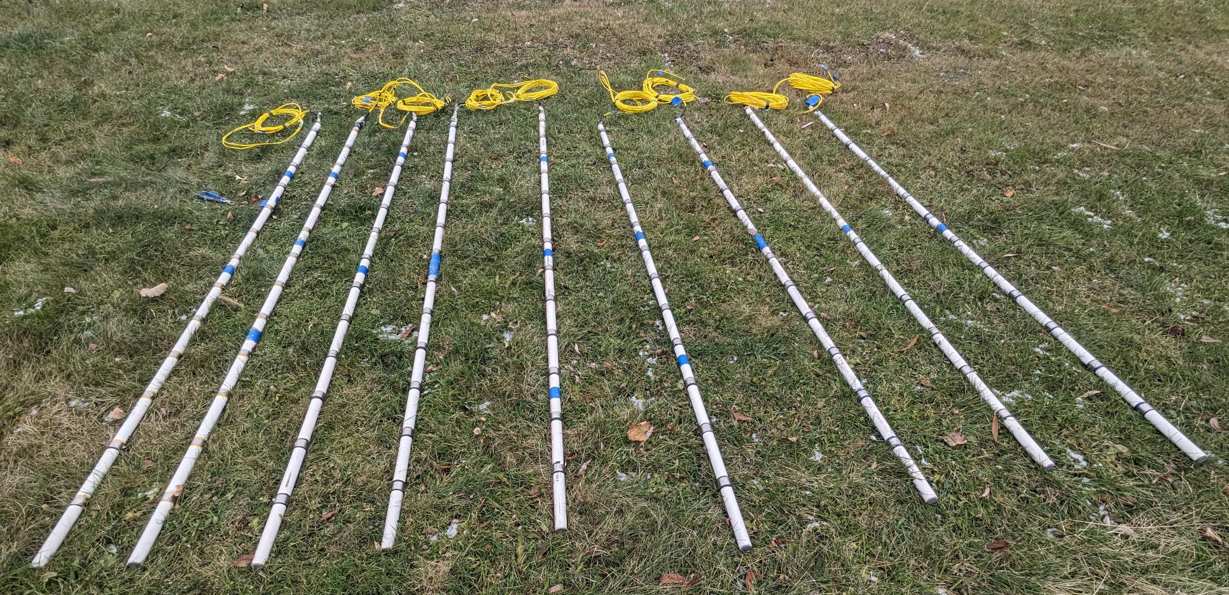
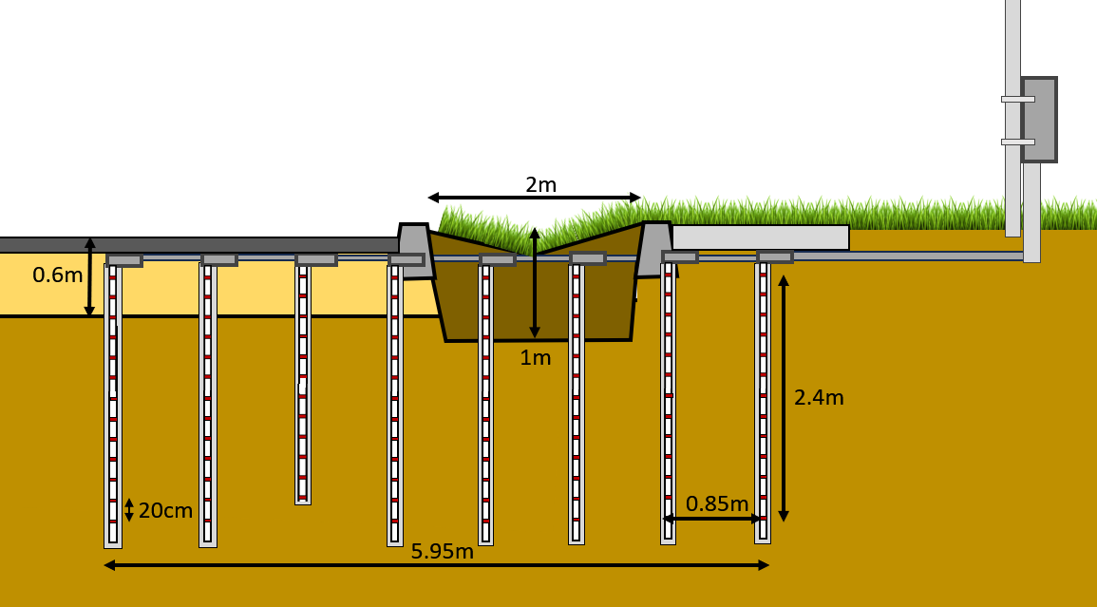
Instrumentation

Slide 8
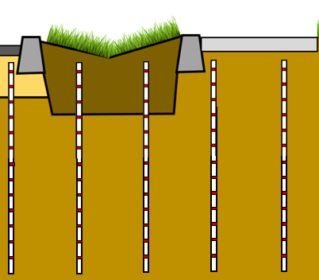
Measurement scheme
Current injected between A and B
Ohm’s Law : Resistance, R = $\frac{\text{U}}{\text{I}} \left(Ω\right)$
Bipole-Bipole measurements
Changes with:
Geometry
Soil (type, minerals)
VWC (%)
NaCl
Temperature (°C)
Porosity, compaction…
U(V) measured between M and N
Notes:
The third and last series of boreholes is where are installed all our probes. 19 probes are installed in those four boreholes. There’s 8 TEROS 12 that measures volumetric water content, temperature and soil electrical conductivity, 2 TEROS 21 that measures suction and temperature, two RT-1 that measures temperature and 8 watermark that measure suction. We are currently still working on waterproofing the datalogger to have continuous measurements.

Slide 9
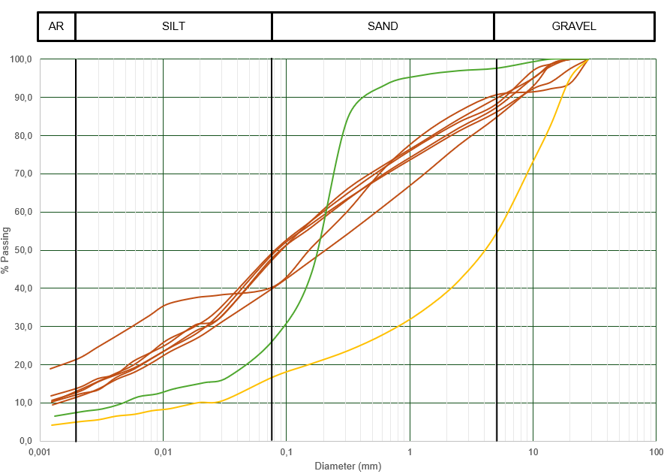
Geologic context
Crushed stone – until 60 cm depth
GI soil
Natural soil – Loose sandy-clayey silt
Sampling
Notes:
The third and last series of boreholes is where are installed all our probes. 19 probes are installed in those four boreholes. There’s 8 TEROS 12 that measures volumetric water content, temperature and soil electrical conductivity, 2 TEROS 21 that measures suction and temperature, two RT-1 that measures temperature and 8 watermark that measure suction. We are currently still working on waterproofing the datalogger to have continuous measurements.

Slide 10
Results
Continuous TL-ERT Data
286 measurement per survey ~1h
1 point
=
1 measurement
511 surveys total
SAS4000
OhmPi

Slide 11
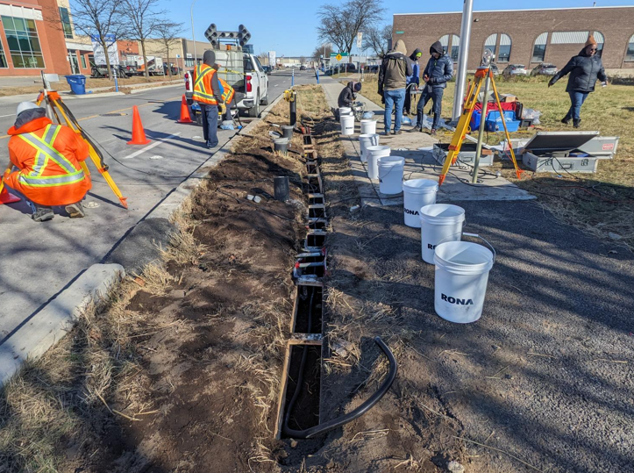
Results: flooding test 13/11
200L at t0, then 400L in 5h, and 150L at the end
water level kept constant until 5PM
10m long
30cm deep / wide

Slide 12
Results: flooding test 13/11
iii. Inversion results : flooding test from 13/11
Temperature variations
-14%
0
+14%
(compared to t0)
Sidewalk side infiltration
3
8
22
63
177
Resistivity (Ωm)
Flooding test start t0 = 11h45
t0 + 8min
t0 + 2h
t0 + 3h15
t0 + 8h
t0 + 1j

Slide 13
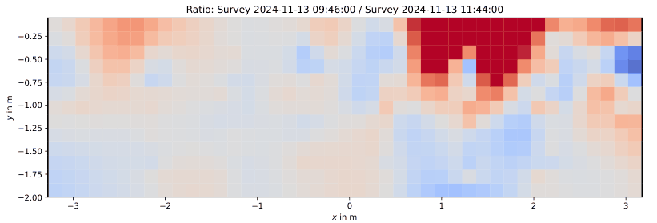
Results: flooding test 13/11
- 14 %
- 7 %
0
+ 7%
+ 14 %
Cross validation by looking at the raw data

Slide 14
Results: flooding test 13/11
Test start
Under GI
Mid GI-sidewalk
mid GI-Road
Under curb

Slide 15
Results : Raining event 22/11
iii. Inversion resuls : raining event from 22/11
Temperature variations
Infiltration through pavement
-5%
0
+5%
(compared to t0)
3
8
23
64
179
Resistivity (Ωm)
t0 = 21/11 04:20
t0 + 1j
t0 + 2j
t0 + 4j
t0 + 4.5j

Slide 16
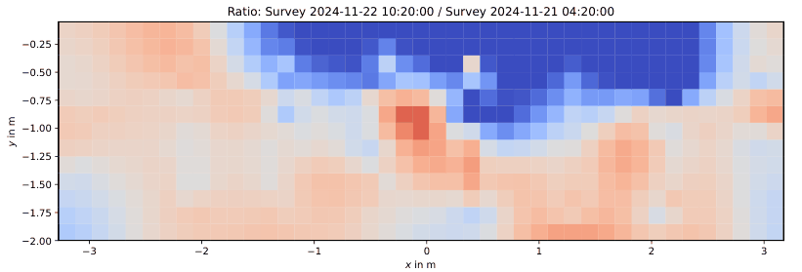
Results: Rain 22/11
- 5 %
- 3 %
0
+ 3%
+ 5 %

Slide 17
Results: Rain 22/11
Under IVD
Mid GI-curb
Under curb

Slide 18
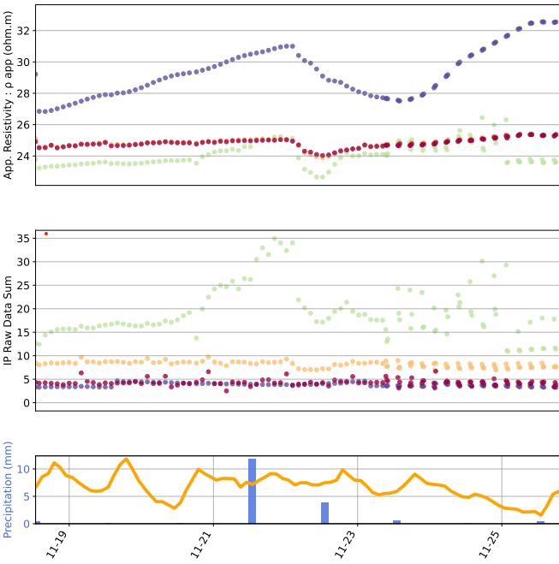
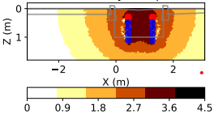
Results: Rain 22/11 - IP

Slide 19
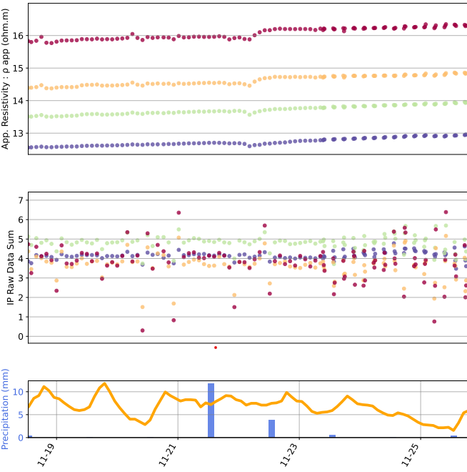
Results: Rain 22/11 - IP

Slide 20
Conclusion
Pavement isn’t that waterproof (in Montreal at least)
Difficulties to have quality IP survey in highly conductive soil (high chloride content)
Strong influence of temperature, which can be corrected with underground sensors
CH-ERT nicely showcases complex flowpaths caused by the heterogenous urban soil profile

Slide 21
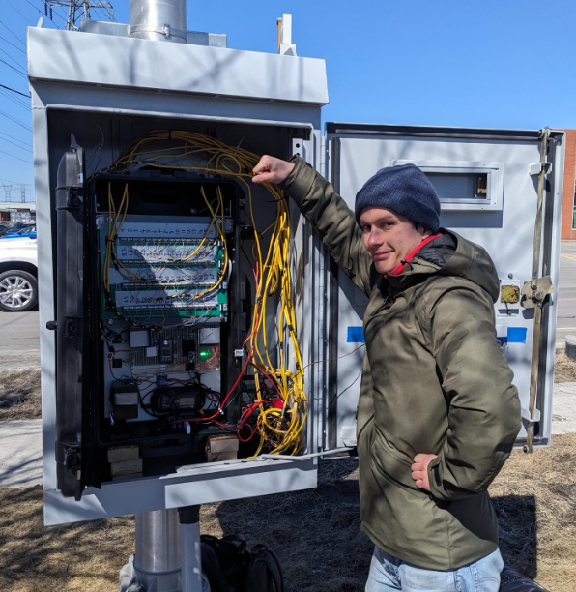
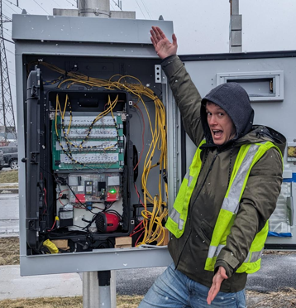
OhmPi installation
OhmPi setup V2 – end of march
R.I.P after 1 successful survey
OhmPi setup V3 – mid april
Working and ONGOING

