Slide 1



Geophysical Multimethod Study to Assess Multi-Layer Covers on Mine Tailings
Thierry Impinna, Adrien Dimech, Gabriel Fabien-Ouellet, Bruno Bussière,
Leila Bedoui, Vincent Boulanger-Martel

Slide 2



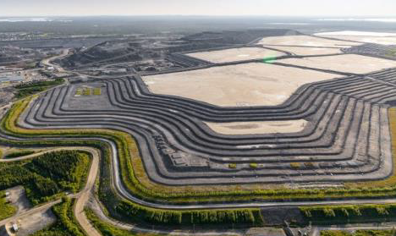

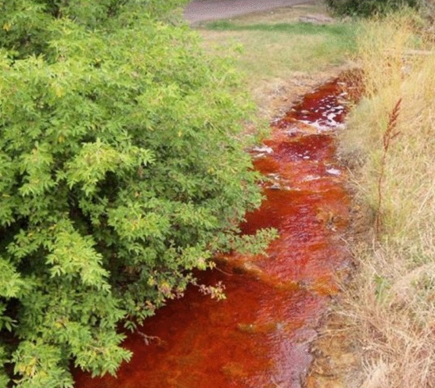
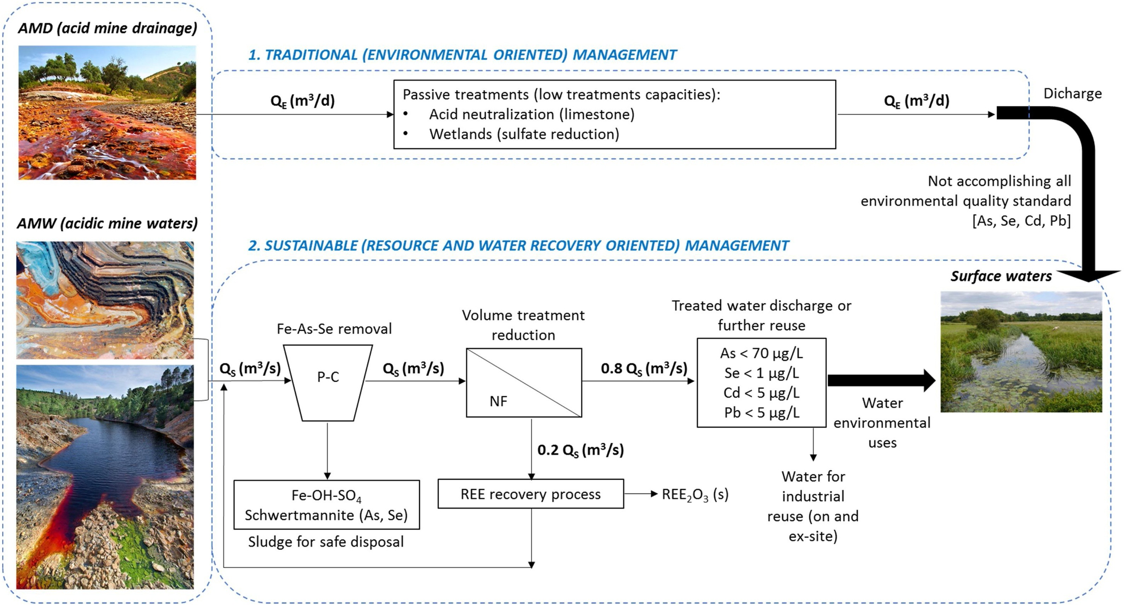

Context : Mining waste storage issues
$
Non valuable material
$$o_{2}$$
Tailings Storage Facilities
=
Oxidation
Tailings
Dimech et al. (2023)
Acid Mine Drainage
Water courses acidification
Sandlin et al. (2020), USA López et al. (2021), Spain

Slide 3


Context : Mining waste storage issues
Tailings Storage Facilities
$$o_{2}$$
Multi-layer cover
Dimech et al. (2023)
Tailings
Types of covers
  Oxygen barrier
  Diversion of infiltration water

Slide 4

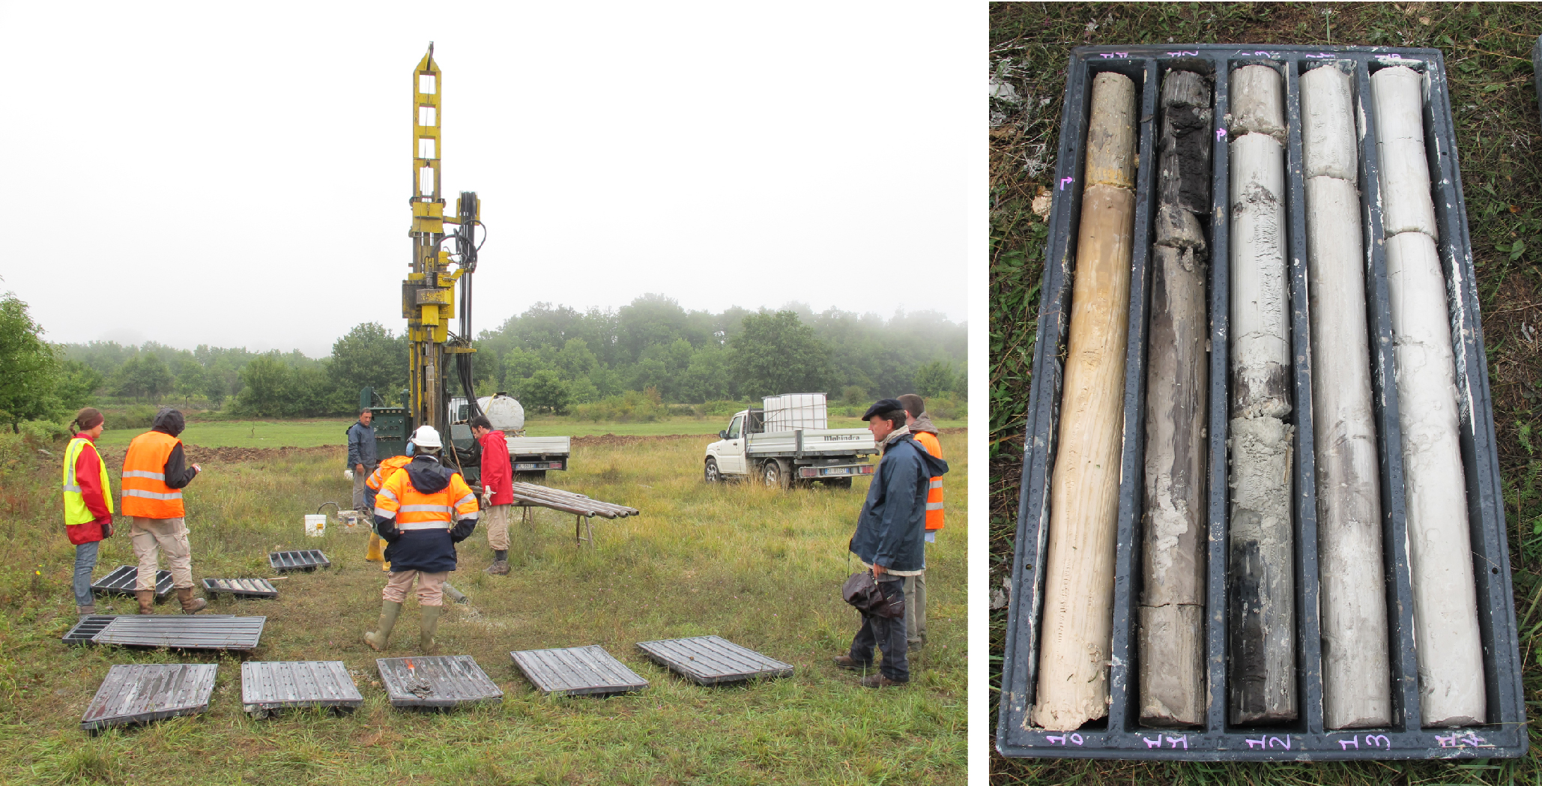
Goal : Imaging the reclamation covers with geophysics
Static imaging :
(find the layers / anomalies)
Time-lapse imaging :
(monitor the cover behaviour during water infiltration)
Silt
Gravel
0,3 m
Silt
0,2 m
Gravel
0,3 m
1 m
0,2 m
Tailings
Tailings
Tailings
Punctual measurements
Larger monitoring scale / level of uncertainty
Multimethod approach
Nicoud et al. (2013)

Slide 5
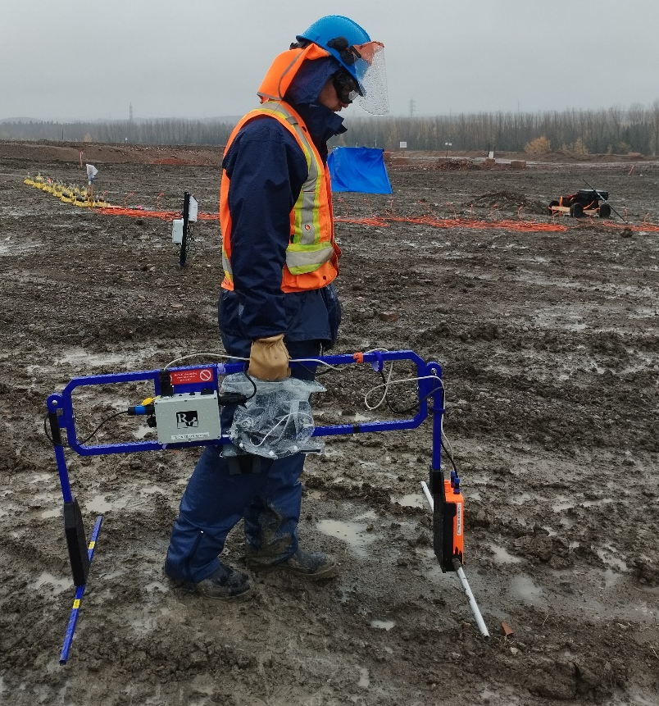
Datasets acquisition : Static imaging
ERT, GPR and Active Seismic
Collocated
64 geophones x 0,5 m
32 m
64 electrodes x 0,5 m
Electrodes ERT
0 m
GPR : 1500 MHz
GPR : 200 MHz
Active Seismic
Rover GPS

Slide 6
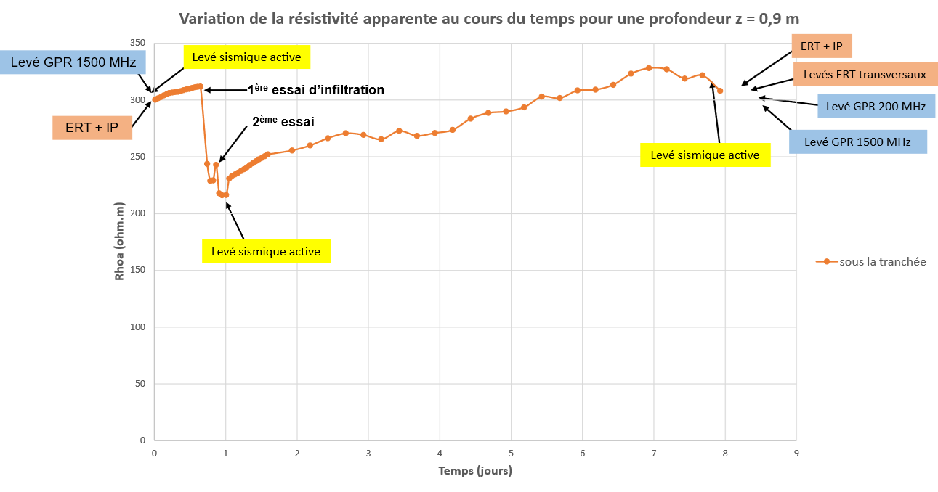
Datasets acquisition : Time-lapse imaging
ERT, GPR and Active Seismic
Collocated
64 geophones x 0,5 m
32 m
trench
64 electrodes x 0,5 m
11 m
trench
0 m
Apparent resistivity variation over time (Ohm.m), under the trench
350
Active Seismic
1st infiltration test
Cross-sectional ERT
300
GPR 200 MHz
2nd test
Active Seismic
GPR 1500 MHz
250
Active Seismic
200
0
1
2
3
4
5
6
7
8
9
Time (days)

Slide 7
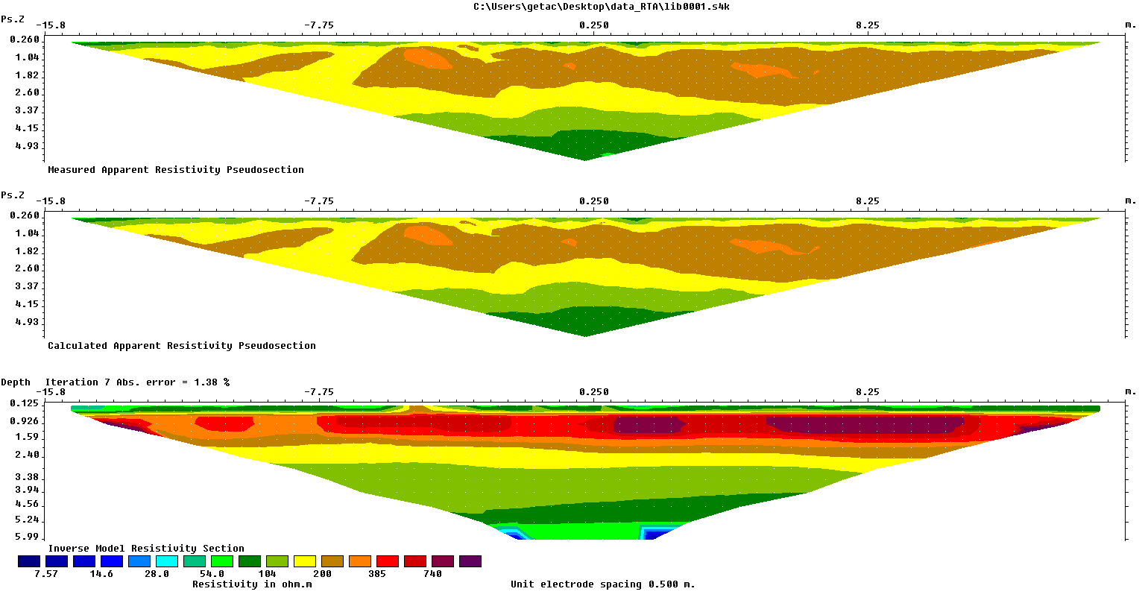
ERT results
A
  Wenner + IP
  64 electrodes x 0.5m
  Sas4000 + Es1064c
  Res2Dinv
V
a
a
a
A
M
N
B
0 m
10 m
20 m
32 m
Depth (m)

Slide 8
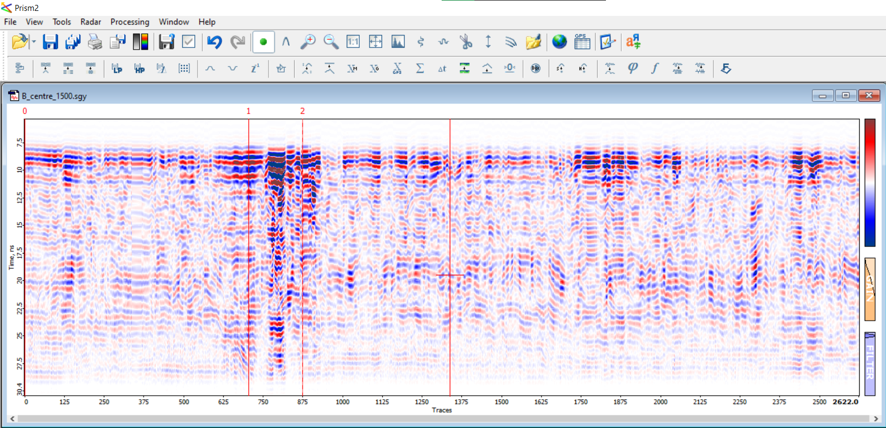
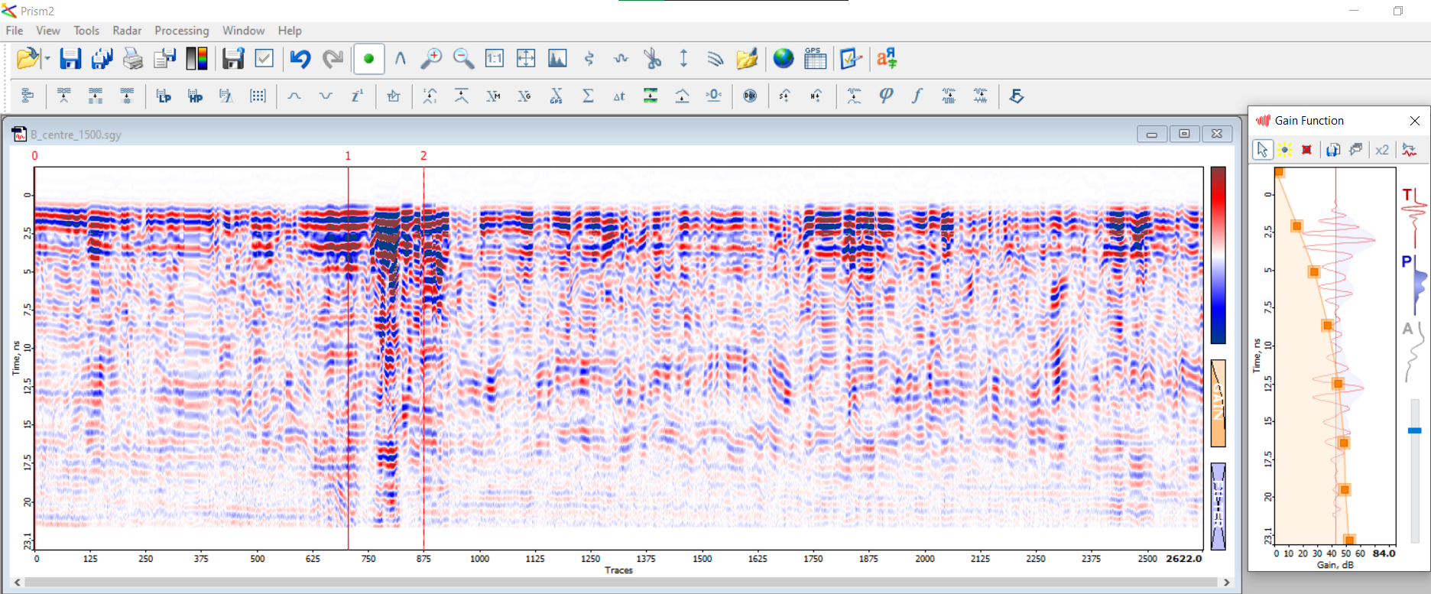
GPR results : (1500 MHz)
0
Gain function
7,5
Arrival time (ns)
20
GPR : 1500 MHz
30
0 m
36 m
40
80
Distance (m)
0
dB
Detection of various interfaces

Slide 9
GPR results : (1500 MHz)
0
Gain function
7,5
~ 3 ns
Arrival time (ns)
~ 9 ns
20
~ 3 ns
GPR : 1500 MHz
30
0 m
Distance (m)
36 m
0
40
80
dB
Detection of various interfaces

Slide 10
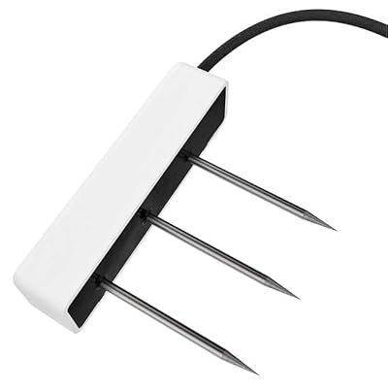
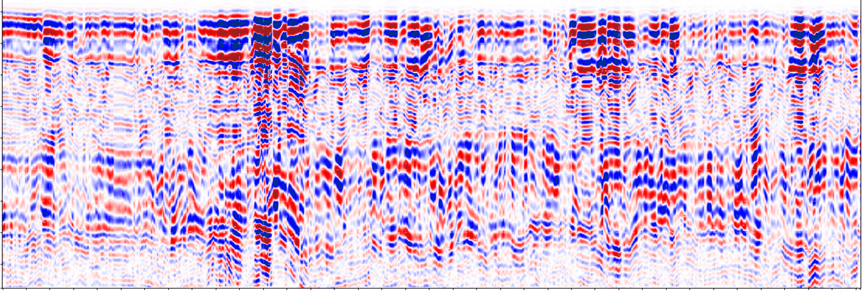



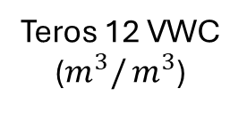

GPR results : (1500 MHz)
Teros 12 VWC ($m^{3}/$ $m^{3}$)
0,30 $ε_{r}$ = 18
Gain function
~ 3 ns
0,09 $ε_{r}$ = 6
~ 3 ns
0,34 $ε_{r}$ = 21
~ 9 ns
~ 9 ns
0,08 $ε_{r}$ = 5
~ 3 ns
~ 3 ns
Silt
0 m
Distance (m)
36 m
40
80
0
Depth (m)
Arrival time converted to depth
dB
0,3
Gravel
0,5
Silt
0,8
Gravel
1
0 m
Distance (m)
36 m

Slide 11
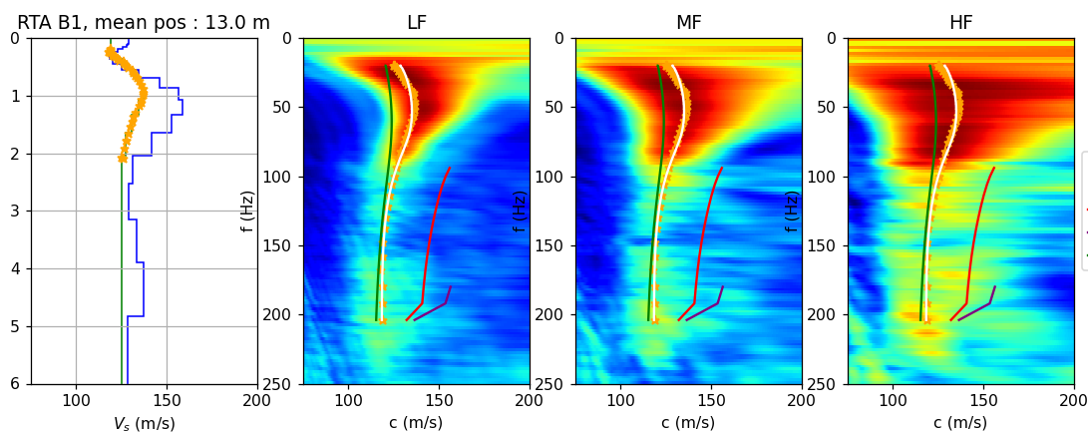
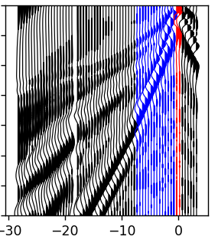
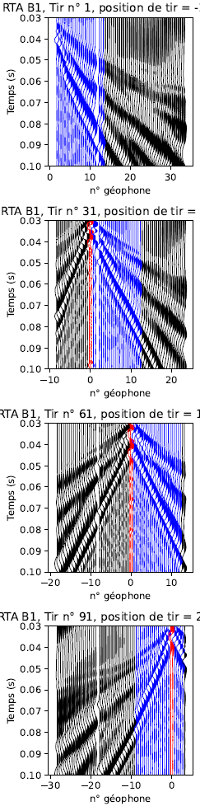
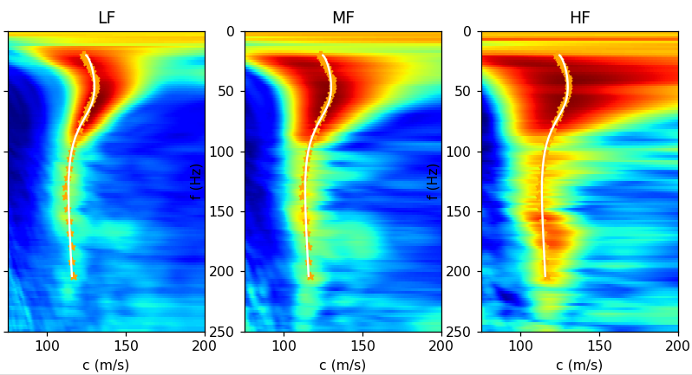
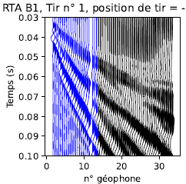
Seismic Results : MASW processing for 1 position
32 m
Vs profile for position X
11 m
position X
0 m
Depth (m)
Time (s)
Vs (m/s)
f (Hz)
LF
f (Hz)
MF
f (Hz)
HF
LF
MF
HF
Time (s)
position (m)
position (m)
position (m)
Phase velocity (m/s)
Phase velocity (m/s)
Phase velocity (m/s)

Slide 12
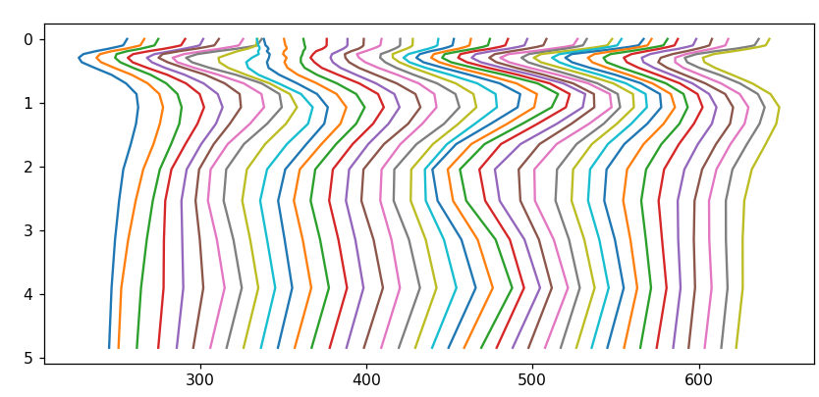
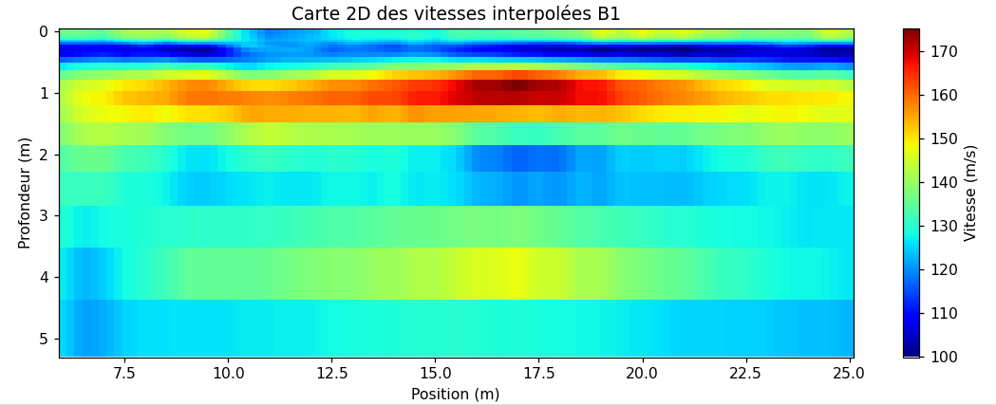
Seismic Results : MASW from 1 Vs profile to 2D-map
Vs profile for position X
Depth (m)
2-Dimensional shear wave velocity map
Vs (m/s)
Depth (m)
Velocity (m/s)
position (m)

Slide 13
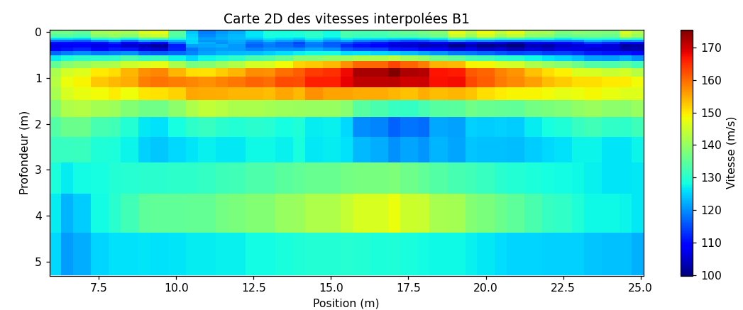

Discussion : vertical resolution
ERT inversion
MASW 2D Vs map
GPR 1500 MHz
0
1
Depth (m)
2
3
Resistivity (Ohm.m)
Velocity (m/s)
8
15
28
54
104
200
385
740
100
110
120
130
140
150
160
170

Slide 14
Discussion : vertical resolution
ERT inversion
ERT inversion
MASW 2D Vs map
MASW 2D Vs map
GPR 1500 MHz
GPR 1500 MHz
0
0
Silt
0,3
Gravel
0,5
Silt
0,8
Gravel
1
1
Tailings
Depth (m)
Depth (m)
2
2
3
3
Resistivity (Ohm.m)
Velocity (m/s)
8
15
28
54
104
200
385
740
100
110
120
130
140
150
160
170

Slide 15
Discussion : lateral variations
0 m
6 m
11 m : Trench
27 m
32 m
GPR 1500 MHz
ERT inversion
MASW 2D Vs map
Resistivity (Ohm.m)
Velocity (m/s)
8
15
28
54
104
200
385
740
100
110
120
130
140
150
160
170

Slide 16
Discussion : lateral variations
0 m
6 m
11 m : Trench
27 m
32 m
GPR 1500 MHz
ERT inversion
MASW 2D Vs map
Resistivity (Ohm.m)
Velocity (m/s)
8
15
28
54
104
200
385
740
100
110
120
130
140
150
160
170

Slide 17
Discussion : lateral variations
0 m
6 m
11 m : Trench
27 m
32 m
GPR 1500 MHz
ERT inversion
MASW 2D Vs map
Resistivity (Ohm.m)
Velocity (m/s)
8
15
28
54
104
200
385
740
100
110
120
130
140
150
160
170

Slide 18
Conclusion
Advantages of the approach :
  Stratigraphy imaging
  Lateral variation
  Volumes / interfaces descriptions
Limitations :
  Poor resolution in first meter for ERT and MASW
  GPR depth of investigation (in case of conductive layer)
Methodology will be deployed on a thicker cover this summer

Slide 19
Thank you for your attention
thierry.impinna.1@ens.etsmtl.ca

