Slide 1
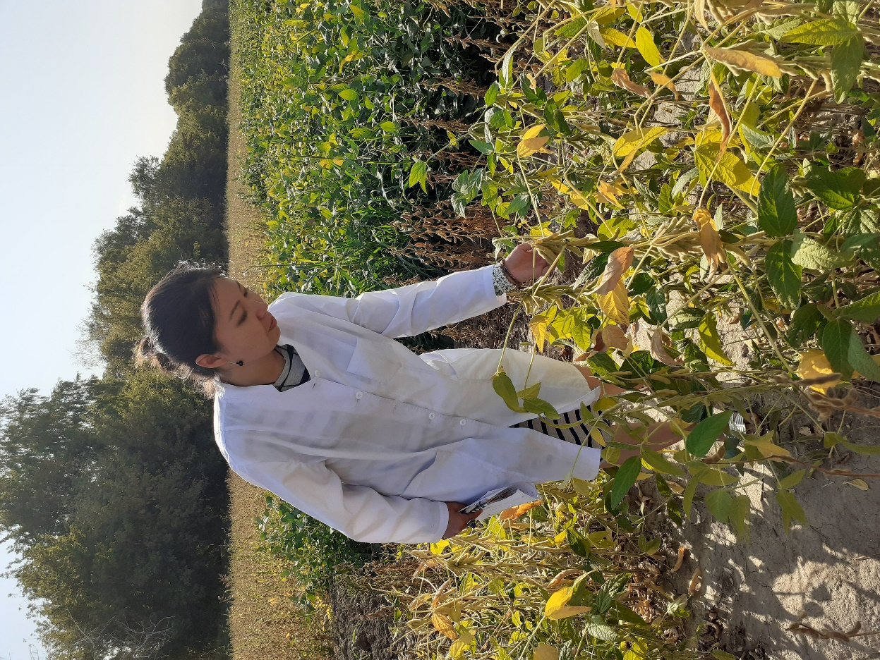
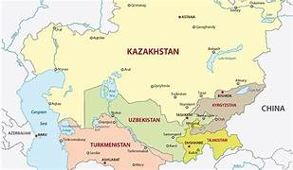
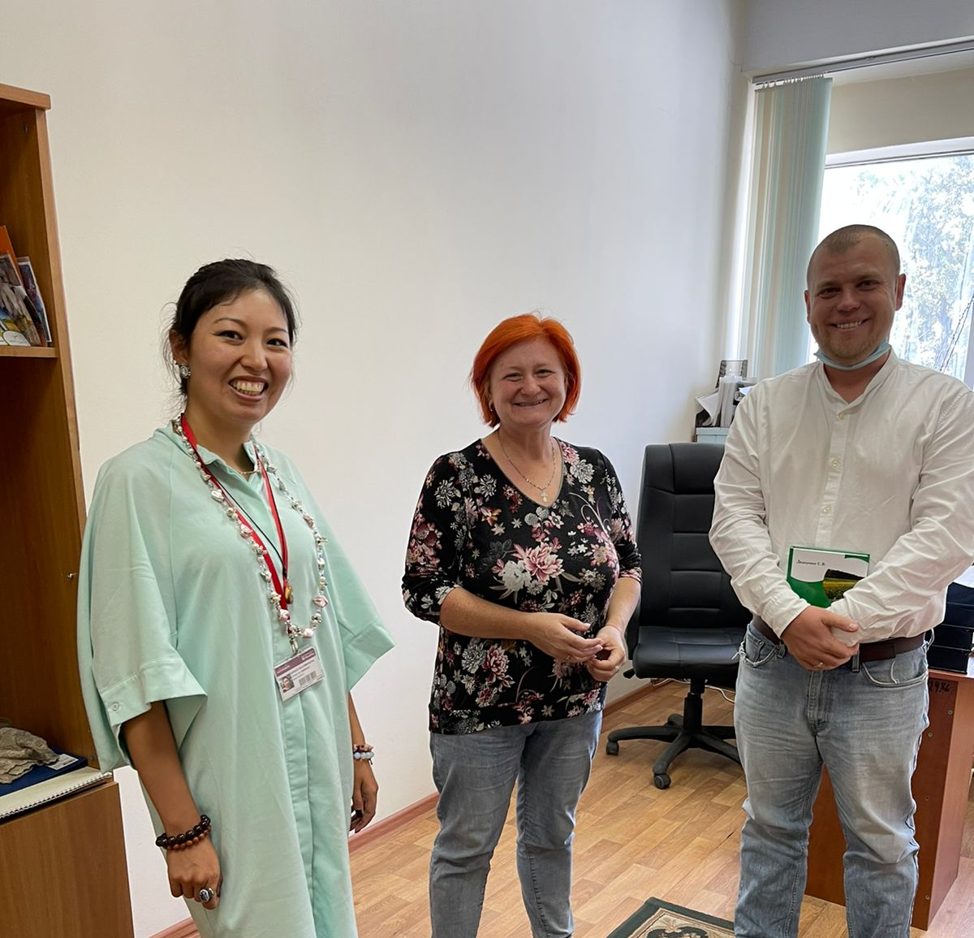
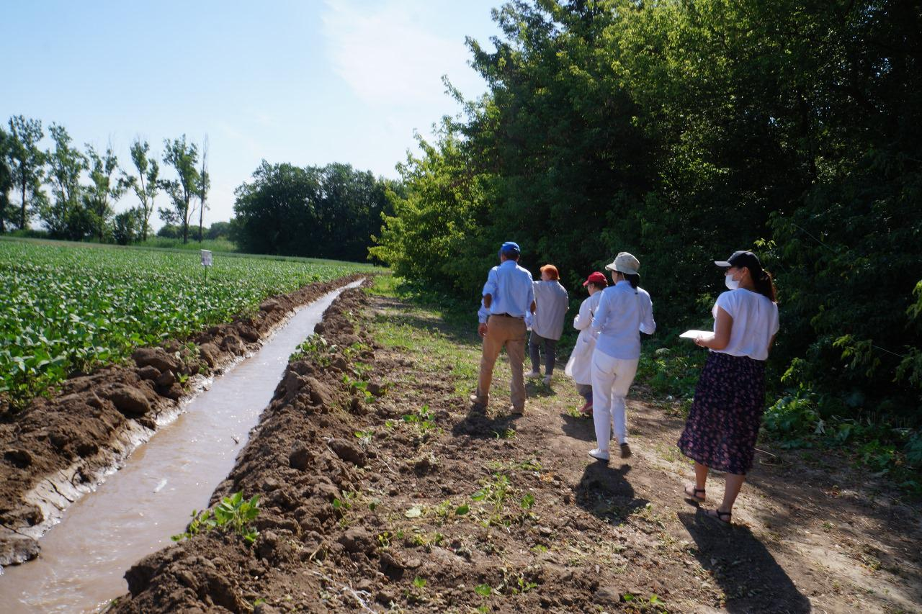
Is food secure in Central Asia: co-produced adaptations of soybean production to changing climate conditions in south-eastern Kazakhstan.
Saule Suleimenova, Martin Lukac, Maria Shahgedanova, Lindsay Todman

Slide 2
My takeaway
As a scientist I don’t know the best. I learned a lot from farmers
We all need each other, and we learn from one another
We walk alongside each other, and co-production is important
Mutual respect and ability to listen
Get out of my comfort zone – not knowing where to stay overnight, getting to the middle of the lake on ice in winter for water samples collection, chasing the farmers
It is a privilege to work together combining our knowledge and experience

Slide 3
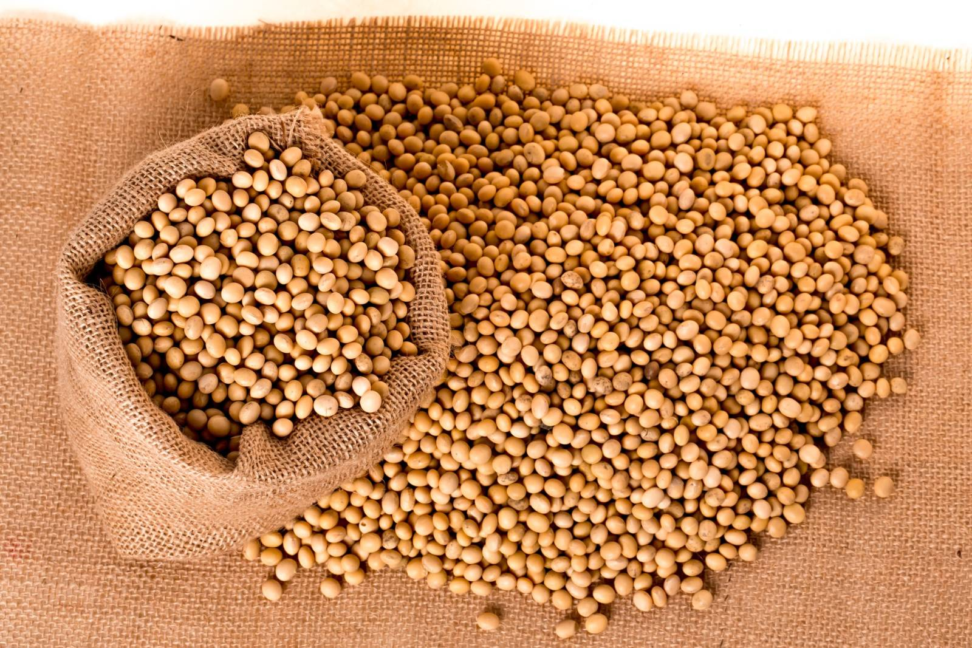
Why soybean?
Soybean production by regions, centner/ha
relatively new crop with great potential for expansion in Central Asia
KZ is the largest soybean producer in Central Asia
crop shifting from relatively cheap wheat to high value profitable
crops (Agro-Industrial Development State Programme for 2017- 2022)
South East Kazakhstan accounts for 85% of country’s soya
Crop diversification policy
Agreement with Chinese companies to export soya
Area of soybean cultivation, thousand hectares

Slide 4
Knowledge gap
critical shortcoming of CA adaption studies - need for more involvement of agricultural practitioners
higher-level stakeholders (e.g. national and regional government) contribute to formulating adaptation strategies
farmers and growers rarely involved
key stakeholders - multiple agronomic, economic, and environmental decisions related to crop production

Slide 5
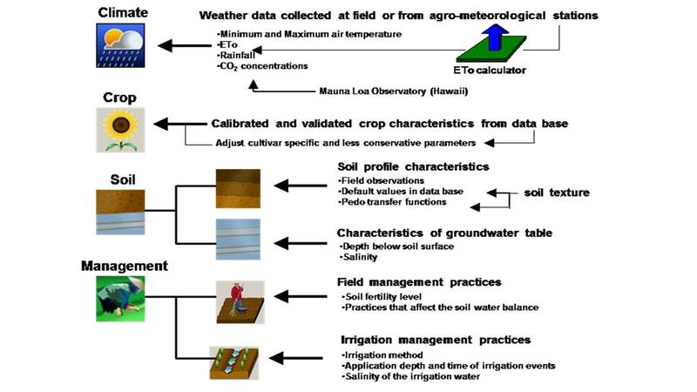
Methodology
AquaCrop FAO crop modelling tool.
Firstly, crop model was calibrated and validated for the first time for the region.
2. Secondly, surveys, semi-structured interviews, group discussions with the main stakeholders (farmers) were conducted
3. Finally, the calibrated and validated crop model is used to understand the response of soybean production to different irrigation types, different irrigation scenarios and adaptation strategies.

Slide 6
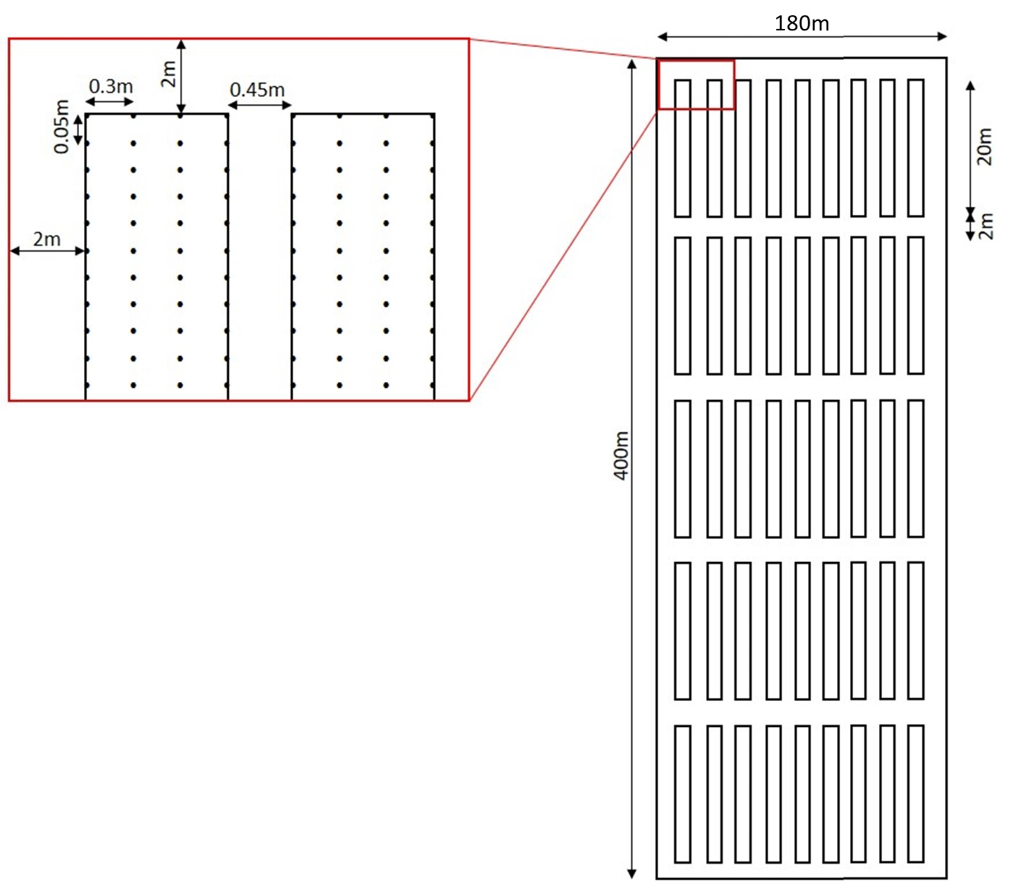
Study area and site location
Almaty region, South east Kazakhstan
Schematic field layout of one treatment block.
There were three treatment blocks in the field for both cultivars. The distance between the blocks with different irrigation treatments was about 10 m to avoid the possibility of one irrigation type affecting the other. The configuration of one such treatment block is shown here (not to scale).
cultivars: long duration Jansaya.
Short-duration Ivushka.
Treatments: furrow irrigation, drip and non-irrigation to represent varying stress conditions
Available time period: 2016-2022

Slide 7
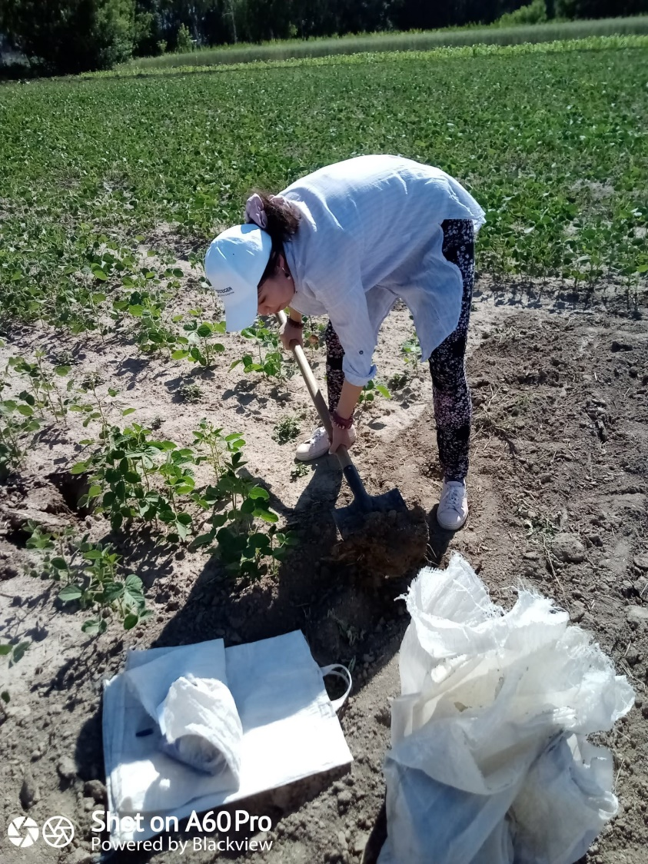
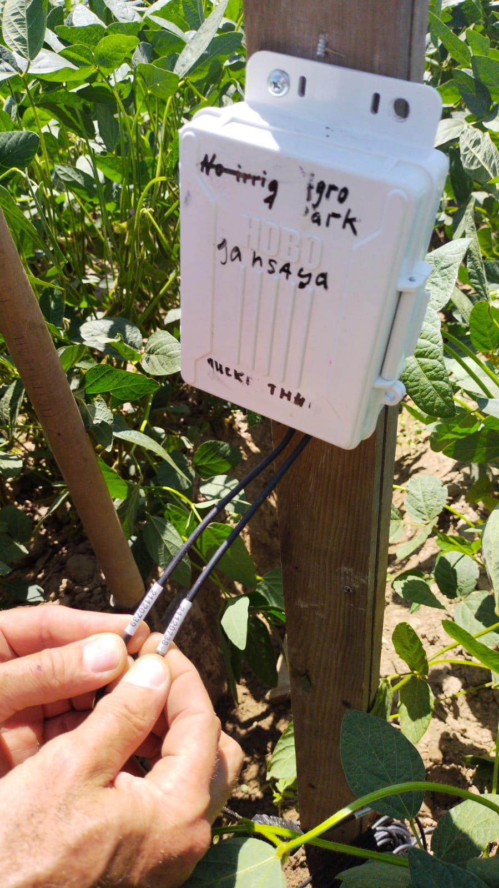
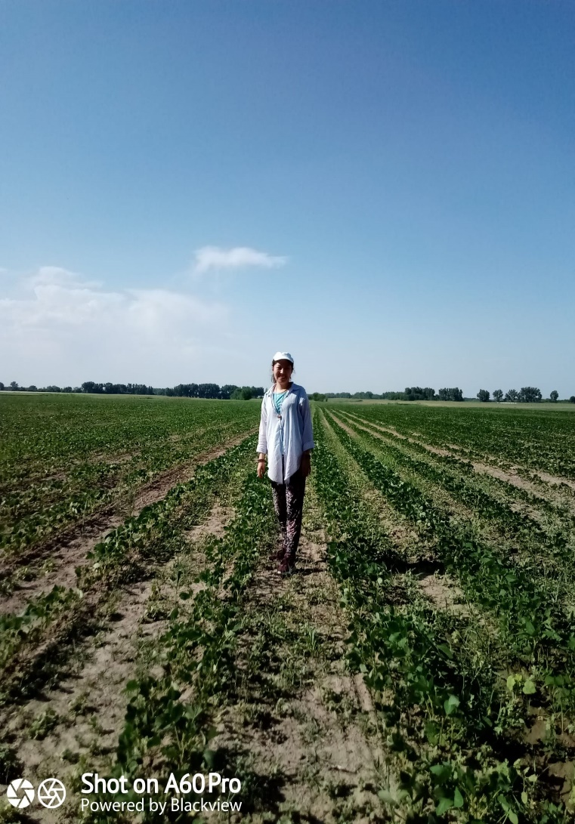
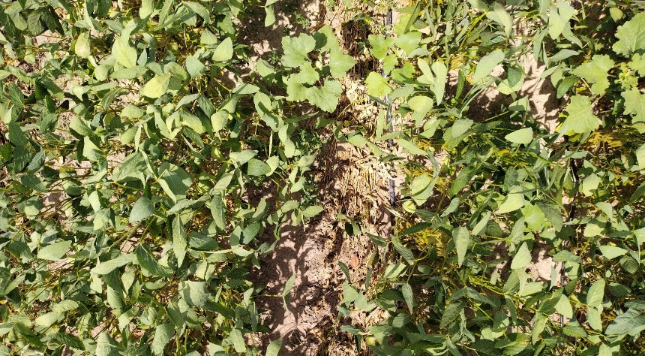
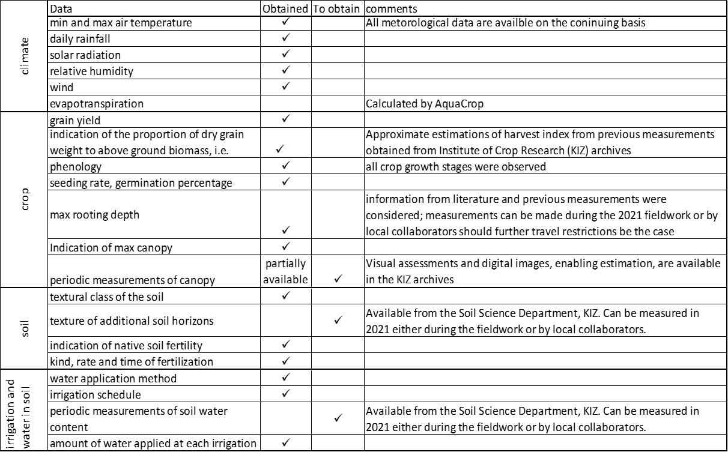
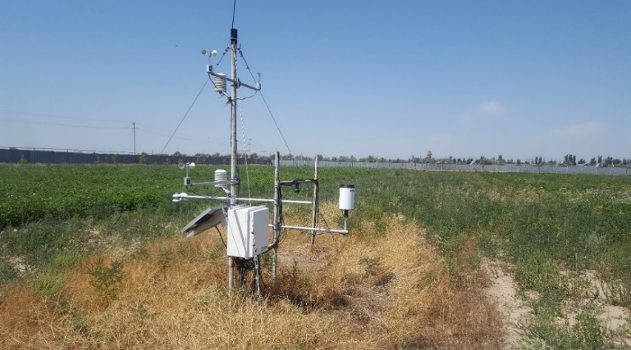
Field work in Kazakhstan and Data collection

Slide 8
Results
Canopy Cover calibration
Aqua Crop model was:
Set up, Calibrated for 2021, 2022, Validated for 2016-2019
Reliable dataset was constructed which is important in data scarce region
Evaluated outcomes: Canopy cover (CC), Dry aboveground biomass (B), Final grain yield (Y)
Statistical results of simulated and observed Canopy Cover values for soybean Jansaya cultivar
 | Year and treatment |  | R² | RMSE, % | NRMSE, % | EF | D
Jansaya | 2022 | F | 0.97 | 6.3 | 16 | 0.93 | 0.98
 |  | D | 0.98 | 6.4
 |  | NI | 0.96 | 8.9 | 18.2 | 0.87 | 0.95
 | 2021 | F | 0.98 | 4.2 | 9.0 | 0.88 | 0.98
 |  | D | 0.99 | 2.7 | 5.8 | 0.97 | 0.99
 |  | NI | 0.95 | 8.4 | 17.7 | 0.90 | 0.87
Ivushka | 2022 | F | 0.99 | 5.2 | 12.7 | 0.98 | 0.99
 |  | D | 0.98 | 5.5 | 13.8 | 0.97 | 0.98
 |  | NI | 0.97 | 7.5 | 17.7 | 0.96 | 0.98
 | 2021 | F | 0.98 | 4.6 | 9.7 | 0.94 | 0.98
 |  | NI | 0.96 | 7.2 | 16.6 | 0.95 | 0.97
AquaCrop effectively captured the temporal changes in canopy development, with simulation results closely aligning with observed values, characterised by high R², EF, and d values and low RMSE values.

Slide 9
Comparison of AquaCrop simulated (lines) and observed (symbols) of dry aboveground biomass Jansaya cultivar.
Simulated and observed yield values for Jansaya soybean cultivar (t/ha), absolute difference between observed and simulated values (F-furrow, D-drip, NI-no irrigation treatment).
Year and treatment |  | Y obs | Y sim | Absolute difference
2022 | F | 2.81 | 3.06 | 0.25
 | D | 3.8 | 4.1 | 0.30
 | NI | 2.03 | 1.78 | 0.25
2021 | F | 2.37 | 2.53 | 0.16
 | D | 2.58 | 2.83 | 0.25
 | NI | 1.03 | 1.27 | 0.24
2019 | F | 3.99 | 4.3 | 0.30
2018 | F | 5.0 | 5.2 | 0.20
2017 | F | 3.47 | 3.82 | 0.35
2016 | F | 5.0 | 5.4 | 0.40
Simulated value of grain yield furrow irrigation in 2022, 2021, 2018 showed good accuracy with absolute difference between observed and simulated values of 0.25, 0.16 and 0.2. For 2016, 2017 and 2019 the absolute difference was 0.5, 0.3 and 0.3, respectively.
The model tended to overestimate the yield. One of the reasons might be that irrigation water applied is not always evenly distributed across the field, which results in actual yield decrease. AquaCrop does not account for this. Overestimation of simulated values can also indicate the potentially attainable yield with improvement of management practices.
Year and treatment |  | r | RMSE, % | NRMSE, % | EF | d
2022 | F | 0.99 | 1.1 | 19.0 | 0.86 | 0.96
 | D | 0.98 | 1.6 | 22.0 | 0.81 | 0.95
 | NI | 0.99 | 0.5 | 14.1 | 0.95 | 0.98
2021 | F | 0.99 | 0.5 | 12.4 | 0.95 | 0.99
 | D | 0.98 | 0.7 | 15.8 | 0.91 | 0.98
 | NI | 0.92 | 0.7 | 17.2 | 0.89 | 0.94
AquaCrop was able to predict the seasonal trend in Jansaya development of dry aboveground biomass well. Drip irrigation treatment in 2022 - the model underestimated accelerated accumulation of biomass. In 2021 drip irrigation treatment the model also slightly underpredicted the biomass growth, although it was less pronounced due to drier conditions.

Slide 10
Yield simulation results
 | Year and treatment |  | Y obs ± variability | Y sim | Absolute difference, tonne ha^{.1} | Relative error, %
Validated years | 2016 | F | 4.9 ± 0.49 | 5.4 | 0.5 | 10.2
 | 2017 | F | 3.47 ± 0.4 | 3.82 | 0.35 | 10.0
 | 2018 | F | 4.9 ± 0.38 | 5.37 | 0.47 | 9.5
 | 2019 | F | 3.99 ± 0.5 | 4.34 | 0.35 | 8.7
Calibrated years | 2021 | F | 2.37 ± 0.35 | 2.54 | 0.17 | 7.17
 |  | D | 2.58 ± 0.2 | 2.74 | 0.16 | 6.2
 |  | NI | 1.03 ± 0.28 | 1.19 | 0.16 | 15.5
 | 2022 | F | 2.80 ± 0.36 | 3.03 | 0.23 | 8.2
 |  | D | 3.8 ± 0.26 | 4 | 0.2 | 5.26
 |  | NI | 1.3 ± 0.29 | 1.44 | 0.14 | 10.7
Overall, the Model was able to simulate the observed values with good accuracy during validation. Generally, AquaCrop can be applicable in the study region, due to overall good performance. Validation for other regions are recommended.
Year and treatment |  | Y obs ± variability | Y sim | Absolute difference, tonne ha^{.1} | Relative error, %
2016 | F | 1.7 ± 0.5 | 2 | 0.3 | 15
2017 | F | 2.3 ± 0.4 | 2.59 | 0.29 | 11.2
2018 | F | 2.4 ± 0.5 | 2.65 | 0.25 | 9.43
2019 | F | 2.21 ± 0.4 | 2.49 | 0.28 | 11.2
2021 | F | 1.34 ± 0.4 | 1.57 | 0.23 | 14.6
 | NI | 0.33 ± 0.2 | 0.5 | 0.17 | 34
2022 | F | 2.16 ± 0.4 | 2.34 | 0.18 | 7.6
 | D | 2.5 ± 0.2 | 2.65 | 0.15 | 5.7
 | NI | 0.69 ± 0.3 | 0.93 | 0.24 | 25.8

Slide 11
First, the model was used to simulate the soybean yield under different sowing dates. This can be utilised for better decision-making by farmers in the region. The highest yield was obtained when soybean was sown on the 1st April (3.2 t ha⁻¹), and the lowest when sown in mid-May (2.3 t ha⁻¹). The model showed that soybean yield benefited from earlier sowing dates (the yield increased by 14.5 %, 12.2 % and 8 % when sowing 1st April, 10th April and 20th April respectively) and the water productivity was higher (ranged between 0.79 to 1.02 kg m³), and in contrast, the yield was limited by late sowing (soybean yield decreased by 18.4 % when sowing 15th May). When sown earlier, the crop is able to utilise snow water stored in the soil after spring melt.
Secondly, different irrigation strategies were analysed. The crop was irrigated at different stages of development. The highest yield was obtained when the crop was irrigated three times - at flowering, during pod formation, and pod filling stages.
Lastly, irrigating by smaller amount of water (75 mm each application) more often (four irrigation applications instead of three) increased the yield by 14.74 % in comparison with current irrigation schedule (three irrigation applications by 100 mm each), which is less effective because of run off and crop being exposed to longer dry periods between applications.
Modelling the effect of different scenarios of sowing dates and irrigation applications on soybean yield.
№ Scenario | Irrigation scenario details | Sowing date | Number of irrigation applications | Total irrigation (mm) | Dry yield (t ha⁻¹) | WP (kg m³)
1 | at flowering (day 49), pod formation (day 74), pod filling (day 105) | 28.04 | 3 | 300 | 2.822 | 0.67
2 |  | 01.04 | 3 | 300 | 3.232 | 1.02
3 |  | 10.04 | 3 | 300 | 3.165 | 0.88
4 |  | 20.04 | 3 | 300 | 3.047 | 0.79
5 |  | 15.05 | 3 | 300 | 2.3 | 0.31
6 | Flowering and pod formation | 28.04 | 2 | 200 | 2.70 | 0.89
7 | Flowering and pod filling | 28.04 | 2 | 200 | 2.3 | 0.63
8 | Pod formation and pod filling | 28.04 | 2 | 200 | 1.8 | 0.49
9 | Flowering | 28.04 | 1 | 100 | 1.2 | 1.2
10 | Pod formation | 28.04 | 1 | 100 | 0.3 | 0.3
11 | Pod filling | 28.04 | 1 | 100 | 0 | 0
12 | At flowering(day 45),before pod (60),pod formation(80), pod filling(105). | 28.04 | 4 | 300 (75 mm each application) | 3.21 | 0.93

Slide 12
Model sensitivity test of yield, t ha ^{.1} to temperature and precipitation change based on 2022 weather data for Jansaya (RMSE for furrow treatment = 0.26, RMSE for NI = 0.22) and Ivushka cultivars (RMSE for furrow treatment = 0.18, RMSE for NI = 0.24).
 |  | 2022 precipitation | 30% less Precipitation all growing season | 30% less Precipitation in May.Jun | 30% less Precipitation Jul.Aug
Jansaya cultivar Yield, t ha ^{.1} with air temperature increase (+2 °C) | Furrow irrigation | 2.822 | 2.775 | 2.796 | 2.799
 | No irrigation | 1.34 | 1.22 | 1.27 | 1.34
Jansaya cultivar Yield, t ha ^{.1} with 2022 observed air Temperature | Furrow irrigation | 3.068 | 3.014 | 3.036 | 3.036
 | No irrigation | 1.44 | 1.26 | 1.33 | 1.33
Jansaya cultivar Yield, t ha ^{.1} with air temperature decrease (-2 °C) | Furrow irrigation | 3.643 | 3.251 | 3.306 | 3.612
 | No irrigation | 2.75 | 2.389 | 2.646 | 2.637
Ivushka cultivar Yield, t ha ^{.1} with air temperature increase (+2 °C) | Furrow irrigation | 2.188 | 2.048 | 2.067 | 2.188
 | No irrigation | 0.99 | 0.74 | 0.75 | 0.98
Ivushka cultivar Yield, t ha ^{.1} with 2022 air Temperature | Furrow irrigation | 2.34 | 2.217 | 2.233 | 2.233
 | No irrigation | 0.96 | 0.67 | 0.68 | 0.68
Ivushka cultivar Yield, t ha ^{.1} with air temperature decrease (.2 °C) | Furrow irrigation | 2.619 | 2.488 | 2.507 | 2.619
 | No irrigation | 0.94 | 0.69 | 0.71 | 0.93
The sensitivity test for Jansaya cultivar with furrow irrigation showed that the yield was less sensitive to 2022 precipitation changes due to balanced irrigation. However, under no irrigation, these changes affected the yield more.
Soybean yield is more sensitive to a 30 % precipitation cut for the whole growing season (1.76 % less Jansaya yield under furrow irrigation and 12.5 % less under no irrigation) than a 30 % cut in the first or second halves of the season (only 1.04% less for furrow treatment, and 7.6 % less for no irrigation). Temperature changes had a greater impact than precipitation. A 2 °C temperature increase shortened the season by 9 days for both cultivars, reducing Jansaya furrow yield by 8.0 %, no irrigation by 6.9 %, and Ivushka furrow by 6.5 %. For Ivushka no irrigation, the effect was negligible. A 2°C temperature decrease lengthened the season by 20 days, increasing Jansaya furrow yield by 18.7 % and no irrigation by 90.9 %. For Ivushka, furrow yield increased by 11.9 %, with no effect under no irrigation.
In summary, a 2°C temperature increase shortens the season, reducing yield, while a decrease lengthens the season, increasing yield. Precipitation reduction impact is larger under no irrigation. Reduction in the second half combined with temperature change did not affect yield.

Slide 13
What is the context we are working in
What works on the ground
What are their perspectives
Science is not just for scientists, not for the science's sake. It is for people
So I combined social science and natural science
Listening and learning from each other

Slide 14
Study area
Annual cycle of temperature and precipitation at Aksengir meteorological station, 1960-2019.
The study sites in two districts of the Almaty region, Karasay and Enbekshikazakh. The inset map shows location of the region. Light pink on the inset map shows Almaty region, and dark pink shows the study sides.

Slide 15
Methods
Sections of the interviews
Set of questions | Type of questions
1 | Factual questions
2 | General questions about the farm (size and ownership rights) and the crops being cultivated
3 | Questions about their soybean cultivation practices, yield, reasons and challenges of growing soya.
3 | Alternative questions if soybean is not grown
4 | Discussion questions about a. stakeholders' future plans and how they will adapt their soya cultivation to changing environmental conditions; b. whether they are interested in obtaining information on modelled soybean yield.
Data collection
Project presentation
Group discussion - 5-7 persons - most interested,
Change their roles from passive listeners to active participants
Questionnaires
Semi-structured interviews

Slide 16
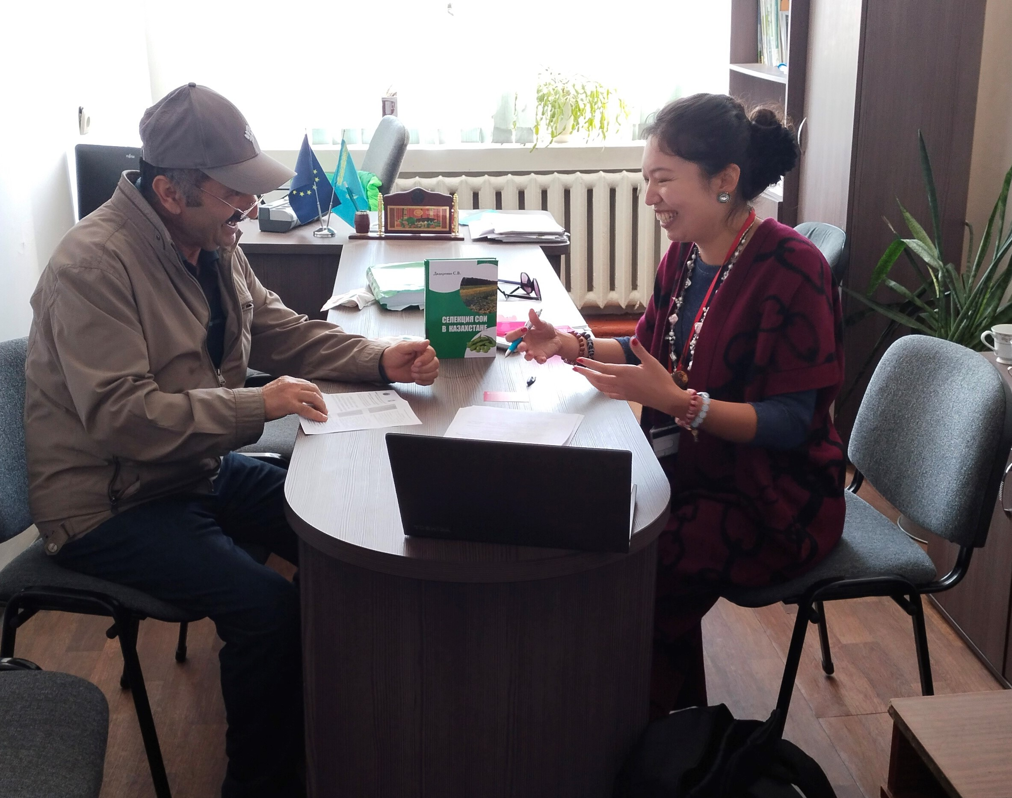
Working with farmers is actually fun

Slide 18
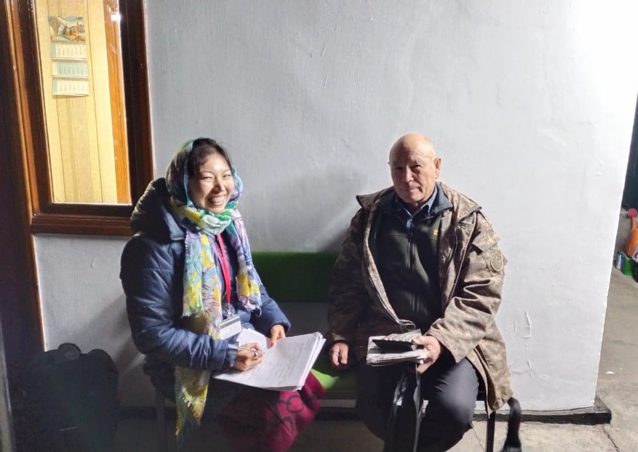
Participants selection
Participants for the interview were selected based on their affiliation to the study region
2 soybean producing districts and 6 villages were selected as representative ones: Karasai (Kaskelen, Almalybak villages), Enbekshikazakh (Chilik, Alga, Baiterek, Koishibek), (similar climate and soils to the study sites)

Slide 19
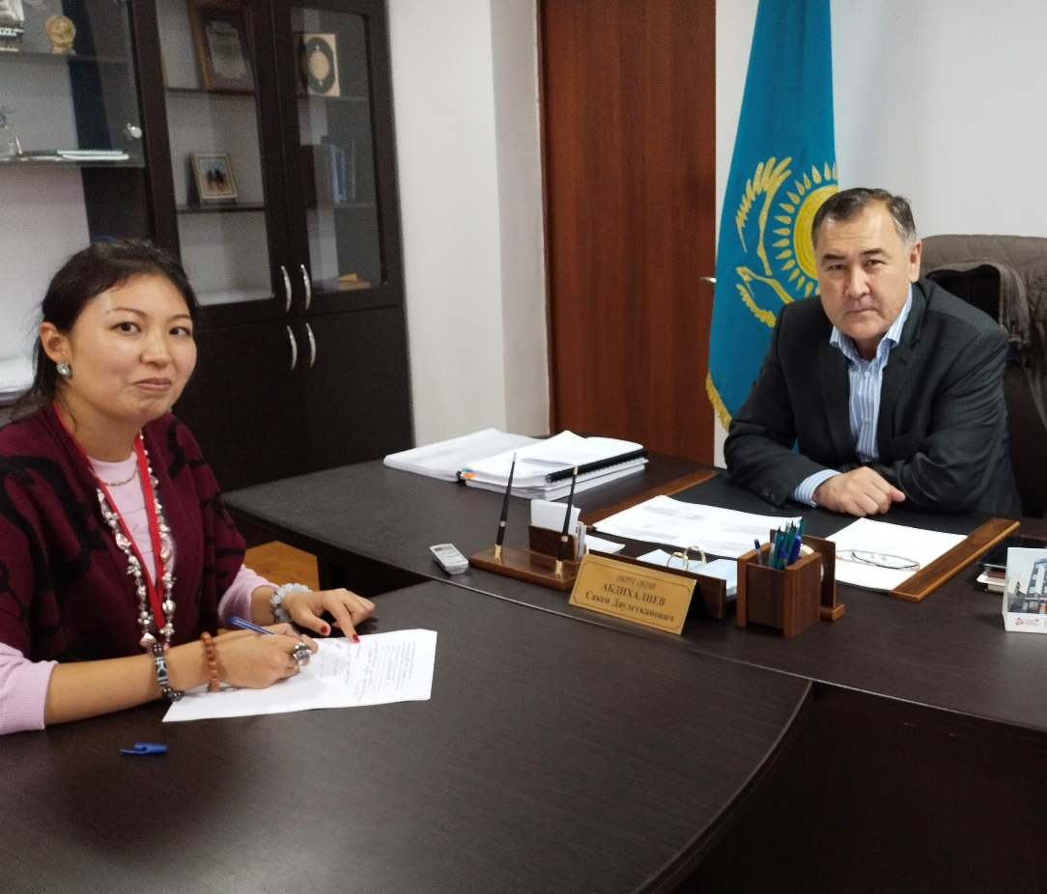
Stakeholders:
small-holder farmers
akimat (local authorities)
scientific community

Slide 20
Main themes identified in the interviews
No. | Responses | Explanation | Number of Participants
Reasons for growing soybean
1 | Cash crop | Soybean can be sold for a better price in comparison with ‘traditional’ crops | 18
2 | Demand | Demand for soya locally and abroad | 18
3 | Crop rotation | It is good for crop rotation | 3
4 | Security or no eye-keeping | unlikely to be stolen from the field | 2
5 | Feed for livestock | Soya as a protein supplement to feed their own livestock | 1
Reason against growing soybean
1 | No experience with soya | ‘…I never tried soybean, so I know little about this crop…’ | 6
2 | Absence of necessary machinery and its high cost | ‘…Soya cannot be harvested by hand, and I must hire a combine. It is too expensive for my small farm…’ | 4
3 | Farmer’s own negative experience | ‘…I tried soya but did not get a good yield, so I stopped it…’ | 2
4 | Neighbours’ negative experience | ‘…My neighbour tried growing soya, and he did not succeed, so it might be risky…’ | 2
Theme 1. The reasons to cultivate soybean.
high demand (locally- s.b.processing factories and abroad), good price, rotation crop, providing supplementary feed for the farmers’ livestock, and physical security of crops (i.e. soya is not targeted by petty thieves). “However much soybean I produce, I can sell it all. There is always demand for soya, which is a cash crop. I stopped growing wheat as it is not very profitable anymore. Now I grow soybean, maise, alfalfa and fruits as it generates more cash.” This finding is in line with the state's policy of expansion of soya production.

Slide 21
Theme 2: The main challenges and barriers faced by the farmers
access to reliable irrigation – poor timing of water irrigation supply. Poor administration and frequent changes in the management of irrigation companies, the absence of clear rules about the provision of irrigation water.
outdated and poorly maintained irrigation system, which causes major water losses (Barrett et al., 2017).
Participants argued that the farms closer to the canals get more water than those further away. Participant E5 stated, “The managers in the water supply organisation keep changing, so sometimes I do not know who to ask for the water. I need to irrigate my crops, and I am ready to pay for it, although water is becoming more expensive. So, we organised water cooperatives … You can get the water, and you need to ask and pay for it in advance. But payment is not a 100 % guarantee if the manager changes”.
E15:“Up to 30-40 % of water is lost before coming to my fields because of old broken canals, but I still have to pay for the contracted amount of water that has been allocated to irrigate my fields”
“I needed the irrigation water in June, but I only got it at the end of July. So, I applied a lot of water then”
issue of transboundary water use adds to uncertainty to the future water use in agriculture. Concern about water availability in a wider Ile (Ili) River basin to which the study area belongs
Financial constraints and lack of expertise

Slide 22
Example of irrigation canal in the study area.

Slide 23
Financial constraints
‘I would like to try drip irrigation, but I cannot afford to get it’ and ‘I need to hire machinery as I do not have my own combine. It is very expensive. Fertilisers and herbicides are very expensive these days. The state provides 50 % of the cost of local fertilisers and 30 % of imported fertilisers, but only after you have bought and implemented them. So, it is not very easy. Where do I get the money to get the fertilisers first?’

Slide 24
Lack of expertise
During the interviews, farmers mentioned that soybeans are still a new crop and were unaware of some management requirements. For example, farmers E1, E13, E21, K2, K4 mentioned they left the soybean in the field for more than a week after the maturation because they were waiting to rent a combine, causing yield loss. The local farmers were unaware that they must harvest the soybean when the seed moisture reaches around 13-14%.
Participant E1 said: ‘I grew only soybean for more than five years in a row because it was very profitable, and the demand was always there. However, I neglected crop rotation, and my yield decreased very much. Then I remembered about crop rotation, so now I rotate my crops every year’.
poor quality, cheap seeds, which tend to be a mixture of varieties, typically obtained from the larger farms.
‘I know my soybean seeds are no good quality. I just got what I could recently. But it’s time to renew my seeds, of course. I want to get good quality, elite or first reproduction seeds from the Kazakh Plant Research Institute next year, if I can afford that, because it will pay off. They have really good seeds in the Institute. Then I can also sell them to my neighbours for several years after I buy from Institute, but I'm not sure if I can afford it’.
Similarly, a farmer E19 from Enbekshikazakh district said, ‘I cannot afford good quality seeds, so I just buy some mixture of cultivars from my neighbour. But it at least gives me some profit, so I think I am fine at least for now’
farmer E18 from Enbekshikazakh district stated, ‘There are no good seeds available. I just buy from my neighbour, who has a bigger farm and claims to have better seeds. He went to the city and got some seeds. But I do not know exactly where to get good seeds. I am also busy because I have another job.’

Slide 25
Theme 3.
Farmers’ perception | Farmers’ concerns | Data | What it means | Farmers (%) expressed their concern
Increasing summer temperature | ‘‘…Summers are getting hotter; it affects our crops’’ | JJA temperatures increased by 0.026°C a⁻¹. R²=0.25; p < 0.05. | Perceptions consistent with data | 95 %
 | ‘‘…The temperature is getting extremely high in summer, it dries up our plants..’’ | Number of days with temperature > 35ºC increases by 3 days per decade; p < 0.05. | Perceptions consistent with data | 65 %
Increasing April and May temperatures | ‘…Springs are getting warmer…’ | April and May temperatures increase at 0.017°C a⁻¹. R²=0.06; p = 0.07. | Perceptions consistent with data | 35 %
Ground frost increasing in May | ‘...In April it can be warm, but suddenly ground frost comes in late April or early May and kills our plants. More frosts now.’ | There was no long-term trend, but more frequent frosts were observed after 2006 – in 2006, 2009, 2010, 2018 and 2019. | Farmers’ perceive recent changes rather than long-term trend. | 23 %
Growing season precipitation is decreasing | ‘… It rains less during the growing season. I think 10 years ago there was more rain helping us irrigate our crops …’ | No change in the growing season (April-August) precipitation; p=0.58. | Perceptions inconsistent with data | 45 %

Slide 26
Observational data from the Askengir meteorological station : a) mean JJA temperatures; b) number of days with T_{max}>35; c) frequency of days with sub-zero temperatures in May; d) precipitation during the growing season (April-August).

Slide 27
Theme 4. Farmer adaptation strategies and their plans.
Adaptation option category | Farmer-driven adaptation options | Barriers | How to overcome barriers | Respondents mentioned (%)
Farm production practices | Continue furrow irrigation | Untimely water supply, high water prices, unclear water supply rules, old canals, poor infrastructure and management | Institutional reforms, more active work of local water users’ associations, better allocation of responsibilities of different administrative levels, funds and investments for infrastructure modernisation. | 73%
 | Diversification of crops | Not enough land, expertise and need to find new market | Land sublease, cooperation with other farmers. | 45%
 | Groundwater use (drilling boreholes) | Financial resources | Access to loans or other finance options. | 38%
 | Changing sowing dates | Spring frosts | Access to timely weather forecast. | 31%
 | Switching to crops not requiring irrigation (rainfed) | Need to find new market, to learn cultivating new crops, less profit from wheat/barley and alfalfa | Optimisation of crop rotation, establishment of new markets. | 27%
 | Changing irrigation schedule | Unreliable water access | Water conservation and water harvesting technology | 23%
 | Short-maturing cultivars | Availability, less yield | Combination with long-maturing cultivars; early harvest can be sold for better price. | 19%
Technological development | Drip irrigation (water management innovation) | Lack of financial resources, lack of knowledge and experience | Experience sharing, state funds, trainings | 38%
 | Drought-resistant cultivars (crop development) | Availability, high price, cultivars need to be adapted for local conditions | Cooperation of farmers with Plant Research Institute for adapted cultivars. | 31%
Financial management | Off-farm employment | Lack of time for farm activities, need to commute | Part-time off-farm employment and increasing income from a farm | 30 %
 | Diversification of income combining arable with livestock agriculture | Effective management, less time for both, need to find the market | Consulting with other farmers, cooperation and learning. | 23%

Slide 28
Conclusions
Challenges - unreliable water access, financial constraints, and limited knowledge of efficient crop management practices.
adaptation strategies—crop diversification, altered sowing dates, and alternative irrigation methods—are recognised by farmers.
While farmers recognise changing weather patterns, their primary concern is immediate water availability due to inefficient irrigation infrastructure. Tactical actions more than strategic planning.
Soya is high-demand crop with considerable economic potential. But enhanced support for farmers is important, access to high-quality seeds adapted to the region, and provide locally relevant crop management information.
Involvement of smallholder farmers in designing sustainable adaptation strategies is important.
This study advocates for an inclusive, practitioner-informed approach to agricultural policy and practice, aimed at sustaining soybean production and rural livelihoods in Kazakhstan, and Central Asian region.

Slide 29
My takeaway
As a scientist I don’t know the best. I learned a lot from farmers
We all need each other, and we learn from one another
We walk alongside each other, and co-production is important
Mutual respect and ability to listen
Get out of my comfort zone – not knowing where to stay overnight, getting to the middle of the lake on ice in winter for water samples collection, chasing the farmers
It is a privilege to work together combining our knowledge and experience

