Slide 1
AFOLU MODEL PRESENTATION
Politecnico di Torino - Energy Modelling Lab, Copenaghen

Slide 2
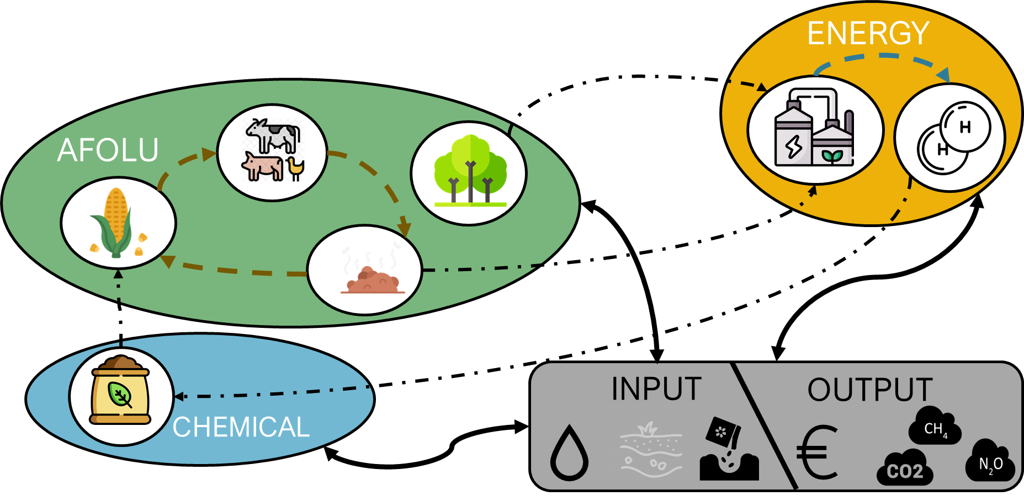
AIM OF THE WORK
We want to capture the interactions between the energy system and the AFOLU sector, decarbonizing both in the optimal way.

Slide 3
Introduction to the MODEL

Slide 4
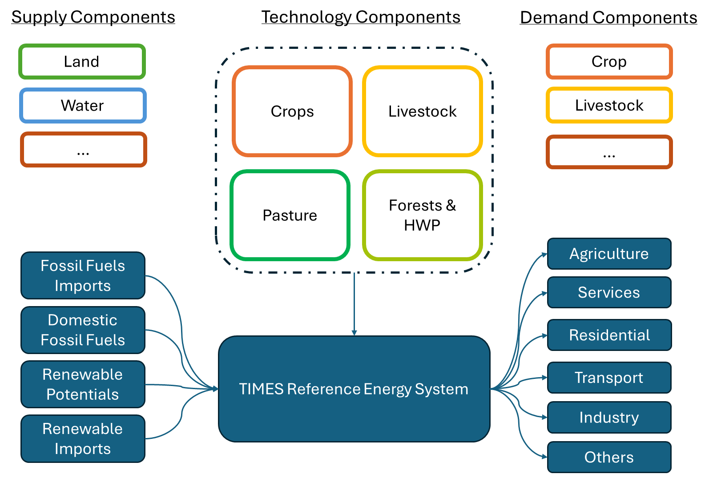
GENERAL FRAMEWORK
AFOLU technology and commodities must be modelled in coherence with FAO data
AFOLU emissions must be accounted in coherence with IPCC classification
The model must ensure integrability with existing TIMES models

Slide 5
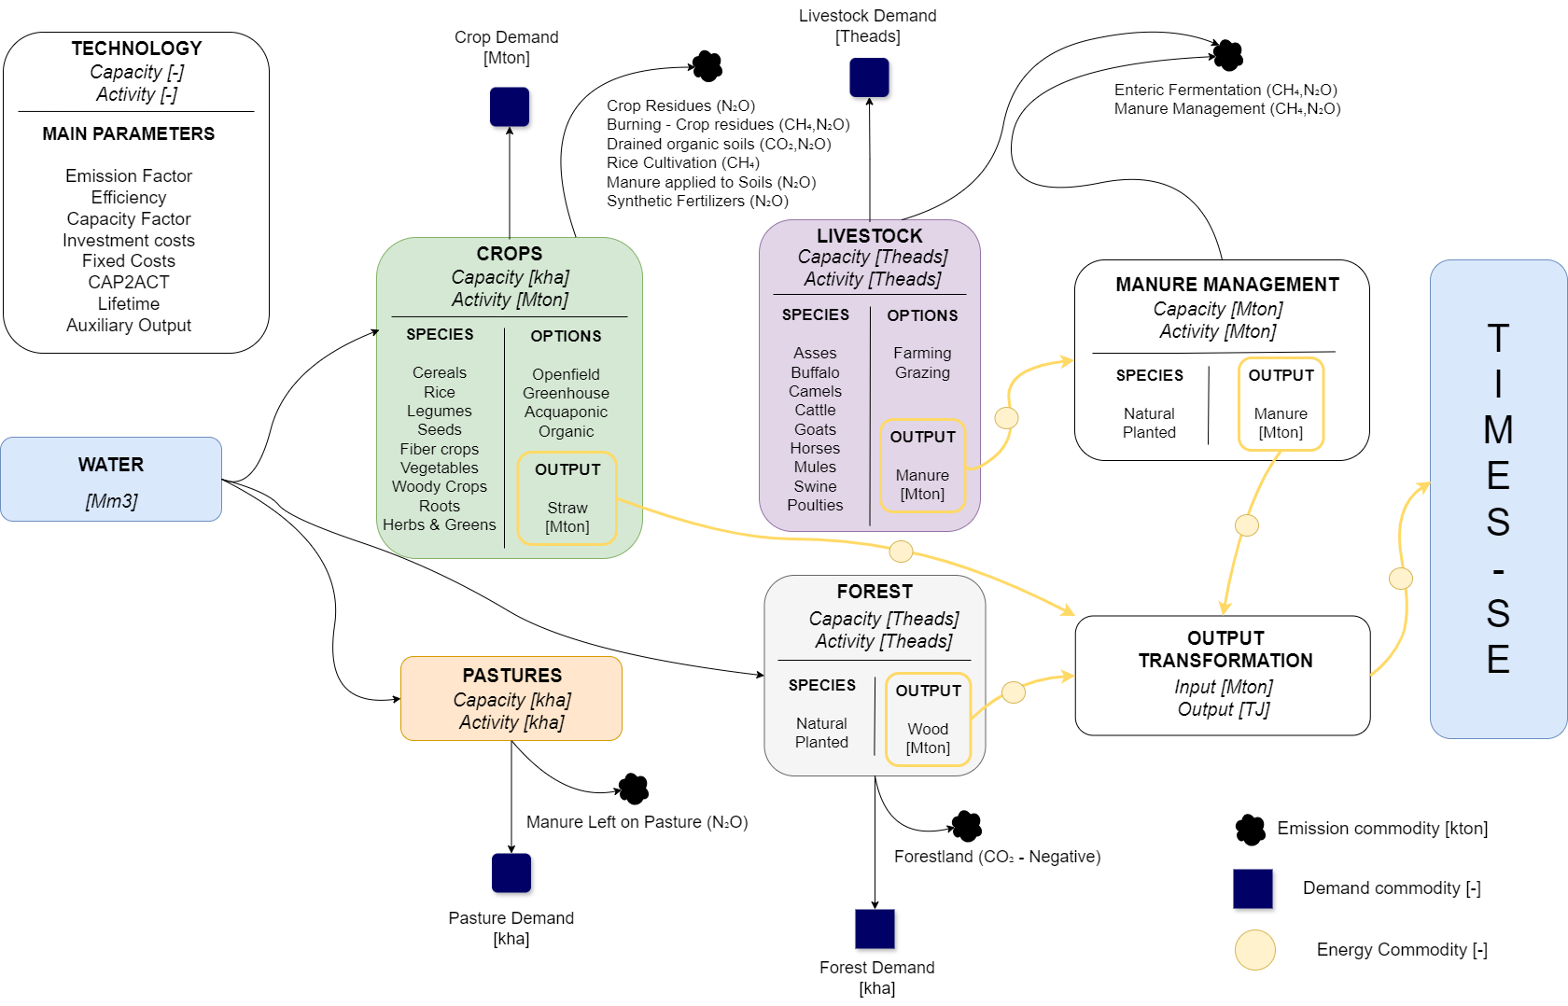
MODEL STRUCTURE - overall

Slide 6
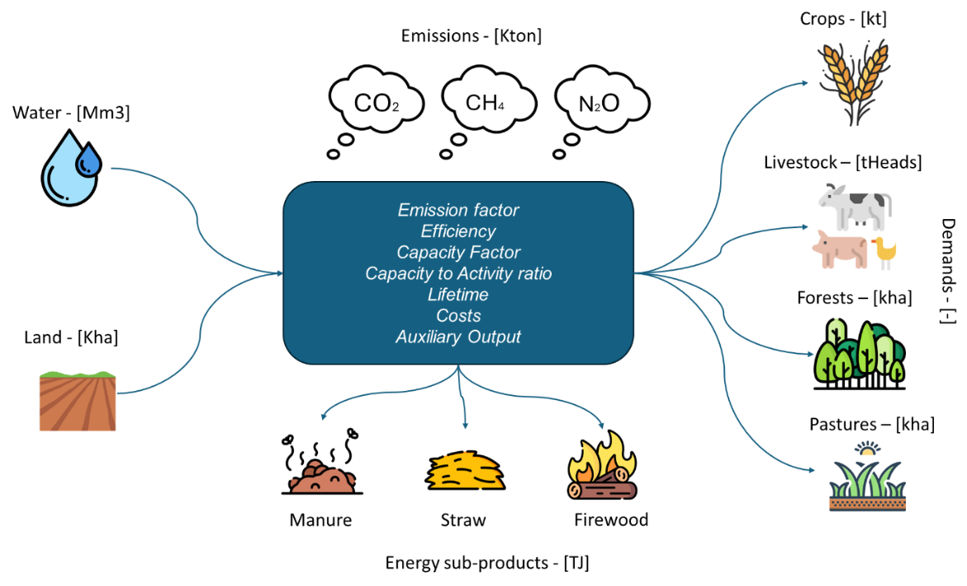
MODEL STRUCTURE – SINGLE COMPONENT

Slide 7
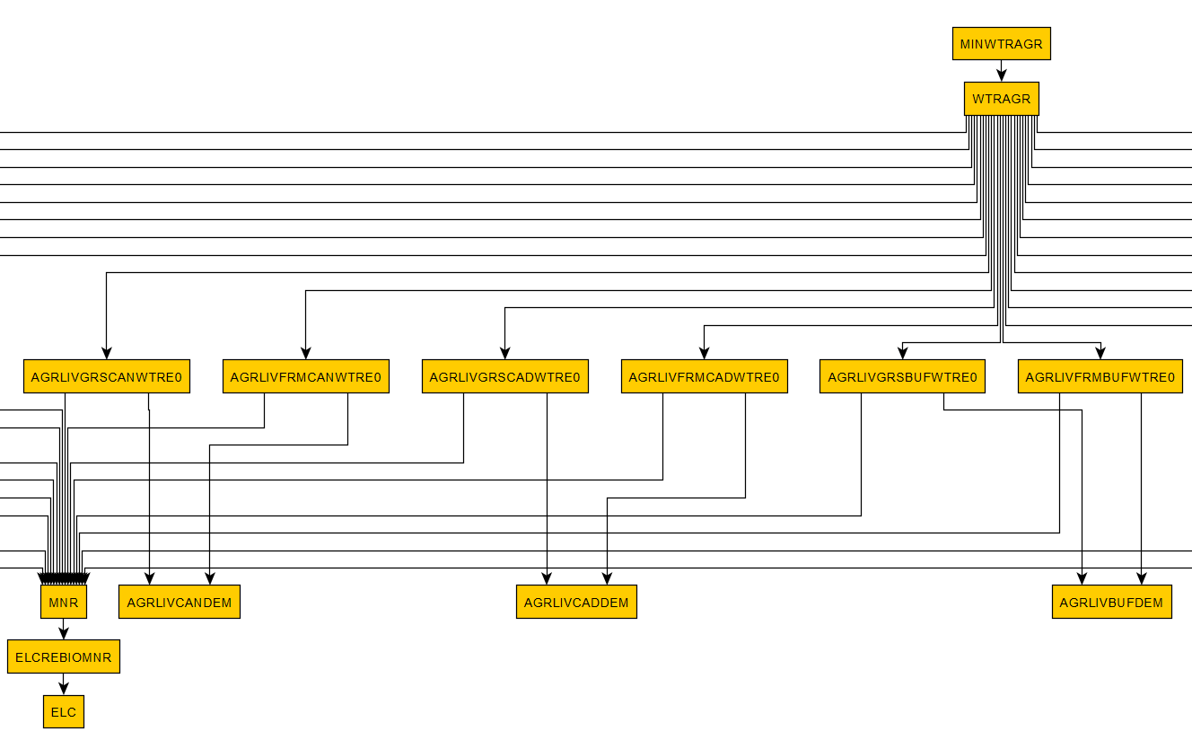
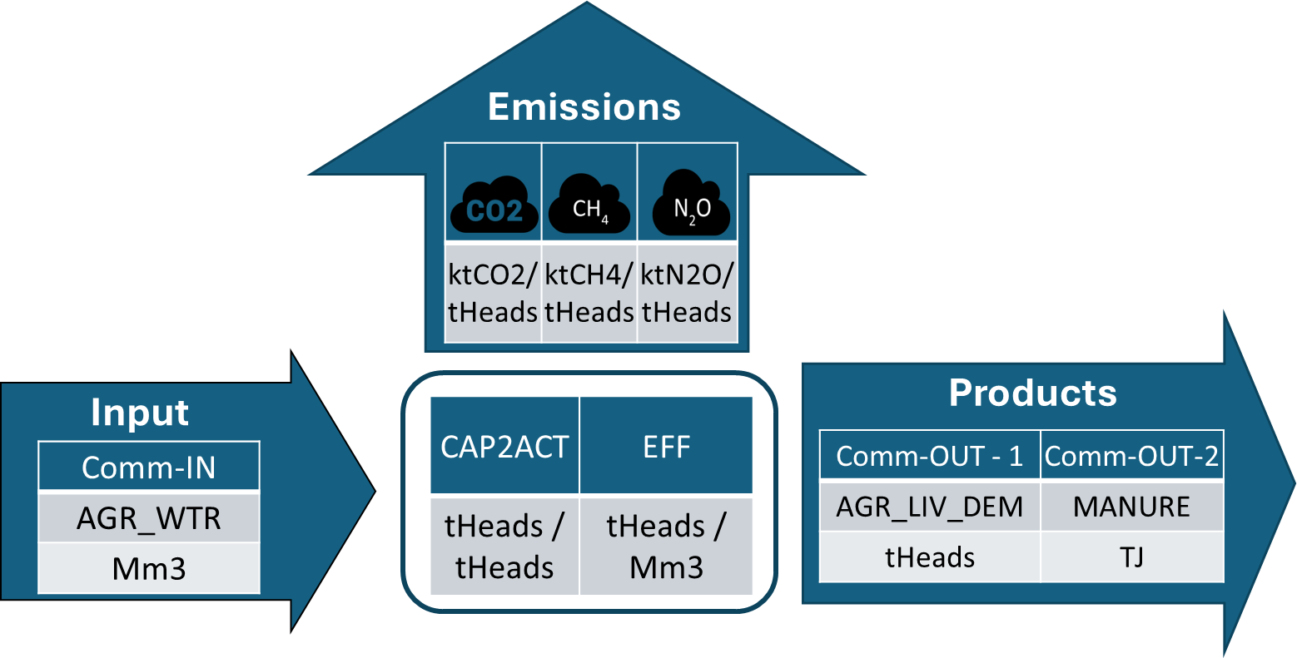
Livestock Modelling
Water accounted as input commodity
Land not directly accounted
Output: Demand, Manure (energy content) and Emissions
Demand satisfied and bioenergy fed into power sector

Slide 8
Livestock options
For each livestock species, there exist different technological options
User specify share of tech use by scenario hypothesis
These options generate different outputs of livestock and manure with higher outputs for farming
Actually, no land is considered directly or indirectly used by livestock, since its consumption is embedded in the other sectors
Grassland
Water Use
Emissions
Farming
Water Use
Emissions

Slide 9
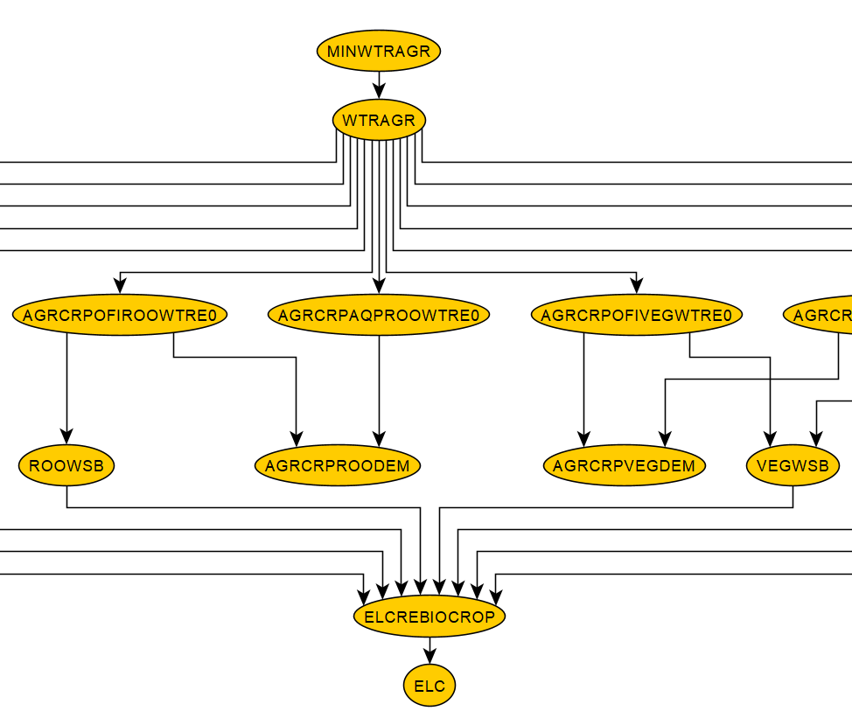
CROPS
Water accounted as input commodity
Land accounted as capacity
Output: Demand, Energy and Emissions
Demand satisfied and bioenergy fed into power sector

Slide 10
CROPS
Open field
Organic
Land Use
Water Use
Emissions
Land Use
Water Use
Emissions
For some crop types, there exists different technological options
Each option have different land use, water use and emissions
User specify share of technology use by scenario hypothesis, but model can optimize
Orgniac cropping are derived from Open field, by not considering the quota emitted by synthetic fertilizers
Green house
Land Use
Water Use
Emissions
Aquaponic
Land Use
Water Use
Emissions

Slide 11
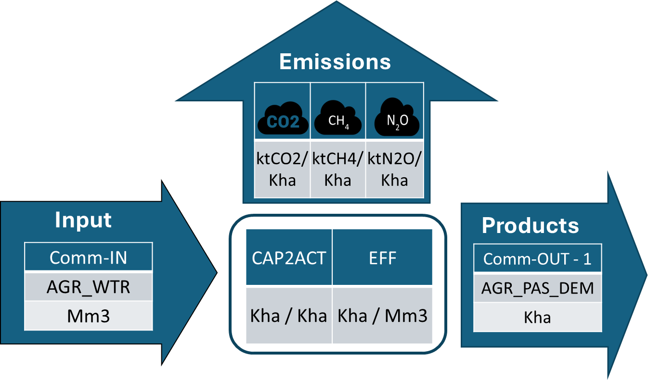
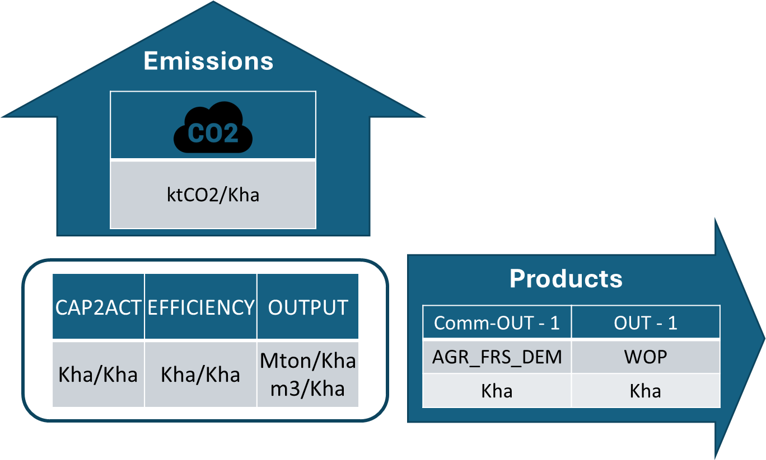
Pastures & forest
Pastures
Pasture, modelled as crops, but with no secondary output
Eventually, water consumed by irrigated ones
Forest satisfy their demand and, based on their carbon apture geographical potential (EF by literature), provides negative emissions and Wood Products
Forests

Slide 12
MANURE MITIGATION OPTIONS
Livestock highest emitting source (see Results)
Need a detailed abatement options representation
ENTERIC FERMENTATION
MANURE MANAGEMENT
MANURE MANAGEMENT
CH4
CH4
N2O
CH4
N2O
No manure mitigation
Anaerobic Digestion
Mitigation options
Spreading
Manure

Slide 13
MANURE MITIGATION OPTIONS
FAO lists several mitigation options for the livestock sector, whit average mitigation potentials by option.
Method |  | Mitigation Potential |  | Source
 |  | CH₄ | N₂O
Daily/Weekly Manure Removal | DWR | 55% | 41% | Mohankumar Sajeev, Winiwarter & Amon (2018)
Anaerobic Digestion | ANDIG | 29% | 23% | Mohankumar Sajeev, Winiwarter & Amon (2018)
Acidification | ACD | 74% | 17% | Mukherji et al. (2023)
Manure Storage Covers | MSC | 12% | -500% | Mohankumar Sajeev, Winiwarter & Amon (2018)
Cost available for kiloton of removed carbon, requiring some conversion to match with TIMES cost.
Species | Cost (DKK/Ktco2EQ)
 | Acidification | Manure Storage Covers | Daily/Weekly Manure Removal
Cattle, dairy | 350 | 971 | 100
Swine, breeding | 483 | 44 | 100
Poultry | 417 | 507 | 100

Slide 14
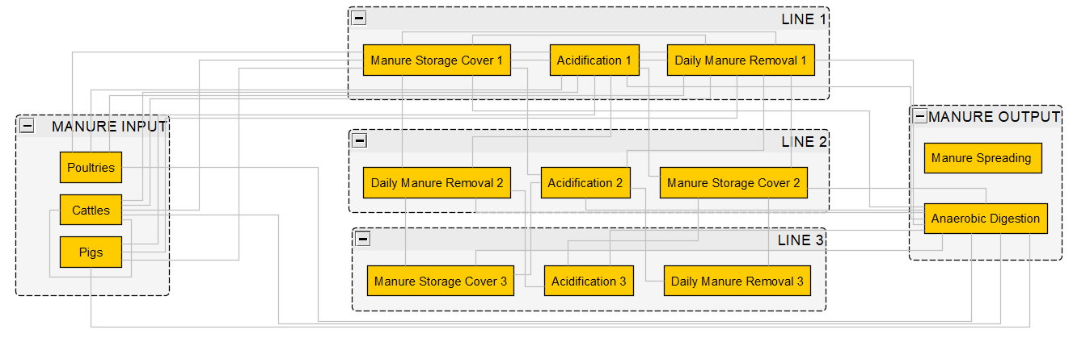
MANURE MITIGATION OPTIONS
Each mitigation option (e.g., Acidification, Manure Storage Cover, Daily Manure Removal) can be combined at different levels, but manure can only progress to either a new mitigation option or an end-point (Spreading, Anaerobic Digestion)

Slide 15
Introduction to excel workbook

Slide 16
FUNCTIONAL REQUIREMENTS
NGHGI
National data
Global FAOSTAT National data
The modeling approach should prioritize data accessibility, scalability, and the simplicity of creating local modeling instances.
To develop decarbonization pathways for the AFOLU sector, the model should be built in coherence with well-established emissions accounting frameworks – also to be coherent with the IPCC guidelines for emission accounting.
Data Transformation
(Nation selection)
VEDA
TIMES
National AFOLU
Instance

Slide 17
Availability of data
Activity & Capacity data
Crops | Livestock |  | Forestland
Pastures |  | Land types
Harvested Wood Products
FAO data are used to definite AFOLU capacity and activities, while their integration with IPCC allow for emission factor definition
Compatibility between IPCC and FAOSTAT data, globally available at a national resolution, is guaranteed by Tier 1 approach
Emission Factors
For the same FAO cluster, aggregated emissions are combined with activity to derive technology specific emission factors

Slide 18
excel STRUCTURE
HYPOTHESIS
Input tables of excel can be filled with data both coming from FAOSTAT and NGHGI
Base file ready for FAO data, adjustment needed for NGHGI format
Three types of sheets: Input – Calculation – VEDA Templates
InputCritical - Yearless
DefaultAFOLU
InputRegions
INPUT
CALCULATIONS
VEDA TEMPLATES
(FAO/NGHGI)
Input data – Emissions
Calc - Livestock
Calc - Crops
Crops
(FAO)
Input data – Area
Input data – Crops
Input data - Livestock Input data - Forest
Livestock
Calc – Land emissions
Calc – Land area
Pastures
Calc – Forests
Calc – Water
Forests
(FIXED)
Emission Factor CH4
Emission Factor N2O
Irrigation Shares
Calc – Others..
Other…

Slide 19
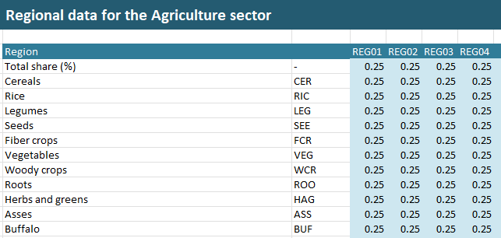
excel STRUCTURE
HYPOTHESIS
InputCritical – Yearless: Critical data for agriculture. It specifies the base-year share for the different technologica options
InputRegions: Specify the share of capacity by model region
DefaultAFOLU: Various Hypothesis on technologies (see documentation)
InputCritical - Yearless
DefaultAFOLU
InputRegions

Slide 20
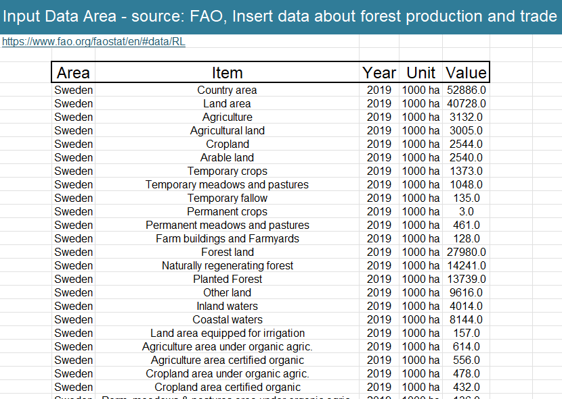
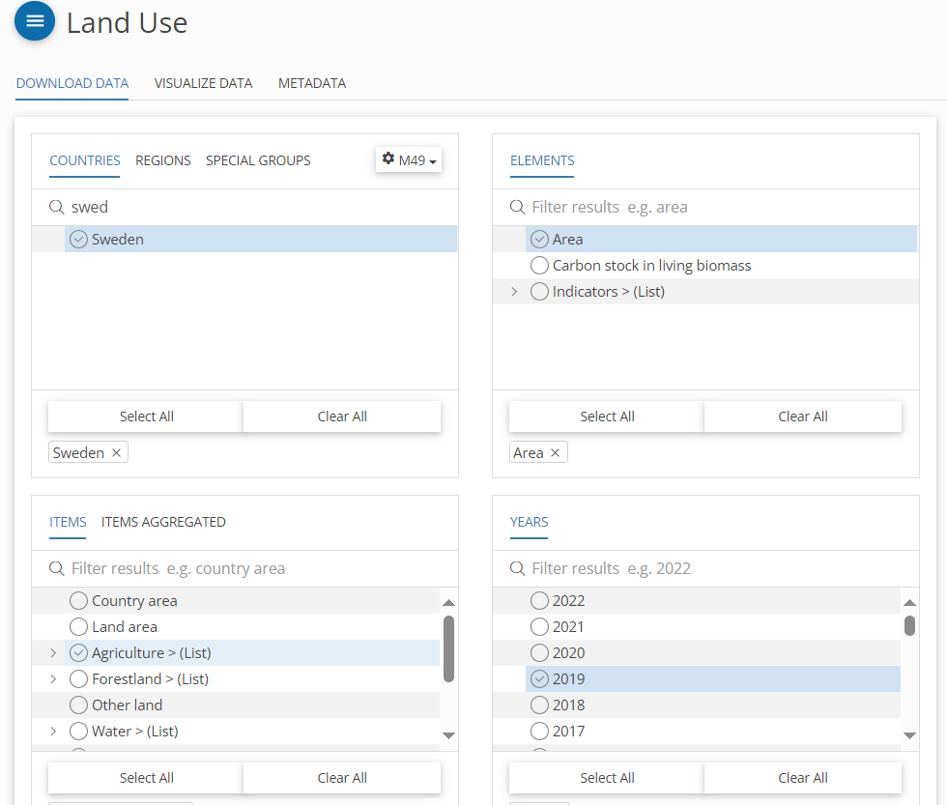
excel STRUCTURE
Input tables of excel can be filled with data both coming from FAOSTAT and NGHGI
Base file ready for FAO data, adjustment needed for NGHGI format
Three types of sheets: Input – Calculation – VEDA Templates
INPUT
(FAO/NGHGI)
Input data – Emissions
(FAO)
Input data – Area
Input data – Crops
Input data - Livestock Input data - Forest
(FIXED)
Emission Factor CH4
Emission Factor N2O
Irrigation Shares
FAO

Slide 21
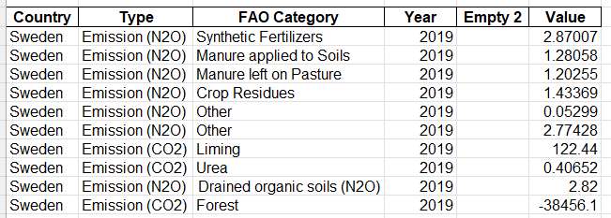
excel STRUCTURE
Input tables of excel can be filled with data both coming from FAOSTAT and NGHGI
Base file ready for FAO data, adjustment needed for NGHGI format
INPUT
(FAO/NGHGI)
Input data – Emissions
NGHGI
(FAO)
Input data – Area
Input data – Crops
Input data - Livestock Input data - Forest
(FIXED)
Emission Factor CH4
Emission Factor N2O
Irrigation Shares

Slide 22
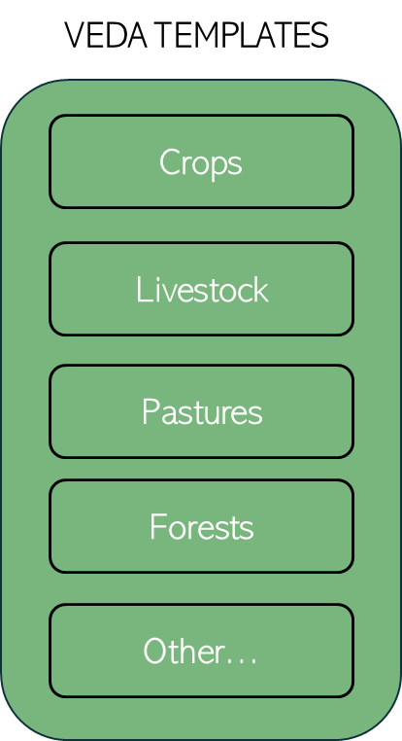
excel STRUCTURE
Some Excel spreadsheets are used to gather inputs and convert them into an intermediate format (e.g., Calc - Land Area, Calc - Land Emissions), while others are designed to calculate data that is directly useful for VEDA (e.g., Calc - Crops).
Some spreadsheets are specific to a single sector (e.g., Calc - Forests, Calc - Crops, Calc - Livestock), while others provide data for multiple sectors simultaneously (e.g., Calc - Water).
CALCULATIONS
$$Crop Yield$$
$$CAP2ACT_{crop\left(i\right)}=\frac{Production_{crop\left(i\right)}[Mton]}{Area_{crop\left(i\right)}[Kha]}$$
Calc – Land emissions
Crops
Calc – Land area
Calc - Crops
$$Water Use$$
$$η_{crop\left(i\right)}\left[\frac{Mm^{3}}{Mton}\right]=(\frac{ Irrigation Consumption \left[Mm^{3}\right]}{Irrigated area_{crop\left(i\right)} \left[Kha\right]})∗\frac{1}{CAP2ACT_{crop\left(i\right)} }$$
Calc – Forests
Calc – Water
Calc - Livestock
$$Emission Factors_{j=CH4,N2O,CO2}$$
$${EF_{j},}_{crop\left(i\right)}\left[\frac{Kt_{em\left(j\right)}}{Mton}\right]=\left(\frac{ Emissions_{j}\left[Kt_{em\left(j\right)}\right]}{Area_{crop\left(i\right)}[Kha}\right)∗\frac{1}{CAP2ACT_{crop\left(i\right)} }$$
Calc – Others..

Slide 23
AFOLU RESULTS

Slide 24
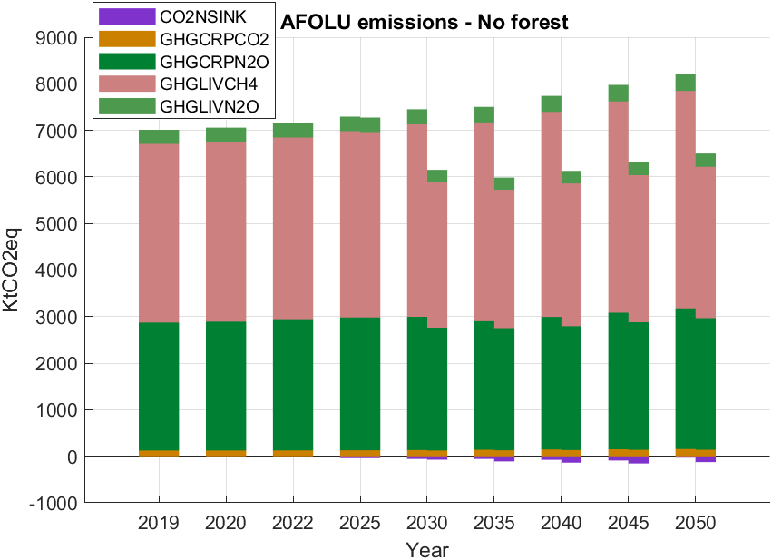
AFOLU RESULTS
Role of forests (-17,000 KtCO₂eq), which remains constant throughout the years, is hidden for the sake of clarity.
Global reduction of total CO2 of 1600 KtCO₂eq, mainly driven by manure mitigation and organic cropping
Almost negligible contribution of Harvested Wood Products (HWP) -, despite all the modelling effort.

Slide 25
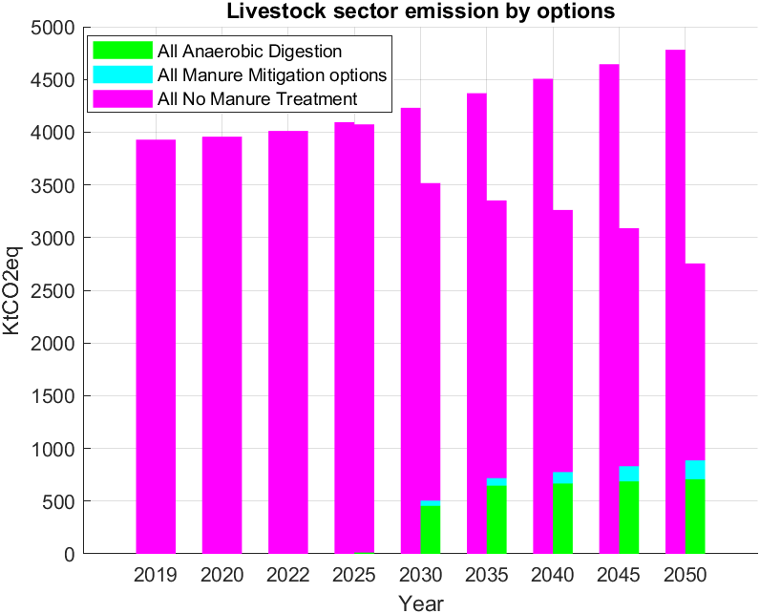
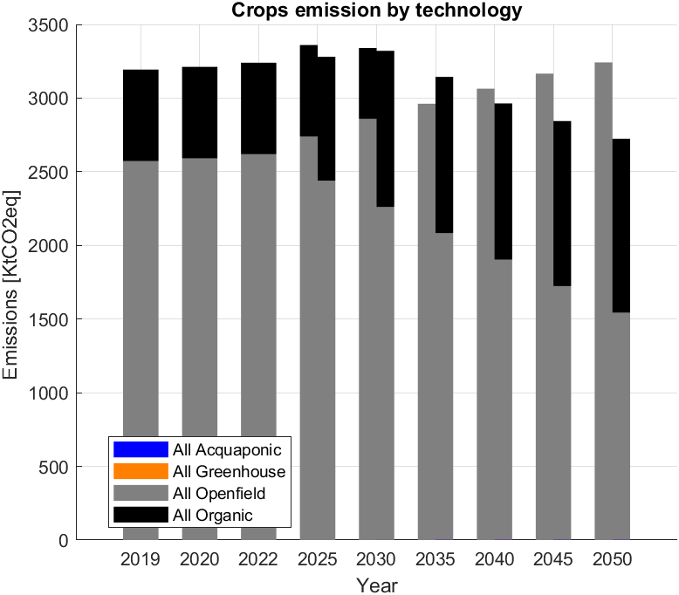
AFOLU RESULTS
Acquaponic and Greenhouse do not find space in this sector (due to Swedish peculiar situation)
Strong limitation in the crop sector decarbonization due to physical constraints
If livestock is net-zeroed alone, stronger space for decarbonization with respect to a global constraint
Anaerobic Digestion limited due to economic reasons

Slide 26
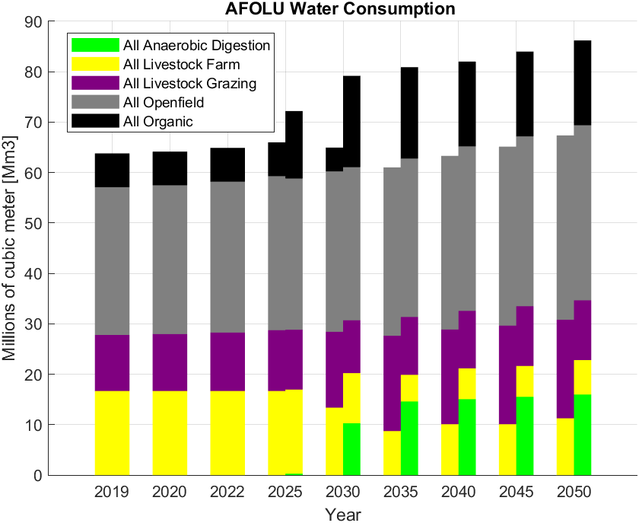
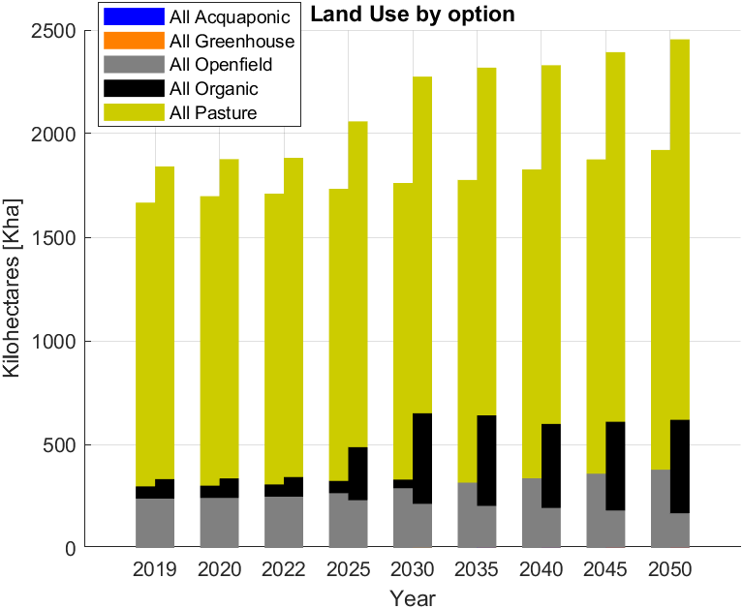
AFOLU RESULTS
Organic crop limited by the available land, considering that forest cannot be changes and a fraction is left for biodiversity purposes
Baseline shifts from farming to grazing livestock due to fictitious price applied on water (1e-10)
Net0 moves to anaerobic digestion

