Slide 1
Pleistocene/Holocene (P/H) boundary oceanic Koefels-comet Impact Series Scenario (KISS) of 12.850 yrs BP Global-warming Threshold Triad (GTT): Part V
Michael Bujatti-Narbeshuber
Intradom Beratungsgesellschaft m.b.H. Vienna, Austria
After 20 years, with 12,854 ± 0.056 ka BP (Wolbach,2018) YDIH, Younger Dryas Impact Hypothesis (Firestone,2007,2009; Moore,2024) confirmed original date of 12.850 cal yrs BP for Continental-Ice, CI-KISS (Bujatti- Narbeshuber,1997b).
270 yrs earlier, Mayan Codex Troano date of Atlantic-Ocean, AO-KISS (13.124 BP), corroborated by Laacher See Eruption (LSE) as impact-volcanism proxy date (Bujatti-Narbeshuber,1997), now 13.160 (Friedrich,2004;Kromer,2004),
13.034 yrs BP (Van Raden,2019), is expanded by Greenland bipolar sulfate (Lin,2022) as Impact-Volcanism-Quadruplet (IVQ). LSE marks start of 5 step- geomagnetism (Dichiara,2023) and (Gravity-Greenhouse Threshold Transition) GTT2-warming “staircase” where LSE-IVQ cooling is overwhelmed by H₂0-gravity-warming (Nikolov,2024,Jucker,2024). GTT2 characterizes Inter-
Aleroed-Cold-Period 2 (IACP2) reaching its maximum with Holocene-End- Aleroed-Temperature (HEAT) Melt-Water-Pulse (MWP) 0B with < 6m step in
sea level (Bard,2010), the real Younger-Dryas- Onset (YDO) trigger, years later reinforced by CI-KISS (12,854 ka BP), supporting biphasic YD-cooling (Max,2022), then warming MWP1B.
IACP evolves through Atlantic-Ocean (AO-) KISS with Mid-Atlantic Ridge & Plateau Lowering Events (MARPLEs), meso-stratospheric water and gas plume of 25,03 x 10¹⁵ tons (Muck,1976), first into IAPC1-Albedo cooling phase (Repschläger,2023) with bleached magmatic, silico-clastic (Davias and Gilbride,2012) “White Mats” (Bujatti-Narbeshuber,2023) and geomagnetic (Mörner,1977; Chen,2020) Gothenburg-Excursion-Onset (GEO), later LSE, marks, despite 5 LSE-IVQ volcanic cooling episodes, the restart into IAPC2 with the rewarming Gravity-Greenhouse-Threshold GTT-staircase.
Finally the full, both Continental-Ice and Atlantic-Ocean (CIAO-) KISS scenario (Bujatti-Narbeshuber and Hoogewerff,1995), is necessary to explain and predict Pleistocene/Holocene-Catastrophic-Climate-Change (PHCCC).

Slide 2
M. Bujatti-Narbeshuber
Pleistocene/Holocene (P/H) boundary oceanic Koefels-comet Impact Series Scenario (KISS) of 12.850 yrs BP Global-warming Threshold Triad (GTT): Part V. First 4 paleo-geographic, paleo-oceanographic, paleo-climatic, proto-scientific parietal publications of mankind, since the oldest by Anonymous, Altamira Cave, Spain, 18.850 cal yrs BP.
M. Bujatti-Narbeshuber (1994,1995,1996,1997a,b,2002,2009a,b,2022,2023,2024)
I: “There is nothing more practical than a good theory” (Ludwig Boltzmann) General Linear Energy-Entropy Compensated Unified Transition-theory of Life (UTL) Special Littoral Double Niche Transition-theory of Human Evolution (LDNT)
II: “It is better to be vaguely right than precisely wrong” (Carveth Reed) This is rationality when scientific information is limited or imprecise
III: “Holocene” = The totally new (Ancient Greek) (Paul Gervais,1850)

Slide 3
M. Bujatti-Narbeshuber
1st Prediction
Stochastic Resonance, at (P/H) boundary of thermohaline criticality to damped-flow transition, evident in ice cores bi-polar half center tipping regulation, triggered by (KISS) P/H Impact Catastrophic Climate Change (ICCC).
2nd Prediction
Europe´s Koefels-crater with 12 glacier-ice-meteorites Alpine rockfalls & America´s Laurentide-ice secondary-ice-meteorites hitting into 1. silici- clastic-sand of white glass production grade “White Mats” 2. shaped to Carolina Bays; is dual Continental Ice-Atlantic Ocean (CIAO) KISS-event.
3rd Prediction
Paleolithic Altamira; La Pasiega a, b; El Castillo first 4 human proto- scientific publications and Mesolithic Gobekli Tepe, enclosure D, T- Pillar 43&18 decoding of Koefels-comet fragment-shower as snakes sinking subaerial Mid Atlantic Ridge & Plateau (MAR-MAP) in first Atlantic Ocean AO-KISS as 90° transition to H=hurt from I=intact as MAP-island symbols with Tsunamies as ( ) brackets in (HI-T)-code.
4th Prediction
Neolithic Göbekli Tepe, Mesoamerican maps, Maya Codex Troiano as 4 Magdalenian-Impact Sequelae Symbolizations (MISS) date Mid Atlantic Ridge & Plateau Lowering Events (MARPLEs) 13.124 yrs BP.

Slide 4
M. Bujatti-Narbeshuber
5th Prediction
KISS-MARPLEs initiates P/H thermohaline criticality to damped flow transition by turning Pleistocene old mode of glacial/interglacial subtropical Gulfstream-Gyrus Lifting Lowering Oscillating Valve Excursion System (GLOVES)-off via catastrophic MAP-submersion shaping Holocene new mode of damped self-constrained CAGE- oscillations.
6th Prediction
Hot climate, very long-lasting Holocene Interglacial, permanent End of Ice Age are probable scenario since IACP1-YD-KISS started 13 kyr duration of parallel Global-warming Threshold Triad (GTT) I- III.
7th Prediction
Albedo phase 1,2,3, with GTT-I Glaciation Threshold Transition, Greenhouse phase 1,2,3, with GTT-II
Gravitation-Greenhouse-Gas Threshold Transition, Thermohaline phase 0,1,2,3, with GTT-III Geomorphological MARPLEs Threshold Transition (13,1kyr)
8th Prediction
SELF-constrained Cosmogenic (H₂O 95%) Anthropogenic
(CO₂,CH₄,N₂O 5%) Gravitation-Greenhouse-Event (CAGE)

Slide 5
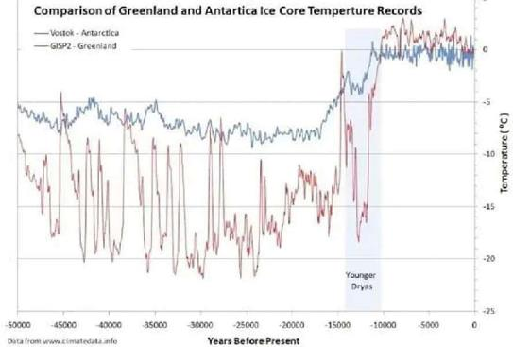
M. Bujatti-Narbeshuber
„White Mats“ MARPLEs-white glass sand, Atlantic Ocean IACP+YD Continental Ice, Carolina Bays „Black Mats“ cooling-warming-cooling dual CIAO-KISS Impacts
* ***

Slide 6
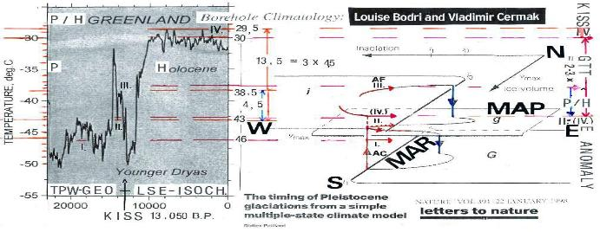
M. Bujatti-Narbeshuber
M. Bujatti-Narbeshuber, EGU 22
Adapted from Didier Pallard:The Timing of Pleistocene glaciations from a simple multiple-state climate model. Nature, Volume 391, p. 378 – 381 and Louise Bodri and Vladimir Cermak, Borehole Climatology, 2007
KISS - TPW - GEO - LSE - Isochrone = Koefels-comet Impact Series Scenario - True Polar Wander - Gothenberg Excursion Onset - Laacher See Event - Isochrone of ~ 13.050 yr BP

Slide 7
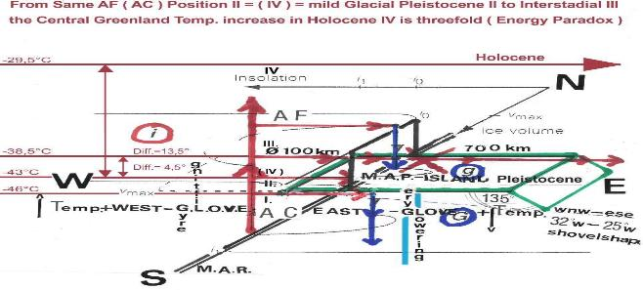
M. Bujatti-Narbeshuber
M. Bujatti – Narbeshuber, EGU 22
Adapted from Didier Pallard:The Timing of Pleistocene glaciations from a simple multiple-state climate model. Nature Volume 391, P. 378 - 381
From G.L.O.V.E.S. on – off Ice-Age Criticality by East ( or West ) of MAR, Azores Front ( AF ) Gyre Lowering – slow ( or Lifting – fast ), inbetween Oszillating Valve Excursion System towards (MARPLES permanent GLOVES off) GTT and Confluence of Holocene Damped Flow

Slide 8
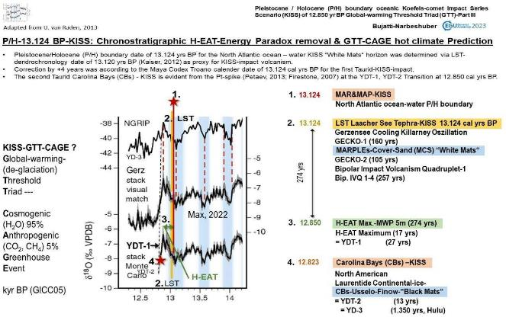
M. Bujatti-Narbeshuber

Slide 9
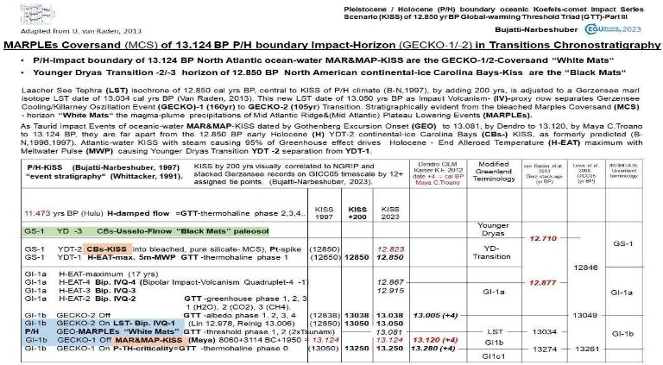
M. Bujatti-Narbeshuber

Slide 10
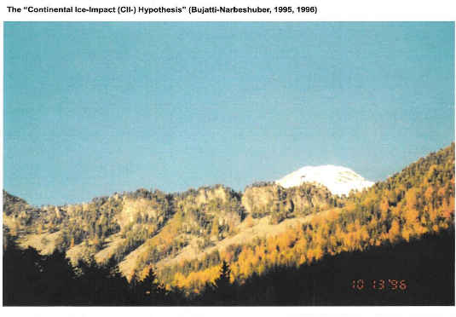
M. Bujatti-Narbeshuber
Koefels-Crater & Ötztal-glacier Ice-peak: Origin of Continental-Ice YD-Carolina Bays & Atlantic-Ocean IACP1- MARPLEs CIAO-KISS

Slide 11
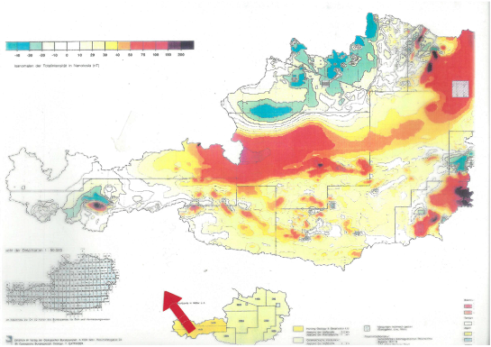
M. Bujatti-Narbeshuber
Koefels geomagnetic anomaly, as KISS impact-magnetism

Slide 12
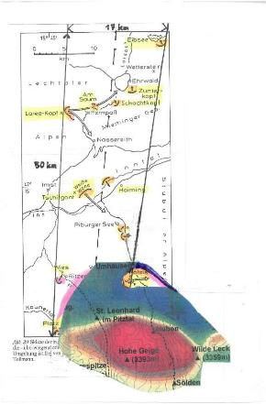
M. Bujatti-Narbeshuber
KISS-geomagnetic Anomaly:
12 Rockfalls in 50 km long, from 12-17 km widening zone.
This new KISS-scenario was immedeately introduced to E. Shoemaker and J. Grant as necessary and sufficient explanation for the
U.S. Carolina Bays genesis as fully analogous „ impact seismic, impact liquefaction features“ albeit there
shaped as „Sand Craters in the Gulf Coastal Plain clastic sediments and
are the first evidence for a late Pleistocene Impact event. Dated by me at 11.300 BP C 14 or 12. 850 BP
(1950) in calender years (see enclosed abstract…)“
(Bujatti-Narbeshuber, 1997a,b).
The KISS-explanation is an oblique KISS-impact scenario into glacier ice with impact seismic, impact rock weakening by meteoritic ice- ejecta fan.
Adapted after Seiberl, 1991; Tollmann, 1992, 1993; Bujatti-Narbeshuber, 1997ab; Ahl & Slapansky, 2003

Slide 13
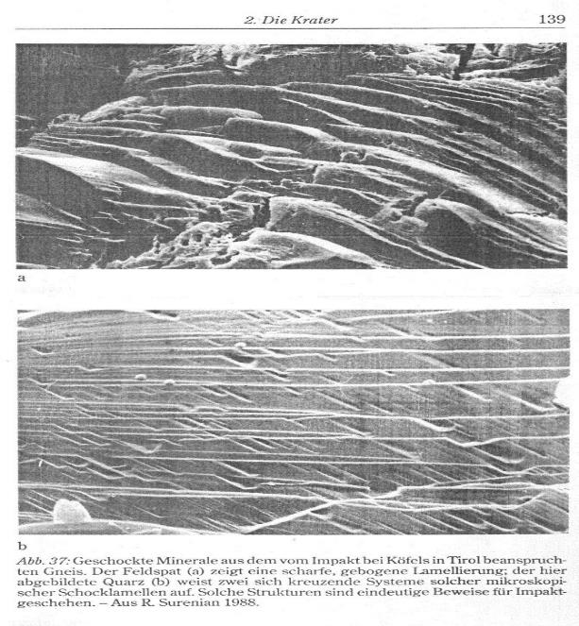
M. Bujatti-Narbeshuber
Aus Tollmann, A.E, 1993:

Slide 14
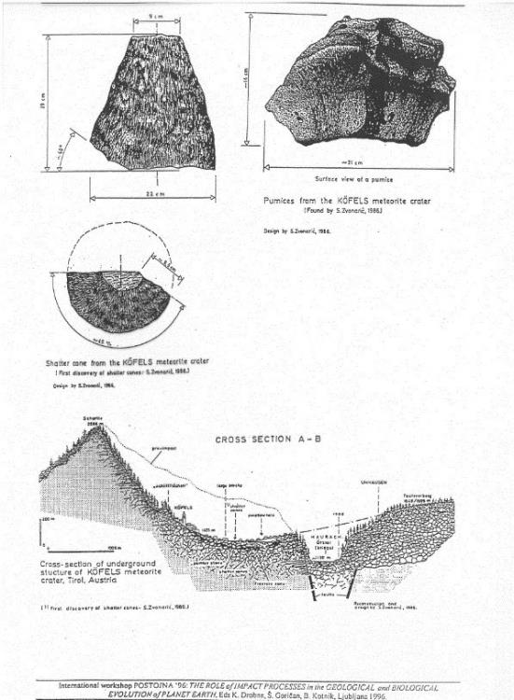
M. Bujatti-Narbeshuber

Slide 15
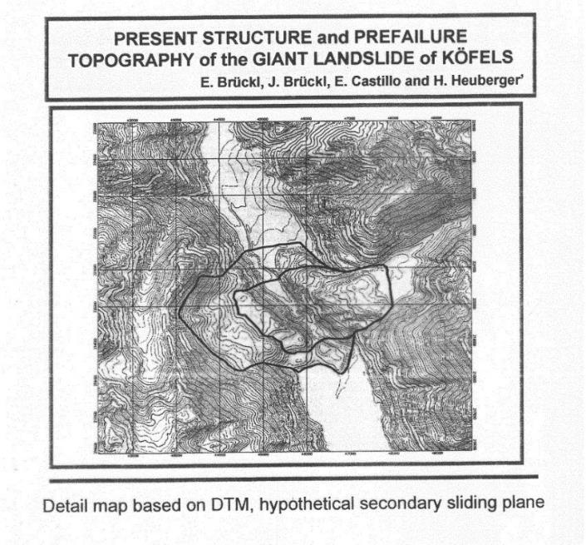
M. Bujatti-Narbeshuber
2001

Slide 16
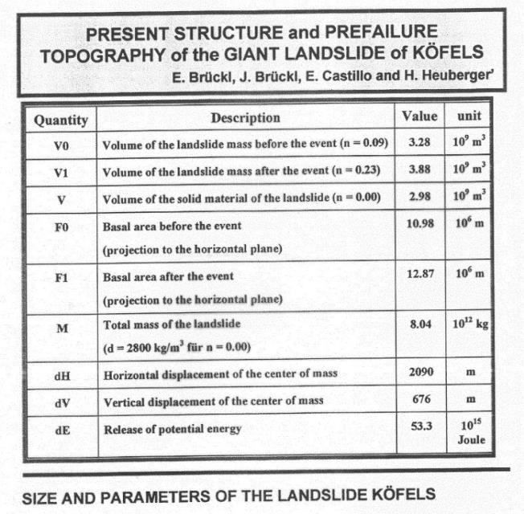
M. Bujatti-Narbeshuber
2001

Slide 17
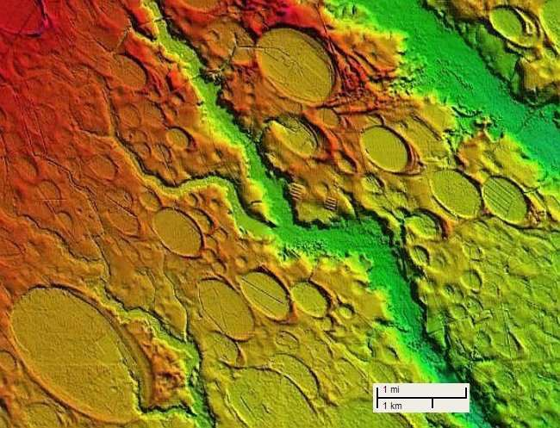
M. Bujatti-Narbeshuber
Replacement of Aeolian & Thermocarst Thaw -Lake Hypotheses:
Dual Continental Ice & Atlantic Ocean KISS-impacts caused dual „Black & White Mats“ in dual „Silicate Sand and Impact Crater liquefaction“ genesis of Carolina Bays.
4 overlapping Carolina Bays as diagnostic co-oriented Impact Funnel Liquefaction features
19

Slide 18
M. Bujatti-Narbeshuber
Dual Continental Ice & Atlantic Ocean CIAO-KISS with dual „Black & White Mats“ in dual Carolina Bays genesis replaces Aeolian & Thermocarst Thaw -Lakes Hypotheses:
M.Bujatti-Narbeshuber
First order evidence from the „Black Mats“ second Continental-Ice CI-KISS-impact is its meteoritic ice ejecta curtain shaping: a) 500.000 LIDAR Carolina Bays, b) with co-oriented trajectories, c) showing decisive „both circular and elliptical“ shapes d) „in any characteristic sector of the field of impact funnels …many partly intersecting (overlapping)ªi^{t}mpact funnels (Muck,1956,1976) repeatedly covered by Younger Dryas „Black Mats“.
First order evidence from the „White Mats“ first Atlantic Ocean AO-KISS-impact (preceding the second CI-KISS by 200-300 yrs) are it´s „White Mats“ found in a) unique stratum, the deepest, bleached Usselo Horizon, b) of bleached, siliciclastic sand, c) non fossiliferous (Goldsborough ridge enigma) d) of highest purity, directly usable in white glass industrial production situated in their sandy-precondition of Carolina Bays.
The „White Mats“ genesis is explained by the AO-KISS into MAR-MAP with MARPLE´s and shallow ocean magma rising, creating strato-mesospheric overheated steam plume with Tunguska like eolian magma-siliciclastic ash- sand transport (B-N, 1995,1997b, 2022,2023). This sand blanket, preceding by 200-300 yrs Carolina Bays formation, is shaped by ensuing Continental Ice KISS meteoritic ice ejecta curtain impacts forming the co-oriented, elliptical, often overlapping Carolina Bays with raised rims as „impact seismic, impact liquefaction features“.
Carolina Bays are found far from the permafrost prerequisite of the Thermocarst Lake Hypothesis, namely as
„Sand Craters in the Gulf Coastal Plain clastic Sediments and are the first evidence for a Late Pleistocene Impact event. “ Bujatti-Narbeshuber,1997b, 2022,2023,2024).
20

Slide 19
M. Bujatti-Narbeshuber
EGU-25 M. Bujatti-Narbeshuber
Koefels-Crater-wall together with background of Ötztal-glacier ice peak inspired the additional Continental-Ice (CI) KISS-impact hypothesis following the Atlantic Ocean (AO) KISS-impact hypothesis. resulting in the dual CIAO-KISS (Bujatti-Narbeshuber 1995, 1996)
I: The CI-KISS-hypothesis states that:
at the ice-age ending P/H Impact Catastrophic Climate Change
an oblique KISS-impact into the 1-2 km thick Ötztal-glacier
caused impact seismic, impact weakening of the prefailure cristalline hard rock under the 1-2 km ice cover and
provided the glacier-ice source-material for the meteoritic (ancient Greek: raising high above and then falling) ice- ejecta curtain with impact seismic, impact weakening, of the underlying limestone,
leading much later in the Holocene, after stabilising ice cover retreat, to the largest cristaline Koefels crater and
to the largest, ejecta-based impact-fan of 12 limestone rockfalls in the Alps, widening over a 50 km length from 12- 17km.
II: The above CI-KISS-scenario was suggested to Eugene Shoemaker, after his visit to Koefels, in Vienna May 5th 1997, as solving the Carolina Bays Enigma: 1. as the catastrophic „first evidence for a late Pleistocene impact event“ where
2. an oblique CI-KISS-impact into the 1-2 km thick Laurentide Continental-Ice (CI) 3. leaving no rock-crater 4. but
provided the glacier-ice source material for the meteoritic ice-ejecta curtain with „impact seismic, impact liquefaction features“ in sand-sheets near the watertable 5. forming as impact-funnels circular to elliptical co-oriented, diagnostic overlapping, sand-craters (Muck, 1956,1976) 6. in ejecta fans reaching even into most Southern “Gulf coastal plains clastic sediments“, beyond any obligatory permafrost reach. This refutes by common sense or computers his explanation of the Carolina Bays as „glaciological features“ of thermocarst or aeolian hypotheses (Bujatti- Narbeshuber 1996,1997a,b).
21

Slide 20
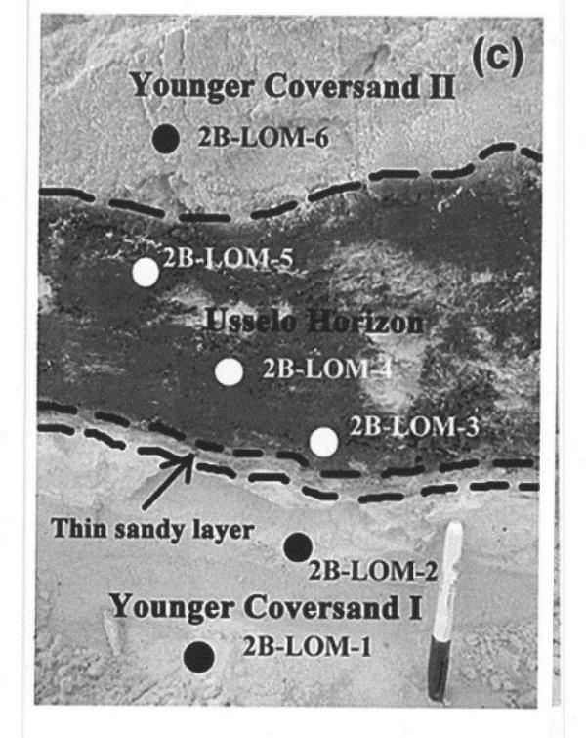
M. Bujatti-Narbeshuber
Alexandre V. Andronikov, Annelies Van Hoesel, Irina E. Andronikova and Wim Z. Hoek, 2016

Slide 21
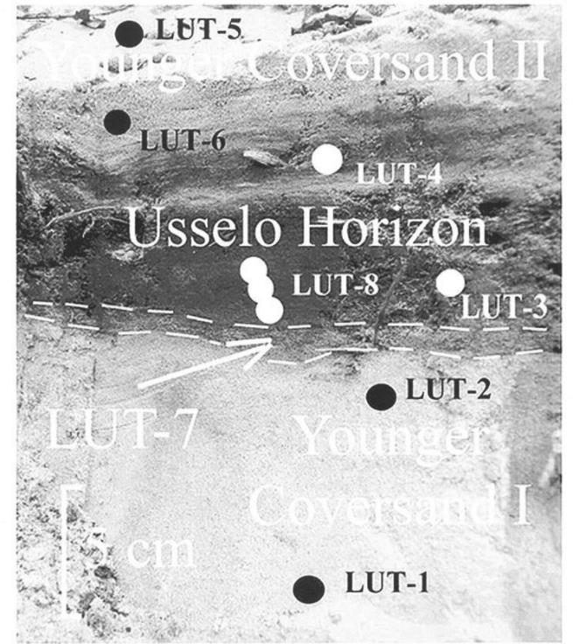
M. Bujatti-Narbeshuber
Alexandre V. Andronikov, Annelies Van Hoesel, Irina E. Andronikova and Wim Z. Hoek, 2016
Arrow = „White Mats“ of Atlantic Ocean KISS 13.124 yrs BP: MARPLEs-plume of bleached sand beneath Laacher See Tephra.
(Stratum of European Usselo horizon)

Slide 22
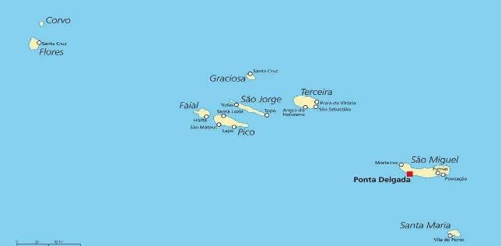
Littoral Transition-theory of Human Evolution:
M. Bujatti-Narbeshuber
Mid Atlantic Ridge & Plateau Lowering Events (MARPLE´s) of IACP-1: Dated with Laache See Tephra as impact volcanism proxy 13.050 yrs BP, Dendrochronology 13.122 yrs BP, Mayan Codex Troano 13.124 BP

Slide 23
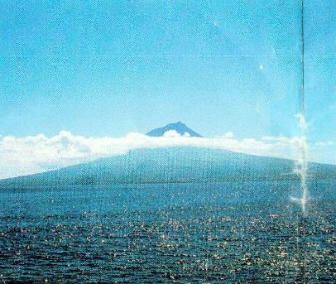
Littoral Transition-theory of Human Evolution:
M. Bujatti-Narbeshuber
freytag & berndt PICO Foto Azores

Slide 24
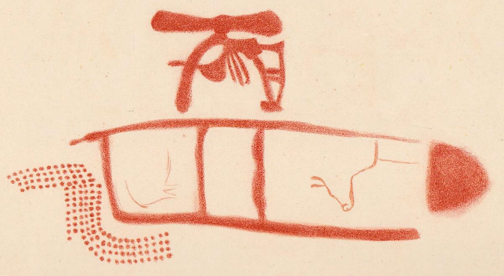
Littoral Transition-theory of Human Evolution:
M. Bujatti-Narbeshuber
1st decoding step is the 90° map-rotation from Upper paleolithic West- to modern North-orientation, adapting thus Breuil, Obermaier, Alcalde del Rio: La Pasiega, Puente-Viesgo (Santander, Espagne, 1913)

Slide 25
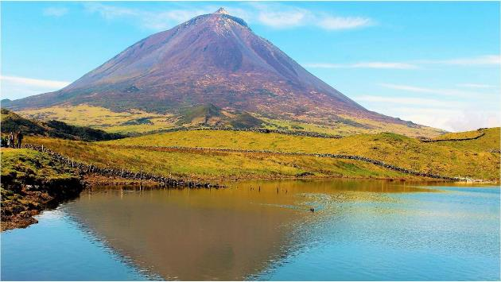
Littoral Transition-theory of Human Evolution:
M. Bujatti-Narbeshuber

Slide 26
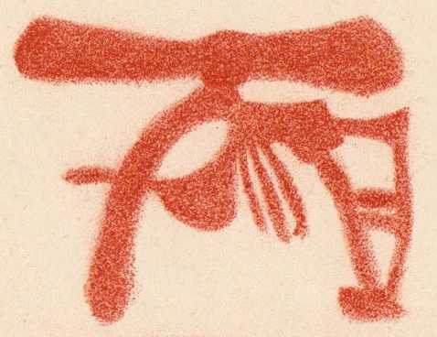
Littoral Transition-theory of Human Evolution:
M. Bujatti-Narbeshuber
PICO-VOLCANO =
Proto Signe Tectiforme,
Steam-Cloud: Ponta do Pico
Top View: Green Landscape
Side View: Volcano-Canyons
a) Quebrada do Norte
a b c
b) Quebrada do Curral
c) Quebrada do Terca
La Pasiega

Slide 27
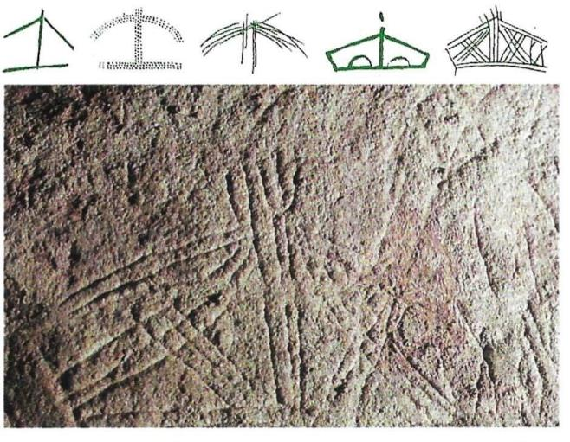
Littoral Transition-theory of Human Evolution:
M. Bujatti-Narbeshuber
Denis Vialou, Aux Coeur de la Prehistoire, Gallimard, 1996
Tektiform Sign

Slide 28
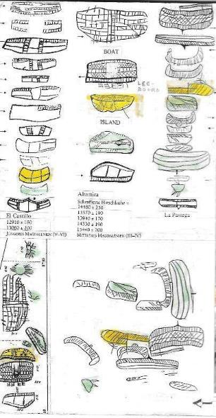
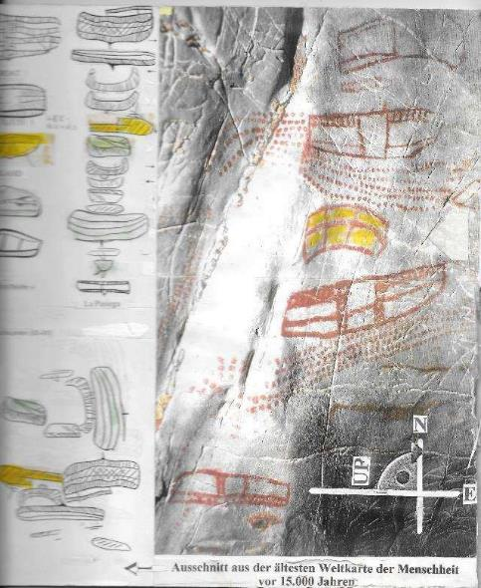
Littoral Transition-theory of Human Evolution:
M. Bujatti-Narbeshuber
Naviform Sign

Slide 29
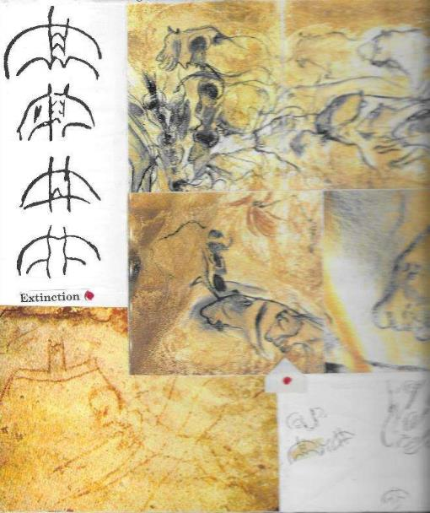
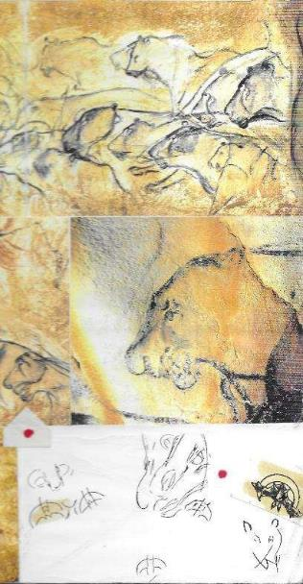
Littoral Transition-theory of Human Evolution:
M. Bujatti-Narbeshuber
Chiropteriform Sign

Slide 30
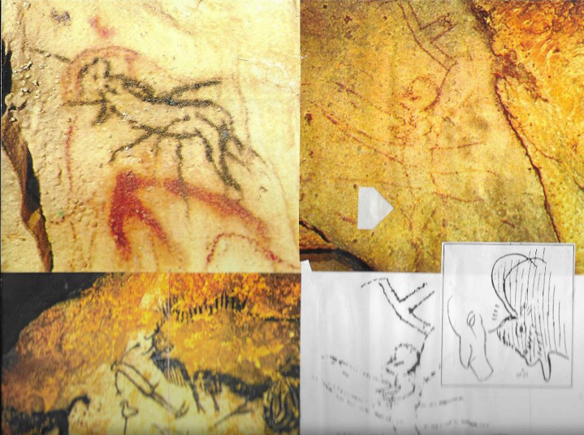
Littoral Transition-theory of Human Evolution:
M. Bujatti-Narbeshuber
Chiropteriform Sign

Slide 31
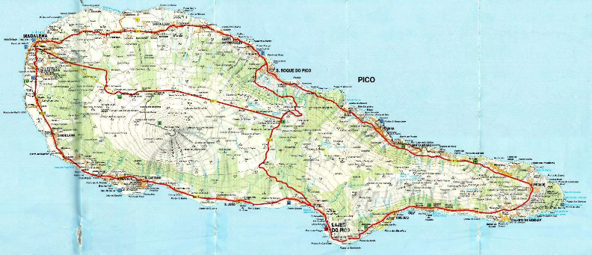
Littoral Transition-theory of Human Evolution:
M. Bujatti-Narbeshuber
Green landscape, present PICO Volcano on PICO Island
Azores Archipel, 1:75000 freytag & berndt

Slide 32
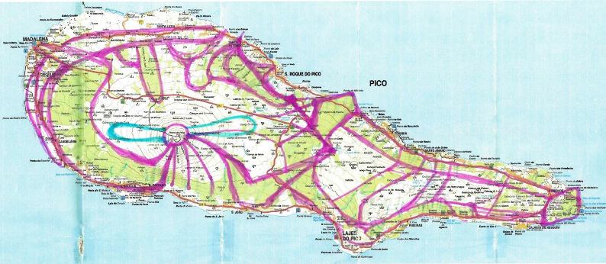
Littoral Transition-theory of Human Evolution:
M. Bujatti-Narbeshuber
Green Landscape (in Violet), Present PICO-Volcano, Steam Cloud (in Blue)
berndt
Adapted Azores Archipel 1:75000 freytag &

Slide 33
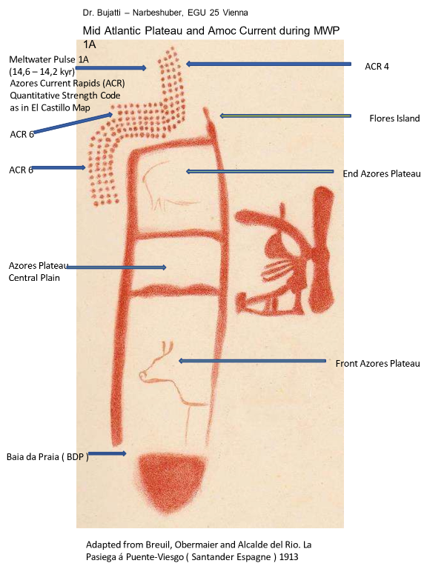
Littoral Transition-theory of Human Evolution:
M. Bujatti-Narbeshuber

Slide 34
Littoral Transition-theory of Human Evolution:
M. Bujatti-Narbeshuber
„ALIEN HELICOPTER“ named „CLAUDIO-MONTE-VERDI“ of „il ritorno d´Ulysse in patria“ lands on Mid Atlantic Plateau (MAP) Garden of Eden, a clouded PICO-mountain-volcano-(in side view 2351m, then +2000m) in green landscape (in top
view): the GLOVES on/off = P/H thermohaline block of P¹r⁴o^{.6}to^{k}S^{yr}ig^{B}n^{P}e⁾Tectiforme = PICO
Ponta do Pico, Illamane, Hoggar
AMOC, seen here „on“ in MWP 1A (14,2-
WEST-Azores Flores Island
Eastern Hills of the Central Plain
Bull´s Rear: defines Azores Current Direction, End of MAP
ACR 4
Bull´s Head: defines the Front of MAP
ACR 6
EAST-Azores
Santa Maria Island
ACR 4
Central Plain Azores Plateau
Baia da Praia ( BDP )
ACR 4-6 = Azores Current Rapids Quantitative Code as in El Castillo Map.
of Vila do Porto
Adapted from Breuil, Obermaier and Alcalde del Rio:
La Pasiega, Puente-Viesgo ( Santander Espagne ) 1913

Slide 35
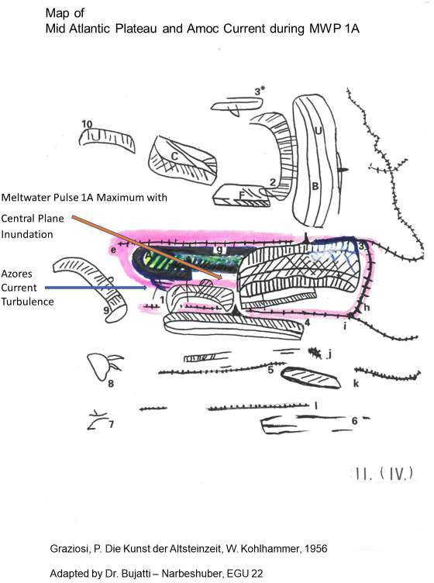
Littoral Transition-theory of Human Evolution:
M. Bujatti-Narbeshuber

Slide 36
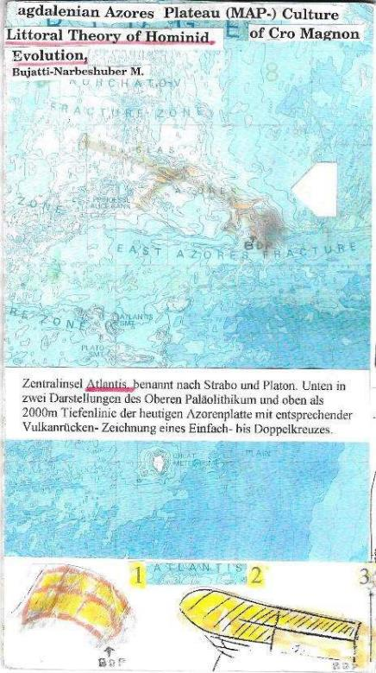
Littoral Transition-theory of Human Evolution:
M. Bujatti-Narbeshuber
Insuliform Sign

Slide 37
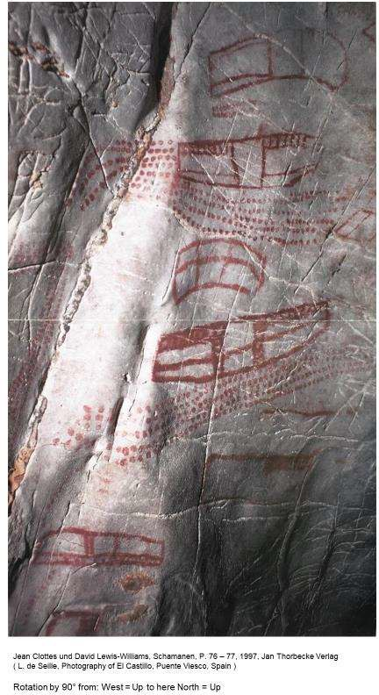
Littoral Transition-theory of Human Evolution:
M. Bujatti-Narbeshuber
39

Slide 38
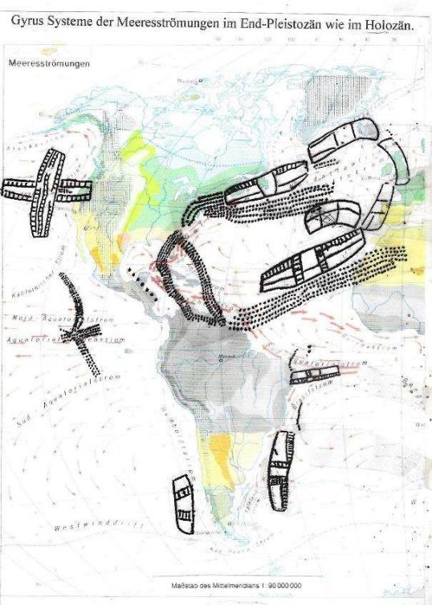
Littoral Transition-theory of Human Evolution:
M. Bujatti-Narbeshuber
El Castillo Ocean Currents

Slide 39
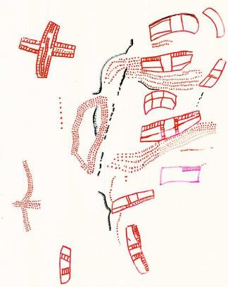
Littoral Transition-theory of Human Evolution:
M. Bujatti-Narbeshuber
Map-Rotation by 90° from: West = Up to North = Up
Adapted from Denis Vialou, Au coer de la Préhistorie,
Dècouvertes Gallimard, P 51, 1996
( M. Lorblanchet, Drawing of El Castillo )

Slide 40
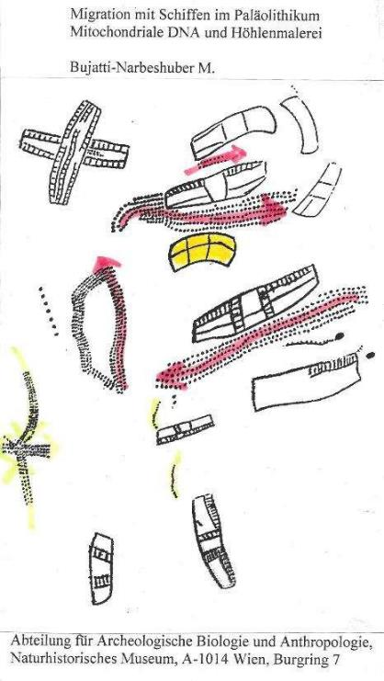
Littoral Transition-theory of Human Evolution:
M. Bujatti-Narbeshuber
El Castillo Ocean Currents and Azores Plateau

Slide 41
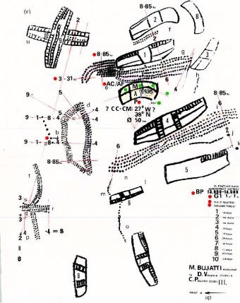
Littoral Transition-theory of Human Evolution:
M. Bujatti-Narbeshuber
EL CASTILLO
13.124 yrs BP
Adapted from Michael Lorblanchet, in Denis Vialou AU DE LA PRÈHISTORIE,
Gallimard, 1996, 51.
This Project was partly supported from,
„Phylogenetic and Ontogenetic Evolution of Creativity from physico – chemical and human biological Viewpoints“,
Grant no. 49.403 / 1-24 / 84 of the Austrian Ministry for Science and Research

Slide 42
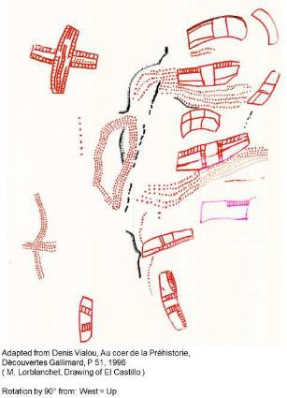
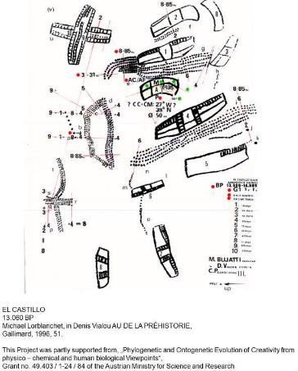
Littoral Transition-theory of Human Evolution:
M. Bujatti-Narbeshuber

Slide 43
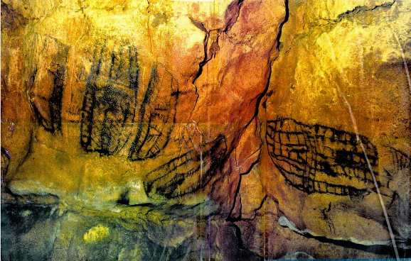
Littoral Transition-theory of Human Evolution:
M. Bujatti-Narbeshuber
ALTAMIRA PHOTO In Denis Vialou, Frühzeit des Menschen, Beck 1992

Slide 44
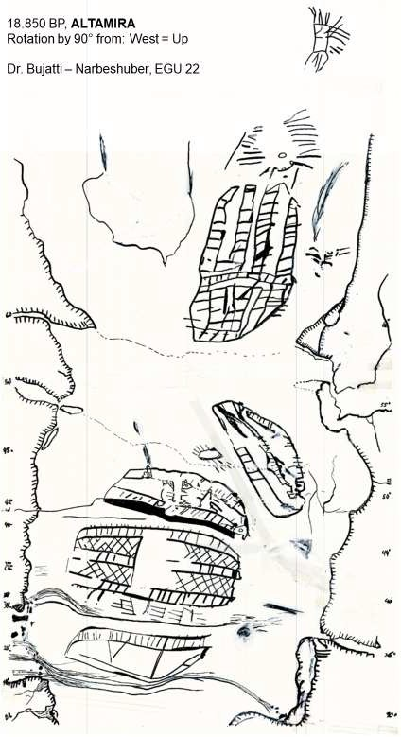
Littoral Transition-theory of Human Evolution:
M. Bujatti-Narbeshuber

Slide 45
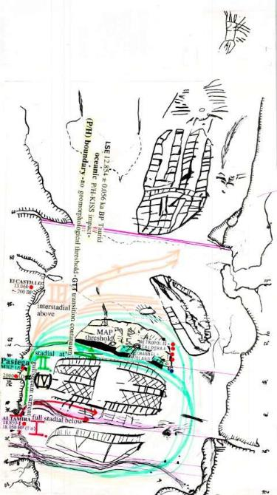
Littoral Transition-theory of Human Evolution:
M. Bujatti-Narbeshuber
ALTAMIRA
18.850 yrs BP,
Rotation by 90° from:
West = Up
to North = Up

Slide 46
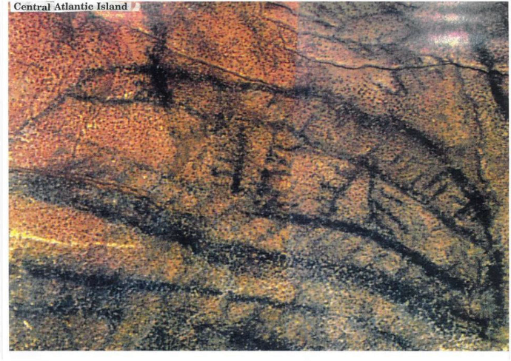
Littoral Transition-theory of Human Evolution:
M. Bujatti-Narbeshuber

Slide 47
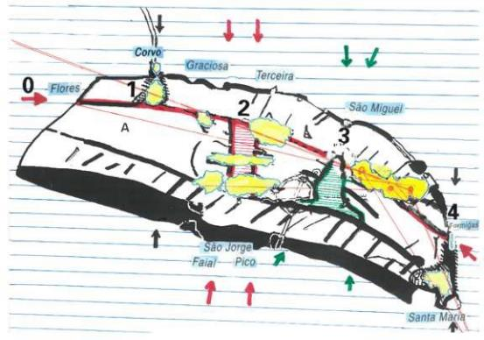
Littoral Transition-theory of Human Evolution:
M. Bujatti-Narbeshuber
49

Slide 48
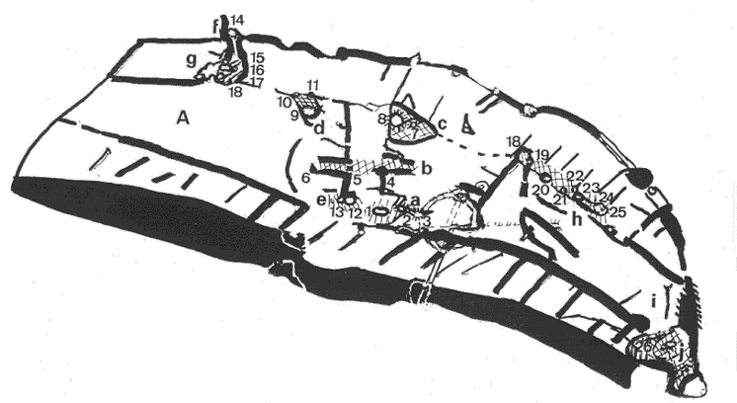
Littoral Transition-theory of Human Evolution:
M. Bujatti-Narbeshuber
32 W bis 25 W Longitude
700 km Mid Atlantic Plateau length Trending West North West to East South East
135° Shovel Shape

Slide 49
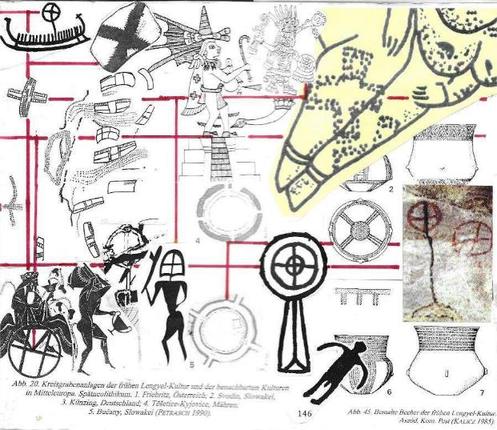
Littoral Transition-theory of Human Evolution:
M. Bujatti-Narbeshuber
Cruziform Sign Metropoliform Sign

Slide 50
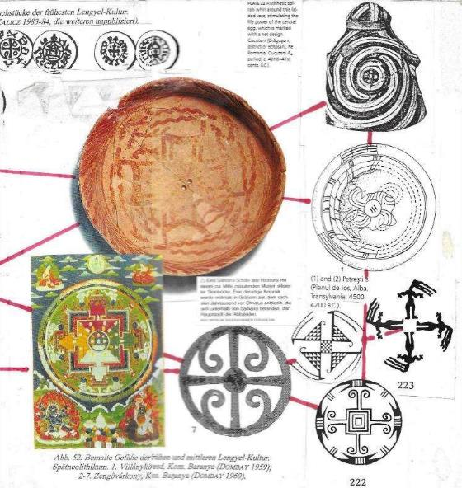
Littoral Transition-theory of Human Evolution:
M. Bujatti-Narbeshuber
Gyriform Sign ( Svastika )

Slide 51
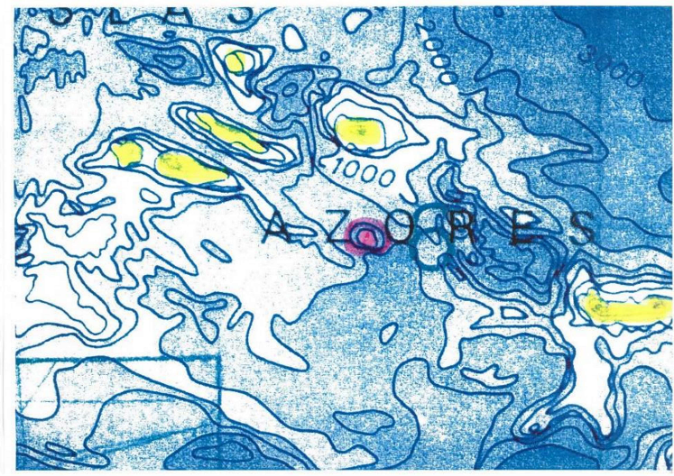
Littoral Transition-theory of Human Evolution:
M. Bujatti-Narbeshuber
Adapted from General Bathymetric Chart of the Oceans (GEBCO), Published by the Canadian Hydrographic Service, Ottawa, Canada. 5th Edition, January 1982, reprinted July 1984

Slide 52
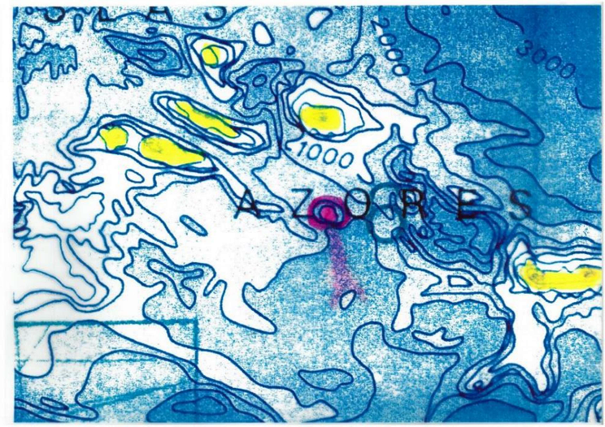
Littoral Transition-theory of Human Evolution:
M. Bujatti-Narbeshuber
Adapted from General Bathymetric Chart of the Oceans (GEBCO), Published by the Canadian Hydrographic Service, Ottawa, Canada. 5th Edition, January 1982,
reprinted July 1984

Slide 53
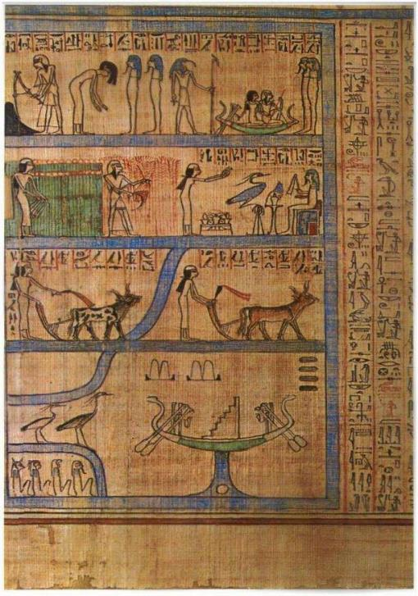
Littoral Transition-theory of Human Evolution:
M. Bujatti-Narbeshuber

Slide 54
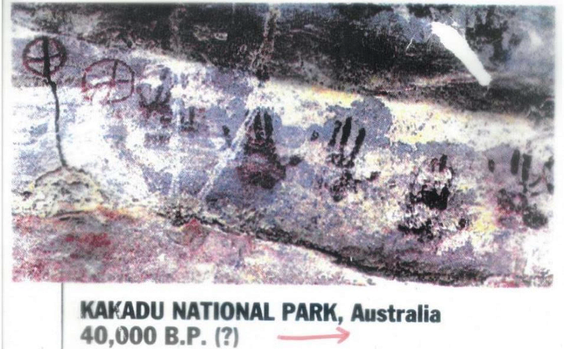
Littoral Transition-theory of Human Evolution:
M. Bujatti-Narbeshuber
Symbols of Metropolis with Channels and Handprints of Ship Crew

Slide 55
Littoral Transition-theory of Human Evolution:
M. Bujatti-Narbeshuber
United Kingdom

Slide 56
Littoral Transition-theory of Human Evolution:
M. Bujatti-Narbeshuber
United Kingdom

Slide 57
Littoral Transition-theory of Human Evolution:
M. Bujatti-Narbeshuber
United Kingdom

Slide 58
Littoral Transition-theory of Human Evolution:
M. Bujatti-Narbeshuber
Faroe Islands

Slide 59
Littoral Transition-theory of Human Evolution:
M. Bujatti-Narbeshuber
Faroe Islands

Slide 60
Littoral Transition-theory of Human Evolution:
M. Bujatti-Narbeshuber
Faroe Islands

Slide 61
Littoral Transition-theory of Human Evolution:
M. Bujatti-Narbeshuber
Iceland

Slide 62
Littoral Transition-theory of Human Evolution:
M. Bujatti-Narbeshuber
Iceland

Slide 63
Littoral Transition-theory of Human Evolution:
M. Bujatti-Narbeshuber
Iceland

Slide 64
Littoral Transition-theory of Human Evolution:
M. Bujatti-Narbeshuber
Svalbard / Spitzbergen

Slide 65
Littoral Transition-theory of Human Evolution:
M. Bujatti-Narbeshuber
Svalbard / Spitzbergen

Slide 66
Littoral Transition-theory of Human Evolution:
M. Bujatti-Narbeshuber
Göbekli Tepe Pillar 18, P/H MISS

Slide 67
Littoral Transition-theory of Human Evolution:
M. Bujatti-Narbeshuber
Gobekli-Tepe Enclosure D
Signe Metropoliforme-Uteriforme
National Geographic, Juni 2011
69

Slide 68
Littoral Transition-theory of Human Evolution:
M. Bujatti-Narbeshuber
Enclosure D, Pillar 43: „I“ – intact to „H“ – hurt 90° - Impact-Snake-Transition HI-T CODE
“The meaning of the H-symbol turned by 90° cannot be unraveled at the present time… It could be just a variety of the same Symbol lying before us. This assumption is possibly supported by the observation, that both symbol-variants nearly always appear in combination with snakes respectively with groups of snakes.”
Klaus Schmidt (Translation by M.Bujatti-Narbeshuber):
„Sie bauten die ersten Tempel: Das rätselhafte Heiligtum der Steinzeitjäger. Die archäologische Entdeckung am Göbekli Tepe, 2006, p.184.
Redrawn from: Die Geburt der Zivilisation. C.C. Mann National Geographic, Juni 2011, p.58
70

Slide 69
Littoral Transition-theory of Human Evolution:
M. Bujatti-Narbeshuber
Serotonin
=
Gobekli – Tepe Enclosure D, Pillar 43:
„I“ – intact to „H“ – hurt
90° - Impact-Snake-Transition
Soma
Bujatti und Riederer, 1976
Adapted from: Die Geburt der Zivilisation. C.C. Mann
National Geographic, Juni 2011, p.58

Slide 70
Littoral Transition-theory of Human Evolution:
M. Bujatti-Narbeshuber
Göbekli Tepe Pillar 18, P/H MISS HI-T Code
Pictures 4, 6 redrawn, from Graham Hancock Magicians of the Gods, 2015
T-Pillars. Pict. A. und E. Tollmann, Und die Sintflut gab es doch, 1993

Slide 71
Research on PHCCC starts from the hypothesis that a Koefels-comet Taurid- fragment impacted into the Ötztal glacier ice near Hohe Geige mountain (3393 m, Tirol, Austria) with Pleistocene/Holocene KISS serving as long sought, necessary trigger factor for the pre-failure weakening of the Koefels crystalline rock, “since there is no other evidence for a pre-existing zone of weakness promoting slope failure” (Zangerl,2021).
Holocene retreat of stabilizing ice, much later, around 9527-9498 cal BP (Nicolussi,2015), lead to the extremely rapid rock slide of Koefels with 3,28 km³ (Brückl,2001).
Koefels-crater is the largest crater in the metamorphic, crystalline area of the Alps. Even seismic fatigue cannot solely explain (Oswald,2021) without the KISS-impact “the particular situation of the Koefels rockslide because it is still unclear why this giant event occurred at this location and within a very strong rock mass” (Zangerl,2021).
Hohe Geige and Koefels crater are furthermore positioned above a unique circular Geomagnetic Anomaly (Ahl, Slapansky,2003) evident in the aeromagnetic map of Austria (Seiberl,1991), suggested as impact magnetism based on growing evidence for a global CIAO-KISS event (Bujatti-Narbeshuber,1997a).
Hohe Geige and Koefels extend northward into a sector, widening from 12 to 17 km, 50 km long, that contains the largest concentration of rock slides
(12) in the Alps (Tollmann,1992; Abele,1974). This is explained by both seismicity or an ejecta curtain from an oblique KISS-impact and already led to solving the Carolina Bays enigma as late Pleistocene, 12.850 cal yrs BP, “paleoseismic, impact-seismic, liquefaction features” (Bujatti-Narbeshuber, 1997b).
Koefels-comet Taurid-fragments with an oblique Ice-impact into the Ötztal glacier low-impedance ice-layer “guiding the pressure wave horizontally thus absorbing up to 70% of the impact energy would significantly reduce both the peak pressures at depth along with their expressions in the rock record” (Stickle,Schultz,2012,2013; French, Koeberl,2010).

Slide 72
EGU 2024
Abstract
Pleistocene / Holocene (P/H) Boundary oceanic Koefels-comet Impact Series Scenario (KISS) of 12.850 yrs BP Global-warming Threshold Triad (GTT) - Part IVb
Michael Bujatti-Narbeshuber
Intradom Beratungsgesellschaft m.b.H. Wien, Austria (dr.bujatti@gmx.at)
P/H-KISS, the geophysical evidence based, multidisciplinary set of hypotheses, explains P/H- paleo-climatological-borehole-evidence. Dual Continental-Ice-Atlantic-Ocean-CIAO-KISS- impact-series-scenario solves “via high stratospheric…greenhouse-gases (higher water & CO2 content)” (Manabe,Wetherald,1967) through GTT and H-EAT-maximum-MWP-(Holocene- End-Alleroed-Temperature-maximum-Melt-Water-Pulse) the P/H-deglaciation-energy-paradox. Furthermore P/H-thermohaline “bipolar-half-center-tipping-regulation” (BIHATI-regulation) constrains critical-Pleistocene-temperature-excursions into damped-Holocene with CIAO-KISS- Albedo-decrease-based “hot-climate-prediction”…“permanent end of the ice age” (Bujatti- Narbeshuber,1997a,2022,2023,2024) confirming (CAGE)-Cosmogenic-(Holocene-95%H2O)- Anthropogenic-(Anthropogene-Anthropospheric 5%CO2,CH4)-Gravity-Greenhouse- (Little&Big-ice-age-termination)-Event.
Undeniable transition into P/H-geophysical theory, started September 22.1997 with letter and abstract (Bujatti-Narbeshuber,1997a,b) to John Grant III, Buffalo University, concerning: “A new explanation of climate as stochastic resonance phenomenon...amplifying the weak signal of Milankovich cycles”, “...triggered by small impacts every ca. 10.000 years…” (Bujatti- Narbeshuber,1997b) into potentially “totally new” (=“Holocene”) climate-regime. Expanding “… the hypothesis that a continental Koefels-comet ice-impact, from the mainly oceanic KISS at the Pleistocene/Holocene boundary, associated with global warming…” (Bujatti- Narbeshuber,Hoogewerff,1995), the letter provided about genesis of U.S.-Carolina Bays (CBs) the following conclusive P/H-impact-evidence:
Undeniable 500.000 LIDAR-CBs were geo-physically explained as “paleo-seismic impact- seismic liquefaction features” (Bujatti-Narbeshuber,1997b).

Slide 73
Undeniable CBs-ice-meteorite-craters, were paradigmatically-relevant-dated 12.850calBP, using GRIP-borehole-KISS-event-stratigraphy-calibration for C14-(Laacher-See-Eruption)-LSE- volcanism-unstratified-sand-intercalated-tephra-dates (Hajdas,Zolitschka,1995) as CBs-KISS- impact-proxy (Bujatti-Narbeshuber,1997a,b): “They include the Sand Craters in the Gulf Coastal Plain clastic Sediments and are the first evidence for a late Pleistocene Impact event. Dated by me at 11.300 BP C 14 or 12.850 BP (1950) in calendar years (see enclosed abstract, Bujatti- Narbeshuber,1997a) of the talk promoting this interpretation.…It combines nicely Bailey (Nature,1944,154: Meteorites or Springs as Geological agents?) with old impact associated meteoritic interpretations albeit in an unexpected way.”
Undeniable evidence are “old impact associated meteoritic interpretations” in the word “meteorite”. Ancient Greek etymology of meteoros (=raised from the ground), from airein (=to raise), with meta (=higher-beyond), preserves eye-witness account of “continental Koefels- comet ice-impact” meteorites, “albeit in an unexpected way”, raised from the ground, higher- beyond earth atmosphere, before hitting “Gulf Coastal Plain clastic Sediments” (Bujatti- Narbeshuber,1997b).
Undeniable CBs on Gulf-coastal-Plain-Sites (GPS) falsify Eugen Shoemaker`s “glaciological- features” as CBs-permafrost-thermokarst-lake-hypothesis (Bujatti-Narbeshuber,1997b).
Undeniable 500.000 CBs provide mathematical-elliptical-circular-conical-sections (Melton&Shriver,1933;Muck,1976;Zamora,2015) with major-axes-non-randomly-converging (Davias&Gilbride,2012; Svenson,2023) towards “continental Koefels-comet-ice-impact” (Bujatti-Narbeshuber,Hoogewerff,1995) within “terminal Wisconsinian” continental-ice-sheet- boundary (Bujatti-Narbeshuber,1997a).
Undeniable 500.000 CBs-sand-impact-structures molded “Gulf Coastal Plain clastic sediments” (Bujatti-Narbeshuber,1997b) or Atlantic-Coast-bleached-sand, often pure-silicate-industrial- white-glass-production-sand-“White-Mats”. Type-locality of this CBs-fossil-free-sand-blanket- horizon is the Goldsboro-Ridge-Enigma (Daniels&Gamble,1969,1970) testifying for the catastrophic first “mainly oceanic KISS” (Bujatti-Narbeshuber, Hoogewerff,1995;Bujatti- Narbeshuber,1997a).
Undeniable 3 Paleolithic-Maps proof oceanic-KISS-Mid-Atlantic-Ridge&Plateau-Lowering- Event-(MARPLE), with (13.124calBP)-“White-Mats”-Atlantic-Ocean-LST-KISS-boundary-

Slide 74
horizon (Bujatti-Narbeshuber,2002,2009,2022,2023). 274yrs later, (12.850yrsBP) second Continental-Ice-CBs-KISS, caused Younger-Dryas-YDT-2-Transition, with chronostratigraphic-Pt-peak-horizon, followed by (YDT-3)-“Black-Mats” (Moore,2017,2023;Hayes,2008;Bujatti-Narbeshuber,2002,2009,2023).
Undeniable North-American “upper bleached sand A2-horizon” (Daniels&Gamble,1972) and North-European “bleached sand layer below Usselo-Finow-horizon” (van Hoesel,2014;Andronikov,2016; Bazelmans,2021;Heuberger,1968;Kusch,2009, 2014,2022) furthermore require 13.124calBP Atlantic-Ocean-LST-KISS-MARPLE- catastrophic-aeolian-transport of submarine-explosive-magmatism-silicates, seafloor- carbonates, volcanic-ash and sea-water in huge strato-meso-spheric overheated-steam- plume (Bujatti-Narbeshuber,2023). It divides Inter-Aleroed-Cold-Period (IACP) into Gerzensee-Cooling-Killarney-Oszillation-P/H-boundary-chronozones (GECKO-1,-2) of Older-Lilium (superbum), Younger-Lilium (pyrophilum=fire-affine) manifesting P/H- boundary-speciation-event of edaphically-highly- specialized, Sandhills-lily (Douglas,2011).
Undeniable 30 times wildfire increase, 13.200BP, with Rancholabrean megafauna extinction (O`Keefe,Science,381,2023) requires LST-KISS-MARPLE-consideration. Associated P/H-silicate-bleached-sand-Euro-American-horizon with GECKO-2 marine- atmospheric-cooling is reminiscent of K-Pg-boundary-impact-generated-plume of 0,8- 8,0-micrometre-sized-silicate-dust-horizon-impactite, generating K/Pg-impact-winter (C.B.Senel et.al., Nature Geoscience, 2023).
Bujatti-Narbeshuber,M.,Hoogewerff,J.A:Journal of Paleopathology,7,2,1995(1996). Iridium, Rare Earth Elements and the Koefels-Comet-Impact-Series Scenario (KISS) of Mass Extinction and Neolithic Paleopathology.

Slide 75
EGU General Assembly, Vienna, 2024
Pleistocene / Holocene (P/H) Boundary Oceanic Koefels-comet Impact Series Scenario (KISS) of 12.850 yrs BP Global-warming Threshold Triad (GTT) - Part IV
M. Bujatti-Narbeshuber
Intradom Beratungsgesellschaft m.b.H. Wien, Austria (dr.bujatti@gmx.at)
The scenario of the Pleistocene/Holocene (P/H) boundary is the most obvious, the definitely latest and the most undisputed Real Climate Change-Transition (RCC-T) into the definitely new climate regime of the Holocene. Climate is always changing, but there are different levels of climate change as illustrated by this latest, very dynamic RCC-T into the “totally new” Holocene aera. It was so aptly named in ancient Greek by Paul Gervais (1850) and this Holocene RCC-Transition at the P/H boundary is both necessary and sufficient, to clearly discern climate change (CC) within a climate regime from the RCC-Transition into a new climate regime. This is exemplified here by CC between stadials and interstadials through critical oscillations in the Pleistocene ice age and then by the RCC-T to the “totally new” Holocene warm-age, a new climate regime with damped oscillations. After this RCC-Transition this new climate regime is again characterized by climate change but now having the characteristic form of damped climate oscillations. It also has by common sense and computation a new and fairly predictable characteristic long-term trajectory of the Cosmogenic and Anthropogenic Greenhouse Event (CAGE). The trajectory lies beyond the glaciation threshold causing albedo loss for further global warming and the hot climate prediction.
To improve this RCC-T predictability the beginning of the Holocene was redefined by shifting it from the end of the Younger Dryas, now seen as boundary condition only, to the initial condition for the Holocene, the start of the RCC-T defining primary event, namely the Pleistocene /Holocene boundary Koefels-comet Impact Series Scenario (KISS) of multiple oceanic-water and continental-glacier-ice impacts (Bujatti-Narbeshuber, 1995(1996).
KISS is now seen as the primary event, initiating the secondary global warming characteristic of the Holocene, by removing the mid-Atlantic geomorphological threshold of the AMOC for equatorial heat and by raising stratospheric cooling through overheated water steam plumes and through water as greenhouse gas, all three lifting the long term climate regime beyond the glaciation threshold and thus solving the energy paradox, with the necessary, equally dramatic Younger Dryas cooling as (tertiary) oscillation, a feedback necessity in this process (Bujatti- Narbeshuber, 2023).

Slide 76
This P/H KISS was causally and specifically linked with the Laacher See Event as impact volcanism, dated to 12.850 yrs BP and not as isostasy volcanism (Bujatti-Narbeshuber, 1997a; Zelinsky, 1996). With this date the original Koefels- comet Impact Series Scenario of an end Pleistocene continental alpine-Ötztal- glacier ice impact with 12 secondary impact-seismic rockfalls after the ice melting in Early Holocene, in the 12 to 17 km narrow ejecta corridor, provided the heuristic for the analogous solution to the U.S. Carolina Bays enigma. It further led to the Eugene Shoemaker interview in Vienna (5.5.1997) after his Köfels visit and after his sudden death to the letter concerning the partial confirmation of the new solution to the Carolina Bays (Bujatti-Narbeshuber, NHM letter to John Grant III, 22.9.1997b). Shoemaker confirmed the “late Pleistocene origin of the Carolina bays and as glaciological features” and this scenario found its further completion from the Koefels-comet-Impact- Series Scenario (KISS) as expressed in the letter to J.Grant:
“I preferred the paleoseismic interpretation. I interpret them as paleoseismic impact-seismic liquefaction features. They include the Sand Craters in the Gulf coastal plain clastic sediments and are the first evidence for a late Pleistocene impact event. Dated by me at 11.300 BP C14 or 12.850 Bp (1950) in calendar years (see enclosed abstract (B-N, 1997a) of the talk promoting this interpretation. A new explanation of climate as stochastic resonance phenomenon, triggered by small impacts every ca. 10.000 yrs amplifying the weak signal of Milankovich cycles) “. Continuing with the J. Grant III letter “…I wanted you to know of this interpretation…It combines nicely Bailey (Nature, 1944) with old impact associated meteoritic interpretations albeit in an unexpected way.”
The title of E.B. Bailey, Nature 154,1944: Meteorites or Springs as Geological agents?) is the key to the solution that “combines nicely with old impact associated meteoritic explanations albeit in an unexpected way …” namely with the new Koefels-Comet continental-glacier-ice impact derived interpretation of the Carolina Bays, seen as partly corroborated by Shoemaker “of late Pleistocene origin and as glaciological features while I preferred the (additional) paleoseismic interpretation. I interpret them as paleoseismic impact-seismic liquefaction features.” These include springs of paleoseismic origin (Tollmann, 1993 p.145, Abb.40) created in “old impact associated meteoritic” fashion from the high stratosphere and the outer space beyond “albeit in an unexpected way” taken literally an unexpected way as glacier ice ejecta, first rising into space and then falling back to earth, thus causing the impact-seismic liquefaction features of the Carolina Bays (M.Bujatti-Narbeshuber, 1995 (1996), 1997 a, b; Zamora, 2015; Davias and Gilbride, 2012) .

Slide 77
MEDGU Barcelona 2024
Pleistocene/Holocene (P/H) boundary oceanic Koefels-comet Impact Series Scenario (KISS) of 12.850 yrs BP Global-warming Threshold Triad (GTT): Part IVc
Michael Bujatti-Narbeshuber
Intradom Beratungsgesellschaft m.b.H. Vienna, Austria
P/H-KISS-theory as Minimum-Theory for extreme P/H-Catastrophic Climate Change (P/H- CCC) provides a Maximum of Predictions for verification.
Central prediction, given by P/H-KISS-theory, precondition for later successes of
geophysical-geochemical confirmations, was the revolutionary early impact date of 12.850 yrs BP, confirmed by Bayesian Analysis of 157 dated records with exactly 12,854+- 0.056 ka BP (Wolbach,2018).
Further KISS-theory predictions concerning dual Continental-Ice & Atlantic Ocean P/H- CIAO-KISS (Bujatti-Narbeshuber, Hoogewerff,1995) were only partly confirmed by Younger Dryas Impact Hypothesis (YDIH) concerned with a continental impact only (Firestone et al.,2007; Moore et al.,2024).
YDIH does not address further Continental-Ice & Atlantic-Ocean P/H-CIAO-KISS-theory- predictions concerning Carolina Bays as secondary-meteoritic “paleo-seismic impact- seismic liquefaction features” and “first proof” of the secondary P/H-Continental-Ice-KISS (Bujatti-Narbeshuber,1995,1997b) confirmed by LIDAR of 500.000 P/H-Continental-Ice- KISS impact-site-oriented, mathematical-elliptical, Carolina Bays (Davias and Gilbride,2012;Zamora,2015).
Falsification of both Continental Ice & Atlantic Oceanic P/H-CIAO-KISS-theory predictions must furthermore address its “Energy-Paradox” solution for Laurentide-Fennoscandian
glacier-melt:
P/H-CIAO-KISS-theory predicts that first P/H-Atlantic-Oceanic-impact, caused Mid Atlantic Ridge & Plateau Lowering Events (MARPLEs) of 13.124 cal yrs BP with mid-Gerzensee- Extreme-Cooling-Killarney-Oscillation (mid-GECKO) with MEGA-plume of “high stratospheric water & volcanic sulfuric acid vapors” (Bujatti-Narbeshuber,1997a).
Associated stratospheric cooling and the future Milankovic´-solar-cooling-cycles are progressively overcompensated by P/H-Global-warming-Threshold Triad (P/H-GTT),
predicted from KISS-MARPLE-H20 (Manabe,Wetherald,1967), predicted as Ice-Age- Termination-Event (I-ATE) (Bujatti-Narbeshuber,1997a,2022).
Latter P/H-GTT-predictions are confirmed by the present CH4-emission spike and by MARPLEs analogous shallow submarine Hunga Tonga volcanisms, with analogous high meso-stratospheric plume effects (Selitto,2022;Schoeberl,2023;Niemayer,2023). KISS- MARPLE-plumes with strato-mesosperic MEGA-water injection, instantaneously initiated parallel P/H-GTT (-I,-II,-III) phases with varying duration (Bujatti- Narbeshuber,1997a,2022,2023):
(GTT-I): Atmospheric (subpolar etc.) albedo-phases with permanent (Holocene) Glaciation-Threshold-Transition-I. (GTT-II): Gravity-Greenhouse-gas-phases (H2O-,CO2-
,CH4-CAGE) with Gravity-Greenhouse-Threshold-Transition-II (Bujatti-Narbeshuber,1997a). (GTT-III): Thermohaline-phases with permanent Geomorphological-Threshold-Transition-
III. Driving Together driving AMOC Pleistocene-criticality into self-constraining (Cosmogenic-Anthropogenic-Gravity-Greenhouse-Event (CAGE) of Holocene-damped flow with ascending temperatures.

Slide 78
KISS-MARPLE predictions are finally confirmed by first scientific publications of mankind, in stone engraved since 18.850 yrs BP: transatlantic-nautical, paleo-geographic- oceanographic, paleo-astronomical, Taurid-Koefels-comet-fragment-trajectory maps, with subaerial MAP-island, metropolis and channels in Göbekli-Tepe (Turkey), El Castillo (Spain), Altamira (Quiros,1994;Pellech et al.,2000;Bujatti- Narbeshuber,1994,1995,1997ab,2002,2009ab,2008,2022,2023;Sweatman,2019).
Keywords: Pleistocene/Holocene, Catastrophic Climate Change, Carolina Bays, Koefels- comet-Impact-Series-Scenario.

Slide 79
Pleistocene / Holocene (P/H) boundary
oceanic Koefels-comet Impact Series Scenario (Kiss) of 12.850 yr BP Global- warming Threshold Triad (GTT)-Part III
Holocene (The totally new)
Paul Gervais 1850
Dr. M. Bujatti -Narbeshuber

Slide 82
Adapted from U. van Raden, 2013
Pleistocene / Holocene (P/H) boundary oceanic Koefels-comet Impact Series Scenario (KISS) of 12.850 yr BP Global-warming Threshold Triad (GTT)-Part III
M. Bujatti-Narbeshuber
“It is right
better than
to be vaguely exactly wrong.“
(C.Read)
The certified 12850 yrs BP to 13080 yrs BP Radiocarbon Plateau (Reinig, Reimer) and Lateglacial Ice Age KISS- chronology

Slide 101
2001

Slide 102
2001

Slide 116
Alexandre V. Andronikov, Annelies Van Hoesel, Irina E. Andronikova and Wim Z. Hoek, 2016

Slide 117
Alexandre V. Andronikov, Annelies Van Hoesel, Irina E. Andronikova and Wim Z. Hoek, 2016

Slide 118
Pleistocene / Holocene (P/H) boundary oceanic Koefels-comet Impact Series Scenario (Kiss) of 12.850 yr BP Global- warming Threshold Triad (GTT)-Part II
Holocene (The totally new)
Paul Gervais 1850
Dr. M. Bujatti -Narbeshuber

Slide 128
Dr. Bujatti – Narbeshuber, EGU 22

Slide 129
Dr. Bujatti – Narbeshuber, EGU 22

Slide 130
Dr. Bujatti – Narbeshuber, EGU 22

Slide 131
Dr. Bujatti – Narbeshuber, EGU 22
X
Luise Bodri and Vladimir Cermak, Borehole Climatology, 2007

Slide 133
Dr. Bujatti – Narbeshuber, EGU 22
ALTAMIRA PHOTO
In Denis Vialou, Frühzeit des Menschen, Beck 1992
Rotation by 90° from: West = Up

Slide 134
18.850 BP, ALTAMIRA
Rotation by 90° from: West = Up
Dr. Bujatti – Narbeshuber, EGU 22

Slide 135
18.850 BP, ALTAMIRA
Rotation by 90° from: West = Up
Dr. Bujatti – Narbeshuber, EGU 22

Slide 136
Dr. Bujatti – Narbeshuber, EGU 22
Adapted from Didier Pallard
The Timing of Pleistocene glaciations from a simple multiple-state climate model. Nature Volume 391, P. 378 – 381 and
Louise Bodri and Vladimir Cermak, Borehole Climatology, 2007
TPW - GEO - LSE Isochrone = True Polar Wander – Gotthenberg Excursion Onset – Laacher See Event – Isochrone 13.050 B.P.

Slide 137
Dr. Bujatti – Narbeshuber, EGU 22
Adapted from Didier Pallard
The Timing of Pleistocene glaciations from a simple multiple-state climate model. Nature Volume 391, P. 378 - 381
From G.L.O.V.E.S on – off Ice-Age Criticallity by East ( or West ) of MAR Azores Front ( AF ) Gyre Lowering – slow ( or Lifting – fast ), inbetween Oszillating Valve Excursion Systems towards GTT Confluence of Holocene Damped Flow

Slide 138
Dr. Bujatti – Narbeshuber, EGU 22

Slide 139
Dr. Bujatti – Narbeshuber, EGU 22

Slide 140
Dr. Bujatti – Narbeshuber, EGU 22
32 W bis 25 W Longitude 700Km Length
Trending West North West to East South East 135° Shouvel Shape

Slide 141
Dr. Bujatti – Narbeshuber, EGU 22

Slide 142
Dr. Bujatti – Narbeshuber, EGU 22
General Bathymetric Chart of the Oceans (GEBCO), Published by the Canadian Hydrographic Service, Ottawa, Canada. 5th Edition, January 1982, reprinted July 1984

Slide 143
Dr. Bujatti – Narbeshuber, EGU 22
General Bathymetric Chart of the Oceans (GEBCO), Published by the Canadian Hydrographic Service, Ottawa, Canada. 5th Edition, January 1982, reprinted July 1984

Slide 144
Dr. Bujatti – Narbeshuber, EGU 22

Slide 145
Dr. Bujatti – Narbeshuber, EGU 22

Slide 146
Dr. Bujatti – Narbeshuber, EGU 22
United Kingdom

Slide 147
Dr. Bujatti – Narbeshuber, EGU 22
United Kingdom

Slide 148
Dr. Bujatti – Narbeshuber, EGU 22
United Kingdom

Slide 149
Dr. Bujatti – Narbeshuber, EGU 22
Faroe Islands

Slide 150
Dr. Bujatti – Narbeshuber, EGU 22
Faroe Islands

Slide 151
Dr. Bujatti – Narbeshuber, EGU 22
Faroe Islands

Slide 152
Dr. Bujatti – Narbeshuber, EGU 22
Iceland

Slide 153
Dr. Bujatti – Narbeshuber, EGU 22
Iceland

Slide 154
Dr. Bujatti – Narbeshuber, EGU 22
Iceland

Slide 155
Dr. Bujatti – Narbeshuber, EGU 22
Svalbard

Slide 156
Dr. Bujatti – Narbeshuber, EGU 22
Svalbard

Slide 157
Dr. Bujatti – Narbeshuber, EGU 22
Signe Metropoliforme – Uteriforme National Geographic, Juni 2011

Slide 158
Dr. Bujatti – Narbeshuber, EGU 22
Göbekli Tepe Pillar 43, P/H KISS

Slide 159
Dr. Bujatti – Narbeshuber, EGU 22
Göbekli Tepe Pillar 43, P/H KISS

Slide 160
Dr. Bujatti – Narbeshuber, EGU 22
Göbekli Tepe Pillar 18, P/H MISS

Slide 161
Dr. Bujatti – Narbeshuber, EGU 22
Göbekli Tepe Pillar 18, P/H MISS

Slide 162
Dr. Bujatti – Narbeshuber, EGU 22
The U – Shaped Rock Formation open to the left is the Gulf Stream during Meltwater Pulse A1 probabely.
Denis Vialou, Frühzeit des Menschen, Beck 1992

Slide 163
Dr. Bujatti – Narbeshuber, EGU 25
Map of
Mid Atlantic Plateau and Amoc Current during MWP 1A
Meltwater Pulse 1A Maximum with Central Plane
Inundation
Azores Current Turbulence
Graziosi, P. Die Kunst der Altsteinzeit, W. Kohlhammer, 1956
Adapted by Dr. Bujatti – Narbeshuber, EGU 22

Slide 164
Dr. Bujatti – Narbeshuber, EGU 25 Vienna
Mid Atlantic Plateau and Amoc Current during MWP 1A
Meltwater Pulse 1A (14,6 – 14,2 kyr)
Azores Current Rapids (ACR)
Quantitative Strength Code as in El Castillo Map
ACR 4
Flores Island
ACR 6
ACR 6
End Azores Plateau
Azores Plateau Central Plain
Front Azores Plateau
Baia da Praia ( BDP )
Adapted from Breuil, Obermaier and Alcalde del Rio. La Pasiega á Puente-Viesgo ( Santander Espagne ) 1913

Slide 165
La Pasiega 15.000 BP
Ad 7: Map of the Magellan Passage to the Pacific

Slide 166
Dr. Bujatti – Narbeshuber, EGU 22
Jean Clottes und David Lewis-Williams, Schamanen, P. 76 – 77, 1997, Jan Thorbecke Verlag ( L. de Seille, Photography of El Castillo, Puente Viesco, Spain )
Rotation by 90° from: West = Up to here North = Up

Slide 167
Dr. Bujatti – Narbeshuber, EGU 22
Adapted from Denis Vialou, Au coer de la Préhistorie,
Dècouvertes Gallimard, P 51, 1996
( M. Lorblanchet, Drawing of El Castillo )
Rotation by 90° from: West = Up

Slide 168
Dr. Bujatti – Narbeshuber, EGU 22
EL CASTILLO
13.060 BP
Michael Lorblanchet, in Denis Vialou AU DE LA PRÈHISTORIE, Gallimard, 1996, 51.
This Project was partly supported from, „Phylogenetic and Ontogenetic Evolution of Creativity from physico – chemical and human biological Viewpoints“,
Grant no. 49.403 / 1-24 / 84 of the Austrian Ministry for Science and Research

