Slide 1
Pleistocene/Holocene (P/H) boundary oceanic Koefels-comet Impact Series Scenario (KISS) of 12.850 yrs BP Global-warming Threshold Triad (GTT): Part V
Michael Bujatti-Narbeshuber
Intradom Beratungsgesellschaft m.b.H. Vienna, Austria
After 20 years, with 12,854 ± 0.056 ka BP (Wolbach,2018) YDIH, Younger Dryas Impact Hypothesis (Firestone,2007,2009; Moore,2024) confirmed original date of 12.850 cal yrs BP for Continental-Ice, CI-KISS (Bujatti-Narbeshuber,1997b).
270 yrs earlier, Mayan Codex Troano date of Atlantic-Ocean, AO-KISS (13.124 BP), corroborated by Laacher See Eruption (LSE) as impact-volcanism proxy date (Bujatti-Narbeshuber,1997), now 13.160 (Friedrich,2004;Kromer,2004), 13.034 yrs BP (Van Raden,2019), is expanded by Greenland bipolar sulfate (Lin,2022) as Impact-Volcanism-Quadruplet (IVQ). LSE marks start of 5 step-geomagnetism (Dichiara,2023) and (Gravity-Greenhouse Threshold Transition) GTT2-warming “staircase” where LSE-IVQ cooling is overwhelmed by H₂0-gravity-warming (Nikolov,2024,Jucker,2024). GTT2 characterizes Inter-Aleroed-Cold-Period 2 (IACP2) reaching its maximum with Holocene-End-Aleroed-Temperature (HEAT) Melt-Water-Pulse (MWP) 0B with < 6m step in sea level (Bard,2010), the real Younger-Dryas- Onset (YDO) trigger, years later reinforced by CI-KISS (12,854 ka BP), supporting biphasic YD-cooling (Max,2022), then warming MWP1B.
IACP evolves through Atlantic-Ocean (AO-) KISS with Mid-Atlantic Ridge & Plateau Lowering Events (MARPLEs), meso-stratospheric water and gas plume of 25,03 x 10¹⁵ tons (Muck,1976), first into IAPC1-Albedo cooling phase (Repschläger,2023) with bleached magmatic, silico-clastic (Davias and Gilbride,2012) “White Mats” (Bujatti-Narbeshuber,2023) and geomagnetic (Mörner,1977; Chen,2020) Gothenburg-Excursion-Onset (GEO), later LSE, marks, despite 5 LSE-IVQ volcanic cooling episodes, the restart into IAPC2 with the rewarming Gravity-Greenhouse-Threshold GTT-staircase.
Finally the full, both Continental-Ice and Atlantic-Ocean (CIAO-) KISS scenario (Bujatti-Narbeshuber and Hoogewerff,1995), is necessary to explain and predict Pleistocene/Holocene-Catastrophic-Climate-Change (PHCCC).

Slide 2
Research on PHCCC starts from the hypothesis that a Koefels-comet Taurid-fragment impacted into the Ötztal glacier ice near Hohe Geige mountain (3393 m, Tirol, Austria) with Pleistocene/Holocene KISS serving as long sought, necessary trigger factor for the pre-failure weakening of the Koefels crystalline rock, “since there is no other evidence for a pre-existing zone of weakness promoting slope failure” (Zangerl,2021).
Holocene retreat of stabilizing ice, much later, around 9527-9498 cal BP (Nicolussi,2015), lead to the extremely rapid rock slide of Koefels with 3,28 km³ (Brückl,2001).
Koefels-crater is the largest crater in the metamorphic, crystalline area of the Alps. Even seismic fatigue cannot solely explain (Oswald,2021) without the KISS-impact “the particular situation of the Koefels rockslide because it is still unclear why this giant event occurred at this location and within a very strong rock mass” (Zangerl,2021).
Hohe Geige and Koefels crater are furthermore positioned above a unique circular Geomagnetic Anomaly (Ahl, Slapansky,2003) evident in the aeromagnetic map of Austria (Seiberl,1991), suggested as impact magnetism based on growing evidence for a global CIAO-KISS event (Bujatti-Narbeshuber,1997a).
Hohe Geige and Koefels extend northward into a sector, widening from 12 to 17 km, 50 km long, that contains the largest concentration of rock slides (12) in the Alps (Tollmann,1992; Abele,1974). This is explained by both seismicity or an ejecta curtain from an oblique KISS-impact and already led to solving the Carolina Bays enigma as late Pleistocene, 12.850 cal yrs BP, “paleoseismic, impact-seismic, liquefaction features” (Bujatti-Narbeshuber, 1997b).
Koefels-comet Taurid-fragments with an oblique Ice-impact into the Ötztal glacier low-impedance ice-layer “guiding the pressure wave horizontally thus absorbing up to 70% of the impact energy would significantly reduce both the peak pressures at depth along with their expressions in the rock record” (Stickle,Schultz,2012,2013; French, Koeberl,2010).

Slide 3
EGU 2024
Abstract
Pleistocene / Holocene (P/H) Boundary oceanic Koefels-comet Impact Series Scenario (KISS) of 12.850 yrs BP Global-warming Threshold Triad (GTT) - Part IVb
Michael Bujatti-Narbeshuber
Intradom Beratungsgesellschaft m.b.H. Wien, Austria (dr.bujatti@gmx.at)
P/H-KISS, the geophysical evidence based, multidisciplinary set of hypotheses, explains P/H-paleo-climatological-borehole-evidence. Dual Continental-Ice-Atlantic-Ocean-CIAO-KISS-impact-series-scenario solves “via high stratospheric…greenhouse-gases (higher water & CO2 content)” (Manabe,Wetherald,1967) through GTT and H-EAT-maximum-MWP-(Holocene-End-Alleroed-Temperature-maximum-Melt-Water-Pulse) the P/H-deglaciation-energy-paradox. Furthermore P/H-thermohaline “bipolar-half-center-tipping-regulation” (BIHATI-regulation) constrains critical-Pleistocene-temperature-excursions into damped-Holocene with CIAO-KISS-Albedo-increase-based “hot-climate-prediction”…“permanent end of the ice age” (Bujatti-Narbeshuber,1997a,2022,2023,2024) confirming (CAGE)-Cosmogenic-(Holocene-95%H2O)-Anthropogenic-(Anthropogene-Anthropospheric 5%CO2,CH4)-Gravity-Greenhouse-(Little&Big-ice-age-termination)-Event.
Undeniable transition into P/H-geophysical theory, started September 22.1997 with letter and abstract (Bujatti-Narbeshuber,1997a,b) to John Grant III, Buffalo University, concerning: “A new explanation of climate as stochastic resonance phenomenon...amplifying the weak signal of Milankovich cycles”, “...triggered by small impacts every ca. 10.000 years…” (Bujatti-Narbeshuber,1997b) into potentially “totally new” (=“Holocene”) climate-regime. Expanding “… the hypothesis that a continental Koefels-comet ice-impact, from the mainly oceanic KISS at the Pleistocene/Holocene boundary, associated with global warming…” (Bujatti-Narbeshuber,Hoogewerff,1995), the letter provided about genesis of U.S.-Carolina Bays (CBs) the following conclusive P/H-impact-evidence:
Undeniable 500.000 LIDAR-CBs were geo-physically explained as “paleo-seismic impact-seismic liquefaction features” (Bujatti-Narbeshuber,1997b).

Slide 4
Undeniable CBs-ice-meteorite-craters, were paradigmatically-relevant-dated 12.850calBP, using GRIP-borehole-KISS-event-stratigraphy-calibration for C14-(Laacher-See-Eruption)-LSE-volcanism-unstratified-sand-intercalated-tephra-dates (Hajdas,Zolitschka,1995) as CBs-KISS-impact-proxy (Bujatti-Narbeshuber,1997a,b): “They include the Sand Craters in the Gulf Coastal Plain clastic Sediments and are the first evidence for a late Pleistocene Impact event. Dated by me at 11.300 BP C 14 or 12.850 BP (1950) in calendar years (see enclosed abstract, Bujatti-Narbeshuber,1997a) of the talk promoting this interpretation.…It combines nicely Bailey (Nature,1944,154: Meteorites or Springs as Geological agents?) with old impact associated meteoritic interpretations albeit in an unexpected way.”
Undeniable evidence are “old impact associated meteoritic interpretations” in the word “meteorite”. Ancient Greek etymology of meteoros (=raised from the ground), from airein (=to raise), with meta (=higher-beyond), preserves eye-witness account of “continental Koefels-comet ice-impact” meteorites, “albeit in an unexpected way”, raised from the ground, higher-beyond earth atmosphere, before hitting “Gulf Coastal Plain clastic Sediments” (Bujatti-Narbeshuber,1997b).
Undeniable CBs on Gulf-coastal-Plain-Sites (GPS) falsify Eugen Shoemaker`s “glaciological-features” as CBs-permafrost-thermokarst-lake-hypothesis (Bujatti-Narbeshuber,1997b).
Undeniable 500.000 CBs provide mathematical-elliptical-circular-conical-sections (Melton&Shriver,1933;Muck,1976;Zamora,2015) with major-axes-non-randomly-converging (Davias&Gilbride,2012; Svenson,2023) towards “continental Koefels-comet-ice-impact” (Bujatti-Narbeshuber,Hoogewerff,1995) within “terminal Wisconsinian” continental-ice-sheet-boundary (Bujatti-Narbeshuber,1997a).
Undeniable 500.000 CBs-sand-impact-structures molded “Gulf Coastal Plain clastic sediments” (Bujatti-Narbeshuber,1997b) or Atlantic-Coast-bleached-sand, often pure-silicate-industrial-white-glass-production-sand-“White-Mats”. Type-locality of this CBs-fossil-free-sand-blanket-horizon is the Goldsboro-Ridge-Enigma (Daniels&Gamble,1969,1970) testifying for the catastrophic first “mainly oceanic KISS” (Bujatti-Narbeshuber, Hoogewerff,1995;Bujatti-Narbeshuber,1997a).
Undeniable 3 Paleolithic-Maps proof oceanic-KISS-Mid-Atlantic-Ridge&Plateau-Lowering-Event-(MARPLE), with (13.124calBP)-“White-Mats”-Atlantic-Ocean-LST-KISS-boundary-

Slide 5
horizon (Bujatti-Narbeshuber,2002,2009,2022,2023). 274yrs later, (12.850yrsBP) second Continental-Ice-CBs-KISS, caused Younger-Dryas-YDT-2-Transition, with chronostratigraphic-Pt-peak-horizon, followed by (YDT-3)-“Black-Mats” (Moore,2017,2023;Hayes,2008;Bujatti-Narbeshuber,2002,2009,2023).
Undeniable North-American “upper bleached sand A2-horizon” (Daniels&Gamble,1972) and North-European “bleached sand layer below Usselo-Finow-horizon” (van Hoesel,2014;Andronikov,2016; Bazelmans,2021;Heuberger,1968;Kusch,2009, 2014,2022) furthermore require 13.124calBP Atlantic-Ocean-LST-KISS-MARPLE-catastrophic-aeolian-transport of submarine-explosive-magmatism-silicates, seafloor-carbonates, volcanic-ash and sea-water in huge strato-meso-spheric overheated-steam-plume (Bujatti-Narbeshuber,2023). It divides Inter-Aleroed-Cold-Period (IACP) into Gerzensee-Cooling-Killarney-Oszillation-P/H-boundary-chronozones (GECKO-1,-2) of Older-Lilium (superbum), Younger-Lilium (pyrophilum=fire-affine) manifesting P/H-boundary-speciation-event of edaphically-highly- specialized, Sandhills-lily (Douglas,2011).
Undeniable 30 times wildfire increase, 13.200BP, with Rancholabrean megafauna extinction (O`Keefe,Science,381,2023) requires LST-KISS-MARPLE-consideration. Associated P/H-silicate-bleached-sand-Euro-American-horizon with GECKO-2 marine-atmospheric-cooling is reminiscent of K-Pg-boundary-impact-generated-plume of 0,8-8,0-micrometre-sized-silicate-dust-horizon-impactite, generating K/Pg-impact-winter (C.B.Senel et.al., Nature Geoscience, 2023).
Bujatti-Narbeshuber,M.,Hoogewerff,J.A:Journal of Paleopathology,7,2,1995(1996). Iridium, Rare Earth Elements and the Koefels-Comet-Impact-Series Scenario (KISS) of Mass Extinction and Neolithic Paleopathology.

Slide 6
EGU General Assembly, Vienna, 2024
Pleistocene / Holocene (P/H) Boundary Oceanic Koefels-comet Impact Series Scenario (KISS) of 12.850 yrs BP Global-warming Threshold Triad (GTT) - Part IV
M. Bujatti-Narbeshuber
Intradom Beratungsgesellschaft m.b.H. Wien, Austria (dr.bujatti@gmx.at)
The scenario of the Pleistocene/Holocene (P/H) boundary is the most obvious, the definitely latest and the most undisputed Real Climate Change-Transition (RCC-T) into the definitely new climate regime of the Holocene. Climate is always changing, but there are different levels of climate change as illustrated by this latest, very dynamic RCC-T into the “totally new” Holocene aera. It was so aptly named in ancient Greek by Paul Gervais (1850) and this Holocene RCC-Transition at the P/H boundary is both necessary and sufficient, to clearly discern climate change (CC) within a climate regime from the RCC-Transition into a new climate regime. This is exemplified here by CC between stadials and interstadials through critical oscillations in the Pleistocene ice age and then by the RCC-T to the “totally new” Holocene warm-age, a new climate regime with damped oscillations. After this RCC-Transition this new climate regime is again characterized by climate change but now having the characteristic form of damped climate oscillations. It also has by common sense and computation a new and fairly predictable characteristic long-term trajectory of the Cosmogenic and Anthropogenic Greenhouse Event (CAGE). The trajectory lies beyond the glaciation threshold causing albedo loss for further global warming and the hot climate prediction.
To improve this RCC-T predictability the beginning of the Holocene was redefined by shifting it from the end of the Younger Dryas, now seen as boundary condition only, to the initial condition for the Holocene, the start of the RCC-T defining primary event, namely the Pleistocene /Holocene boundary Koefels-comet Impact Series Scenario (KISS) of multiple oceanic-water and continental-glacier-ice impacts (Bujatti-Narbeshuber, 1995(1996).
KISS is now seen as the primary event, initiating the secondary global warming characteristic of the Holocene, by removing the mid-Atlantic geomorphological threshold of the AMOC for equatorial heat and by raising stratospheric cooling through overheated water steam plumes and through water as greenhouse gas, all three lifting the long term climate regime beyond the glaciation threshold and thus solving the energy paradox, with the necessary, equally dramatic Younger Dryas cooling as (tertiary) oscillation, a feedback necessity in this process (Bujatti-Narbeshuber, 2023).

Slide 7
This P/H KISS was causally and specifically linked with the Laacher See Event as impact volcanism, dated to 12.850 yrs BP and not as isostasy volcanism (Bujatti-Narbeshuber, 1997a; Zelinsky, 1996). With this date the original Koefels-comet Impact Series Scenario of an end Pleistocene continental alpine-Ötztal-glacier ice impact with 12 secondary impact-seismic rockfalls after the ice melting in Early Holocene, in the 12 to 17 km narrow ejecta corridor, provided the heuristic for the analogous solution to the U.S. Carolina Bays enigma. It further led to the Eugene Shoemaker interview in Vienna (5.5.1997) after his Köfels visit and after his sudden death to the letter concerning the partial confirmation of the new solution to the Carolina Bays (Bujatti-Narbeshuber, NHM letter to John Grant III, 22.9.1997b). Shoemaker confirmed the “late Pleistocene origin of the Carolina bays and as glaciological features” and this scenario found its further completion from the Koefels-comet-Impact- Series Scenario (KISS) as expressed in the letter to J.Grant:
“I preferred the paleoseismic interpretation. I interpret them as paleoseismic impact-seismic liquefaction features. They include the Sand Craters in the Gulf coastal plain clastic sediments and are the first evidence for a late Pleistocene impact event. Dated by me at 11.300 BP C14 or 12.850 Bp (1950) in calendar years (see enclosed abstract (B-N, 1997a) of the talk promoting this interpretation. A new explanation of climate as stochastic resonance phenomenon, triggered by small impacts every ca. 10.000 yrs amplifying the weak signal of Milankovich cycles) “. Continuing with the J. Grant III letter “…I wanted you to know of this interpretation…It combines nicely Bailey (Nature, 1944) with old impact associated meteoritic interpretations albeit in an unexpected way.”
The title of E.B. Bailey, Nature 154,1944: Meteorites or Springs as Geological agents?) is the key to the solution that “combines nicely with old impact associated meteoritic explanations albeit in an unexpected way …” namely with the new Koefels-Comet continental-glacier-ice impact derived interpretation of the Carolina Bays, seen as partly corroborated by Shoemaker “of late Pleistocene origin and as glaciological features while I preferred the (additional) paleoseismic interpretation. I interpret them as paleoseismic impact-seismic liquefaction features.” These include springs of paleoseismic origin (Tollmann, 1993 p.145, Abb.40) created in “old impact associated meteoritic” fashion from the high stratosphere and the outer space beyond “albeit in an unexpected way” taken literally an unexpected way as glacier ice ejecta, first rising into space and then falling back to earth, thus causing the impact-seismic liquefaction features of the Carolina Bays (M.Bujatti-Narbeshuber, 1995 (1996), 1997 a, b; Zamora, 2015; Davias and Gilbride, 2012) .

Slide 8
MEDGU Barcelona 2024
Pleistocene/Holocene (P/H) boundary oceanic Koefels-comet Impact Series Scenario (KISS) of 12.850 yrs BP Global-warming Threshold Triad (GTT): Part IVc
Michael Bujatti-Narbeshuber
Intradom Beratungsgesellschaft m.b.H. Vienna, Austria
P/H-KISS-theory as Minimum-Theory for extreme P/H-Catastrophic Climate Change (P/H-CCC) provides a Maximum of Predictions for verification.
Central prediction, given by P/H-KISS-theory, precondition for later successes of geophysical-geochemical confirmations, was the revolutionary early impact date of 12.850 yrs BP, confirmed by Bayesian Analysis of 157 dated records with exactly 12,854+- 0.056 ka BP (Wolbach,2018).
Further KISS-theory predictions concerning dual Continental-Ice & Atlantic Ocean P/H-CIAO-KISS (Bujatti-Narbeshuber, Hoogewerff,1995) were only partly confirmed by Younger Dryas Impact Hypothesis (YDIH) concerned with a continental impact only (Firestone et al.,2007; Moore et al.,2024).
YDIH does not address further Continental-Ice & Atlantic-Ocean P/H-CIAO-KISS-theory-predictions concerning Carolina Bays as secondary-meteoritic “paleo-seismic impact-seismic liquefaction features” and “first proof” of the secondary P/H-Continental-Ice-KISS (Bujatti-Narbeshuber,1995,1997b) confirmed by LIDAR of 500.000 P/H-Continental-Ice-KISS impact-site-oriented, mathematical-elliptical, Carolina Bays (Davias and Gilbride,2012;Zamora,2015).
Falsification of both Continental Ice & Atlantic Oceanic P/H-CIAO-KISS-theory predictions must furthermore address its “Energy-Paradox” solution for Laurentide-Fennoscandian glacier-melt:
P/H-CIAO-KISS-theory predicts that first P/H-Atlantic-Oceanic-impact, caused Mid Atlantic Ridge & Plateau Lowering Events (MARPLEs) of 13.124 cal yrs BP with mid-Gerzensee-Extreme-Cooling-Killarney-Oscillation (mid-GECKO) with MEGA-plume of “high stratospheric water & volcanic sulfuric acid vapors” (Bujatti-Narbeshuber,1997a). Associated stratospheric cooling and the future Milankovic´-solar-cooling-cycles are progressively overcompensated by P/H-Global-warming-Threshold Triad (P/H-GTT), predicted from KISS-MARPLE-H20 (Manabe,Wetherald,1967), predicted as Ice-Age-Termination-Event (I-ATE) (Bujatti-Narbeshuber,1997a,2022).
Latter P/H-GTT-predictions are confirmed by the present CH4-emission spike and by MARPLEs analogous shallow submarine Hunga Tonga volcanisms, with analogous high meso-stratospheric plume effects (Selitto,2022;Schoeberl,2023;Niemayer,2023). KISS-MARPLE-plumes with strato-mesosperic MEGA-water injection, instantaneously initiated parallel P/H-GTT (-I,-II,-III) phases with varying duration (Bujatti-Narbeshuber,1997a,2022,2023):
(GTT-I): Atmospheric (subpolar etc.) albedo-phases with permanent (Holocene) Glaciation-Threshold-Transition-I. (GTT-II): Gravity-Greenhouse-gas-phases (H2O-,CO2-,CH4-CAGE) with Gravity-Greenhouse-Threshold-Transition-II (Bujatti-Narbeshuber,1997a). (GTT-III): Thermohaline-phases with permanent Geomorphological-Threshold-Transition-III. Driving Together driving AMOC Pleistocene-criticality into self-constraining (Cosmogenic-Anthropogenic-Gravity-Greenhouse-Event (CAGE) of Holocene-damped flow with ascending temperatures.

Slide 9
KISS-MARPLE predictions are finally confirmed by first scientific publications of mankind, in stone engraved since 18.850 yrs BP: transatlantic-nautical, paleo-geographic-oceanographic, paleo-astronomical, Taurid-Koefels-comet-fragment-trajectory maps, with subaerial MAP-island, metropolis and channels in Göbekli-Tepe (Turkey), El Castillo (Spain), Altamira (Quiros,1994;Pellech et al.,2000;Bujatti-Narbeshuber,1994,1995,1997ab,2002,2009ab,2008,2022,2023;Sweatman,2019).
Keywords: Pleistocene/Holocene, Catastrophic Climate Change, Carolina Bays, Koefels-comet-Impact-Series-Scenario.

Slide 10
Pleistocene / Holocene (P/H) boundary oceanic Koefels-comet Impact Series Scenario (Kiss) of 12.850 yr BP Global-warming Threshold Triad (GTT)-Part III
Holocene (The totally new)
Paul Gervais 1850
Dr. M. Bujatti -Narbeshuber

Slide 11
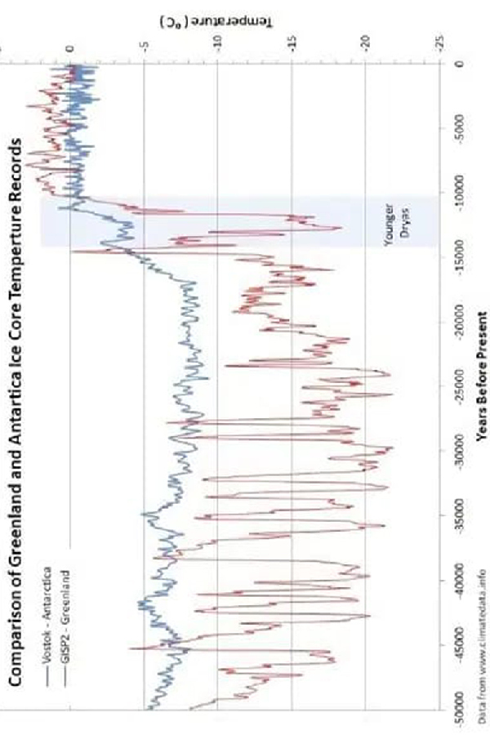

Slide 13
Adapted from U. van Raden, 2013
Pleistocene / Holocene (P/H) boundary oceanic Koefels-comet Impact Series Scenario (KISS) of 12.850 yr BP Global-warming Threshold Triad (GTT)-Part III
M. Bujatti-Narbeshuber
“It is better to be vaguely right than exactly wrong.“ (C.Read)
The certified 12850 yrs BP to 13080 yrs BP Radiocarbon Plateau (Reinig, Reimer) and Lateglacial Ice Age KISS-chronology

Slide 14
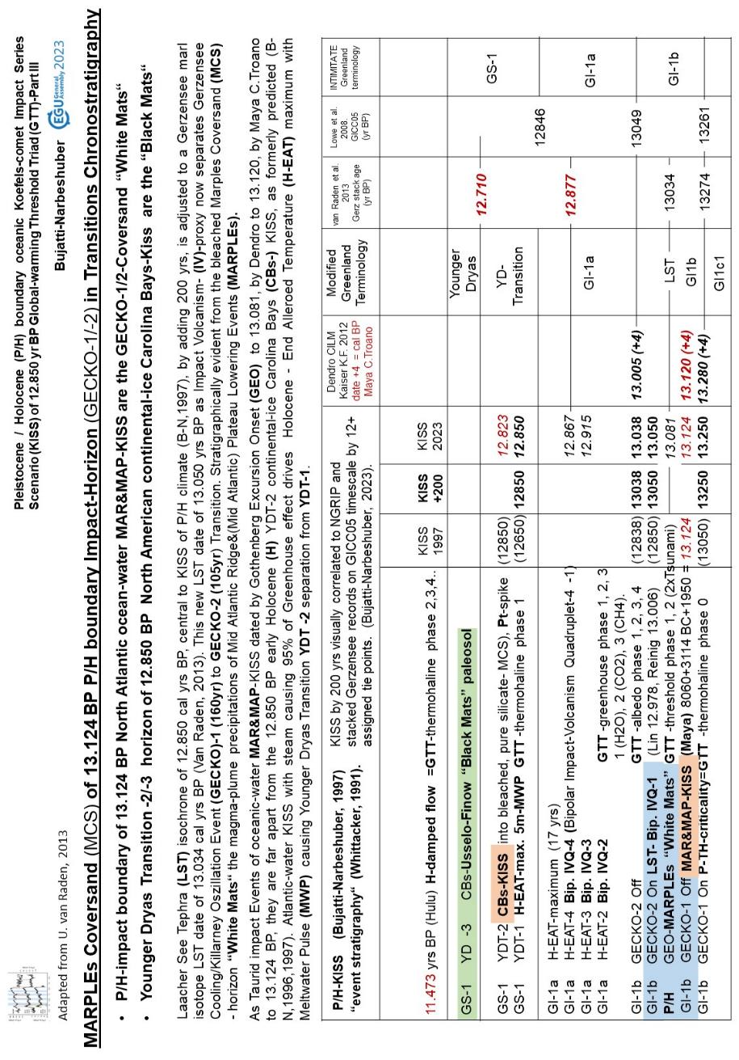

Slide 15
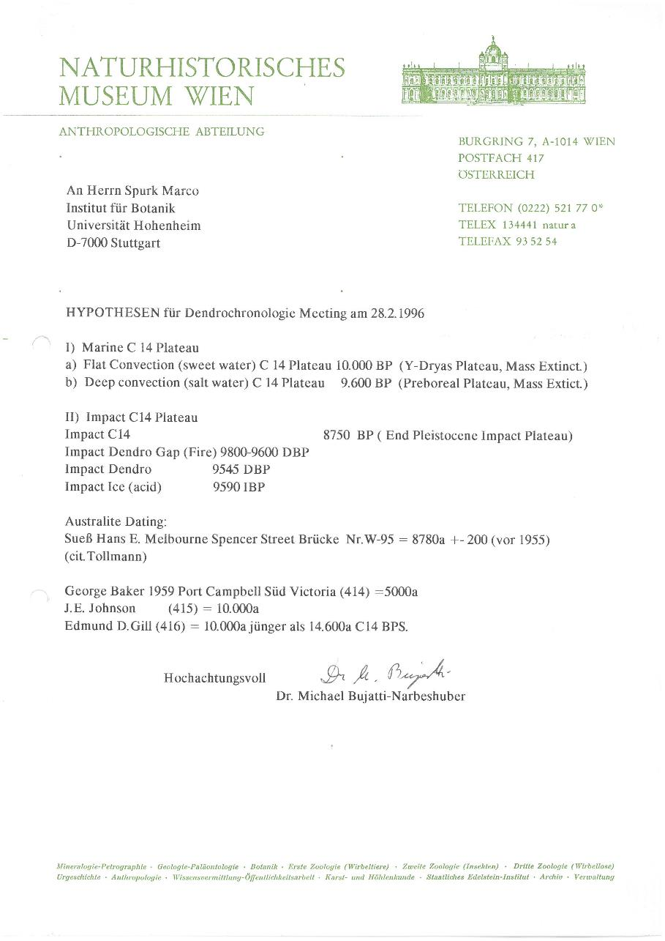

Slide 17
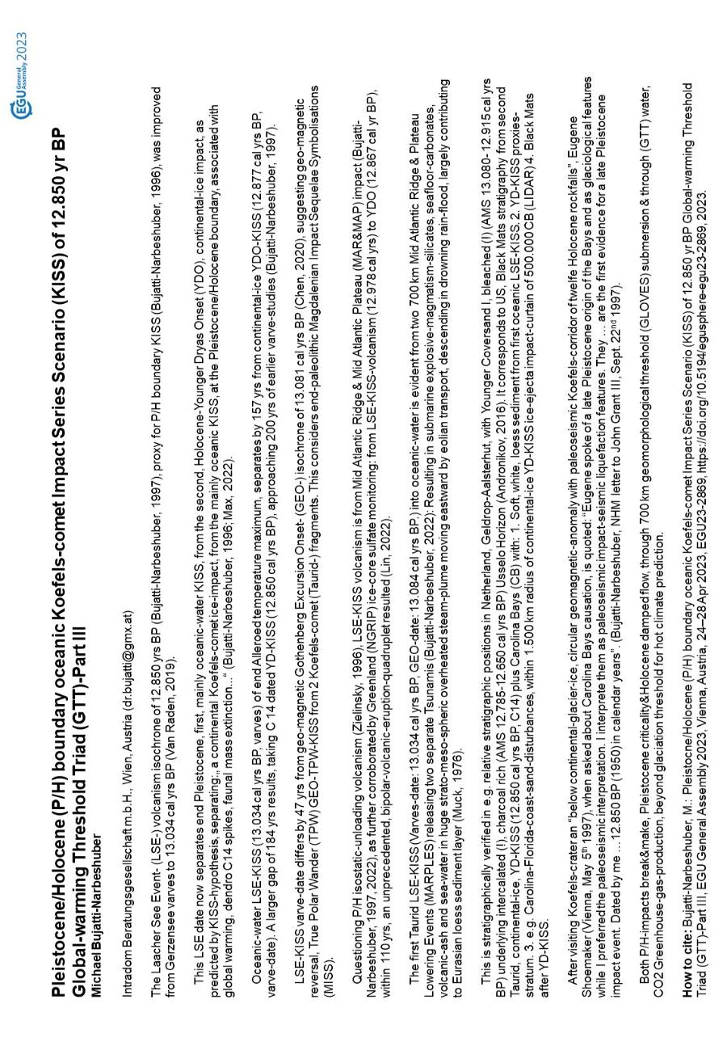

Slide 24
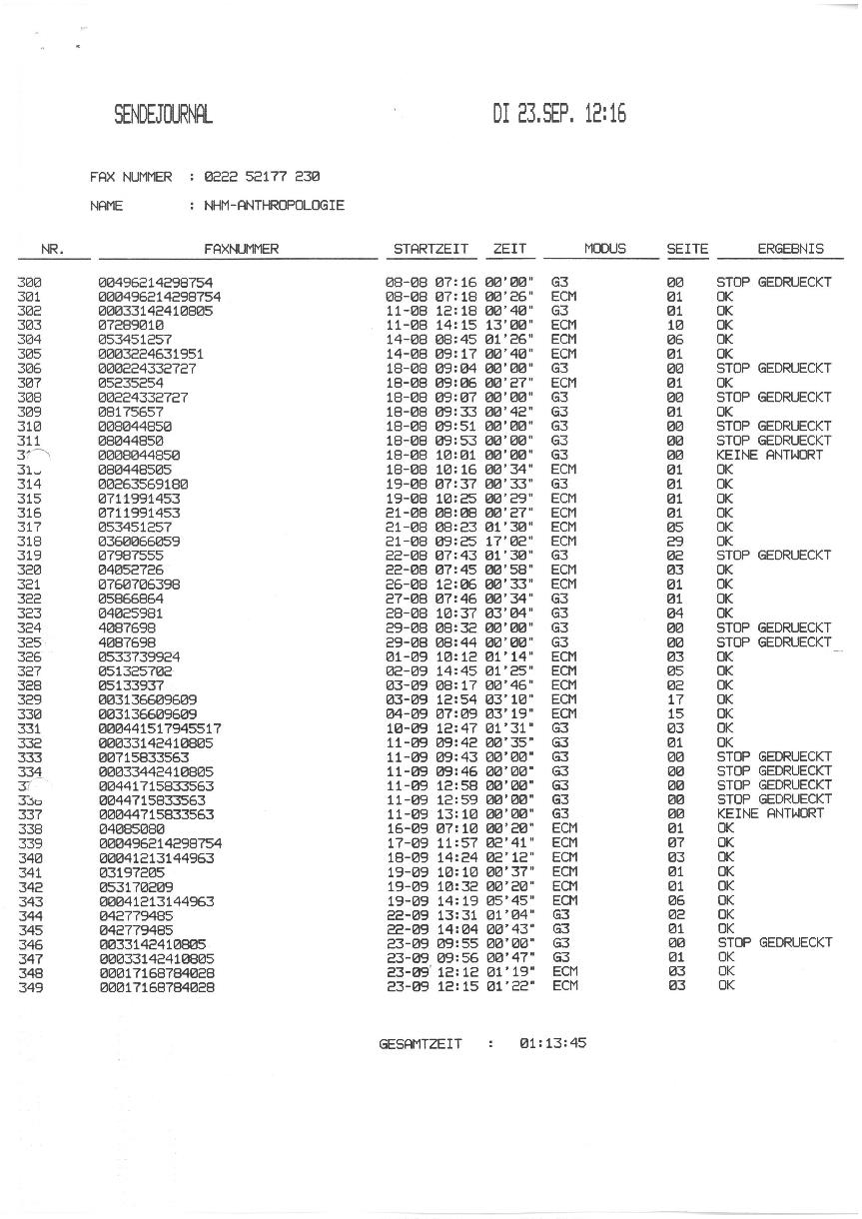

Slide 27
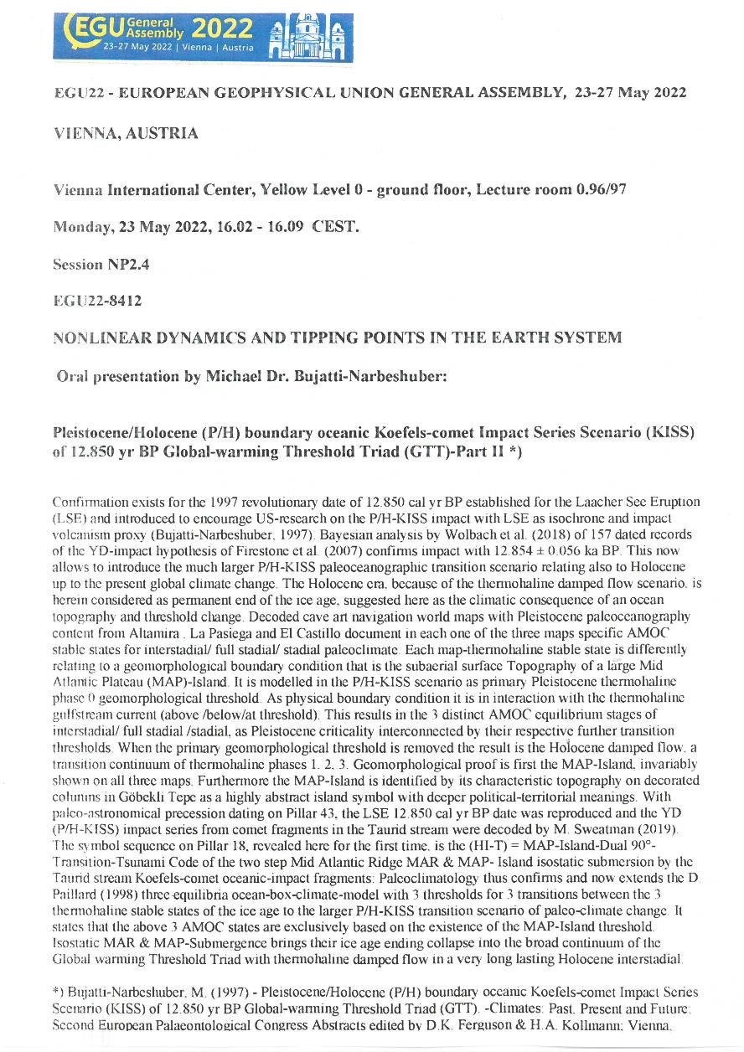

Slide 29
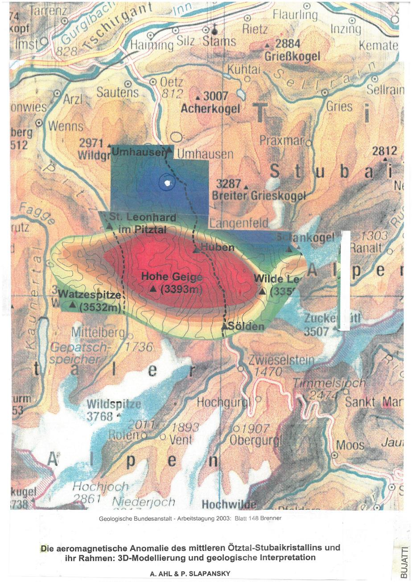

Slide 32
2001

Slide 33
2001

Slide 34
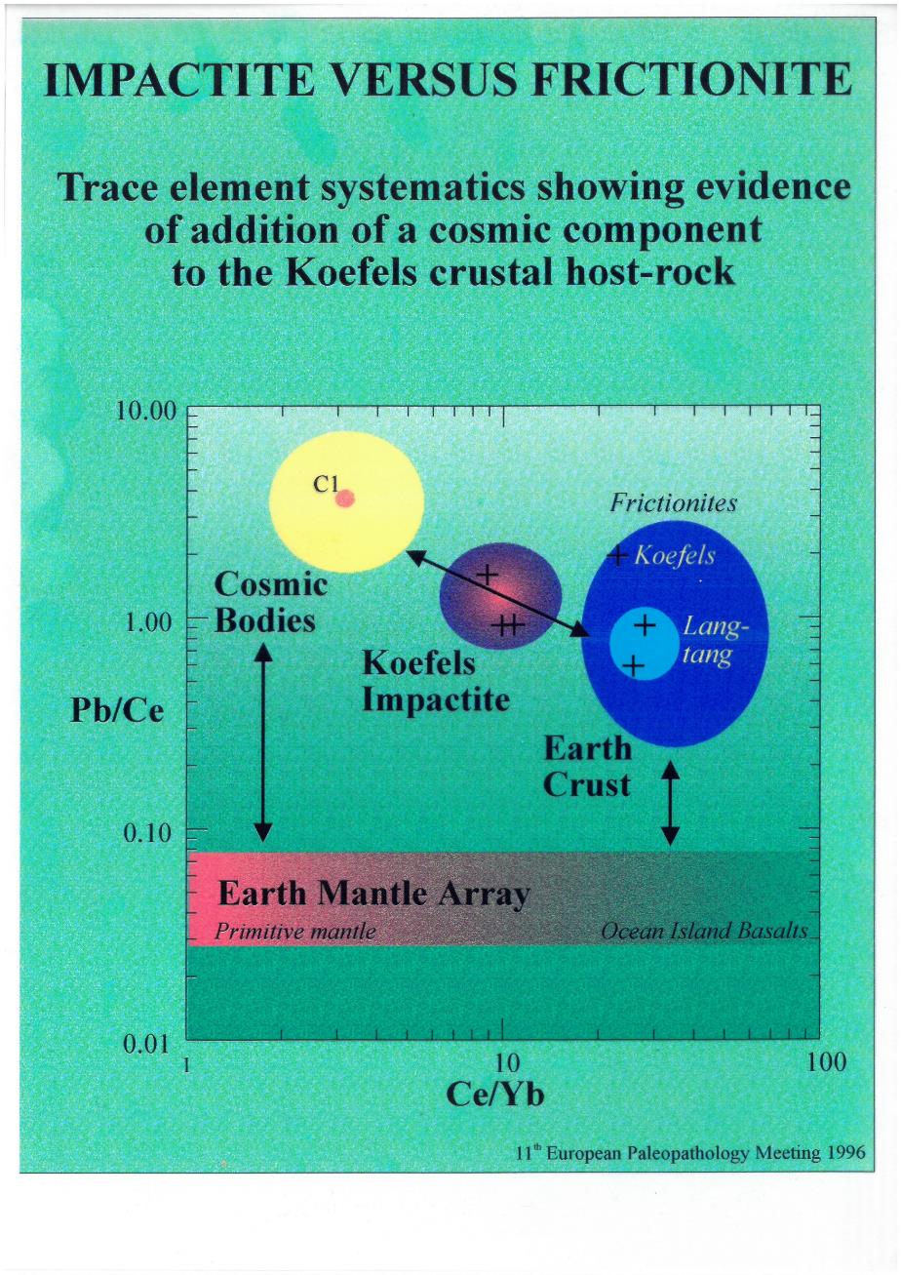

Slide 35
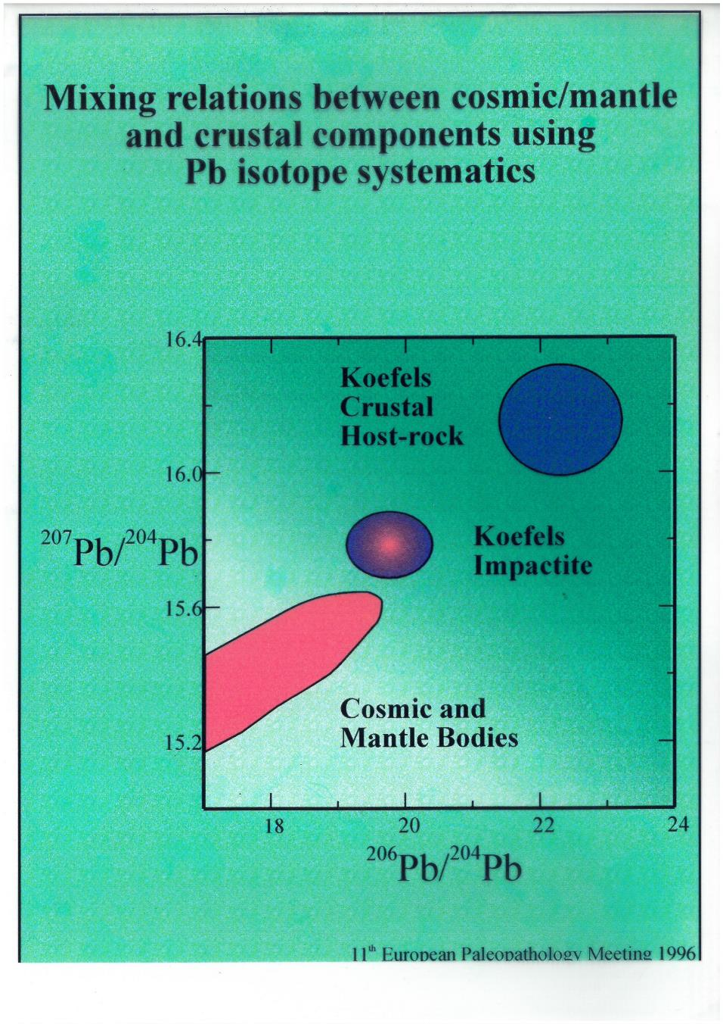

Slide 38
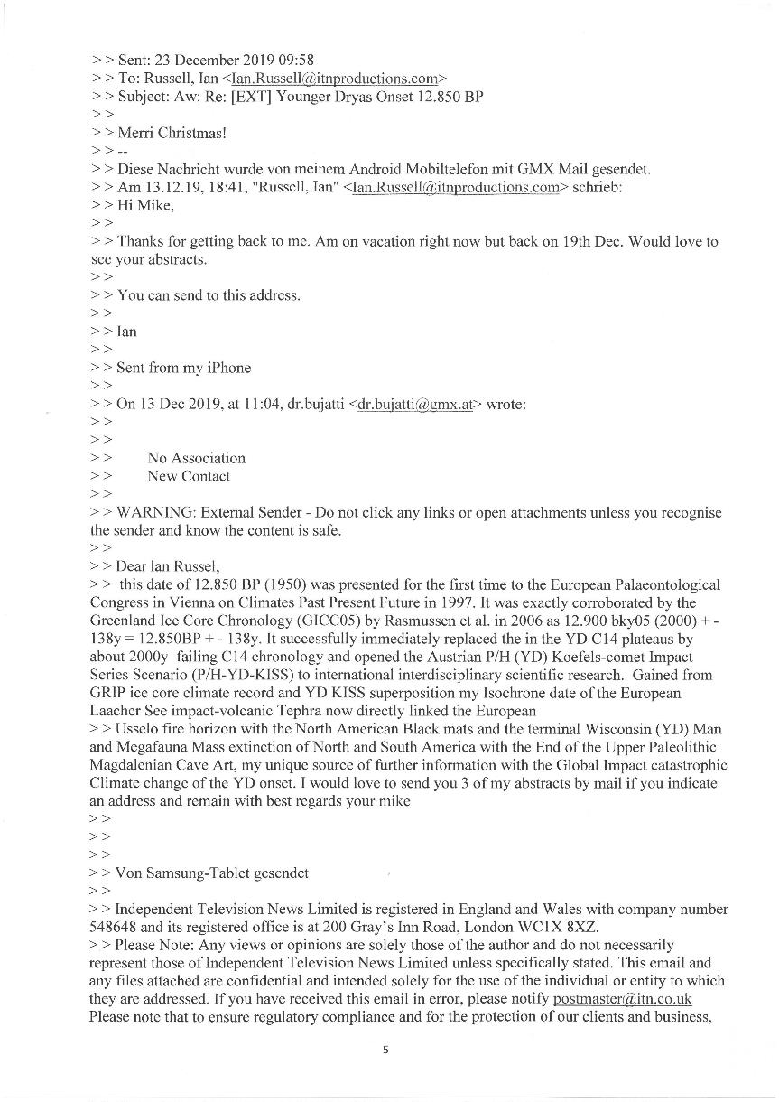

Slide 39
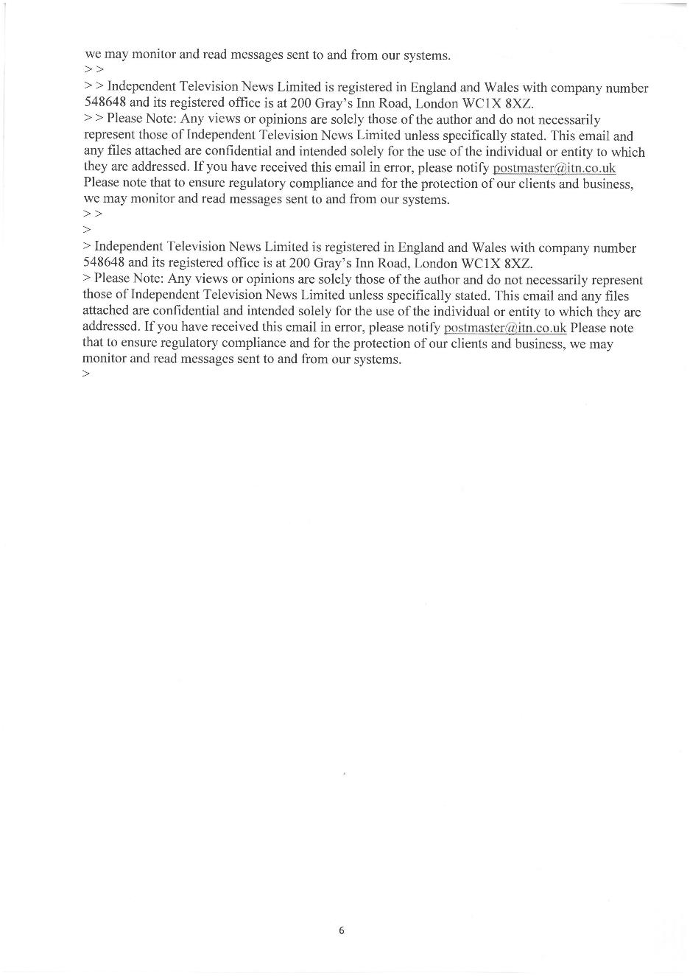

Slide 40
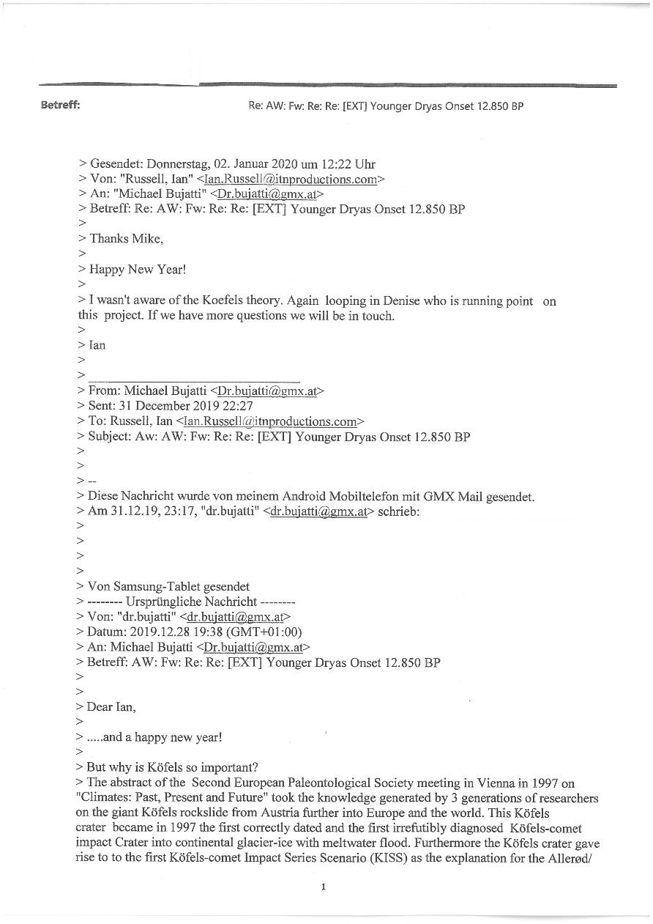

Slide 41
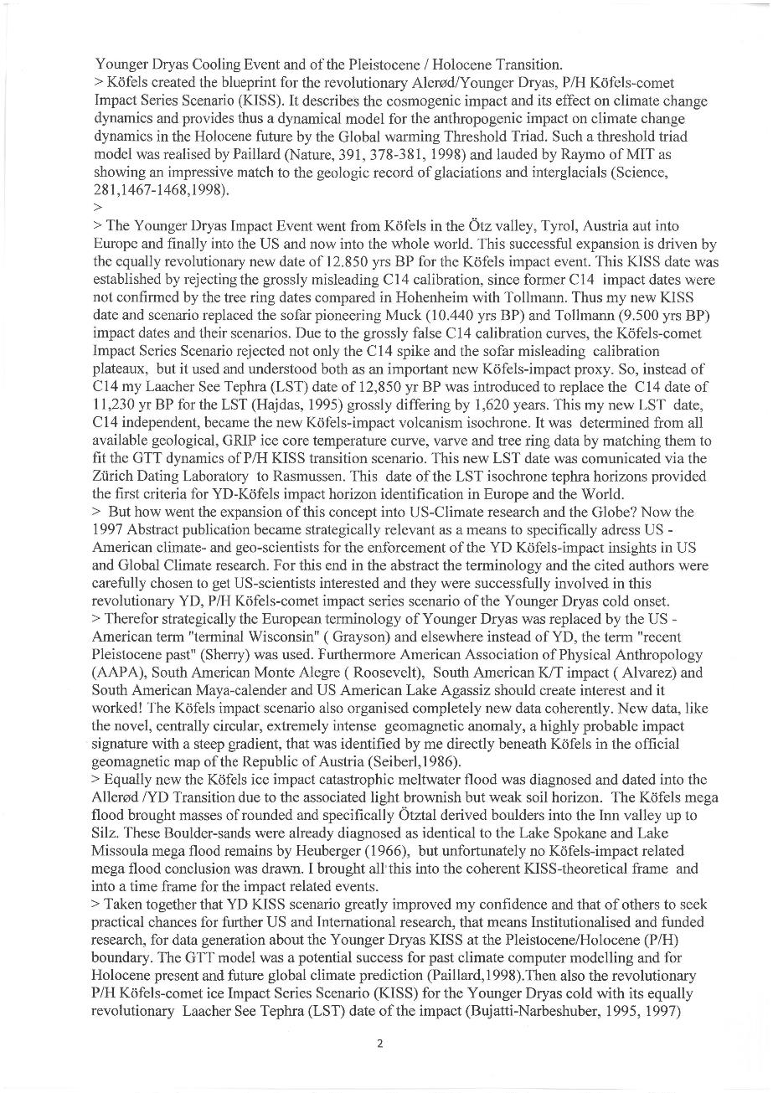

Slide 42
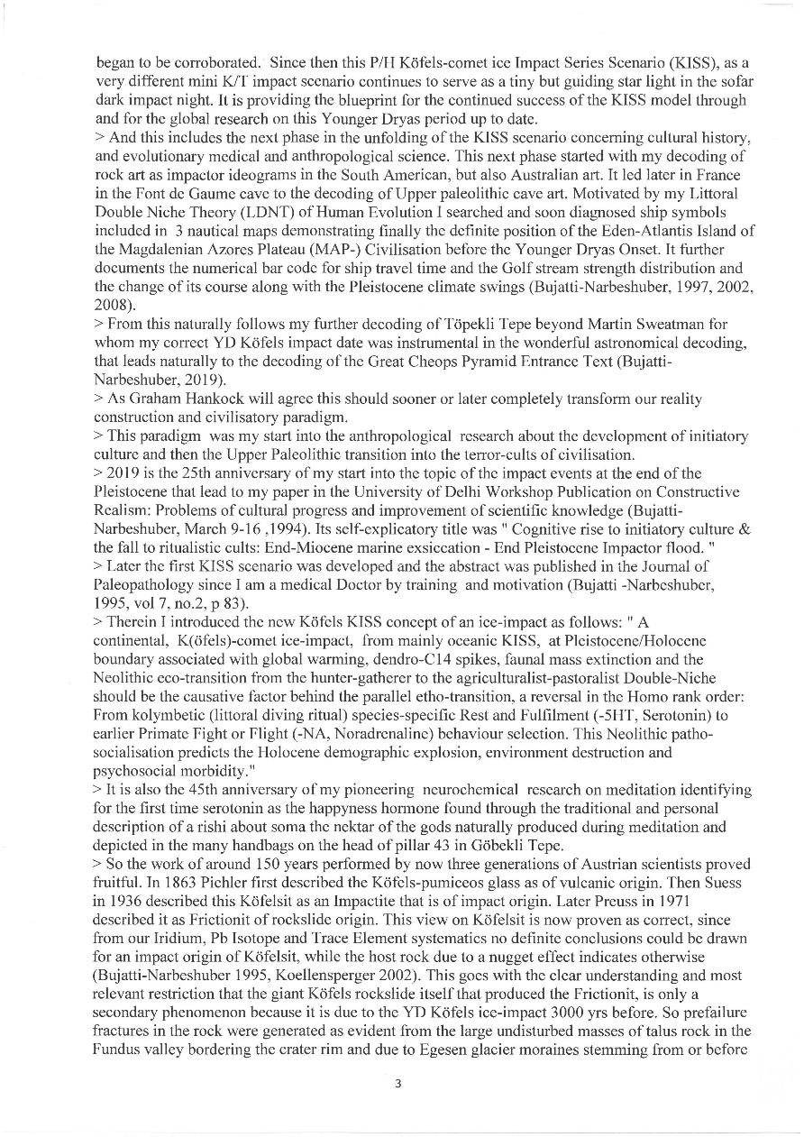

Slide 43
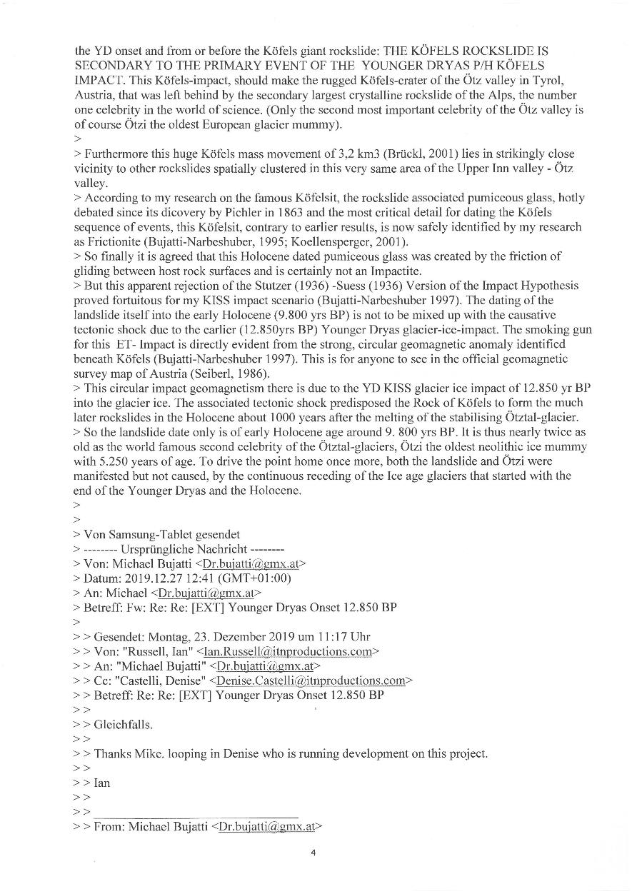

Slide 44
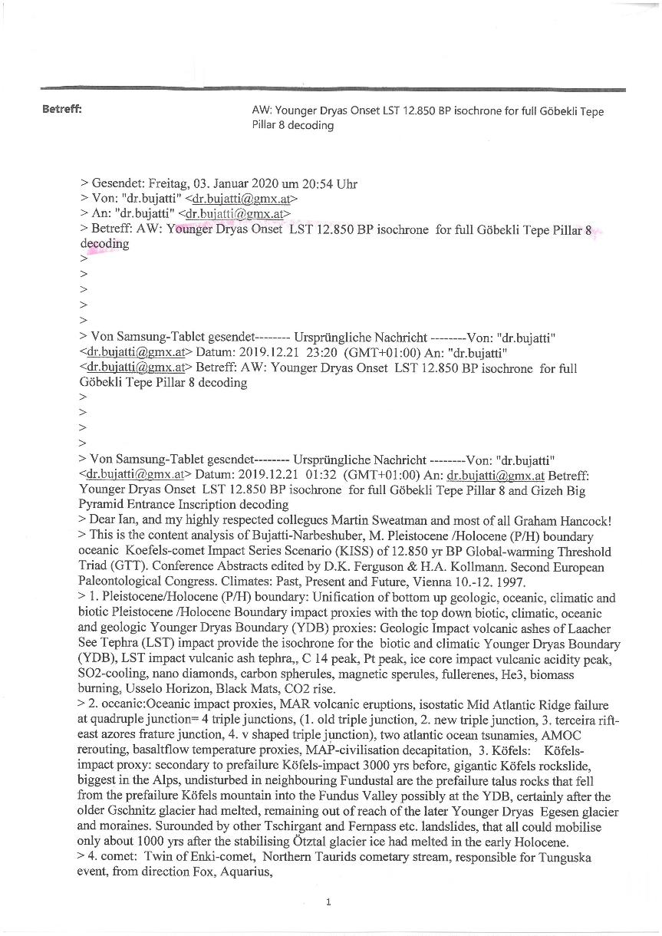

Slide 45
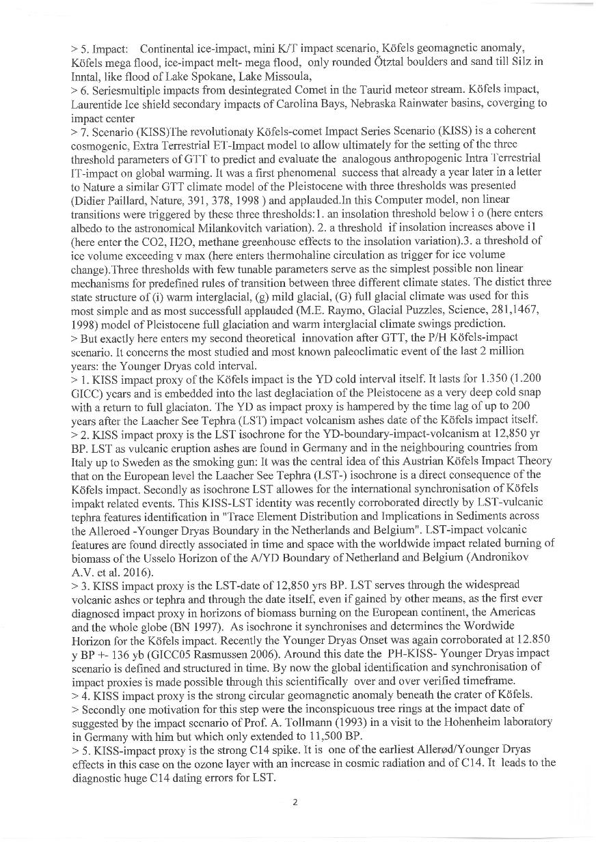

Slide 46
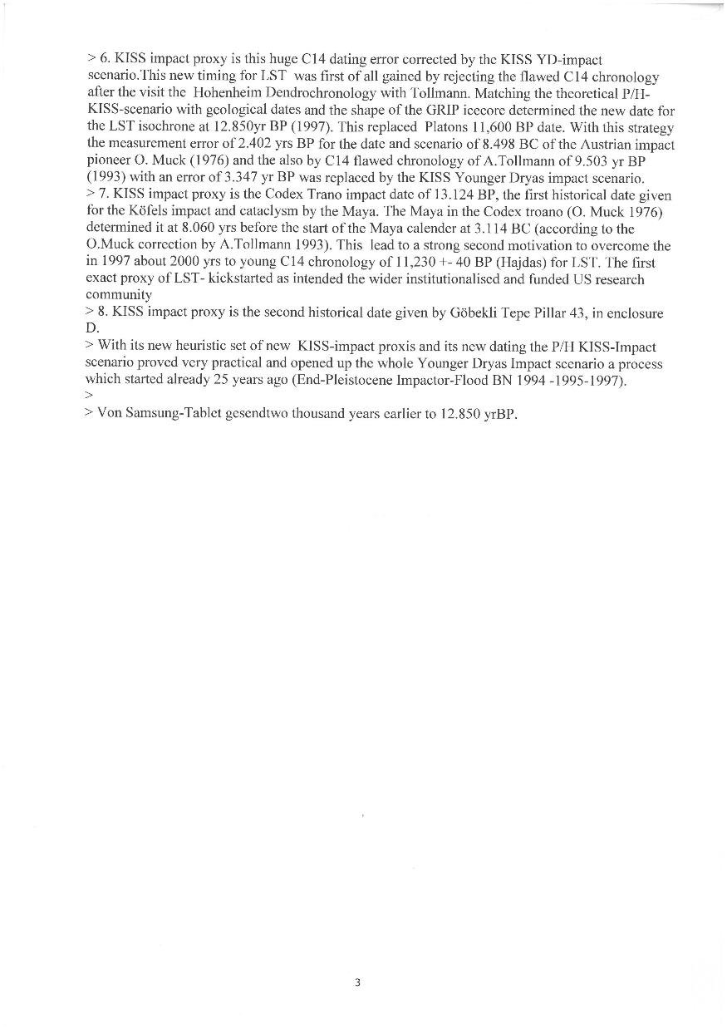

Slide 47
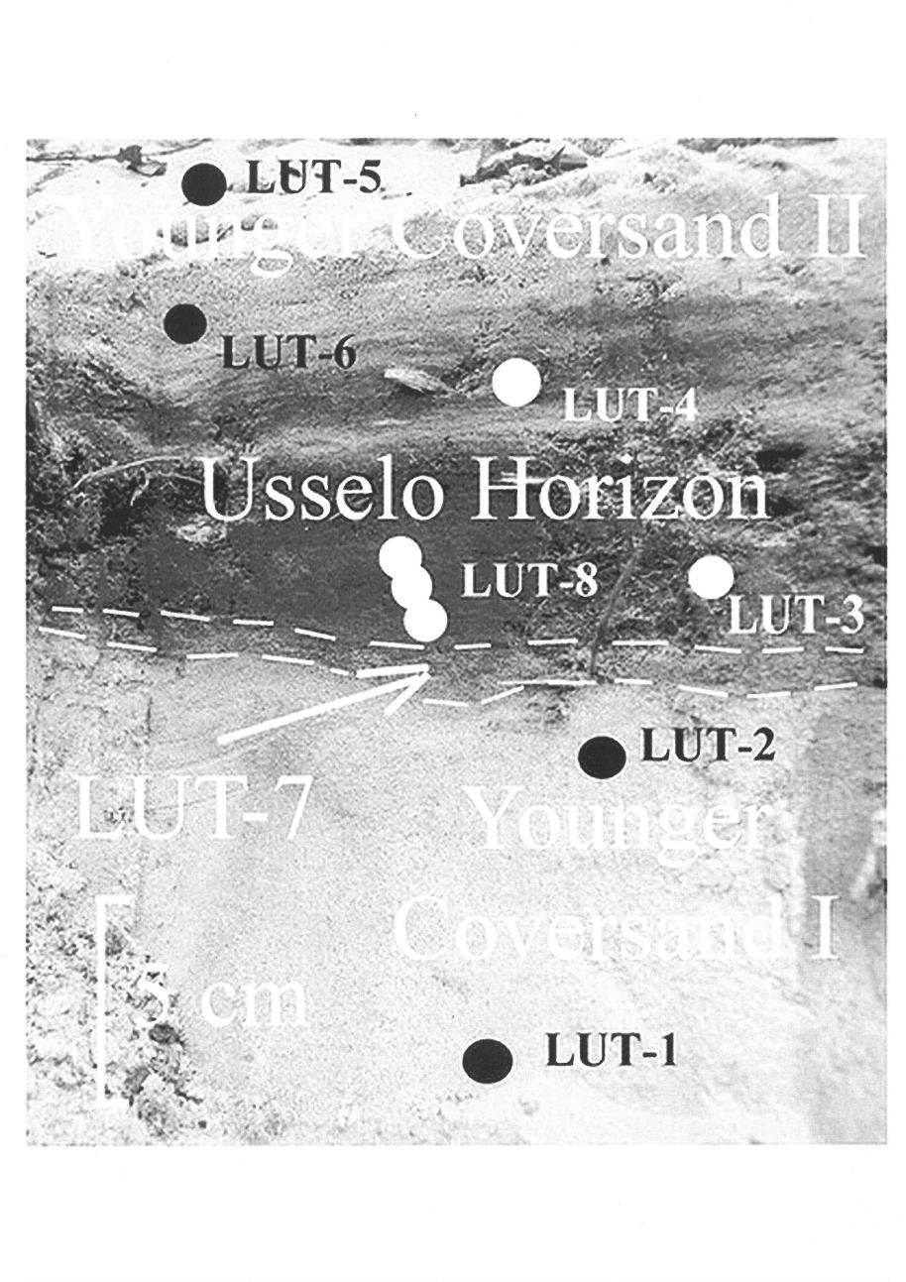
Alexandre V. Andronikov, Annelies Van Hoesel, Irina E. Andronikova and Wim Z. Hoek, 2016

Slide 48
Alexandre V. Andronikov, Annelies Van Hoesel, Irina E. Andronikova and Wim Z. Hoek, 2016

Slide 49
Pleistocene / Holocene (P/H) boundary oceanic Koefels-comet Impact Series Scenario (Kiss) of 12.850 yr BP Global-warming Threshold Triad (GTT)-Part II
Holocene (The totally new)
Paul Gervais 1850
Dr. M. Bujatti -Narbeshuber

Slide 53
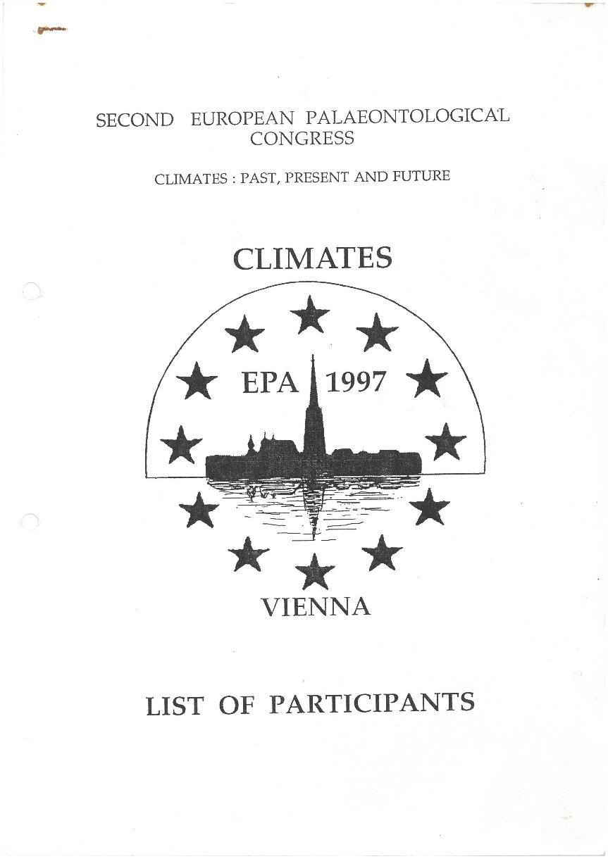

Slide 54
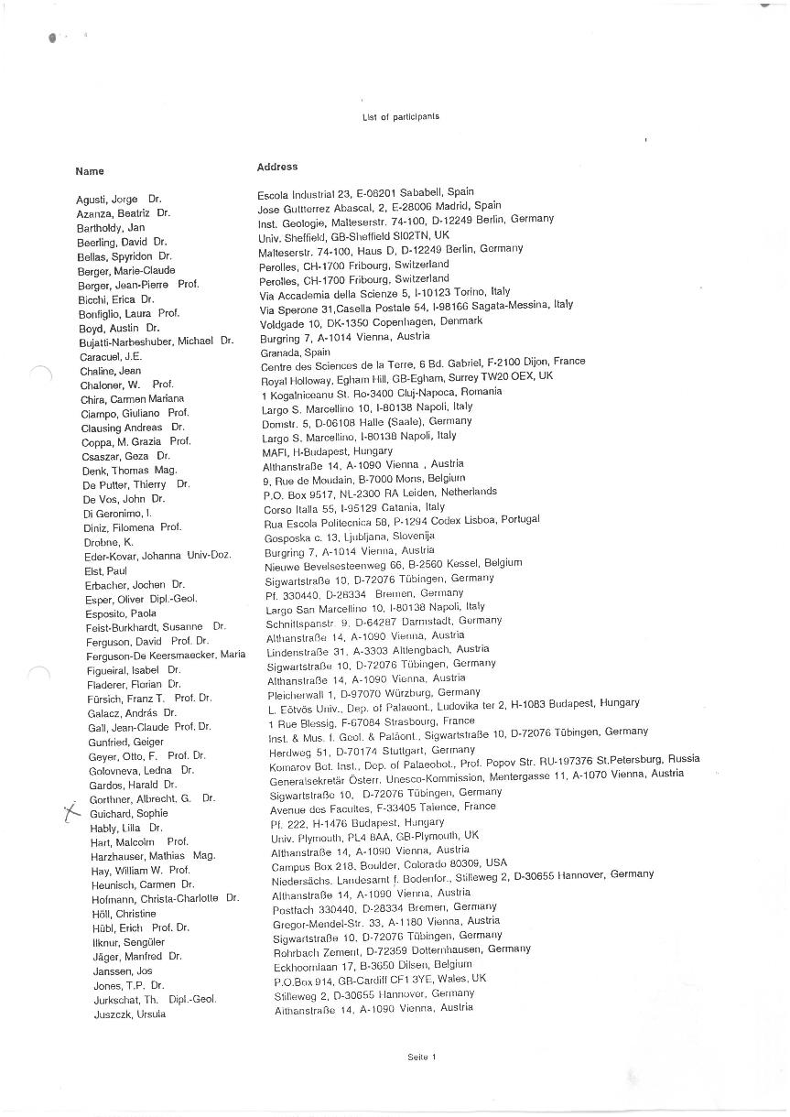

Slide 55
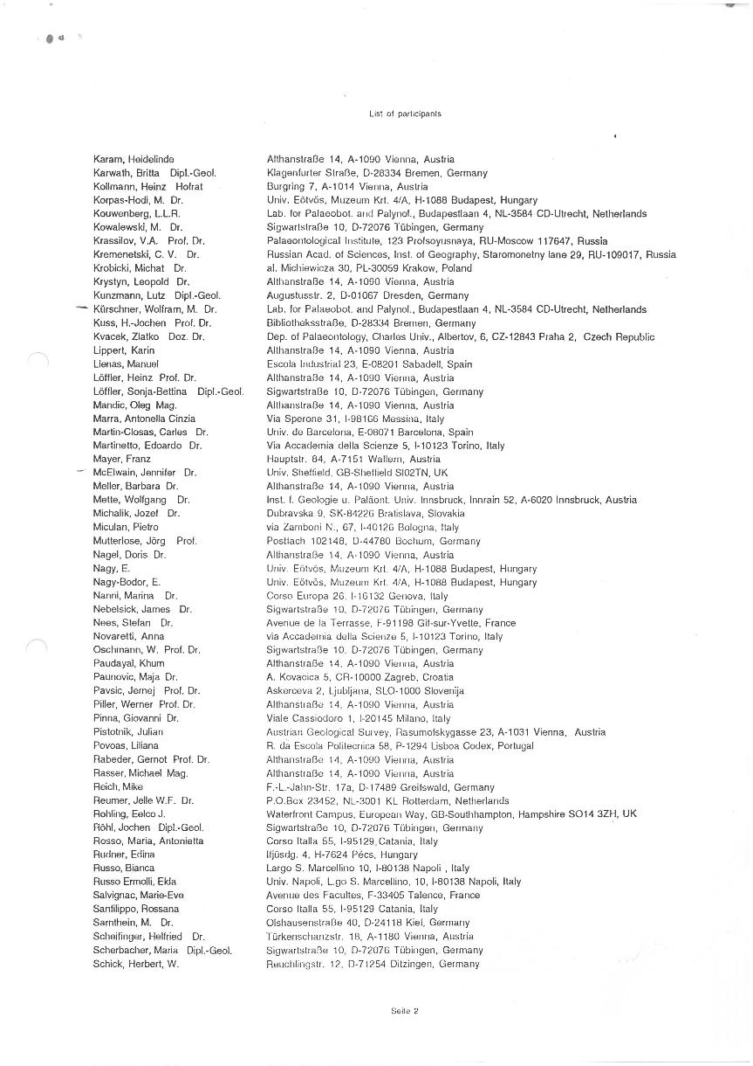

Slide 56
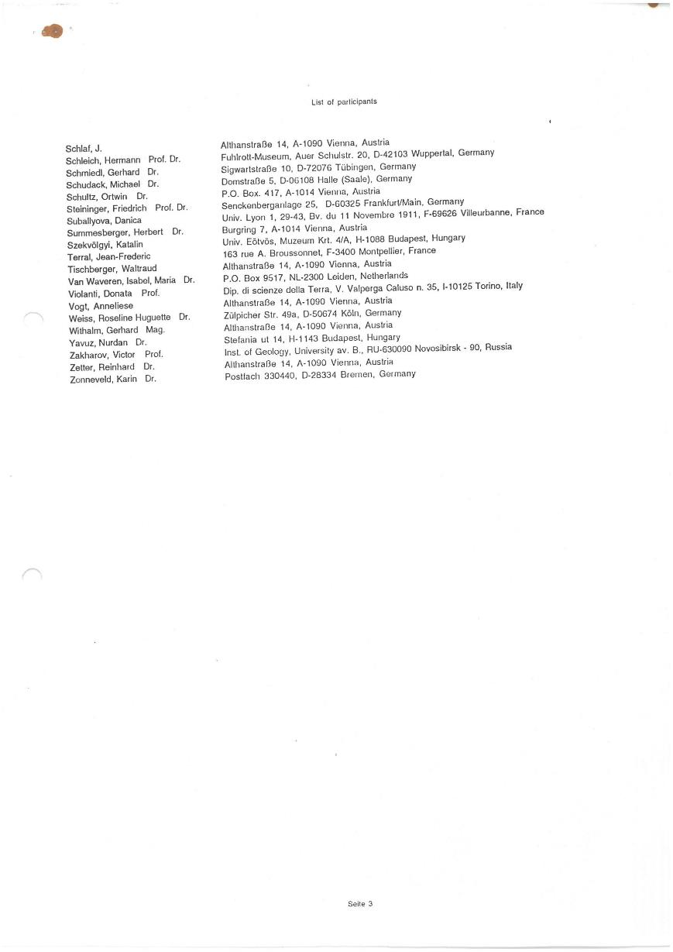

Slide 59
Dr. Bujatti – Narbeshuber, EGU 22

Slide 60
Dr. Bujatti – Narbeshuber, EGU 22

Slide 61
Dr. Bujatti – Narbeshuber, EGU 22

Slide 62
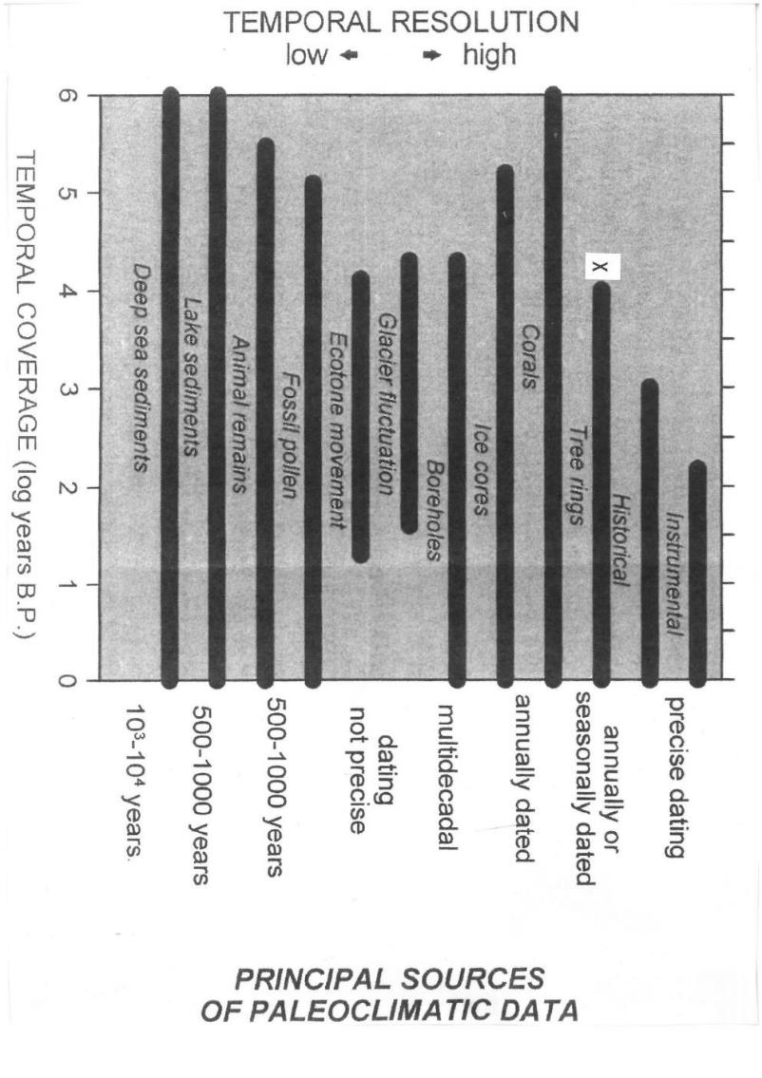
Dr. Bujatti – Narbeshuber, EGU 22
X
Luise Bodri and Vladimir Cermak, Borehole Climatology, 2007

Slide 63
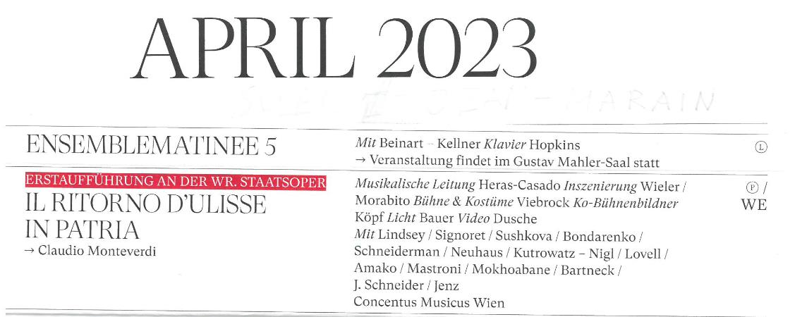

Slide 64
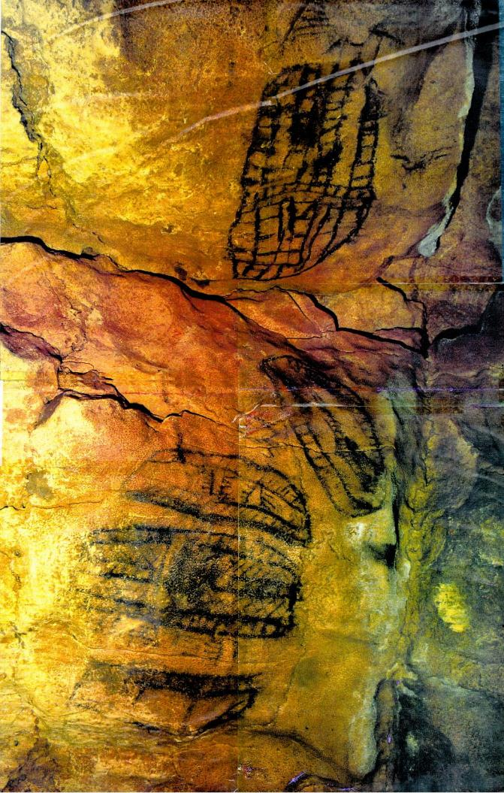
Dr. Bujatti – Narbeshuber, EGU 22
ALTAMIRA PHOTO
In Denis Vialou, Frühzeit des Menschen, Beck 1992
Rotation by 90° from: West = Up

Slide 65
18.850 BP, ALTAMIRA
Rotation by 90° from: West = Up
Dr. Bujatti – Narbeshuber, EGU 22

Slide 66
18.850 BP, ALTAMIRA
Rotation by 90° from: West = Up
Dr. Bujatti – Narbeshuber, EGU 22

Slide 67
Dr. Bujatti – Narbeshuber, EGU 22
Adapted from Didier Pallard
The Timing of Pleistocene glaciations from a simple multiple-state climate model.
Nature Volume 391, P. 378 – 381 and
Louise Bodri and Vladimir Cermak, Borehole Climatology, 2007
TPW - GEO - LSE Isochrone = True Polar Wander – Gotthenberg Excursion Onset – Laacher See Event – Isochrone 13.050 B.P.

Slide 68
Dr. Bujatti – Narbeshuber, EGU 22
Adapted from Didier Pallard
The Timing of Pleistocene glaciations from a simple multiple-state climate model.
Nature Volume 391, P. 378 - 381
From G.L.O.V.E.S on – off Ice-Age Criticallity by East ( or West ) of MAR Azores Front ( AF ) Gyre Lowering – slow ( or Lifting – fast ), inbetween Oszillating Valve Excursion Systems towards GTT Confluence of Holocene Damped Flow

Slide 69
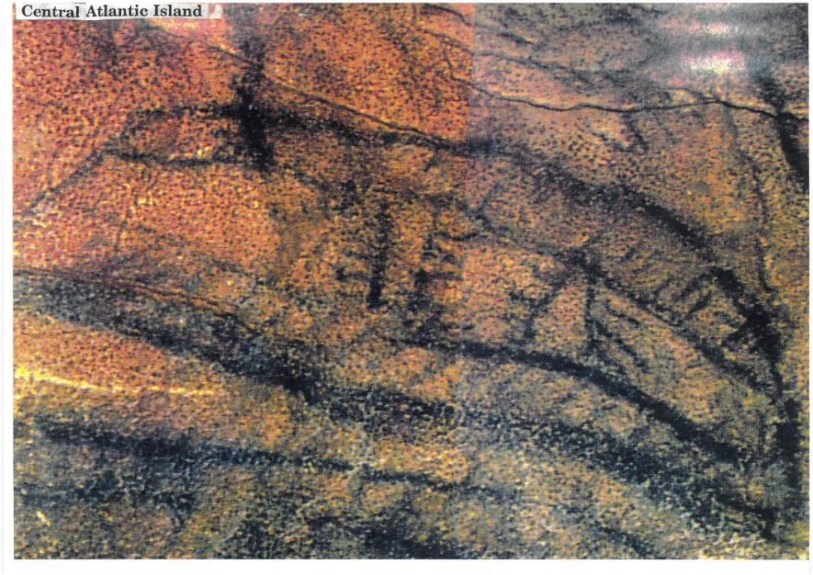
Dr. Bujatti – Narbeshuber, EGU 22

Slide 70
Dr. Bujatti – Narbeshuber, EGU 22

Slide 71
Dr. Bujatti – Narbeshuber, EGU 22
32 W bis 25 W Longitude
700Km Length
Trending West North West to East South East
135° Shouvel Shape

Slide 72
Dr. Bujatti – Narbeshuber, EGU 22

Slide 73
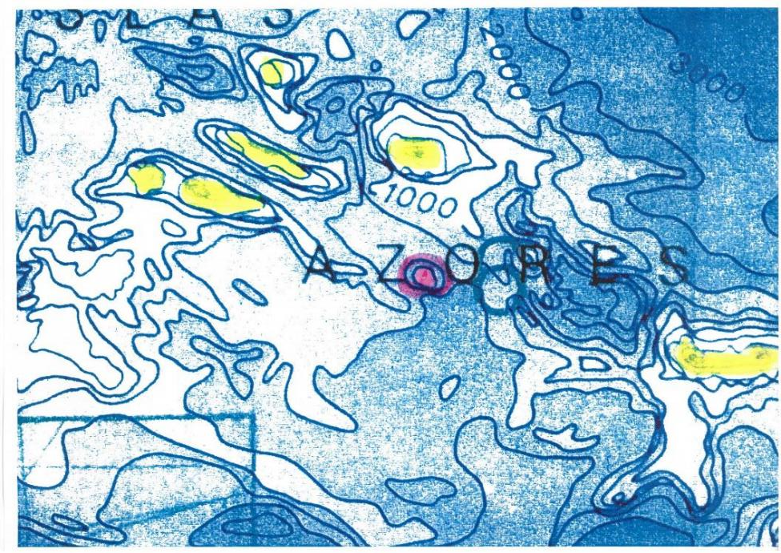
Dr. Bujatti – Narbeshuber, EGU 22
General Bathymetric Chart of the Oceans (GEBCO), Published by the Canadian Hydrographic Service, Ottawa, Canada. 5th Edition, January 1982, reprinted July 1984

Slide 74
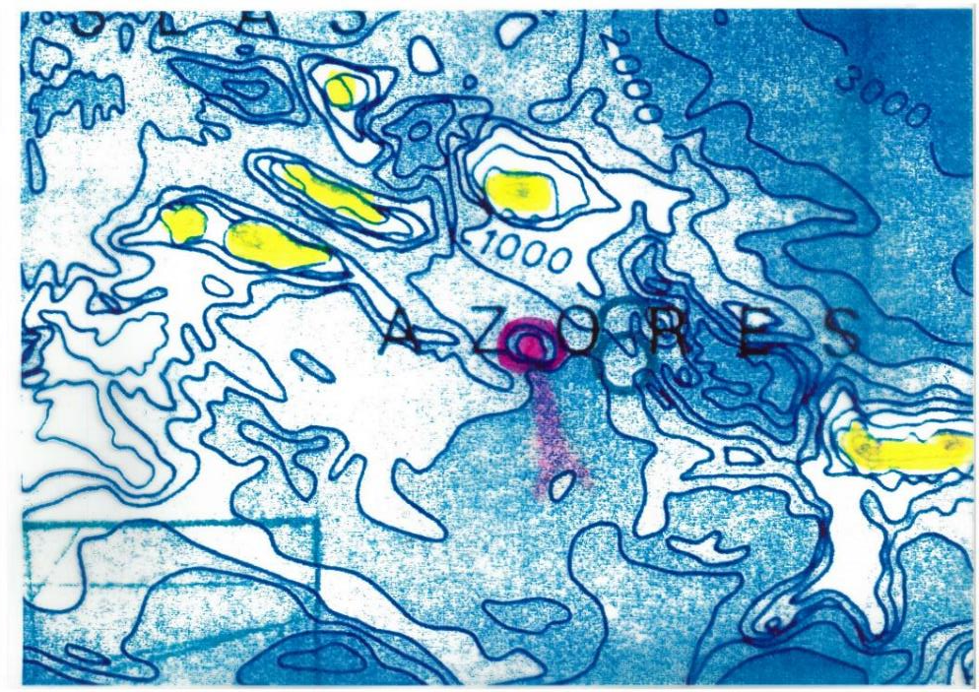
Dr. Bujatti – Narbeshuber, EGU 22
General Bathymetric Chart of the Oceans (GEBCO), Published by the Canadian Hydrographic Service, Ottawa, Canada. 5th Edition, January 1982, reprinted July 1984

Slide 75
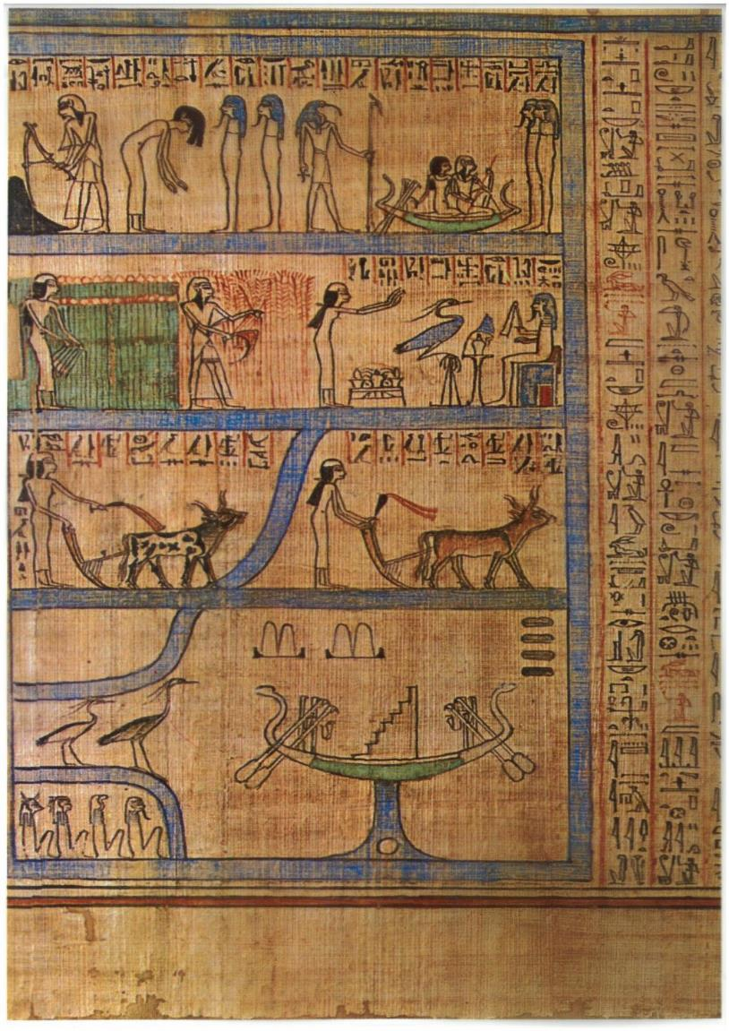
Dr. Bujatti – Narbeshuber, EGU 22

Slide 76
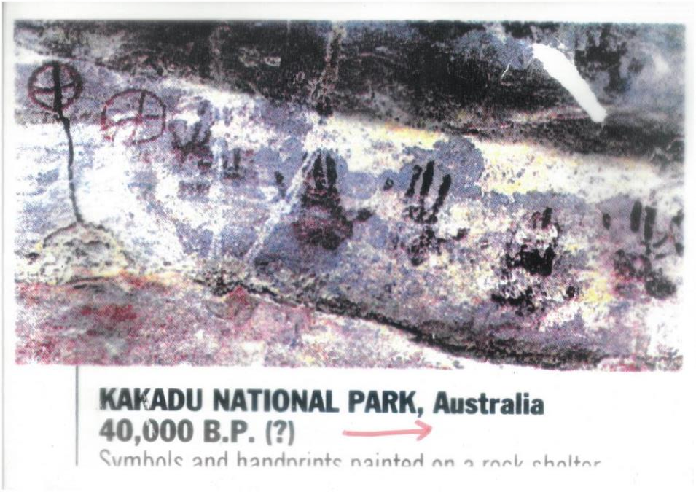
Dr. Bujatti – Narbeshuber, EGU 22

Slide 77
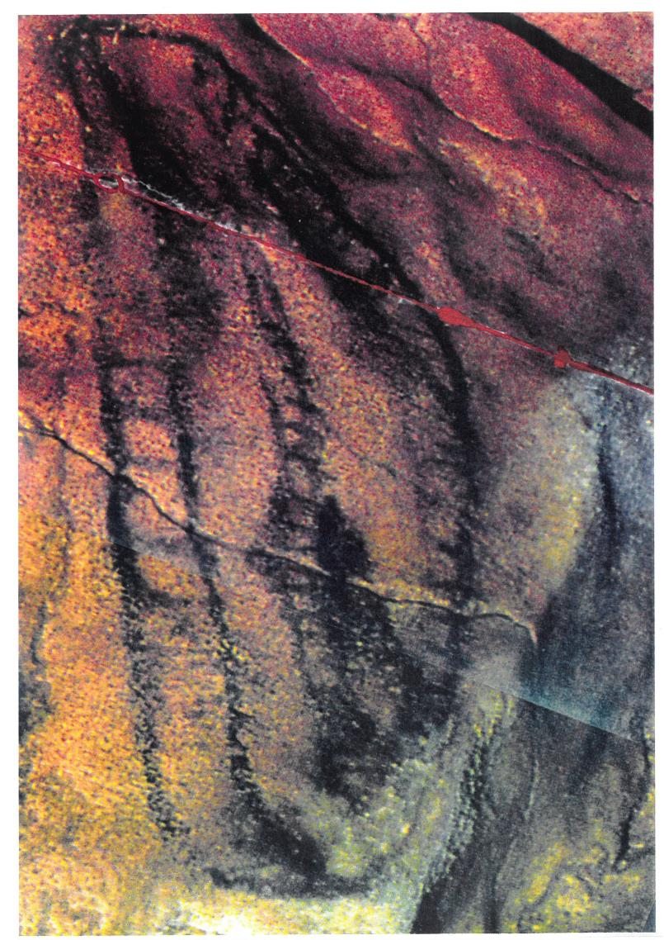
Dr. Bujatti – Narbeshuber, EGU 22
United Kingdom

Slide 78
Dr. Bujatti – Narbeshuber, EGU 22
United Kingdom

Slide 79
Dr. Bujatti – Narbeshuber, EGU 22
United Kingdom

Slide 80
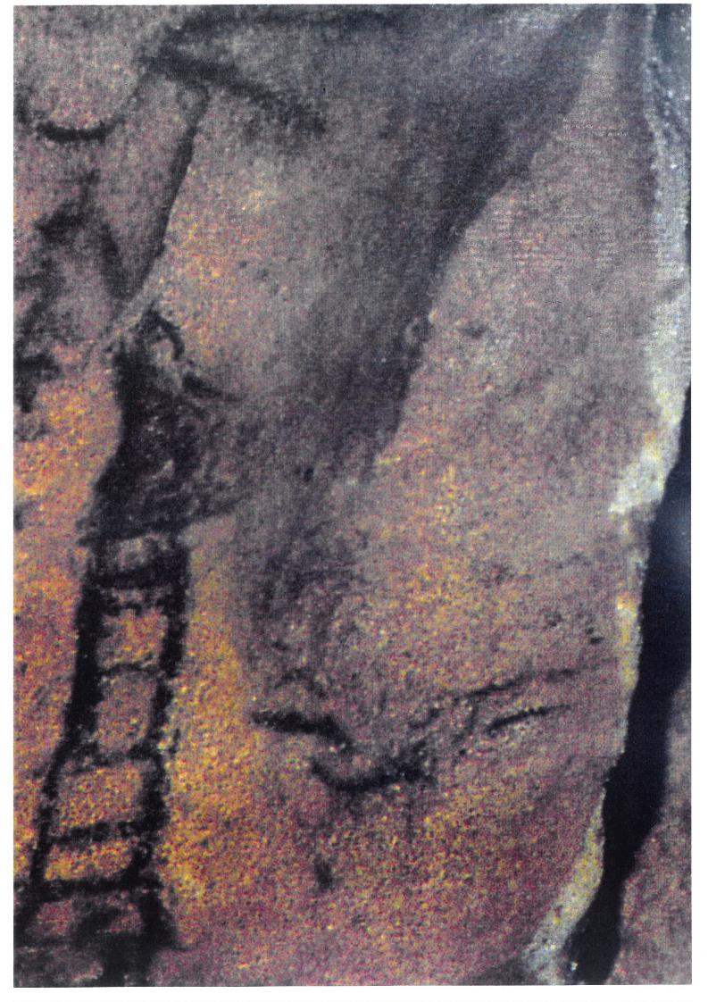
Dr. Bujatti – Narbeshuber, EGU 22
Faroe Islands

Slide 81
Dr. Bujatti – Narbeshuber, EGU 22
Faroe Islands

Slide 82
Dr. Bujatti – Narbeshuber, EGU 22
Faroe Islands

Slide 83
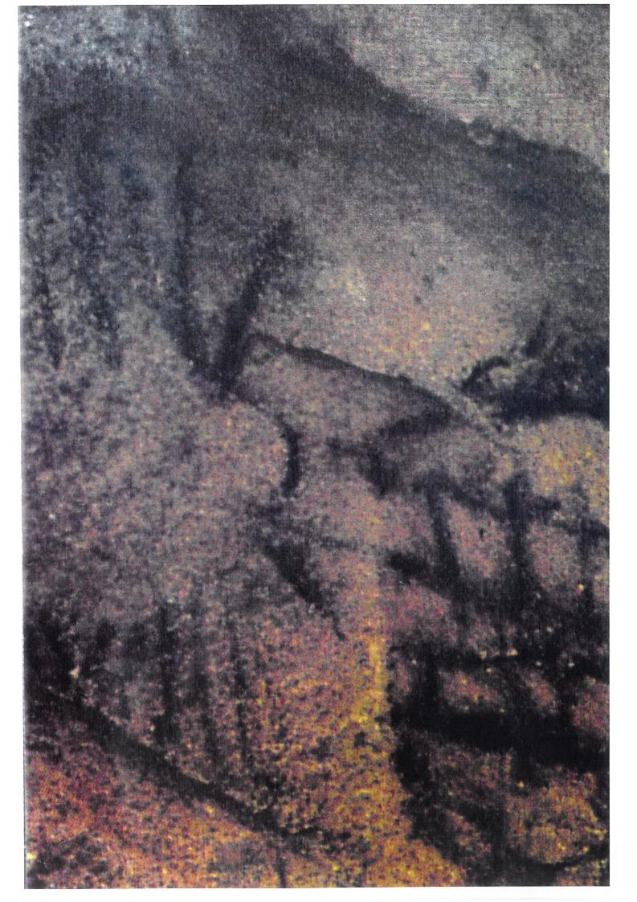
Dr. Bujatti – Narbeshuber, EGU 22
Iceland

Slide 84
Dr. Bujatti – Narbeshuber, EGU 22
Iceland

Slide 85
Dr. Bujatti – Narbeshuber, EGU 22
Iceland

Slide 86
Dr. Bujatti – Narbeshuber, EGU 22
Svalbard

Slide 87
Dr. Bujatti – Narbeshuber, EGU 22
Svalbard

Slide 88
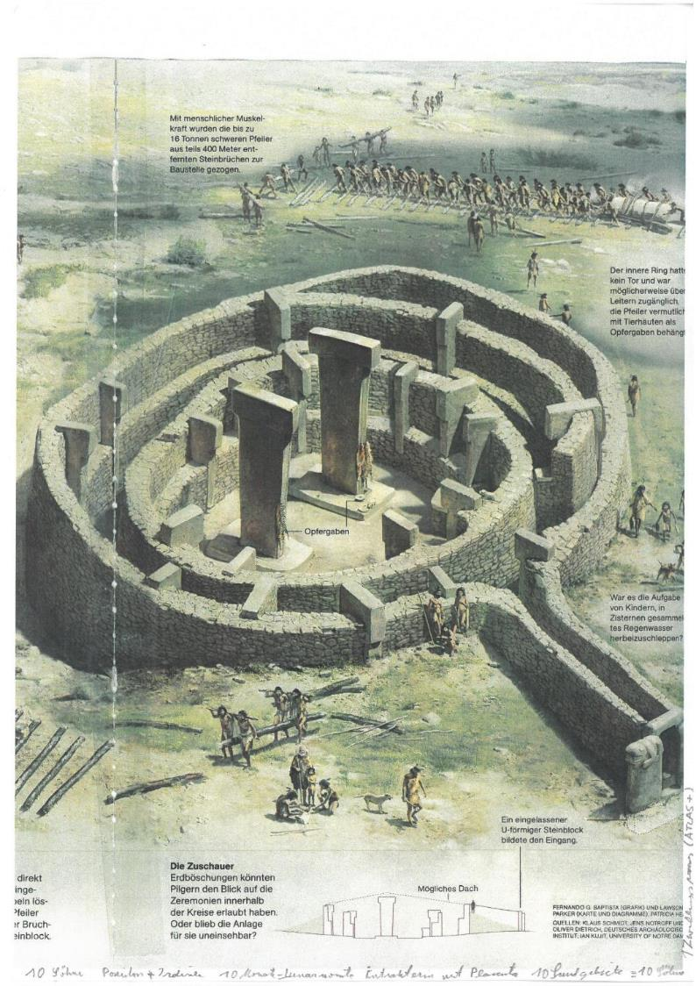
Dr. Bujatti – Narbeshuber, EGU 22
Signe Metropoliforme – Uteriforme
National Geographic, Juni 2011

Slide 89
Dr. Bujatti – Narbeshuber, EGU 22
Göbekli Tepe Pillar 43, P/H KISS

Slide 90
Dr. Bujatti – Narbeshuber, EGU 22
Göbekli Tepe Pillar 43, P/H KISS

Slide 91
Dr. Bujatti – Narbeshuber, EGU 22
Göbekli Tepe Pillar 18, P/H MISS

Slide 92
Dr. Bujatti – Narbeshuber, EGU 22
Göbekli Tepe Pillar 18, P/H MISS

Slide 93
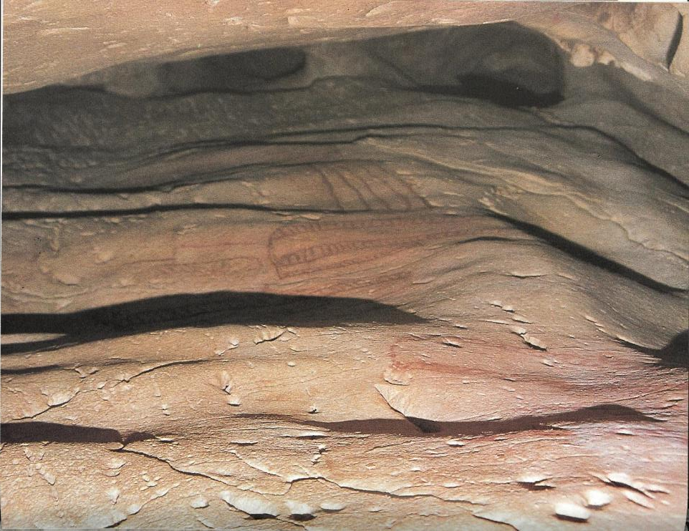
Dr. Bujatti – Narbeshuber, EGU 22
The U – Shaped Rock Formation open to the left is the Gulf Stream during Meltwater Pulse A1 probabely.
Denis Vialou, Frühzeit des Menschen, Beck 1992

Slide 94
Dr. Bujatti – Narbeshuber, EGU 25
Map of
Mid Atlantic Plateau and Amoc Current during MWP 1A
Meltwater Pulse 1A Maximum with
Central Plane
Inundation
Azores
Current
Turbulence
Graziosi, P. Die Kunst der Altsteinzeit, W. Kohlhammer, 1956
Adapted by Dr. Bujatti – Narbeshuber, EGU 22

Slide 95
Dr. Bujatti – Narbeshuber, EGU 25 Vienna
Mid Atlantic Plateau and Amoc Current during MWP 1A
Meltwater Pulse 1A
(14,6 – 14,2 kyr)
ACR 4
Azores Current Rapids (ACR)
Quantitative Strength Code
as in El Castillo Map
Flores Island
ACR 6
ACR 6
End Azores Plateau
Azores Plateau
Central Plain
Front Azores Plateau
Baia da Praia ( BDP )
Adapted from Breuil, Obermaier and Alcalde del Rio. La Pasiega á Puente-Viesgo ( Santander Espagne ) 1913

Slide 96
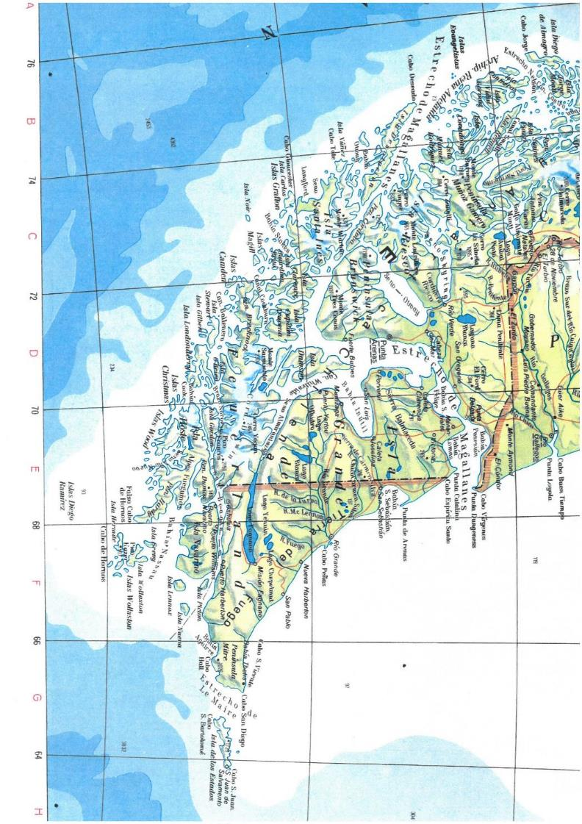
La Pasiega 15.000 BP
Ad 7: Map of the Magellan
Passage to the Pacific

Slide 97
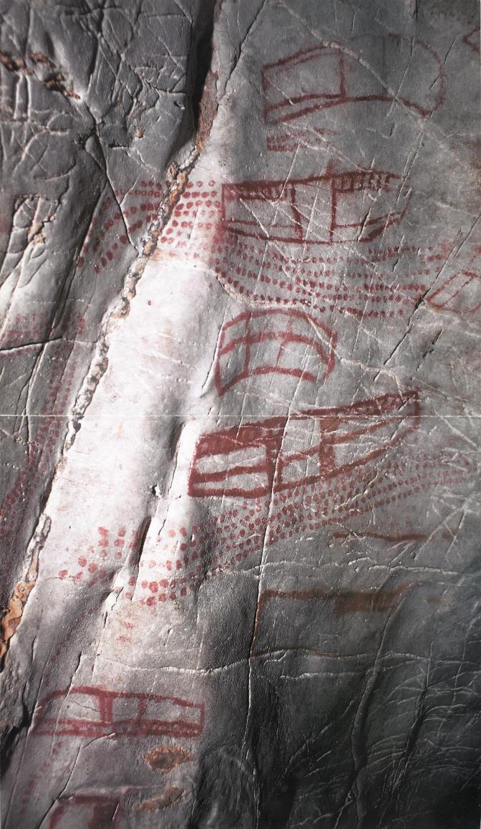
Dr. Bujatti – Narbeshuber, EGU 22
Jean Clottes und David Lewis-Williams, Schamanen, P. 76 – 77, 1997, Jan Thorbecke Verlag
( L. de Seille, Photography of El Castillo, Puente Viesco, Spain )
Rotation by 90° from: West = Up to here North = Up

Slide 98
Dr. Bujatti – Narbeshuber, EGU 22
Adapted from Denis Vialou, Au coer de la Préhistorie,
Dècouvertes Gallimard, P 51, 1996
( M. Lorblanchet, Drawing of El Castillo )
Rotation by 90° from: West = Up

Slide 99
Dr. Bujatti – Narbeshuber, EGU 22
EL CASTILLO
13.060 BP
Michael Lorblanchet, in Denis Vialou AU DE LA PRÈHISTORIE,
Gallimard, 1996, 51.
This Project was partly supported from, „Phylogenetic and Ontogenetic Evolution of Creativity from physico – chemical and human biological Viewpoints“,
Grant no. 49.403 / 1-24 / 84 of the Austrian Ministry for Science and Research

Slide 102
