Slide 1
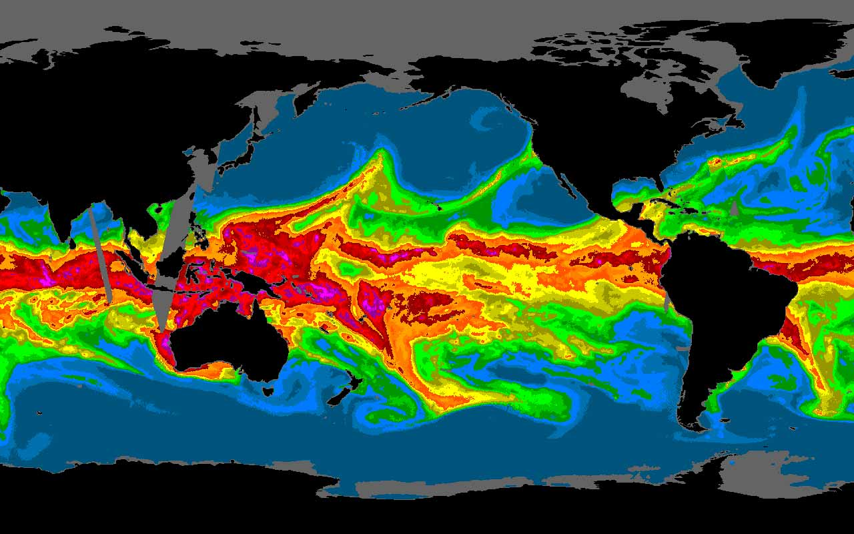
The Response of Sea Surface Temperature to Atmospheric Rivers (Nature Communications 2024)
Center for Western Weather and Water Extremes
許天耀 = Hsu, Tien-Yiao (he/him)
Matthew Mazloff, Sarah Gille, Mara Freilich, Rui Sun, Bruce Cornelle
2025/05/02 @ EGU (virtual)
Notes:
Hi everyone I am Tien-Yiao. I use he/him pronoun. I am happy to share my work published last year on Nature Communication on how ocean SST respond to atmosphere rivers.

Slide 2
Motivation
Atmospheric rivers (ARs) cause $1 billion loss annually in Western United States (Prince et al. 2021)
Simulating local air-sea interaction improves the AR prediction by producing better boundary condition, i.e., sea surface temperature (SST) (Sun et al. 2021).
AR’s air-sea interaction has been studied in an AR-centered composite fashion (Shinoda et al. 2019) but the ocean processes are not quantified.
Our goal: quantifying AR’s spatial-temporal impact over North Pacific SST by using SST budget.

Slide 3
SST tendency budget
$$\frac{∂Θ}{∂t}=\frac{−1}{c_{p}ρ}\frac{∂F}{∂z}−∇⋅\left(\vec{v}Θ\right)+\frac{∂}{∂z}\left(K\frac{∂Θ}{∂z}\right)+∇_{H}⋅\left(K_{H}∇_{H}Θ\right)$$
High wind, temperature and moisture
Vertically integrate within the mixed layer
Shortwave
Sens
Latent
Longwave
Ekman transport
Mixed layer deepening
(entrainment)
Mixed layer shoaling
(detrainment)
Temporal coverage: 1993—2017, October—March
Ocean dataset: ECCOv4
Atmosphere dataset: ERA-interim
Regridded to $2^{∘}×2^{∘}$ in lat-lon

Slide 4
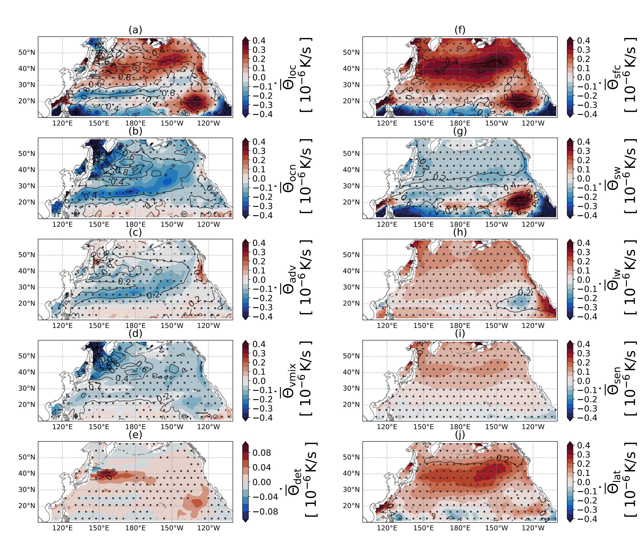
SST Tendency Decomposition
Strong temporal-spatial dependency of both AR forcing and ocean modification.
In some regions, ocean cooling overcompensates the forced SST warming by atmosphere.
Notes:
There is a strong temporal-spatial dependency of both AR forcing and ocean modification.
Ocean compensates the AR warming. In some regions, it can completely offset the anomalous atmospheric warming.

Slide 5
Atmospheric forcing is relatively similar by design.
Ocean response is the strongest during Oct-Nov with vertical mixing being the most variable. This shows the importance of the dependency on the background mean states.

Slide 6
Key points
Hsu, T. Y., Mazloff, M. R., Gille, S. T., Freilich, M. A., Sun, R., & Cornuelle, B. D. (2024). Response of sea surface temperature to atmospheric rivers. Nature Communications, 15(1), 5018.
There is a strong temporal-spatial dependency of both AR forcing and ocean modulation.
Ocean cools the AR warming. In some regions, it can completely offset the anomalous atmospheric warming.
There is strong interannual variability of ocean response.
In search of academic or industrial position!
tienyiao@ucsd.edu
meteorologytoday.github.io/

Slide 7
Key points
High wind, temperature and moisture
There is a strong temporal-spatial dependency of both AR forcing and ocean modulation.
Ocean cools the AR warming. In some regions, it can completely offset the anomalous atmospheric warming.
There is strong interannual variability of ocean response.
Shortwave
Sens
Latent
Longwave
Vertical diffusion
Ekman transport
Mixed layer shoaling
(detrainment)
Mixed layer deepening
(entrainment)
tienyiao@ucsd.edu
https://meteorologytoday.github.io/
In search of academic or research position!

Slide 8
Anomalous surface wind drives cold southward Ekman advection. Wind increases the TKE of surface ocean and enhances cooling due to vertical mixing.
Coastal California has opposite Ekman advection response.

