Slide 1




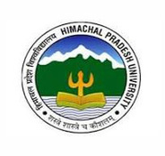



ADVANCED ECOSYSTEM RESTORATION: INTEGRATING PHYTOREMEDIATION WITH SATELLITE-BASED AND SENSING IN THE PIN VALLEY NATIONAL PARK, HIMALAYAS, INDIA.
Presented by: Deepika Sharma
Department of Botany, Himachal Pradesh University (HPU), Shimla, India
1

Slide 2
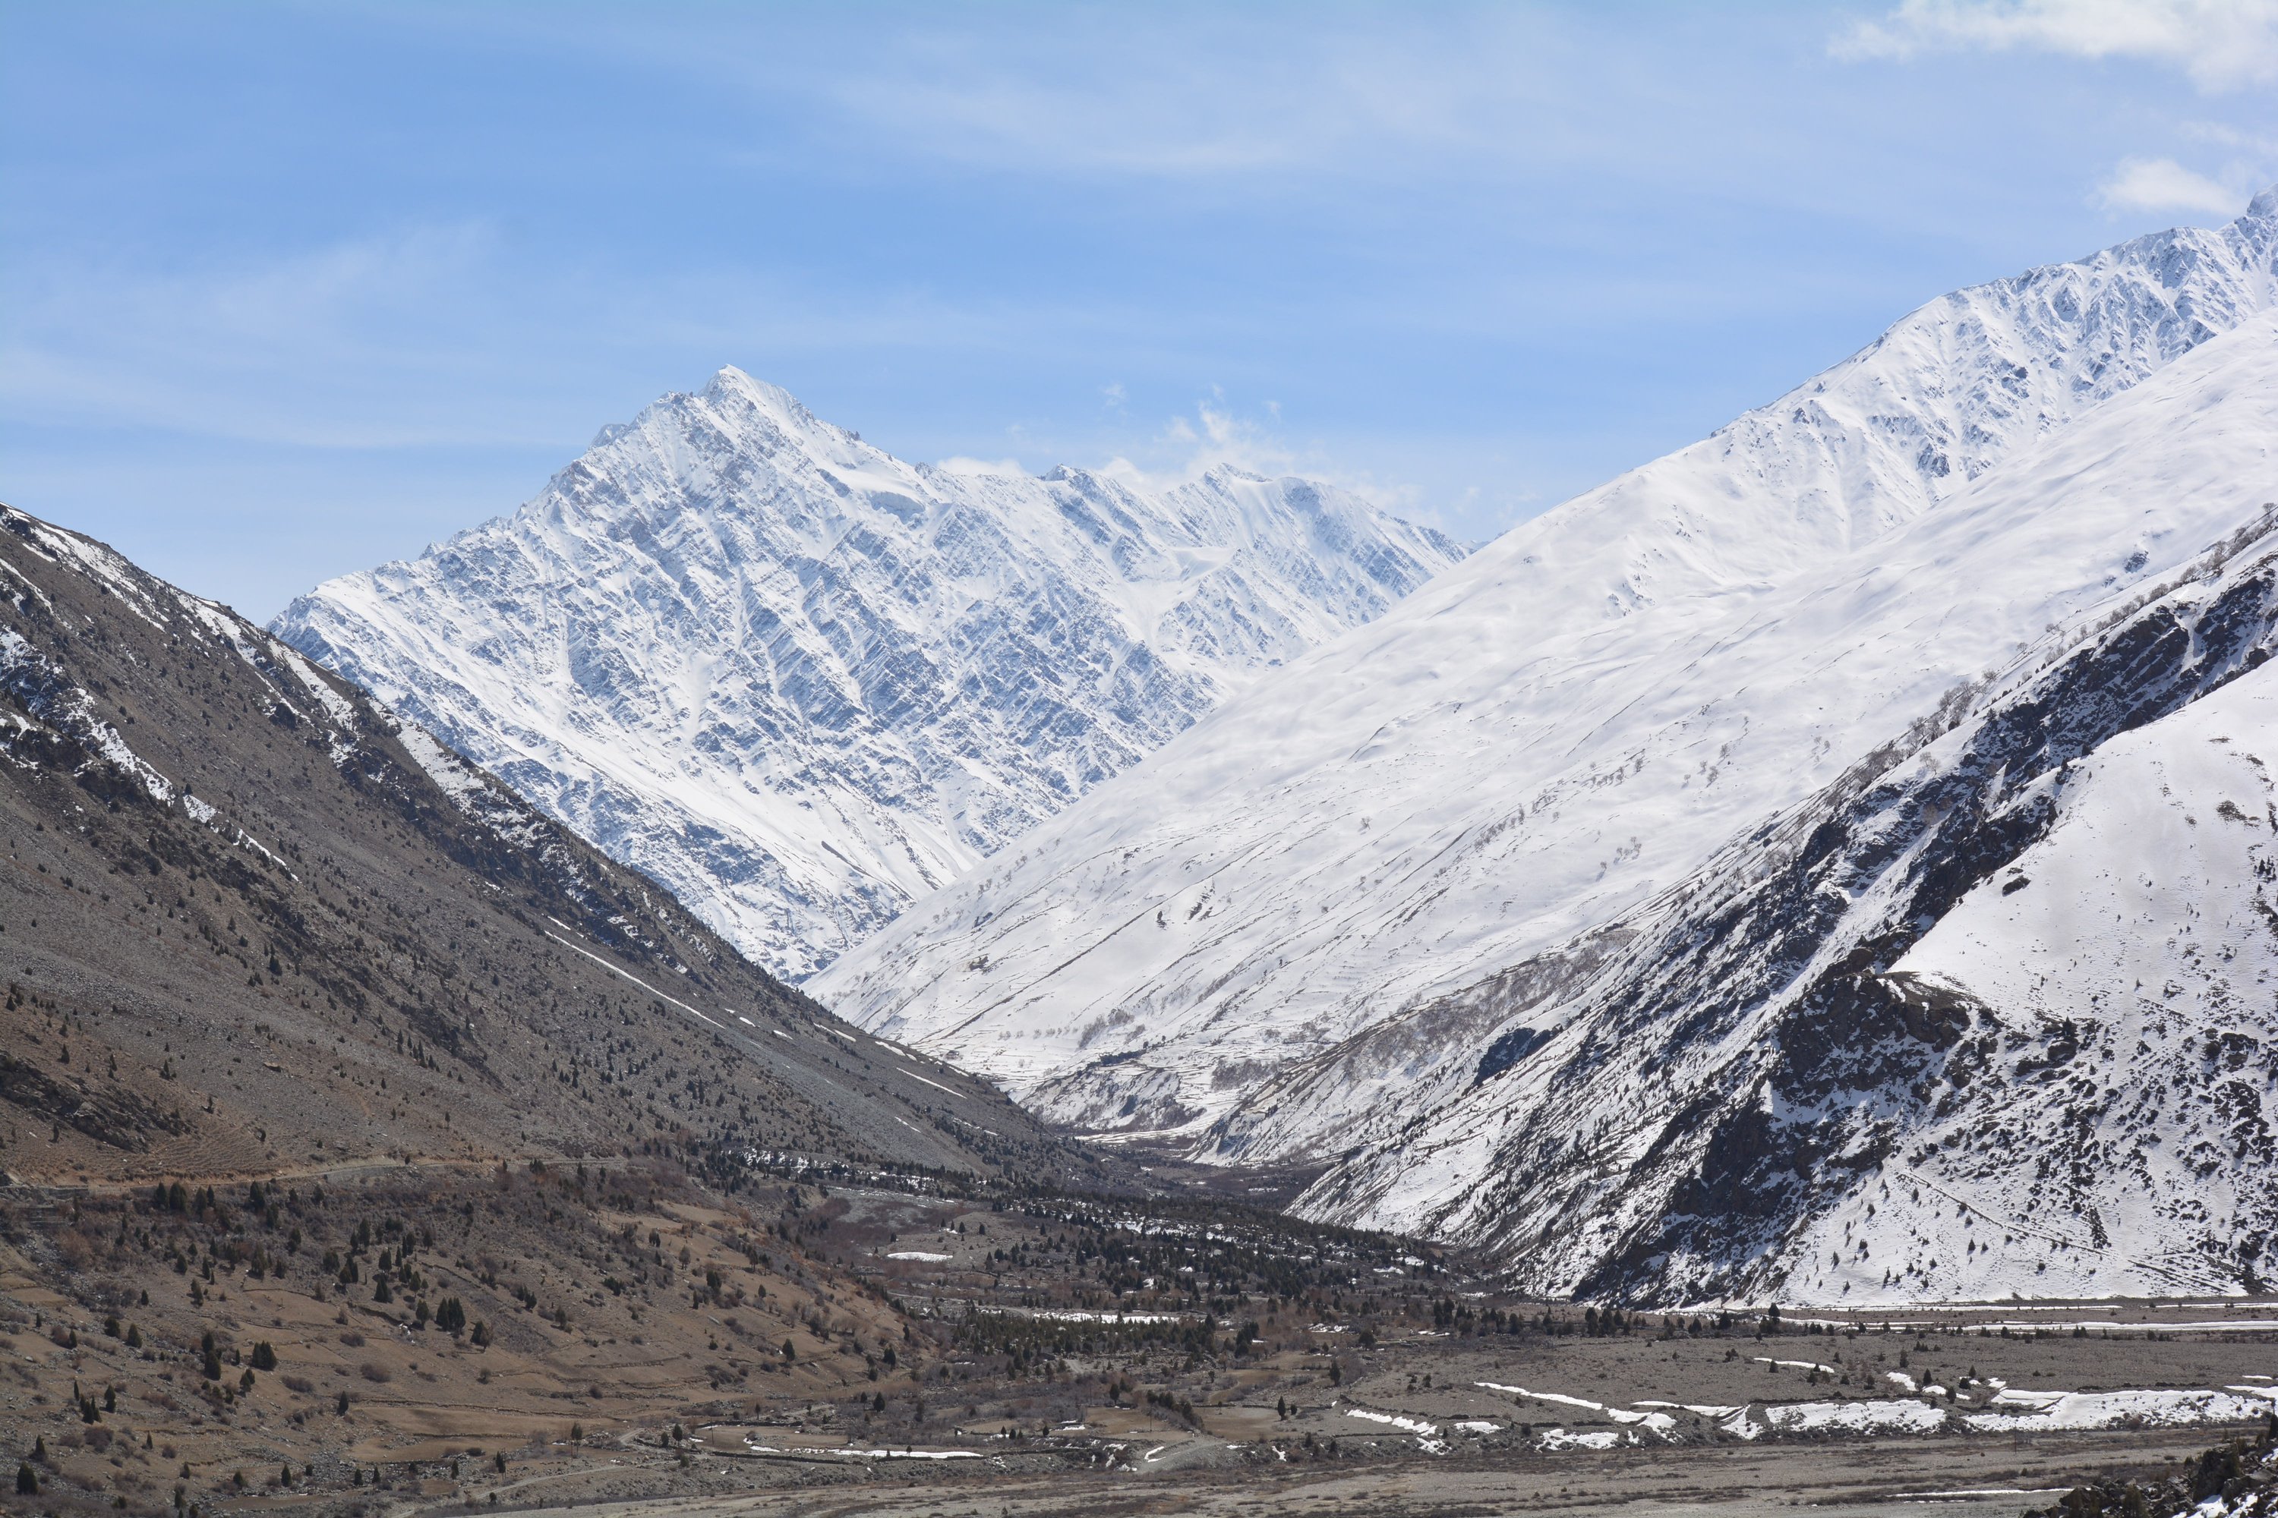
Index & Outline
➣ INTRODUCTION
➣STUDY AREA & DESCRIPTION
➣METHODOLOGY & WORKFLOW
➣RESULTS & DISCUSSION
➣FUTURE RESEARCH DIRECTIONS
2

Slide 3


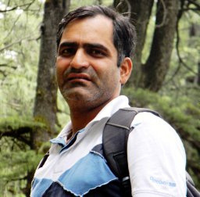
TEAM MEMBERS
Department of Botany, Himachal Pradesh University (HPU), Shimla, India
School of Interdisciplinary Research (SIRe), Indian Institute of Technology Delhi, IIT Delhi, India
Department of Botany, Sardar Patel University, Mandi, Himachal Pradesh, India
3

Slide 4
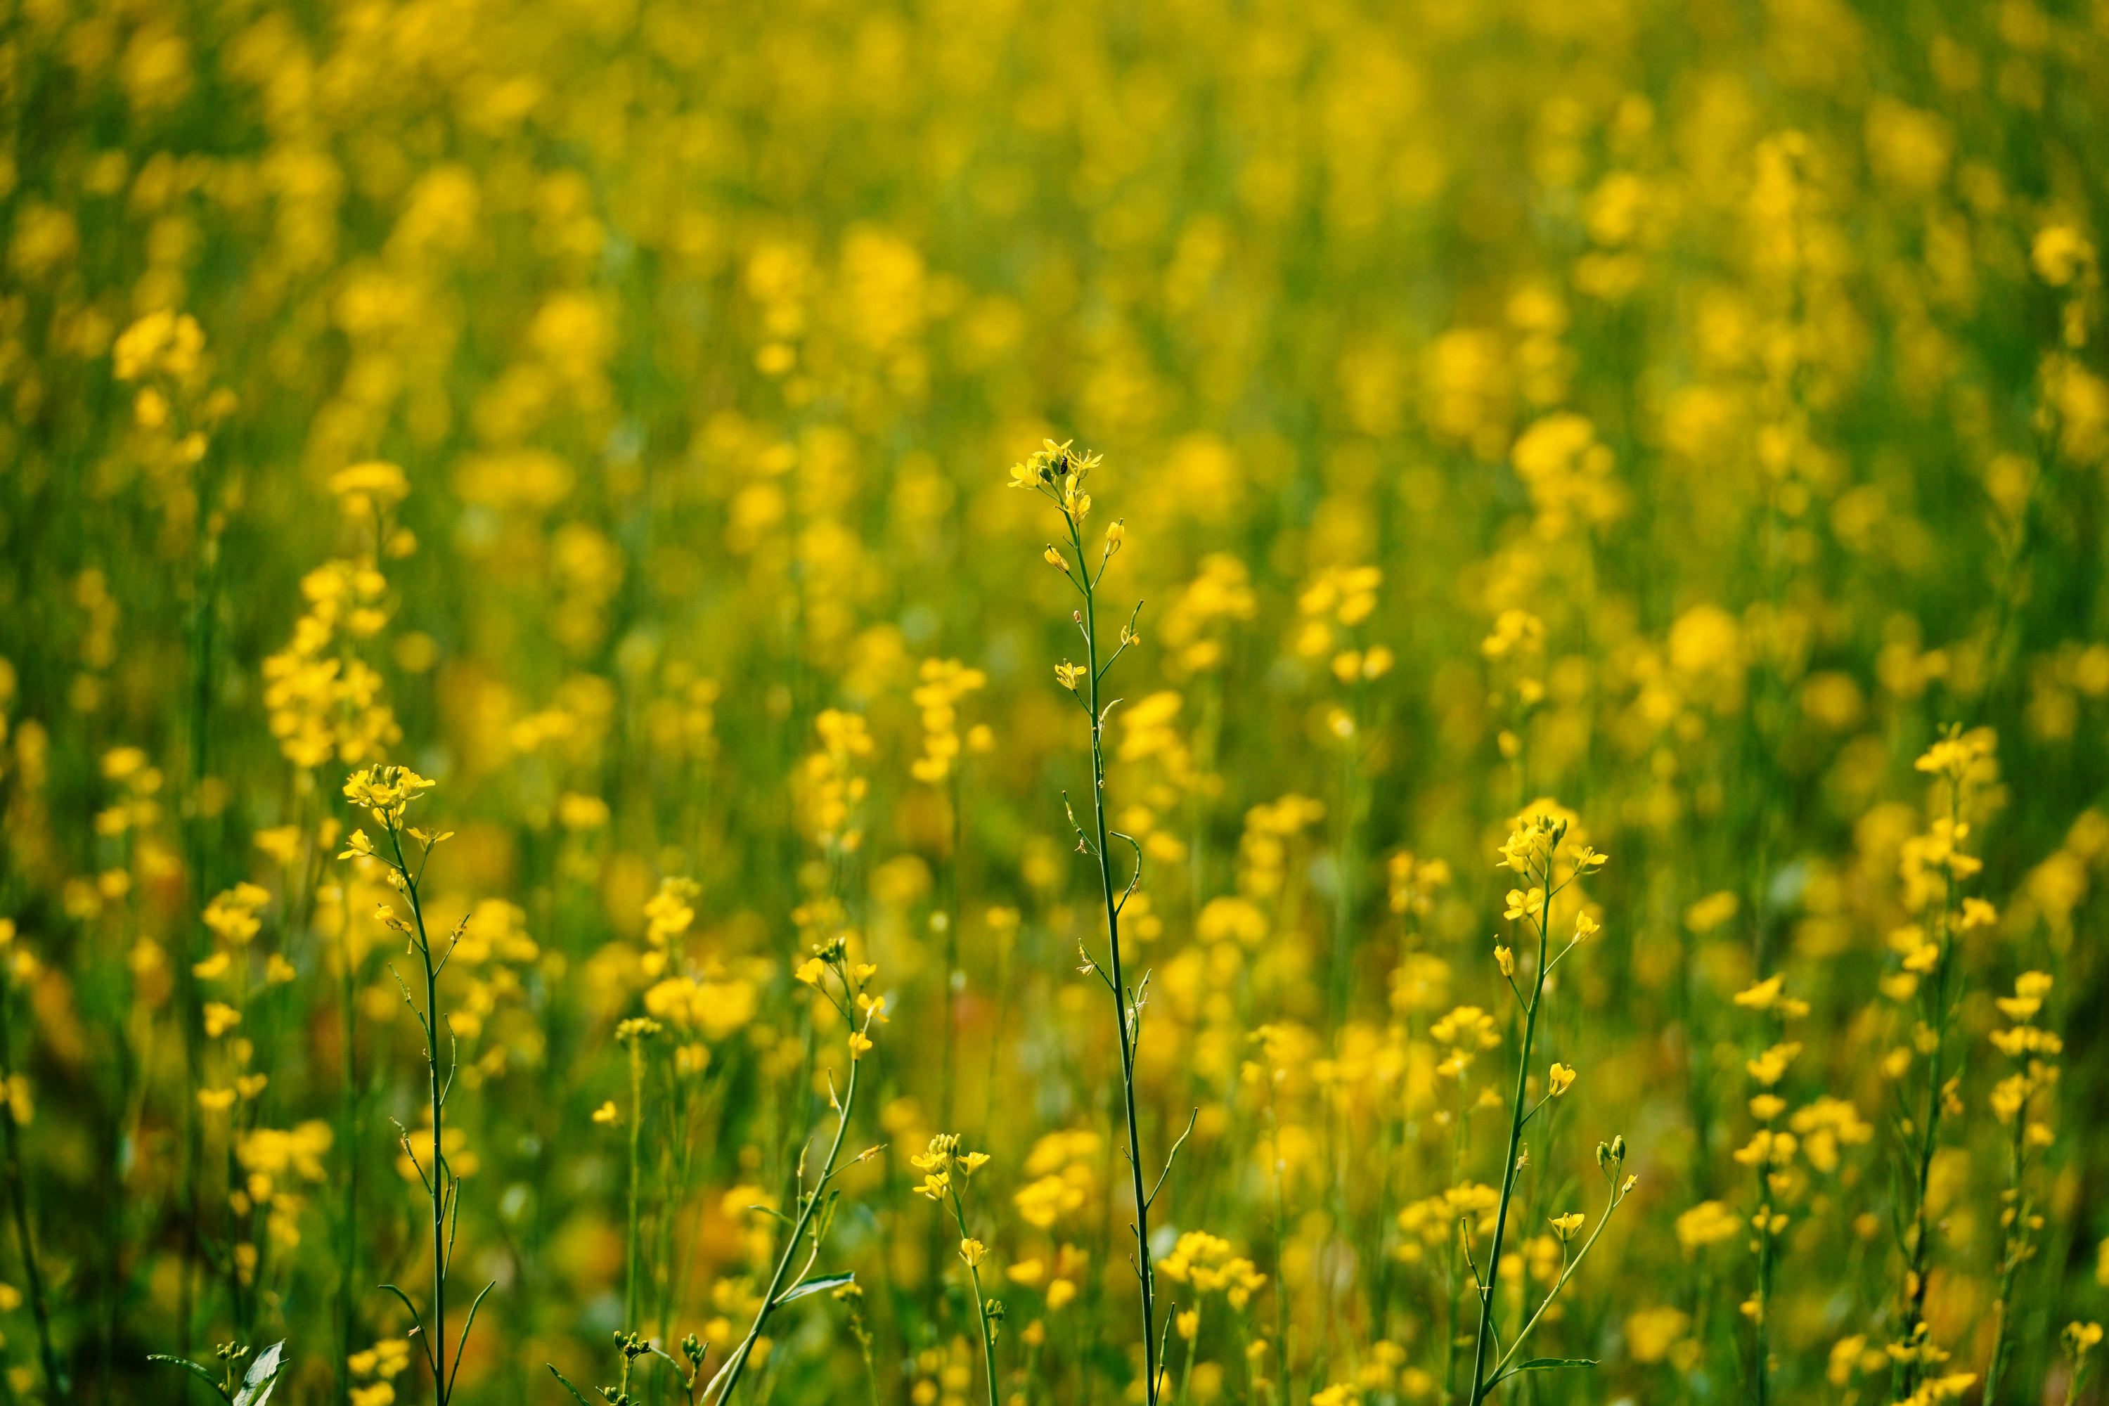
INTRODUCTION
➣ Pin Valley National Park is a fragile Himalayan ecosystem facing ecological threats due to
anthropogenic pressure and climate change.
➣ Heavy metal contamination and environmental degradation necessitate urgent restoration strategies.
➣ Phytoremediation and remote sensing offer a sustainable, non-invasive approach for
monitoring and restoring ecosystems.
➣ Brassica juncea (Indian mustard) excels in phytoextraction for contamination remediation.
➣ Populus species are effective in phytostabilization, mitigating heavy metal pollution.
➣ This study explores how phytoremediation techniques, combined with satellite-based remote sensing,
can assess and restore contaminated regions within the Pin Valley National Park, Himalayas, India.
4

Slide 5
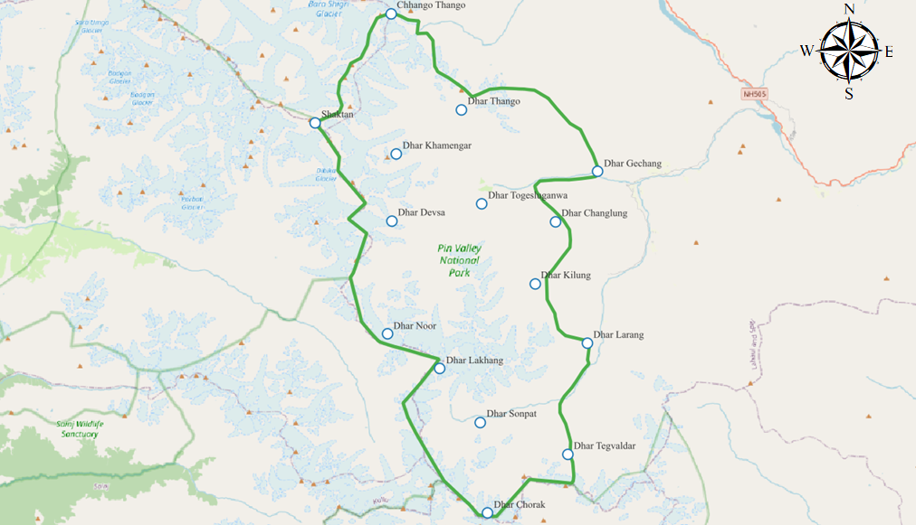
STUDY AREA & DESCRIPTION
Study Area: Pin Valley National Park, Himachal Pradesh, Spiti Valley, Himalayas, India.
➣ Cold desert ecosystem with extreme temperatures (-20°C in winter to 20°C in summer).
➣ Low annual precipitation (~200 mm).
➣ Covers 675 km², with elevations ranging from 3,200 m to 6,000 m.
➣ Diverse habitats: Alpine steppe and scrub.
➣ Flora: Over 100 species of flowering plants.
➣ Fauna: ~30 species of mammals (Snow Leopard, Himalayan Ibex) & 150+ bird species.
Research Significance
➣ Climate Change Studies: Adaptation strategies in extreme conditions.
➣ Heavy Metal Contamination: High lead, cadmium, and arsenic levels in specific zones.
➣Phytoremediation Focus: Evaluating Brassica juncea & Populus for remediation.
5

Slide 6
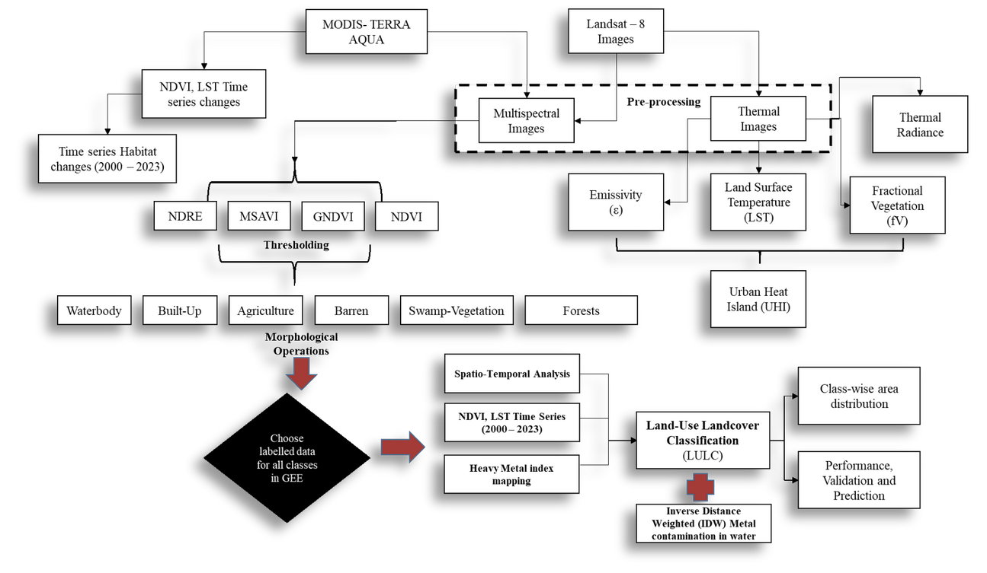
METHODOLOGY & WORKFLOW
Methodology Overview
➣ Remote Sensing & Spatial Analysis → Utilized MODIS & Landsat-8 (2000–2023) for long-term monitoring.
  Key Indicators → NDVI (vegetation health), LST (thermal variations), & spectral indices (EVI, NDRE ) for biomass estimation and plant stress assessment.
  ➣ Image Pre-processing → Radiometric & atmospheric corrections for noise removal; emissivity calculation for land surface thermal properties.
➣ Heavy Metal Contamination Mapping → Spatial analysis correlating NDVI, LST, and heavy metal indices to identify pollution hotspots.
➣ Land Use & Land Cover (LULC) Classification
  Classes Analyzed → Water bodies, built-up areas, agriculture, barren land, swamp vegetation, forests.
  Method Used → Inverse Distance Weighted (IDW) interpolation for land cover mapping & contamination estimation.
  Validation Accuracy → Over 85% accuracy ensured by comparing classified images with field data.
  Area Distribution Analysis → Evaluated land use impact on heavy metal concentrations across the park.
6

Slide 7
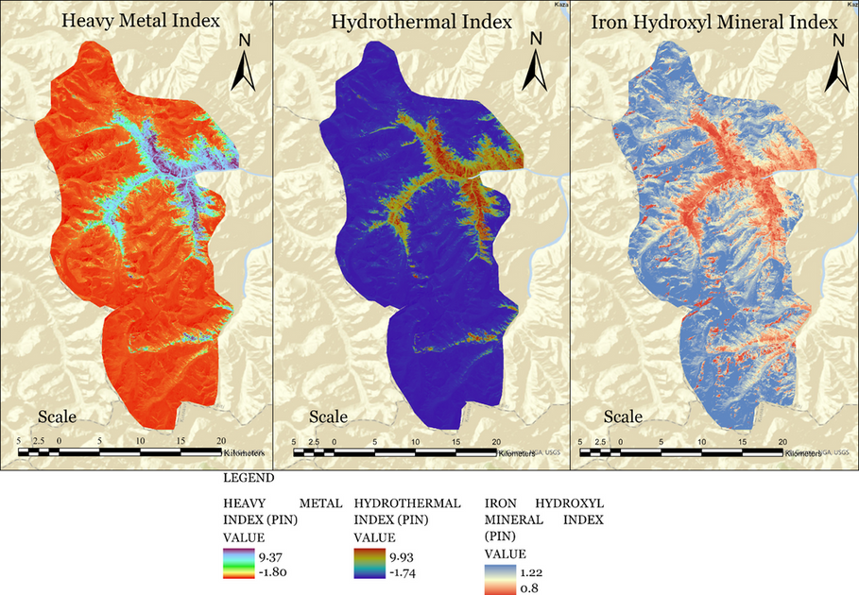
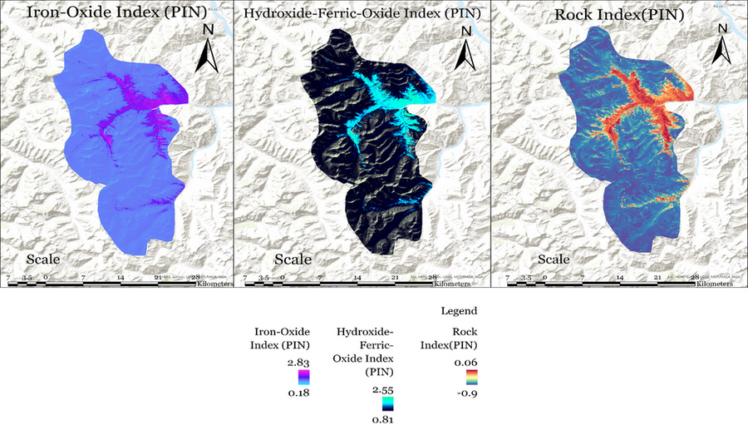
RESULTS & DISCUSSION
Heavy Metal Index Analysis
Heavy Metal Index (HMI):
➣ Values range from -1.80 (low contamination) to 9.37 (high contamination).
➣ Red zones indicate heavy metal hotspots linked to industrial and anthropogenic activities.
Hydrothermal Index (HI):
➣ Ranges from 1.74 to 9.93, indicating moisture availability and thermal variations.
➣ Blue areas: High moisture, crucial for biodiversity conservation.
➣ Low HI areas: Higher environmental stress, impacting plant growth and ecosystem resilience.
Iron Hydroxyl Mineral Index (IHMI):
➣ Values range from 0.80 to 1.22.
➣ High IHMI areas: Indicate iron-bearing minerals, which can neutralize acidity but may also promote heavy metal retention and bioaccumulation.
Iron-Oxide Index (IOI):
➣ Values range from 0.18 to 2.83.
➣ Purple regions: Indicate high iron oxide concentrations, influencing soil fertility and nutrient availability.
Hydroxide-Ferric-Oxide Index (HFOI):
➣ Values range from 0.81 to 2.55.
➣ Bright areas: High ferric hydroxide concentrations, aiding nutrient cycling and reducing heavy metal
bioavailability.
Rock Index (RI):
➣ Values range from -0.9 to 0.06.
➣ Higher RI values indicate localized geological formations influencing soil properties, drainage patterns, and habitat suitability.
7
Notes:
7

Slide 8
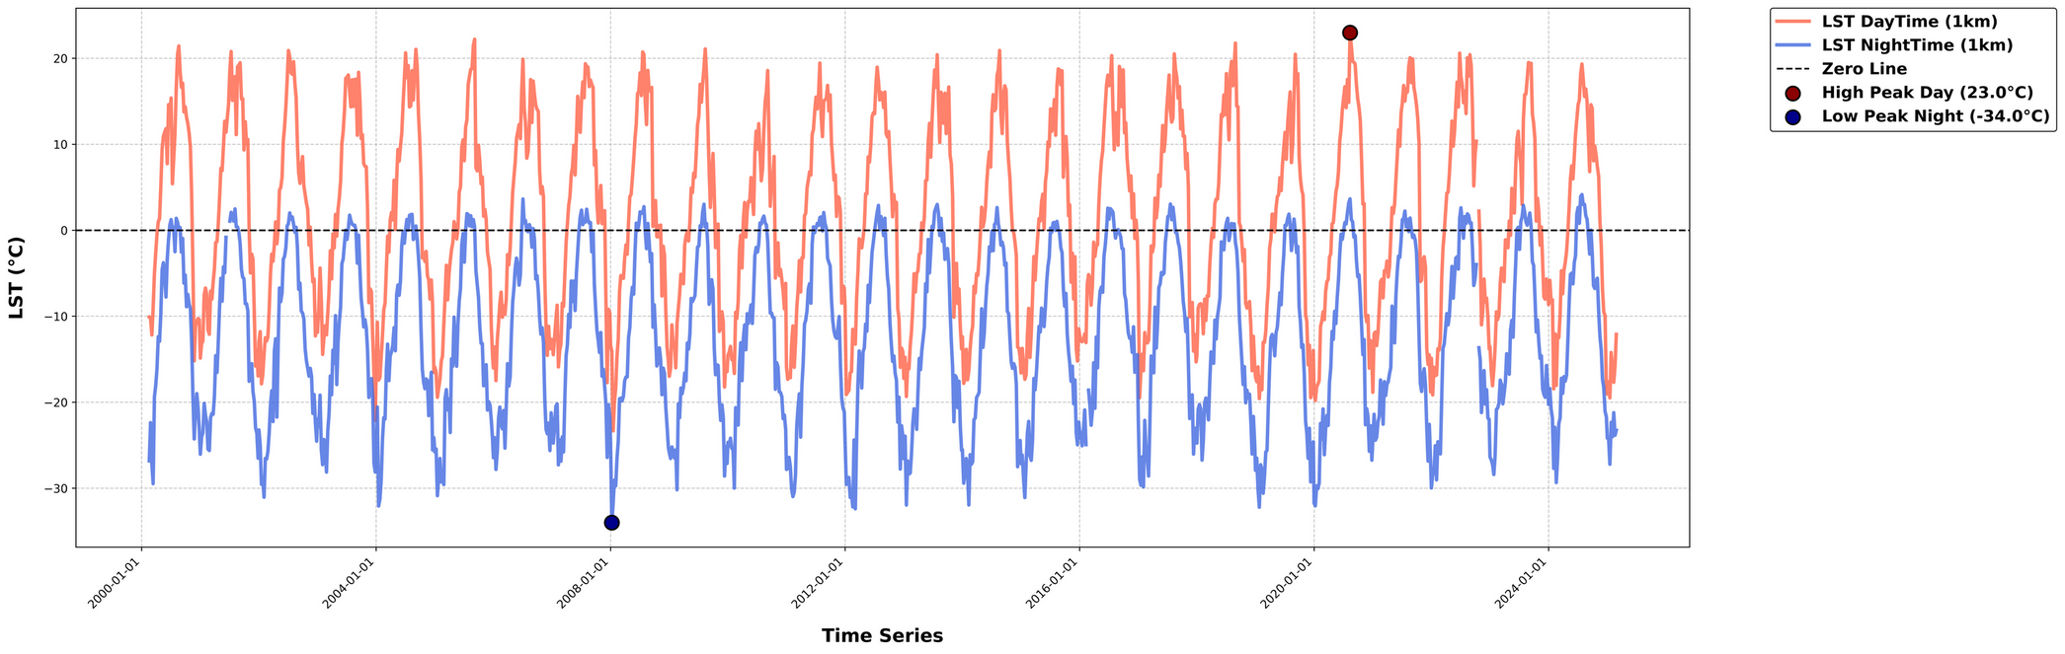
RESULTS & DISCUSSION
Land Surface Temperature (LST) Variation: Daytime vs. Nighttime Trends :
Seasonal Day-Night Temperature Cycle:
➣ Daytime LST (red) exhibits regular peaks (~23°C in 2023), while nighttime LST (blue) shows deep troughs, reaching a low of -34°C in 2008.
➣ This suggests strong seasonal variations, possibly influenced by terrain, vegetation cover, and atmospheric conditions.
Temperature Extremes & Climate Indicators:
➣ The highest daytime peak (23°C) and lowest nighttime dip (-34°C) indicate extreme temperature fluctuations, which may impact ecosystem stability, vegetation health, and surface energy balance.
Long-Term Thermal Stability:
➣ Despite short-term variations, the LST trends remain consistent over decades, reflecting natural climate cyclicity rather than abrupt changes.
➣ However, any shifts in peak values over time may hint at climate change impacts or land-use changes.
8

Slide 9
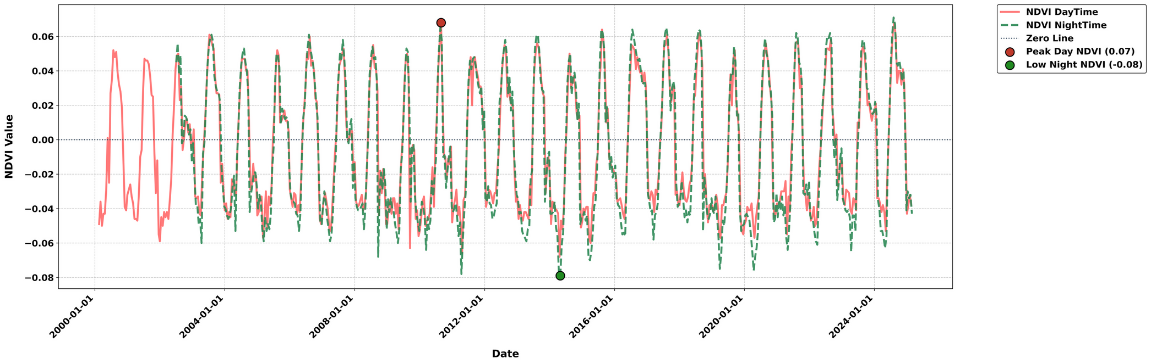
RESULTS & DISCUSSION
Diurnal Variation in NDVI: Daytime vs. Nighttime Trends:
➣ Day-Night NDVI Variability: The NDVI values exhibit minor fluctuations between daytime (solid red) and nighttime (dashed green), indicating diurnal variations in vegetation reflectance.
➣ Extreme NDVI Events: The highest daytime NDVI (0.07 in 2012) and the lowest nighttime NDVI (-0.08 in 2016) suggest significant shifts in vegetation health, possibly linked to seasonal climate changes or land cover modifications.
➣ Overall Stability: Despite occasional short-term deviations, the general trend of daytime and nighttime NDVI
remains consistent over the years, confirming robust vegetation dynamics over time.
9

Slide 10
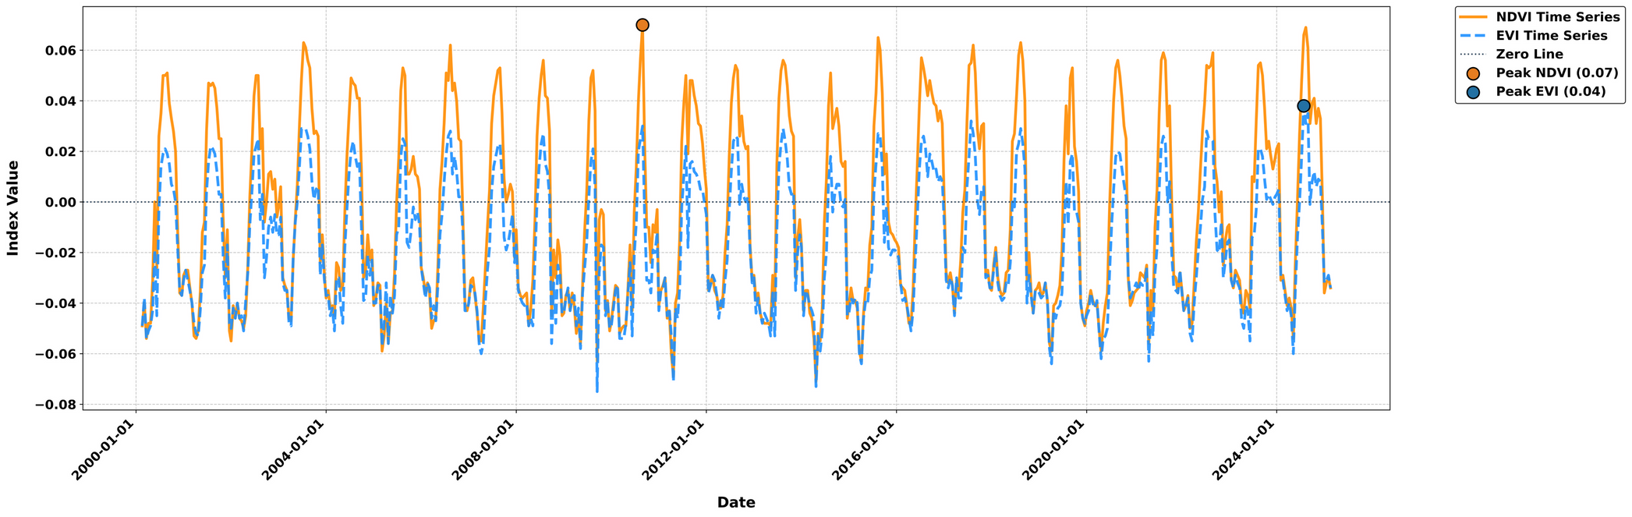
RESULTS & DISCUSSION
Temporal Variation in NDVI and EVI Time Series:
➣ Seasonal and Inter-Annual Variability: The NDVI (solid orange) and EVI (dashed blue) time series show strong seasonal fluctuations, indicating cyclic vegetation dynamics influenced by climatic and phenological changes.
➣ Peak Vegetation Trends: The highest NDVI (0.07) in early 2012 and the highest EVI (0.04) in early 2024 suggest
periods of maximum vegetation activity, possibly linked to favourable environmental conditions or land use improvements.
➣ EVI vs NDVI Differences: EVI remains lower than NDVI throughout, reflecting EVI’s correction for
atmospheric and soil background effects, making it more reliable for vegetation health assessment.
10

Slide 11
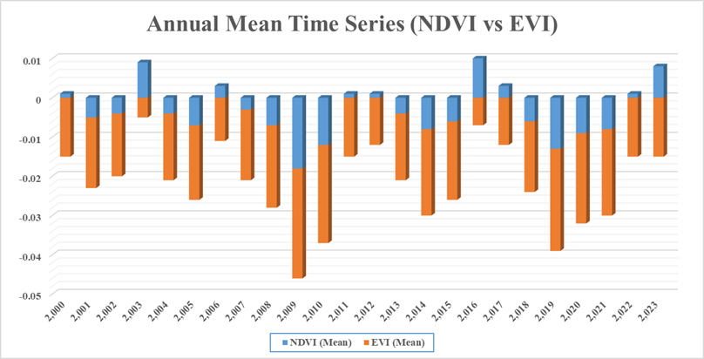
RESULTS & DISCUSSION
NDVI Time-Series Analysis
Comparison of Annual Mean NDVI and EVI Trends:
➣ Vegetation Variability (2000–2023): NDVI and EVI show inter-annual fluctuations, with notable declines in 2009, 2010, and 2019, indicating possible environmental stress or land-use changes.
➣ NDVI vs EVI Comparison: NDVI values are generally higher than EVI, reflecting EVI’s sensitivity to atmospheric corrections and canopy structure, which is crucial for accurate vegetation monitoring.
➣ Significant Positive Trends: 2003, 2016, and 2023 exhibit higher NDVI values, suggesting improved vegetation health, possibly due to favourable climatic conditions or restoration efforts.
11

Slide 12
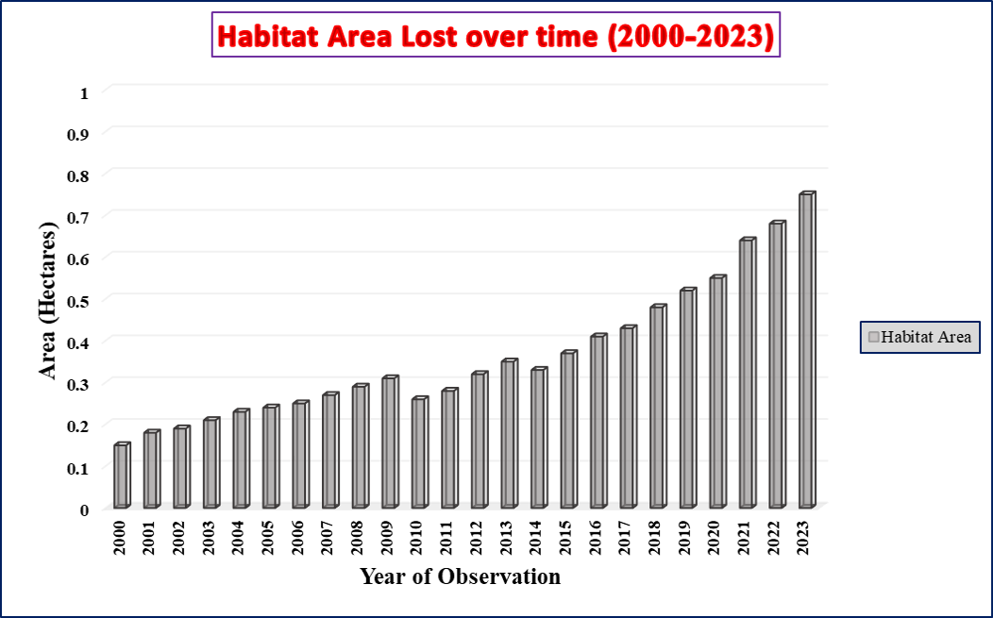
RESULTS & DISCUSSION
Habitat Loss Over Time (2000-2023):
➣ 2000: Habitat loss ~0.12 hectares.
➣ 2007: Loss doubled to ~0.25 hectares.
➣ 2010-2022: Rapid increase, reaching ~0.87 hectares by 2022.
➣ 2023: Further rise to ~1 hectare, marking a 0.13-hectaree increase from 2022.
12

Slide 13
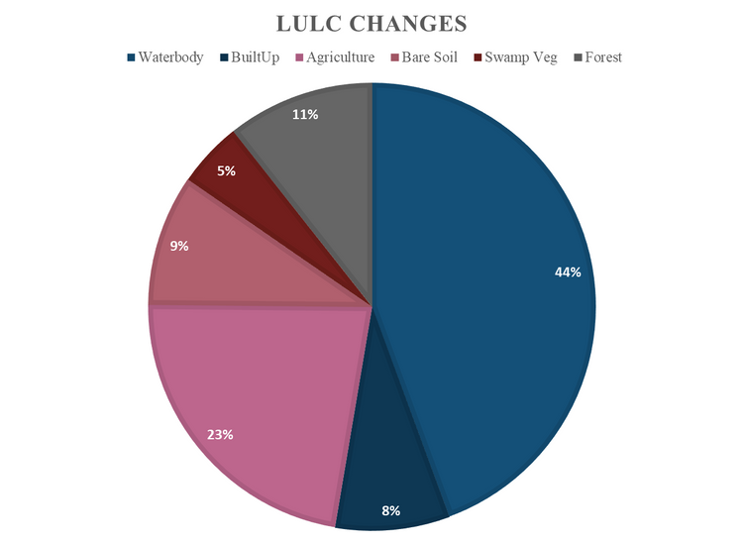
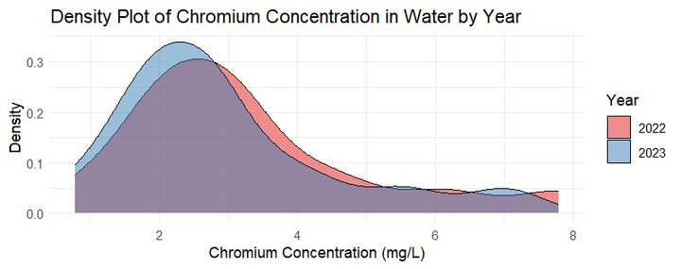
RESULTS & DISCUSSION
Land-Use Land Cover (LULC) Changes
➣ Forests (44%) dominate the landscape, followed by agriculture (23%), built up areas (11%), waterbodies (9%), swamp vegetation (8%), and bare soil (5%).
➣ Urbanization, agriculture, and bare soil expansion may impact biodiversity, water resources, and ecosystem stability.
13

Slide 14
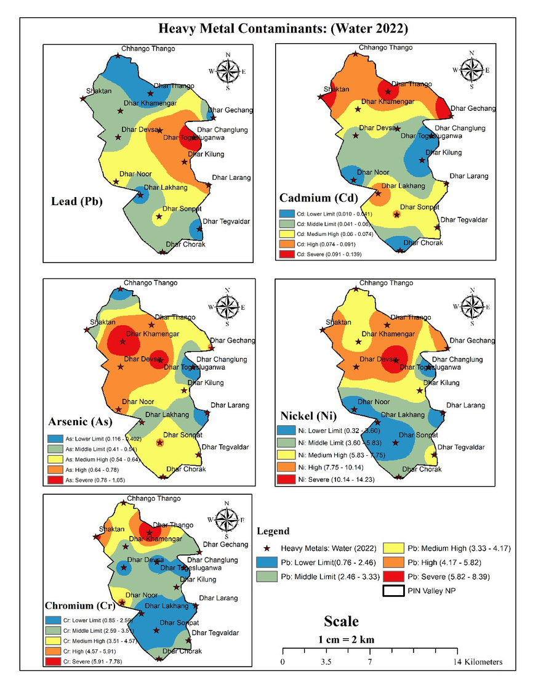
RESULTS & DISCUSSION
Heavy Metal Contamination in Water & Sediment
➣ Brassica juncea effectively accumulates Cd (150 mg/kg) and Pb (200 mg/kg), while Populus is efficient in absorbing Ni (120 mg/kg) and Cr (180 mg/kg), demonstrating strong phytoremediation potential.
➣ Chromium levels in water showed a decline from 2022 to 2023, with peak concentrations dropping from 3–4 mg/L to ~2.5 mg/L.
➣ Severe heavy metal contamination detected in Dhar Devsak, Dhar Lakhang, and Dhar Sonpet, with Pb (4.17– 5.82 mg/L), Cd (0.091–0.139 mg/L), As (0.64–0.78 mg/L), Ni (10.14–14.23 mg/L), and Cr (5.82–8.39 mg/L) posing ecological and health risks.
14

Slide 15


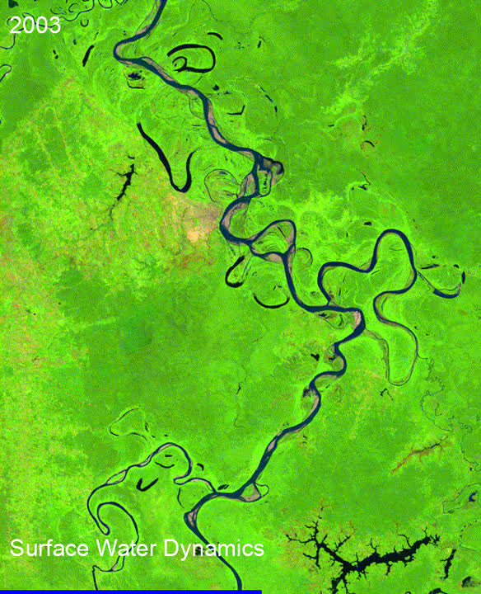
FUTURE RESEARCH DIRECTIONS
➣ This research supports SDG 15 (Life on Land) for ecosystem restoration and SDG 17 (Partnerships for the Goals) by fostering interdisciplinary collaboration.
➣ Pin Valley Monitoring: Use remote sensing to track vegetation and soil health changes.
➣ Ecological Indicators: Assess species diversity and soil quality for conservation.
➣ Comparative Study: Expand research to Keoladeo Ghana National Park and similar sites.
Email id
deepikasharma05081992@gmail.com
Department of Botany, Himachal Pradesh University (HPU), Shimla, India
15

