Slide 1
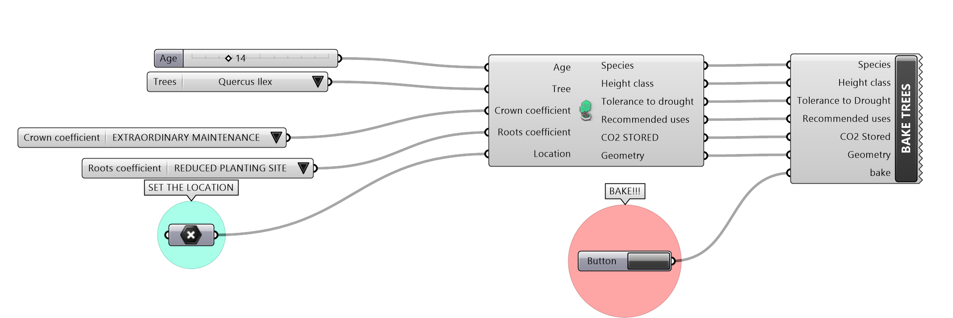
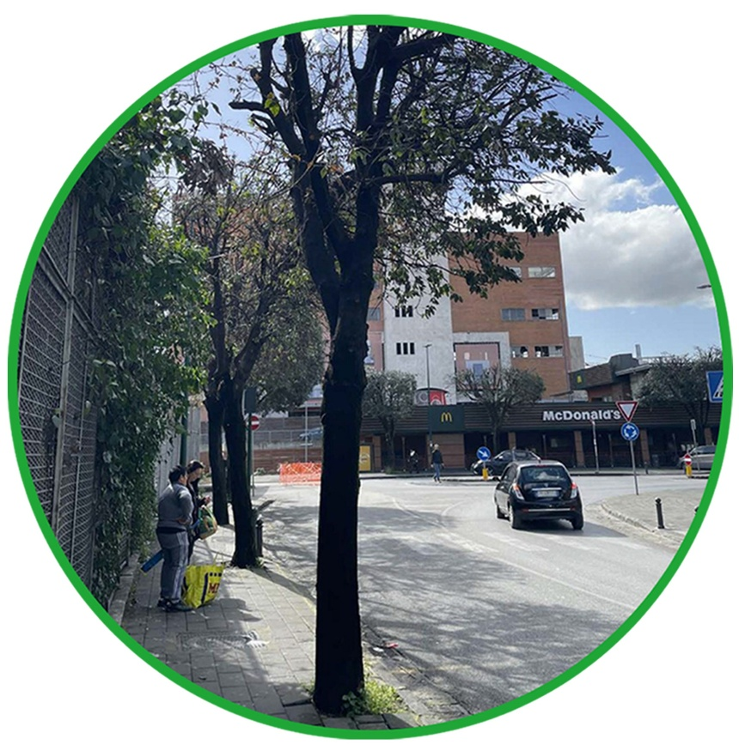
CO2 stored by trees: calculation details
CALCULATION TOOL IN GRASSHOPPER
CALCULATION FORMULA
CO2 stored = V * D * 0,5* Cf
(Arno Frühwald 2002)
V= Volume woody biomass (m³)
D= density (species specific) (kg/m³)
Cf = CO₂ conversion factor (3,67)¹
Volume woody biomass (V)
V = Volume stem (51%) + (crown coefficient) + (roots coefficient)
(Birdsey, 1992)
Tree management (pruning)
CROWN COEFFICIENT
Space for the tree (planting site)
ROOTS COEFFICIENT
INFORMATION
ZERO MAINTENANCE = 1.48
ORDINARY MAINTENANCE = 0.98
EXTRAORDINARY MAINTENANCE = 0.68
OPTIMAL PLANTING SITE = 1.4
DISCRETE PLANTING SITE = 0.9
REDUCED PLANTING SITE = 0.6
Species = Quercus Ilex
Density =525 kg/m³
H= 5,60 m (14y)
DBH= 0,15 m (14y)
CROWN COEFFICIENT:
EXTRAORDINARY MAINTENANCE = 0.68
ROOTS COEFFICIENT:
REDUCED PLANTING SITE = 0.6
Volume woody biomass (V) = 0,089 m³
CO2 stored = 85.79 kg CO₂eq
¹This value considers that 1kg of Carbon is equal to 3,67 kgCo2

Slide 2
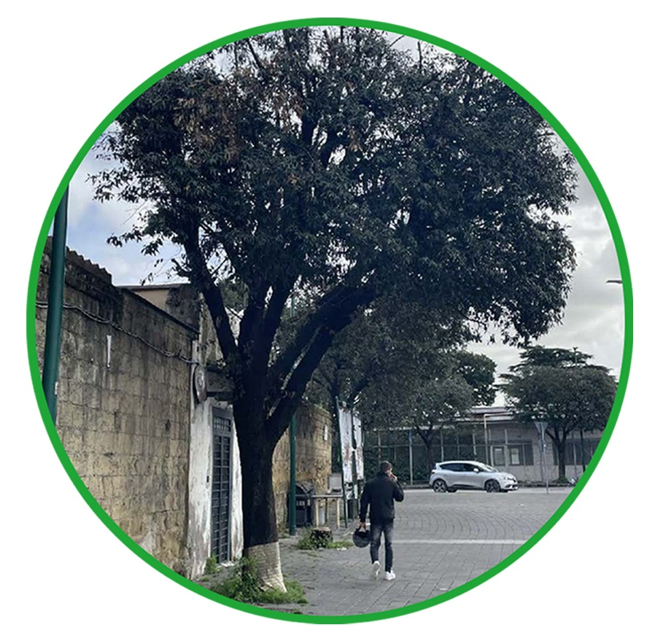
CO2 stored by trees: calculation details
CALCULATION TOOL IN GRASSHOPPER
CALCULATION FORMULA
CO2 stored = V * D * 0,5 * Cf
(Arno Frühwald 2002)
V= Volume woody biomass (m³)
D= density (species specific) (kg/m³)
Cf = CO₂ conversion factor (3,67)¹
Volume woody biomass (V)
V = Volume stem (51%) + (crown coefficient) + (roots coefficient)
(Birdsey, 1992)
Tree management (pruning)
CROWN COEFFICIENT
Space for the tree (planting site)
ROOTS COEFFICIENT
INFORMATION
ZERO MAINTENANCE = 1.48
ORDINARY MAINTENANCE = 0.98
EXTRAORDINARY MAINTENANCE = 0.68
OPTIMAL PLANTING SITE = 1.4
DISCRETE PLANTING SITE = 0.9
REDUCED PLANTING SITE = 0.6
Species= Quercus Ilex
Density = 525 kg/m³
H= 7.19 m (17y)
DBH= 0.20 m (17y)
CROWN COEFFICIENT:
ORDINARY MAINTENANCE = 0.98
ROOTS COEFFICIENT:
REDUCED PLANTING SITE = 0.6
Volume woody biomass (V) = 0.24 m³
CO2 stored = 105.89 kg CO₂ eq
¹This value considers that 1kg of Carbon is equal to 3,67 kgCo2

Slide 3
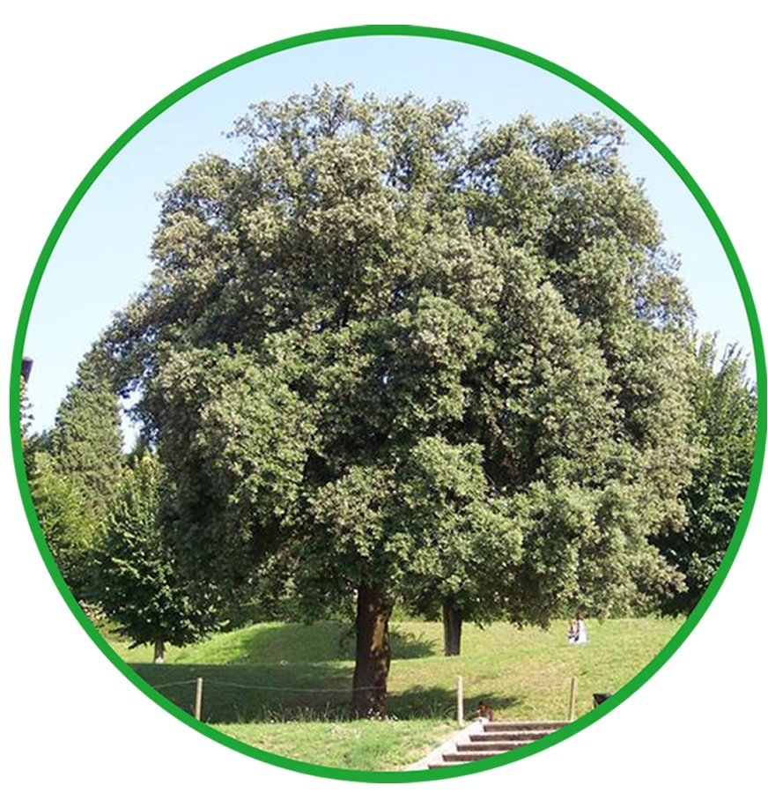
CO2 stored by trees: calculation
CALCULATION TOOL IN GRASSHOPPER
CALCULATION FORMULA
CO2 stored = V * D * 0,5 * Cf
(Arno Frühwald 2002)
V= Volume woody biomass (m³)
D= density (species specific) (kg/m³)
Cf = CO₂ conversion factor (3,67)¹
Volume woody biomass (V)
V = Volume stem (51%) + (crown coefficient) + (roots coefficient)
(Birdsey, 1992)
Tree management (pruning)
CROWN COEFFICIENT
Space for the tree (planting site)
ROOTS COEFFICIENT
INFORMATION
ZERO MAINTENANCE = 1.48
ORDINARY MAINTENANCE = 0.98
EXTRAORDINARY MAINTENANCE = 0.68
OPTIMAL PLANTING SITE = 1.4
DISCRETE PLANTING SITE = 0.9
REDUCED PLANTING SITE = 0.6
Species= Quercus Ilex
Density:=525 kg/m³
H= 8.98 m (20y)
DBH= 0.25 m (20y)
CROWN COEFFICIENT:
ZERO MAINTENANCE = 1.48
ROOTS COEFFICIENT:
OPTIMAL PLANTING SITE = 1.40
Volume woody biomass (V): 0.88 m³
CO2 stored: 850 kg CO₂ eq
¹This value considers that 1kg of Carbon is equal to 3,67 kgCo2

