Slide 1

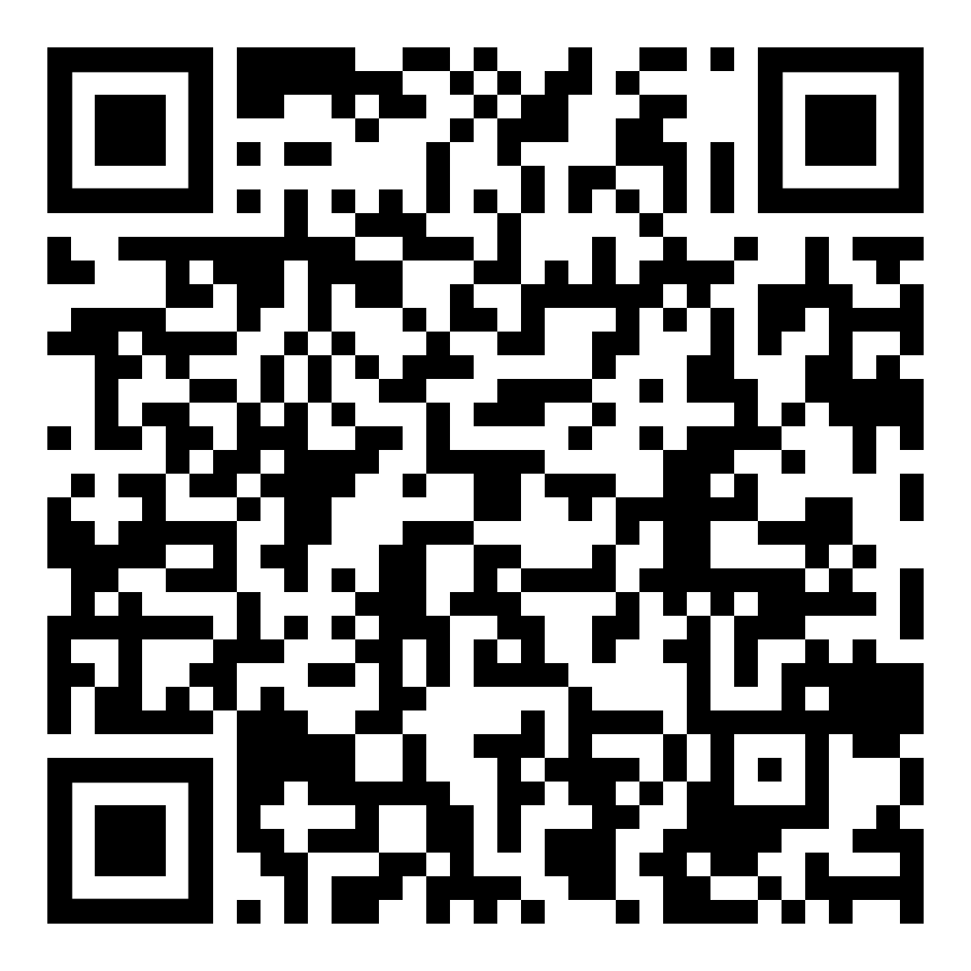




The International Seismological Centre (ISC) Earthquake Toolbox for MATLAB: Interactive Access to Earthquake Observations & Parameters
Tom Garth
Ryan Gallacher
Kostas Leptokaropoulos
tom.garth@isc.ac.uk
EGU25-20943 | PICO | ESSI2.10
28th April 2025, |PICO Spot 4.8

Slide 2
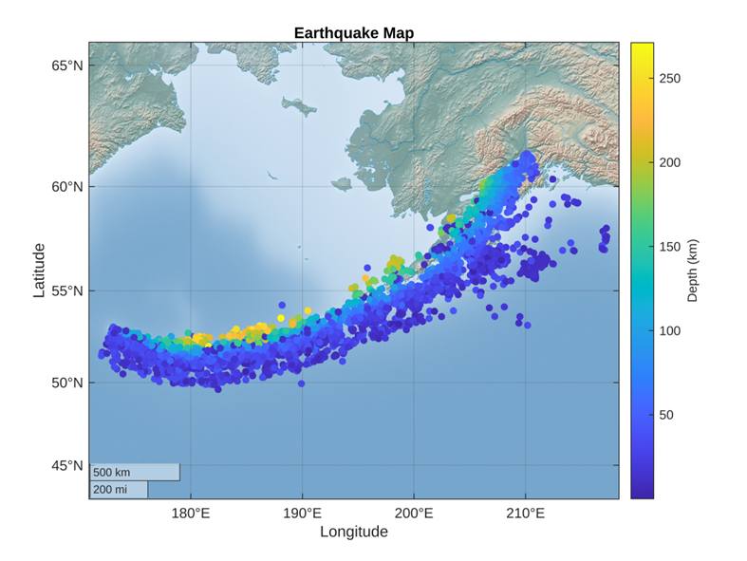

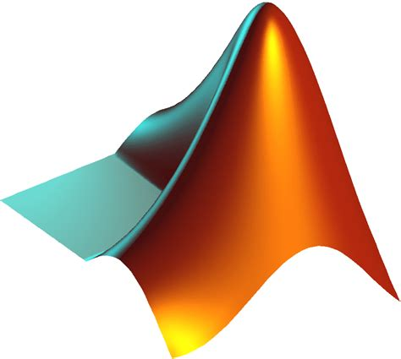

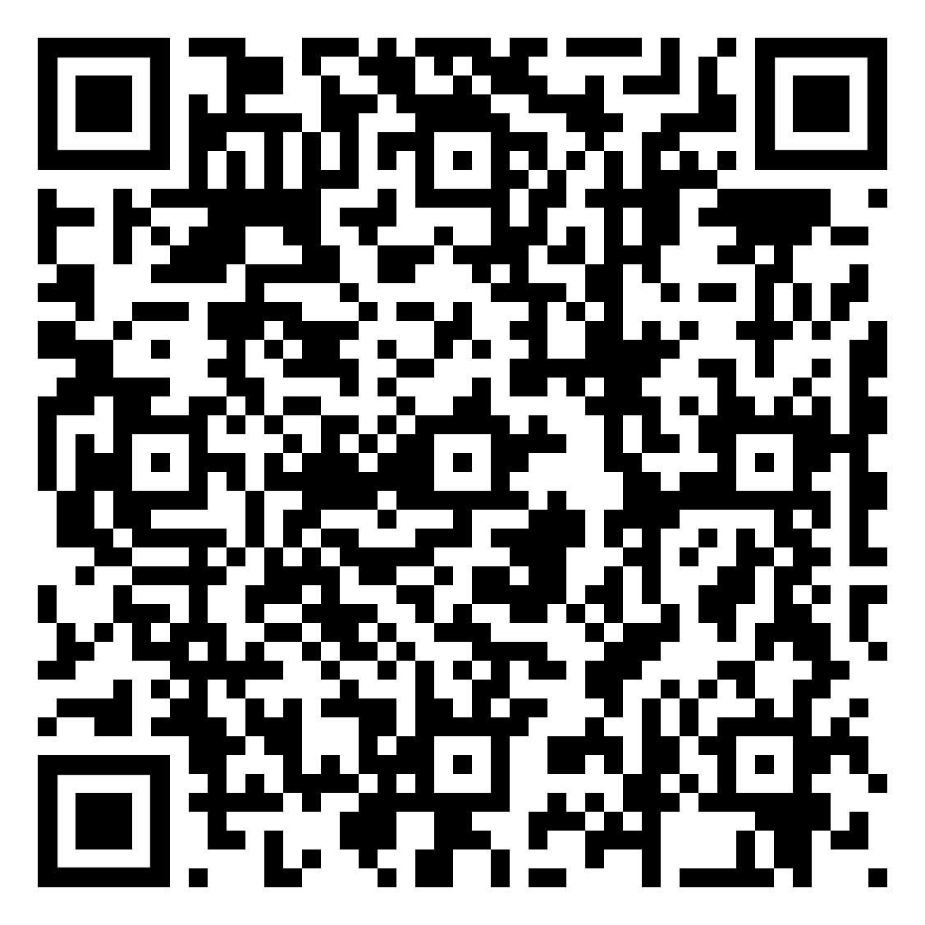
Download, process and visualize earthquake catalogues directly from the ISC Bulletin using the ISC Earthquake Toolbox for MATLAB
Online Dynamic Poster:

Slide 3
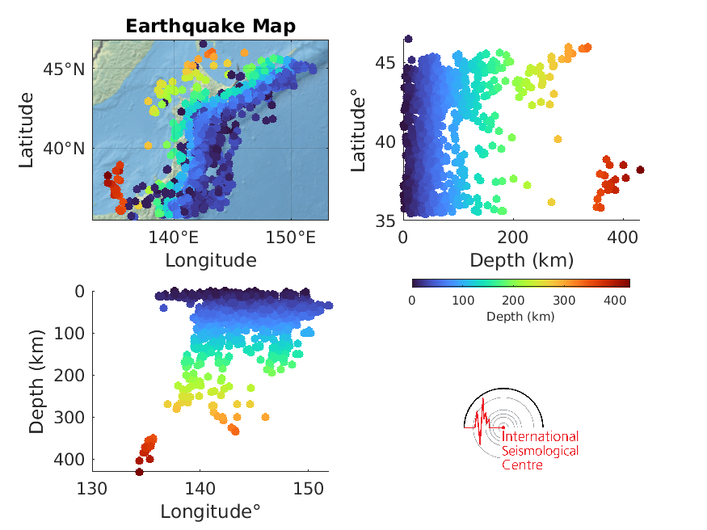
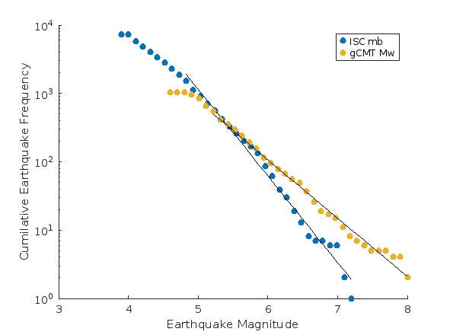
4 Tutorial Live Scripts
“Introduction_ISCToolboxForMATLAB.mlx” - A brief overview of the toolbox
“WB1_Download_ISC_Data.mlx” - Interactively search the ISC database, and build a data set based on the area, time span and magnitude range.
“WB2_Exploring_Earthquake_Locations.mlx” – Explore the downloaded data with a focus on plotting earthquake locations.
“WB3_Exploring_Earthquake_Magnitudes.mlx” - Compare different earthquake magnitude types, enabling interactive Mc and b-value calculations.
More to come!!

Slide 4

Download ISC Data

Slide 5
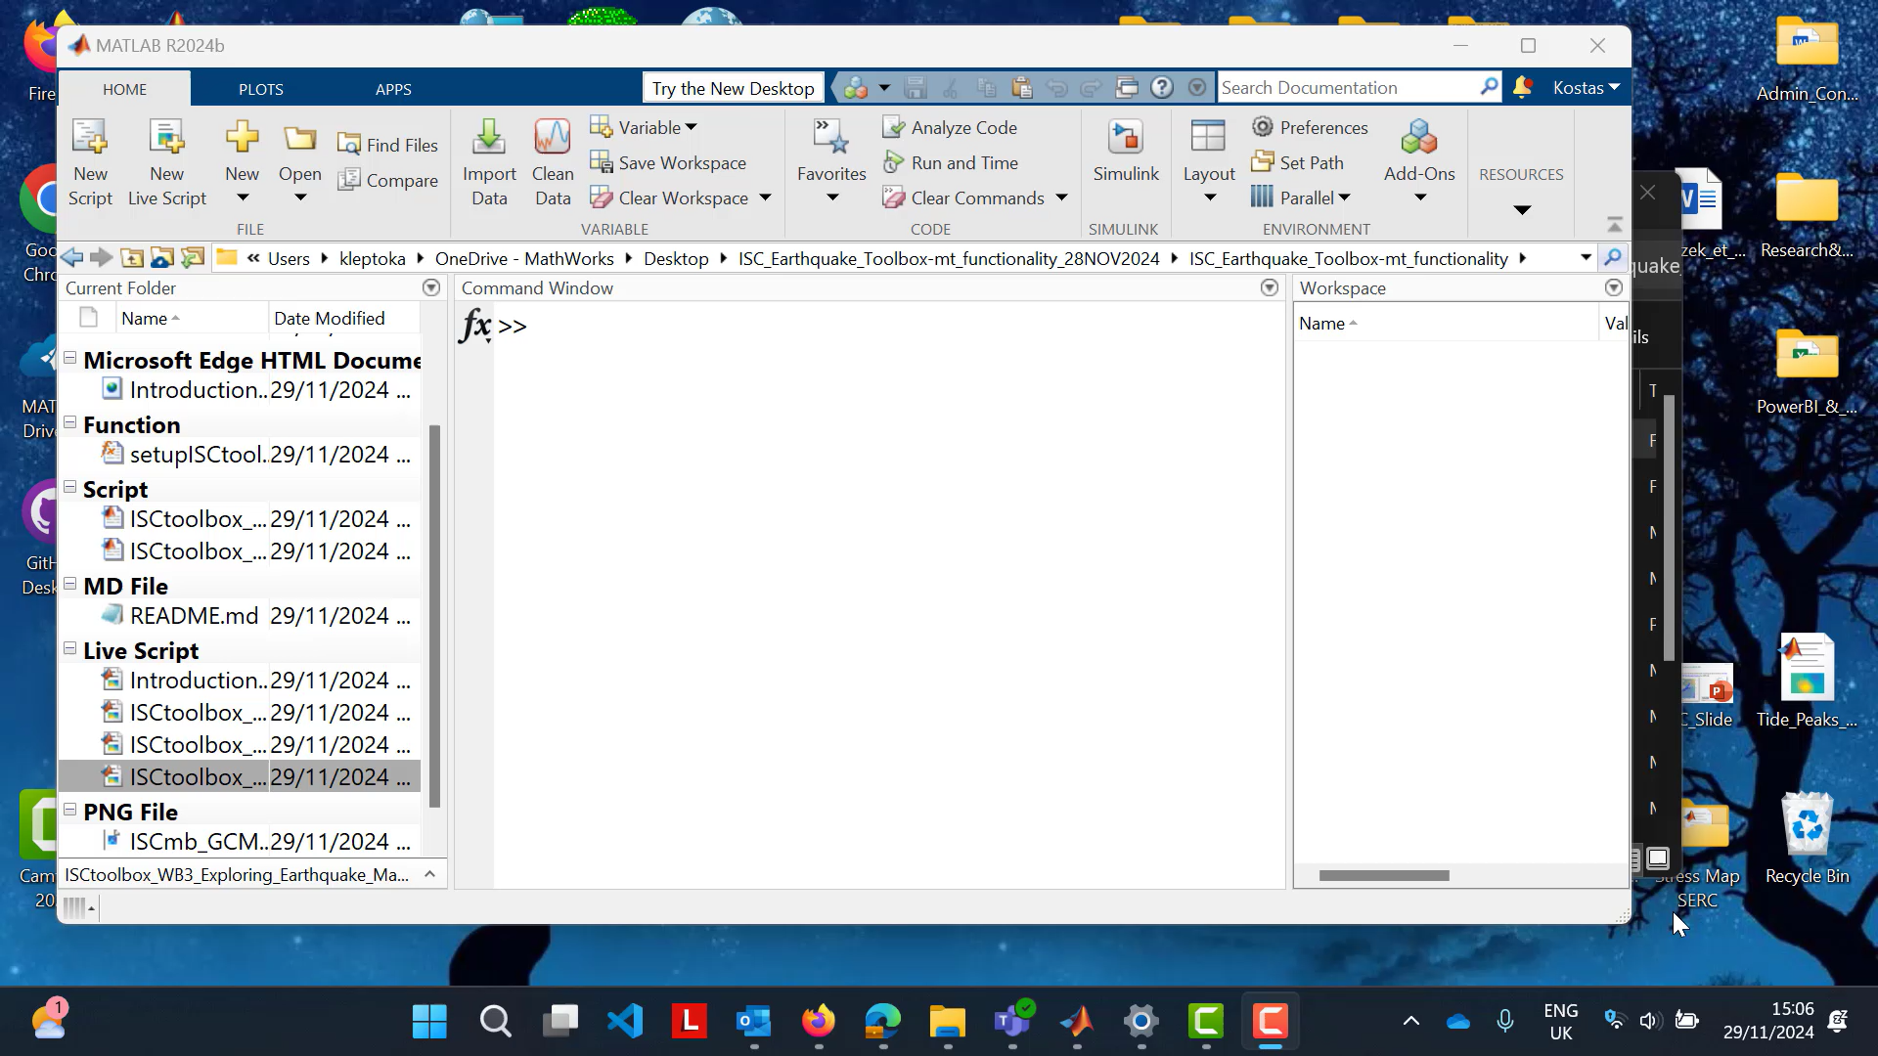
Explore Earthquake Locations and Magnitudes

Slide 6
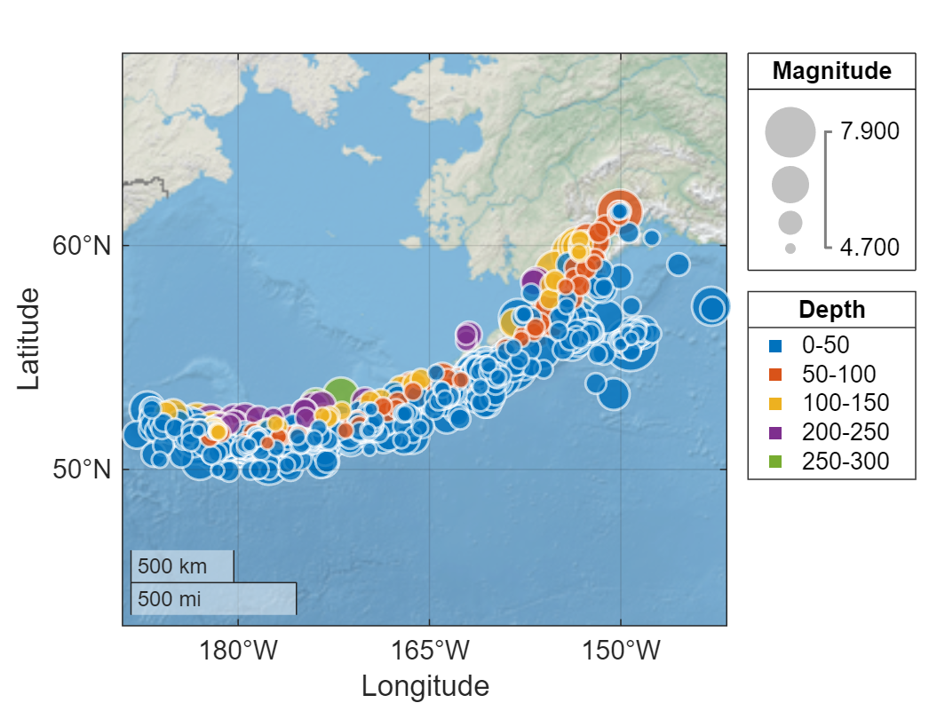
Resources
You can access (download, clone, or open in MATLAB Online) the ISC Earthquake Toolbox from
GitHub
File exchange
Check out the
AGU 2024 dynamic poster
ISC Blog
MATLAB Blog
For more information email earthquake-toolbox@isc.ac.uk or visit the MathWorks Booth #26, Ground (Yellow) Floor

