Slide 1
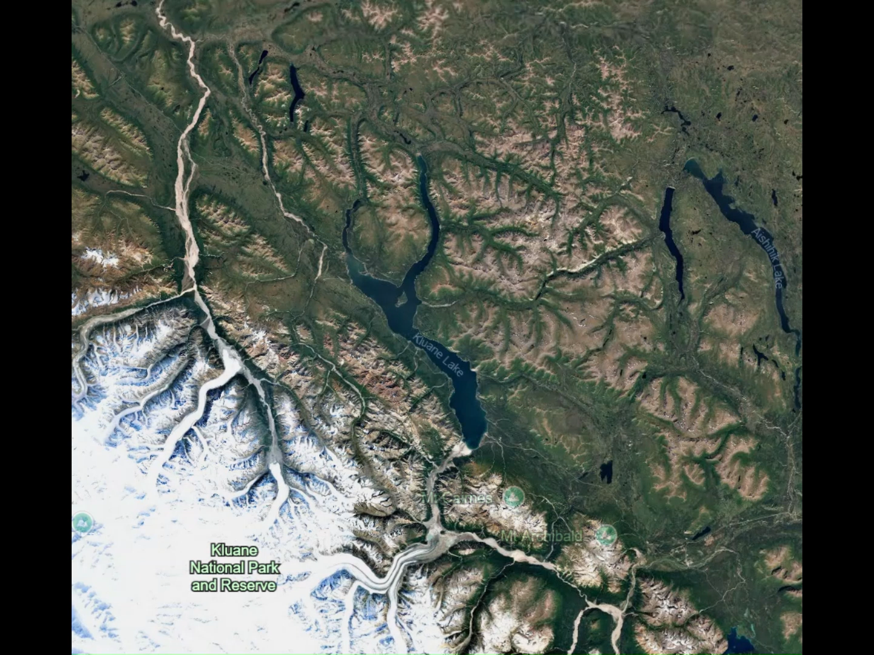


Exploring the Potential of SWOT Altimetry for Retrieving Lake Ice Thickness
Exploring the Potential of SWOT Altimetry
for Retrieving Lake Ice Thickness
Jennifer Fatt
Dr. Grant Gunn
Dept. of Geography and Environmental Management
Jennifer Fatt
Dr. Grant Gunn
Dept. of Geography and Environmental Management

Slide 2
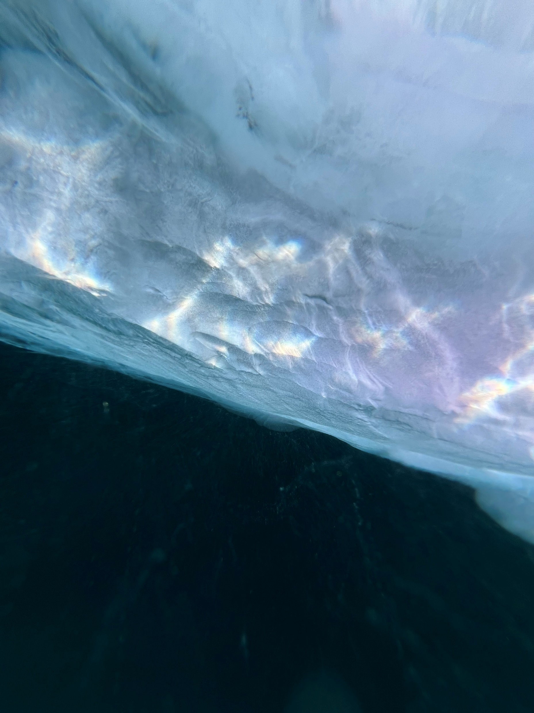
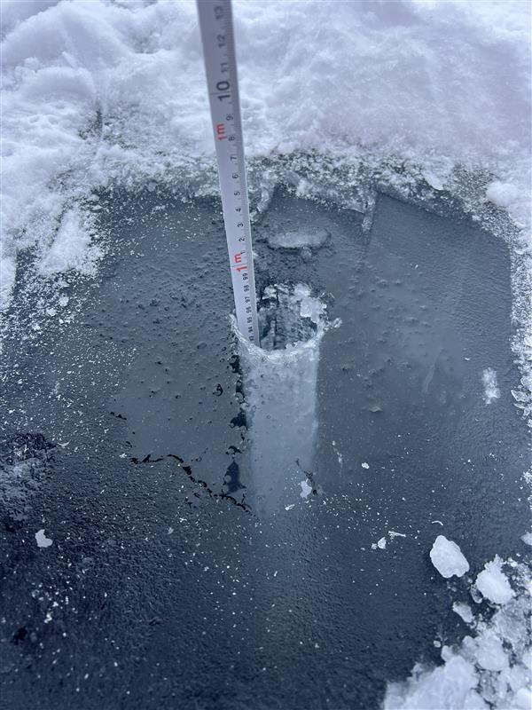
Motivation | Lake ice thickness
Lake ice is an ECV (GCOS)
LIT is a thematic variable of lake ice
Hydrologically, socioeconomically significant
Currently no sensors designed to monitor lake ice
LIT is decreasing
Notes:
Motivation: new methodology proposed
Background: MSc student focused on remote sensing of the Canadian sub-arctic
Majority of the lakes at high lats exp some degree of seasonal ice cover
Sig for remote communities in high latitudes

Slide 3
Study Site | Lhù’ààn Mân (Kluane Lake)
Largest lake in the Yukon Territory (400 km²)
River diversion into Pacific Ocean in 2016
Sensor overpass
Notes:
Objective: can we use radar alt to reliably retrieve LIT - opportunity bc data is already being collected
Sudden env change – Kaskawulsh glacier retreat in 2016
Lead to river diversion away from Kluane and into the pacific ocean instead
Resulted in a drastic water level drop 1m
Study Site Unique case study and study site bc of diversity of sensors that cross over the lake that we don’t typically see

Slide 4
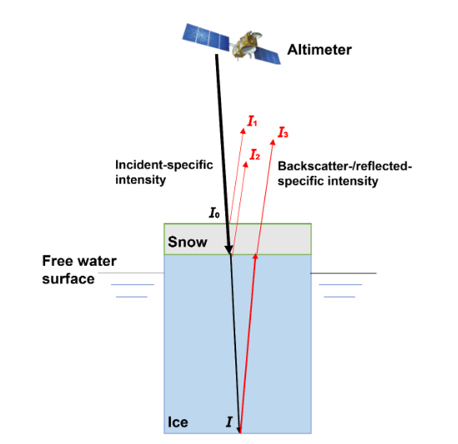
Background | Altimetry + LIT
Successful LIT retrieval from altimeters
Ku-band radar
Multiple sensors
SWOT
Relative permittivity
[1] (Li et al., 2023)
Notes:
Sentinel-3b and sentinel-6 are legacy satellites to SWOT, with all three carrying an altimeter capable of Ku-band (13.575 GHz) radar which is able to transmit through the lake ice, and any snow cover, and into the water below and return. The radar therefore hits two interfaces as it penetrates the lake ice: the ice/air interface and the ice/water one
Air has a relative permittivity of around 1, snow is approx. 3, and water is 80 – this impacts the transmission of the radar through these mediums and therefore requires correction for the speed of light
Account for speed of light in mediums using this calc (relative perm)
Incorp multiple sensors bc past looked at one
Relative perm of air vs ice

Slide 5
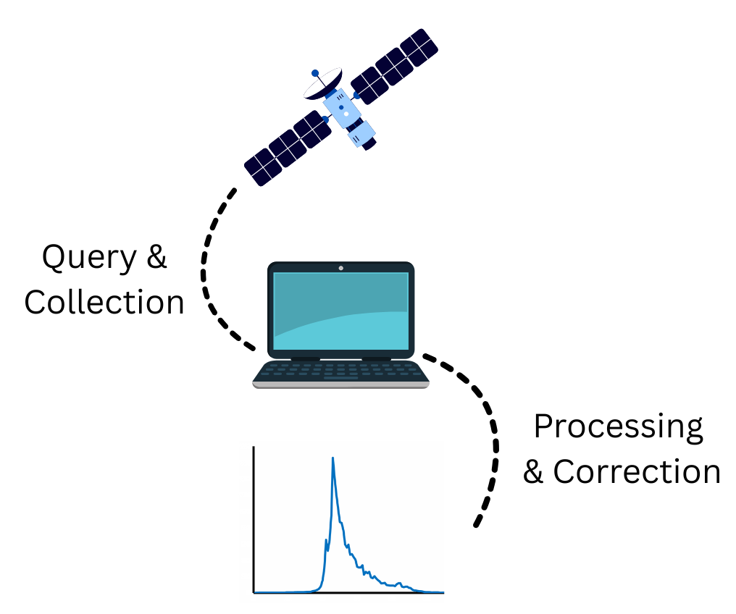
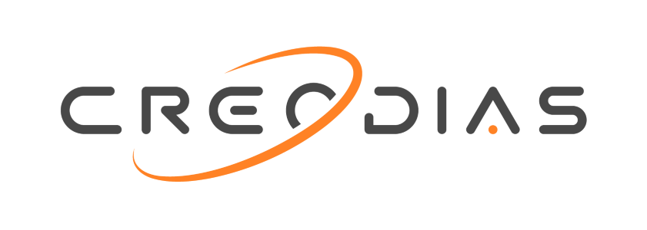


Methods | LIT
Notes:
Methods
After querying the data from various open-source sites to obtain the products I need, I ran it through several algorithms to extract the necessary variables for waveform production including coordinates, power, and range gates. Once extracted the dual-peak waveform can then be used to estimate LIT after the correction for light through the interfaces
Dual-peak freshwater waveform
Correction for light through interfaces

Slide 6
Peak 1
Peak 2
Snow: 3
Ice: 1
Water: 80
Peak 2
Peak 1
Notes:
The two interfaces intercepted by the radar can be clearly seen as distinct two-step waveforms specific to freshwater ice
The leading-edge peak, peak 1, being the ice/air interface
And the tallest peak, peak 2, is the ice/water interface
The radar time delay between these two peaks can then be used to estimate the lake ice thickness thanks to the delay doppler altimeters aboad each sensor
Move waveform slide before data set
Thinking back to relative perm, air and ice have a contrast that’s relatively low - therefore 100% of the signal is not returned to the sensor whereas ice to water is large contrast and ref coeff is nearly 100% of the incidence signal being returned due to this contrast
real reflection, imaginary absorb

Slide 7
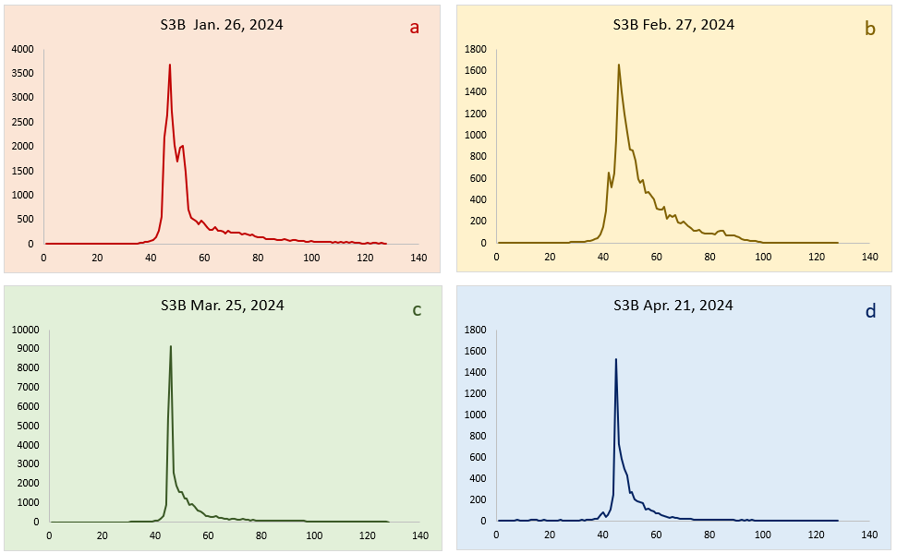
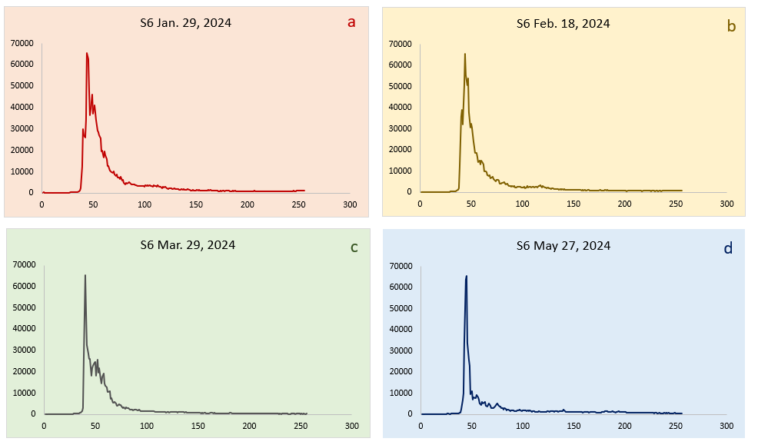
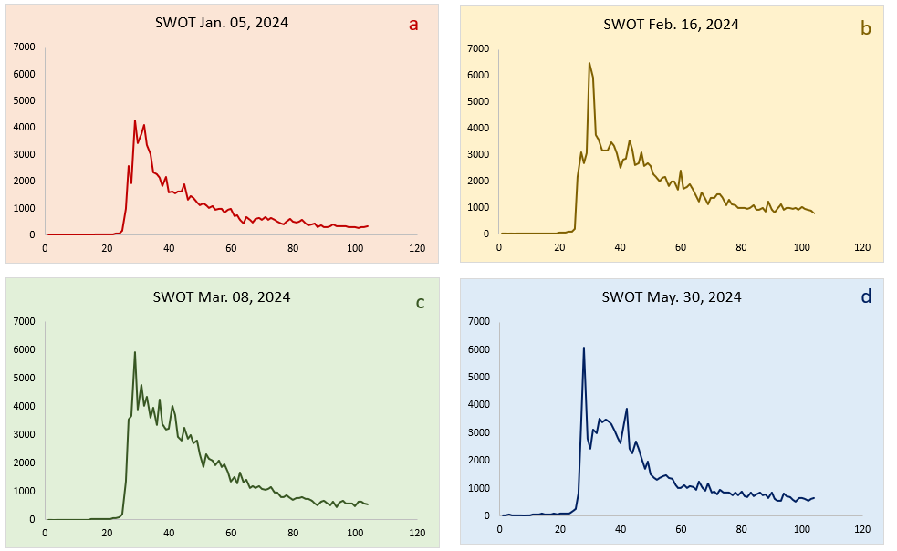
Sentinel-3 Sentinel-6 SWOT
Data Sets | Sensors
Notes:
Here we can see the open water, early season, ice on and ice off waveforms for the three sensors

Slide 8
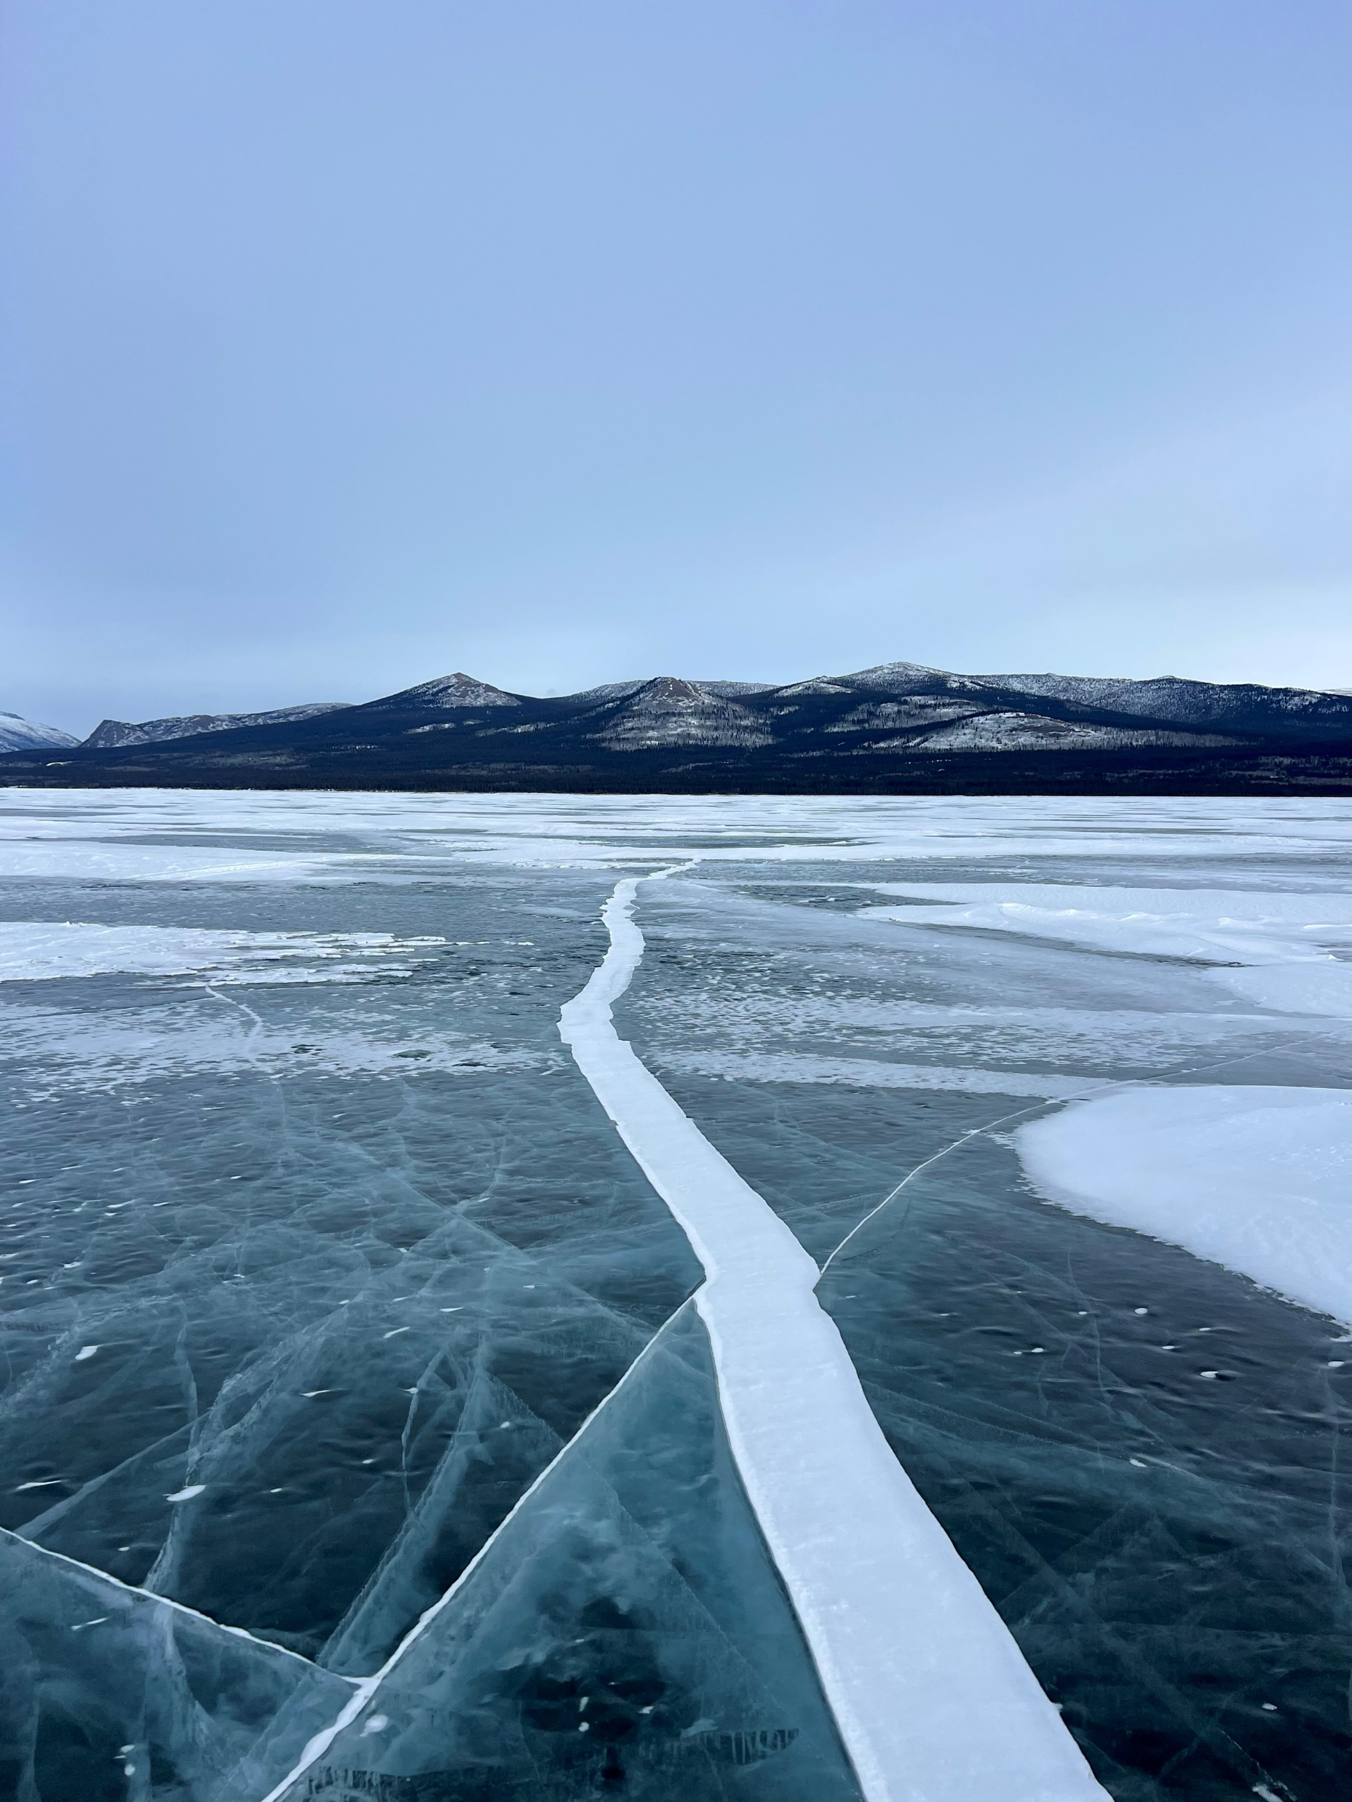
Results | Comparison and Validation: CLIMo and In Situ Data
Sensor | Revisit Time | Location
Sentinel-3 | 27 days | 61.83234, -138.520364
Sentinel-6 | 10 days | 61.209578, -138.580603
SWOT | 21 days | 61.251343, -138.738952
Buoys | Daily | 61.122343, -138.506476
CLIMo Simulation | Daily | 61.20816, -138.584
Notes:
Discussion
The Canadian lake ice model (CLIMo) has successfully simulated lake ice when provided with accurate meteorological data
Points along transect
RMSE of range in sat vs in situ LIT vals

Slide 9
Time Series | Ice Phenology 2024
Notes:
Results
S6 has a repeat cycle of 10 days, S3B is every 27 days, and SWOT is every 21 days
not enough for stats (RMSE)
Multiple points on lake and seeing if they all agree

Slide 10
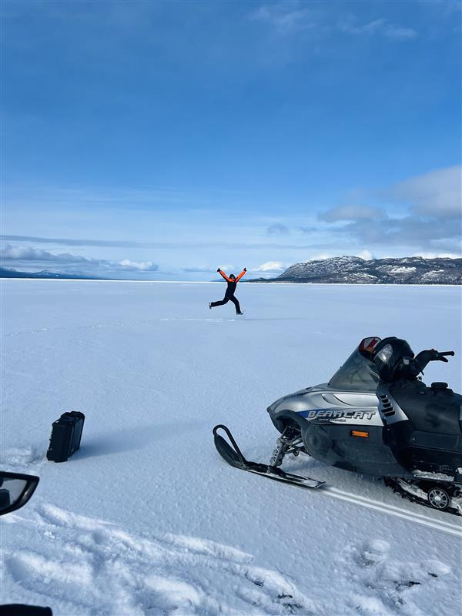
Now What? | Future Research
Longer time series on Kluane
SWOT altimeter LIT retrieval on other lakes of various sizes
SWOT retracking algorithm to automate the process
Limitations
Notes:
Limitations of research
- LIT min and max for SAR
Snow on top of ice wetness, amount
Melt
Buoys and in situ retrievals not exact same as sat coords

Slide 11



Acknowledgements
Contact: Jennifer Fatt | jcfatt@uwaterloo.ca
Dr. Grant Gunn
CSA ROSS Grant CSA-23SUESLAKE

Slide 12
References
[1] Li, X., Long, D., Cui, Y., Liu, T., Lu, J., Hamouda, M. A., & Mohamed, M. M. (2023). Ice thickness and water level estimation for ice-covered lakes with satellite altimetry waveforms and backscattering coefficients. Cryosphere, 17(1), 349–369. Scopus. https://doi.org/10.5194/tc-17-349-2023
[2] Mangilli, A., Thibaut, P., Duguay, C. R., & Murfitt, J. (2022). A New Approach for the Estimation of Lake Ice Thickness From Conventional Radar Altimetry. IEEE Transactions on Geoscience and Remote Sensing, 60. Scopus. https://doi.org/10.1109/TGRS.2022.3186253
[3] Duguay, C. R., Flato, G. M., Jeffries, M. O., Ménard, P., Morris, K., & Rouse, W. R. (2003). Ice‐cover variability on shallow lakes at high latitudes: Model simulations and observations. Hydrological Processes, 17(17), 3465–3483. https://doi.org/10.1002/hyp.1394

