Slide 1
A Study on the Seasonal Correlation between O₃ and PM_{2.5} in Seoul
Department of Environmental Engineering, Anyang University, Anyang, Gyeonggi, Republic of Korea
Hui-Jeong Lim

Slide 2
Table of Contents
Ⅰ Introduction
Ⅱ Theoretical Background
Ⅲ Data and Methods
Ⅳ Results and Discussion
Ⅴ Conclusion

Slide 3
Ⅰ. Introduction
1. Background
Air pollution significantly impacts human health and the environment.
O₃ and fine particulate matter (PM_{2.5}) in Seoul have considerable effects on health and the environment, with their concentrations varying by season.
Understanding seasonal air quality variations in Seoul is crucial.
2. Research Purpose
Investigate the seasonal correlation
between O₃ and PM_{2.5}
in Seoul from 2015 to 2023.
Enhance the understanding of air quality changes.
Contribute to environmental policy-making.
3. Introduction to methodology
Using Python for data processing and correlation analysis, we analyze the relationship between O₃ and fine particulate matter (PM_{2.5})
The results are compared seasonally.

Slide 4
Ⅱ. Theoretical Background
1. PM_{2.5}
3. Effect of PM_{2.5} on O₃
Definition: PM_{2.5} refers to ultrafine particulate matter with a diameter of 2.5 µm or less.
Composition
Primary particles: Naturally occurring elemental components, fuel combustion emissions, primary organic matter (POM), and elemental carbon (EC).
Secondary particles: Ionic components (SO₄²⁻, NO₃⁻, NH₄⁺), secondary organic matter (SOM).
Health Effects: WHO Group 1 Carcinogen, Causes Respiratory and Cardiovascular Diseases.
Surface heterogeneous reaction: Influences tropospheric O₃ formation.
Suppression effects
Summer: PM_{2.5} absorbs radicals, suppressing O₃ formation (Li et al., 2019)
High aerosol concentrations: Weaken light transmittance, reducing O₃ production
(Feng et al., 2016; Li et al., 2011)
Winter: High concentrations of PM_{2.5} block solar radiation, decreasing O₃ (Jia et al., 2017)
2. Chemical behavior of O₃ and PM_{2.5}
in the atmosphere
4. Seasonal Management Strategies
Role of O₃: Facilitates the mechanism by which NOx and VOCs convert into PM_{2.5}.
Oxidation reaction: Plays a crucial role in the formation of secondary organic aerosols (SOA).
Current status: Limitations of managing O₃ and PM_{2.5} separately (Seoul Institute, 2018)
Necessity: Integrated management strategy and control of VOCs and Nox
Research objective: To analyze the seasonal correlation between O₃ and PM₂.₅ concentrations in Seoul (2015–2023)

Slide 5
Ⅲ. Data and Methodology
1. Data source
2. Methodology
Air pollutant measurement
data
Urban air monitoring network data from 25 districts in Seoul
Hourly data from January 1, 2015, 01:00 to December 31, 2023, 24:00
Analysis of concentrations of O₃, PM_{2.5}, and NO₂
PM_{2.5} and NO₂: Hourly average data for each district, used as daily average concentrations
O₃: 8-hour average (MDA8) used as daily average concentration
Monthly average concentrations and correlation coefficients among O₃, PM_{2.5}, and NO₂: Calculated monthly using daily average data by district
Conducting Pearson bivariate correlation analysis using Python
Analysis of the correlation between O₃ and fine dust using Pearson correlation analysis or multiple regression analysis
Research period: Seasonal data (spring, summer, autumn, and winter) from 2015 to 2023 were used(Each measurement was included in the analysis only if the proportion of valid data exceeded 75%)
Cloud cover: Expressed as the percentage (%) of the sky covered by clouds, based on the entire sky being 100% at the observation site.
Hourly solar radiation data: The total amount of radiation energy received per unit area over one hour (MJ/m²).
Meteorological
Data
KMA Automated Synoptic Observing System (ASOS)
2015–2023, Seoul (37°57′N, 126°97′E) Solar radiation and cloud cover data

Slide 6
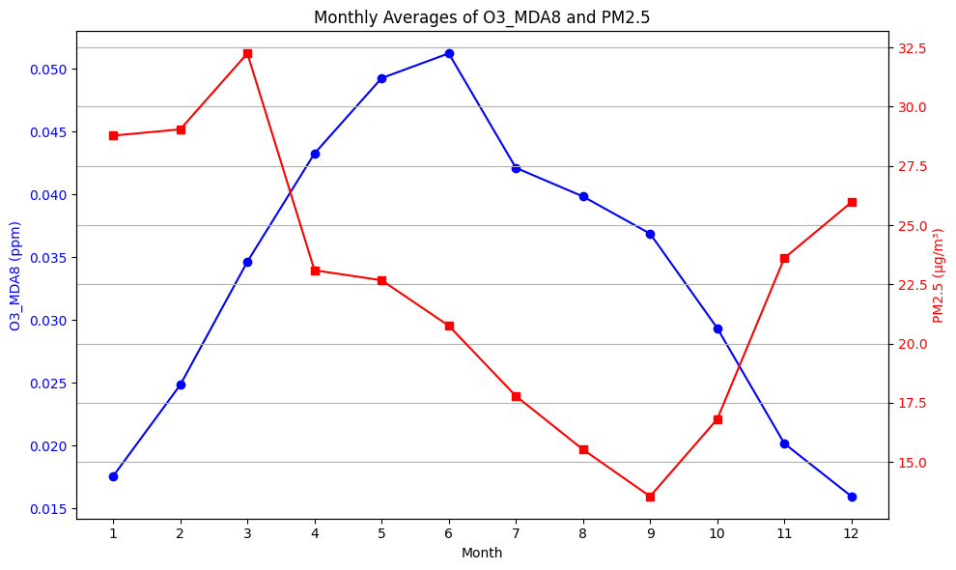
Ⅳ. Results and Discussion
1. Seasonal Distribution and Correlation of O₃ and PM_{2.5} Concentrations
Monthly Distribution of O₃ and PM_{2.5} Concentrations
T
O₃
Concentrations increase during spring and summer when sunlight is strong,
Tend to decrease in winter
PM_{2.5}
Increased fuel consumption and prevailing northwesterly winds lead to higher concentrations in spring and winter.
Increased precipitation causes a decrease in summer concentrations.
(Both O₃ and PM_{2.5} drop sharply in August due to rainfall.)
[Figure 1] Monthly variation of averaged maximum daily 8-hour O₃ and PM_{2.5} in Seoul during from 2015 to 2023.

Slide 7
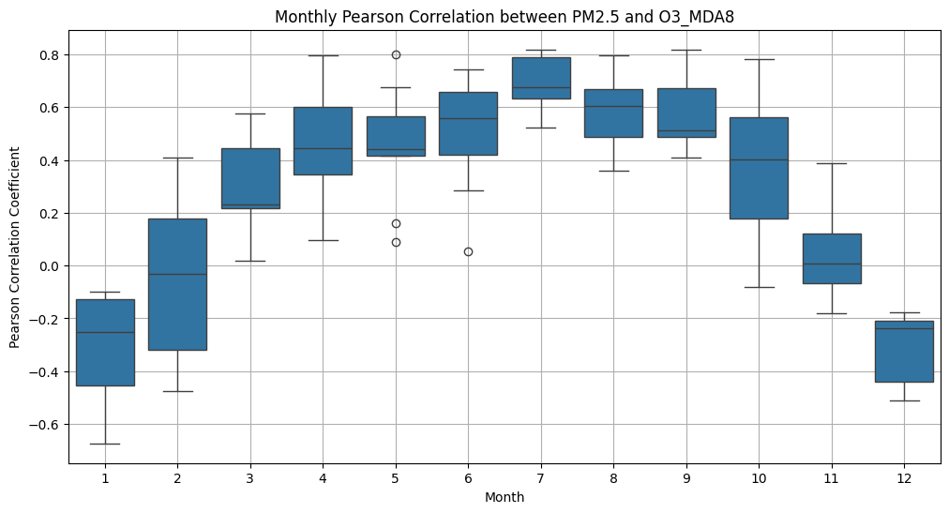
Ⅳ. Results and Discussion
2. Correlation between PM_{2.5} and O₃ in Seoul
[Figure 1] Monthly Pearson correlation coefficients (p < 0.01) between PM_{2.5} and O₃_MDA8 in Seoul
O₃–PM_{2.5} Correlation Analysis
Positive correlations in all districts from March to September
Strong correlations in summer (Jun–Aug): 0.50–0.69 with low variability
Negative correlations in winter (Jan, Feb, Dec): –0.32 to 0.04
Seasonal patterns are distinct
Winter: Negative correlation (O₃↓, PM_{2.5}↑)
Summer: Strong positive correlation (Both ↑)
Potential for photochemical smog in summer
Uncertainty in Feb & Oct
→ high correlation variability
This analysis identifies key factors driving seasonal differences in O₃–PM2.5 correlation between summer (June–August) and winter (January, February, December)

Slide 8
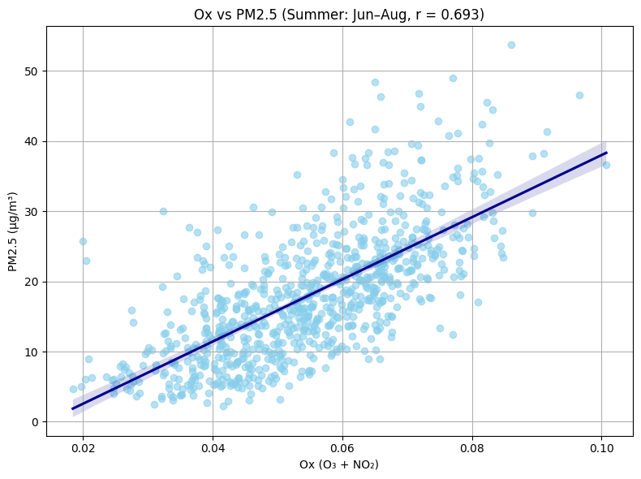
Ⅳ. Results and Discussion
4. Correlation Characteristics Between O₃ and PM_{2.5} During Summer
To assess the impact of secondary formation, we analyzed the relationship between O_{x} (O₃ + NO₂) and PM_{2.5} during summer in Seoul.
Monthly Correlations (O₃ vs PM_{2.5}):
june: r = 0.50
July: r = 0.69 (strongest)
August: r = 0.60
The scatter plot shows a strong positive correlation between Ox and PM_{2.5} in July (r = 0.69).
Conclusion:→ Atmospheric oxidative capacity has a significant influence on the secondary formation of PM_{2.5} during summer.
[Figure 3] Scatter plot and correlation (p < 0.01) between PM_{2.5} and O_{x} in Seoul (June–August, all years)

Slide 9
Ⅳ. Results and Discussion
5. Characteristics of the Correlation Between O₃ and PM_{2.5} in Winter
1) Assessment of PM_{2.5}'s Suppressive Effect on O₃ Production
In winter, High PM_{2.5} → Less solar radiation, more cloud cover
Leads to reduced O₃ formation
In Seoul winter:
→ Peak solar radiation drops sharply with higher PM_{2.5}
→ Cloud cover increases throughout the day
O₃ suppression is strongest during midday hours
[그림4] Diurnal change of (a) Solar radiation and (b) Cloud cover under three PM_{2.5} levels over 16~36 µg/m³, 36~75 µg/m³ and exceeding 76 µg/m³ during winter in Seoul, from 2015 to 2023.

Slide 10
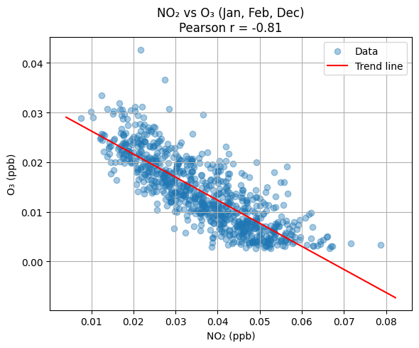
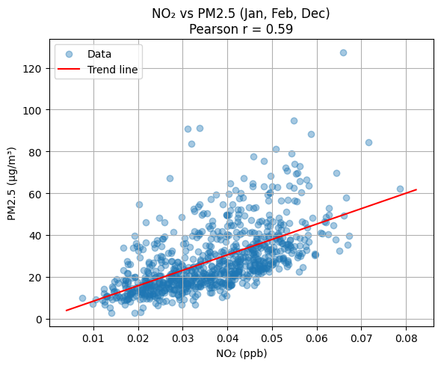
Ⅳ. Results and Discussion
5. Wintertime Correlation Between O₃ and PM2.5 (Jan, Feb, Dec)
O₃fect of NOx on O₃ Suppression
Correlation of
daily averaged
concentration of
NO2 with
(a) O₃ and
(b) PM_{2.5}
during winter
in Seoul, from 2015 to 2023
(confidence
level of 99%).
O₃ Formation, Destruction
O₃ is formed and destroyed through the
photolysis cycle of NO₂.
In the presence of VOCs, O₃ concentration
increases.
The response of O₃ depends
on the VOC/NOx ratio:
NOx-limited regime (high VOCs/NOx):
→ O₃ increases with NO, little effect from VOCs.
VOCs-limited regime (low VOCs/NOx):
→ O₃ increases with VOCs, decreases with NOx.
→ The Seoul Metropolitan Area tends toward a
VOCs-limited regime, so increasing NOx can reduce
O₃ production efficiency.
NOx and PM_{2.5}:
→ NOx contributes to PM_{2.5} formation.
→ Due to limited NO data, NO₂ is used as a proxy.
Winter 2015~2023 Observations (Seoul):
NO₂ and O₃: Strong negative correlation (r = -0.81).
NO₂ and PM_{2.5}: Positive correlation(r = 0.59).
High NO₂ concentrations → lower O₃,
higher PM_{2.5}

Slide 11
Ⅳ. Results and Discussion
5. Wintertime Correlation Between O₃ and PM_{2.5} (Jan, Feb, Dec)
3) Comparative Influence of NOx and PM_{2.5} on O₃ During Winter
Key Factors: NOx and PM2.5
Correlation Analysis
O₃ vs NO₂: Strong negative correlation (r = -0.56 to -0.69)
O₃ vs PM_{2.5}: Weak negative correlation (r = -0.05 to -0.31)
In winter, NOx has a greater impact on O₃ reduction than PM2.5.
Compared to findings from China, the influence of PM2.5 on O₃ formation in Seoul appears to be relatively minor.
The O₃-suppressing effect of NOx plays a more significant role.
In Seoul’s winter, NOx is a key factor in O₃ reduction.
Correlation coefficient of O₃ with PM_{2.5} and NO2
(confidence level of 99%) during winter in Seoul, 2015~2023.
 | Jan | Feb | Dec
O₃-PM_{2.5} | -0.25 | -0. 19 | -0.36
O₃-NO2 | -0.84 | -0.81 | -0.83

Slide 12
Ⅴ. Conclusion
Seasonal Correlation Between O₃ and PM_{2.5}
Study Overview
Analysis of O₃ and PM_{2.5} concentrations in 25 districts of Seoul from 2015 to 2023
Period : 2015.01.01 ~ 2023.12.31
Correlation Coefficients
Summer: Strong positive correlation between O₃ and PM_{2.5} (average r = 0.60)
Winter: Negative correlation between O₃ and PM_{2.5} (average r = -0.37)
Cause Analysis
Summer: High solar radiation → More O₃ → Enhanced atmospheric oxidation → Promotes secondary PM_{2.5} formation
Winter: O₃ suppression by NOx > Solar radiation blocking effect by PM_{2.5}
Conclusion
The interaction between O₃ and PM_{2.5} varies by season due to different meteorological conditions
Seasonal strategies are needed for effective air quality management

