Slide 1
Supplementary

Slide 2
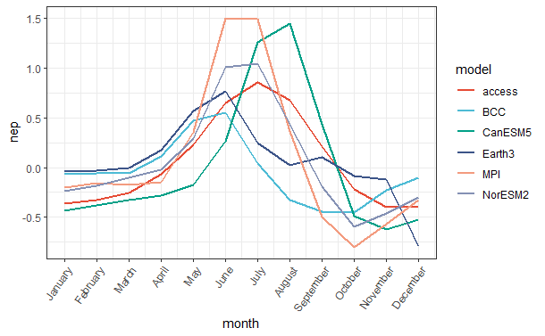
Surface C seasonal cycle from CMIP6 models
This plot shows multi-year average seasonal cycle of net ecosystem production (NEP) over 1982-2014 from 6 CMIP6 models at northern high latitudes.
Models differ in the magnitude and timing of NEP peak.

Slide 3
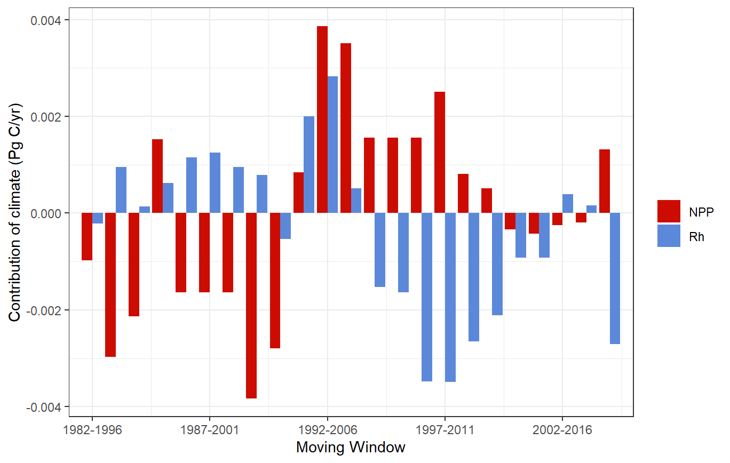
Shifting effect of climate
Increasing temperature in northern high latitudes had a increasingly negative effect on heterotrophic respiration, promoting the release of CO₂ to atmosphere

