Slide 1

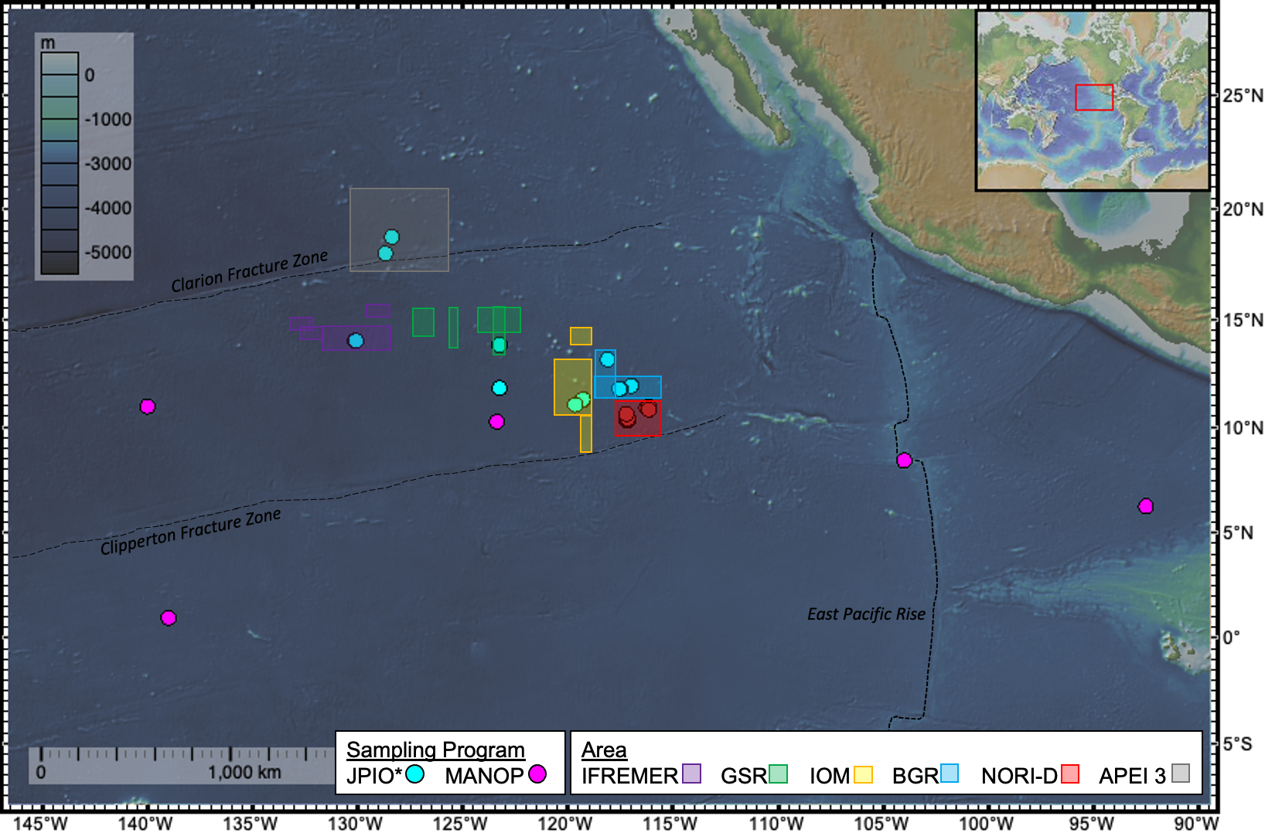

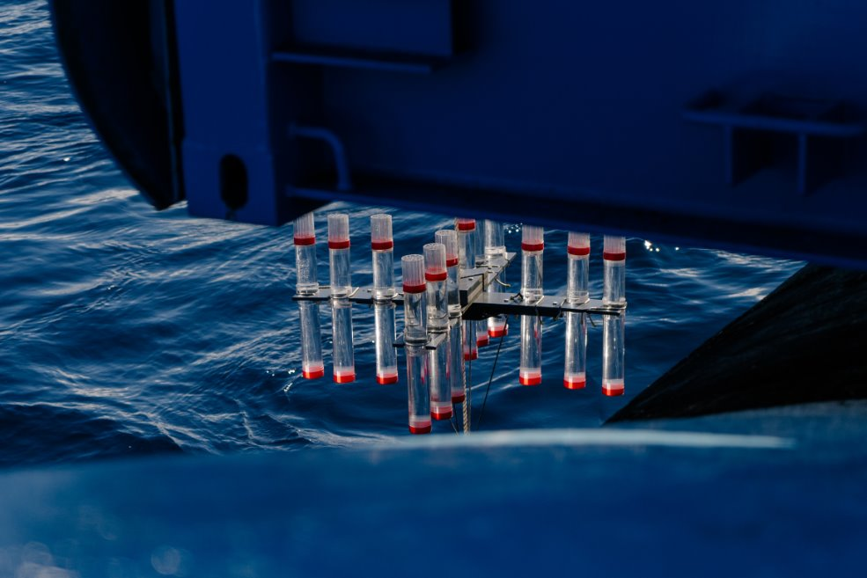
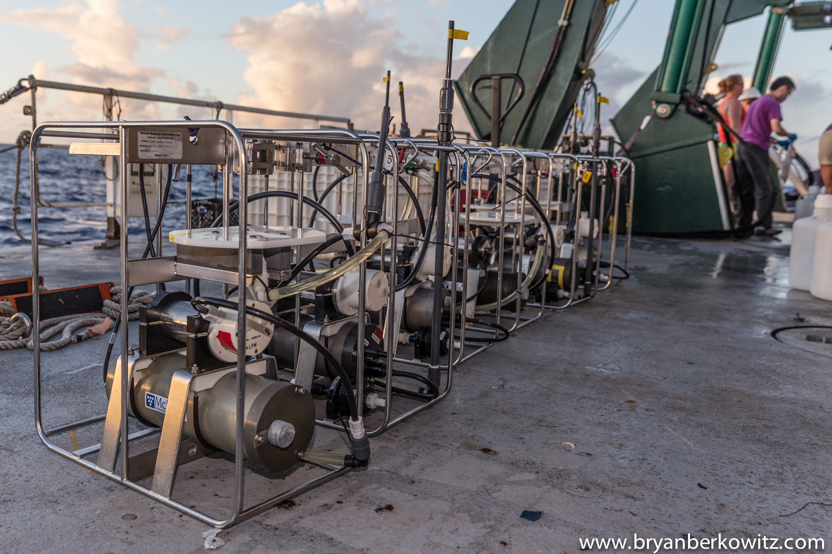
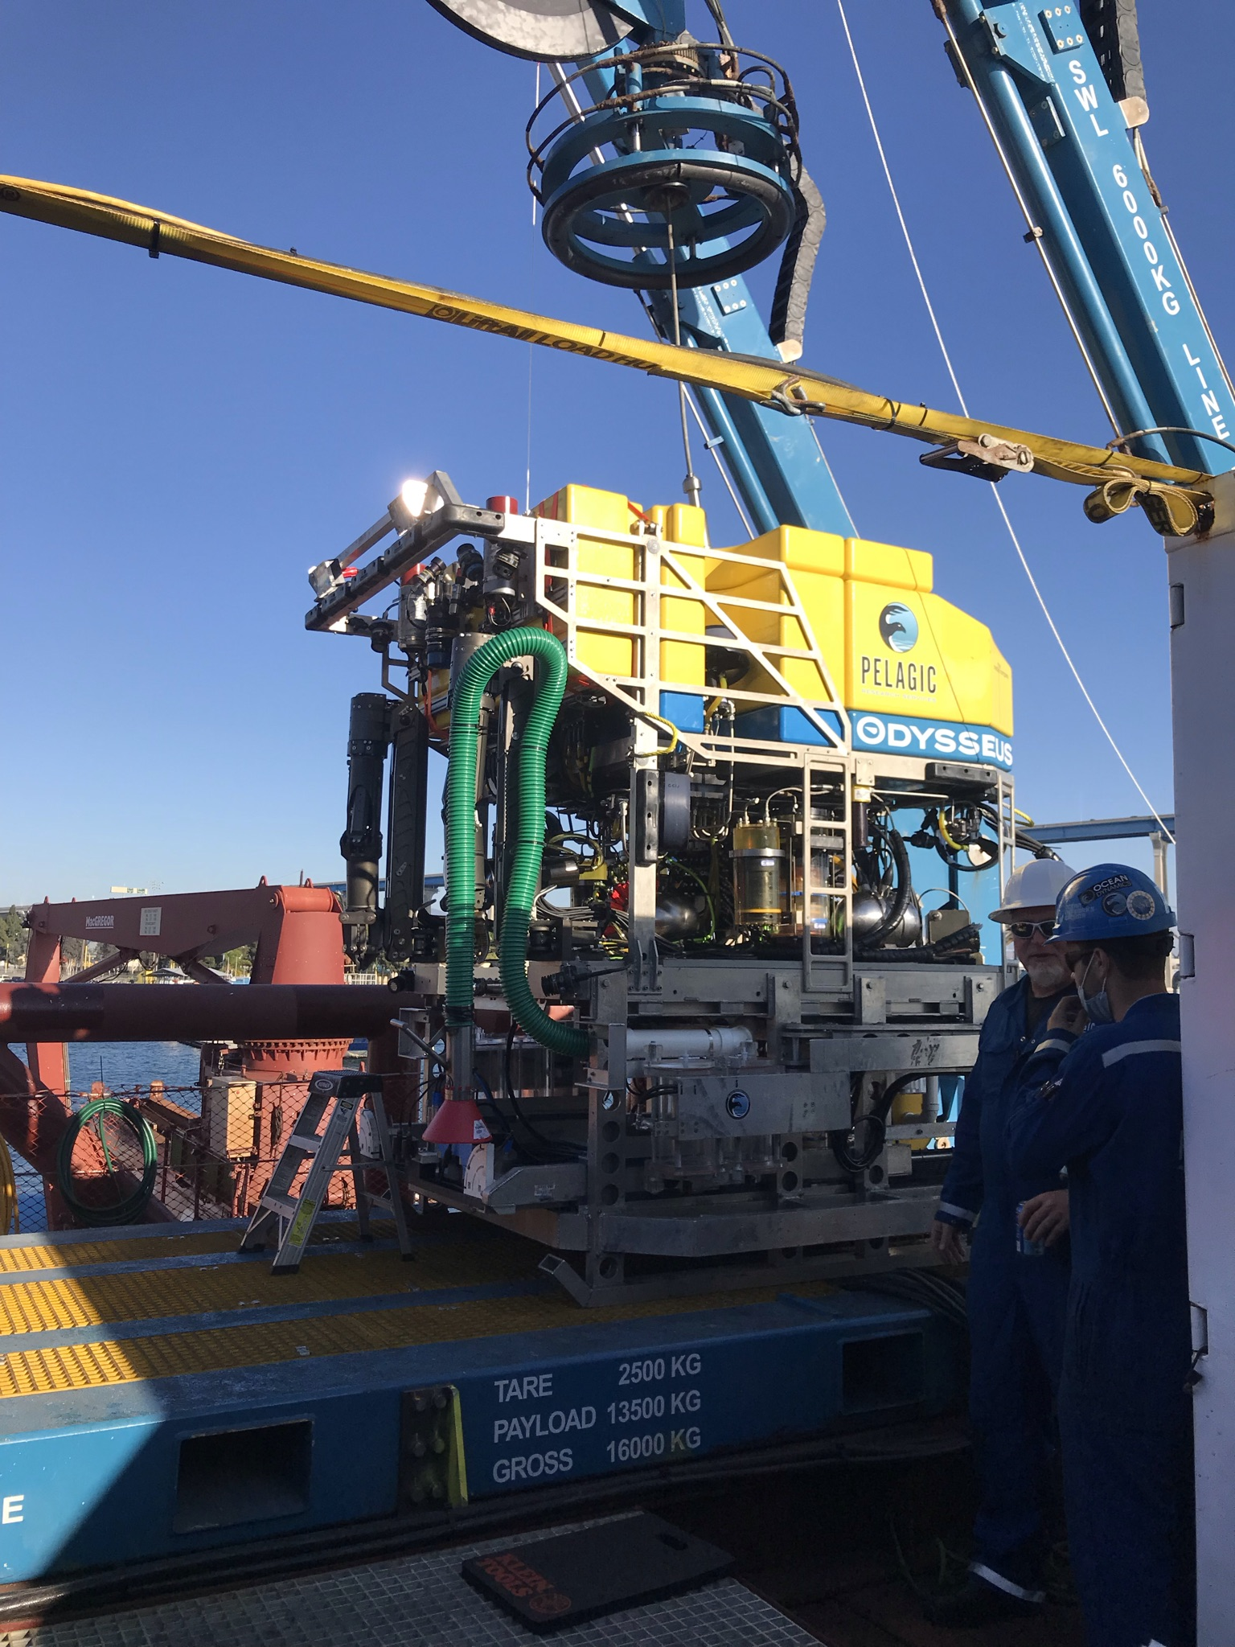
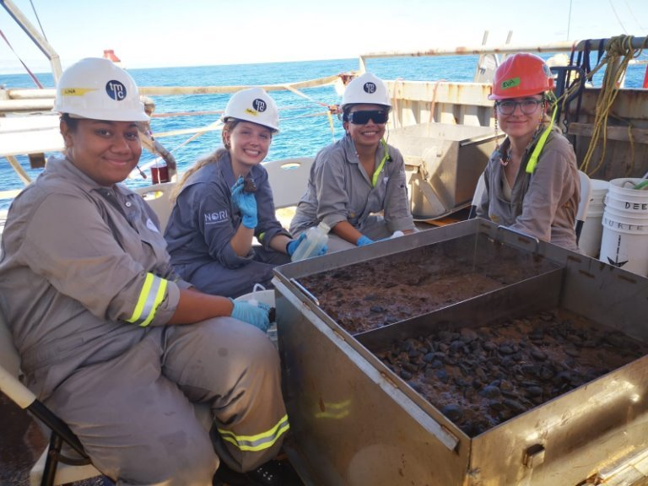
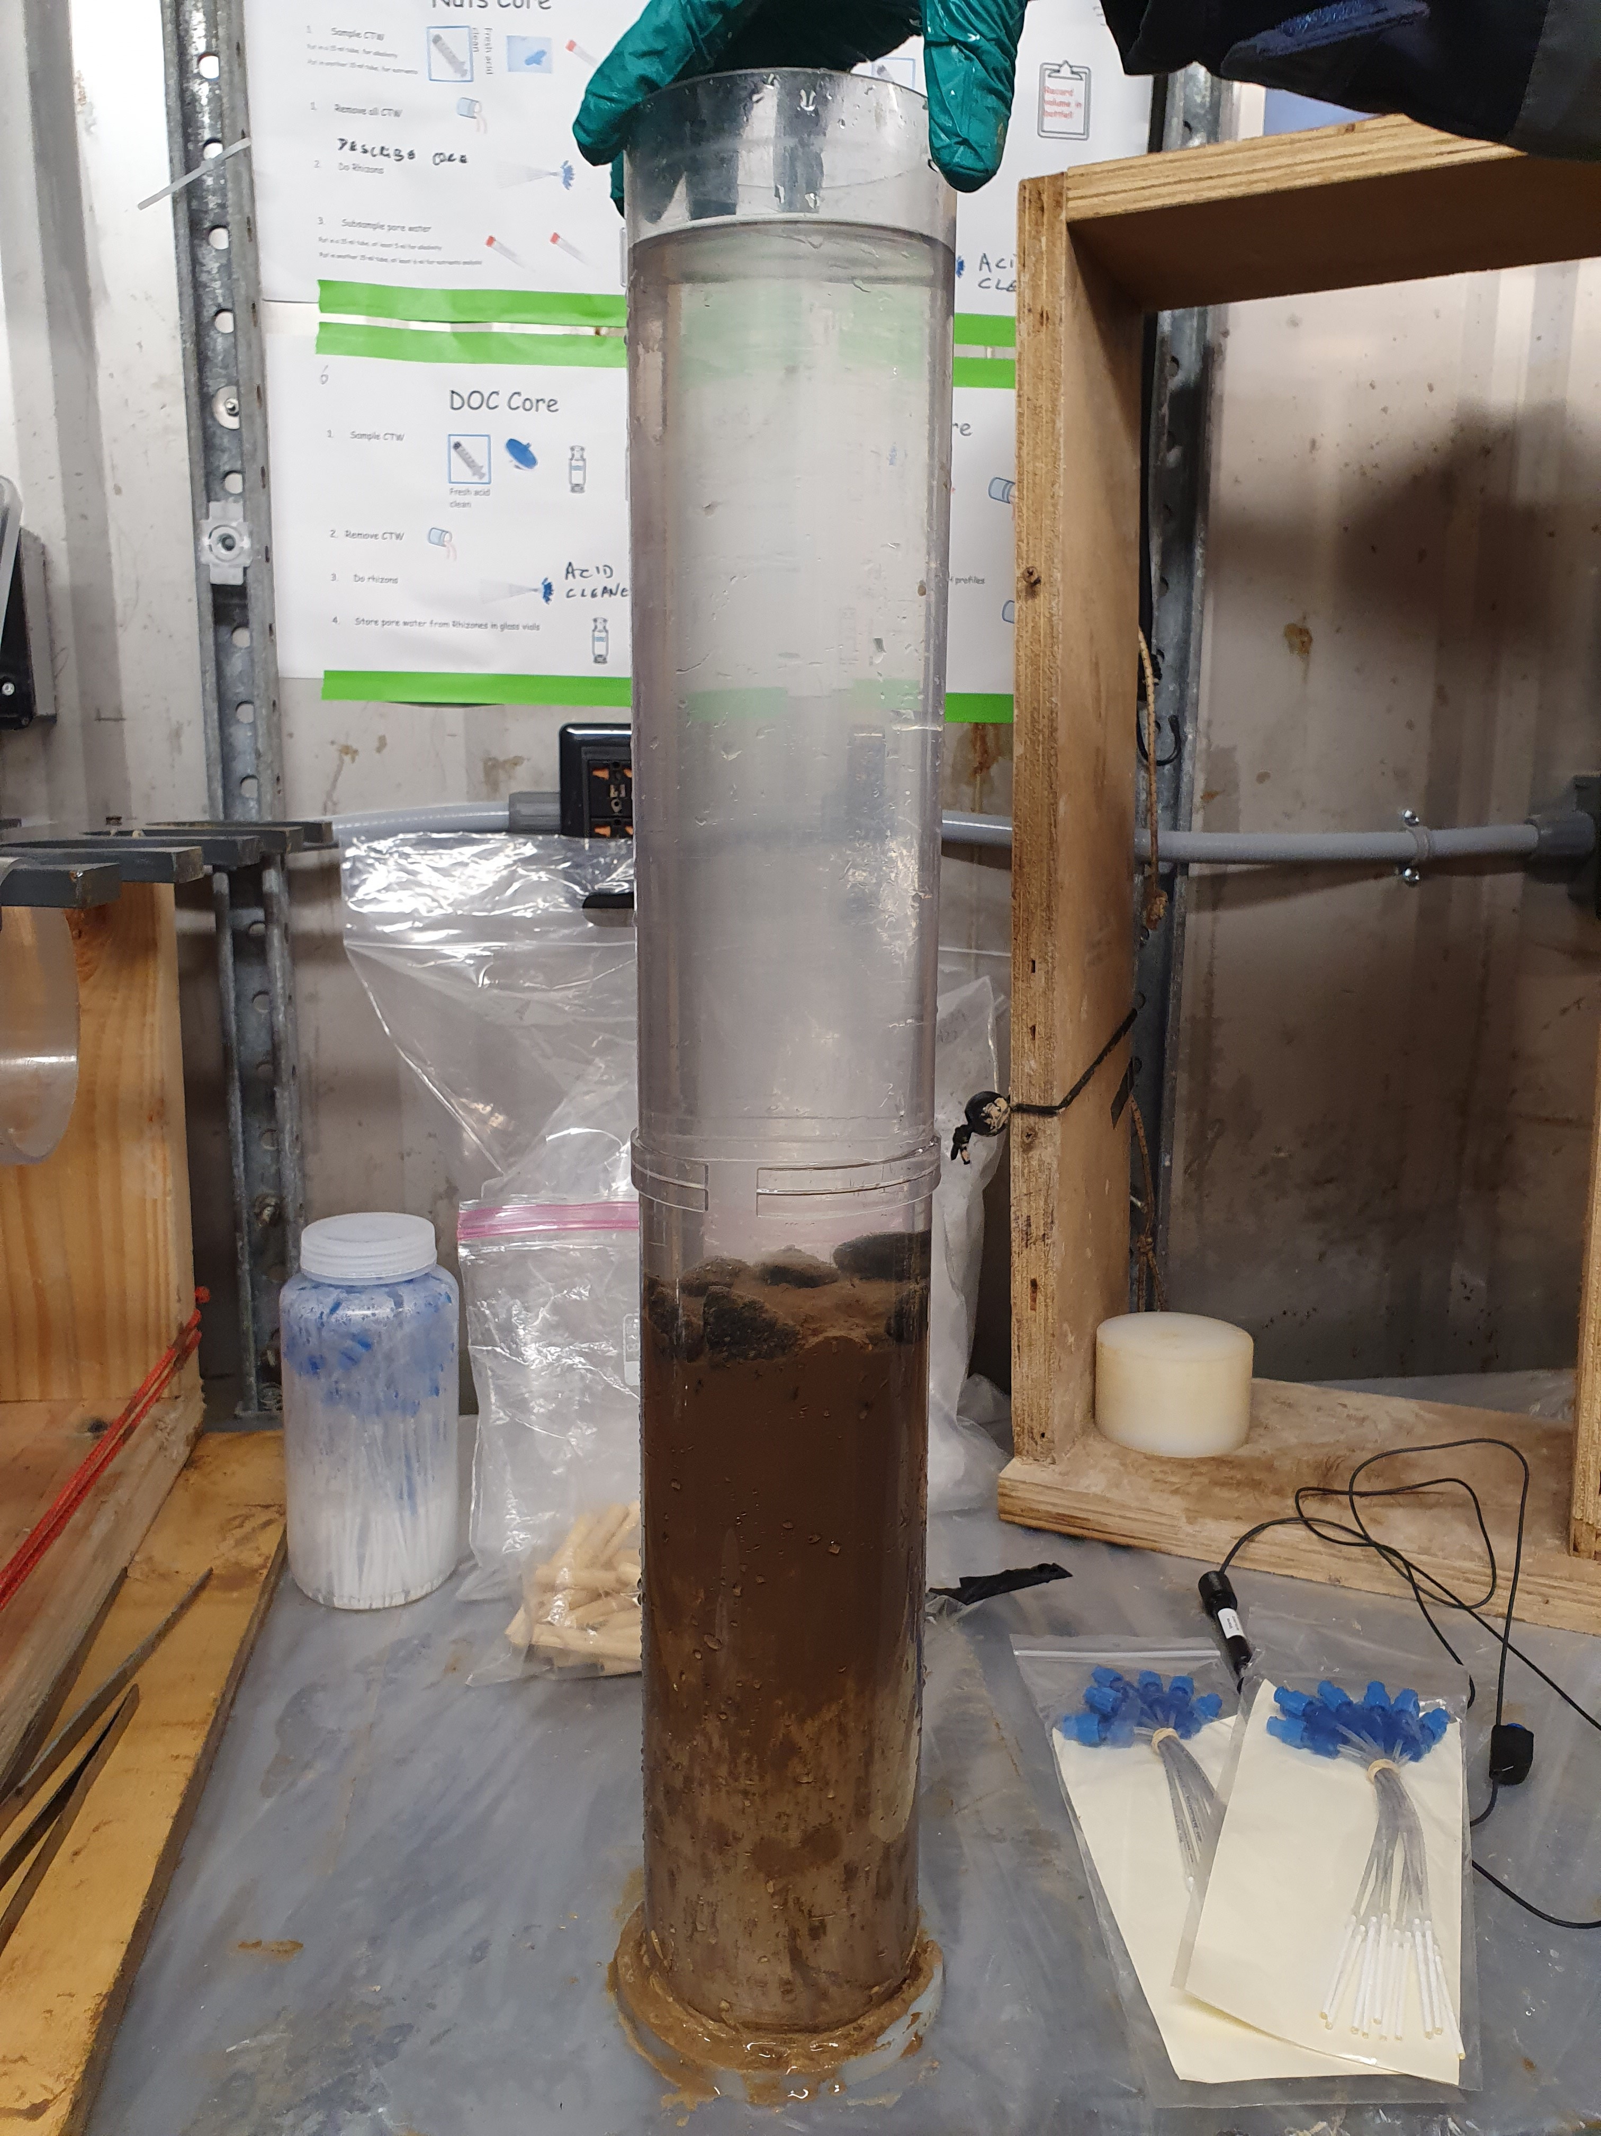
Temporal Variability in Organic Carbon Fixation and Fate in the CCZ
What is the temporal variability in surface ocean productivity, and to what extent are sinking flux, sedimentary carbon and faunal abundance coupled?
How does trial deep sea mining impact the sediment carbon pool?
20 N
10 N
0
140 W
120 W
100 W
Woulds, C.¹, Lough, A.¹, Homoky, W.¹, Drazen, J.², Popp, B.N.², White, A., Ferrón, S.², Dowd, M.², Glover, A.³, Dahlgren, T.⁴, Stewart, E. C. D.³, Ingels, J.⁵, O’Malley, B.⁶, Jones, D. O. B.⁷ , Fleming B.⁷, Simon-Lledo, E.⁷, Jeffreys, R.⁸, Blackbird, S.⁸, Clerici, S.¹, Wolff, G.⁸, Smith, A⁷., Sweetman, A. K.⁹ *correspondence c.woulds@leeds.ac.uk

Slide 2
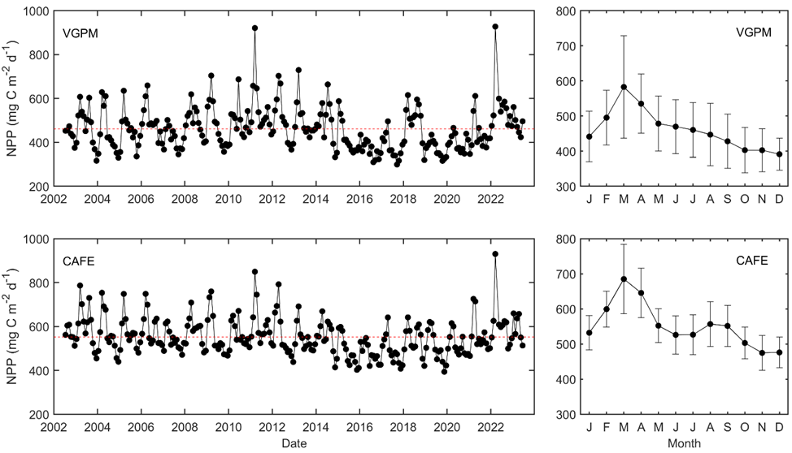
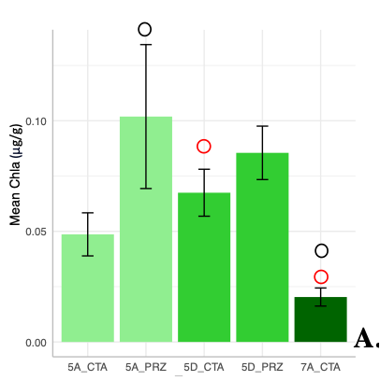
Temporal Variability and (De)Coupling
Seasonal and inter-annual variability in productivity
Shallow sinking flux coupled to productivity
Limited coupling to sedimentary C pool and faunal abundance
Consumption, trophic interactions and lateral transport important

Slide 3
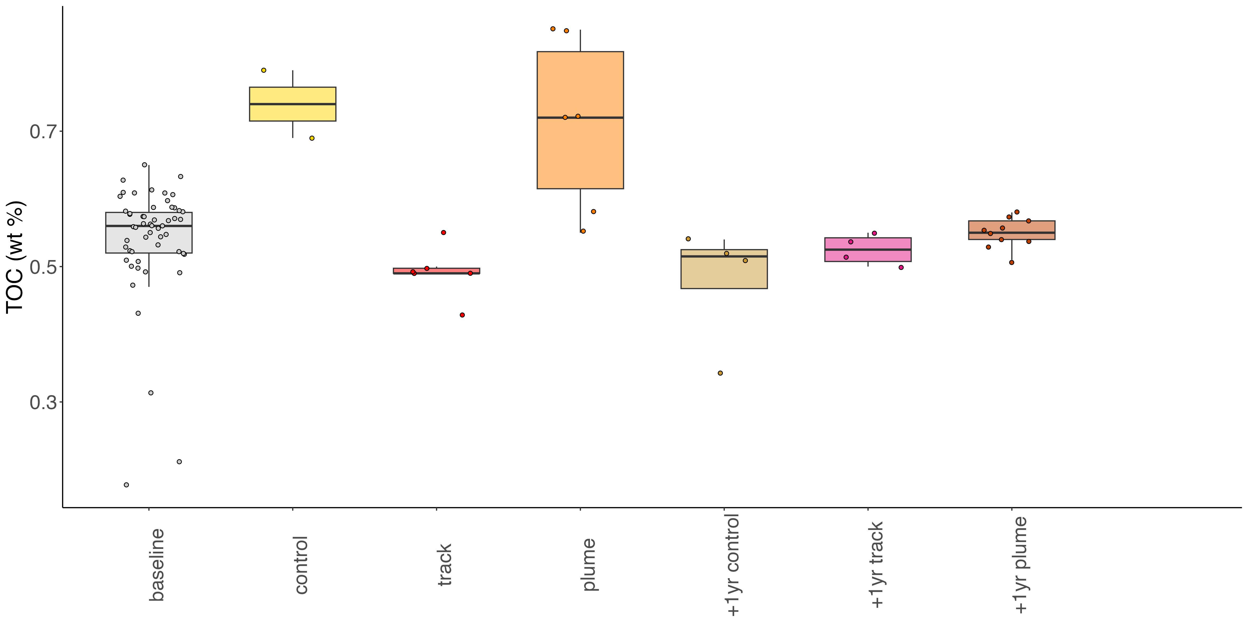
Response to Test Mining
Enhanced variability in sedimentary TOC following test mining
Return to baseline within one year

Slide 4
Temporal Variability in Organic Carbon Fixation and Fate in the CCZ
Woulds, C.¹, Lough, A.¹, Homoky, W.¹, Drazen, J.², Popp, B.N.², White, A., Ferrón, S.², Dowd, M.², Glover, A.³, Dahlgren, T.⁴, Stewart, E. C. D.³, Ingels, J.⁵, O’Malley, B.⁶, Jones, D. O. B.⁷ , Fleming B.⁷, Simon-Lledo, E.⁷, Jeffreys, R.⁸, Blackbird, S.⁸, Clerici, S.¹, Wolff, G.⁸, Smith, A⁷., Sweetman, A. K.⁹ *correspondence c.woulds@leeds.ac.uk
[1] Faculty of Environment, University of Leeds, Leeds, UK; [2] School of Ocean and Earth Science and Technology, University of Hawaii, USA; [3] Department of Life Sciences, Natural History Museum, UK; [4] Climate and Environment Division, NORCE, Norway; [5] National Institute of Water and Atmospheric Sciences, New Zealand; [6] Eckerd College, Florida, USA; [7] Ocean BioGeosciences, National Oceanography Centre, UK; [8] School of Environmental Sciences, University of Liverpool, UK; Scottish Association for Marine Science, UK.

Slide 5
Carbon Fixation and Fate
Abyssal sediments sequester ~50 Tg C y⁻¹
Exported organic matter feeds benthic ecosystems
Spatial, seasonal and interannual variability are present in surface ocean primary productivity
Comprehensive data sets are rare, so direct coupling from the surface ocean through the water column to sediment and benthic communities is understudied

Slide 6
Research Questions
To what extent do primary productivity vary seasonally and interannually?
To what extent are surface productivity and export / sinking flux at different depths coupled?
Are temporal variations in productivity and sinking flux reflected in sediment organic carbon concentration and composition?
How does the abundance of different benthic communities respond to organic carbon supply?

Slide 7
Methods
Method | Spring 2020 | Fall 2020 | Spring 2021 | Fall 2021 | Winter 2021 | Fall 2022
Surface productivity (satellite) |  | X | X | X |  | X
Surface productivity (oxygen production) |  |  | X | X
Shallow sinking flux |  |  | X | X
Mid-water traps (2000 m and 500 m above bottom)
Sediment composition (TOC, chl-a, lipids, δ¹³C) |  | X | X |  |  | X
Megafauna | X |  |  |  | X | X
Macrofauna |  | X | X |  |  | X
Meiofauna (metazoan) |  | X | X |  |  | X
Foraminifera |  | X | X |  |  | X
Sediment community DIC production |  | X | X

Slide 8
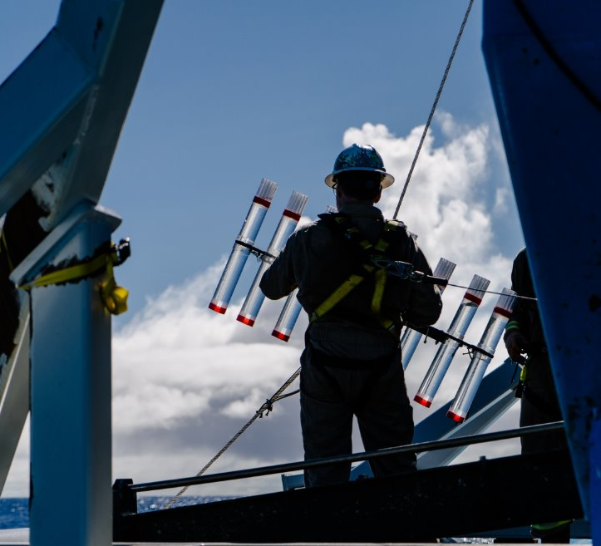
Floating sediment trap array deployment

Slide 9
McLane in situ pumps for particle collection

Slide 10
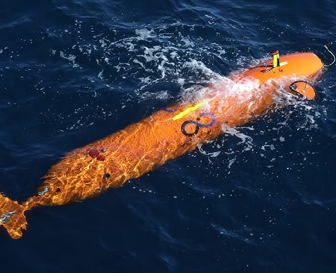
ROV and AUV used for megafaunal imaging

Slide 11
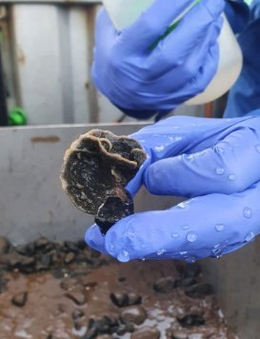
Macrofauna collected from box cores

Slide 12
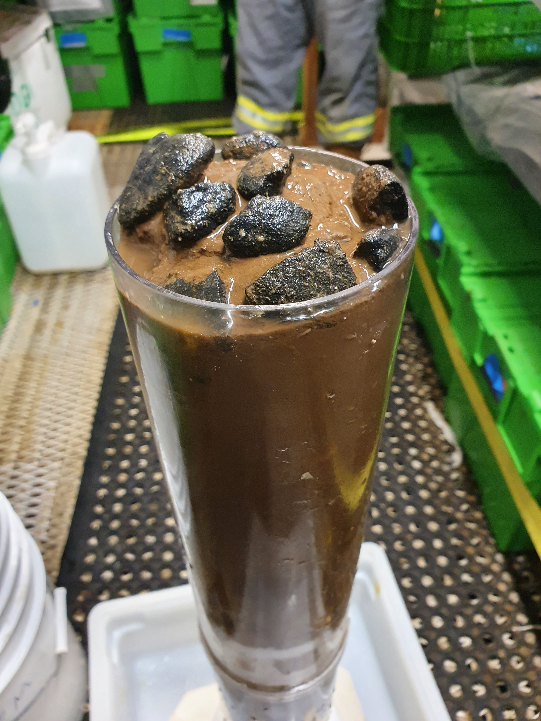
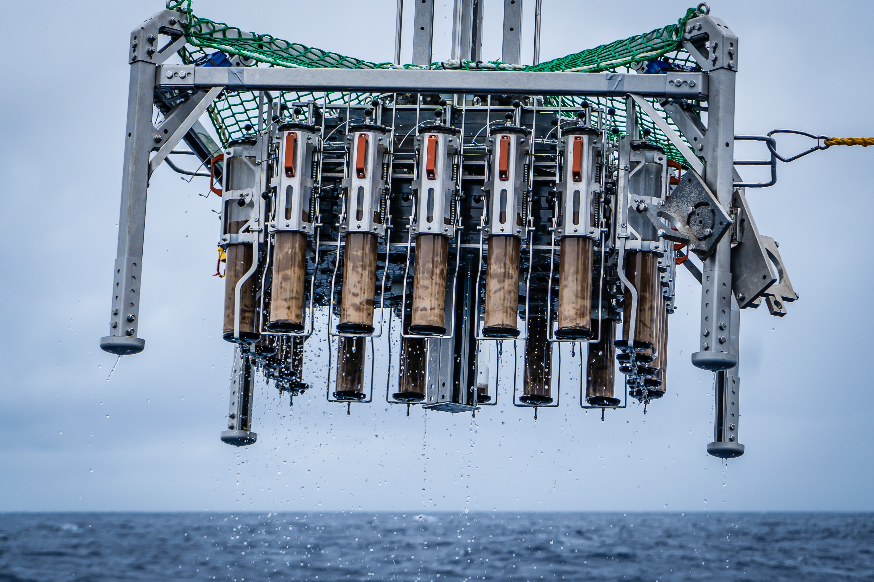
Photo credit: The Metals Company
Meiofauna, foraminifera and sediment collected from megacores

Slide 13


Primary Productivity

Slide 14
Primary Productivity - Seasonality
Primary productivity maximal during spring (February – April)
Fall peak sometimes present (August – September)
Season | Measured Primary Productivity mmol O₂ m⁻² d⁻¹
Spring 2021 | 2.39 ± 0.08
Fall 2021 | 1.46 ± 0.21

Slide 15
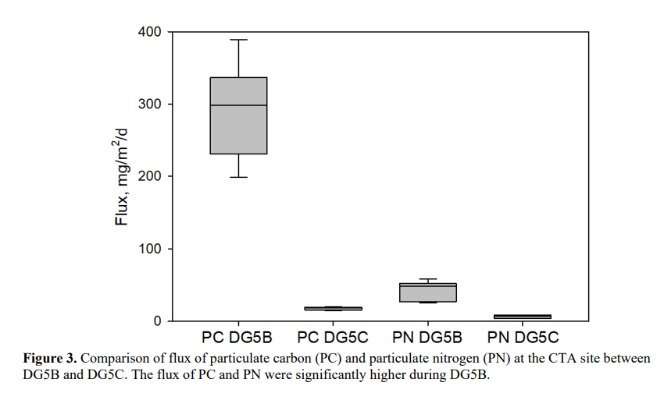
Export and Sinking Flux
Spring 2021
Fall 2021
Seasonality was reflected in shallow traps – so primary productivity is coupled to shallow sinking flux

Slide 16
Primary Productivity - Interannual
Comparatively low productivity from 2016 - 2020
Spring bloom in 2021 was a return to ‘average’ conditions, and was higher than that in 2020
Both years within the range of inter-annual variability since 2002
Spring peak in 2022 was the highest since 2002

Slide 17
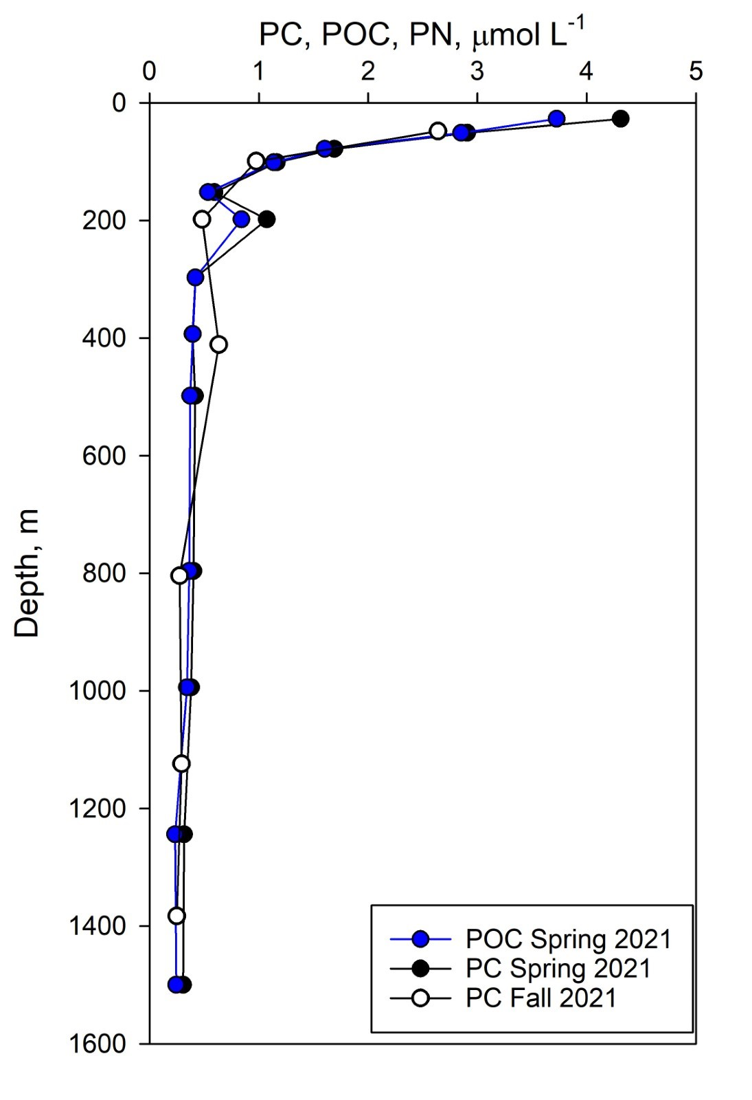
Export and Sinking Flux
Majority of OC degradation occurs just below the photic zone

Slide 18
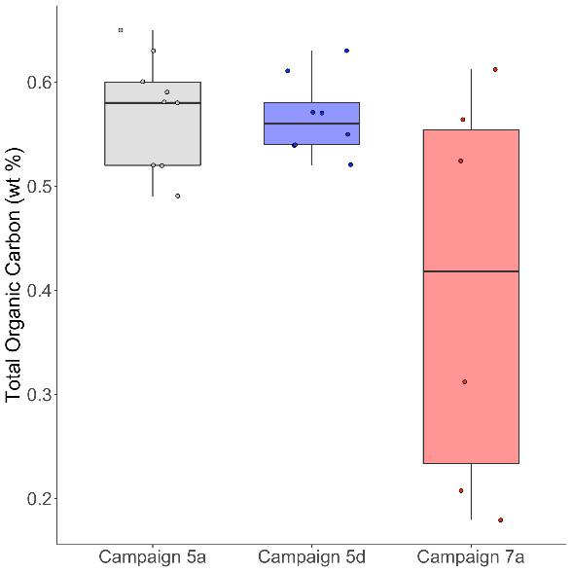

Sedimentary Carbon
Fall 2020
Spring 2021
Fall 2022
Seasonal variability not present
Interannual variability is present
Sedimentary TOC not fully coupled to surface productivity and export flux

Slide 19
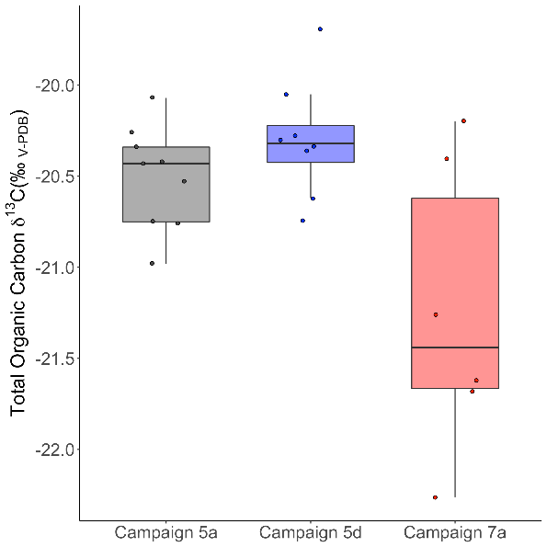
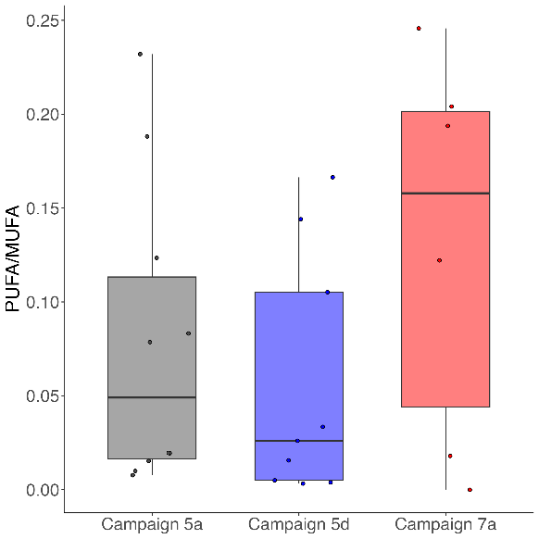

Sedimentary Carbon
Fall 2020
Spring 2021
Fall 2022
Fall 2020
Spring 2021
Fall 2022
Fall 2020
Spring 2021
Fall 2022
Reduced TOC and chlorophyll-a in 2022 despite peak primary productivity
Suggests rapid utilisation in water column or lateral transport
Fatty acids show ‘more reactive’ organic carbon

Slide 20
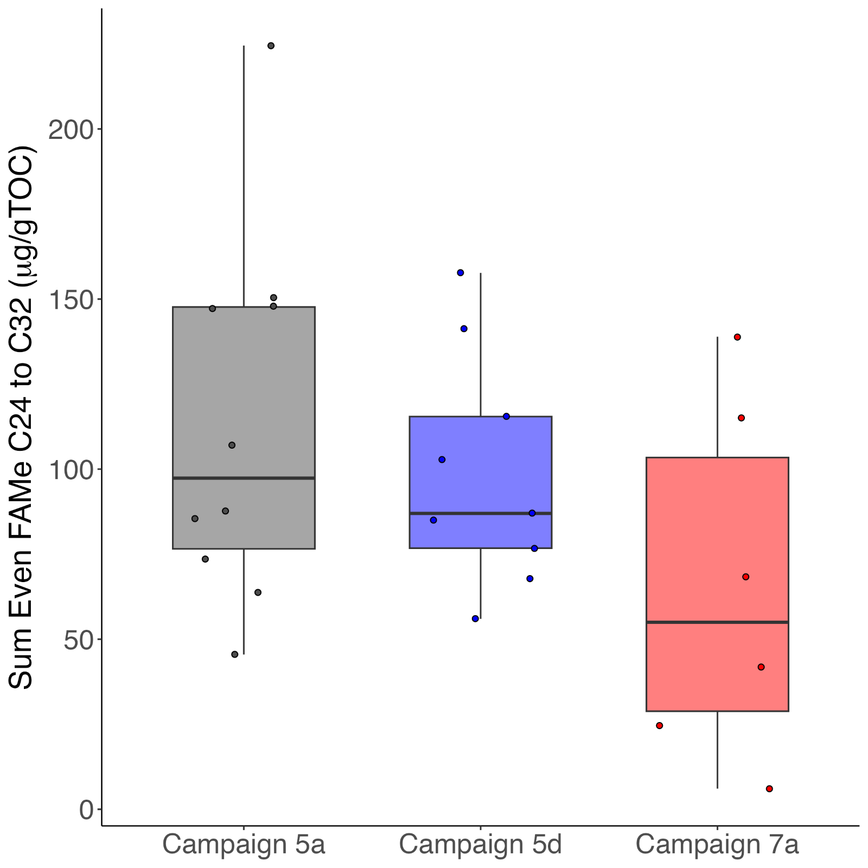
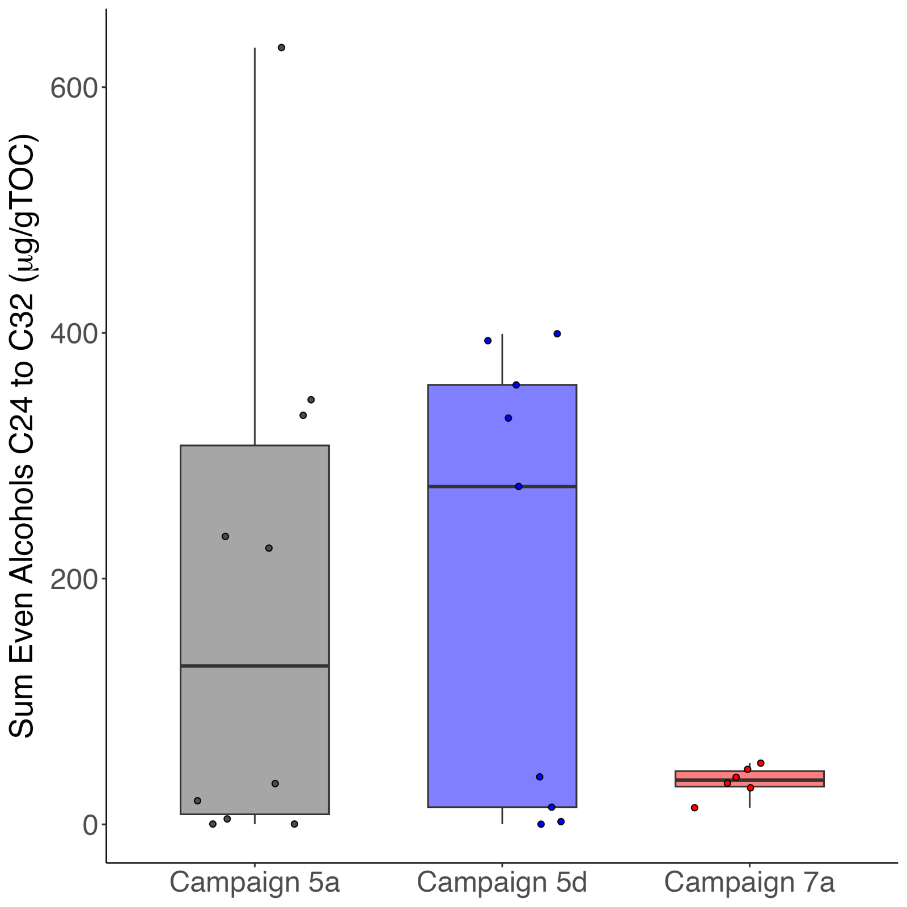
Sedimentary Carbon
Fall 2020
Spring 2021
Fall 2022
Fall 2020
Spring 2021
Fall 2022
Fatty acids and alcohols suggest a reduction in input from terrestrial plants in fall 2022, allowing ‘more reactive’ marine carbon to dominate
Likely linked to La Nina wind patterns

Slide 21
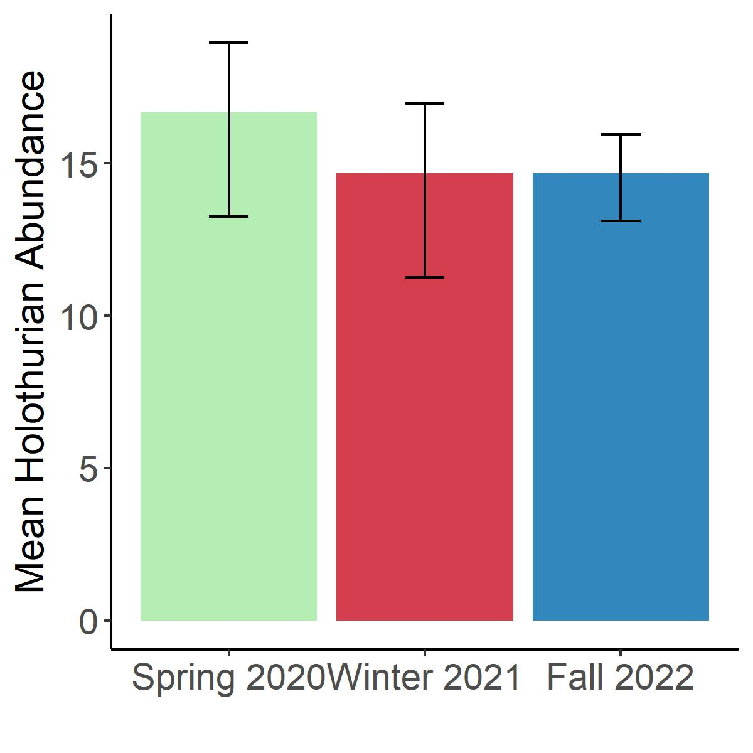


Faunal Response - Megafauna
Holothurian abundances showed no significant differences across years.
Suggests that megafaunal deposit feeders are not sensitive to changes in sedimentary TOC over these time scales.

Slide 22
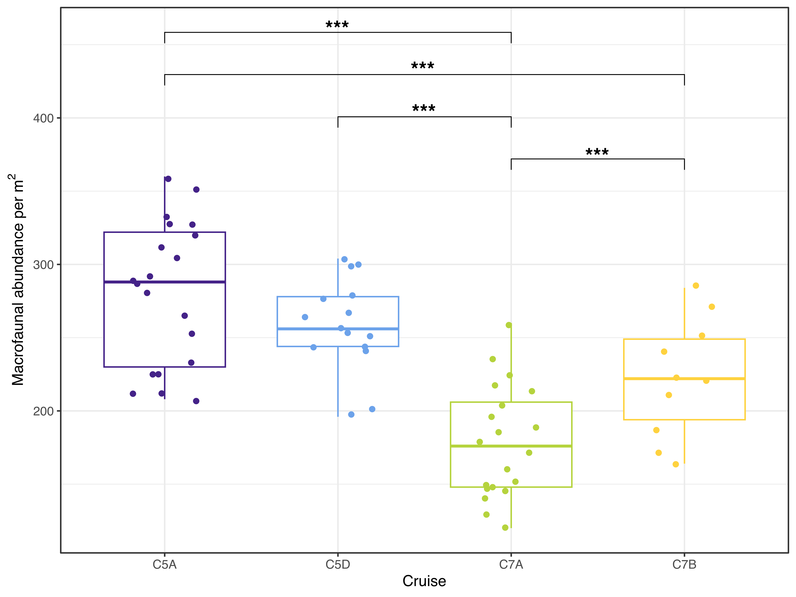


Faunal Response - Macrofauna
Macrofaunal abundance coupled to sediment TOC
Seasonal variability not present
Interannual variability is present.
Fall 2020
Spring 2021
Fall 2022
Fall 2022
NORCE, Norway

Slide 23
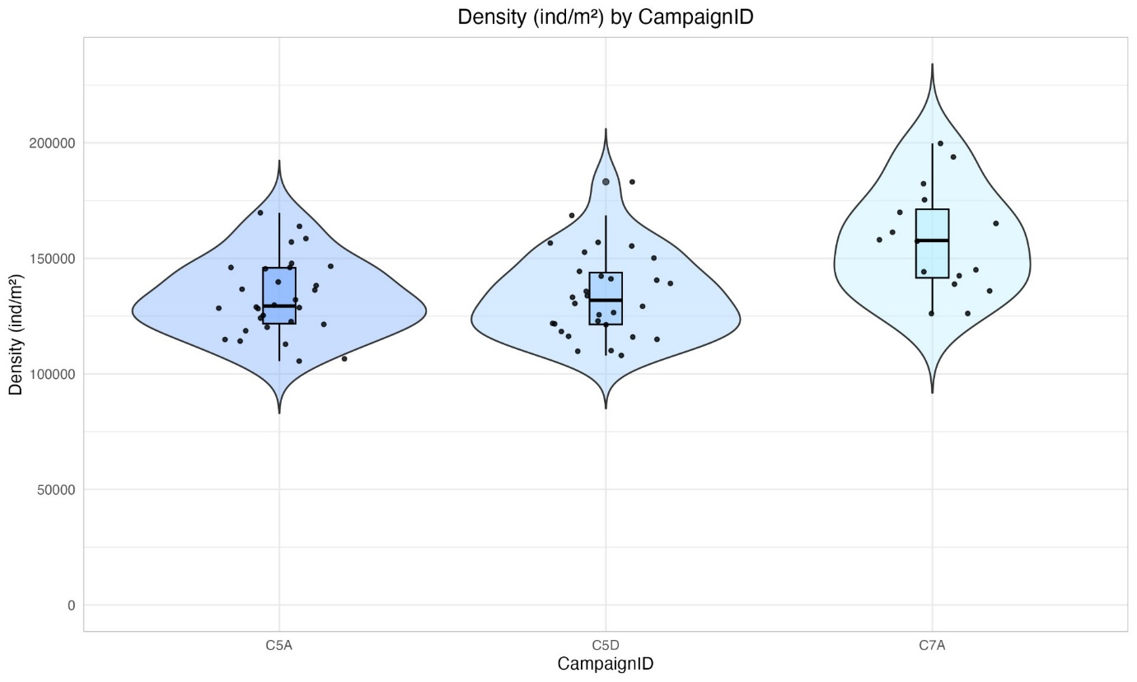
Faunal Response - Foraminifera
No seasonal variability
Increase in fall 2022
Release from predation / competition?
Rapid response to OC input?
Fall 2020
Spring 2021
Fall 2022

Slide 24

Faunal Response - Meiofauna
Large decrease from Fall 2020 to Spring 2021; similar densities in Fall 2022 compared to Spring 2021
Meiofauna potentially in 'starvation' mode, or for other reasons not able to respond to spring 2021 or 2022 productivity
Significant seasonal variability present (based on 337 cores)
Potentially trophic interactions present
Fall 2020
Spring 2021
Fall 2022

Slide 25
Summary
Seasonal and inter-annual variability in primary productivity
Export flux coupled to seasonal variability
Organic carbon consumption during sinking leads to pelagic and benthic carbon pools being largely de-coupled
Sediment carbon pool does not vary seasonally, but shows inter-annual variation
Sediment carbon pool shows very limited coupling to surface ocean productivity
Faunal groups respond differently to organic carbon supply changes, revealing importance of life stages / styles, and interactions between groups

Slide 26


Acknowledgements
Funded by and seagoing campaigns run by The Metals Company
Particular thanks to seagoing party of campaigns 5A, 5B, 5C, 5D and 7A
Thanks to all technical and support colleagues who contributed to data production

