Slide 1
Unravelling artificial intelligence in resources planning and flood disaster mitigation
Robust Flood Prediction

Slide 2
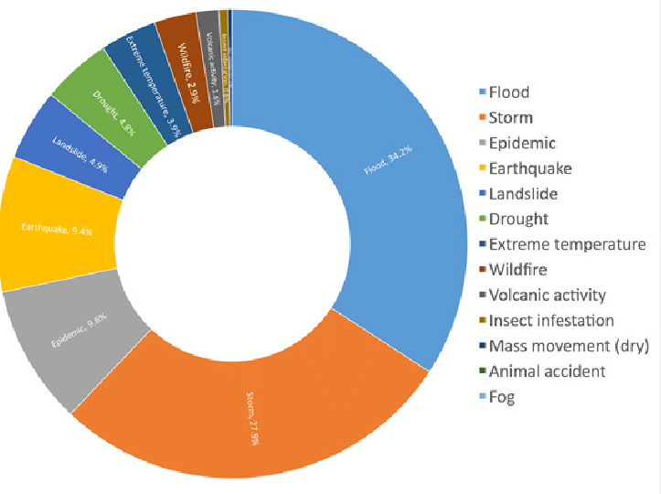
Flood Impact
Flood prediction is a critical area of research due to its significant impact on human life, infrastructure, and the environment
Accurate flood prediction models can aid in disaster preparedness and risk management, reducing the adverse effects of floods.

Slide 3
Flood Prediction
Refers to identifying, monitoring, and alerting authorities or individuals about the presence or likelihood of flooding in a particular area.
It involves using various technologies and methods to detect, predict, and mitigate the impacts of floods.

Slide 4
Flood Variables
Accurate flood prediction requires integrating climate, land, and infrastructure factors to proactively manage risk.
Predictive models must account for both natural and man-made factors to enable timely, location-specific flood risk management.

Slide 5
Factors In Play
Monsoon Intensity: Heavier or prolonged rainfall increases flood risk, especially when exceeding soil absorption and drainage capacity.
Topography & Drainage: Low-lying areas and poor natural drainage accelerate water accumulation, worsening flood impact.
River Management: Lack of desilting, encroachments, and weak embankments reduce river flow efficiency, increasing overflow likelihood.
Deforestation: Reduces land’s ability to absorb rainwater, leading to higher surface runoff and greater flood vulnerability.

Slide 6
Factors In Play
Urbanization: Rapid development increases impervious surfaces (concrete, asphalt), reducing natural absorption and leading to higher runoff and urban flooding.
Climate Change: Intensifies extreme weather events, making rainfall patterns more erratic and increasing the frequency and severity of floods.
Dam Quality & Maintenance: Poorly maintained or aging dams pose structural risks and may fail to control water flow effectively during heavy rains.
Siltation: Sediment buildup in rivers and reservoirs reduces water-carrying capacity, increasing chances of overflow and flooding.

Slide 7
Feature Correlation in Flood Prediction Models
Feature correlation reveals how different environmental, climatic, and human-induced factors interact to influence flood risk.
Strong correlations help prioritize key predictors, improve model accuracy, and support more informed mitigation strategies.
Key Feature Insights
Topography & Drainage: Steeper slopes may reduce flood duration but increase flash flood risk; poor drainage in flat terrains correlates with waterlogging.
River Management: Strong inverse correlation—better-managed rivers lower flood occurrences by controlling water flow and overflow zones.
Deforestation: Positively correlated with surface runoff and soil erosion, increasing flood risk in previously forested areas.
Urbanization: Strong correlation with localized flooding due to impermeable surfaces and reduced natural drainage.

Slide 8
Modeling
We use Random Forest and XGBoost Regressor due to their ability to handle non-linear relationships, complex feature interactions, and missing data effectively.

Slide 9
Random Forest
Random Forest offers strong baseline accuracy and robustness.

Slide 10
XGBoost
XGBoost enhances performance with boosting, improving precision in identifying high-risk flood zones.

Slide 11
Thank You
Abhinav Kaushal Keshari
(Roshn Group)
keshariabhinavk1996@gmail.com
akeshari.c@roshn.sa

