Slide 1
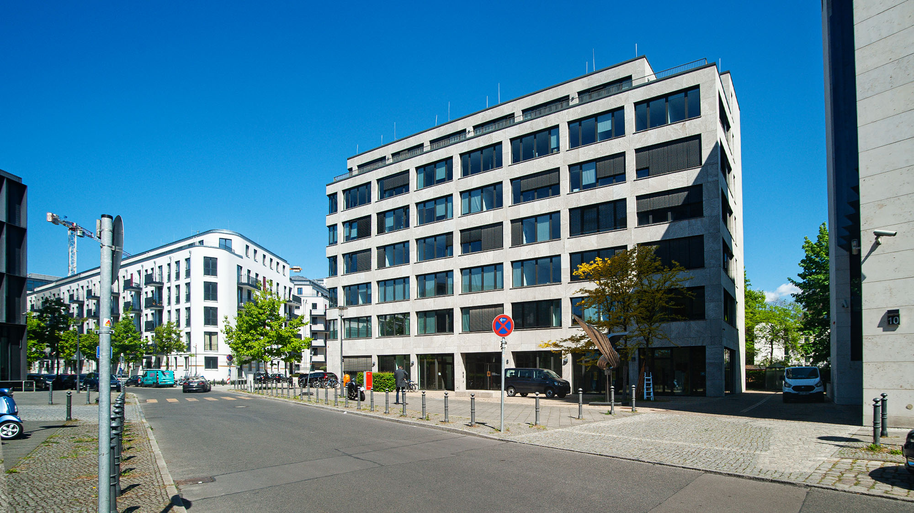



Rigid - ductile
Numerical modelling of possible processes in a nuclear waste disposal
Carlo Dietl and Carsten Rücker (BASE)
Presented at EGU 2025 in session ERE3.3, 28 April 2025

Slide 2
Rigid – ductile: the task
We investigated the deformation behaviour of rigid bodies in a plastic/ductile matrix – such as nuclear waste canisters in salt backfill or bentonite.
Within the evaluation period the waste containers will be weakened due to corrosion.
Numerical models shall help to understand deformation processes within and around the containers.
- DISCLAIMER -
The data on material characteristics and their evolution in the model is not that of real canisters or backfill. This study is qualitative and investigates the possibilities of modelling.

Slide 3
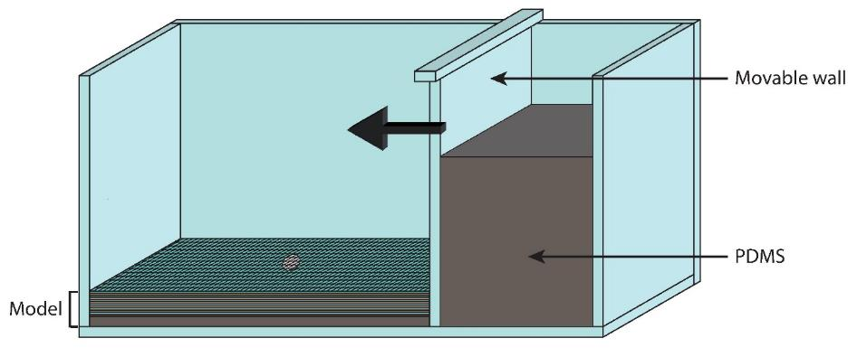
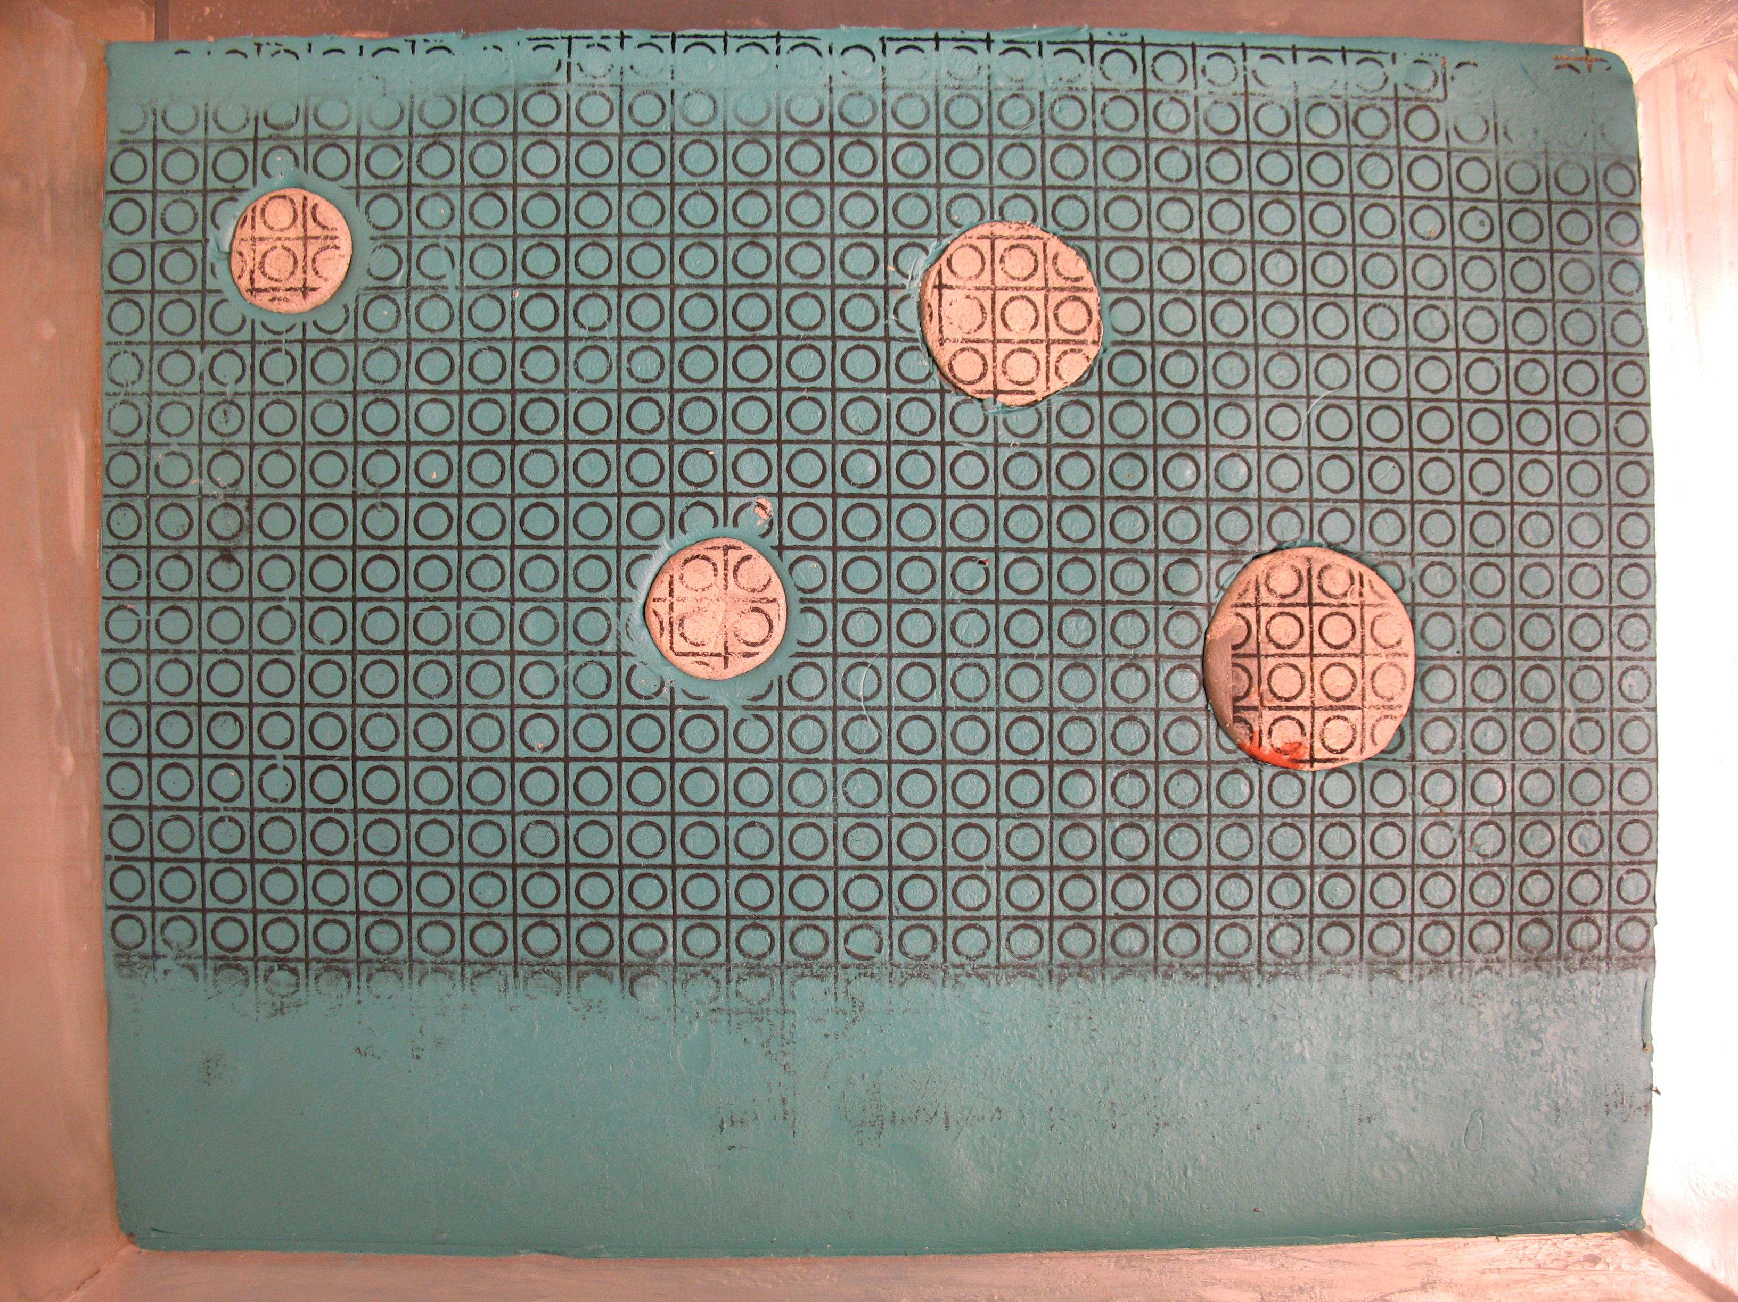
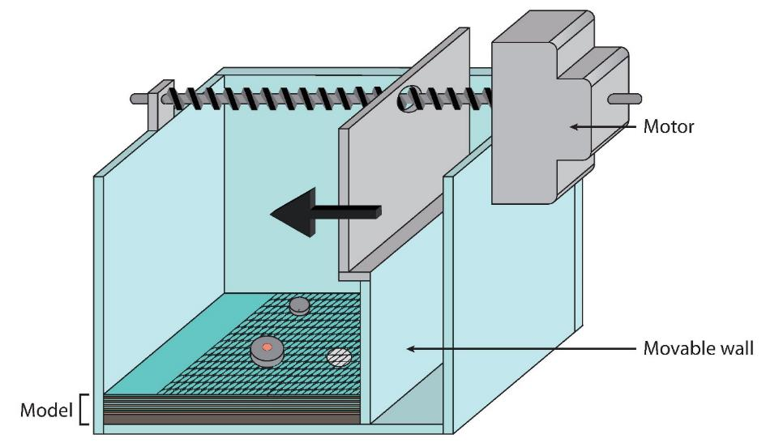
Precursor studies: own analogue models

Slide 4
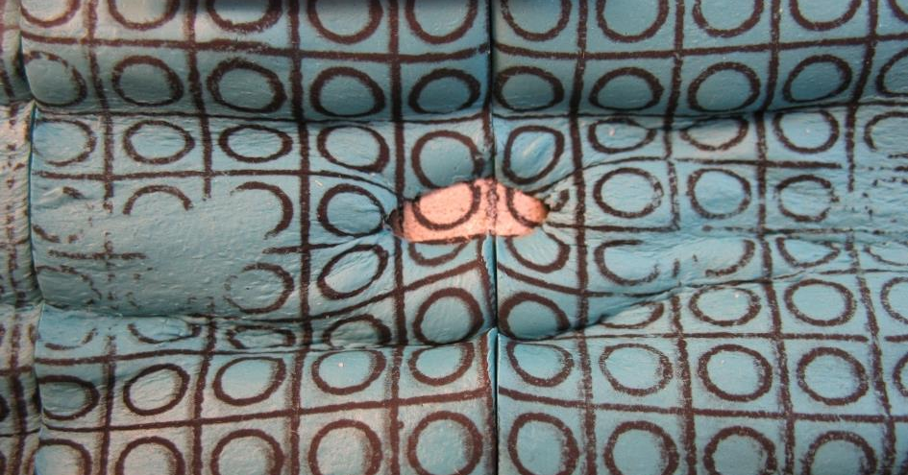
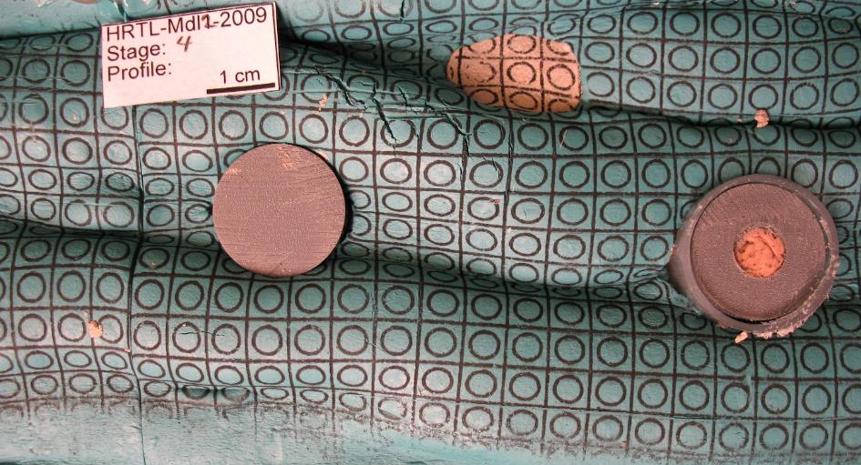
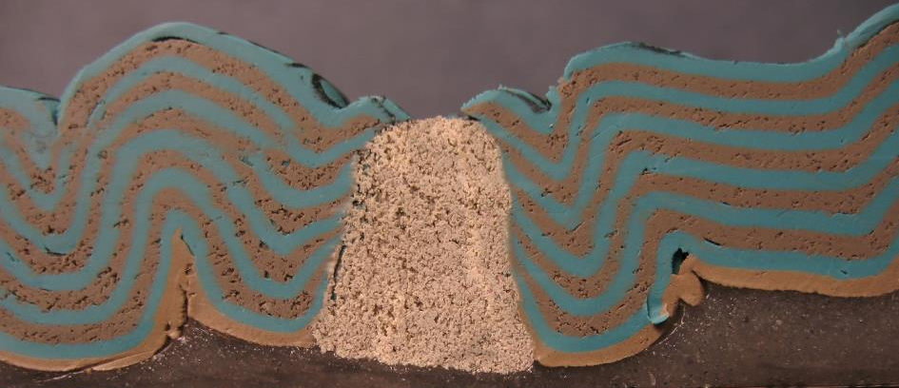
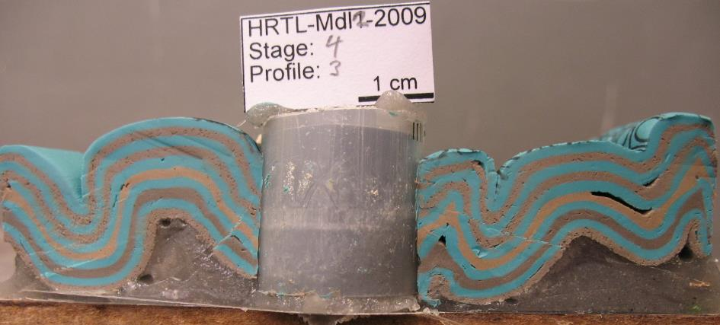
Model 1
Model 2
1 cm
1 cm

Slide 5
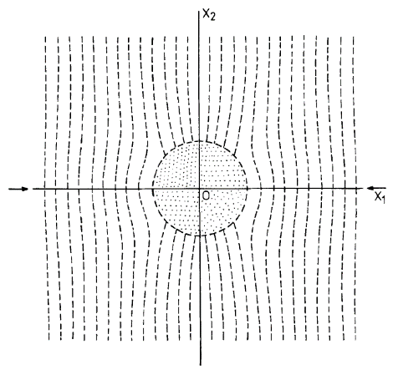
Model 1
Model 2
Postdeformational axial ratios of the strain markers:
    within the matrix: 1.68
    within the plasticine cylinder: 1.12
Two broad anticlines around the strong plasticine cylinder
Superficial funnel structure around the plasticine cylinder
Postdeformational axial ratios of the strain markers:
    within the matrix: 1.44 to 1.98
    within the plasticine cylinder: 1.29 and 1.41
Syncline structures around all cylinders
Superficial embryonic funnel structures around all four cylinders
Syntectonic pluton with high magma pressure
Pretectonic pluton
Mandal & Chakraborty (1990)

Slide 6
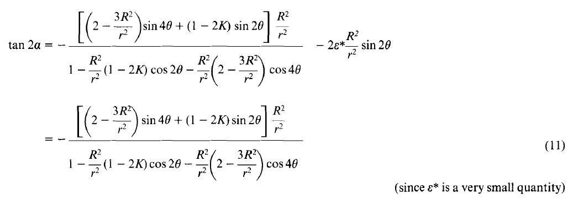

Mandal & Chakraborty (1990): the analytical solution for the strain field around a syntectonic pluton with a high magma pressure
Orientations of the principal axes of the infinitesimal strain ellipse at any point (r, 0) on the
x₁x₂ plane where a is the orientation of one of the principal axes with respect
to the x₁ axis and ε* is the magnitude of the far-field principal strain.
The math behind it:
Strain field around a syntectonic pluton with a high magma pressure
u and v are the finite displacement components along the x₁ and x₂ axes respectively

Slide 7
Rigid – ductile: the aims
Reproduce the empirical analogue models and the analytical solutions of Mandal and Chakraborty (1990)
Evaluation of the rheological and tectonic conditions under which not only the plastic matrix but also the original containers are deformed

Slide 8
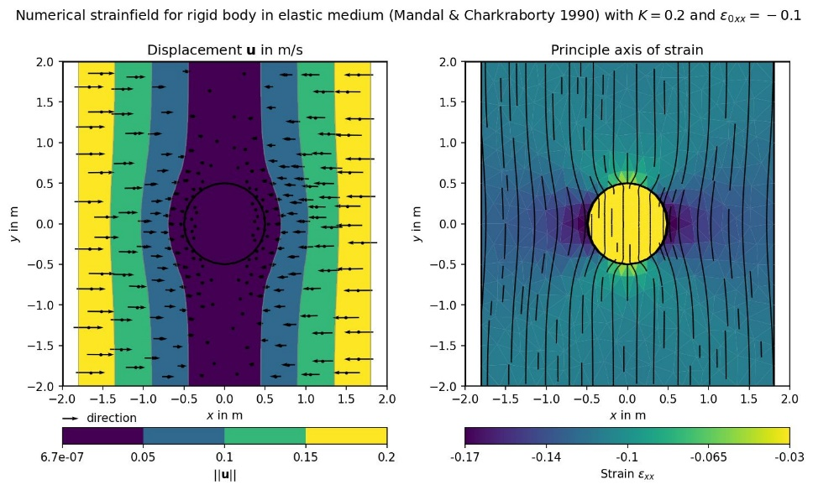
Mandal & Chakraborty (1990) numerically solved*
Compression!
Compression!
*own FEM-Python solution Oscar with linearelastic solver (Mohr-Coulomb) from the OSTHM in-house research project based on pyGIMLi

Slide 9
What shall be modelled with respect to the waste containers?
We calculated simple, generic models for testing the Oscar software
Various material configurations were simulated:
          Full steel “cylinder” (if it is possible to talk about a cylinder in 2D)
          Hollow cylinder
          Thick copper and/or steel casings around a hollow cylinder or a steel cylinder
          The matrix consists always of rock salt
The deformation is purely linear elastic, no creep laws were applied!
The effect of corrosion was modelled by lowering the Young’s moduls (E) and increasing the Poisson ratio (ν) of the canister materials
E and ν were changed
in four steps:
Rock salt stays mechanically unchanged with E = 20 GPa and ν = 0.25
Lateral compression of the 2D model; top and bottom are not fixed
material | steel |  | copper
corrosion steps | E [GPa] | ν | E [GPa] | ν
0 | 200 | 0.300 | 120 | 0.360
1 | 180 | 0.303 | 108 | 0.364
2 | 100 | 0.342 | 60 | 0.410
3 | 20 | 0.381 | 12 | 0.457
4 | 2 | 0.390 | 1.2 | 0.468

Slide 10
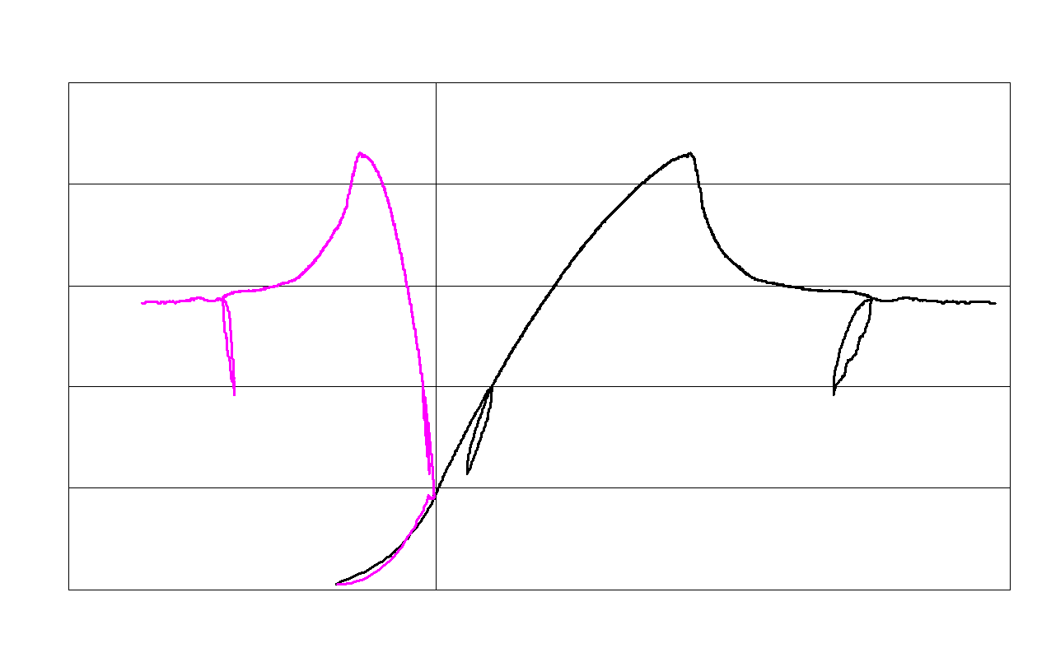
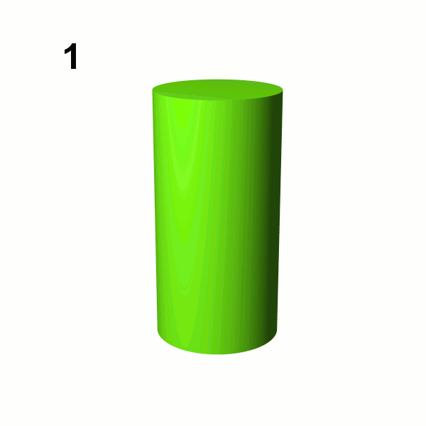


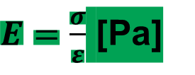
Poisson ratio and Young‘s modulus
$$ν=\frac{ε_{r}}{ε_{a}}$$
$E=\frac{σ}{ε}$ [Pa]
material failure (at peak strength)
material failure (at peak strength)
residual strength
12-13
residual strength
6-11
axial deformation
12-13
14-15
6-11
14-15
axial stress σ₁
hysteresis 1
(base for
Poisson ratio ν)
hysteresis 2
hysteresis 2
radial deformation
hysteresis 1 (Young`s modulus E)
1-5
1-5
strain ε

Slide 11
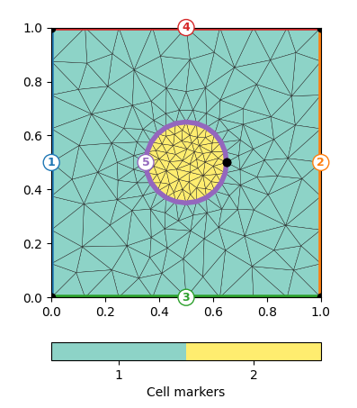
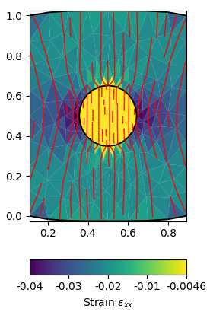
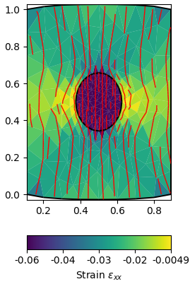
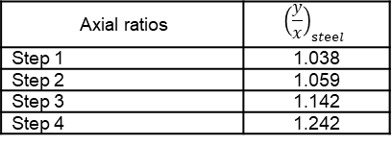
Model 1: Full steel cylinder in the salt matrix
Top and bottom are not fixed!
Most important observation:
As long as
E_{container} > E_{matrix}
the strain and stress trajectories bend inward;
as soon as E_{container} < E_{matrix}
they bend outward.
Step 1
Step 4
Compression
Compression
Axial ratios | $${\left(\frac{y}{x}\right)}_{steel}$$
Step 1 | 1.038
Step 2 | 1.059
Step 3 | 1.142
Step 4 | 1.242

Slide 12
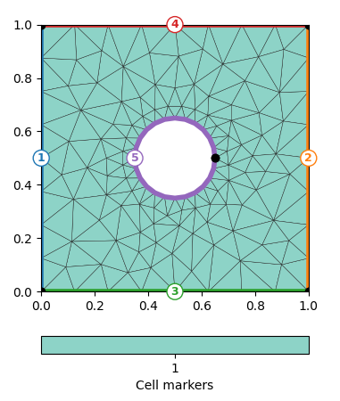
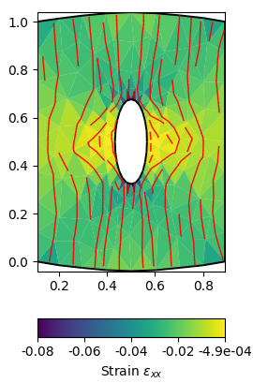
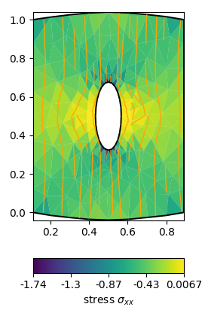
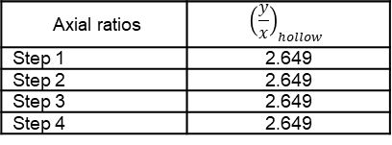
Model 2: Hollow cylinder in the salt matrix
Most important observation:
Final deformation is reached already in corrosion
step 1.
Step 1 = Step 4
Axial ratios | $${\left(\frac{y}{x}\right)}_{hollow}$$
Step 1 | 2.649
Step 2 | 2.649
Step 3 | 2.649
Step 4 | 2.649

Slide 13
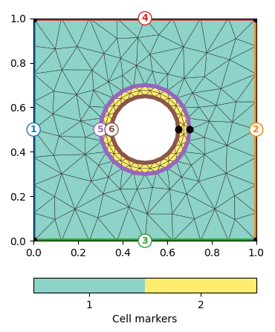
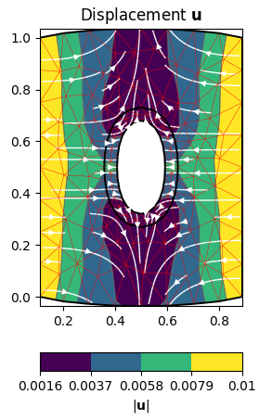
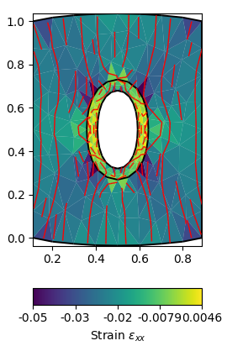
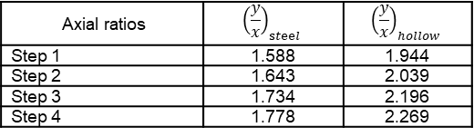
Model 3: Hollow cylinder with thick steel casing in the salt matrix
Most important observation:
The presence of a casing prevents that the final deformation is already reached in step 1.
Step 1
Axial ratios | $${\left(\frac{y}{x}\right)}_{steel}$$ | $${\left(\frac{y}{x}\right)}_{hollow}$$
Step 1 | 1.588 | 1.944
Step 2 | 1.643 | 2.039
Step 3 | 1.734 | 2.196
Step 4 | 1.778 | 2.269

Slide 14
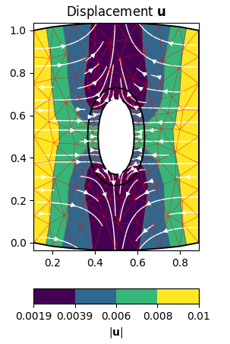
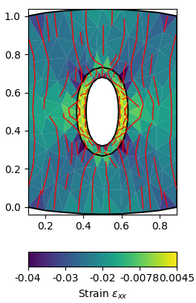
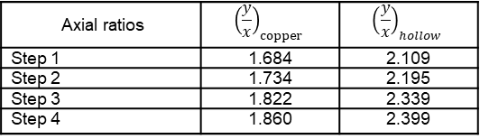
Model 4: Hollow cylinder with thick copper casing in the salt matrix
Step 1
Most important observation:
The lower stiffness of copper leads to a slightly stronger deformation of the casing compared to the thick steel casing.
Axial ratios | $${\left(\frac{y}{x}\right)}_{copper}$$ | $${\left(\frac{y}{x}\right)}_{hollow}$$
Step 1 | 1.684 | 2.109
Step 2 | 1.734 | 2.195
Step 3 | 1.822 | 2.339
Step 4 | 1.860 | 2.399

Slide 15
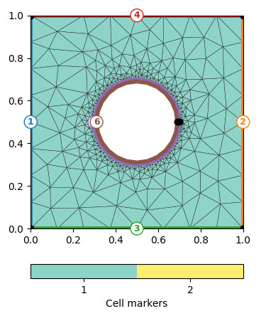
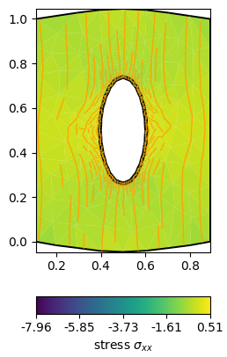
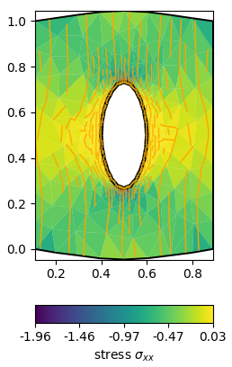
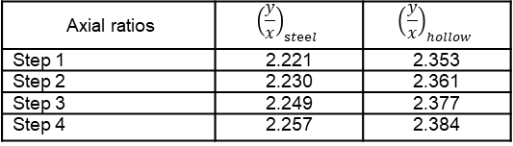
Model 5: Hollow cylinder with thin steel casing in the salt matrix
Most important observation:
The casing thickness has an impact on the deformation intensity – as depicted by the axial ratios of the casing and the container interior.
Step 1
Step 4
Axial ratios | $${\left(\frac{y}{x}\right)}_{steel}$$ | $${\left(\frac{y}{x}\right)}_{hollow}$$
Step 1 | 2.221 | 2.353
Step 2 | 2.230 | 2.361
Step 3 | 2.249 | 2.377
Step 4 | 2.257 | 2.384

Slide 16
Take home messages
We worked with simple, generic 2D models
Rigid – ductile is a conceptual study: The models were not designed to mimic realistic disposal conditions. Therefore, the results do not predict the behaviour of real canisters
The results of the analogue models and the analytical solution can be reproduced numerically
The linear elastic solver works → creep laws were not considered!
The software ‘Oscar’ allows for the modelling of rigid bodies of varying composition
Weakening of the container materials by lowering of the Young’s modulus and rising the Poisson ratio leads to the deformation of the container under lateral compression
Casing thickness, container material and filling have an impact on the intensity of the elastic deformation of the container
The applied Jupyter scripts will be available on the BASE webpage for the public (soon)
Absolute quantities (time, length, stress) will be available with future versions of the models

