Slide 1
PANGEOS COST action Uncertainty propagation in remote sensing
COST Action CA22136
Egor Prikaziuk¹, Gary Llewellyn^{2,6}, Laura Mihai³, Agnieszka Bialek⁴, Andreas Hueni⁵, Mike Werfeli⁵, Jose Luis Gomez-Dans⁶, Jochem Verrelst⁷, Jose Luis Garcia-Soria⁷, Joseph Fennell⁸, Dessislava Ganeva⁹, and Shawn Carlisle Kefauver¹⁰
Faculty of Geo-Information Science and Earth Observation (ITC), University of Twente, the Netherlands
Excel Aviation, Northamptonshire, the UK
National Institute for Laser, Plasma and Radiation Physics, Bucharest, Romania
National Physical Laboratory, Teddington, the UK
University of Zurich, Zurich, Switzerland
King's College London, London, the UK
Image Processing Lab (IPL), University of Valencia, Valencia, Spain
The Open University, Milton Keynes, UK
Space Research and Technology Institute, Bulgarian Academy of Sciences, Sofia, Bulgaria
University of Barcelona, Barcelona, Spain
COST (European Cooperation in Science and Technology) is a funding agency for research and innovation networks. Our Actions help connect research initiatives across Europe and enable scientists to grow their ideas by sharing them with their peers. This boosts their research, career and innovation. http://www.cost.eu

Slide 2
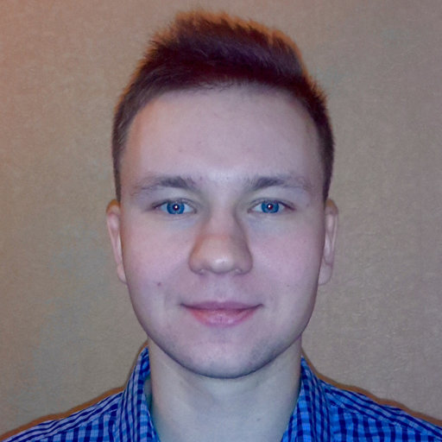
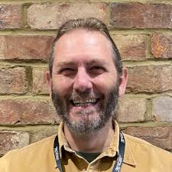
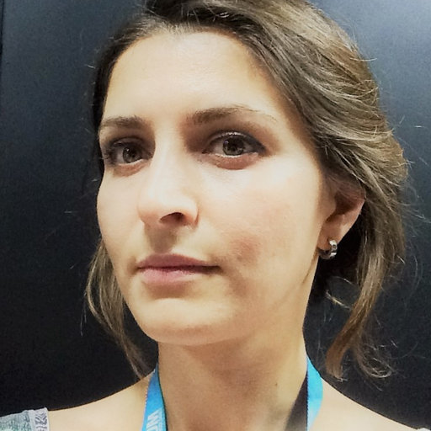
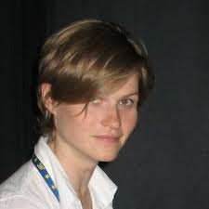
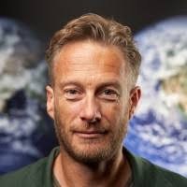
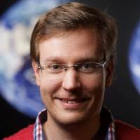
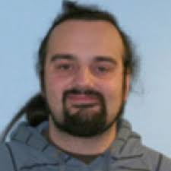
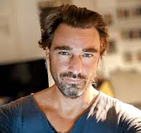
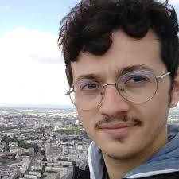
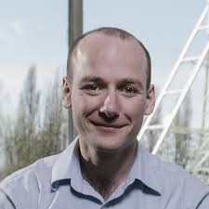
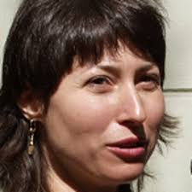
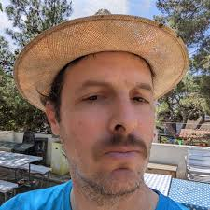
Egor Prikaziuk¹,
Gary Llewellyn^{2,6},
Laura Mihai³,
Agnieszka Bialek⁴,
Andreas Hueni⁵,
Mike Werfeli⁵,
Jose Luis Gomez-Dans⁶,
Jochem Verrelst⁷,
Jose Luis Garcia-Soria⁷,
Joseph Fennell⁸,
Dessislava Ganeva⁹,
Shawn Carlisle Kefauver¹⁰
https://github.com/pangeos-cost/uq-training

Slide 3
Who am I?
2021-… – Assistant professor
Plant ecological hydrology
ITC, University of Twente
2021-2022 R&D – eLEAF
Sugarcane and grape wine yield prediction with EO
2017-2021 – PhD in remote sensing
ITC Faculty Geo-Information Science and Earth Observation
University of Twente, Netherlands
2015-2016 – Bioinformatics institute
Saint-Petersburg, Russia
2010-2016 – BSc and MSc in plant physiology and biochemistry
Saint-Petersburg State University, Russia

Slide 4
SCOPE model
Soil –Canopy observation of photochemistry and energy fluxes
fluxes
radiation (light)
Yang, P., Prikaziuk, E., Verhoef, W., & van der Tol, C. (2021). SCOPE 2.0: A model to simulate vegetated land surface fluxes and satellite signals. Geoscientific Model Development Discussions, 2021, 1–26. https://doi.org/10.5194/gmd-2020-251

Slide 5
PANGEOS structure

Slide 6
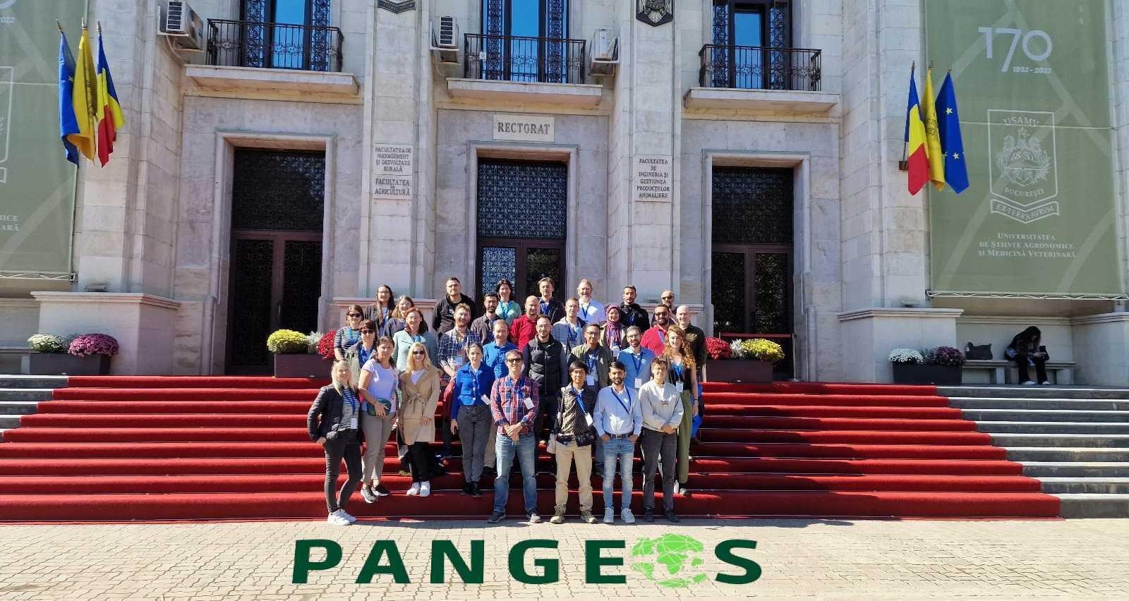
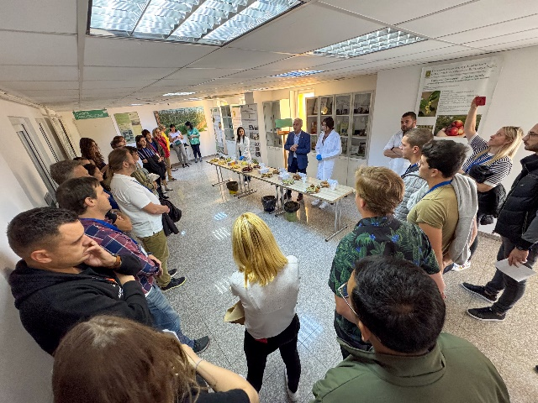
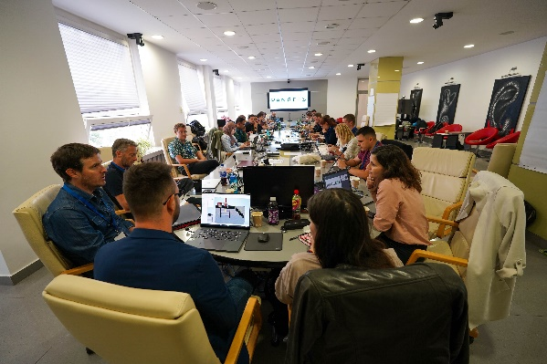
Highlights from GP1
https://pangeos.eu/news/
Bucharest, Romania, 30 September-4 October 2024, Training School led by WG4 *70 applications for 30 participants. Details available at https://pangeos.eu/ss1/.
Uncertainty analysis and protocol standardization assessment summer school on novel and operational hyperspectral data products. Training materials organized at github in preparation for publication - https://github.com/pangeos-cost/uq-training.

Slide 7
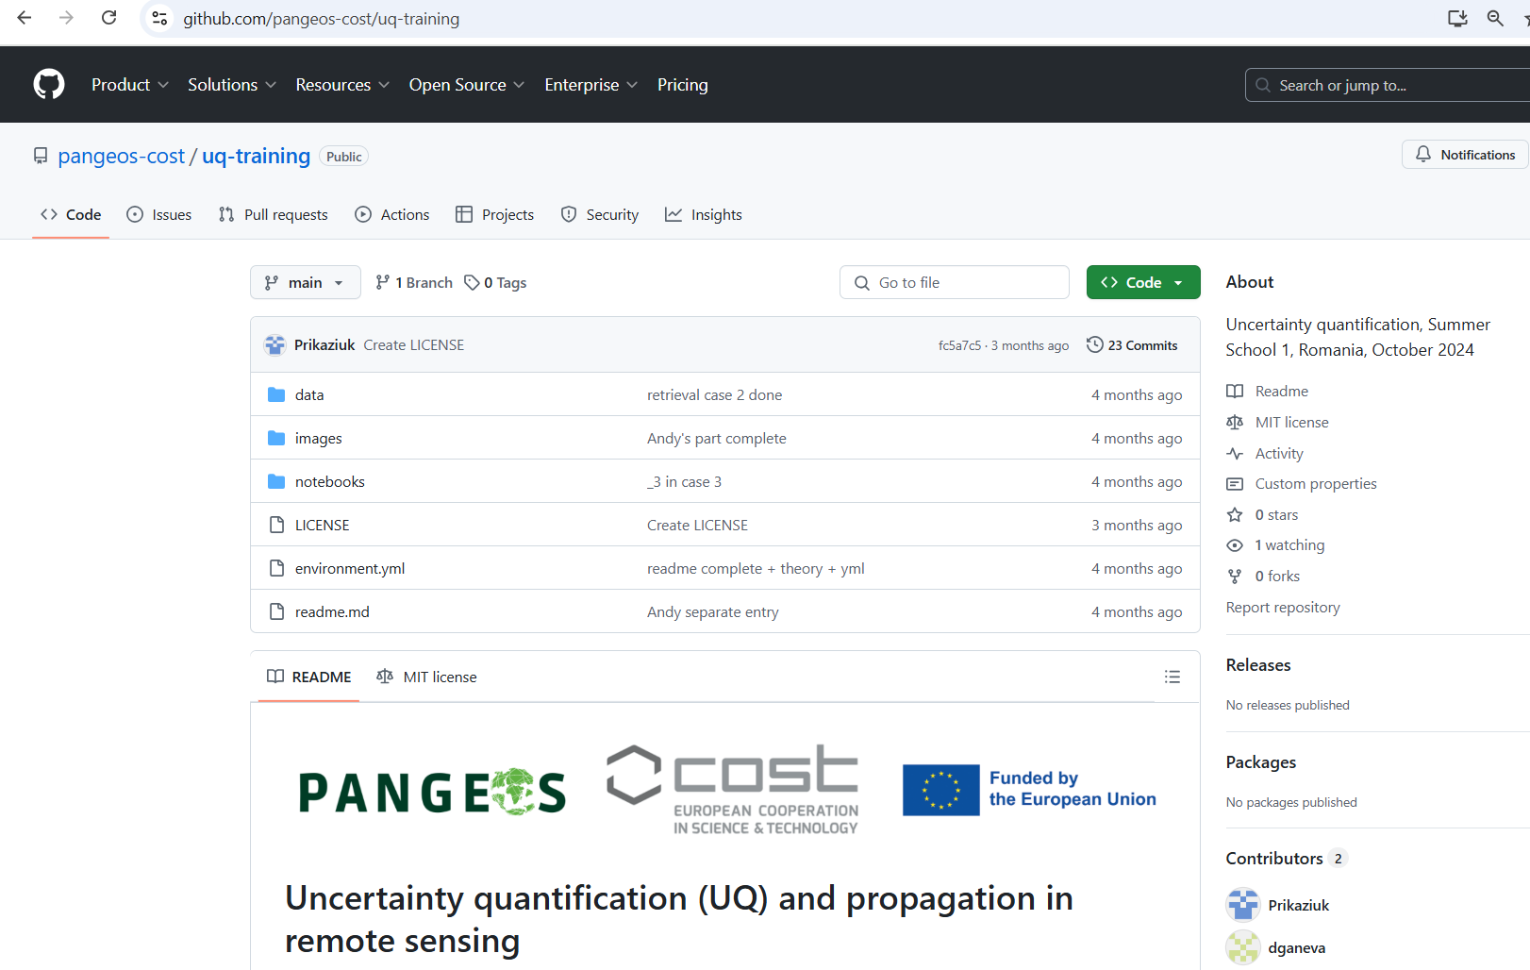

Slide 8
uncertainty vs error
traits -> processes
DNs -> reflectance
reflectance -> traits
bonus

Slide 9
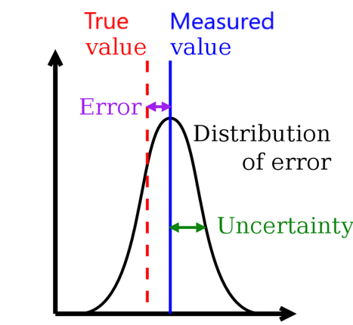
uncertainty is the confidence in the measured (or modelled) value
Povey, A. C., & Grainger, R. G. (2015). Known and unknown unknowns: uncertainty estimation in satellite remote sensing. Atmospheric Measurement Techniques, 8(11), 4699–4718. https://doi.org/10.5194/amt-8-4699-2015

Slide 10
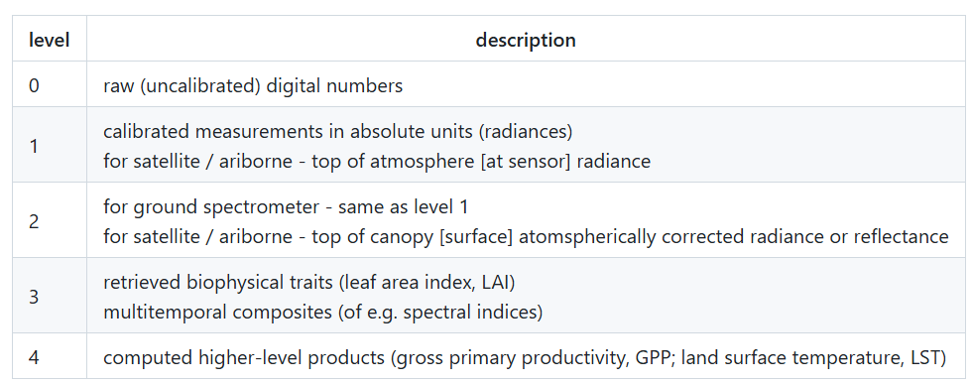
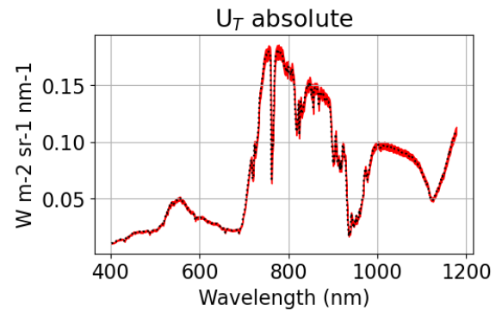
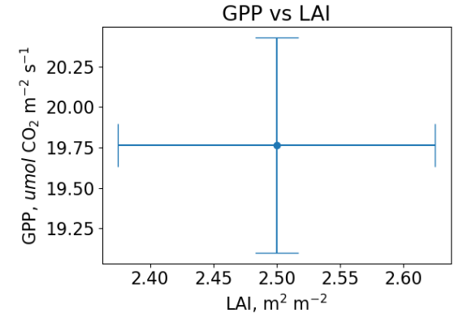
propagation of uncertainty
raw DN
traits (LAI)
radiance
reflectance
advanced (GPP)

Slide 11
uncertainty vs error
traits -> processes
DNs -> reflectance
reflectance -> traits
bonus

Slide 12
propagation of uncertainty
raw DN
traits (LAI)
radiance
reflectance
advanced (GPP)

Slide 13
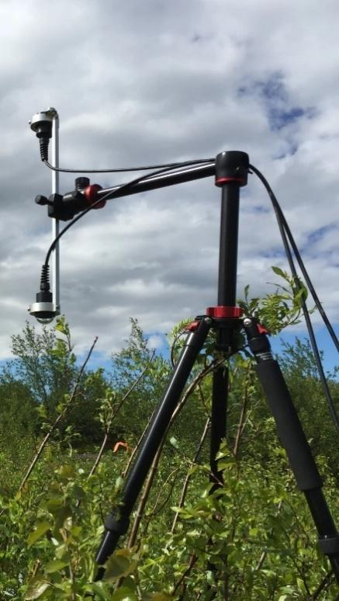
example of a traceability chain for reflectance
irradiance, E
start here
radiance, L
Figure by Laura Mihai
Figure by Michal Antala

Slide 14
example of a traceability chain for reflectance
irradiance, E
start here
radiance, L
Figure by Laura Mihai
Figure by Michal Antala

Slide 15
example of a traceability chain for reflectance
irradiance, E
start here
radiance, L
Figure by Laura Mihai
Figure by Michal Antala

Slide 16
example of a traceability chain for reflectance
irradiance, E
start here
radiance, L
Figure by Laura Mihai
Figure by Michal Antala

Slide 17
example of a traceability chain for reflectance
irradiance, E
start here
radiance, L
Figure by Laura Mihai
Figure by Michal Antala

Slide 18
example of a traceability chain for reflectance
irradiance, E
start here
radiance, L
Figure by Laura Mihai
Figure by Michal Antala

Slide 19
example of a traceability chain for reflectance
irradiance, E
start here
radiance, L
Figure by Laura Mihai
Figure by Michal Antala

Slide 20
example of a traceability chain for reflectance
irradiance, E
start here
radiance, L
Figure by Laura Mihai
Figure by Michal Antala

Slide 21
example of a traceability chain for reflectance
irradiance, E
start here
radiance, L
Figure by Laura Mihai
Figure by Michal Antala

Slide 22
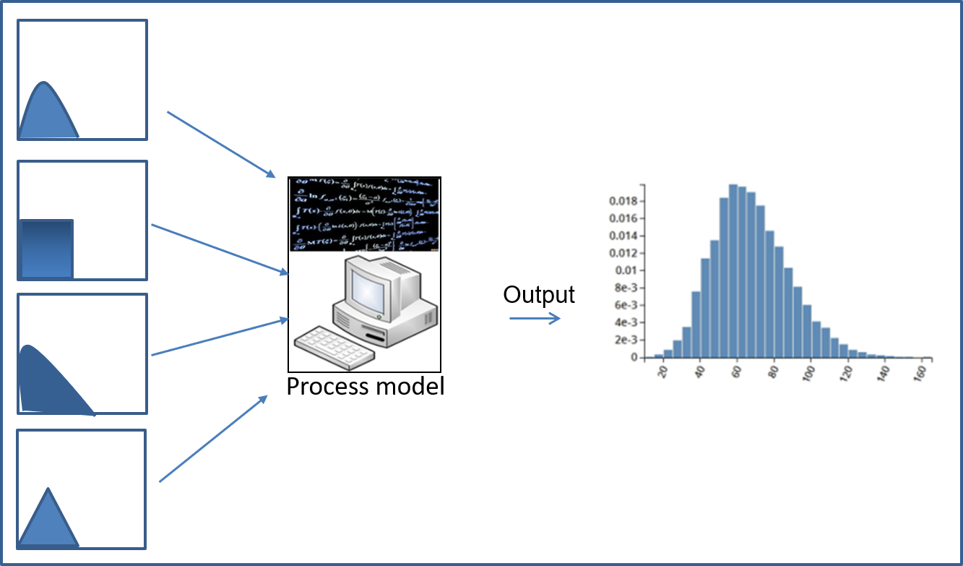
Monte Carlo uncertainty propagation
Reflectance
Figure 17 on https://dictionary.helmholtz-uq.de/content/monte_carlo_method.html

Slide 23
Total = random + systematic
U_{T} = U_{R} + U_{S}
irradiance, E
radiance, L
Figure by Michal Antala

Slide 24
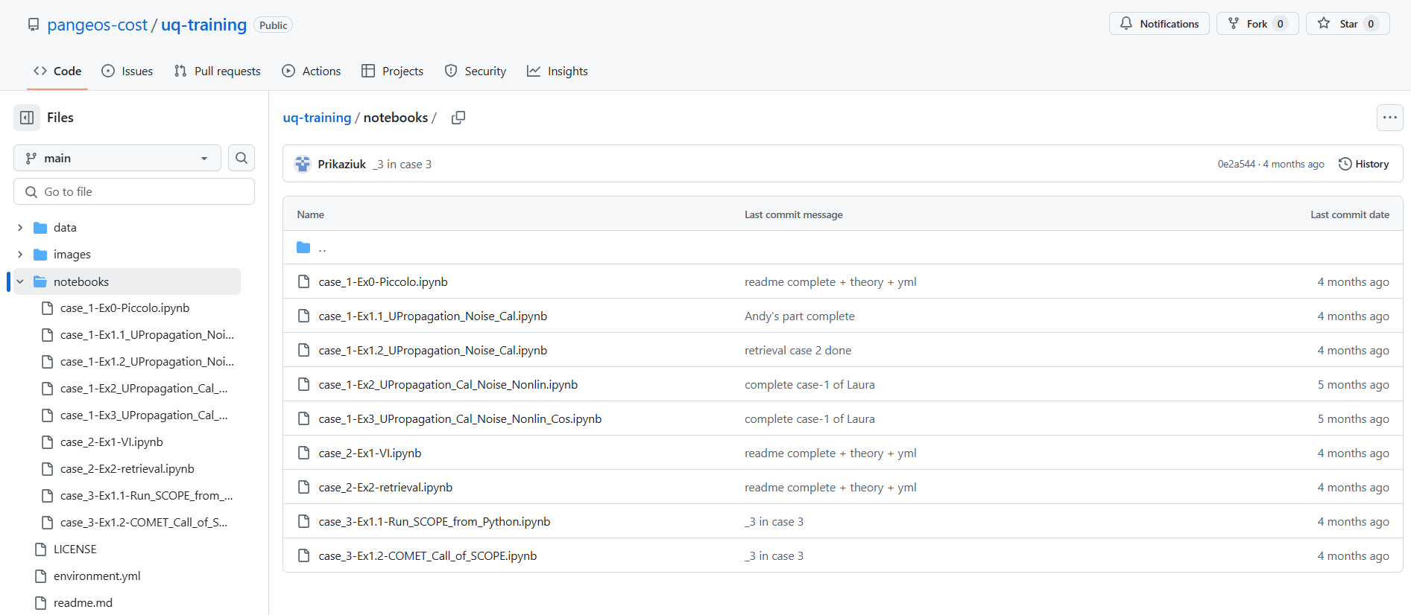
L0 -> L2: ground spectrometer

Slide 25
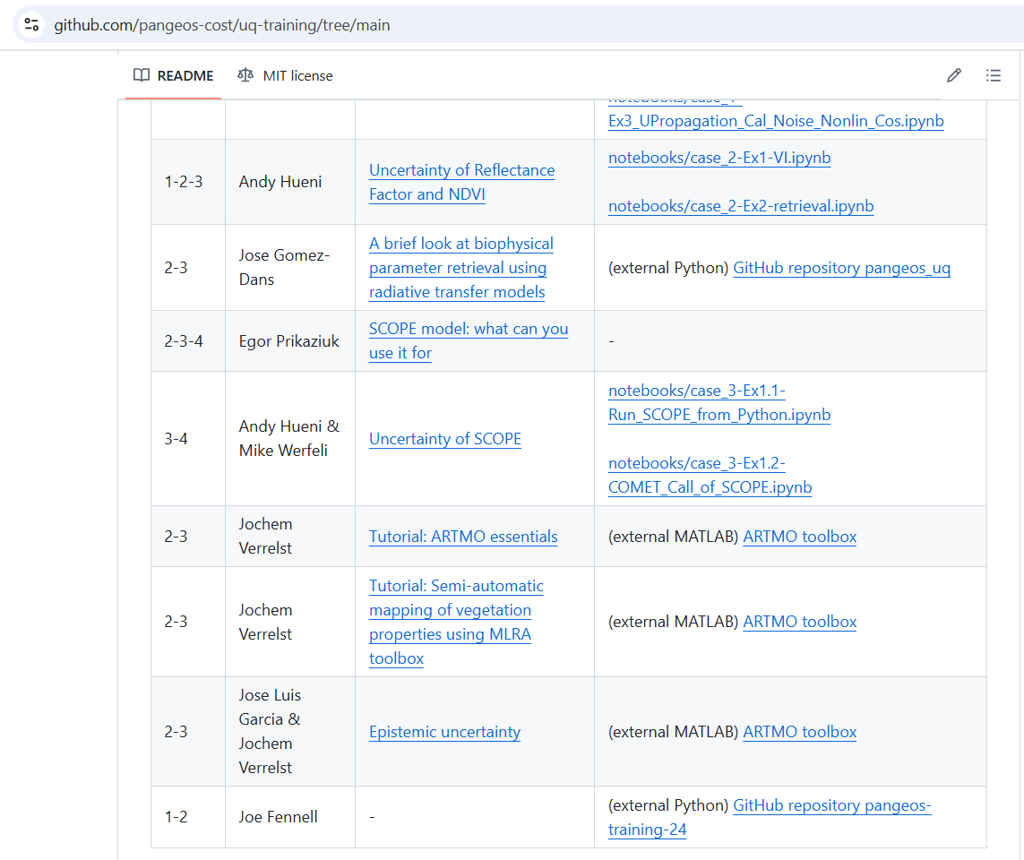
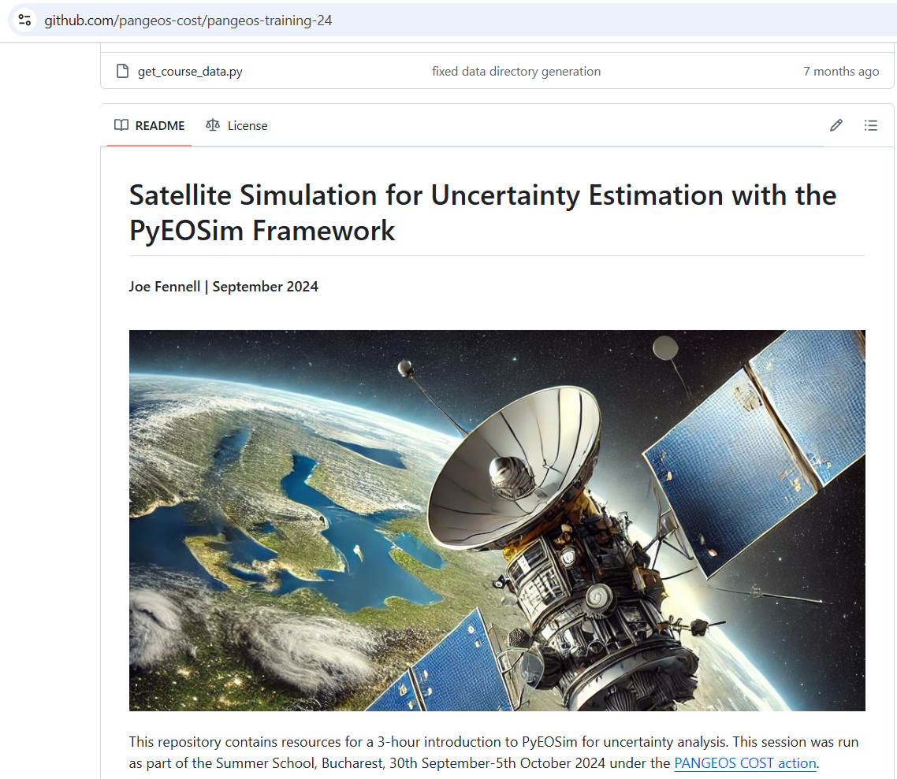
L0->L2: airborne or satellite

Slide 26
uncertainty vs error
traits -> processes
DNs -> reflectance
reflectance -> traits
bonus

Slide 27
propagation of uncertainty
raw DN
traits (LAI)
radiance
reflectance
advanced (GPP)

Slide 28
L2 -> L3: retrieval
Verrelst, J., Malenovský, Z., van der Tol, C., Camps-Valls, G., Gastellu-Etchegorry, J. P., Lewis, P., North, P., & Moreno, J. (2018). Quantifying Vegetation Biophysical Variables from Imaging Spectroscopy Data: A Review on Retrieval Methods. Surveys in Geophysics, 1–41. https://doi.org/10.1007/s10712-018-9478-y

Slide 29
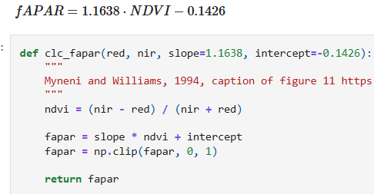
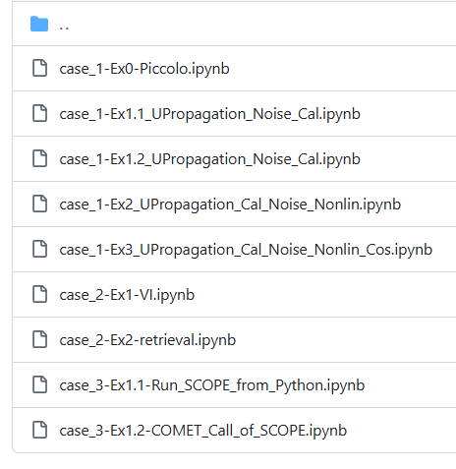
L2 -> L3: retrieval
Monte Carlo propagation
Verrelst, J., Malenovský, Z., van der Tol, C., Camps-Valls, G., Gastellu-Etchegorry, J. P., Lewis, P., North, P., & Moreno, J. (2018). Quantifying Vegetation Biophysical Variables from Imaging Spectroscopy Data: A Review on Retrieval Methods. Surveys in Geophysics, 1–41. https://doi.org/10.1007/s10712-018-9478-y

Slide 30
L2 -> L3: retrieval Monte Carlo uncertainty propagation
B4 +/- U_{R}
fAPAR
B4 +/- U_{S}
B8 +/- U_{R}
B8 +/- U_{S}
Figure 17 on https://dictionary.helmholtz-uq.de/content/monte_carlo_method.html

Slide 31
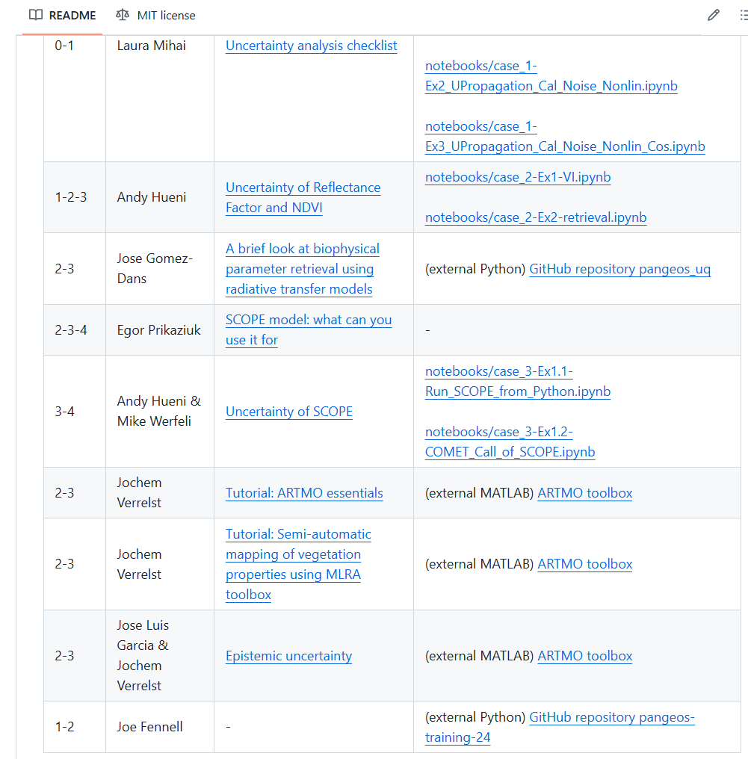
L2 -> L3: retrieval
epistemic uncertainty
Verrelst, J., Malenovský, Z., van der Tol, C., Camps-Valls, G., Gastellu-Etchegorry, J. P., Lewis, P., North, P., & Moreno, J. (2018). Quantifying Vegetation Biophysical Variables from Imaging Spectroscopy Data: A Review on Retrieval Methods. Surveys in Geophysics, 1–41. https://doi.org/10.1007/s10712-018-9478-y

Slide 32
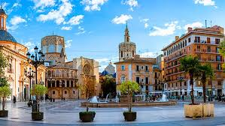
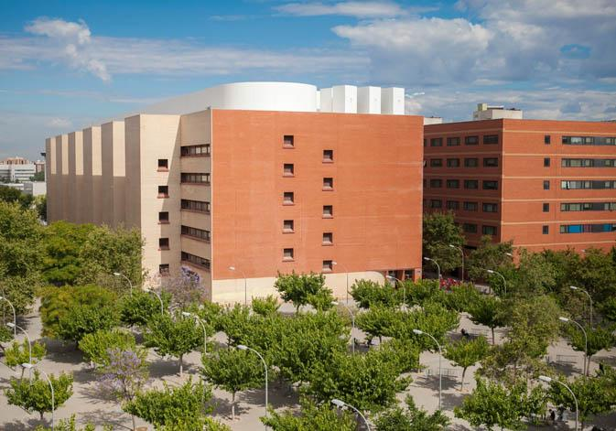
WG-4 Meeting Valencia, Spain
January 27-31, 2025
Uncertainty Analysis and Standardization
(4-5 participants)
5 day workshop for:
•
WG 4 and
•
WGs 1-3
•
Main Objective:
•
Get a back door (code) to be able to propagate uncertainties
through the ARTMO tool box using PunPy (CoMet tool kit)
Venue: University of Valencia
https://www.uv.es/

Slide 33
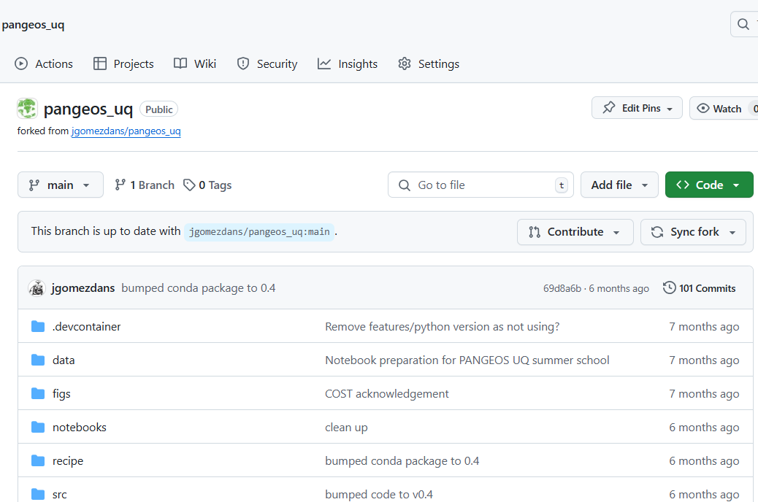
L2 -> L3: retrieval
Bayesian uncertainty
Verrelst, J., Malenovský, Z., van der Tol, C., Camps-Valls, G., Gastellu-Etchegorry, J. P., Lewis, P., North, P., & Moreno, J. (2018). Quantifying Vegetation Biophysical Variables from Imaging Spectroscopy Data: A Review on Retrieval Methods. Surveys in Geophysics, 1–41. https://doi.org/10.1007/s10712-018-9478-y

Slide 34
Advantage of Bayesian uncertainty non-gaussian shape
Cab
Cm
Cw
LAI
ALA
Cbrown
soil
soil

Slide 35
uncertainty vs error
traits -> processes
DNs -> reflectance
reflectance -> traits
bonus

Slide 36
propagation of uncertainty
raw DN
traits (LAI)
radiance
reflectance
advanced (GPP)

Slide 37
SCOPE model
Soil –Canopy observation of photochemistry and energy fluxes
fluxes
radiation (light)
Yang, P., Prikaziuk, E., Verhoef, W., & van der Tol, C. (2021). SCOPE 2.0: A model to simulate vegetated land surface fluxes and satellite signals. Geoscientific Model Development Discussions, 2021, 1–26. https://doi.org/10.5194/gmd-2020-251

Slide 38
Monte Carlo uncertainty propagation
LAI
GPP
incoming radiation
air temperature
air humidity
Figure 17 on https://dictionary.helmholtz-uq.de/content/monte_carlo_method.html

Slide 39
uncertainty vs error
traits -> processes
DNs -> reflectance
reflectance -> traits
bonus

Slide 40
Egor Prikaziuk¹,
Gary Llewellyn^{2,6},
Laura Mihai³,
Agnieszka Bialek⁴,
Andreas Hueni⁵,
Mike Werfeli⁵,
Jose Luis Gomez-Dans⁶,
Jochem Verrelst⁷,
Jose Luis Garcia-Soria⁷,
Joseph Fennell⁸,
Dessislava Ganeva⁹,
Shawn Carlisle Kefauver¹⁰
https://github.com/pangeos-cost/uq-training

Slide 41
propagation of uncertainty
raw DN
traits (LAI)
radiance
reflectance
advanced (GPP)

Slide 43
uncertainty vs error
traits -> processes
DNs -> reflectance
reflectance -> traits
bonus

Slide 44
EGU General Assembly 2025 "Remote Sensing for Sustainable Agriculture and Forestry“ POSTER SESSION TUESDAY afternoon April 30 ORAL SESSION ALL DAY WEDNESDAY MAY 1.

Slide 45
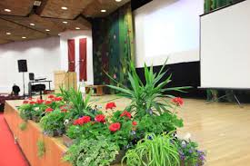
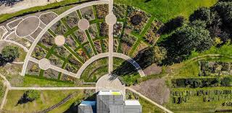
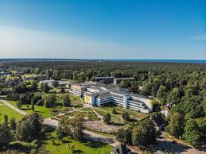
PANGEOS End of Year GP2 Conference Jūrmala, Latvia
September 11-12, 2025
Feeding different data sets into improved computational geometry method-CGM (WG1+2)
(estimated 40-50 participants)
Venue: Bulduri Agri-Food Technical School
https://bulduri.lv/

Slide 46
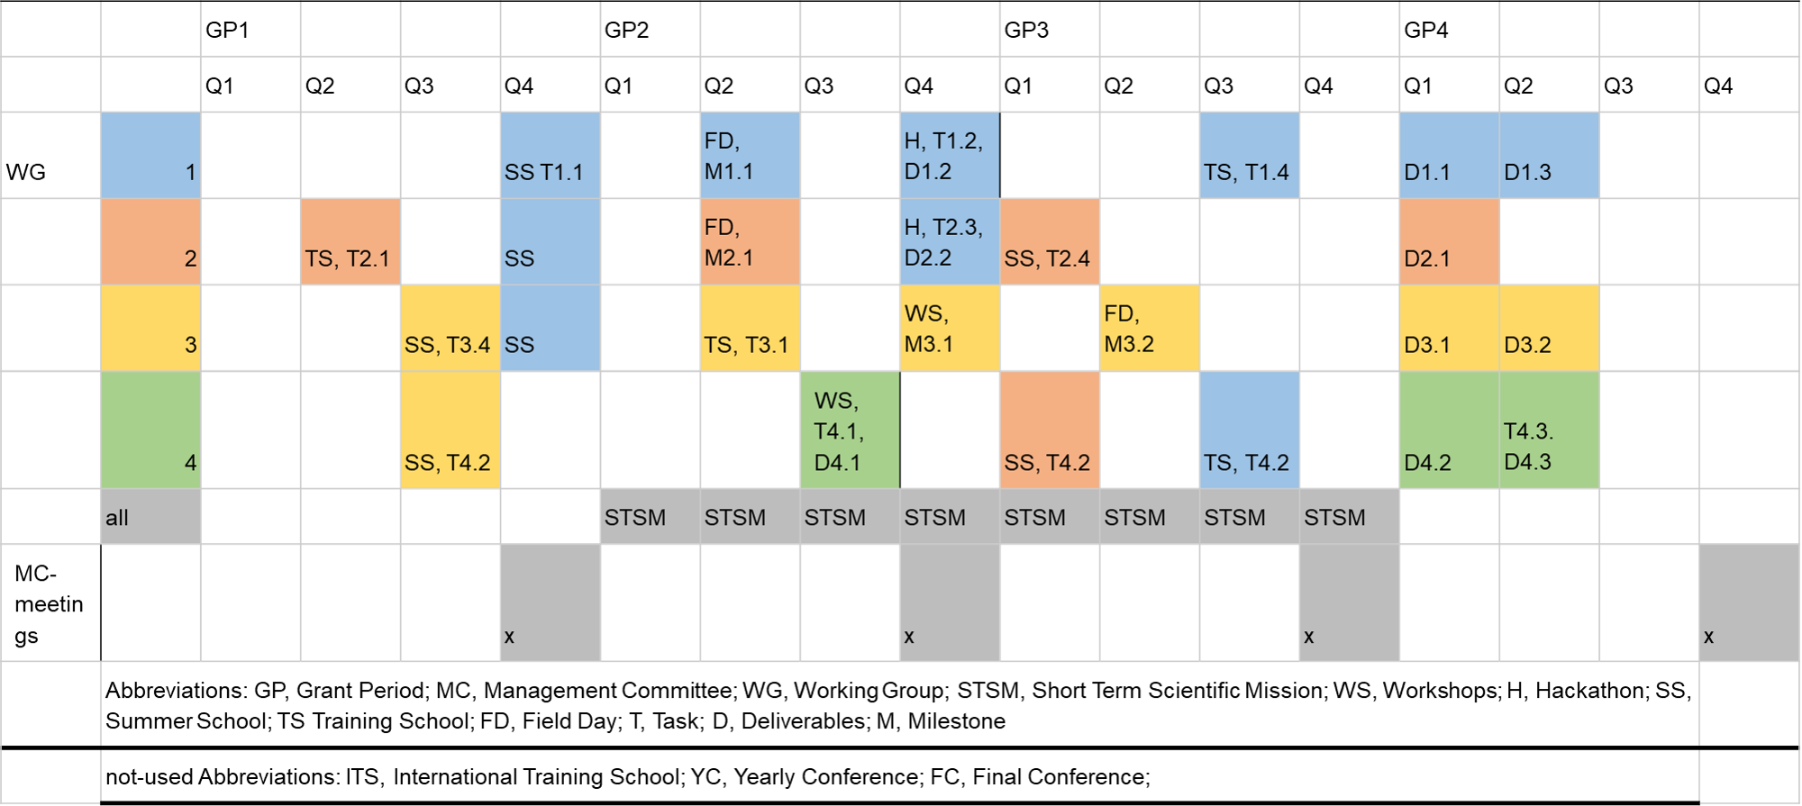
PANGEOS COST Action Looking Forward to 2025-2027
COST (European Cooperation in Science and Technology) is a funding agency for research and innovation networks. Our Actions help connect research initiatives across Europe and enable scientists to grow their ideas by sharing them with their peers. This boosts their research, career and innovation. http://www.cost.eu

Slide 47
pangeos.eu

Slide 48
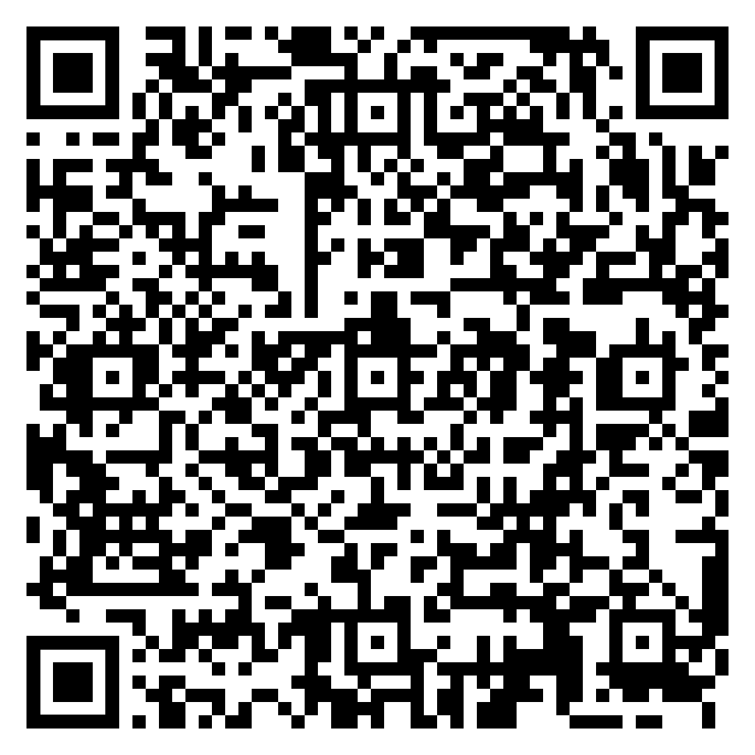
Submit an article to a special issue in Frontiers of Environmental Science (IF 3.3)

Slide 49
Egor Prikaziuk
University of Twente
EGU 2025
30 April 2025
e.prikaziuk@utwente.nl
This abstract is supported by the EU COST (European Cooperation in Science and Technology) Action CA22136 “Pan-European Network of Green Deal Agriculture and Forestry Earth Observation Science” (PANGEOS).
COST Action CA22136
COST (European Cooperation in Science and Technology) is a funding agency for research and innovation networks. Our Actions help connect research initiatives across Europe and enable scientists to grow their ideas by sharing them with their peers. This boosts their research, career and innovation. http://www.cost.eu

