Slide 1
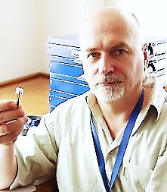
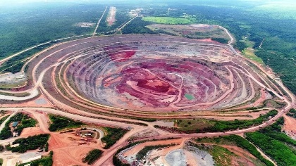
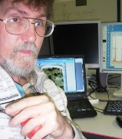
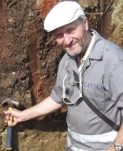
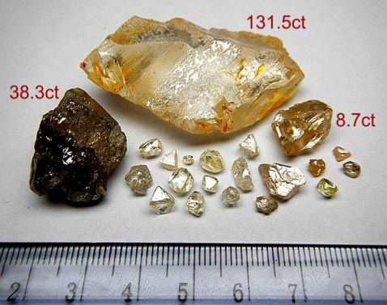
Mantle section 3000 through Angola and Congo based on kimberlite indicator minerals from kimberlites
Vladimir Zinchenko¹, Igor Ashchepkov², Alexander Ivanov³,
Beneditu Paulu Manuel¹, Joao Tunga Felix ⁴
Mining Society CATOCA, Angola,
Institute of Geology and Mineralogy of the Russian Academy of Sciences, Russia
St. Petersburg Mining University, Russia
LUELE Mining Society, Angola
The 3000 km long mantle section southwest and northeast across the entire Congo craton, including Angola and the Congo Democratic Republic (DRC), was constructed from diamond satellite mineral (ISA) analyses from kimberlites (and placers) using monomineral thermobarometry (Ashchepkov et al., 2017) and Surpher 8 software..
The section crosses the Lucapa corridor from the Kunene field to Lushinga in Angola and runs from Mbuji-Mai to the Banalia field in the DRC. The Northwest-SEE section from Bas Congo to Kundelungu was also built. The entire SW-NE profile consists of at least 6 parts in Angola and another 3 in the DRC, according to the grouping of kimberlite fields. There are areas with higher concentrations of pipes, corresponding to the boundaries of lithospheric terranes, where the mantle columns are more homogenized. Mantle sections show a rather contrasting layering. They are sharper and more subtle in the P-FO2 and Fe# diagram and less pronounced in the P-ToC and P-CaO, Fe# garnets. The section in Angola includes several regions with denser kimberlite populations, including Cunene, Cubango, Lubango, and a long stretch from Longo to Kamatue, including the Catoca cluster. The last highly diamondiferous part of the section differs from the other parts by the significant heating of the lower part of the mantle with a relatively high amount of pyroxenite and eclogite material, which probably determines the high diamond content. In several mantle clusters, heating and an increase in Fe# are observed, accompanied by low oxygen volatility, which corresponds to a high content of diamonds.
кимберлиты
россыпи
Fig.1. Schematic map of the location of kimberlites and placers in the Congo craton (in Angola and Congo Democratic Republic )

Slide 2
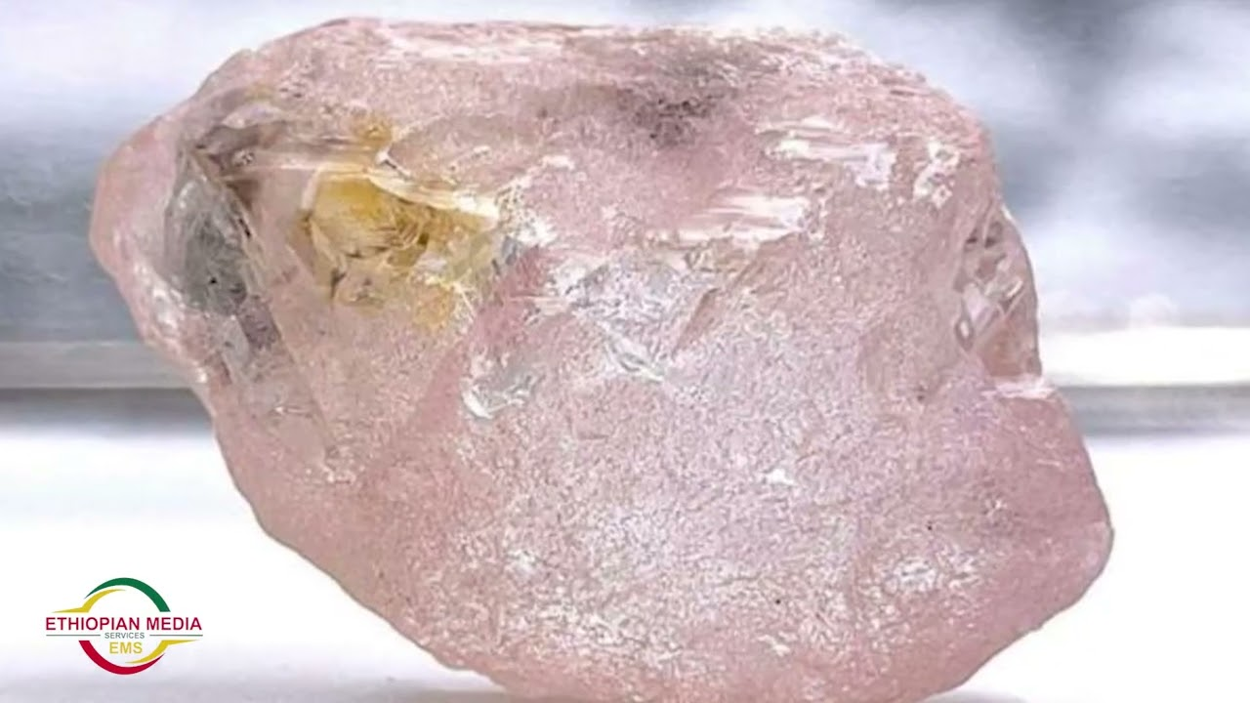
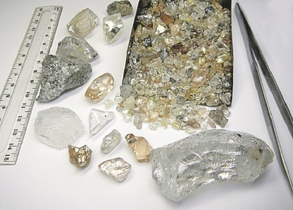
In Angola, these are the Kuilo-Luele-CatoCa and Kamafuka-Kamachia fields, and in the Congo of the DR - the Mbuji-Mai and Wamba fields. The relative homogenization of the mantle under Catoc and nearby regions means a higher permeability of the mantle with a concentration of protokimberlite magma chambers not only at the base of the lithospheric mantle, but also in intermediate and middle pyroxenite levels. Mineralogy suggests the presence of weakly oxidized eclogites, dunites, and Mg-rich ilmenite and -chromite-containing metasomatites. Probably, under such conditions, many diamonds grew in the proto-kimberlite process in large magma chambers at the base of the lithosphere, where large grains of the CLIPPIR type in the form of megacrystals could form. The uppermost relatively thin layers of the upper mantle horizons formed in the Early Archean are inclined towards the Catoca-Kamachia site in the northeastern part of the Congo, where the concentration of eclogites is higher, probably due to accretion during subduction. RSF Grant 24-27-00411
a
b
c
d
e
f
    Figure 2 PTXfO2 diagram for SCLM under the Catoca cluster pipe. Conventions: 1. Cpx: 2. PT (Nimis, Taylor, 2000), 2-ToC (Nimis, Taylor, 2000) - Ashchepkov et al., 2017); 4 the same for the eclogites; 5. Garnet (mono) - 6. ToC (O'Neil, Wood, 1979)-P(GPa)(Ashchepkov et al., 2010), 7- same for eclogites; 8. Chromite: ToC (O'Neil, Wall, 1989) - P(GPa) (Ashchepkov et al., 2010). 9. Ilmenite ToC (Taylor et al., 1998) - P(GPa) (Ashchepkov et al., 2010). Graphite-diamond lines (Kennedy and Kennedy, 1976) (red); (Day, 2012) pink. (Ashchepkov et al.,2021; Zinchenko et al., 2021)

Slide 3
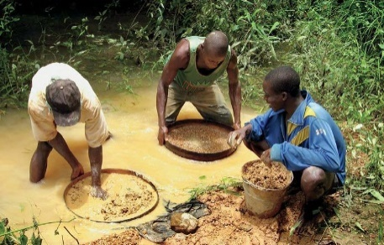
4. Structure of the mantle columns from SE Lucapa corridor and NW part of the Congo –Kasai craton
a
b
c
d
e
f
Diagrams of PTXfO2 mantle sections under the southeastern part of the Lukap corridor and the northwestern part of the Congo-Kasai craton The symbols are set as in (Fig. 2)

Slide 4
a
b
c
d
e
f
g
h
i
Fig 4. Mantle section through the south-northeast of the Lukap corridor(a. Δlog(QMF) (Gudmundsson, Wood, 1995); b. Fe# Gar; c. CaO Gar.; d. ToC Gar(O'Neil, Wood, 1979); e. TiO2 Gar; f. Cr2O3 Gar; g. ToC EclPxt (Nimis, Taylor, 2000); h. Fe# EclPxt; i. FO2 EclPxt (Ashchepkov et al., 2012)

Slide 5
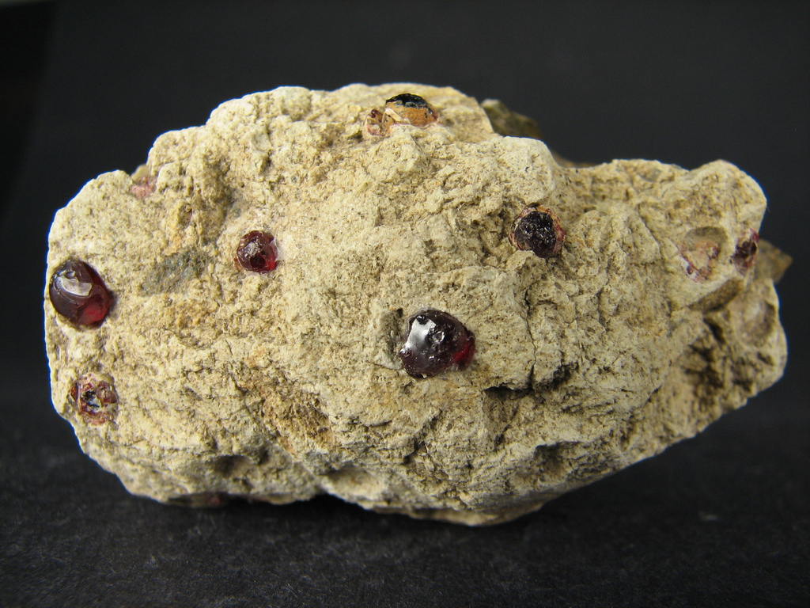
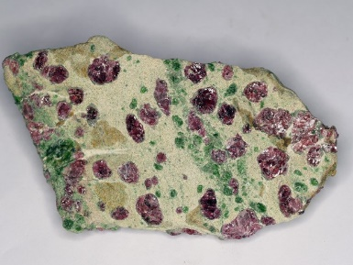

In the upper part of the SPZ, most of the layers from 2 to 4.5 GPa are inclined to the northwest. A high degree of heating was found in Kuele, Kwanza and in the section from Luilo to Kamatue. The latter region is the most productive for diamonds. They also have a hated layer of 7.5 to 6 GPa. And another interesting feature: they are less in Fe# from the base of the lithosphere to the top of the SCLM. These areas are also less oxidized, which has a beneficial effect on the stability of the diamond.
Fig.5. Mantle section through the Congo-Kasai craton in the southwest-northeast (Kunene - Banalia). Contours: a. Pressure [3,4]; b. Fe# minerals together [3]; c. Δlog(QMF) [5].

Slide 6

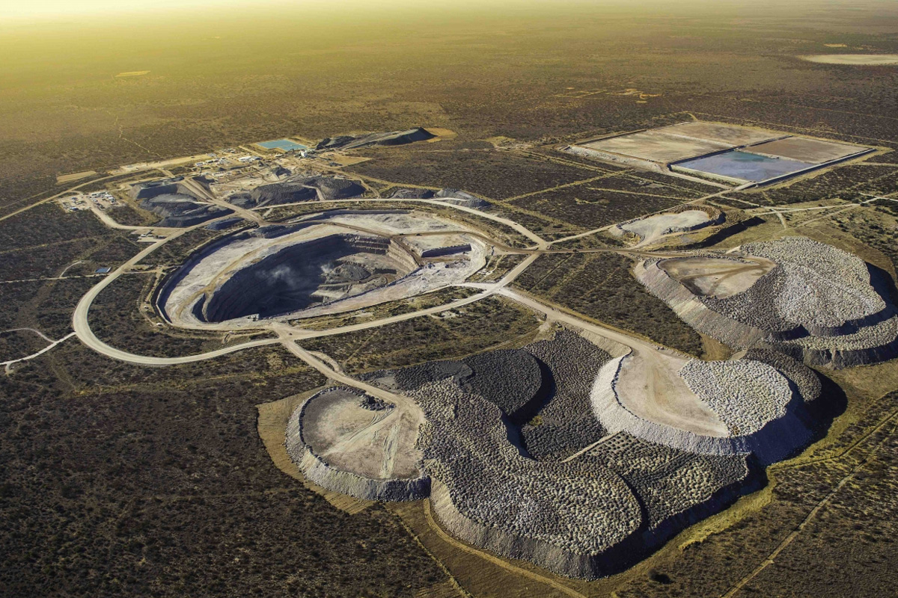
Mantle transect through the Congo-Kasai craton
SEE-NWW (Bas Congo-Kandelungu fields)
    The Congolese part of the section also contains two regions with a similar rather high degree of warming at the base of the lithosphere near the Mbuji-Mai and Badibanga areas, where diamondiferous pipes are located. No significant lowering of Fe# has been detected, and the mantle structure in the Congolese part appears flatter than in Angola. In addition, the oxidation conditions are higher. Here in Congo, DR, kimberlites with a high diamond content are not found, but there are a few placers of diamonds.
    Fig.6. Mantle section through the Congo-Kasai craton NEE-SWW (Lower Congo-Kundelungoo. Contours: a. ToC b. Fe# minerals together; c. Δlog (QMF)

Slide 7
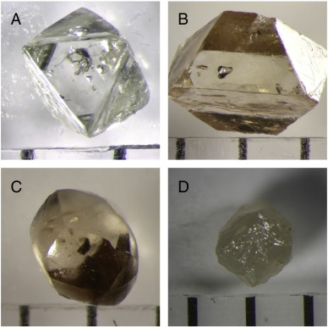
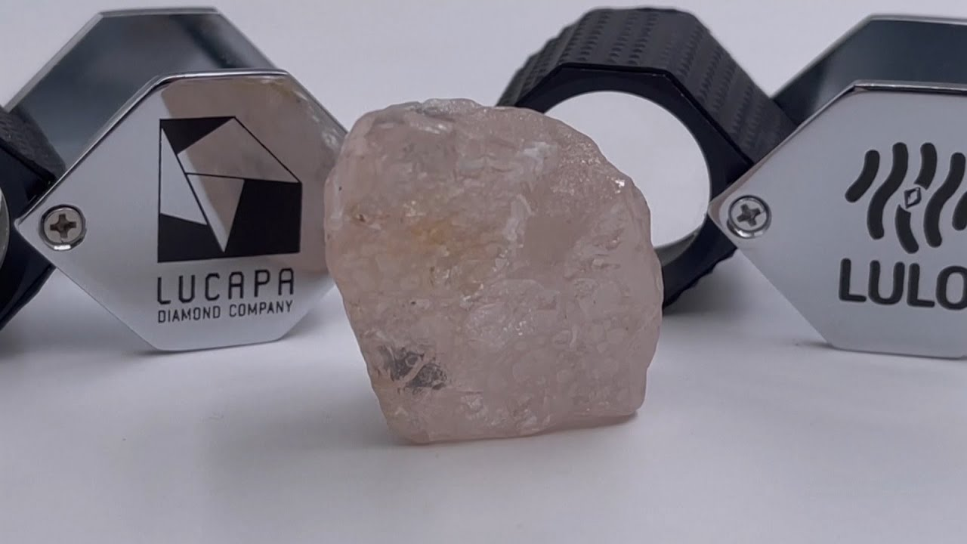
Conclusions
    There are lateral changes in the composition and structure of the mantle beneath the Kasai craton in Angola, the southwestern parts of which are more depleted and subject to water metasomatism.
    . There is a tilt of the depleted productive horizon from northeast to southwest, possibly caused by ancient Archean subduction
    In the mantle structures, an increase in the content of diamonds in a south-westerly direction along the Lukapa corridor was revealed, coinciding with a decrease in FO2 and an increase in depletion and an increase in heating
    The Angolan part of the submeridional section consists of 6 subterranean layers with the slopes of the layers in the upper part to the north
    The productive northeastern part of the Lukapa Corridor is a zone of collision with a large number of Eclogites and Dunites
    The less productive part of the Congo exposes a flat structure with a warmed southern part in the center
    Acknowelegements. The work is supported by the Ministry of Science and Higher Education of the Russian Federation. We are grateful to the IGM SB RAS Novosibirsk Mining University in St. Petersburg, Russia. CATOCA Mining Society, Angola, LUELE Mining Society, Angola
    This work was supported by the RSF grant 24-27-00411.
Thank you for your attention!!

