Slide 1
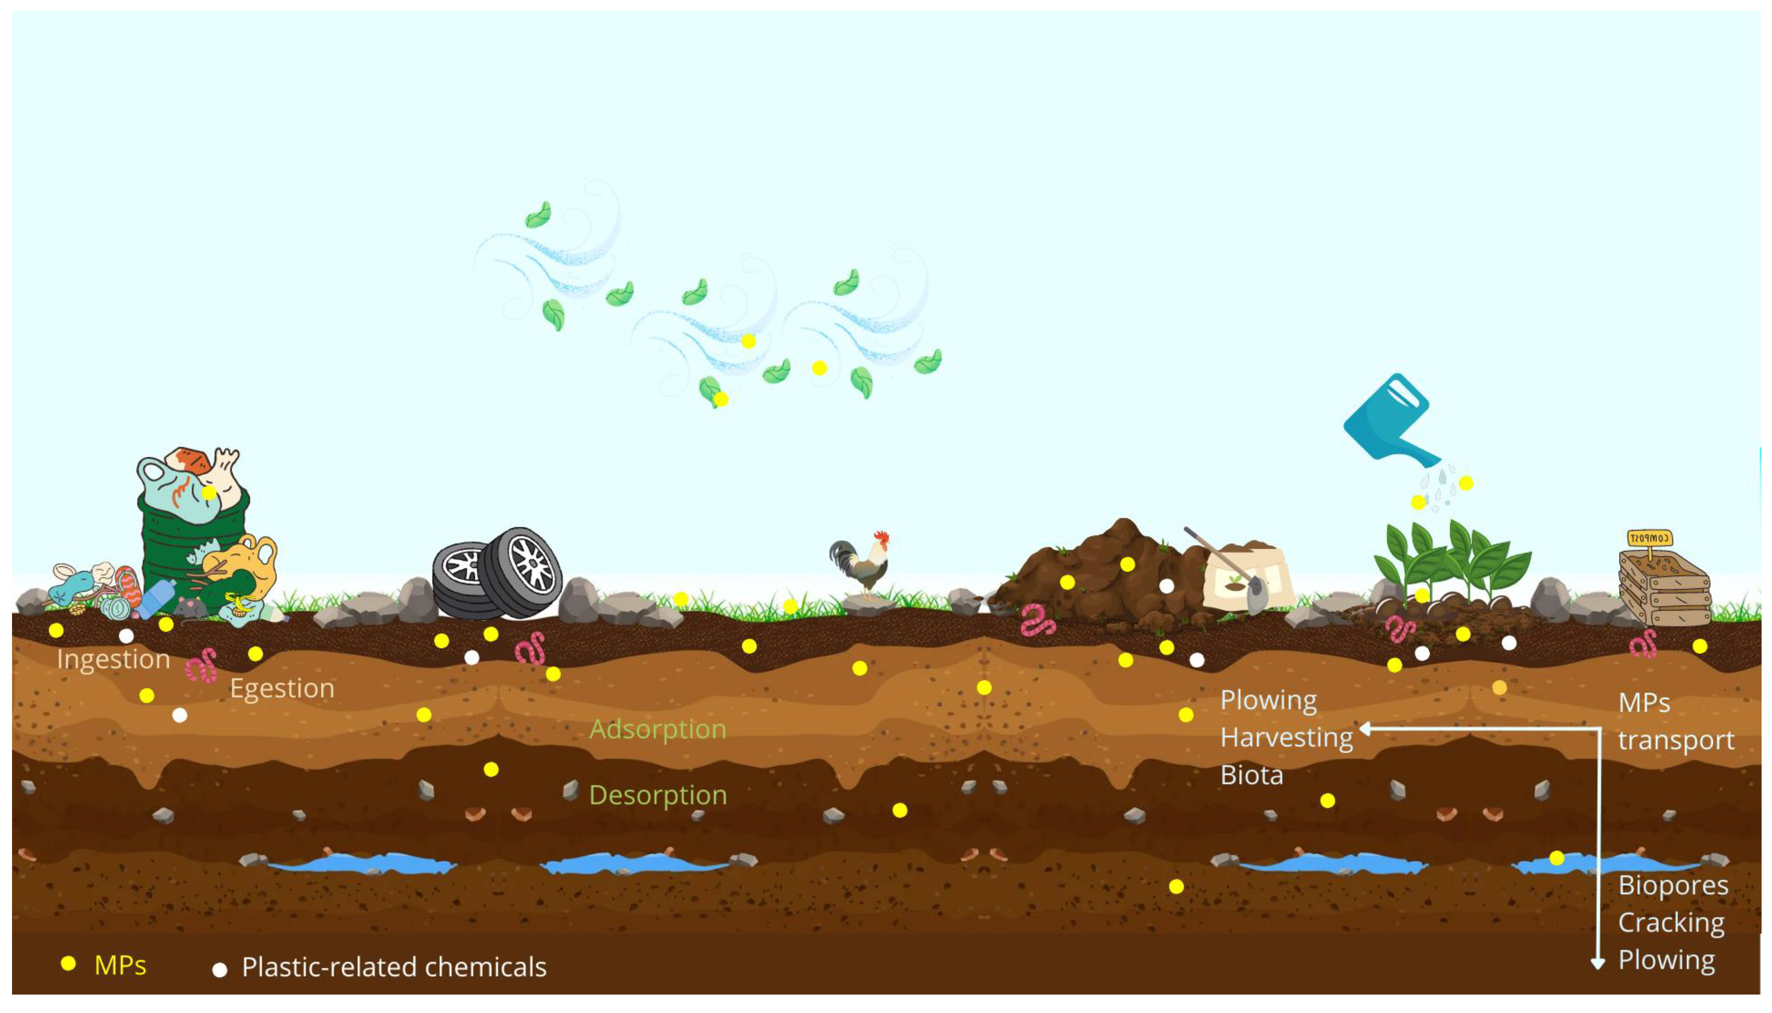
Drip Irrigation Promoted Migration of Microplastic Particles Across Vertical Soil Columns
European Geosciences Union (EGU)
Mohd Faraz Khan ª, Chandrashekhar Prasad Ojha ^{b}
ª PhD Student Department of Civil Engineering, Indian Institute of Technology Roorkee, Roorkee
^{b} Professor Department of Civil Engineering, Indian Institute of Technology Roorkee, Roorkee

Slide 2
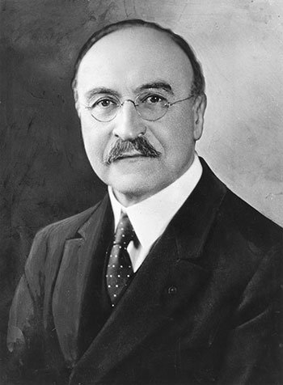
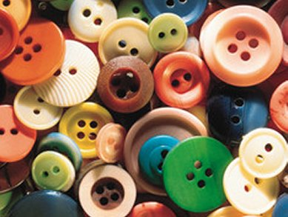
1.Introduction
Fully synthetic plastic was invented in 1907.
He combined two known chemicals, formaldehyde & phenol, under heat and pressure.
Leo H. Baekeland
Bakelite type telephone made in 1930s
Radio receiver in Bakelite case
Source:-( https://www.sciencemuseum.org.uk )

Slide 3
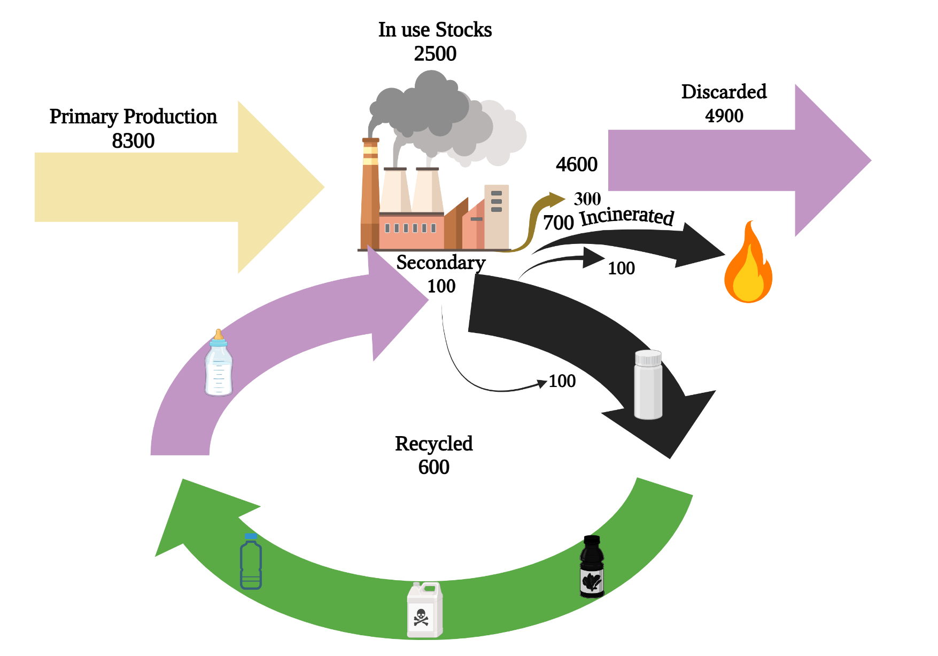
1.2 Problem Statement
Global production of plastics >320 million tons (Mt) per year.¹
Plastic production is expected to double in the next 20 years.²
6–26% is recycled, meaning up to 94% ends up in landfills or released into the environment.^{4,5}
Current era has been referred to as the Plasticene.⁶
MPs has been detected in air,⁷oceans,⁸⁻¹⁰ soils, sediments, & surface waters .¹¹⁻¹³
Fig 1. Global production, use, and fate of polymer resins, synthetic fibers, and additives (1950 to 2015; in million metric tons).¹⁴ ^{(Revisualized)}

Slide 4
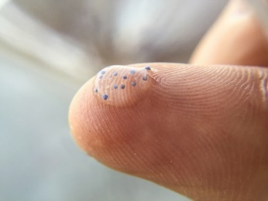
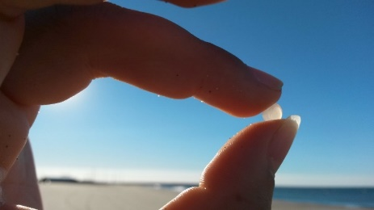
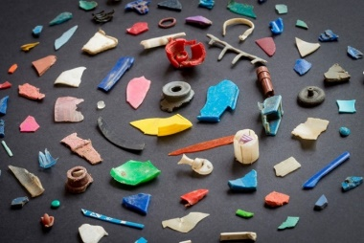
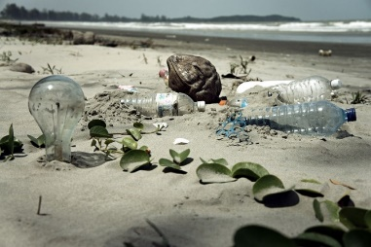
1.3 Introduction to Microplastics
Microplastics are fragments of plastic less than 5 mm in length, ¹⁹according to the U.S. NOAA*^{20,21} and the ECA**. ²²
Pollution by entering natural ecosystems from sources, including.²⁰⁻²²
Plastic Pollutant Size Classification²³
**National Oceanic and Atmospheric Administration **European Chemical Agency

Slide 5
1.4 Global Releases of Primary Microplastics²⁴
1.Cosmetics Industry
(Microbeads)
For Example:-
Poly-Ethylene
Poly-Propylene
3.Manufactured goods
(Pellets)
Granules and small resin pellets are raw material
Accidental spillage during transport
Inappropriate use as packing materials
2.Clothing
(Fibres)
For Example:-
Synthetic fibres
(i.e. , nylon ,acrylic )
Source:-shed from clothing
One load of laundry=1,900 fibres
4.Coastal Tourism
(Fragments
Fibres & Films)
Recreational Activities
(ghost nets & fishing gears)
Source:-International Union of Conservation & Nature

Slide 6
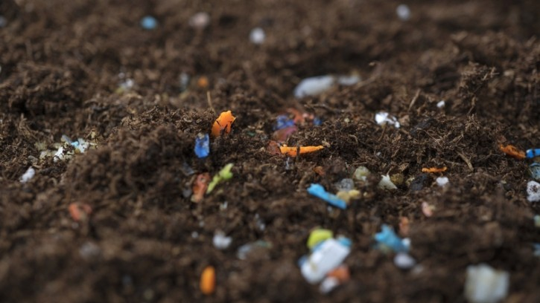
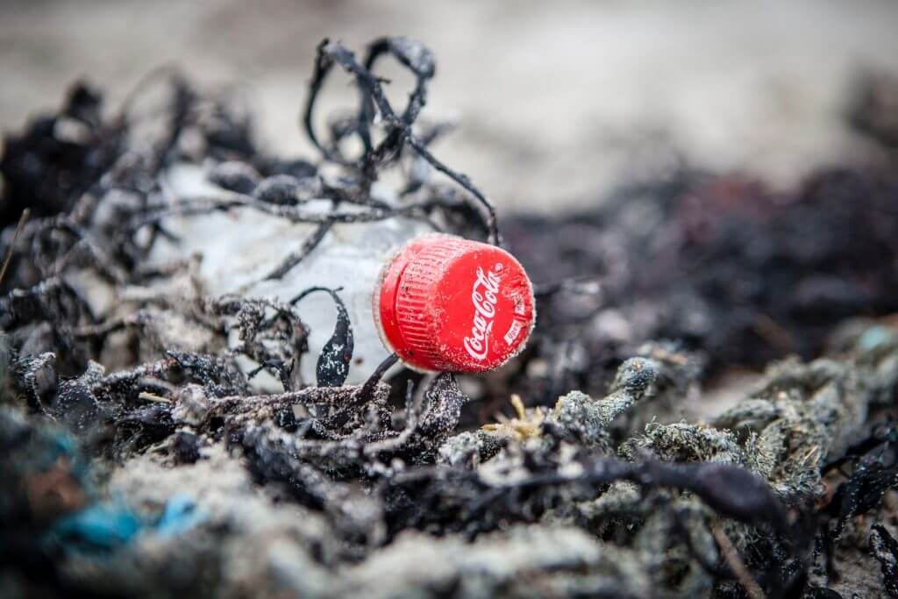
2.1 How Plastics reach the soil?
Aerial deposition²⁷
Discarded plastic litter fragmentation²⁸
Plastic mulching or other agricultural products²⁹
Compost of sewage sludge addition ³⁰
Vehicular Tire abrasion ³¹

Slide 7
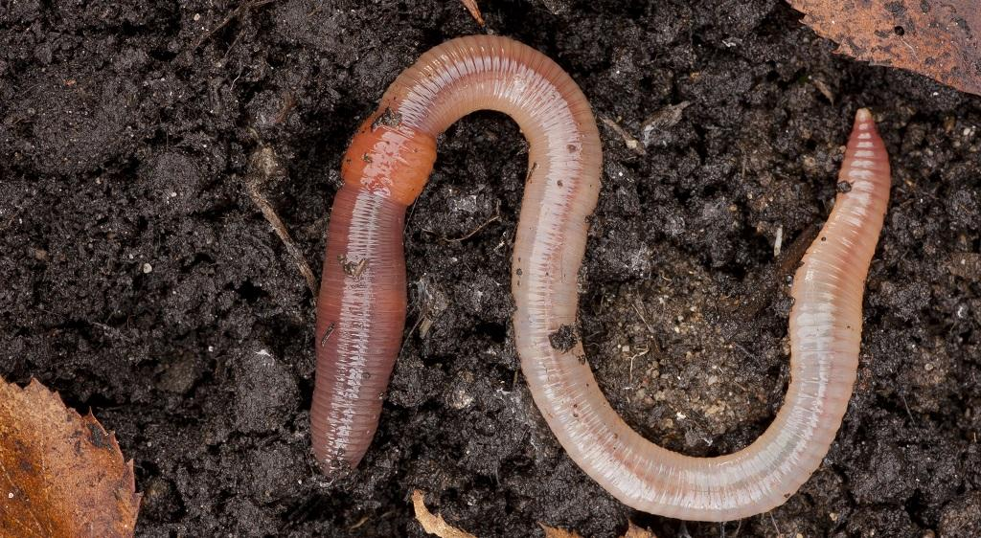
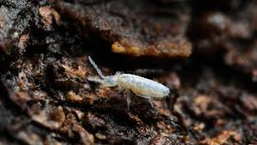
2.2 Transport of microplastics into soil
Earthworms efficiently transport various sized microplastic beads down into the soil(10 cm depth,21 days)³²
Collembola (spp.) transport microplastic beads horizontally(several cm within days)³³
Other noteworthy means of transportation³²
Plowing, Harvesting
Root channels
Movement with water

Slide 8
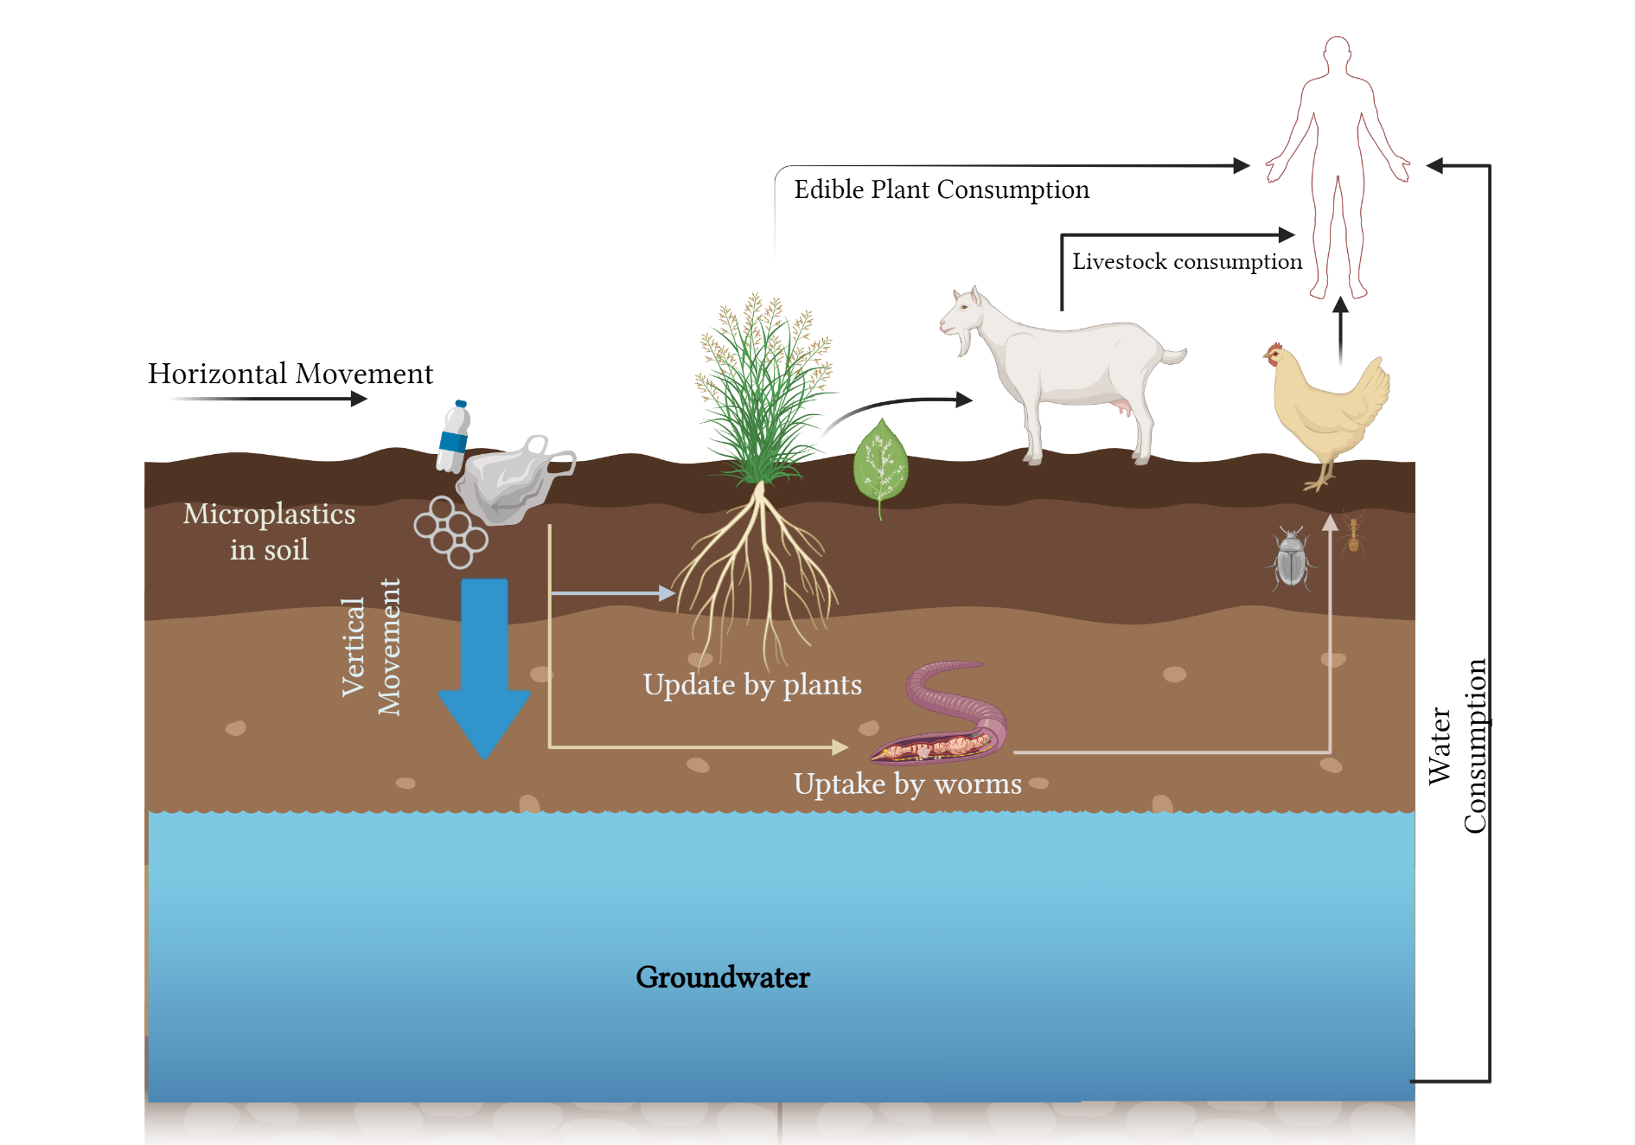
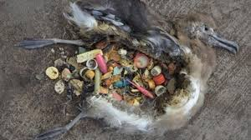
3.Literature Review
Impacts³⁷
Reproductive and Developmental Toxicity
Uptake of Endocrine Disruptive additives(BPA)
Reduced food security due to disturbed soil microbiomes
Fig.2 Microplastic Pathways to Human through soil
(Revisualization)

Slide 9
4. Research Gaps
1.Transport mechanism of MPs on land is still poorly understood.
2.Role of environmental factors such as rainfall, temperature, and wind in the distribution and transport of microplastics in soil.
3.Examining how soil organisms (e.g., earthworms) interact with microplastics and influence their transport and fate in soil.
4.Studying the degradation processes of microplastics in soil, including physical fragmentation, chemical weathering, and biological degradation.
Fig.3 MPs Transport Pathways on Land ³⁹

Slide 10
5. Material and Method
Microplastic Preparation:-Materials: Polypropylene MPs were used. Preparation: Plastics were of 35-40 microns size.
Soil Selection and Preparation:-Source: Sand was collected from a riverbed. Cleaning: Washed, dried, and treated at 550°C to remove organic matter. Gradation: Fluvial Sand was sieved to ensure a well-graded particle size distribution.
Column Setup:-Column Dimensions: 5 cm diameter and 31.5 cm depth. Layering: Uniform sand layer for effluent discharge.1.18 mm sized IS sieved Gravel at bottom acting as a base Simulation: Water was applied via bottle dripper system mimicking agricultural system. Drip pumping rate at one L/Hour.
Experimental Conditions:-Duration:-Experiments ran for 1-2 days. Effluent Collection: Effluent water was collected at intervals.
Microplastic Extraction :-Method: Water was collected as leachate and passed through vacuum filteration assembly and collected on a 0.22-micron membrane filter paper. Analysis: Supernatant was filtered, and MPs were visualized using fluorescence microscopy which were dyed with Coumarin 6 .

Slide 11
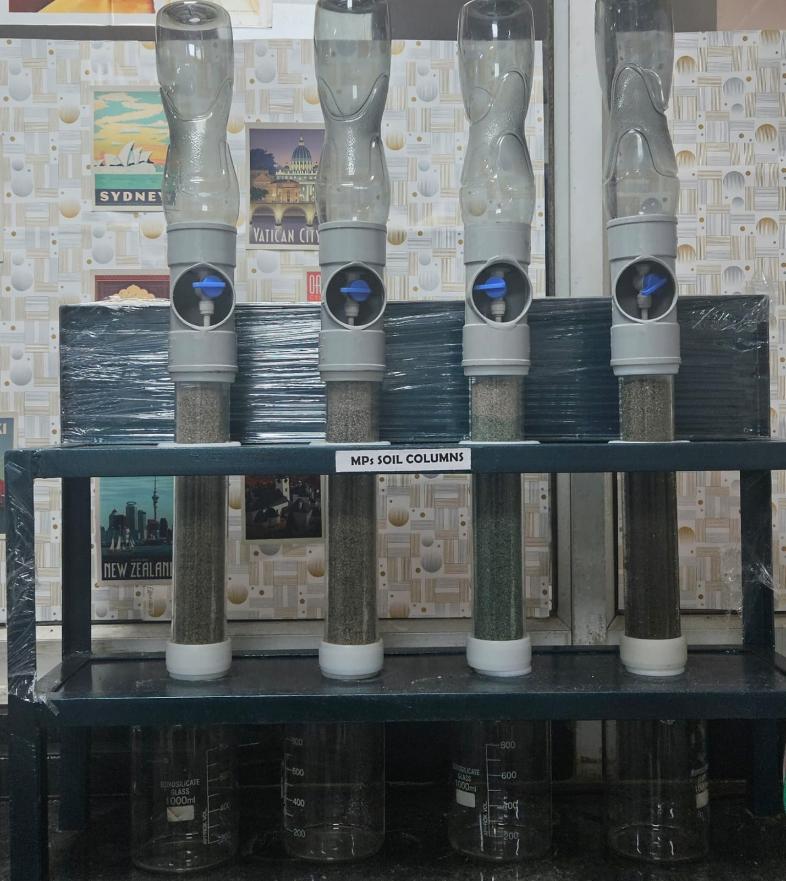
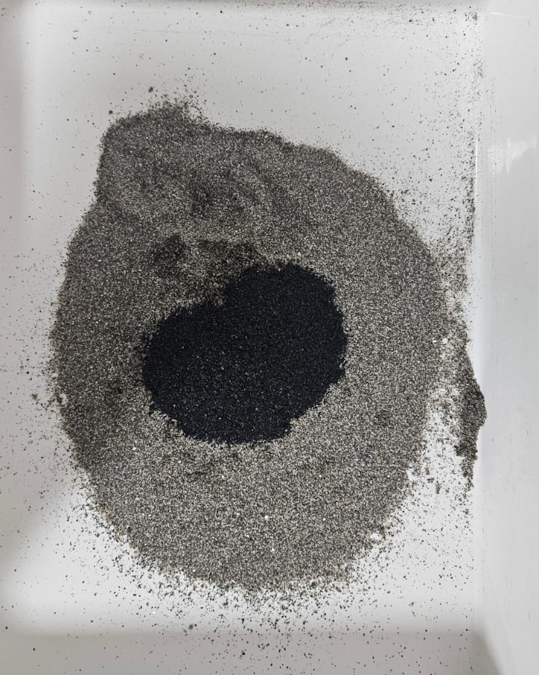
6. Experimental Setup
1.Material
Polypropylene MPs Particles
Size:- 35-40 µ
5.Experimental Duration
Experiments ran for 1-2 Days.
2. Column Material
Fluvial Sand was collected from a riverbed. Washed, dried, and
treated at 550°C to remove
organic matter
C
6.Effluent Collection
Effluent water was collected at
intervals.
O.M
H.A
NPK
7.Microplastic Extraction
Water was collected as leachate
and passed through vacuum filteration assembly
and collected on a 0.22-micron
membrane filter paper.
3.Column Packing
MPs Placed in the Upper in 5 cm layer.
8 Analysis
Supernatant was filtered, and MPs were visualized using fluorescence microscopy which were dyed with Coumarin 6 .
4.Drip Simulation: Water was applied via dripper system one L/hour Intensity.
Fig.4 MPs Column Studies Transport Setup

Slide 12
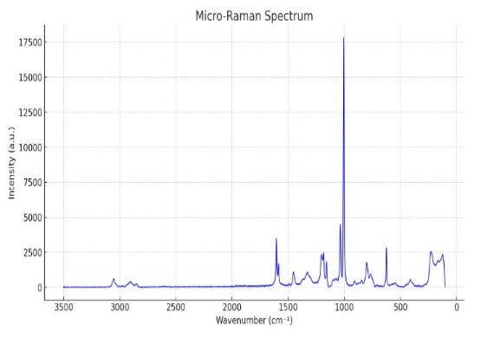
7. Results
Control Column
NPK
Fig. 6 µ-Raman Polypropylene (PP)
VERMICOMPOST
HUMIC ACID
Fig.7 Fluorescence Microscope- Optika B-383 PLI/LD
Fluorescence Microscope- Optika B-383 PLI/LD
µ-Raman-Renishaw Invia Confocal Raman Microscope
Notes:
Each curve represents how microplastics move through the porous medium in response to different treatments.
1️⃣ Control (PP Only) – Brown Solid Line
Slowest breakthrough (delayed curve).
Why?
In pure soil, microplastics are retained due to adsorption and filtration.
The absence of external chemicals means normal hydrodynamic and adhesion forces act on MPs.
Takes longer for microplastics to fully exit.
2️⃣ Humic Acid (PP + HA + Soil) – Green Dotted Line
Fastest breakthrough (earliest rising curve).
Why?
Electrostatic repulsion: Humic acid coats microplastics, preventing adhesion to soil particles.
Steric hindrance: Organic molecules in humic acid create a barrier that reduces interaction between MPs and soil.
MPs travel faster and exit earlier.
3️⃣ NPK Fertilizer (PP + NPK + Soil) – Blue Dashed Line
Faster than control but slower than humic acid.
Why?
NPK alters soil structure by changing particle aggregation and microbial activity, which can reduce microplastic retention.
Some microbial processes can alter MP surface properties, increasing their movement.
MPs exit earlier than control but later than humic acid.
4️⃣ Vermicompost (PP + Vermicompost + Soil) – Purple Dashed Line
Moderate transport rate (between control and NPK).
Why?
Vermicompost contains organic matter, which can enhance MP mobility by coating their surfaces.
However, it also increases soil porosity, leading to some MP retention.
Breakthrough is slightly faster than control but slower than NPK and humic acid.
Breaking it down:
C = The concentration of microplastics in the effluent (outflow) at a given time.
C₀ = The initial concentration of microplastics in the influent (inflow or input solution).
C/C₀ = The relative concentration (i.e., how much of the initial microplastic concentration is detected in the outflow over time).
Interpretation in Breakthrough Curves:
C/C₀ = 0 → No microplastics detected in the outflow (initial phase, retention in soil).
C/C₀ = 0.5 → Breakthrough time → Half of the initial concentration has reached the outlet.
C/C₀ = 1 → Complete breakthrough → The outlet concentration equals the input concentration, meaning no further retention is occurring.

Slide 13
8.Conclusion
Humic Acid shows the fastest microplastic transport due to electrostatic repulsion & steric hindrance.
NPK fertilizer increases mobility by altering soil structure and microbial activity.
Vermicompost moderately increases MP movement, balancing adsorption and transport.
Control column retains MPs the longest, showing lower transport due to natural soil filtration.
Elliptical
Angular
Fig.9 MPs FESEM Image PP
Notes:
Microplastic pollution in agricultural soils can be increased by fertilizers (NPK) and organic amendments (humic acid, vermicompost).Humic acid enhances MP mobility the most, meaning soils with high organic matter can facilitate MP leaching into groundwater. Understanding breakthrough dynamics helps in environmental risk assessment of MPs in soils.

Slide 14
9.References
1) Wright, S. L.; Kelly, F. J. Plastic and human health: A micro issue? Environ. Sci. Technol. 2017, 51 (12), 6634−6647.
2) MacArthur, D. E.; Waughray, D.; Stuchtey, R. M., The New Plastics Economy: Rethinking the Future of Plastics; World Economic Forum, 2016.
3) Nizzetto, L.; Futter, M.; Langaas, S. Are agricultural soils dumps for microplastics of urban origin? Environ. Sci. Technol. 2016, 50 (20), 10777−10779.
4) O’Connor, M. C., Only 14% of plastics are recycledCan tech innovation tackle the rest? The Guardian, 22 February, 2017; https:// www.theguardian.com/sustainable-business/2017/feb/22/plasticsrecycling-trash-chemicals-styrofoam-packaging.
5) Dris, R.; Imhof, H.; Sanchez, W.; Gasperi, J.; Galgani, F.; Tassin, B.; Laforsch, C. Beyond the ocean: Contamination of freshwater ecosystems with (micro-) plastic particles. Environ. Chem. 2015, 12, 539.
6) Reed, C. Dawn of the Plasticene age. New Sci. 2015, 225, 28−32.
7) Panko, J. M.; Chu, J.; Kreider, M. L.; Unice, K. M. Measurement of airborne concentrations of tire and road wear particles in urban and rural areas of France, Japan, and the United States. Atmos. Environ. 2013, 72, 192−199.
8) Barnes, D. K.; Galgani, F.; Thompson, R. C.; Barlaz, M. Accumulation and fragmentation of plastic debris in global environments. Philos. Trans. R. Soc., B 2009, 364 (1526), 1985−98.
9) Thompson, R. C.; Moore, C. J.; vom Saal, F. S.; Swan, S. H. Plastics, the environment and human health: Current consensus and future trends. Philos. Trans. R. Soc., B 2009, 364 (1526), 2153−66.
10) da Costa, J. P.; Santos, P. S. M.; Duarte, A. C.; Rocha-Santos, T. (Nano)plastics in the environment - Sources, fates and effects. Sci. Total Environ. 2016, 566−567, 15−26
11) Nizzetto, L.; Bussi, G.; Futter, M. N.; Butterfield, D.; Whitehead, P. G. A theoretical assessment of microplastic transport in river catchments and their retention by soils and river sediments. Environ. Sci. Process Impacts 2016, 18 (8), 1050−9.
12) Dubaish, F.; Liebezeit, G. Suspended microplastics and black carbon particles in the Jade system, Southern north sea. Water, Air, Soil Pollut. 2013, 224 (2), 1352.
13) Zubris, K. A. V.; Richards, B. K. Synthetic fibers as an indicator of land application of sludge. Environ. Pollut. 2005, 138 (2), 201−211.

Slide 15
9.References
24.IUCN , Primary Microplastics in the Oceans, 2017)
25.Lassen, Carsten, et al. "Microplastics: occurrence, effects and sources of releases to the environment in Denmark." (2015).
27.Janice Brahney et al.Plastic rain in protected areas of the United States.Science368,1257-1260(2020).DOI:10.1126/science.aaz5819 28. Kwak, Jin Il, and Youn-Joo An. "Length-and polymer-dependent ecotoxicities of microfibers to the earthworm Eisenia andrei." Comparative Biochemistry and Physiology Part C: Toxicology & Pharmacology 257 (2022): 109354.
29. Bläsing, Melanie, and Wulf Amelung. "Plastics in soil: Analytical methods and possible sources." Science of the total environment 612 (2018): 422-435.
30. Weithmann, Nicolas, et al. "Organic fertilizer as a vehicle for the entry of microplastic into the environment." Science advances 4.4 (2018): eaap8060.
31. Baensch-Baltruschat, Beate, et al. "Tyre and road wear particles (TRWP)-A review of generation, properties, emissions, human health risk, ecotoxicity, and fate in the environment." Science of the total Environment 733 (2020): 137823.
32.Rillig, Matthias C., Rosolino Ingraffia, and Anderson A. de Souza Machado. "Microplastic incorporation into soil in agroecosystems." Frontiers in plant science 8 (2017): 305719.
33. Maaß S, Daphi D, Lehmann A, Rillig MC. Transport of microplastics by two collembolan species. Environ Pollut. 2017 Jun;225:456-459. doi: 10.1016/j.envpol.2017.03.009. Epub 2017 Mar 17. PMID: 28318789.
34. Hidalgo-Ruz, Valeria, et al. "Microplastics in the marine environment: a review of the methods used for identification and quantification." Environmental science & technology 46.6 (2012): 3060-3075.
35. Browne, Mark A., Tamara S. Galloway, and Richard C. Thompson. "Spatial patterns of plastic debris along estuarine shorelines." Environmental science & technology 44.9 (2010): 3404-3409.
36. Geyer, Roland, Jenna R. Jambeck, and Kara Lavender Law. "Production, use, and fate of all plastics ever made." Science advances 3.7 (2017): e1700782.

Slide 16
9.References
37.Potential Health Impact of Microplastics: A Review of Environmental Distribution, Human Exposure, and Toxic Effects.Yue Li, Le Tao, Qiong Wang, Fengbang Wang, Gang Li, and Maoyong Song.Environment & Health 2023 1 (4), 249-257.DOI: 10.1021/envhealth.3c00052
38.Andrady, A. L. Microplastics in the Marine Environment. Mar. Pollut. Bull. 2011, 62 (8), 1596−1605
39. Lwanga, E.H., Beriot, N., Corradini, F. et al. Review of microplastic sources, transport pathways and correlations with other soil stressors: a journey from agricultural sites into the environment. Chem. Biol. Technol. Agric. 9, 20 (2022). https://doi.org/10.1186/s40538-021-00278-9 40. Kung, Hsin-Chieh & Wu, Chien-Hsing & Cheruiyot, Nicholas & Mutuku, Justus & Huang, Bo-Wun & Chang-Chien, Guo-Ping. (2023). The Current Status of Atmospheric Micro/Nanoplastics Research: Characterization, Analytical Methods, Fate, and Human Health Risk. Aerosol and Air Quality Research. 23. 220362. 10.4209/aaqr.220362.

