Slide 1
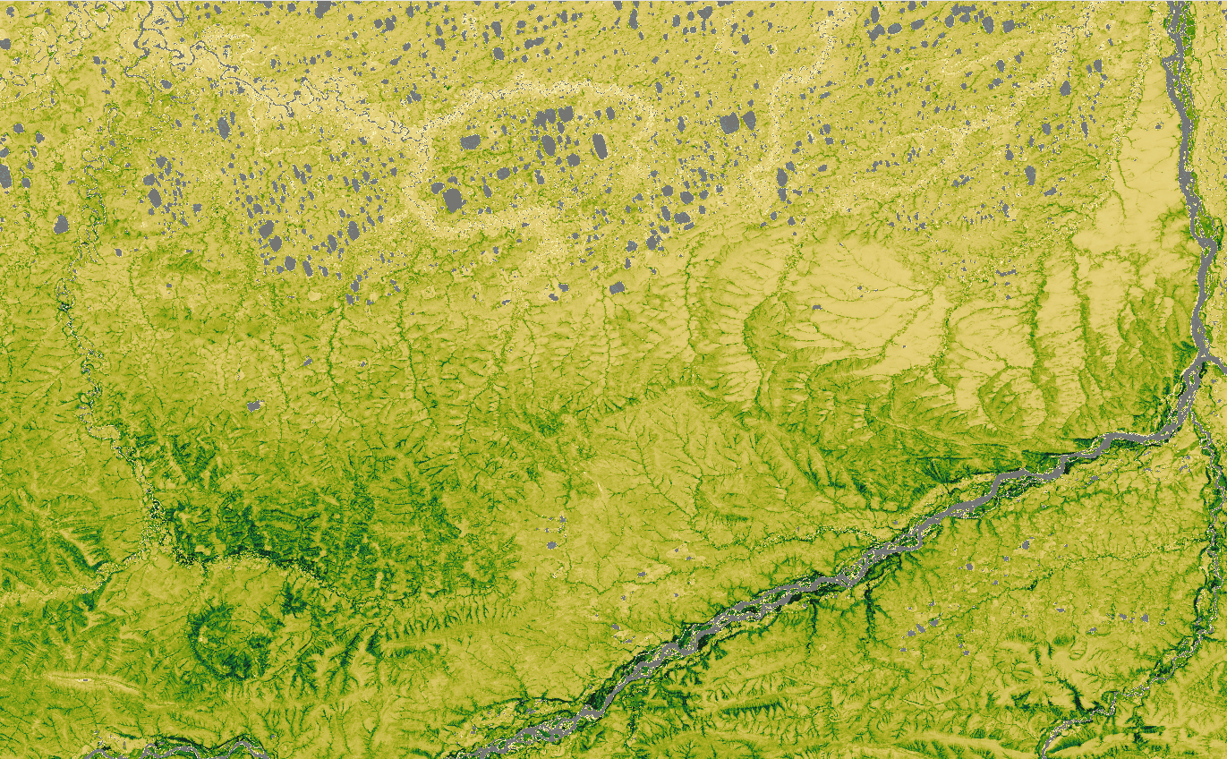





Next generation Arctic vegetation maps Aboveground plant biomass and woody dominance mapped at 30 m resolution across the tundra biome
Kathleen Orndahl
Northern Arizona University
Logan Berner, Matt Macander, Scott J. Goetz & the Arctic Plant Biomass Synthesis Network

Slide 2
Why?

Slide 3
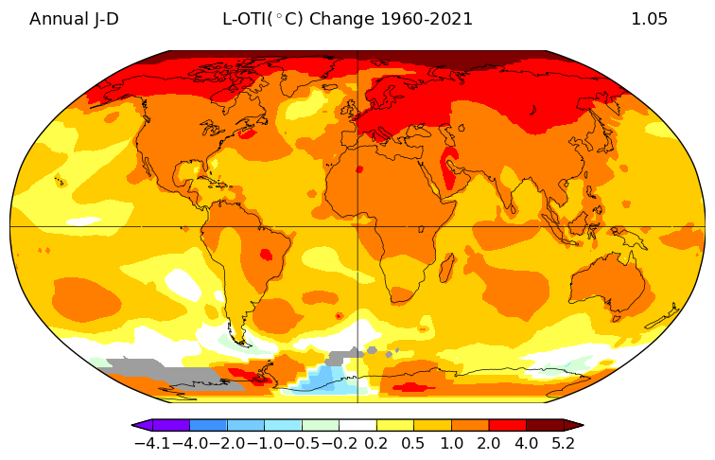
Arctic and boreal regions are warming 2-4 times faster than the rest of the planet
NASA GISS Surface
Temperature Analysis (v4)
Changes in mean annual temperature from 1960-2021
Notes:
Impetus for a lot of the work we all do
Change in mean annual temperature from 1960-2021
Arctic and boreal regions are warming much faster than the rest of the planet
The often cited statistic is the Arctic is warming 2 times faster than the rest of the planet…
…But new research suggests it might actually be closer to 4 times faster
Temperature change (°C) of a specified mean period over a specified time interval based on local linear trends.
https://data.giss.nasa.gov/gistemp/maps/

Slide 4
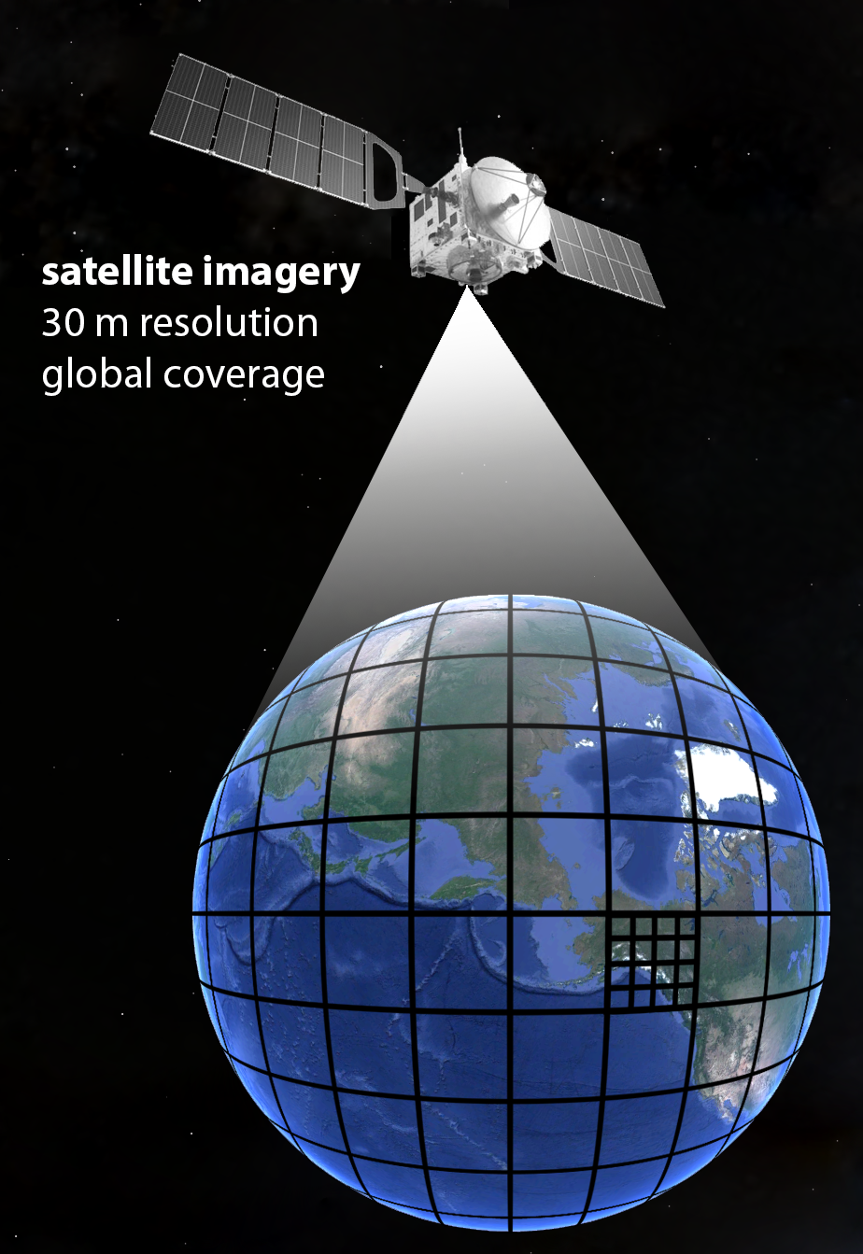
BIOMASS
Fundamental ecosystem property
Sensitive to changes in climate
Closely tied with ecological function
Carbon accounting

Slide 5
How?

Slide 6
Field-Based Calibration / Validation Data
Biomass Maps
Plant
Woody plant
Random Forest
Model
Remotely Sensed
Predictor Data

Slide 7
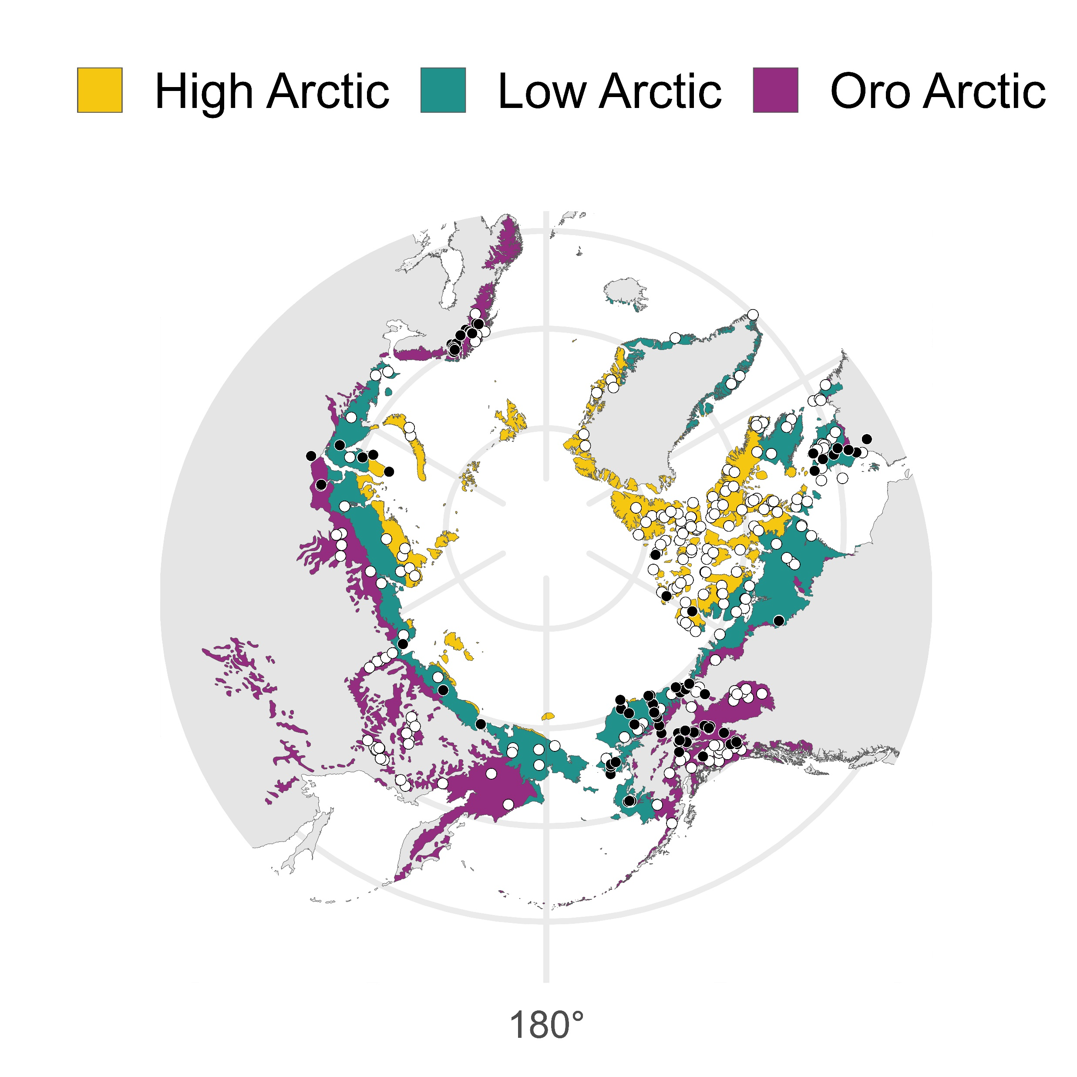
Calibration/validation data
The Arctic Plant Aboveground Biomass Synthesis Dataset
Berner et al. (2024)
50+ collaborators
2,000+ biomass harvest plots
200+ unique sites
un-vegetated (created from high resolution imagery)
vegetated (field based)

Slide 8
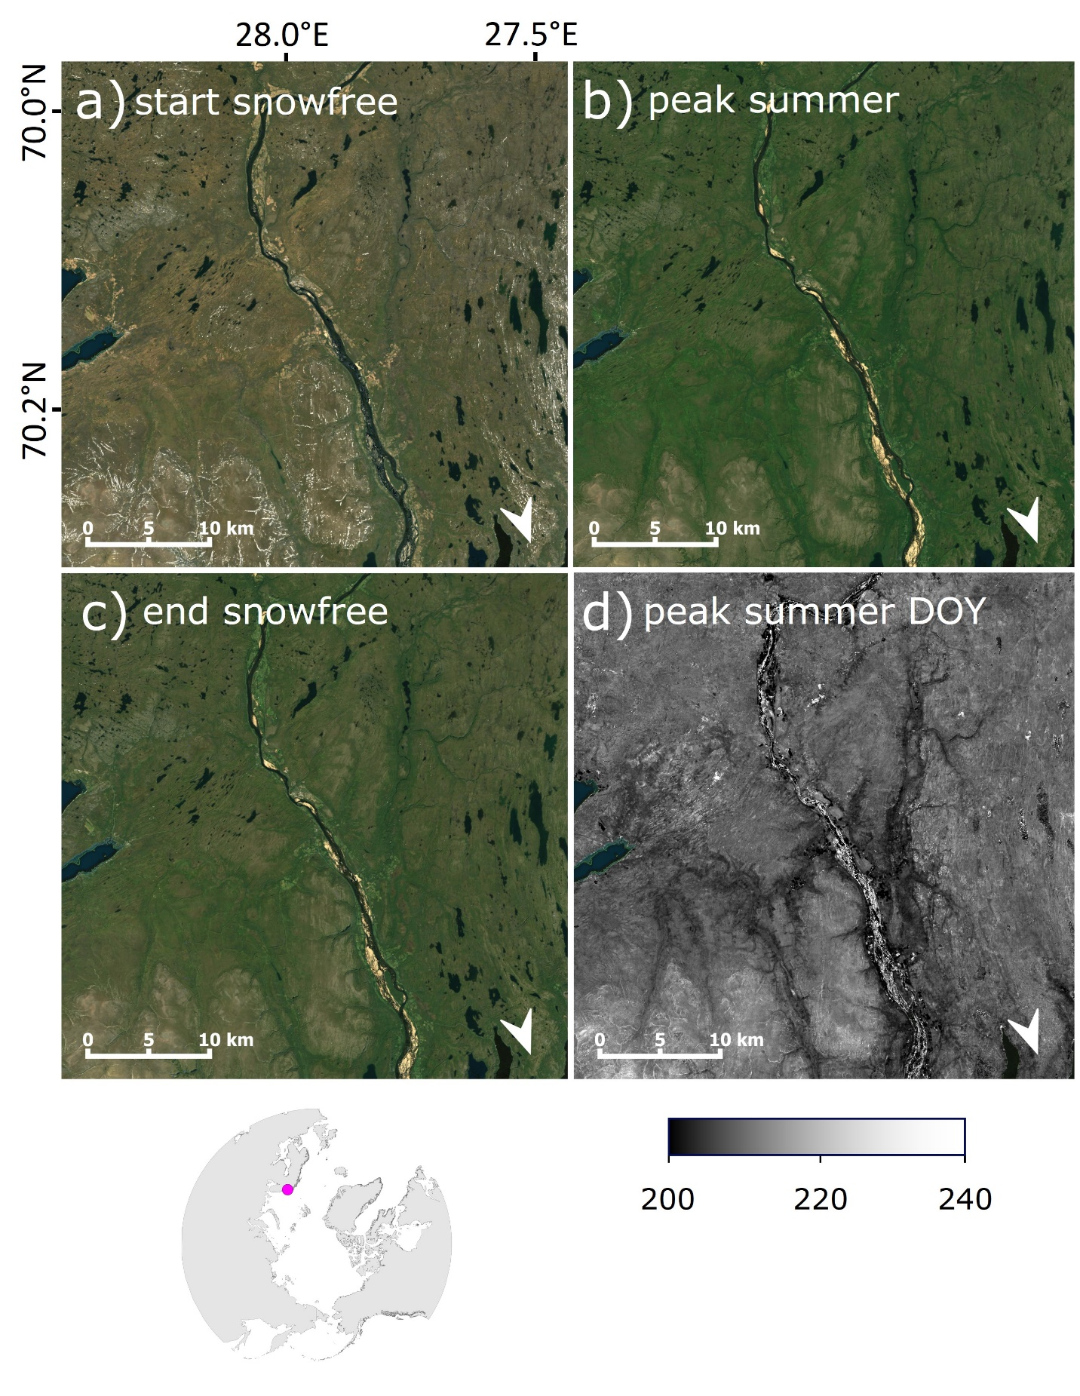
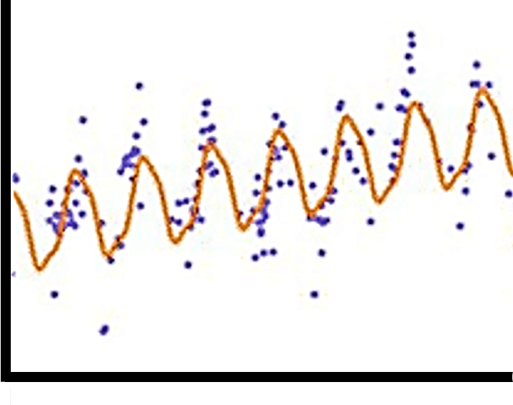
Interannual trend
Seasonal trend
NDVI
Predictor data (Landsat)
TIME
Notes:
Backbone of predictors are Landsat based data
Won’t go into details
In a nutshell we use a large Landsat time series along with an algorithm called the CCDC
The CCDC essentially models patterns of seasonal reflectance as well as interannual patterns
We can use these models to create these maps of synthetic or modeled reflectance for a particular time

Slide 9
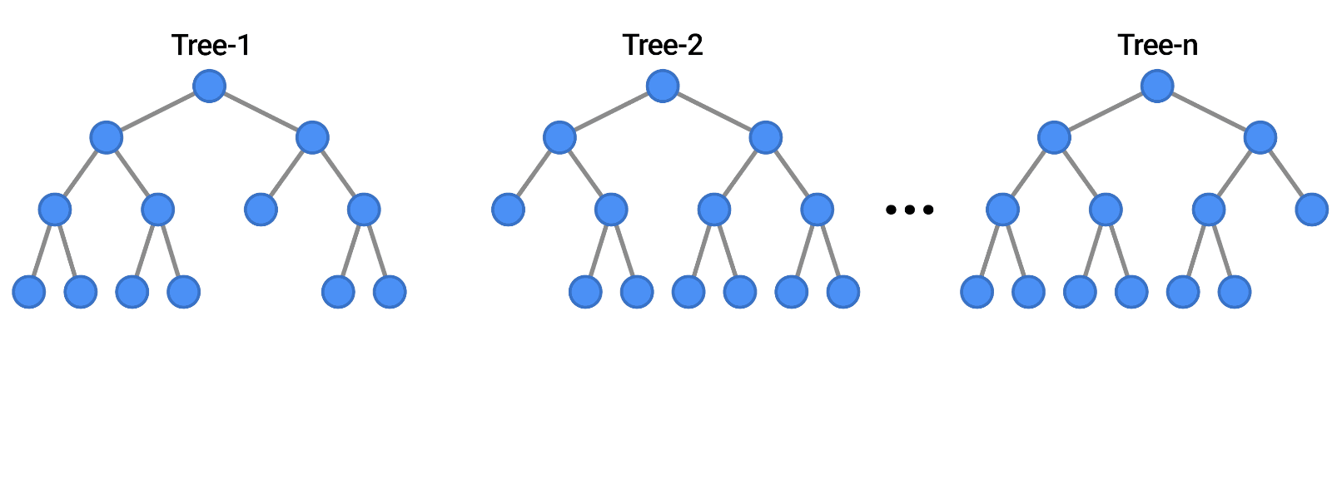
RANDOM FOREST
Nested cross validation
Feature selection
Hyperparameter tuning
Model

Slide 10
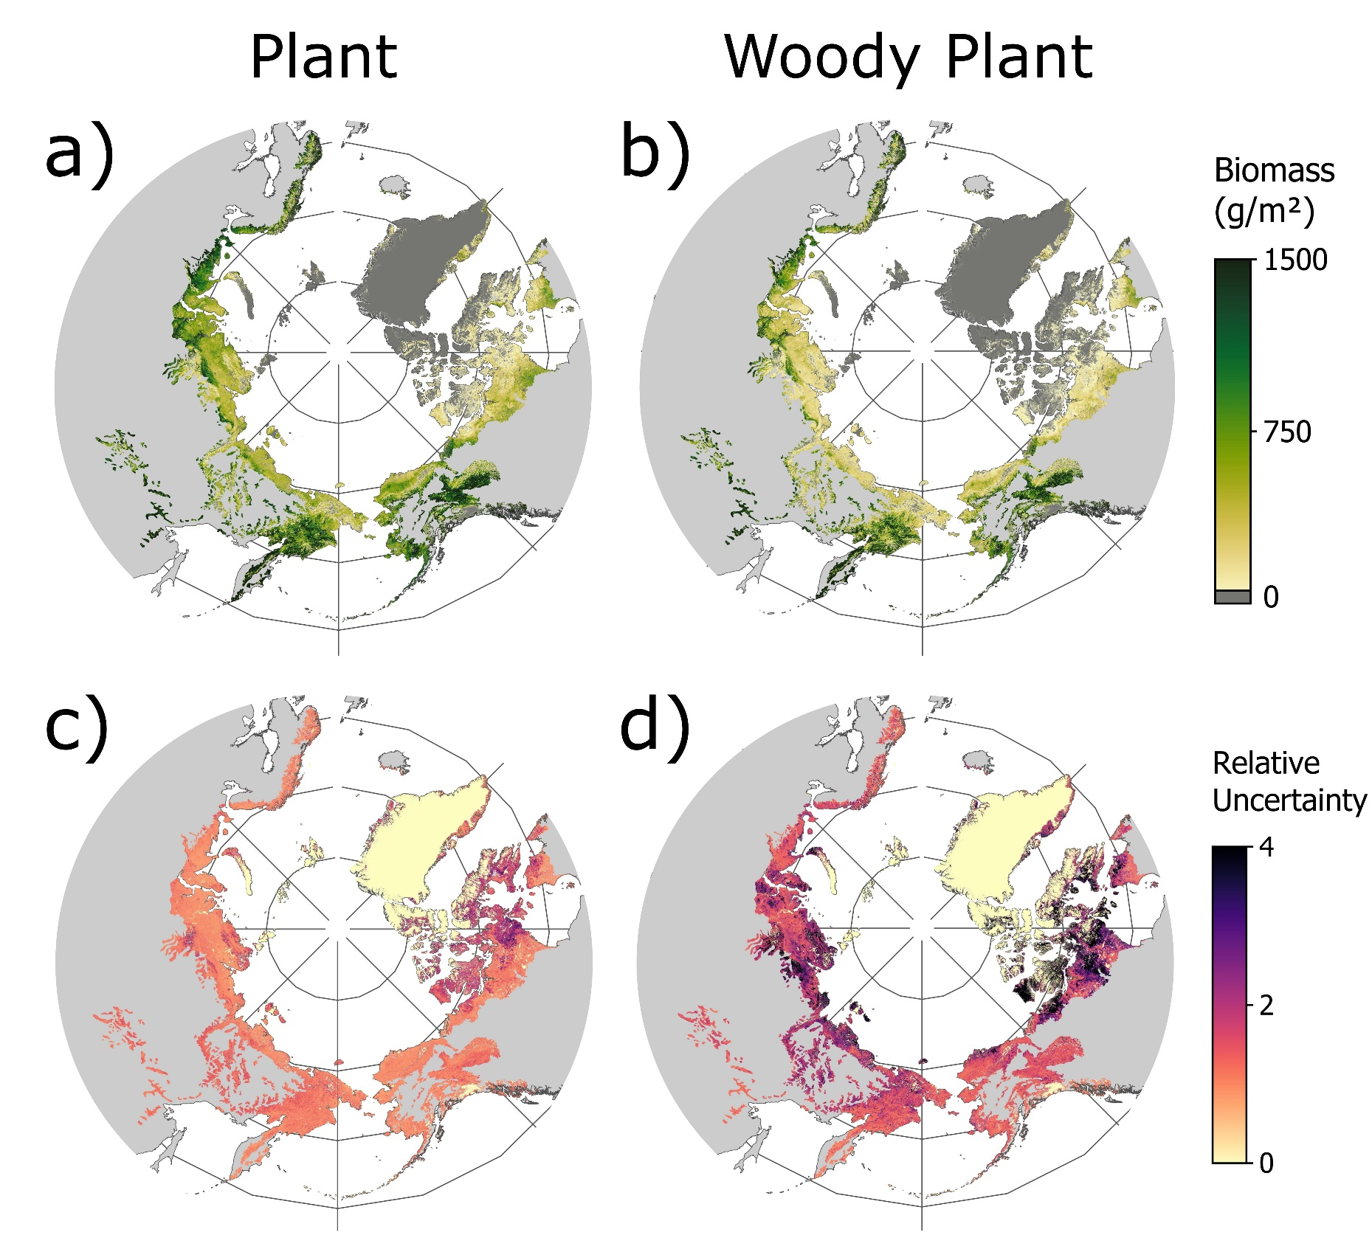

Woody Plant Dominance
Biomass maps
2020 Pan-Arctic biomass maps and associated uncertainty

Slide 11
What?

Slide 12
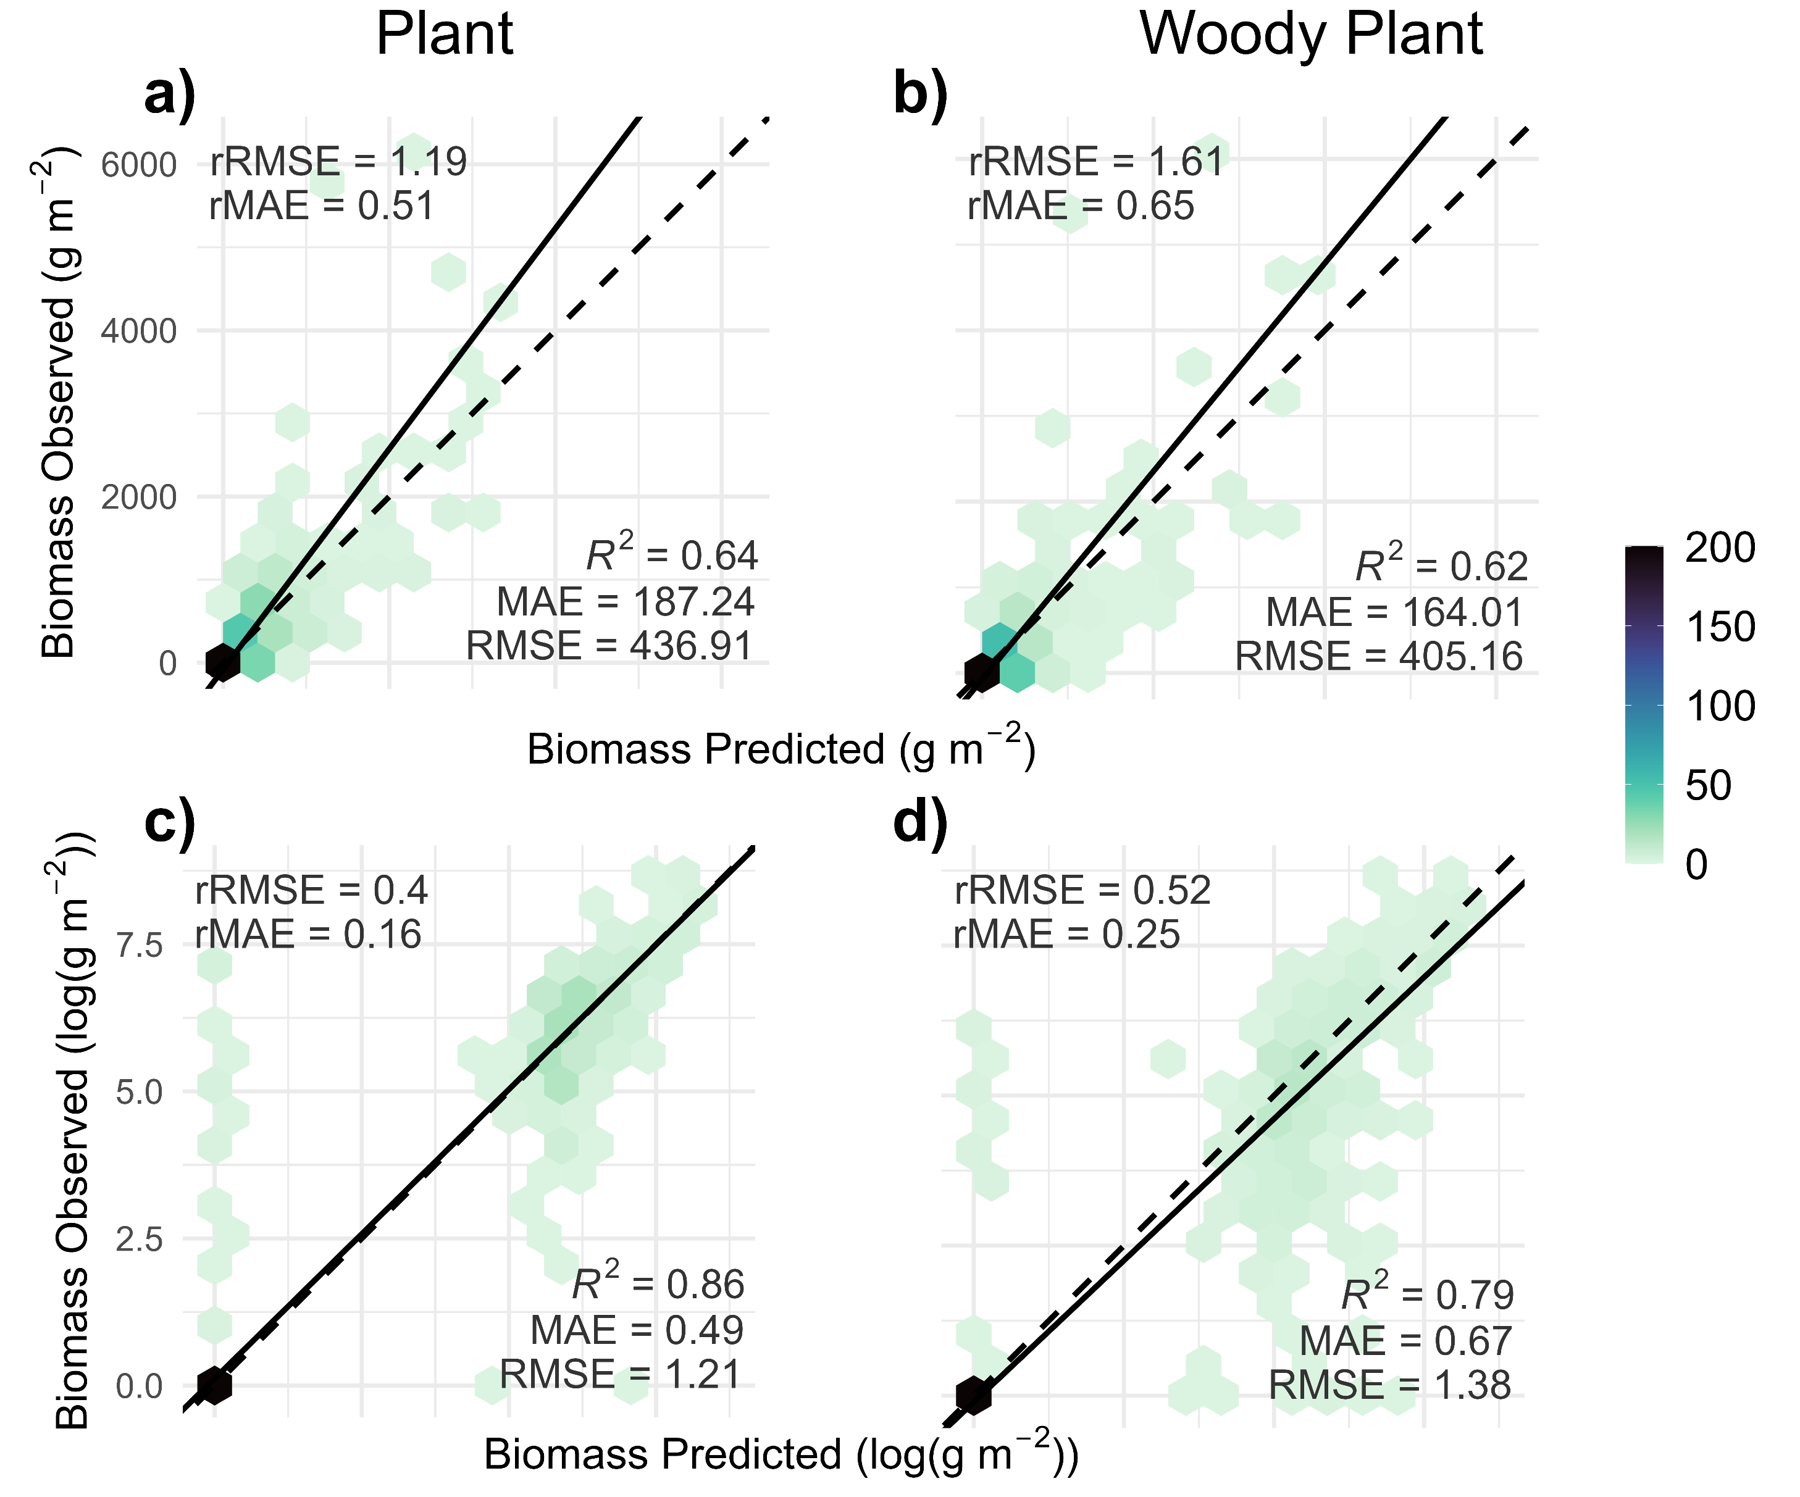
Reasonable accuracy
*Plant biomass excludes lichens

Slide 13
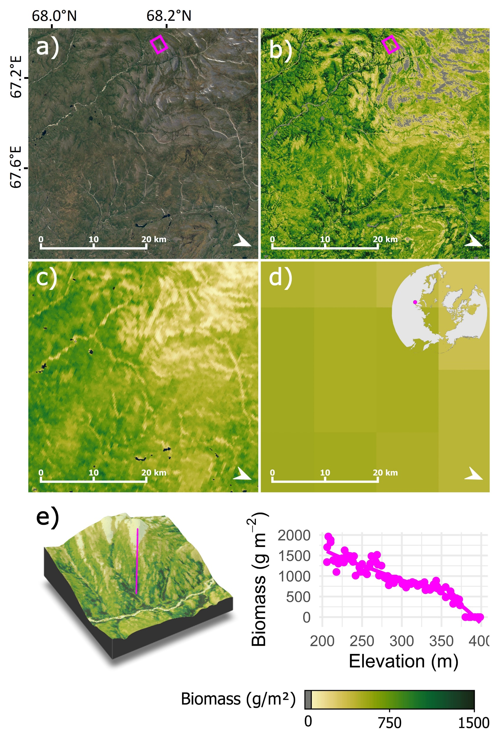
Total Pan Arctic biomass similar across resolutions, more detail resolved @ 30 m
High Arctic | 168 [88, 295] Tg | 199 Tg | 322 Tg
Low Arctic | 1296 [790, 2081] Tg | 1365 Tg | 1488 Tg
Pan Arctic | 1464 [877, 2375] Tg | 1564 Tg | 1809 Tg
30 m
Orndahl et al. 2024
300 m
Spawn et al. 2020
8 km
Raynolds et al. 2012

Slide 14


30 m resolution illustrates how fine scale patterns are shaped by local topography/hydrology

Slide 15
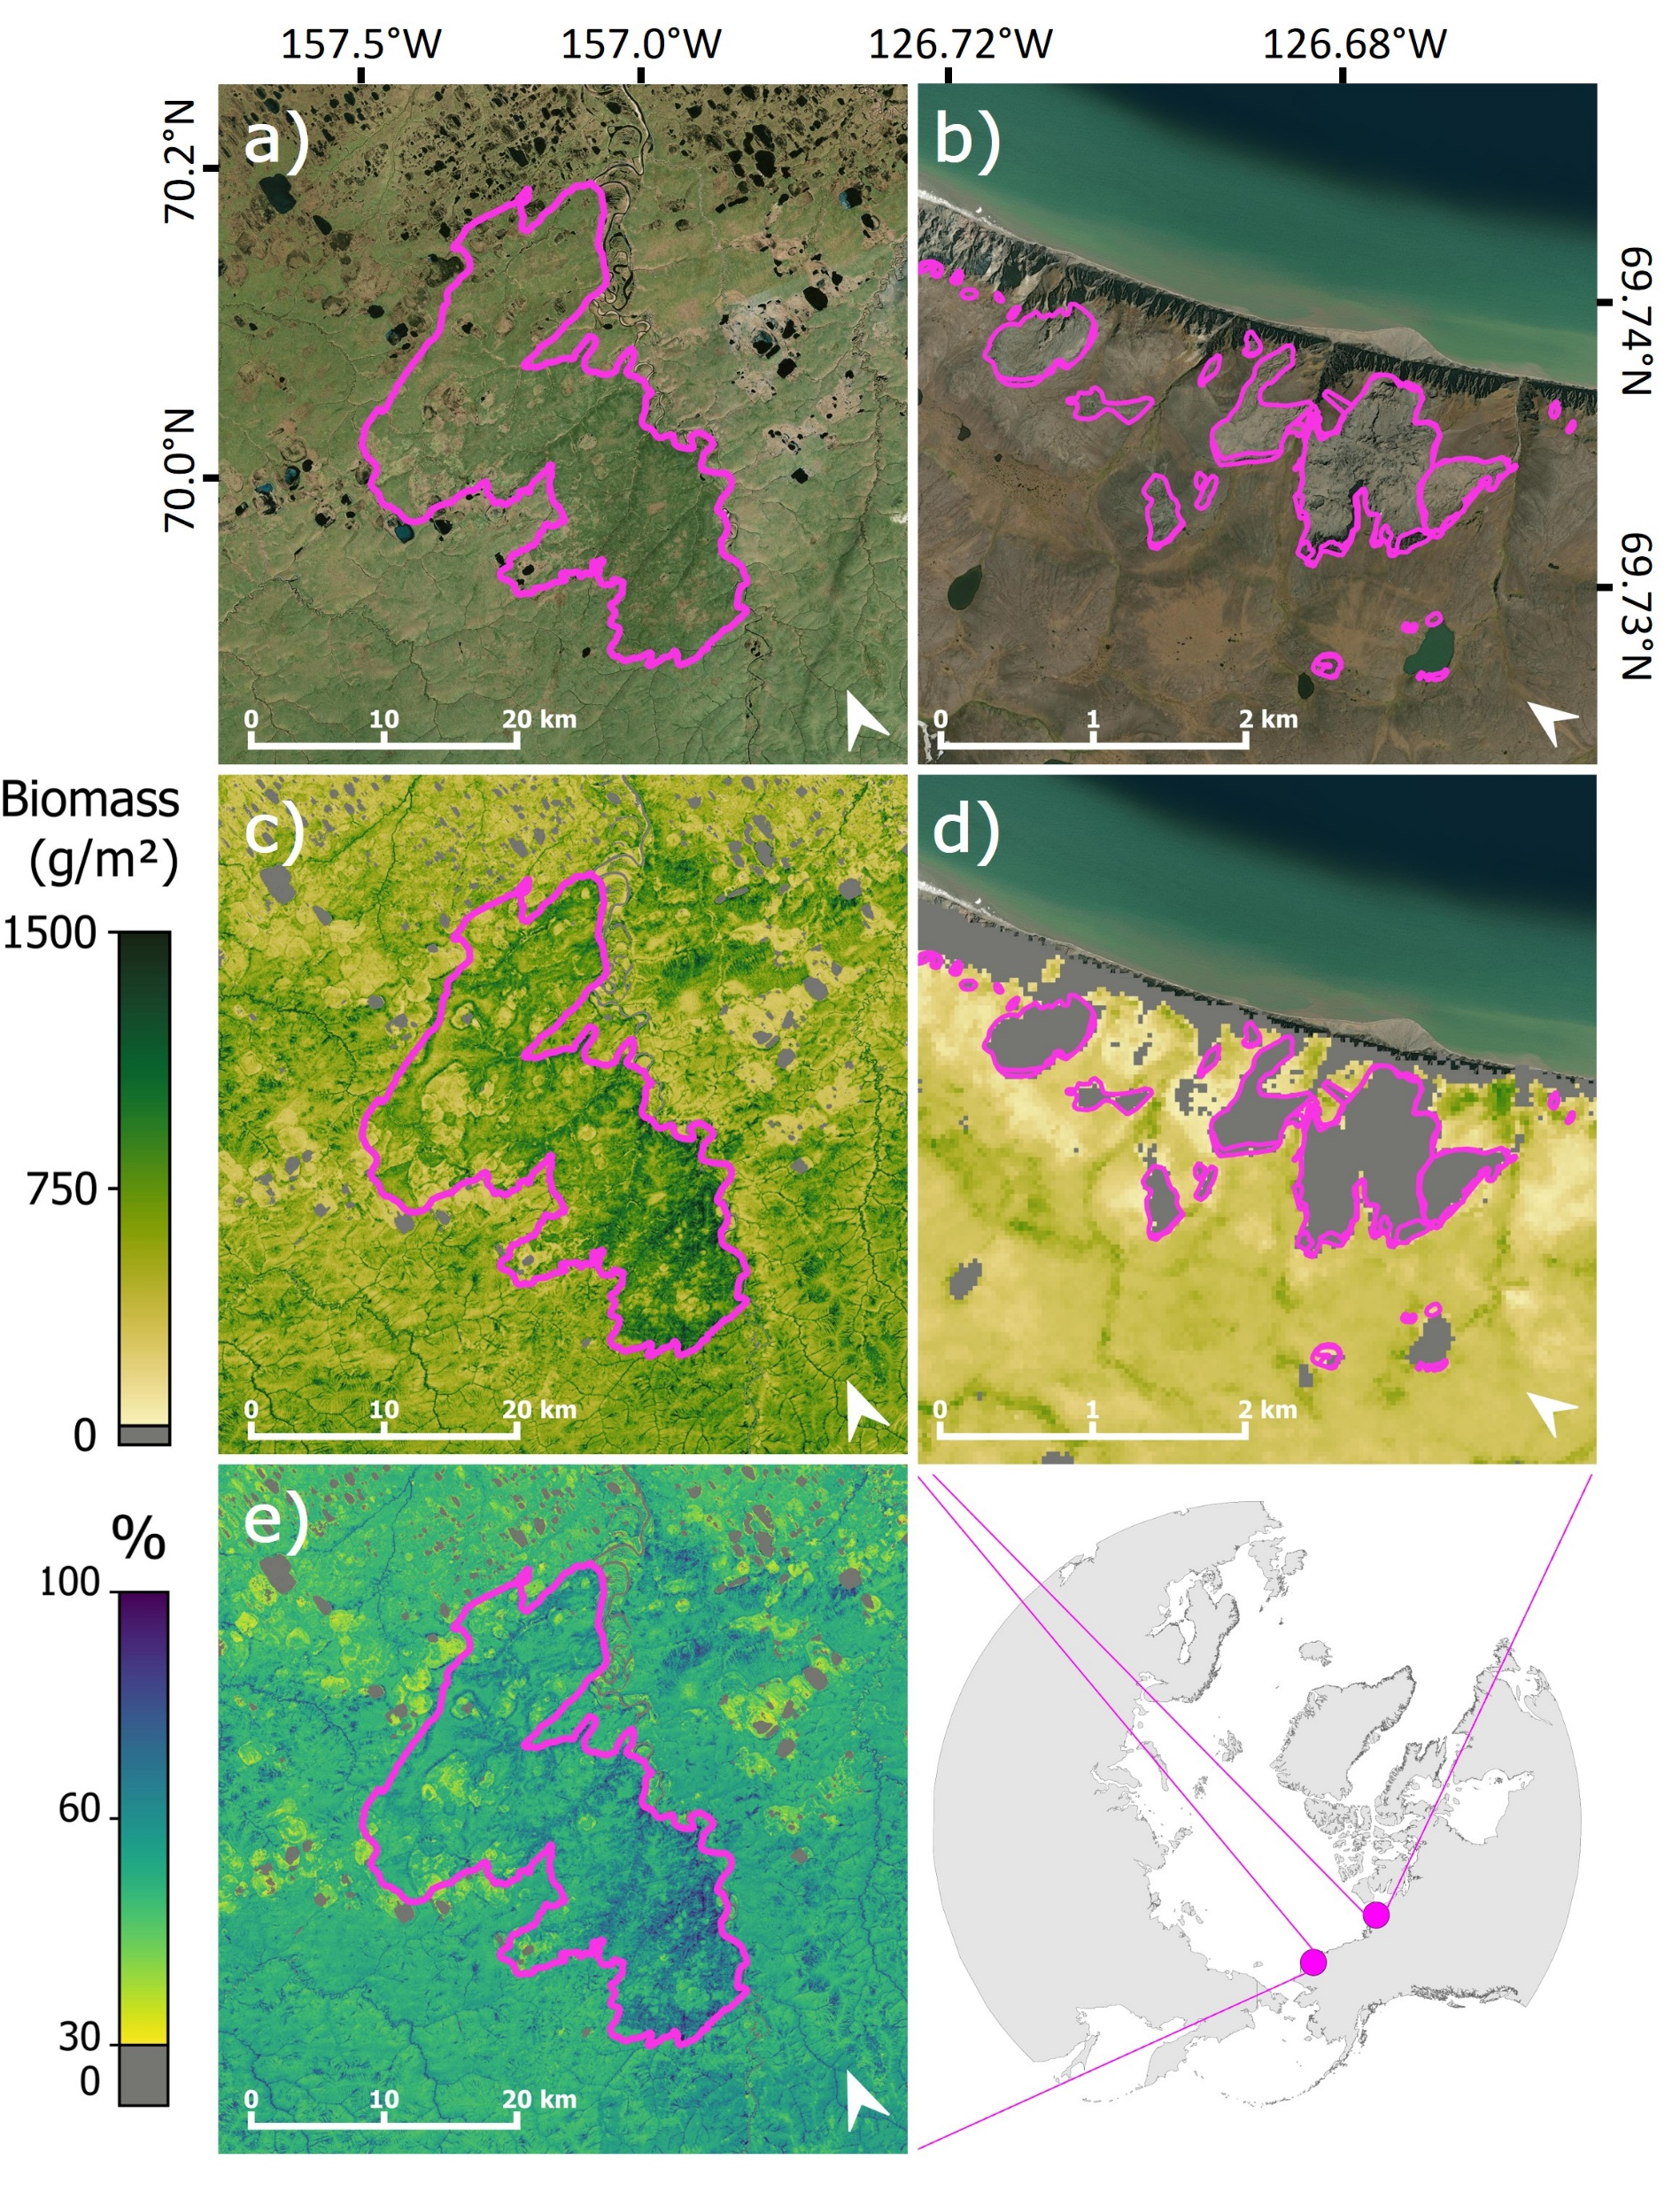
Maps pick up legacy of disturbance across the Arctic

Slide 16
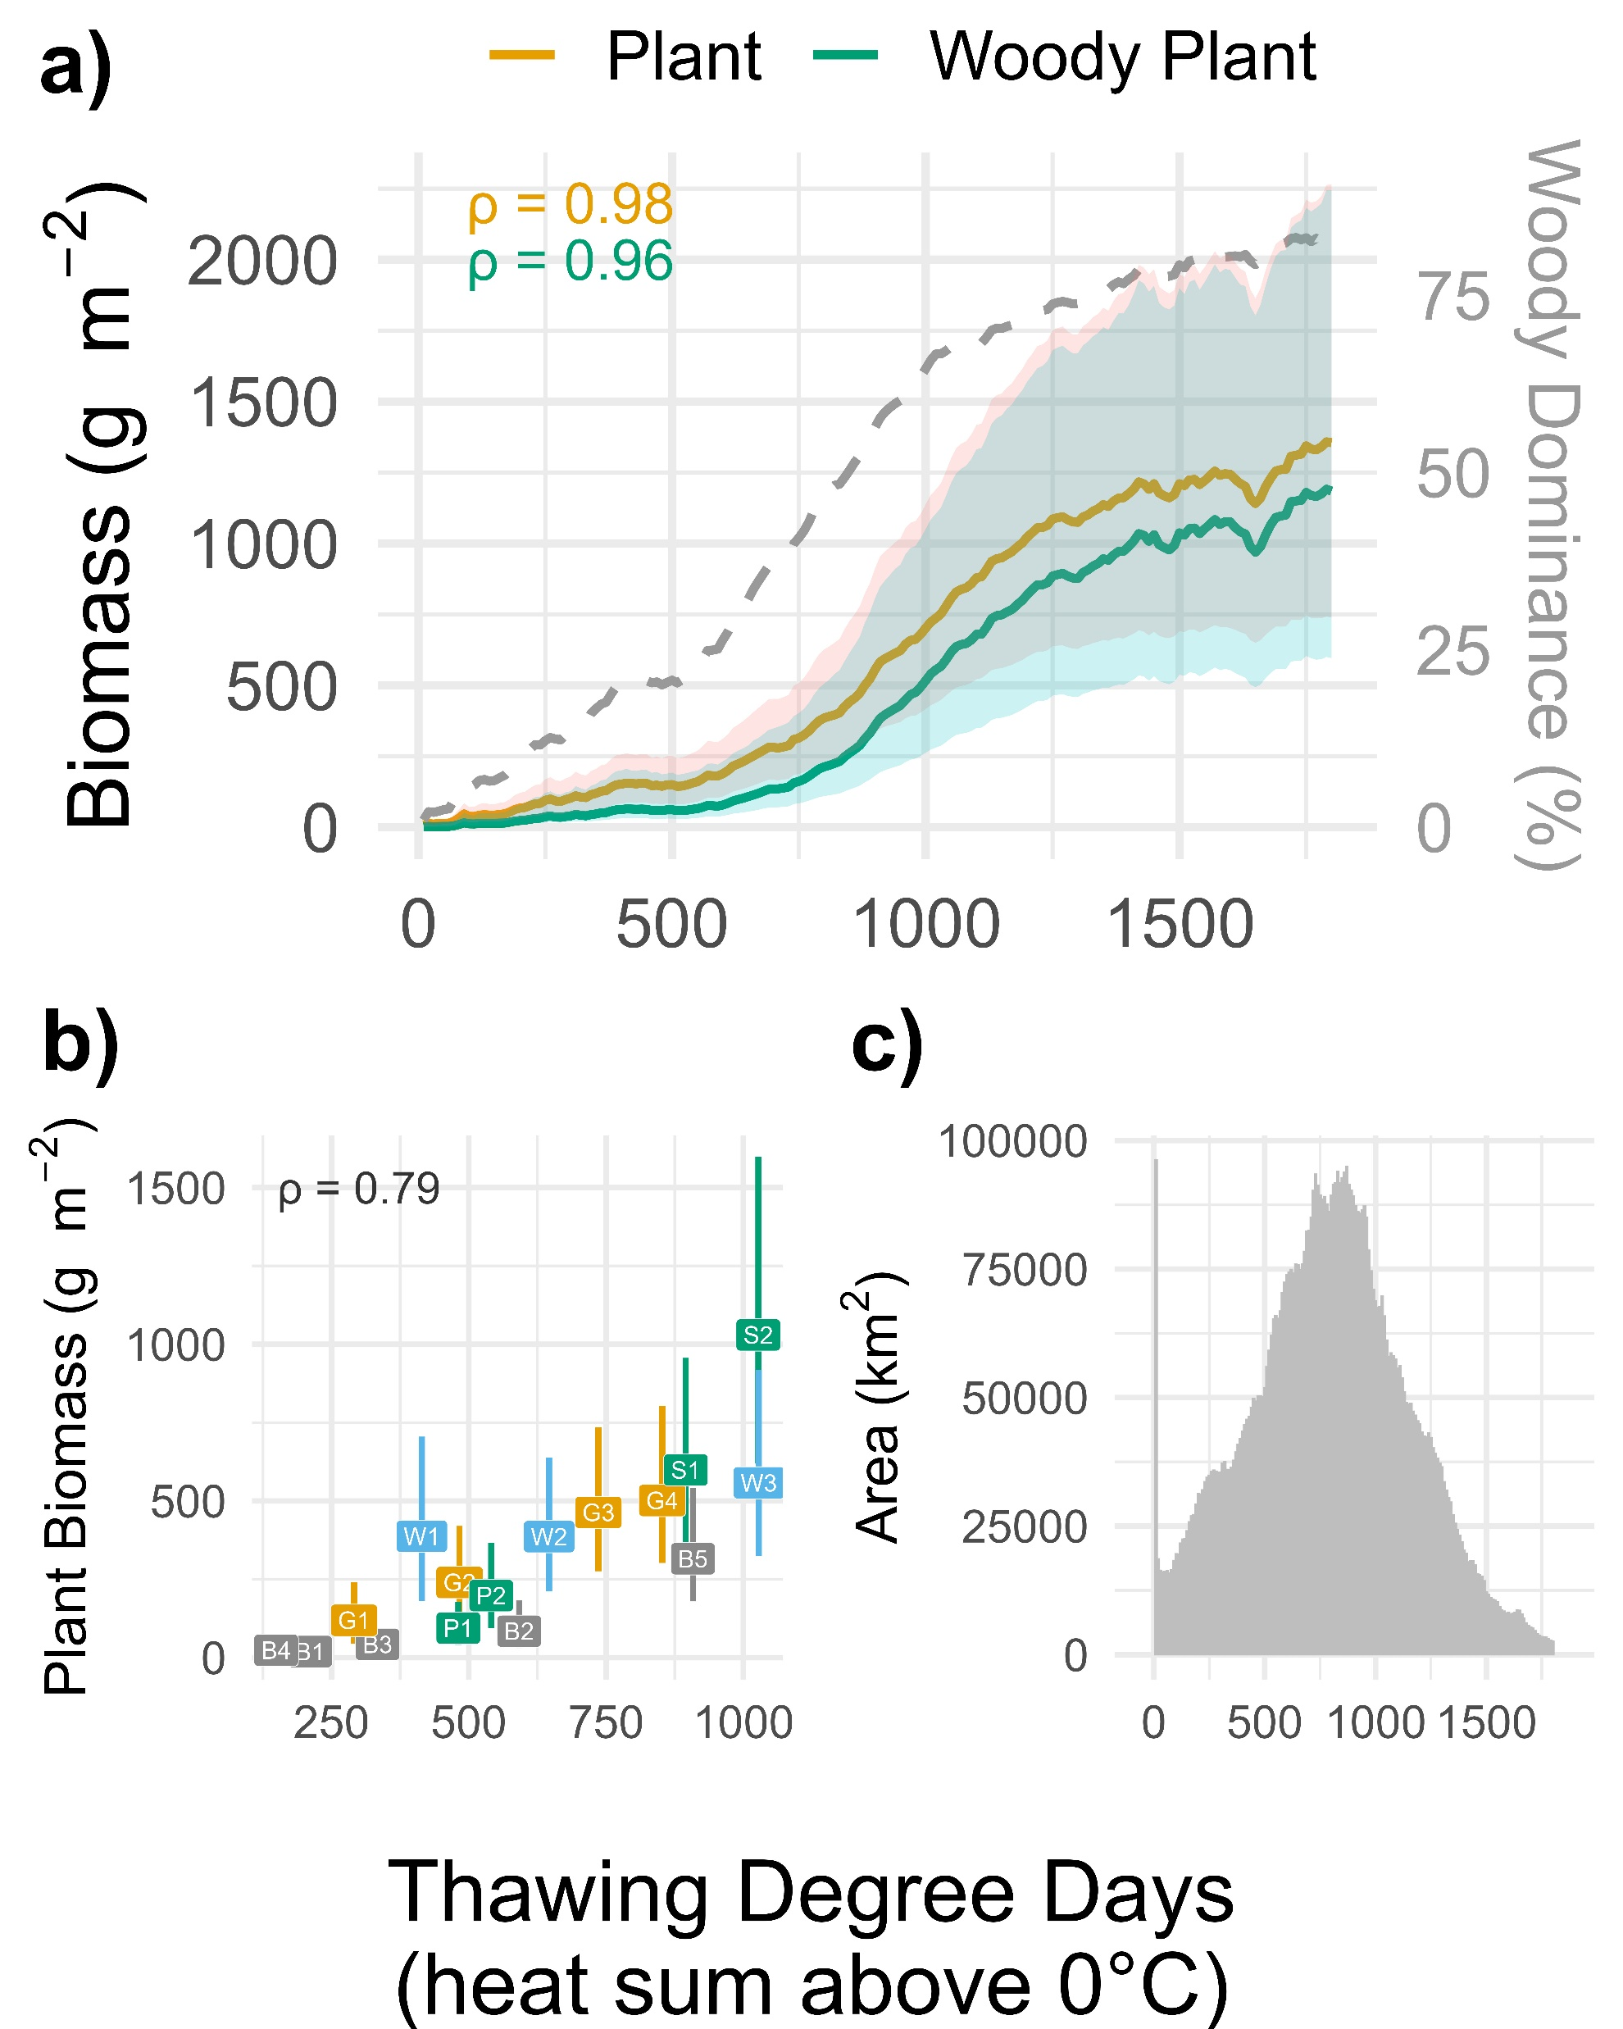
Biomass was correlated with climate (thawing degree days)

Slide 17
What next?

Slide 18
Potential Applications:
Wildlife
Carbon accounting
Ecosystem modeling
Land use planning
Snow models
Wildfire/fuels modeling
Data collection prioritization
Model validation
Coming soon:
Change! 2000-2020

Slide 19

Questions? Kathleen.Orndahl@nau.edu
Scan for maps →

