Slide 1
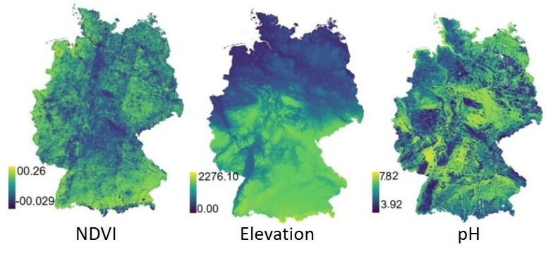
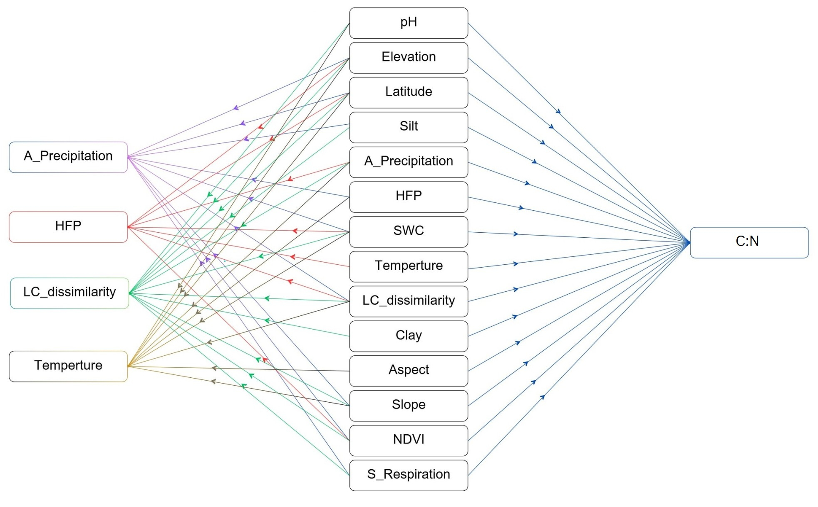
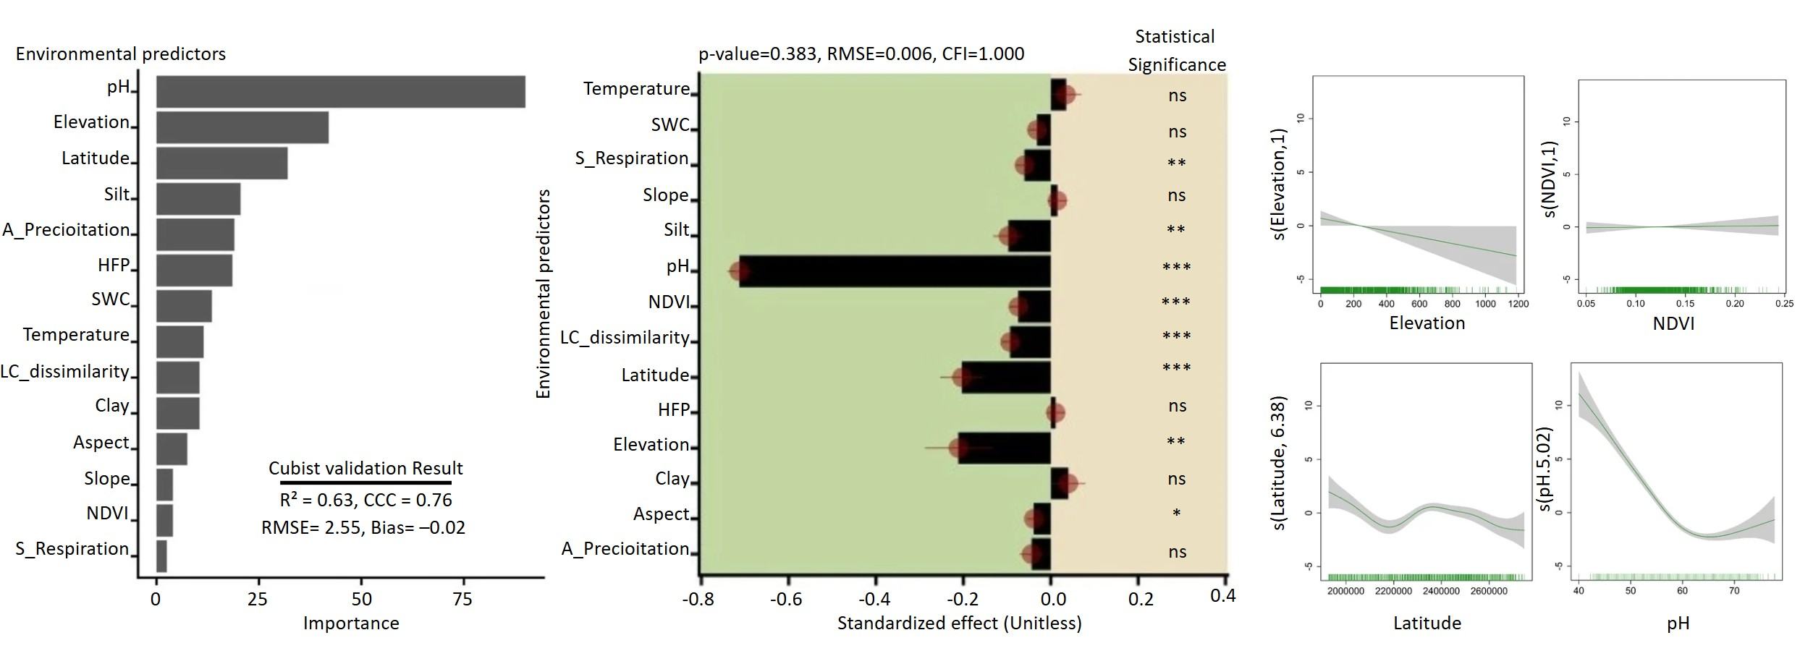
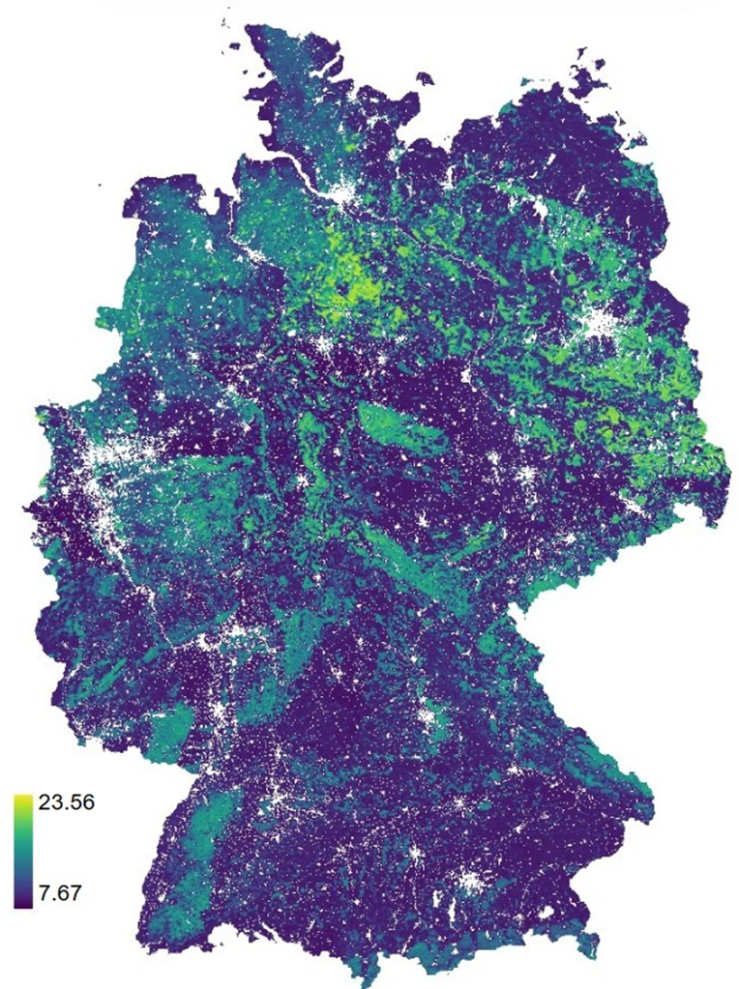
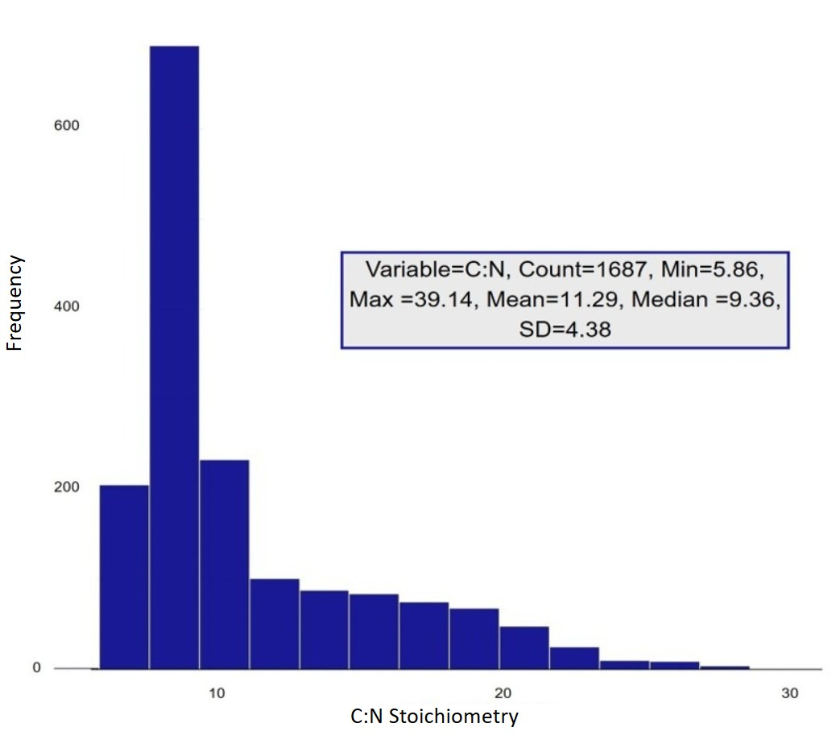
Identifying the Spatial Drivers of Soil Carbon-Nitrogen Stoichiometry in Germany
Pegah Khosravani^{1*}, Ndiye Michael Kebonye^{1,2}, Majid Baghernejad³, Ali Akbar Moosavi³, Seyed Roohollah Mousavi⁴, and Thomas Scholten^{1,2}
¹ University of Tübingen, Department of Geosciences, Soil Science and Geomorphology, Germany. ² University of Tübingen, Cluster of Excellence Machine Learning: New Perspectives for Science, Germany.
³ Shiraz University, Department of Soil Science, Iran. ⁴ University of Tehran, Department of Soil Science, Iran.
Introduction
Environmental predictors for spatial analyses
Materials and methods
GAM and SEM models
for effective analysis
Soil organic matter contains large amounts of carbon (C) and nitrogen (N) and is an essential food source for soil microbes and plants. C and N are critical to all biological processes, where C serves as an energy source and N is considered the most important limiting element for vegetation growth. The stoichiometric relationship between carbon and nitrogen (C:N) is a key indicator of nutrient cycling, soil health and biological activity, and how this affects soil properties and ecosystem functioning.
However, very little research has addressed the spatial variability of soil C:N stoichiometry over large areas and the underlying influence of environmental predictors. The frequency distribution over Germany (Figure 1) shows a wide C:N range from 5.86 to 39.14 with a strong skewness and a long tail towards higher ratios. Our objectives to better understand the spatial distribution are (i) to identify key environmental predictors of soil C:N stoichiometry using causal analysis and (ii) to clarify how the importance of different environmental predictors varies in predicting C:N stoichiometry.
As environmental predictors (Figure 2), we used soil properties such as acidity (pH), topographic variables such as elevation (MSL), and land use practices as reflected by remotely sensed Normalized Difference Vegetation Index (NDVI). Statistical relationships between environmental predictors and C:N stoichiometry were calculated using generalized additive models (GAM) and structural equation modelling (SEM) (Figure 3).
Cubist machine learning model
The Cubist machine learning model was chosen for predicting soil C:N stoichiometry due to its critical ability to process large, multifaceted datasets and model complex, non-linear interactions among environmental predictors like pH, elevation, and vegetation, ensuring robust and accurate predictions essential for understanding spatial biogeo-chemical dynamics.
Figure 2: Spatial distribution of environmental predictors over Germany with a spatial resolution of 250 m/pixel
Figure 3: Graphical relationship between C:N stoichiometry and environmental predictors
Results
Spatial prediction map
Cubist result
SEM result
GAM result
Figure 4: Spatial prediction of the C:N stoi-chiometry for Germany using the Cubist model
Figure 5: Cubist model validation and environmental predictors importance
Figure 6: Influence of environmental predictors on C:N stoichiometry by SEM analysis
Figure 7 : Multivariate analysis of environmental predictors influencing C:N stoichiometry using GAM model.
Figure 1: Frequency distribution and descriptive parameters of C:N stoichiometry for Germany
Main findings
Contact information
The Cubist model reduces the range of the C:N stoichiometry by around 50 % from 33.28 to 15.89, with the high values being significantly more attenuated than low values (Figures 4 and 5). High values occur in areas with low pH such as the lowlands of northern Germany where acidic soils restrict microbial decomposition and nitrogen mineralization, leading to carbon accumulation. Conversely, lower C:N stoichiometry characterizes southern and central Germany including mid-latitude mountains and part of the Alps with calcareous soils from marl- and limestone, overcoming cooler temperatures at higher elevations. However, elevation plays a pivotal role for C:N stoichiometry in high mountain areas with soils from granitic rocks.
Both SEM and GAM analyses confirm these trends, with SEM revealing a negative relationship between C:N stoichiometry and pH, elevation, and vegetation cover (Figures 6, 7). The Cubist model validates these findings (R² = 0.63, CCC = 0.76), highlighting pH, elevation, and latitude as essential predictors for C:N stoichiometry in Germany.
Pegah Khosravani
Department of Geosciences, Soil Science and Geomorphology, University of Tübingen, Germany
pegah.khosravani@uni-tuebingen.de

