Slide 1






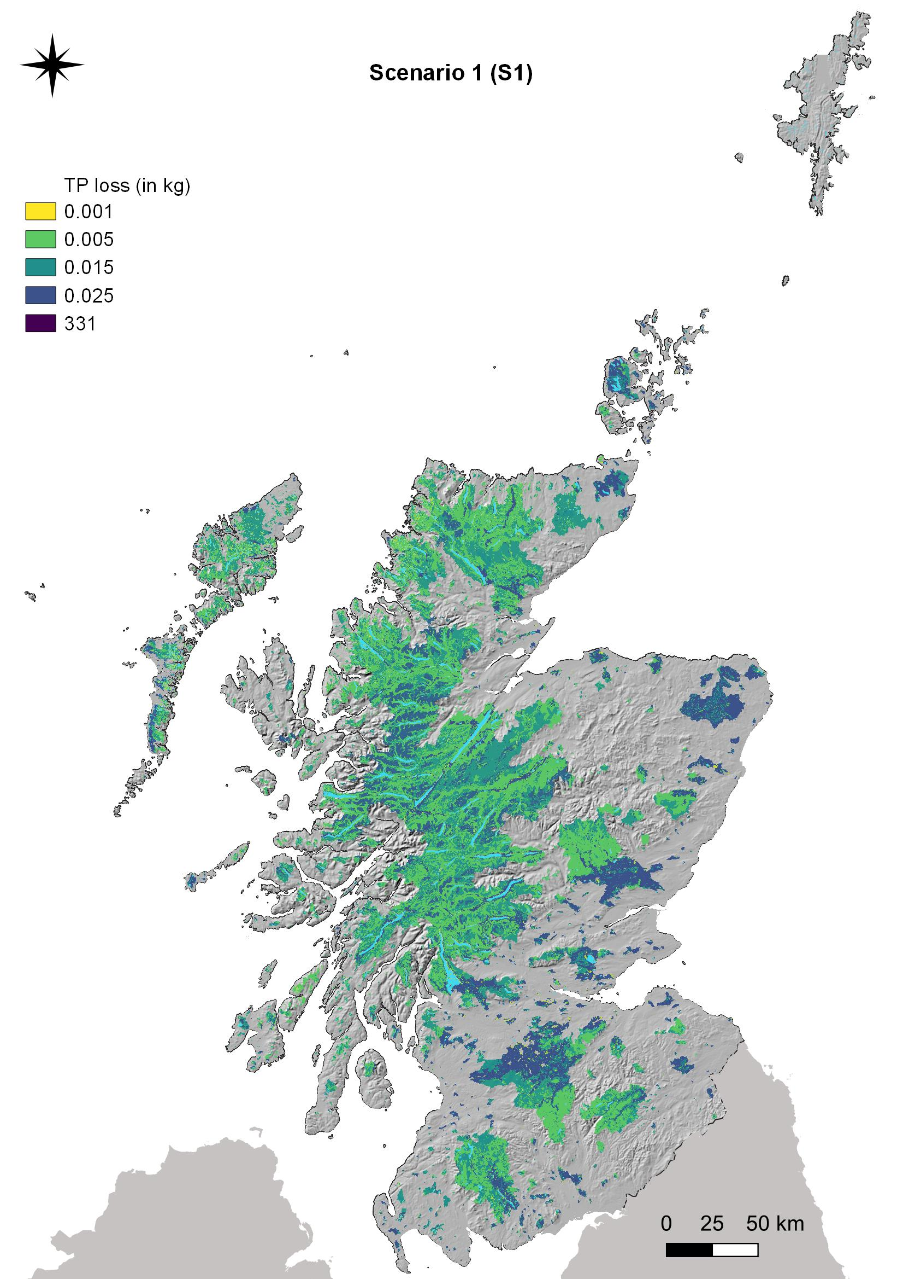
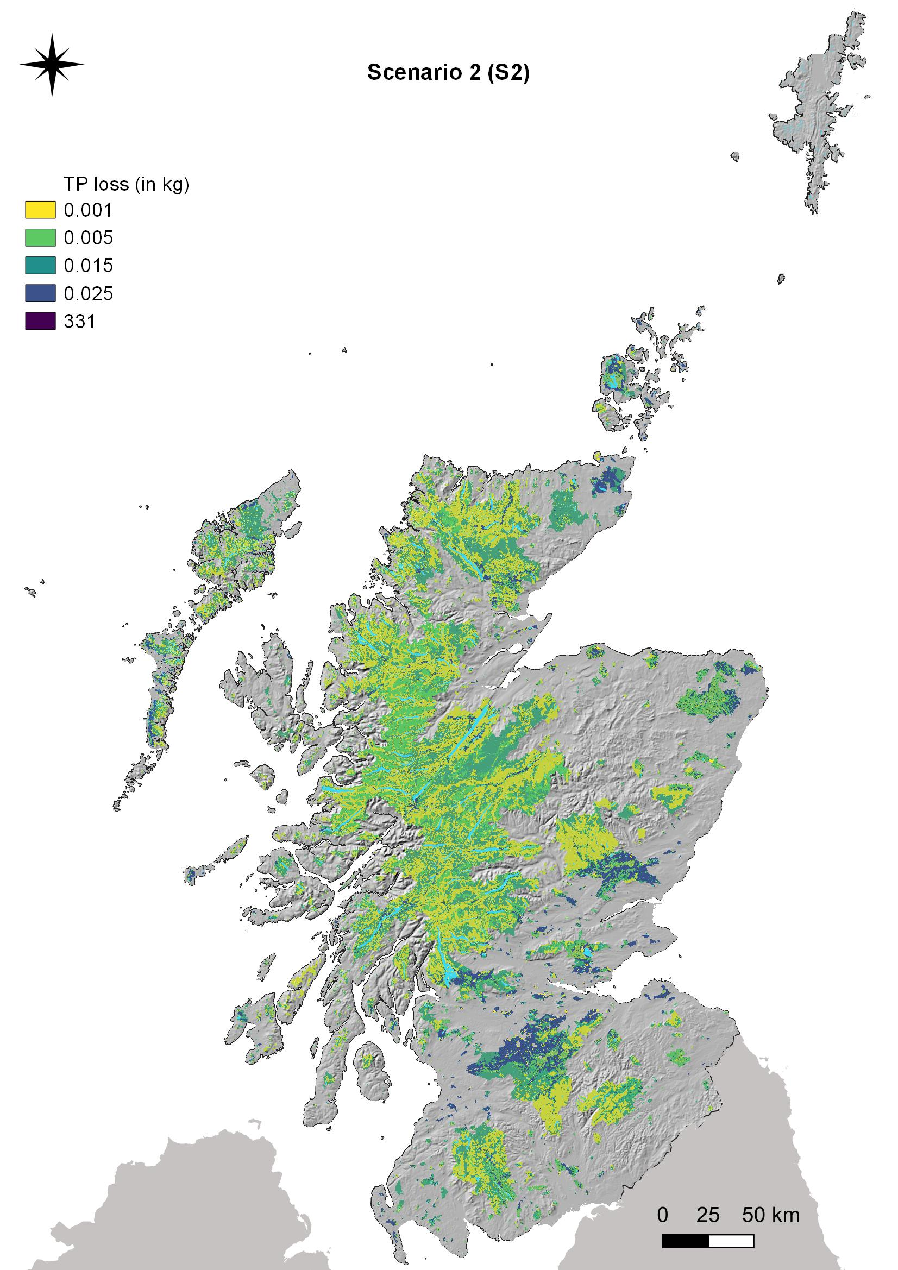
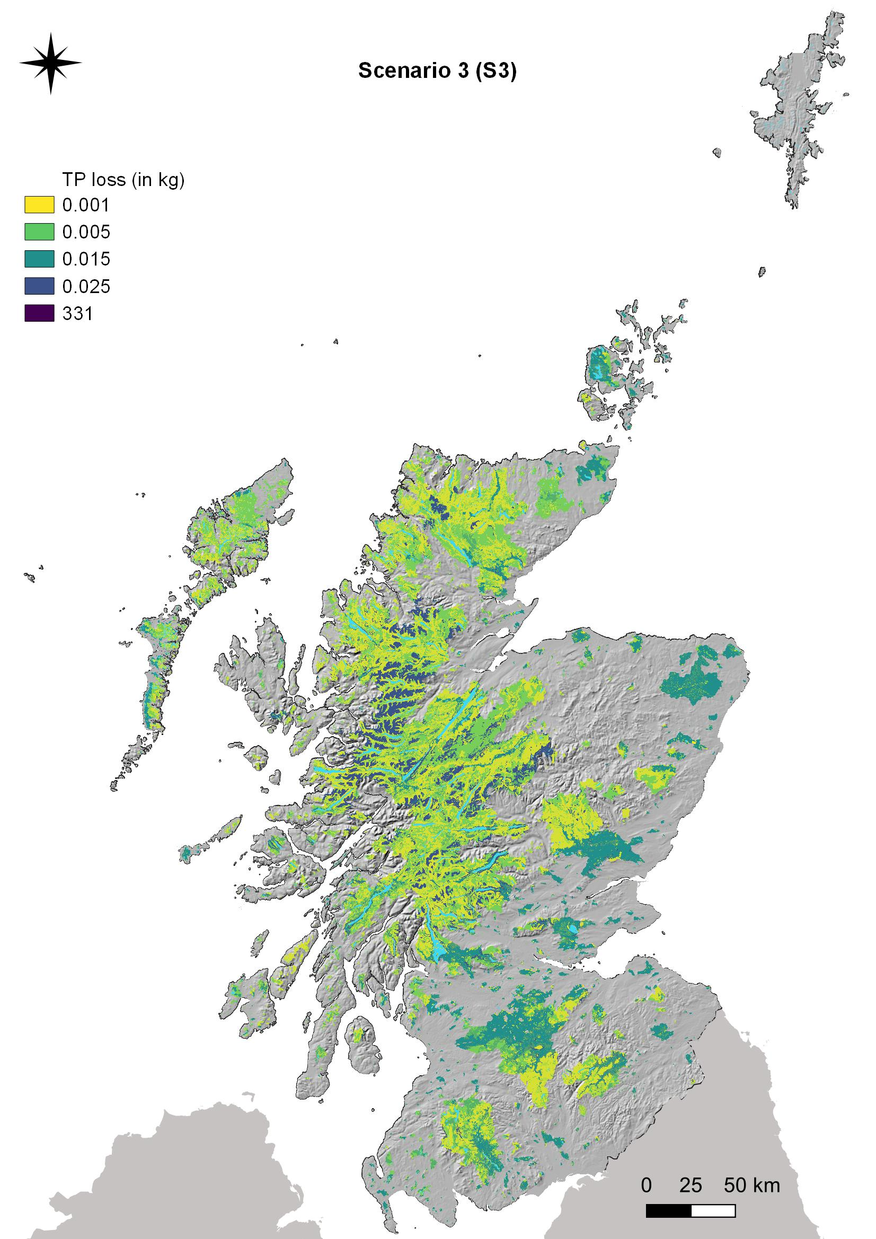
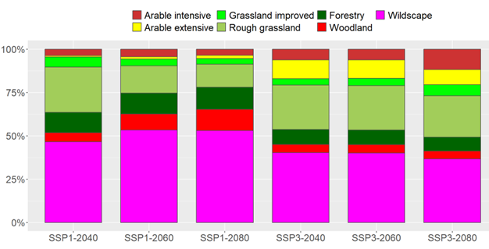

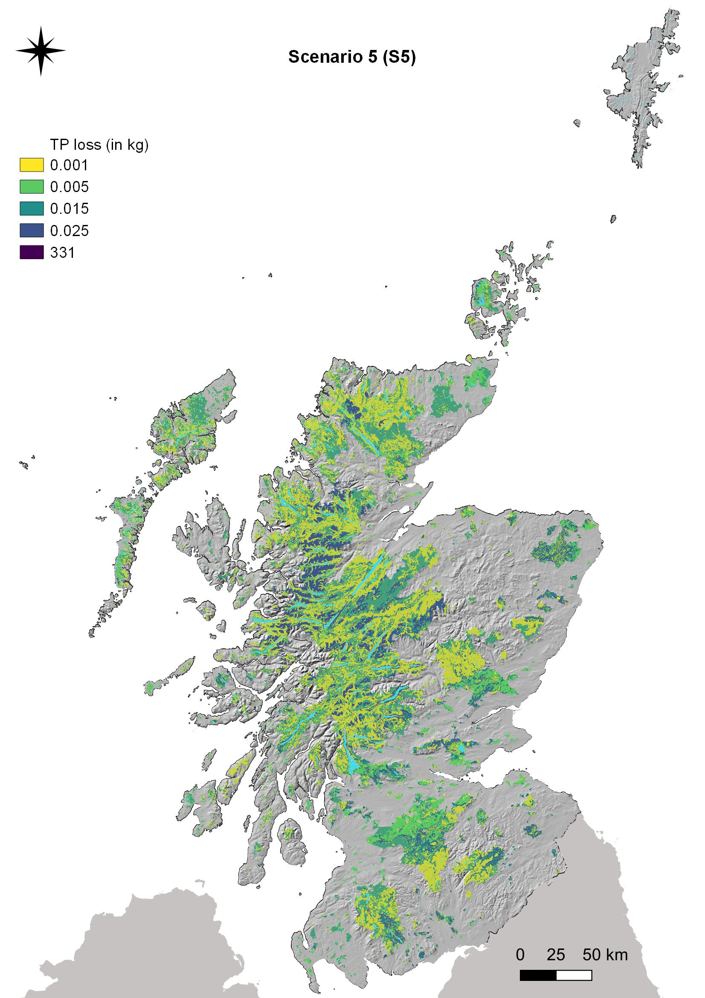
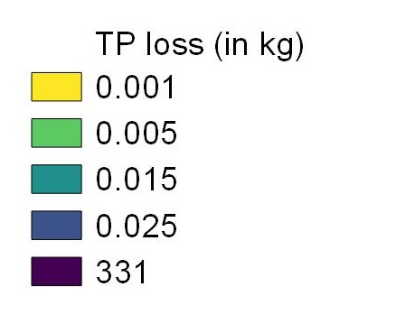
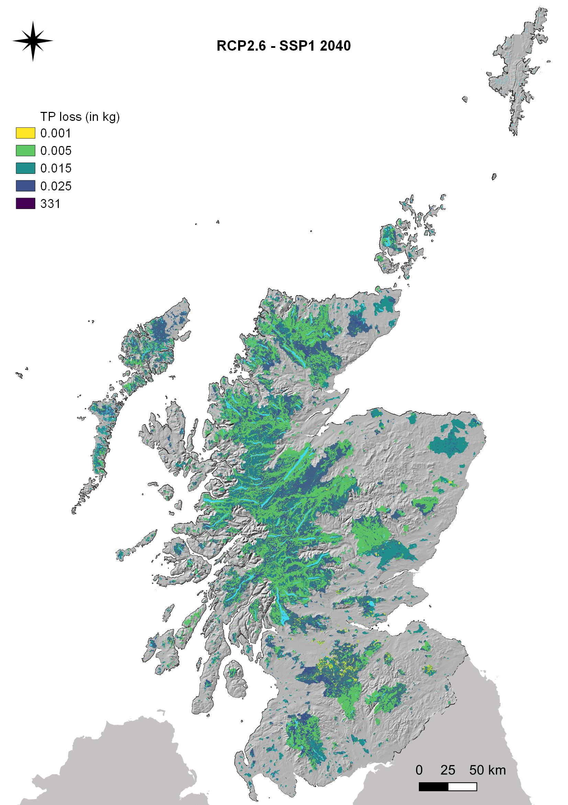

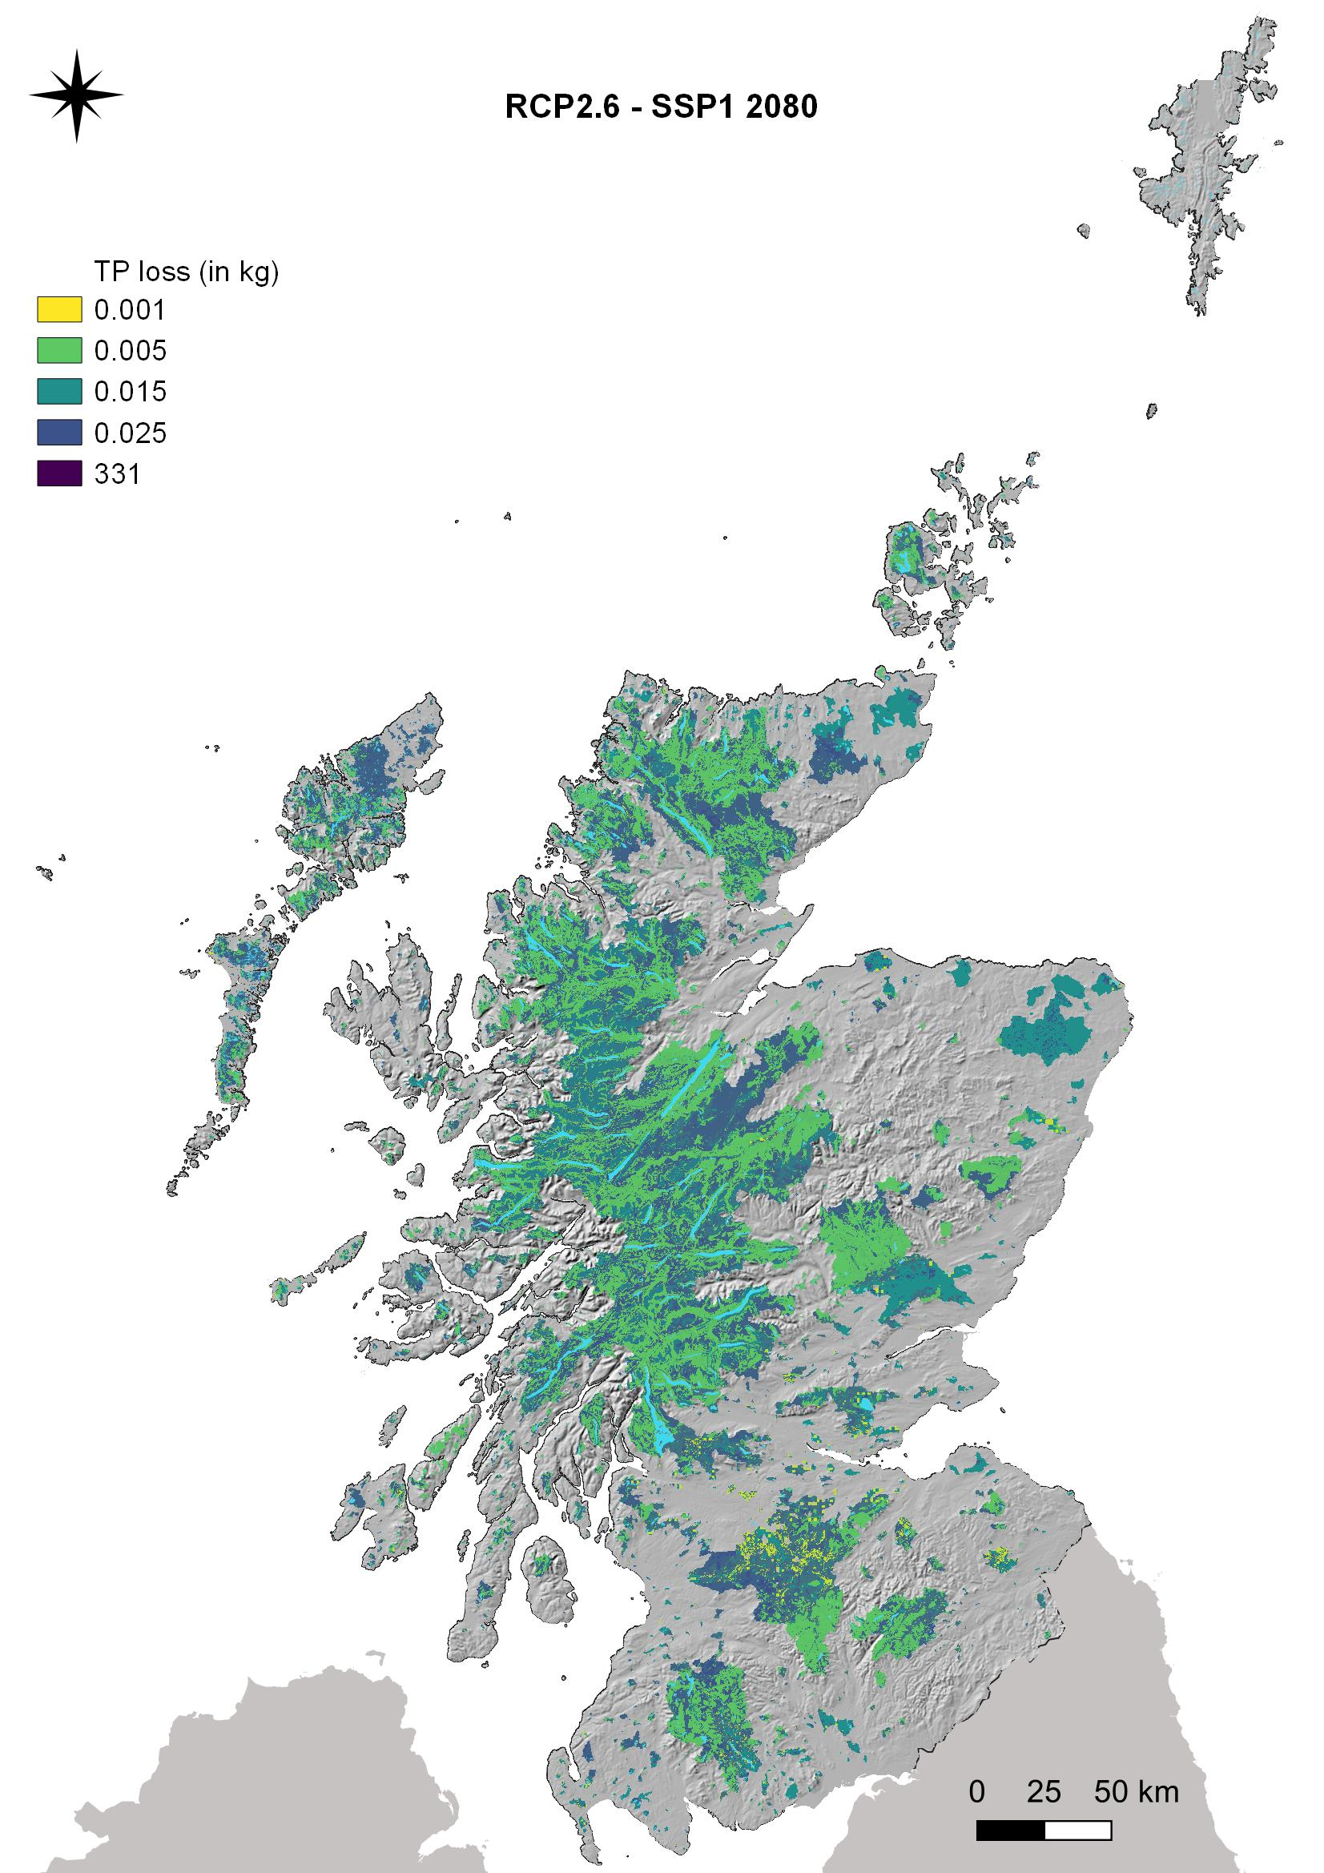
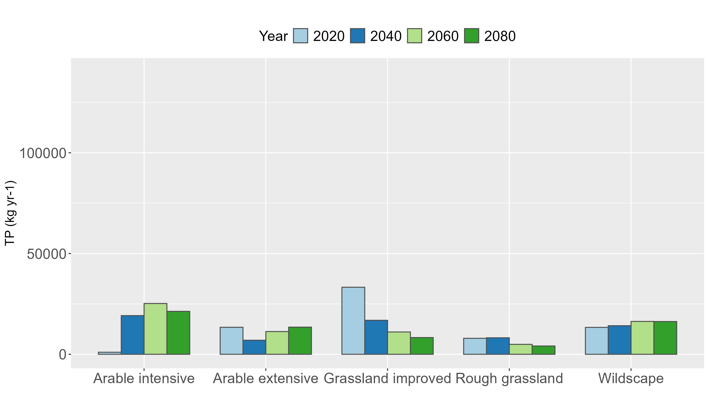
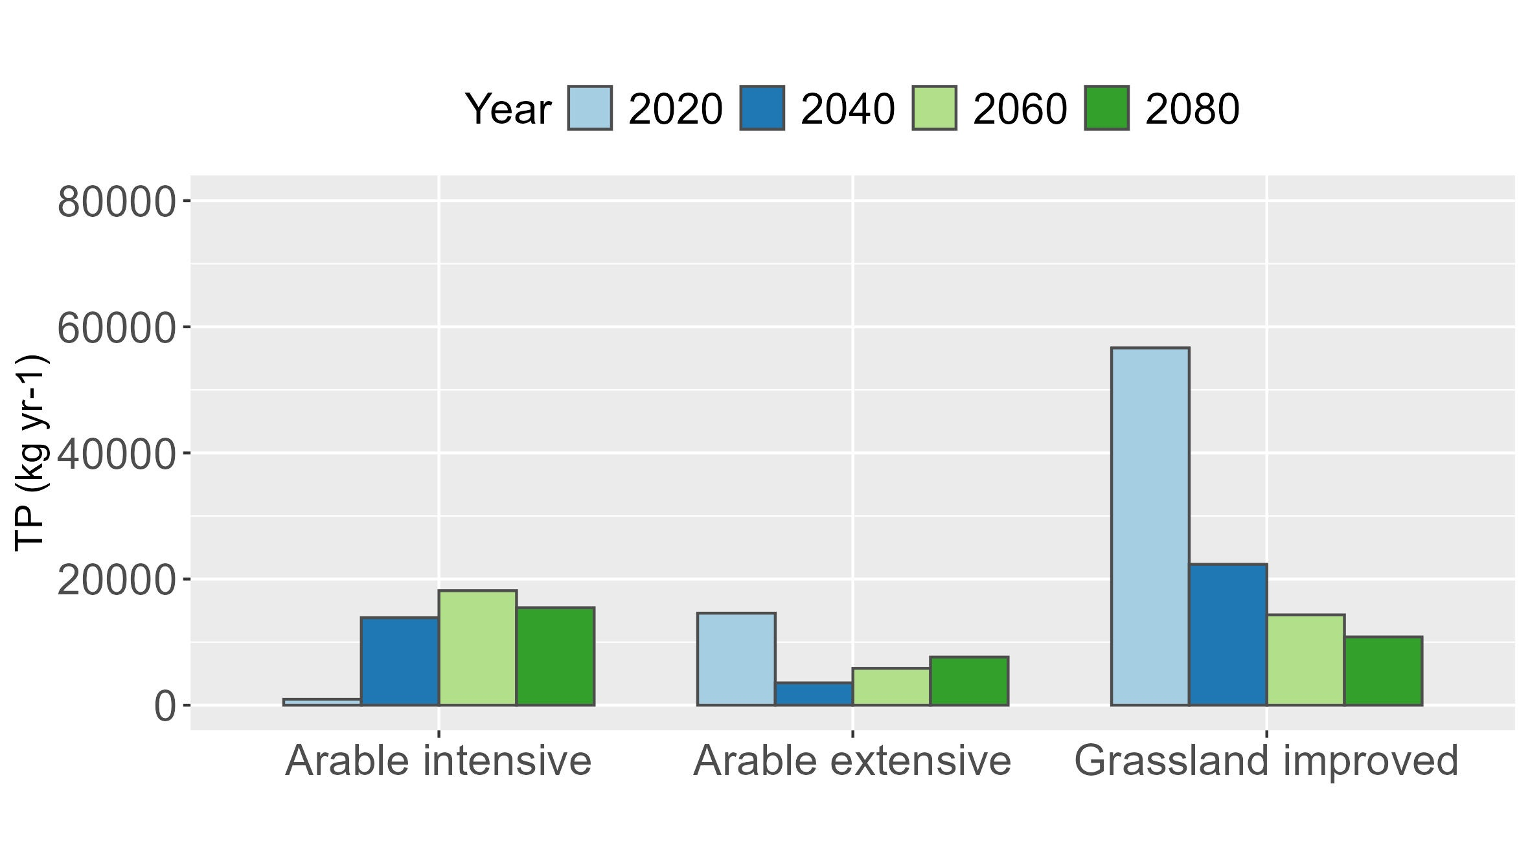
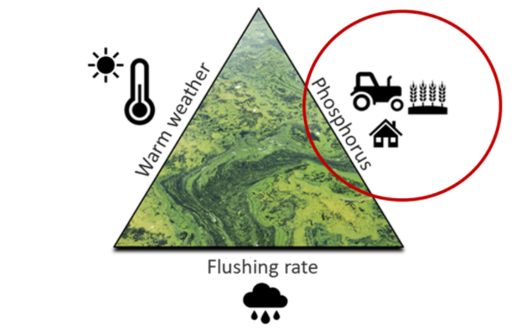
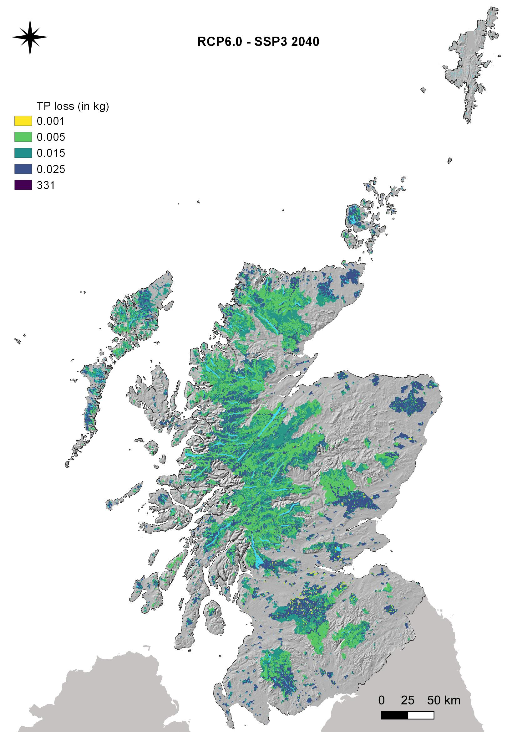

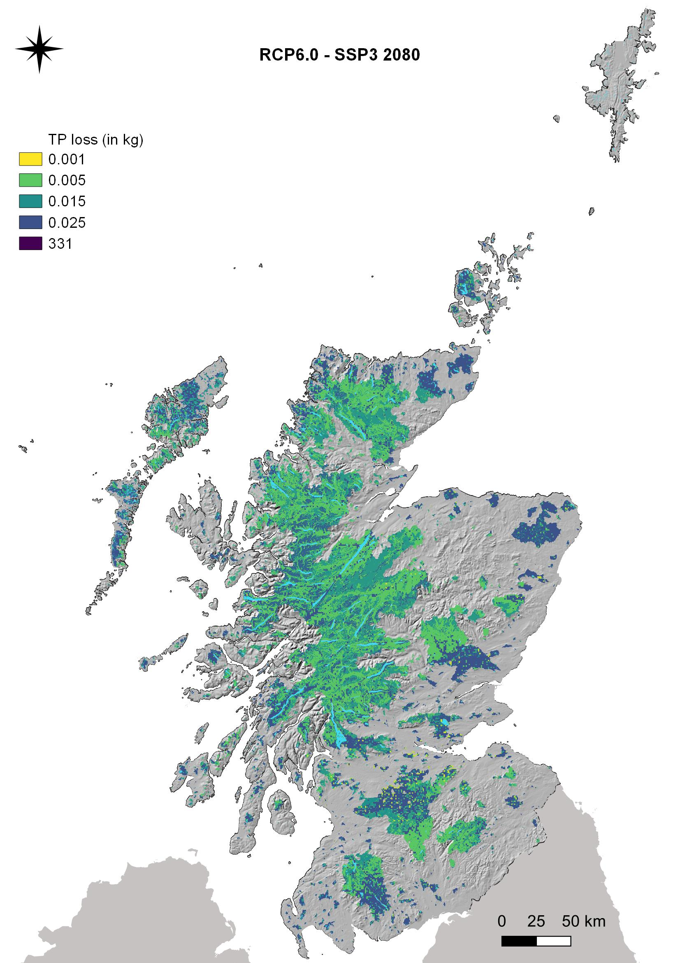
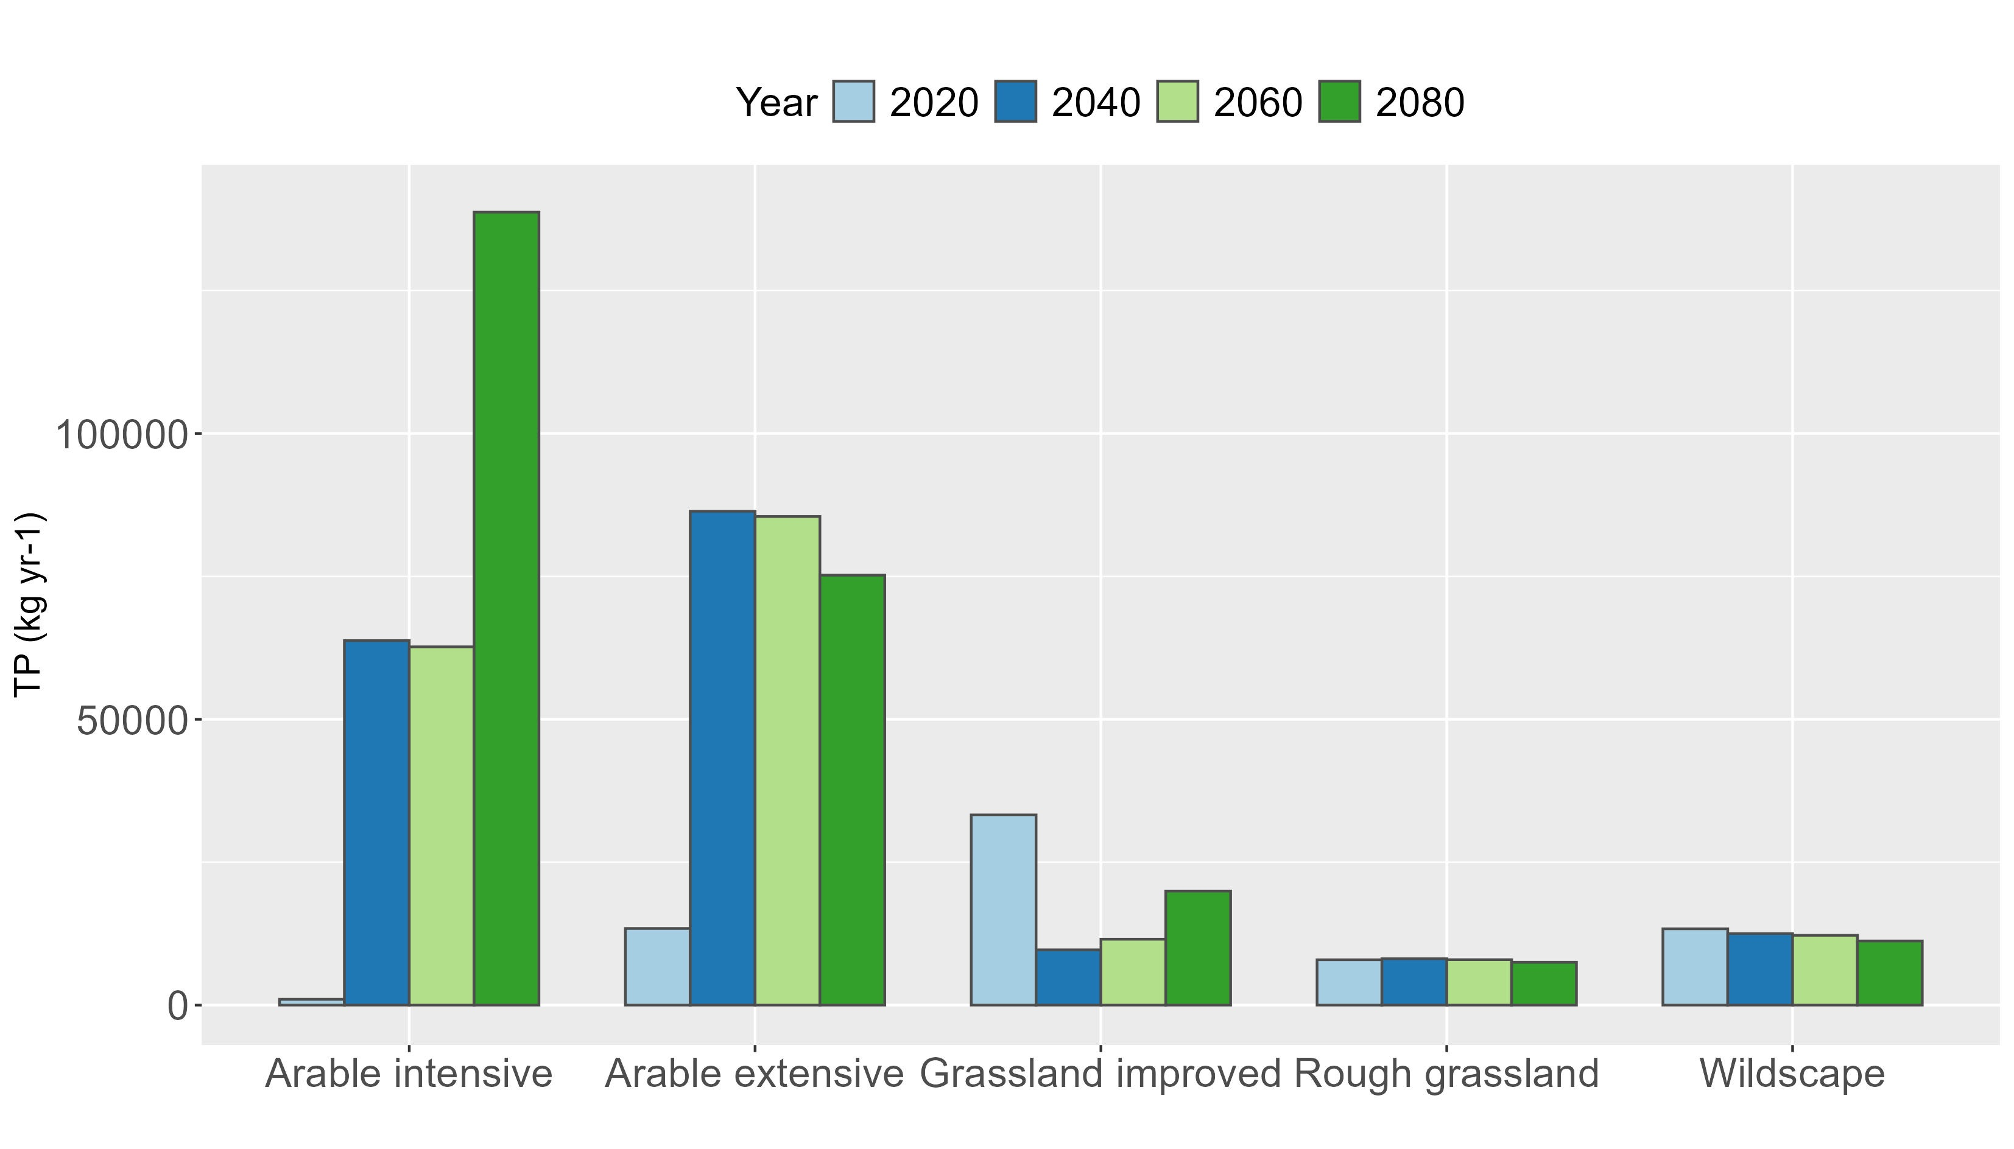
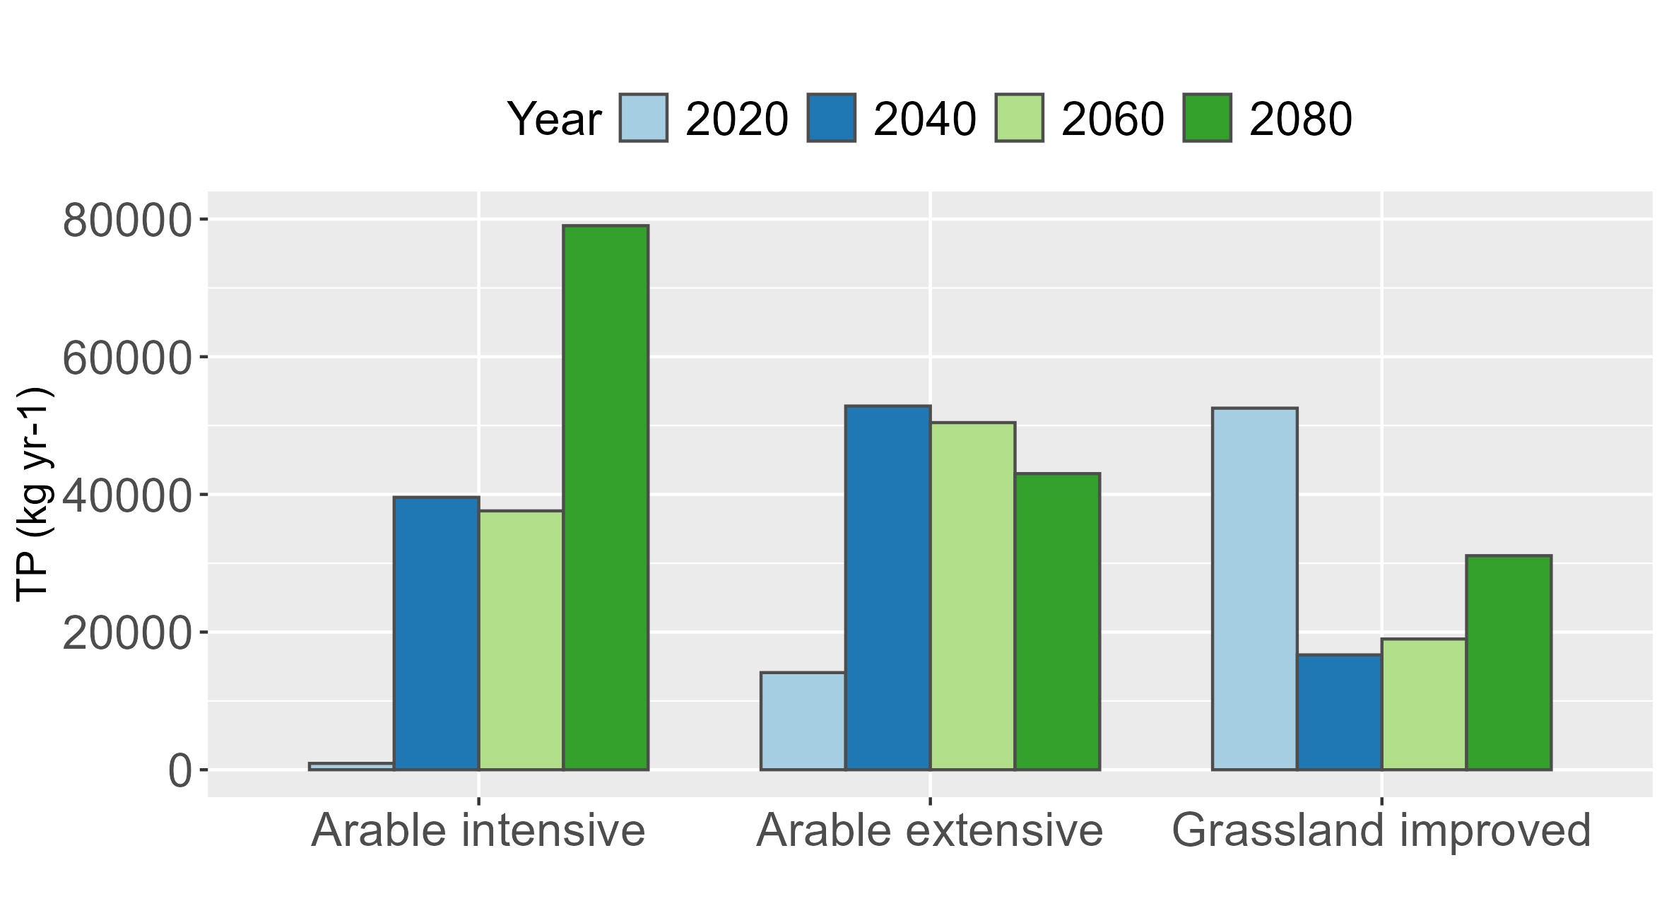
Understanding the effects of future climate, land cover and land management change on total phosphorus losses to lakes in Scotland
Miriam Glendell¹, Zisis Gagkas¹, Kerr Adams¹, Linda May² and Phil Taylor²
¹The James Hutton Institute, Environmental and Biochemical Sciences Group, Aberdeen, United Kingdom
²UK Centre of Ecology & Hydrology, Edinburgh, UK
Miriam.Glendell@hutton.ac.uk
More sustainable land use coupled with lower emission scenarios can help to mitigate climate change impacts on future phosphorus losses.
Methods
Results
A Bayesian network model Phosphorisk³ was used to simulate TP losses from runoff/soil erosion, field drains, farmyards, septic tanks and sewage treatment works in Scotland.
Introduction
S1
S2
S3
Lakes are warming globally. Scotland’s standing waters are already warming and this will continue into the future¹. These changes are likely to cause more frequent and/or more intense algal blooms, increasing the risk of harmful algal blooms (cyanobacteria) releasing toxins into the water. These toxins can lead to detrimental environmental and health impacts.
This project² explored strategies to mitigate the effects of climate change on Scottish standing waters.
We simulated terrestrial losses of total phosphorus (TP) to Scotland’s standing waters via surface and sub-surface pathways to assess:
The potential of land management measures to mitigate TP loss for a baseline period up to 2020.
The combined effects of land use and climatic change scenarios on future TP losses until 2080.
-46%
-19%
S4
S5
-1%
-46%
Shared Socio-economic Pathways | Climate change scenarios
 | RCP2.6 Low emissions | RCP6.0 High emissions
SSP1 – Sustainability: Sustainable and co-operative society, intensive agriculture decreasing over time. Sustainable land use. | 2040, 2060, 2080 | 2040, 2060, 2080
SSP3 – Regional rivalry: Food production dominates land uses, with other ecosystem services as by-products of enforced low-intensity management. | 2040, 2060, 2080 | 2040, 2060, 2080
Figure 2 TP losses under mitigation scenarios S1-S5 under current climate.
Figure 3 Projected landcover change under two RCP2.6 x SSP1 and RCP6.0 x SSP3 scenarios based on CRAFTY GB⁴.
a)
2040
2060
2080
Soil erosion
Drains
a) RCP2.6 x SSP1
Table 1 Combined climatic and socio-economic impacts were simulated using scenarios of greenhouse gas emission (RCPs) and land cover change (SSPs).
Five mitigation scenarios were modelled under current climate conditions:
S1: Baseline for 2020 based on current land cover
S2: Fertiliser application rate below agronomic optimum
S3: Fertiliser application rate at agronomic optimum
S4: Increase the extent of buffer strips to 8m
S5: Maximum mitigation (fertilisers below agronomic optimum and increased buffer strips)
b)
2040
2060
2080
b) RCP6.0 x SSP3
Figure 4 TP losses under two future scenarios a) RCP2.6 x SSP1 (16-20% reduction on baseline) and b) RCP6.0 x SSP3 (77-138% increase on baseline).
Figure 5 Simulated TP losses from soil erosion and field drains under two future scenarios a) RCP2.6 x SSP1 and b) RCP6.0 x SSP3.
Figure 1 Agricultural diffuse pollution is the second most important cause of freshwaters failing to achieve Good Ecological Status in Europe . TP, temperature and flushing rate are three critical risk factors affecting the likelihood of algal blooms occurring in lakes.
Conclusions
Targeted extensive land-based mitigation measures focused on the management of soil nutrient status at or below agronomic optimum can significantly reduce TP losses.
This should include holistic management of soils to maximise soil organic matter content and nutrient use efficiency.
Climate change impacts can be reduced by following more sustainable land management scenarios.
Acknowledgements
This research was funded by Scotland’s Centre of Expertise for Waters (CREW), which is funded by the Scottish Government. CREW is a partnership between the James Hutton Institute, and Scottish higher education and research institutes.
References
1. May, L. et al. (2022) Assessing climate change impacts on the water quality of Scottish standing waters. https://www.crew.ac.uk/publication/assessing-climate-change-impacts-water-quality-scottish-standing-waters
2. May, L., Glendell, M. et al. (2024) Mitigating Climate Change Impacts on the Water Quality of Scottish Standing Waters. Centre of Expertise for Waters https://www.crew.ac.uk/publication/mitigating-climate-change-phase-2
3. Glendell et al. (2022) A systems approach to modelling phosphorus pollution risk in Scottish rivers using a spatial Bayesian Belief Network helps targeting effective mitigation measures. Front. Env. Sci. 10.3389/fenvs.2022.976933
4. Brown, C. et al. (2022) Agent-Based Modeling of Alternative Futures in the British Land Use System. Earth’s Future 10. 10.1029/2022EF002905

