Slide 1

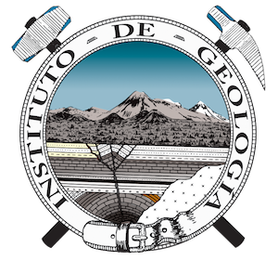

Understanding hydrologic connectivity of groundwater and surface water in western Mexico using chemistry and stable isotopes
Ramírez González, L. ¹, Olea Olea, S. ², Sánchez-Murillo, R. ³, and Villanueva Estrada, R. E. ⁴
¹ Posgrado en Ciencias de la Tierra, Instituto de Geología, Universidad Nacional Autónoma de México, Ciudad Universitaria, 04510, Ciudad de México, México.
² Departamento de Dinámica Terrestre y Superficial, Instituto de Geología, Universidad Nacional Autónoma de México, 04510, Ciudad Universitaria, Ciudad de México, México.
³ Department of Earth and Environmental Sciences, University of Texas at Arlington, 500 Yates Street, Arlington, TX 76019, USA
⁴ Unidad Michoacán, Instituto de Geofísica, Universidad Nacional Autónoma de México, 58190, Morelia, México.
Contacto: lore.ram.gon@gmail.com

Slide 2
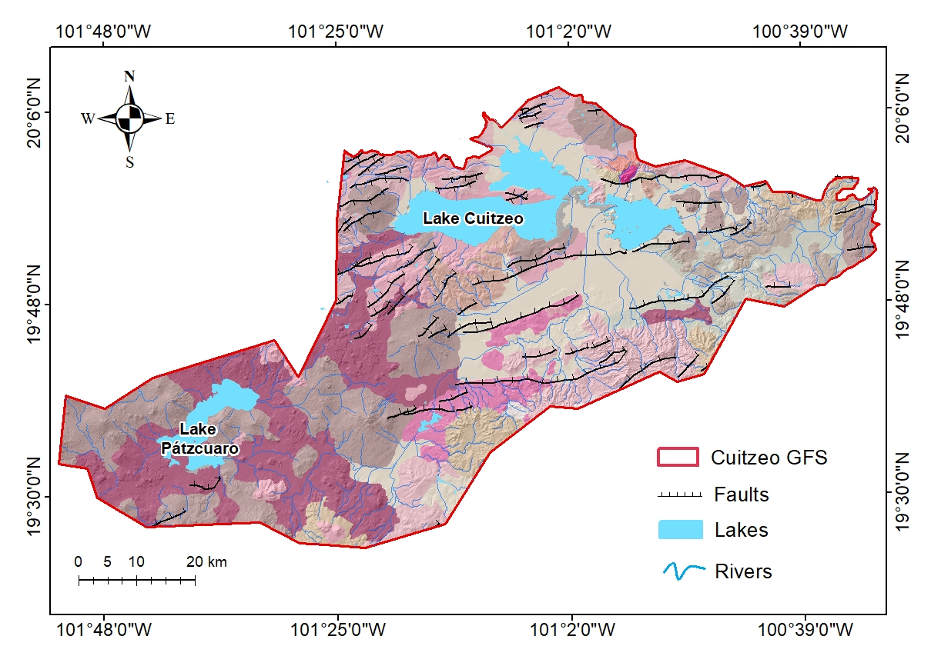
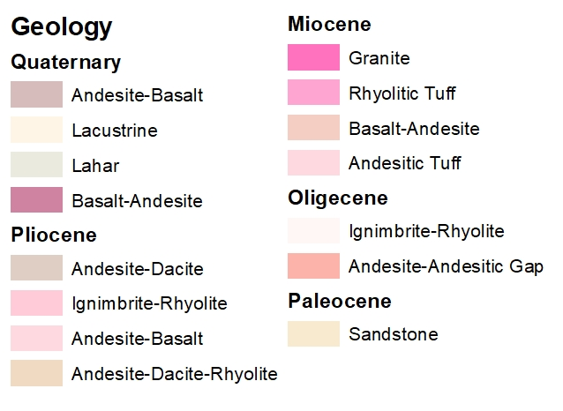
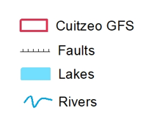
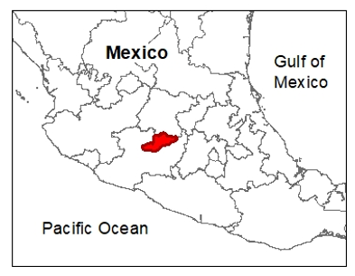
Study Area
Oligocene
Lithology varies from volcanic rocks (andesite and basalt), at higher elevations, to fluvial and lacustrine sediments, more common at lower elevations
The region is characterized by both tectonic and volcanic processes developed because of same convergent plate regime.

Slide 3
Identify relevant hydrological pathways at a regional scale using a combined approach to study GW-SW interaction in western Mexico, considering stable isotopes of oxygen (¹⁸O) and hydrogen (²H) and statistical analysis.
Objective
Methodology
Sampled 96 water sources (wells, springs, rivers, lakes) during dry season (April 2025)
Long-term isotope rainfall measurements used as reference in dual isotope plots (RENIP Querétaro)
Plot dual-isotope diagrams including global (GMWL) and regional meteoric water lines

Slide 4
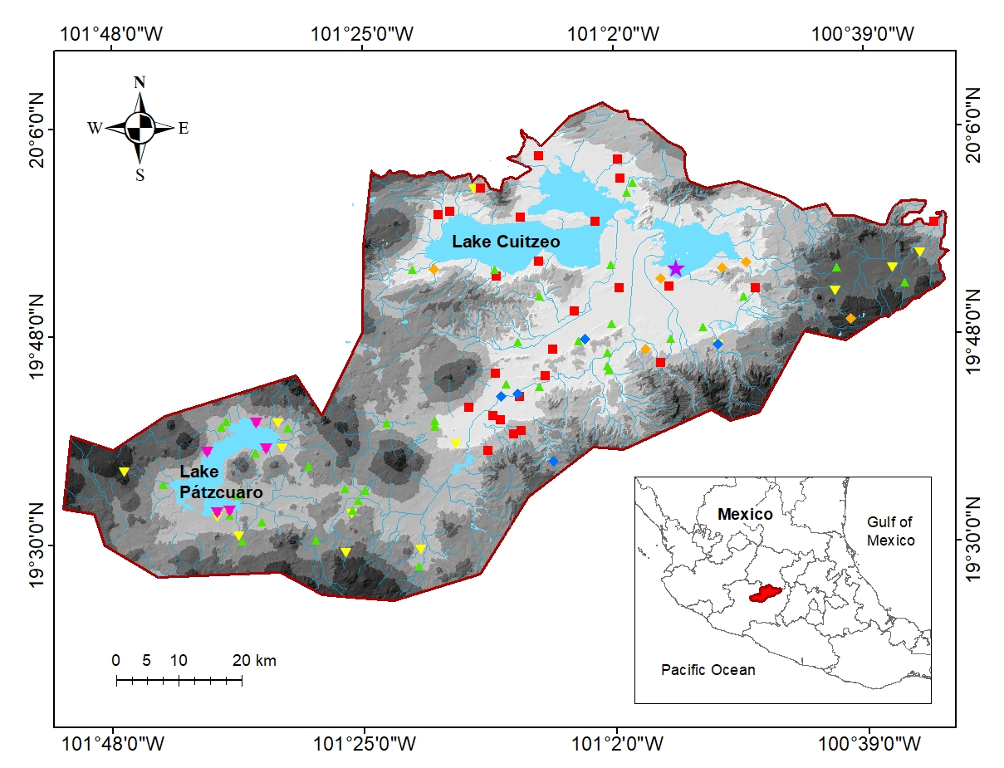
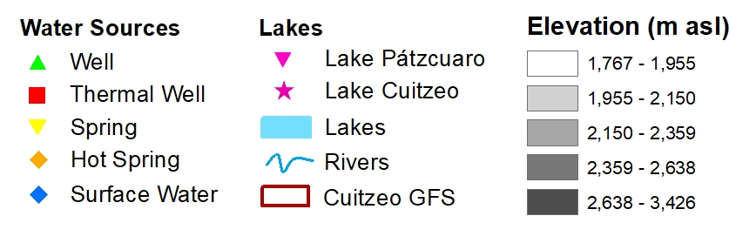
Results

Slide 5
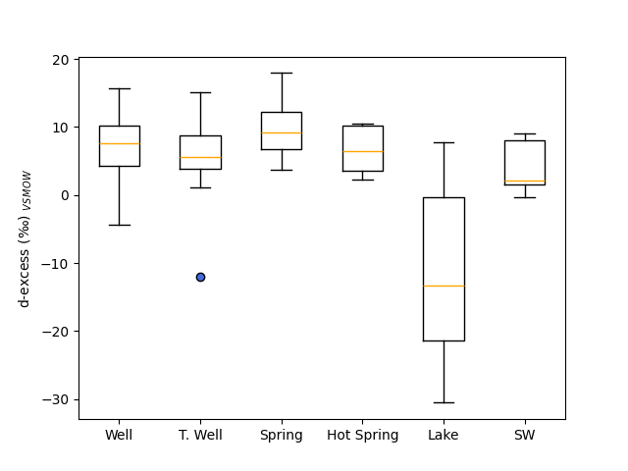
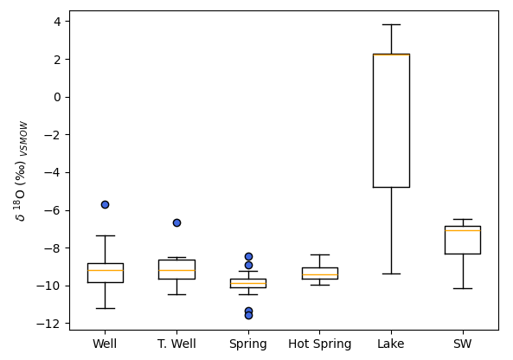
Lake samples exhibited the largest variability, as well as the lowest d-excess values reported for SW samples
Results
Wells and springs reveal strong connectivity to modern precipitation
Widespread drought showed lake water (LW) isotopes enriched beyond the isotopic range observed in precipitation samples
Minor importance of recent meteoric water for the recharge of the geothermal reservoir
Thermal influence on groundwater processes, related to both tectonic and volcanic processes developed in the region

Slide 6
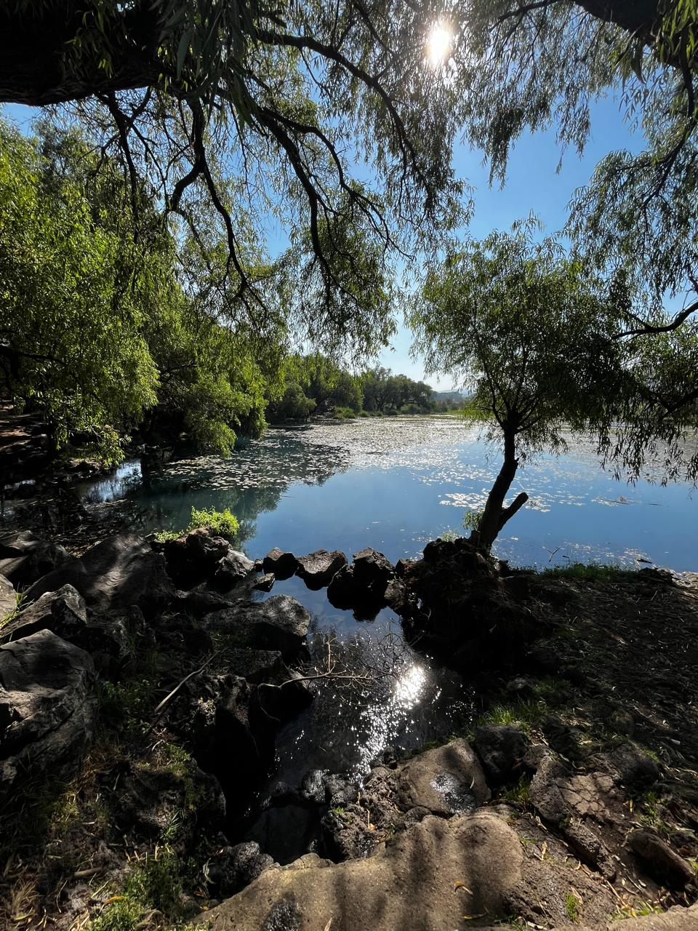
Conclusions
Environmental tracers, such as stable isotopes can help us understand complex SW-GW interactions at a broader scale. This is particularly true for arid and semi-arid areas where interactions are becoming more complex under the effects of human activity.
Further studies:
Monitor rainfall events (May – November) for stable isotopes analysis (2025)
Collect complementary groundwater data such as apparent ages and flow metrics
Estimate recharge elevation

