Slide 1


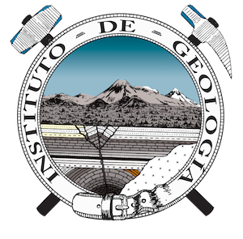
Land subsidence and groundwater flow systems in Mexico caused by intensive groundwater extraction.
HS8.2.3 - The role of groundwater flow systems in enhancing sustainable water management and solving environmental issues
Luis Angel Jiménez Martínez - Oscar Arnoldo Escolero Fuentes - Selene Olea Olea - Priscila Medina Ortega

Slide 2
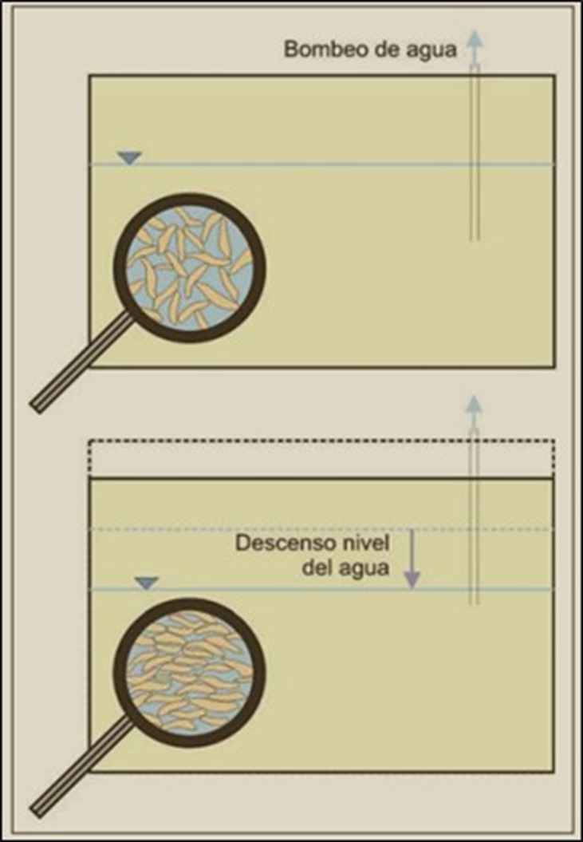
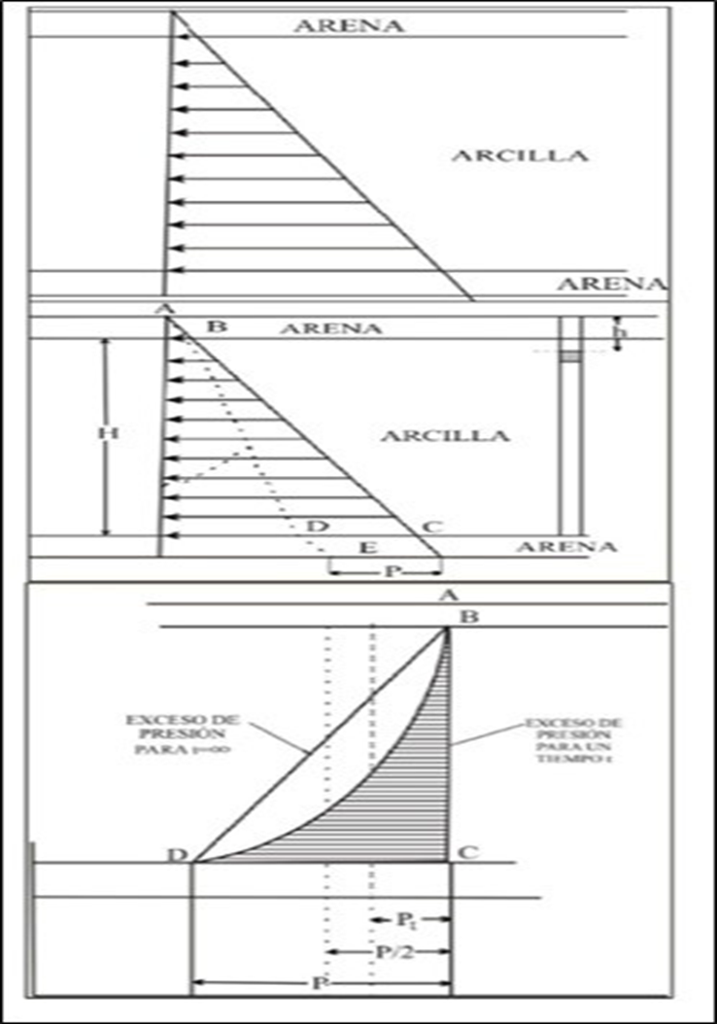
Introduction
Subsidence causes impacts over extensive areas and prolonged periods of time.
Dr. Carrillo proposed that, when large volumes of groundwater are extracted, the pressure exerted by the water between the soil particles’ pores is reduced.

Slide 3
Objectives
To identify subsidence associated with groundwater extraction in Mexico through the development of maps representing affected areas and their hydrogeological conditions, resulting in a comprehensive map and an analysis of the impacts of subsidence.
To classify the level of damage in areas affected by subsidence or ground sinking, with a focus on overexploited aquifer zones.
To analyze the geospatial distribution of subsidence, taking into account hydrogeological and social factors.
To relate subsidence to hydrogeological conditions, integrating key variables into the SIRAS model to provide an interpretation focused on Regional Groundwater Flow Systems.

Slide 4



Methodology
Collection of geological and hydrological data from scientific and governmental sources such as CONAGUA, INEGI, and geological bulletins.
Use of digital tools, elevation models, and GNSS station data to identify areas with significant subsidence.
Analysis of the relationship between intensive groundwater extraction and land subsidence.
Development of thematic maps integrating geological and hydrological factors related to affected zones.
Implementation of the SIRAS model as a reference framework for data integration and analysis.
Interpretative analysis of subsidence processes, highlighting key hydrogeological variables.

Slide 5
Results
43 subsidence sites were identified across Mexico, categorized according to the Regional Groundwater Flow Systems (SIRAS).
14 states were affected, with the highest subsidence rates concentrated in the central region, associated with intensive groundwater extraction.
Many affected areas show aquifer drawdown, leading to water stress and a strong correlation with subsidence processes.

Slide 6
Results
The relationship between geology and land subsidence is complex, as subsurface composition influences site-specific vulnerability.
Geological faults and fractures have a major impact on the SIRAS framework and the affected aquifers.
An integrated perspective is essential to fully understand the phenomenon, linking geological, hydrological, and social factors.

Slide 7
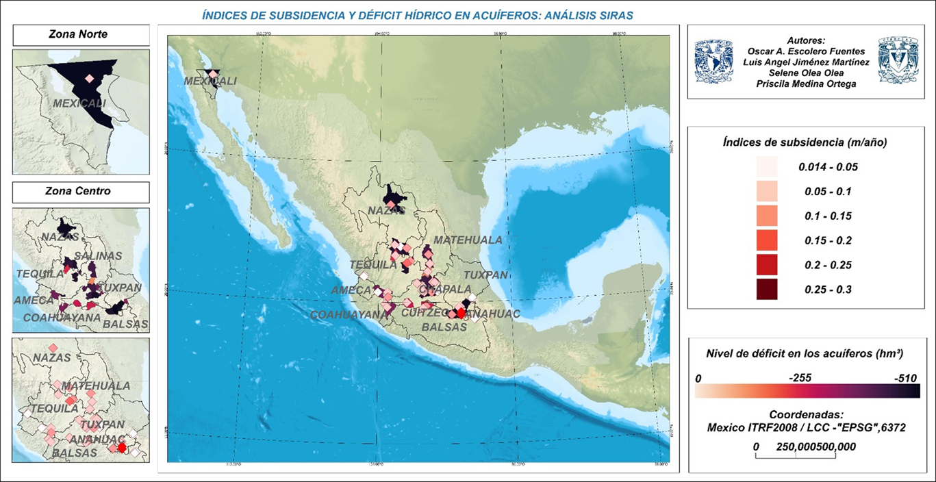
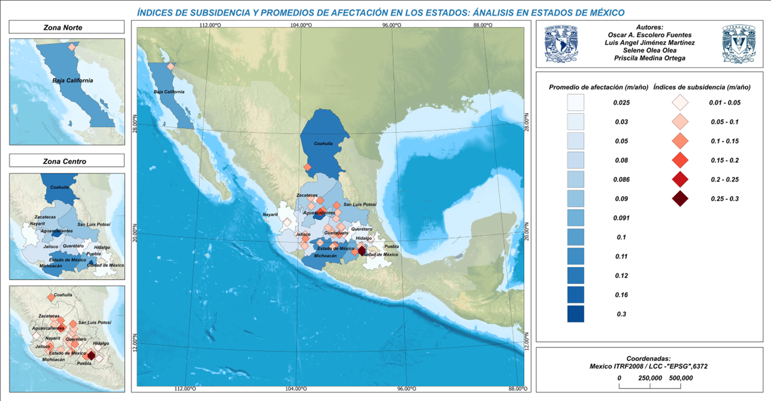

Slide 8
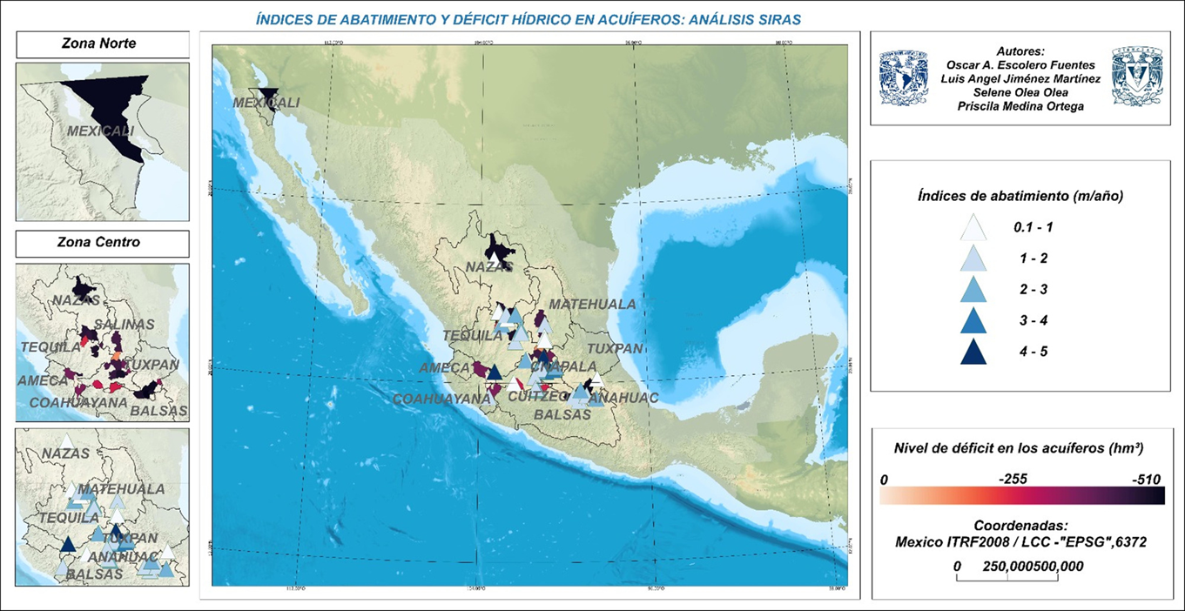
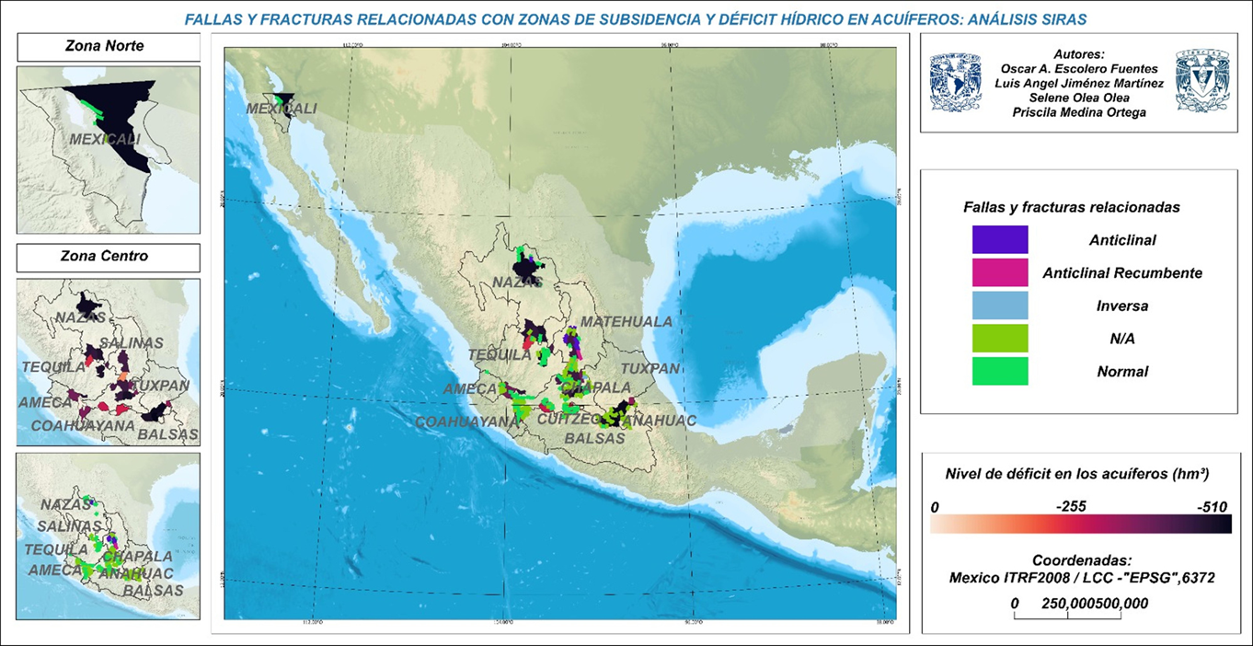

Slide 9
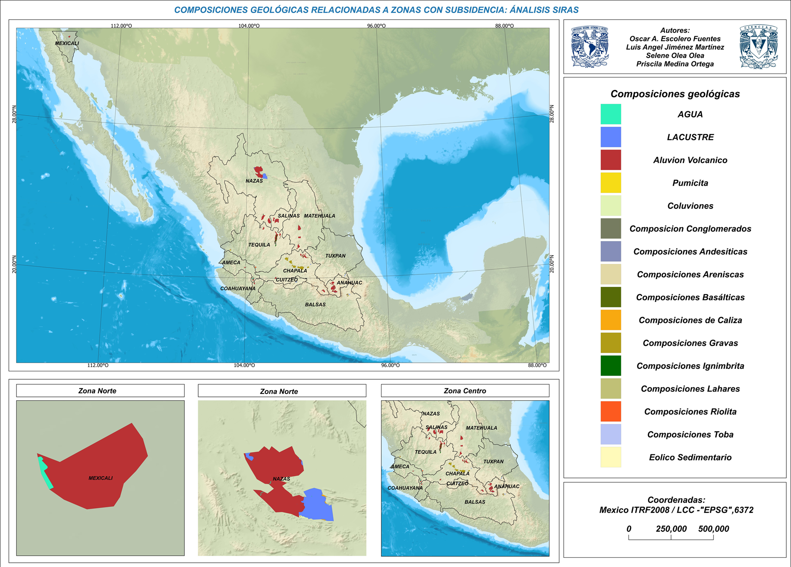

Slide 10
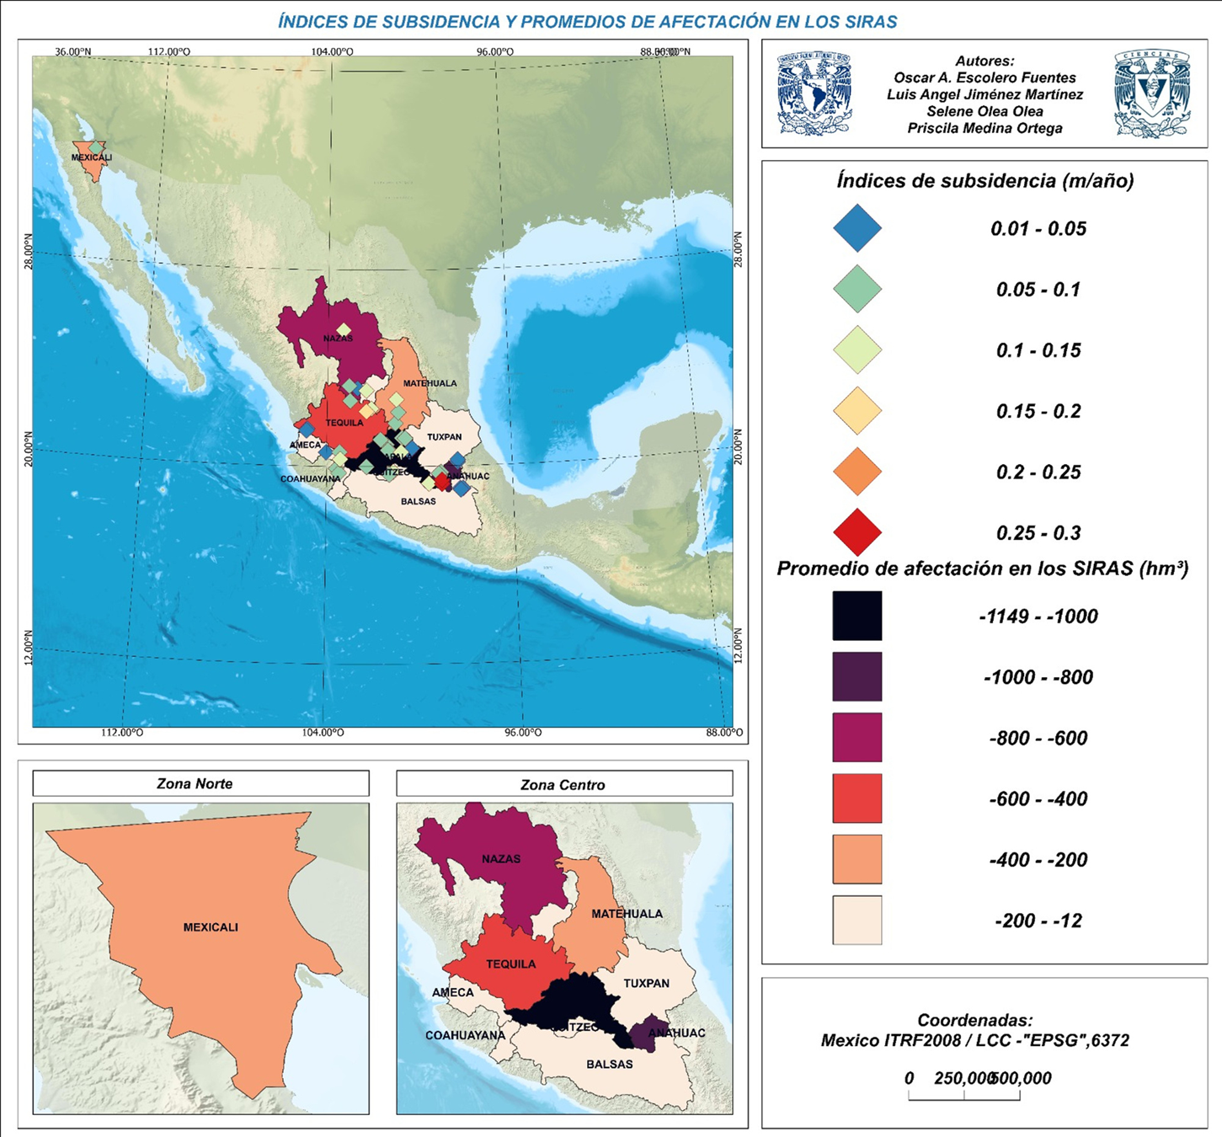

Slide 11
Discussion
Extraction–subsidence relationship: Land subsidence is primarily driven by intensive groundwater extraction, aquifer deficits, geological variability, and human activity. Areas with higher extraction rates show more severe subsidence.
Spatial variability: While high extraction generally correlates with subsidence, exceptions exist where low-extraction aquifers experience significant ground sinking, indicating the role of geological and temporal factors.
Impact on SIRAS: Twelve Regional Groundwater Flow Systems are affected by subsidence, with Chapala, Tequila, and Anáhuac being the most impacted due to high concessions and extraction volumes.
Geological susceptibility: Volcanic soils, gravels, and alluvial sediments—especially in the Trans-Mexican Volcanic Belt—are more prone to subsidence due to the presence of faults and fractures.
Projections: If current extraction trends continue, some areas could subside by up to 3 meters per year over the next two decades, exacerbating overexploitation and water stress.

Slide 12
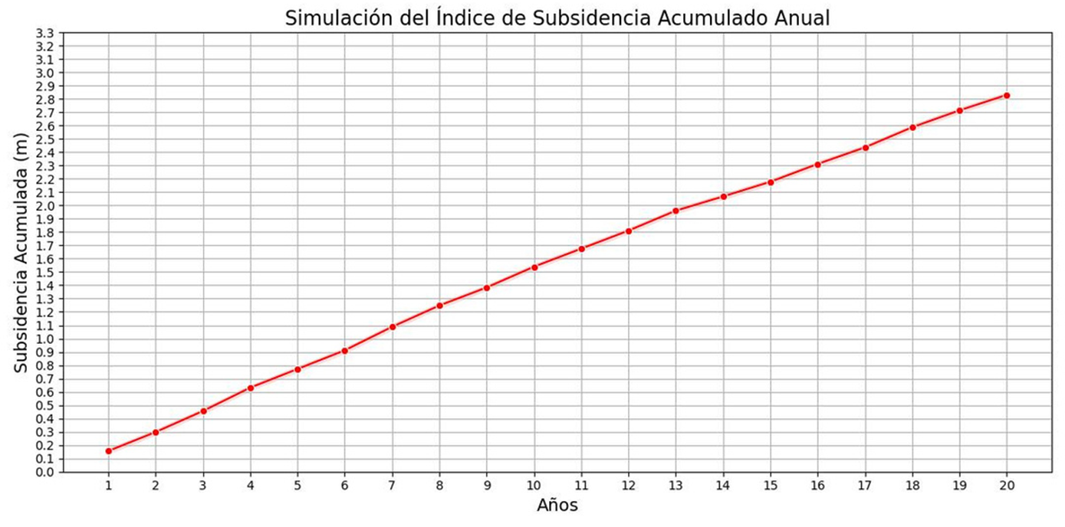
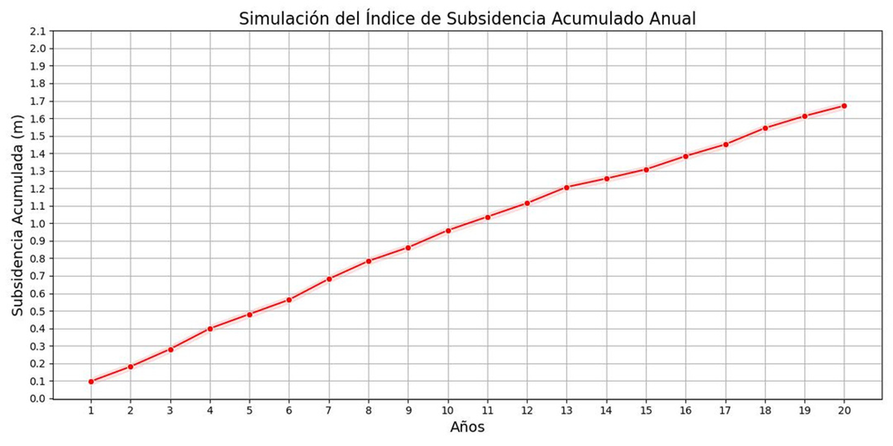

Slide 13
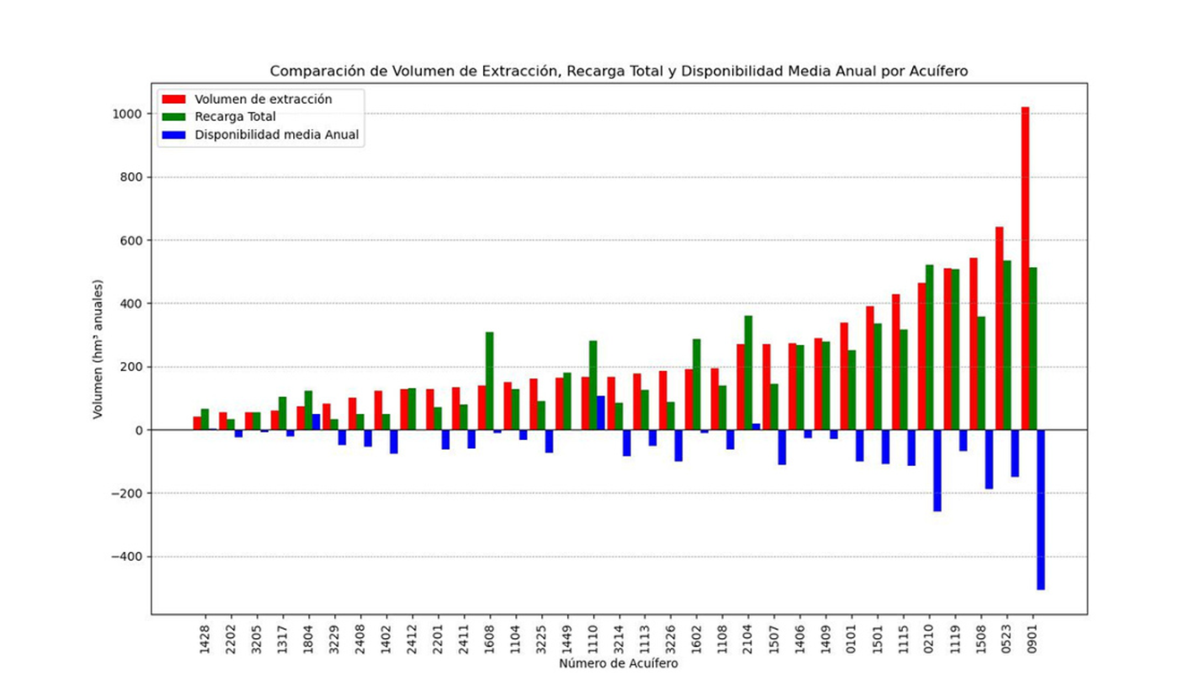

Slide 14
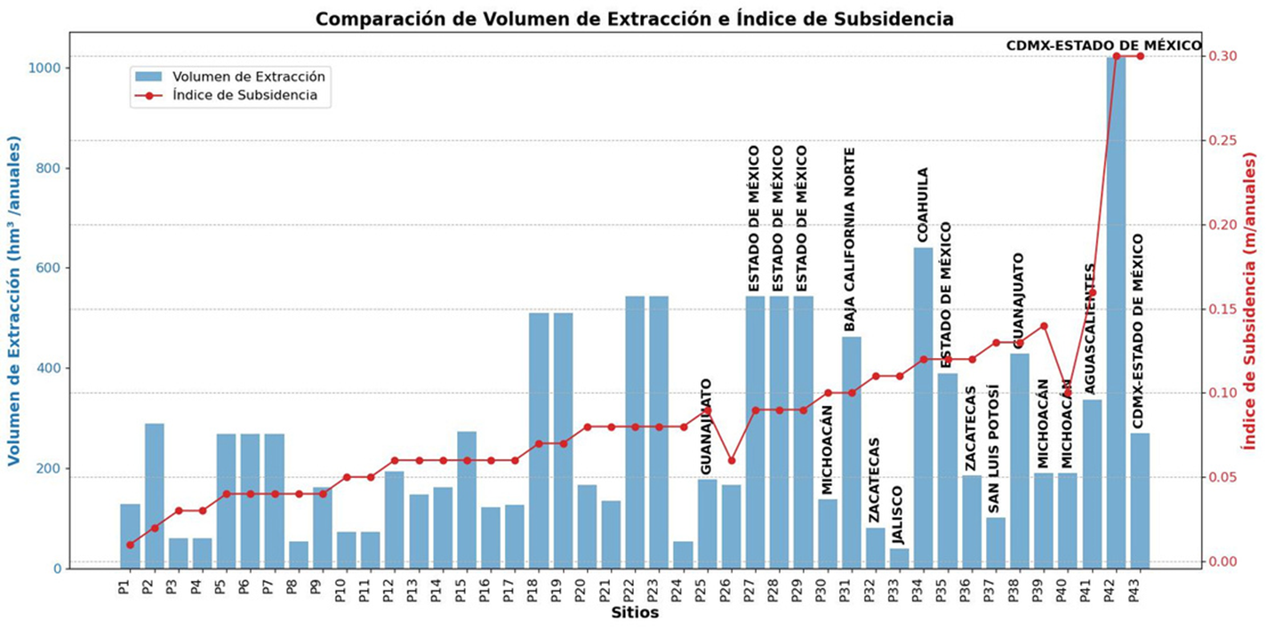

Slide 15
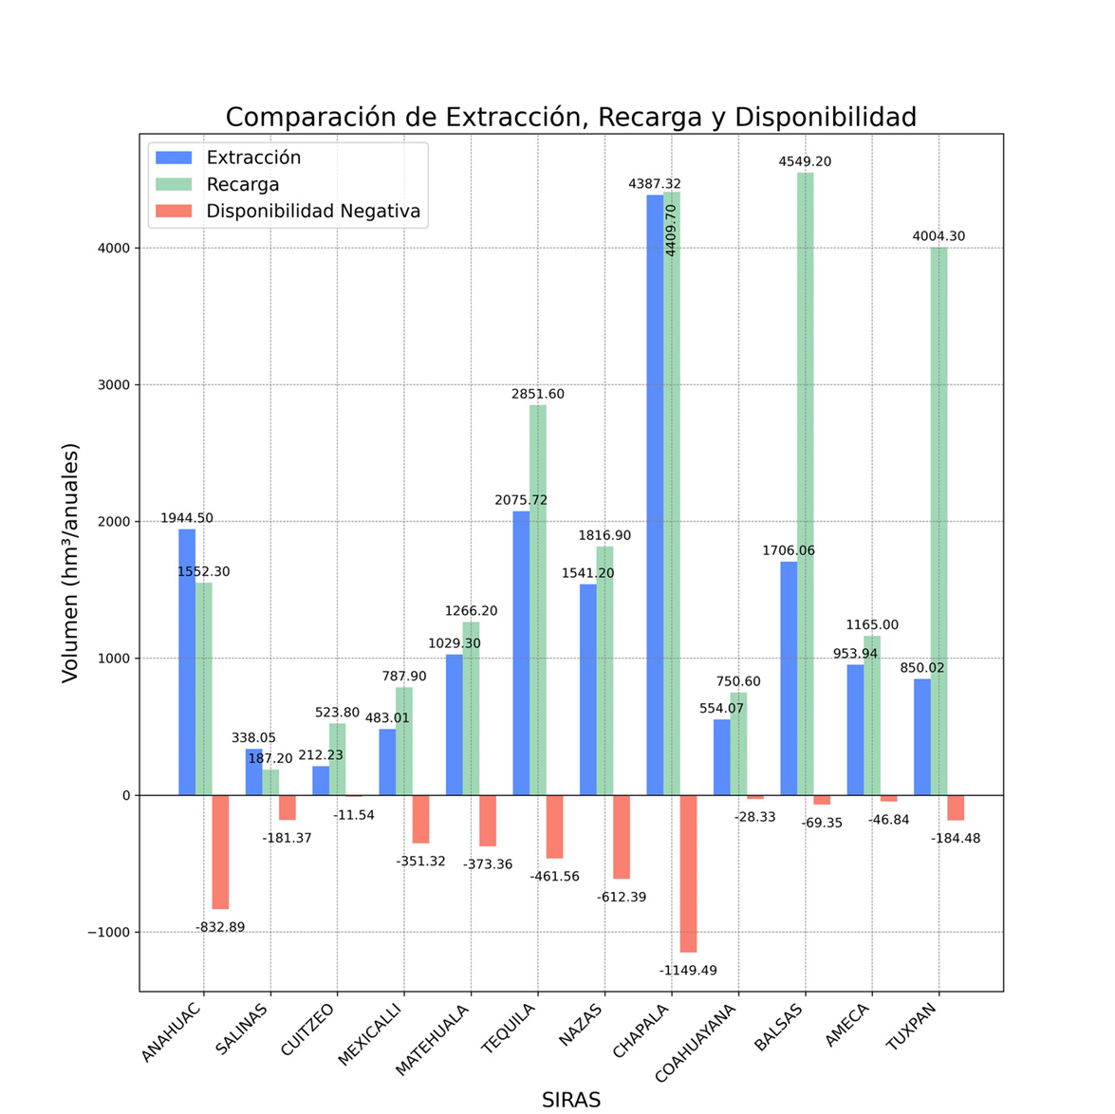

Slide 16
Conclusions
Subsidence in Mexico is closely linked to intensive groundwater extraction.
The maps produced provide an integrated view of the phenomenon, highlighting regions with critical water stress and aquifer deficits.
There is an urgent need for sustainable water management strategies, including accurate monitoring, concession review, and the adoption of efficient technologies.
Science must lead these efforts to secure long-term water access and ensure the well-being of future generations.

Slide 17
References
Berbeyer, R. M. (1957). Hundimiento de la Ciudad de México y su relación con los estudios de mecánica de suelos, geoquímicos, geofísicos y geológicos de las aguas del subsuelo de la cuenca del Valle de México. Boletín de la Sociedad Geológica Mexicana, 20(2), 3–28.
Cabral-Cano, E., Díaz-Molina, O., & Delgado-Granados, H. (2011). Subsidencia y sus mapas de peligro: Un ejemplo en el área nororiental de la Zona Metropolitana de la Ciudad de México. Boletín de la Sociedad Geológica Mexicana, 63(1), 53–60. http://www.scielo.org.mx/scielo.php?script=sci_arttext&pid=S1405-33222011000100005
Cabral-Cano, E., Dixon, T. H., Miralles-Wilhelm, F., Díaz-Molina, O., Sánchez-Zamora, O., & Carande, R. E. (2008). Space geodetic imaging of rapid ground subsidence in Mexico City. GSA Bulletin, 120(11–12), 1556–1566. https://doi.org/10.1130/B26001.1
Carreón-Freyre, D. C., & Cerca, M. (2006). Integration of geological properties in the study of the subsidence and fracturing phenomena in two urban areas of Mexico. In Proceedings of the 10th IAEG International Congress, Nottingham, UK, 610.
Carreón-Freyre, D. C., Hidalgo-Moreno, C. M., & Hernández-Marín, M. (2006). Mecanismos de fracturamiento de depósitos arcillosos en zonas urbanas. Caso de deformación diferencial en Chalco, Estado de México. Boletín de la Sociedad Geológica Mexicana, 58(2), 237–250.
Carrillo, N. (1948). Influence of artesian wells in the sinking of Mexico City. In Proc. 2nd Int. Conference on Soil Mechanics (pp. 7). Rotterdam, Holland: International Society for Soil Mechanics and Geotechnical Engineering.
Escolero, O. (2018). Sistemas regionales de flujo de agua subterránea en México (1ª ed.). Jiutepec, Morelos.
INEGI. (2019). Detección de zonas de subsidencia en México con técnicas satelitales (Vol. 1). Instituto Nacional de Estadística y Geografía. https://www.inegi.org.mx
INEGI. (2021). Detección de zonas de subsidencia en México con técnicas satelitales (Vol. 2). Instituto Nacional de Estadística y Geografía. https://www.inegi.org.mx
INEGI. (2022). Detección de zonas de subsidencia en México con técnicas satelitales (Vol. 3). Instituto Nacional de Estadística y Geografía. https://www.inegi.org.mx
Tomás, R., Herrera, G., Delgado, J., & Peña, F. (2009). Subsidencia del terreno. Enseñanza de las Ciencias de la Tierra, 17(3), 295–302.
Wang, N. (2017). Estudio de subsidencia por extracción de fluidos [Tesis doctoral, Universidad Politécnica de Madrid].

