Slide 1

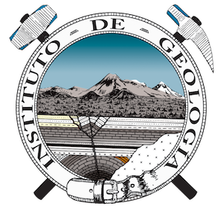



NATIONAL AUTONOMOUS UNIVERSITY OF MEXICO
FACULTY OF SCIENCE
HYDROGEOCHEMICAL CHARACTERIZATION FROM HISTORICAL DATA OF THE GROUNDWATER FLOW SYSTEM IN THE CENTER OF MEXICO
Aurora Llanos Solís, Selene Olea Olea
Abstract
April 29, 2025
HS8.2.3
The role of groundwater flow systems in enhancing sustainable water
management and solving environmental issues

Slide 2
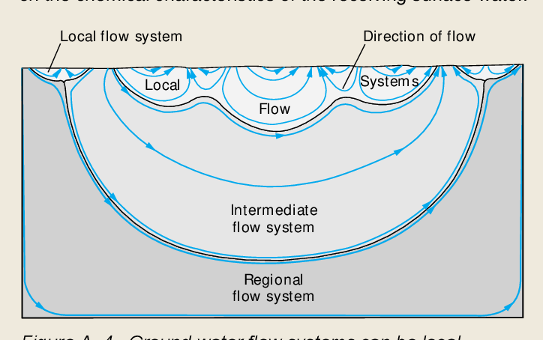
Introduction
A regional flow system is a single system which have different flow components( local, intermediate and regional) which depend on physics, chemical an climatic characteristics of groundwater.
Fig. 2. Regional groundwater systems in Mexico (Siras).
(Escolero, 2018).
In Mexico 65 regional groundwater flow systems have been defined, incluiding the Cuitzeo system (2018).
Fig. 1. Groundwater flows. (Winter et al. 1998)

Slide 3
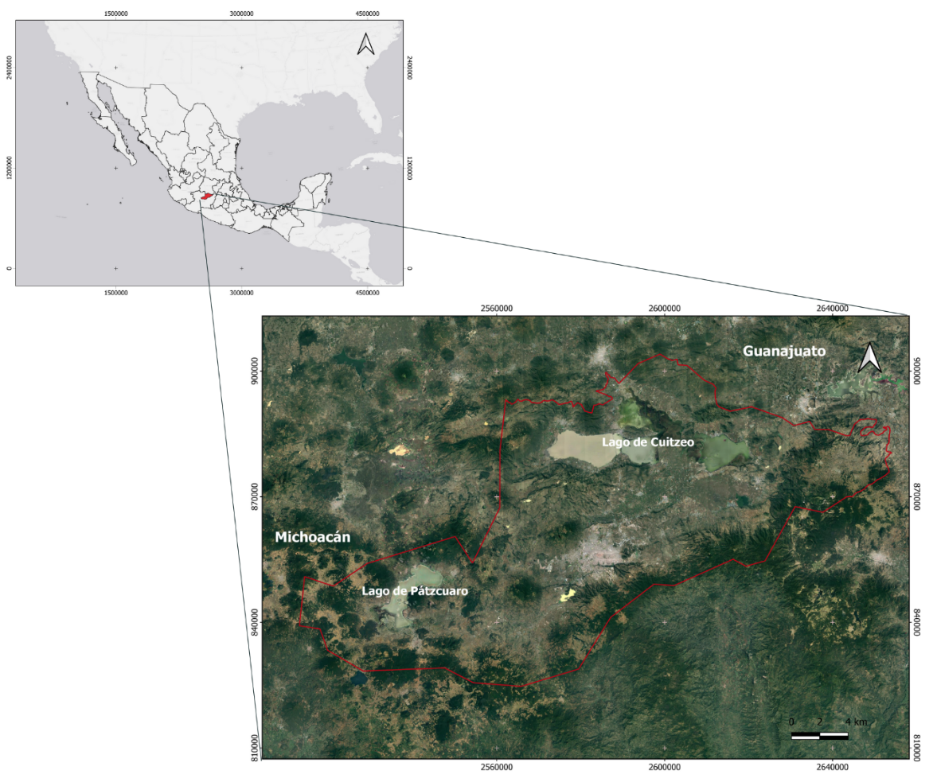
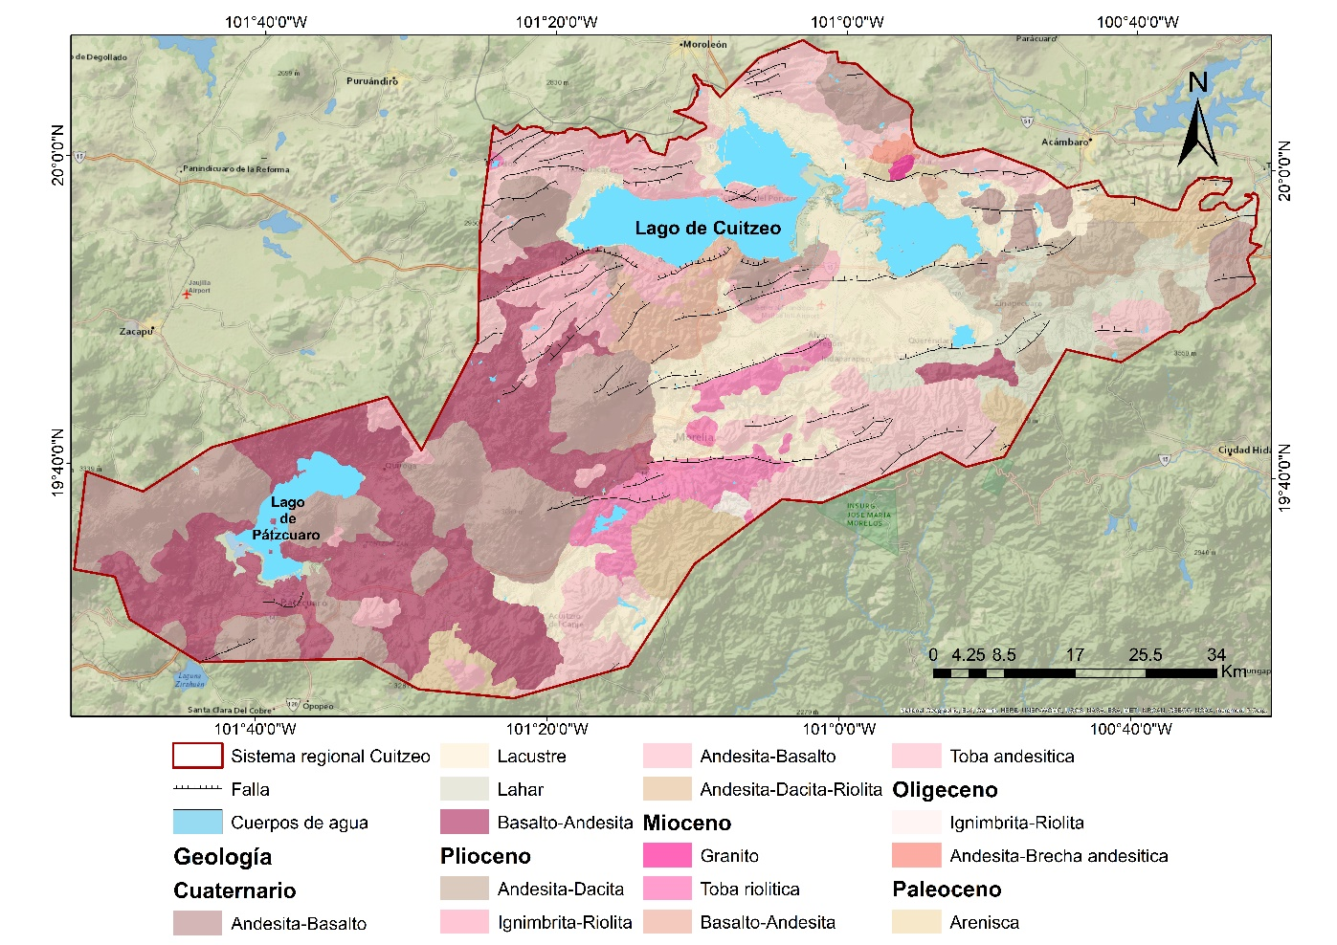
Study Area
Cuitzeo Flow system is located in the northwest of the Michoacán state and southeast from Guanajuato state, has an extensión of 5208 km² (Escolero, 2018). The region belongs to the middle part of the Trans Mexican Volcanic Belt, and is also situated in the Morelia-Acambay fault system.
Fig. 3. Study area
Fig. 4. Geology of the study area

Slide 4
Objective
Describe the hydrogeochemical characteristics of the study area based in historic data compiled in the order of the developing a conceptual hydrogeological model.
Methodology
Hydrogeochemical data were compiled for the years 1983, 1990, 1997, 1999, 2001, 2002, 2003, 2006, 2007, 2014, and 2015, incluiding physicochemicals parameters: temperature (T°C), pH, Total Dissolved Solids (TDS), and major ions (Ca2+, Mg2+, Na+, K+, SO42-, Cl-, HCO3-, CO32-, and NO3-)
With the data of the year 2014 we generate hydrogeochemical diagrams (Piper, Mifflin, Gibbs) also we applicated a Cluster analysis and an end-member mixing model (EMMA). These resources were used to define the groundwater flows.
Groundwater flow net using dta from statics levels from 2024 (Surfer 16 and ArcMap 10.5)
Developing of the conceptual hydrogeochemical model

Slide 5
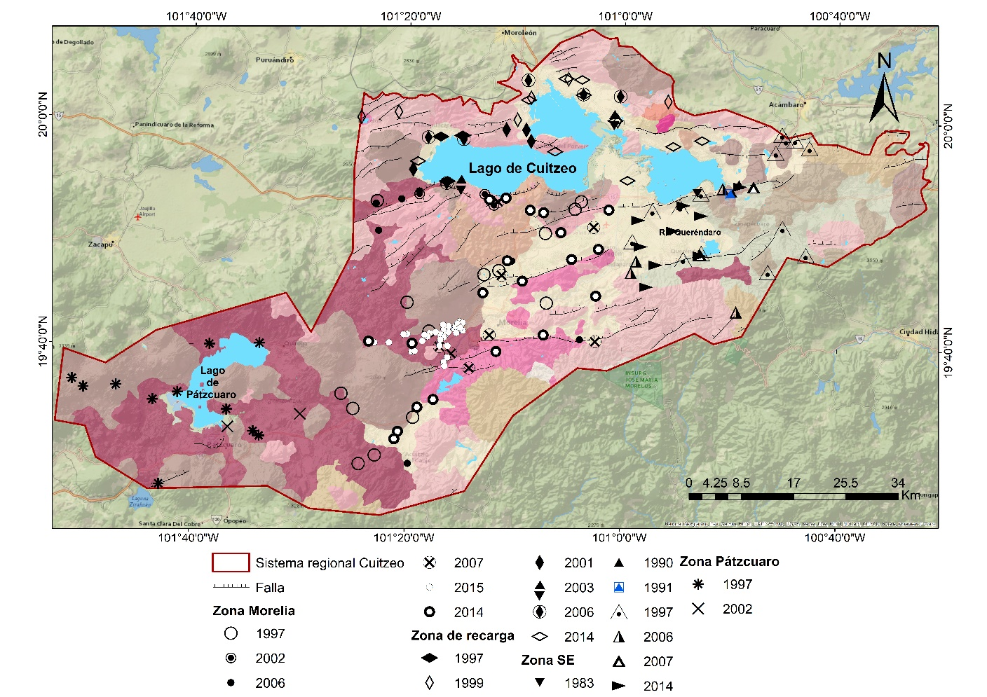
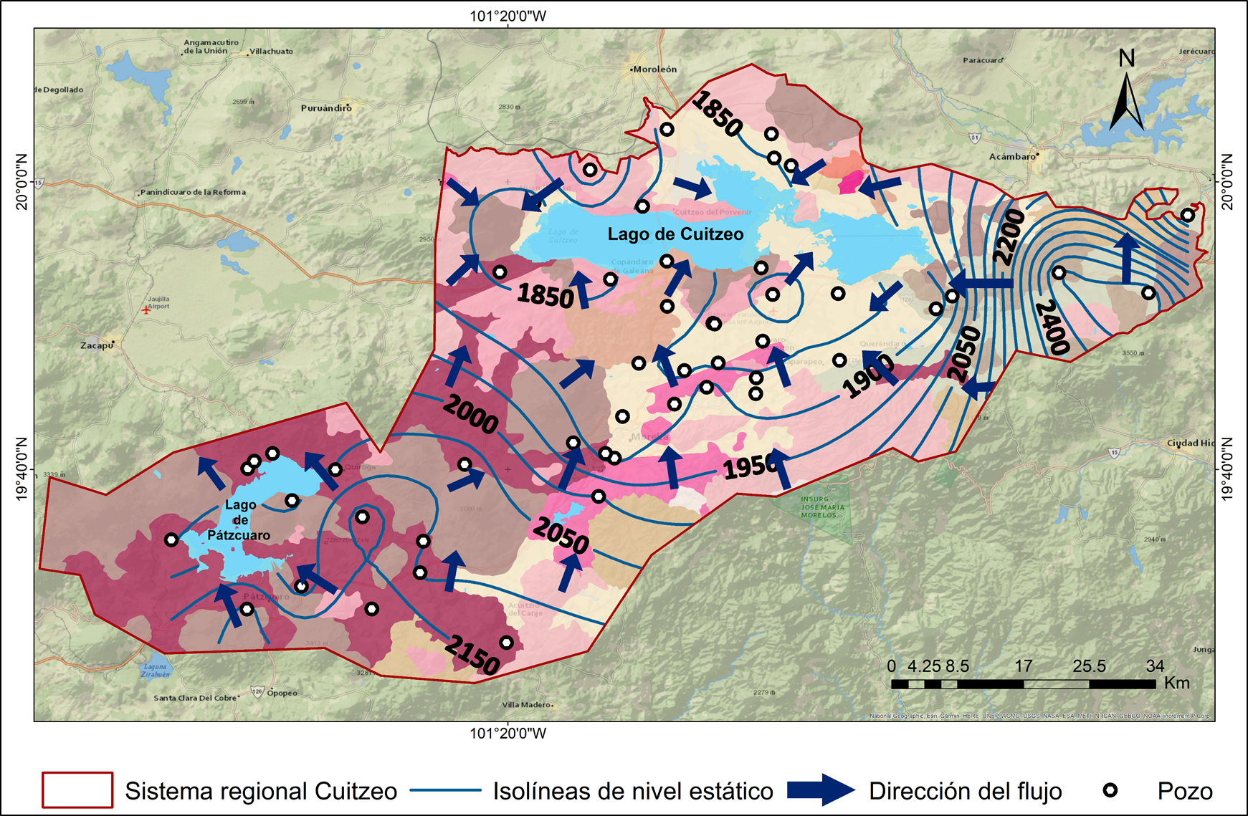
Recopiled data 171 sites with hidrogeoquimical data for 1983, 1990, 1997, 1999, 2001, 2002, 2003, 2006, 2007, 2014, and 2015. 44 piezometrics levels from wells in the zone for the year 2024. Identify 3 groundwater movement directions: towards Lake Cuitzeo, Lake Pátzcuaro and the center of the zone in the Morelia city
Results
Fig. 5. Sites with collected data
Fig. 6. Cuitzeo system groundwater flownet

Slide 6
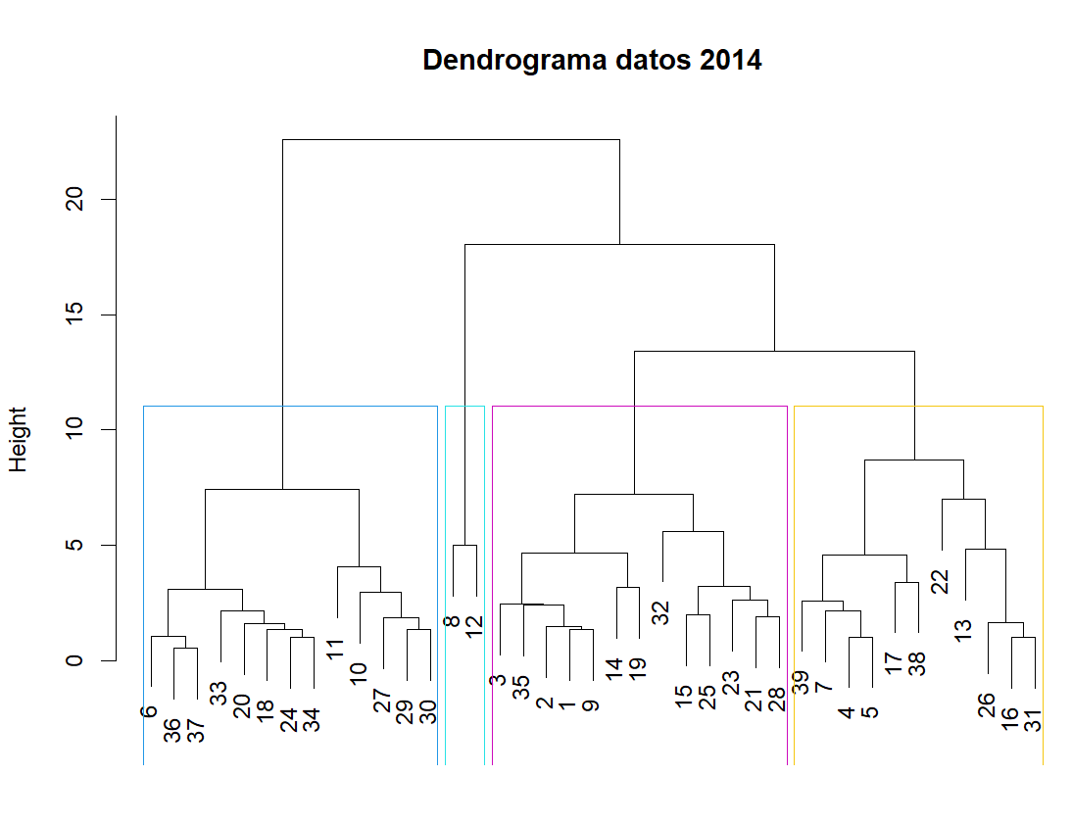
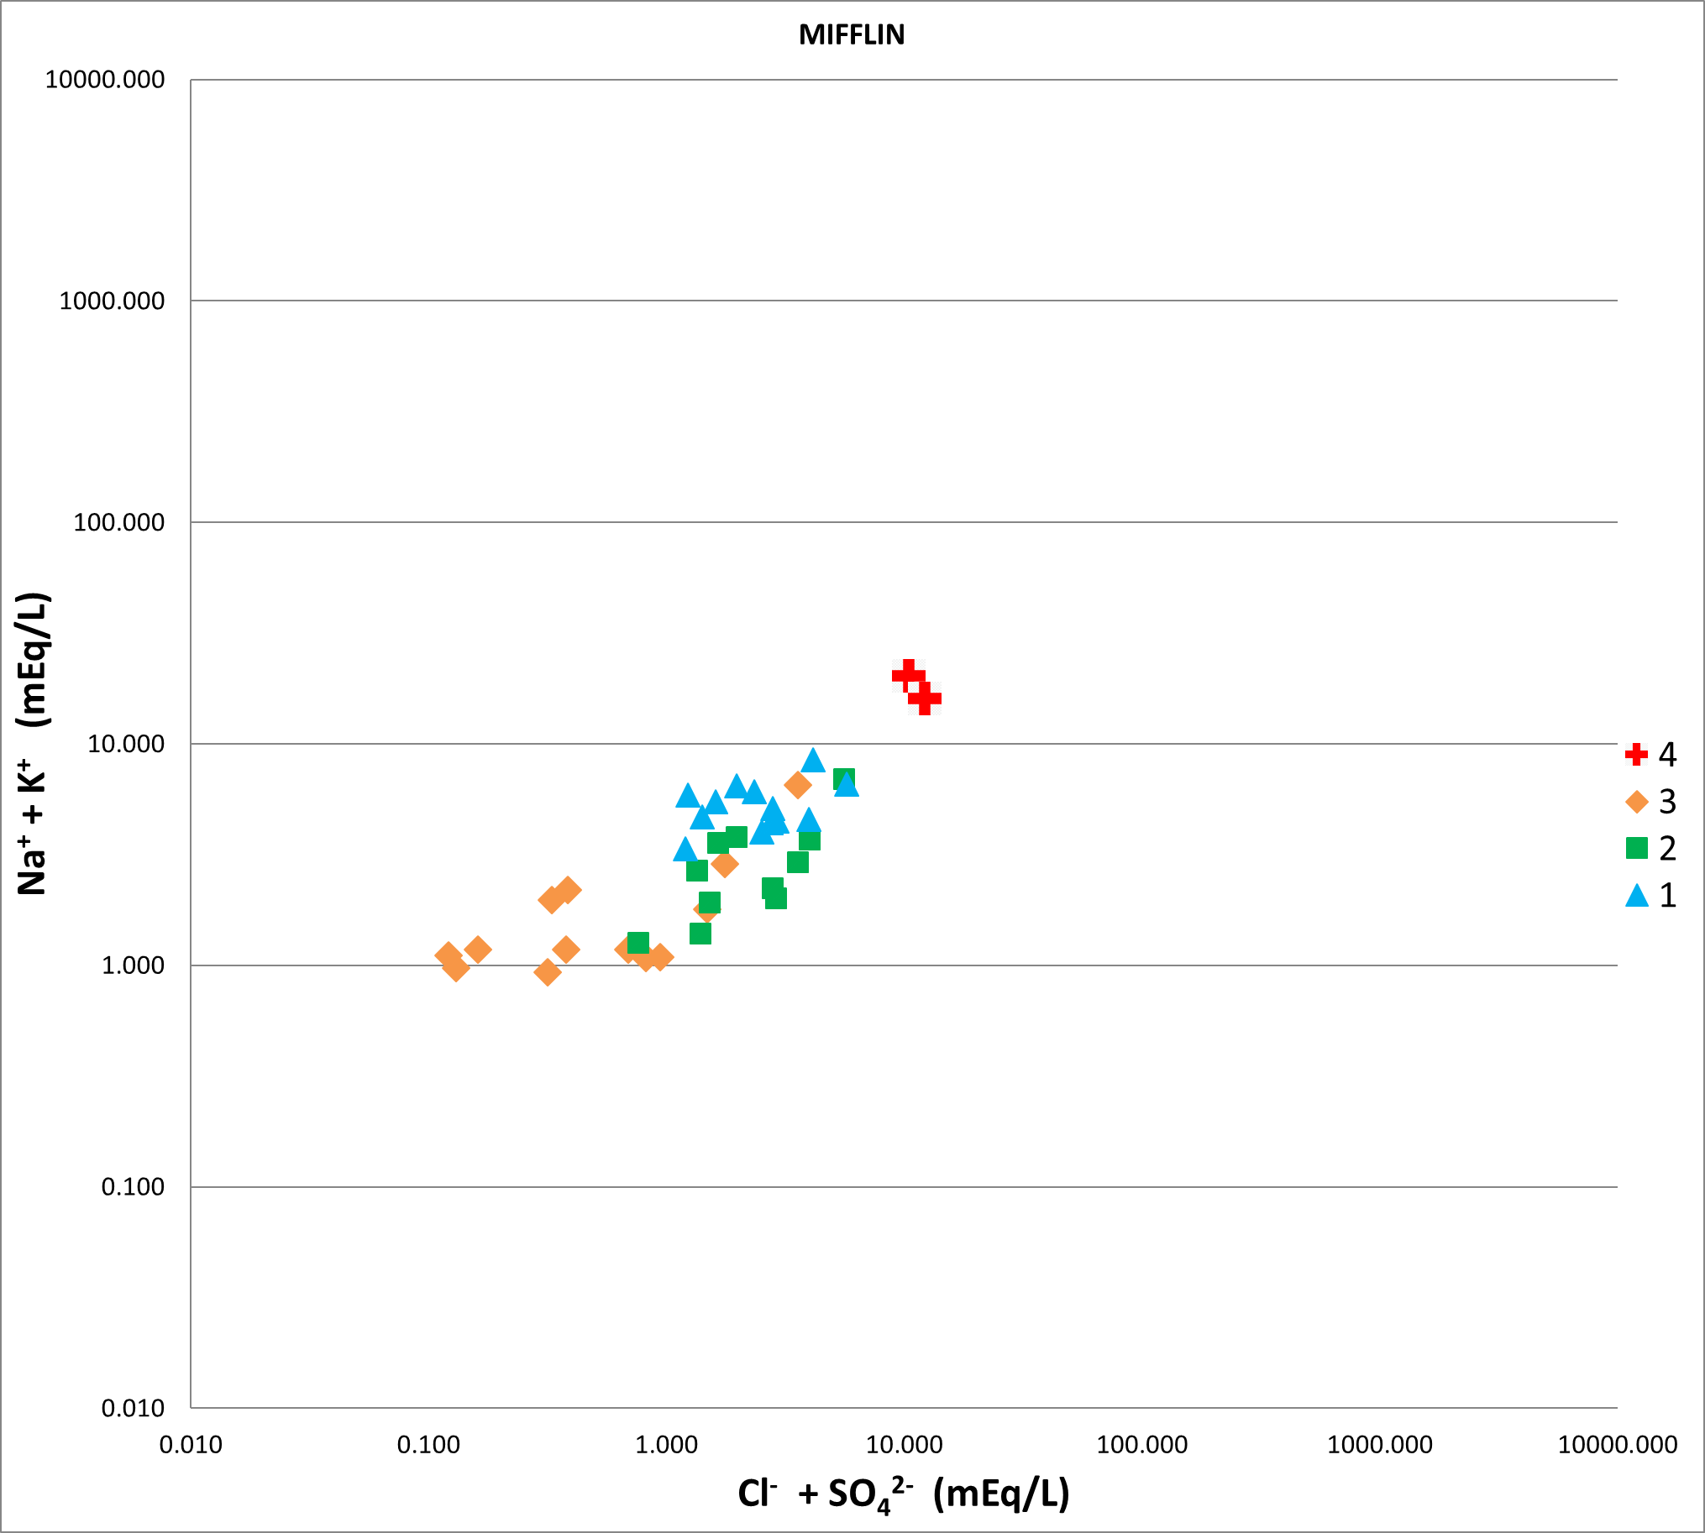
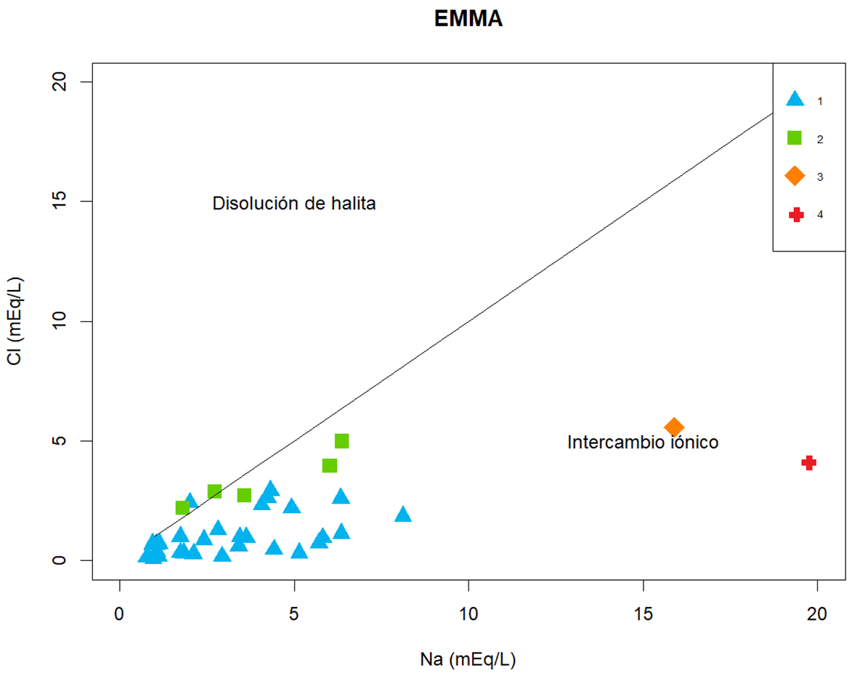
Results
Cluster analysis
Data collected for 2014 shows 4 groups, where a mixing process betweenn them can be observed in Piper and Mifflin diagrams.
Fig. 7. Dendrogram of the cluster analysis
EMMA
Fig. 8. Piper diagram with cluster data
Fig. 9. Mifflin diagram with cluster data
By observing the data distribution in the Piper diagram, it can be identify that group 1 and 2 correspond to mixed bicarbonate waters, while the group 3 and 4 tend to be mainly sodium-choride water.
In the Scatter plot all the sites are located in the ion exchange zone, mainly group 3 and 4.
Fig. 10. Piper diagram with EMMA data
Fig. 11. Scatter plot Na vs Cl (meq/L) with EMMA data

Slide 7
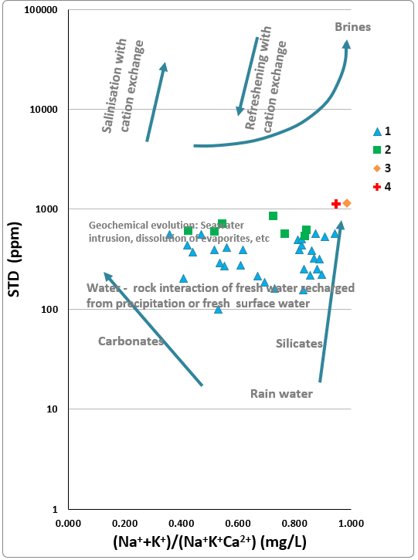
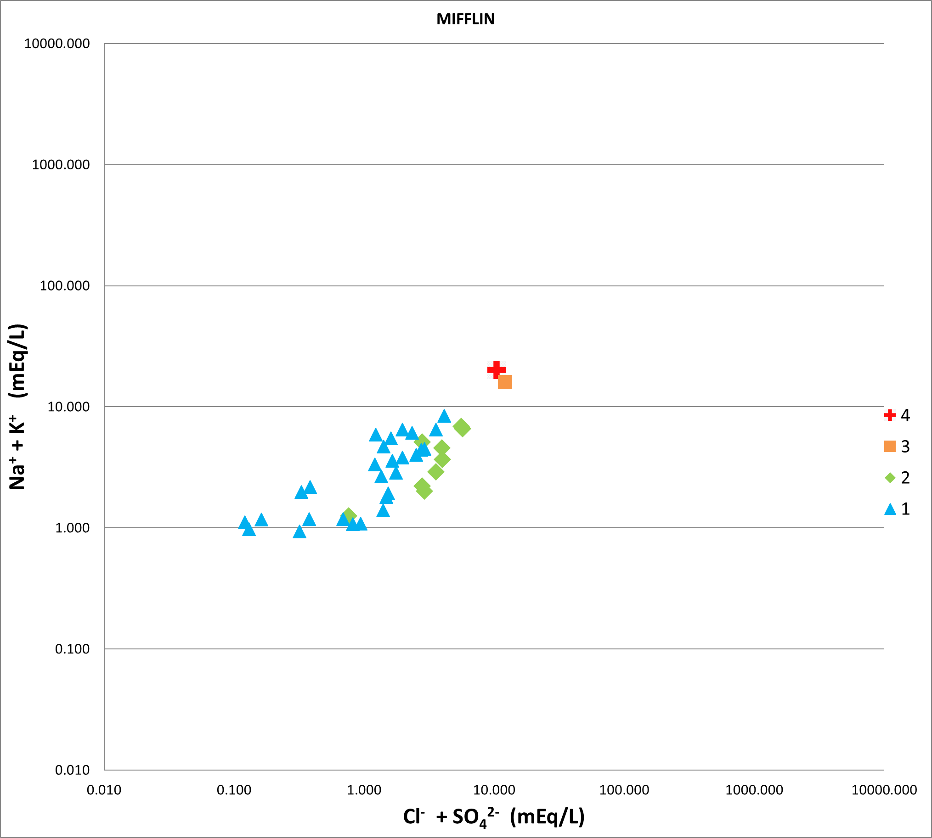
Results
Fig. 13. Mifflin diagram.
Fig. 12. Gibbs diagram.
In the diagrams, we can observe again 4 groups but only 2 of them present a mixing process. Group 1 and 2, which are local and intermediate flows because of the menor concentration of SDT and ion concentrations (Fig.12 and 13). Group 3 and 4 are richer in SDT (more than 1000 ppm) and have a major ion concentration, thus indicates a more evolutionated groundwater therefore corresponding to a regional flow.

Slide 8
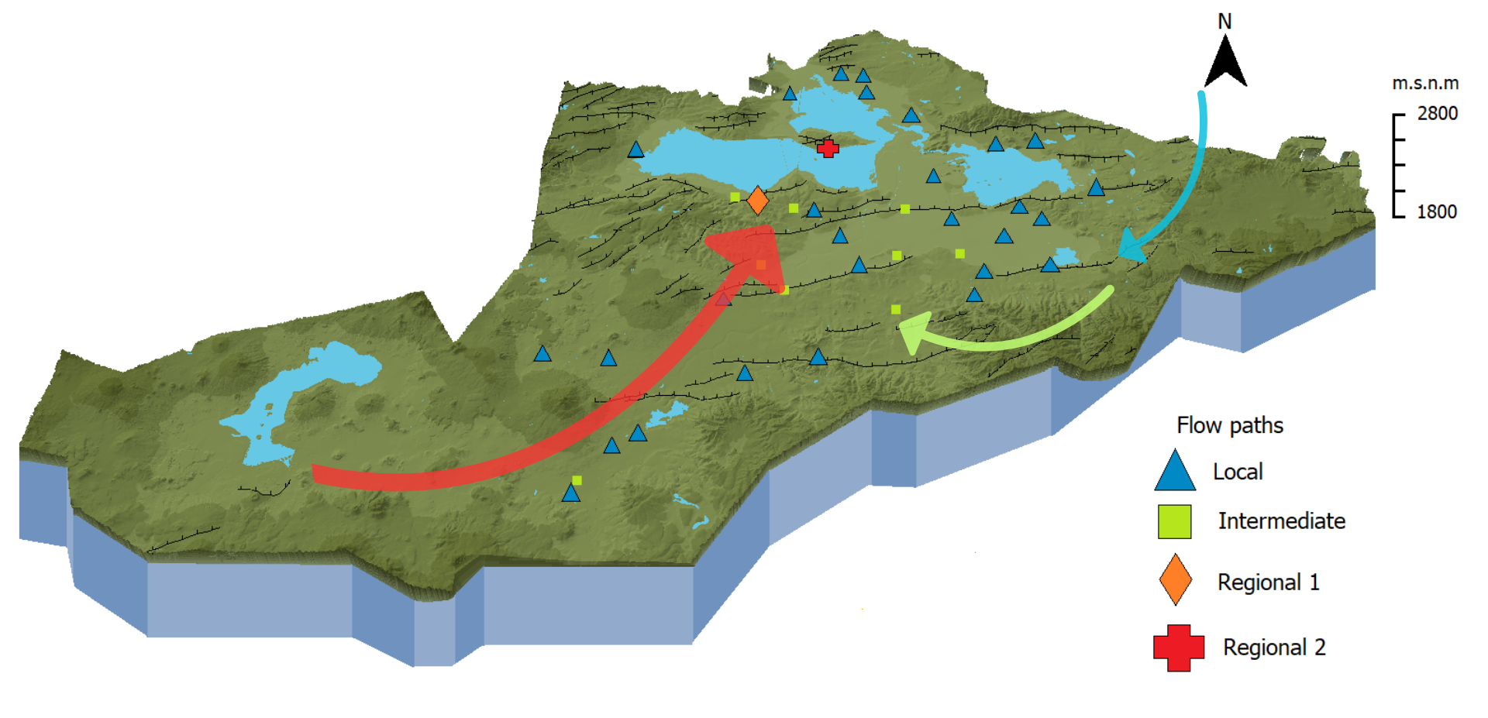
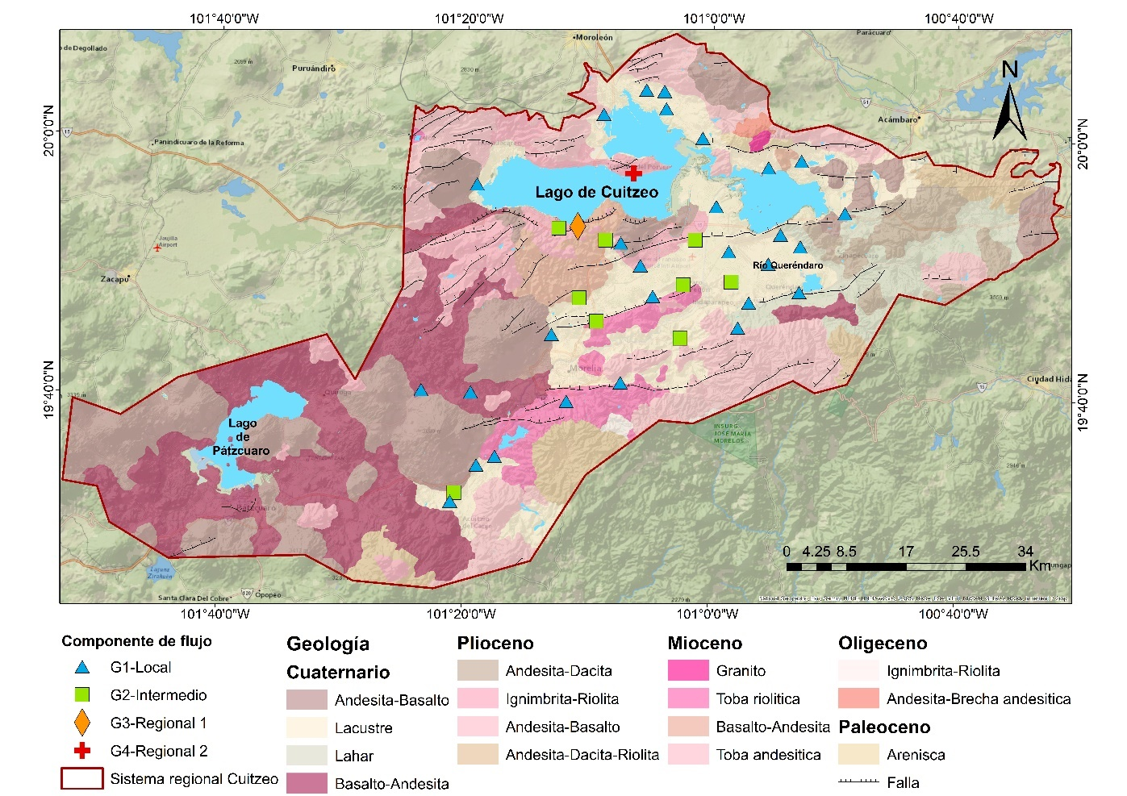
Results
Conceptual hydrogeochemical model
The blue arrow indicates a local flow, the green arrow represents an intermediates flow, and the red arrow indicates regional flows. We can observed the representation of the groundwater in 3 paths, local are shallow meanwhile regional flow occur at major depths. Other important thing is how the group 3 and 4 are located in geologial faults.

Slide 9
Conclusions
We identified 4 groundwater Flow paths: local, intermediate and two regionals with distintics characteristics, one presentes an evolution which responds to Chebotarev sequence and the other indicates water from major profundity which ascends through geological faults.
There are a mixing process between local and intermediate flows in the center zone of the area of study ( Morelia city).
The evolution of the groundwater is dominated by water-rock interactions and ion exchange processes. This geochemical evolution begins with the infiltration of groundwater in the exterior boundaries of the system -mainly in the north zone of Lake Cuitzeo- where the water is charecterized as bicarbonate type (HC03). The water evolves along the Flow paths from the boundaries of the system towards the Cuitzeo lake where becomes dominated by major ions such as SO4-/Cl- (sulfate-chloride groundwater)

Slide 10
Acknowledgments
Proyecto PAPIIT N° IA101924 “Aplicación de un enfoque multifactorial para comprender los procesos hidrogeológicos ambientales en el agua subterránea y los cuerpos con los que tiene conectividad hidrológica: caso de estudio sistema de flujo Cuitzeo”.
References
Winter, T.C., Harvey, J.W., Franke, O.L., Alley, W.M., Casadevall, T.J., & Hirsch, R.M. (1998). Ground water and surface water a single resource: U.
Escolero Fuentes, Ó. A. (2018). Sistemas regionales de flujo de agua subterránea en México (1st ed.). Instituto Mexicano de Tecnología del Agua.
aurorallanos@ciencias.unam.mx

