Slide 1
Utilizing Distributed Temperature Sensors in a Single Well with a Heating Line Source to Simultaneously Estimate the Direction and Velocity of Groundwater Flow
Cheng-Han Liu & Yung-Chia Chiu
National Taiwan Ocean University, Institute of Earth Sciences, Keelung, Taiwan

Slide 2
Content
Motivation & Purpose
Research Framework
Method
Distributed temperature sensor(DTS)
Thermal Vector-DTS (TV-DTS)
Analytical Solution of a Linear Heat Source
TV-DTS laboratory Test
Experimental Site
Experimental Site Background
TV-DTS Results
Site 1
Site 2
Single Well Heating Results
Site 1
Site 2
Conclusion

Slide 3
Motivation
Purpose
Cost-Effective
Determine Flow Direction and Velocity
High-Resolution Data
New Measurement Method
Hydrogeological Investigation
Pollutants
Groundwater Direction and Velocity
Groundwater Resource Management
Geological Risk Assessment
Traditional Methods
Require Multiple Wells
Time consuming
Inaccurate data
Pumping Test
Cross-borehole tracer test

Slide 4
Research Framework
The conceptual design of the Thermal-vector DTS
Research and Development
Lab test
Thermal-vector DTS heating field test
Data Processing & Calibration
Analytical Solution of a Linear Heat Source
Flow Direction and Velocity

Slide 5
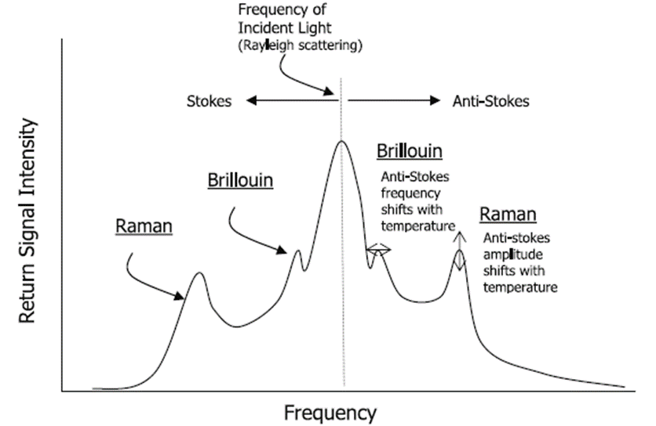
Method
Distributed temperature sensor(DTS)
A laser pulse analyzer sends laser pulses into an optical fiber cable.
As the light travels through the fiber, part of it is backscattered due to interactions with the fiber material and received by the system.
The system analyzes the backscattered signals(Raman scattering) to estimate the temperature distribution along the fiber.
(Selker et al., 2006)
$$T\left(z,t\right)=\frac{γ}{\ln\left(\frac{P_{S}\left(z , t\right)}{P_{aS}\left(z , t\right)}\right)+C\left(t\right)−\int_{0}^{z}{∆α\left(z′\right)dz′}}$$
(https://www.apsensing.com/technology/dts)

Slide 6
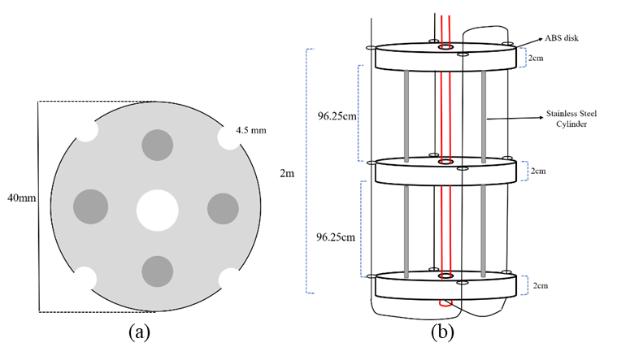
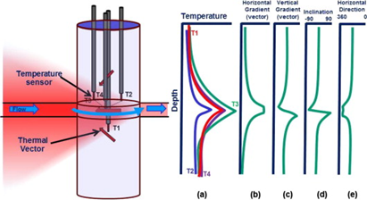
Method
Thermal Vector-DTS (TV-DTS)
TVP concept: Central heater + 3 surrounding sensors to estimate groundwater velocity and direction at a specific depth.
TV-DTS: The optical fiber replaces the traditional heater and temperature sensors used in TVP.
Single heated fiber (center) and four sensing fibers (surround).
With single-well heating test
Analyze temperature differences caused by groundwater flow to estimate flow direction and flow velocity.
(Zlotnik & Tartakovsky, 2018)
(Pehme et al., 2014）

Slide 7
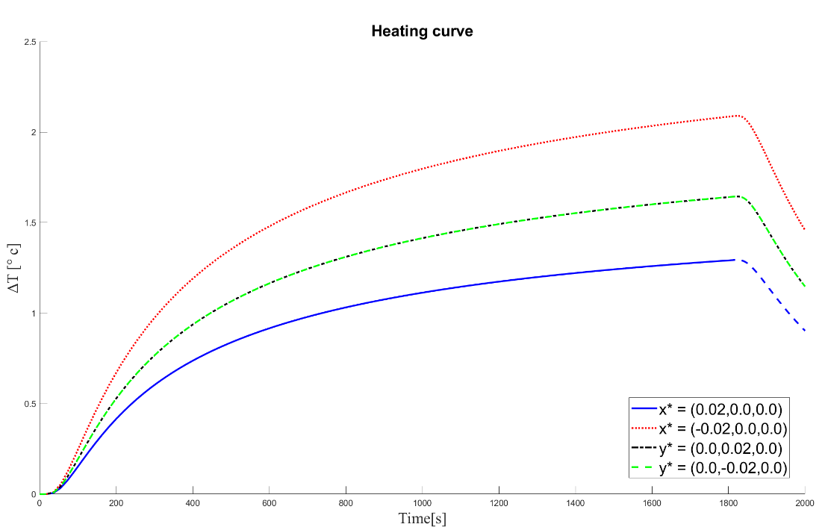
Method
Analytical Solution of a Linear Heat Source
In the TV-DTS experiment conducted in this study for analyzing groundwater flow direction, the heat source was treated as a fixed point source (E) that supplied heat over a finite heating duration ($t_{p}$​).
The solution accounts for a finite-duration point source in a three-dimensional domain:
$$T\left(\tilde{x,}\tilde{y},\tilde{z},t\right)=\left\{\begin{aligned}T_{p}\left(\tilde{x,}\tilde{y},\tilde{z},t\right) 0≤t≤t_{p} \\ T_{p}\left(\tilde{x,}\tilde{y},\tilde{z},t\right)−T_{p}\left(\tilde{x,}\tilde{y},\tilde{z},t−t_{p}\right) t≥t_{p}\end{aligned}\right.$$
$T_{p}\left(\tilde{x,}\tilde{y},\tilde{z},t\right)=\frac{E/(ρc)}{8πD_{T}t_{p}R}e\overline{z}[e^{−\overline{R}}erfc\left(\frac{R−Vt}{2\sqrt{D_{L}t}}\right)+e\overline{R}erfc(\frac{R+Vt}{2\sqrt{D_{L}t}})$]
$E$:Heat pulse energy $ρc$: heat capacity of hosting medium
$V$: heat transport velocity $D_{L}$:thermal dispersivity tensor (longitudinal)
$(\tilde{x,}\tilde{y},\tilde{z})$:By rotating the field coordinate system (x, y, z)
Convert the local coordinate system to the main coordinate system by rotation.
Used to estimate groundwater velocity and direction by fitting to observed temperature curves.
(Zlotnik & Tartakovsky, 2018)

Slide 8
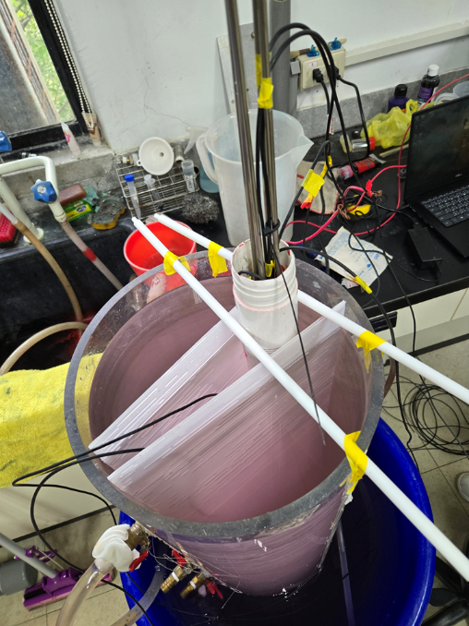
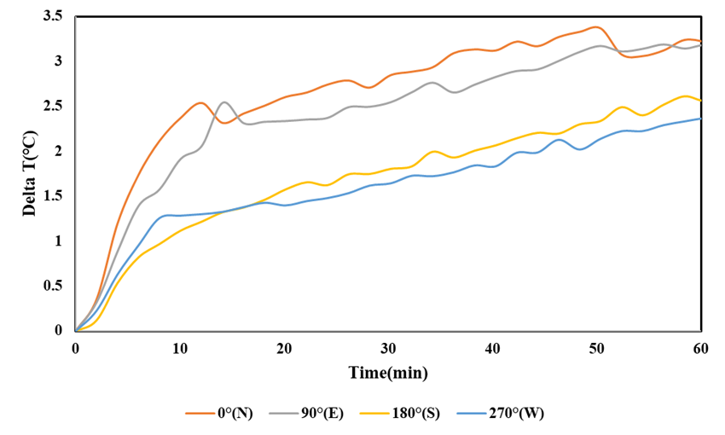
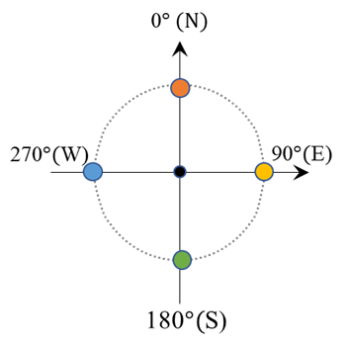
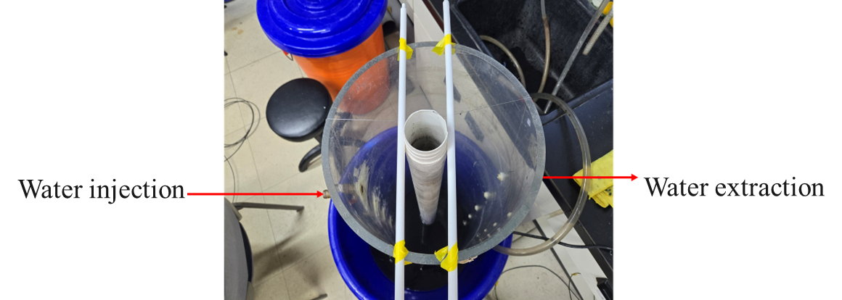
TV-DTS laboratory Test
Experimental Setup
Flow direction setup: S to N
Heating Power : 30 W/m
Heating duration: 60 minutes
Experimental Result
Flow direction : SW to N
 | Max ΔT($℃$) | Cumulative Temperature($℃$)
0°(N) | 3.36 | 84.19
90°(E) | 3.19 | 77.50
180°(S) | 2.65 | 55.42
270°(W) | 2.37 | 51.83

Slide 9
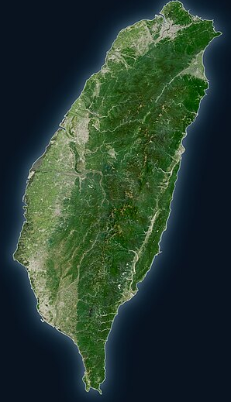
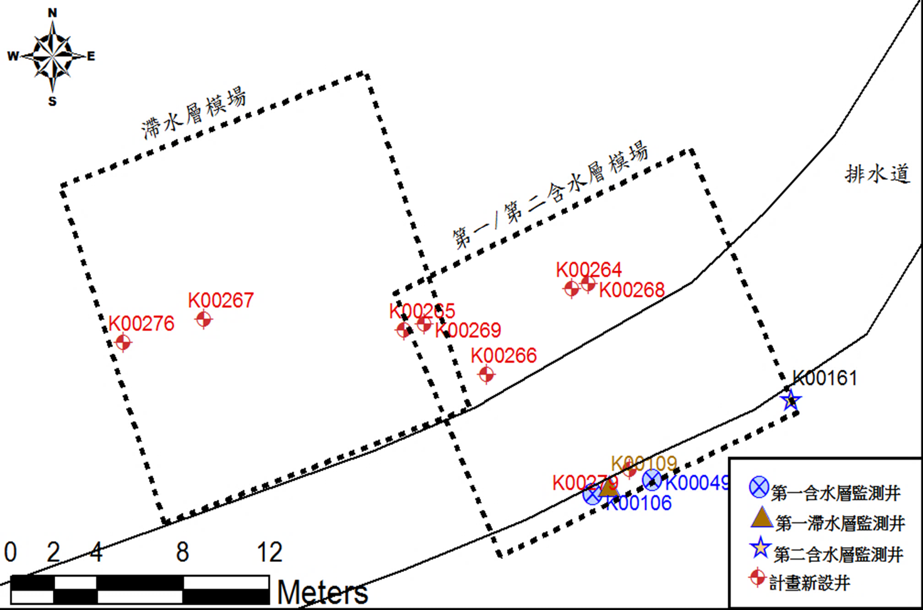
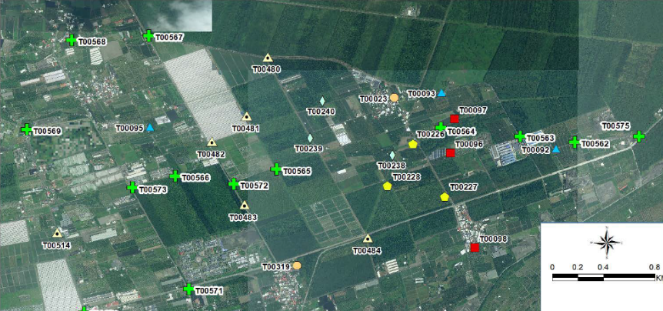
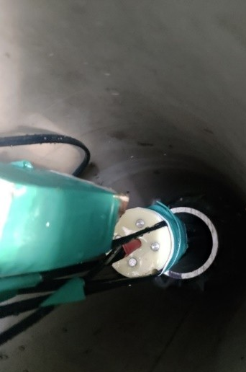
Experimental Site
Site 1:The north of Taiwan
Site 2:The south of Taiwan
Well T00226 TV-DTS Test
Heating power: 11W/m
Heating duration: 30 min
Test depths:38-40m
Well K00264 TV-DTS Test
Heating power: 30W/m
Heating duration: 45 min
Test depths:8-10m

Slide 10
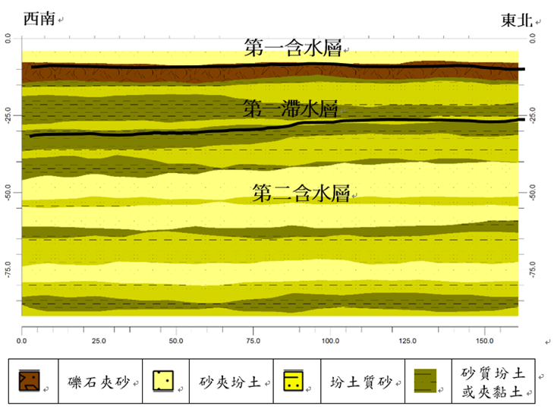
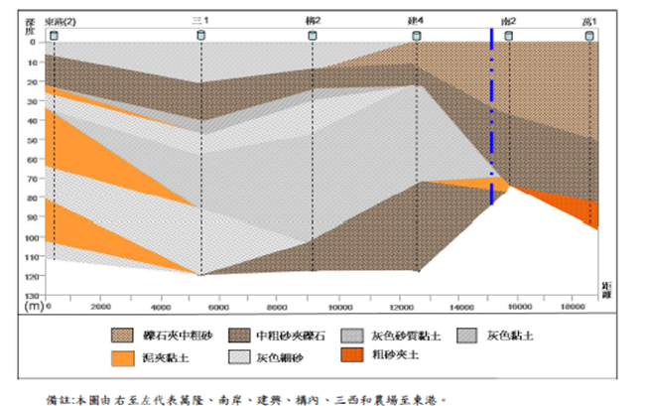
Experimental Site Overview
Name | Well depth(m) | Casing diameter(inch) | Screened interval(m)
K00264 | 12.1 | 2” | 3-12
Name | Well depth(m) | Casing diameter(inch) | Screened interval(m)
T00226-1 | 44 | 2” | 38.0-44.0
SW
NE
W
E
First Aquifer
Confining Layer
First Aquifer
Second Aquifer
First Confining Layer
Second Aquifer
Second Confining Layer
Gravelly sand
Sand + Silty Clay
Gravel with coarse sand
Medium coarse sand with gravel
Silty Sand
Sandy Silt or clay lenses
Silt with Clay
Gray fine sand
Gray sandy clay
Gray clay
Coarse sand with soil

Slide 11
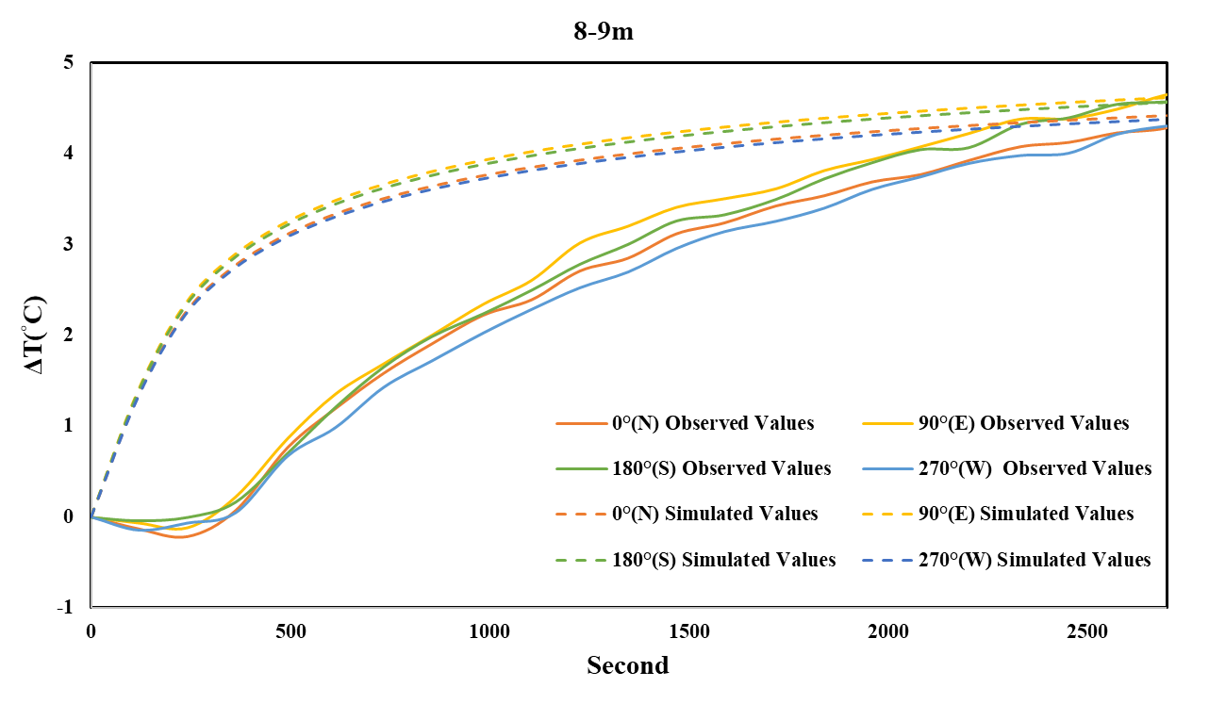
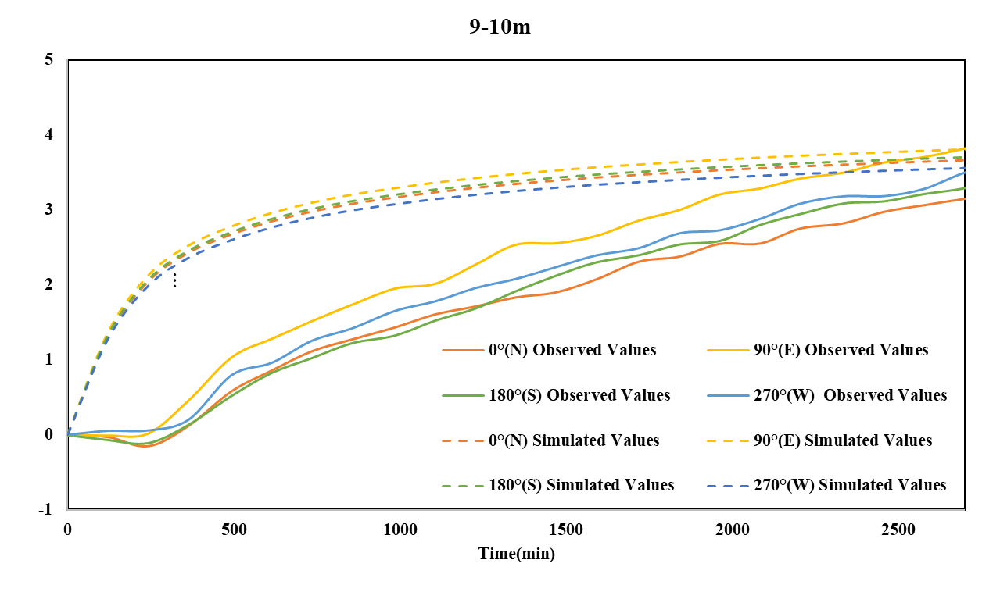
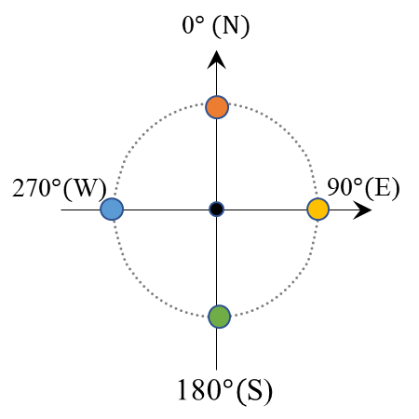
TV-DTS Test Results
Site 1
Previous research flow direction
 | Cumulative Temperature($℃$) | Max ΔT($℃$)
N 8-9m | 86.25 | 4.42
E 8-9m | 89.93 | 4.61
S 8-9m | 88.93 | 4.56
W 8-9m | 85.29 | 4.37
 | Cumulative Temperature($℃$) | Max ΔT($℃$)
N 9-10m | 72.96 | 3.67
E 9-10m | 75.93 | 3.82
S 9-10m | 73.84 | 3.72
W 9-10m | 70.96 | 3.57
Velocity: 0.2-0.3 m/d, RMSE:1.9-2.3℃

Slide 12
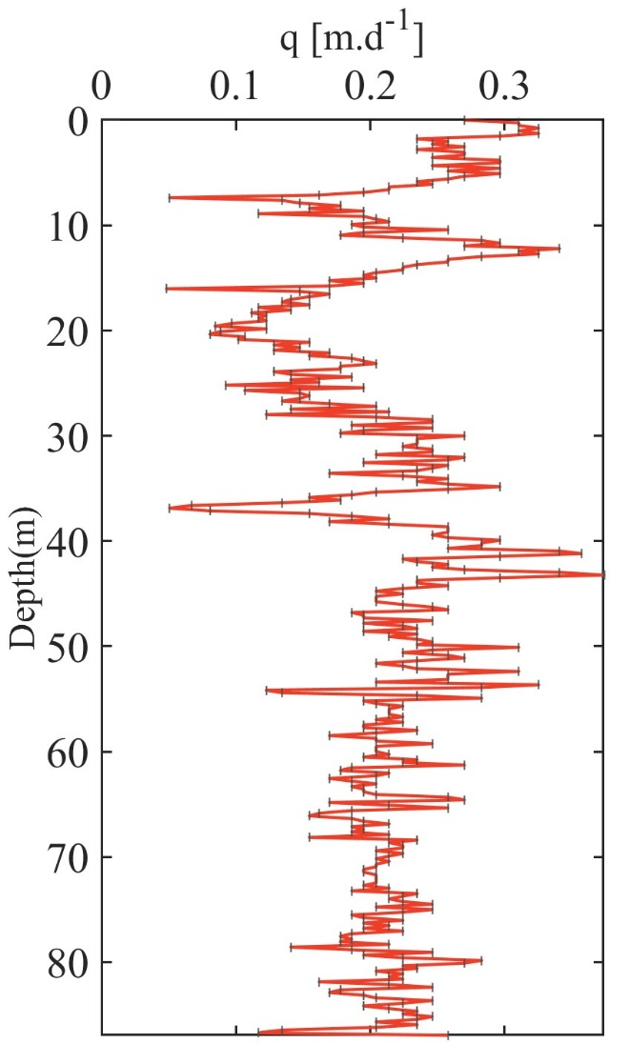
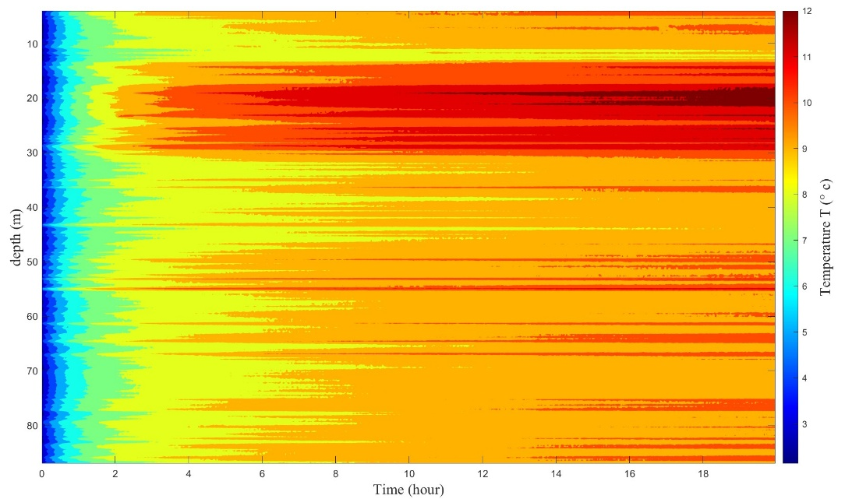
Single Well Heating Results
Site 1
Heating Power: 20 W/m
Heating Duration: 20 hrs
Higher Velocity
Lower Velocity
Velocity: 0.05-0.37 m/d

Slide 13
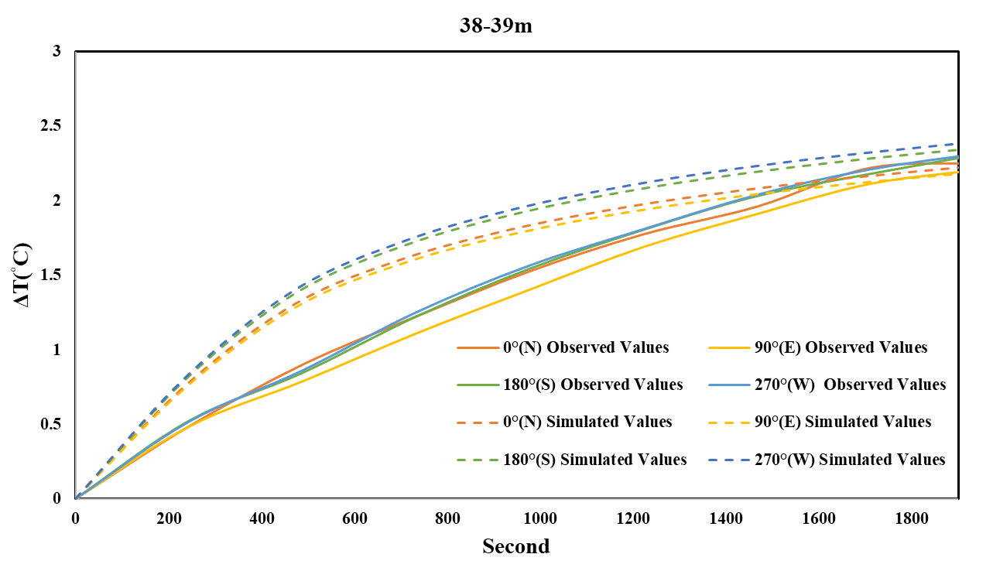
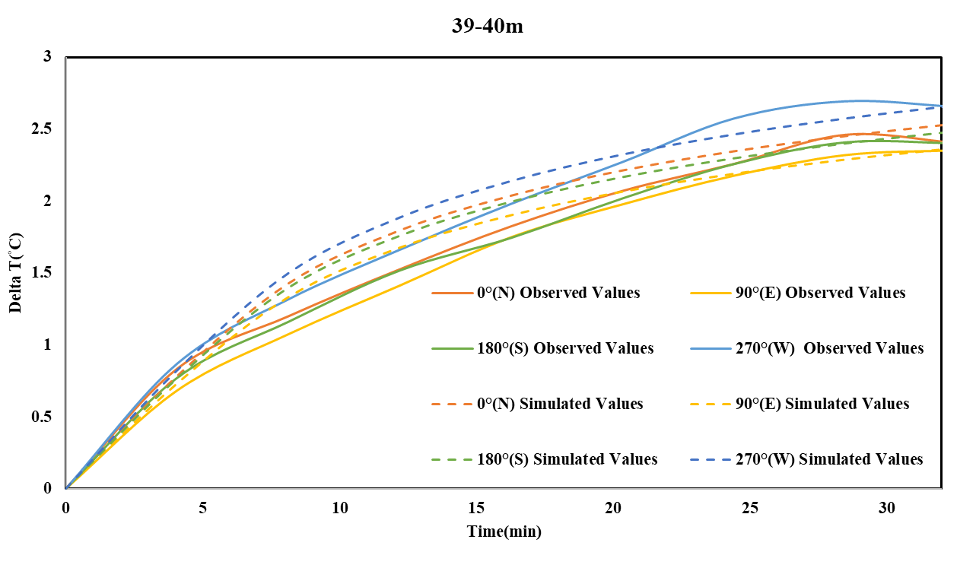
TV-DTS Test Results
Site 2
Previous research flow direction
 | Cumulative Temperature($℃$) | Max ΔT($℃$)
N 38-39m | 13.9 | 2.22
E 38-93m | 13.64 | 2.18
S 38-39m | 14.65 | 2.34
W 38-39m | 14.93 | 2.39
 | Cumulative Temperature($℃$) | Max ΔT($℃$)
N 39-40m | 15.59 | 2.54
E 39-40m | 14.55 | 2.37
S 39-40m | 15.27 | 2.49
W 39-40m | 16.36 | 2.66
Velocity:0.08-0.43 m/d, RMSE:0.1-0.3℃

Slide 14
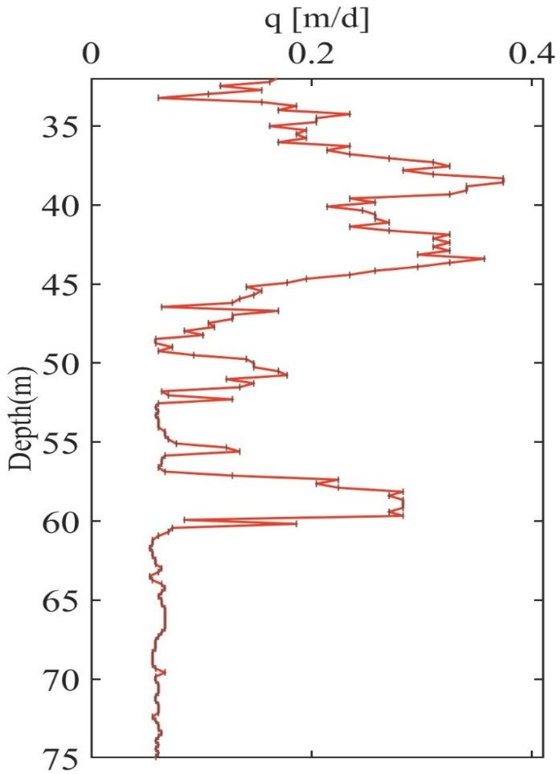
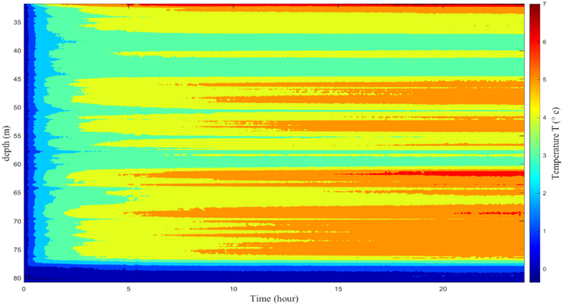
Single Well Heating Results
Site 2
Heating Power: 11 W/m
Heating Duration: 24 hrs
Higher Velocity
Lower Velocity
Velocity: 0.06-0.37 m/d

Slide 15
Conclusion
This study presents a new approach to estimate the groundwater flow direction and velocity from a single well heat pulse response test. The method utilizes a heating cable and a single fiber-optic cable with DTS technology, replacing traditional temperature sensors with fiber optics to provide more stable and high-precision temperature measurements in both time and space.
After laboratory testing, the TV-DTS was applied to two different field test sites, combined with a thermal tracer that does not disturb groundwater and soil. By fitting the field test results with the analytical solution of heat transfer, the groundwater flow direction and velocity at specific depths in the well can be accurately estimated.
Compared to traditional multi-well methods, this approach reduces cost, time, and uncertainty in data interpretation. Based on the results, TV-DTS shows highly potential for identifying groundwater flow direction and velocity based on thermal signals. It can also can provide the current detail status of groundwater velocity field and be used as a reference tool for selecting remediation strategies for contaminated sites.

