Slide 1
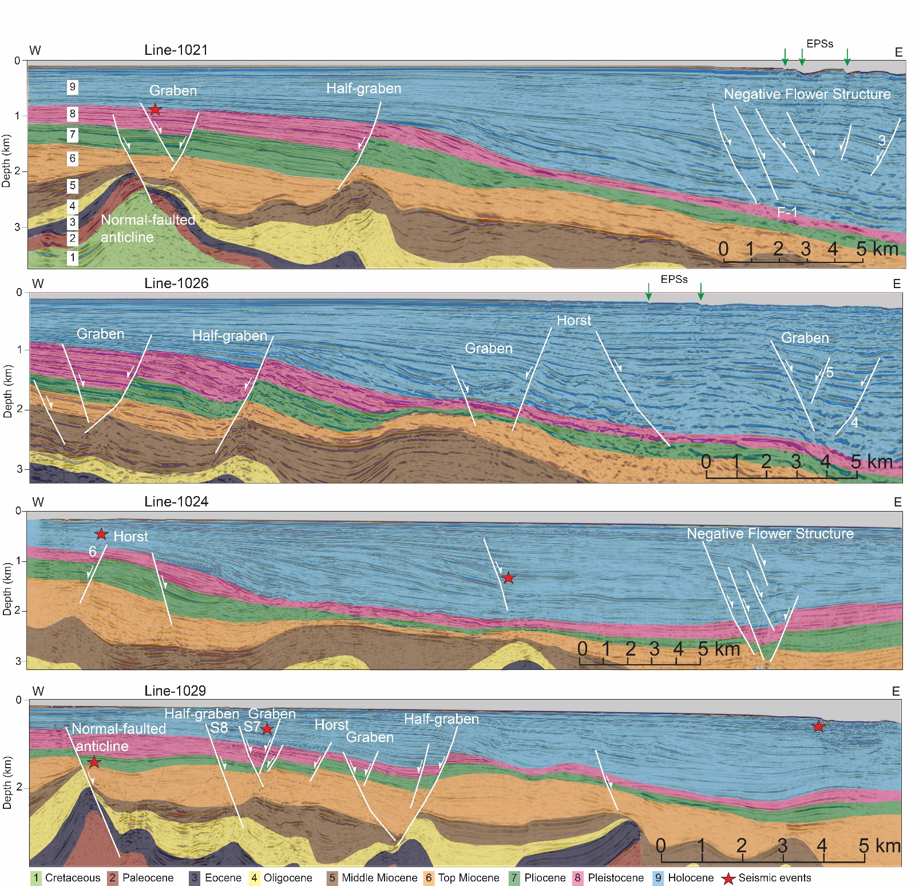
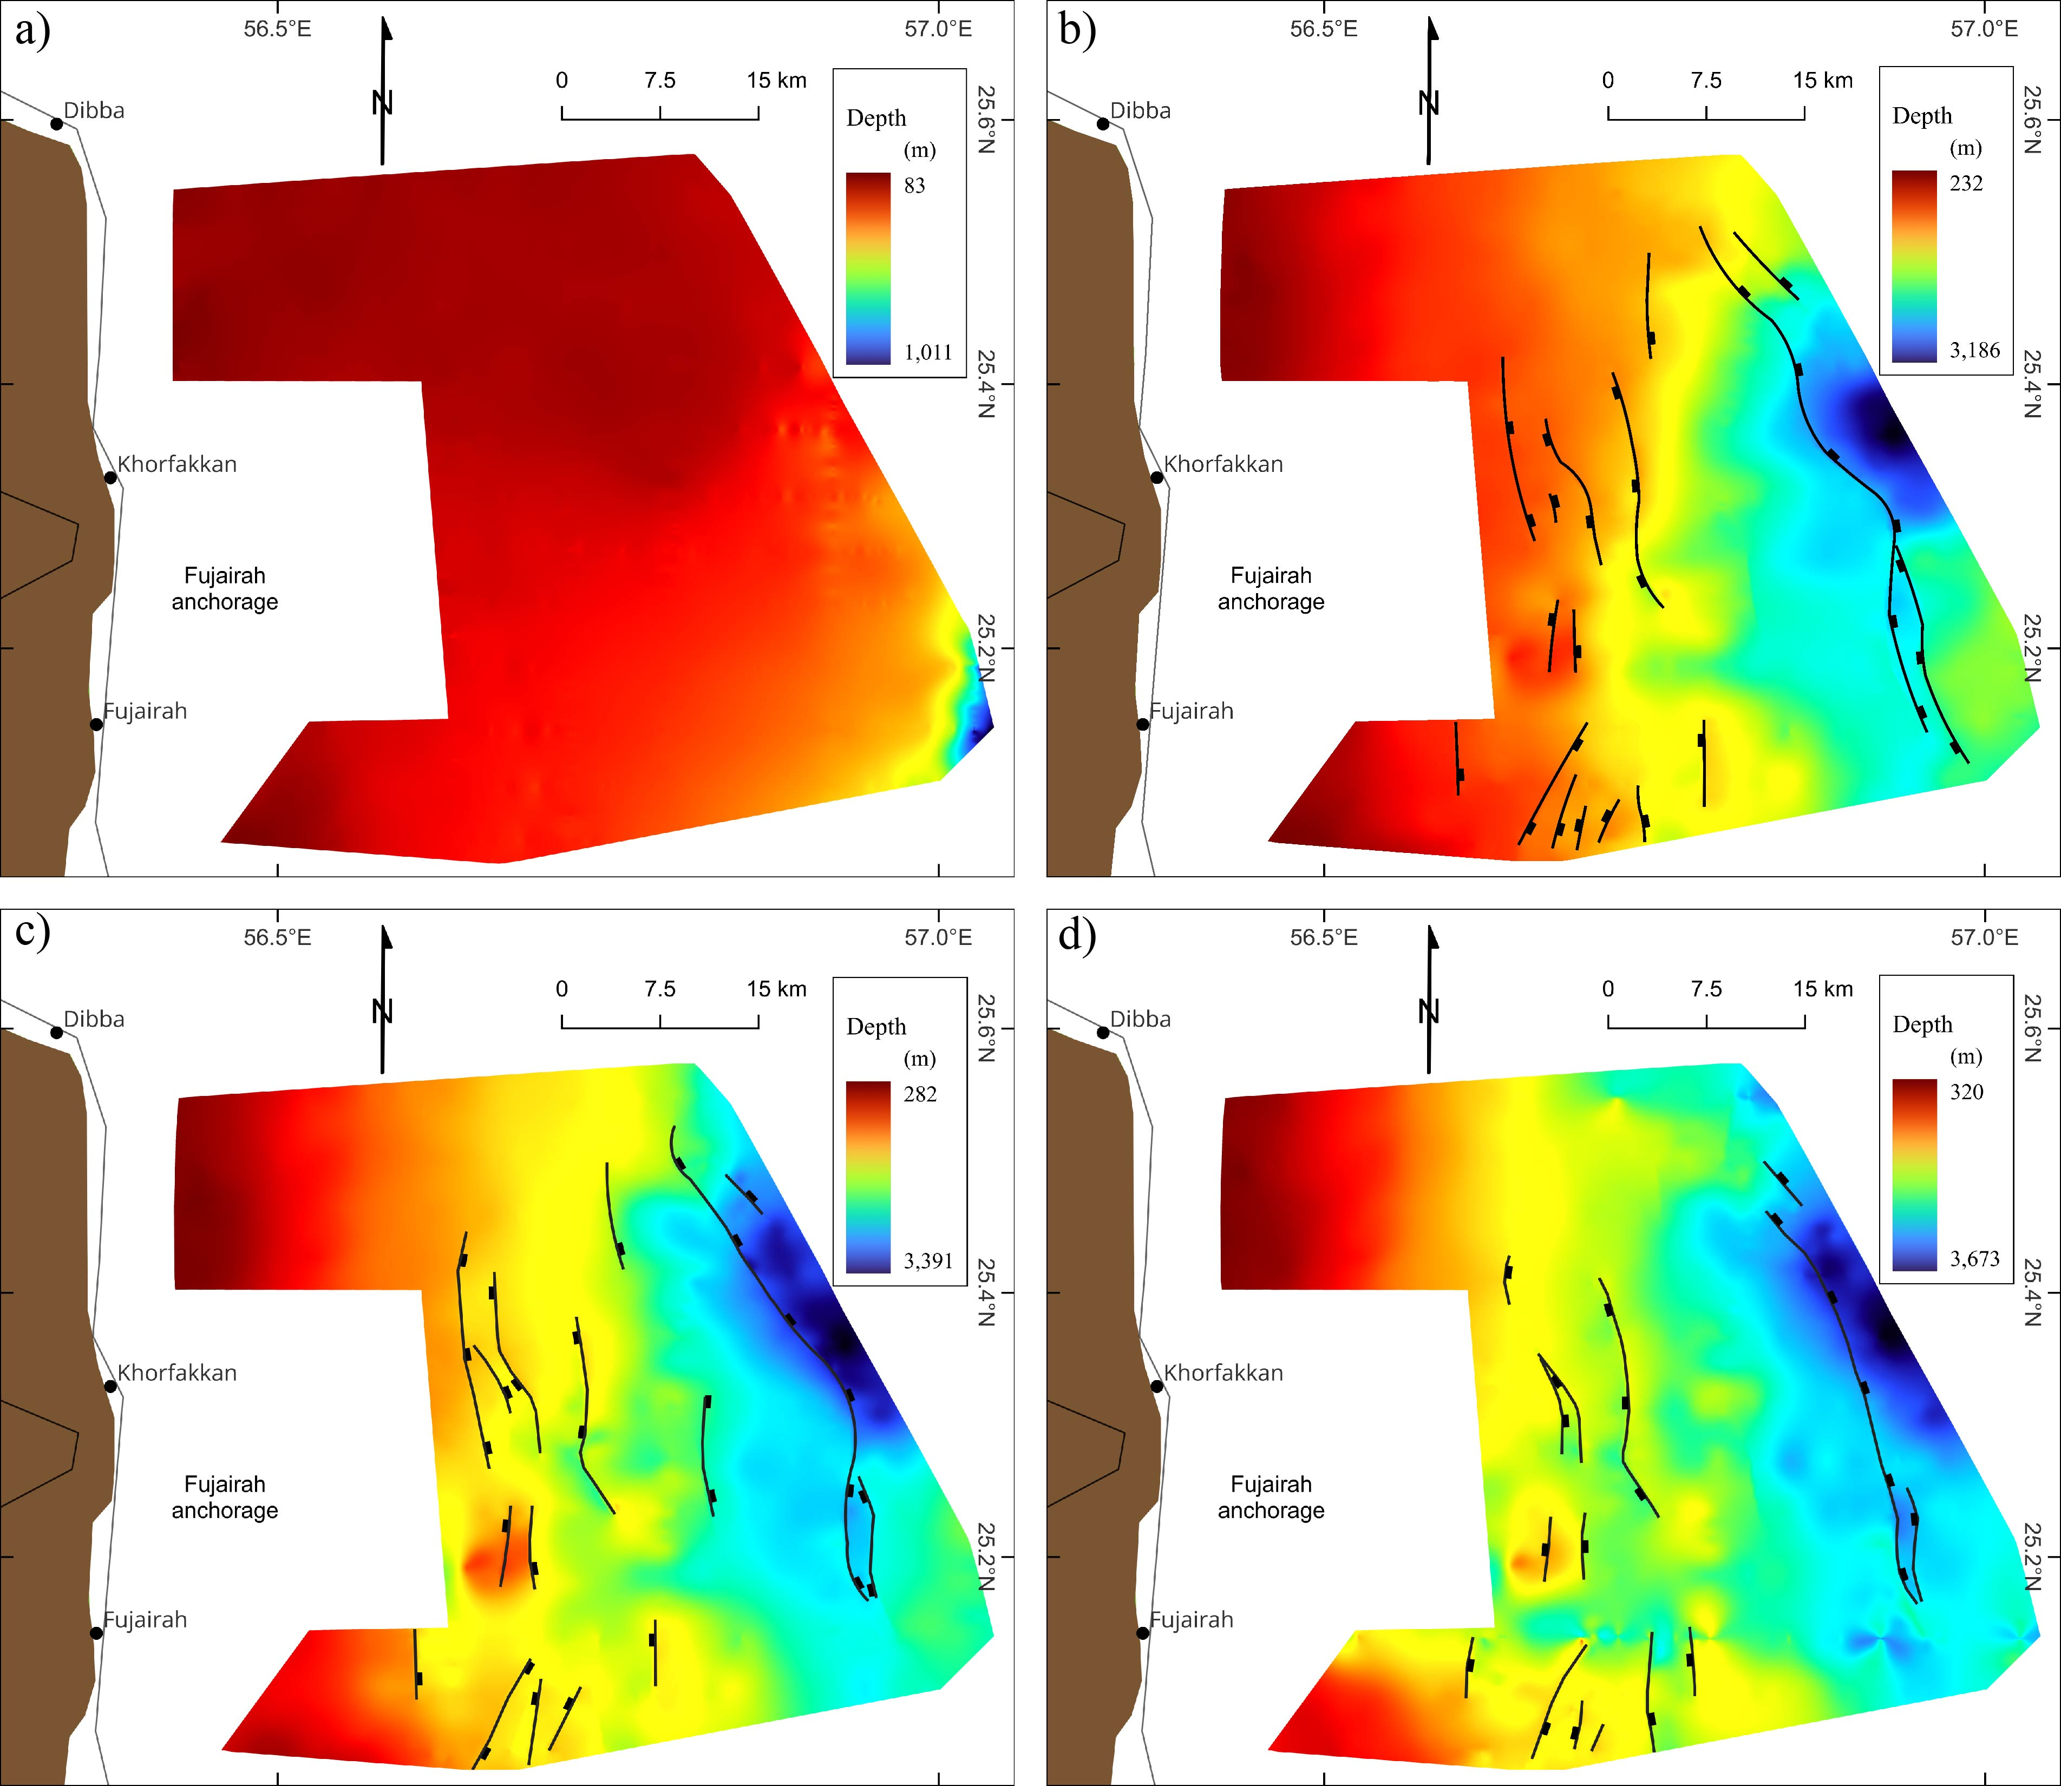
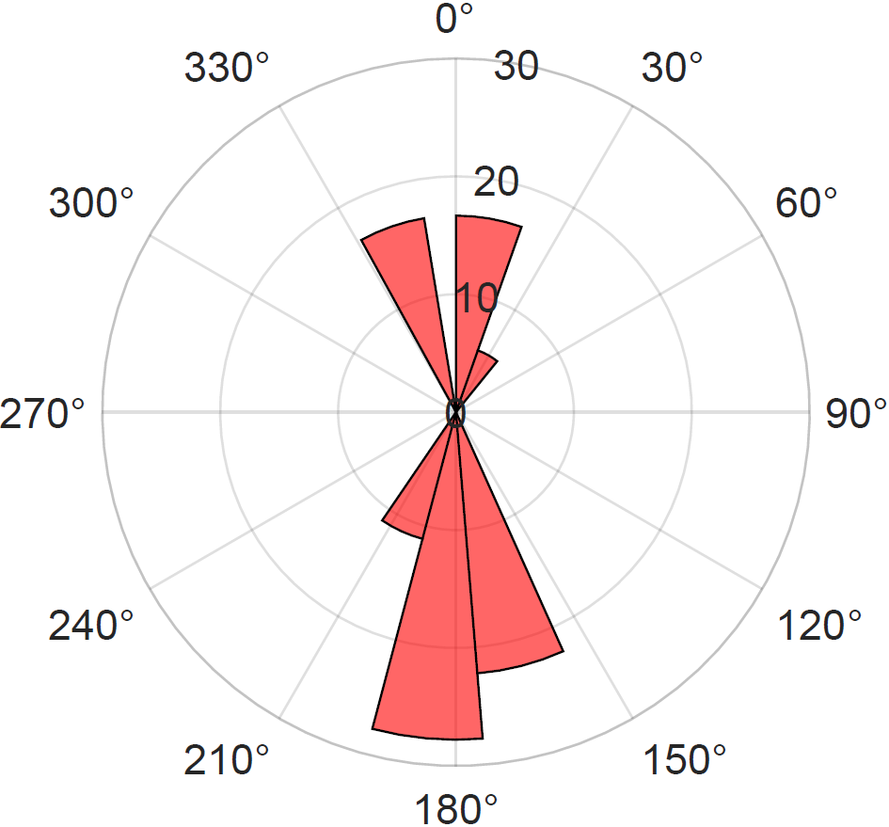
EGU25-3031: Mapping Active Seabed Ruptures in the Eastern Offshore UAE, Gulf of Oman
Omar Aldhanhani¹ (100050202@ku.ac.ae), Mohammed Y. Ali¹, Ahmed Abdelmaksoud¹, Aisha AlSuwaidi¹
¹Khalifa University for Science and Technology. Abu Dhabi 127788, UAE
a)
Abstract
The eastern offshore region of the United Arab Emirates, located along the northeastern boundary of the Arabian Plate in the Gulf of Oman, is influenced by the tectonic activity of the Zendan-Minab fault system and the Makran subduction zone. This research integrates data from multi-beam bathymetry, seismic reflection profiles, and earthquake monitoring to analyze fault behavior and regional tectonics. High-resolution bathymetric surveys, conducted with an EM 712 multi-beam echo sounder, reveal N-S to NNW fault lineaments. Some of these structures correspond to shallow earthquake events (magnitude ~2–3 Mw) occurring at depths of less than 5 km. Seismic reflection data indicate that these faults penetrate up to 3 km into the subsurface, cutting through Paleocene-aged sediments, especially in the eastern side. Additionally, sediment accumulation within Pleistocene-Holocene deposits, ranging from 1 to 2.5 km in thickness, and signs of eastward tilting suggest tectonic activity related to the Makran subduction. The clockwise change in shelf orientation over time (from NNW–SSE to NE–SW), the clockwise rotation of the depocenter (from NNE to ENE), and the presence of a sinistral strike-dip slip duplex are likely attributed to the Miocene-onward counterclockwise rotation of the Arabian Plate combined with subsidence associated with the Makran Subduction Zone.
Fig. 5: Sediment thickness and sedimentation rates maps (derived from surface maps) at various time frames: a) Holocene, b) Pleistocene, and c) Pliocene. Note that depocenter change with time from NNE to E (moving clockwise) and gets larger in size. The black circle is a zone of artefacts that caused probably due to issues with interpolation.
Fig. 6: Holocene – Pliocene total sediment thickness map together with faults heights to compare their correlation. Note that thick sediments are associated with higher and taller faults compared to thin sediments.
b)
a)
b)
c)
d)
Fig. 1: a) Geological map of the northeastern margin of Arabia, showing the outcropped units of UAE – Oman Mountains, tectonic systems and seismicity in the region. The earthquake catalogue spans from 1924 – 2025 (International Seismological Center, 2025), b) a basemap offshore the eastern UAE of available dataset, including twenty 2D seismic reflection profiles, 3 exploration wells and multi-beam bathymetry (blue grid).
a)
Fig. 7d
Results
a)
b)
Fig. 7: Multibeam bathymetric map that imaged with obvious fault segments (2 – 8) and other geomorphic features: a) Full bathymetry map off-coast UAE Eastern Offshore mapped with fault lineaments that confirmed by seismic reflection data (see Fig. 2), b) Zoom-in view in the northeastern sector of the map revealing sea-floor features in details and, c) another enlarged display of the bathymetry map in the southwestern sector, showing the sinistral strike-dip slip duplex that imaged via the integration of structures observed from bathymetry map and seismic reflection (see Fig. 7d). The duplex is trending NNW – SSE and opens NE – SW, d) imaged faults from seismic reflection lines with other small-scale faults (highlighted in question marks) that are observed from the bathymetry but not clear in seismic due to its limited resolution. Earthquake catalogue from ISC (1924 – 2025) is plotted to refer for active faults.
c)
d)
Conclusions
Acknowledgements
The Fujairah Basin is characterized by north-south trending normal faults (some of which are seismically active), forming grabens half-grabens and negative flower structures, with fault lengths ranging from 7 to 30 km.
Multibeam bathymetry analysis reveals distinct fault segments and eroded pockmarks-related scarps, suggesting interactions between tectonic processes and sedimentary erosion.
Sedimentation rates increased significantly in the Holocene (~12–249 m/ka) compared to the Pliocene-Pleistocene (~0.3–0.6 m/ka), probably due to the extreme humid climatic conditions during early Holocene.
Clockwise shifts in shelf strike with time (NNW-SSE to NE – SW), clockwise rotation of depocenter (NNE to ENE) and observed sinistral strike-dip slip duplex are likely caused by the counterclockwise rotation of Arabia since Miocene and the subsidence by Makran Subduction Zone.
We express our gratitude to the Environment Agency Abu Dhabi (EAD), OceanX, the crew of the R/V OceanXplorer, and the M/V Hawk Explorer for their support in collecting the datasets utilized in this study.
Fig. 3: Surface/depth maps of different horizons that are generated from seismic reflection interpretation: a) Top Holocene, b) Top Pleistocene, c) Top Pliocene, and d) Top Miocene.
Related papers:
Ali, M.Y., Ismaiel, M., Abdelmaksoud, A., Pilia, S., Watts, A.B. and Searle, M.P., 2025. Geophysical Investigations of the Fujairah Basin, East Coast of United Arab Emirates: Insights Into Tectonic Evolution. Journal of Geophysical Research: Solid Earth, 130(4), p.e2024JB030345.
Abdelmaksoud, A., Al-Suwaidi, A.H., Ali, M., Shah, A., Almehairbi, S.S., Al Ali, L.M. and Ali, M.Y., 2025. Evidence of pockmarks and seafloor gas venting in the northwestern Arabian Sea. Communications Earth & Environment, 6(1), p.41.
a)
b)
Fig. 2: East- west seismic reflection profiles that interpret the main chronostratigraphic horizons with dominant structures of normal faults. Red stars are locations of earthquakes (from ISC) that aligned with some mapped faults. Numbers (1 – 8) represent that fault lineaments that cut the seafloor from the bathymetry map. The dark green arrows in the first two sections erosive pockmarks structures (EPSs) that are clearly prominent in the bathymetry map.
Fig. 4: Observed trends of the normal faults captured from seismic profiles: a) faults strike and b) dip angles.

