Slide 1




The efficient delivery of highly-siderophile elements to the core creates a mass accretion catastrophe for the Earth
Richard Anslow¹, Maylis Landeau², Amy Bonsor¹, Jonathan Itcovitz^{1,3}, Oliver Shorttle¹
¹ University of Cambridge, ² Université de Paris (IPGP), ² Imperial College London
Overview
Metal entrainment in magma ponds and the solid mantle
Navigation
The orange home button takes you to this title page
Enlarge pictures by clicking on them
A mass accretion catastrophe
Potential solutions

Slide 2
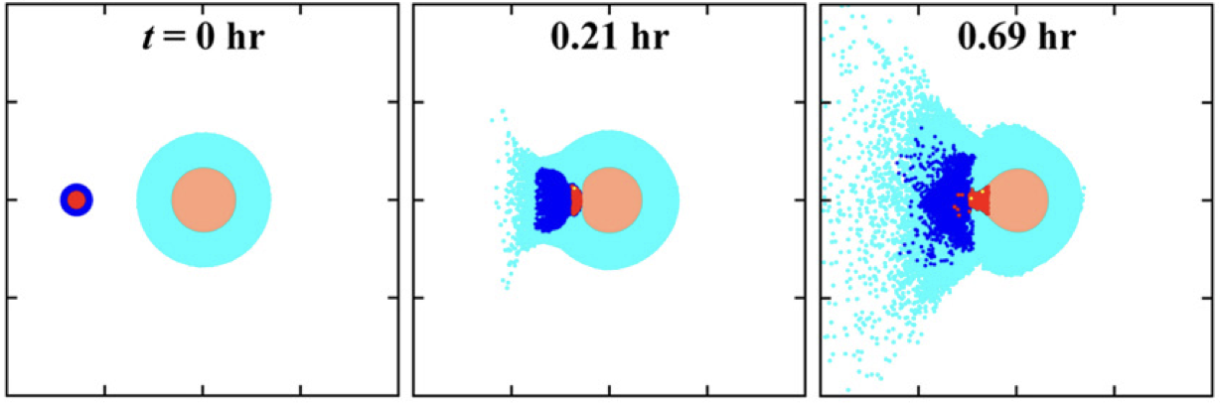
The dispersal of metal and HSEs in the aftermath of an impact
Genda et al., 2017 (EPSL)
Several studies assume most mass accreted during the late veneer was delivered by large, differentiated planetesimals (e.g., Bottke et al., 2010; Brasser et al., 2016).
The metallic cores of these impactors are roughly twice as dense as the silicate mantle: large fractions of this metal is liable to sink to Earth’s core under the action of gravity (e.g., Genda et al., 2017, Marchi et al., 2018, Citron & Stewart 2022, Itcovitz et al., 2024).

Slide 3
The dispersal of metal and HSEs in the aftermath of an impact
The ability of an impactor to deliver HSEs to the mantle depends on the distribution of metal post-impact.
There is a large diversity of post-impact scenarios, largely driven by impactor size.
Large impactors will melt the upper mantle and release liquid metal into a magma pond. Small impactors will not penetrate the crust and generate little melt.

Slide 4
The entrainment of metal and its HSEs in a magma pond
Metal drops can be suspended in a turbulent magma pond when convective frictional forces exceed the negative buoyancy force (Solomatov et al., 1993; Sturtz et al., 2021).
The mass of suspended metal depends on the diameter of metal drops, and the heat flux at the top of the magma pond (F).
Studies suggest metal fragments into d~1mm drops after large impacts: the suspended metal fraction is 3 orders of magnitude smaller than required to account for observed HSEs.

Slide 5
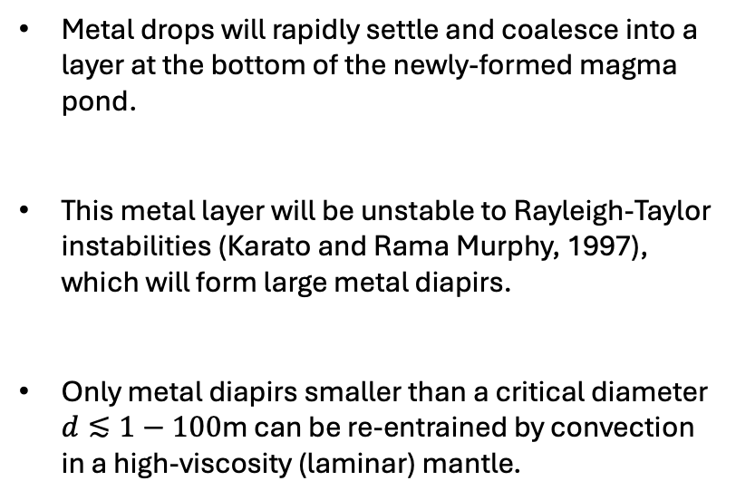
The entrainment of diapirs in the solid mantle
Metal drops will rapidly settle and coalesce into a layer at the bottom of the newly-formed magma pond.
This metal layer will be unstable to Rayleigh-Taylor instabilities (Karato and Rama Murphy, 1997), which will form large metal diapirs.
Only metal diapirs smaller than a critical diameter $d≲1−100\text{m}$ can be re-entrained by convection in a high-viscosity (laminar) mantle.

Slide 6
A mass accretion catastrophe for Earth?
Can observed HSEs be delivered by only small (<~1km) planetesimals?
To deliver enough mass in small bodies to deliver Earth’s HSEs, an implausibly large mass must also be delivered in larger planetesimals (with diameters in the range ~1-1000km).
To avoid this mass accretion catastrophe, large planetesimals must contribute to Earth’s HSEs. To accurately constrain mass accretion estimates during the late veneer, we must understand the responsible physical process(es)!

Slide 7
Potential solutions to this mass accretion paradox
An oxidised late veneer
Vaporisation of impactor cores
Mass accretion with no free metal phase will efficiently deliver HSEs to the mantle
Recent studies support a high wt% of carbonaceous late accretion (Fischer-Gödde et al., 2020; Burkhardt et al., 2021)
Recent studies suggest vapor production has been underestimated during late accretion (Kraus et al., 205, Saurety et al., 2025).
Condensation and rain-out of vaporised core material can deliver very small metal droplets to Earth’s surface (Kraus et al., 2015; Itcovitz et al., 2024).
The size of metal droplets condensed from the vapor cloud depends on both impactor diameter and impact velocity (Johnson & Melosh, 2012). This is crucial to estimate the efficiency of HSE delivery.
+ others…

Slide 9


Slide 10


$ε=0.3\%$
$ε=0.9\%$
$ε$ – the fraction of energy from buoyancy forces converted into gravitational potential energy of metal drops

Slide 12
D_{max} – maximum planetesimal diameter in the size-frequency distribution
D_{crit} – critical diameter above which metal and HSEs are lost to Earth’s core

Slide 13
f_{o} = 0.3 (Burkhardt+ 2021)
f_{o} = 0.6 (Fischer-Gödde+ 2020)
D_{max} – maximum planetesimal diameter in the size-frequency distribution
f_{o} – the mass fraction of oxidised planetesimals accreted during the late veneer

