Slide 1


Lubricated soft granular shear explaining an origin of slow-slip phenomena's statistics
2 May 2025
EGU25-327
Experimental study using fault gouge analogue of spherical hydrogel particles
Yuto Sasaki, Hiroaki Katsuragi
Department of Earth and Space Science
University of Osaka
Supported by SASAKAWA SRG 2024-6006, JSPS KAKENHI JP23H04134, JP24H00196
Notes:
I’m Yuto Sasaki from the University of Osaka, Japan.
We found that lubricated soft granular shear explains an origin of slow-slip phenomena's statistics.
We performed shear experiments using fault gouge analogue of spherical hydrogel particles.
When I started this project, I thought it would take half a year. That was two years ago.

Slide 2
Enigmatic origin between slow/regular earthquakes
Moment-frequency distribution
In Cascadia
10^{–4}
Exponential
10^{–6}
Slow EQs
(Chestler & Creager, 2017)
Cumulative frequency (/s)
10^{–8}
Regular EQs
(Hyndman et al., 2003)
10^{–10}
0
2
4
Moment M₀ (10¹², 10¹⁸ Nm)
Notes:
The origin of differences between slow slip phenomena or slow earthquakes and regular ones is enigmatic.
And I will talk about the two differences in this slide.
This figure shows the moment-frequency distribution.
Horizontal axis is seismic moment in linear and vertical axis is cumulative frequency in logarithmic.
These example data observed in Cascadia indicate slow earthquakes, these are low frequency earthquakes, exhibit exponential distribution and regular ones are not.

Slide 3
Enigmatic origin between slow/regular earthquakes
Moment-frequency distribution
In Cascadia
1
10^{–4}
Exponential
Power
10^{–6}
Slow EQs
(Chestler & Creager, 2017)
Cumulative frequency (/s)
10^{–8}
Regular EQs
(Hyndman et al., 2003)
10^{–10}
0
2
4
Moment M₀ (10¹², 10¹⁸ Nm)
Notes:
In log-log plot, the same data show these trends.
As you know, regular earthquakes follow power law known as Gutenberg-Richter law.

Slide 4
Enigmatic origin between slow/regular earthquakes
Moment-frequency distribution
Moment-duration scaling
In Cascadia
(Ide & Beroza, 2023 and its refs; Kanamori & Anderson, 1975)
1
10^{–4}
Slow EQs
10⁶
Exponential
Power
M₀∝T ¹
10^{–6}
Slow EQs
(Chestler & Creager, 2017)
10³
Cumulative frequency (/s)
Duration T (s)
M₀∝T ³
10^{–8}
Regular EQs
(Hyndman et al., 2003)
10⁰
Regular EQs
10^{–10}
0
2
4
10¹⁰
10¹⁵
10²⁰
Moment M₀ (10¹², 10¹⁸ Nm)
Moment M₀ (Nm)
Notes:
Second, the moment-duration scaling is also different.
This figure shows the relationship between moment and duration in log-log plot.
Slow earthquakes hold moment proportional to duration.
In contrast, regular earthquakes follow this cubic scaling.
And no one knows the cause for these statistical differences.

Slide 5
Enigmatic origin between slow/regular earthquakes
Moment-frequency distribution
Moment-duration scaling
In Cascadia
(Ide & Beroza, 2023 and its refs; Kanamori & Anderson, 1975)
1
10^{–4}
Slow EQs
10⁶
Exponential
Power
FEW EXPERIMENTAL DATA
(Okazaki & Katayama, 2015)
on the origin of slow earthquakes’ statistics
M₀∝T ¹
10^{–6}
Slow EQs
(Chestler & Creager, 2017)
10³
Cumulative frequency (/s)
Duration T (s)
M₀∝T ³
10^{–8}
Regular EQs
(Hyndman et al., 2003)
10⁰
Regular EQs
10^{–10}
0
2
4
10¹⁰
10¹⁵
10²⁰
Moment M₀ (10¹², 10¹⁸ Nm)
Moment M₀ (Nm)
Notes:
Unfortunately, few experimental studies including this paper investigate the origin of the distinctive origin of slow earthquakes statistics.

Slide 6
Purpose of this study
Clarify the origin of slow earthquakes’ statistical laws
→ Effects of fluid lubrication & gouge strength on slip
Moho
Slow EQs
on fluid-lubricated
and “soft” faults
after Hyndman et al (2015)
and Obara (2020)
Notes:
So, the purpose of this study is to clarify the origin of slow earthquakes’ statistical laws.
Because many studies mention the fluid-lubricated and soft fault plays an important role on slow earthquakes like this,
we experimentally investigated the effects of fluid lubrication and fault gouge strength on the statistics of stick-slip phenomena.

Slide 7
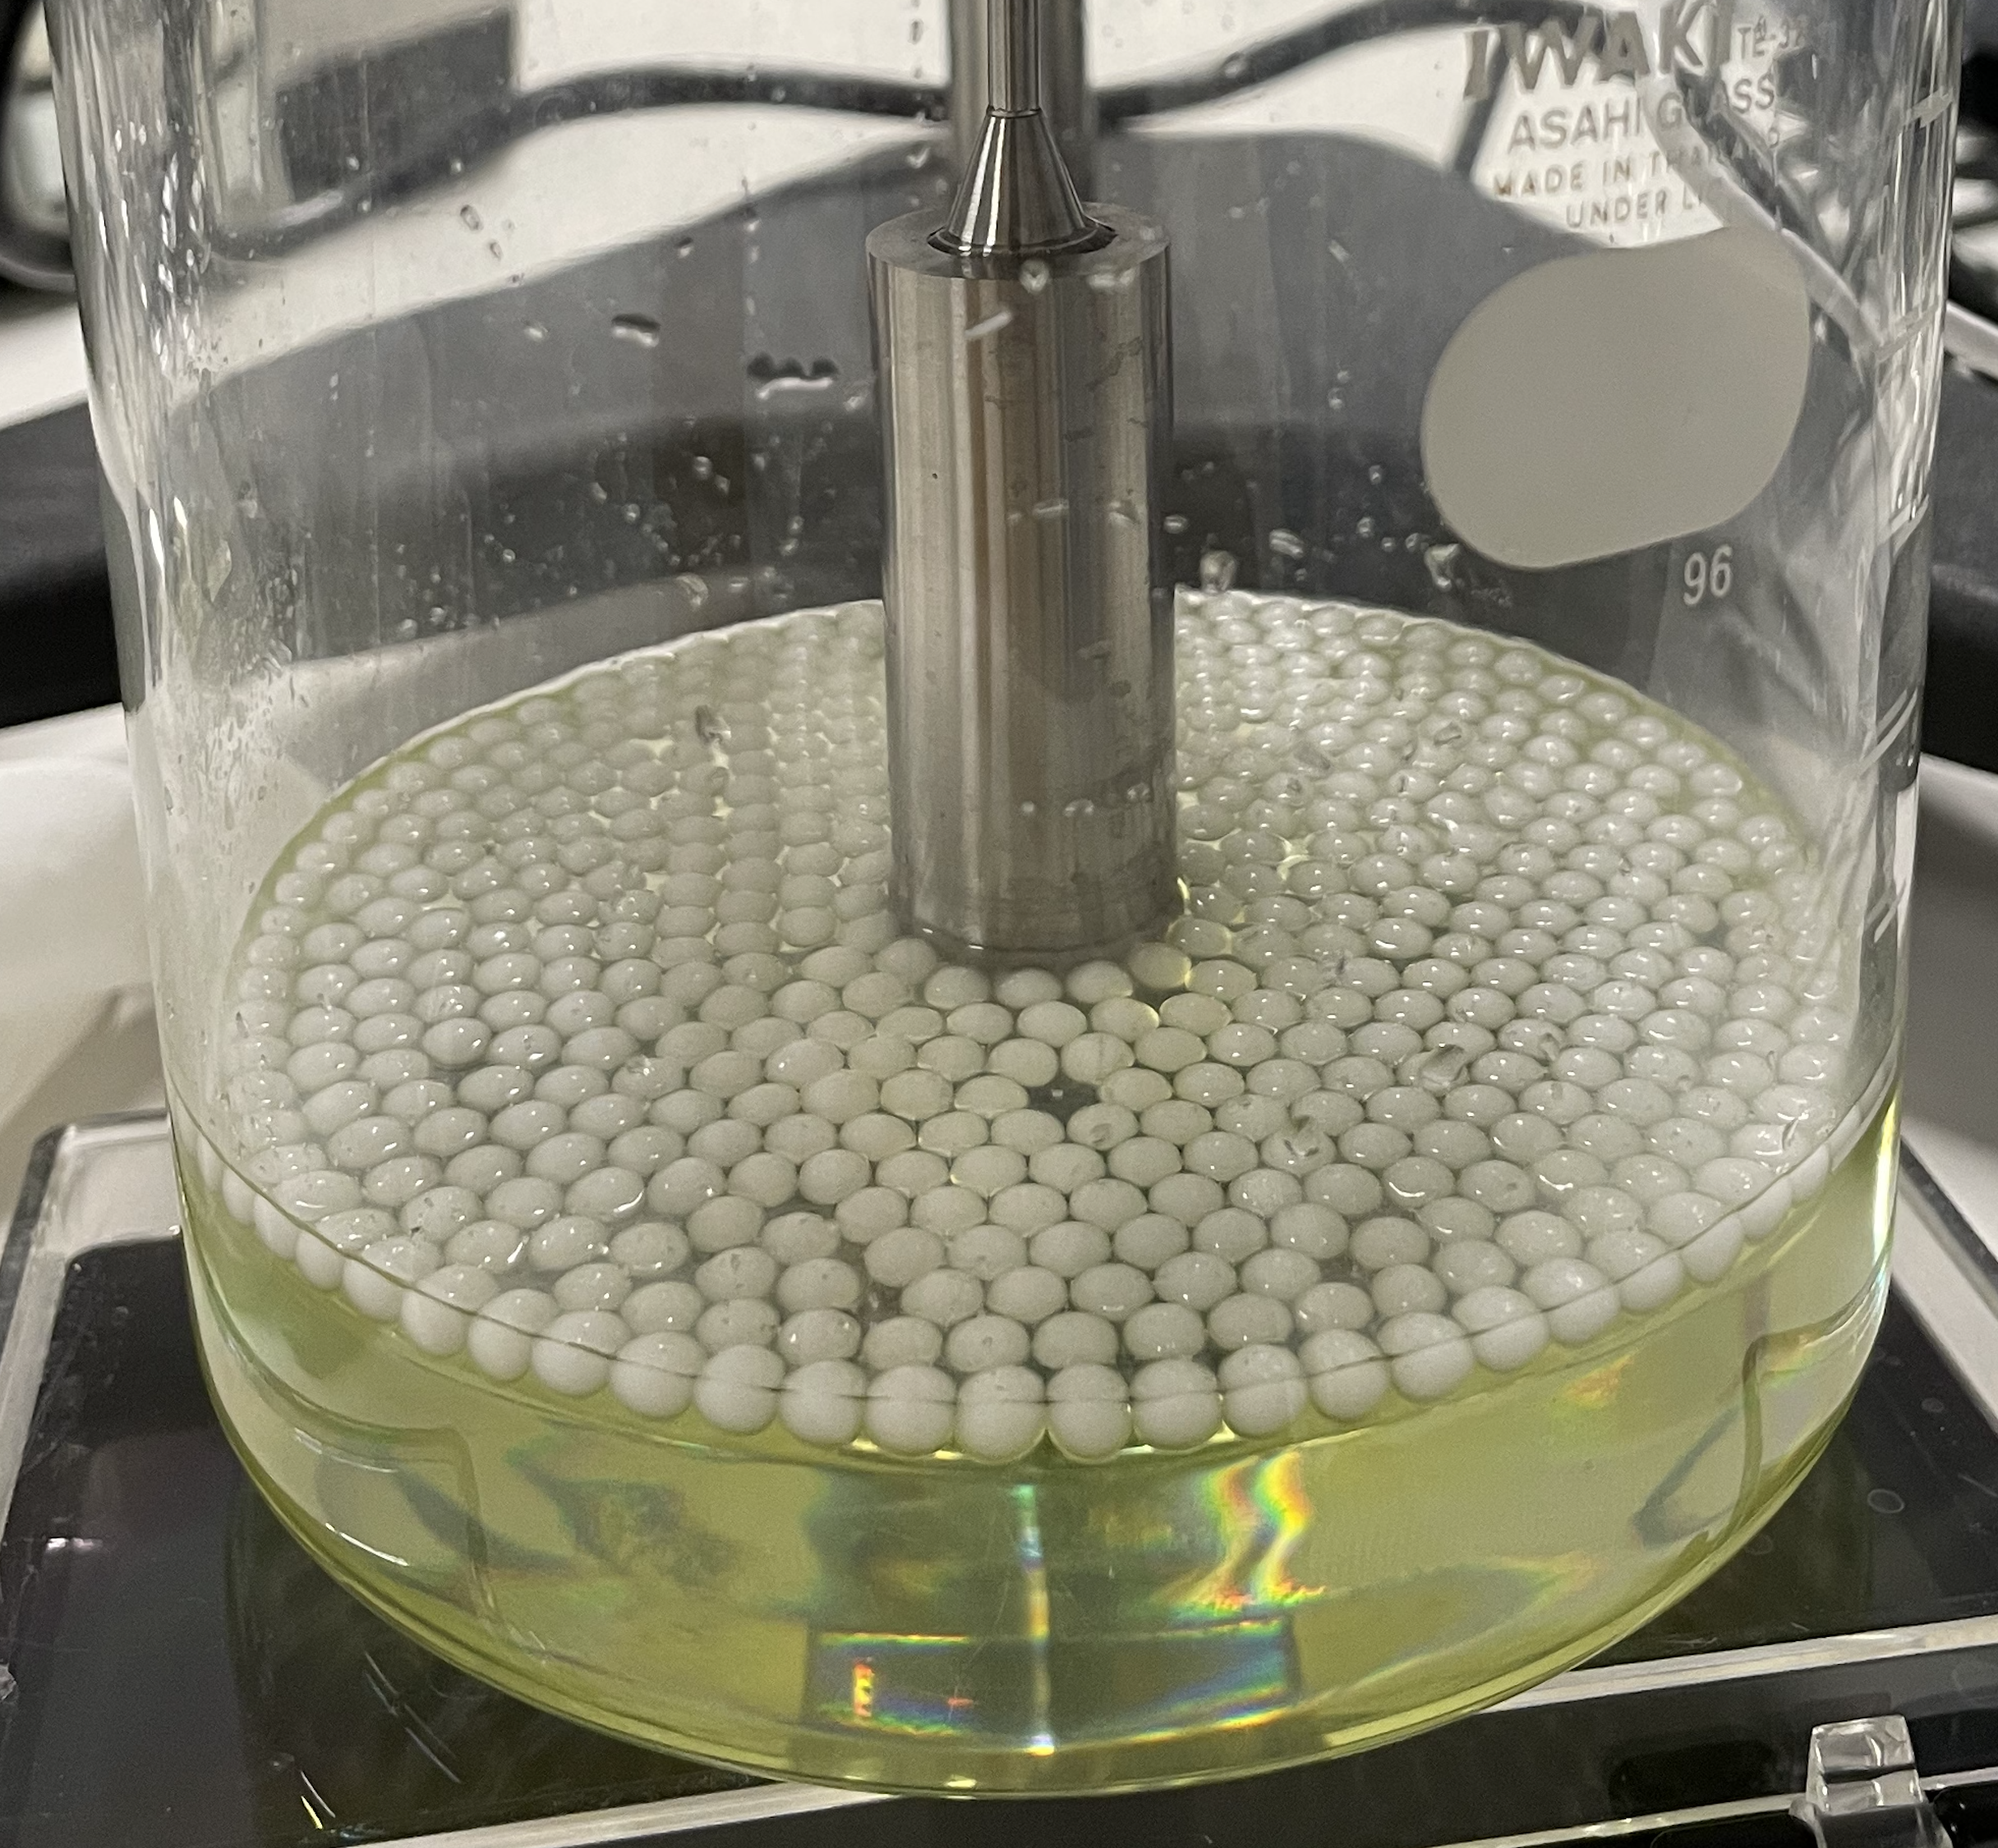

Quasi-2D stick-slip tests of lubricated particles
At porosity
φ= 0.2–0.4
Gouge
analog
hydrogel
spheres
Motor
0.6˚/s
Glued
Lubricant fluid
Sodium polytungstate
solution
Notes:
We conducted the quasi 2D stick-slip shear tests on lubricated particles.
As fault gouge analog, we used these spherical hydrogel particles in a monolayer.
And this is floated on a lubricant heavy liquid of sodium polytungstate solution.
The same particles are glued on this central rotary cylinder.
This cylinder rotates by the motor pf 0.6˚/s and sheared the particle layer.
Shear tests were conducted at porosity of 0.2–0.4.

Slide 8
Quasi-2D stick-slip tests of lubricated particles
4
At porosity
φ= 0.2–0.4
Measure torque
（2 Hz）
φ= 0.18
2
Torque (µN m)
Gouge
analog
hydrogel
spheres
0
500
φ= 0.27
Motor
0.6˚/s
Time (s)
600
Glued
Lubricant fluid
Sodium polytungstate
solution
Notes:
We measured the torque of the cylinder.
The temporal evolution of toque shows a decrease in porosity increase the mean strength and fluctuating amplitude.
Torque drop corresponds to slip event.

Slide 9
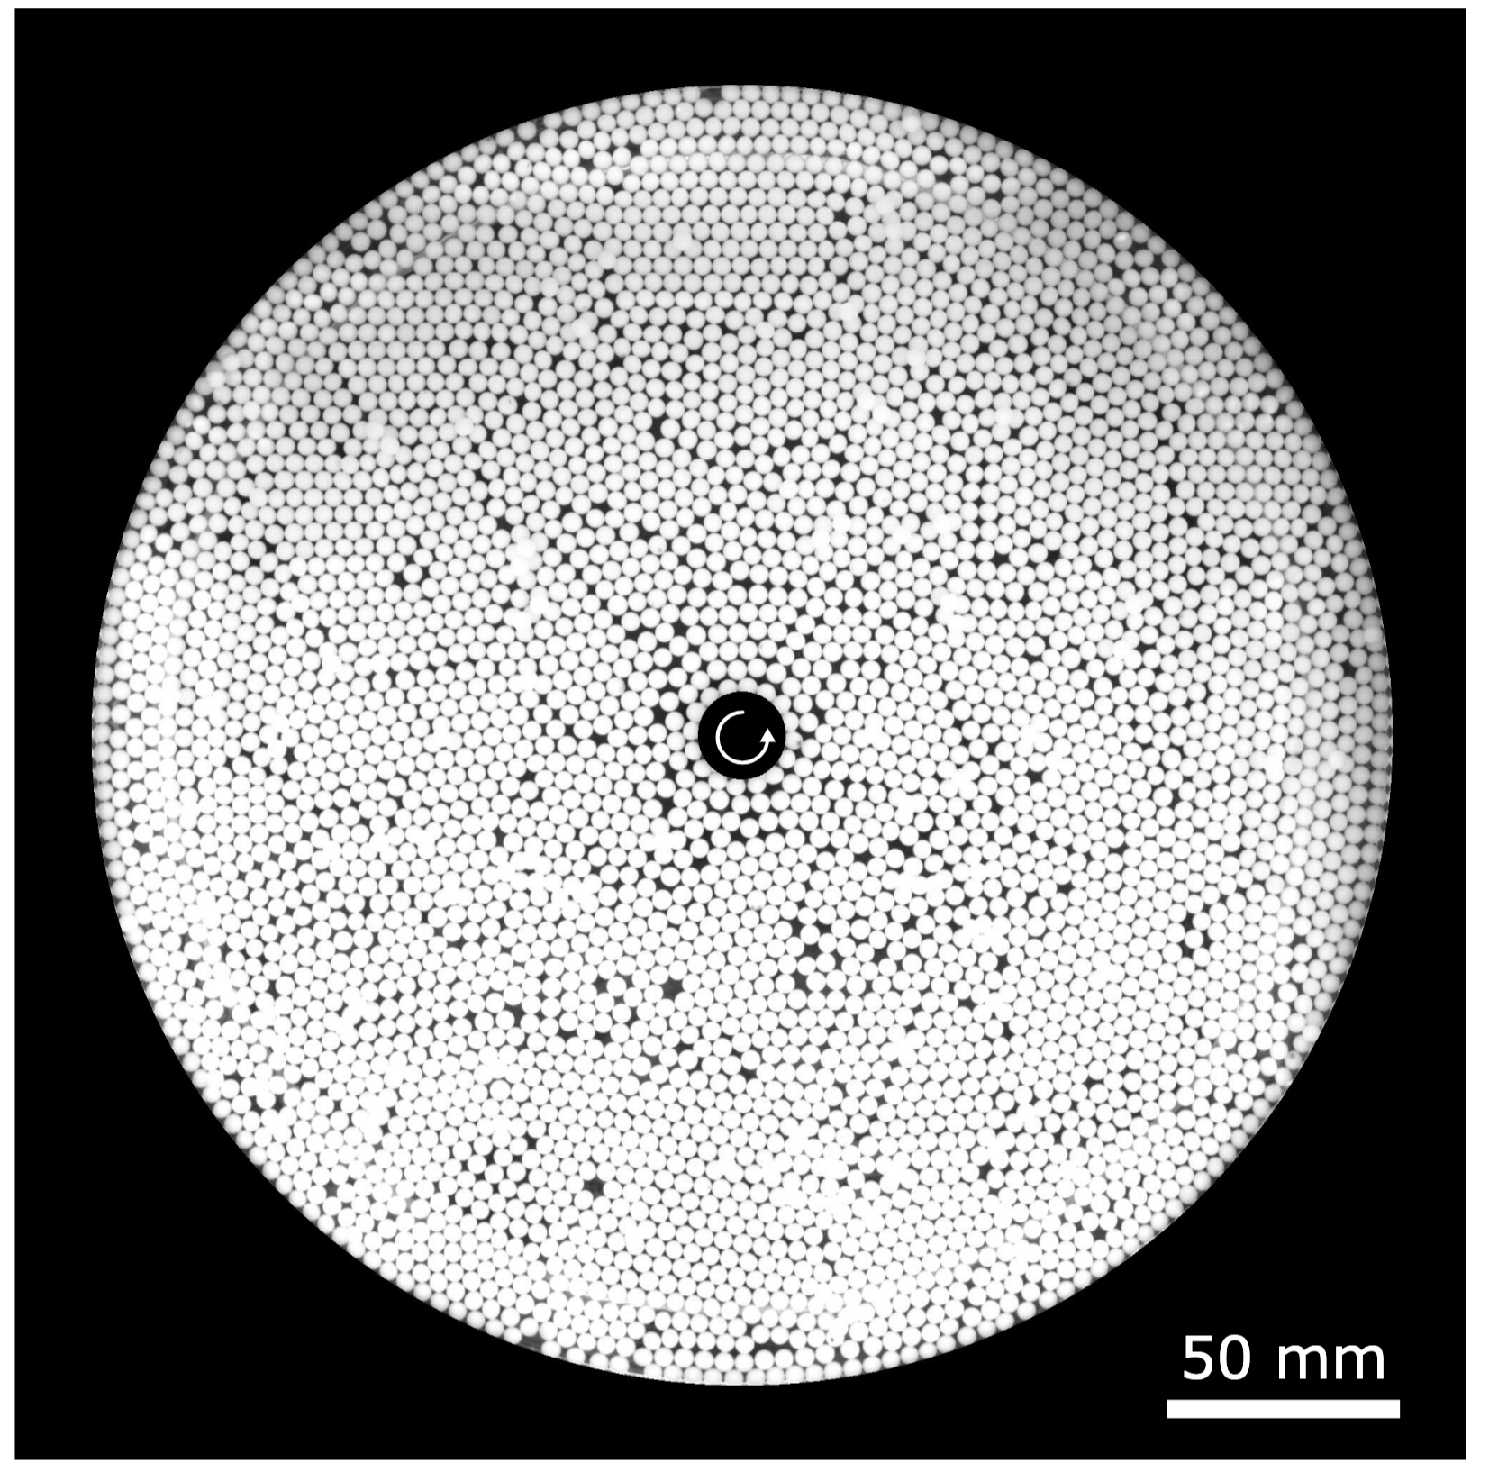
Quasi-2D stick-slip tests of lubricated particles
4
At porosity
φ= 0.2–0.4
Measure torque
（2 Hz）
φ= 0.18
2
Torque (µN m)
Gouge
analog
hydrogel
spheres
0
500
φ= 0.27
Motor
0.6˚/s
Time (s)
600
Rotary
shear
Glued
φ= 0.23
(3560 particles)
Lubricant fluid
Sodium polytungstate
solution
Record video
(10 Hz)
Notes:
Simultaneously, we recorded the particle motion from the bottom.
An example image is like this.
We used around 4000 particles.

Slide 10
Quasi-2D stick-slip tests of lubricated particles
4
At porosity
φ= 0.2–0.4
Measure torque
（2 Hz）
φ= 0.18
1 event!
2
Torque (µN m)
Gouge
analog
hydrogel
spheres
0
500
φ= 0.27
Motor
0.6˚/s
Time (s)
600
Rotary
shear
Glued
φ= 0.23
(3560 particles)
Lubricant fluid
Sodium polytungstate
solution
Record video
(10 Hz)
Notes:
In this talk, I will only show the results of mechanical measurements,
And we defined one slip event as monotonic torque drop.
From the torque drop amplitude and recorded slip area, we calculated the seismic moment.
In the next slide, I will show the statistics of the moment.

Slide 11
Moment-frequency distribution
10^{–1}
10^{–2}
Cumulative frequency (/s)
10^{–3}
10^{–4}
0
1
2
Moment M₀ (10^{–8} Nm)
Notes:
The moment-frequency distribution follows exponential function.
X axis is moment in linear and y axis is cumulative frequency in logarithmic.
You can see they are all exponential.
Color indicates several porosities.

Slide 12
Moment-frequency distribution
10^{–1}
Lower
porosity
10^{–2}
φ= 0.18
Cumulative frequency (/s)
10^{–3}
φ= 0.41
10^{–4}
0
1
2
Moment M₀ (10^{–8} Nm)
Notes:
And a decrease in porosity from 0.41–0.18 increases the moment.

Slide 13
Moment-frequency distribution
10^{–1}
1
10^{–2}
Cumulative frequency (/s)
10^{–3}
10^{–4}
0
1
2
Moment M₀ (10^{–8} Nm)
Notes:
If we plot these data in log-log plot, you can see they don’t follow power law.

Slide 14
Moment-frequency distribution
10^{–1}
1
In Cascadia
1
10^{–4}
10^{–2}
10^{–6}
Cumulative frequency (/s)
Regular EQs
(Hyndman et al., 2003)
Slow EQs (LFE)
(Chestler & Creager, 2017)
10^{–3}
10^{–8}
10^{–4}
10^{–10}
0
1
2
0
2
4
Moment M₀ (10^{–8} Nm)
Moment M₀ (10¹², 10¹⁸ Nm)
Notes:
As I showed in the beginning, seismic observation also suggest that slow earthquakes follow exponential size distributions.
To find the conditions for the power law, we also used more rigid glass beads instead of soft hydrogel particles.

Slide 15
Moment-frequency distribution
10^{–1}
In Cascadia
1
Rigid glass beads
10^{–4}
10^{–2}
10^{–6}
Cumulative frequency (/s)
Regular EQs
(Hyndman et al., 2003)
Slow EQs (LFE)
(Chestler & Creager, 2017)
10^{–3}
10^{–8}
10^{–4}
10^{–10}
0
1
2
0
2
4
Moment M₀ (10^{–8} Nm)
Moment M₀ (10¹², 10¹⁸ Nm)
Notes:
However, rigid particles also follow exponential distribution

Slide 16
Moment-frequency distribution
10^{–1}
Rigid glass
1
In Cascadia
1
10^{–4}
10^{–2}
10^{–6}
Cumulative frequency (/s)
Regular EQs
(Hyndman et al., 2003)
Slow EQs (LFE)
(Chestler & Creager, 2017)
10^{–3}
10^{–8}
10^{–4}
10^{–10}
0
1
2
0
2
4
Moment M₀ (10^{–8} Nm)
Moment M₀ (10¹², 10¹⁸ Nm)
Notes:
And no power laws.

Slide 17
Moment-frequency distribution
In lubrication
10^{–1}
1
In Cascadia
1
Exponential
10^{–4}
10^{–2}
10^{–6}
Cumulative frequency (/s)
Regular EQs
(Hyndman et al., 2003)
Slow EQs (LFE)
(Chestler & Creager, 2017)
Power
10^{–3}
10^{–8}
Exponential
10^{–4}
10^{–10}
0
1
2
0
2
4
Moment M₀ (10^{–8} Nm)
Moment M₀ (10¹², 10¹⁸ Nm)
Notes:
Therefore, exponential distributions can be observed in lubrication granular system and also in slow earthquakes.
In contrast, regular earthquakes and also dry frictional experiments exhibit power law distribution.
Now, let’s move on to the moment-duration scaling.

Slide 18
Moment–duration scaling
10²
10¹
Duration T (s)
10⁰
M₀∝T ¹
M₀∝T ³
10^{–1}
10^{–10}
10^{–9}
10^{–8}
10^{–7}
Moment M₀ (Nm)
Notes:
X axis is moment and y axis is duration of each event in log-log plot.
You can see the collapsed relationship between moment and duration.
And the moment is nearly proportional to duration.

Slide 19
Moment–duration scaling
10²
Lower porosity
φ= 0.18
10¹
Duration T (s)
φ= 0.41
10⁰
M₀∝T ¹
M₀∝T ³
10^{–1}
10^{–10}
10^{–9}
10^{–8}
10^{–7}
Moment M₀ (Nm)
Notes:
Color indicates a decrease in porosity and the relationship remains solid.

Slide 20
Moment–duration scaling
(Kanamori & Anderson, 1975;
Ide & Beroza, 2023 and its refs)
10²
Slow EQs
10⁶
10¹
M₀∝T ¹
Duration T (s)
10³
M₀∝T ³
10⁰
M₀∝T ¹
10⁰
M₀∝T ³
Regular EQs
10^{–1}
10^{–10}
10^{–9}
10^{–8}
10^{–7}
10¹⁰
10¹⁵
10²⁰
Moment M₀ (Nm)
Moment M₀ (Nm)
Notes:
Again, as you see in the beginning, slow earthquakes follow the linear scaling and regular ones follow the cubic scaling.
When we investigate this relationship for rigid glass beads instead of soft hydrogels,

Slide 21
Moment–duration scaling
(Kanamori & Anderson, 1975;
Ide & Beroza, 2023 and its refs)
10²
Rigid glass beads
Slow EQs
10⁶
10¹
M₀∝T ¹
Duration T (s)
10³
M₀∝T ³
10⁰
M₀∝T ¹
10⁰
M₀∝T ³
Regular EQs
10^{–1}
10^{–10}
10^{–9}
10^{–8}
10^{–7}
10¹⁰
10¹⁵
10²⁰
Moment M₀ (Nm)
Moment M₀ (Nm)
Notes:
they exhibit some power law scaling, which is similar to regular earthquakes.

Slide 22
Moment–duration scaling
(Kanamori & Anderson, 1975;
Ide & Beroza, 2023 and its refs)
10²
Rigid glass beads
Slow EQs
Hydrogel
10⁶
10¹
M₀∝T ¹
Duration T (s)
10³
M₀∝T ³
M₀∝T ³
10⁰
M₀∝T ¹
10⁰
M₀∝T ¹
M₀∝T ³
Regular EQs
10^{–1}
10^{–10}
10^{–9}
10^{–8}
10^{–7}
10¹⁰
10¹⁵
10²⁰
Moment M₀ (Nm)
Moment M₀ (Nm)
Notes:
Therefore, this study demonstrates the scaling analogous to earthquakes.

Slide 23
Distinguish the mechanisms of slow/regular EQs
？
Regular
EQs
T ¹
GR law
Gouge strength
(Rigidity)
T
P (M₀)
Exp
T ³
Slow
EQs
？
M₀
M₀
Fluid lubrication
(Friction)
Notes:
We can review our findings so far like this schematic.
As the horizontal axis, we investigated the effect of fluid lubrication, which partially means friction decrease.
It modifies the moment-frequency distribution form exponential to power-law Gutenberg-Richter form.
As the vertical axis, we also found the gouge particle strength, which means rigidity in this study, changes the moment-duration scaling from linear to cubic.
In earthquake science communities, there are two categories of earthquakes of slow and regular earthquakes, but some another types might be recognized from observation data.

Slide 24

Preprint on arXiv
Summary
Performed the stick-slip experiments
on the monolayer of lubricated particles
Moment-frequency distribution
exponential in both soft hydrogel and rigid beads
Moment-duration scaling
linear in soft hydrogel and power in rigid beads
Slow EQs moment might monitor faults’ porous structure
Notes:
In summary, we performed the stick-slip experiments on the monolayer of lubricated spherical particles.
As moment-frequency distributions, exponential ones emerge in both soft hydrogel and rigid beads.
As moment-duration scaling, it is linear in soft hydrogel and power in rigid beads.
And finally, the statistics of Slow EQs moment potentially monitor fault core’s porous structure.
Here I show the link of the preprint including this talk and please feel free to talk to me anytime.
Thank you for your listening.

