Slide 1
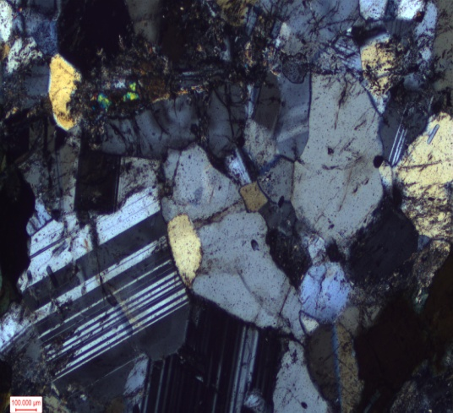
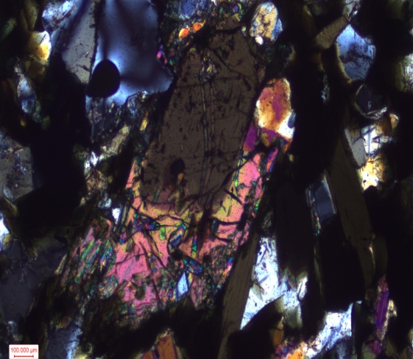
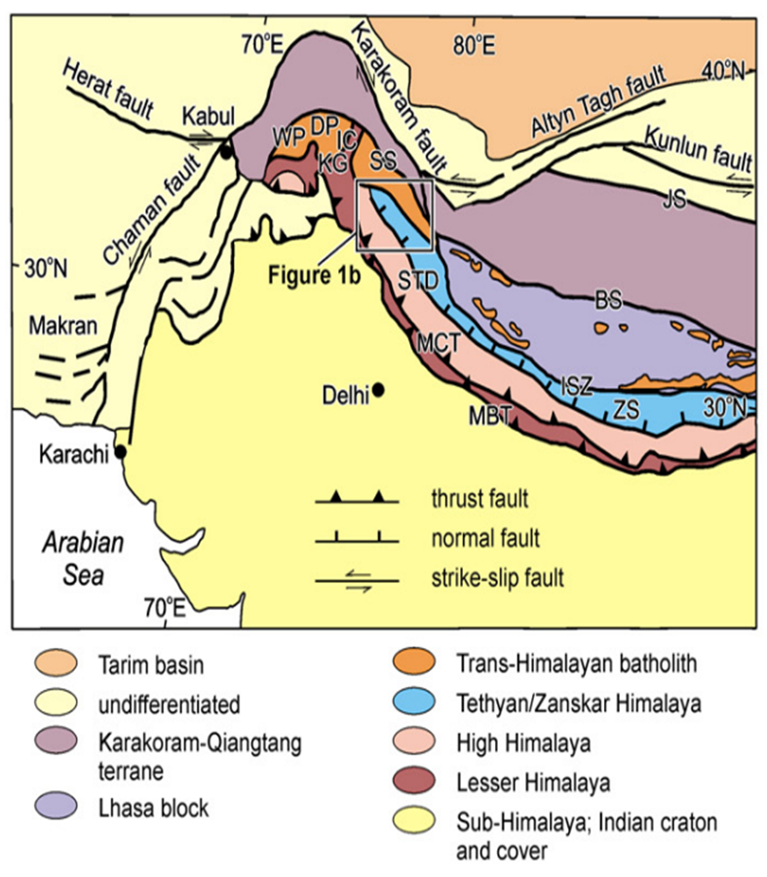
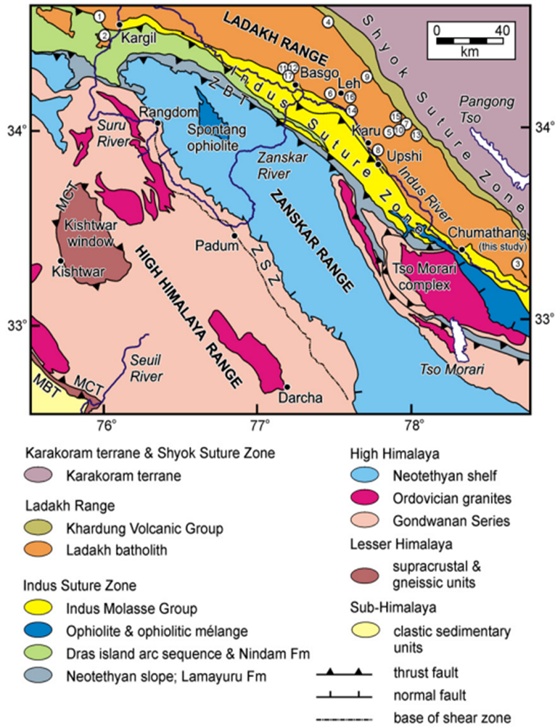
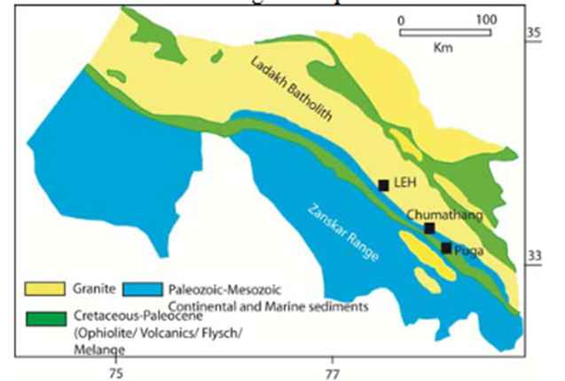
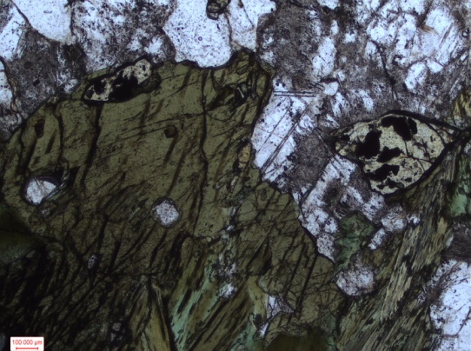
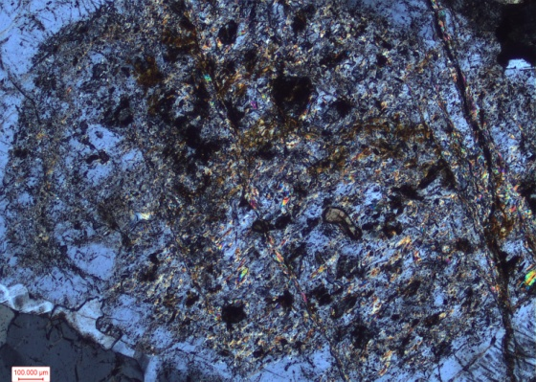
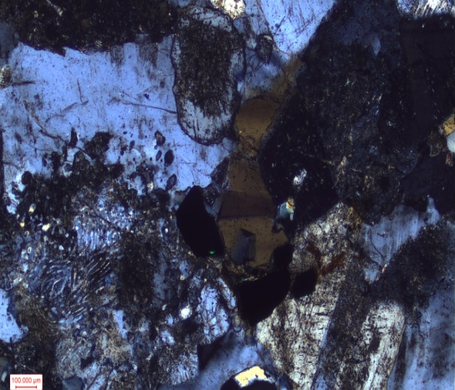
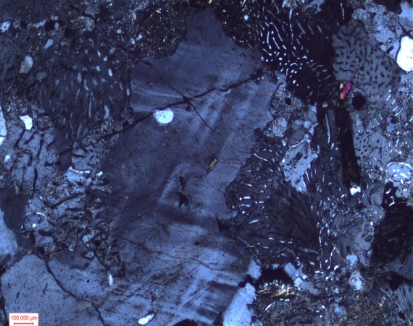
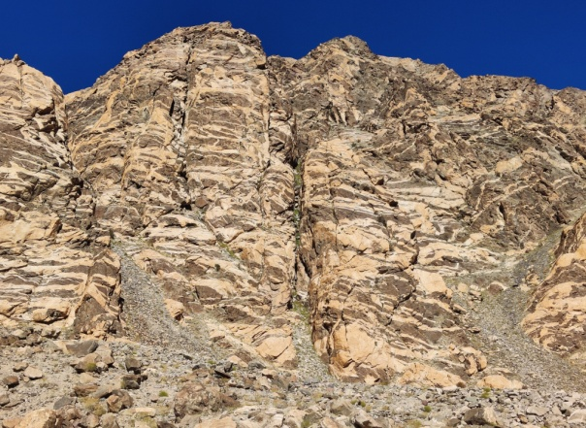
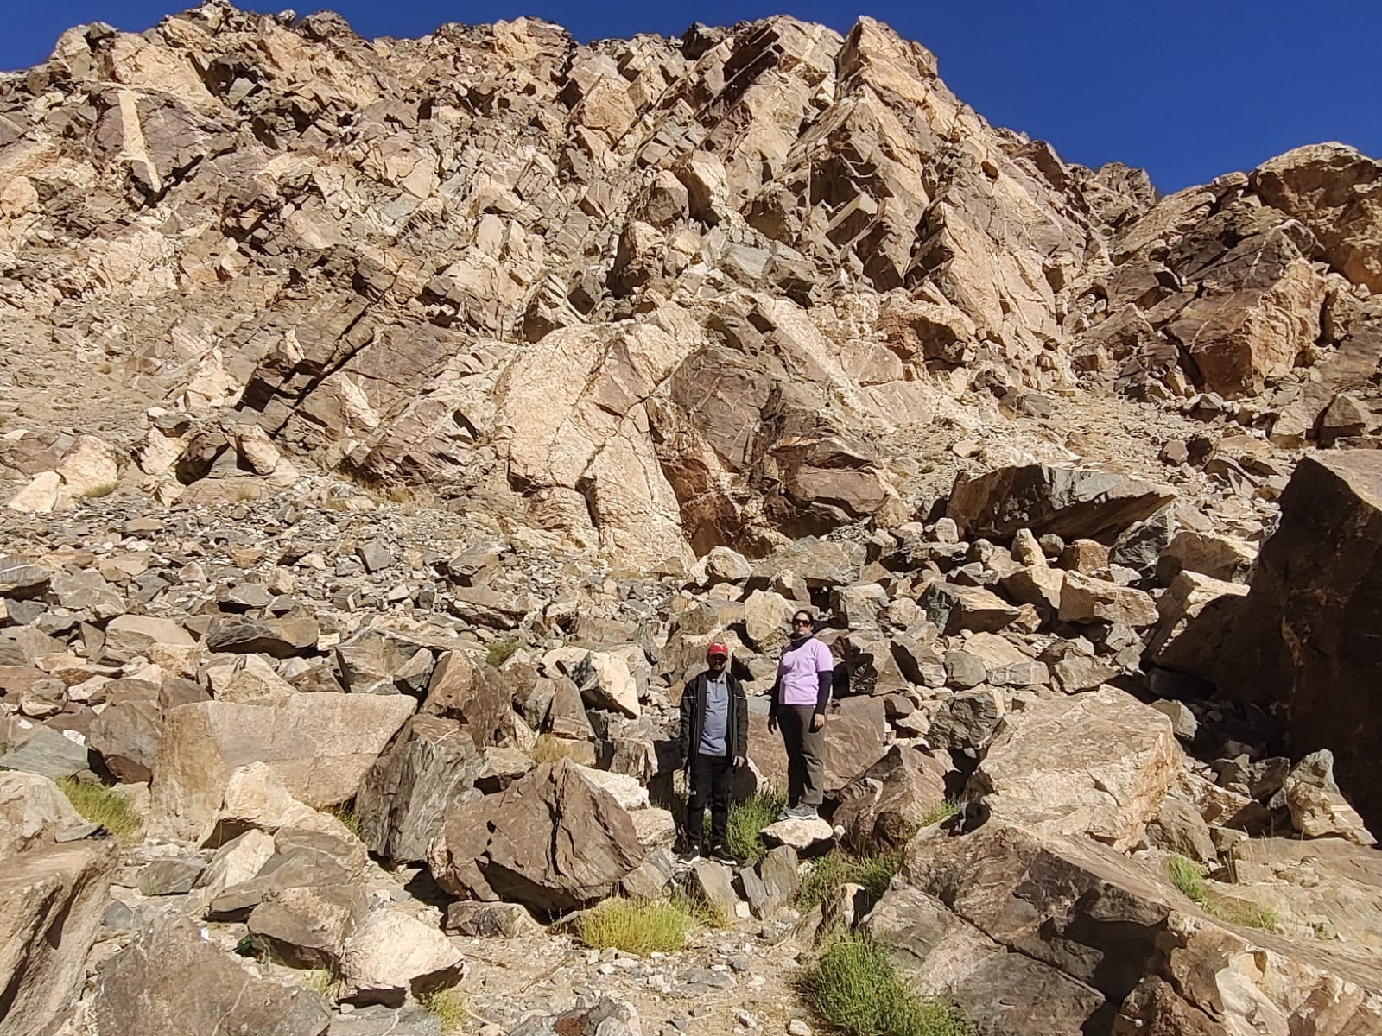
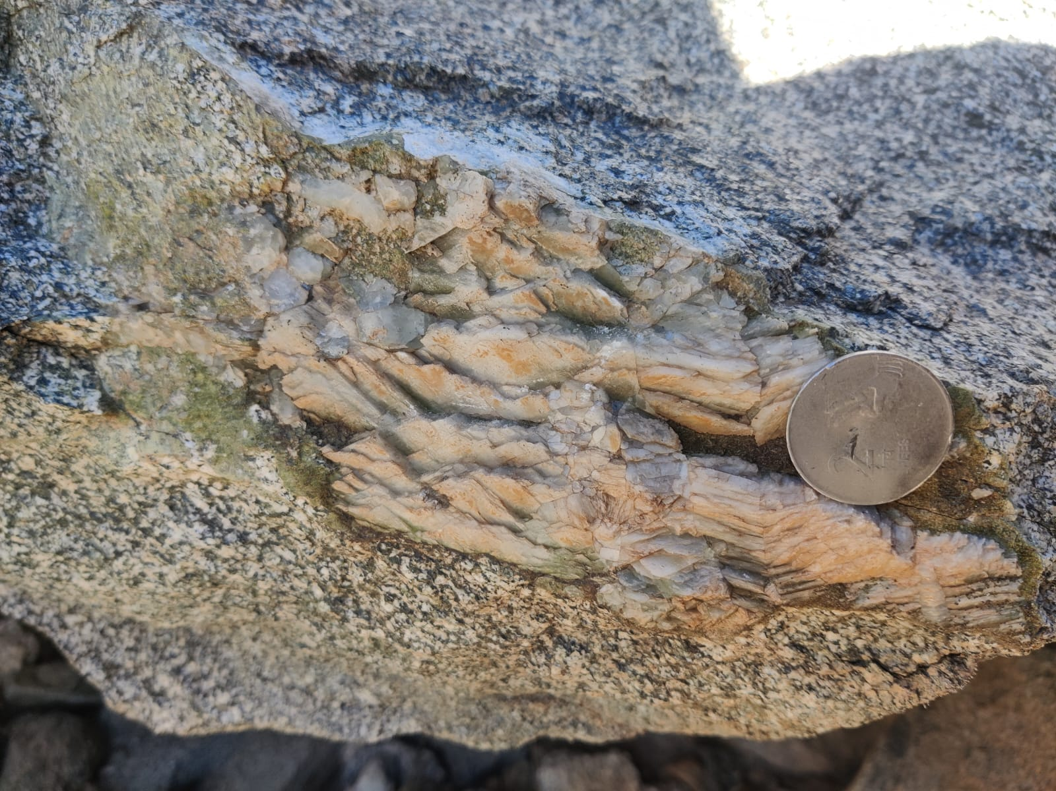
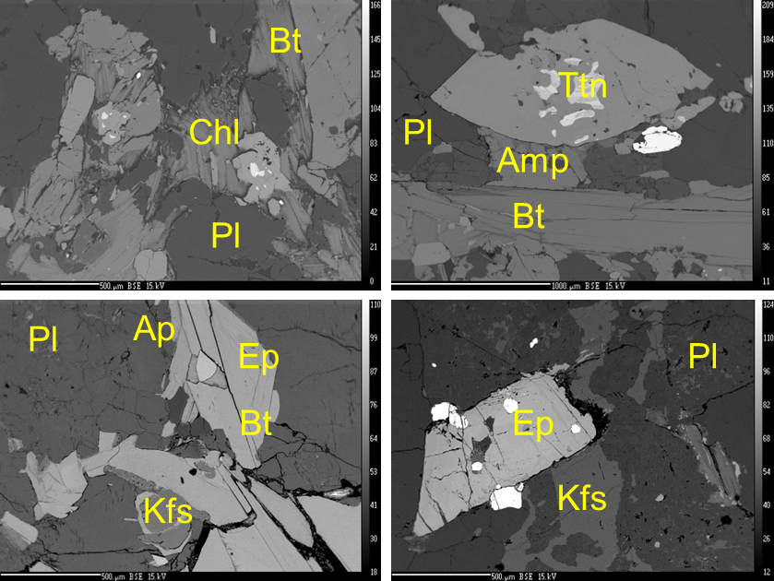
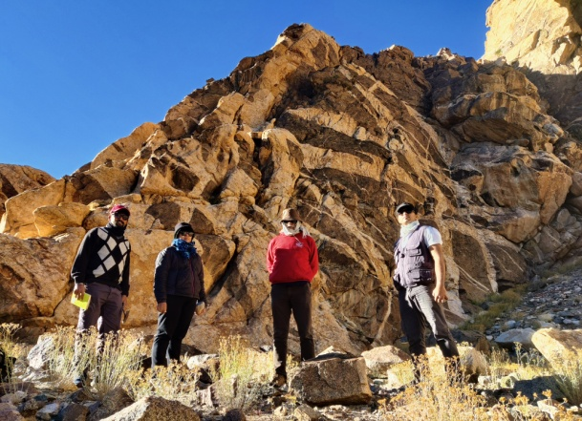
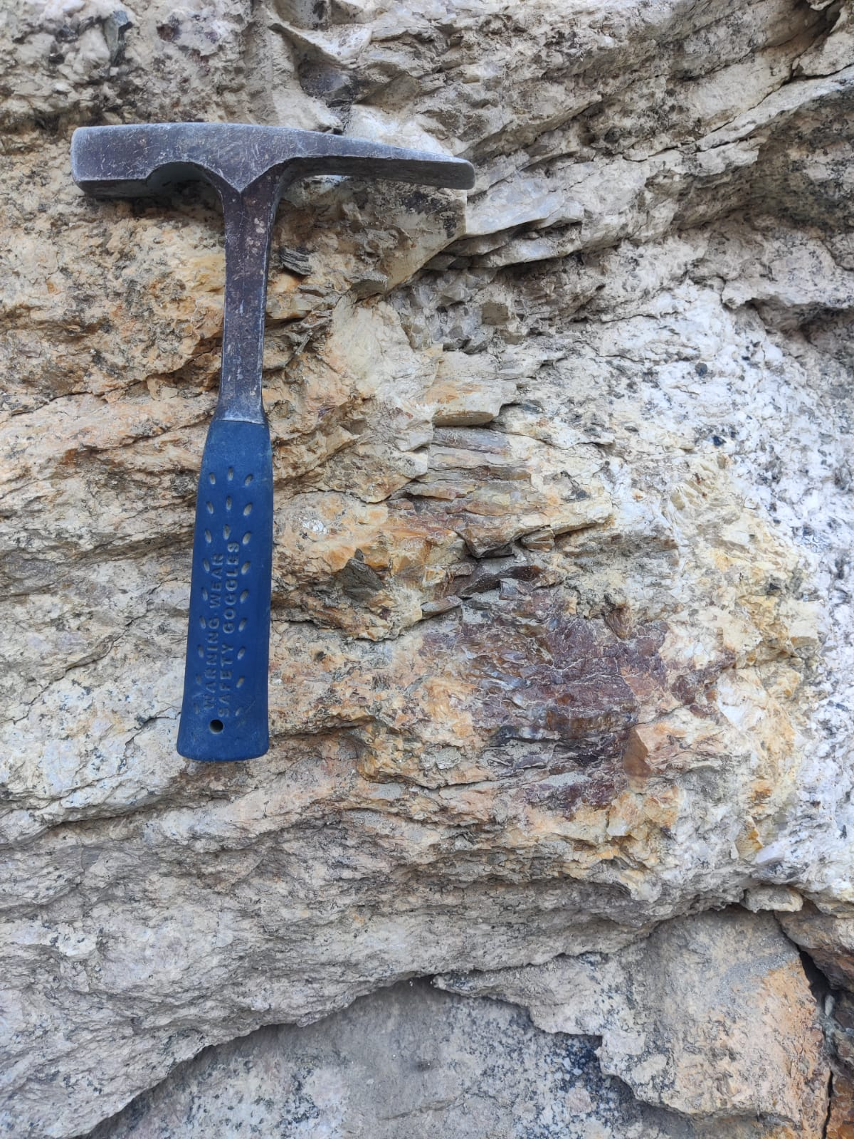
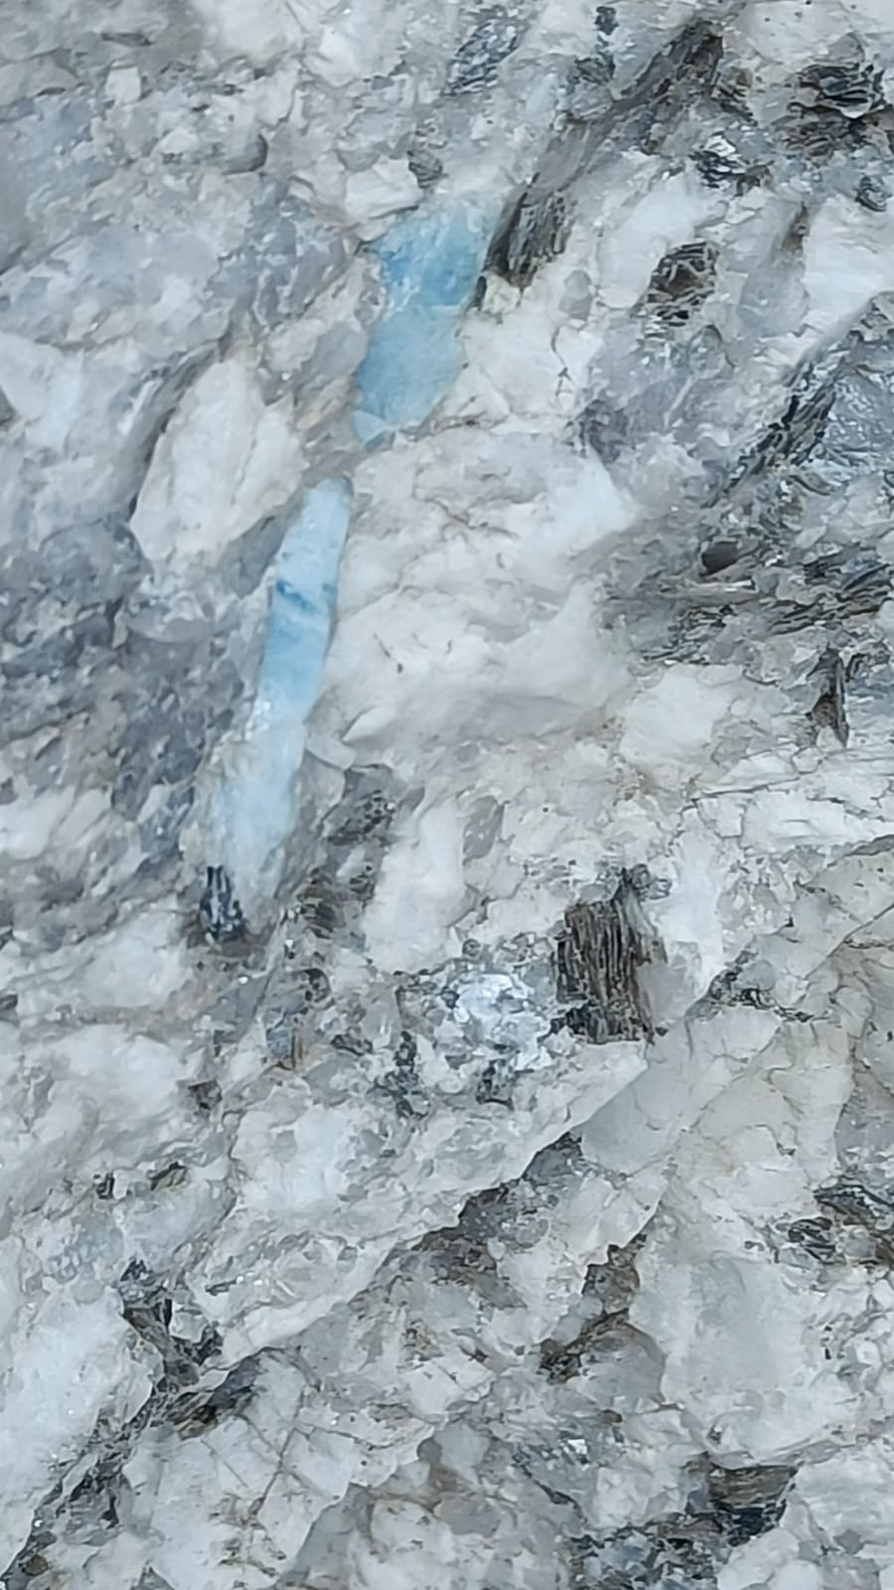
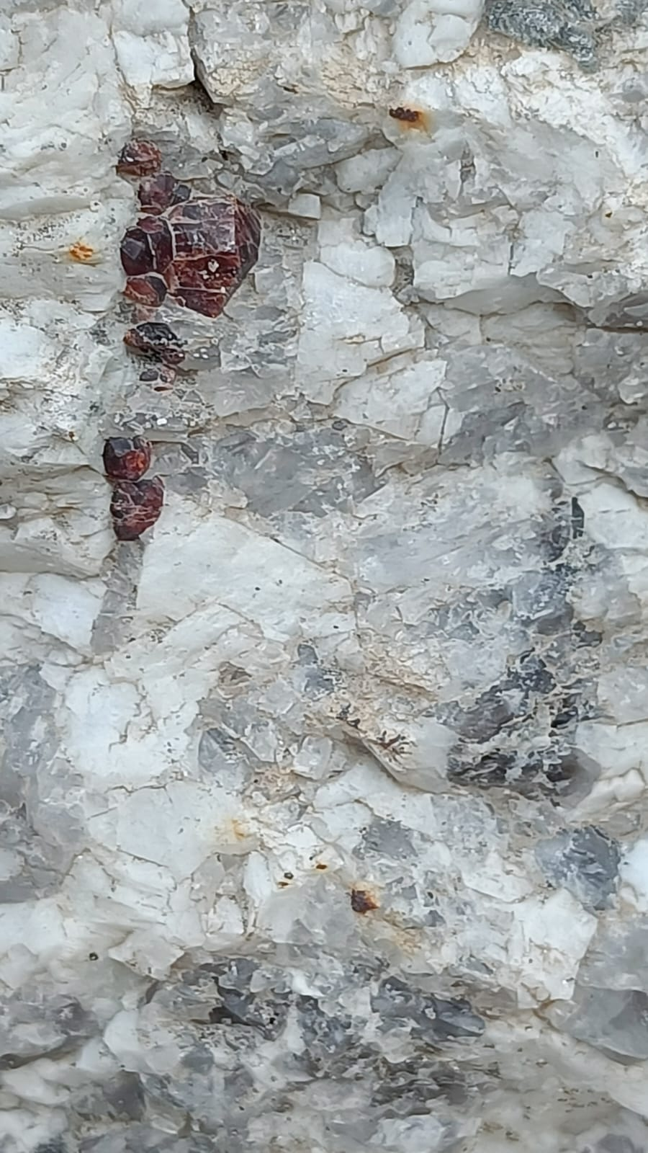
Petrogenesis of magmatic and hydrothermally derived late stage minerals associated with granitic plutonic complexes: A case study from the Ladakh Batholith, NW Himalayas, India.
Deepak Bhoir¹, Mallika Jonnalagadda², Gajanan Walunj², Hardik Sanklecha², Rishabh Bose², Bibhas Kulkarni², Raymond Duraiswami³, and Nitin Karmalkar³
1Department of Geology , SPPU, Pune, India; *(deepakbhoir878@gmail.com), 2.Interdisciplinary School of Science, SPPU, India; 3.Department of Environmental Science, SPPU, India.
EGU25-331
1. Introduction
The Trans-Himalayan and Himalayan orogenic belts, one of the youngest mountain chains in the world are a result of subduction and closure of Neo-Tethyan oceanic lithosphere and subsequent collision of the Indian and Eurasian continental plates (Rowley 1996; Najman et al. 2010; Bouilhol et al. 2013; Jain 2014).
The Ladakh Batholith (2500 km long body) that evolved as a single entity during the late Cretaceous and early Palaeogene (Pundir et al., 2020, and references therein) represents an integral part of the Trans-Himalayan calc-alkaline magmatic belt extending from Nanga Parbat in the east to Lhasa in Tibet, and is bounded by Shyok Suture Zone (SSZ) in the north and ITSZ in the south (Maheo et al. 2006).
3. Petrography and Mineral chemistry
Under the microscope, granodiorite is medium- to coarse-grained consisting of quartz, plagioclase (An₃₂₋₅₉ Ab₅₀₋₆₅), microcline, amphibole (pargasite-ferro-pargasite), and biotite, with accessory minerals such as zircon, sphene, apatite, magnetite, and ilmenite. In contrast, the leucogranite is more felsic and enriched in quartz, plagioclase (An_{0.23-27} Ab₇₁₋₉₉), orthoclase, microcline, tourmaline, fluorite, muscovite, and biotite.
Pegmatites typically contain quartz, plagioclase (An₇₋₂₆ Ab₇₂₋₉₂) , orthoclase, microcline and minor biotite, muscovite, and zircon. Minerals like tourmaline, chlorite, fluorite, aquamarine, baryte etc. are commonly observed along vein margins.
Presence of minerals like biotite, amphibole and epidote clearly suggest that both phases of granites and pegmatites were formed from a high temperature magma source. Temperature estimates of 730⁰C to 782⁰C were calculated using the calibrations of Ridolfi (2021) based on Amphibole chemistry whereas temperatures of 583 ⁰C to 655 ⁰C were calculated using thermometric calculations using Mg# and Ti in Biotite after Luhr et al., (1984).
Hydrothermal Alteration evidenced by pronounced chloritization in close proximity to fluorite mineralization zones has been observed in the field.
Microscopically, chlorite is seen associated with biotite (with high Fe, Mn and Mg) as well as in several parts of the granitoid body. Chlorite is typically pycnochlorite with minor brunsvigite- ripidolite and rarely diabantite.
Empirical geothermometer after Calthelineau, (1988 ) using Al^{iv} of chlorite has been used and yields temperatures between 220⁰C to 345⁰C indicating low temperature alteration of the host rocks.
Flourite typically green, purple, white and brown indicates different stages of fluid evolution with Ca contents varying between 55 wt.% to 61 wt. % with F varying between 41 wt% to 47 wt.% higher than previous reports.
Allanite, a REE-rich mineral belonging to the epidote group, has been identified in the present study and exhibit compositional zoning with rims enriched in Ca, Mg and Al as compared to core.
Qtz
Feld
All
Plg
Ep
Amp
Ttn
2. Study Area
The study area is located along the collided junction between Indian and Eurasian crustal plates lying along the suture zone evidenced by presence of numerous hot springs. Geologically the area exposes plutonic igneous and sedimentary rocks. On the eastern side of the Indus River, approximately 3.6 km east of Chumathang (33° 20′ 56″ N; 78° 22′ 35″ E), batholithic rocks are exposed along a spectacular cliff section ca. 365 m in height.
Two dominant plutonic phases that characterize the Ladakh batholith are exposed at this locality viz. a dark hornblende-rich granodiorite and a lighter leucogranite that occurs as an impressive network of criss-crossing, metre-scale dykes and veins that exhibit an intrusive relationship.
The older phase comprises a hornblende-rich granodiorite. This unit is dark in colour, massive, medium- to coarse-grained and equigranular. It varies in composition from quartz monzodiorite to predominantly granodiorite and locally it contains mafic xenoliths with hornfelsic margins.
The younger plutonic phase sends tongues, apophyses and veins of leucocratic granite into the Hbl granodiorite giving a distinct zebra pattern. All granite/granodiorite contacts are sharp, massive, and texturally vary from aplitic, medium to coarse-grained, to pegmatitic.
Several pegmatite veins of variable thickness are seen cross-cutting both phases of granite and at times intrude into the older metasediments.
Sericitization of plag
Perthite texture
Myrmikite texture
4. Result and Conclusions
Magmatic Evolution: Presence of predominant minerals like amphiboles and biotite clearly suggest that both phases of granites and pegmatites were formed from a high temperature magma source with accessory minerals like zircon, apitite, titanite, illemnite.
Magma Mixing and Hybridization: Field evidences of presence of mafic microgranular enclaves (MMEs) within the granitic matrix suggests complex magmatic processes involving mixing between mantle-derived mafic magmas and crustal-derived felsic melts.
Hydrothermal Alteration: Hydrothermal processes played a crucial role in modifying the mineralogical composition of the granitoid rocks, leading to the formation of secondary minerals that provide insights into the thermal and chemical conditions prevalent during the late stages of the batholith's evolution. Formation of secondary minerals such as chlorite, muscovite, calcite and fluorite have been identified as a key process in the hydrothermal evolution of these rocks.
Fluorite Mineralization: The Chumathang pegmatite deposits are characterized by fluorite crystals exhibiting zoning from green to purple, indicating sequential crystallization. Trace element analyses show that these fluorites are enriched in rare earth elements (REEs) and yttrium, with distinct variations between different color zones, reflecting changes in the composition of the hydrothermal fluids over time
Mineralization Patterns: The zoning patterns observed in fluorite crystals from the Chumathang pegmatites reflect the dynamic nature of the hydrothermal systems, with variations in fluid composition influencing mineral deposition over time.
Cl
Aq
5. Acknowledgements:
The authors acknowledge the support of SERB by way of SERB POWER GRANT (SPG/2020/000453) project awarded to MKJ and MoES project (MoES/P.O. (Geo)/101(h)/2015) awarded to NRK and RAD.
Gt
Fl

