Slide 1
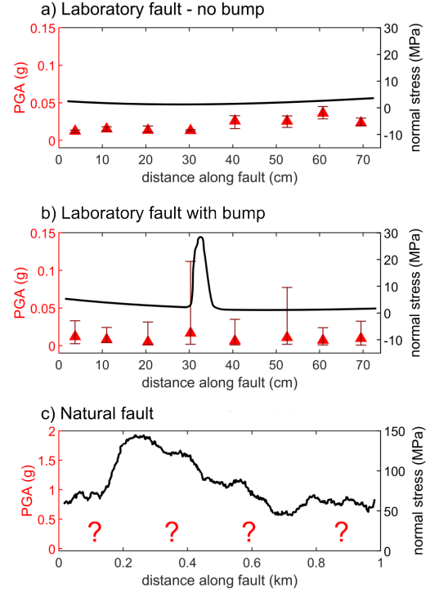
Heterogeneous high frequency seismic radiation from complex ruptures
Sara Beth Cebry¹ and
Gregory McLaskey²
¹U. S. Geological Survey
²Cornell University
Cebry, et al. (2023) JGR
Cebry and McLaskey (2024) Seismica
This work was supported by NSF Grant #1847139.

Slide 2
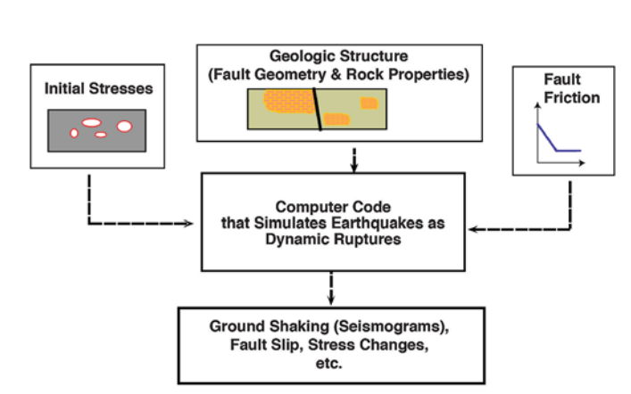
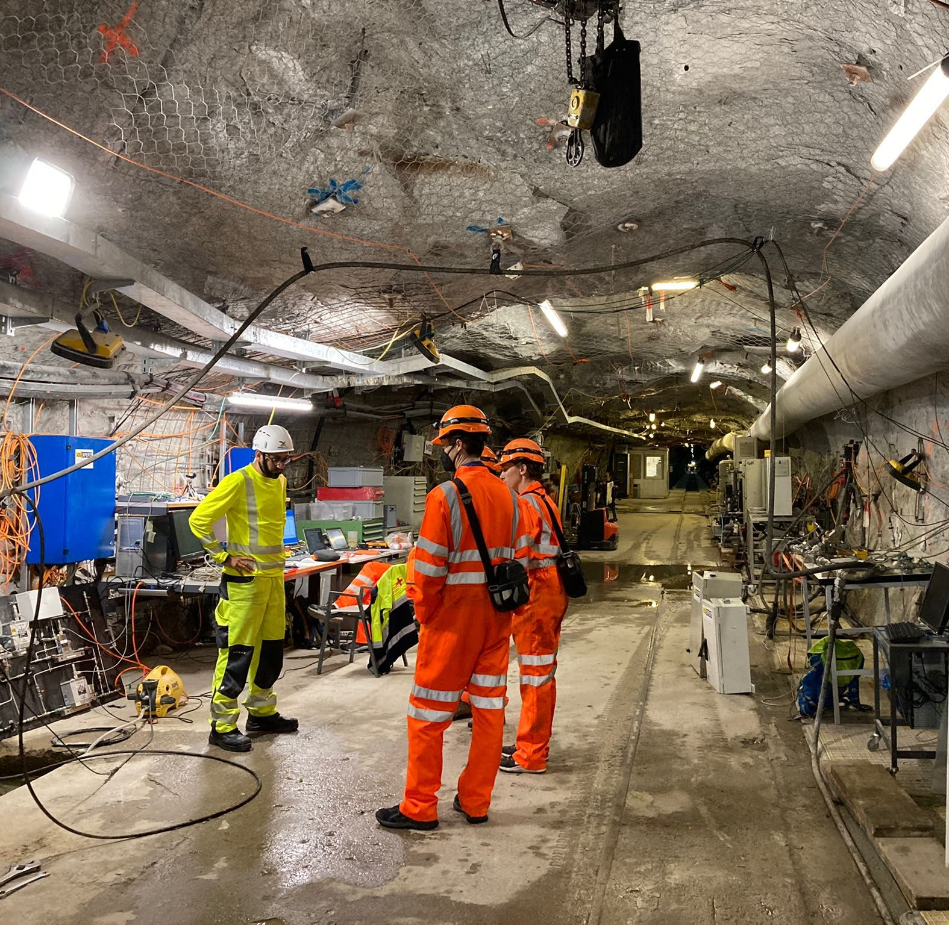
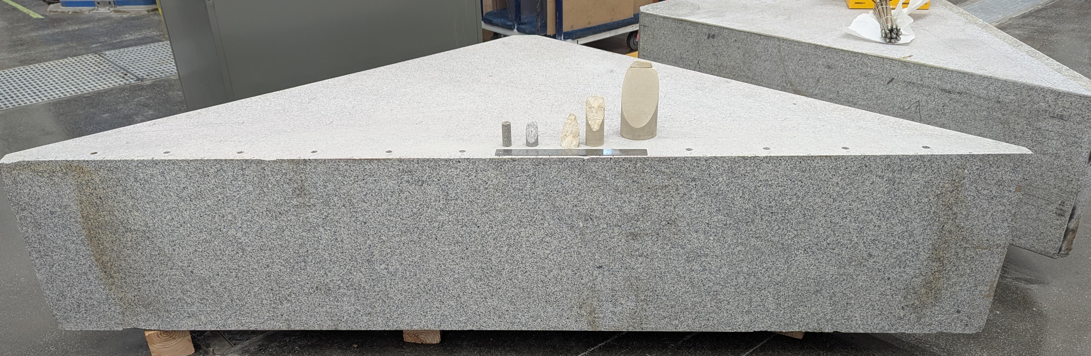
Scaling of earthquake studies
Dynamic rupture models
Harris et al., 2018
Deep
modeling studies
natural faults
Temperature and/or Pressure
small-scale lab experiments
in-situ experiments
large-scale lab experiments
Shallow
In-situ (Bedretto, 1.5 km deep)
Fault size, L/h*
Small-scale (USGS, 1.25 – 7.8 cm)
Large-scale (USGS, 2m)
Notes:
So far this figure is largely experimental focused, but modeling studies exist at all these scales. And most importantly, modeling allows us to bridge these different scales, utilizing laboratory observations to understand what is happening on natural faults and providing a means to fill in the measurement(???) gaps of laboratory studies
This great graphic from Harris et al., 2018 shows the flow for dynamic rupture models, but we can say the same for connections between Griffith’s crack criteria and quasi static LEFM models
there’s a similar connections between theoretical, quasi-static, and anatlytical models

Slide 3
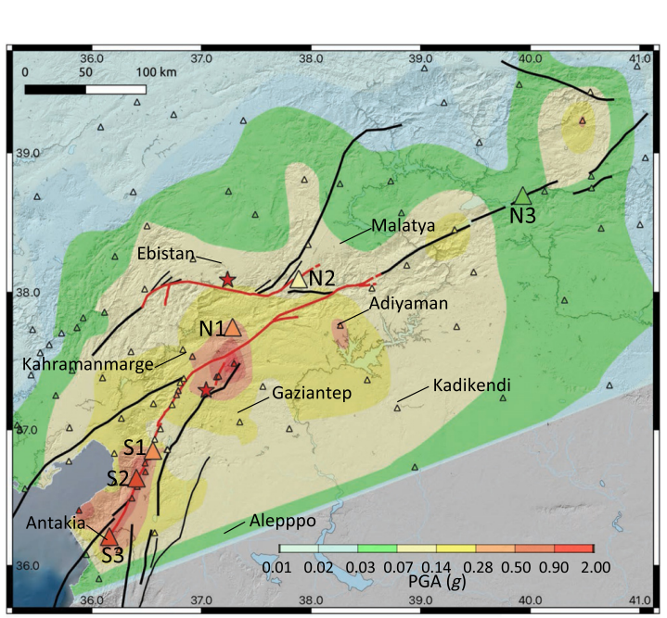
Natural observations inspire large-scale laboratory study
Order of magnitude variations in PGA
Complex fault geometry
2023 Türkiye earthquake doublet
Li et al., 2025
Mai et al., 2023
Notes:
Where my work typically falls is
Specifically, this work focuses on two observations which are both highlighted well by the 2023 turkey earthquake doublet, although this is by no means the only observation
Order of mag variations in PGA – effected by several factors – site and path conditions play an huge roll, but source properties are also important
Related to source properties, fault geometries are complex

Slide 4
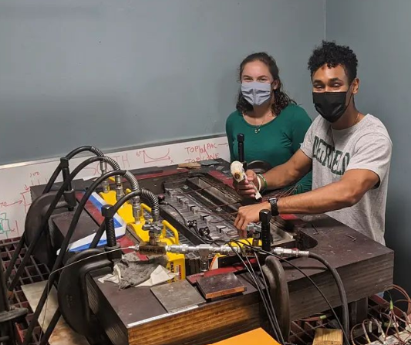
Laboratory earthquakes
Sample-average applied normal stress
Sample-average applied shear stress
Preliminary experiments being conducted in 2021
740 mm
Notes:
To study how fault geometry can effect PGA,
Experiments presented here were conducted on a 740 mm laboratory fault housed at Cornell university. Initial experiments were conducted in 2021

Slide 5
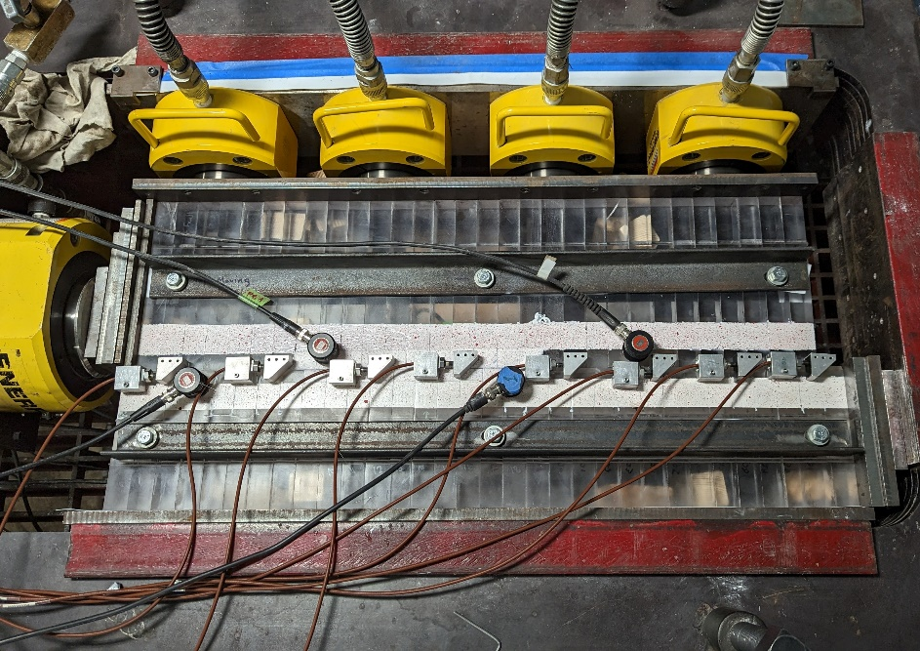
How we add a “bump”
Shims
Add metal “shims” between PMMA and loading frame
Shims
Steel rods

Slide 6
How we add a “bump”
Shims
Add metal “shims” between PMMA and loading frame
Shims
Steel rods

Slide 7
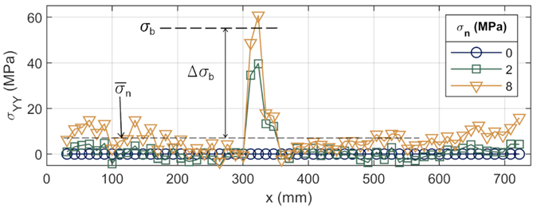
How we add a “bump”
Shims
$σ_{n}(x)$
Shims
distance along the fault, x

Slide 8
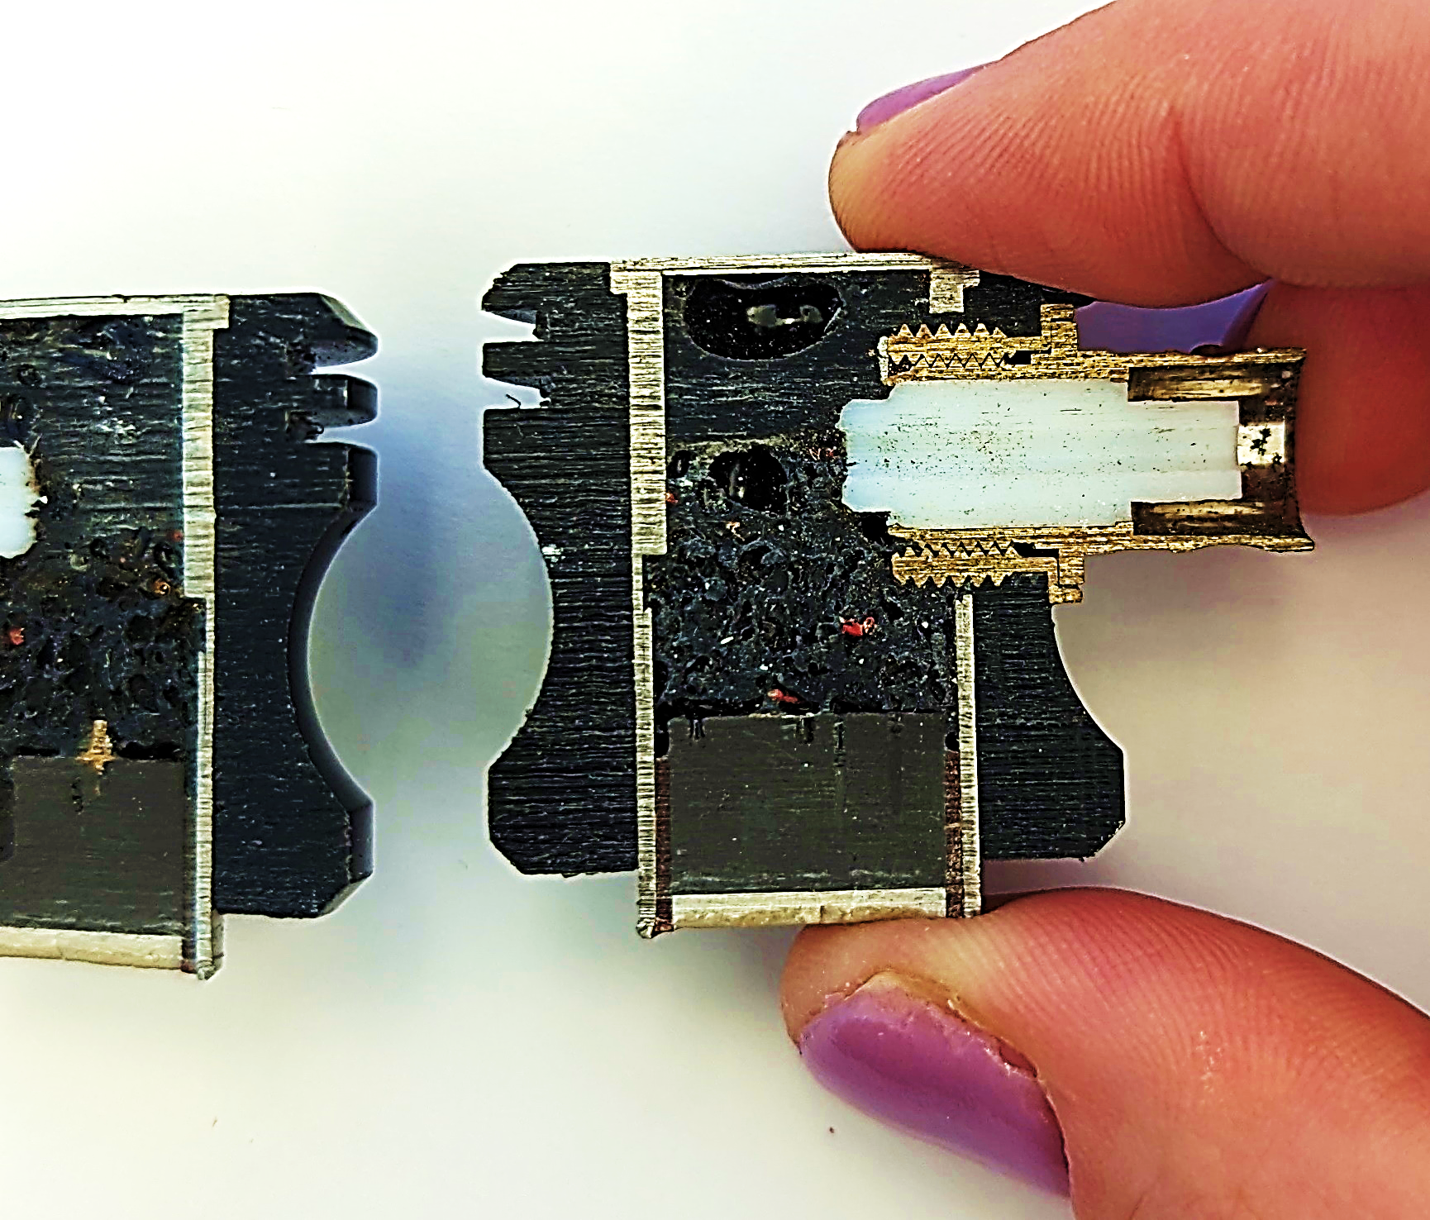
Ground motions at 8 locations along the fault
Panametrics V103
Damping material
Backing mass
Piezoelectric disk
Raw ground motions (V)
Notes:
Re ran experiments and varied bump stress and background stress

Slide 9
Spatial heterogeneity of radiated energy
Continuous
(no bump)
Notes:
We can use the radiated high frequency energy to see rupture behavior.
To compare bump vs no bump, we’ll compare two representative events at 2 Mpa normal stress, the first is from an experiment without a bump.
Explain plot
Smooth propagation, no pauses
Constant rupture front speed, beyond super shear

Slide 10
Spatial heterogeneity of radiated energy
Continuous
(no bump)
Complex
(large bump)
Order of magnitude larger than continuous
Notes:
Explain complex plot
Rupture started in the center of the sample, ruptured towards forcing end, paused briefly, then rupture reinitiated on the other side of the bump. At this point the entire fault has ruptured except the bump. Shortly after this, rupture reinitiated on the bump and re-ruptured the entire fault.
Overall rupture velocity did not correlate with slip rate, continuous slipped beyond super shear, yet PGA on complex was larger

Slide 11
Small events prime bump for large release of energy
At $\overline{σ_{n}}$= 2 MPa
High stress drop
Localized rupture area
Enhanced high frequencies
Enhanced PGA
Continuous
(no bump)
Complex
(large bump)
Supported by modeling studies:
Das and Aki (1977)
Madariaga (2006)
Shi and Day (2013)
Dunham et al. (2011)
Oral et al. (2022)
Notes:
In order to understand the complexity in individual ruptures, its is helpful to zoom out and note the complexity in the earthquake supercycle.
The bump acts as an earthquake gate
Builds up stress when small events terminate due to a high strength excess on the bump
When bump slips, releases large amount of stress,
This happens over a very localized area, so, assuming a Brune/Madariaga relationship between area and fc, the corner frequency is high
The short answer is there is a large difference in strength excess between the ruptures with and without a bump.

Slide 12
Key Points
Complex ruptures due to a bump radiated more high frequency energy during rupture
Spatially heterogeneous PGA
Smooth, continuous ruptures do not match natural observations of PGA
Cebry, Sorhaindo, and McLaskey (2023) JGR
Cebry and McLaskey (2024) Seismica
Notes:
We propose that geometrical heterogneities may be a plausible explanation for natural observations of variations in near fault PGA, such as during the 2023 Kahramanmaraş Turkey earthquakes. Since the heterogeneities are the result of structural features, large PGA during one earthquake would be a strong predictor of large PGA in the same location during a subsequent earthquake rupturing the same fault section

Slide 13
SUPPLEMENTAL

Slide 15
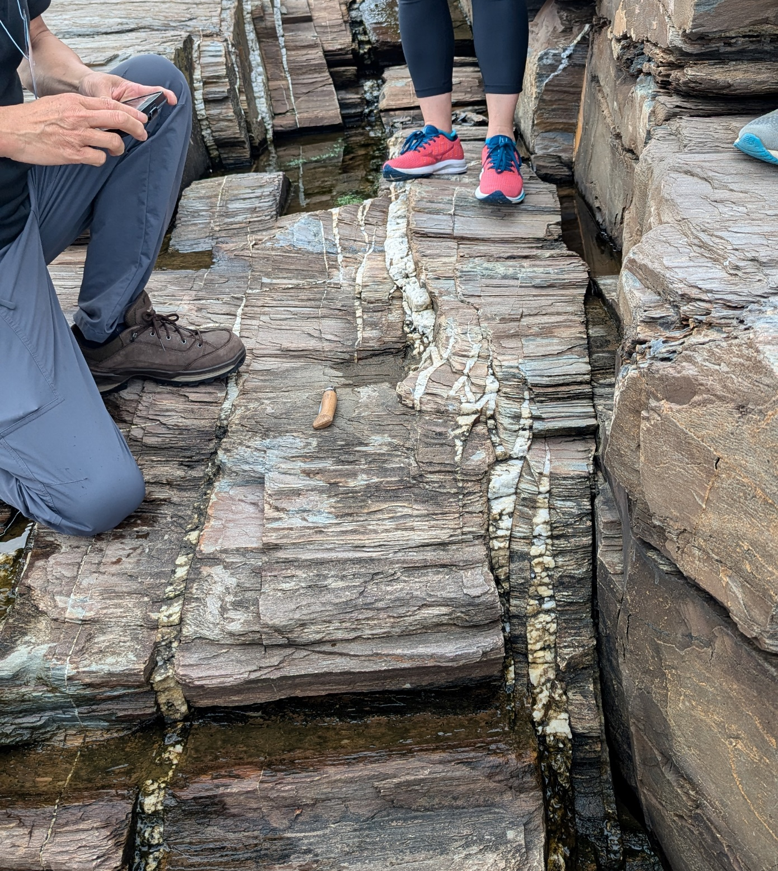
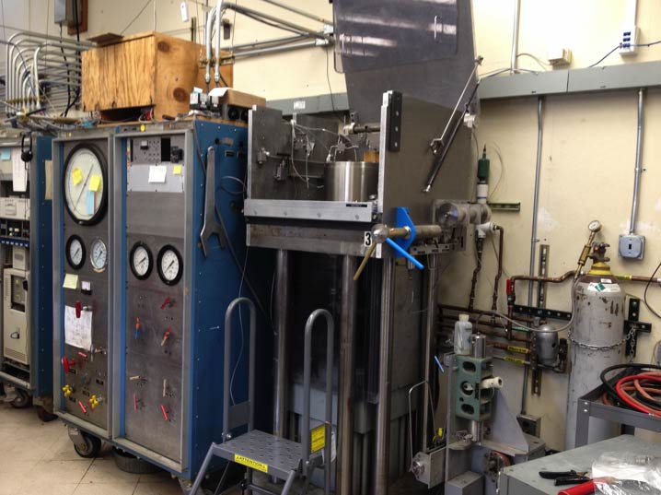
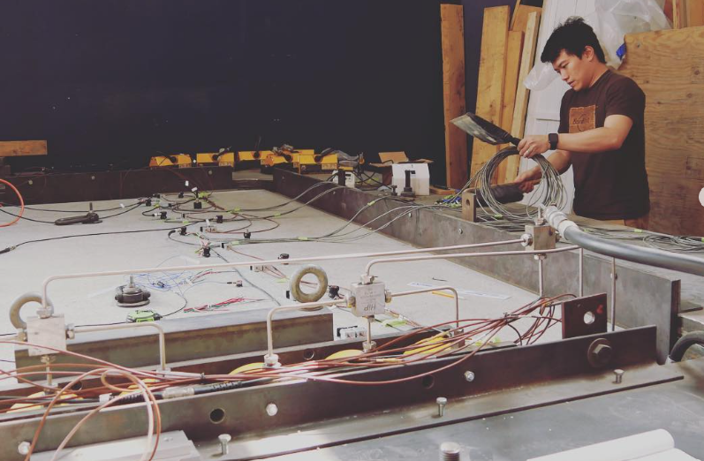
Scaling of earthquake studies
Deep (high pressure (0.1 – 1 GPa) / temperature)
Temperature and/or Pressure
natural faults
Natural
(Cape Elizabeth, ME)
small-scale lab experiments
in-situ experiments
In-situ (Bedretto, 1.5 km deep)
large-scale lab experiments
Shallow (room temperature / 10 MPas pressure)
Fault size, L/h*
Notes:
En echelon vein

Slide 16
PEAK SLIP RATE

Slide 17
SLIP ON BUMP

Slide 18
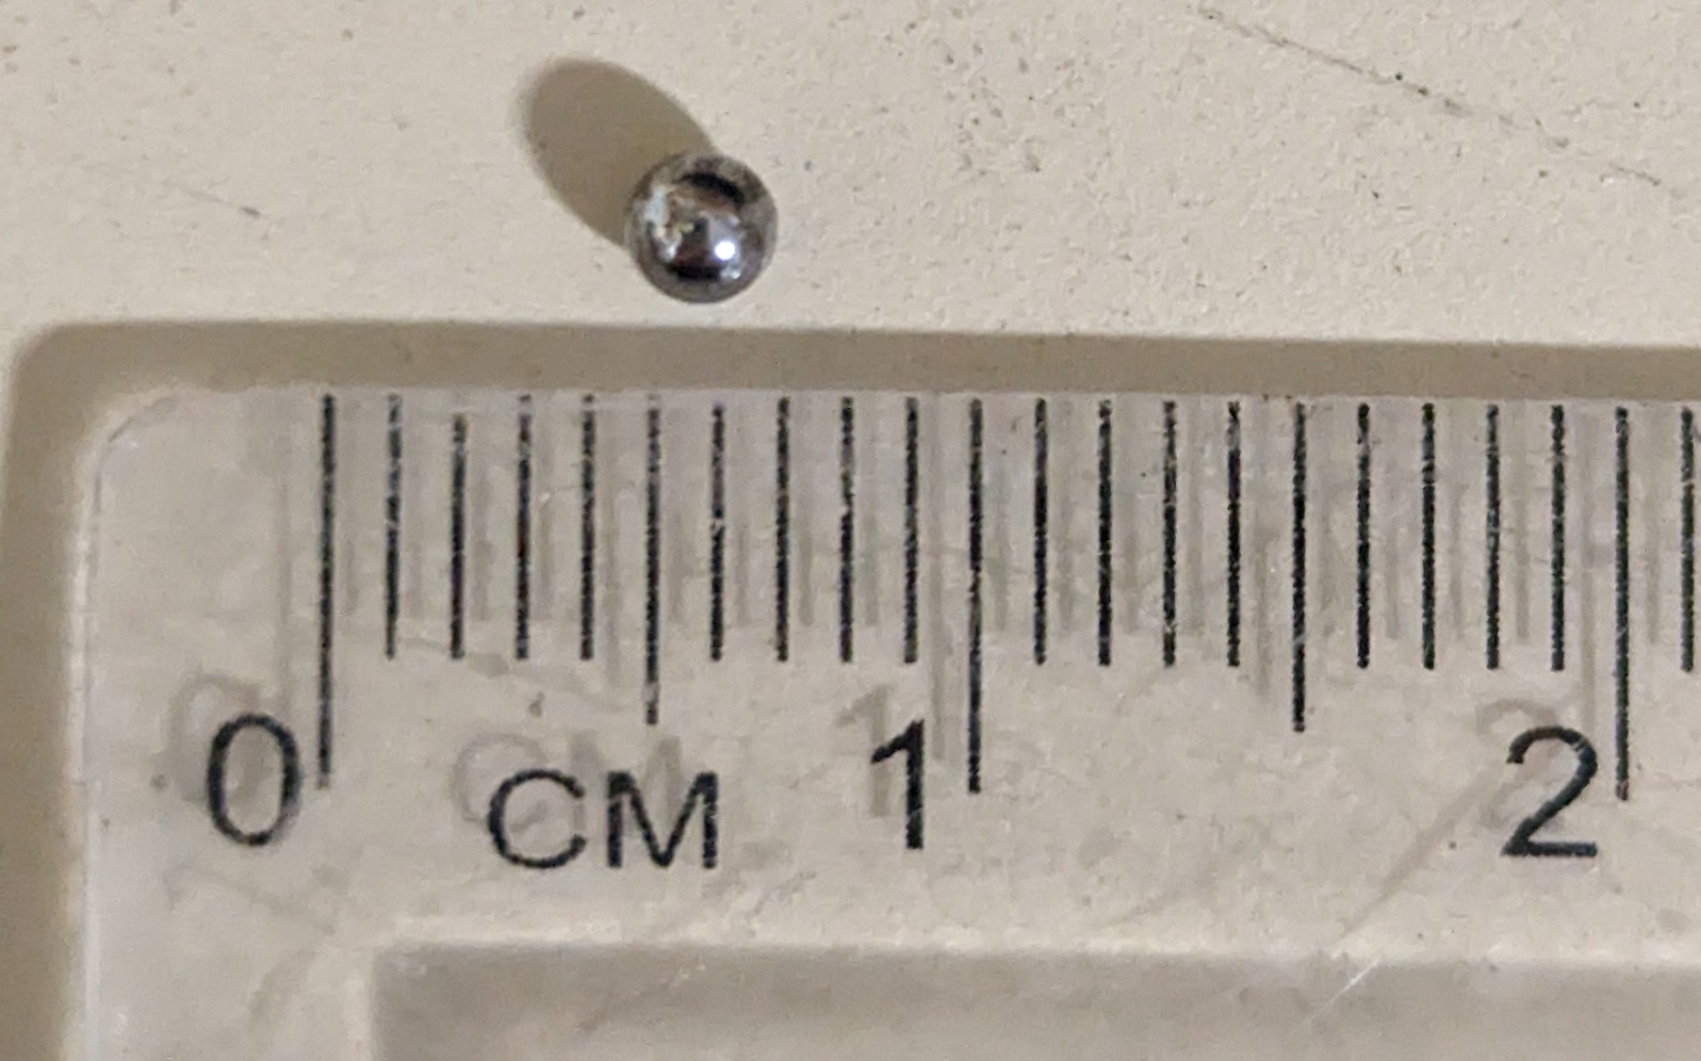
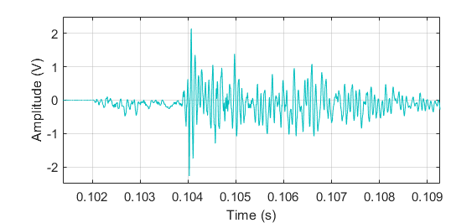
Lab seismology – system calibration
Wave propagation
Sensor and recording system
Source
Signal
$$s\left(t\right)=m\left(t\right) ⨂ g\left(t\right) ⨂ i(t)$$
$$S\left(f\right)=M\left(f\right) ∗ G\left(f\right) ∗ I(f)$$
Ball drop as empirical Green's function
McLaskey et al., 2015
Wu and McLaskey, 2018
Notes:
calibrate entire recording system by dropping a steel ball onto the sample and using this as an empirical greens function event with a known change in momentum (energy)

Slide 19
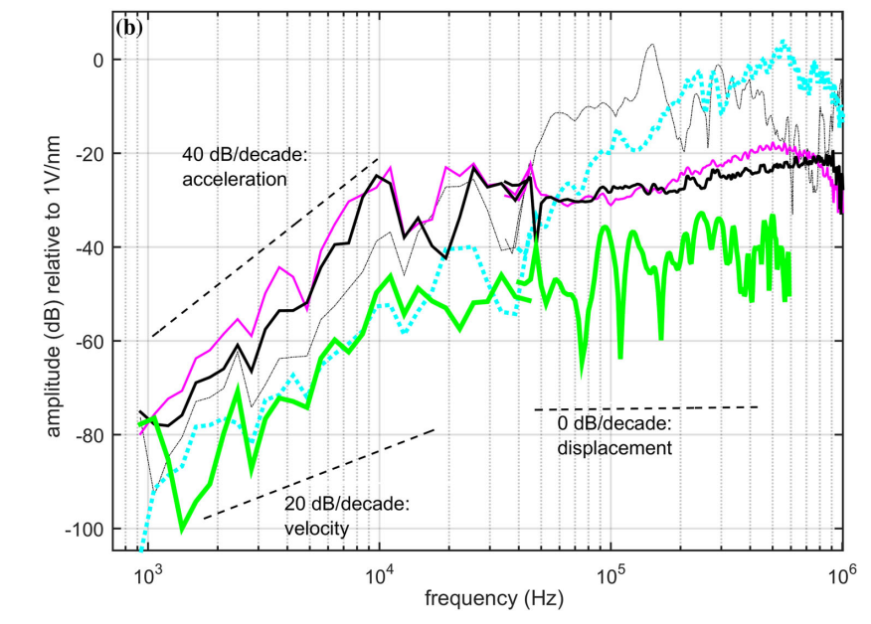
Calibration of PZs
Ball drop method
Direct Calibration for PGA
McLaskey and Glaser, 2010
Wu and McLaskey, 2018
McLaskey et al., 2015

Slide 20
With Brune

Slide 21
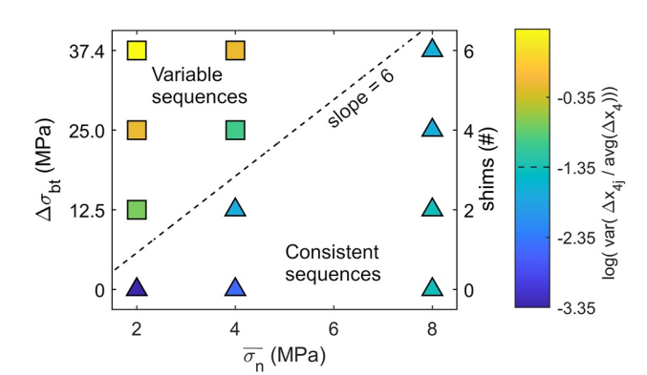
Complex rupture sequences

Slide 22
What controls if rupture terminates at bump?
Bump strength
(High fracture energy)
Bump does not slip
Bump prominence:
$$∆σ_{b}/\overline{σ_{n}}$$
Strength excess
Incoming rupture
Stress increase from incoming rupture
(Energy at crack tip)
Stress already on bump
($∆τ_{pot}$)
(Changes throughout experimental run)
Notes:
One main difference in variable vs consistent sequences is the occurrence of partial events where rupture terminates on the bump.
There are three factors that control whether or not the bump ruptures, bump strength, stress increase, and stress already on bump. And if you like to think in energy you also have three similar factors.
And we’re framiliar with some of these already, stress on bump over bump strength is also known and strength excess, but this changes throughout the experiment. Bump strength, which is promotional to the stress on the bump, and stress increase, which is proportional to the sample average normal stress, remain constant. So we combine these two factors into the parameter of bump pr

Slide 23
Increasing bump prominence
${∆σ}_{b}= σ_{b}− \overline{σ_{n}}$
Variable – bump sometimes stops rupture
$∆σ_{b}/\overline{σ_{n}}$ $=6$
${∆σ}_{b}$
$σ_{n}(x)$
$\overline{σ_{n}}$
$${∆σ}_{b}$$
distance along a fault, x
Consistent – bump does not stop rupture
Notes:
Cool, but where does this come from? Why 6?

Slide 24
Look for something that better shows why PGA is higher

