Slide 1
Analysis of PM_{2.5} Impacts from Agricultural Vinyl Waste
Treatment Processes and Uncollected Waste
Hyunjun Park¹ , Minseon Park¹ , Namhoon Lee² , and Hui-Young Yun²
1. Department of Environmental Engineering, Anyang university, Anyang, Gyeonggi, Republic of Korea.(pook0212@hanmail.net)
2. Department of Environmental and Energy Engineering, Anyang university, Anyang, Gyeonggi, Republic of Korea

Slide 2
Background and Purpose
Since 2012, the Korea Environment Corporation has been commissioning recycling facilities to efficiently recycle waste vinyl for cultivation
Establishing and operating a for “agricultural waste management system” for collecting and managing waste vinyl for cultivation
For the efficient operation and management of recycling facilities, a quality management system is being operated through performance evaluation and collection grade system for private collection business operators
the limits of private facility demand
Negative disposal
of unused plastic
waste vinyl pileup
Investigation on the Contribution of Fine Dust
Analysis of fine dust generated by burning unwound waste vinyl
Identify the demand for recycling facilities by predicting the amount of waste vinyl generated for agriculture
Calculate the amount of fine dust generated by recycling facilities
Notes:
Since 2012, the Korea Environment Corporation (KECO) has outsourced agricultural vinyl waste recycling operations to private facilities and built a management system for tracking collection and treatment performance.
To improve efficiency, a quality control system is in place, including performance evaluations and a grading system for private collectors.

Slide 3
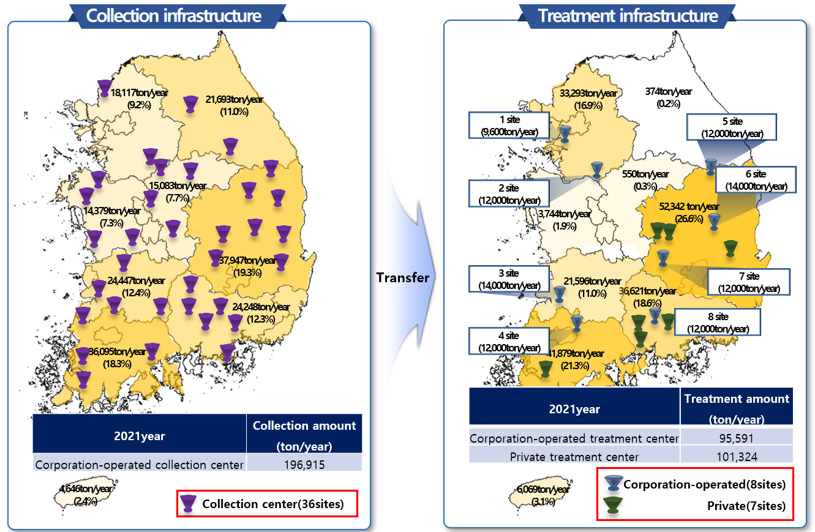
Current Status of Waste Vinyl Treatment Infrastructure in Agriculture
In 2021, a total of 196,915 tonnes of agricultural waste vinyl were collected through 36 corporate-run collection centers across the country.
The collected waste was transferred to 15 treatment centers, including 8 corporate operating facilities and 7 private facilities.
The largest amount of treatment was handled in the Southeast region, accounting for 26.6% of the country's total.
<Fig.1> Waste Vinyl Treatment Infrastructure in Agriculture
3

Slide 4
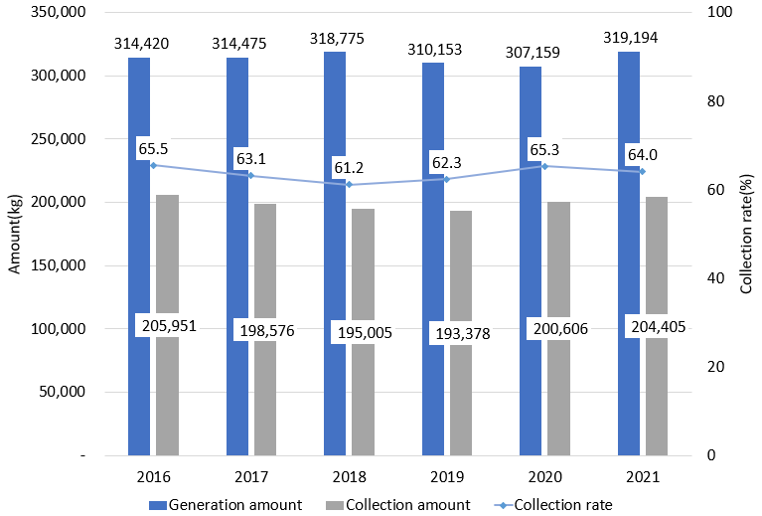
Amount of waste vinyl generated and collected in Agriculture
From 2016 to 2021, the annual generation of agricultural waste vinyl remained relatively stable, ranging from 307,000 to 319,000 kg.
The collection amount showed slight fluctuations, leading to a collection rate between 61.2% and 65.5%.
In 2021, the collection rate was 64.0%, with 204,405 kg collected out of 319,194 kg generated.
The uncollected portion is mostly disposed of through open burning, which raises concerns over air pollution and health impacts.
<Fig. 2> Amount of waste vinyl generated and collected in Agriculture

Slide 5
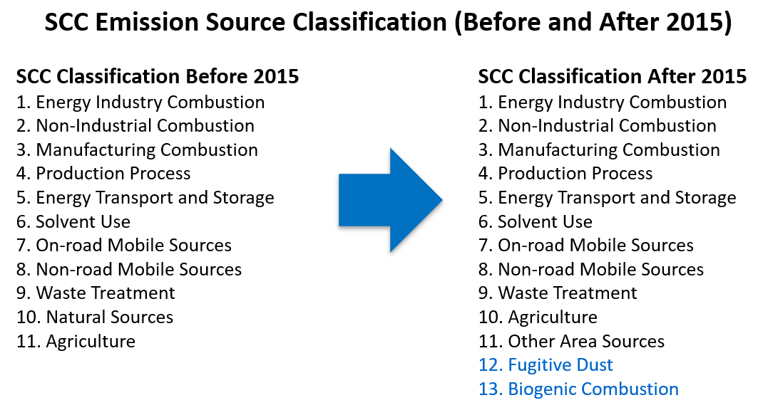
Introduction to CAPSS (Clean Air Policy Support System)
What is CAPSS?
The Clean Air Policy Support System (CAPSS) is a comprehensive emission information system based on the Air Pollutants Emission Inventory, which calculates and provides statistical emission information necessary for air quality policy implementation through systematic collection and management of basic data.
CAPSS annually calculates the emissions of nine air pollutants (TSP, PM_{2.5}, PM₁₀, SOx, NOx, VOCs, NH₃, CO, BC) emitted from point, area, and mobile sources, and the calculated emissions are provided in various types of statistical data such as pollutant, source, and region through the National Air Pollutant Emission Service.
CAPSS emission source classification is based on the European CORINAIR (SNAP 97) system, expanded to 13 categories to reflect Korea's context, with fugitive dust and biomass burning officially included in national statistics from 2015.
Purpose
- To estimate air pollutant emissions from various sources
- To support environmental policy decisions
- To provide data for modeling and air quality forecasting
5
Notes:
The CAPSS emission source classification system is based on the European CORINAIR emission source classification system (SNAP 97).
Starting with the 2007 data, the emission source classification was adapted to domestic realities, and fugitive dust was added from the previous 11 categories to 12 categories.
Starting with the 2011 data, biogenic combustion was added to the list of 13 major categories.
However, emissions of fugitive dust and biogenic elements have been included in official emissions statistics since 2015.
The emission factors used in CAPSS prioritize emission factors developed by domestic research institutes, and emission factors not developed in Korea were applied by reviewing EU CORINAIR SNAP 97, US EPA AP-42, etc.

Slide 6
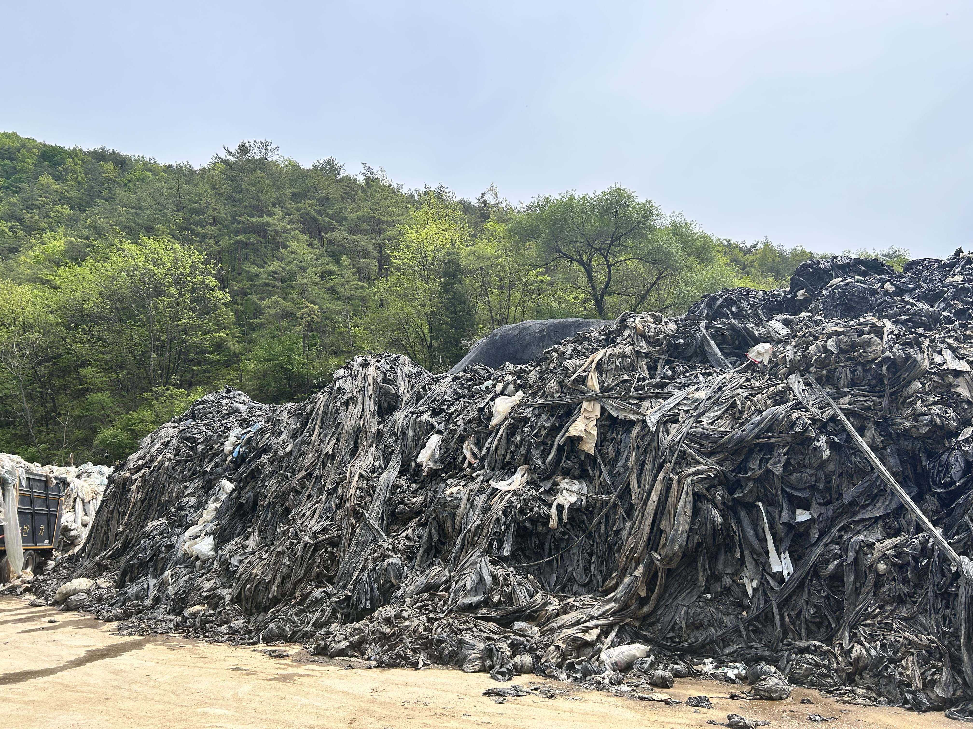
Agricultural Waste Vinyl fine dust CAPSS emission coefficient
For collected agricultural waste vinyl, PM2.5 emissions were estimated using emission factors for crushing, shredding, and sorting processes.
For uncollected waste, open burning emission factors for household waste were applied, though differences may exist for vinyl-specific burning.
<Table 1> Emission coefficient of fine dust according to the treatment method of waste vinyl in agriculture
Category | SOC | PM_{2.5} Emission Factor
Waste treatment (Construction waste recycling) | 120801100 | - Crushing | 0.00012kg/ton
 |  | - Shredding | 0.00075kg/ton
 |  | - Sorting | 0.00043kg/ton
 |  | - Conveyor operation | 0.000055kg/ton
Collected Waste |  | Uncollected Waste
Shredding | 0.00012kg/ton | open burning | 7.12kg/ton
Crushing | 0.00075kg/ton
Sorting | 0.00043kg/ton
Category | SOC | PM 2.5 Emission Factor
Open burning (household waste) | 13010100 | 0.00712 kg/kg

Slide 7
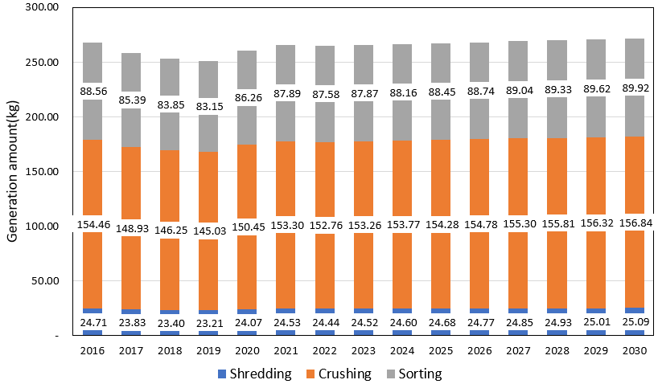
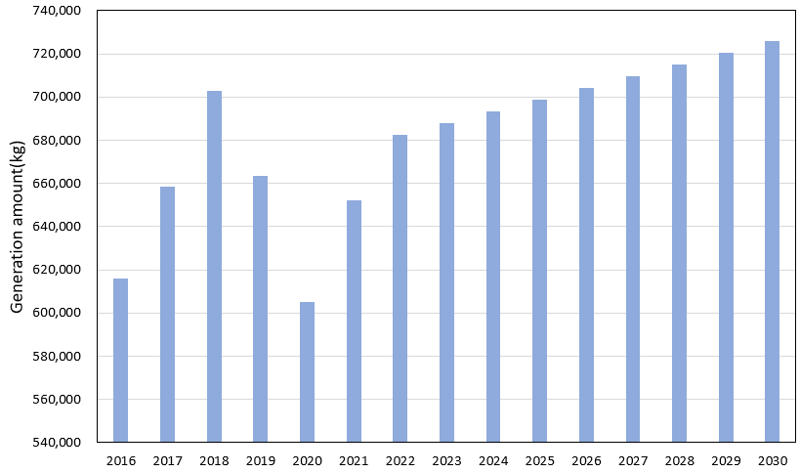
Key-results
Estimated PM_{2.5} emissions using the CAPSS system and applied linear regression to forecast future emission levels.
<Fig. 3> Collected treatment PM_{2.5} generation amount
<Fig. 4> Uncollected open burning PM_{2.5} generation amount
📌 the emissions from formal treatment will total around 272 kg
📌 open burning alone will emit over 725,000 kg of PM_{2.5} — 2,600 times more.
7
Notes:
Since 2012, the Korea Environment Corporation (KECO) has outsourced agricultural vinyl waste recycling operations to private facilities and built a management system for tracking collection and treatment performance.
To improve efficiency, a quality control system is in place, including performance evaluations and a grading system for private collectors.

Slide 8
Forecast of Agricultural Waste Vinyl and PM2.5 Emissions results
Forecast of Agricultural Waste Vinyl Generation
From 2021 to 2030, the generation of waste vinyl is expected to either decrease by 1,624 tons or increase by 9,606 tons depending on the trend.
A 5-year average growth rate was used assuming an increase in vinyl waste generation.
Forecast of PM2.5 Emissions from Collected Waste
Based on collection data, PM2.5 emissions in 2030 are projected as follows: 25 kg from crushing, 157 kg from shredding, and 90 kg from sorting.
The total emission is estimated to be 272 kg, which is 6 kg higher than in 2021.
Forecast of PM2.5 Emissions from Uncollected Waste
Open burning of uncollected waste is expected to generate 725,779.45 kg of PM2.5 by 2030, over 2600 times more than collected waste.
Since 40% of total agricultural waste is assumed to be uncollected and burned, it significantly affects PM2.5 emissions.
Therefore, it is necessary to improve the collection system and secure treatment facilities for stable waste management.
8
Notes:
Since 2012, the Korea Environment Corporation (KECO) has outsourced agricultural vinyl waste recycling operations to private facilities and built a management system for tracking collection and treatment performance.
To improve efficiency, a quality control system is in place, including performance evaluations and a grading system for private collectors.

Slide 9
Thank you

