Slide 1


Impacts of the 2022 Extreme Heatwave and Drought on Camellia oleifera Production in China
Tianying Wang (wangty196@gmail.com)
Sihua Liu, Jiazhi Fan, Xiqiang Shuai, Bing Sui, Yongzhong Chen
Hunan Key Laboratory of Meteorological Disaster Prevention and Reduction, Changsha, China Institute of Meteorological Sciences of Hunan Province, Changsha, China Hunan Academy of Forestry, Changsha, China
Veinna, Austria | 30 Apr 2025
Supplementary Materials

Slide 2
Overview
Extreme heat and drought affected major Camellia oleifera production in 2022
Meteorological extremes
Significant impacts on fruit yield, oil content, and plant survival
Exploring the time periods and indicators of the impact of high temperature and drought on Camellia oleifera

Slide 3
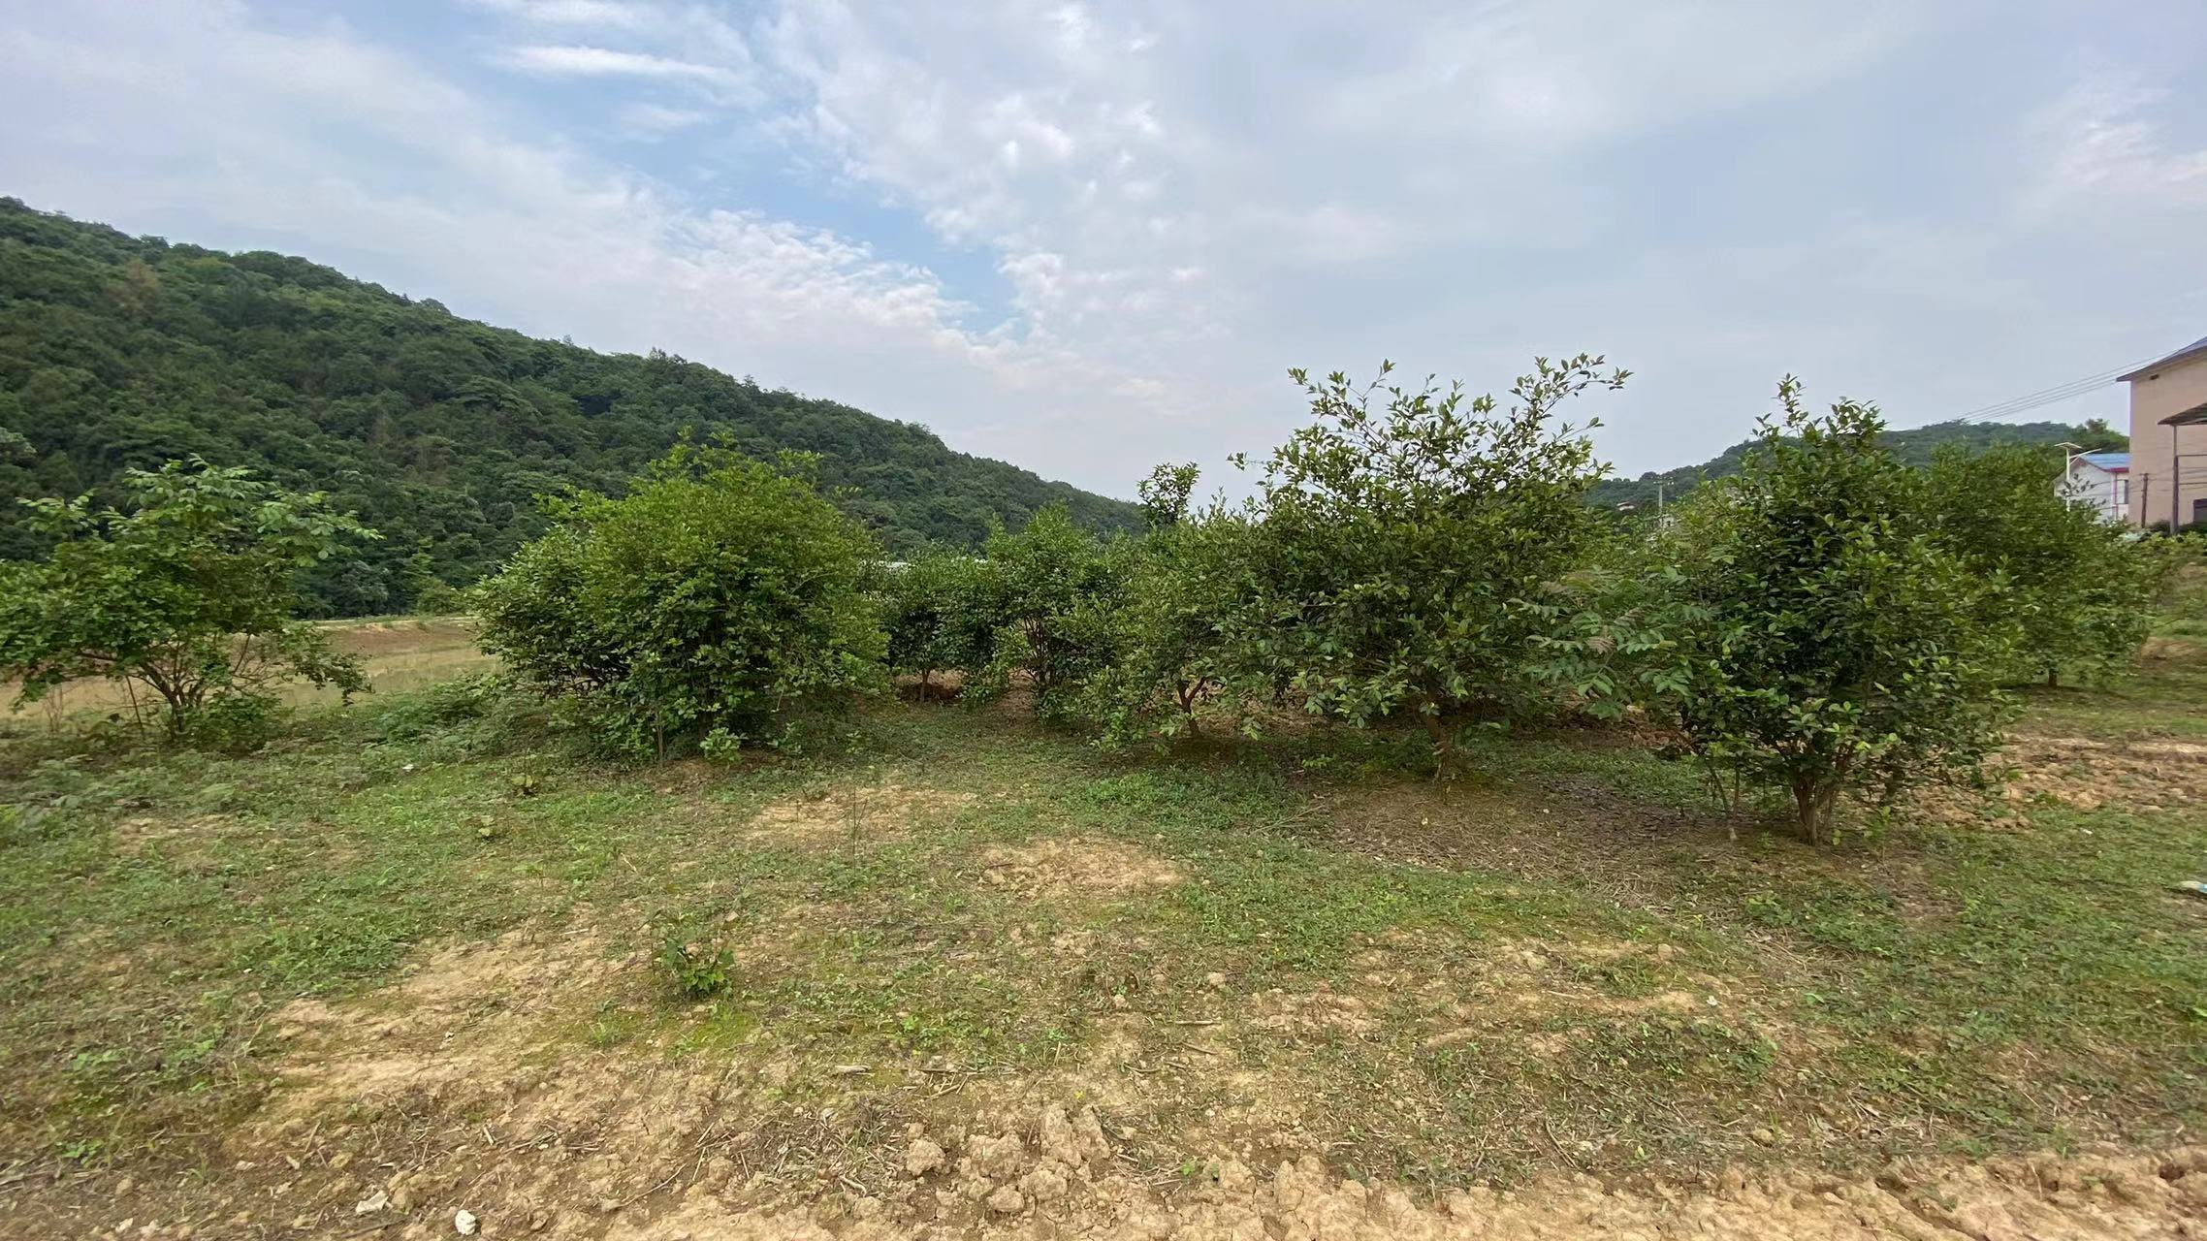
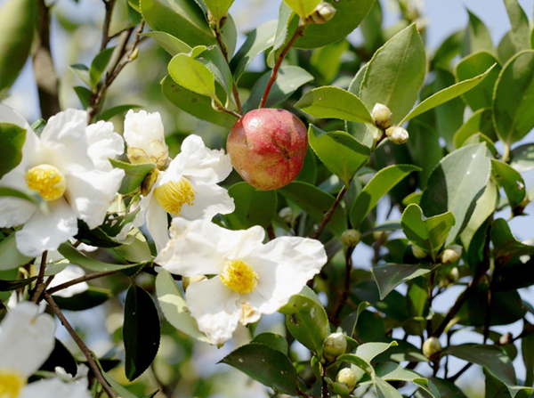
Camellia oleifera (Oil-tea Camellia) :Unique woody edible oil tree in China
• Size: 2-6m evergreen shrub/small tree • Unique Trait: Flowers and fruits coexist (Oct-Dec) • Yield: 3-8kg seeds/tree, producing premium edible oil • Value: Sustainable “Oriental Olive Oil” for subtropical hills

Slide 4
Camellia oleifera (Oil-tea Camellia) :Unique woody edible oil tree in China
Unique to China with 2,300+ years cultivation history
15 major production provinces (Hunan, Jiangxi, etc.)
20-month growth cycle with critical phases:
→ Fruit expansion (July-Aug)
→ Oil accumulation (Aug-Oct)
→ Flower maturation (Mid-Aug to Mid-Sep)
Industry value ↑300% in past decade (Chen et al., 2020)
Key Expansion Area
Core Development Area
Fig. National Camellia oleifera Development Layout in China (2023-2025)
Three-Year Action Plan for Accelerating the Development of the Camellia Oleifera Industry(2023-2025), 2022.

Slide 5
Growing Climate Risks
2022 Yangtze River Basin event:
→ Record-breaking, large-scale, high-intensity, and prolonged high-temperature drought. (Xu et al., 2024)
→ TOP1 high-temperature days & BOTTOM1 cumulative rainfall for the same period since 1961. (MWR, 2023)

Slide 6
Documented impacts
Year 2010:
→ Damage and mortality in Camellia oleifera forests and seedlings(Cao et al., 2014)
Year 2013:
→ significant decrease in the survival rate of newly planted and young forests in Southeast Guizhou (Yuan et al., 2014)
→ seedling survival rate in some Camellia oleifera nurseries in Hunan was only 30%, with an average mortality rate of 29% for grafted seedlings and an average mortality rate of 52.5% for newly planted (Chen et al., 2014)
Year 2021:
→ significant decrease in oil content in Hengyang, Hunan (Yang et al., 2022)

Slide 7
Research Methodology
1. Physiological Measurements:
Effects of drought on physiological and biochemical indicators such as photosynthesis and chlorophyll content, as well as yield indicators like fresh fruit weight and oil content. (Linder, 2000; Huang et al., 2013; Zhong et al.,2015)
2. Climate Correlation Models:
→ T_{ave} and R in September are significantly correlated with the oil content of common camellia oil tea in China. (Yu et al., 1999)
→ ≥37℃ day thresholds (Liao et al., 2020)
→ Thermal accumulation (≥30℃) (Xie et al., 2021)

Slide 8
Data and Methods
1. Data Sources
→ Typical hot and dry year in China in recent years: 2013, 2021, and 2022.
→ Meteorological data (from the Tianqing Meteorological Big Data Centre) including daily R and Tmax data from 1307 national meteorological observation stations in 15 main Camellia oleifera producing provinces in China.
→ Camellia oleifera production data and disaster information were collected through literature review, field surveys in affected areas, and comprehensive statistical assessments, including fresh fruit yield, disaster-affected area, oil content, and plant phenotype characteristics in main Camellia oleifera producing provinces.

Slide 9
Data and Methods
2. Research Methods
a. High Temperature Characteristics(Liao et al., 2019; Guo et al., 2023):
→ The cumulative days with maximum daily temperature ≥ 35 ℃ and ≥ 39 ℃ (D_{Tm35}, D_{Tm39})
→ Extreme maximum temperature (T_{max}),
→ The longest duration of maximum daily temperature ≥ 35 ℃ (CD_{Tm35})

Slide 10
Data and Methods
2. Research Methods
b. Drought Characteristics(Liao et al., 2020):
→ Cumulative precipitation (R_{t})
→ the longest consecutive days without effective rainfall (daily R <10mm) (CD_{nr})

Slide 11
Data and Methods
Impact Assessment Method on Camellia oleifera Production
Comprehensive Statistical Assessment:
Impact and disaster information collected from literature and surveys(Liao et al., 2019; Liao et al., 2020; Xie et al., 2021; Cao et al., 2014; Yang et al., 2022; Ding, 2022).
b. Field Surveys:
→ Extensive field surveys were conducted in Hunan and Jiangxi in 2022.
→ Random sampling method,

Slide 12
2022 Camellia Heat Map
Early onset, prolonged duration, record temperatures (July-Sept 2022)
Days with T_{max} ≥35℃: 37-69 days in core regions
Continuous days with T_{max} ≥35℃: up to 36-41 days locally
Days with T_{max} ≥39℃: 10-43 days in core regions, Record T_{max}: 40.0-45.0℃
*The base maps in all images on this page are shapefiles of
China’s 15 main Camellia oleifera producing provinces.
SHA’ANXI
HENAN
SHA’ANXI
HENAN
ANHUI
SICHUAN
ANHUI
SICHUAN
HUBEI
HUBEI
CHONGQING
CHONGQING
ZHEJIANG
HUNAN
JIANGXI
ZHEJIANG
HUNAN
JIANGXI
GUIZHOU
FUJIAN
GUIZHOU
FUJIAN
YUNNAN
YUNNAN
GUANGXI
GUANGDONG
GUANGXI
GUANGDONG
HAINAN
HAINAN
Cumulative number of days with T_{max} ≥35℃ (d)
Extreme Maximum Temperature (℃)
High Temp Dist. In 15 Major Camellia oleifera Provinces of China (Jul 1 - Sep 20)
*The base maps in all images on this page are shapefiles of China’s 15 main Camellia oleifera producing provinces.

Slide 13
2022 Camellia Drought Map
Prolonged drought with minimal rainfall (July-Dec 2022)
Cumulative rainfall: 65.8-250.0 mm in core regions
Continuous days without effective rain: up to 61-89 days
*The base maps in all images on this page are shapefiles of
China’s 15 main Camellia oleifera producing provinces.
SHA’ANXI
HENAN
SHA’ANXI
HENAN
SICHUAN
ANHUI
ANHUI
HUBEI
SICHUAN
HUBEI
CHONGQING
ZHEJIANG
CHONGQING
HUNAN
JIANGXI
HUNAN
JIANGXI
ZHEJIANG
GUIZHOU
FUJIAN
GUIZHOU
FUJIAN
YUNNAN
YUNNAN
GUANGXI
GUANGDONG
GUANGXI
GUANGDONG
HAINAN
HAINAN
Cumulative rainfall (mm)
Longest consecutive days without effective rainfall (d)
Precip. Dist. In 15 Major Camellia oleifera Provinces of China (Jul 20 - Dec 1)
*The base maps in all images on this page are shapefiles of China’s 15 main Camellia oleifera producing provinces.

Slide 14
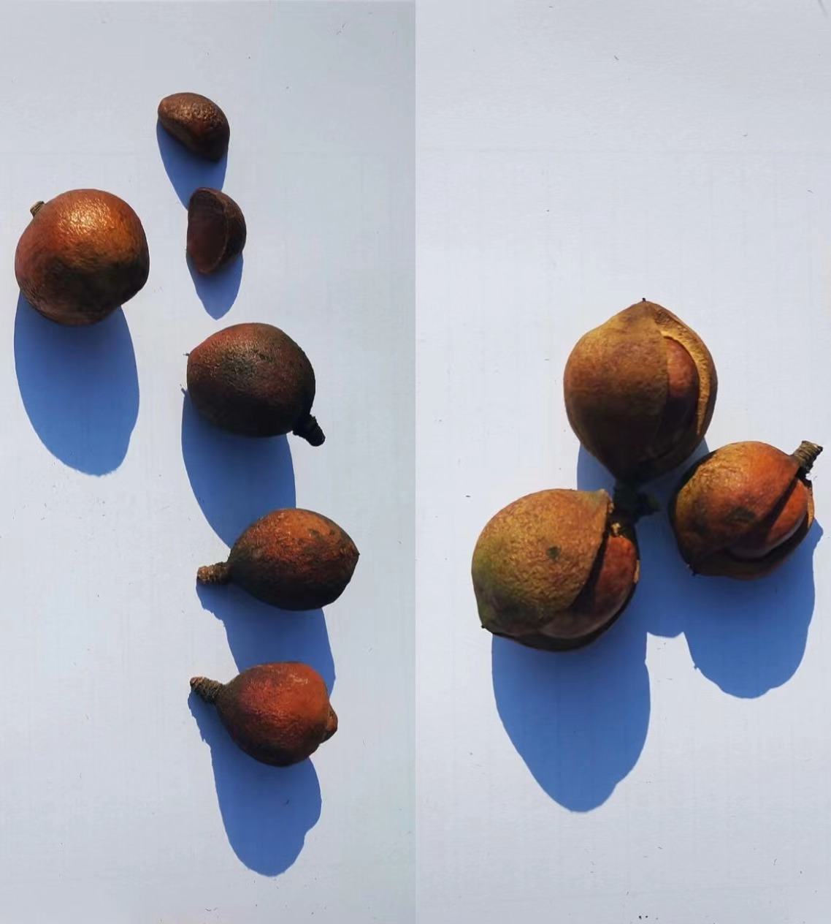
Impact on Fruit Yield
Widespread small, dry, cracked fruits and premature drop
Severe yield reductions:
- Hunan: 10-35% of normal yield
- Jiangxi: 10% in worst areas
- Zhejiang: 2% in severely affected plantations
- Guizhou: 28% reduction from 2021
- Chongqing: 33% reduction from 2021
Small fruit, dried fruit and cracked fruit from southern Hunan

Slide 15
Impact on Oil Content
Severe reductions in high-temperature regions:
- Fresh fruit oil: 2.0-3.0% (40% below normal)
- Dry seed oil: 16.0-18.0% (30% below normal)
Less heat-affected regions showed smaller reductions:
- Guizhou: 5.9% fresh fruit oil (only 6% reduction)
• Heat duration more critical than drought alone for oil synthesis

Slide 16
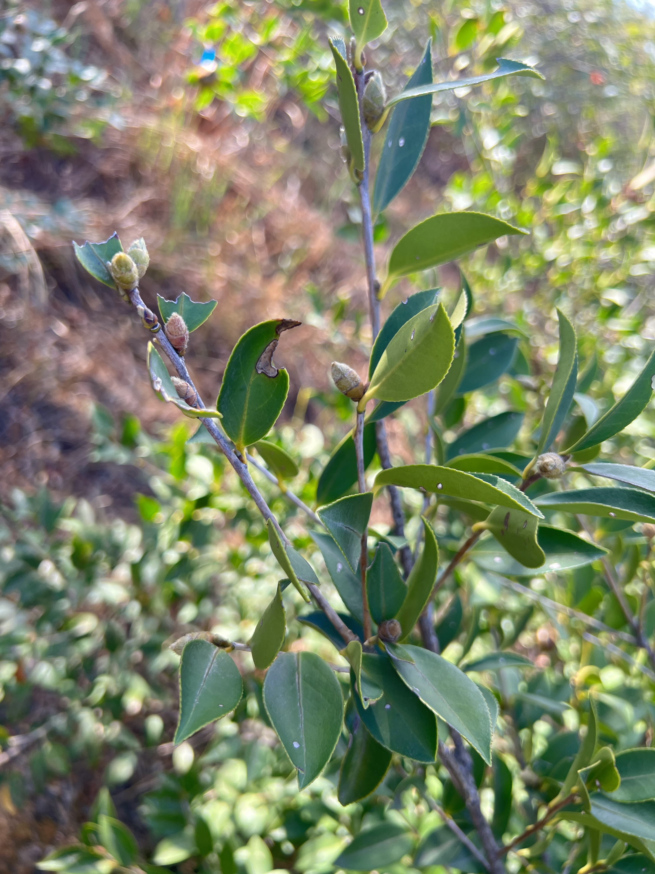
Impact on Buds and Fruit Set
Healthy bud
Bud mortality: 10.6-37.2% in surveyed areas
Delayed flowering by up to 1 month
Poor synchronization reduced pollination
2023 fruit set severely affected:
- Some plants showed <1% fruit set
- Abnormal fruit drop observed
Long-term productivity impacts expected
Withered bud

Slide 17
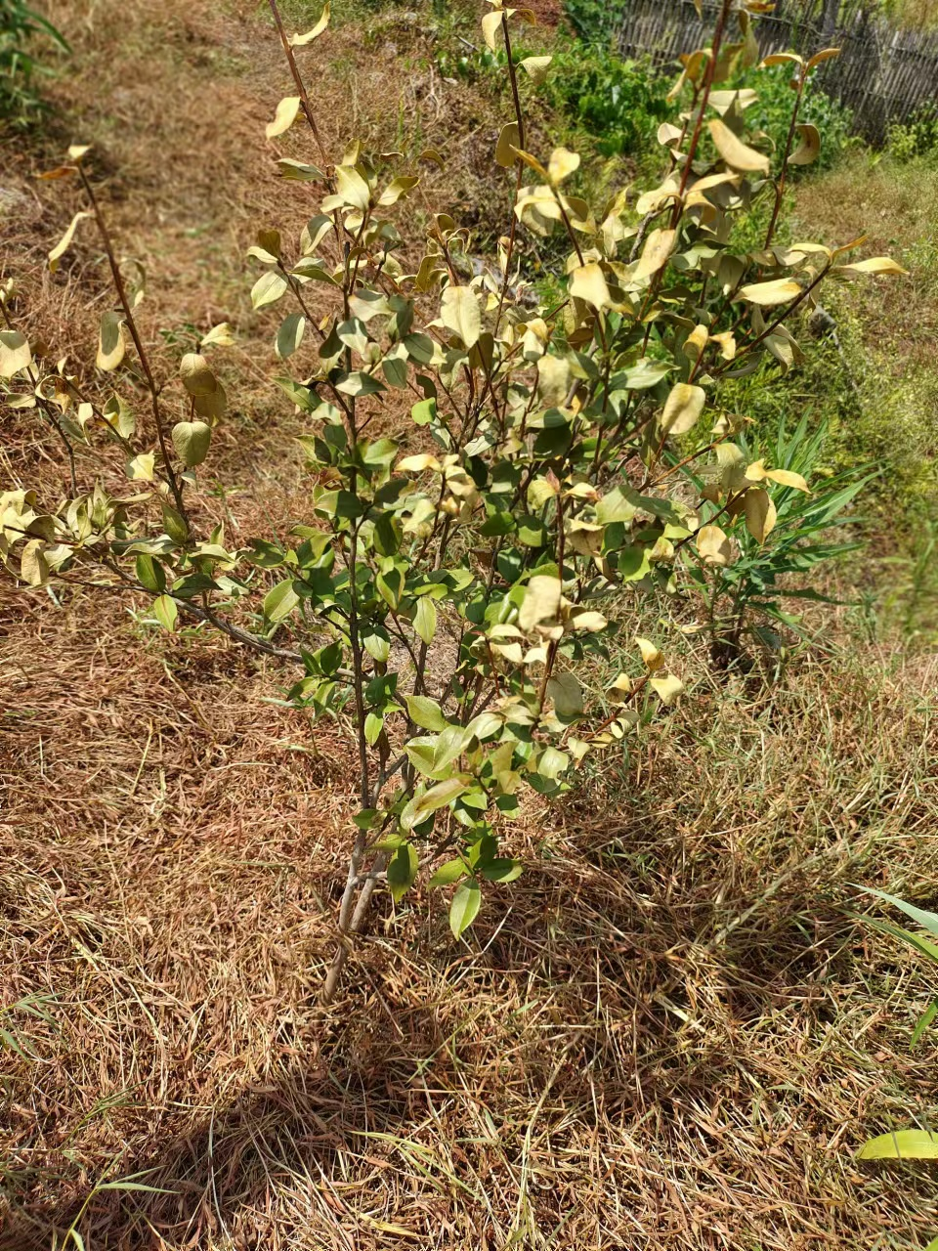
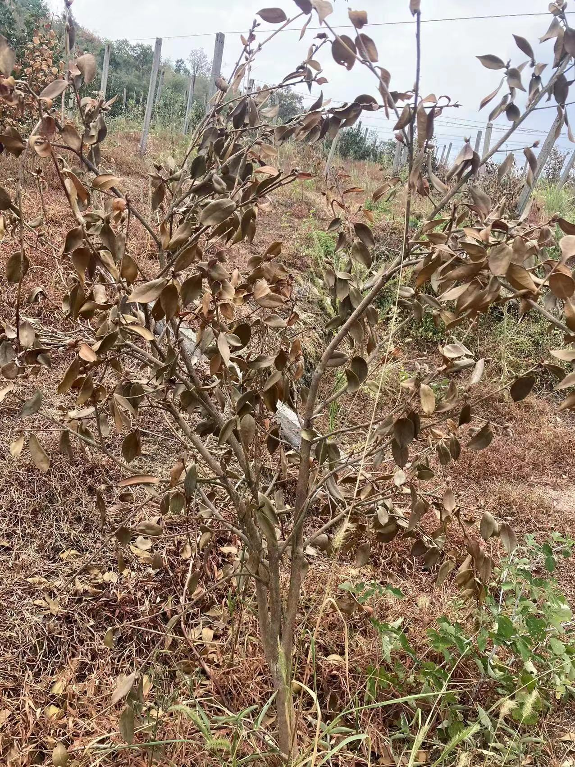
Impact on Plant Survival
New plantations:
- Mortality: 71.0-74.5% in core regions
Young stands:
- Mortality: 15.2-70.4%
Mature stands:
- Mortality: 9.2-14.7%
Nurseries:
- Mortality: 18.0-40.0%
Regional impacts:
- Hunan: 24% young stands with ≥60% mortality
- Guizhou: 40% severe damage in some areas
Western Hunan
Southeastern Guizhou

Slide 18
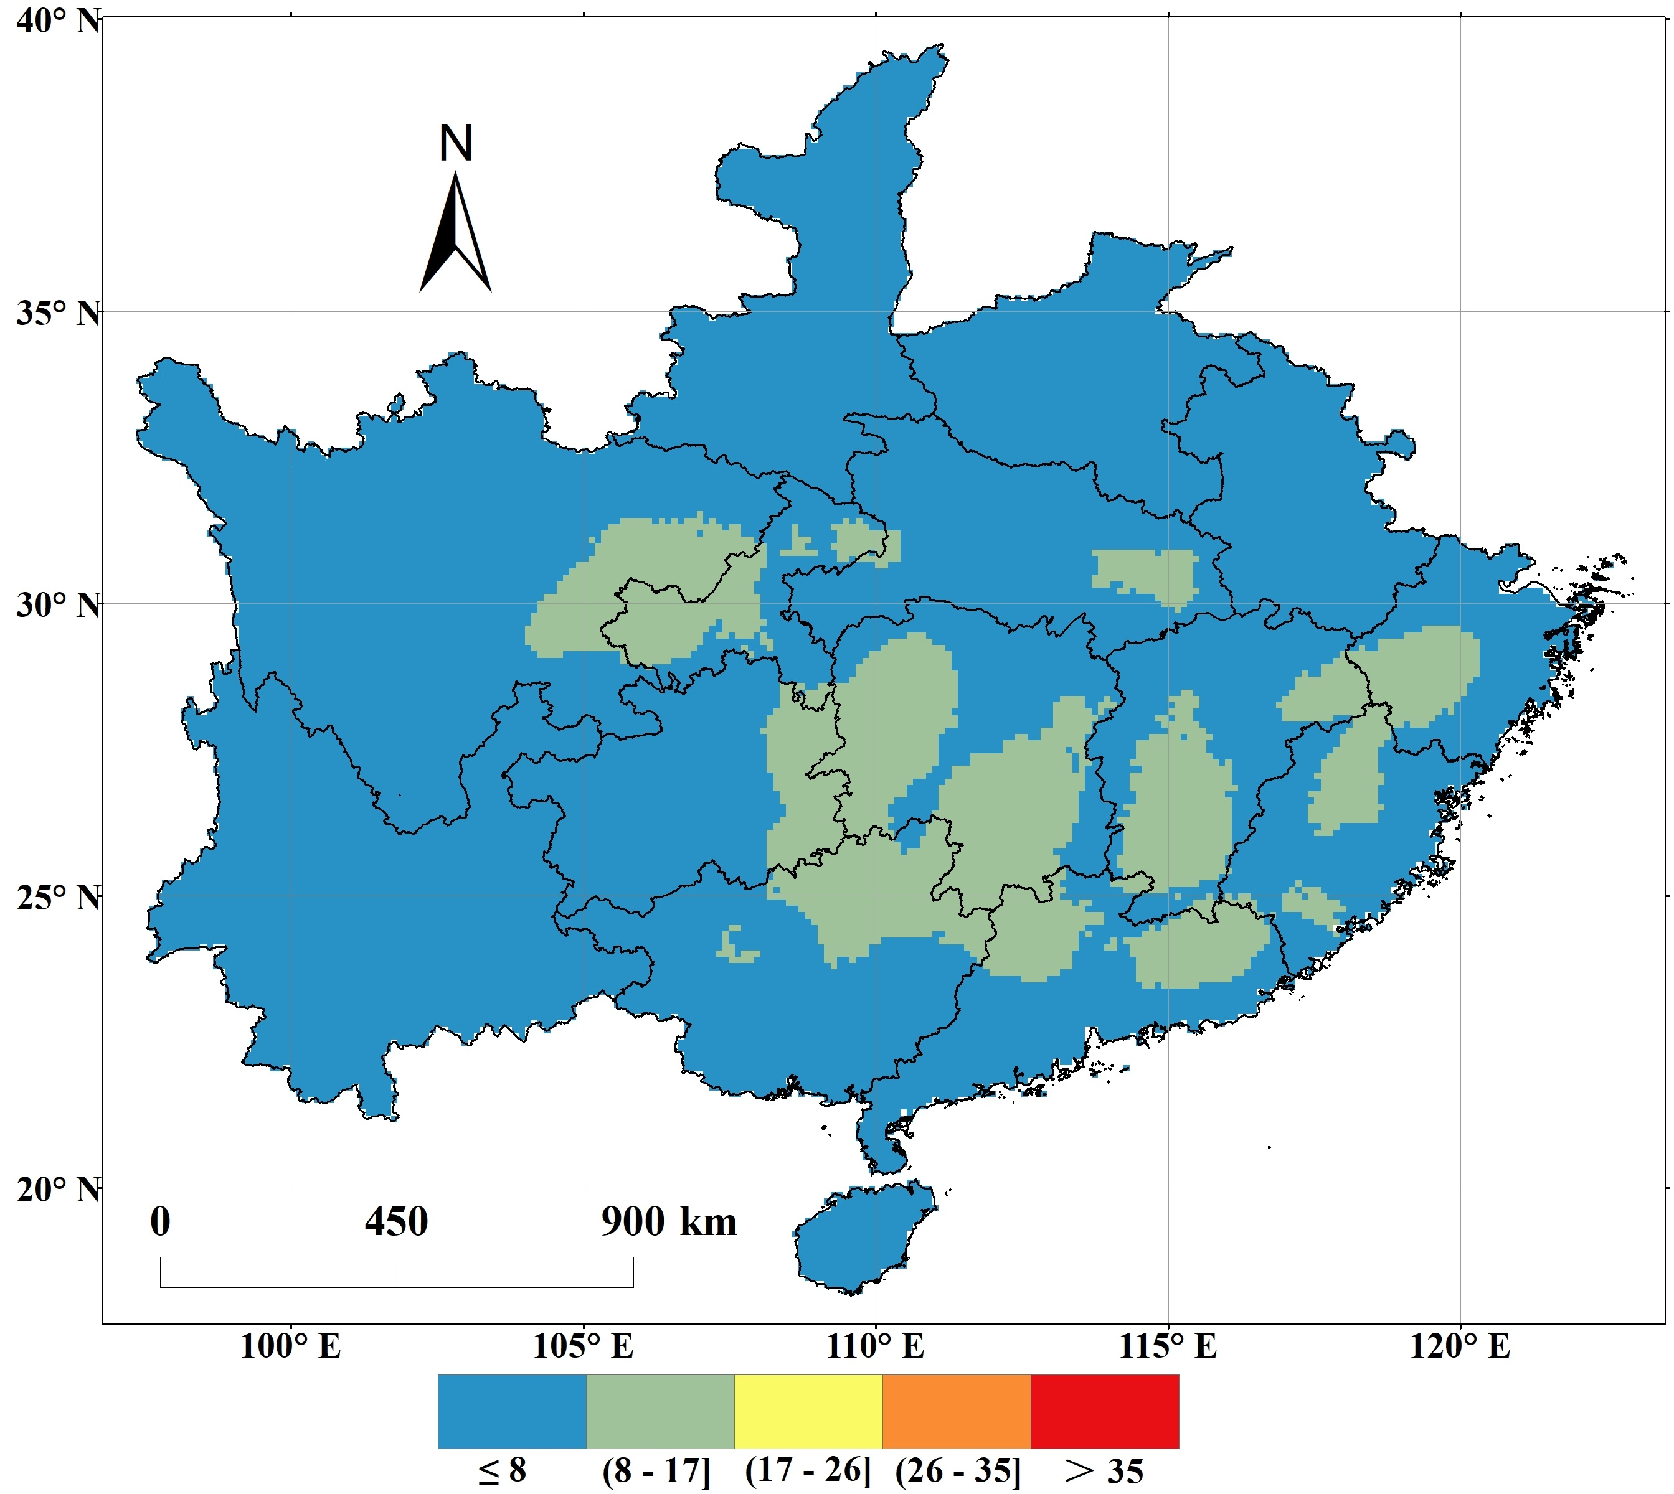
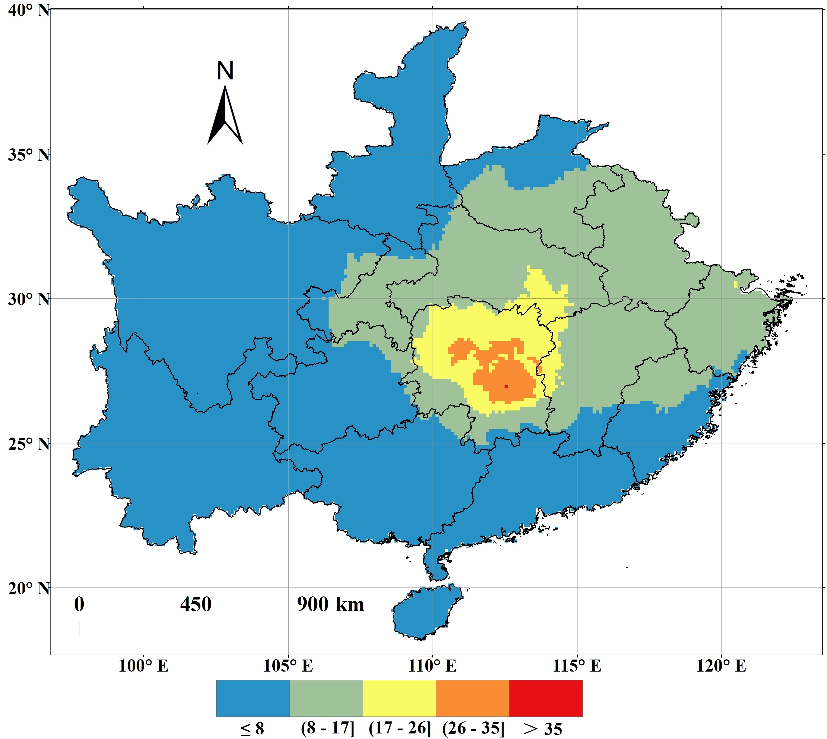
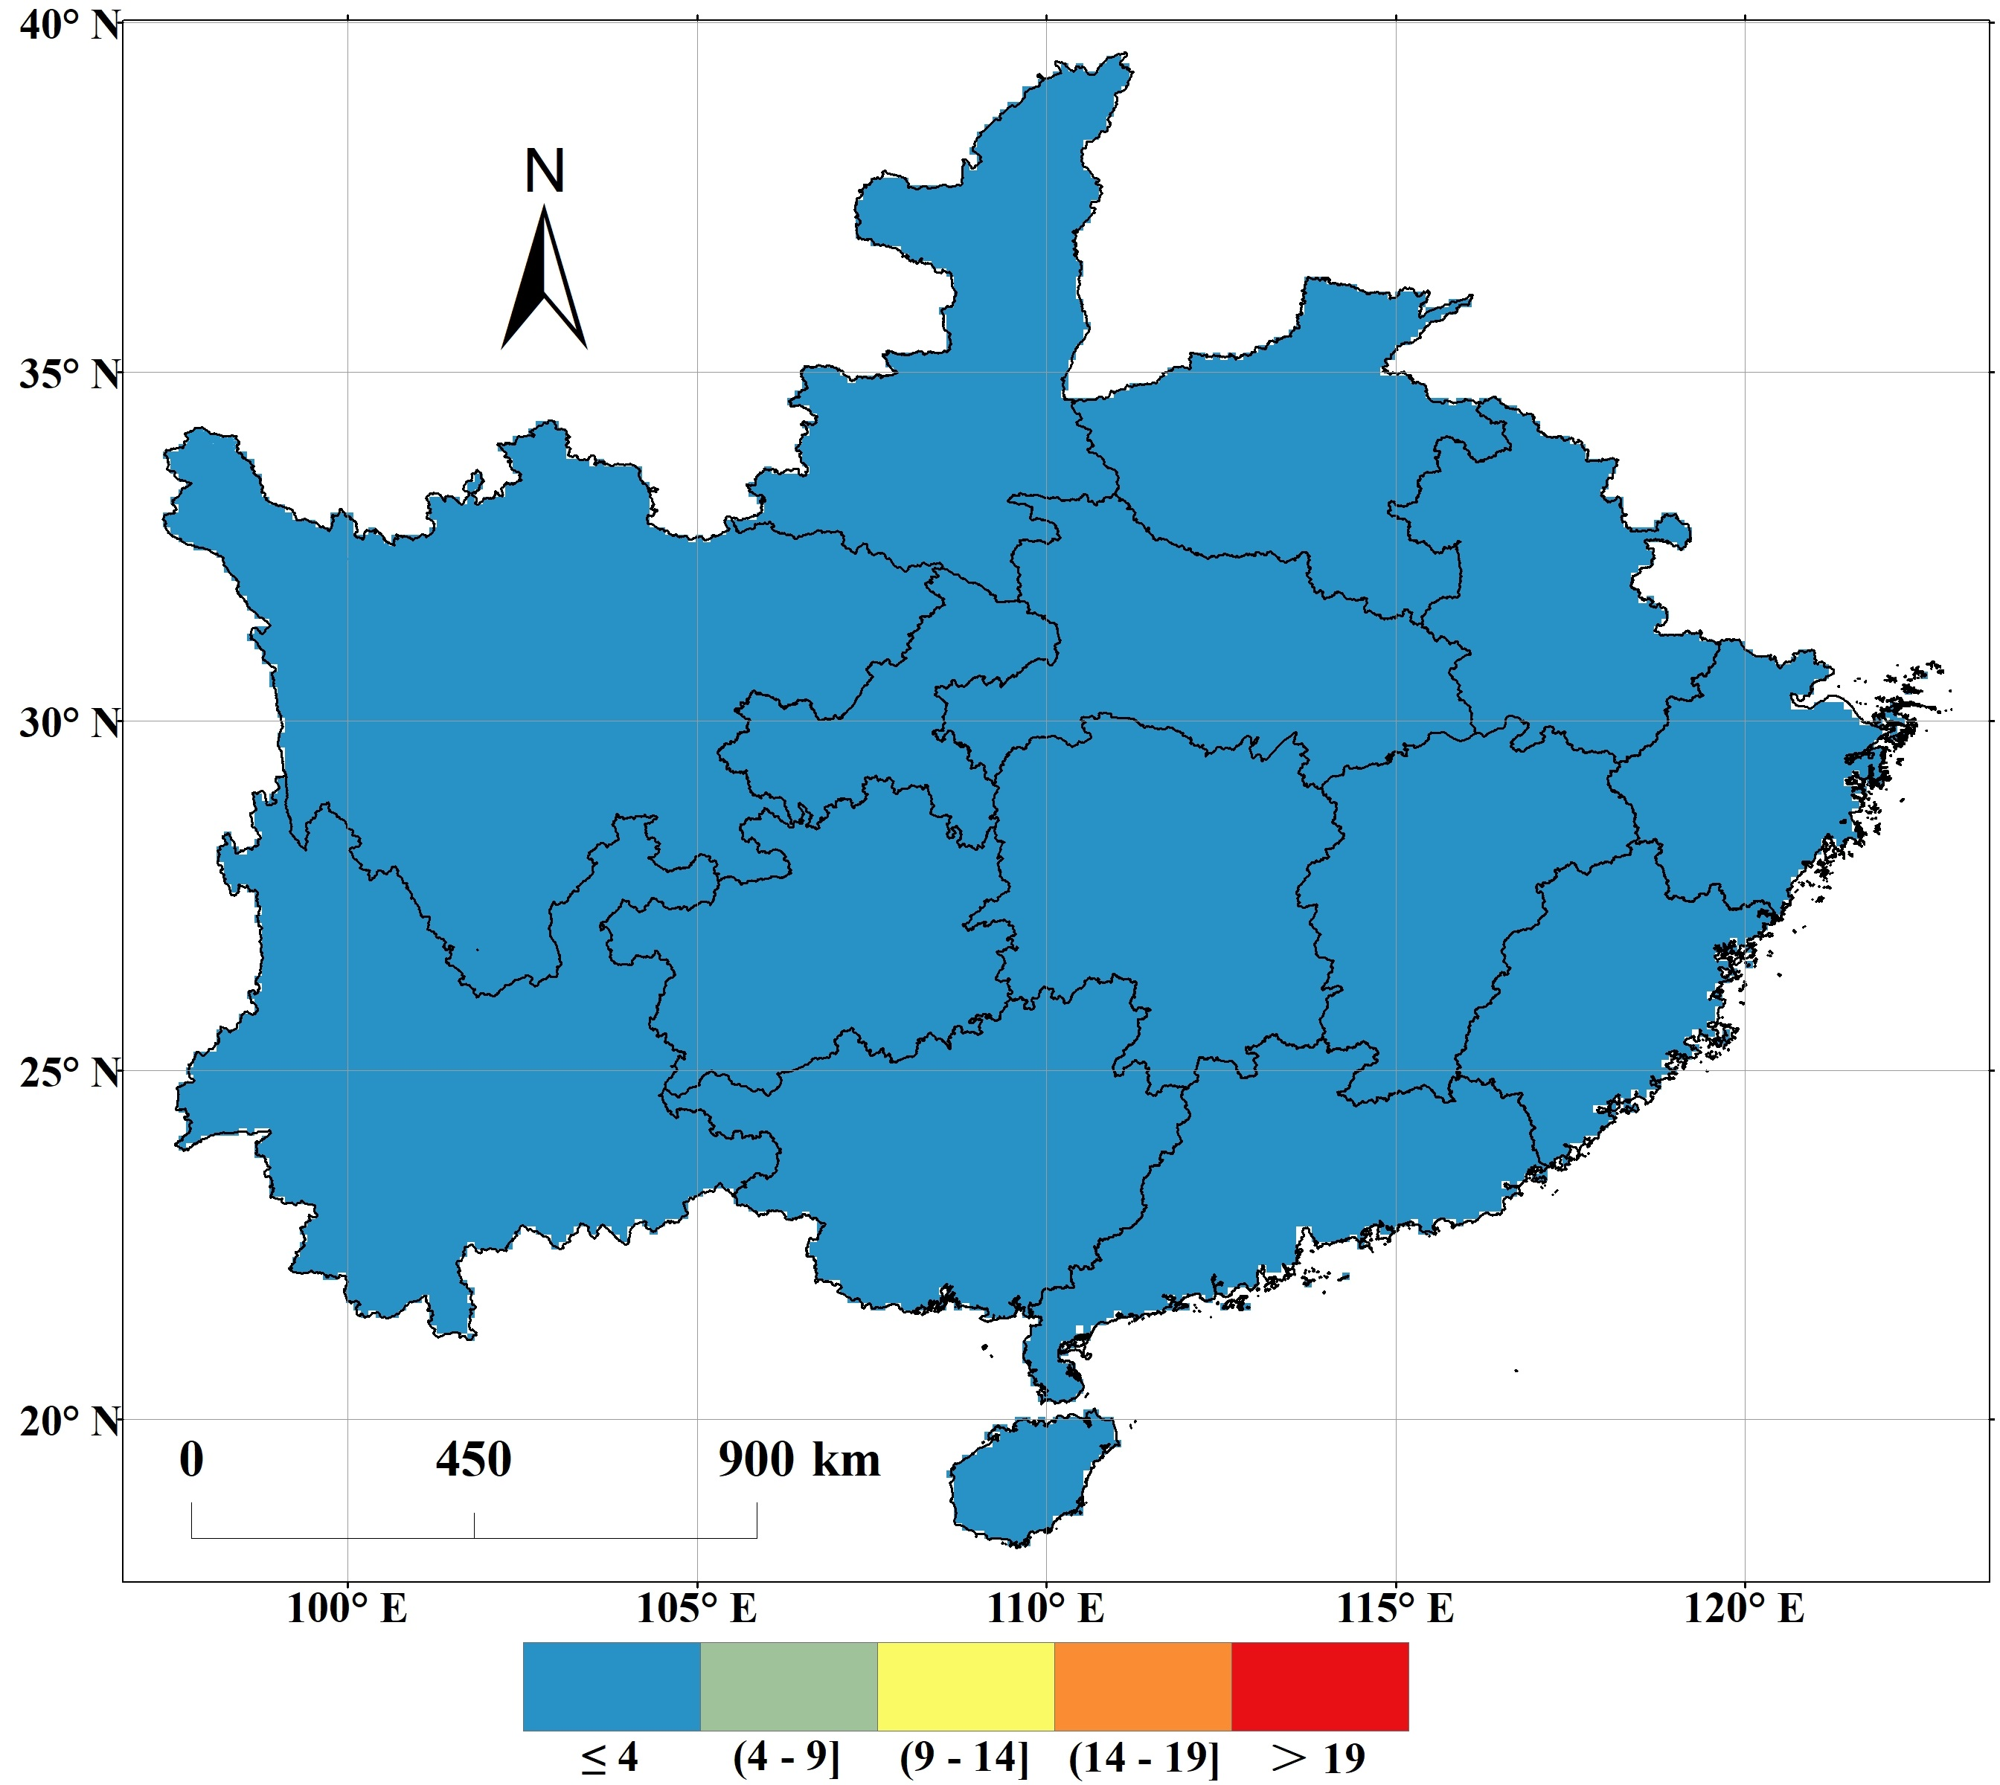
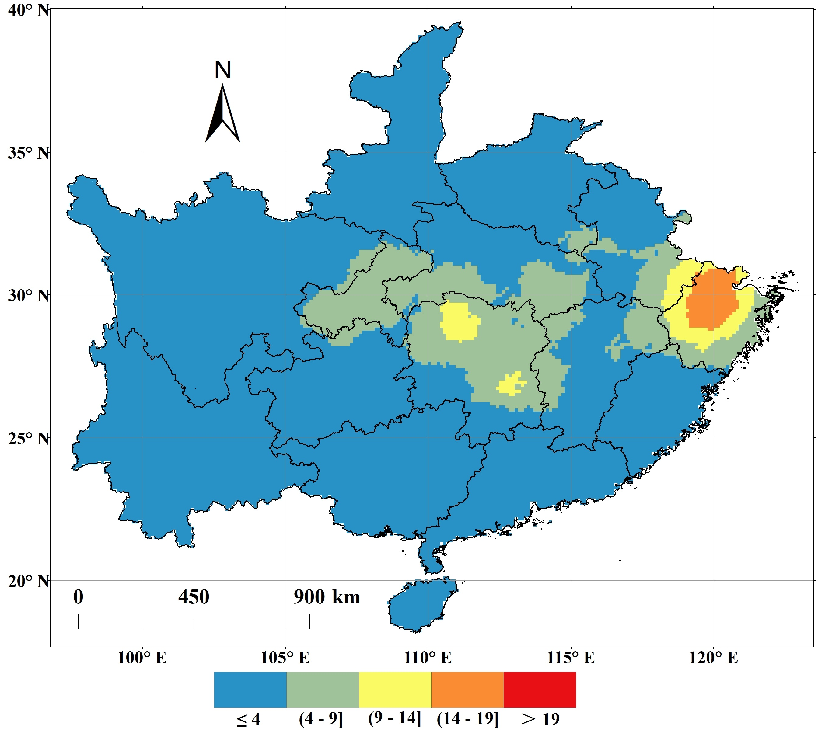
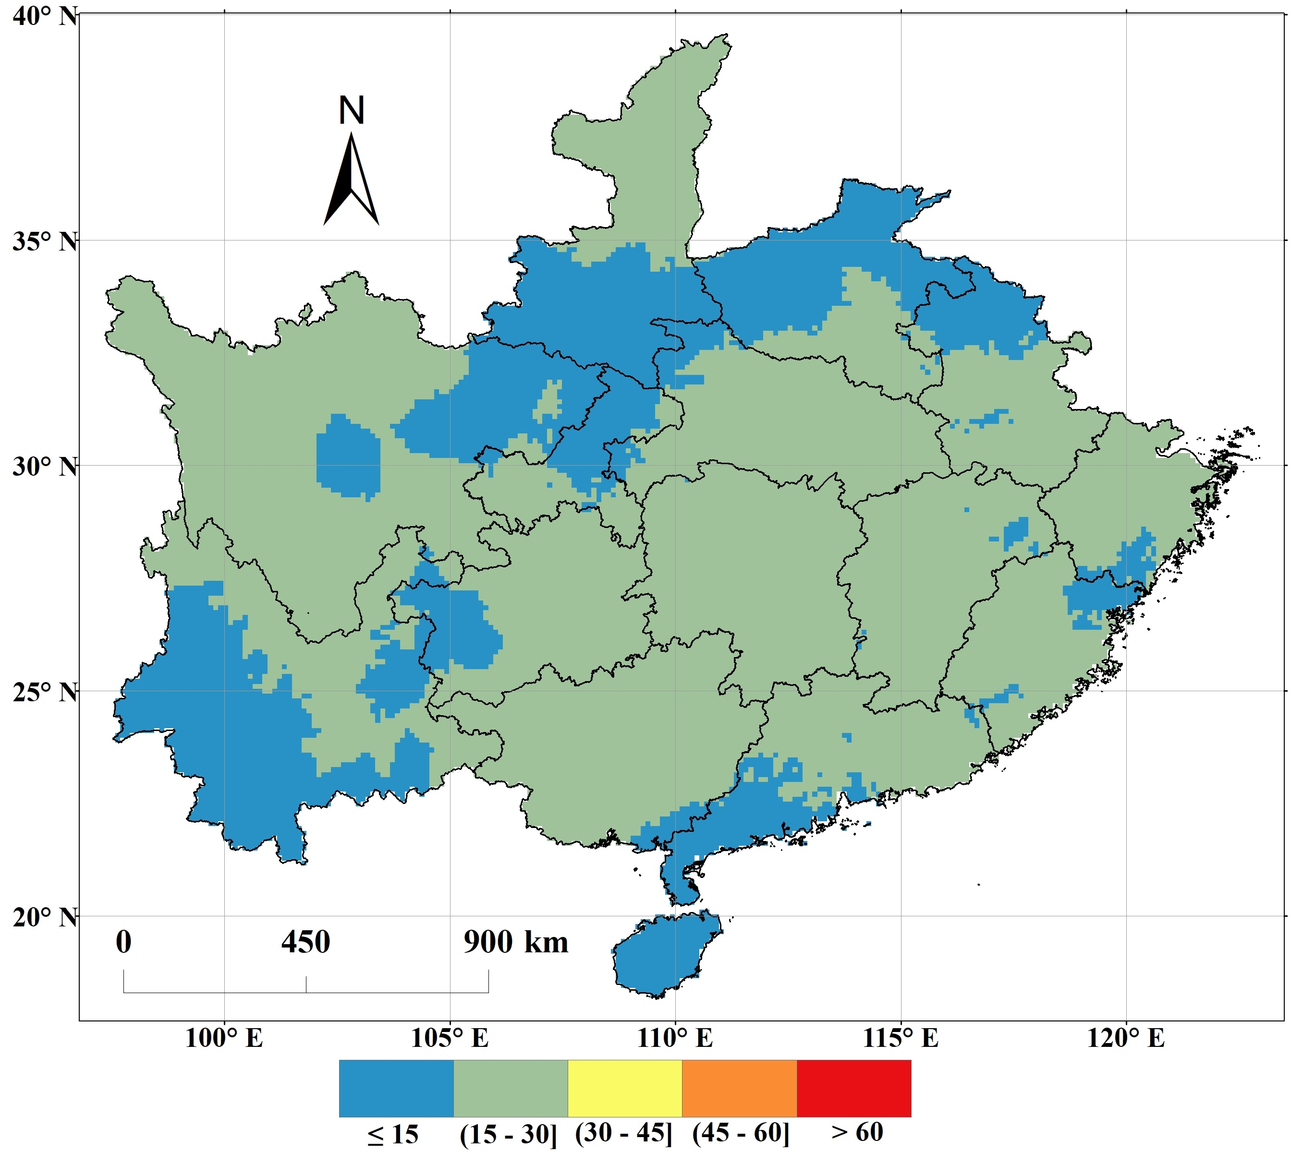
Comparison of Heat-Drought Events
Heat-Drought Parameters | 2022 | 2021 | 2013
Occurrence Period | Jul-early Sep (heat) Jul-early Dec (drought) | Sep-early Oct | Jul-late Aug (started at Jun-end in Hunan)
CD_{Tm35} (d)
D_{Tm39} (d)
CD_{nr} (d)
*The base maps in all images on this page are shapefiles of
China’s 15 main Camellia oleifera producing provinces.
*The base maps in all images on this page are shapefiles of China’s 15 main Camellia oleifera producing provinces.

Slide 19
Comparison of Heat and Drought Impacts
Impact | 2022 | 2021 | 2013
Key Phenological period | Peak fruit expansion, oil accumulation, bud maturation | Oil accumulation | Peak fruit expansion, early oil accumulation
Impact on Current Year Yield | ① low fresh fruit yield, high fruit drop rate, small fruit, severe yield failure; ② low oil content | Low oil content in several areas | ① Low fresh fruit yield, some fruit drop and cracking; ② Low oil content in several areas
Impact on Next Year Yield | ① High proportion of bud drying and abscission; ② Delayed flowering, affecting pollination and fruit setting, low fruit setting rate and high abnormal fruit drop rate in the following year | No significant impact | No significant impact
Long-Term Impact | ① The mortality rate of newly afforested forests in Hunan and Jiangxi provinces is nearly 80%; ② High mortality rate of young forests in severely water-deficient areas | No significant impact | ① The mortality rate of newly afforested forests in some severely water-deficient areas is more than 50%; ② Partial death of young forests

Slide 20
Critical Damage Thresholds
Abnormal fruit drop & yield reduction:
- CD_{Tm35}≥18d & CD_{nr}≥31d (e.g., 2013 Hunan, 2022 Hunan-Jiangxi-Zhejiang)
Complete crop failure:
- CD_{Tm35}≥27d & CD_{nr}≥46d (e.g., 2022 Hunan-Jiangxi-Zhejiang)
Significant oil content reduction:
- CD_{Tm35}≥9d & D_{Tm39}≥3d during oil accumulation (Li, 2022)
Flower bud mortality:
- CD_{nr}≥46d during bud maturation (e.g., 2022 Hunan)
New plantation mortality:
- CD_{Tm35}≥15d & CD_{nr}≥31d (e.g., 2013/2022 Hunan)

Slide 21
Key Conclusions
1. 2022 heat-drought event was unprecedented in:
- Duration
- Intensity
- Spatial extent
2. Heat more detrimental than drought for oil synthesis
3. Severe impacts on:
- Current year yield (fresh fruit yield, oil accumulation)
- Following year production (bud maturation, fruit set)
- Plant survival
4. Climate adaptation strategies urgently needed

Slide 22
Core References
National Forestry and Grassland Administration, National Development and Reform Commission, Ministry of Finance. (2022). Three-Year Action Plan for Accelerating the Development of the Camellia Oleifera Industry (2023-2025).
Ministry of Water Resources of the People’s Republic of China. (2023). China Flood and Drought Disaster Prevention Bulletin 2022 [M]. Beijing: China Water & Power Press.
Xu, W., Yuan, W., Wu, D., et al. (2024). Impacts of record-breaking compound heatwave and drought events in 2022 China on vegetation growth. Agricultural and Forest Meteorology, 344, 109799.
Chen, Y. Z., Deng, S. H., Chen, L. S., et al. (2020). A new view on the development of oil tea Camellia industry. Journal of Nanjing Forestry University (Natural Sciences Edition), 44(1), 1-10.
Zhuang, R. L. (2012). Chinese Camellia Oleifera [M]. Beijing: China Forestry Publishing House.
Liao, Y. F., Guo, L. Y., Jiang, Y. H., et al. (2020). Camellia Oleifera and Climate [M]. Hunan: Hunan University Press.
Guo, L. Y., Jiang, Y. H., Li, M. S., et al. (2023). Construction and zoning of climatic index system for Camellia abundance: Example of ordinary Camellia in Hunan. Chinese Journal of Oil Crop Sciences, 45(5), 1042-1052.

Slide 23
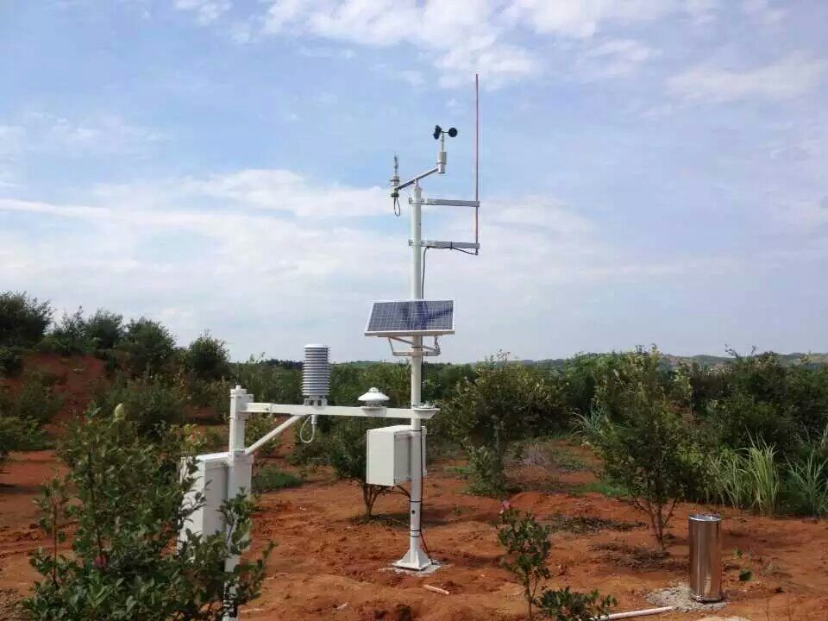
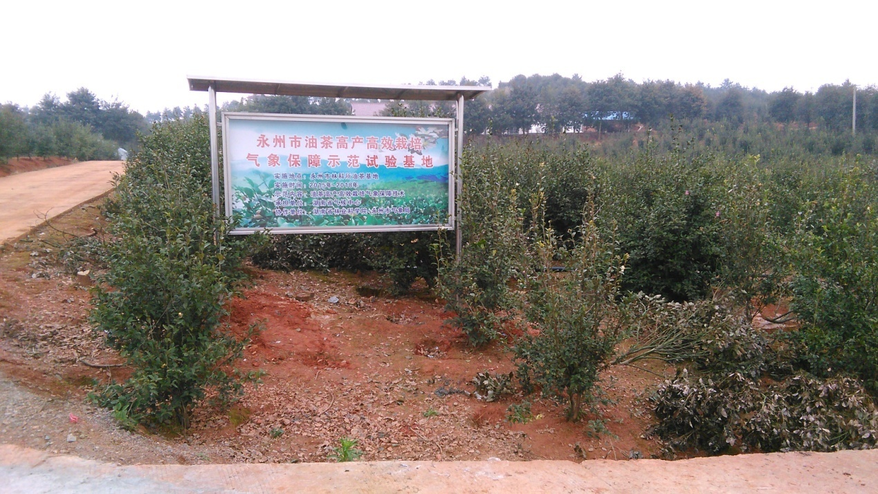
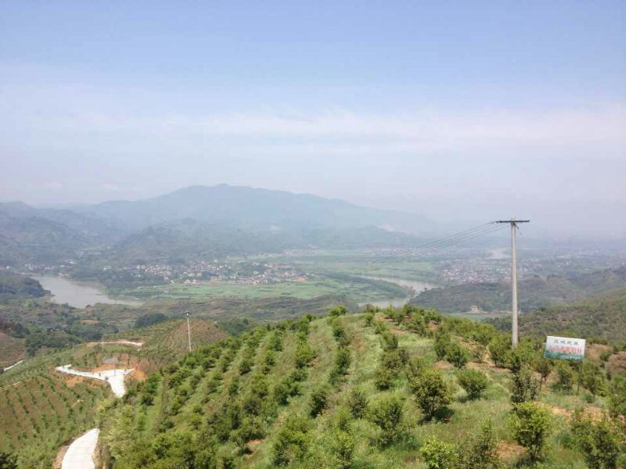

Thank you!

