Slide 1
Paper EGU25-3395
A 10ka Holocene record of cyclic precipitation in a closed catchment in SE Australia, associated with episodes of solar Grand Minima and variations in galactic cosmic ray flux
Michael W Asten, Earth Insight, Melbourne Australia E: michael.asten.ei@gmail.com
Phone&SMS: +61 412 348682
Ken G McCracken, retired
Kathryn Fitzsimmons, School of Earth Atmosphere and Environment,
Monash University, Melbourne Australia

Slide 2
EGU25-3395 On-site presentation
A 10ka Holocene record of cyclic precipitation in a closed catchment in SE Australia, associated with episodes of solar Grand Minima and variations in galactic cosmic ray flux
Michael W Asten, Earth Insight, Hawthorn Vic Australia
Ken G McCracken, retired
Kathryn Fitzsimmons, School of Earth Atmosphere and Environment, Monash University, Melbourne Australia
ABSTRACT
Lake George is a closed basin located 50 km north-east of Canberra, in southeastern Australia. Historical records indicate that lake levels directly reflect precipitation; eight cycles of high water levels (up to 7m depth), interspersed with dry lake conditions, have occurred since 1820 CE. Over longer time scales, shoreline sediments also record phases of high water up to 14m depth in Lake George during the past 15000 years. Optically stimulated luminescence (OSL) chronologies show multiple high lake phases extending through the Holocene, with a dominant cyclic pattern of c. 2300 y.
Here we compare the Holocene lake-level data with astronomical and solar phenomena over the same time period. In particular, we calculate a cyclicity in the Grand Alignments (GAs) of the four Jovian planets of 4628 y and near GAs occurring at 2314 y intervals, the timing of which is coeval with the Lake George filling events. GAs have been observed to align with solar Grand Minima (GMs) (eg Maunder and Spoerer Minima) in solar activity (sunspots) which produce phases of high galactic cosmic ray flux on Earth. The timing of GMs is obtained by reconstruction of ¹⁰Be and ¹⁴C fluxes as recorded in terrestrial sediments. These high fluxes also appear to show a temporal relationship with occurrence of the lake level highs.
The recognition of cosmic ray flux episodes, rather than individual GMs, strongly indicates an association between observed solar activity and the high lake levels as preserved in the Lake George sediment archive. The time span 0-9.4ka contains four GM episodes and 13 OSL dated lake levels. Of the latter, 69% date within the episodes of GM. The evidence suggests that high precipitation in the Lake George basin has been associated with Jovian planet grand alignments and near GAs for at least the past 15000 years, and with phases of reduced solar and interplanetary magnetic field strength and increased GCR flux in the vicinity of the Earth.
The study supports the hypothesis that solar activity exhibits the well-known Hallstatt cycle periodicity (2300 yr). Mechanisms for cause and effect remain subjects for further study.
How to cite: Asten, M. McCracken, K., Fitzsimmons, K: A 10ka Holocene record of cyclic precipitation in a closed catchment in SE Australia, associated with episodes of solar Grand Minima and variations in galactic cosmic ray flux, , EGU General Assembly 2025, Vienna, Austria, 28Apr–2May 2025, EGU25-3395, 2025

Slide 3
PART 1
EXAMPLE OF MILLENIAL CYCLES OF TERRESTRIAL
CLIMATE
-inland lake sediments

Slide 4
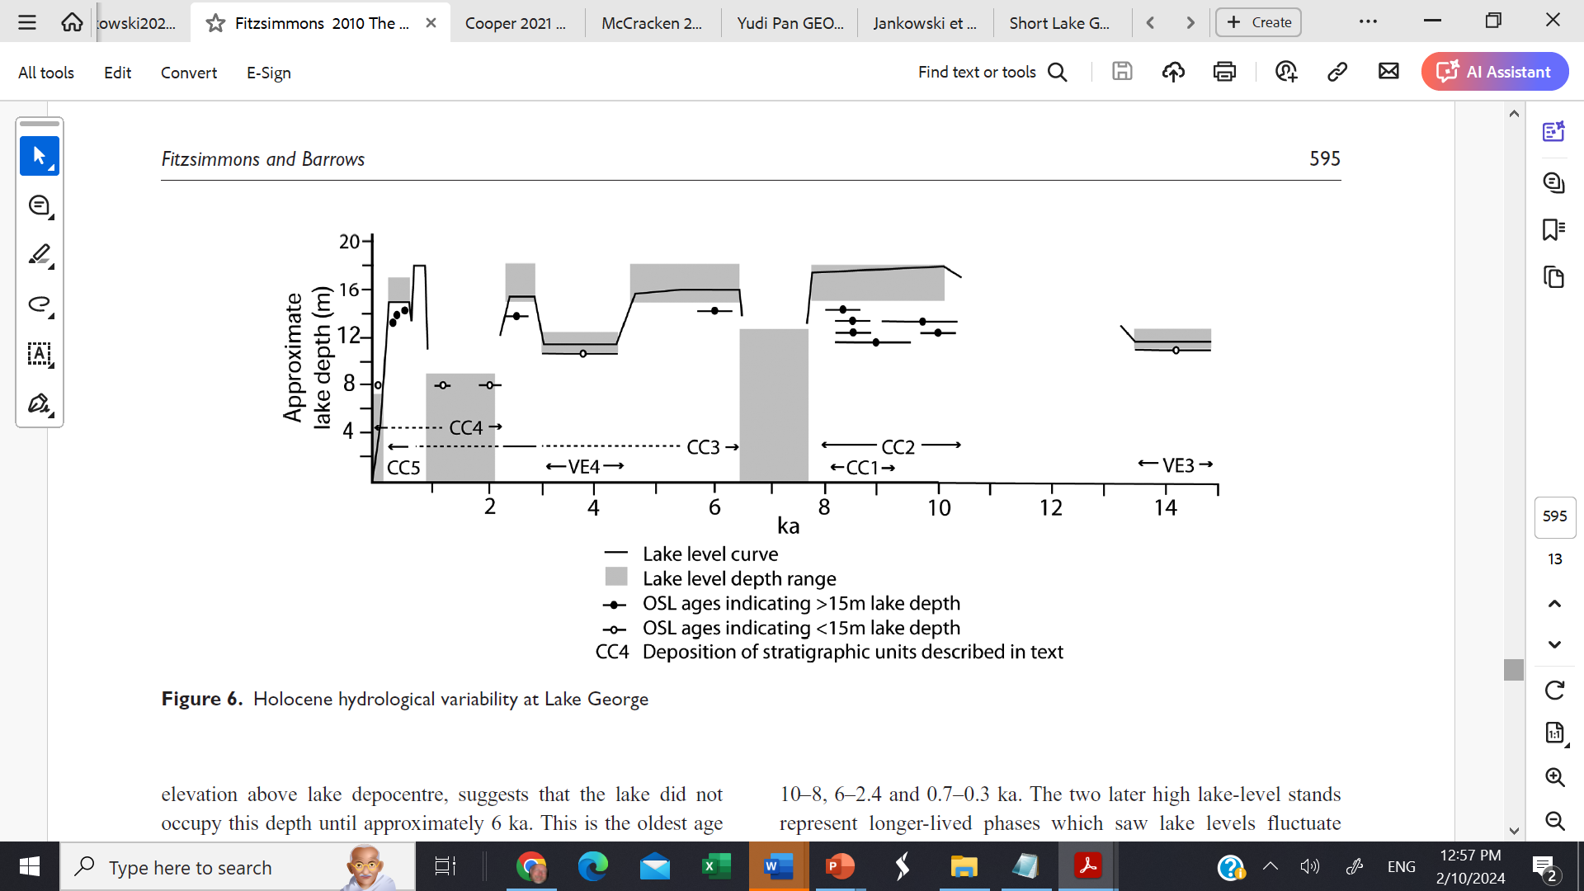
EXAMPLE - LAKE GEORGE NSW
Geological data from sedimentology of Lake George catchment
Lake depth (m)
Historic maximum
Lake levels from dated sediments (via optically stimulated luminescence (OSL))
kYear BP->
Fitzsimmons and Barrows 2010, The Holocene

Slide 5
LAKE GEORGE NSW
depth
kYear BP->
Grand alignments of Jovian planets
Separation of alignments is 2314 yr
= HALLSTATT CYCLE
(Scafetta et al, 2016)
Near-grand alignment
McCracken et al, 2014

Slide 6
LAKE GEORGE NSW
depth
kYear BP->
Grand alignments of planets
Observed Solar Grand minima
from cosmic ray data 14C &10Be
(Usoskin 2013)
Maunder, Sporer, Wolf, Oort minima

Slide 7
LAKE GEORGE NSW
depth
kYear BP->
Grand alignments of planets
Cosmic ray data from 2020
qC14 with Intcal20 calibration
(Reimer et al 2020, updated by Beer 2025, personal comm)
Q14C data 0-15ka after 1000yr hi-pass filter
Cosmic ray flux maxima mark solar activity Grand Minima
q14C ->
0
4
8
12
kYear BP->

Slide 8
PART 2
EXAMPLE OF SPACE WEATHER
high cosmic ray flux Low solar activity

Slide 9
LAKE GEORGE NSW
depth
kYear BP->
Grand alignments of planets
Dark yellow = Episodes of solar Grand Minima 0-9ka
(from McCracken et al, 2013)
Cosmic ray data from 2020
qC14 with Intcal20 calibration
(Beer 2025, personal comm)
Q14C data 0-15ka after 1000yr hi-pass filter
q14C ->
Light yellow = Episodes of solar Grand Minima interpreted for 9-15ka
0
4
8
12
kYear BP->

Slide 10
CONCLUSIONS
TERRESTRIAL HYDRO-CLIMATE: Dated shoreline lake sediments record phases of high water during the Holocene & earlier (0-15000 ka)
dominant cyclic pattern of period c. 2300 y.
SPACE WEATHER MILLENIAL SCALE: Cosmic ray flux data shows associated cyclic pattern of Episodes of solar Grand Minima
Correlated with Planetary Grand Alignments
2300 y is the Hallstatt cycle previously
observed in terrestrial cosmogenic and geophysical data
→

Slide 11
CONCLUSIONS
TERRESTRIAL HYDRO-CLIMATE: Dated shoreline lake sediments record phases of high water during the Holocene (0-15000 ka)
dominant cyclic pattern of period c. 2300 y.
SPACE WEATHER MILLENIAL SCALE: Cosmic ray flux data shows associated cyclic pattern of Episodes of solar Grand Minima
Correlated with Planetary Grand Alignments
2300 y is the Hallstatt cycle previously
observed in terrestrial cosmogenic and geophysical data
Space weather terrestrial hydro-climate

Slide 12
ACKNOWLEDGEMENTS
Jurg Beer supplied q14C cosmic ray data 0-20ka, 10 year sampling, hipass filtered with cutoff 1000 y

Slide 13
[ENDS]
30 Aug 2025

Slide 14
APPENDIX 1
SPECTRUM OF qC14 COSMIC RAY FLUX 0-15ka deduced from ice-cores
See how Holocene cosray peaks for
Gleissberg, de Vries and Hallstatt peaks are CLEARER for option b where timeseries data restricted to post-Younger Dryas years

Slide 15
Beer cosmic ray data unfiltered 0-15ka
Younger Dryas cold 11.5-13.5ka
Next slide shows 2 options
LS spectrum of data 0-15ka
LS spectrum of data 0-10.8ka EXCLUDES the Younger Dryas and previous glaciation

Slide 16
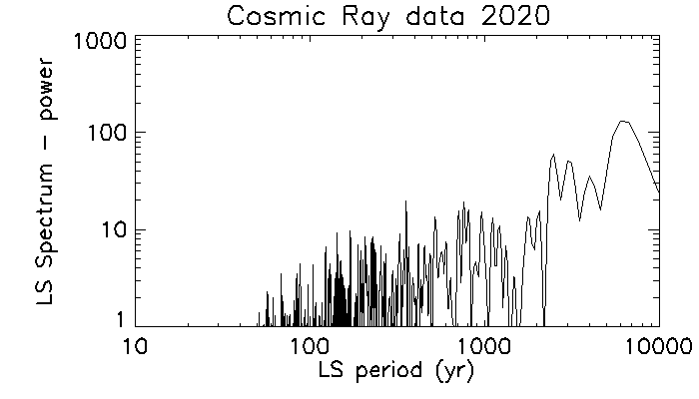
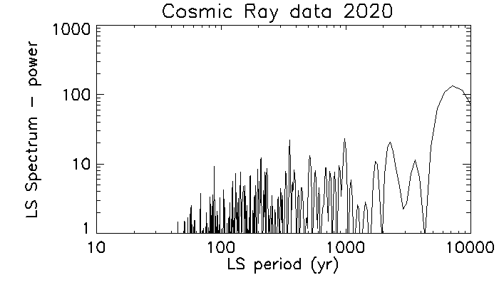
Spectrum for full data set 0-15ka shows lower resolution
Spectrum for reduced data set 0-10.8ka (ie post-Last glacial Maximum) shows improved resolution of key cycles Gleissberg, de Vries, Hallstatt
Beer data 0-15ka
Beer data 0-10.8ka
Unnamed
~6000y
Unnamed 350y
De Vries 210y
Gleissberg 87y
Hallstatt 2300y

Slide 17
APPENDIX 2
This paper may be compared with earlier work showing a c. 85 y Gleissberg cycle (Asten and McCracken, EGU23-15726)
That earlier paper looks at the 225 year annual record of Lake George levels and the flood records of the Hawkesbury-Nepean river. Spectra of these records show a strong peak at period of c. 80 y, corresponding to the Gleissberg cycle, well known in solar studies.
The spectral peak at period c. 210 year is the de Vries cycle which is restricted to the intervals that include solar Grand Minima
( McCracken et al, Solar Physics, 2013).
Ref: Michael Asten and Ken McCracken, 2023, Is multidecadal prediction of flood patterns possible for infrastructure planning purposes using the 10000 year cosmogenic isotope (10Be and 14C) record?, Paper EGU23-15726

Slide 18
REFERENCES

